Slide 1
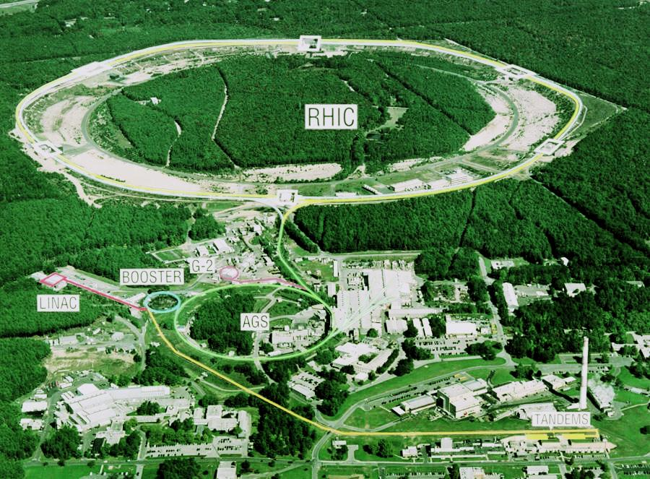
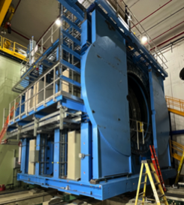
What is sPHENIX?
sPHENIX is a major upgrade to the PHENIX detector. It is a large-acceptance, high-rate detector for Heavy Ion physics that repurposes >$20M in existing PHENIX equipment, infrastructure and support facilities.
The detector is optimized to measure jet and heavy quark physics by incorporating a Time Projection Chamber, Electromagnetic and Hadronic Calorimeter with a high rate DAQ/Trigger and a 1.4 T solenoidal magnetic field.

Slide 2
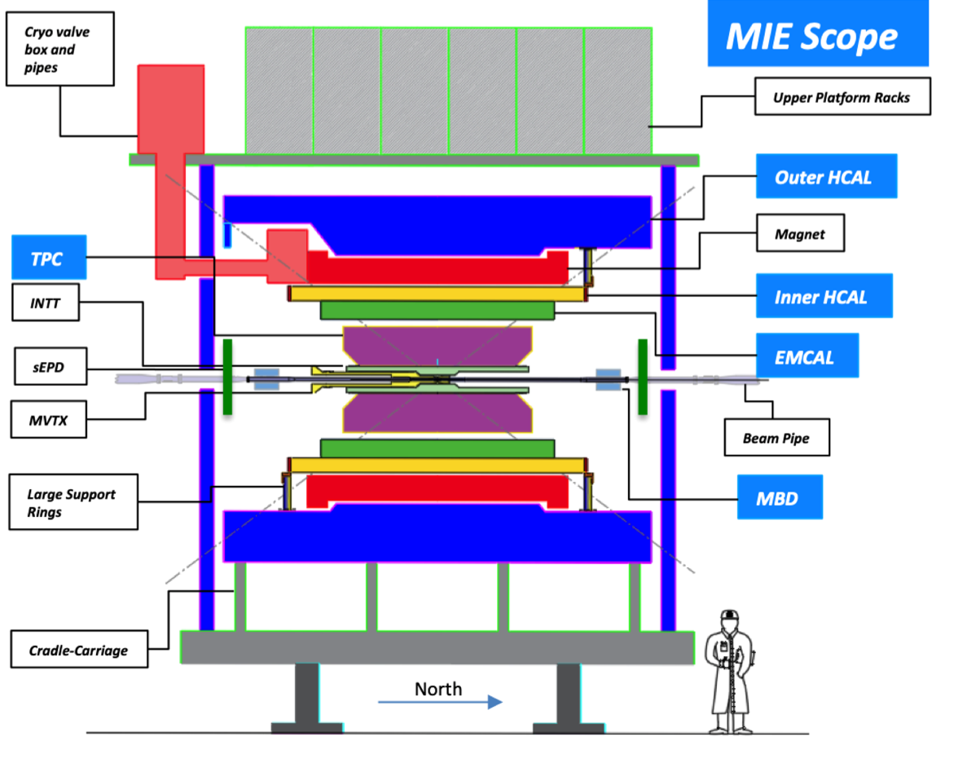
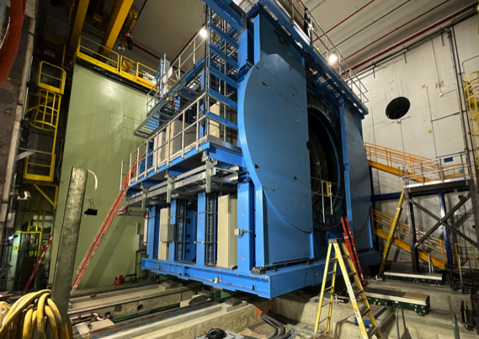
sPHENIX Components: Vertical Slice and Actual

Slide 3
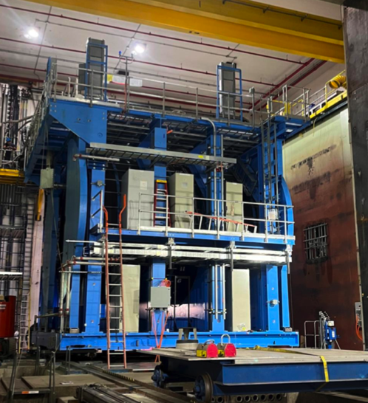
sPHENIX MIE Project Overview
TPC | Project Director | Last CD Achieved | % Complete | CPI | SPI
$26.5M | Edward O’Brien | PD-2/3 | 100% BCWP/BAC@ 10/31/2022 | 1.00 | 1.00
Scope
Detector systems produced, tested and ready for installation: Time Projection Chamber w/ electronics, Electromagnetic Calorimeter w/ electronics, Hadronic Calorimeter w/ electronics, DAQ/Trigger, Minimum Bias Detector, Project Management
Not in scope
SC-Magnet, Bldg/Det Infrastructure, Installation and System Commissioning
Schedule
CD-0 received Sept 2016
CD-1/3A received Aug 2018
PD-2/3 received Sept 2019
PD-4 approval Dec 2022
Cost
$26.5M AY TPC ~$300k remains of uncommitted funds

Slide 4
MIE Scope
A Time Projection Chamber (TPC), Electromagnetic Calorimeter (EMCal), and a Hadronic Calorimeter (HCal) all covering 2π in azimuth. The TPC and HCal have pseudorapidity coverage of -1.1 ≤ η ≤ 1.1. The EMCal has pseudorapidity coverage of ‑0.85 ≤ η ≤ 0.85.
A Minimum Bias Trigger Detector (MBD).
Readout electronics to fully instrument the TPC, EMCal, HCal and MBD.
A Data Acquisition (DAQ) system with the capability to readout the TPC, EMCal, HCal and MBD with an event rate and data-logging rate commensurate with the sPHENIX physics goals.
A DAQ/Trigger system that can provide minimum bias and energy cluster triggers at a rate necessary to carry out the sPHENIX physics program in AA, pA and pp collisions at RHIC.
Project Management to carry the project scope through to a successful on time and on budget completion.

Slide 5
Available Resources & External Dependencies
BNL has granted the sPHENIX MIE/ 1008 I&F an Extraordinary Project Rate (Reduced Overhead)
Reuse of >$20M of existing infrastructure and equipment from the PHENIX experiment including use of the Building 1008 (PHENIX) complex
BNL contributed labor from RHIC Ops ($27.97M AY as of 10/31/22) ( 80% the PHENIX group in Phys Dept in addition to CAD, BNL Instrumentation, NSLSII and Magnet division)
Former BaBar SC-magnet received from SLAC spring 2015. Tested to full current at BNL 2018 & 2022.
Collaborator contributed labor (subsystem assembly and testing, QA, calibration, commissioning)
Other detector subsystems
Si strip detector (INTT) primary funding from RIKEN Lab –Japan with additional US and international contributions.
Extended (in eta) EMCal coverage to (-1.1< eta < 1.1) primarily funded by Chinese collaborating Inst with additional US contributions.
Inner HCal Instrumentation is a BNL funded capital project ($1.68M)
Time Projection Outer Tracker (TPOT) is a French-US Combined funded capital project (BNL contribution $0.63M)
sPHENIX Event Plane Detector (sEPD) is an NSF-funded MRI for an ($0.99M)

Slide 6
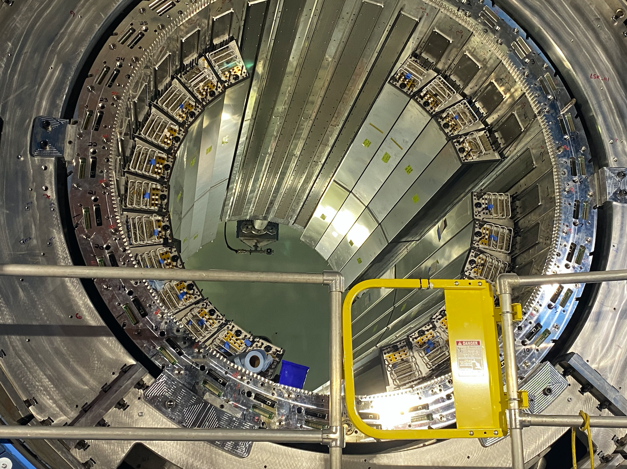
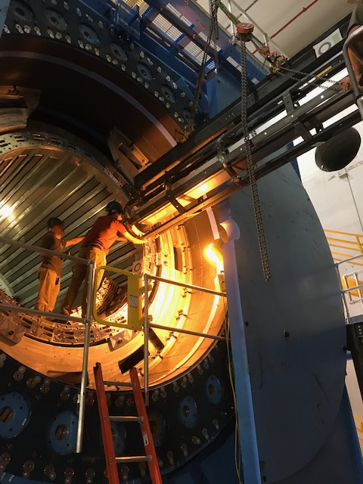
sPHENIX Installation Status
18 EMCal sector-pairs installed
As of 10/6/22
23/32 EMCal Sector pairs installed as of 11/17/22
EMCal Installation in progress

Slide 7
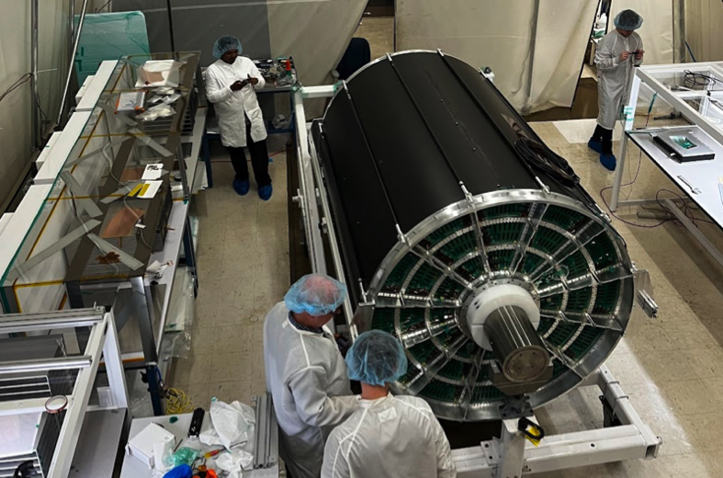
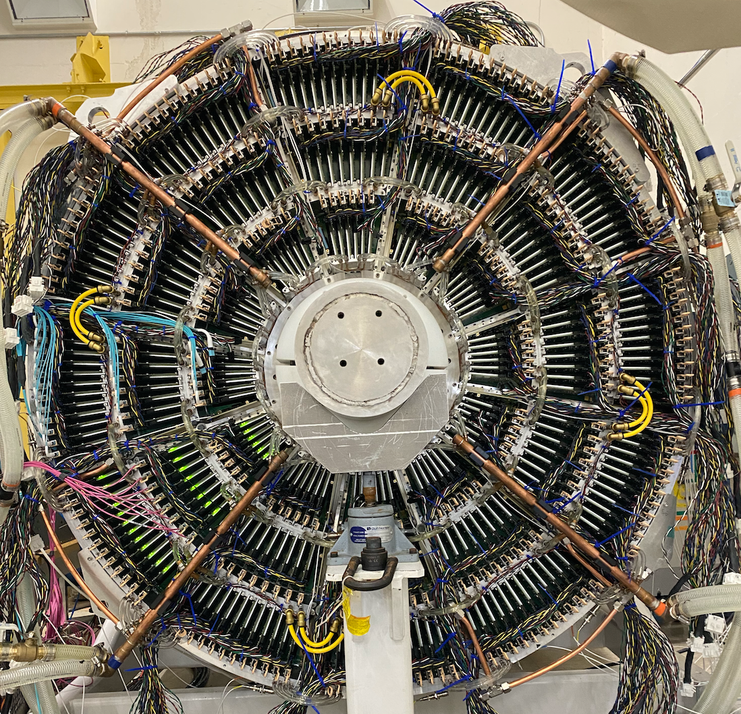
sPHENIX MIE Deliverable and KPP Status
All OHCal sectors complete, installed, tested.
All IHCal sectors complete, installed, tested.
All EMCal sectors complete, preinstall tested, 72% installed
All Calorimeter electronics complete, tested.
TPC Assembled at SBU. TPC performance tests ongoing
TPC electronics Fee & FELIX boards complete.
All DAQ/Trigger components complete.
All MBD detector and electronics components complete.
Everything in the MIE WBS dictionary has been delivered
TPC controller board not in the dictionary 33% done. All boards delivered by Dec 8.
All KKPs met except:
TPC live channel count (Glenn’s talk) is ½ done. Complete by 11/23
TPC mip complete by 12/2
TPC Assembled at SBU
One side of TPC fully instrumented
Fee Boards installed on TPC

Slide 8
Performance Metrics: sPHENIX MIE KPP’s
System | Demonstration or Measurement | Threshold KKP’s | Objective KPP’s
Time Projection Chamber | Preinstall, Bench tests | ≥ 90% live channels based on laser, pulser, cosmics | ≥ 95% live channels based on laser, pulser, cosmics
Time Projection Chamber | Preinstall, Bench tests | Ion back flow ≤ 2% per GEM module avgd over active area of ea GEM module | Same
Time Projection Chamber | Preinstall, Bench tests w/ cosmics | ≥ 90% single hit efficiency/mip track, averaged over active TPC volume | ≥ 95% single hit efficiency/mip track, averaged over active TPC volume
Time Projection Chamber Front End Electronics | Preinstall, Fee stand alone bench tests | Cross talk ≤ 2% per channel averaged over all channels | Same
EM Calorimeter | Preinstall, Bench tests | ≥ 90% live channels based on LED, cosmics | ≥ 95% live channels based on LED, cosmics
Hadronic Calorimeter | Preinstall, Bench tests | ≥ 90% live channels based on LED, cosmics | ≥ 95% live channels based on LED, cosmics

Slide 9
Performance Metrics: sPHENIX MIE KPP’s
System | Demonstration or Measurement | Threshold KKP’s | Objective KPP’s
EM Calorimeter | Preinstall, Bench tests | Each sector w/ an absolute energy precalibration of ≤ 35% RMS | Same
Hadronic Calorimeter | Preinstall, Bench tests | Each sector w/ an absolute energy precalibration of ≤ 20% RMS | Same
Min Bias Trigger Detector | Preinstall, Bench tests | ≥ 90% live channels based on laser. 120 ps/channel timing resolution w/ bench test | ≥ 95% live channels based on laser. 100 ps/channel timing resolution w/ bench test
DAQ/Trigger | Event rate | 10 kHz w/ random pulser | 15 kHz w/ random pulser
DAQ/Trigger | Data Logging rate | 10 Gbit/s with pulser | Same

Slide 10
Summary
The sPHENIX MIE proceeded very well despite challenges due to the COVID pandemic and supply chain issues.
The scope of the $26.499M project is 100% complete based on EV with a CPI=1.0 and an SPI=1.0. Approximately $300k is budget remains uncommitted though the final accounting has not yet been completed.
All deliverables in the WBS dictionary are complete
All KPPs as defined in the PMP are complete with the exception of the:
TPC live channel count. Ongoing (50% complete) with end date expected to be 11/23
TPC minimum ionizing track measurement with end date expected 12/2
All deliverable and KPP details available in Glenn’s presentation

Slide 11
Back Up

Slide 12
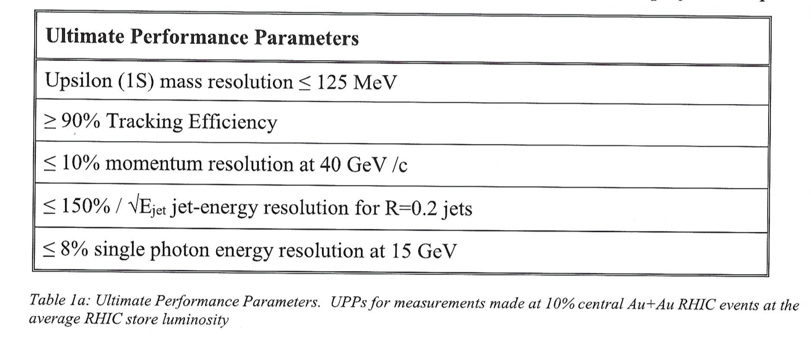
Performance Metrics: Ultimate Performance Parameters
From the sPHENIX MIE PMP approved by DOE/BNL Sept 2019

Slide 13
Scope Reduction to the MIE
Request in scope reduction to MIE made in Sept 2022 due to supply chain issues that made certain components very delays or impossible to obtain.
Remove DCMII
PO 396499 line item 2, Columbia U contract, $140,000 direct
Remove 5/6 of diffuse laser
PO 405031 w/ RPMC. One of six laser delivered.
Balance commits $239415 direct
Remove fiber splitter from the MIE, $69,000 not yet placed
Total direct $ to remove : $379,415 in commits, $69,000 in unallocated budget both from Cat A.
Including overhead 1.11703*(448,415)=$500,893 TPC reduction
Requested Revised TPC = $26,499,000

Slide 14
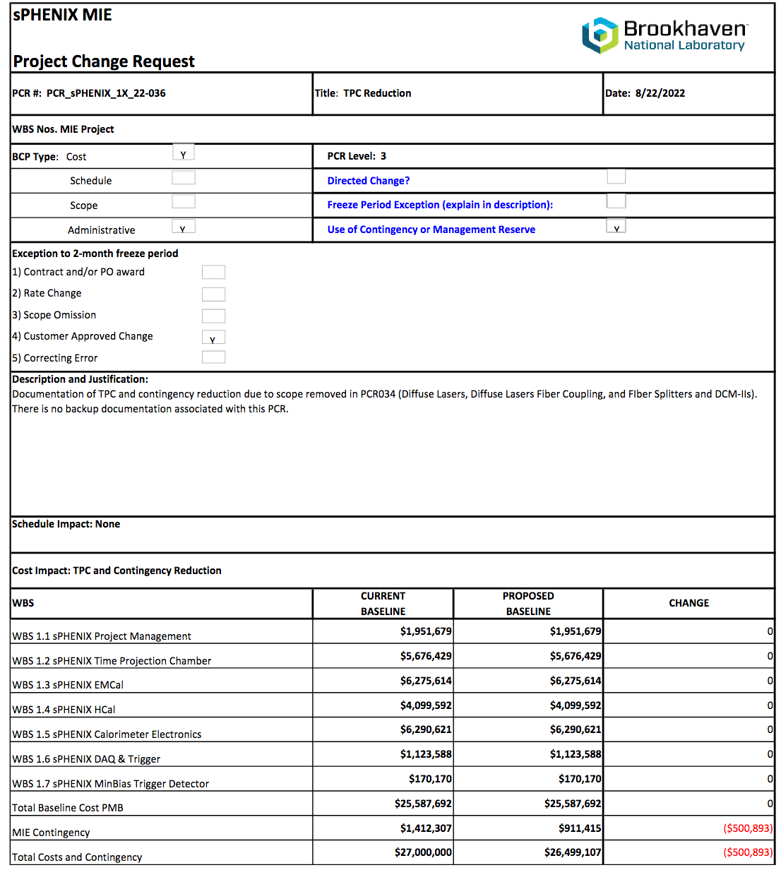
Proposed Reduction in MIE Total Project Cost

