Slide 1
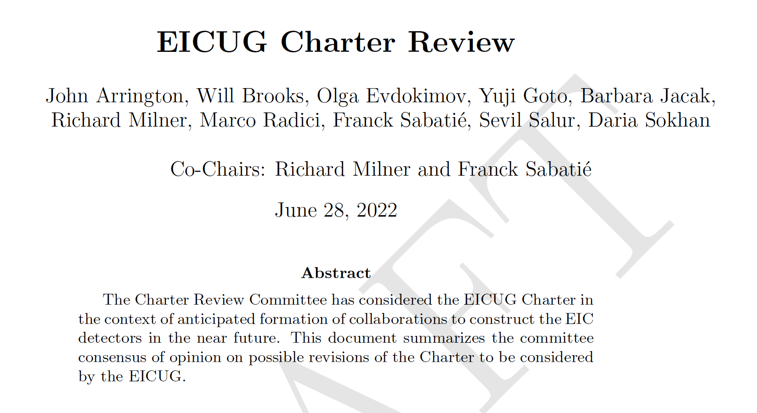

Slide 2
The Charter states
We are in Phase 3

Slide 3
Transition to Detector Collaborations
Following the March 14, 2022 request, the Committee met and discussed via phone, email and Zoom.
The June 28th draft document summarized consensus ideas that have emerged as worthy of consideration and was presented to the membership at the EICUG annual meeting in July 2022.
Subsequently, the draft was iterated on with the SC who also consulted their standing committees.
On November 11, the draft Charter was distributed to the EICUG membership for consideration.
Phasing out the Institutional Board as EPIC Collaboration is formed
=> one vote per EICUG member, retain institutional representatives
Continuity in the Chair-line
- cycle through Chair-elect, Chair, Past-Chair
- divide responsibilities among each
- transition in summer 2023: Marco to become Chair, Renee to become Past-Chair and
new Chair-Elect voted in
Elected DEI Representative on Steering Committee

Slide 6
Path Forward
Draft revised EICUG Charter has been put before the EICUG membership for comment.
Please submit comments before December 2^{nd,} 2022 to:
Renee Fatemi renee.fatemi@uky.edu
Richard Milner milner@mit.edu
Final version will be put to a vote soon after.

