Slide 1
Update to Jim Fast’s EIC model using Nikki Apadula’s EIC detector status from her
11-7-2022 presentation,
UPDATED GEOMETRY IN MODEL:
Walter Sondheim
LANL
November 21st, 2022

Slide 2
Nikki Apadula’s EPIC SVT layout 11-7-2022

Slide 3
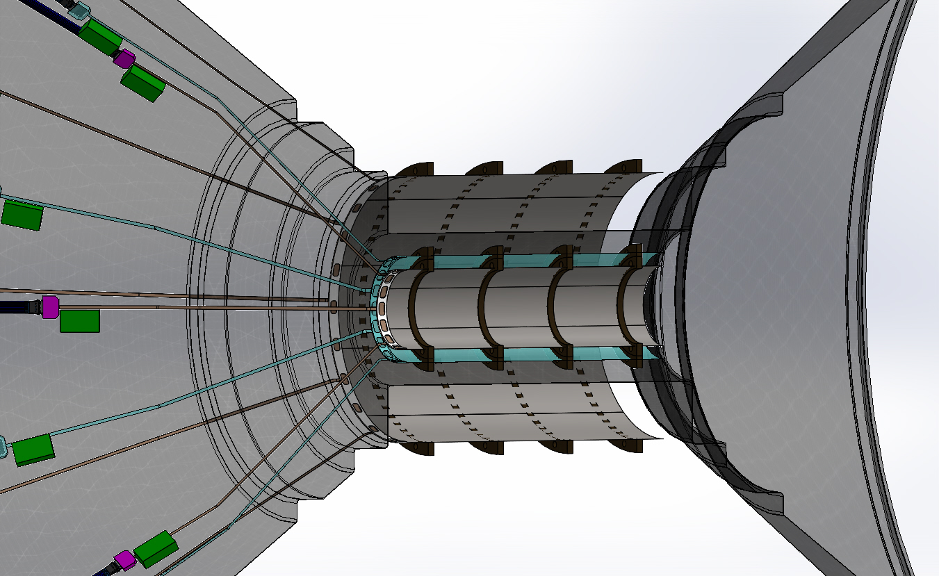
Updated EPIC SVT Solidwworks model using these parameters, updated radius layer 2:

Slide 4
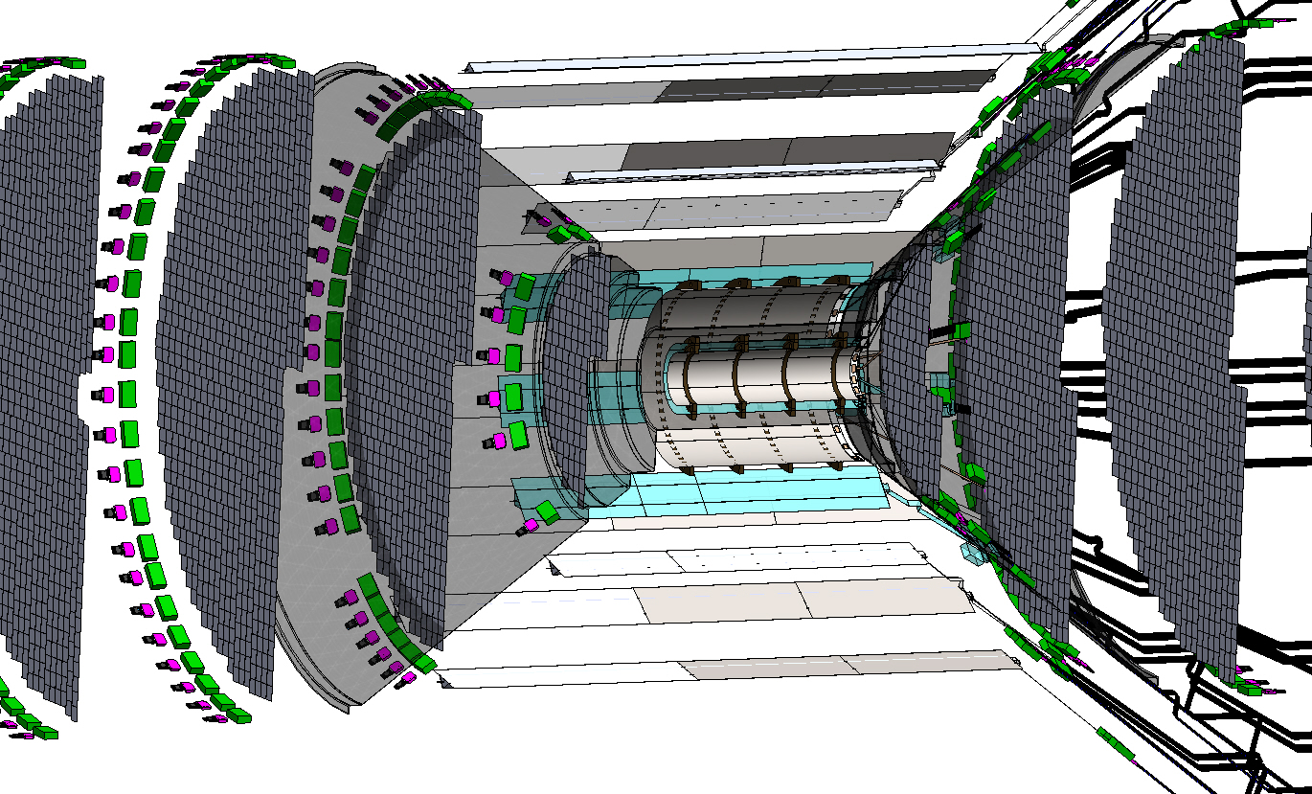
NO conflict between layers 3 & 4 with disks:

Slide 5
CAD Model updated 11-20-2022
The silicon barrel layers 0 through 4 have been relocated to Nikki’s current geometry
The Z location for the disks have also been relocated to Nikki’s current geometry but not their radial dimension
The services have not been updated in these views, except for the barrel layer routing

Slide 6
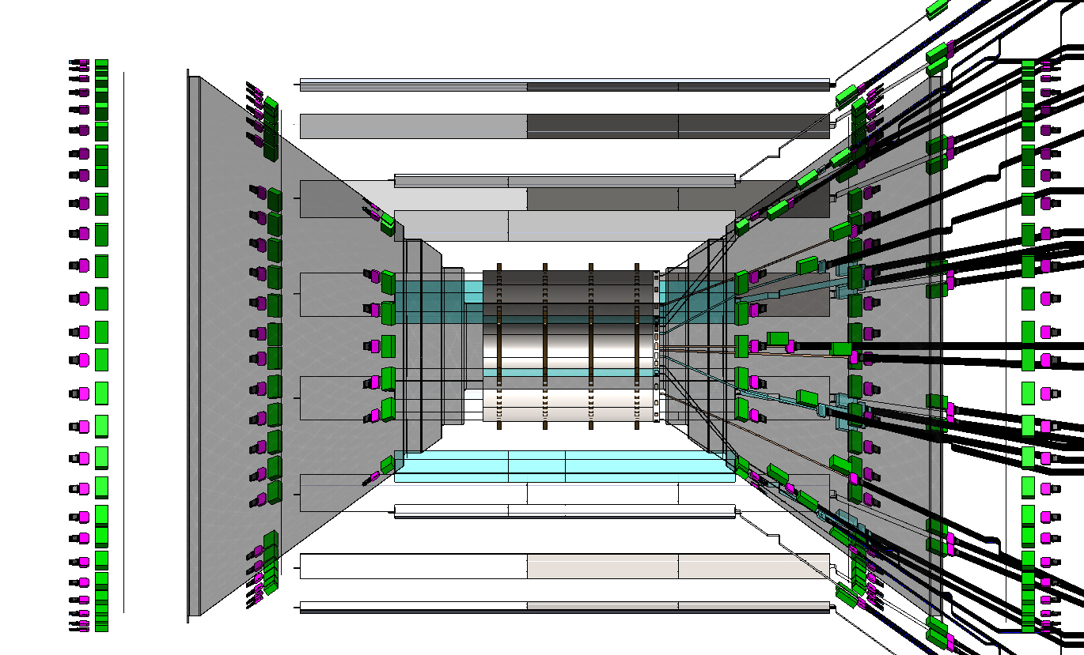
Need the increase the number of staves in layers 3 & 4, the length are correct:

