Slide 1
Considerations on EIC LAS Design for ePIC SVT Configuration v0.0
21/11/2022
Notes:
The abstract pattern can be removed or repositioned if required. Be careful to ‘Send to Back’ so that it does not obscure any important information.

Slide 2
Background
EPIC - SVT
Building on two talks from last time
https://indico.bnl.gov/event/17713/contributions/70439/attachments/44360/74847/20221107-ePIC-SVT-cfg-v0.0.pdf (Laura)
https://indico.bnl.gov/event/17713/contributions/70440/attachments/44407/74938/Apadula_EICSC_11_7_22.pdf (Nicky)
Current design misses engineering detail
Need to think about this, and about unanswered questions…

Slide 3
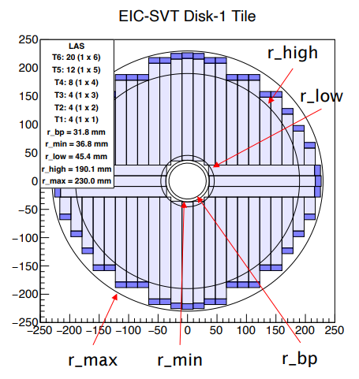
Engineering Issues - Electronics
Stitching
ITS3 plans long, thin sensors of a single length
Suitable for vertex layers…
…however, current disc plans envision many lengths
Will this be possible?
ITS3 Plan
https://indico.cern.ch/event/1127562/contributions/4904520/attachments/2511611/4318769/20220921.PL.MOSS.TWEPP2022.pdf

Slide 4
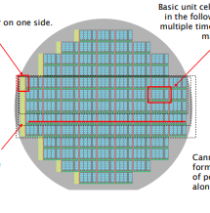
Engineering Issues - Electronics
Stitching
What adjustments to the stitching plan are possible?
Are multiple layouts per wafer possible, or one type per wafer?
Implications for yield, cost, number of wafers…
☑
?
?

Slide 5
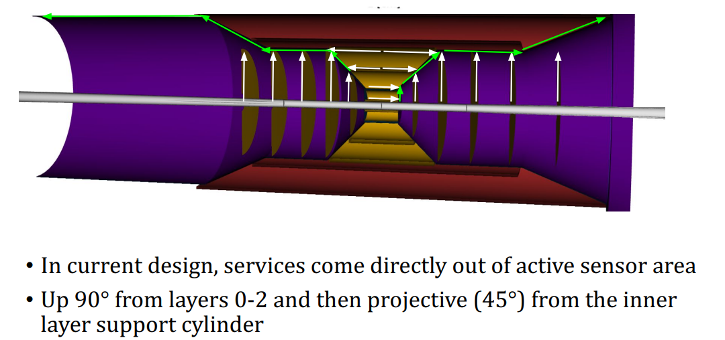
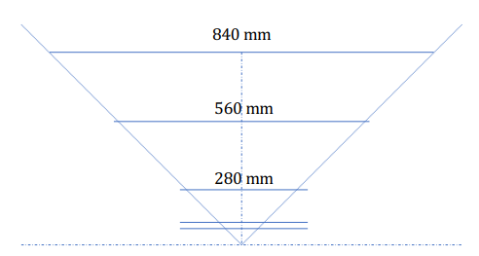
Engineering Issues - Electronics
Powering
How will power reach the various layers?
Vertex
Powered from one side
Issues around 90 degree bend explored in Nicky’s talk from last week
Staves
Current plan for longest barrel layer is 4 sensors of 1x7 reticules
How to power? PCB? Copper Lines? Effect on material budget?

Slide 6
Engineering Issues - Electronics
Powering
Staves
Longest barrel layer is 3x longest possible sensor
How to power? PCB? Copper lines? Effect on material budget?
Yield issues with using long (1x7) sensors? But additional material issues with using smaller ones? Acceptable trade-off?

Slide 7
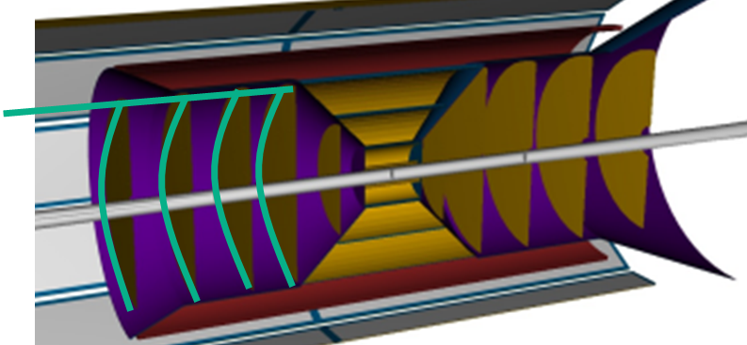
Engineering Issues - Electronics
Powering
Discs
Similar issues
Perhaps less severe, due to distance from interaction point, but needs physics simulation

Slide 8
Engineering Issues - Electronics
Cable Mass Reduction vs. Design Effort
Using ITS3 as is for the staves and discs (even with stitching plan changes) leads to the cabling level outlined in the prior slides
Is this acceptable from a physics point of view?
Reduction would require
Stand-alone or integrated DC-DC or serial powering blocks
Suitable design database access
Option | Mass | Timeline | Notes
Do nothing – cabling only | Highest | N/A – do nothing
Stand-alone DC-DC/serial powering | Medium | Use existing - ?? 180nm development – Q1 2024
Integrated DC-DC/serial powering | Lowest | Standalone – Q1 2024 Integrated – Q1 2025 | Database access critical

Slide 9
Engineering Issues - Electronics
Data Handling
Note that power cabling issues apply equally to data cabling.
Possibly harder, since cannot be combined.
Data aggregation needed for staves?
Miscellaneous
What level of access will be possible?
Current modelling assumes only silicon in the active area, but this is not the case…
Effect of sensor peripheries?

Slide 10
Summary
Technical Questions
What level of access will be possible?
What stitching plans are permissible? Different sensor sizes?
Modelling Questions
Effect of true sensor profile?
Effect of sensor peripheries?
Power/Data
What degree of power/data cabling would be needed in the current design?
How would this affect the physics simulations?
Does this imply the need for on-chip power management or on-chip data aggregation?
How to track these questions? Also, other points to capture, like those raised last week.

Slide 11
Notes:
The abstract pattern can be removed or repositioned if required. Be careful to ‘Send to Back’ so that it does not obscure any important information.

