Slide 1
EIC Project Update
Elke Aschenauer and Rolf Ent
Co-Associate Directors for the Experimental Program
ePIC General Meeting
December 8th 2022

Slide 2
Jim Yeck Mail to EIC Project 11/26/22
Dear EIC Project Team,
Good news! I am happy to report that the slower than planned ramp up of the EIC start-up phase is resolved by the Inflation Reduction Act (IRA) funding. We are restoring our momentum and remain committed to expeditiously achieving the upcoming DOE Critical Decision (CD) milestones. We continue to plan according to our Reference Funding Profile Version 3’ (V3 plus IRA), which assumes $90M in the FY2023 annual appropriation and subsequently ramping up to $300M per year by FY2026.
We are preparing for a major DOE status review scheduled for January 31 – February 2, 2023. The primary focus of this review is to provide an update on status since CD-1 and our plans to achieve CD-3a, CD-2, and CD-3. In consideration of our current status and the funding plans, we are making an adjustment to our CD plans as described below:
CD-3a, Long Lead Procurement Approval = No Change. DOE review in October 2023 and DOE approval of CD-3a in January 2024.
CD-2, Performance Baseline Approval = Revised. DOE review in October 2024 and CD-2 approval in January 2025.
CD-3, Start of Construction Approval = No Change. DOE review TBD and CD-3 approval in April 2025 prior to RHIC Shutdown in June 2025.
After consultation with DOE, we are accepting a later date for CD-2 given the limited people resources available and our priority on completing preliminary and final design of CD-3a Long Lead Procurement items. This schedule acknowledges slower than planned progress in the last two years including: ramp-up of staff, execution of contracts, securing international partners, and a delay in securing the $100M of New York State funding for an EIC Infrastructure Project.
We will continue to manage to our preliminary baseline, using formal change control and EVMS starting in July 2023. This is essential in order to maintain the CD-3a approval date as it drives the overall schedule and requires a clear understanding of the baseline technical scope.
There are important details to work out concerning the sequence of activities, particularly reviews after CD-2 approval and prior to CD-3 approval. Plans for the CD approvals in 2025 will continue to develop as we discuss the details with DOE. Please continue to hire, partner, collaborate, and define in-kind deliverables /institutions. The pace of the project will be determined by our ability to grow the effort dedicated to project activities and schedule performance.
Best wishes for this Thanksgiving holiday break!
Sincerely, Jim

Slide 3
Jim Yeck Mail 12/02/22
Dear Rolf,
Dear Elke,
This short note provides further clarification on project plans and the EIC Critical Decision schedule. There is very little change in the project plans. We will develop the project performance baseline (scope, technical performance, cost, and schedule) on the original schedule. DOE approval of the performance baseline, Critical Decision 2, will be one year later. The additional time results in a higher level of project design maturity and a higher quality baseline at the time of approval. We will request CD-2 and CD-3 approval prior to the RHIC shutdown in summer of 2025. A change in the RHIC shutdown plans is extremely unlikely as the cost-effective construction of the EIC depends on the redirection of RHIC operations funding to EIC construction.
The progress defining the EIC Project Detector scope has well aligned with the project schedule. The Project Detector performance baseline preparation should not be altered or slowed as a consequence of the change in the CD-2 approval timeline.
Sincerely,
Jim

Slide 4
Schedule till a week ago
Schedule Now
Conclusion of
RHIC Operations
06/2025
CD-2
01/2025
early
CD-4A
04/2031
early CD-4
CD-4A
04/2032
CD-0
12/2019
CD-2/3A
01/2024
CD-1
06/2021
CD-3A
01/2024
CD-3
04/2025
CD-4
04/2034
Preliminary
Design
Conceptual
Design
Preliminary
Design
Final
Design
Construction
Transition into
Operations
Start of
Operations
&
Science
Final Design LLPs
Approve final design
for all subdetectors
Design Maturity: ~90%
Need TDR
January 2023:
start change control
process for detector
April 2023:
train EVMS process
Approve preliminary design
for all subdetectors
Design Maturity: >60%
Need “pre-”TDR
Define Baseline:
Subdetector technologies,
Scope, Cost & Schedule
Design Maturity: 50% – 60%
Long Lead Procurement items
Design Maturity: ~90%
Plan is tracked through EVMS
& Change control process
Need Pre-TDR
Define Baseline:
Subdetector technologies,
Scope, Cost & Schedule
Long Lead Procurement items
Design Maturity: ~90%
Plan is tracked through EVMS
& Change control process
Need TDR for LLPs

Slide 5
Upcoming Events
October-December – EIC Subsystem Status Reviews on Tracking, Particle Identification Systems, Electromagnetic Calorimetry, Hadronic Calorimetry, Infrastructure/Installation, Polarimetry
  already completed
    Magnet Incremental Design and Safety Review (6.10.07) – Preliminary 30% Design
    IR Integration and Ancillary detectors (6.10.11)
    Electronics/Computing Subsystem Status Review (6.10.08 & 6.10.09)
    Magnet Incremental Design and Safety Review (6.10.07) – 60% Design
    Calorimetry Review (6.10.05 & 6.10.06) – 6th and 7th of December
  in planning stage
    Polarimetry Review (6.10.14) – Early January, One-day review, checking availability of reviewers
    Incremental Integration/Installation Review – waiting for sPHENIX installation schedule
  To do beyond
    Tracking Review (6.10.03)
    Particle Identification Review (6.10.04) → Looking at options in February
    Infrastructure Review (6.10.10)
    Magnet Incremental Design and Safety Review (6.10.07) – 90% Design ~September 2023
EIC Project R&D - DAC Meeting 19th – 21st October)
Final Report: https://indico.bnl.gov/event/17159/attachments/43857/76048/DAC-Report-Oct22-vf.pdf
DOE OPA Status Review - Confirm CD-2/3A Plans Jan. 31 – Feb. 2, 2023
DOE CD3A OPA Review and ICR October 2023
DOE CD 3A ESAAB Approval January 2024

Slide 6
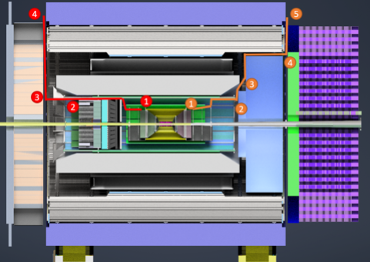
Update on Services
Remember:
Fill excel-sheet at https://wiki.bnl.gov/EPIC/index.php?title=Project_Information
Define choke points
layout conduits
separate services, signal cables, HV&LV, cooling
calculate cooling current through HV and LV cables
Currently a factor 2-3 over space budget
→ will need to iterate
→ might need to integrate DC-DC
converters and other means to
split the HV & LV out inside the
detector
→ material budget
Presentation planned: GDI 12th of December 2022

Slide 7
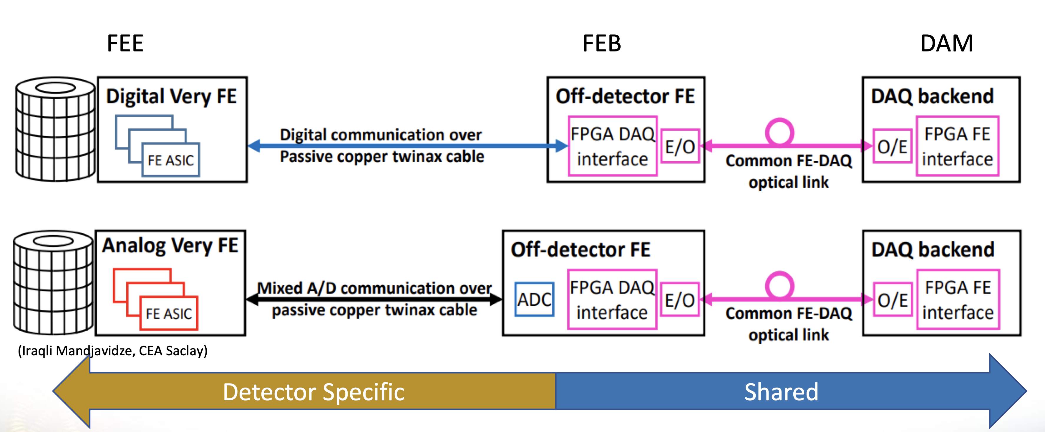
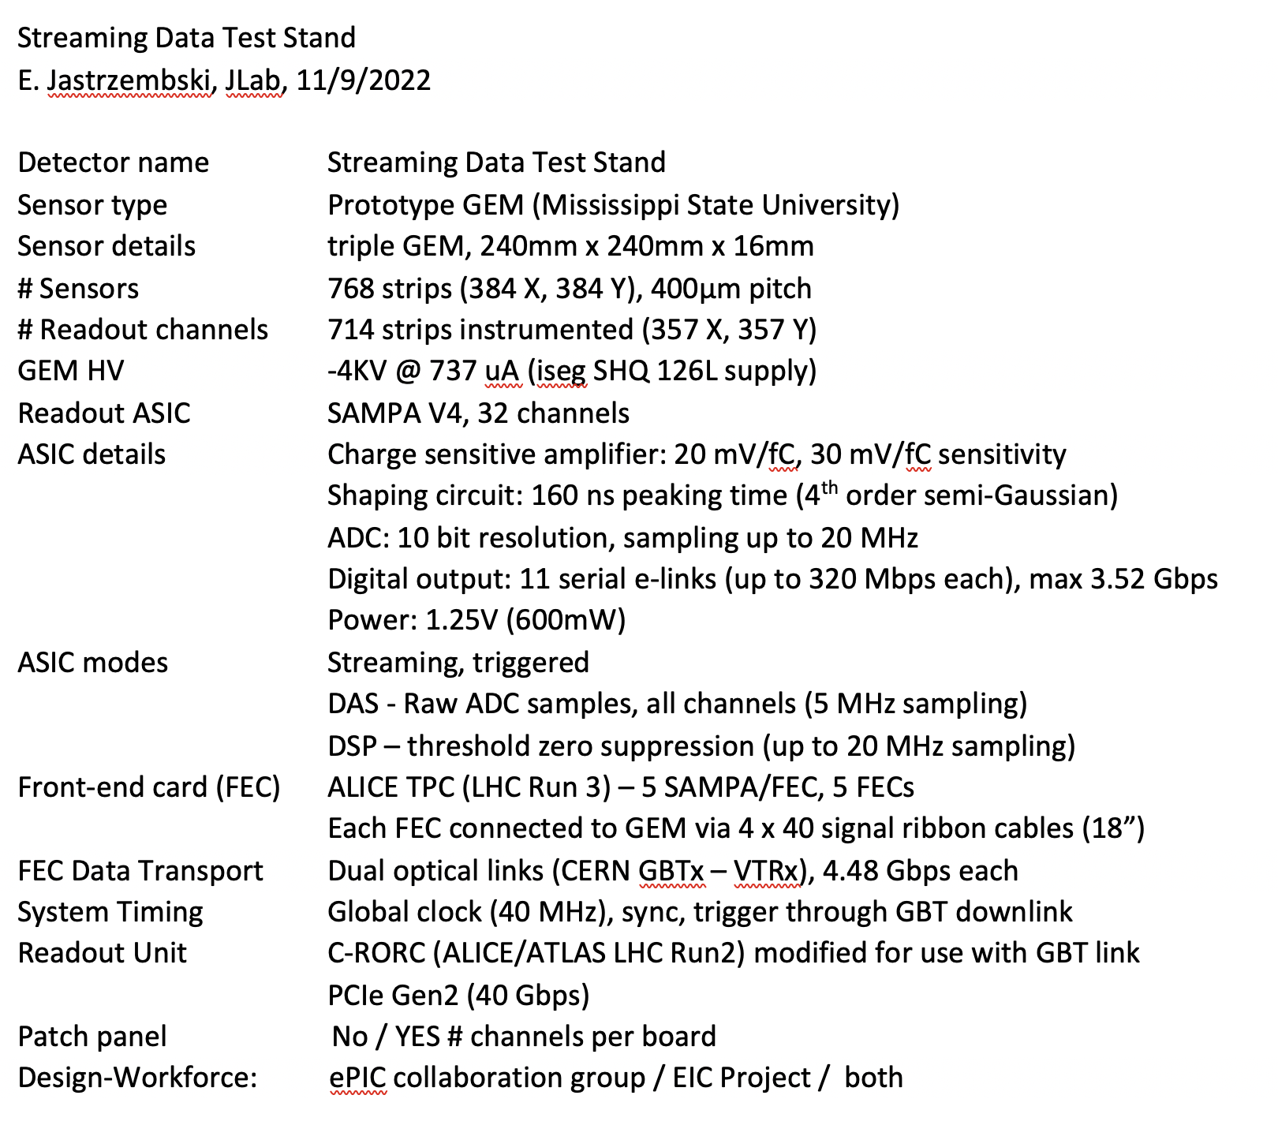
Next “ePIC – Project” Project: Subdetector Readout Chains
Will integrate read-out chain questionnaire for all subdetectors following these examples to be filled by experts following the services collection in the service excel-sheet
FEB
RDO
Sensor
detector specific
FEB:
detector specific
RDO:
hopefully one board
common to many
subdetectors

Slide 8


Slide 9


Slide 10
Change Control – Context
CD-2 – Approve Performance Baseline: CD-2 is an approval of the preliminary design of the project and the baseline scope, cost, and schedule. What is most relevant is that CD-2 means there is now a definitive plan that the project will be measured against in cost, schedule and technical performance.
This means that at CD-2 the baseline is fixed
Scope is known
Cost is known
Schedule is known
This has implications for any change in scope, cost and schedule which have to go through a formal change control process with thresholds for approval defined in the Project Execution Plan – a formal document signed off by DOE
It is good practice to start using the change control process well in advance of CD-2.
For accelerator scope this has been in use for the last year
For detector scope this will start January 2023

Slide 11
Accelerator Technical Change Control Process
Example based on EIC accelerator
This procedure shall be invoked if any of the following conditions are met:
The change will result in changing of a global design parameter from the list below:
  beam energy
  range of beam energy
  design luminosity
  design polarization
  bunch frequency
  bunch charge
  beam-beam parameters including crossing angle
  major technology changes for magnets, RF, vacuum, instrumentation and controls
The change will require a cost change which is greater than 5M $ or 20% of the contingency fund in its WBS level 3 category.
The change will affect the design progress of systems in other WBS level 2 categories.
The change may cause a schedule delay of more than 30 days.
The change will constitute an increase of performance risk of 10% measured in integrated luminosity, or cost risk which is greater than 20 M$ or 60% of the contingency fund in its WBS level 3 category or a schedule risk of greater the 60 days.
This is used for EIC accelerator scope presently. The latter bullets will need to be modified after CD-2 as cost and schedule contingencies are not defined system by system anymore, and the various numbers used are moot.

Slide 12
Technical Change Control
Initiating Stage
  A proposed change initiated by a requester
  The change is discussed among home WBS level 3 and level 2 category
Preparation Stage
  The requester generates the form and collects all supporting material
  Pre-TCCB review if needed
Review Stage
  All material regarding the change is submitted to the TCCB
  TCCB review meeting
  TCCB provides recommendations
Complete Stage
  TCCB submits recommendations to the EIC Technical Director
  New baseline announced if change accepted
  Case documented
Requester
TCCB Board
TCCB Chair + TD
This is used for EIC accelerator scope.
An equivalent for EIC detector may make direct use of technical work done within ePIC collaboration.

Slide 13
DOE Order Change Control Process
Not for the faint of heart…

Slide 14
Baseline Change Control – from Project Execution Plan
Tim Hallman/DOE-NP
Robert Caradonna
Jim Yeck/EIC Project
Changes in technology require DOE Federal Project Director approval.
After baselining contingency is owned by DOE – they need to approve use.
You build management reserve (MR) by having items come in below estimate.

Slide 15
Baseline Change Control – from Project Execution Plan
After baselining schedule contingency is also owned by DOE

Slide 16
Baseline Change Control – from Project Execution Plan

Slide 17
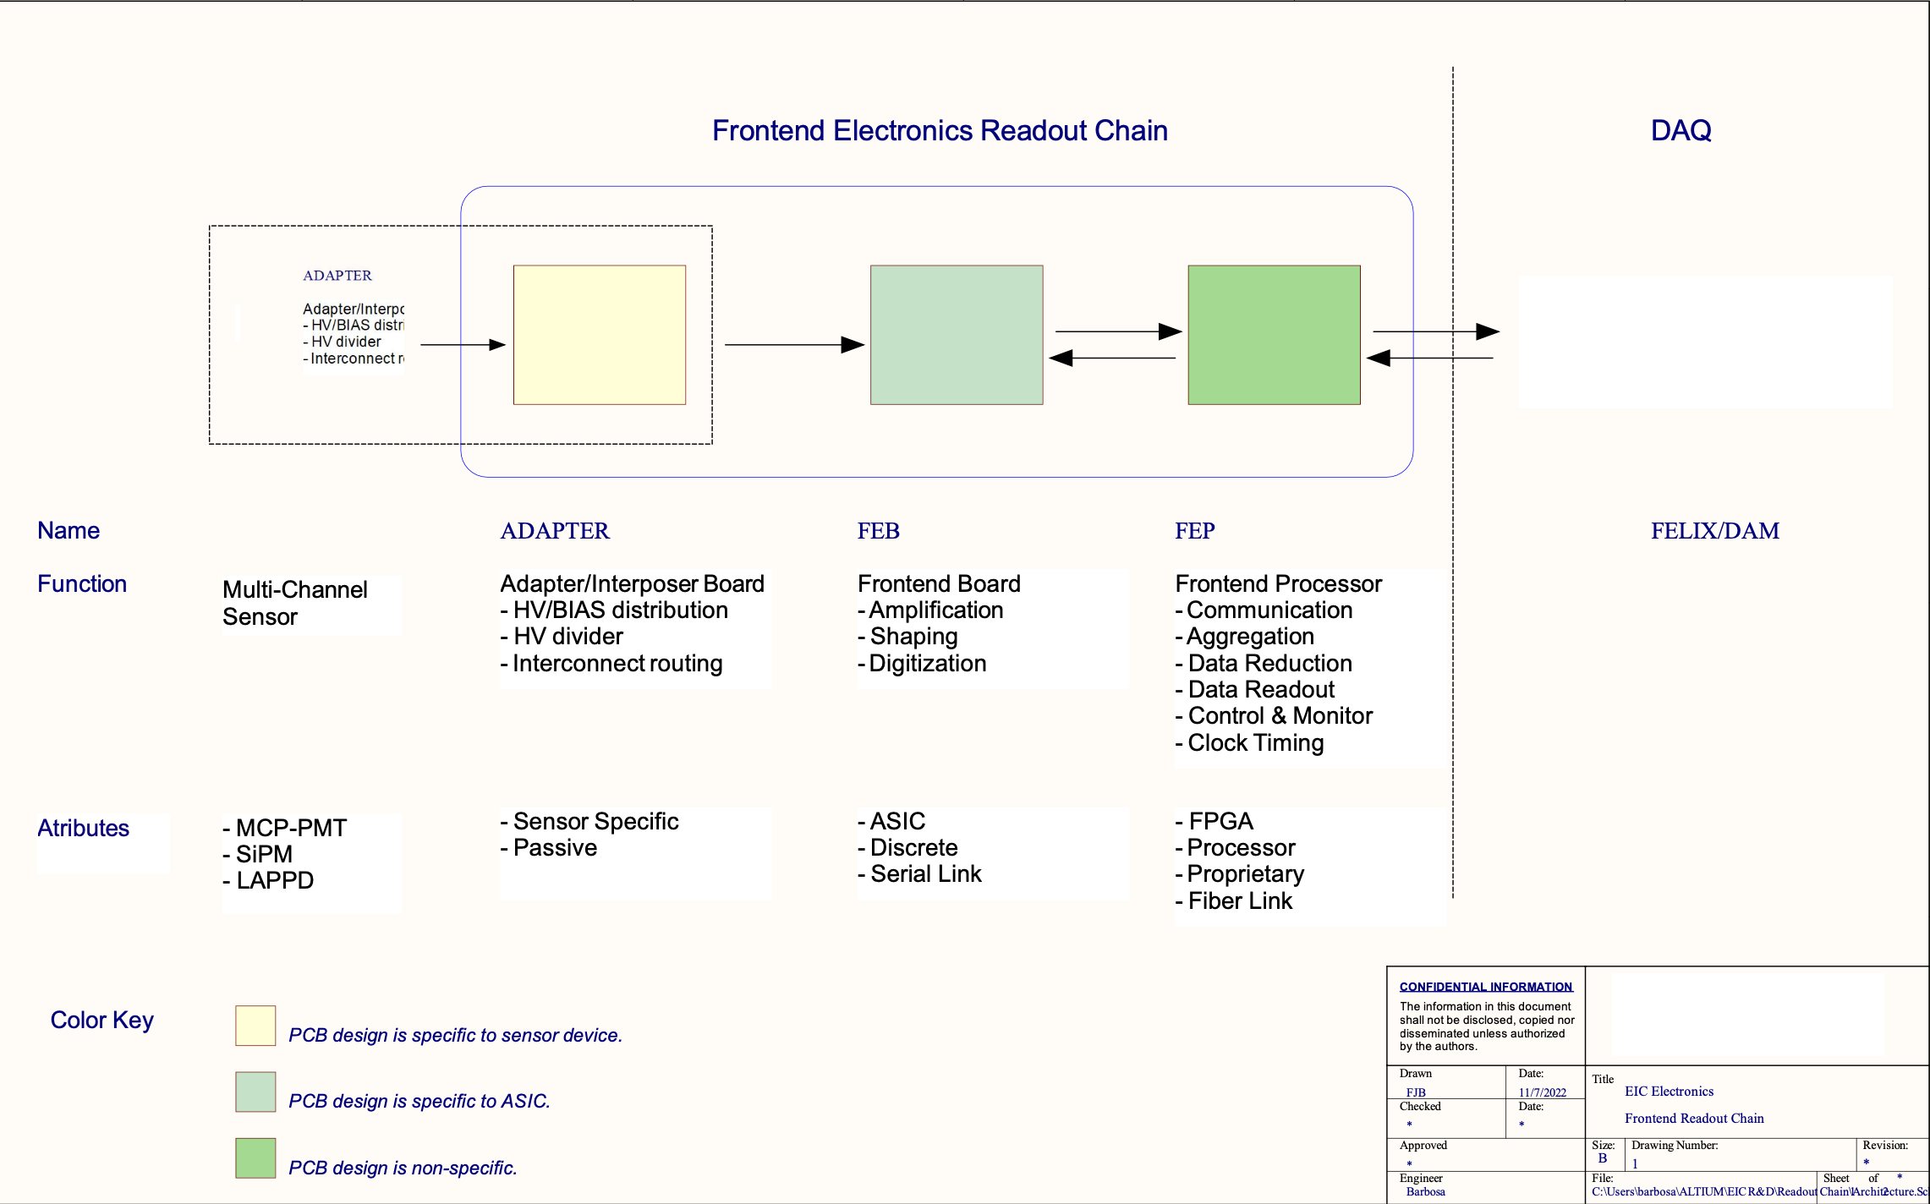
Next ePIC – Project Project: Subdetector Readout Chains
Collaboration between ePIC DAQ/Electronics WG and Project Electronics & DAQ CAMs
Goal:
define readout chain for each subdetector
  determine synergies between different subdetectors
  determine what support is needed from the project in design of front-end-electronics
Sub-detector
Sensor

