Slide 1
Minor Fe isotopes in Fast Region
G.P.A. Nobre, M. Herman, D. Brown,
National Nuclear Data Center, Brookhaven National Laboratory
R. Capote, A. Trkov
Nuclear Data Section, IAEA
Mini-CSEWG 2016, April 11th – 12th, 2016

Slide 2
Minor isotopes: inspired on ⁵⁶Fe input
CC for incident/outgoing channels + DWBA
Soukhovitskii and Capote dispersive OMP
Gilbert-Cameron level densities
Consistency among level-density parameters

Slide 3
⁵⁴Fe
Same Soukhovitskii and Capote
dispersive OMP
Same energy-dependent reduction
of (n,tot) up to 3 MeV
Fitted new LD parameters to (n,p),
(n,2n) and (n,α) to dosimetry (IRDFF)
Kept pre-equilibrium parameters within reasonable range
Fitted deformation of DWBA levels to fill gap in double-differential neutron spectra

Slide 4
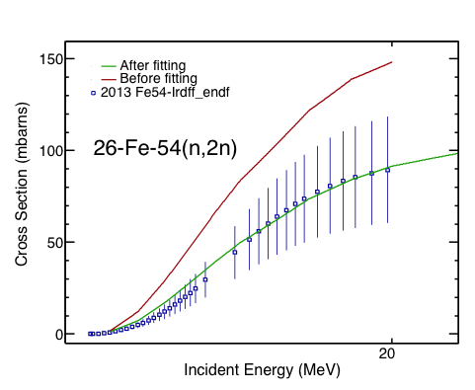
⁵⁴Fe

Slide 5
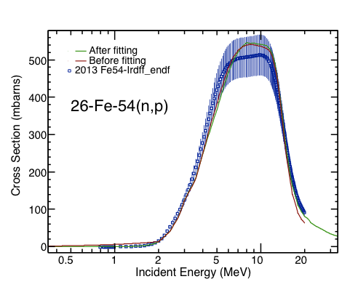
⁵⁴Fe

Slide 6
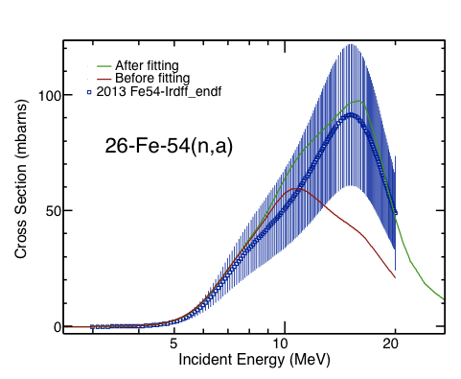
⁵⁴Fe

Slide 7
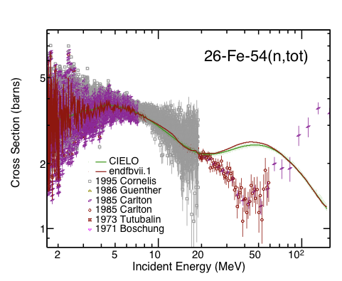
⁵⁴Fe

Slide 8
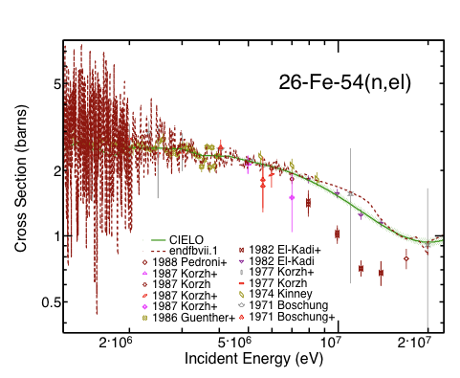
⁵⁴Fe

Slide 9
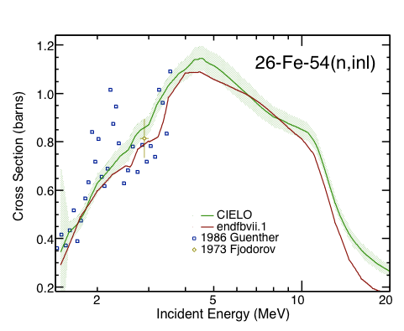
⁵⁴Fe

Slide 10
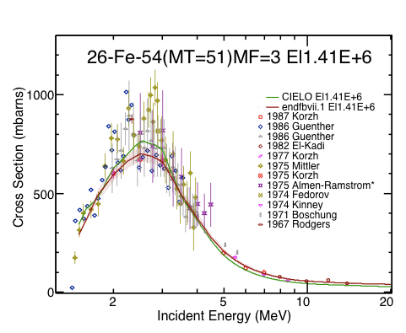
⁵⁴Fe

Slide 11
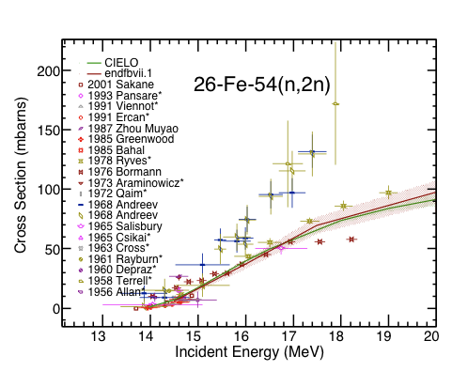
⁵⁴Fe

Slide 12
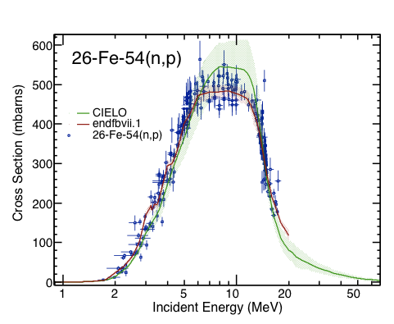
⁵⁴Fe

Slide 13
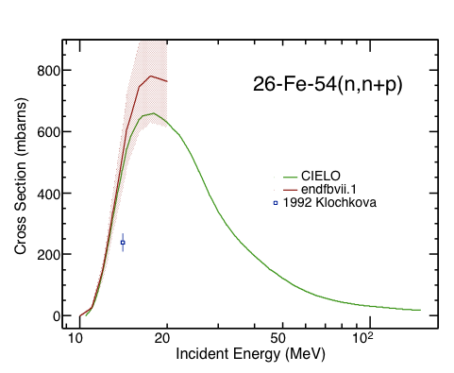
⁵⁴Fe

Slide 14
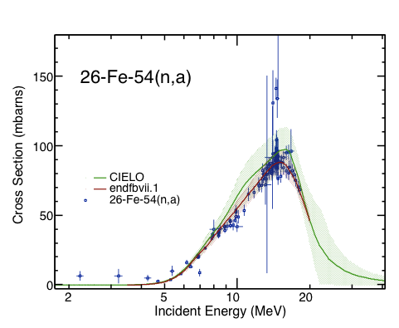
⁵⁴Fe

Slide 15
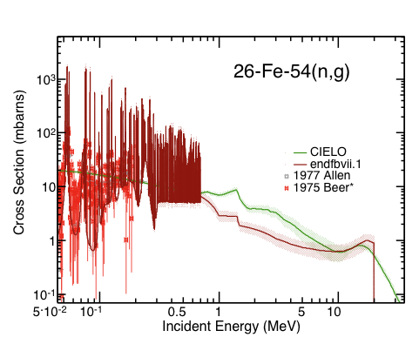
⁵⁴Fe

Slide 16
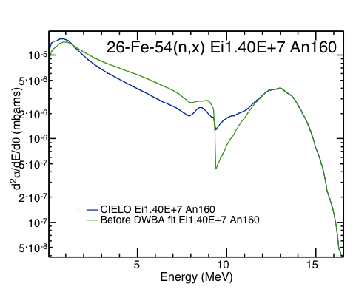
⁵⁴Fe

Slide 17
⁵⁷Fe
Soukhovitskii-Capote OMP for odd
iron isotopes
No reduction of (n,tot) necessary
Few experimental datasets
(No dosimetry file)
Fit (n,p) to select experiments
Low-energy peak for inelastic cross section

Slide 18
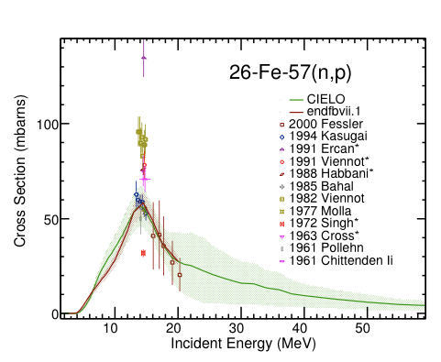
⁵⁷Fe

Slide 19
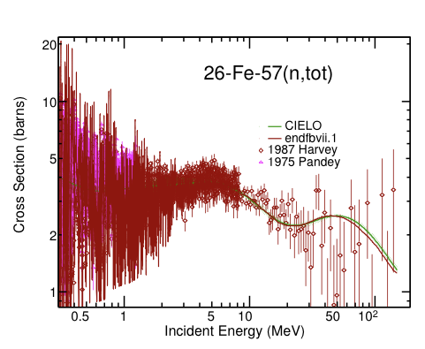
⁵⁷Fe

Slide 20
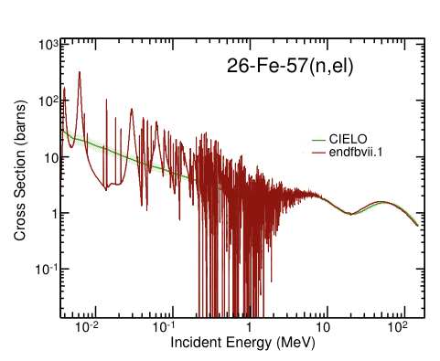
⁵⁷Fe

Slide 21
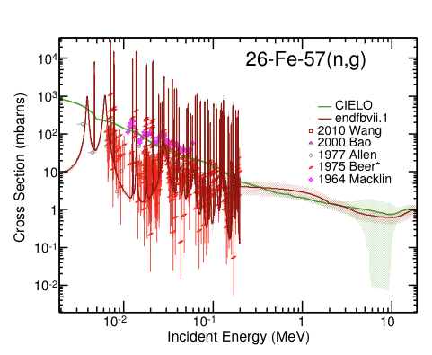
⁵⁷Fe

Slide 22
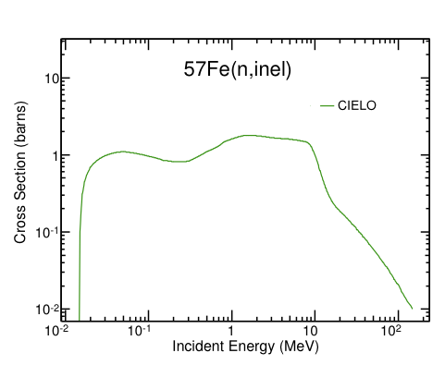
⁵⁷Fe

Slide 23
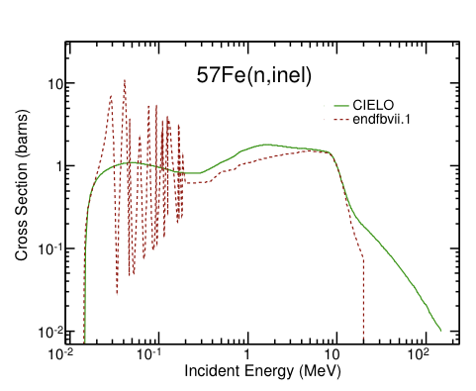
⁵⁷Fe

Slide 24
⁵⁸Fe
Soukhovitskii-Capote OMP for even
iron isotopes
No reduction of (n,tot) necessary
Even fewer experimental datasets
(No dosimetry file)
Fit (n,a) to the few experiments
available

Slide 25
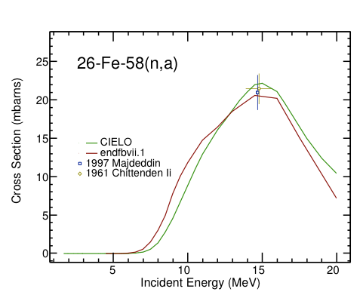
⁵⁸Fe

Slide 26
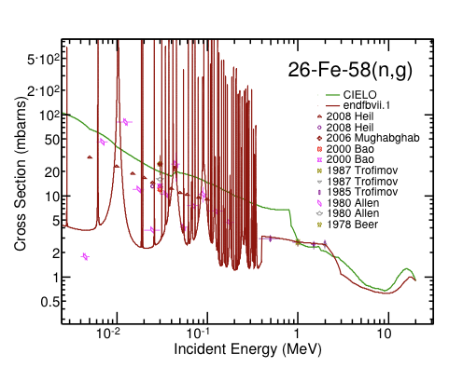
⁵⁸Fe

Slide 27
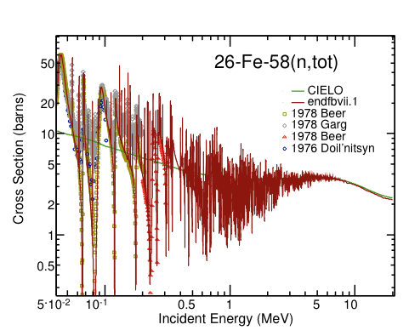
⁵⁸Fe

Slide 28
Conclusions
First versions of evaluated files for iron isotopes are ready
Promising results even though minor improvements will be necessary
Preliminary calculations of covariances were performed for main reactions
Validation and tests have begun
Consistency among isotope parameters

