Slide 1
Resonance Region Evaluations of Minor Fe Isotopes
D. Brown, S. Mughabghab

Slide 2
Minor Fe isotopes may play outsized role in some nuclear systems, especially systems used to validate 56Fe
x 5.8%
x 91.72%
x2.2%
x0.28%

Slide 3
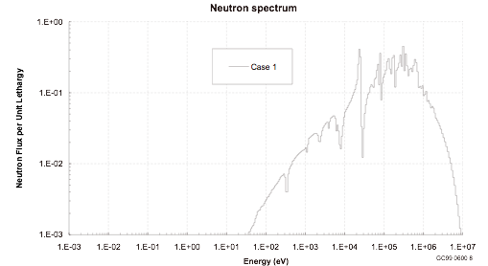
HEU-MET-INTER-001 very sensitive to 10 - 50 keV part of cross section

Slide 4
Major changes to RRR of minor Fe isotopes
⁵⁴Fe — modified from Atlas, converted to Reich-Moore
⁵⁷Fe — modified from Atlas, converted to Reich-Moore (LRF=7), including (n,n’)
⁵⁸Fe — adopted JEFF-3.2 evaluation from Moxon
not discussed — we may need to visit ⁵²Cr, the last untweaked component of stainless steel

Slide 5
Experimental results since last evaluation
The only new measurement of resonance parameters since 2005 is that of CERN which reported the capture Kernels at the ND13 conference in graphical form. The agreement of the CERN capture kernels with the ORNL and GEEL results is very good, showing that the resonance capture widths are well determined. As a result, the re-evaluation of the resonance parameters for the Fe isotopes received little or no change from values reported in the ATLAS.
— Said Mughabghab 3/2016

Slide 6
Major changes to RRR of minor Fe isotopes
⁵⁴Fe — modified from Atlas, converted to Reich-Moore
⁵⁷Fe — modified from Atlas, converted to Reich-Moore (LRF=7), including (n,n’)
⁵⁸Fe — adopted JEFF-3.2 evaluation from Moxon
not discussed — we may need to visit ⁵²Cr, the last untweaked component of stainless steel

Slide 7
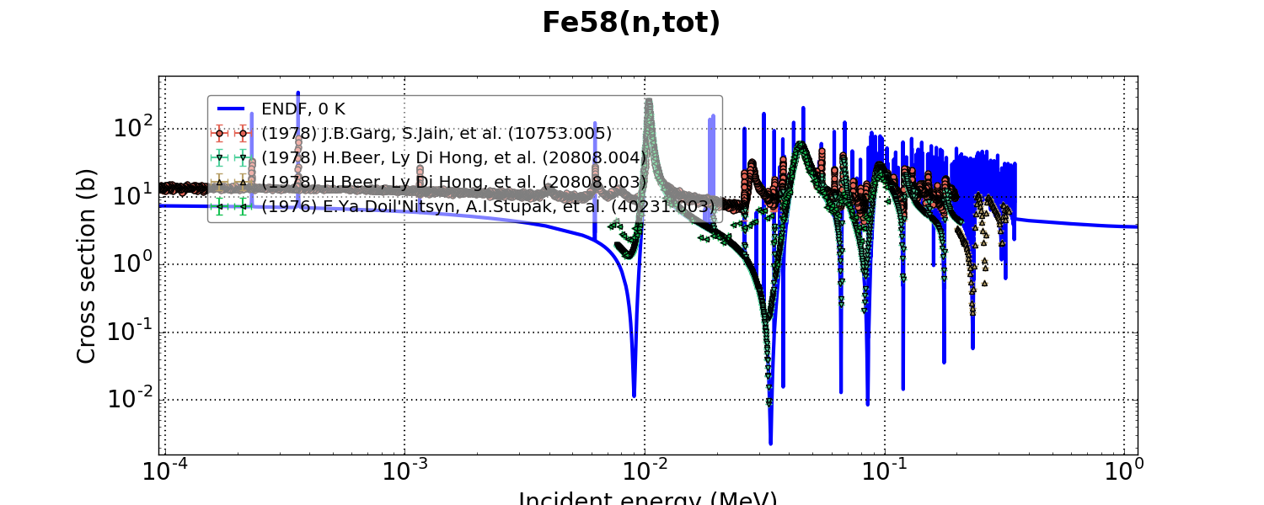
⁵⁸Fe: from Moxon
Moxon evaluation taken from JEFF-3.2. The unresolved region is for self-shielding only. All angular distributions, including RRR and URR, are calculated by EMPIRE.
Garg contaminated with ⁵⁴Fe, ⁵⁷Fe

Slide 8
Major changes to RRR of minor Fe isotopes
⁵⁴Fe — modified from Atlas, converted to Reich-Moore
⁵⁷Fe — modified from Atlas, converted to Reich-Moore (LRF=7), including (n,n’)
⁵⁸Fe — adopted JEFF-3.2 evaluation from Moxon
not discussed — we may need to visit ⁵²Cr, the last untweaked component of stainless steel

Slide 9
⁵⁴Fe: from new Atlas, but in RM
Convert MLBW (LRF=2) to Reich Moore (LRF=3)
  improved interference minima, but messed up thermal
Added/adjusted fictitious strong levels to fix thermal cross section
Imposed fictitious strong levels above Emax to get better interference effects and improve agreement with total cross section data

Slide 10
Before
After
ER (keV) | L | J | Γɣ (eV) | Γn (eV) | J | Γɣ (eV) | Γn (eV)
-1223.3 | 0 | n/a | n/a | n/a | 1/2 | 1.0 | 64,062
-22.24 -> -20.499 | 0 | 1/2 | 1.55 | 8474 | 1/2 | 1.55 | 6872
740.56 | 2 | 1/2 | 0.96 | 386.5 | 3/2 | 0.96 | 386.5
741.44 | 2 | 1/2 | 0.96 | 424 | 3/2 | 0.96 | 424
814.627368 | 0 | n/a | n/a | n/a | 1/2 | 4.0 | 1508.68838
815.801766 | 0 | n/a | n/a | n/a | 1/2 | 4.0 | 4148.82574
824.106211 | 0 | n/a | n/a | n/a | 1/2 | 4.0 | 3848.05147
833.931452 | 0 | n/a | n/a | n/a | 1/2 | 4.0 | 5844.58959
847.326171 | 0 | n/a | n/a | n/a | 1/2 | 4.0 | 5565.40352
1000 | 0 | n/a | n/a | n/a | 1/2 | 4.0 | 26,000

Slide 11

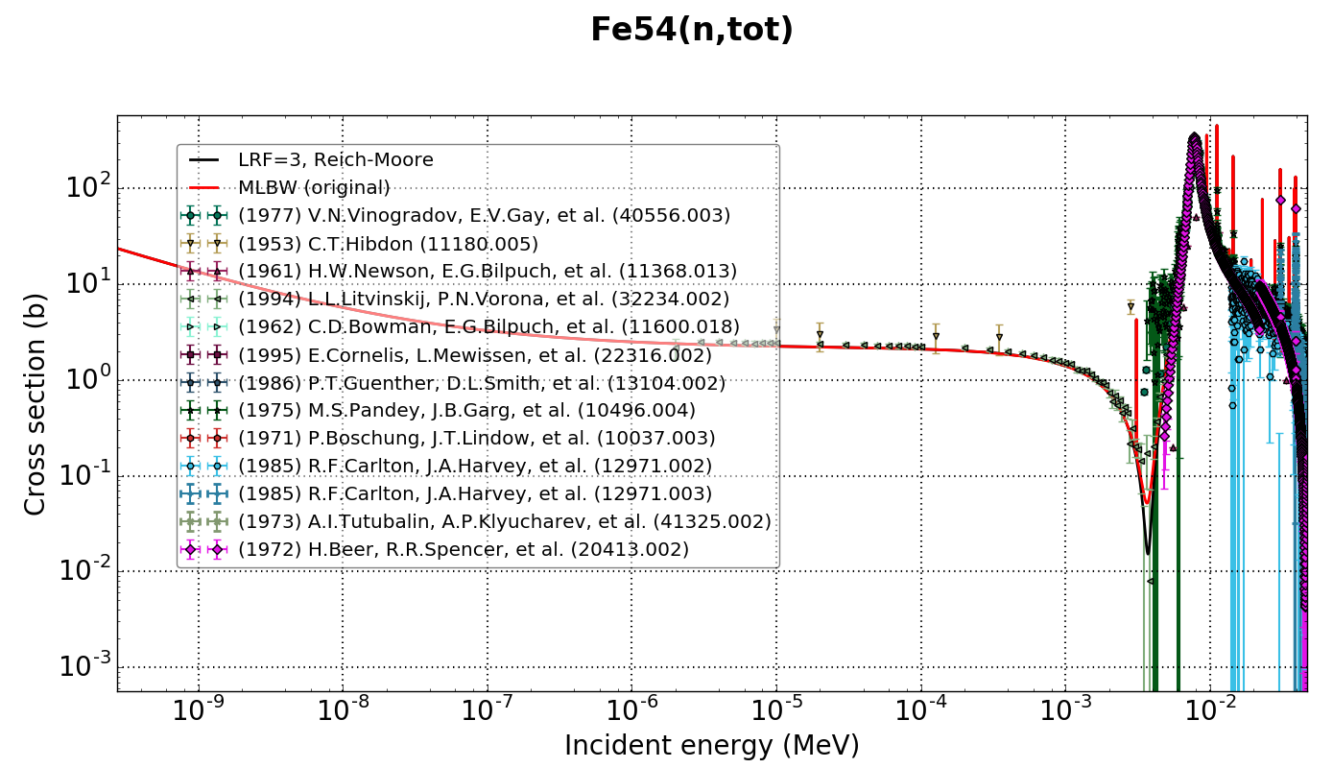
Tweaks of bound levels get low energy part correct

Slide 12
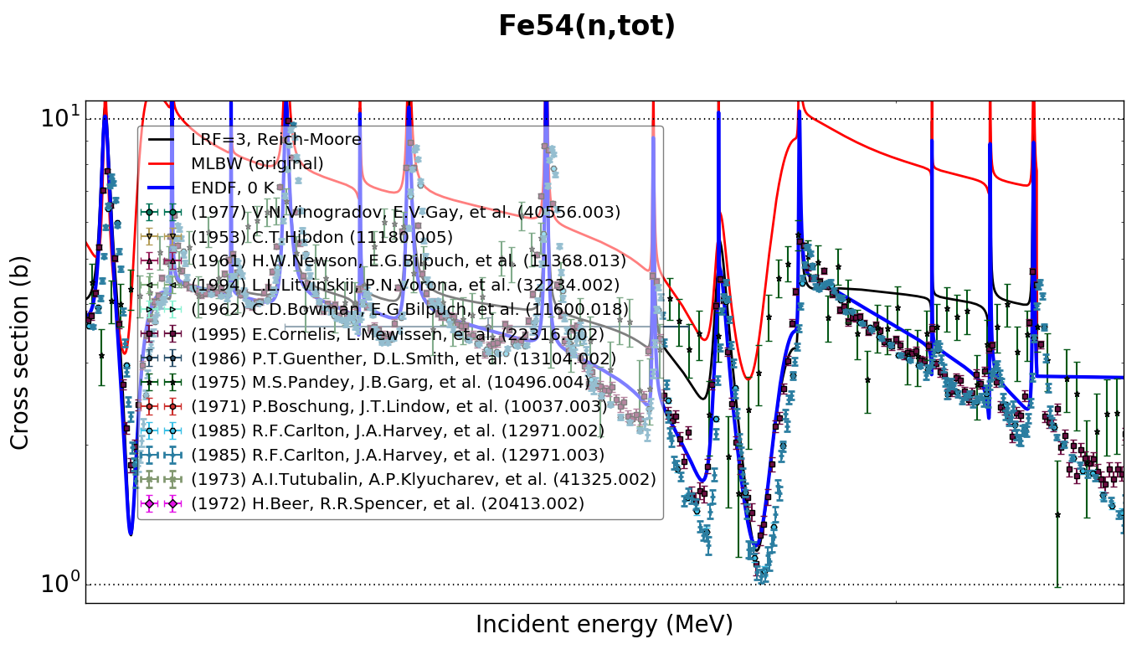
Added a cluster of high energy S-wave resonances to interfere at the upper end and pull down the valleys

Slide 13
Major changes to RRR of minor Fe isotopes
⁵⁴Fe — modified from Atlas, converted to Reich-Moore
⁵⁷Fe — modified from Atlas, converted to Reich-Moore (LRF=7), including (n,n’)
⁵⁸Fe — adopted JEFF-3.2 evaluation from Moxon
not discussed — we may need to visit ⁵²Cr, the last untweaked component of stainless steel

Slide 14
⁵⁷Fe: from new Atlas, but converted to Reich-Moore (LRF=7)
Said’s resonances given in MLBW formatted ENDF file with extra column containing (n,n’) widths
  (n,tot), (n,el) and (n,g) widths based on Geel parameters, likely generated in Reich-Moore approximation
  (n,n’) resonances determined by subtracting capture resonances from (n,tot) where no (n,el) present
    Ex = 14.410 keV
    S wave only
    Capture widths known only from area under resonance
MACS(30 keV)=42 mb, consistent with Bao’s recommended value of 40 mb
  Switching to RM disturbs this result
Dave converted resonances into LRF=7 format and flipped the approximation flag to Reich-Moore, keeping resonance parameters (mostly) unchanged

Slide 15
Summary of Said’s work on MLBW parameters
For Fe-57, aside from the fictitious resonances, to achieve agreement with the measurements, the only significant change is an increase in the parameters of the 6.22 keV resonance from a scattering width of 380 eV (ATLAS value) to 400 eV. Because of this change, the parameters of the two postulated bound levels have to be adjusted to describe the thermal capture cross section as well as the coherent scattering amplitude.
— Said Mughabghab 3/2016

Slide 16
To our knowledge, this is first time an LRF=7 evaluation was produced without SAMMY

Slide 17
To our knowledge, this is first time an LRF=7 evaluation was produced without SAMMY
Therefore, peer review from Andrej Trkov and Red Cullen was essential

Slide 18
A.Trkov and D.E. Cullen reviewed evaluation
Initial version of file crashed RECENT2010 and RECENT2015
  RECENT implements SAMMY mandated ordering of channels within a spin group; will crash if ordering “incorrect”
  tracked down a goof in the channel spin assignments in the MLBW->LRF=7 translation
Initial version of file crashed NJOY2012
  tracked down to FUDGE setting the library version to “-1”
“Second” version passed both codes, but there were many warnings and other issues to be addressed

Slide 19
Red’s major concerns
Have the background cross sections been correctly handled in all reactions?
Has potential scattering converged at the L specified in file?
Are there missing (L,J,S,MT) combinations from the channel specification?
Are there missing s- or p- wave resonances?
The valleys in the (n,tot) toward the upper end of the RRR are filled in in this evaluation
Do we match the MACS(30 keV) value for capture?

Slide 20
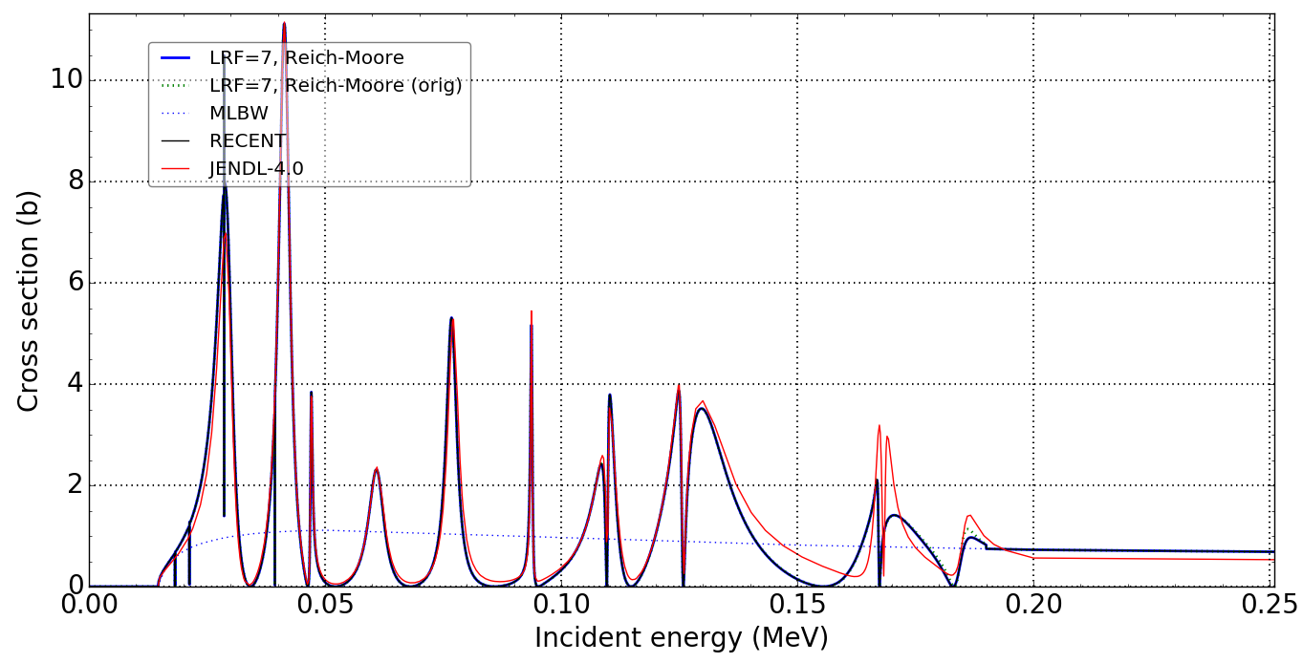
1. Have the background cross sections been correctly handled in all reactions?
MT=51
Err… no. There was a bug in the assembly script that kept the MT=51 cross section from being zeroed. It is fixed now. The other reactions are OK.

Slide 21
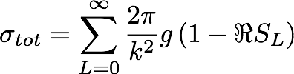

2. Has potential scattering converged at the L specified in file?
The potential scattering part of the total and elastic cross sections are expanded in terms of the orbital angular momentum of the incident neutron, L:
The sum must be truncated at finite NL
Added convergence test to FUDGE:
Q: Has the sum converged? A: No, but the scattering length has been tuned to get the potential scattering correct at the current NL (=1). Therefore, rather than refitting, keep the “unconverged” sum.

Slide 22

3. Are there missing (L,J,S,MT) combinations from the channel specification?
RECENT has two tests to detect this:
  Sum rule of statistical weights:
  “Brute force” loop through all allowed L,J,S
FUDGE now has both of these tests:
WARNING: The spin statical weights for L=1 sums to 2.25, but should sum to 3.0.
You have too few channels for reaction n + Fe57
WARNING: The spin statical weights for L=0 sums to 0.375, but should sum to 1.0.
You have too few channels for reaction n + Fe57_e1
WARNING: The spin statical weights for L=1 sums to 1.125, but should sum to 3.0.
You have too few channels for reaction n + Fe57_e1
WARNING: Missing a channel with angular momenta combination L = 0, J = 2.0 and S = 2.0 for "n + Fe57_e1"
WARNING: Missing a channel with angular momenta combination L = 1, J = 1.0 and S = 1.0 for "n + Fe57"
WARNING: Missing a channel with angular momenta combination L = 1, J = 1.0 and S = 2.0 for "n + Fe57_e1"
WARNING: Missing a channel with angular momenta combination L = 1, J = 2.0 and S = 2.0 for "n + Fe57_e1"
WARNING: Missing a channel with angular momenta combination L = 1, J = 3.0 and S = 2.0 for "n + Fe57_e1"

Slide 23
Do we need these empty channels?
  They are potential scattering only.
  Evaluation apparently “pre-tuned” to match potential scattering without these channels
None of ORNL LRF=7 evaluations have empty/pure potential scattering channels and in fact neither Luiz nor Vlad think they were needed

Slide 24
First attempt to fix: by adding more channels to get their potential scattering
spin |  | ɣ+⁵⁸Fe (I=0⁺) |  | n+⁵⁷Fe (I=1/2⁻) |  | n’+⁵⁷Fe_e1 (I=3/2⁻) |  | #
group | J^{Π} | L | S | L | S | L | S | res
0 | 0⁺ | 0 | 1 | 0 | 0 |  |  | ~10
1 | 0⁻ | 1 | 1 | 1 | 1 | 1 | 1 | 6
 | 0⁺ |  |  |  |  | 2 | 2 | unused
2 | 1⁺ | 0 | 1 | 0 | 1 | 0 | 1 | ~25
4 | 1⁻ | 1 | 1 | 1 | 0 | 1 | 1 | ~30
 | 1⁻ |  |  | 1 | 1 | 1 | 2 | unused
5 | 1⁺ | 2 | 1 | 2 | 1 | 2 | 1 | pot. only
 | 1⁺ |  |  |  |  | 2 | 2 | unused
 | 2⁺ |  |  |  |  | 0 | 2 | unused
6 | 2⁻ | 1 | 1 | 1 | 1 | 1 | 1 | ~40
 | 2⁻ |  |  |  |  | 1 | 2 | unused
7 | 2⁺ | 2 | 1 | 2 | 0 | 2 | 1 | pot. only
 | 2⁺ |  |  | 2 | 1 | 2 | 2 | unused
 | 2⁺ |  |  |  |  | 1 | 2 | unused
 | 3⁻ |  |  |  |  | 1 | 2 | unused
8 | 3⁺ | 2 | 1 | 2 | 1 | 2 | 1 | pot. only
 | 3⁺ |  |  |  |  | 2 | 2 | unused
 | 4⁺ |  |  |  |  | 2 | 2 | unused
= spin
ambiguity
in MLBW
Despite the increased bookkeeping, it didn’t change anything substantive

Slide 25
Have we blundered into a format failing?
LRF=7 groups resonances into spin groups with common J
SAMMY and hence RECENT make some undocumented demands on spin groups:
  All spin groups apparently are required to have MT=102 and MT=2 channels
  Resonances in a spin group must be ordered by MT=102, then MT=2, then rest of channels in order of increasing mass (?)
Does NJOY make these same demands?
In 57Fe, not all channels could fit in spin groups that satisfy these requirements

Slide 26
4. Are there missing s- or p- wave resonances?
Probably. The correct diagnosis is to look at the staircase plot for anomalous plateaus.
This affects the angular distributions in a big way, less so for the cross sections after Doppler broadening.
However, this evaluation is so low priority (no one will be transporting moles of neutrons though slabs of pure 57Fe) that its not clear if this passes the cost/benefit test.

Slide 27
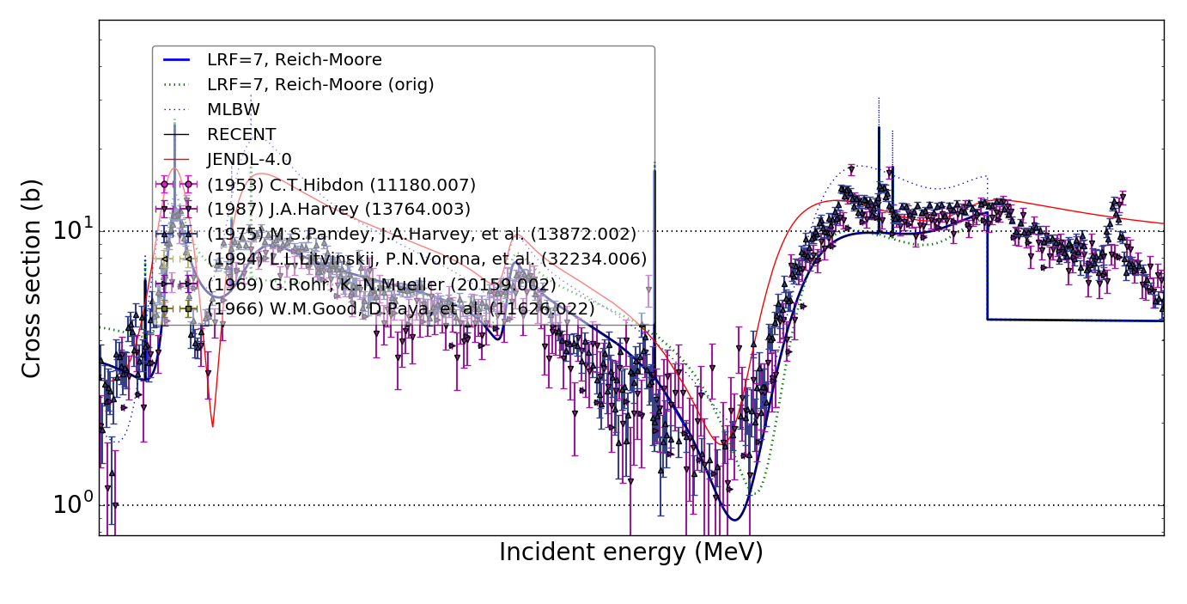
5. The valleys in the (n,tot) toward the upper end of the RRR are filled in in this evaluation
As Red pointed out, we have to get the valleys in between resonance correct, especially for fission spectrum neutrons
The cross sections near Emax of the RRR were problematic (see green curve)
(n,tot)
log scale on too coarse a grid, sorry!

Slide 28
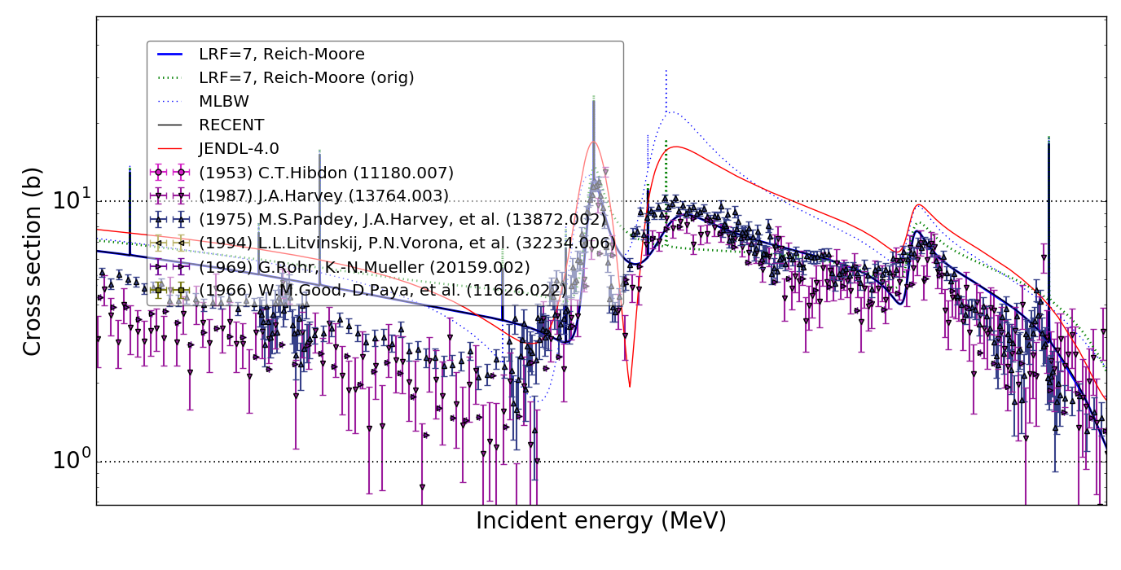
5. The valleys in the (n,tot) toward the upper end of the RRR are filled in in this evaluation
Reworked near Ehi
  add 4 s-wave above Ehi to get tails
  add 1 s-wave at 169.31 keV to get interference
  tweak 3 resonances near 185 keV to get interference better
(n,tot)
log scale on too coarse a grid, sorry!

Slide 29
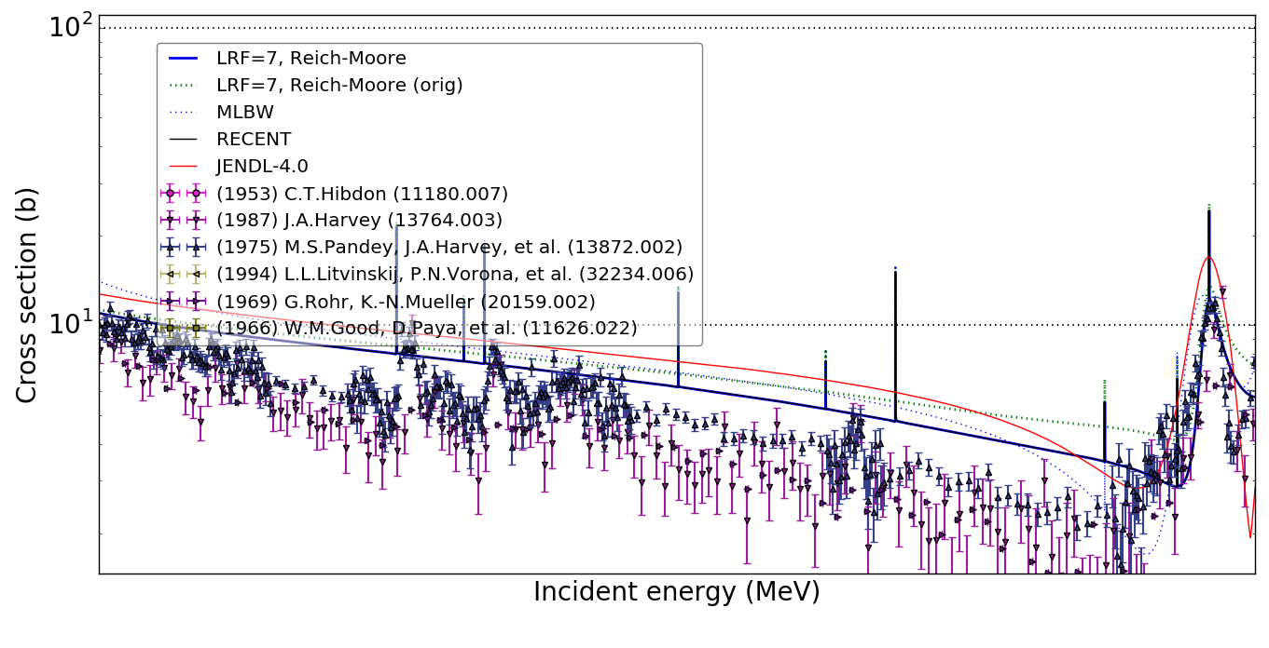
5. The valleys in the (n,tot) toward the upper end of the RRR are filled in in this evaluation
In range 140 to 165 keV still too high
(n,tot)
log scale on too coarse a grid, sorry!

Slide 30
5. The valleys in the (n,tot) toward the upper end of the RRR are filled in in this evaluation
Before
After
ER (kev) | J | Γt (eV) | Γn (eV) | Γɣ (eV) | Γt (eV) | Γn (eV) | Γɣ (eV)
169.31 | 0 |  |  |  | 1801.38 | 1800 | 1.38
176.30 | 0 | 701.20 | 700.00 | 1.20 | 501.20 | 500 | 1.20
185.00 | 1 | 3903.00 | 3500.00 | 3.00 | 5203.00 | 4800 | 3.00
189.50 | 0 | 3201.50 | 3200.00 | 1.50 | 4201.50 | 4200 | 1.50
194.25 | 0 |  |  |  | 703.55 | 700 | 3.55
197.30 | 0 |  |  |  | 702.57 | 700 | 2.57
198.90 | 0 |  |  |  | 701.18 | 700 | 1.18
200.10 | 0 |  |  |  | 700.99 | 700 | 0.99
1) Ehi=190 keV; 2) Γɣ determined from gΓnΓɣ/Γ assuming gΓn/Γ=0.253;
3) ER=185 keV has MT51 resonance with Γn’=400 eV;
4) new resonances from Atlas with tuned Γn

Slide 31
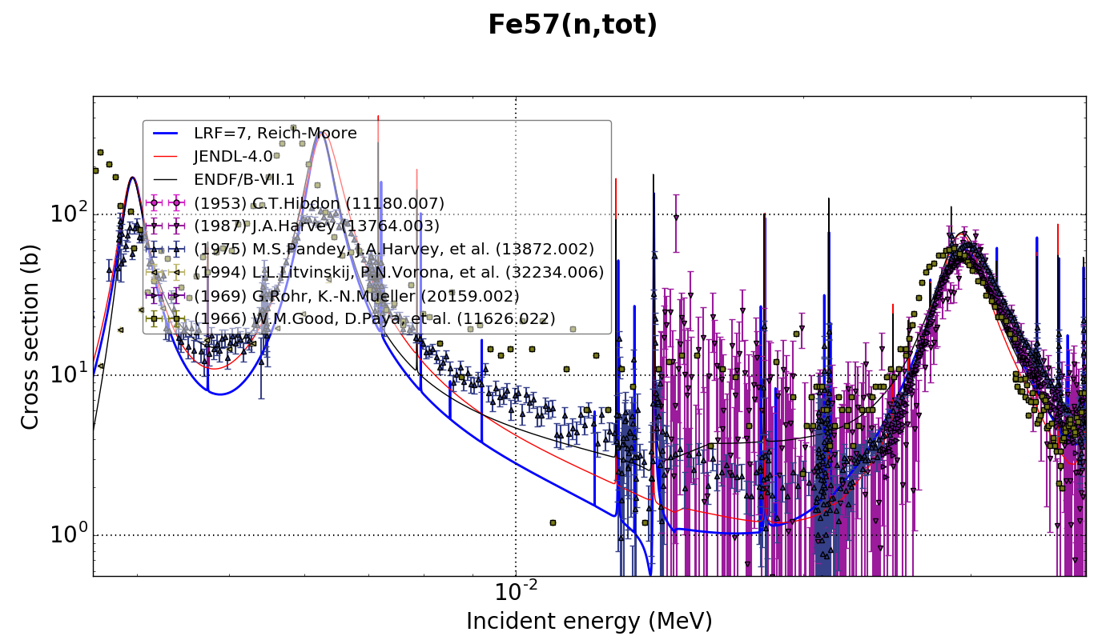
5. The valleys in the (n,tot) near 25 keV live in “window” of 56Fe resonances
J^{Pi}=0+
L=0
E0=3.955 keV
Gn=0.214 keV
J^{Pi}=1+
L=0
E0=6.220 keV
Gn=0.380 keV
J^{Pi}=1+
L=0
E0=29.05 keV
Gn=3.45 keV
Before: miss valley

Slide 32
Tweaked bound levels and resonance at 6.22 keV
Before
After
ER (kev) | J | Γt (eV) | Γn (eV) | Γɣ (eV) | Γt (eV) | Γn (eV) | Γɣ (eV)
-55.00 | 0 |  |  |  | 27,000.8 | 27,000.0 | 0.8
-2.33 | 1 | 66.62 | 64.89 | 1.73
-1.22 | 1 |  |  |  | 11.51 | 9.51 | 2.00
6.22 | 1 | 381.15 | 380.00 | 1.15 | 401.15 | 400.00 | 1.15
Also, remember R’ = 6.3 -> 5.9 fm

Slide 33
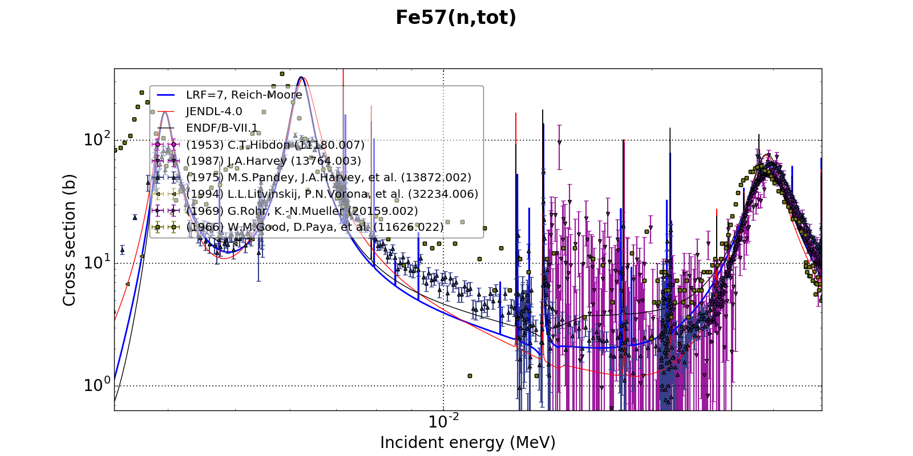
After: Nail valley

Slide 34
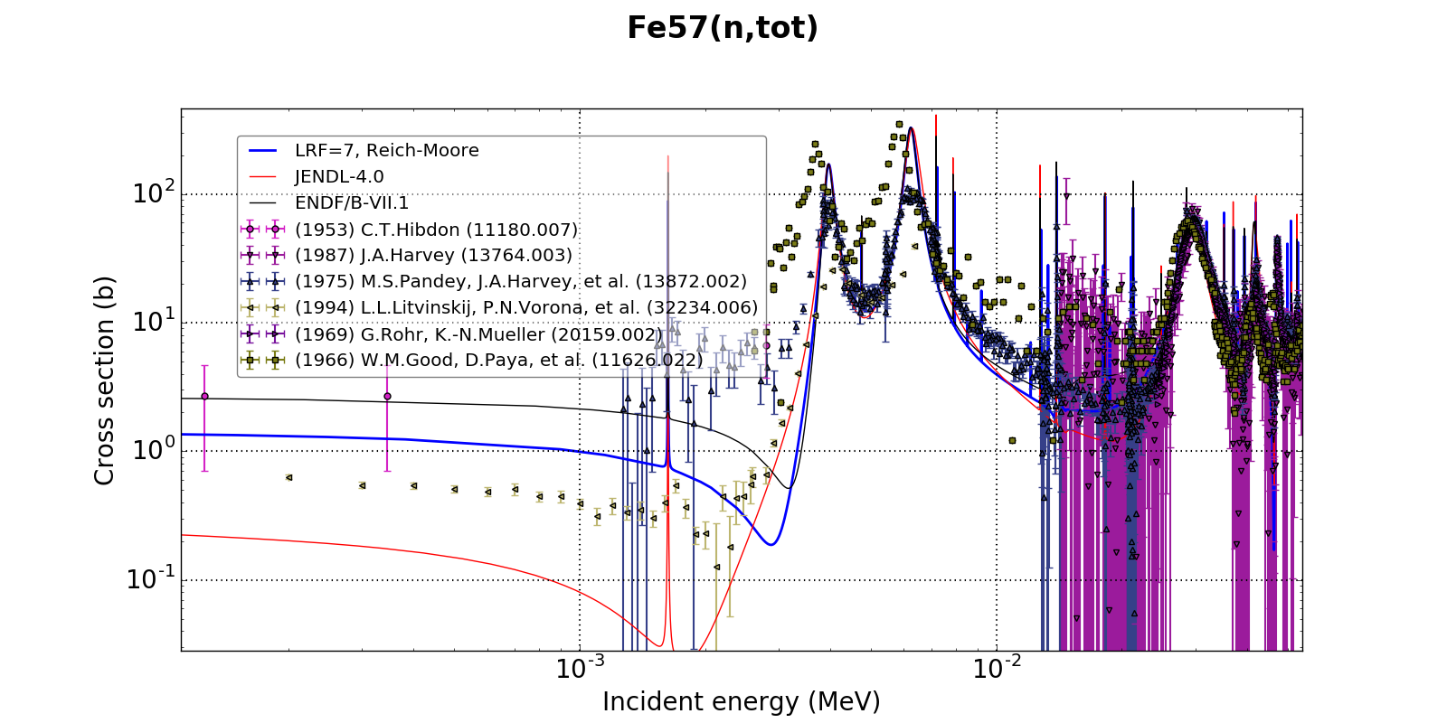
Don’t trust Hibdon or Litvinskij

Slide 35
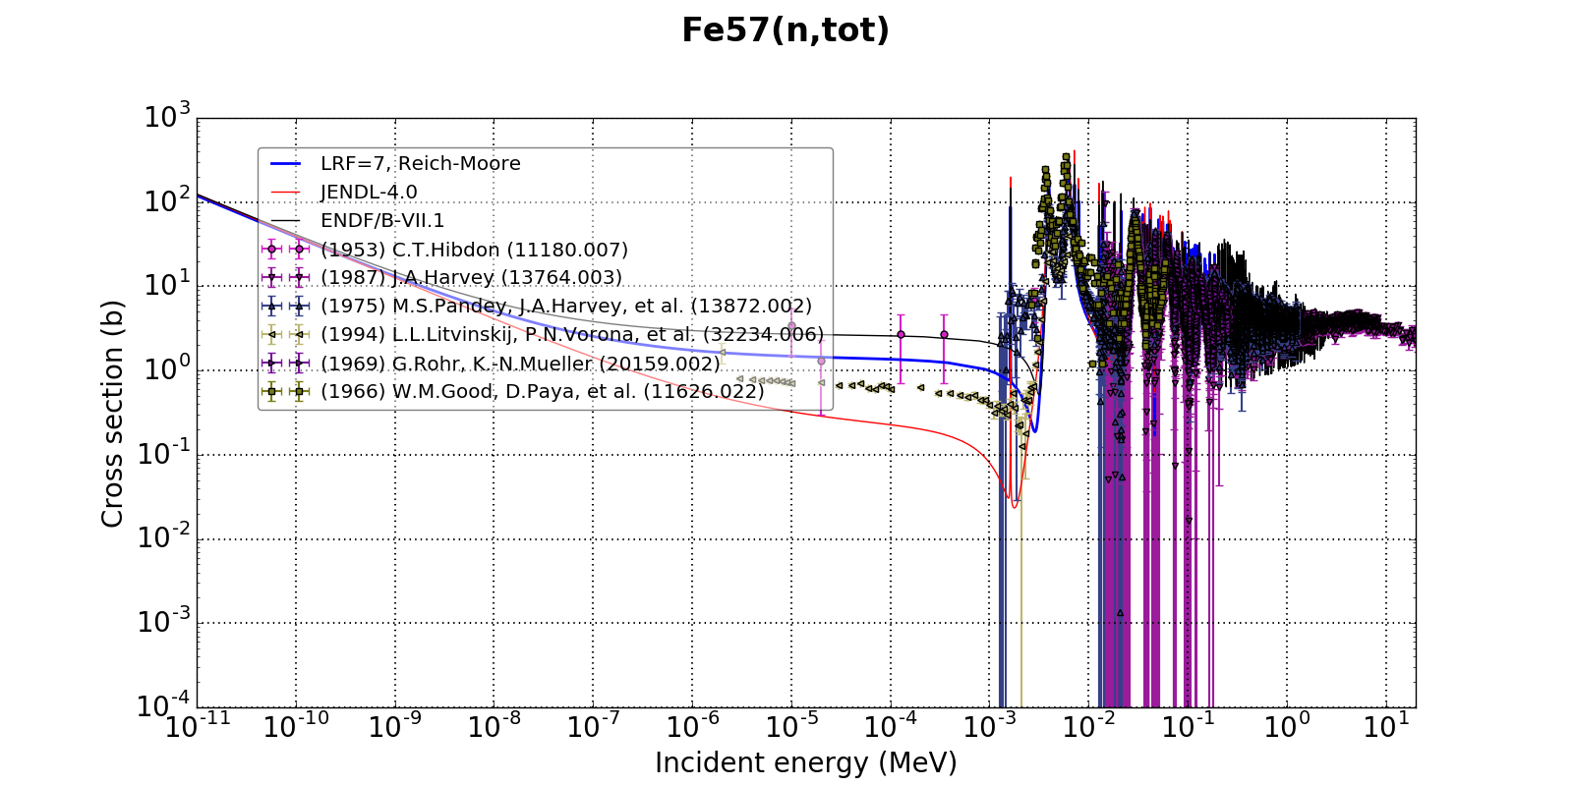
ok here

Slide 36
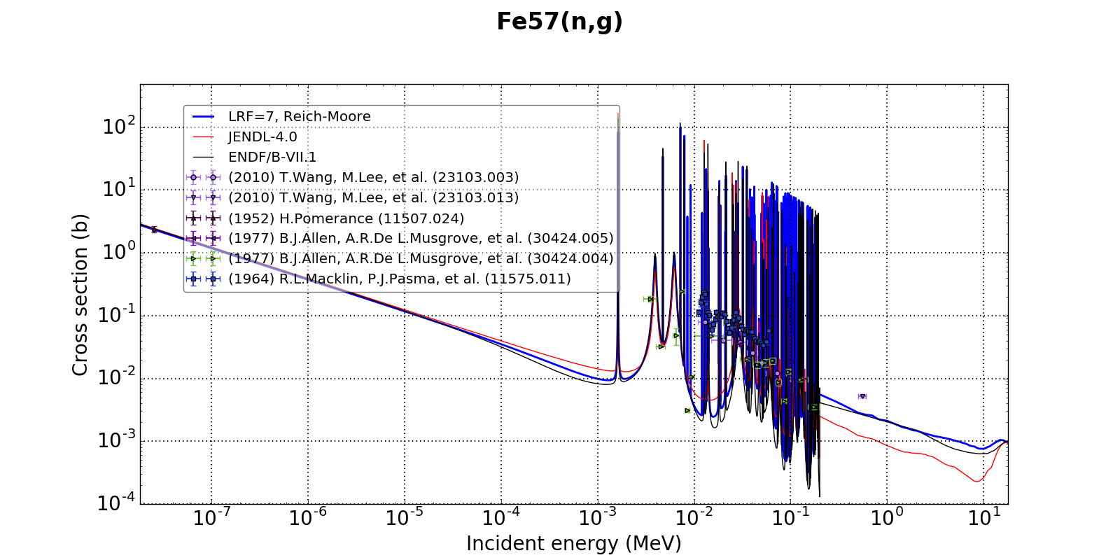
get thermal dead on
(by design)

Slide 37
6. Do we still match the
MACS(30 keV) value for capture?
MACS(30 keV) very useful for quick-n-dirty data validation
Bao et al. values are the experimental values compiled in Bao et al. At. Data & Nucl. Data Tables 76, 70-154 (2000)
Given the spread in experimental data, the
LRF=7 values are probably good enough
Source | MACS(30 keV)
MLBW | 41.38 mb
LRF=7 | 36.02 mb
Atlas (exp) | 36.0 +/- 2.7 mb
Atlas (calc) | 42.1 +/- 8.4 mb
Kadonis-0.3 | 32 mb
Bao et al. (1) | 39.9 +/- 4 mb
Bao et al. (2) | 36.0 +/- 2.3 mb
Bao et al. (3) | 28 +/- 6 mb

Slide 38
Summary
Developed RRR evaluations for ^{54,57,58}Fe
Converting ⁵⁷Fe from MLBW to LRF=7 revealed potential format problems (or just processing code problems?)
Added several new tests to FUDGE which will undoubtably reveal in many many more ENDF file bugs
We have not made covariances yet
MACS (30 keV)
 | β0 | KADONIS | ENDF/B-VII.1* | JENDL-4.0*
⁵⁴Fe | 28.3±1.3 | 29.6±1.3 | 21.6±2.7 | 21.6
⁵⁶Fe | 11.2±1.1 | 11.7±0.5 | 11.5±1.1 | 11.8
⁵⁷Fe | 36.02 | 40.0±4.0 | 28.5±4.6 | 30.2
⁵⁸Fe | 13.7±1.5 | 13.5±0.7 | 19.7 | 14.0
*B. Pritychenko and S. F. Mughabghab, Nuclear Data Sheets 113, 3120 (2012)

