Slide 1
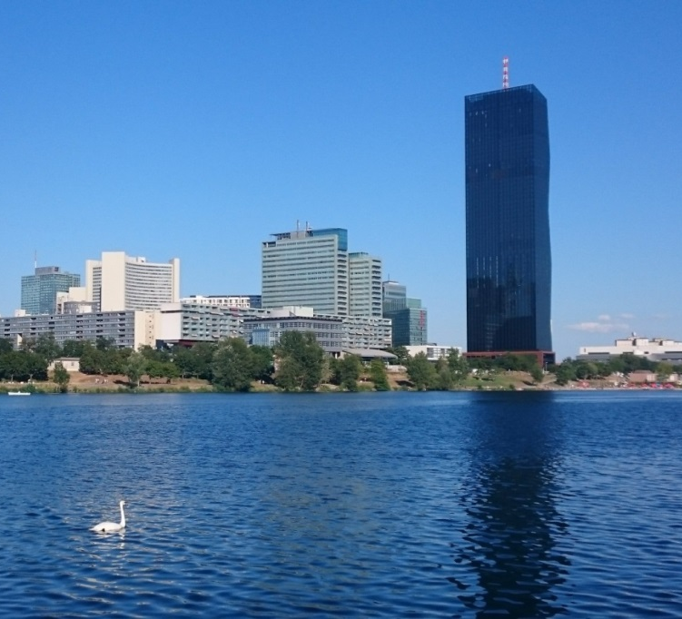
Validation of CIELO evaluations
A. Trkov and R. Capote

Slide 2
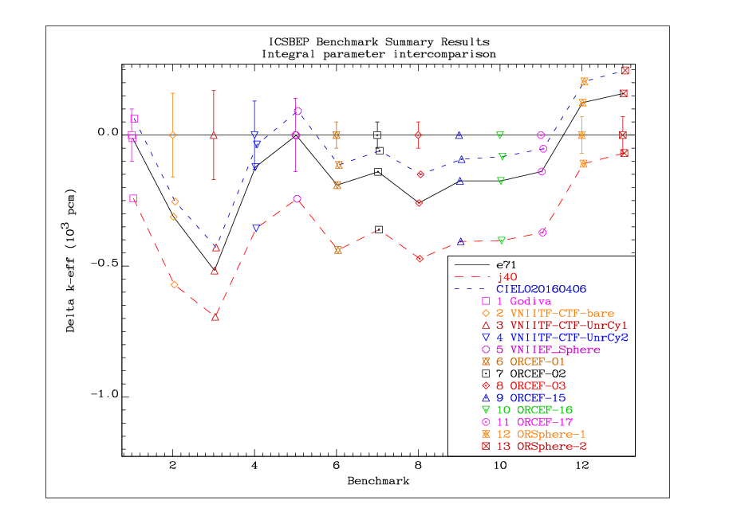
HEU bare
assemblies

Slide 3
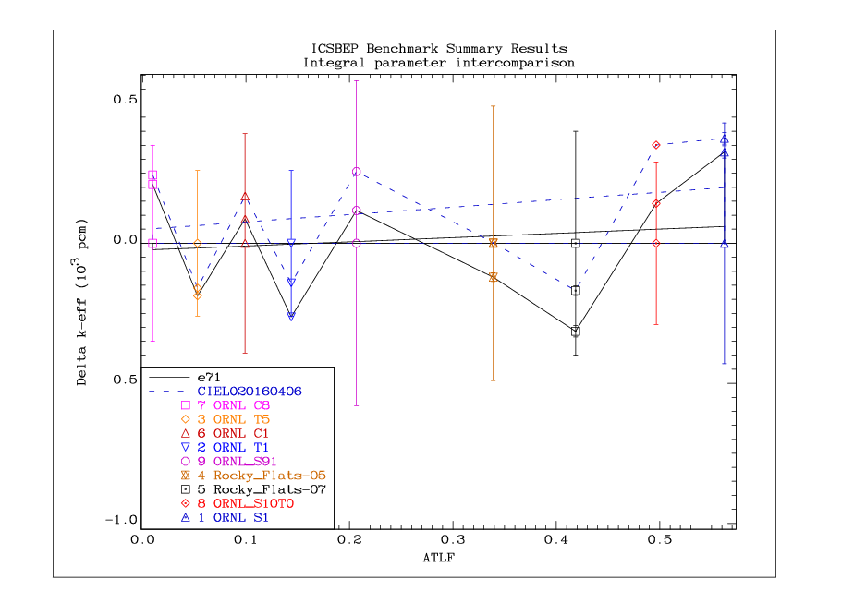
HEU solutions
vs ATLF

Slide 4
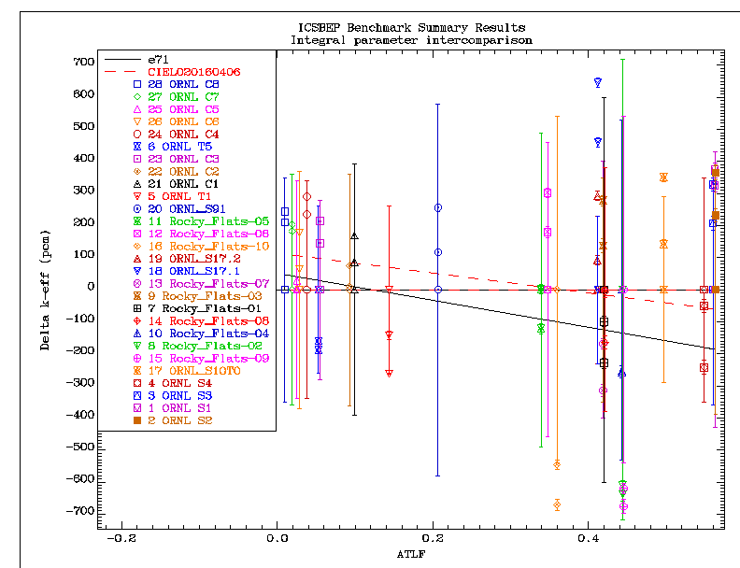
HEU solutions
vs ATLF

Slide 5
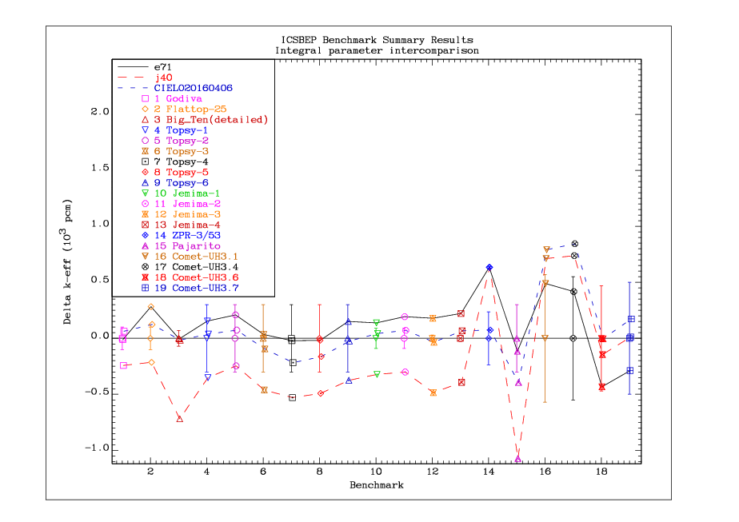
Fast assemblies
U5 & U8

Slide 6
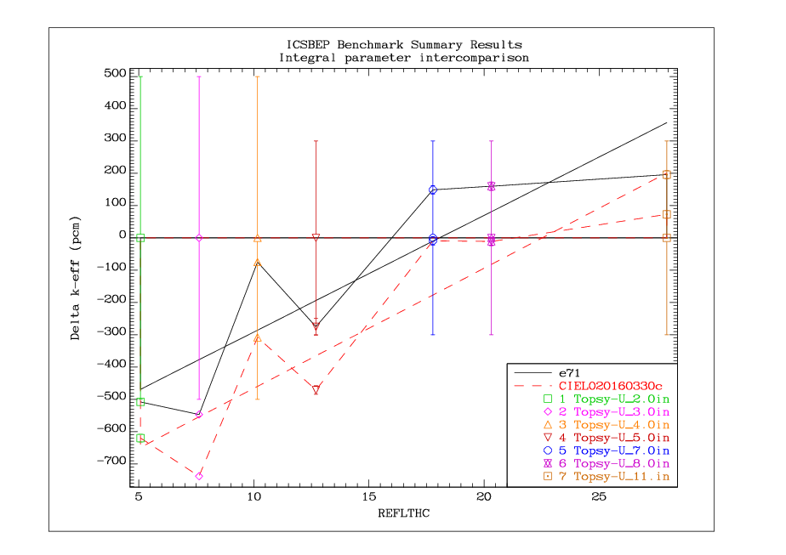
U8 reflectors

Slide 7
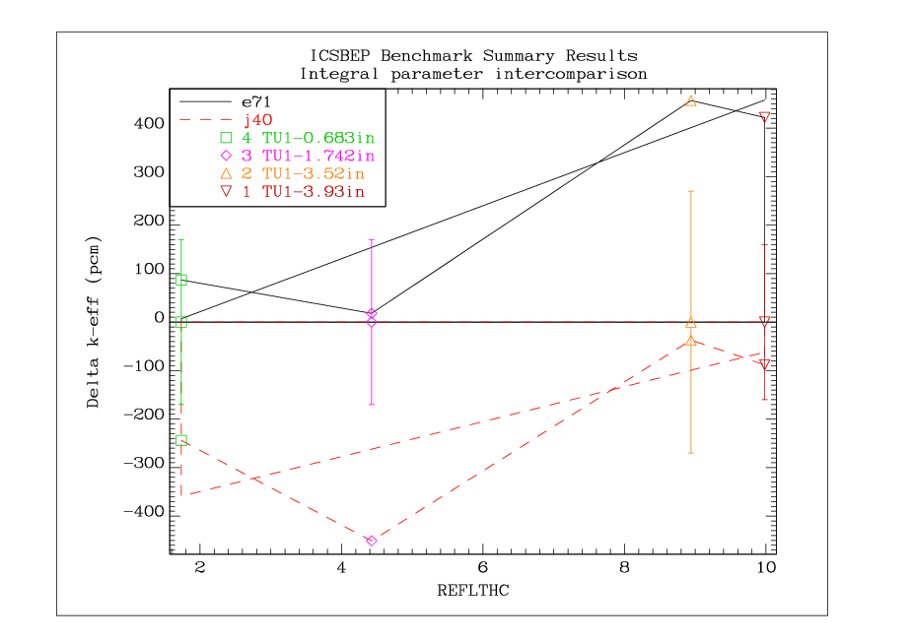
U8 reflectors

Slide 8
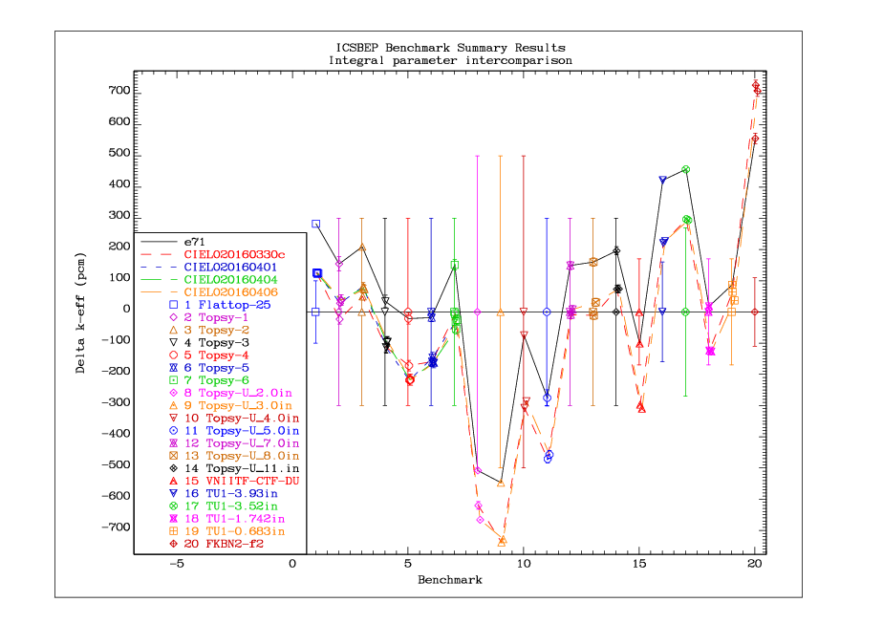
U8 reflectors

Slide 9
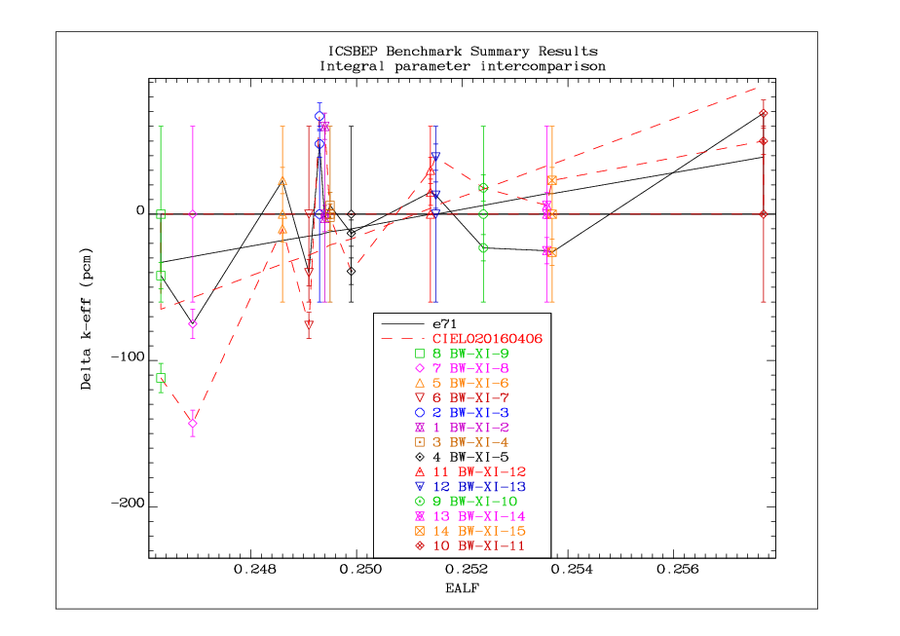
Thermal lattices
vs EALF

Slide 10
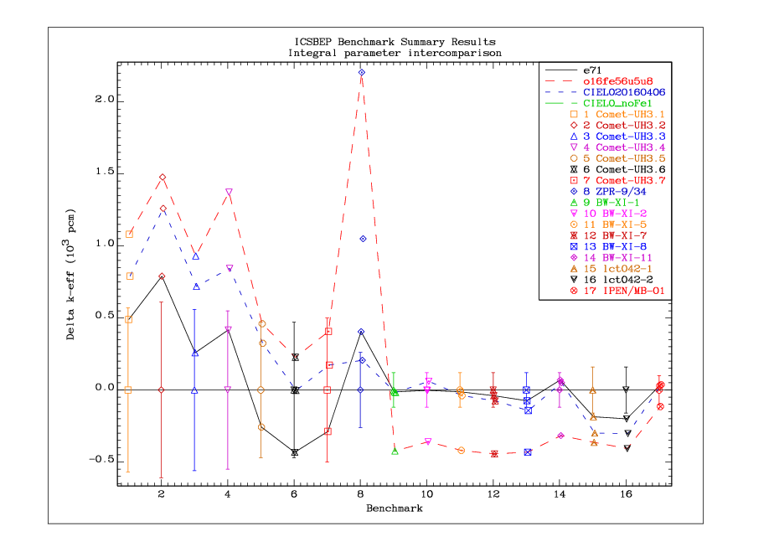
Comet-UH3
(hmi003)

Slide 11
