Slide 1


CIELO U-238 evaluation (RR+fast)
R.Capote, A.Trkov, M.Sin, M.W.Herman, V.G.Pronyaev, E.Sh.Soukhovitskii, P. Schillebeeckx, I.Sirakov, S.Kopecky,
D.Bernard, G.Noguere, A. Daskalakis, Y.Danon

Slide 2
n + ²³⁸U
resonance region

Slide 3
New Standard GMA fit
vs IRMM data
²³⁸U(n,γ)

Slide 4
New Standard GMA fit ²³⁸U(n,g),¹⁹⁷Au(n,g) vs Wallner AMS
²³⁸U(n,g)
²³⁸U(n,g)/¹⁹⁷Au(n,g)
kT=25 keV
Wallner: 0.391± 0.017 b (4.3%)
GMA: 0.3939 b (+0.74%)
kT=426 keV
A. Wallner: 0.108±0.004 b (3.7%)
GMA: 0.1078 b (-0.2%)
kT=25 keV
Wallner: 0.620±0.023 (3.7%)
GMA: 0.6276 (+1.2%)
kT=426 keV
Wallner: 0.687±0.022 (3.2%)
GMA: 0.6853 (-0.25%)

Slide 5
n + ²³⁸U fast region (E_{n}>150 keV)
(n,f) and (n,γ) from 2006 Neutron Standards
(to be updated with new GMA Standard fit)
PFNS adopted from Talou-Rising analysis
(n,2n) feedback from CEA Cadarache
and TUNL new data (Krishichayan et al)

Slide 6
IAEA evaluation process (no covar.)
RIPL
ENDF eval.
(no covar.)
EMPIRE
(TALYS)
Modeling codes
Physics !
+
Local
input
Benchmarking
& Validation
Res. Param.
SAMMY, Phys.
NO
YES
*
Are measurements
reproduced?
diff. & “clean” int.
ENDF file Assembly
& Verification- Trial file

Slide 7
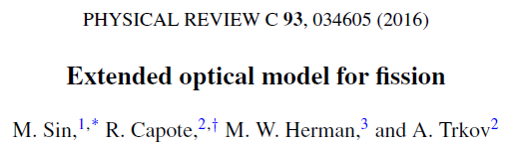
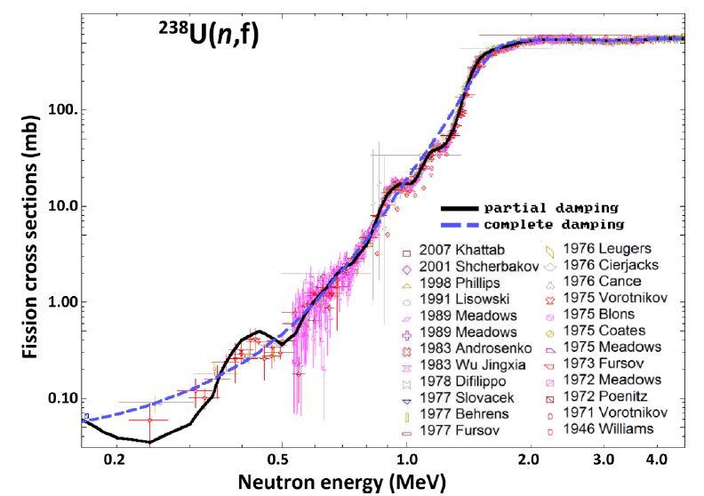
²³⁸U(n,f)

Slide 8
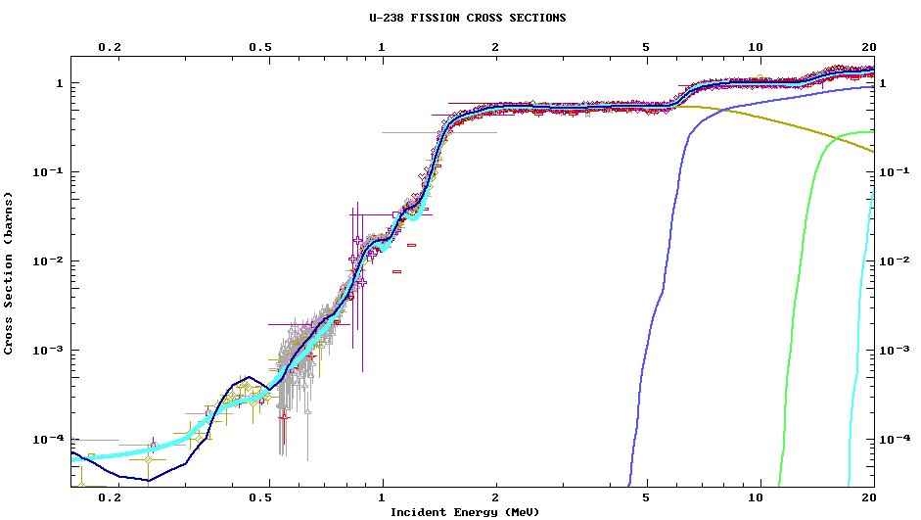

Empire ²³⁸U(n,f) vs ENDF/B-VII.1
²³⁸U(n,f)
²³⁸U(n,f) - ib46 = ENDF-B/VII.1=STD

Slide 9
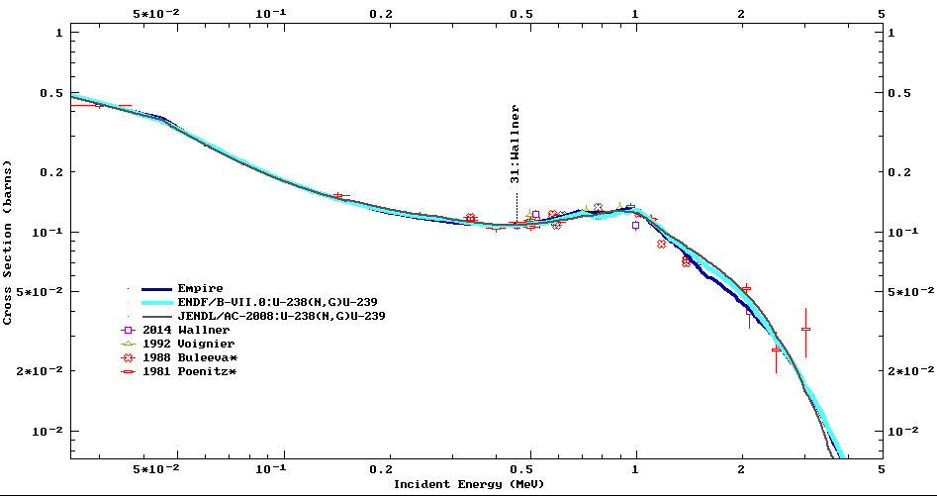
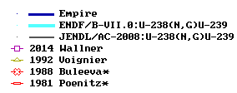
Empire ²³⁸U(n,γ) vs ENDF/B-VII.1
²³⁸U(n, γ ) - ib46 = ENDF-B/VII.1=STD

Slide 10
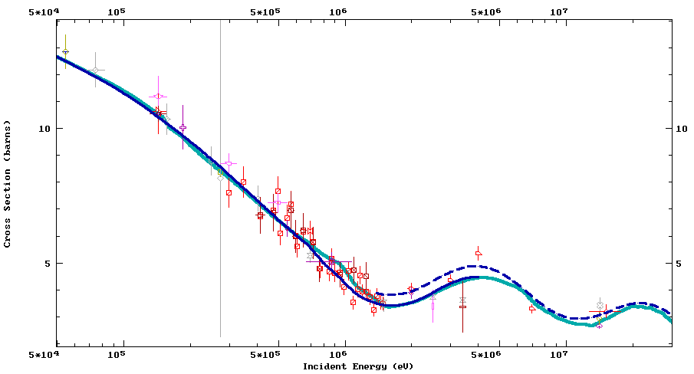
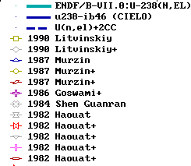
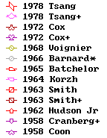
²³⁸U(n,el), ²³⁸U(n,sct) el+2 inel

Slide 11
σ_{in}(tot), σ_{in} (2⁺), σ_{in} (4⁺) , σ_{in} (1⁻) , σ_{in} (3⁻)...
R. C., M. Sin, A. Trkov, M. W. Herman, D. Bernard, G. Noguere, A. Daskalakis, and Y. Danon.
NEMEA-7 proceedings, NEA SG-40 (2014) “Evaluation of neutron induced reactions on ²³⁸U nucleus”

Slide 12
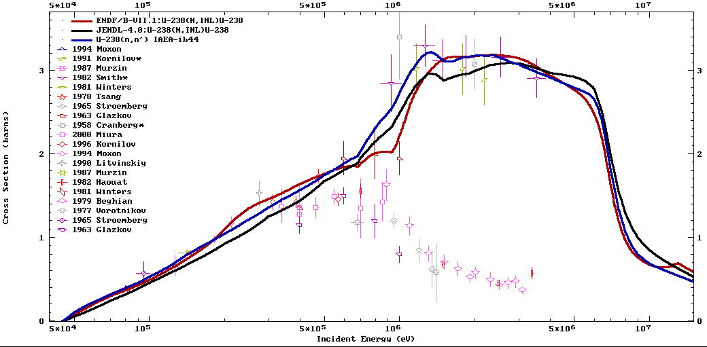
σ_{in}(tot), new physics: EW, 21-CC OMP
²³⁸U(n,inl) SACS [²³⁵U(n_{th},f) PFN]
ENDF-B/VII.1 257 ± 41 mb
U238-ib46 261 mb
JEFF 3.1.2 261 mb
Special thanks to T. Kawano, S. Hilaire

Slide 13
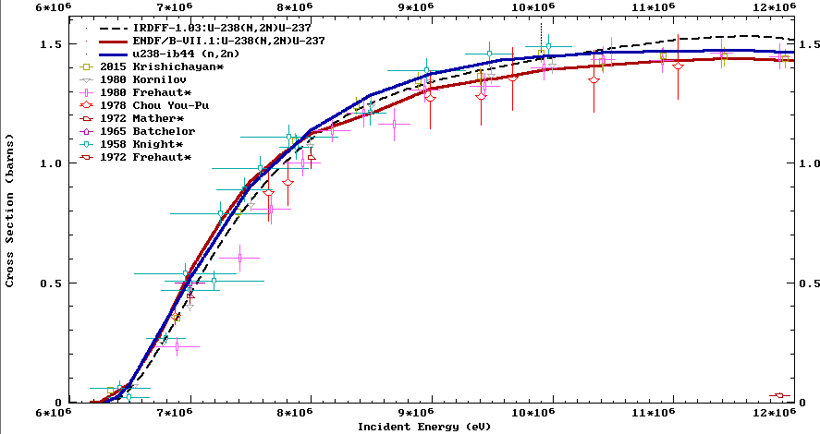
σ(n,2n) vs TUNL and SACS
²³⁸U(n,2n) SACS [²⁵²Cf(sf)]
Blinov et al (corr) 20.6 ± 2.2 mb
ENDF-B/VII.1 21.35 ± 1.9 mb
U238-ib46 21.6
²³⁸U(n,2n) SACS [²³⁵U(n_{th},f) PFN]
ENDF-B/VII.1 14.8 ± 1.3 mb
U238-ib46 14.8 mb
JEFF 3.1.2 14.1 mb
Frehaut 1980 still low after renorm. by 1.09
(possible PFN effect)

Slide 14
SACS(n,2n) confirmed by SACS ratio syst.

Slide 15
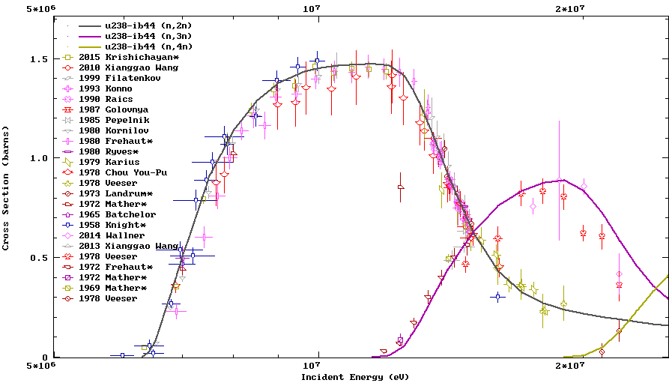
σ(n,2n), σ(n,3n), σ(n,4n)
²³⁸U(n,3n) SACS
[²³⁵U(n_{th},f) PFN]
ENDF-B/VII.1 75 ± 10 μb
U238-ib46 87 μb
JEFF 3.1.2 87 μb

Slide 16
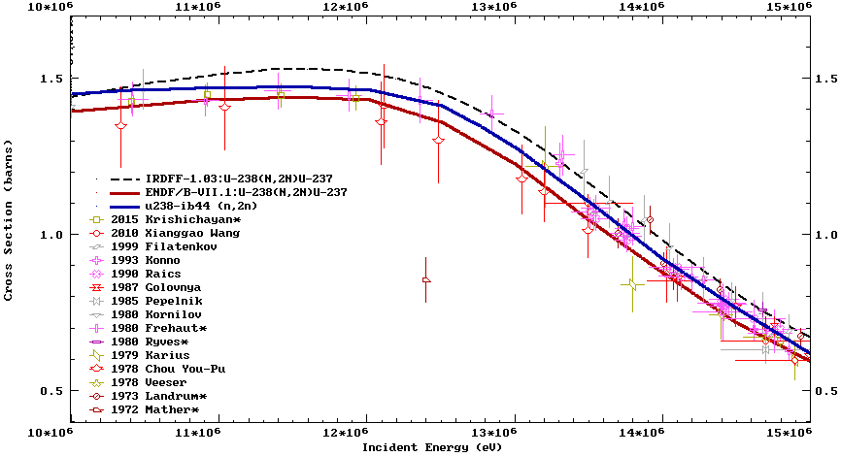
σ(n,2n) vs TUNL (above 10 MeV)

Slide 17
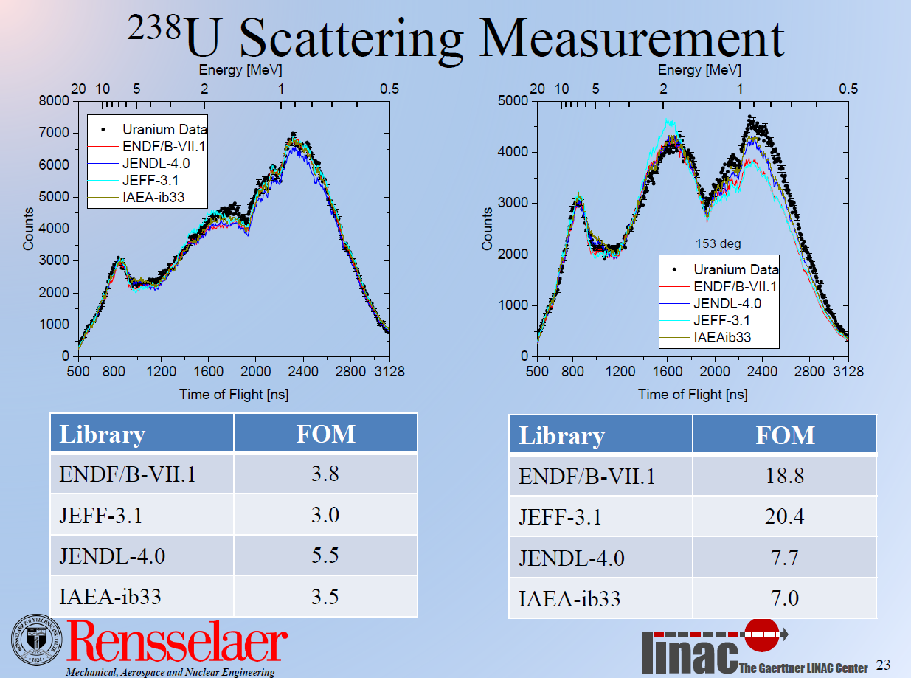
RPI exp. essential to define d²σ_{el}/dEdΩ

Slide 18
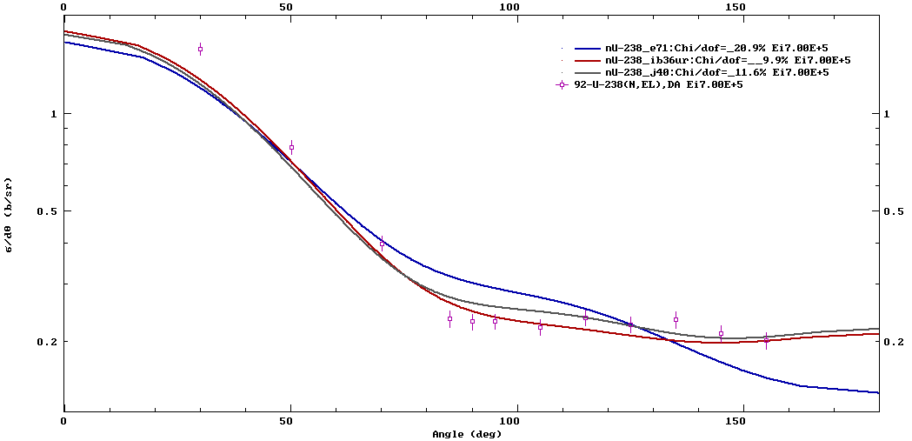

²³⁸U(n,el), E_{n}=700 keV, ang. distributions

Slide 19
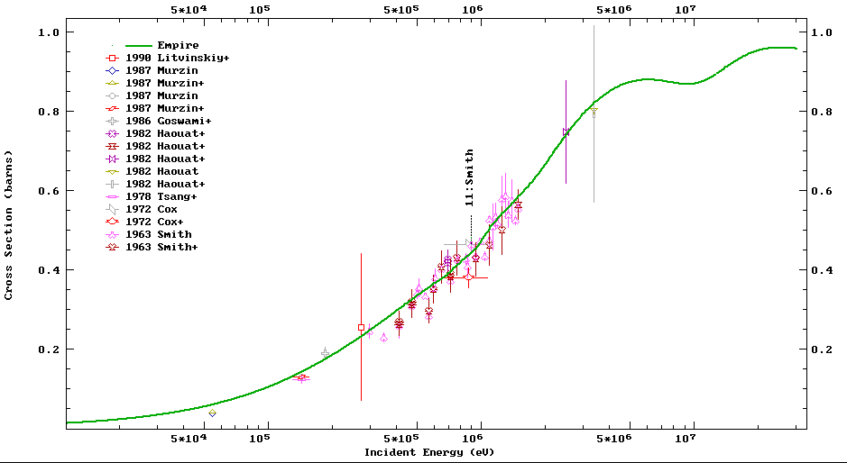
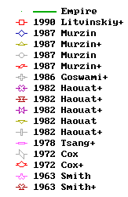
²³⁸U elastic μ-bar

Slide 20
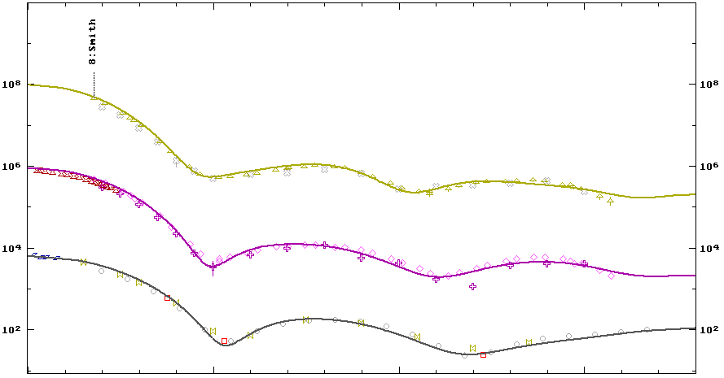

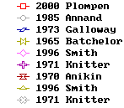
²³⁸U(n,el+2CC), angular distributions

Slide 21
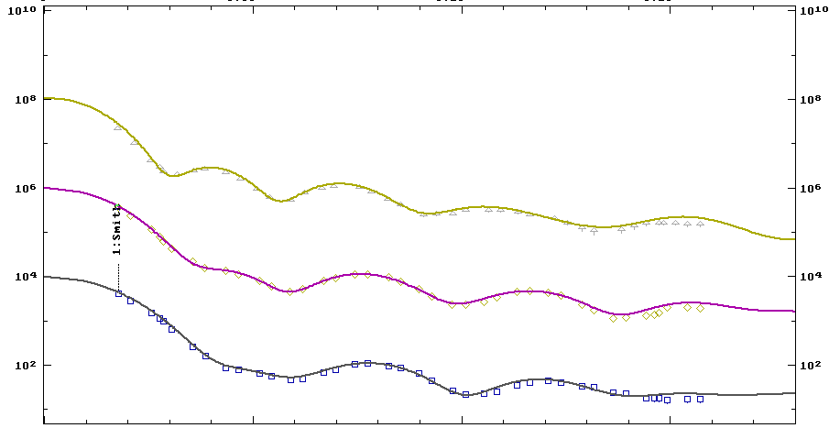

²³⁸U(n,el+2CC), angular distributions

Slide 22
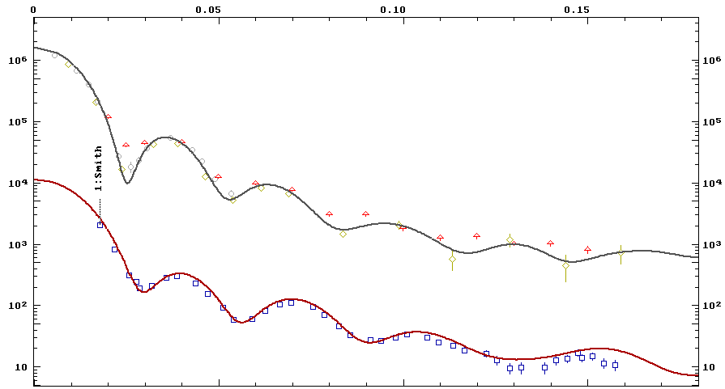
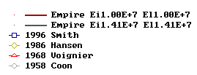
²³⁸U(n,el+2CC), angular distributions

Slide 23
Conclusions: ²³⁸U file almost ready
Resonance range: New measurements and independent REFIT analysis lead to better RPs (bound states)
Non-standard region below 20 keV and URR improved
New Standard (GMA): excellent agreement with Wallner
New fast evaluation with elastic/inelastic improvements
PFNS adopted from Talou-Rising for all incident energies
RPI quasi-diff. data - a big help for fast region
Capture and fission in fast region from Neutron Standards
Better multiple neutron emission (CEA Cadarache feedback, LANL feedback, inelastic + diff. TUNL data)
Good agreement between B/VII.1 SACS and new eval.

