Slide 1
New n + ²³⁵U evaluation (fast)
R. Capote, A. Trkov, M. Sin,
M.W. Herman, V.G. Pronyaev

Slide 2
IAEA evaluation process (no covar.)
RIPL
ENDF eval.
(no covar.)
EMPIRE
(TALYS)
Modeling codes
Physics !
+
Local
input
Benchmarking
& Validation
Res. Param.
SAMMY, Phys.
NO
YES
*
Are measurements
reproduced?
diff. & “clean” int.
ENDF file Assembly
& Verification- Trial file

Slide 3
n + ²³⁵U fast region (E_{n}>2.25 keV)
(n,f) from 2006 Neutron Standards
(to be updated with new GMA Standard fit)
(n,γ): Adopted from B/VII.1
(Update based on Jandel/RPI ?)
(n,f): 3H barrier with absorption
PFNS adopted from IAEA CRP
(incl. Rising-Talou analysis above thermal)

Slide 4
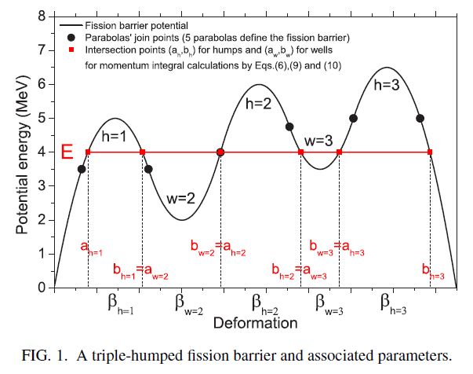

Slide 5
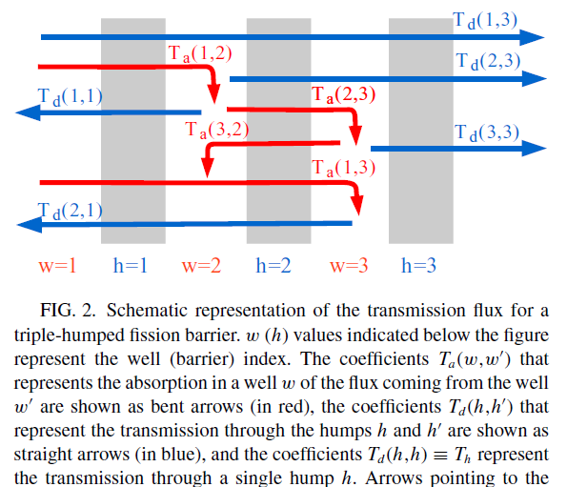
Optical model for fission: 3H

Slide 6
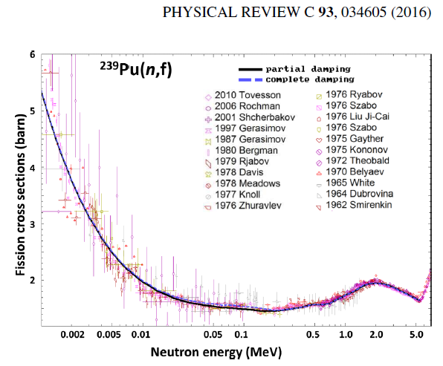
²³⁹Pu(n,f) 2H barrier, independent barriers ok

Slide 7
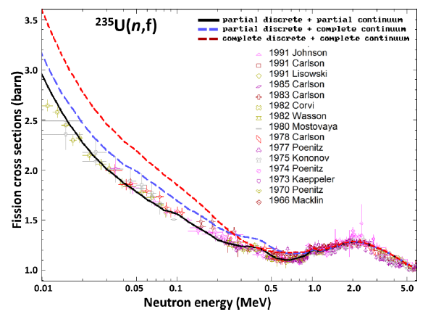
3H barrier !

Slide 8
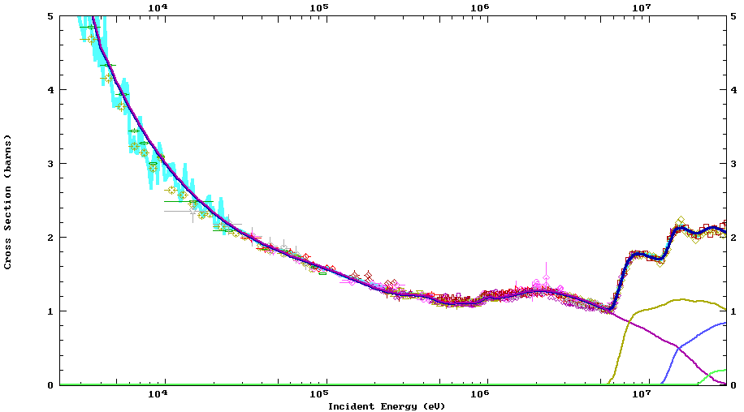
Empire ²³⁵U(n,f) vs ENDF/B-VII.1
²³⁵U(n,f)
²³⁵U(n,f)-ib6a = ENDF-B/VII.1=STD

Slide 9
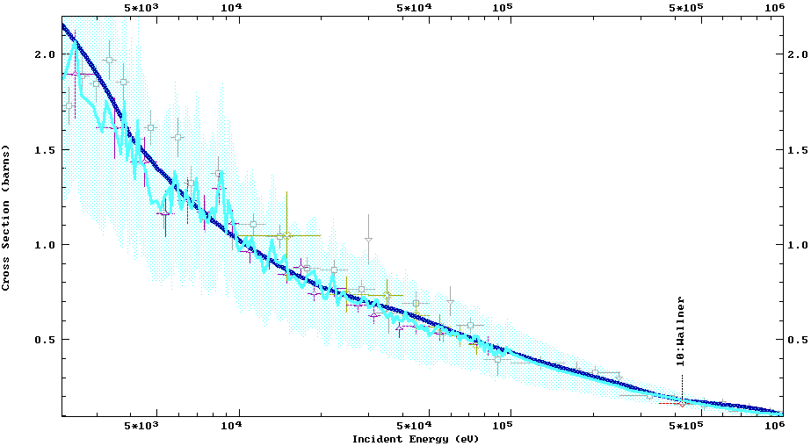
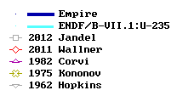
Empire ²³⁵U(n,γ) vs ENDF/B-VII.1
²³⁵U(n,γ ) - ib6a = ENDF-B/VII.1

Slide 10
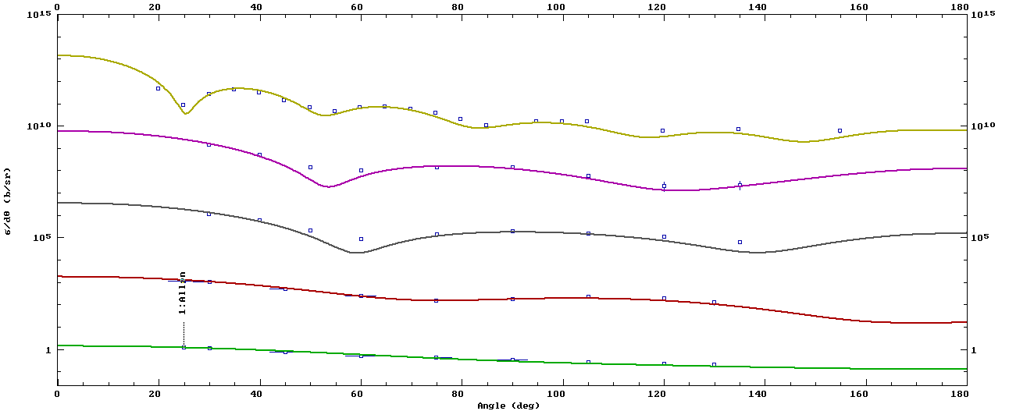
²³⁵U(n,el), ²³⁵U(n,sct) ang.distributions
14.0 MeV
3.0 MeV
2.0 MeV
1.0 MeV
0.5 MeV

Slide 11
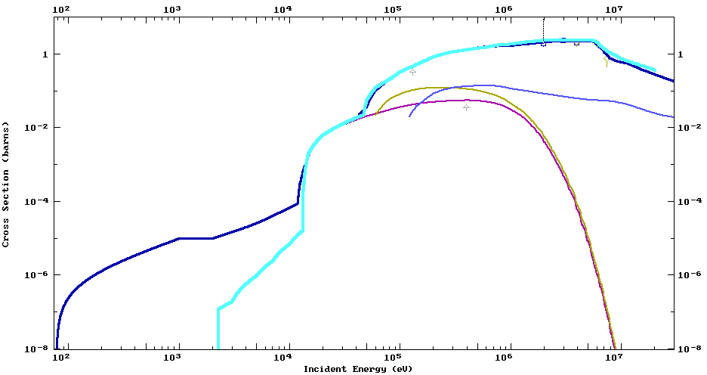
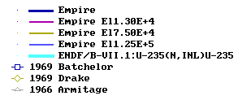
²³⁵U(n,inl) (b6a) vs ENDF/B-VII.1

Slide 12
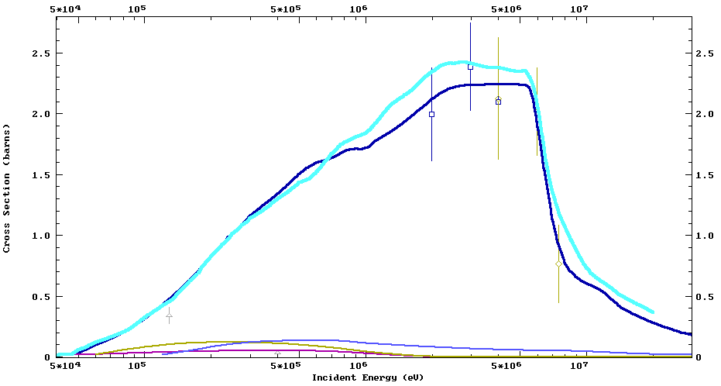
²³⁵U(n,inl) (b6a) vs ENDF/B-VII.1
²³⁵U(n,inl) SACS [²³⁵Un_{th}
ENDF-B/VII.1 1977 ± 128 mb
U235-ib6a 1848 mb
JEFF 3.2 1912 mb

Slide 13
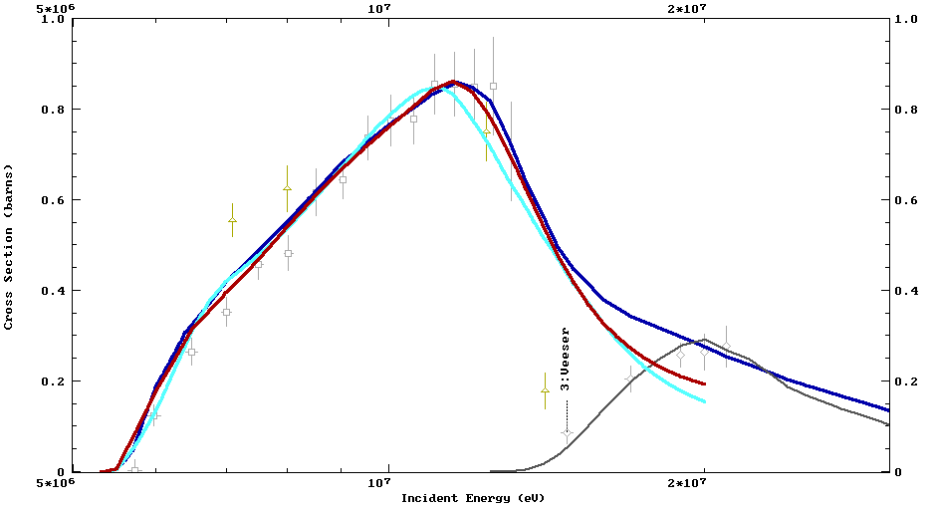
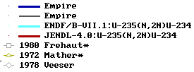
σ(n,2n), σ(n,3n) vs ENDF/B-VII.1
²³⁵U(n,2n) SACS [²³⁵Unth]
ENDF-B/VII.1 11.6 ± 0.6 mb
U235-ib6a 12.1 mb
JEFF 3.2 18.2 mb

Slide 14
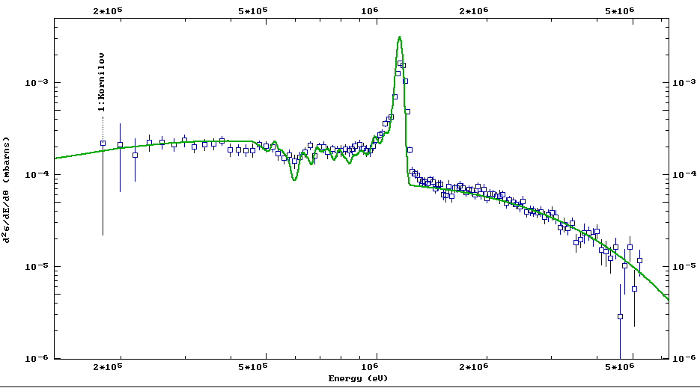
²³⁵U+n, DDX yield, E_{n}=1.19 MeV, 120 deg

Slide 15
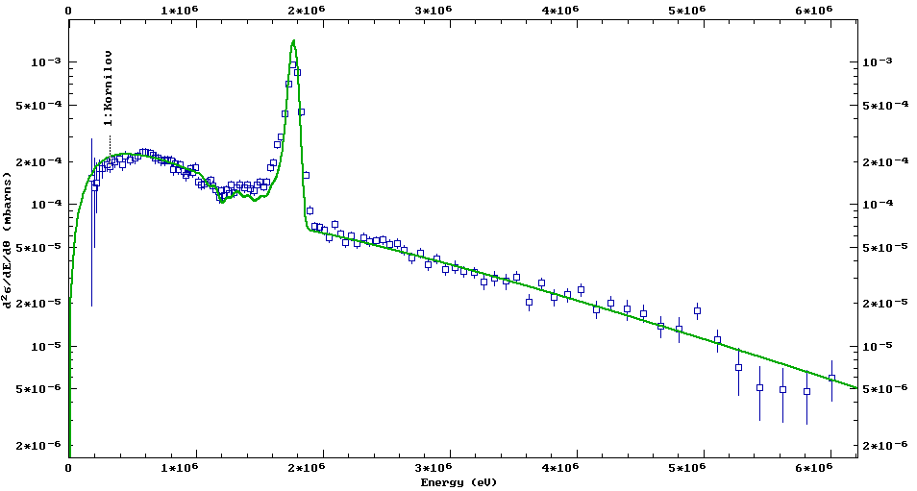
²³⁵U+n, DDX yield, E_{n}=1.79 MeV, 120 deg

Slide 16
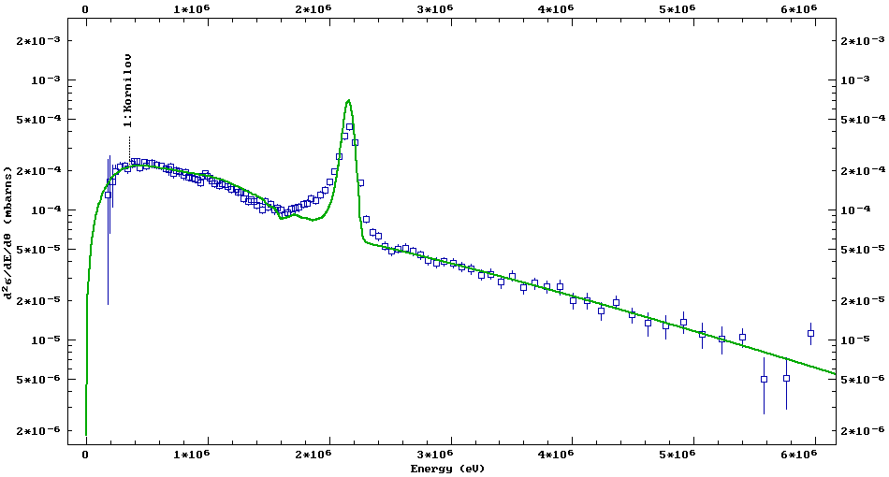
²³⁵U+n, DDX yield, E_{n}=2.19 MeV, 120 deg

Slide 17
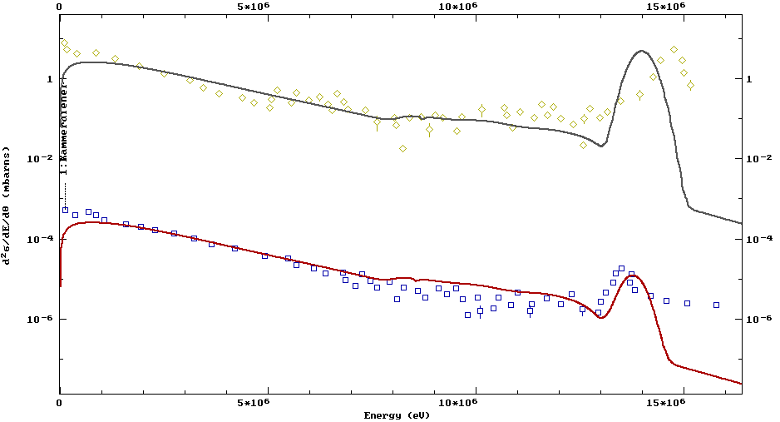
²³⁵U+n, DDX yield, E_{n}=14 MeV
30 deg
150 deg

Slide 18
Conclusions: ²³⁵U fast region
Better physics → improved performance
New fast evaluation with 3H fission barriers leading to elastic/inelastic and (n,xn) consistent changes
PFNS thermal from IAEA CRP (E_{av}=2.00(1) MeV)
PFNS fast adopted from Talou-Rising
Fission in fast region from 2006 Neutron Standards
(to be updated based on new GMA Standard fit)
Capture in fast region from ENDF/B-VII.1
(update based on Jandel/RPI data ??)
Good agreement between B/VII.1 SACS and new eval.

