Slide 1
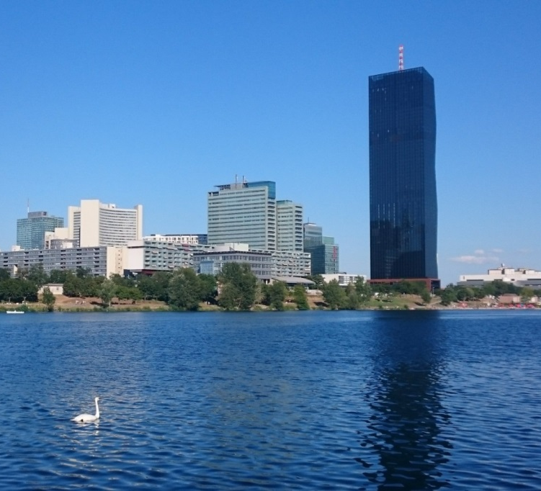

Update on standard cross sections and thermal neutron constants
V. G. Pronyaev, R. Capote, A. Trkov
+ IAEA Neutron Standard Data Development Project

Slide 2
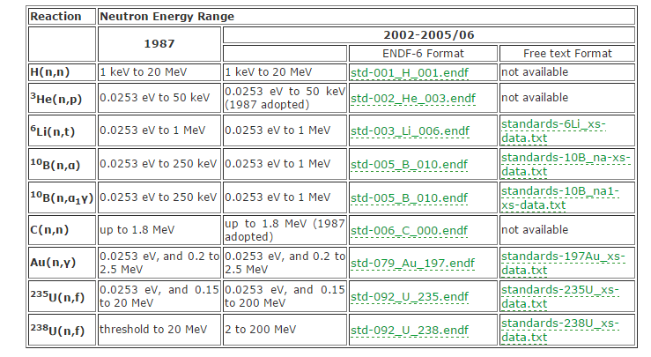
Neutron Standards evaluation (2006)
www-nds.iaea.org/standards/

Slide 3
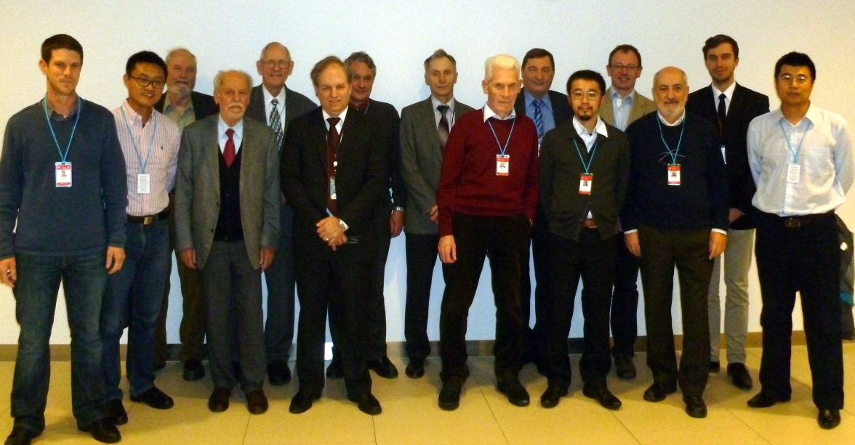
On-going work on Neutron Standards
www-nds.iaea.org/standards/
IAEA TM, 1-5 Dec. 2014
Report INDC(NDS)-0677
Next TM, 25-29 July 2016
New experimental data added
Recommended ²³⁵U(n,f) fission RIs exp. verified (n_TOF)
Preliminary fit undertaken (latest 03/2016)
New Thermal Constants fit done
²³⁵U(n_{th},f) PFNS by GMA fit (Trkov, Capote, Pronyaev)
Release of new Neutron Standards, 4Q 2016

Slide 4
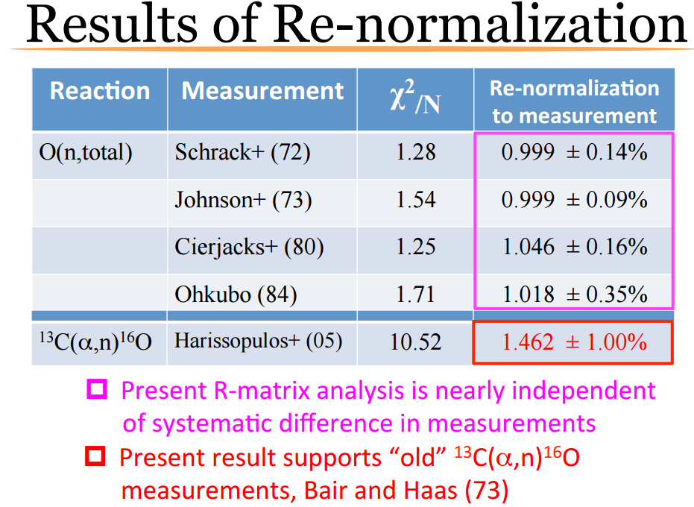
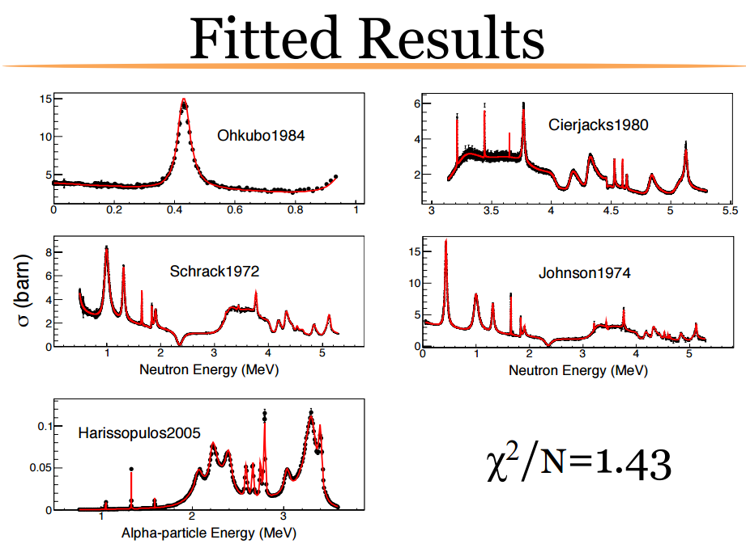
IAEA TM on Neutron Standards, 12/2014
Two ¹⁶O CIELO candidate evaluations: LANL (Hale), ORNL (Leal)
Kunieda et al, www-nds.iaea.org/index-meeting-crp/TM-neutron-std/docs/Kunieda-STD-2014.pdf (INDC(NDS)-0677 rep., IAEA 2015)
=> Higher cross sections preferred ~ ENDF-B/VI values

Slide 5
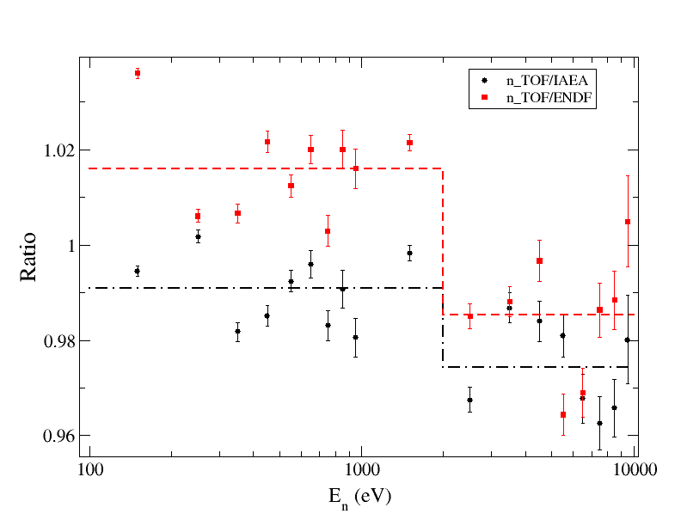
Recommended ²³⁵U(n,f) resonance integrals confirmed by n_TOF
Duran et al, WONDER 2015

Slide 6
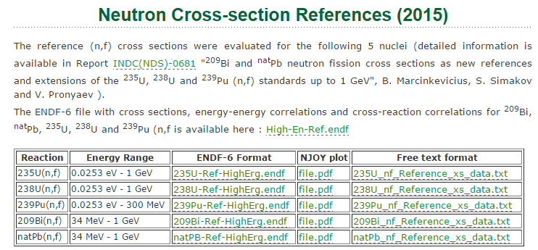
NEW: (n,f) cross sections up to 1 GeV
www-nds.iaea.org/standards/

Slide 7
New Standard GMA fit
vs IRMM data
²³⁸U(n,γ)

Slide 8
New Standard GMA fit ²³⁸U(n,g),¹⁹⁷Au(n,g) vs Wallner AMS
²³⁸U(n,g)
²³⁸U(n,g)/¹⁹⁷Au(n,g)
kT=25 keV
Wallner: 0.391± 0.017 b (4.3%)
GMA: 0.3939 b (+0.74%)
kT=426 keV
A. Wallner: 0.108±0.004 b (3.7%)
GMA: 0.1078 b (-0.2%)
kT=25 keV
Wallner: 0.620±0.023 (3.7%)
GMA: 0.6276 (+1.2%)
kT=426 keV
Wallner: 0.687±0.022 (3.2%)
GMA: 0.6853 (-0.25%)

Slide 9
2200 m/s and 20°C Maxwellian neutron data: Thermal Constants
WESTCOTT, C. H. et al, Atomic Energy Review 3 (1965) 3
HANNA, G. C., WESTCOTT, C. H., LEMMEL, H. D. et al,
Atomic Energy Review 4 (1969) 3, also INDC(NDU)-012
LEMMEL, H. D. et al, Proc. Conf. Nucl. Cross Sect. & Tech., Wash. DC,
3-7 March 1975, NBS Spec. Publ. 425, 286 (1975), also INDC(NDS)-132
LEMMEL, H. D. et al, Proc. Int. Spec. Symp. Neutron Standards & Applications,
NBS Spec. Publ. 493, 170 (1977)
LEMMEL, H. D., IAEA Technical Reports Series 227 (1983), p.71
STEHN, J. R., DIVADEENAM, M. and HOLDEN, N. E.,
Conf. NDST, Antwerp, 1982, Proc. edited by K.H. Boeckhoff (1983) p. 685.
DIVADEENAM, M. and STEHN, J. R., Ann. Nucl. Energy 11 (1984) 375-404
AXTON, E. J., Geel Report GE/PH/01/86
PRONYAEV, V. G., CARLSON, A. et al., 2004-2016

Slide 10
Evolution of Thermal Constants 1975-…
1) Lemmel 1975
Axton 1986
 | Micr+macr. | Micr. only
σ(n,f) | 583.5±1.3 | 587.7±1.9
σ(n,γ) | 97.4±1.3 | 93±2
ν(tot) | 2.400(5) | 2.387(6)
 | Micr+macr. | Micr. only
σ(n,f) | 582.8±1.17 | 585.1±1.62
σ(n,γ) | 99.1±0.7 | 96.1±1.74
ν(tot) | 2.4330(36) | 2.4261(46)
K1 | 718.6 | 721.24
Mic-mac discrepancy noted
Pronyaev et al, GMA 2004
Pronyaev et al, GMA 2015
 | Micr+macr. | ENDF/B-VI
σ(n,f) | 584.2±1.1 | 584.88
σ(n,γ) | 99.3±0.7 | 98.66
ν(tot) | 2.4324(4) | 2.4367(5)
K1 | 719.67 | 722.7
 | Micr+macr. | Micr. only
σ(n,f) | 584.4±1.0 | 587.2±1.4
σ(n,γ) | 99.30±0.72 | 96.8±1.7
ν(tot) | 2.4321(36) | 2.4250(46)
K1 | 719.9 | 722.82

Slide 11
New Thermal constants (03/2016)
Constant | Microscopic & macroscopic data 2004 (GMA) | Microscopic & macroscopic data 03/2016 (GMA) | Microscopic data + Wallner AMS 03/2016 (GMA)
SF-U5 | 584.4 (585.0) | 587.0±1.0 | 586.5±1.4
SG-U5 | 99.3 (98.7) | 98.3±1.3 | 100.2±2.0
NU-U5 | 2.4358 (2.4367) | 2.4256±0.0045 | 2.4264±0.0046 (2.429)
K1 | 721.35 | 722.2 | 721.0 (722.6)
Hardy | 722.7±3.9 (*)
SF-PU9 | 750 (747.9) | 751.9±2.2 | 751.8±2.2
SG-PU9 | 271.5 (270.7) | 270.8±3.1 | 271.1±3.2
NU-PU9 | 2.884 (2.8789) | 2.878±0.006 | 2.878±0.006
Used by M. Pigni in ²³⁵U(n,f) RP fit (o17)

Slide 12
Pu-239 challenges

Slide 13
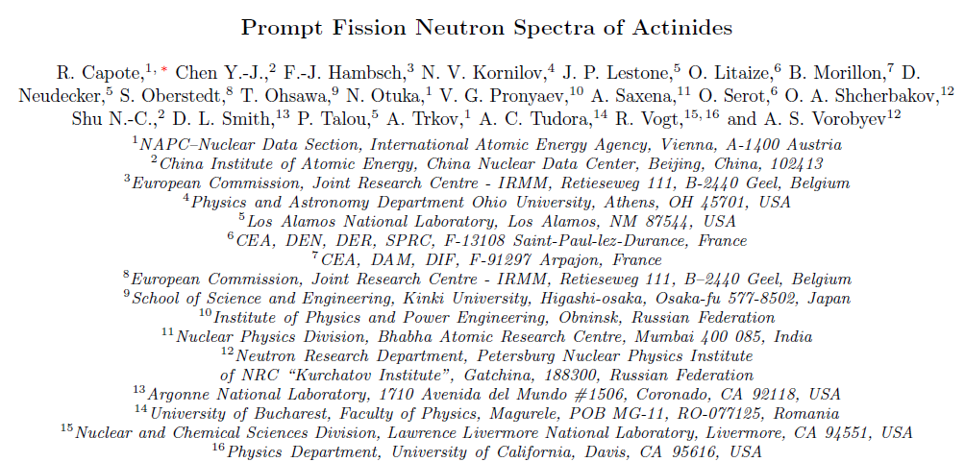
PFNS evaluation challenges
IAEA Coordinated Research Project 2008-2014
Paper accepted by Nuclear Data Sheets (Jan. 2016)

Slide 14
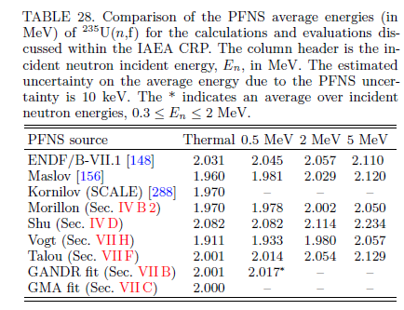
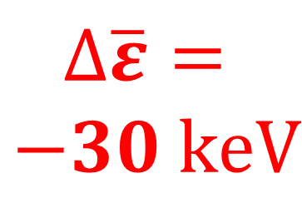
PFNS average energy ²³⁵U(n,f)
$$∆\overline{ε}=$$
$$−30 keV$$
non-model
fit

Slide 15
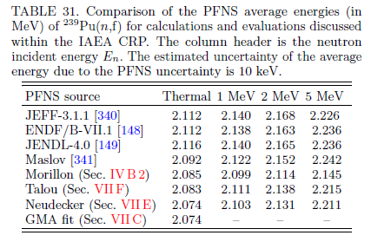
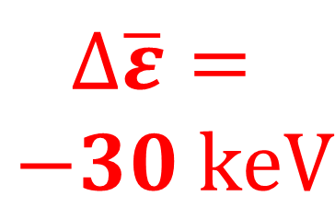
PFNS average energy ²³⁹Pu(n,f)
$$∆\overline{ε}=$$
$$−30 keV$$
non-model
fit

Slide 16
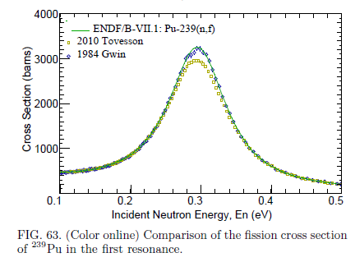
R.C. et al, Nucl. Data Sheets 131(2015) 1

Slide 17
Conclusions: New Standards will be ready
Thermal constants mic-mac and micro fits CONSISTENT
  - Wallner et al. AMS ²³⁵U capture data critical
IAEA CRP ²³⁵U(n_{th},f) PFNS proposed as a reference neutron field (in addition to ²⁵²Cf(sf))
Recommended ²³⁵U(n,f) resonance integrals below 10 keV confirmed by n_TOF experiment (problem in B/VII.1)
New GMA fit for ¹⁹⁷Au(n,γ) and ²³⁸U(n,γ) in excellent agreement with Wallner et al AMS data
Light elements updated by Hale R-matrix fit
IAEA CRP ²³⁹Pu(n_{th},f) PFNS with Eav= 2.073(10) discrepant from B/VII.1 value of 2.112

