Slide 1
Issues with ENDF-VIII candidate evaluations
Mini-CSEWG, April 11 2016
Caleb M Mattoon: presented by Bret R Beck

Slide 2
Testing rev. 807 from the NNDCforge repository (Thursday April 7)
What evaluations cause trouble for Fudge translation?
Use Fudge physics testing with error sensitivity turned down, to detect ‘worst cases’ of unnormalized distributions, energy imbalance, etc.
A few other long-standing issues

Slide 3
Step 1: test Fudge-GND translation
Translate neutron, gamma, proton, deuteron, triton, helium3, standards, photoat, atomic_relax and electron sub-libraries
neutrons: 5 failures
O16, W182-186
protons: 2 failures
H2 and Pb207
Other sublibraries are fine

Slide 4
n-008_O_016
Two discrepancies in new CIELO evaluation:
For MT=103, MF=13 and 14 disagree about what level the 277.4 keV gamma is emitted from. ENSDF supports MF=13, recommend we adopt that for MF=14 as well.
For MT=107, the MF=3 cross section starts at 2.355 MeV but the MF=13 gamma production cross sections all start at 2.3545 MeV. Recommend making MF=13 thresholds equal to MF=3
Minor format issues: MF 13/14 should use LP=1 for gammas whose parent is known
This is an issue in many ENDF files.
See tracker item #980, including suggested patch file

Slide 5
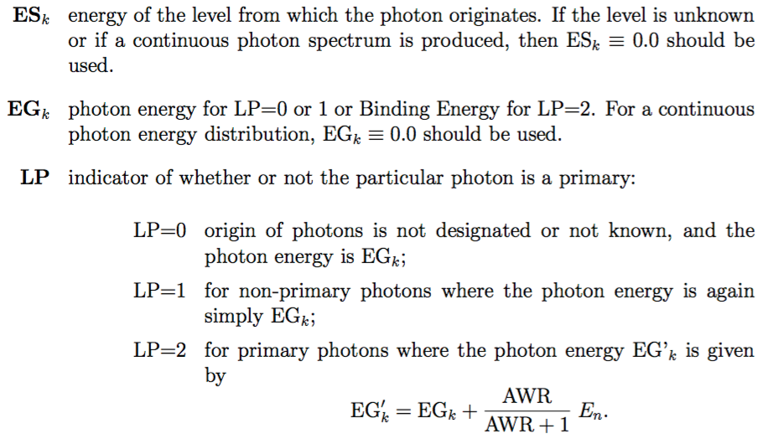
Documentation in ENDF manual on LP in sections 12 and 13.
Example from Li6 with LP set to 1 when it should be 0.
4.776000+5 0.000000+0 1 2 1 2 32512102

Slide 6
Bad level index in MF=12 for neutrons/n-050_Sn_113
ENDF documentation 12.2.2 states:
All MTs for MF=12 region have this issue:
51-82, 601-639 and 801-817
Yes there are others: e.g., neutrons/n-054_Xe_131.
5.011300+4 1.119350+2 2 1 2 0502812 51

Slide 7
n-074_W_182, 183, 184, 186: MF=8 and 10 are used to store experimental fission cross section
Discussion with A. Trkov:
“Measurements of the fission cross section of W-isotopes exist. The question is how to include them in the ENDF files... I included fission into MF10... there is a small inconsistency if ENDF-6 rules are followed very strictly: ZAP (i.e. ZA of the residual) is undefined for fission. I set it to zero. My logic was the gamma-photon as a residual is physically meaningless, therefore ZAP=0 is simply a flag that the residual is undefined. Strictly speaking, this convention should be added to the ENDF-6 manual”
Should we adopt this convention (and document in the manual)?

Slide 8
p-001_H_002
A primary gamma is listed in MF=6 MT=102, but the primary energy does not increase with incident energy
0.000000+0 0.000000+0 1 2 1 2 128 6102
2 2 128 6102
0.000000+0 1.000000+5 1 0 2 1 128 6102
-5.493539+6 1.000000+0 128 6102
0.000000+0 1.500000+8 1 0 2 1 128 6102
-5.493539+6 1.000000+0 128 6102
Could be our misunderstanding of format manual (we only have a few examples where primary gammas are listed in MF=6)
NNDCforge tracker #979 has our proposed fix
Last value should be -1.053728+8 to account for incident energy?

Slide 9
p-082_Pb_207
Outgoing products in MF=6 MT=5 include Bi194, outgoing energy spectrum for that product has several problems
For incident proton energy = 150 MeV, outgoing energies are not in ascending order
At the same incident energy, outgoing spectrum is FAR from normalized (integral = 2.35*10⁶)!
NNDCforge tracker #669 has tentative, partial fix

Slide 10
Missing covariances?
Some important covariance matrices disappeared in CIELO updates!
Latest Fe56 and Pu239 evaluations contain no covariance data
MF=33 MT=1,2,4,16,17 all disappeared from new U238 evaluation

Slide 11
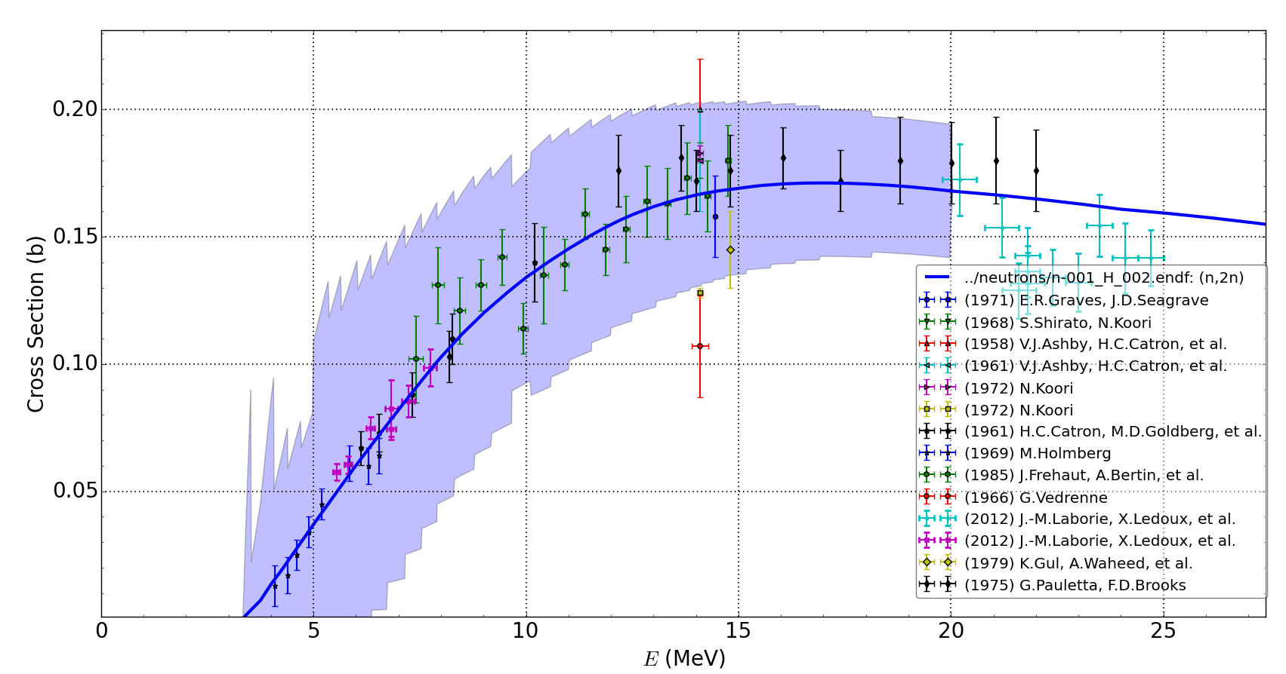
Questionable covariances
In n-001_H_002, the covariance matrix for (n,2n) is computed from other matrices: MT1 – MT2 – MT102. Experimental data suggests smaller uncertainty would be appropriate:

Slide 12
Sample warnings from Fudge physics checking (neutron sub-library)
Negative elastic cross sections in resonance region for Ar40, Gd152 and Dy160. In each case, ‘background’ cross section in MF=3 is negative, overwhelms resonance contribution
Ar40: dips negative near 978.3 keV
Gd152: dips negative 14 times between 33 eV and 2.2 keV
Dy160: 7 times between 330 eV and 1.85 keV

Slide 13
32 evaluations need denser energy grids in URR
ENDF manual suggests giving 3-10 points per decade, points shouldn’t differ by more than factor of 3
When energy grids are sparser than that, reconstruction codes give different results (looked at NJOY, AMPX, PREPRO and Fudge)
Why not thicken URR grid (using evaluator’s recommended interpolation)?
Energy grid differences by factor of 3 or more:
As74, Kr82, Nb94, Nb95, Mo99, Sn123, Sb125, Te127m, Te129m, I131, Cs136, Ba140, Ce139, Nd147, Pm148, Pm149, Pm151, Sm153, Eu152-156, Gd153, Gd154, Gd157, Tb160, Dy156, Dy158, Ho166m, Er167

Slide 14
Probability distributions dropping below -0.01:
Y90: in MT=53, energy_{in} = 15,17,18 MeV
Te132: MT=52, energy_{in} 18 MeV
Xe136: MTs 51, 54, 56, 57
Ho165: MTs 2 and 51
Hf177 and Hf179: MT=2
Au197: MTs 2 and 53 (worst case: P = -0.223 for MT53)
U239: MT = 2, MTs 62-81
U240: MTs 51 and 52
U241: MT = 2, MTs 51-72

Slide 15
Other random questions (mainly about neutron sub-library) from me + other nuclear data users at LLNL:
Evaluations for Ne isotopes?
P31 lumps all inelastic into MT=91, can we break that up into discrete states?
Expanded covariance estimates
N14?
Charged-particle sub-libraries?

