Slide 1
Evaluation of pre-ENDF/B-VIII Cross Section
Mark Chadwick
Deputy Associate Director (actg.), ADX
Los Alamos National Laboratory
Thx to many many for input.
LA-UR-15-
UNCLASSIFIED
Notes:
TEMPLATE NOTES:
Section tabs can be modified to the desired color. To insert a tab into a new slide, simply copy and paste the grouped items.
The quote bar can be used for text that you would like to highlight - simply copy and paste the grouped items into your desired slide.
Please try to use high resolution images. When placing an image into a slide, keep the image anchored, either to the top header bar or to the bottom footer bar. Images can bleed off the slide as well.

Slide 2
ENDF/B-VII.8 Goal is to advance our database for the most impactful isotopes – actinides, iron, oxygen, … – using CIELO work
Numerous fundamental cross section advances
  Resonances
  Fast region capture, fiss, scattering, …. nubar), PFNS spectra …
  Standards
Challenge is to preserve and improve integral criticality, transport, & spectral index performance
For example our new:
  U235 IAEA thermal PFNS incr. thermal criticality
  16O Hale n,alpha lowers thermal criticality
“Mosteller” suite of 119 critical assemblies that we track over time (MCNP6 calculations)
1985
1999
2006
2011
Pre-VIII.CSEWG.Nov2015 for 235,8U,239Pu,16O changes from 0.42% to 0.44% (Forrest Brown)
Not too bad!
We will evaluate new results soon, but optimistic that improvements have been made
Kiedrowski

Slide 3
Plan for Reaching ENDF/B-VIII Release in 2018
Higher risk:
Inelastic scattering
Capture in fast region
More PFNS upgrades
…
END/B-VIII.0 2017/18
- Further major upgrades
Draft NDS document 1-year from now, for Jan-2018 publication
Pre-ENDF/B-VIII, 2016
Base upgrades established (covariances not yet added)
+ numerous variants
Standards,1H, 16O, 56Fe, 235,8U, 239Pu,
C,Ne,Ca,Ni,Cu,As,Re,W, …
Thermal kernels (SG42)
END/B-VIII.0 2017/18
- Modest upgrades
Low risk:
Fission product yields, TKE
PFGS (fission gammas)
PFNU (nu)
…
CIELO help
END/B-VII.1, 2011
- Widely used in DOE &
around world

Slide 4
Some highlights of recent work supporting ENDF/VIII
²³⁵U.
  Resonances - major effort from IAEA+ORNL, looks to improve performance relative to Nov-2015 “19c file”. IAEA thermal PFNS; LANL/RPI/CERN capture. Needs more testing and peer review (Leal et al).
  Fast region. We have 2 options: base = modest upgrade to VII.1 using Talou et al PFNS informed by Chi-nu data; possible major upgrade IAEA’s new fast region. Much testing and peer review needed.
²³⁸U. Major new effort from IAEA with key data from Geel, RPI, TUNL, …
²³⁹Pu. Modest change to B-VII (we await Chi-nu data): Neudecker PFNS above 5 MeV & Romano thermal tweak. Kawano has begun studying impact of new DANCE capture data.
⁵⁶Fe. Major BNL effort with IAEA, BNL, Leal, …
¹⁶O. Hale’s evaluation v. similar to earlier one we tested, now he has merged with higher energy data. Informed by CIELO discussions o low energy cross section, n,a, and total RPI data
Goal of this meeting is to
assess candidate B-VIII evaluations
Work plan to “finalize” such evaluations by end of Sept
Enable Nov. CSEWG to present comprehensive testing
Notes:
1) We have extended the Los Alamos (Madland-Nix) model of PFNS in various ways by introducing an anisotropy parameter to model the emission of neutrons from rotating fragments; different temperature distributions in the light and heavy fragments; modified the optical model potentials used to calculate the inverse cross-sections of neutron emissions from the fragments; etc.
2) We have performed an extensive and thorough analysis of experimental PFNS data, including MCNP simulations of several past experimental setups, often leading to significantly increased error bars and significantly more realistic correlation matrices.
3) Items 1) and 2) led to a much more robust evaluation of PFNS data for Pu239 at 0.5 MeV incident neutron energy.
4) This work is done in collaboration with Chi-Nu at LANSCE, and the IAEA (Roberto Capote)

Slide 5
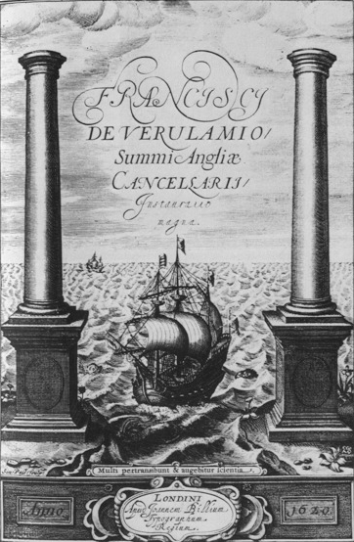
Nuclear never ends …
Plus Ultra : there is more beyond
(motto of the great scientific pioneers of the 16th & 17th Century)
Francis Bacon’s Novum Organum (1620): Straits of Gibraltar flanked by the colossal pillars of Hercules.
Inscription: Many shall pass too and fro and knowledge shall be increased
Notes:
1) We have extended the Los Alamos (Madland-Nix) model of PFNS in various ways by introducing an anisotropy parameter to model the emission of neutrons from rotating fragments; different temperature distributions in the light and heavy fragments; modified the optical model potentials used to calculate the inverse cross-sections of neutron emissions from the fragments; etc.
2) We have performed an extensive and thorough analysis of experimental PFNS data, including MCNP simulations of several past experimental setups, often leading to significantly increased error bars and significantly more realistic correlation matrices.
3) Items 1) and 2) led to a much more robust evaluation of PFNS data for Pu239 at 0.5 MeV incident neutron energy.
4) This work is done in collaboration with Chi-Nu at LANSCE, and the IAEA (Roberto Capote)

Slide 6
Backup
Notes:
1) We have extended the Los Alamos (Madland-Nix) model of PFNS in various ways by introducing an anisotropy parameter to model the emission of neutrons from rotating fragments; different temperature distributions in the light and heavy fragments; modified the optical model potentials used to calculate the inverse cross-sections of neutron emissions from the fragments; etc.
2) We have performed an extensive and thorough analysis of experimental PFNS data, including MCNP simulations of several past experimental setups, often leading to significantly increased error bars and significantly more realistic correlation matrices.
3) Items 1) and 2) led to a much more robust evaluation of PFNS data for Pu239 at 0.5 MeV incident neutron energy.
4) This work is done in collaboration with Chi-Nu at LANSCE, and the IAEA (Roberto Capote)

Slide 7
Summary of Data Testing of new pre-VIII.CSEWG.Nov15 Files (u5=19c ; u8=4c=iaea ib44 ; o16=5c=halead; pu9=23c) cf. VII.1
Fast region:
  Unreflected: Jezebel, Godiva (~equally good)
  Pu & HEU Flattops (a bit worse. 238U reflection?)
  Bigten (a bit worse)
Thermal region:
  Pu solutions – much better
  U5 solutions – reasonably good. Plotted against above-thermal-leakage shows a good intercept but a small positive bias slope.
  LEU worse (LCT5,7 down 100-200 pcm, per Kahler) - u8 impact?
Phase space of evaluation trial files, for testing, is very large. Much ENDF testing work done by Kahler (LANL) and Trkov, Capote (IAEA):
Single Substitutions of new files into VII.1
Substitutions of ensembles into VII.1 (u5,8,pu9,o16, …)

Slide 8
235U pre-VIII file, NAME=19c
Updates near 2 keV using Leal et al resonances, based on LANSCE /DANCE & RPI data, & lower-energy resonance changes (near 7.8-11 eV), & nubar changes: i.e. Low energy part of IAEA file u235ib02i2g6cnu3f2
Prompt Fission Neutron Spectra
  Adopt IAEA thermal spectrum evaluation, Eav=2.00 MeV (versus 2.03 MeV)
  Above thermal, Rising-Talou evaluation to 5 MeV (matches Chi-nu & NUEX)
Known Issues not yet addressed:
  A major IAEA upgrade, including fast energies may reach maturity …
  Nubar near thermal and above needs attention (mean values, fluct)
  Res. integral in 7.8-11 eV incr 2% ~ 246 b-eV (Carlson; Leal). V&V ing
  Capture updates may be needed in 10s of keV region (and above?) based on DANCE, Wallner data. New data coming with NEUANCE.
  Kawano, Capote et al are studying inelastic models & evaluation updates, with future use of RPI-type semi-integral scattering data
  PFGs; P(nu), Chi(nu); TKE updates; FPY TUNL updates esp at 14 MeV.
  Data testing of void reactivity (Japanese help?); Criticality performance?

Slide 9

²³⁵U : Two LANL experiments cover the whole emission energy range – Chi-nu (LANSCE) and NUEX (Lestone-Shores)
Talou-Rising is a bit different to the IAEA PFNS 0.5-2 MeV – but not a lot
Previous VII.1 unphysical (?) structure in few-MeV range removed.
A future upgrade will increase Eav in 15-20 MeV range
Operated by Los Alamos National Security, LLC for NNSA

Slide 10
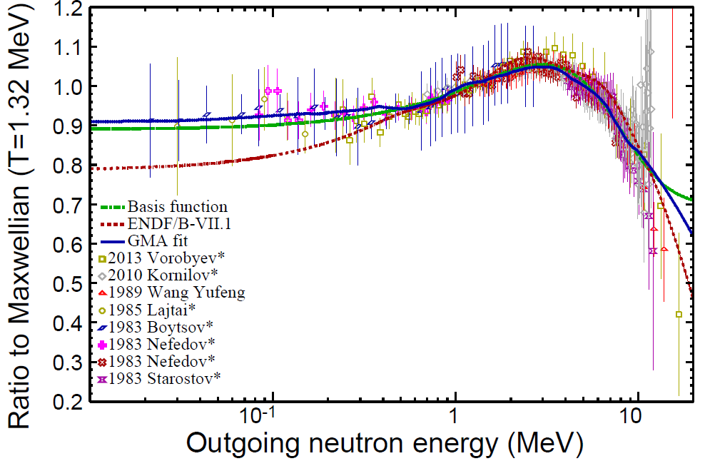
²³⁵U thermal PFNS adopted from IAEA Standards work. Changing from eav 2.03 to 2.00 MeV has major implications
IAEA : <E>=2.00±0.01
ENDF-B/VII.1: <E>=2.03
We are adopting this work owing to the significant quality effort devoted; it increases thermal criticality
Other changes to 235U resonances, nubar, and 16O compensate for the change
Operated by Los Alamos National Security, LLC for NNSA

Slide 11
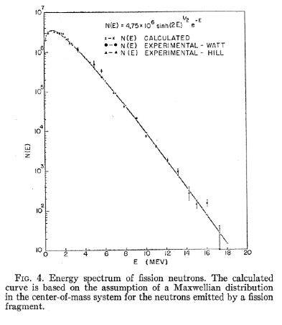
²³⁵U thermal PFNS adopted from IAEA Standards work.
New Eav=2.00 MeV Agrees with Watt’s LANL 1952 Analysis!
Watt spectrum: N(E)~exp(-E/a).sinh(sqrt(b.E))
Eav=(3/2)(1+a.b./6). (Broadhead, ORNL, PHYSOR2004)
a=1, b=2
Eav=2.00 MeV
Phys. Rev. 87, 1037 (1952)
Operated by Los Alamos National Security, LLC for NNSA

Slide 12
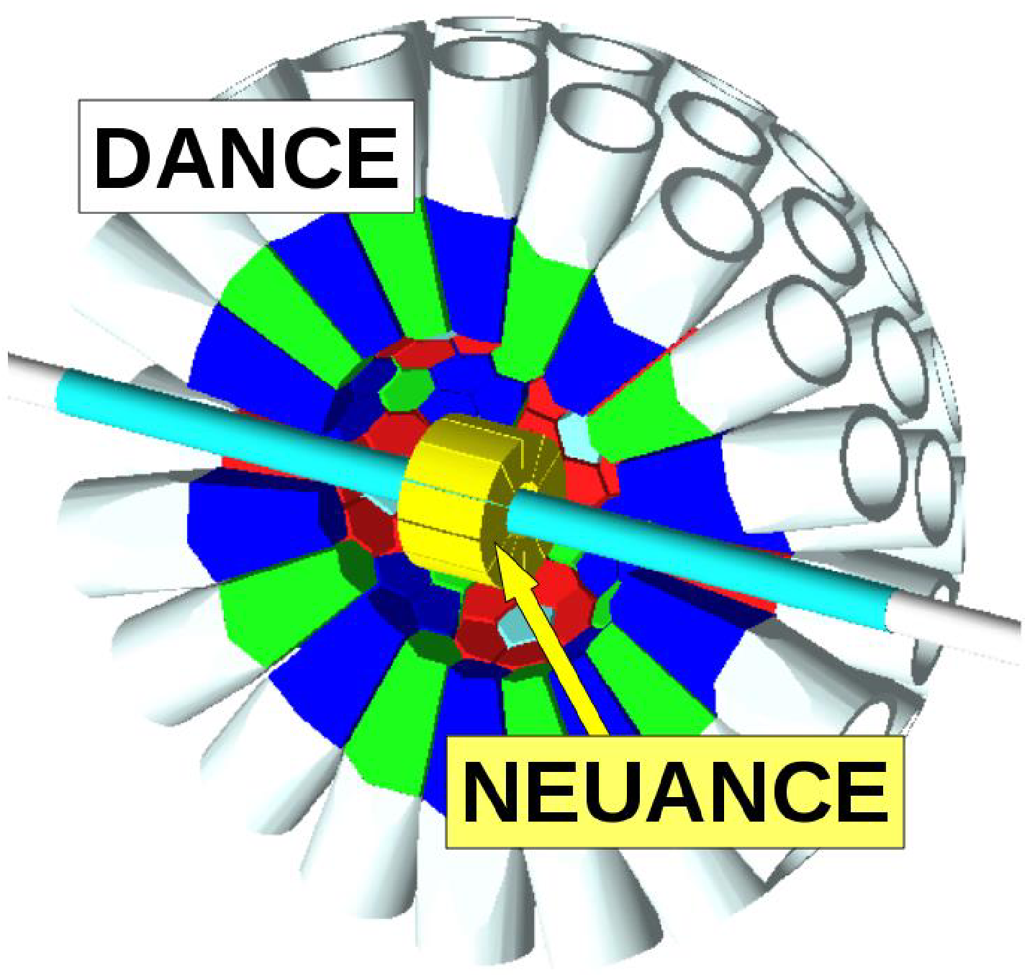
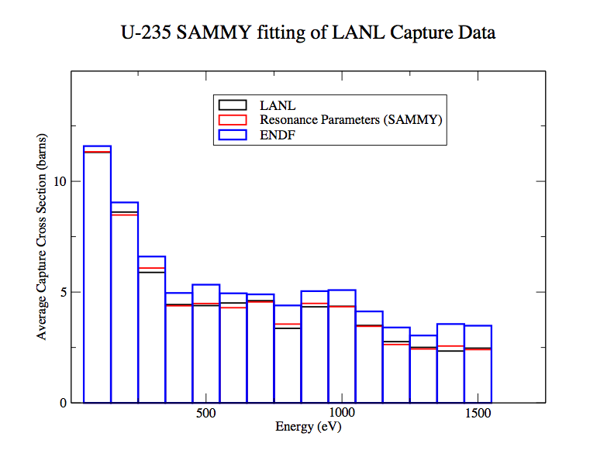
235U capture
RPI and DANCE Capture data agree and have impacted new SAMMY analysis
No change yet above a few keV, since ENDF represents the data reasonably well and recent AMS (Wallner) and DANCE data different. Forthcoming NUANCE data at LANSCE should further increase the data accuracy

Slide 13
235U nubar - IAEA studying fluctuations
Uses this trial “nu3” nubar file from IAEA – but more work needed
VII.1, JEFF3.x, JENDL4 do not use fluctuations
Data and existing evaluations

Slide 14
235U fission products
Update 14 MeV (and 0.5 MeV if needed) FPYs in ENDF, based on recent TUNL-LLNL-LANL Gooden et al. measurements

Slide 15
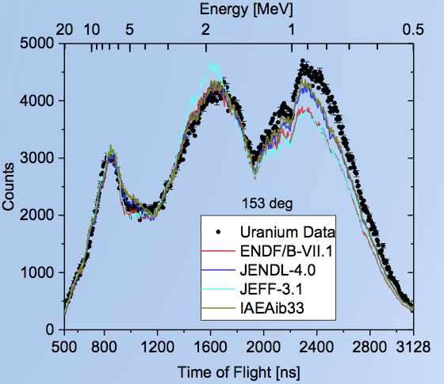
238U pre-VIII file, NAME=04c (IAEA ib44)
Major new 238U evaluation from IAEA, see talks by Capote & Trkov:
Includes:
  Inelastics from calculations and data (including RPI semi-integral data)
  Capture consistent with standards
  n,2n influenced by TUNL data
  Resonances adopted from B-VII, but being updated by new IRMM resonance analysis
Known Issues not yet addressed:
  PFNS not yet changed. Some surprising results obtained at RPI and France regarding the spectrum shape below a few MeV – need confirmation
  TKE updates; FPY TUNL updates esp at 14 MeV.
RPI

Slide 16
239Pu pre-VIII file, NAME= “23c”
NEA/WPEC SG34 resonances
SG34/JEFF3.2 nubar at low energies up to 650 eV, total nubar recalculated
PFNS > 5 MeV from LANL/Neudecker evaluation, ENDF< 5 MeV still VII.1
PFNS “Romano tweak” at thermal to better model thermal solution criticality
Old Young fast nubar tweak removed by Talou, now follows data
Huge section of delayed gammas removed
Known issues not yet addressed:
  Unresolved resonances – consider use of ISSF=1 pointwise
  Leal resonances /capture up to 4 keV; Additional Leal work in resonances?
  Inelastics from calculations and data (including future RPI semi-integral data)
  Capture changes motivated by DANCE/NEUANCE – waiting for data
  Testing of Neudecker 14 MeV PFNS against pulsed sphere exp.
  PFNS data from Chi-nu ; add in TKE up to 14 and above; TUNL FPYs.
  PFGS and gamma-production in file6?; TPC fission – waiting for final data

Slide 17
239Pu nubar - both <650 eV; and fast range
New fast nubar from Talou follows a covariance fit to data, and removes the higher tweak
SG34 nubar used appears low …

Slide 18
239Pu PFNS: In fast region < 5 MeV, no change
Above thermal and up to 5 MeV our pre-ENDF/B-VIII evaluation uses VII.1
Denise Neudecker’s work is adopted only above 5 MeV.
Note though that other recent evaluations (IAEA, Denise N, Patrick T) get 2.08 MeV average energy at thermal – softer than this
It is premature to change the PFNS here, as we await Chi-nu data. The existing evaluation matches Lestone and Chatillon (Granier-mod.) data well, and peforms well in integral simulations

Slide 19
239Pu PFNS from 5-20 MeV from Neudecker Calculations and Evaluations
“Current” is adopted in pre-VIII. The new structure in these PFNS better characterize the multi-chance fission process, although it is not clear they better represent the Chatillon data!
We need to do integral data testing against 14 MeV Livermore pulsed spheres.

Slide 20
239Pu PFNS at Thermal
Romano tweak ~ invisible compared to VII.1
We await Chi-nu data before we want to change the evaluation here
Softening the PFNS will increase thermal criticality simulations, potentially removing the SG34 gains unless other changes are made

Slide 21
239Pu data – Chatillon versus Chatillon+Granier-correction
& Role of removing Staples data
Add details

Slide 22
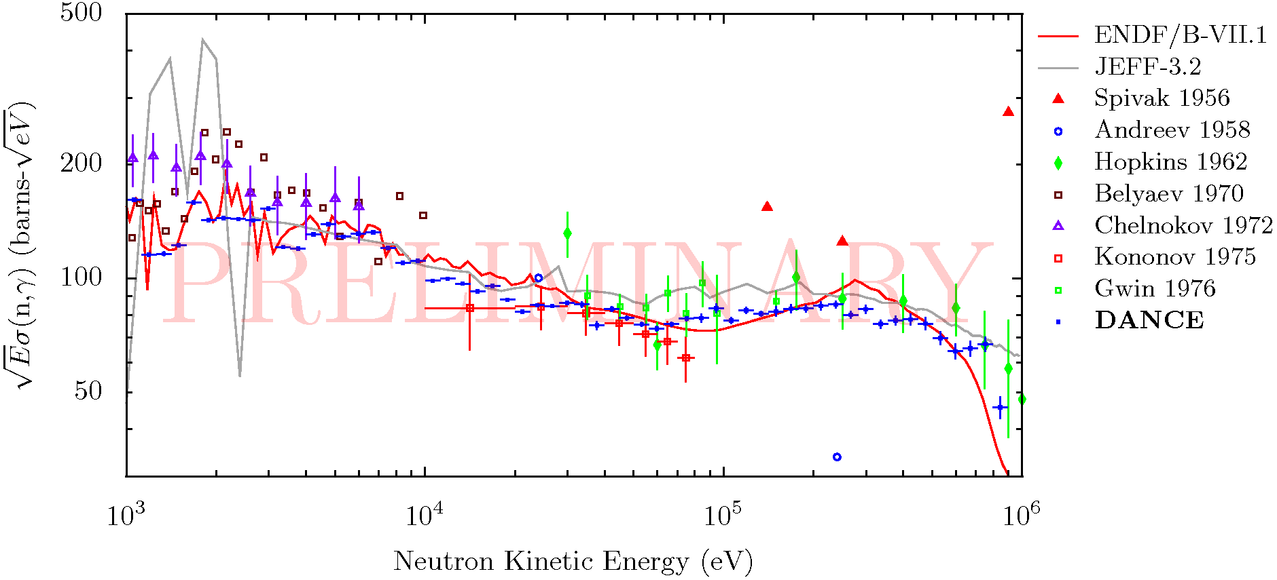
Preliminary Results for ²³⁹Pu. Although data appear to largely support VII.1, much work needed to integrate into a VIII Evaluation (resonances and high energy)
Issues in keV region analysis largely resolved
Working through systematic uncertainties

Slide 23
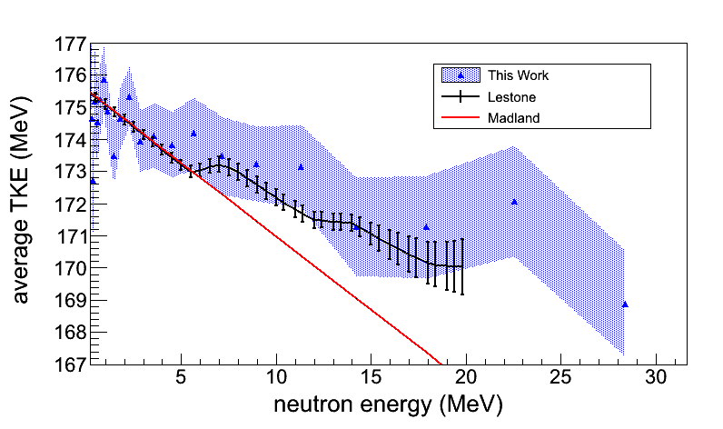
239Pu fission products
Update 14 MeV (and 0.5 MeV if needed) FPYs in ENDF, based on recent TUNL-LLNL-LANL Gooden et al. measurements
First complete TKE measurement to above 14 MeV will influence a B-VIII fission energy change
Some, but not all, VII.0->VII.1 changes supported by new data

Slide 24
56Fe pre-VIII file, NAME= beta1 (Svn rev.88)
Major new 56Fe evaluation from BNL, see next talk by BNL:
Incudes:
  ORNL resonances up to 846 keV with JENDL-4.0 angular distributions
  total 846keV - 4 MeV: JEFF-3.2 (smoothed Berthold/Weigmann data)
  MT51,52 up to 4 MeV: smoothed Negret (Geel) data
  Remaining reactions EMPIRE calculations up to 29 MeV
    Gilbert-Cameron LD instead of microscopic HFB to improve neutron spectra
    R. Haight alpha emission reproduced, improved (n,2n), inelastic consistent with Nelson data after Chinese corrections
  RPI semi-integral data testing performed on beta0(!) version indicated need for improvement of neutron spectra (beta1 under testing)
  Preliminary validation comparable to VII.1 except 2 experiments
Known Issues not yet addressed:
  Decide on RR region (new ORNL evaluation?) and ang. distributions
  Extension to higher energies, covariances, other isotopes
Notes:
This info may change if the new ORNL RR arrives in time for assembling and testing a new file. We have no info about RPI testing of beta1.

Slide 25
16O pre-VIII file, NAME= o16 =5c IAEA_halead
(An updated version has recently been released by Hale)
Major new 16O evaluation from LANL, merged with VII.1 above ~5.5 MeV by IAEA
Includes:
  R-matrix leads to ~30% increased (n,a) in the 3-6 MeV range – closer to where B-VI was before the B-VII reduction.
  Fair agreement with new RPI total cross section data in 3.2 – 6 MeV region (C/E = 1.01, VII.1 was 0.988).
Known Issues not yet addressed:
  Data testing on transmission problem – issues identified.
  Doesn’t quite match the Plompen et al CIELO thermal elastic/total recommendation (3.765 bars)
  Waiting for possible LANL LENZ (n,a) 3-5 MeV measurement relative to 6Li(n,a)
  Merging new Hale evaluation with higher energy (>8 MeV) old data
  Comparison with ORNL & Kunieda calcs? Details of work planned?

Slide 26
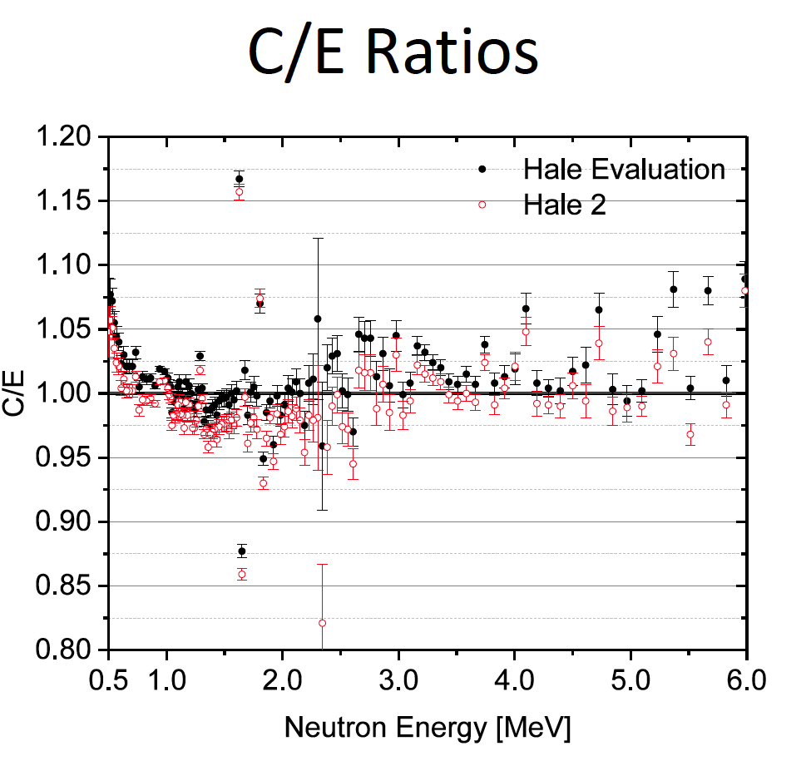
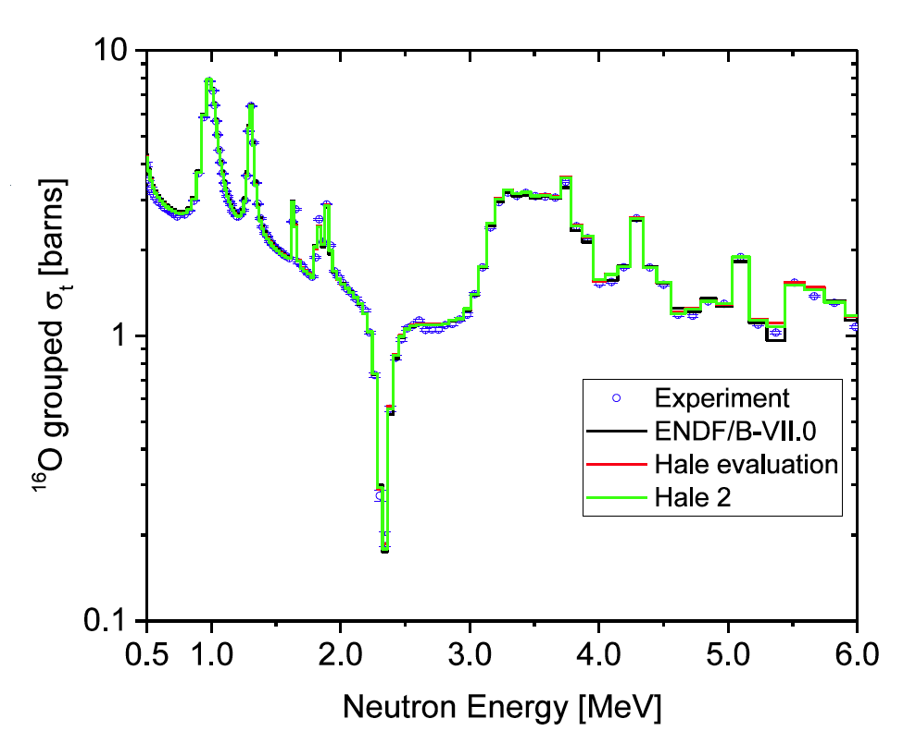
16O Hale evaluations compares well with new RPI data
Ratio of Integral from 3.2-6 MeV Hale=1.01 +/- 0.03; Hale2=1.005 +/- 0.003
In the 1-2 MeV Hale2’s lower total cross section is influenced by other data

Slide 27
16O Hale evaluations at low energies compared to CIELO work of Kopecky, Plompen, Lubitz, …
Slightly different from their 3.765 b. Resolve differences if possible. Schneider, with Ohkubo and Johnson, push for a value slightly higher than Kopeck et al’s assessment. (Need to addBistler, but unlikely to change assesment)

Slide 28
16O Hale evaluations for total cross section and n,alpha
(New evaluation of a few weeks ago… but similar to tested iaea-halead file )
Total cross section scaling of Cierjacks data ~ consistent with other CIELO conclusions
Inverse Bair-Haas data used in fit
IRMM1 is Bair-Haas converted to inverse channel, with no renomalization (as recommended by Georginis).
[earlier IRMM Georginis had the 4.2 MeV peak near just over 0.1b, more like old VII.1, before he recommended a higher normalization]
Differences above 6.5 MeV are dur to LANL R-matrix fit influenced by total cross section data and Bair-Haas inverse data

Slide 29
Conclusions
Much progress, with improved physics
We have a base set of files that perform adequately in integral simulations
- future improvements in integral performance still a goal
Much work will be also needed to add credible covariances
This creates optimism that we can release ENDF/B-VIII in the 2017/2018 time frame
- NDS big paper for CIELO & VIII planned for Jan 2018.
Notes:
1) We have extended the Los Alamos (Madland-Nix) model of PFNS in various ways by introducing an anisotropy parameter to model the emission of neutrons from rotating fragments; different temperature distributions in the light and heavy fragments; modified the optical model potentials used to calculate the inverse cross-sections of neutron emissions from the fragments; etc.
2) We have performed an extensive and thorough analysis of experimental PFNS data, including MCNP simulations of several past experimental setups, often leading to significantly increased error bars and significantly more realistic correlation matrices.
3) Items 1) and 2) led to a much more robust evaluation of PFNS data for Pu239 at 0.5 MeV incident neutron energy.
4) This work is done in collaboration with Chi-Nu at LANSCE, and the IAEA (Roberto Capote)

Slide 30
Plan for Reaching ENDF/B-VIII Release in 2018
END/B-VIII.0 2017/18
- Further major upgrades
Higher risk:
Inelastic scattering
Capture in fast region
More PFNS upgrades
…
Pre-ENDF/B-VIII, 2015
Base upgrades established (covariances not yet added)
+ numerous variants
1H, 16O, 56Fe, 235,8U, 239Pu,
9Be?,C,Ne,Ca,Ni,Cu,As,Re,W, …
Thermal kernels (SG42)
END/B-VIII.0 2017/18
- Modest upgrades
Low risk:
Fission product yields, TKE
PFGS (fission gammas)
PFNU (nu)
…
CIELO help
Labs providing evaluations:
LANL, ORNL, BNL
IAEA, IRSN, CEA, IRMM
CAB, CNL
END/B-VII.1, 2011
- Widely used in DOE &
around world

