Slide 1

Summary of
Relativistic Astrophysics:
Volume 2, The Structure and Evolution of the Universe
by Ya. B. Zel'dovich and I. D. Novikov
Presentations to the BNL Astrophysics Journal Club
~ March 2, March 30, April 27, May 13, June 15, July 13, July 20, August 31, October 12, November 1, November 15 & November 22, 2022
Les Fishbone
LGF Consulting LLC

Slide 2
Comments
1. Errors?
2. At least three installments if you wish.
3. Subjects for focus in future installments?
4. Subjects to exclude in future installments?

Slide 3
Publication History
1. Relyativistskaya Astrofizika (Relativistic Astrophysics)—Russian original; Nauka, 1967.
2. Relativistic Astrophysics: Volume 1, Stars and Relativity--English translation of the first part of the 1967 Russian original, revised and enlarged by the authors; translated by Eli Arlock, edited by Kip S. Thorne and W. David Arnett; The University of Chicago Press, 1971.
3. Stroenie i Evolutsiya Vselennoy (The Structure and Evolution of the Universe)--Russian original, 1975.
4. Relativistic Astrophysics: Volume 2, The Structure and Evolution of the Universe--English translation of the 1975 Russian original, revised and enlarged by the authors; translated by Leslie Fishbone, edited by Gary Steigman; The University of Chicago Press, 1983.
_________
* Book 4 in the list is the basis for this presentation.

Slide 4
Retrospective
5. My Universe: Selected Reviews, by Ya. B. Zel'dovich with others; ed. by Ya. B. Zel'dovich, B. Ya. Zel'dovich and M. V. Sazhin; translated from the original Russian by M. V. Sazhin; 1992, Harwood Academic Publishers.
Review of Book 4
Joseph Silk in Science, Vol. 223, 10 Feb. 1984.

Slide 5


Slide 6
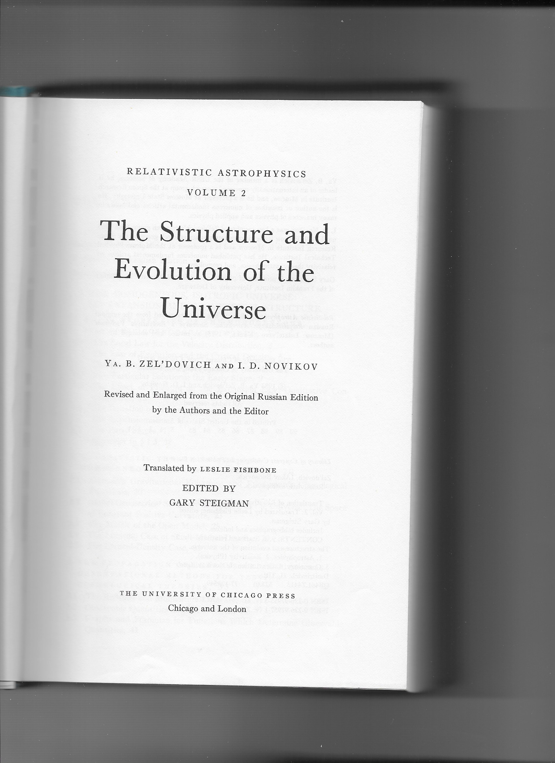

Slide 7
Biographical Information
(from Wikipedia)
Yakov Borisovich Zel'dovich
1914-1987; born in Minsk, then lived in St. Petersburg, Kazan, and Moscow
Educated at Leningrad (now St. Petersburg) State University and the Leningrad Polytechnic Institute (now Peter the Great St. Petersburg Polytechnic University)
Awarded Candidate of Science in 1936 and Doctor of Science in 1939
Married and had five children
Worked on combustion, explosions, shock waves, and nuclear weapons until about 1963; worked on elementary particle physics, astrophysics, and cosmology thereafter
Many honors

Slide 8
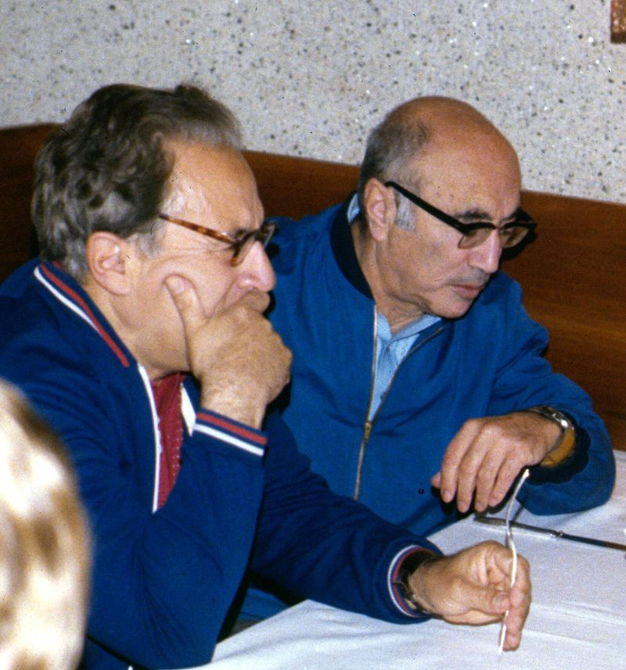
Zel'dovich (right) with Iosif Shklovsky

Slide 9
Weapons Work Described

Slide 10
Biographical Information
(from Wikipedia, Neils Bohr Institute website, and a 1979 interview with Spencer Weart of the American Institute of Physics)
Igor Dmitrievich Novikov
1935- ; born in Moscow and lives there and in Copenhagen
Educated at Moscow (State?) University
Awarded Candidate of Science in 1965 and Doctor of Science in 1970
Currently affiliated with the Lebedev Physics Institute and Neils Bohr International Academy
Has worked on reltivity theory, astrophysics, and cosmology
Awarded (with K. Thorne and R. Penrose) the first John Archibald Wheeler Prize in 2020 by the President of the Italian Physical Society

Slide 11
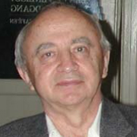
Novikov

Slide 12
How Did I Become Involved?
Graduate Study at the University of Maryland completed in 1972
National Academy of Sciences Exchange Fellowship; residence in Moscow during 1973
Attendance at Symposium of the International Astronomical Union in Poland on the occasion of the 500th anniversary of the birth of Copernicus; at the Symposium, Zel'dovich himself asked me if I would translate the book
Looking back on the book on the work and time required to translate it (π times original estimate!), I wonder how I did it! I did much of the work while a postdoc at the University of Utah.

Slide 13
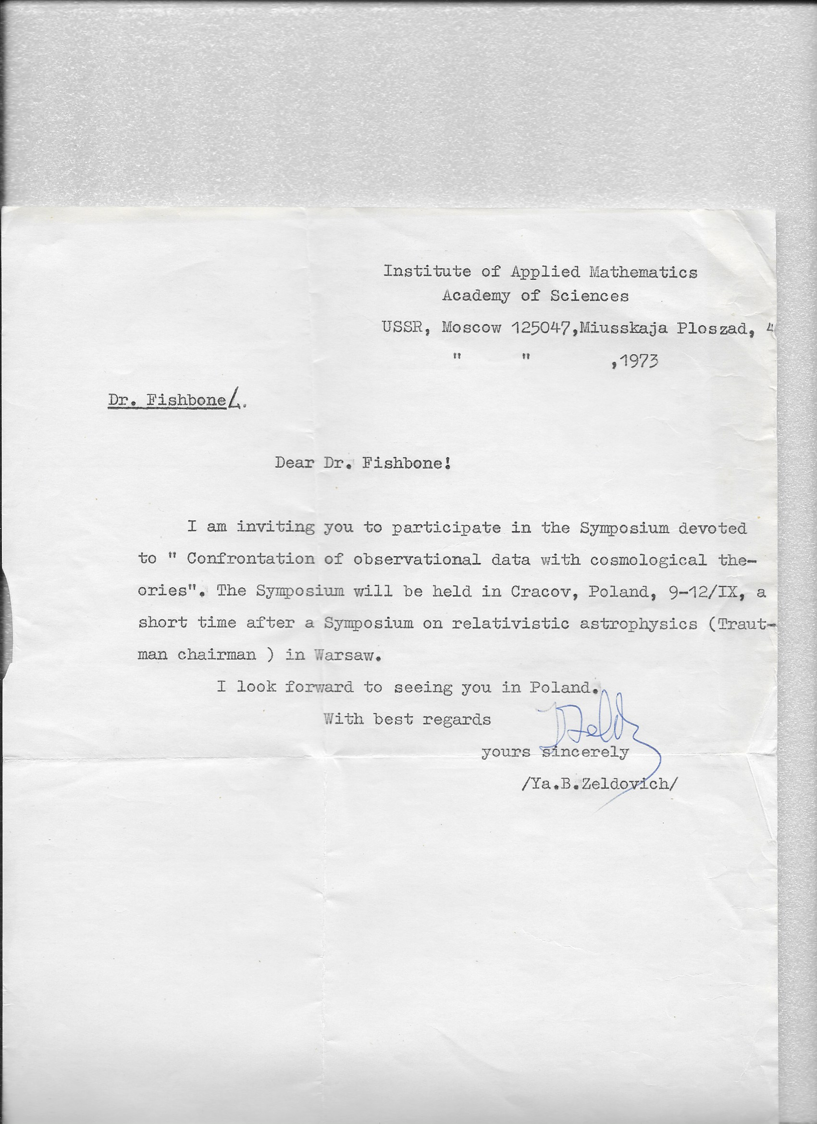
Zel'dovich (right) with Iosif Shklovsky

Slide 14
Preface to the Russian and English Editions
The authors credit the Soviet mathematician Alexander Friedmann and the American astrophysicist Hubble with providing the theoretical and observational bases, respectively of modern cosmology.

Slide 15
Main Table of Contents
Editor's Foreword
Preface to the English Edition
Introduction
I. The Homogeneous, Isotropic Universe: Its Expansion and Geometrical Structure
II. Physical Processes in the Hot Universe
III. Gravitational Instability in Cosmology; Galaxy Formation
IV. Anisotropic Cosmology
V. The Singularity and New Theoretical Developments
References
Author Index
Subject Index

Slide 16
References
Twenty-three pages of references
Two of these reference pages list papers by Zel'dovich alone or in collaboration with others, including Novikov; one quarter of a page lists papers by Novikov alone or with Zel'dovich
A selection of other authors cited is Abell, Alfven, Bahcall, Belinsky, Berger, Bisnovatyi-Kogan, Bondi, Braginsky, DeWitt, Dicke, Dirac Doroshkevich, Einasto, Einstein, Feynman, Field, Fowler, Friedmann, Gamow, Ginzburg, Grishchuk, Gunn, Hawking, Hoyle, Hubble, Jeans, Khalatnikov, Landau, Lifschitz, Longair, Milne, Misner, Ozernoy, Parker, Peebles, Penrose, Penzias, Press, Rees, Sakharov, Sandage, Sciama, Shapiro, Shklovsky, Spitzer, Starobinsky, Steigman, Sunyaev, Teukolsky, Thorne, Tinsley, Tolman, Vainshtein, Weinberg, Wheeler, Wilson and Zwicky.

Slide 17
What Had Not Been Discovered When the Book Was Written?
1. Accelerating expansion of the universe.
2. Anisotropy of the microwave background radiation.
3. Cosmological inflation
4. Additional facts
Therefore, keep in mind that the book, this summary, and my expository notes and statements represent a snapshot in time (from the mid 1980s at the latest) —not today's picture.
Additionally, I shall not give historical notes or bibliographic citations in my expository notes.

Slide 18
I. The Homogeneous, Isotropic Universe:
Its Expansion and Geometrical Structure
1. LOCAL PROPERTIES OF THE HOMOGENEOUS, ISOTROPIC COSMOLOGICAL MODEL
2. RELATIVISTIC THEORY OF THE HOMOGENEOUS, ISOTROPIC UNIVERSE
3. THE PROPAGATION OF PHOTONS AND NEUTRINOS; OBSERVATIONAL METHODS FOR TESTING COSMOLOGICAL THEORIES
4. THE COSMOLOGICAL CONSTANT

Slide 19
I. The Homogeneous, Isotropic Universe:
Its Expansion and Geometrical Structure
1. LOCAL PROPERTIES OF THE HOMOGENEOUS, ISOTROPIC COSMOLOGICAL MODEL
  1.1 The Local Law for the Velocity Distribution
  1.2 The Law of Evolution and the Critical Density
  1.3 The Duration of the Expansion
  1.4 Two Particular Solutions; the Early Stage
  1.5 The Effect of Pressure on the Expansion Law: Qualitatitve Considerations
  1.6 The Equation of Motion
  1.7 The Expansion Time
  1.8 The Early Stages
  Appendix to Section 1.3

Slide 20
I. The Homogeneous, Isotropic Universe:
Its Expansion and Geometrical Structure
2. RELATIVISTIC THEORY OF THE HOMOGENEOUS, ISOTROPIC UNIVERSE
  2.1 Einstein's Gravitational Equations and Friedmann's Cosmological Equations
  2.2 Global Geometrical Structure of a Model of the Universe: The Space of Constant Positive Curvatrue
  2.3 The Metric of the Open Model
  2.4 The Limiting Case of Small Matter Density
2.5 The Critical-Density Case

Slide 21
I. The Homogeneous, Isotropic Universe:
Its Expansion and Geometrical Structure
3. THE PROPAGATION OF PHOTONS AND NEUTRINOS; OBSERVATIONAL METHODS FOR TESTING COSMOLOGICAL THEORIES
  3.1 The Redshift and Momentum Decrease
  3.2 Observable Quantities and the Horizon
3.3 Graphs and Formulae for Functions Which Determine Observable Quantities
  3.4 Working Formulae as Functions of the Redshift z
  3.5 The First Approximation and Euclidean Space; the Deceleration Parameter
  3.6 The Distribution with Respect to Apparent Magnitude
  3.7 On the Possibility of Choosing among Cosmological Models by Observations of Distant Objects

Slide 22
I. The Homogeneous, Isotropic Universe:
Its Expansion and Geometrical Structure
3. THE PROPAGATION OF PHOTONS AND NEUTRINOS; OBSERVATIONAL METHODS FOR TESTING COSMOLOGICAL THEORIES (continued)
  3.8 The Evolution of Radio Sources
  3.9 The Determination of H₀ and q₀ from Observations
  3.10 Observable Quantities in a Universe That Is Homogeneous Only on the Average
  3.11 Kinetic Equations for Photons
  3.12 Is the Redshift Unambiguously Explained by the Expansion of the Universe?

Slide 23
I. The Homogeneous, Isotropic Universe:
Its Expansion and Geometrical Structure
4. THE COSMOLOGICAL CONSTANT
  4.1 Does the Cosmological Constant Differ from Zero
  4.2 Cosmological Models with the Λ Term
  Appendix to Part I: The Semiclosed Model and the Physical Interpretation of the Kruskal Metric

Slide 24
II. Physical Processes in the Hot Universe
5. INTRODUCTION TO PART II
6. THERMODYNAMIC EQUILIBRIUM AT THE BEGINNING OF THE COSMOLOGICAL EXPANSION
7. THE KINETICS OF ELEMENTARY-PARTICLE PROCESSES
8. THE RADIATION-DOMINATED PLASMA AND THE RELIC RADIATION

Slide 25
II. Physical Processes in the Hot Universe
5. INTRODUCTION TO PART II
  5.1 Introductory Remarks and Historical Review
  5.2 Electromagnetic Radiation in the Universe—a Review of the Observations
  5.3 Observational Proof of the Existence of the Relic Radiation (RR)

Slide 26
II. Physical Processes in the Hot Universe
5. INTRODUCTION TO PART II
  5.1 Introductory Remarks and Historical Review
  5.2 Electromagnetic Radiation in the Universe—a Review of the Observations
  5.3 Observational Proof of the Existence of the Relic Radiation (RR)

Slide 27
II. Physical Processes in the Hot Universe
6. THERMODYNAMIC EQUILIBRIUM AT THE BEGINNING OF THE COSMOLOGICAL EXPANSION
6.1 Basic Epochs in the Evolution of the Hot Universe
6.2 The Cosmological Expansion of the High-Temperature Plasma and the Condition of Thermodynamic Equilibrium
6.3 The Hadron Era in the Evolution of the Universe
6.4 Hagedorn's Theory
6.5 The Equilibrium Concentration of Nucleon and Antinucleons in the Charge-asymmetric Universe

Slide 28
II. Physical Processes in the Hot Universe
7. THE KINETICS OF ELEMENTARY-PARTICLE PROCESSES
7.1 Neutrinos in the Theory of the Hot Universe
7.2 Cosmological Gravitational Waves
7.3 Antinucleons in the Hot Model
7.4 Relic Quarks in the Hot Model
7.5 Nucleosynthesis in the Hot Model
7.6 A Comparison of the Observational Data on the Distribution of Light Elements in the Universe with the Predictions of Theory

Slide 29
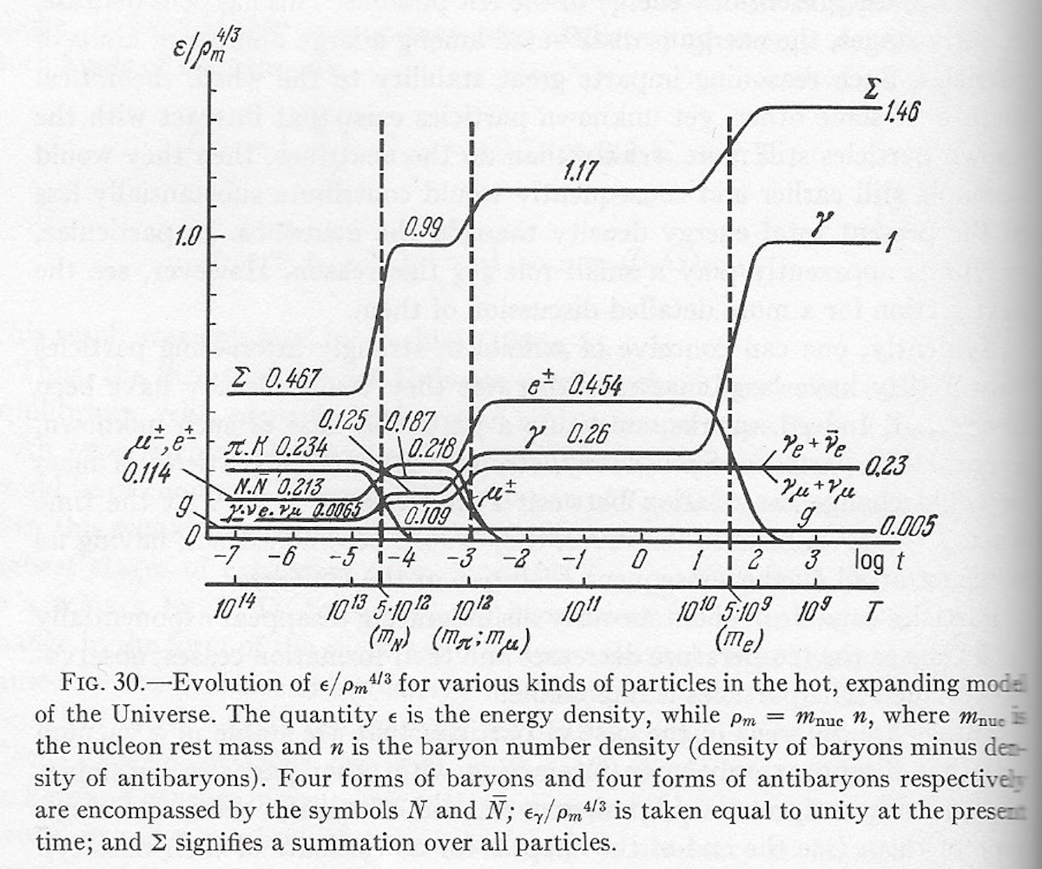

Slide 30
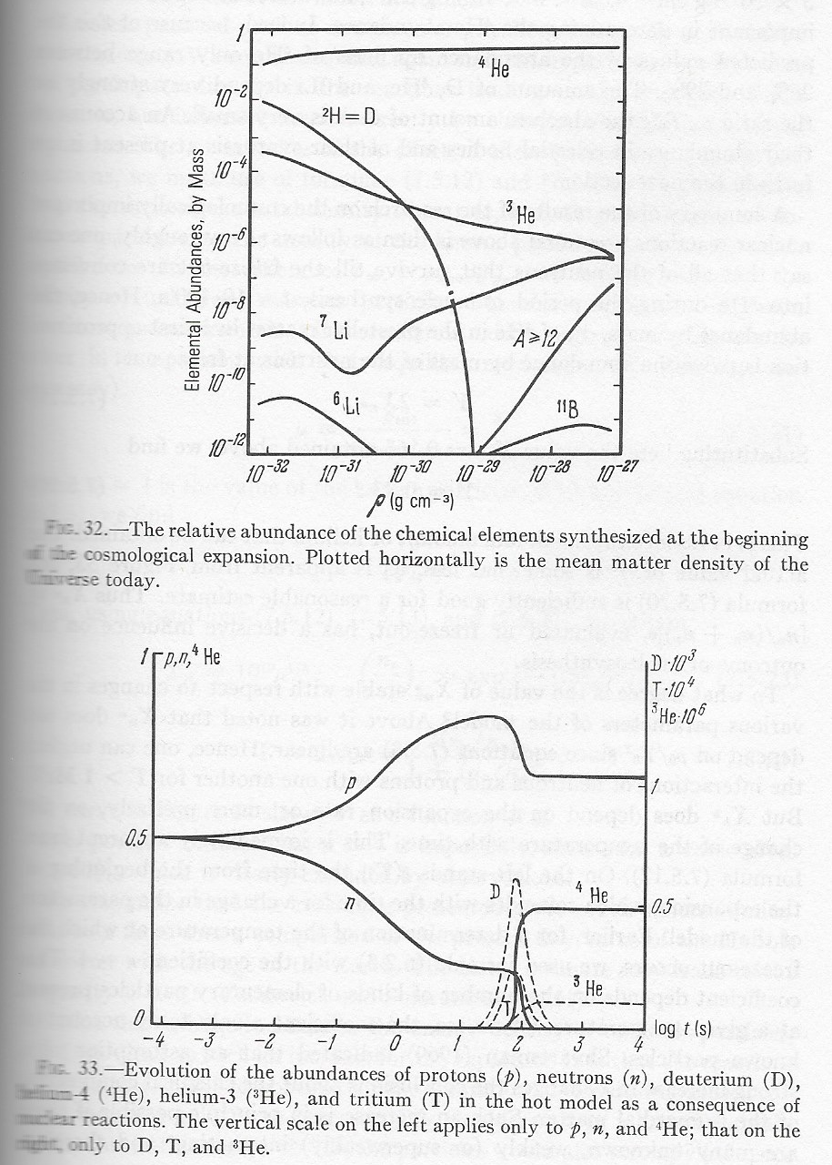

Slide 31
II. Physical Processes in the Hot Universe
8. THE RADIATION-DOMINATED PLASMA AND THE RELIC RADIATION
8.1 Introduction and General Review
8.2 Recombination: Equilibrium and Kinetics
8.3 The Interaction between the Electrons and the Photons in the Dilute Plasma
8.4 The Effect of the Electrons on the Radiation Spectrum
8.5 Early Energy Release and Quasi-Equilibrium
8.6 When Does the Relic Radiation Arise?
8.7 Late Energy Release
8.8 The Intergalactic Gas: Its Radiation and Density
8.9 Radio Emission by the Ionized Intergalactic Gas and the Epoch of Neutral Hydrogen
8.10 The Interaction of Cosmic Rays with the Relic Radiation

Slide 32
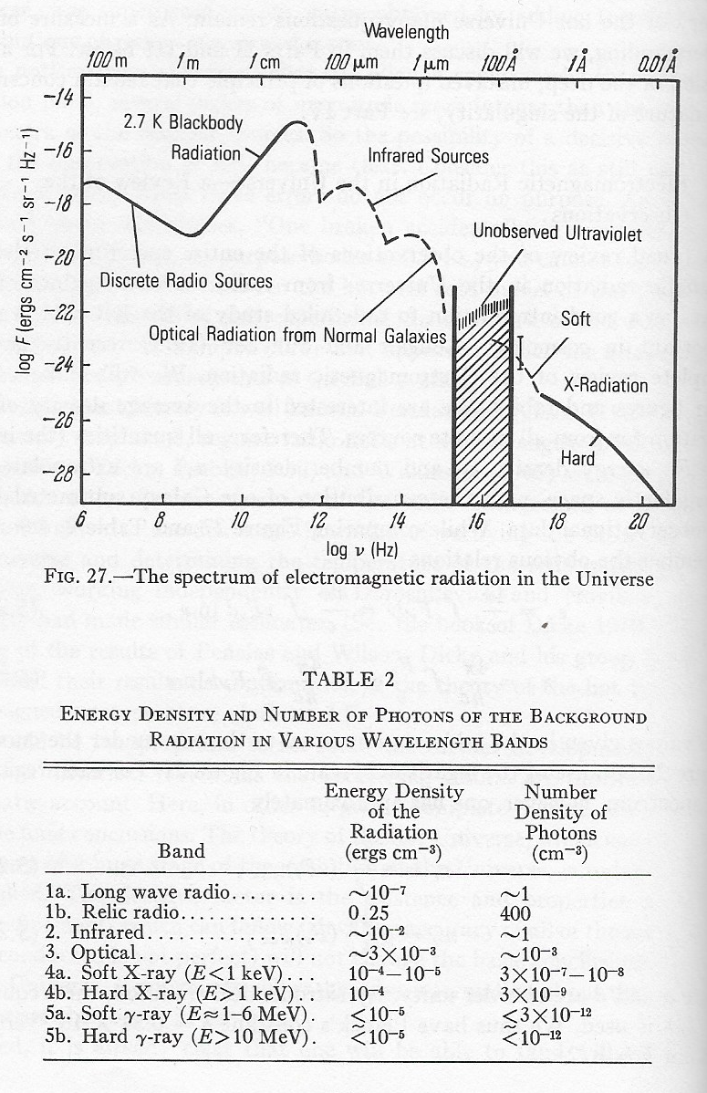

Slide 33
III. Gravitational Instability in Cosmology; Galaxy Formation
9. INTRODUCTION TO PART III
10. GRAVITATIONAL INSTABILITY IN NEWTONIAN THEORY
11. INSTABILITY IN THE HOT MODEL
12. GRAVITATIONAL INSTABILITY IN THE GENERAL THEORY OF RELATIVITY
13. STATISTICAL THEORY
14. THE NONLINEAR THEORY OF PERTURBATIONS AND THERMAL INSTABILITY
15. THEORIES OF GALAXY FORMATION
16. RESEARCH ON PERTURBATIONS USING THE RELIC RADIATION
17. GRAVITATIONAL WAVES IN COSMOLOGY

Slide 34
III. Gravitational Instability in Cosmology; Galaxy Formation
9. INTRODUCTION TO PART III
10. GRAVITATIONAL INSTABILITY IN NEWTONIAN THEORY
10.1 Jeans's Theory
10.2 The Instabilty of Expanding, Homogeneous Matter
10.3 Large-Scale Perturbations; the Self-Similar Solution
10.4 A View of Perturbations as Variations in the Parameters of a Solution; the Evolution of Perturbations in a Nonflat (Ω ≠ 1) Model
10.5 Formulae Describing the Evolution of Perturbations
10.6 Numerical Estimates
10.7 The Instability of a Collisonless, Self-Gravitating Gas

Slide 35
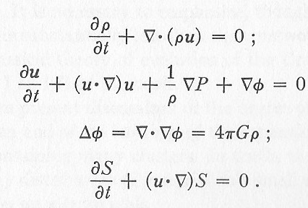
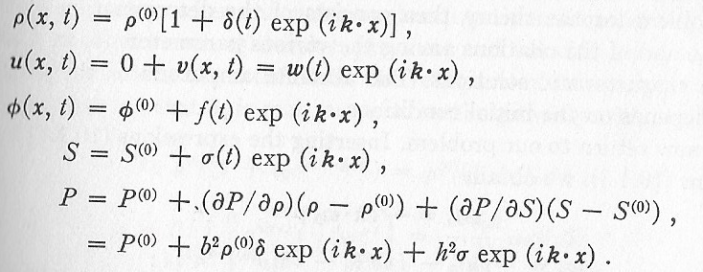
Equations of Hydrodynamics and of Perturbation Solution

Slide 36
III. Gravitational Instability in Cosmology; Galaxy Formation
11. INSTABILITY IN THE HOT MODEL
11.1 Conditions for the Growth of Perturbations
11.2 Dissipative Processes and the Decay of Adiabatic Perturbations
11.3 The Interactions of Perturbations with Free Particles
11.4 Entropy Perturbations
11.5 Rotational Perturbations
11.6 Matching Perturbations When the Equation of State Changes

Slide 37
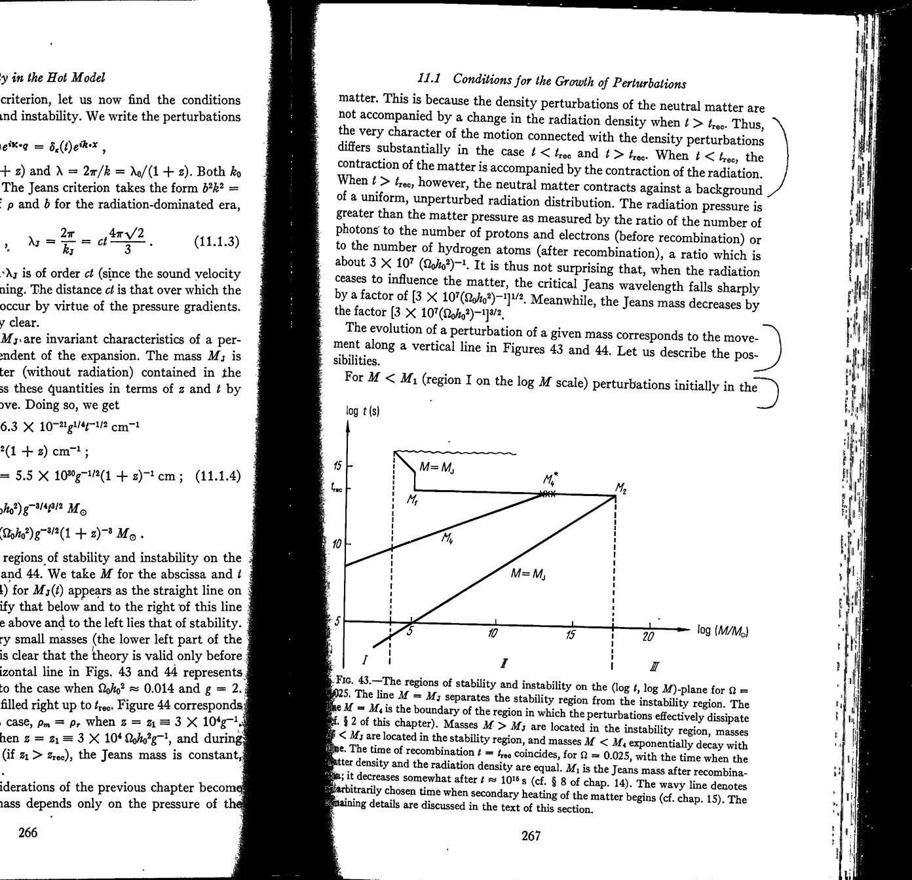

Slide 38
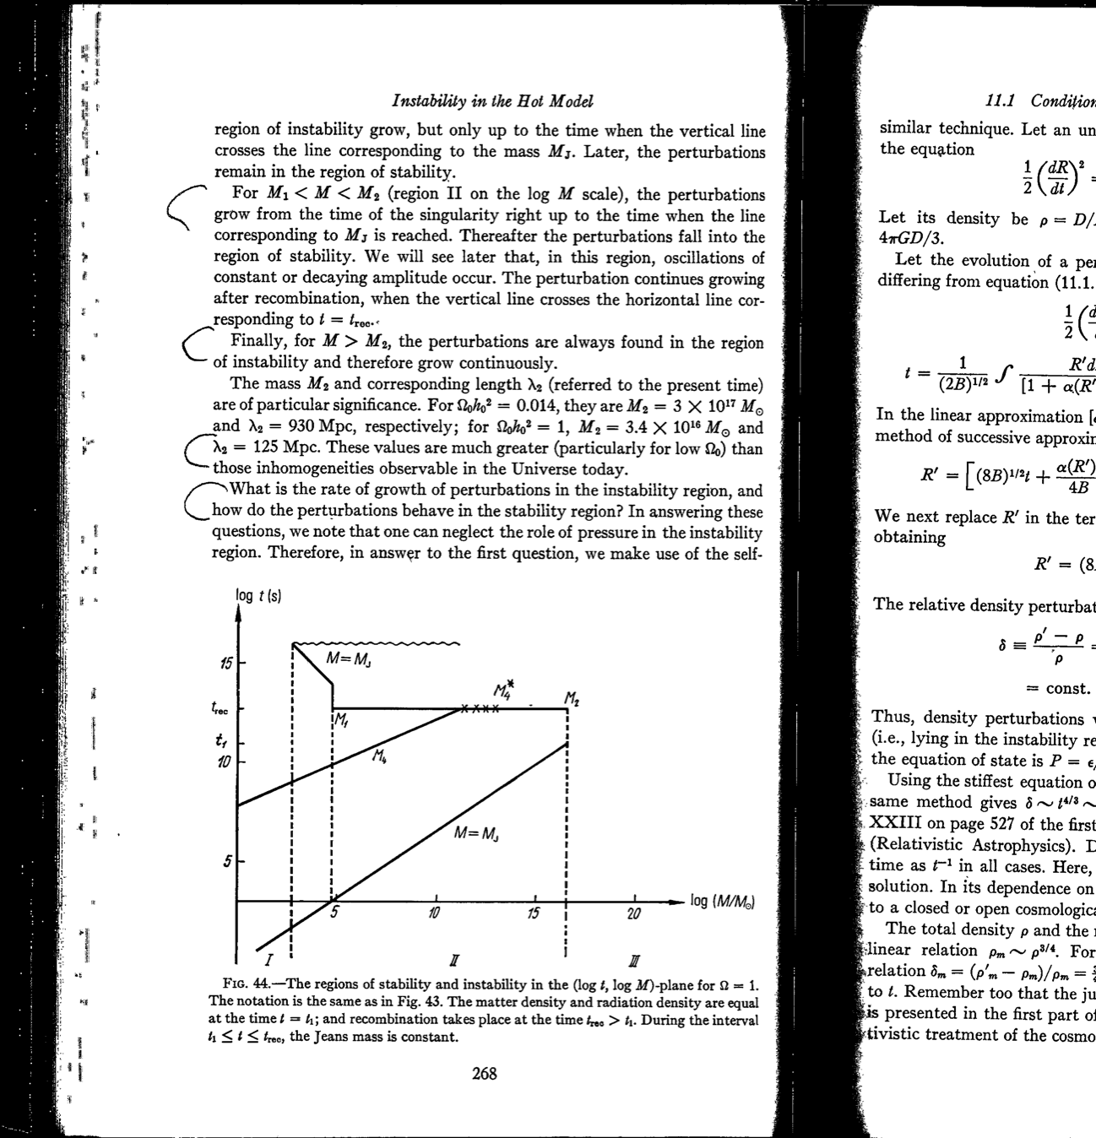

Slide 39
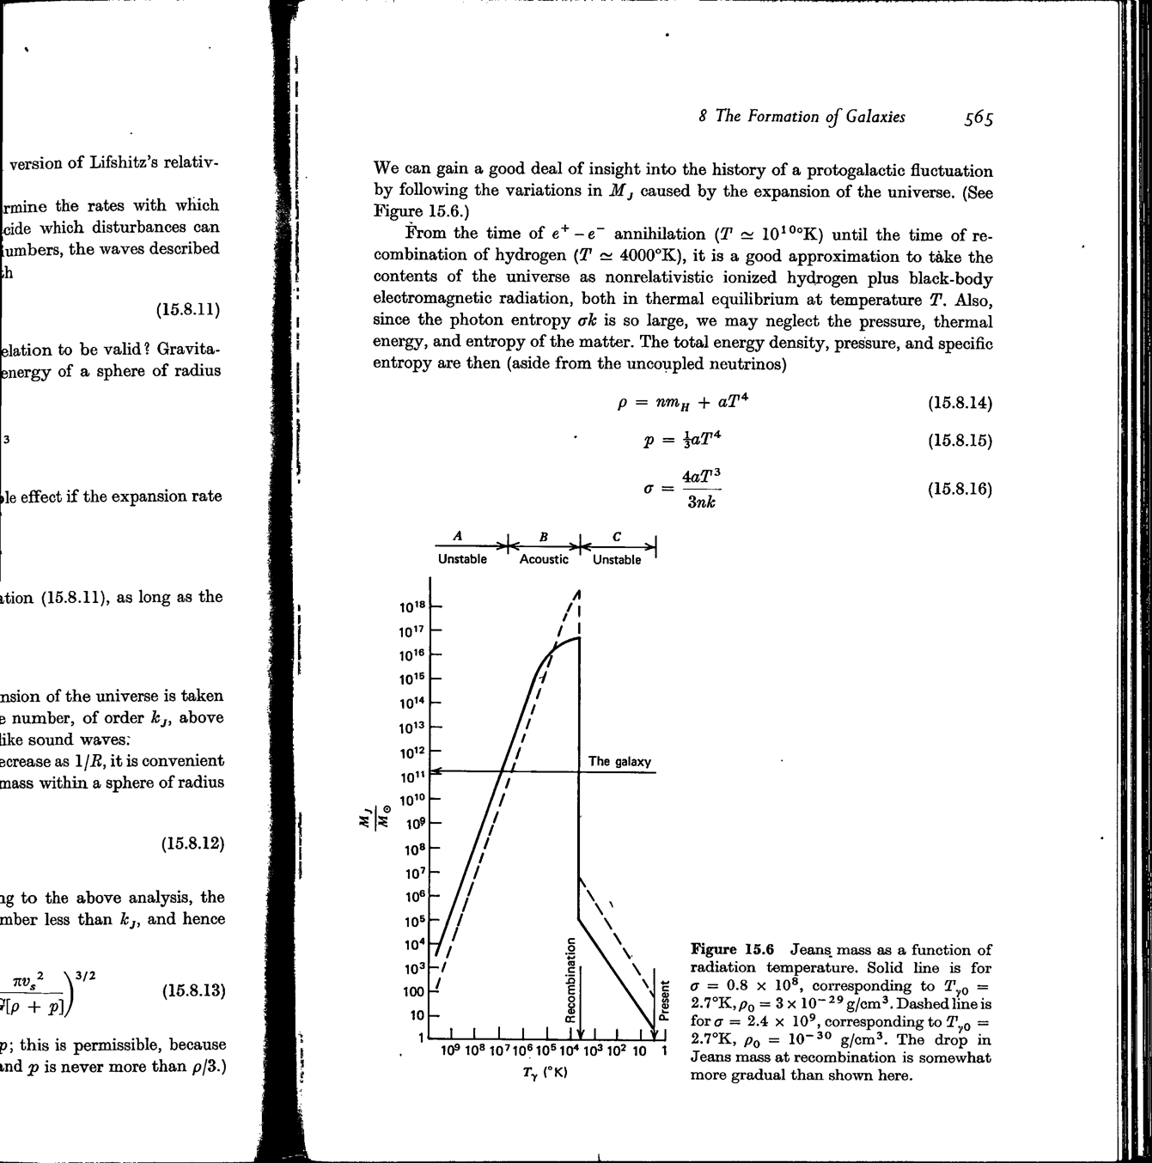

Slide 40
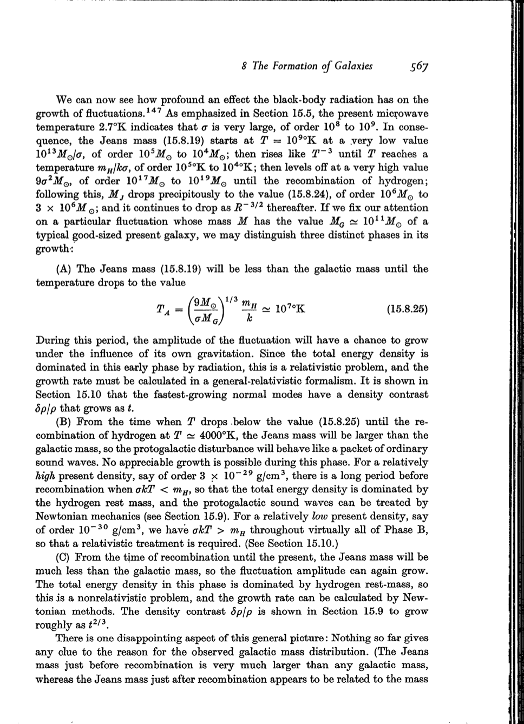

Slide 41
III. Gravitational Instability in Cosmology; Galaxy Formation
12. GRAVITATIONAL INSTABILITY IN THE GENERAL THEORY OF RELATIVITY
12.1 General Principles and Equations
12.2 Classification of the Perturbations
12.3 Scalar Perturbations with Free Particles
12.4 Vector (Rotational) Perturbations
12.5 Tensor Perturbations and Gravitational Waves
12.6 Entropy Perturbations in Relativistic Theory
12.7 The Quasi-Isotropic Solution and the Hypothesis of a Uniform Distribution of Perturbations
12.8 Long-Wavelength Perturbations and Their Representation in Terms of Spherical Waves

Slide 42
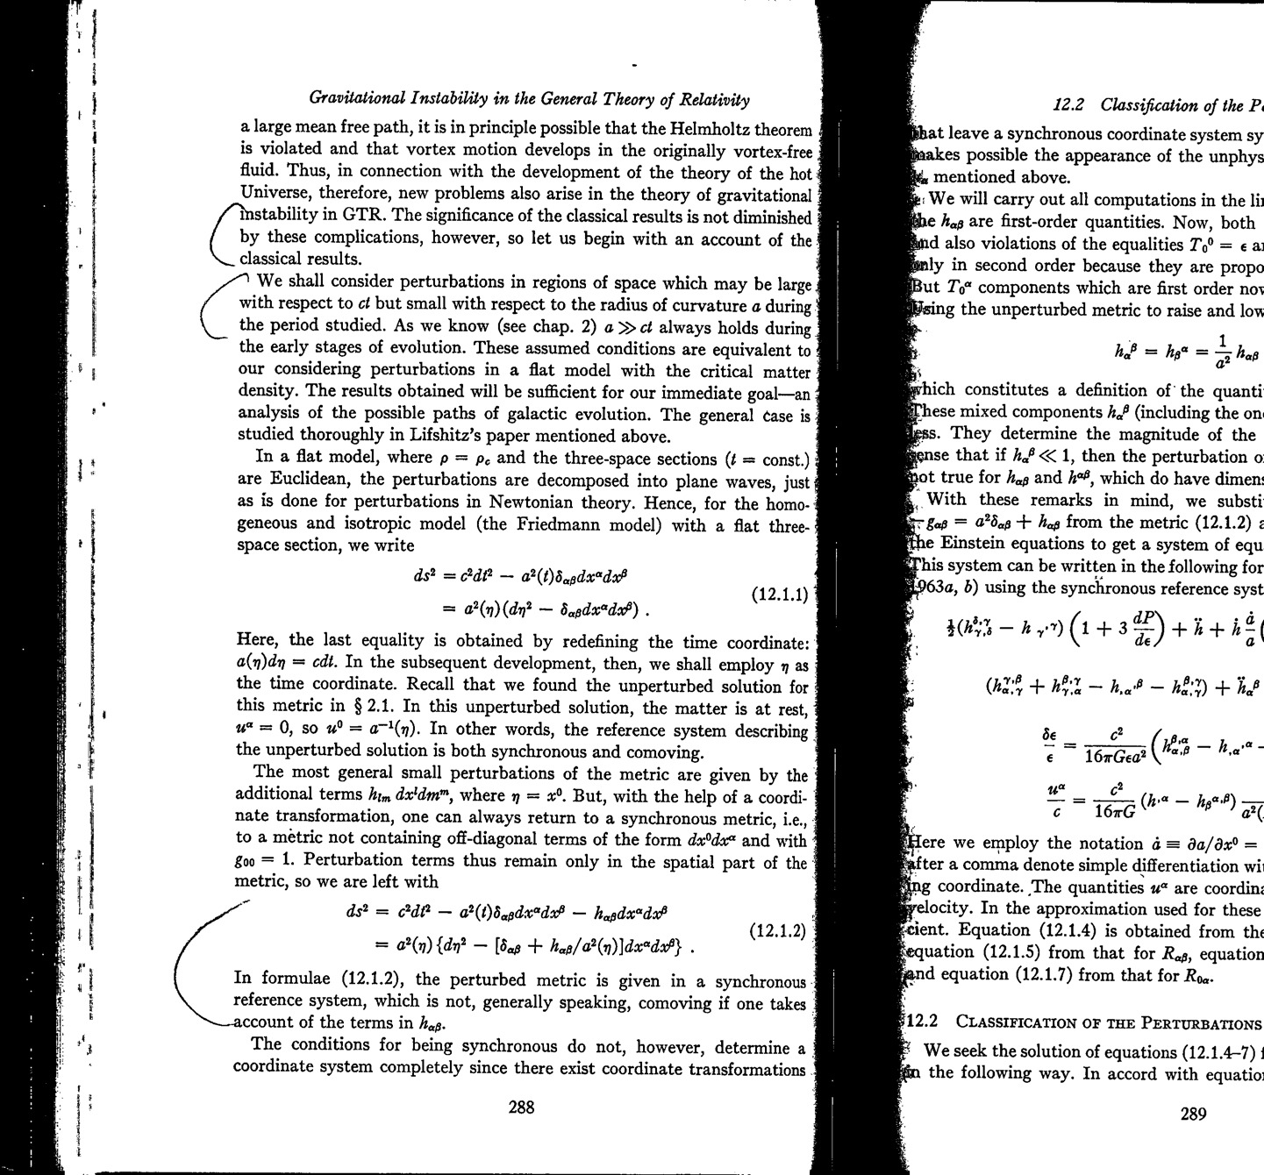

Slide 43
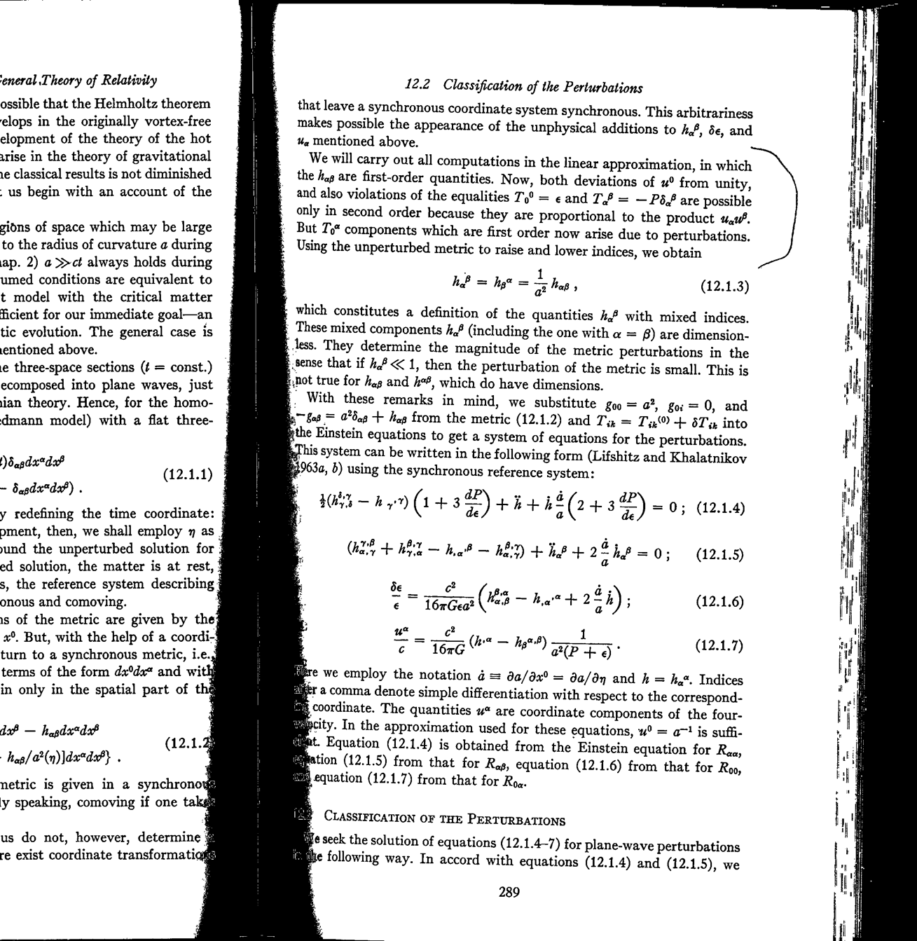

Slide 44
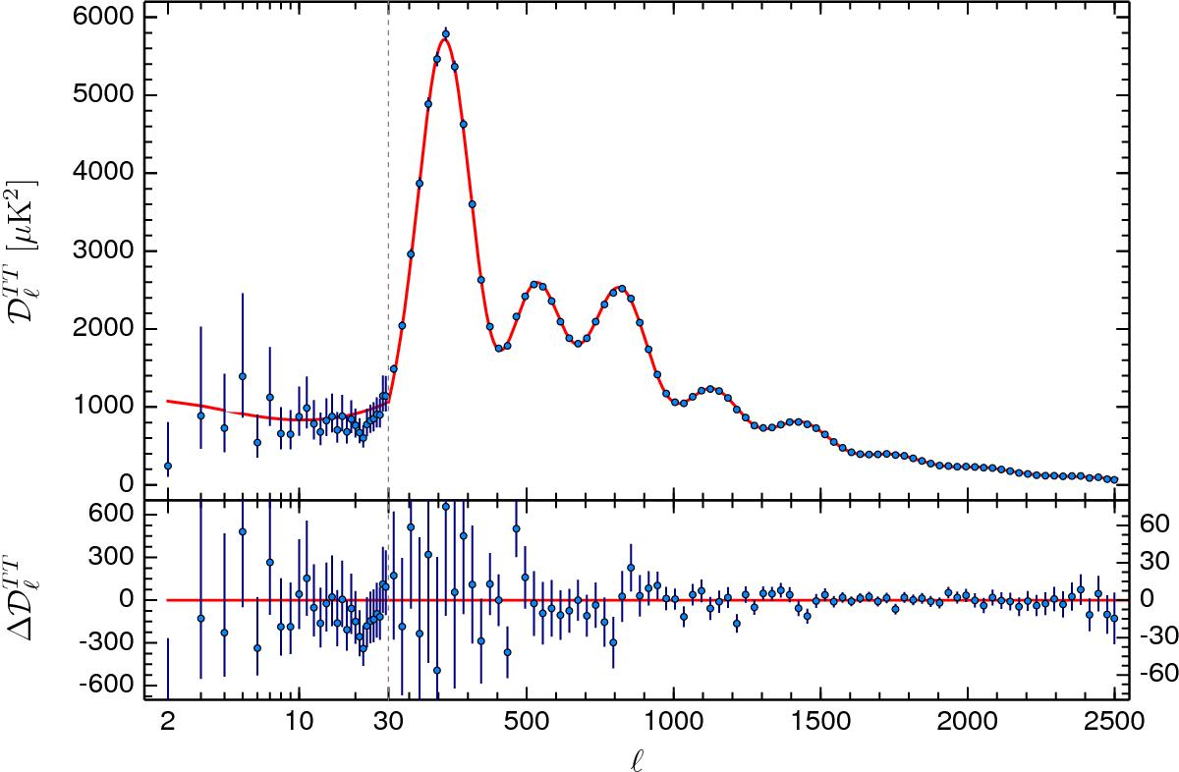
Click to view fullscreen

Slide 45
III. Gravitational Instability in Cosmology; Galaxy Formation
13. STATISTICAL THEORY
13.1 Randomness and Fourier Analysis
13.2 The Correlation Function and the Sizes of Self-Gravitating Objects
13.3 Deviations from the Average Density in a Given Volume
13.4 The Limitations and Complexity of the Linear Theory

Slide 46
III. Gravitational Instability in Cosmology; Galaxy Formation
14. THE NONLINEAR THEORY OF PERTURBATIONS AND THERMAL INSTABILITY
14.1 Perturbations in a Matter-Domionated Model; Problems Admitting Exact Solutions
14.2 Perturbations in a Matter-Dominated Model; an Approximate Analysis of a General Asymmetric Case (the “Pancake” Model)
14.3 Nonlinear Spectral Theory
14.4 The Emergence of Long-Wavelength Perturbations from a Gas of Stars or Star Clusters
14.5 Thermal Instability and the Separation of a Homogeneous Gas into Phases
Appendix to Section 14.2

Slide 47
Lagrangian and Eulerian Descriptions
In classical field theories, the Lagrangian specification of the flow field is a way of looking at fluid motion where the observer follows an individual fluid parcel as it moves through space and time.^{[1][2]} Plotting the position of an individual parcel through time gives the pathline of the parcel. This can be visualized as sitting in a boat and drifting down a river.
The Eulerian specification of the flow field is a way of looking at fluid motion that focuses on specific locations in the space through which the fluid flows as time passes.^{[1][2]} This can be visualized by sitting on the bank of a river and watching the water pass the fixed location.
—From Wikipedia
I

Slide 48
III. Gravitational Instability in Cosmology; Galaxy Formation
15. THEORIES OF GALAXY FORMATION
15.1 Introduction
15.2 Adiabatic Perturbations: Prerequisites
15.3 Shock Wavesy
15.4 Thermal Processes in the Compressed Gas
15.5 Cluster Masses and Protocluster Fragmentation
15.6 Galaxy Rotation
15.7 Galactic Magnetic Fields
15.8 The Theory of Entropy Perturbations
Mathematical Appendix to Section 15.9

Slide 49
III. Gravitational Instability in Cosmology; Galaxy Formation
15. THEORIES OF GALAXY FORMATION (continued)
15.9 The Vortex Theory
15.10 A Comparison of the Evolutionary Theories of Galaxy Formation
15.11 Observational Data Concerning the Properties of Galaxies and Galaxy Clusters; the Average Density of Matter in the Universey
15.12 Astrophysical Consequences of the Existence of a Heavy Neutral Lepton
Mathematical Appendix to Section 15.9

Slide 50
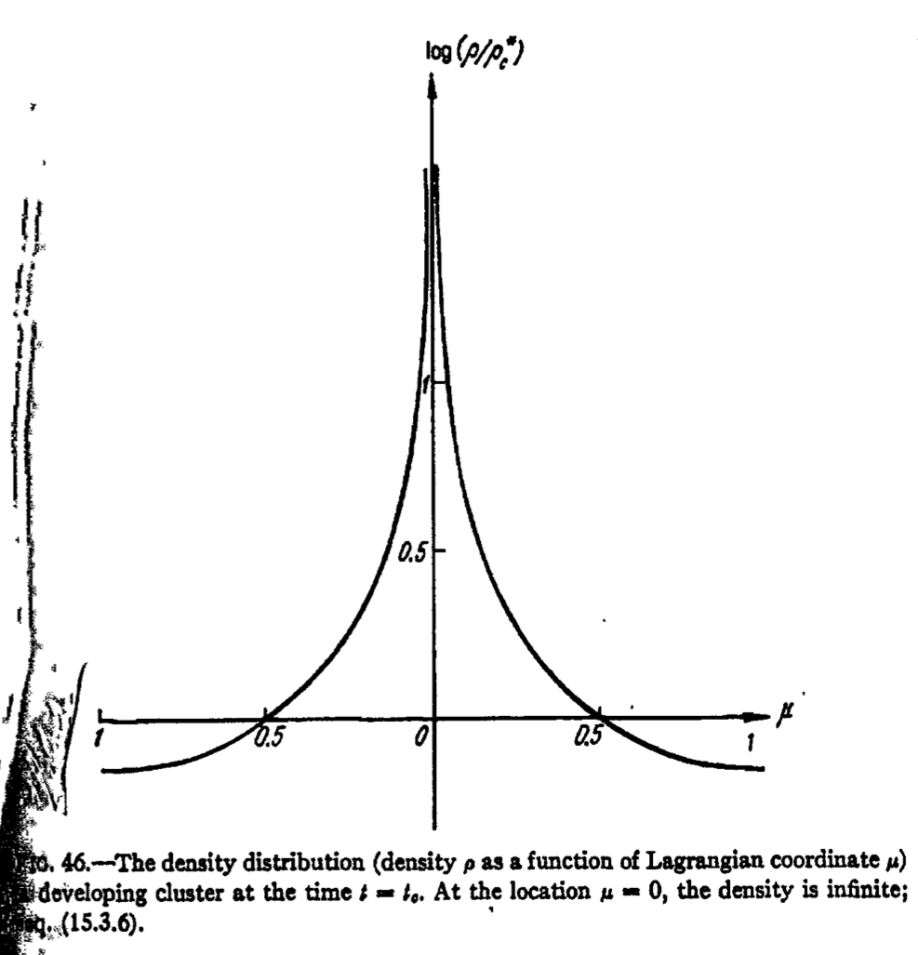

Slide 51
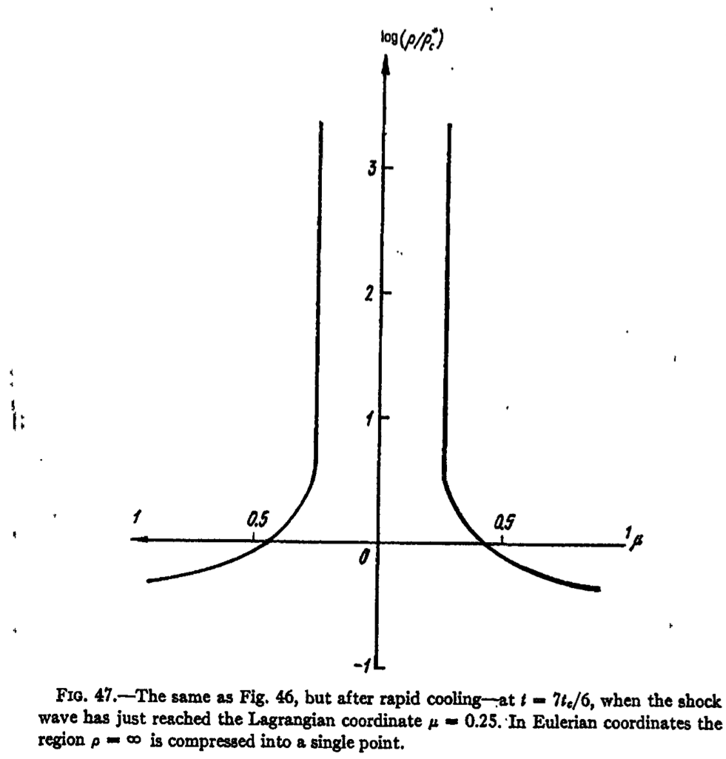

Slide 52
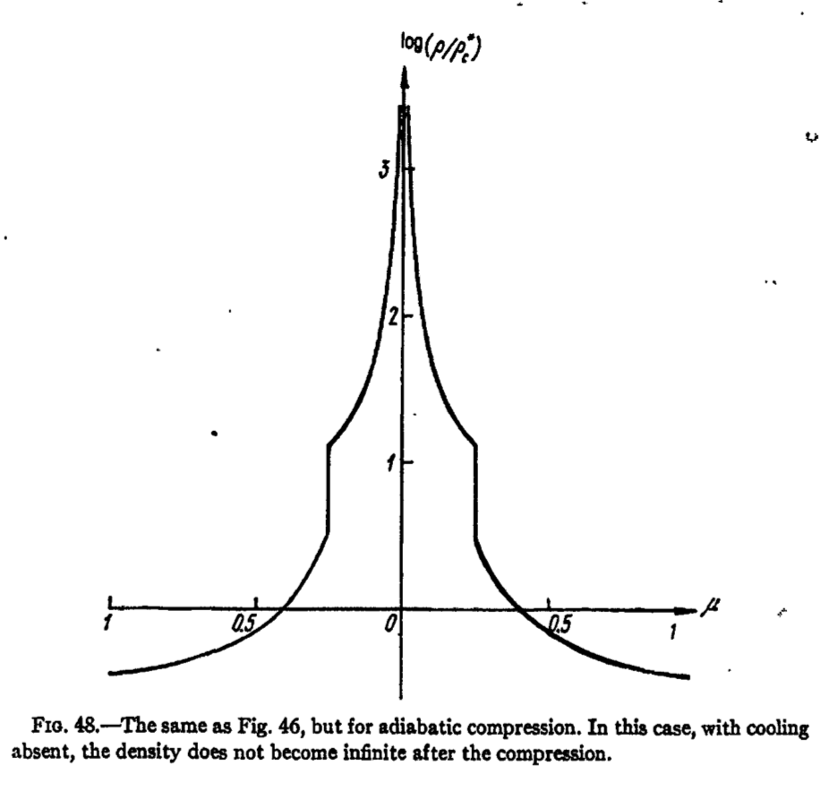

Slide 53
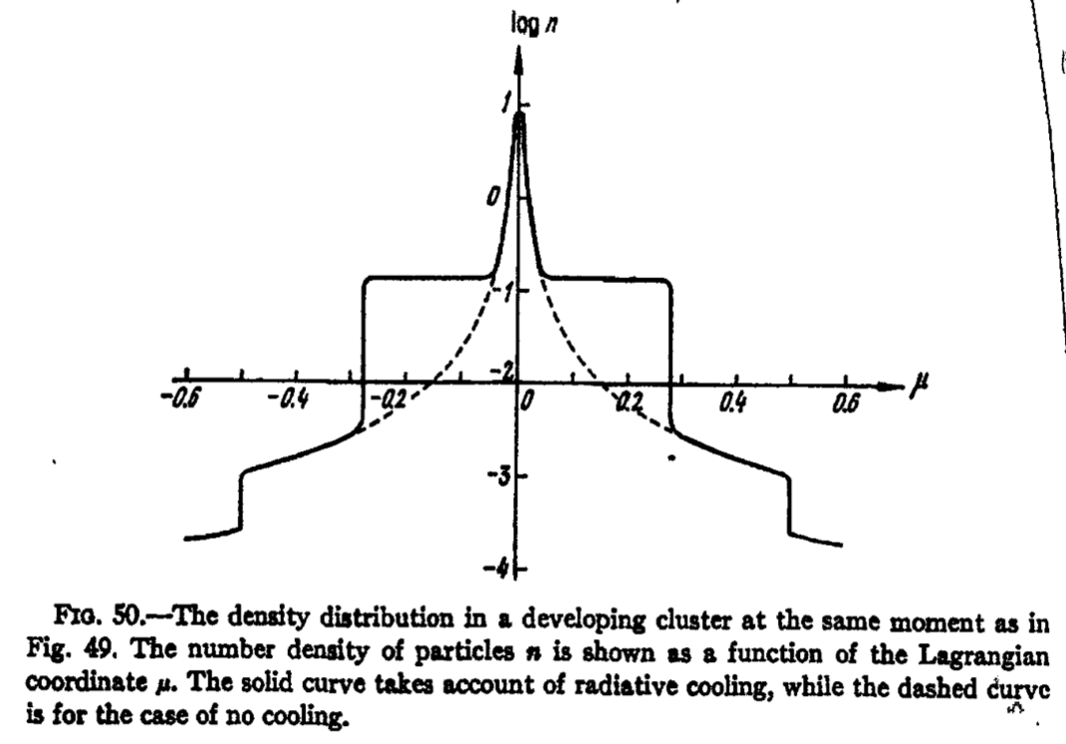

Slide 54
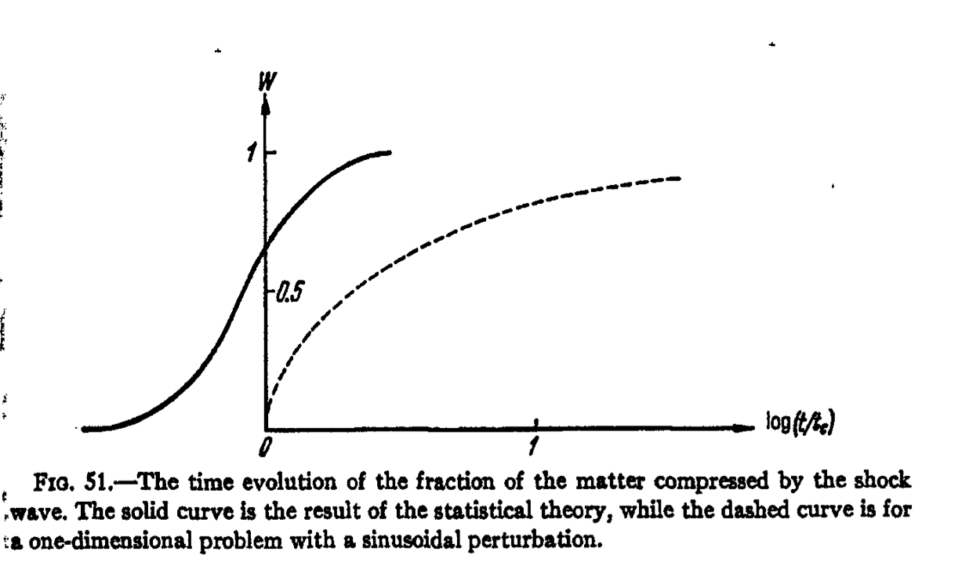

Slide 55
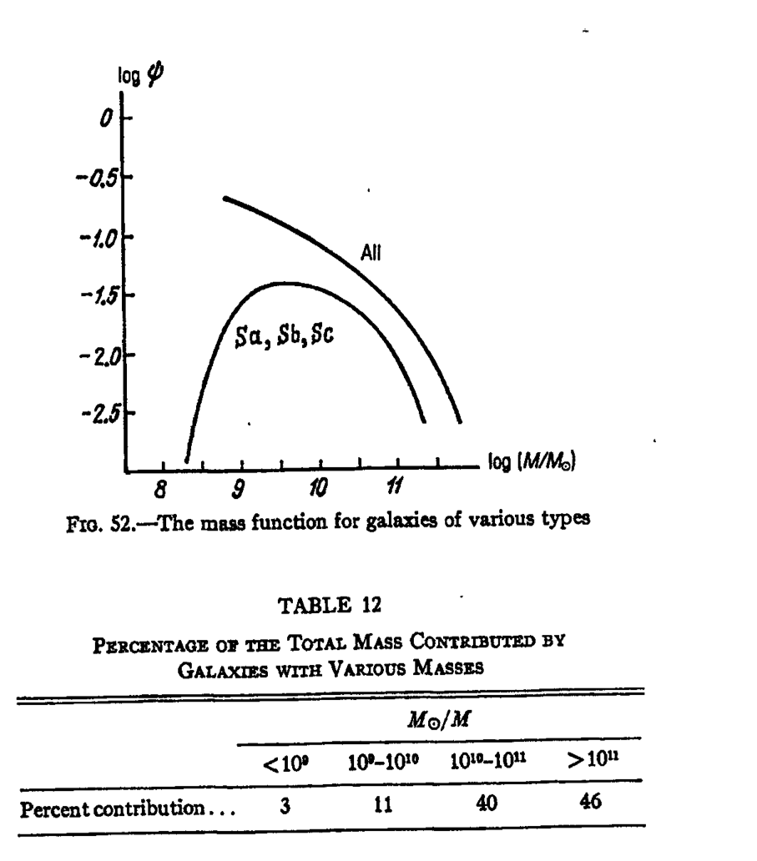

Slide 57
III. Gravitational Instability in Cosmology; Galaxy Formation
16. RESEARCH ON PERTURBATIONS USING THE RELIC RADIATION
16.1 Introduction
16.2 Antimatter Annihilation
16.3 Adiabatic Perturbations, Acoustic Oscilations, and Their Effect on the Relic Radiation Spectrumy
16.4 Perturbations of the Spatial Homogeneity and Isotropy of the Relic Radiation
16.5 The Detection of Density Perturbations Using the Relic Radiation
16.6 The Perturbation Spectrum and the Low-Density, Hyperbolic Model
16.7 The Angular Distribution of the Relic Radiation Fluctuations

Slide 58
III. Gravitational Instability in Cosmology; Galaxy Formation
17. GRAVITATION WAVES IN COSMOLOGY
17.1 Introduction
17.2 General Information about Gravitational Waves
17.3 Gravitational Waves in the Theory of Small Perturbations of a Cosmological Modely
17.4 The Expected Intensity of Relic, Short-Wavelength Gravitational Radiation
17.5 The Equipartition Theorem and Long-Wavelength Gravitational Radiation
17.6 The Generation of Gravitational Waves in the Present Epoch
17.7 The Angular Distribution of the Relic Radiation Fluctuations
17.8 The Peculiar Motion Induced by Gravitational Waves
17.9 The Interconversion of Gravitational and Electromagnetic Waves

Slide 59
IV. Anisotropic Cosmology
18. INTRODUCTION TO PART IV
19. VERY SIMPLE ANISOTROPIC COSMOLOGICAL MODELS
20. MATTER IN AN ANISOTROPIC COSMOLOGICAL MODEL
21. THE PHYSICS OF PROCESSES DURING THE EARLY STAGES OF EXPANSION IN ANISOTROPIC MODELS
22. A GENERAL ANALYSIS OF HOMOGENEOUS COSMOLOGICAL MODELS

Slide 60
IV. Anisotropic Cosmology
18. INTRODUCTION TO PART IV
19. VERY SIMPLE ANISOTROPIC COSMOLOGICAL MODELS
19.1 The Newtonian Theory of a Very Simple Homogeneous, Anisotropic (HA) Model as the Limiting Case of a Local Problem
19.2 A Paradox Involving Newtonian Gravitational Theory
19.3 A Simple Reltivistic Model: the “Vacuum” Solution Near a Singularity
19.4 A Comparison of the Newtonian and Relativisitc Problems

Slide 61
IV. Anisotropic Cosmology
20. MATTER IN AN ANISOTROPIC COSMOLOGICAL MODEL
20.1 Isotropization of a Model with a Stress-Energy Tensor of the Pascal Form
20.2 The Effect of a Spatially Anisotropic Stress-Energy Tensor on a Cosmological Model
20.3 Cosmological Models with a Homogeneous Magnetic Field
20.4 Perturbations in a Homogeneous, Anisotropic (HA) Universe
20.5 The Instability of the Cosmological Models with Respect to the Emergence of Overall Matter Motions

Slide 62
IV. Anisotropic Cosmology
21. THE PHYSICS OF PROCESSES DURING THE EARLY STAGES OF EXPANSION IN ANISOTROPIC MODELS
21.1 Weakly Interacting Particles in an Anisotropic Cosmological Model
21.2 Neutrinos in an Anisotropic Model
21.3 The Effect of Viscosity on the Expansion of Anisotropic Models
21.4 The Kinetic Theory of Neutrinos in an Anisotropic Model; the Self-Similar Solution
21.5 Primordial Nucleosynthesis in Anisotropic Models

Slide 63
IV. Anisotropic Cosmology
22. A GENERAL ANALYSIS OF HOMOGENEOUS COSMOLOGICAL MODELS
22.1 The Concept Of The Homogeneity of a Cosmological Model
22.2 A Differential Criterion for Homogeneity
22.3 The Dynamical Properties of Homogeneous Models Near a Singularity
22.4 The “Mixmaster” Model
22.5 On the Impossibility of Mixing in the Mixmaster Model
22.6 Quantum Limitations on the Mixmaster Model

Slide 64
IV. Anisotropic Cosmology
22. A GENERAL ANALYSIS OF HOMOGENEOUS COSMOLOGICAL MODELS (continued)
22.7 The Isotropization of Homogeneous Cosmological Models in the Course of Expansion
22.8 The Anisotropy of the Relic Radiation (RR) in Bianchi Type I Models with the Critical Matter Density
22.9 The Expected Anisotropy of the Relic Radiation (RR) in Homogeneous, Anisotropic (HA) Models with a Curved Three-Dimensional Space

Slide 65
V. The Singularity and New Theoretical Developments
23. THE COSMOLOGICAL SINGULARITY
24. PHYSICAL PROCESSES NEAR A SINGULARITY AND DEVELOPMENTS IN THE THEORY OF GRAVITATION

Slide 66
V. The Singularity and New Theoretical Developments
23. THE COSMOLOGICAL SINGULARITY
23.1 Introduction
23.2 The Singularity at the Beginning of the Expansion
23.3 The General Cosmological Solution with a Singularity

Slide 67
V. The Singularity and New Theoretical Developments
24. PHYSICAL PROCESSES NEAR A SINGULARITY AND DEVELOPMENTS IN THE THEORY OF GRAVITATION
24.1 Introduction
24.2 Cosmological Consequences of Hagedorn's Theory
24.3 Quantium Phenomena That Take Place near Singular States of a Metric and in Strong Gravitational Fields
24.4 The Creation of Charged Particles in Electrodynamics
24.5 The Mathematical Theory of Particle Creation
24.6 Superspace and Mini-Superspace
24.7 The Hypothesis of Baryon Nonconservation and the Charge Asymmetry of the Elementary Particles

Slide 68
V. The Singularity and New Theoretical Developments
24. PHYSICAL PROCESSES NEAR A SINGULARITY AND DEVELOPMENTS IN THE THEORY OF GRAVITATION (continued)
24.8 The Cold Universe and the Perturbation Spectrum
24.9 The Steady-State Theory of the Universe
24.10 Mach's Principle and the Coincidences among Large Numbers Occurring in Physics and Cosmology
24.11 The General Theory of Relativity (GTR) and the Topological Structure of the Universe
24.12 Local Topology, White Holes, Black Holes, and Cosmology
24.13 Statistical Phyusics and Gravitation
24.14 The Brans-Dicke Theory of Gravitation (BDT) and its Cosmological Consequences

Slide 69
V. The Singularity and New Theoretical Developments
24. PHYSICAL PROCESSES NEAR A SINGULARITY AND DEVELOPMENTS IN THE THEORY OF GRAVITATION (continued)
24.15 Cosmology and New Hypotheses in Field Theory
24.16 An Oscillating Universe?
24.17 The Creation of Gravitons near the Singularity
24.18 The Singularity and Conformal Invariance
24.19 The Direction of Time

Slide 70
V. The Singularity and New Theoretical Developments
24. PHYSICAL PROCESSES NEAR A SINGULARITY AND DEVELOPMENTS IN THE THEORY OF GRAVITATION (continued)
24.15 Cosmology and New Hypotheses in Field Theory
24.16 An Oscillating Universe?
24.17 The Creation of Gravitons near the Singularity
24.18 The Singularity and Conformal Invariance
24.19 The Direction of Time

Slide 71
Other References for This Presentation
Wikipedia
Weinberg
Planck results

