Slide 1
Collider-Accelerator Department Machine Advisory Committee
Wolfram Fischer Deputy Associate Laboratory Director for Accelerators, NPP Chair, C-AD
C-AD Machine Advisory Committee
13 December 2022
Notes:
15 min => 10 slides

Slide 2
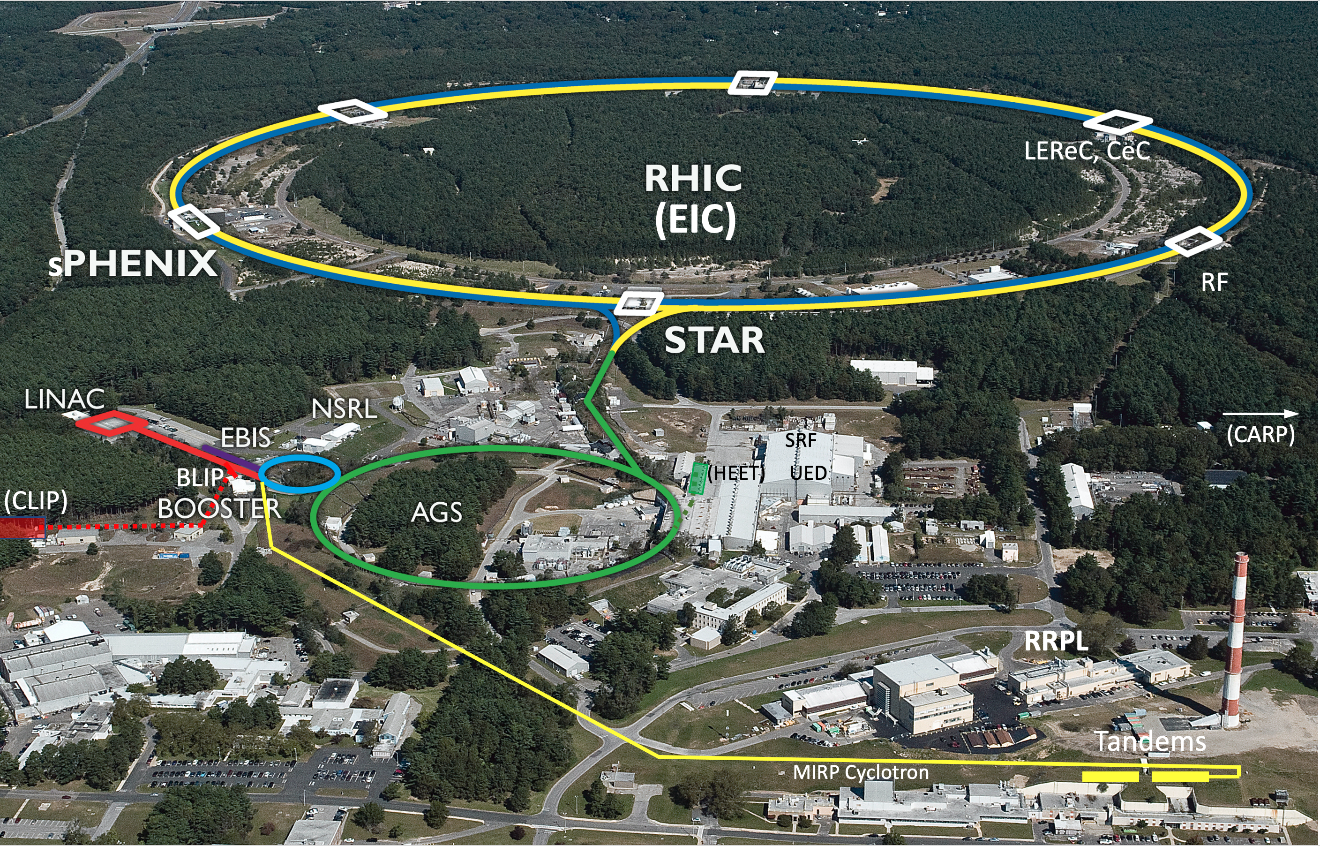
Collider-Accelerator Department facilities
Uniquely flexible and only hadron collider in US for exploration of QCD phase diagram and proton spin
Injectors also used for application programs: - Linac/BLIP for isotope production - Booster/NSRL for space radiation studies
- Tandem for industrial/academic users
R&D for future facilities and application sources, cooling, pol. beams, …

Slide 3
Collider-Accelerator Department
Mission: Design, develop, commission and operate state-of-the-art accelerators to carry out accelerator-based experiments in an environmentally responsible and safe manner. Perform accelerator R&D towards the next generation of accelerator facilities and accelerator applications in support of national needs.
FY2022: 402 head, 361 FTE (282 RHIC)
Significant legacy infrastructure issues (AGS started operation in 1960) are being addressed through continuous renovation and replacement of obsolete equipment.

Slide 4
Accelerator Readiness Reviews
Major effort for department. At one point C-AD was working on 5 ARR simultaneously.
All legacy accelerators must undergo Accelerator Readiness Reviews
Isotope Program also requires ARRs, frequent target reviews
ARR Tandem November 2022 – done
ARR AP Hot Cell December 2022 – done
USI sPHENIX sc magnet (IRR w/ external) March 2023
ARR MIRP Cyclotron FY 2023
ARR ATF (in ATRO, assisting) November 2023
ARR Linac+Booster November 2024
ARR AGS September 2026
… then need to get ready for EIC ARRs

Slide 5
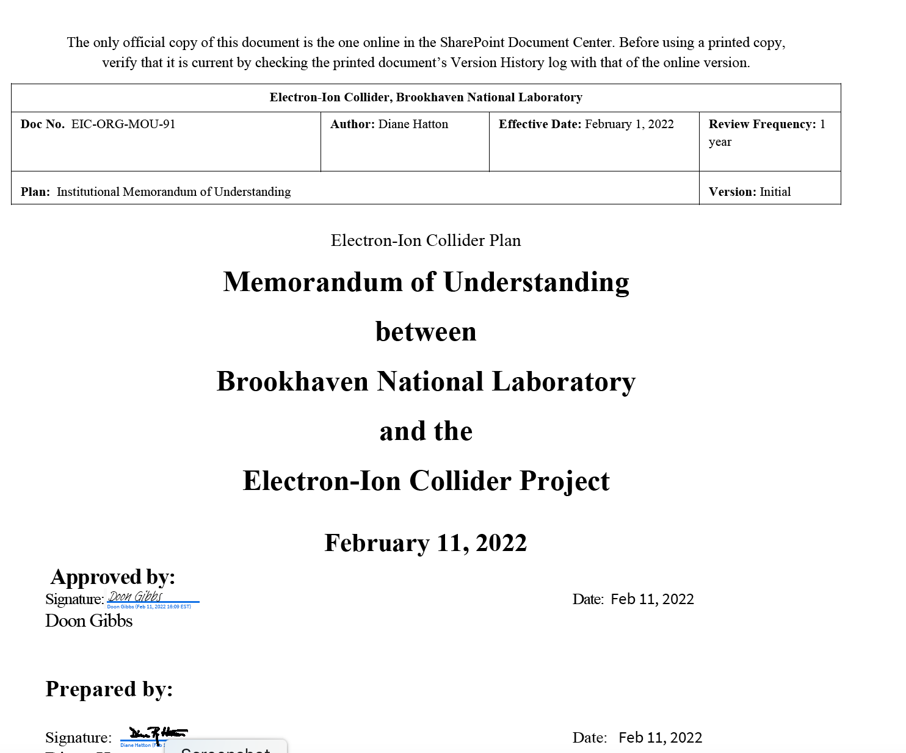
C-AD and EIC
EIC Project has staff at BNL and JLab EIC Directorate at BNL separate from NPP
C-AD staff use for EIC in 3 forms:
Staff transfer
Matrixed staff with individual or group MOUs (>20%, ~70 people)
FY2021 – 17 FTE in C-AD on EIC
FY2022 – 15 FTE in C-AD on EIC
also have reversed MOU
EIC scope execution in C-AD with C-AD staff
C-AD MAC does not review EIC project topics

Slide 6
MAC-19

Slide 7
C-AD MAC
3 more RHIC Runs planned
Then start of EIC construction planned
R&D focus on
Source development
Hadron beam cooling
Polarized beams
Application programs
Isotope production
Space radiation studies

Slide 8
Committee Members (4-year terms)
Andrei Seryi, JLab (2023) – Chair
Tadashi Koseki, KEK (2023) – excused
Richard Scrivens, CERN (2023)
Andreas Lehrach, RWTH Aachen (2026)
Uli Wienands, ANL (2026)
Sasha Valishev, Fermilab (2026)

Slide 9
Charge
The Collider-Accelerator Department (C-AD) is preparing for the 3 more years of running with the new sPHENIX detector and STAR. After completion of the RHIC program there will be transitions to Electron Ion Collider (EIC) construction, commissioning, and operation.
During this year’s MAC we request the committee’s review and advice on (i) the operation with sPHENIX and (ii) the presented R&D initiative.
For each item, please address the following charge questions:
Are the technical goals realistic and is the progress appropriate to meet the stated goals?
Are there any technical issues that were missed and/or need additional attention by the team?
Is the accelerator R&D effort well executed and future work well planned?
Any other comments on the C-AD accelerator operation and R&D are welcome.
It is requested that a concise report responsive to this charge be forwarded to the C-AD Chair, Wolfram Fischer, by 23 December 2022.

Slide 10
Recommendations from MAC-18
R1: Perform an assessment of components and spares needed to continue running in the EIC era.
Ongoing effort as part of the 25-year plan. Have annual review.
R2: Further evaluate the possible beam loss mechanisms that are caused by instabilities or other phenomena which occur faster than the present reaction time and for which the upgraded MPS is presently blind. Continue studies of compatibility of the MPS upgrade for EIC operations and make a detailed presentation at the next MAC, together with possible alternatives.
Present status of MPS in talk by Matthieu Valette. EIC is investigating use of solid-state switches, in locations removed from beam.
R3: Since the time for cooling experiments in 2022 and 2023 may be limited, prioritize the variety of planned cooling experiments based on the needs of the EIC precooler and high-energy cooler designs, while aiming to avoid possible loss of time due to potential gun damage in high current studies.
For CeC and LEReC plans see presentations by Vladimir Litvinenko and Alexei Fedotov. No dedicated CeC time in Run-23, need to demonstrate better system stability. Can use APEX time (16 h every other week).

Slide 11
Recommendations from MAC-18
R4 (pol He-3): The resources required for completing the R&D should be confirmed and made available.
Polarized He-3 source update in presentation by Ed Beebe.
R5 (high-current SRF gun): Develop the overall plan, including schedule and goals for the high current and polarized beam R&D project.
This work has been given lower priority relative to CeC. It requires hardware changes that would create a risk for CeC.
R6 (CLIP p accelerator): Continue working on the separate proposals for the proton and ion parts. Clarify beam requirements by the isotope program. Analyze the presented options including approximate cost analysis and select the most feasible.
Work on CLIP continues. Cost estimate for both ion and proton accelerators done, working on civil construction, target, hot cell. CDR progressing for target and civil construction. Last year the Isotope Program’s focus was on 2 ARRs for the AP Hot Cells and the MIRP Cyclotron, still to be completed.

Slide 12
Recommendations from MAC-18
R7 (CLIP Ion): Complete the conceptual design, concentrating more on feasibility than optimization. Identify stages for the project and develop a schedule and budget for each phase.
Work on CLIP continues. Cost estimate for both ion and proton accelerators done, working on civil construction, target, hot cell. CDR progressing for target and civil construction. Last year the Isotope Program’s focus was on 2 ARRs for the AP Hot Cells and the MIRP Cyclotron, still to be completed.
R8 (Li ECRIS): Clarify the timeline for development of a source and the resources needed. Clarify the criticality of a Li beam to the CLIP program, and if low intensities are of use in a staged development.
Work on CLIP continues. Cost estimate for both ion and proton accelerators done, working on civil construction, target, hot cell. CDR progressing for target and civil construction. Last year the Isotope Program’s focus was on 2 ARRs for the AP Hot Cells and the MIRP Cyclotron, still to be completed.
R9 (HEET): Continue to pursue effective methods to improve the spill structure for slow extraction of low intensity beams.
In 2022 the HEET did not receive funding to pursue this question. However, in 2023 we will receive design study funds and will begin looking more carefully at the spill structure correction methods to include into the refined design and cost estimate. In addition, in November 2022 a new postdoc, Bhawin Dhital, joined the department, supported by the NASA program. He will focus on improving the NSRL beam quality including the spill.

