Slide 1
RHIC Performance Update
Michiko Minty
Associate Chair for Accelerators and Applications
Accelerator Division Head
December 13, 2022

Slide 2
Contents
Recent RHIC Run Performance
Beam Energy Scan program (BES-II during RHIC Run-19 through Run-21)
RHIC Run-22: last full energy p↑+p↑ run prior to EIC construction
RHIC Run-23 to Run-25
RHIC 25 year upgrade plan and cryo upgrade for the EIC
Response to recommendation from C-AD MAC 2021
Summary
2
M. Minty, CAD MAC – Dec 2022

Slide 3
Recent RHIC Run Performance
M. Minty, CAD MAC – Dec 2022

Slide 4
Beam Energy Scan (BES) Program
BES-I: 2010 - 2011, 2014
BES-II: 2018 - 2020
From 2015 NSAC Long Range Plan for Nuclear Science
4
M. Minty, CAD MAC – Dec 2022
Notes:
Picture from 2015 NSAC long-range plan

Slide 5
Principle Investigator
Alexei Fedotov
Low Energy RHIC electron Cooling (LEReC)
704 MHz Cu Deflector Cavity
704 MHz SRF
Booster Cavity
Cathode
loading system
RF Diagnostic Beamline
Transport
Beamline
Technologies
Merger
Beamline
Injection beam dump
2.1 GHz Cu Cavity
DC gun
high QE cathodes
high-power fiber laser
5 RF systems, including one SRF
machine protection
many magnets
instrumentation
100 meters of beamlines
704 MHz Cu Cavity
9 MHz Cu Cavity
COOLING
in Yellow RHIC ring
e⁻
e⁻
e⁻
RHIC TRIPLET
RHIC DX
DC e⁻ Gun
COOLING
in Blue RHIC ring
LF solenoid
HF solenoid
Transport solenoid
Quad corrector
Trim corrector
Corrector 3.8 ID
Corrector 6.0 ID
BPM 2.4 ID
BPM 4.8 ID
Bellows
Ion pump
180°
Bending
Magnet
Extraction beam line
High-Power Beam Dump
* NOT to scale
A. Fedotov et al, Experimental Demonstration of Hadron Beam Cooling Using Radio-Frequency Accelerated Electron Bunches, Physical Review Letters 124, 084801 (Feb 2020).
First operational electron cooling in a collider (Run-20)
Critical for lowest-energy RHIC program in Run-21
5
M. Minty, CAD MAC – Dec 2022

Slide 6
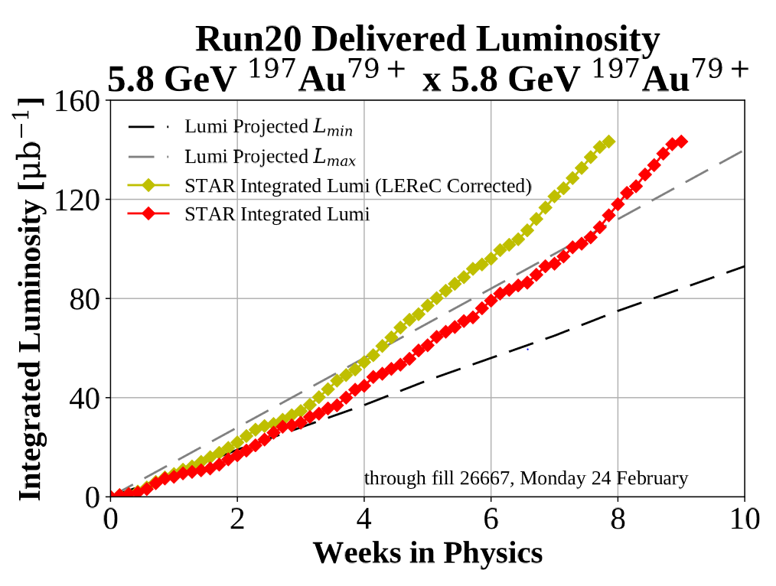
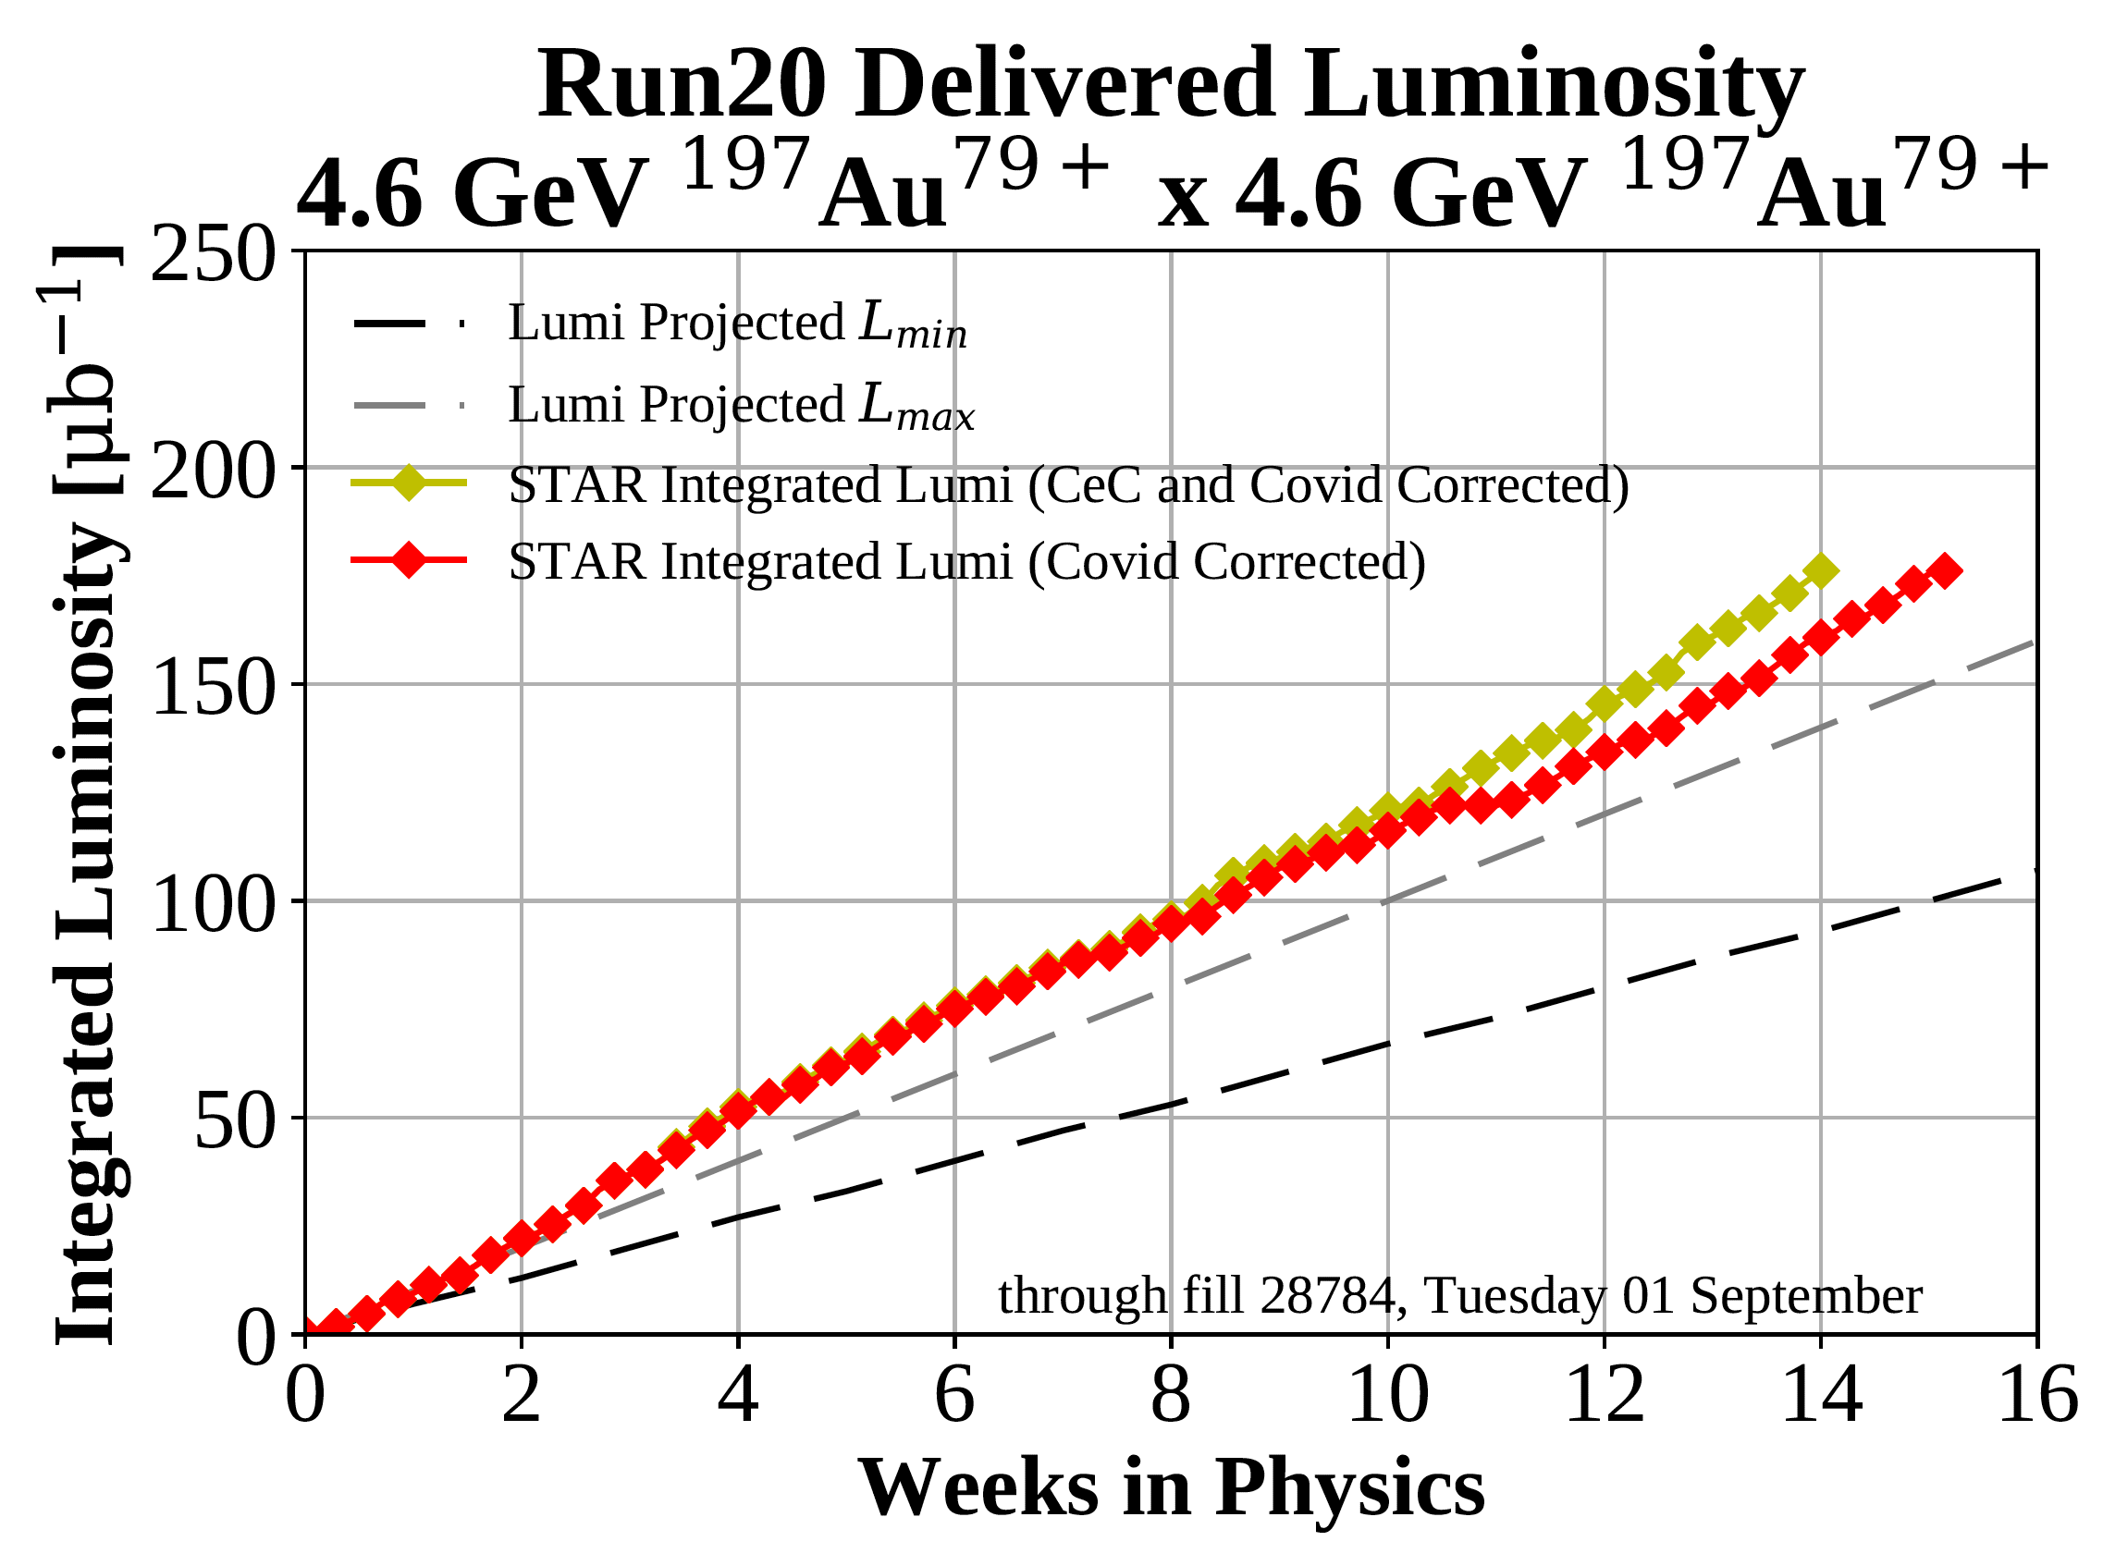
RHIC Run-20 – first operational use of LEReC
First demonstration of high-energy bunched-beam electron cooling
First application of electron cooling in a collider
Run Coordinator: Chuyu Liu (Run-19 to 21)
LEReC Principal Investigator: Alexei Fedotov
All Run-20 goals achieved or exceeded
M. Minty, CAD MAC – Dec 2022

Slide 7
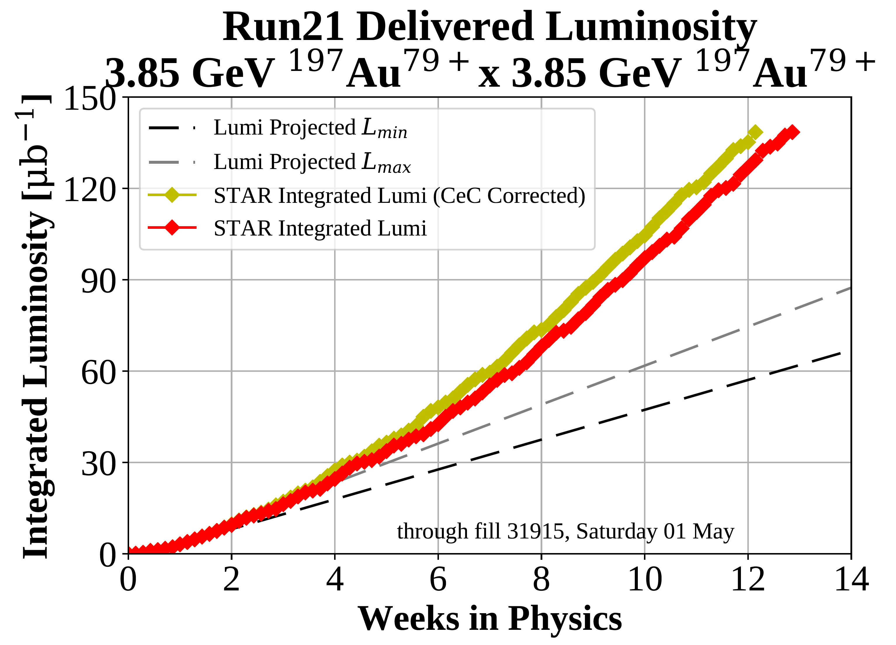
RHIC Run-21 – highest priority for BES-II
Run Coordinator: Chuyu Liu (Run-19 to 21)
LEReC Principal Investigator: Alexei Fedotov
Second year with low-energy electron cooler (LEReC)
Most difficult energy (~40% lower than nominal injection energy)
max projected
min projected
Highest priority Run-21 goal significantly exceeded
M. Minty, CAD MAC – Dec 2022

Slide 8
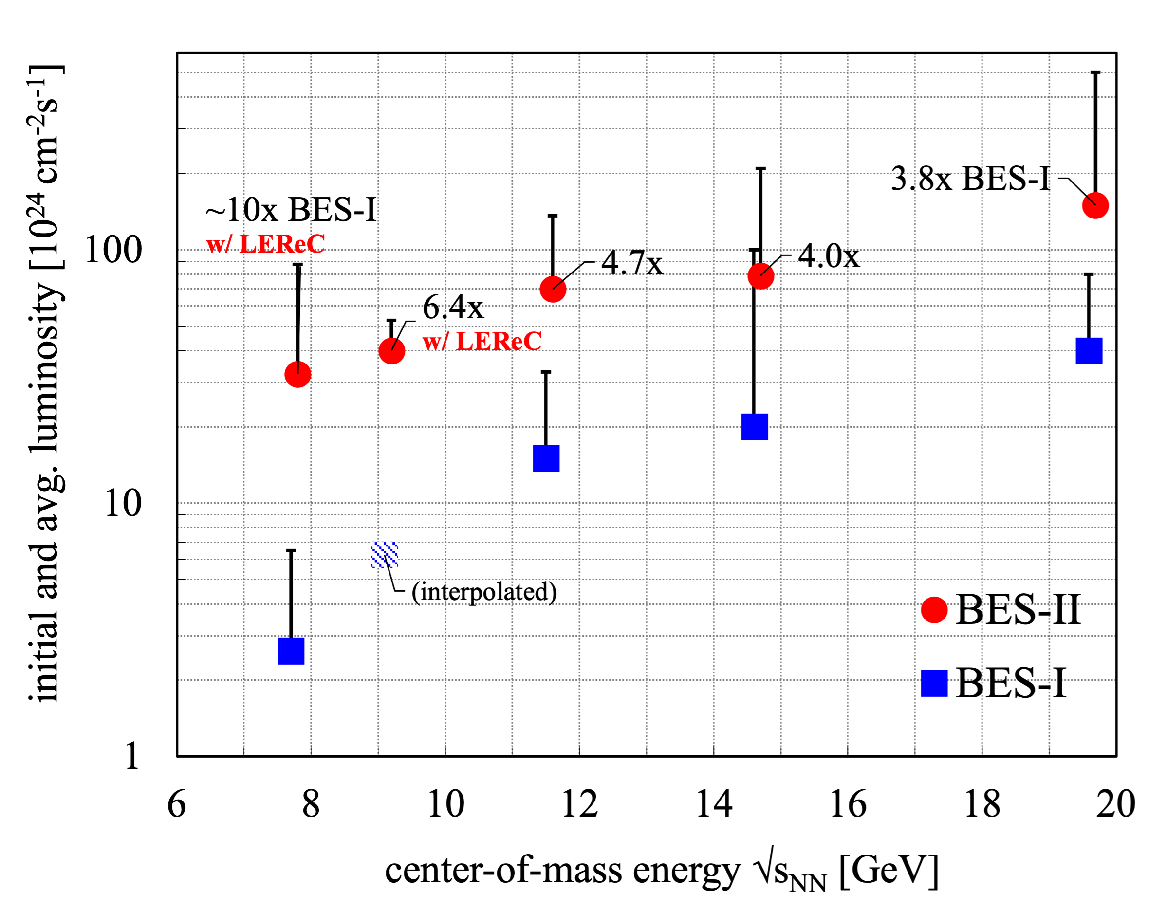
BES-I vs BES-II luminosity
3rd year
2nd year
1st year
Goal was L_{avg} (BES-II) = 4x L_{avg} (BES-I)
~10x BES-I
with LEReC
In BES-II
3.8 x L_{avg} (BES-I)
4.0 x L_{avg} (BES-I)
4.7 x L_{avg} (BES-I)
6.4 x L_{avg} (BES-I)
~10 x L_{avg} (BES-I)
1st year
2nd year
with LEReC
at lowest beam energies
3rd year
Successful completion of the multi-year BES program
M. Minty, CAD MAC – Dec 2022

Slide 9
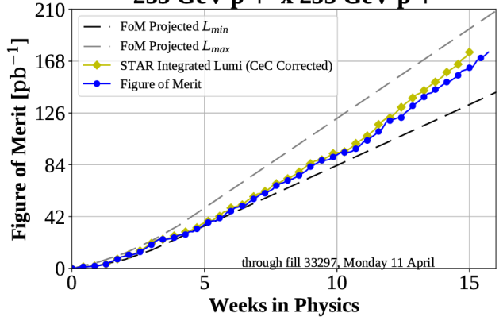
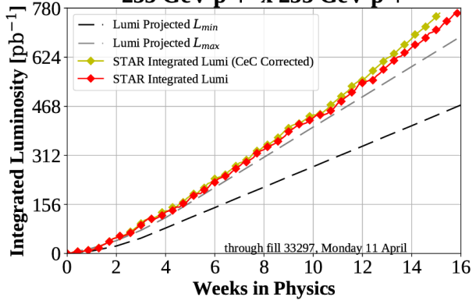
RHIC Run-22 – last full energy p↑+p↑ run at RHIC
Run coordinator: Vincent Schoefer
Run-22 delivered figure of merit
p↑+p↑ polarized proton collisions at 508 GeV c.o.m. with
new STAR forward detector upgrade
Schedule
final cooldown to 4K delayed by 13 days
14 day run extension granted by DOE Office of NP
(Unusual) run challenges
Run-22 delivered luminosity
two snake magnets damaged (power outage)
extended running with AGS Westinghouse motor generator
Performance summary
forward program: 107%, exceeding the goal
mid-rapidity: ~98%, achieving the goal
Successful completion of last full energy polarized proton run
M. Minty, CAD MAC – Dec 2022

Slide 10
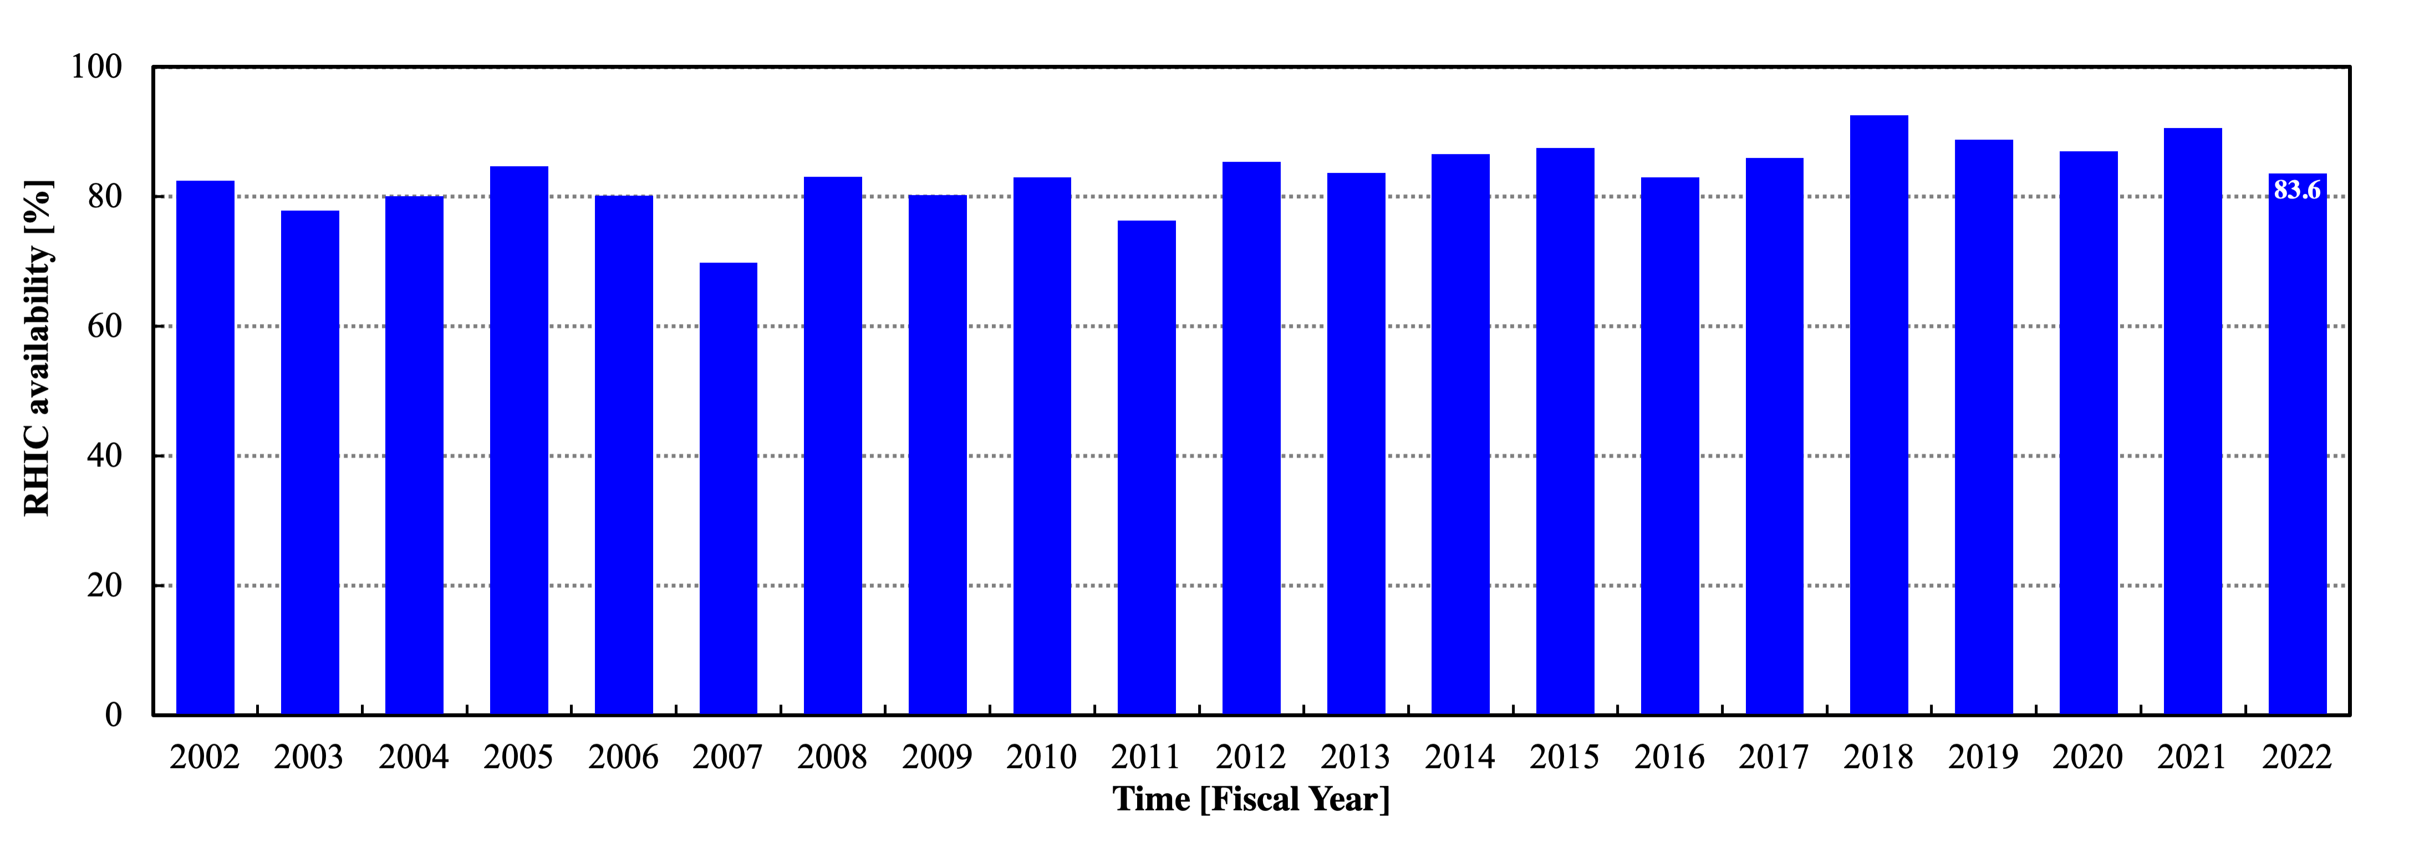
RHIC Availability
Au+Au
(BES-II)
low energy
p↑+p↑
courtesy C. Naylor
255 GeV
86.7% 10-year average
Availability = beam time / scheduled beam time (denominator excludes scheduled maintenance)
Availability goal: 85% (raised in FY20, from 82.5%)
>85% availability achieved averaged over last 10 years
M. Minty, CAD MAC – Dec 2022

Slide 11
RHIC runs 2023 - 2025
M. Minty, CAD MAC – Dec 2022

Slide 12
RHIC Run Scenarios 2023 – 2025
M. Minty, CAD MAC – Dec 2022

Slide 13
Reliability - operation during summer months
Concerns
Heat
Many support buildings not equipped to operate with sustained high temperatures
Many unique AC systems
Humidity
Reduced cooling tower efficiency, increased load on AC equipment
Condensation issues
Power
More frequent power dips and/or outages (storm related), possible brown-outs
Air Conditioning
Aging equipment, some obsolete controls and parts
Maintenance
ensure existing systems are operable at full capacity
verify existing AC spares inventory (9 portable units, 6 portable high-volume fans)
Mitigation
AC ductwork modifications
New procurements
spare AC systems for RHIC alcoves (5)
portable AC units for RHIC service buildings (6) for power supply quench detection racks
M. Minty, CAD MAC – Dec 2022

Slide 14
Reliability - injector complex
LINAC RF power amplifiers - continuing to maintain a 5-year inventory
Transitioned (completed in 2019) from person-based to group-based operational support by transfer of
responsibilities to C-AD support groups
LINAC / AGS Increased detail in shutdown schedule management lately as time available for maintenance becoming shorter with expanding user programs at MIRP (isotope production) and NSRL (NASA)
AGS Motor generators (MG) – Siemens MG and back-up Westinghouse MG with 40+ and 60+ years in operation, respectively: coordinating closely with new companies (TECO Westinghouse, Industrial Power Systems, and ABB)
Note: accelerator readiness reviews are needed for these (existing) facilities
M. Minty, CAD MAC – Dec 2022

Slide 15
Reliability – infrastructure upgrades
Select BNL Science Lab Initiatives (SLIs)
1) Critical Utilities Rehabilitation Project, CURP (FY20 – FY26, $92M) – CD2/3 completed
Electrical distribution system upgrade including a new feeder to replace 60-year-old underground feeder and 13.8 kV switch gear
Steam distribution system upgrade (replace up to 3 central plant chillers, install an additional chilled water storage tank)
2) Critical Utilities Revitalization & Enhancement, CURE ($200-350M) – proposed
Replace or refurbish components of the original building electrical distribution equipment (all more than 50-years old switchgears, motor control centers, power panels and automatic transfer switches) to enhance operational safety and reliability in several facilities
Notes: compatibility and availability of spares a concern, however components are generally reliable upgrades improve safety during servicing
M. Minty, CAD MAC – Dec 2022

Slide 16
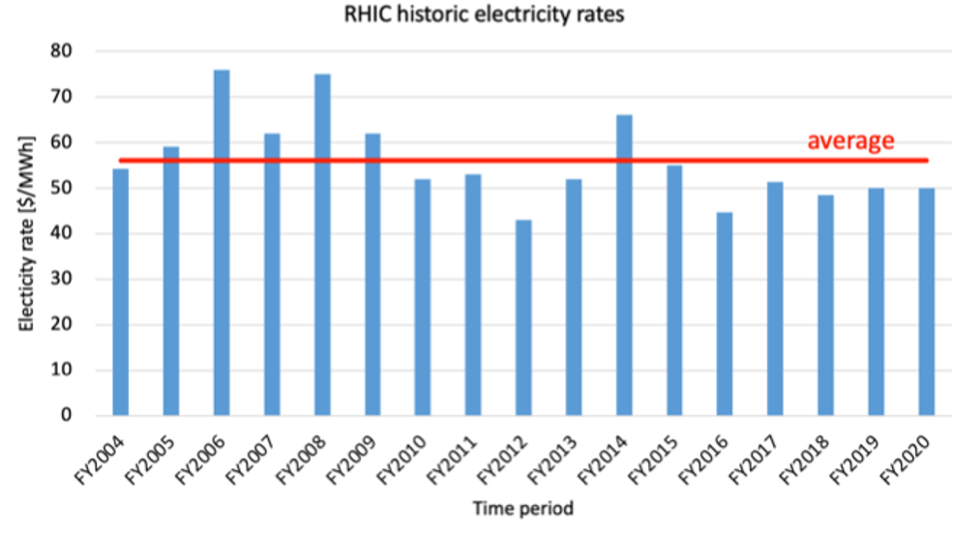
Other factors affecting operational reliability
Personnel
retirements, relocations, and burnout – addressing with
active hiring in close coordination with HR and recruiters
training and (some) mentoring of new and existing workers
improving documentation of procedures, workplans, project archiving
Electrical costs
no fixed price contract, price volatility
FY21: $41/MWh
FY22: $61/MWh
FY23: planning with $69/MWh
$57/MWh
Cost of LHe
BNL contract bid for $50/gallon
sole source quote received (Oct 27) for $77.4/gallon
M. Minty, CAD MAC – Dec 2022

Slide 17
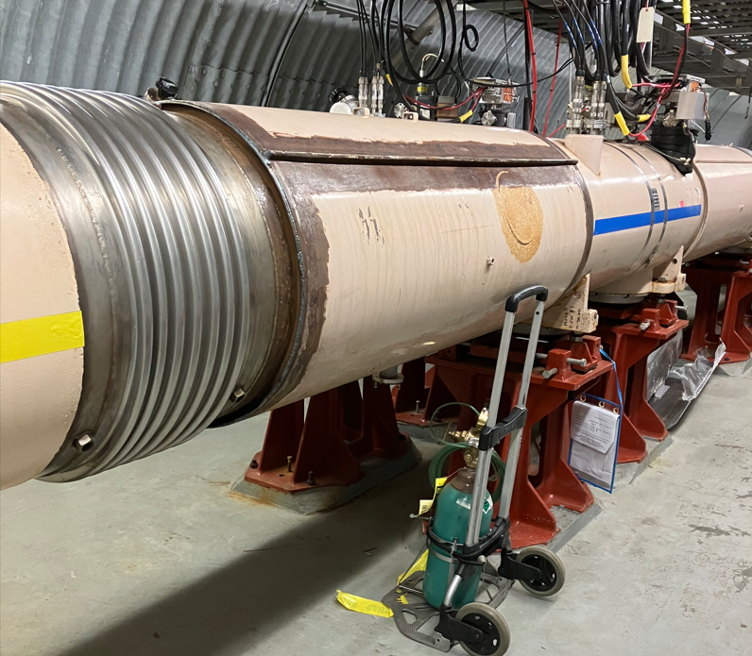
RHIC Snake Magnet – plan for Run-24
Dummy magnet installed and fully tested (leak-checked) for Run-23
Installation prior to Run-23 contingent on sPHENIX schedule and available workforce
Installation schedule estimate with early start
installation mechanical ~ 3 weeks
electrical testing ~ 3 weeks
Repair completion: March 23, 2023 (schedule detail in backup slides)
Repaired RHIC Snake Magnet will be ready for Run-24
M. Minty, CAD MAC – Dec 2022

Slide 18
RHIC 25-year plan and cryo upgrade for the EIC
M. Minty, CAD MAC – Dec 2022

Slide 19
25+ Year Upgrade Plan
Manager: Rob Michnoff
Goals
maintain technical infrastructure
ensure hadron injector complex ready for EIC commissioning while also running for external users (NSRL and BLIP), and possibly HEET
ensure that system upgrades satisfy both short-term injector and RHIC needs as well as longer-term EIC requirements
Initiated in 2018 for RHIC and the injector complex with considerations for the EIC
Assessed periodically based on need for
performance upgrades
upgrades of obsolete systems
Assumes no further large accelerator upgrades until the end of RHIC operations in 2025
M. Minty, CAD MAC – Dec 2022

Slide 20
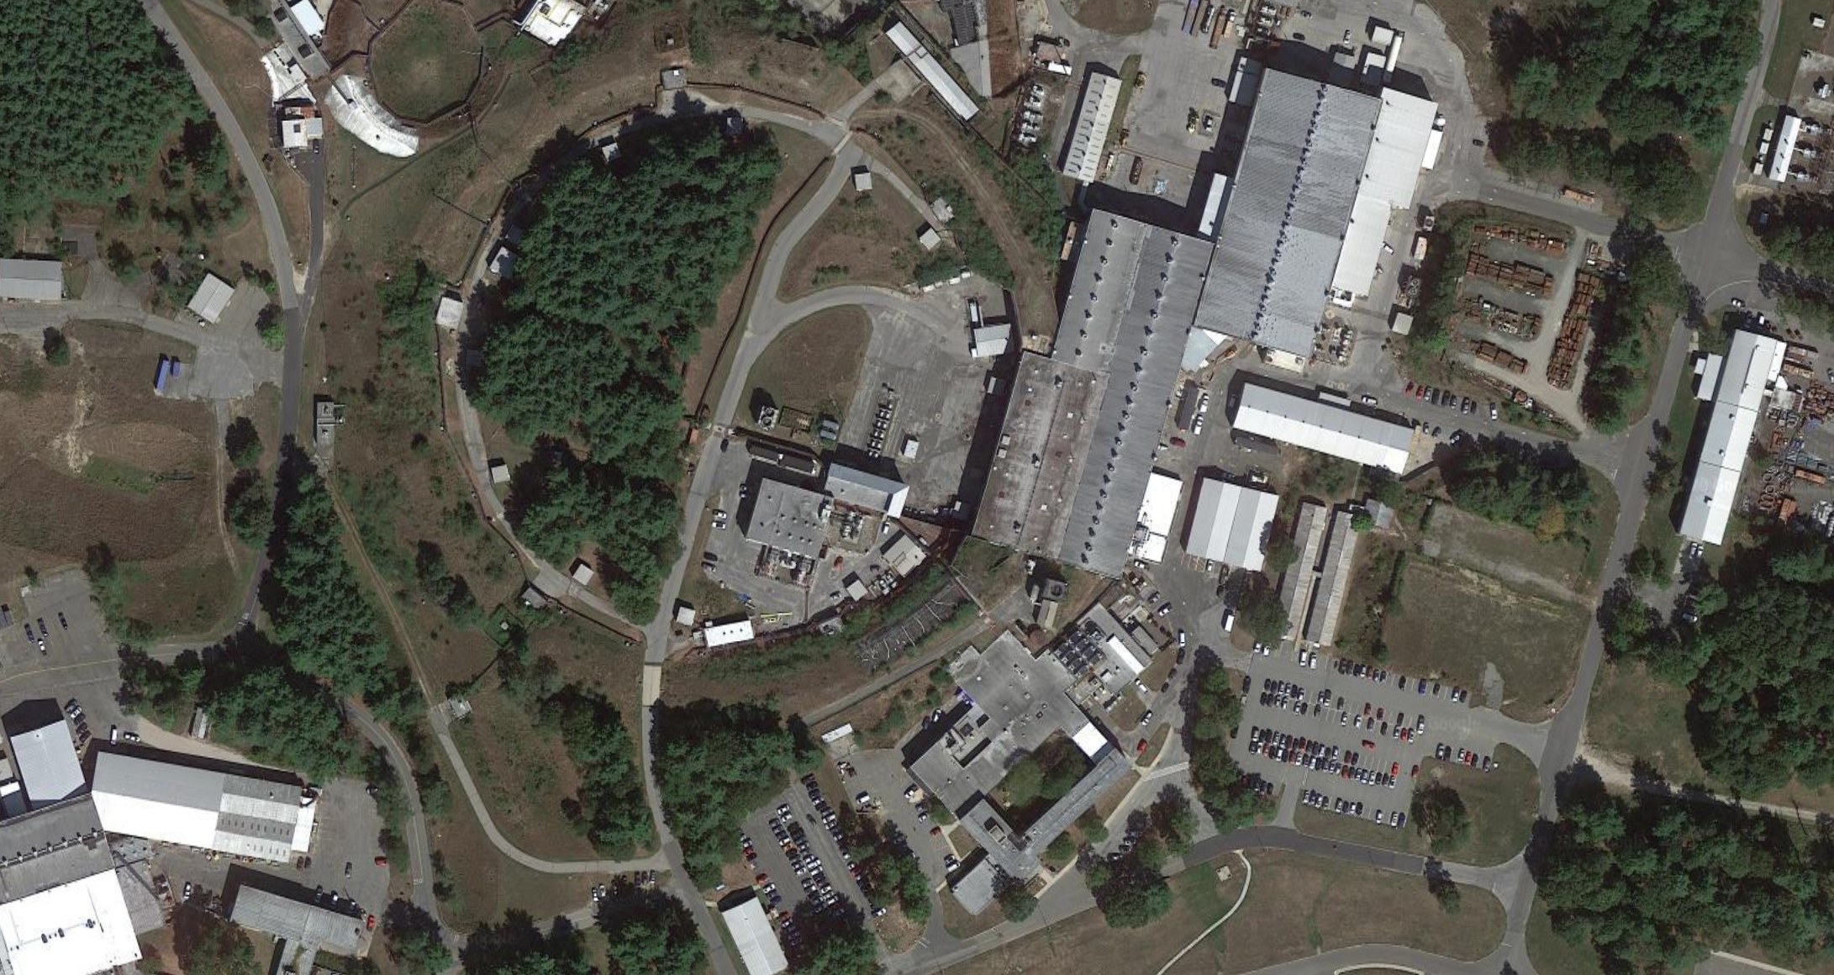
Technical infrastructure upgrades
Building upgrades supported mostly by BNL, technical upgrades by C-AD
Bldg. 912 Existing SRF Infrastructure
(clean rooms, HPR, VTFs, RF test area)
Existing Laser development area
Cryo Upgrade in progress
Bldg. 924 Instrumentation
Upgrade complete
Bldg. 905 Vacuum
Almost complete
Bldg. 911 Power Supplies
Complete
20
M. Minty, CAD MAC – Dec 2022

Slide 21
2018 – Evaluation of upgrade and infrastructure needs for RHIC+EIC Over Next 25+ Years
 | (all numbers in $M) | Total cost | RHIC |  |  | EIC
 |  | with OH | Total | Ops | CE/AIP | Total | Ops | CE/AIP
1 | Buildings | 0.8 | 0.8 | 0.8 | 0.0 | 0.0 | 0.0 | 0.0
2 | Water Systems | 4.9 | 2.2 | 1.1 | 1.1 | 2.7 | 1.0 | 1.7
3 | Electric Power Distribution | 16.6 | 9.2 | 2.0 | 7.2 | 7.4 | 0.2 | 7.2
4 | Electrical Systems | 42.0 | 37.1 | 15.3 | 21.8 | 4.9 | 0.8 | 4.2
5 | Cryogenic Systems | 23.9 | 23.9 | 2.4 | 21.5 | 0.0 | 0.0 | 0.0
6 | Vacuum Systems | 10.0 | 4.8 | 2.8 | 2.0 | 5.3 | 0.5 | 4.8
7 | RF Systems | 11.0 | 1.7 | 0.1 | 1.5 | 9.4 | 1.4 | 8.0
8 | Instrumentation Systems | 11.2 | 9.8 | 3.2 | 6.6 | 1.4 | 1.0 | 0.4
9 | Controls Systems | 32.3 | 12.1 | 8.4 | 5.9 | 20.2 | 6.3 | 13.9
10 | Preinjector Systems | 1.2 | 1.2 | 0.6 | 0.6 | 0.0 | 0.0 | 0.0
11 | Other | 0.1 | 0.0 | 0.0 | 0.0 | 0.1 | 0.0 | 0.1
 | Total cost | 154.2 | 102.8 | 36.9 | 68.2 | 51.4 | 11.1 | 40.2
 | Annual cost | 6.1
 | Expected annual funding | 5.5 | 5.5 | 2.0 | 3.5 | 5.5 | 2.0 | 3.5
Paid in part by lab infrastructure funding
Largest medium-term need
Update in progress
Costs initially sorted into funding streams (eventually assumed by EIC)
C-AD labor not included (historically used ~25 FTE for upgrades)
Some large items (e.g. Booster MMPS $11.5M, Booster transformers $4.8M) not captured in present funding plan
21
Present plans call for use of all AIP funds to support cryogenic system upgrades
21
M. Minty, CAD MAC – Dec 2022

Slide 22
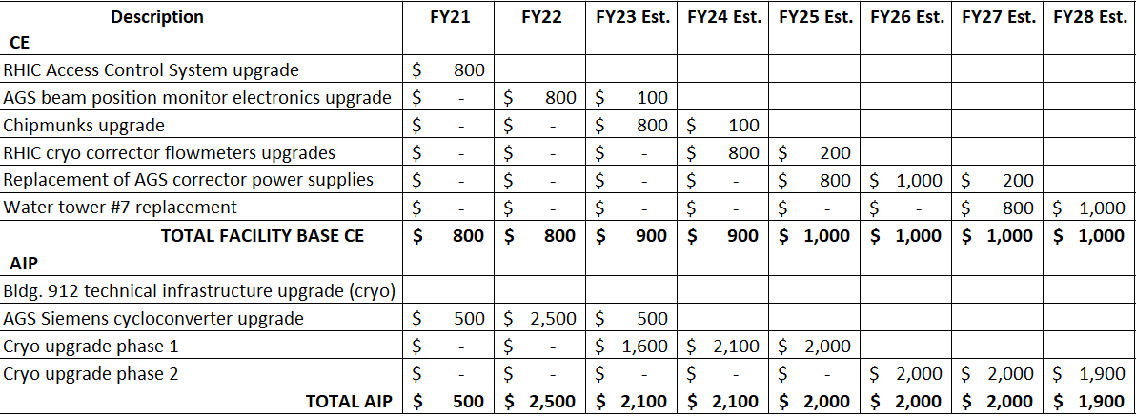
AIP and CE Funding plan (FY2021-2028) - updated 2022 LMBB scenario 1
Availability goal raised from 82.5% to 85% two years ago
Booster Main Magnet Power Supply upgrade not presently funded by AIP
CE completed before end of FY2025 and AGS cycloconverter upgrade would still benefit RHIC
Majority of AIP funding needed for cryo upgrades, not sufficient for completion before EIC commissioning starts (cryo upgrades would continue beyond FY2028)
[Note: AIPs can only start with all funding in hand]
M. Minty, CAD MAC – Dec 2022

Slide 23
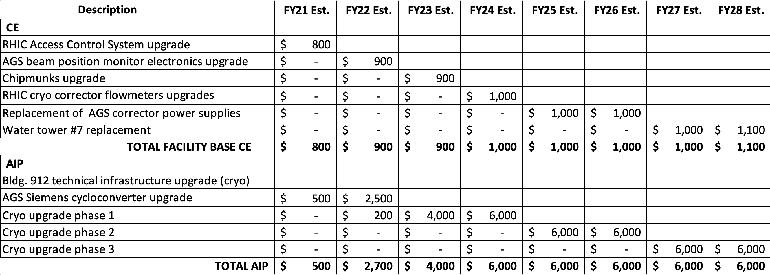
AIP and CE Funding plan (FY2021-2028) - 2022 LMBB scenario 2
Availability goal raised from 82.5% to 85% 2 years ago
Almost same plan for Capital Equipment as for Scenario 1
CE completed before end of FY2025 and AGS cycloconverter upgrade would still benefit RHIC
Alternative funding resources requested to complete cryo upgrades before the EIC
M. Minty, CAD MAC – Dec 2022

Slide 24
Cryo upgrade detail
Bldg 912 SRF test facility
new Cryo Plant: $7M available in the AIP bank for major procurements
received quotes for planned work significantly higher than expected – coordinating to reduce scope
Phase 1 upgrade: main 4K Plant
oil skids, intercoolers/aftercoolers, ambient vaporizers
Phase 2 upgrade: main 4K Plant
cold end (10K-4.5K) heat exchanger and expander 7
Phase 3 upgrades for reduction in Helium consumption
main 4K plant: replace mechanical joints and flanged warm valves with welded joints
collider ring: replace current lead return circuits and valve box fittings with welded joints
more urgent now: 7% per year price increase over 15 years; significant increase last year
M. Minty, CAD MAC – Dec 2022

Slide 25
Response to Recommendation from C-AD MAC 2021
M. Minty, CAD MAC – Dec 2022

Slide 26
Recommendation: Perform an assessment of components and spares needed to continue running in the EIC era
Ongoing effort as part of the 25-year plan
LINAC/Booster/AGS
oversight of component spares continue to be maintained by support groups
LINAC/Booster will continue to operate in support of user programs
AGS may operate if HEET facility is funded
The EIC does not place additional requirements on the (hadron) injectors
Spares for the new electron accelerators (Rapid Cycling Synchrotron and Electron Storage Ring) are the purview of the EIC Project
For the EIC Hadron Storage Ring, multiple superconducting magnets will be available
M. Minty, CAD MAC – Dec 2022

Slide 27
Summary
M. Minty, CAD MAC – Dec 2022

Slide 28
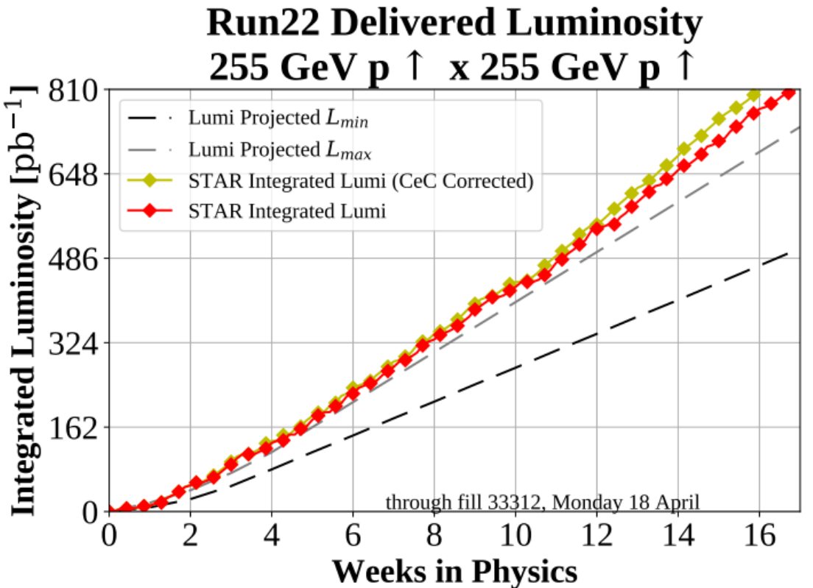
Summary
RHIC runs – 4 years solid and successful performance
RHIC run performance (Runs 19-21) – completion of the BES-II program with LEReC
successful (beyond expectation) demonstration of high-energy electron beam cooling
first-ever utilization of high-energy bunched-beam electron beam cooling in a collider
completion of multi-year beam energy scan program
RHIC Run-22 - last run with full energy polarized proton collisions
with 2-week extension, goals met despite challenges (RHIC Blue Ring Siberian Snake, extended operation
using AGS backup motor generator)
Reliability challenges in upcoming runs
proactively addressing concerns about operation through summer months
emergent increase in electricity and helium costs
challenged by dynamically changing workforce
RHIC Blue Snake magnet repair and mitigation plan for Run 2024
repairs to be completed March, 2023
dummy magnet in place for Run-23, installation prior to Run-23 TBD
expected to be ready for run-24
Ongoing and planned AIP and CE projects including RHIC 25-year plan and cryo upgrade
all AIP funds are planned to be spent on cryo upgrades
cryo upgrades will likely continue beyond FY28 with present level of AIP funding
alternative funding resources needed to complete main cryo upgrades
w/ LEReC
w/ LEReC
M. Minty, CAD MAC – Dec 2022

Slide 29
Backup Slides
M. Minty, CAD MAC – Dec 2022

Slide 30
LEReC summary for 2020
3-D cooling was commissioned and optimized using 2 MeV electron beam for Physics operation at √s_{NN} = 9.2 GeV.
First operational electron cooling in a collider (cooling of ion beams in collisions and luminosity optimization with cooling) was established.
Stable 24/7 running of high-current electron accelerator over many weeks.
Cooling was made operational, including implementation of laser position feedback, intensity feedback, energy feedback, automatic cooling section orbit corrections and feedback.
Controls of LEReC accelerator was transferred to the MCR operations, with support by LEReC experts when needed.
Five LEReC peer-review articles were published (see listing in reference slides): one Phys Rev Letters and four Phys Rev Accel Beams papers, including two which were selected as “Editors’ suggestion”.
Alexei Fedotov received 2019 Brookhaven Science and Technology Award with citation of world’s first “demonstration of bunched beam electron cooling”
M. Minty DOE 2020 Site Visit

Slide 31
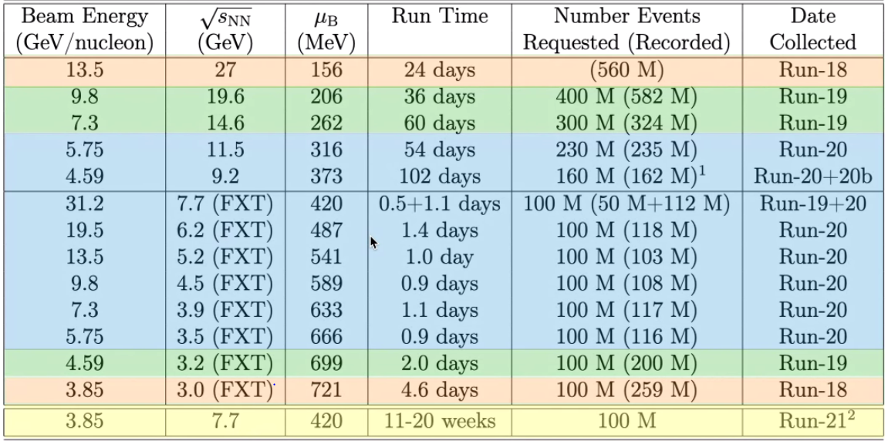
Beam Energy Scan II scoreboard
all Run-20 goals achieved or exceeded
M. Minty DOE 2020 Site Visit

Slide 32
RHIC Run-21 – completion of entire beam use request
8.65
17.3
1.7 B
100 200 d+Au 100 M 4
100 M (central)
Highest priority FY21 goal for BES-II achieved with LEReC in 13 weeks.
Met all next-priority STAR goals including an additional d+Au run (8 modes + beam delivery for CeC).
Missions achieved with limited on-site staff and full off-site coverage during the COVID pandemic.
All Run-21 goals achieved or exceeded + additional d+Au run
M. Minty DOE 2021 Site Visit

Slide 33
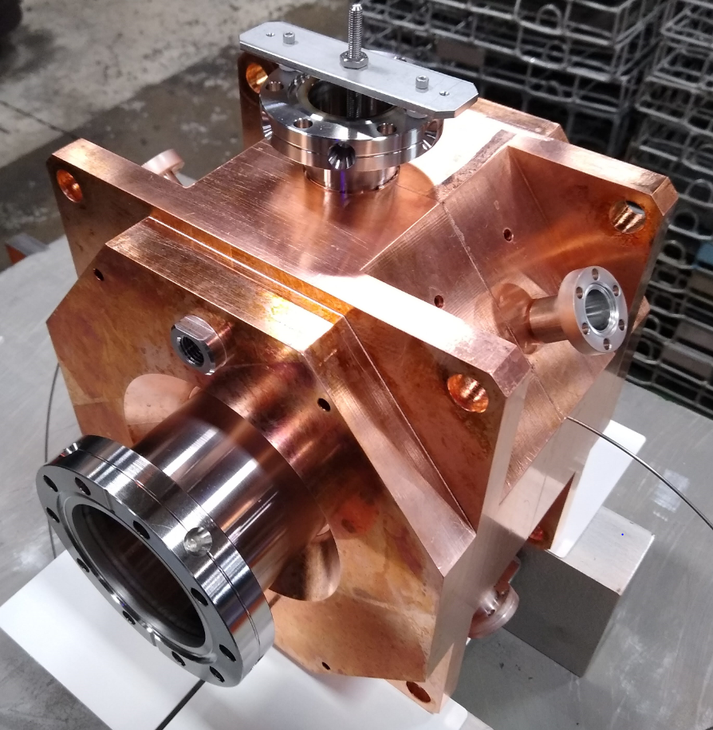
Highlights from FY21 BES-II program with LEReC
Run Coordinator: Chuyu Liu
Operated 24/7 high-current electron beams with stable cooling at lowest-ever, and most challenging, RHIC beam operating energy (3.85 GeV/n) in FY21 Run.
All performance goals attained. Additional operational improvements implemented:
New LEReC 1.4 GHz cavity and new RHIC bunch-by-bunch dampers
Feedback-based beam control for electron orbits in cooling sections, electron beam energy, electron beam intensity and laser position feedback.
Utilization of existing 3rd harmonic (28 MHz) cavity in RHIC to reduce ion beam peak current
Optimization of electron beam currents based on operational experience
15-20 mA (for Au ions at 4.6 GeV/n in 2020)
8-20 mA (for Au ions at 3.85 GeV/n in 2021)
Select demonstrated additional technological advances:
Robust photocathodes with high initial Quantum Efficiency
Photocathode lifetimes of 6-10 days
Stable and reliable operation of high-power fiber laser for photoelectron gun
1.4 GHz cavity
With LEReC, the highest-priority goal of the BES-II program was successfully completed in FY21 in ~ 13 weeks.
M. Minty DOE 2021 Site Visit
Notes:
1.4 GHz cavity, amplifier and circulator installed November, 2020. Designed to increase the electron bunch length from 0.4 to 0.6 ns while preserving the slice energy spread. Intent to reduce the “heating” effect from the electrons on the ions.
Bunch-by-bunch damper: used repurposed stripline kickers and existing BPMs. Long-desired general purpose device to combat instabilities. Reduces tune spread to allow for smaller chromaticity.

Slide 34
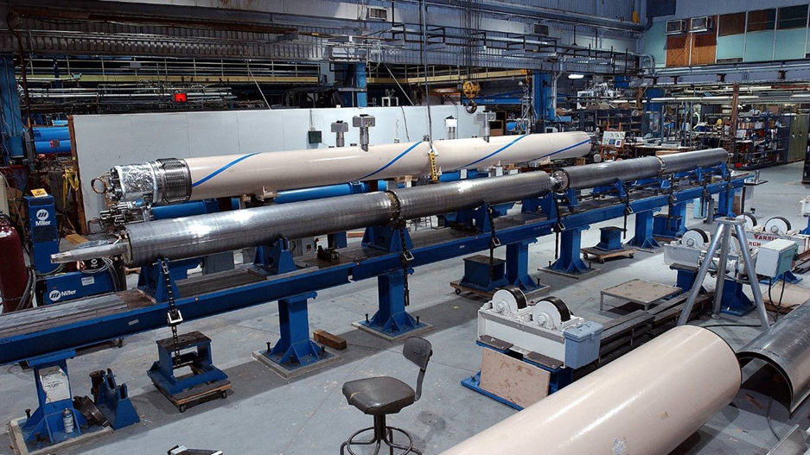
RHIC Blue Snake Magnet
damaged
Two Snake magnets damaged during Run-22 (12/3/21, 12/12/22)
During Run-22
all 4 spare magnets tested at SC Magnet Division (SMD)
prepared plans for repair (SMD and C-AD)
Gary McIntyre (C-AD, retired) hired as consultant
During and after RHIC run
one spare magnet appropriately reconfigured (SMD)
After RHIC run
extensive electrical testing and training (C-AD electrical systems group)
transported to SMD for repair (6/6/22), next slides
Note: plan for Run-23 is Au+Au (unpolarized), snake magnet needed for Run-24 (p↑+p↑ )
M. Minty, CAD MAC – Dec 2022

Slide 35
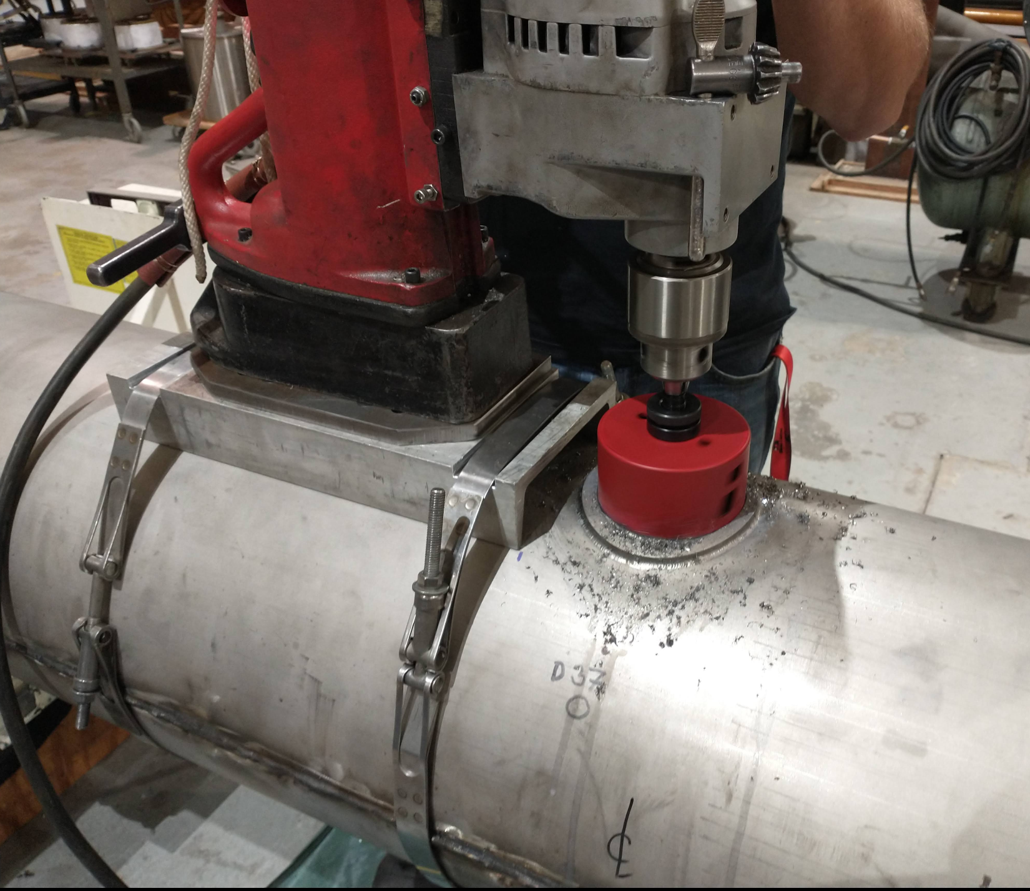
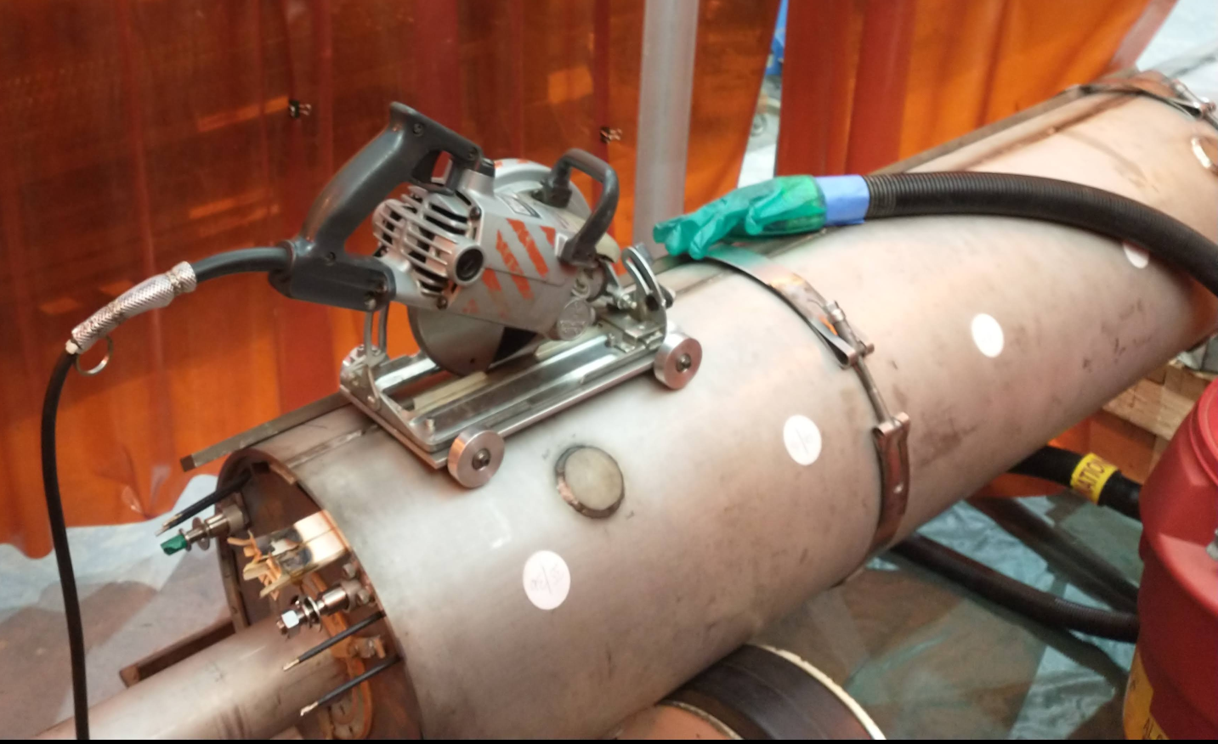
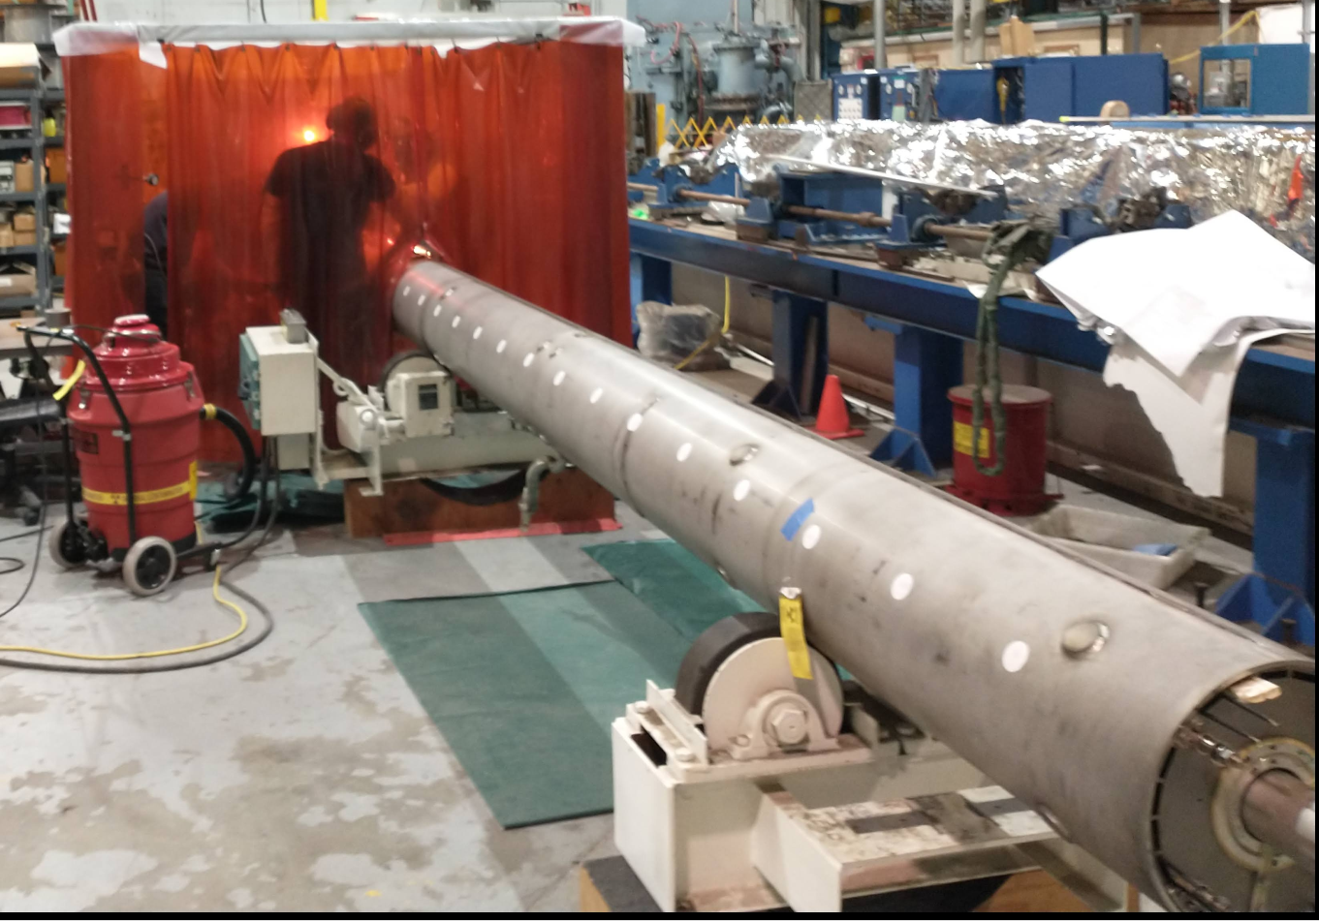
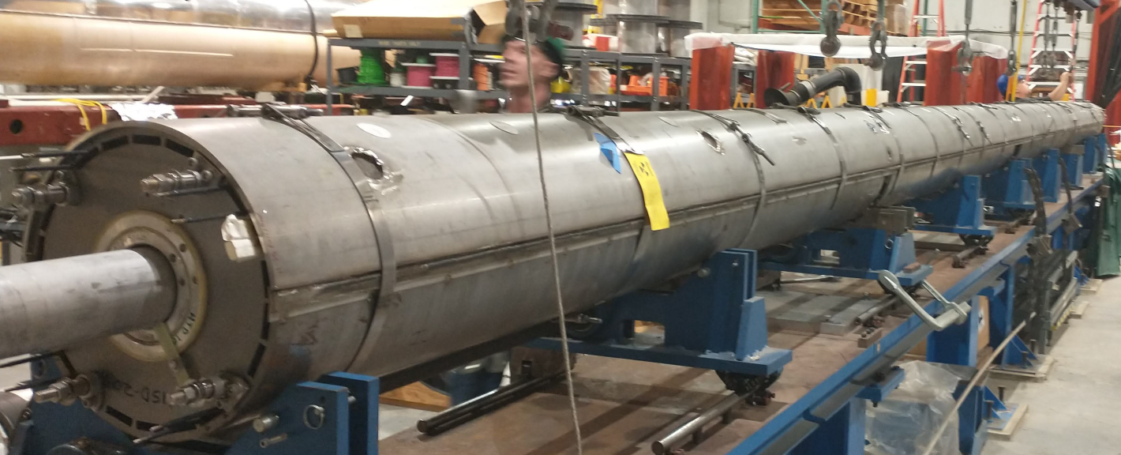
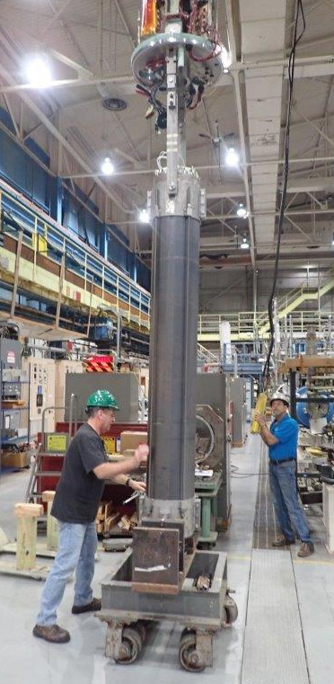
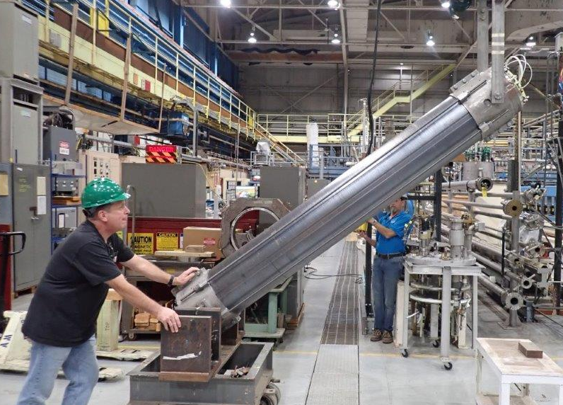
RHIC Snake Magnet - repair details
M. Anerella (SMD)
Work completed
1 Spare Storage Unit
reworked to correct configuration
Hung on top hat and is being wired for cold test
1 Spare Storage Unit
Electrically tested & ready for magnet assembly
Magnet Disassembly
Cold mass, heat shields removed from cryostat
Cold mass disassembly nearly complete
End volumes, bus work removed
Helium vessel shells cut off
Cold mass reinstalled onto assembly fixture
Cold test 1 Storage Unit
Remove beam pipe / BPM assembly
Remove storage units from assembly fixture & replace with spares
Complete cold mass assembly & pressure/leak check test
Complete cryostatted magnet assembly
Work remaining
Repair completion: March 3 , 2023 (schedule detail in backup slides)
M. Minty, CAD MAC – Dec 2022

Slide 36
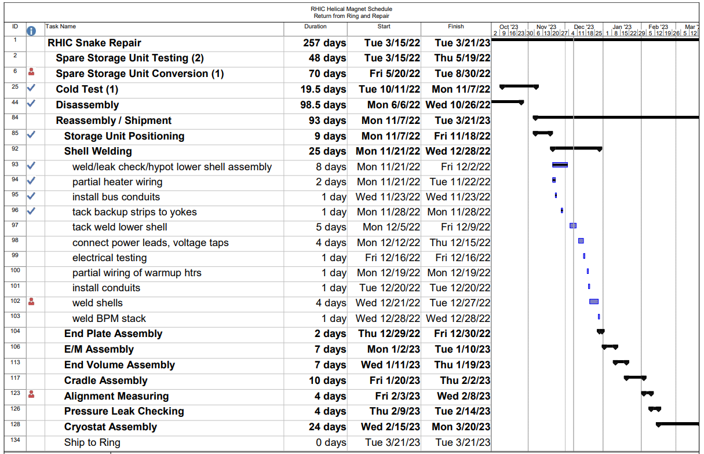
RHIC Snake Magnet - repair schedule
M. Anerella (SMD)
M. Minty, CAD MAC – Dec 2022

