Slide 1
Polarization Increase with AGS Skew Quadrupoles
Compensating horizontal partial snake resonances with coupling resonances
V. Schoefer
For J. Avronsart ,J. Cintorino, V. Badea, H. Huang, D. Lehn, R. Lynch, G. Mahler, I. Marneris, J. Sandberg, N. Tsoupas, J. Tuozzolo
12/13/2022
C-AD Machine Advisory Committee Meeting

Slide 2
Overview
Review of the problem: depolarization from horizontal partial snake resonance in the AGS and their correction with betatron coupling
Magnet and power supply design
Schedule and planning
Operational considerations (commissioning and error tolerance)

Slide 3
RHIC Polarized Beam Complex
 | Max Energy [GeV] | Pol. At Max Energy [%]
Source+Linac | 0.2 | 82-84
Booster | 2.5 | ~80-84
AGS | 23.8 | 67-70 | p-Carbon
RHIC | 255 | 55-60 | Jet, full store avg*
2 Siberian Snakes/ring
Spin flipper
Absolute Polarimeter (H jet)
RHIC pC Polarimeters
PHENIX
* Includes both ramp loss and store decay
STAR
Spin Rotators
(longitudinal polarization)
Spin Rotators
(longitudinal polarization)
LINAC
BOOSTER
Pol. H⁻ Source
Helical Partial
Siberian Snake
 | Relative Ramp Polarization Loss (Run 17, full run avg)
AGS | 17 %
RHIC | 8 %
AGS
200 MeV Polarimeter
AGS Polarimeter
Strong AGS Snake

Slide 4
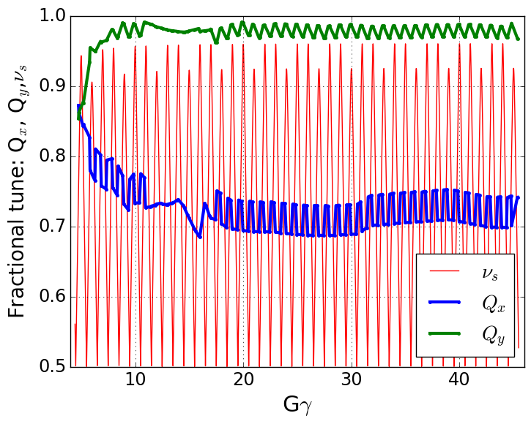
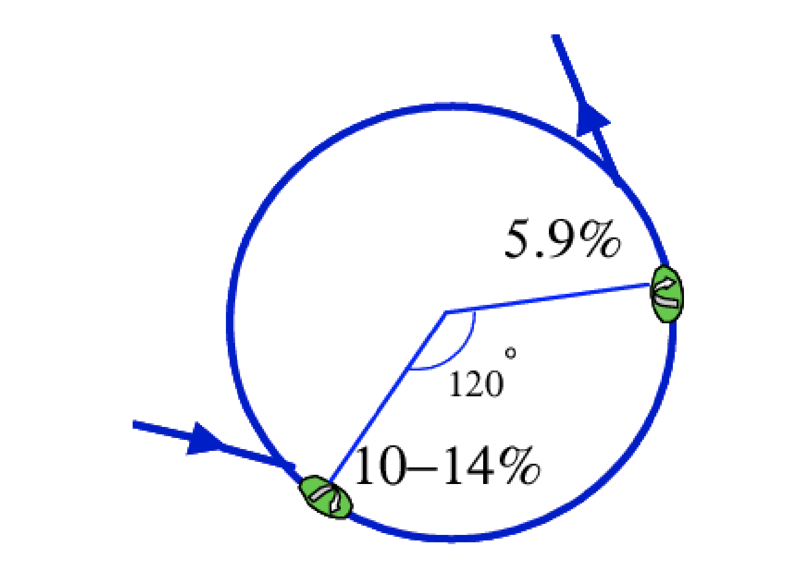
Polarized Protons in AGS
Polarization is preserved in the AGS with two partial helical dipole snakes (10% and 6% rotation)
Provides spin tune ‘gap’ where imperfection and vertical intrinsic resonance condition are never met
  ν_{s} ≠ N (full spin flips)
  ν_{s} ≠ N +/- Q_{y}
Horizontal resonance condition still met
  ν_{s} = N +/- Q_{x}
  Horizontal resonance are weak, but many (82 crossings)
  Currently handled with fast tune jump
    ΔQ_{x} = 0.04, 100 μs
Spin tune gap
Hor resonance crossings
Tune
jump
(pause tune jump
near transition)
Extraction
Injection

Slide 5
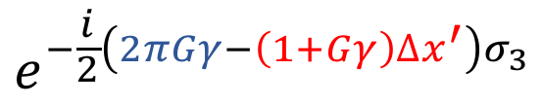
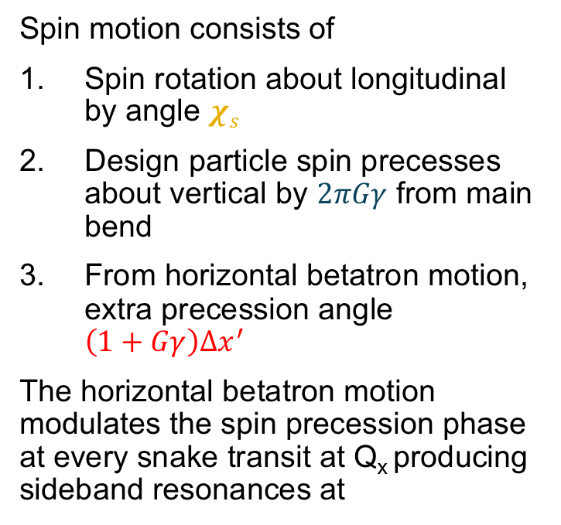

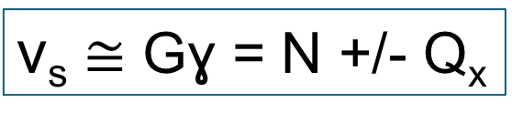
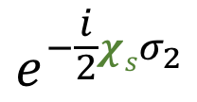
Partial snakes drive horizontal resonances
Simple case (one partial snake)
“Toy AGS ring”
Spin motion consists of
Spin rotation about longitudinal by angle $χs$
Design particle spin precesses about vertical by $2πGγ$ from main bend
From horizontal betatron motion, extra precession angle $\left(1+Gγ\right)∆x^{′}$
The horizontal betatron motion modulates the spin precession phase at every snake transit at Q_{x} producing sideband resonances at
$$e^{−\frac{i}{2}χsσ_{2}}$$
Partial snake
$$e^{−\frac{i}{2}\left(2πGγ−\left(1+Gγ\right)∆x^{′}\right)σ_{3}}$$
$\text{ν}\text{s}$ ≅ Gɣ = N +/- Q_{x}
$∆x^{′}$ = the one-turn change in betatron angle

Slide 6
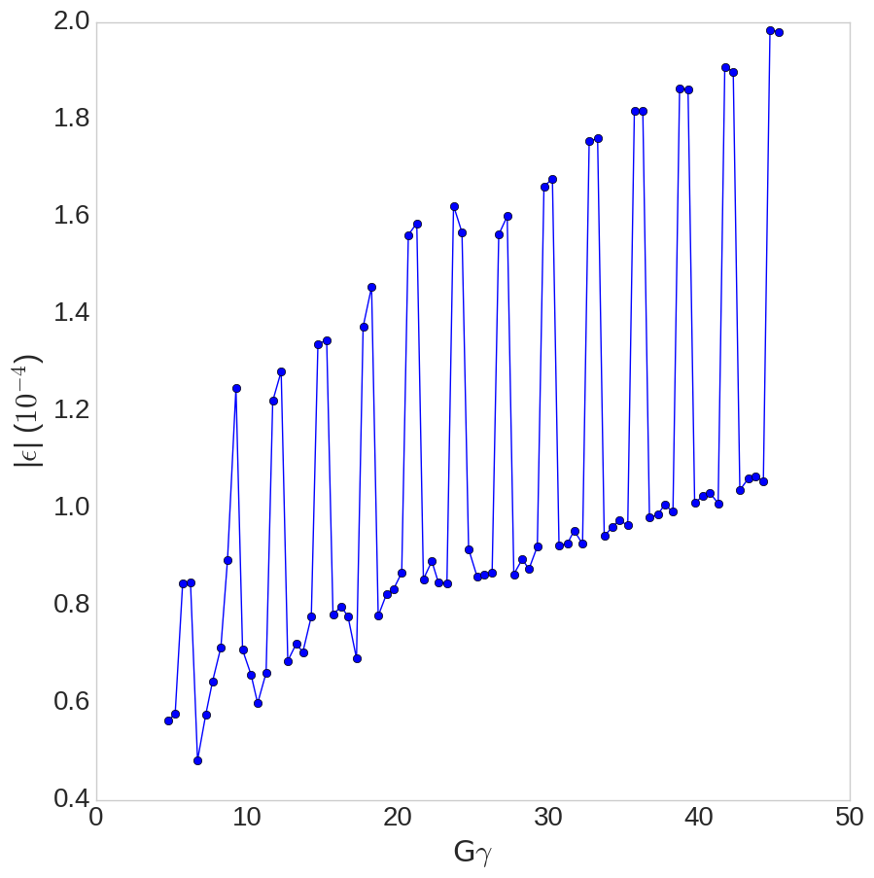

Horizontal resonances in the AGS
Horizontal Resonance Amplitudes in AGS
Two snakes, separated by 1/3 circumference
  Modulated resonance amplitude highest near Gɣ = 3N (when snakes add constructively)
Horizontal resonances occur
every 4-5 ms at the standard AGS acceleration rate
$$ε_{x,rms,norm}=1.67 μm$$

Slide 7
Polarization loss from horizontal resonances
With no mitigation: ~20% relative polarization loss
Horizontal tune jump (used since 2011): Avoids half the loss, 10% relative polarization loss remains
Remaining polarization loss from residual crossing rate, spin tune spread comparable to tune jump size
Zgoubi simulation of polarization loss with and without tune jump, agrees well with measured tune jump performance
Goal of resonance compensation is to reduce the polarization loss from horizontal snake resonances to 0%
With jump
NO dp/p spread
With tune jump
+ dp/p spread
No mitigation
Plot courtesy of Y. Dutheil

Slide 8
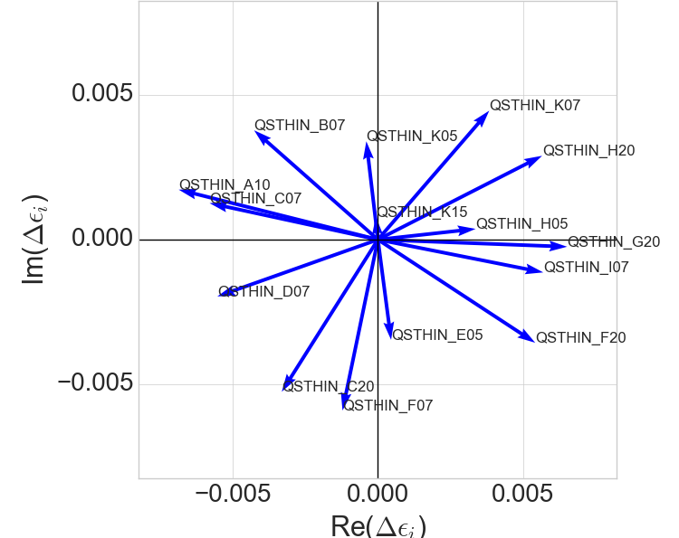
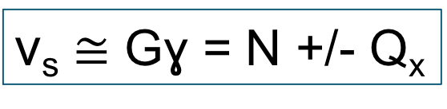
Resonance compensation via coupling
Depolarizing resonances from partial snakes and betatron coupling have the same frequencies
Spin resonance terms from skew quads in AGS
Gɣ = 43.72
$\text{ν}\text{s}$ ≅ Gɣ = N +/- Q_{x}
Every skew quadrupole represents a complex resonance driving term
Place a collection of skew quadrupoles in the ring to cancel the partial snake driving term.
“Just” linear algebra

Slide 9
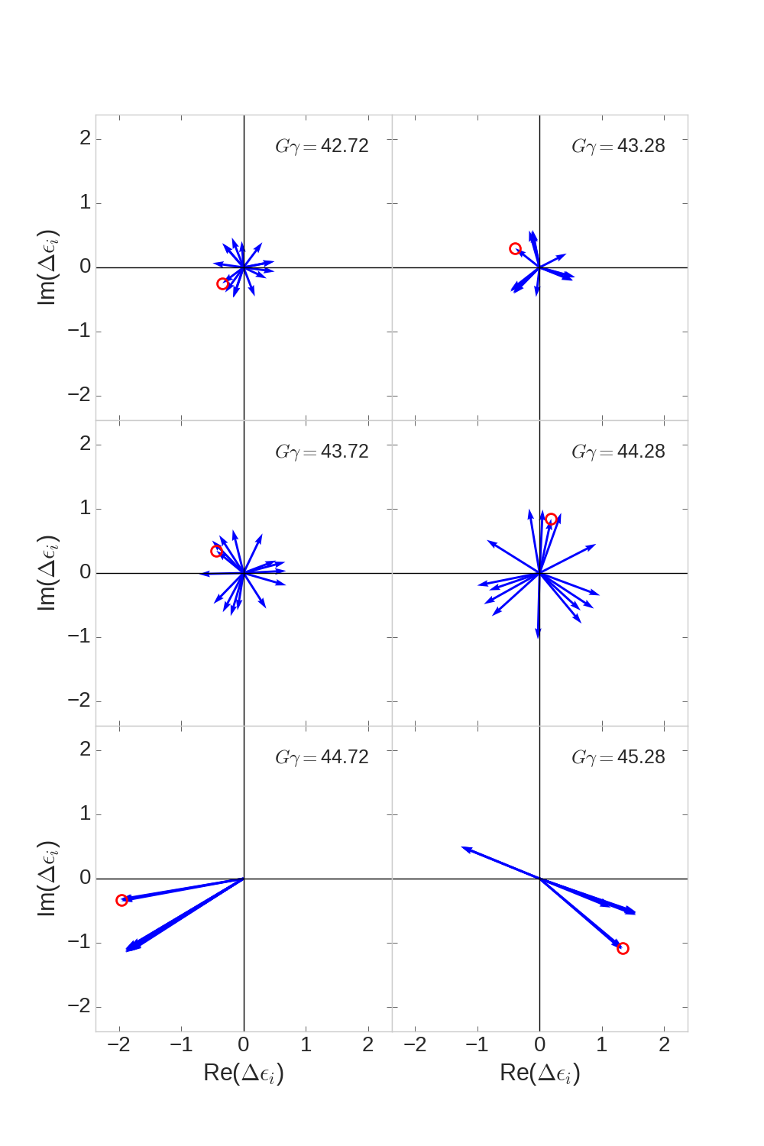
Partial snake resonance suppression with betatron coupling
Skew quad correction vectors (last six hor resonances)
In principle minimizing resonance strength (calculated with SPRINT) and coupling (two complex numbers) takes 4 skew quads
BUT:
There are 82 such linear algebra problems to solve
AND:
Phasing between skew quadrupole terms and snake terms varies wildly resonance to resonance
AND:
Correction vectors are frequently parallel, especially near strong vertical intrinsic resonances
Solution strategy: search for a solution with a distributed number of weaker, fast ramping skew quadrupoles
Phase offset chosen so that snake drive term is purely real
Red circle marks the same skew quad in each frame, phase changes rapidly from resonance to resonance

Slide 10
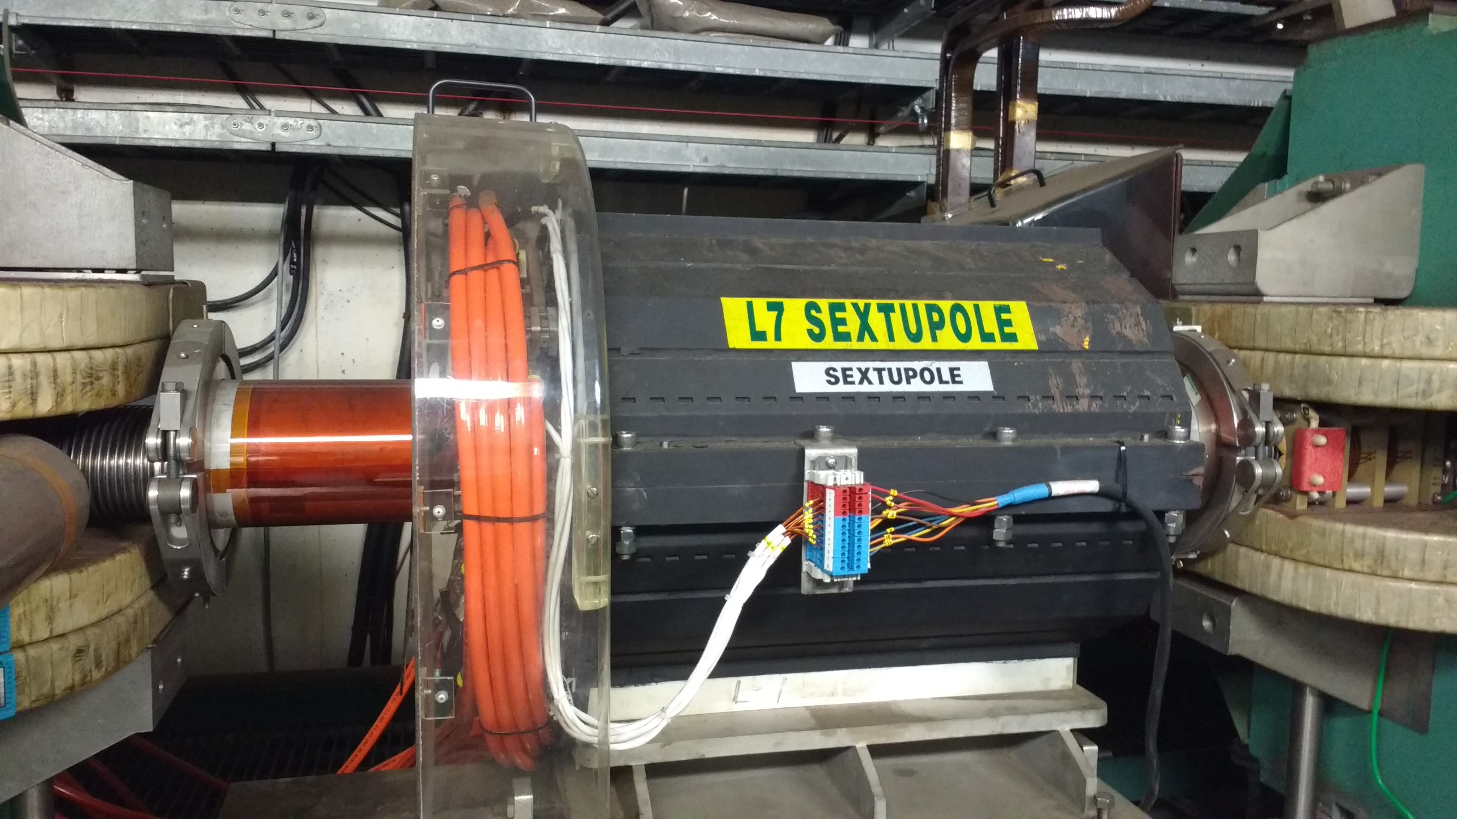
Magnets and implementation
Physics constraints:
Correct all 82 horizontal resonance terms
  Keep total depolarization from horizontal resonances under 0.1% (in simulation)
Limit coupling to preserve stability with near-integer Q_{y}
  Coupling induced tune shifts < 0.005
  Tune split in AGS is large (~0.2), but near-integer vertical is sensitive to small perturbation
Limited locations in the AGS
7” (18 cm) available drifts
Including some of the longer straights, leaves about 30 possible locations
Spanning the vector space for all 82 resonances and limiting the coupling-induced tune shifts with reasonable field in the available space requires 15 skew quadrupoles

Slide 11
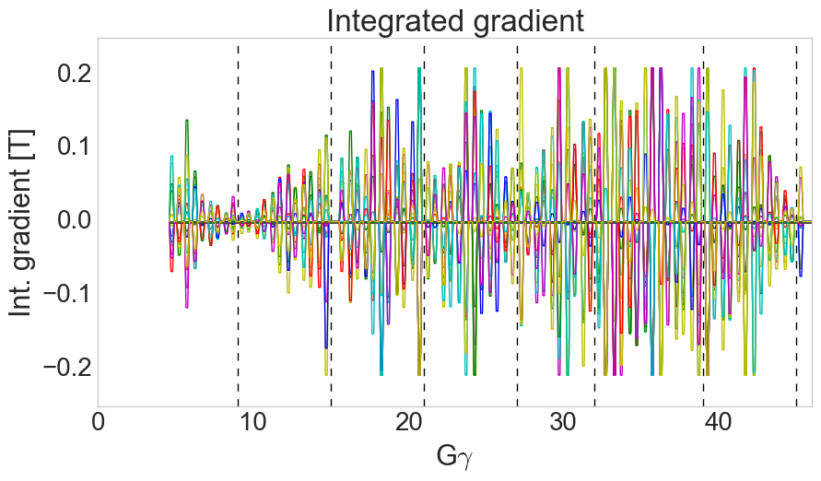
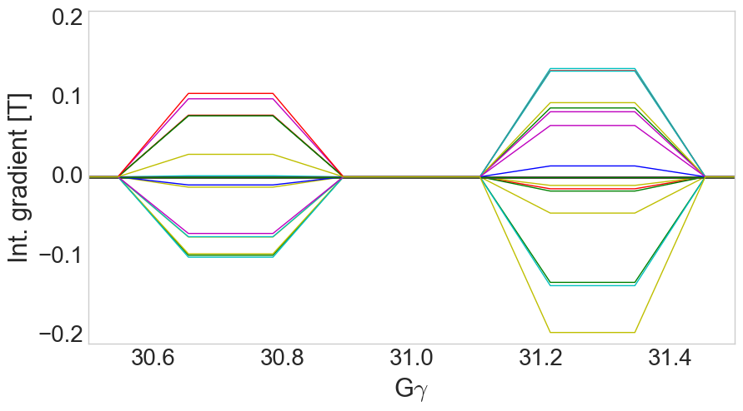
Gradients for Resonance Correction
A set of 15 skew quadrupoles with integrated skew quadrupole gradient <= 0.2 T meets the physics requirements
  9 locations at narrow locations in the AGS adjacent to sextupoles
  6 locations in longer (mostly empty) straight sections
  Locations determined largely by brute force optimization from the available ~30 locations
Pulsing the skew quads with 1 ms rise, 1.2 ms flattop and 1 ms fall allows changing currents quickly to accommodate new correction vectors every resonance
  Also avoids having skew fields during strong vertical intrinsics (tracking showed small polarization losses at these with skew quads powered)
Calculated resonance strength reducible to zero at almost every resonance
Each trace= 1 skew quad
1.0 ms
1.2 ms
1.0 ms

Slide 12
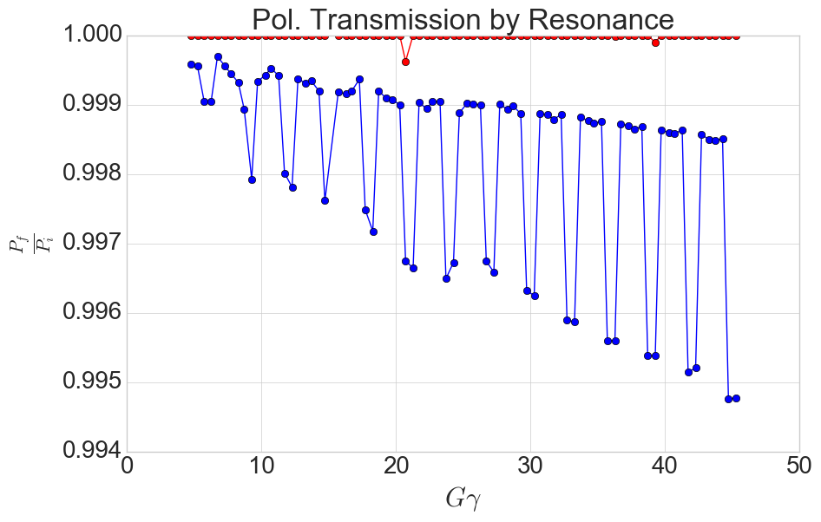
Gradients for Resonance Correction
A set of 15 skew quadrupoles with integrated skew quadrupole gradient <= 0.2 T meets the physics requirements
  9 locations at narrow locations in the AGS adjacent to sextupoles
  6 locations in longer (mostly empty) straight sections
  Locations determined largely by brute force optimization from the available ~30 locations
Pulsing the skew quads with 1 ms rise, 1.2 ms flattop and 1 ms fall allows changing currents quickly to accommodate new correction vectors every resonance
  Also avoids having skew fields during strong vertical intrinsics (tracking showed small polarization losses at these with skew quads powered)
Calculated resonance strength reducible to zero at almost every resonance
Corrected
Uncorrected (no tune jump)
Calculated from residual |ε|
(Two highly degenerate cases push the coupling constraint and have incomplete compensation. Could be relaxed with operational experience)

Slide 13
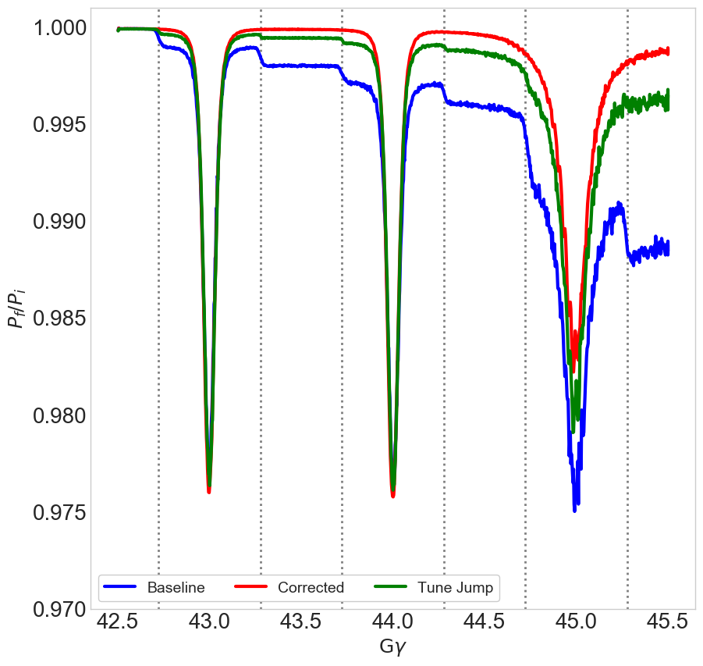

Tracking with correction
Zgoubi simulation shows that depolarization from horizontal resonances can be totally eliminated with betatron coupling (red trace)
Benefits of the coupling-based correction relative to tune jump:
  Possibility of full resonance correction (better than tune jump)
  Tune jump is sensitive to timing at the +/- 100 μs level. Skew quad correction is on for a 1.2l milliseconds (+/- 600 μs) around the resonance.
$$\left\langle P_{n}\right\rangle$$
ε_{x}= ε_{y} =2 μm (rms norm)
ε_{long} = 0.8 eV-s
Theory and tracking simulation in:
Phys. Rev. Accel. Beams 24, 031001
Correction with 15 skew quadrupoles (Zgoubi simulation)
Last six resonance crossings (vertical dashed lines),
including strongest two near Gg = 45

Slide 14
Machine Advisory Committee Recommendation from MAC-17 (Dec 2020)
“Continue optimization of the skew quad scheme, aiming for reduction of power.”
Two main power considerations
  Dissipation from eddy currents due to pulsing
  High frequency, high power perturbations to power grid

Slide 15
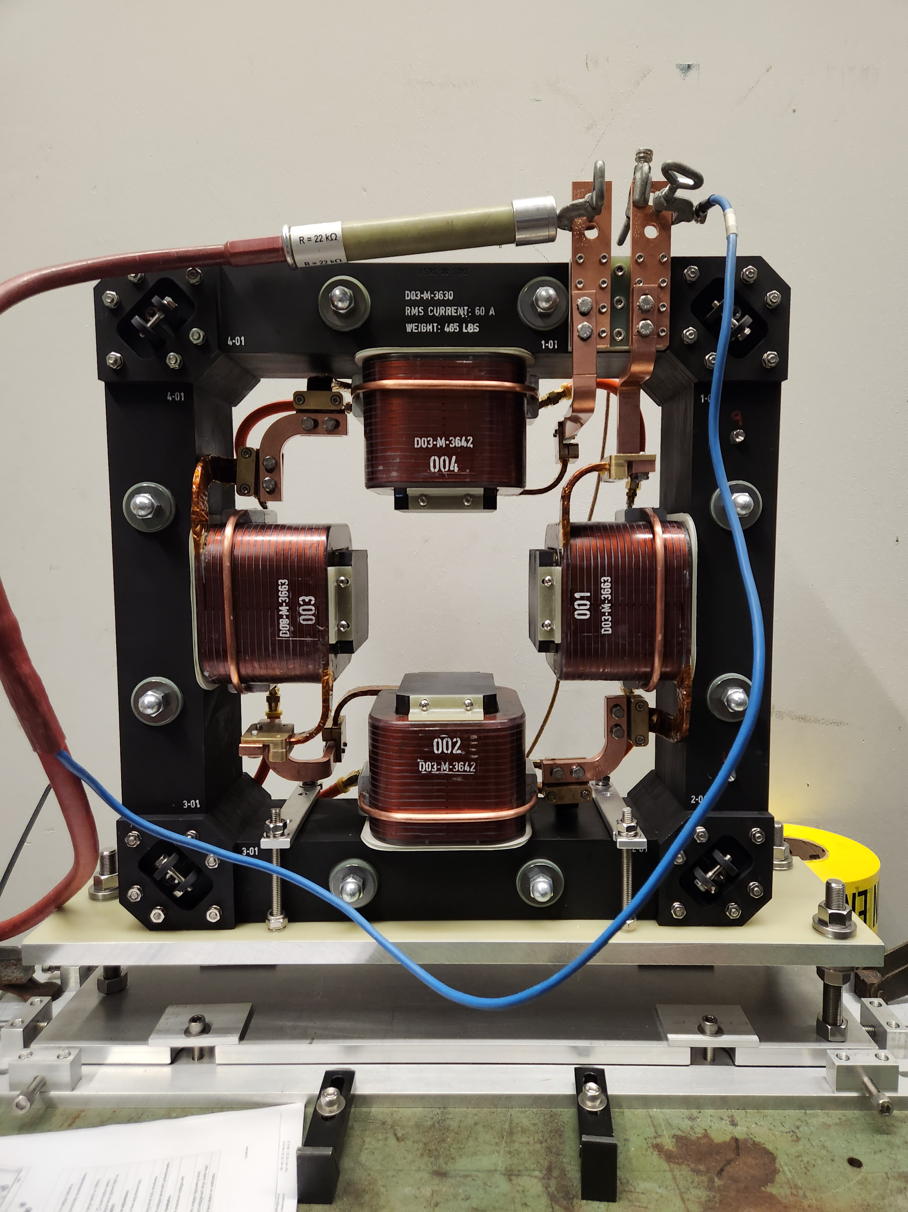
Magnet design
Test stand at CAD
Primary design constraints
  Provide the necessary skew quad gradient
  Minimize heating from eddy currents due to many fast (1 ms) ramps
  Fit in the narrow 18 cm drifts next to sextupoles
Design features
Laminated magnet (0.025") to prevent eddy currents in the yoke
17 turns, with 4-stranded parallel cable. Minimizes eddy currents in the coil
Turns end ~1/4” away from pole tip to avoid the worst of the heating
Physical length short (17 cm) to make best use of beamline space
Design of stranded coils
Final Design | Value | Unit
Length | 17 | cm
Bore radius | 8.5 | cm
Integrated gradient | 0.2 | T
Current | 185 | A
Power (peak, total 15 mags) | 1.1 | MW
Turns | 17
Lamination thickness | 0.025 | in
Conductor dimension | 5x5 | mm x mm
Simulated heating is about 20 W (average) in each of the four coils at operational currents.
Plan is for air cooling, water cooling can be added to pads attached to the coils if needed.

Slide 16
Magnet design
Test stand at CAD
Recommendation from MAC-17 (Dec. 2020): Continue optimization of the skew quad scheme, aiming for reduction of power.
Peak power reduced (2→1 MW) by
  Better optimization of magnet location (reduced field requirement)
  Magnet design optimizations
Concerns about high frequency power perturbations to grid addressed in power supply design
Design of stranded coils
Final design | Value | Unit
Length | 17 | cm
Bore radius | 8.5 | cm
Integrated gradient | 0.2 | T
Current | 185 | A
Power (peak, total 15 mags) | 1.1 | MW
Turns | 17
Lamination thickness | 0.025 | in
Conductor dimension | 5x5 | mm x mm
Preliminary design presented at MAC-17
Property | Value | Unit
Integrated gradient | 0.45 | T
Current | 500 | A
Power (peak, total 15 magnets) | 2 | MW

Slide 17
Power supply design
Power supply simulation
Design challenge for power supply: high frequency pulsing with high peak power (> 1 MW)
Take advantage of duty cycle.
  Pulsing only 400 ms out of 4-6 seconds
  Cap bank charges off-cycle, discharges into load during pulsing
Meets all the physics requirements
First article power supply due for delivery in March 2023
Cur [A]
Magnet current
Cap voltage
Votlage [V]
Load voltage
Time [s]
400 ms pulse train
during acceleration
Cap bank recharge
Repeat period of AGS (4 sec)
Conservative simulation assumes
  max peak-to-peak pulsing through whole cycle. Expected real rms current is half what is simulated.
  4 second AGS rep rate (typically 6 seconds)

Slide 18
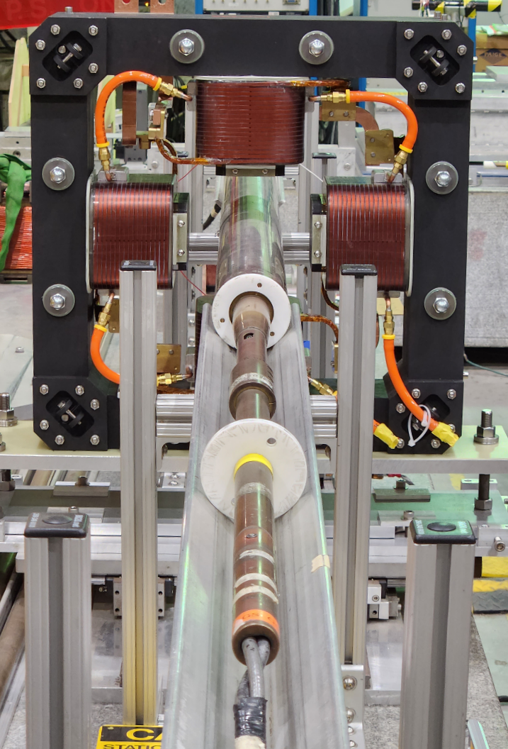
Status and scheduling
Magnets
  First article magnet arrived Oct 26, 2022
  Heating test with a low rep rate test supply (1.2 ms rise and fall, 1.0 ms flattop, only 10 Hz rep rate) complete
    No rise in temperature above DC tests with same rms current
    Important first test of coil eddy current heating
  Rotating coil measurements in DC mode happening now
  Pulsed mode field measurements with test supply to follow through December 2022
  Once first article approved (next 1-2 weeks), vendor delivers 2 magnets every 2-3 weeks
    Only 1 of 15 locations requires a vacuum break.
Power supplies
  First article power supply due in March ‘23 (delayed by vendor due to parts shortage, working with them to expedite)
    Required for final measurements of heating with operational current functions
    After acceptance test: 4 units delivered every 6 weeks
  Cables procured, cable tray requirements spec’d. Space in service buildings identified.
Skew quad on rotating coil stand at BNL
18

Slide 19
Schedule overview
AGS Startup
RHIC Startup
Mag meas.
Delivery and installation of magnets, cable pulling
Installation on maintenance days (1 day/2 wks)
First article p.s. tests
p.s. delivery and installation
Controls software development, magnet mount fabrication
RHIC Run 23 (May-Sep ‘23): Au-Au collisions, possibility for testing resonance correction with protons in AGS
Tests possible even with less than full set of magnets/supplies by end of run
developing a staging plan for optimum order of installation
RHIC Run 24 (2024) : p-Au and p-p, commissioning and operation of resonance correction system
Last planned RHIC operation with protons

Slide 20
Commissioning tasks
Develop code for beam-based centering in skew quad (large horizontal orbit excursions+skew quads+near integer Q_{y})
Adapt orbit control tools used for jump quad centering to skew quad operation
Verify/correct tune shifts from the extra coupling
Scan ‘global’ knobs: sinusoidal beta-beat errors, global timing shifts
  Empirical scans were helpful with the tune jump quads to maximize benefit to polarization, check and improve margins
  Good target for machine learning efforts (see later presentations)
Tests with polarized beam can be ‘staged’
  Improved polarization visible with 6-8 installed skew quads
  Also possible to start with correction strengths scaled down and iterate upward to full correction

Slide 21
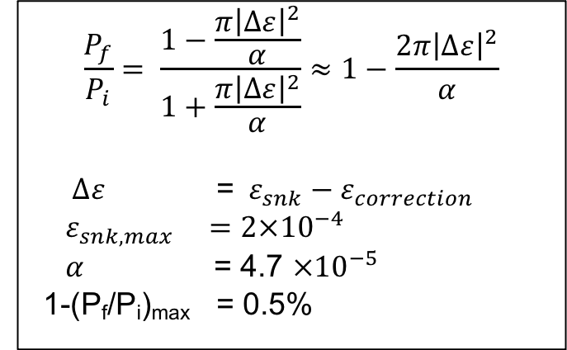
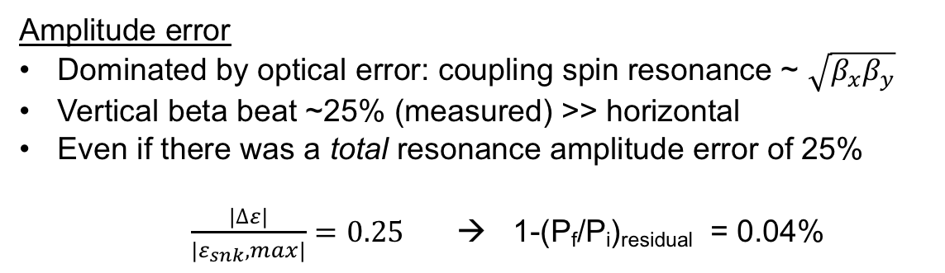
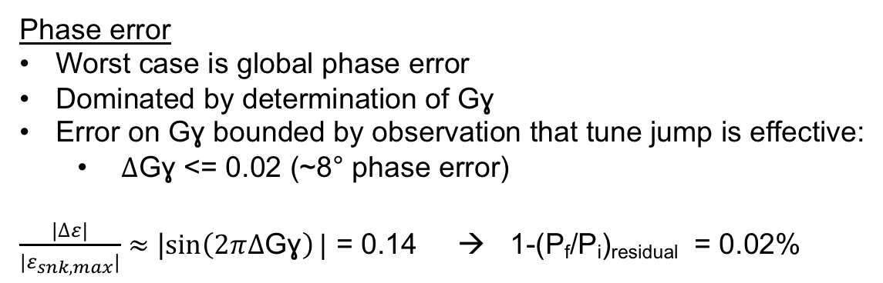
Error tolerance
What if the calculated correction has the wrong phase or amplitude? Difficult to tune individual resonances, signal very small.
Froissart-Stora polarization loss for small residual resonance $∆ε$
$$\frac{P_{f}}{P_{i}}= \frac{1−\frac{{π\left|∆ε\right|}^{2}}{α}}{1+\frac{{π\left|∆ε\right|}^{2}}{α}}≈1−\frac{{2π\left|∆ε\right|}^{2}}{α}$$
$$∆ε \text{=} ε_{snk}−ε_{correction}$$
$${ ε}_{snk,max} =2×{10}^{−4}$$
$α$ = 4.7 $×{10}^{−5}$
1-(P_{f}/P_{i})_{max} = 0.5%
Phase error
Worst case is global phase error
Dominated by determination of Gɣ
Error on Gɣ bounded by observation that tune jump is effective:
  $∆$Gɣ <= 0.02 (~8° phase error)
$\frac{|∆ε|}{{|ε}_{snk,max}|}≈$ |$\sin\left(2π∆\text{G}\text{ɣ}\right)|$ = 0.14 → 1-(P_{f}/P_{i})_{residual} = 0.02%
Amplitude error
Dominated by optical error: coupling spin resonance ~ $\sqrt{β_{x}β_{y}}$
Vertical beta beat ~25% (measured) >> horizontal
Even if there was a total resonance amplitude error of 25%
$\frac{|∆ε|}{{|ε}_{snk},max|}=$ $0.25$ → 1-(P_{f}/P_{i})_{residual} = 0.04%
Resonance compensation is robust with respect to likely errors. Even worst case over 90% of the correction effect persists.

Slide 22
Summary
Design of skew quad magnets and supplies complete. Main technical issues of magnet heating and pulsed power addressed in the design
  Field and power requirement reduced by a factor of 2 with better location and magnet optimization
First article magnet at BNL, field being measured now, pending successful acceptance tests, delivery of more magnets through early 2023
First article power supply due in March 2023
Operational testing possible in RHIC Run 23 (May-Sept 2023) behind RHIC Au-Au operation
On schedule for commissioning for use during RHIC polarized proton operations in Run 24
References
V. Schoefer, Using betatron coupling to suppress horizontal intrinsic spin resonances driven by partial snakes ,Phys. Rev. Accel. Beams 24, 031001
N. Tsoupas et al, A skew quadrupole for the AGS to minimize the polarization losses of the polarized beams, C-A/AP/657

Slide 23
Backup Slides

Slide 24




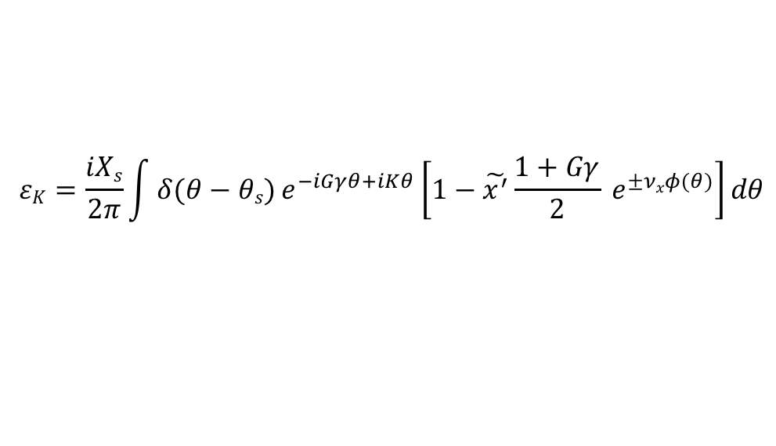
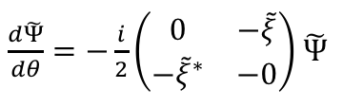



Partial snake resonances are ‘hybrid’ resonances
M.Bai showed horizontal closed orbit motion can interact with a vertical intrinsic to produce a set of sideband resonances*.
Similar procedure shows horizontal betatron motion can interact with the snake spin kick in the same way
$\frac{dΨ}{dθ}=−\frac{i}{2}\left(\begin{matrix}F & −ξ \\ −ξ^{∗} & −F\end{matrix}\right)$ $Ψ$
$$Ψ=\exp{[\frac{i}{2}σ3(Gγθ−(1+Gγ\text{)}\text{x}\text{’(}θ)ρ\text{ ]}\tilde{Ψ}}$$
$\frac{d\tilde{Ψ}}{dθ}=−\frac{i}{2}\left(\begin{matrix}0 & −\tilde{ξ} \\ −{\tilde{ξ}}^{∗} & −0\end{matrix}\right)$ $\tilde{Ψ}$
$$ξ=i Xs δ\left(θ−θs\right)$$
$$spin precessing frame$$
$\tilde{ξ}=i Xs δ\left(θ−θs\right)$ $e^{−i(Gγθ−\left(1+Gγ\right)x^{′}\left(θ\right))}$
$$F=Gγ−\left(1+Gγ\right)x′′(θ)ρ$$
$\tilde{ξ}=i Xs δ\left(θ−θs\right)$ $e^{−i(Gγθ−\left(1+Gγ\right)x^{′}\left(θ\right))}$
$$x^{′}(θ)=\tilde{x^{′}}sin⁡(νxθ)$$
Expansion to get trig out of the exponent. Keep linear terms and Fourier transform:
$$εK=\frac{iXs}{2π}\int{δ(θ−θs)}e^{−iGγθ+iKθ}\left[1−\tilde{x^{′}}\frac{1+Gγ}{2} e^{±νxφ(θ)}\right]dθ$$
*Phys Rev Lett, Vol 84, 6, 2000

Slide 25
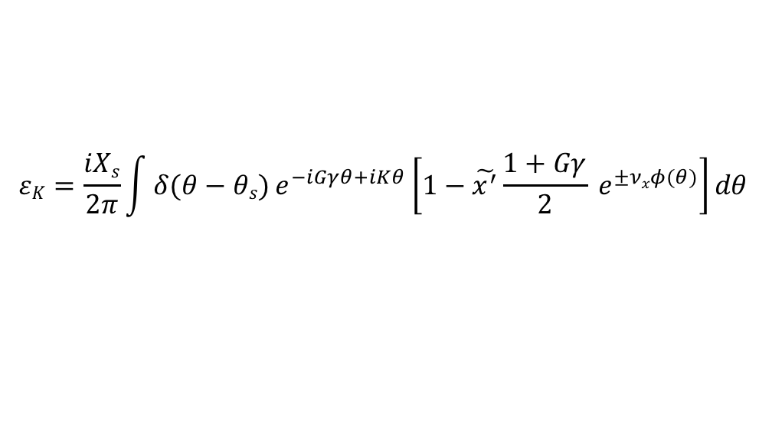

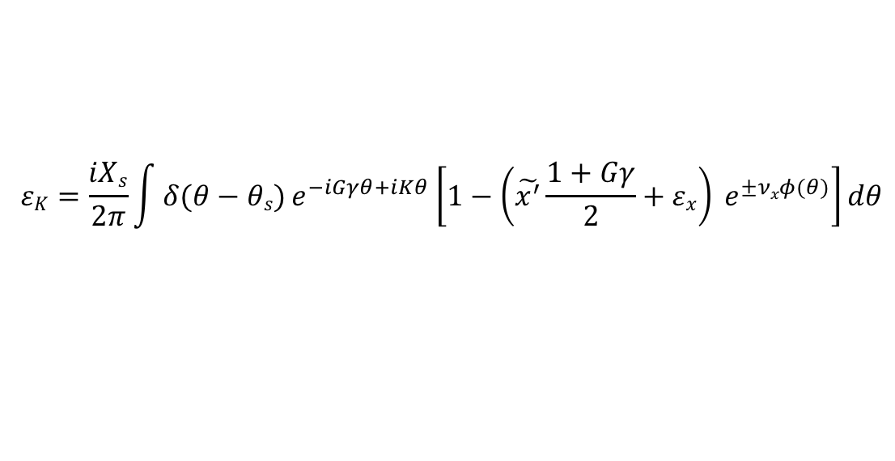
Partial snake resonances are ‘hybrid’ resonances
$$εK=\frac{iXs}{2π}\int{δ(θ−θs)}e^{−iGγθ+iKθ}\left[1−\tilde{x^{′}}\frac{1+Gγ}{2} e^{±νxφ(θ)}\right]dθ$$
Term 1: Amplitude X_{s}/2π, non-zero when $Gγ=K$ , snake imperfections
Term 2: Amplitude ~ $\tilde{x^{′}}$, non-zero when$Gγ±νx=K$ , intrinsic resonance driven by the phase modulation of the snake imperfections
What if another intrinsic resonance is present at frequency ν_{x}:
$ξ=i Xs δ\left(θ−θs\right)$+ ${εxe}^{±νxφ(θ)}$
$$εK=\frac{iXs}{2π}\int{δ(θ−θs)}e^{−iGγθ+iKθ}\left[1−\left(\tilde{x^{′}}\frac{1+Gγ}{2}+εx\right) e^{±νxφ(θ)}\right]dθ$$
A second intrinsic resonance at the horizontal betatron tune can be used to cancel the partial snake resonance term.
Easiest way to make one is with betatron coupling

