Slide 1
ML for Luminosity Optimization
Xiaofeng Gu
Collider-Accelerator Department, BNL
Dec 14, 2022

Slide 2
Outline:
Motivation
Bayesian and Gaussian Process
XGBoost for Offline Analysis
Road Map for Luminosity Optimization
Others

Slide 3
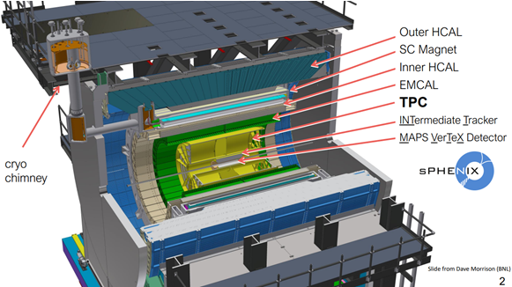
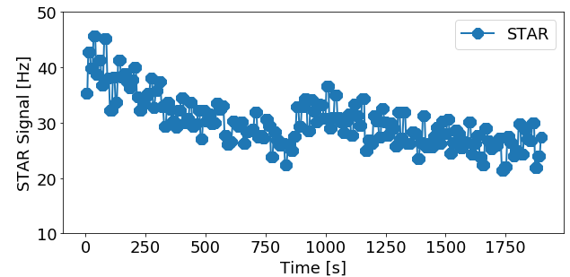
1) Motivation--RHIC luminosity Optimization
sPHENIX will start to take physics data starting in 2023.
The VTX detector locates at ± 10 cm from the interaction point (IP). Therefore, we would like to maximize (1) the ‘vertex’ luminosity within ± 10 cm while minimizing (2) the collision outside this region, to avoid detector backgrounds.
The sPHENIX luminosity signal could be noisy (3).
It can be affected by many parameters (4) at the same time. It is not easy to distinguish the effects of one parameter from all other parameters separately.
Therefore, optimizing the performance of sPHENIX becomes a two- or multi-objective optimization problem with possible noisy signals and involves many parameters.
Machine learning (BO) could be a good choice. See more about this in the previous presentation (Georg Hoffstaetter).
Global Parameters:
Orbit (Dipole)
Tune (Quadrupole),
Chromaticity (Sextuple)
Octupole
Local (IR) Parameters:
Beta*
S*
Alignment
Other Parameters:
RF Voltage
Collimator Position

Slide 4
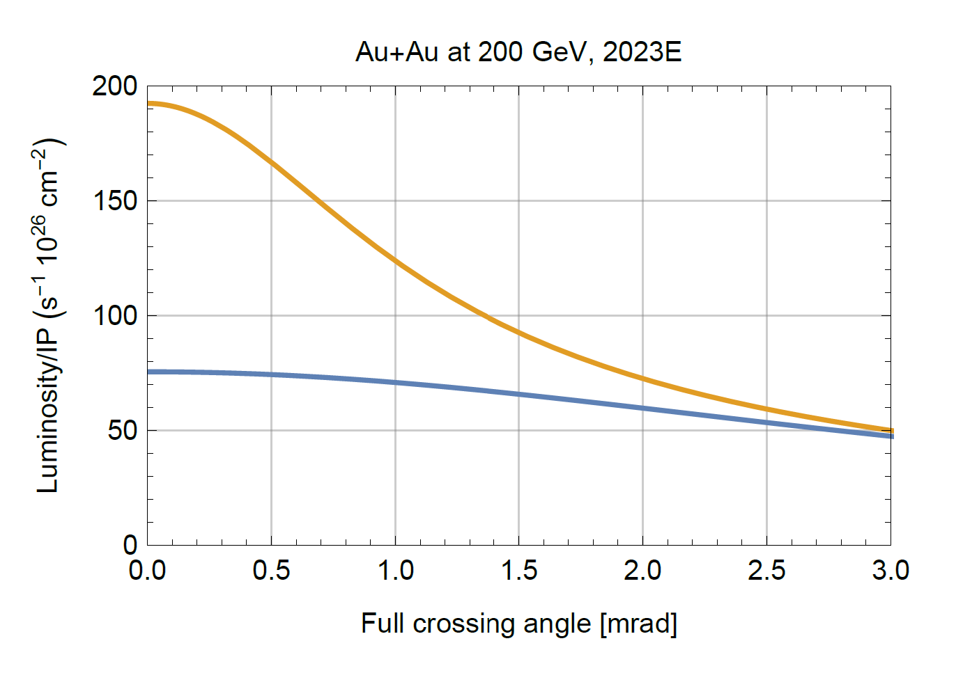
4) Motivation--RHIC luminosity Optimization
Global Parameters:
Orbit (Dipole)
Tune (Quadrupole),
Chromaticity (Sextuple)
Octupole
Local Parameters (Q1-Q5):
Beta* (x, y for 1 ring)
S* (1 ring)
Alignment
Other Parameters:
RF Voltage
Collimator Position
Intensity
sPHENIX:
Collision with 2 mrad crossing angle: will minimize the collision from undesired locations.
This needs a finer beat* and s* than previous operations. Early studies show the uncorrected s* may be as high as 10-30 cm. The diagnostic instruments for the beat* and s* are outside the interaction region.
Q1~Q5 will be used for optimization. But other parameters will be included for modeling.
To do the optimization with fewer data points as well as provide some uncertainty information, an online BO algorithm will be used.
ALL
VTX
Courtesy of W. Fischer

Slide 5
Outline:
Motivation
Bayesian and Gaussian Process
XGBoost for Offline Analysis
Road Map for Luminosity Optimization
Others

Slide 6
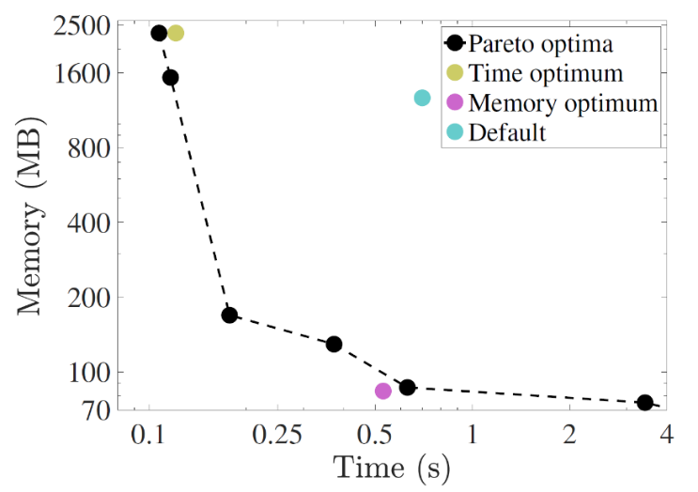
2) Bayesian optimization at LBNL GPTune
Several features of GPTune (BLNL) are very useful for HPC simulation codes, including:
relies on dynamic process management for running applications with varying core counts and GPUs
can incorporate coarse performance models to improve the surrogate model
allows multi-objective tuning such as tuning a hybrid of computation, memory and communication
allows multi-fidelity tuning to better utilize the limited resource budget
supports checkpoints and reuse of historical performance database.
Application:
Conduct parameter optimization for several HPC codes. The most notable result is for the multiscale production-level full-blown simulation codes, M3D-C1 and NIMROD that are used in the fusion Tokamak design.
https://github.com/mkturkcan/GPTune
https://nimrodteam.org/meetings/team_mtg_5_21/nimrod_meeting_YangLiu.pdf

Slide 7
2) Bayesian optimization at SLAC
Currenty Xopt provides:
optimization algorithms:
cnsga Continuous NSGA (nondominated sorting genetic algorithm)-II with constraints.
bayesian_optimization Single objective Bayesian optimization (w/ or w/o constraints, serial or parallel).
mobo Multi-objective Bayesian optimization (w/ or w/o constraints, serial or parallel).
bayesian_exploration Bayesian exploration.
sampling algorithms:
random sampler
Convenient YAML/JSON based input format.
Driver programs:
xopt.mpi.run Parallel MPI execution using this input format.
https://github.com/ChristopherMayes/Xopt
https://christophermayes.github.io/Xopt/assets/xopt_overview.pdf

Slide 8
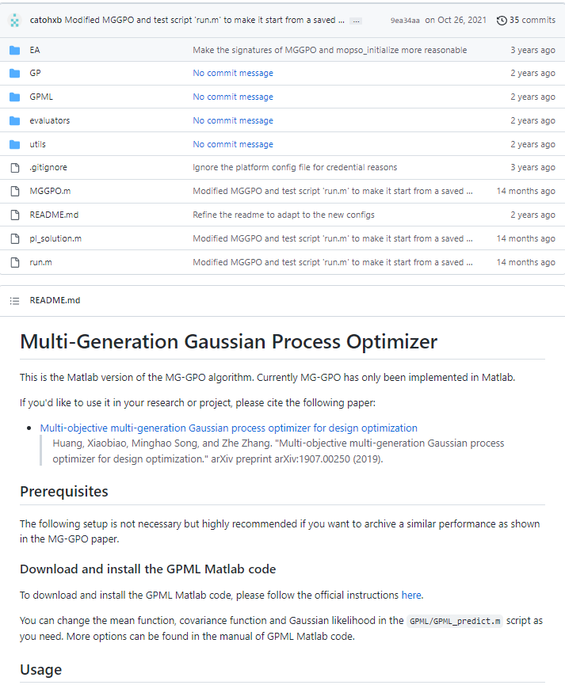
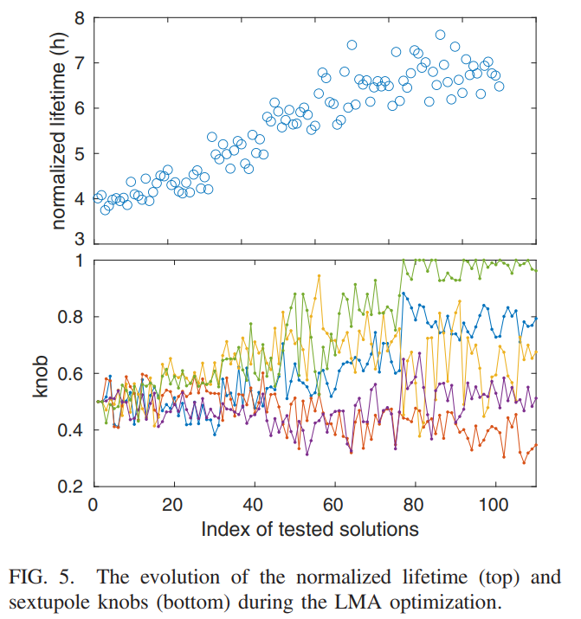
2) Bayesian optimization at ANL
Multi-Generation Gaussian Process Optimizer
https://github.com/SPEAR3-ML/MG-GPO
https://journals.aps.org/prab/pdf/10.1103/PhysRevAccelBeams.24.082802

Slide 9
2) Bayesian optimization at BNL
**Advanced Bayesian Optimizations (BO)** used to optimize the cooling rate in the LEReC system.
Standard BO is well-known for optimizing black-box functions. The implementation bayesian_optimization is chosen for its concise process.
A physics-informed GP was purposed in [1], the process converges faster when extracting a Hessian matrix from the historical inputs data.
However, the previous methods only work well in a static environment. In the LEReC system, the ion intensity is decreasing over time which affects the cooling rate. The techniques in [2] is incorporated to deal with the dynamic features of the
system.
[1] A. Hanuka, X. Huang, J. Shtalenkova, etc.,
[Physics-informed Gaussian Process for Online Optimization of Particle Accelerators.](https://arxiv.org/abs/2009.03566)
[2] Andreas Krause and Cheng Soon Ong,
[Contextual Gaussian Process Bandit Optimization.](https://papers.nips.cc/paper/2011/hash/f3f1b7fc5a8779a9e618e1f23a7b7860-Abstract.html)
Courtesy of Y. Gao
LEReC beam alignment with BO for a better cooling
Yuan Gao, etc. See the previous presentation (Kevin Brown)
https://github.com/jmetzen/bayesian_optimization
https://github.com/jwangjie/Gaussian-Processes-Regression-Tutorial

Slide 10
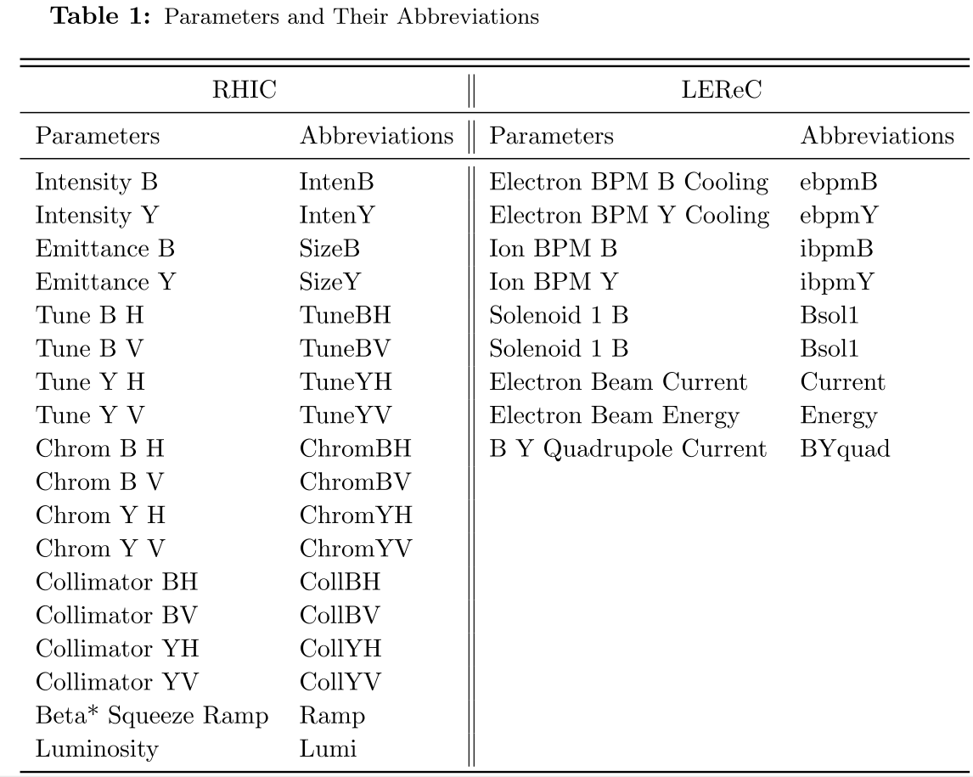
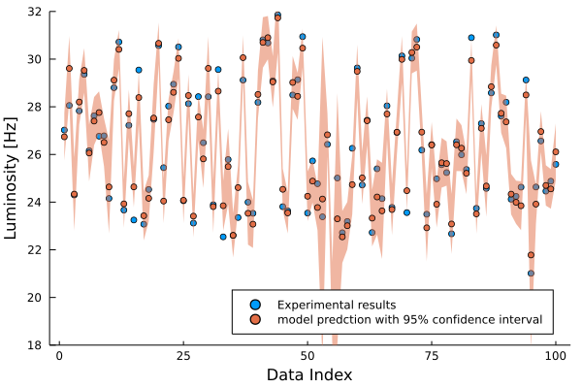
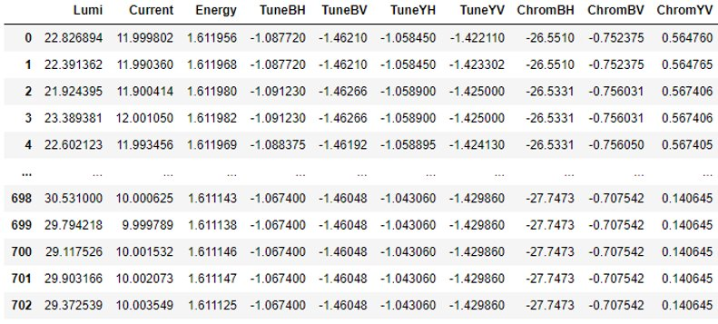
2) Bayesian optimization at BNL (offline)
2020/21 Low Energy Run
Global Parameters:
Tune (Quadrupole),
Chromaticity (Sextuple)
Local LEReC Parameters:
Electron beam Current
Energy
Alignment
Other Parameters:
Beta* Squeeze Ramp
Collimator Position
703 useful stores
GP model with uncertainty for the same experimental data

Slide 11
Outline:
Motivation
Bayesian and Gaussian Process
XGBoost for Offline Analysis
Road Map for Luminosity Optimization
Others

Slide 12
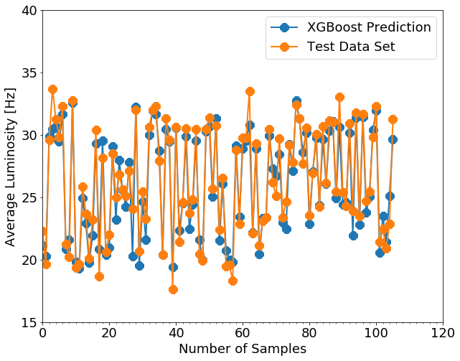
3) XGBoost application at BNL (Offline)
XGBoost python package:
Multi-dimensions nonlinear regression algorithm: good for f(x1,x2,x3, … , x26) with n>3 or 4. (Higgs Machine Learning Challenge)
The black-box model: 80% data for training, 20% data for test and comparison
Model R_2 score: 0.90, predicts the luminosity very well.

Slide 13
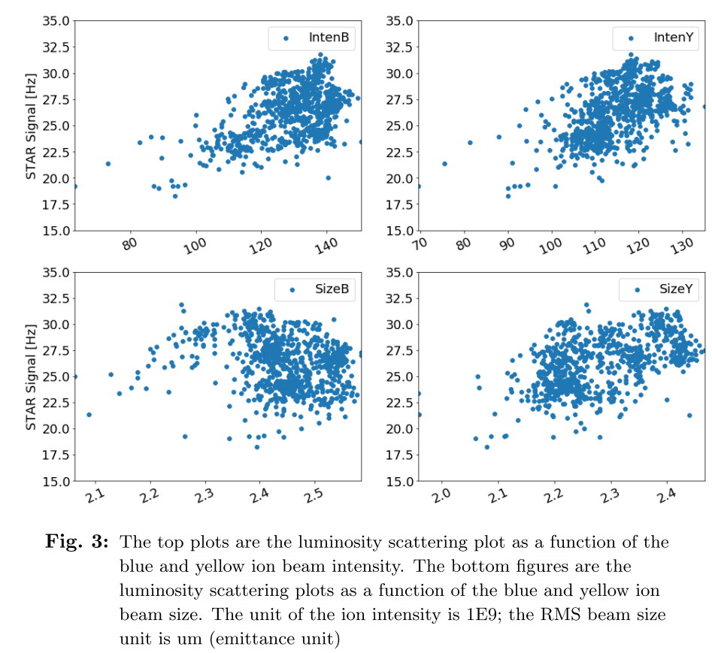
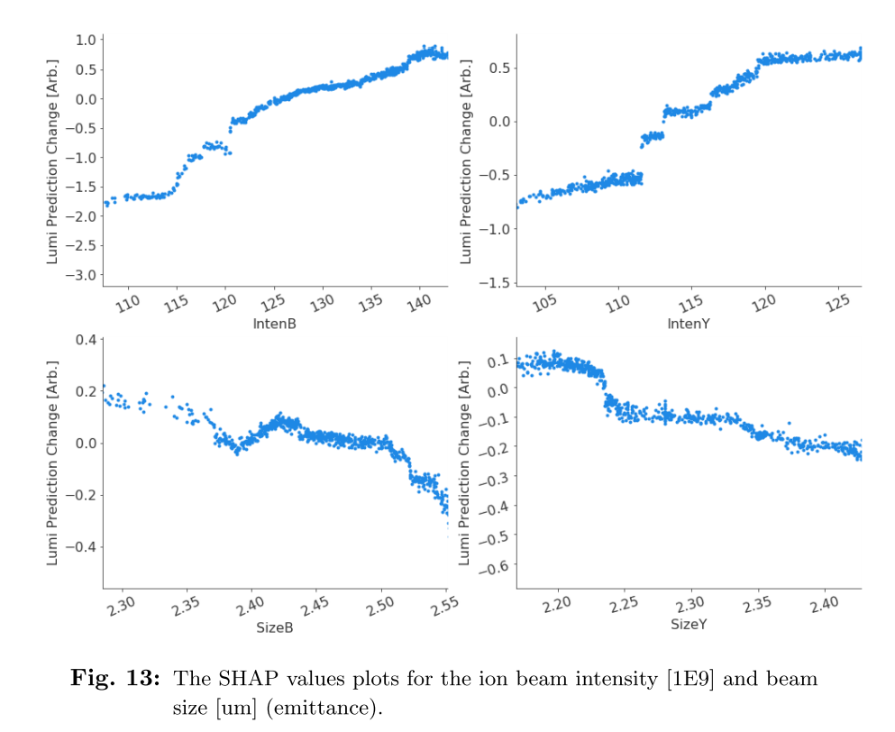
4) XGBoost Model Validated with 2020 Data
Not clear.
Doesn't agree with the theory​
Clear trend and they both agree with the theory.

Slide 14
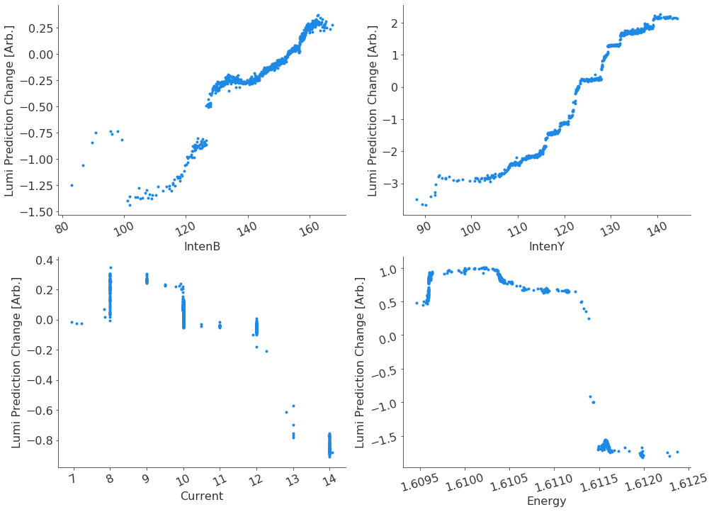
3) XGBoost application at BNL (2021, Offline)
Intensity: IntenY ~ 5 Hz, IntenB ~ 2 Hz; higher blue beam loss? Or blue beam was injected first?
Current: 10 A, more data points (6A) to confirm the optimized value.
Energy: this plot can't be used for optimization.
The same energy feedback setpoint, the actual energy can be different.

Slide 15
Outline:
Motivation
Bayesian and Gaussian Process
XGBoost for Offline Analysis
Road Map for Luminosity Optimization
Others

Slide 16
4) Offline Luminosity Optimization with Model
Machine
parameters
Optimization method
Offline Model
Luminosity model
Optimization parameter
GPTune
MG-GPO
Xpot
Gaussian Process
BB3D
guinea-pig
Q1-Q5
MADX
Bmad
Luminosity
https://gitlab.cern.ch/clic-software/guinea-pig

Slide 17
4) Online Luminosity Optimization
Machine
parameters
Optimization method
Parameters Limit
Set to RHIC
Luminosity Measurement
Checking
The Limits
GPTune
MG-GPO
Xpot
Gaussian Process
New Q1-Q5 Parameters
VTX
signal
Q1-Q5
Warning: Limited User

Slide 18
Outline:
Motivation
Bayesian and Gaussian Process
XGBoost for Offline Analysis
Road Map for Luminosity Optimization
Others

Slide 19
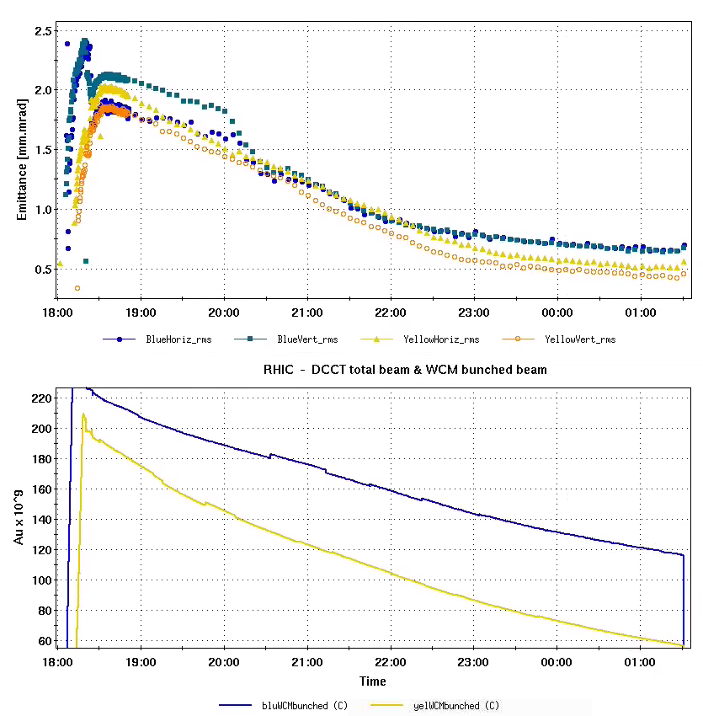
5) Challenges and Collaboration
Challenges:
Changing the Dispersion at IP (re-matching with madx?)
Changing the optics around the ring
The signals (normalized luminosity) are noisy (luminosity, intensity, instrumentation, …)
The beam emittance is changing during the store
Au Emittance
End of store time.
Collaboration:
CAD control, operation, RF, AP group
MSU (maybe a student during the summer)
LBNL (code, offline analysis)
More help?
Au Intensity

Slide 20
5) Summary
Machine learning has some advantages for RHIC luminosity (sPHENIX) optimization (multi-object, many parameters, fewer experimental data points, uncertainty, noisy signals, exploring new data range…).
There are several Bayesian Optimization methods (online and offline) available and installed for RHIC luminosity optimizations. Will evaluate and use them for Run23.
The roadmap for the application is available, with some challenges. Offline algorithms with models will be developed first, and the online version will be followed with two layers of machine protection.
Not like an unsupervised machine learning algorithm, BO is a supervised machine learning algorithm and there will be no newly created parameters involved. Q1~Q5 strengths and the collimator position will be used for optimization. But other parameters will be included for modeling.
End-of-store time can be used for the online model tuning.

Slide 21
Thank you.

