Slide 1
LEReC-based R&D
Alexei Fedotov
C-AD MAC
December 13-15, 2022

Slide 2
Outline
Response to LEReC recommendations from 2021
LEReC cooling studies R&D
LEReC high-current R&D
Future plans
2

Slide 3
Response to recommendations from MAC 2021
R1-2: Since the time for cooling experiments in 2022 and 2023 may be limited, prioritize the variety of planned cooling experiments based on the needs of the EIC precooler and high-energy cooler designs, while aiming to avoid possible loss of time due to potential gun damage in high current studies. Consider lowering the priority of high voltage high current gun studies, as these studies can presumably be done elsewhere or later, while the window of opportunity for LEReC cooling study is limited.
Cooling studies were a priority in 2022 and are priority for run 2023.
Because very limited RHIC time was available for cooling experiments (Run-22 was with protons while cooling studies required Au ions) this allowed to proceed, very carefully, with high-current R&D, which went very well.
For the EIC, the high-current R&D is of critical importance since it is an integrable part of both low and high-energy EIC coolers.

Slide 4
Distinctive features of LEReC
LEReC is fully operational electron cooler which:
  utilizes RF-accelerated electron bunches
  uses non-magnetized electron beam (there is no magnetization at the cathode and there is no continuous solenoidal field in the cooling section)
LEReC approach is directly scalable to high energies: Baseline for the EIC Precooler (13 MeV), see presentation by D. Kayran.
LEReC operations for RHIC physics program (Beam Energy Scan II) concluded in 2021. Starting June 2021 LEReC is being used for dedicated experimental studies of various cooling topics.
4

Slide 5
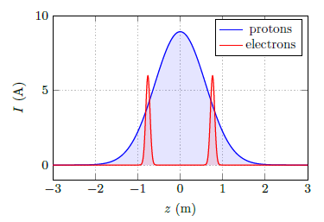
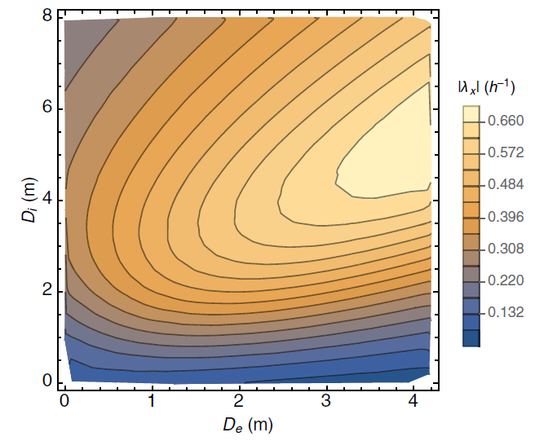
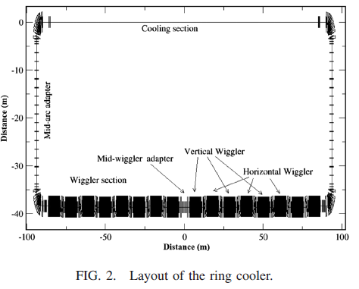
Importance of LEReC cooling studies for future high-energy coolers, including EIC
Electron cooling using bunched electron beams (LEReC-type cooler) is proposed for:
Pre-cooling of protons at 24GeV for EIC (13 MeV electron cooler)
Cooling protons directly at collision energy of 41GeV in EIC (22 MeV electron cooler)
A. Fedotov, S. Benson et al., “Low energy cooling for EIC”, BNL-220686-2020-TECH (2020)
Cooling of protons at the highest energy of 275GeV using storage ring electron cooler (150 MeV)
H. Zhao, J. Kewisch, et al., “Ring-based electron cooler for high energy beam cooling”, Phys. Rev. Acc. Beams 24, 043501 (2021)
Dispersive cooling (275GeV, EIC):
Horizontal cooling rate
150 MeV Storage Ring
electron cooler

Slide 6
Cooling experiments using LEReC
Coherent excitations of ions and circular attractors – completed, paper submitted for publication
Recombination of ions without continuous magnetic field in cooling section – completed
Machine learning at LEReC – completed, paper published
Emittance growth of ion beam (“heating”) due to interaction with bunched electron beam – additional studies were performed in 2022
Dispersive cooling (redistribution of cooling decrements), to provide stronger transverse cooling – started in 2021, to be continued.
Effects of the presence of the electron beam on the ion beam lifetime (beam-beam from electron cooler beam): This is extremely important effect when one considers electron coolers for colliders, such as for the EIC - to be performed.
Other EIC-related experiments are under discussion: a) Cooling in single plane with decoupling b) maintaining large emittance aspect ratios in the presence of non-linear coupling, including space charge; other…
RHIC run in 2022 was with protons with very limited time available for studies with Au ions: Only single APEX experiment on “heating” was performed.

Slide 7
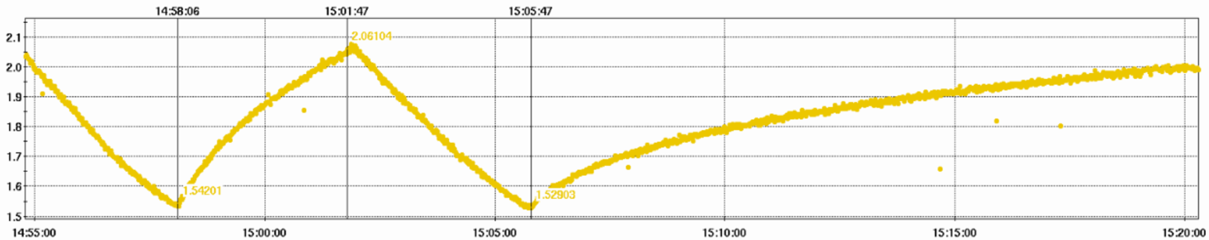
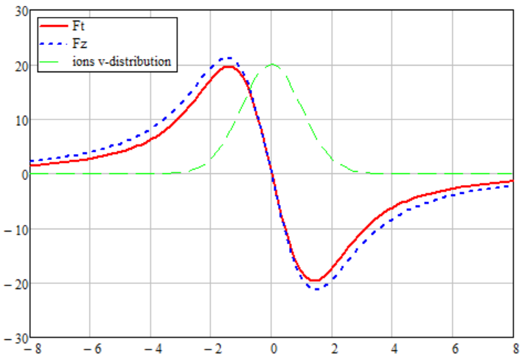
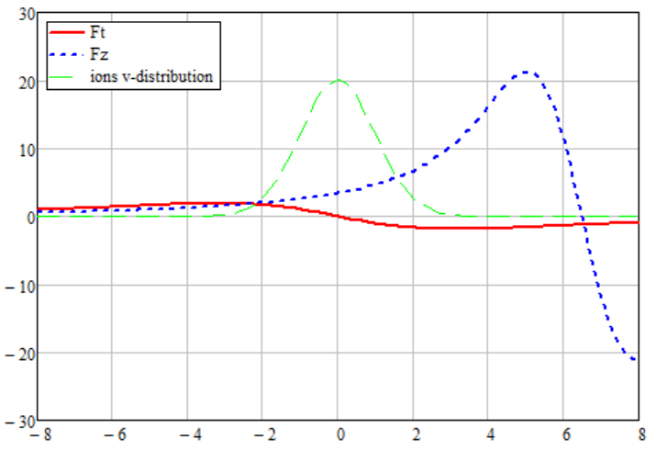


Electron-ion heating experiment
In the presence of e-beam and with the “zeroed” cooling we observed a much faster growth of the transverse size of the i-bunch than the IBS driven size growth.
We called this additional growth of the emittance “the electron-ion heating”
pre-cooling
IBS + e-i heating
IBS
Vertical bunch size [mm]
pre-cooling
e-beam is turned off
Time
E-beam is 5 kV ($μ_{iz}≈6.3σ_{v_{ez}}$) off energy
E-beam is on energy
We suppress the cooling while keeping the electron beam in the CS by detuning the electron beam energy by a few kV
Friction force [eV/m]
Friction force [eV/m]
$$v_{it}/σ_{v_{et}};v_{iz}/σ_{v_{ez}}$$
$$v_{it}/σ_{v_{et}};v_{iz}/σ_{v_{ez}}$$
7

Slide 8
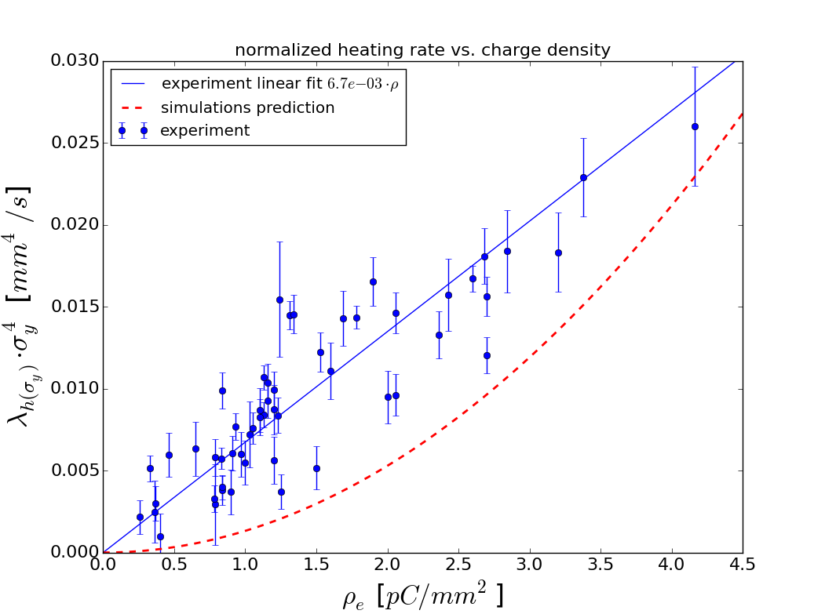

Electron-ion heating (comparison to models)
Several theories were applied to the experimental data, but none of them predict experimentally observed dependence).
$$λ_{h\left(σ_{y}\right)}σ_{y}^{4}=C_{0}ρ_{e}$$
A simple “random walk model” with either dipole or focusing kicks.
A more sophisticated model where focusing kicks from the space charge of e-bunches drive synchro-betatron resonances and the heating effect occurs due to the longitudinal IBS continuously “dragging” individual ions through resonances.
The red dashed line shows the model’s prediction for the heating rate on the average e-beam density. The simulations include the cooling force, intra-beam scattering, ion-electron focusing and electron-ion focusing kick.
New ideas were explored during 2022 experiment (next slide).
8

Slide 9
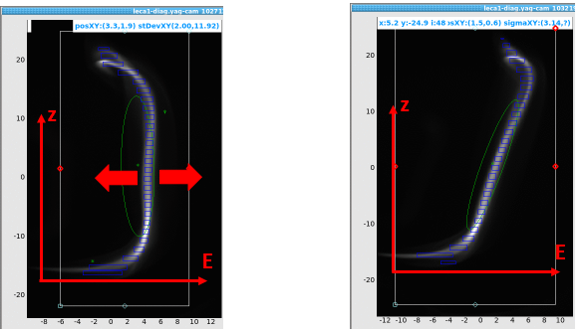


2022 heating experiment: Does energy offset produce heating?
E-beam is 5 kV ($μ_{iz}≈6.3σ_{v_{ez}}$) off energy
A substantial enough offset in electron beam energy creates a mechanism of longitudinal heating
This heating can be partially redistributed to transverse direction through coupling
To check whether we “create” transverse heating by offsetting beam energy we performed measurements with chirped e-bunch.
Friction force [eV/m]
offset
chirp
$$v_{it}/σ_{v_{et}};v_{iz}/σ_{v_{ez}}$$
We compared the heating measured for the e-beam with energy offset and the beam with the chirp, large enough to produce a similar cooling force suppression
9

Slide 10
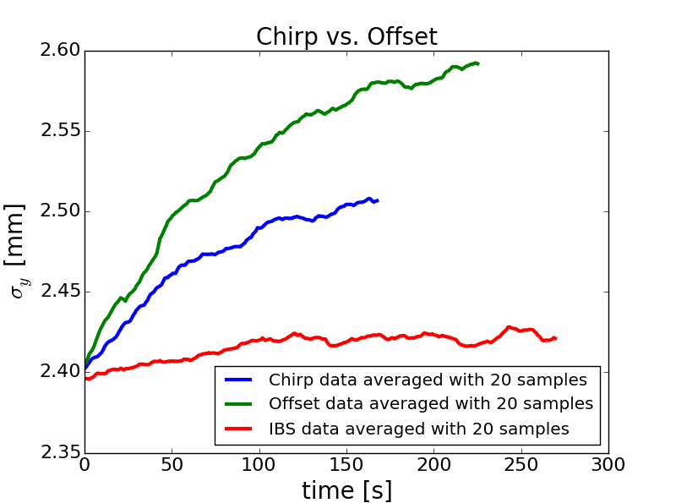
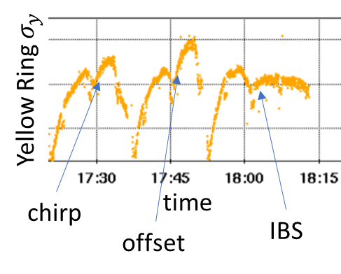
Electron-ion heating: Chirp vs. offset
Substantial part of emittance growth can be explained by the energy offset.
10

Slide 11
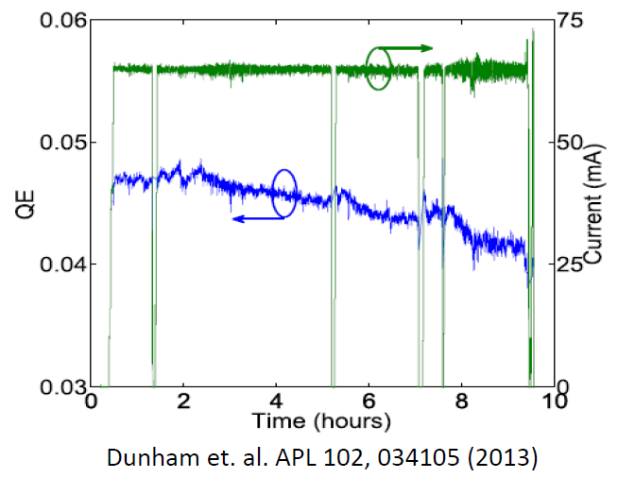
High-current R&D
Motivation: EIC coolers, low-energy coolers (13 and 22MeV) and high-energy SHC-CeC (150 MeV), require stable long-term operation of electron source at around 100mA current.
LEReC Gun (built by Cornell University) is designed to operate up to 100mA.
Each HVPS inverter is rated for 37.5kW power. This determines at which voltage what current could be run with a single inverter. For example, one can go up to 100mA at 375kV with a single inverter. It may be possible to go to higher currents with two inverters. Tests with two inverters are in progress.
HVPS multiplier boards are rated at 100mA. Tests are presently underway to determine maximum current which will be allowed for operations.
High-current operational experience:
Demonstration of 65mA over several hours at Cornell
Long-term (>24 hours) LEReC operation without
gun trips at around 20mA
High-current R&D at BNL using DC Gun is in progress.

Slide 12
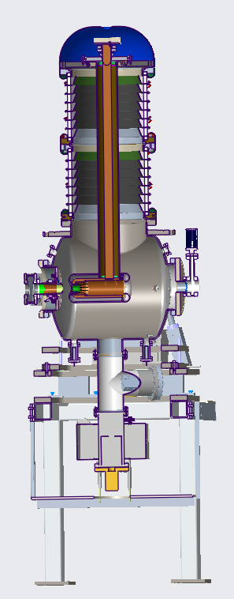
Electron source high-current R&D
Explore LEReC Gun operation with high-current: 50-100mA. Determine limitation both of the Gun and the HVPS.
Explore Gun and HVPS long-term stability at high currents.
Explore Gun voltage limitations: can one have stable long-term high-current operation at 400kV, 425kV?
Explore operation with active cathode on center vs cathode off center.
Explore large cathode area vs small active area. Explore various laser spot sizes on the cathode.
Explore cathode QE at various laser powers with and without cathode stalk cooling.
Test multi-alkali photocathodes using different growth methods.
High-charge high-peak current (beam halo and losses), explore possible upgrade of laser system to allow ramping of high-current for fixed electron bunch charge.
This R&D is of critical importance for the EIC coolers,
which are presently under design.

Slide 13
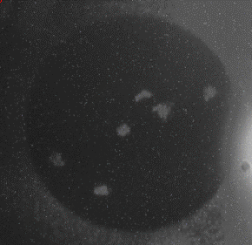
Initial high-current CW operation: 30 mA with large cathode and laser on the center (July 23, 2018)
Gun trips
Cathode with damaged spots after several gun trips

Slide 14
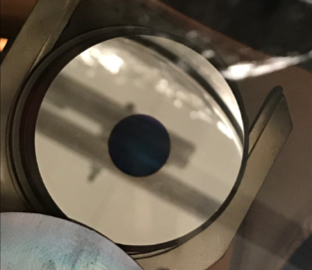
Stable high-current operation (2018)
At the end of full LEReC commissioning in September 2018:
Stable (without gun trips) operation at 30mA current was achieved with:
1) Anode bias to prevent ion back bombardment (without it, Gun tripped every 30min or so). Bias of 1kV was sufficient to make Gun stable long-term (no difference 1-3kV; kept anode bias at 3kV).
2) Using off-center small-area active cathode.
3) Laser feedbacks, including intensity feedback.
No Gun trips
On center large (12mm) active area used during 2017-18
Off center by 4 mm small active cathode area (6mm),
used at the end of 2018 and 2019-2022.
14

Slide 15
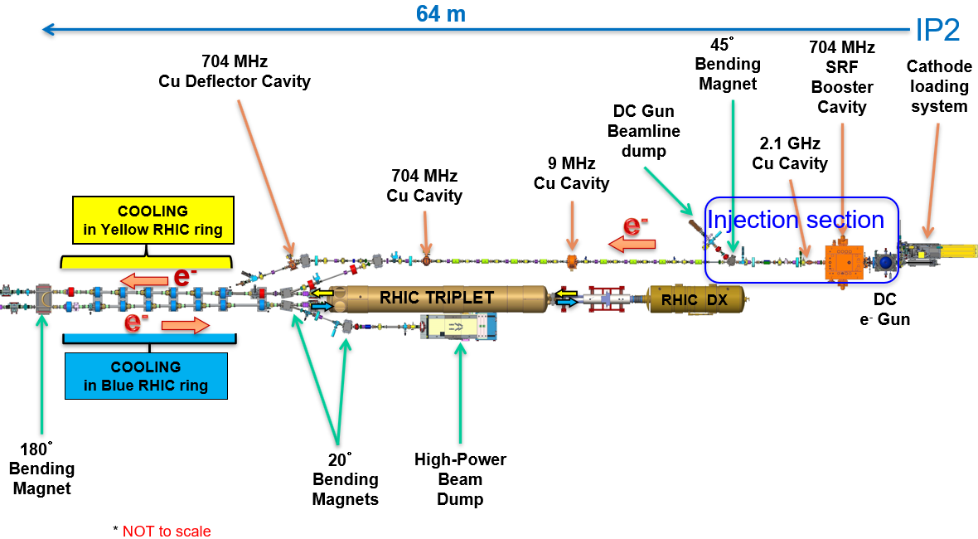
Operation during RHIC Run-22 (Nov’21-April’22)
High-current R&D studies (without ions):
Explore Gun operation at high current in present LEReC configuration:
Running e-beam to high-power beam dump (140kW): requires dedicated RHIC time (was not available in 2022) – plan is to request some periods during Maintenance Days when IP2 could be closed earlier (while work at other IPs continues)
Running in parallel to RHIC operations to injection dump (25kW) – limited by dump power
25 kW
dump
140 kW
dump

Slide 16
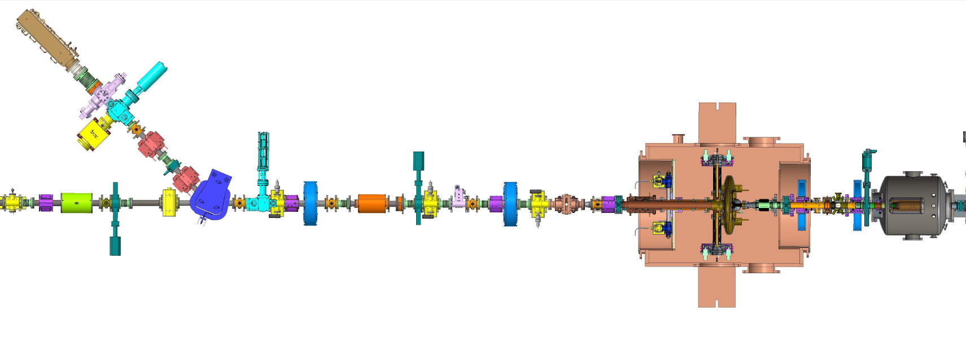
LEReC Injection section
Injection dump (limited to 25 kW)
DC Gun
@350kV
2.1 GHz RF cavity
@ 0MV
SRF Booster cavity
@ 0.15MV
7 m
16

Slide 17
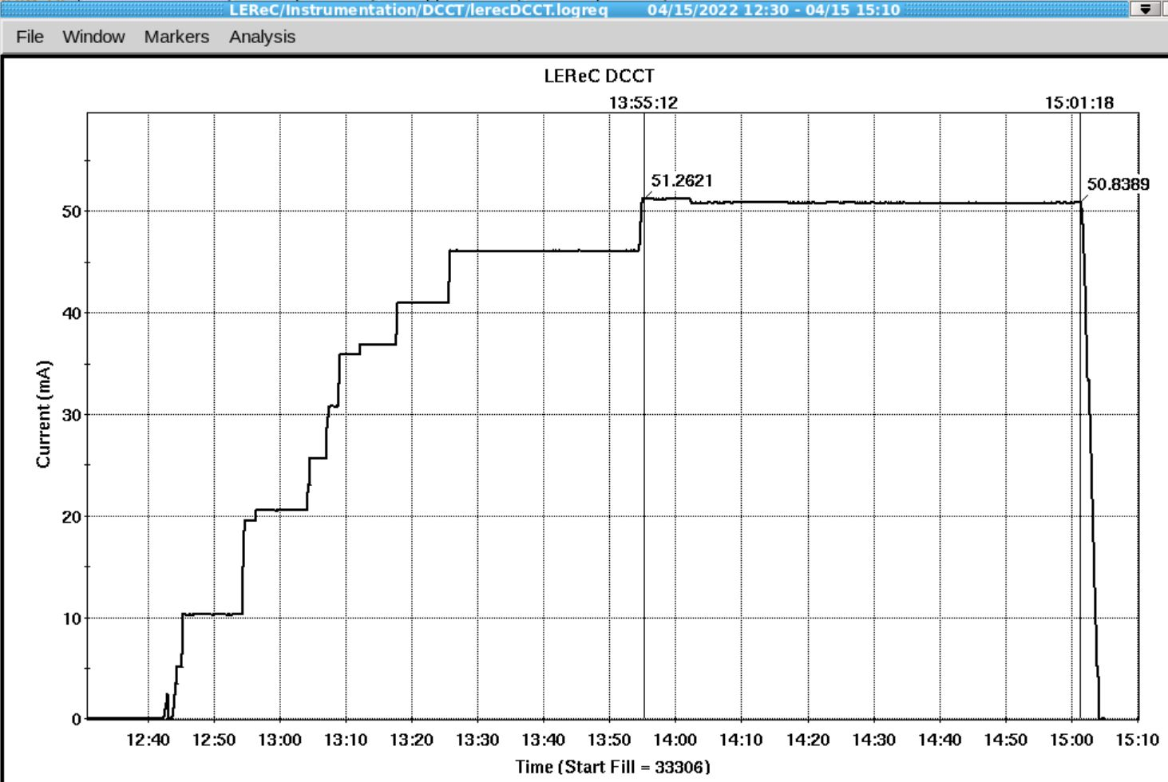
High-current operation: 2022
During 2022 operation using injection beam dump configuration, establishing of high-current was limited by:
Beam optics with space charge.
Beam losses at limiting apertures.
Need to ramp down current and Gun volage when large losses (from RHIC or CeC) are expected, to protect HVPS electronics (high-current tests were done in parallel to RHIC ops).
HVPS trips on overcurrent.
Stable operation at 50mA @0.5MeV (limited by 25kW injection dump power) was established
Operation at 50mA current
17

Slide 18
LEReC Run-23 Plan and beyond
2023:
Cooling studies (with Au ions):
Continue cooling studies using Accelerator Physics Experiments time.
High-current R&D studies (without ions):
1) Explore long-term stability at high currents up to 50mA, using injection beam dump.
2) Explore Gun operation at high currents above 50mA:
Requires propagating e-beam to high-power beam dump (100 meters of beam line and 4 RF cavities, one RF cavity was removed to allow for easier high-current transport in this configuration). It also requires dedicated time (could use some time during Maintenance Days) since we have to propagate electron beam through common sections with RHIC.
After 2023 RHIC run:
Further high-current R&D studies: moving high-power beam dump closer to the Gun. Could be done if all cooling studies are completed.

Slide 19
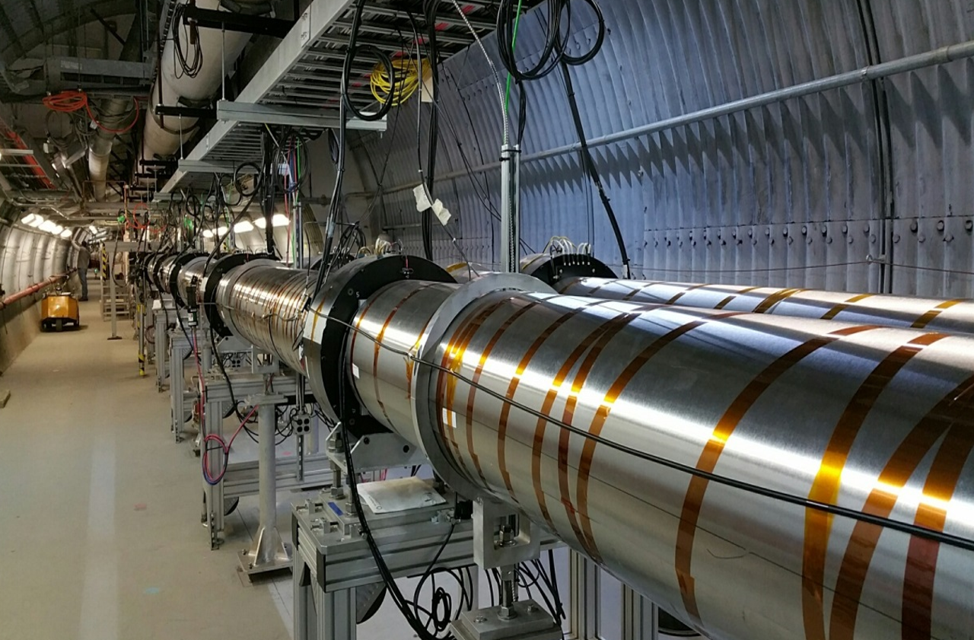
Summary
LEReC successfully operated for RHIC physics program in 2020 and 2021, making it the world’s first operational electron cooler to cool ions directly at collision energy.
Presently, LEReC is being used for dedicated experimental studies of various cooling topics and high-current R&D.
Several dedicated cooling experiments are already completed (coherent excitations, recombination, machine learning). Several cooling experiments are in progress or planned (heating, dispersive cooling, lifetime studies, cooling with decoupling).
High-current R&D using LEReC Gun started in 2022. Stable operation at 50mA was established.

