Slide 1
Extending the LEReC concept to EIC injection energy e-cooler
Dmitry Kayran
C-AD MAC
December 13-15, 2022

Slide 2
Outline
Introduction
LEReC concept
Precooler requirements
Integration with SHC
Beam dynamics simulation results
  Injector
  Cooling sections consideration
Benefit of using 2nd harmonics in HSR
Summary
2

Slide 3
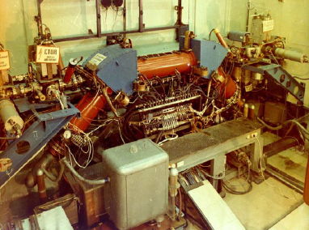

Electron Cooling
The method of electron cooling was first presented by G.I. Budker
(Novosibirsk) at Symposium
in Saclay, 1966.
First experimental
electron cooling demonstration at NAP-M storage ring (Novosibirsk, Russia, 1974).
Regular electron cooling is a well-established technique with almost 50 years of experimental experience.
High Voltage DC coolers: (1974-): all DC electrostatic accelerators; all use magnetic field to confine electron beam (magnetized cooling). FNAL Recycler cooler: Pelletron electrostatic generator (4MeV electrons), transport of electron beam without continuous magnetic field.
RF acceleration (High Energy approach): BNL LEReC electron cooler (2019-21): First RF-linac based electron cooler (approach is directly extendable to higher energies). LEReC does not use any magnetization of electrons. LEReC was successfully used for RHIC operations in 2020-21 to cool ion bunches directly at collision energy.
3

Slide 4
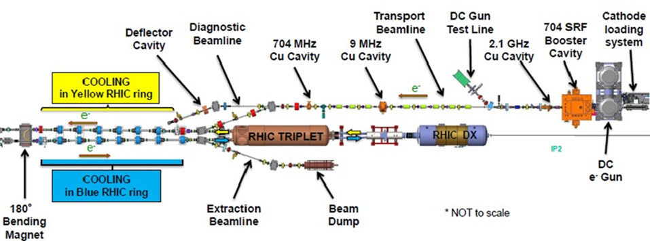
LEReC layout and features
LEReC is fully operational electron cooler which:
  utilizes RF-accelerated electron bunches
  uses non-magnetized electron beam (there is no magnetization at the cathode and there is no continuous solenoidal field in the cooling section)
  provides simultaneously cooling for two hadron beams in two different cooling sections
LEReC approach is directly scalable to high energies (10’s MeV)
4

Slide 5
LEReC beam structure used in cooling section
N_ion=6e8
Ions structure:
120 bunches
f_rep=120x75.8347 kHz=9.1 MHz
N_ion=6e8, I_peak=0.25 A
Rms length=12 nsec
Electron bunches:
f_SRF=703.5 MHz
Q_e=75 pC, I_peak=0.18 A
FWHM=400 psec
1.42 nsec
9 MHz bunch structure
30 electron bunches per ion bunch
0.3
Electron Macro-bunch
0.2
110
nsec
I,A
Long ion bunches
with 9MHz RF
0.1
0.0
-200
-100
0
100
200
-60
-40
-20
0
20
40
60
time, nsec
time, nsec
5

Slide 6
LEReC electron beam parameters
Cooler parameters used for RHIC operations | electrons | protons
Au ions beam energy, GeV/nuclei | 3.85 | 4.6
Electron kinetic energy, MeV | 1.6 | 2.0
RHIC RF frequency, MHz | 9 | 9
Cooling section length, m | 20 | 20
Cooling sections beta function, m | 20-30 | 20-30
Electron bunch (704MHz) charge, pC | 30-70 | 50-70
Charge in macbunch, nC | 1-2 | 1.5-2
Average current, mA | 8-20 | 15-20
Normalized emittance, rms, um | <2.5 | <2.5
RMS bunch length, psec | 400 | 400
RMS dp/p | < 4e-4 | <4e-4
RMS angles in cooling section, urad | <150 | <150
Non-magnetized cooling approach, 704 MHz SRF booster, 30-36 e-bunches per each Au bunch

Slide 7
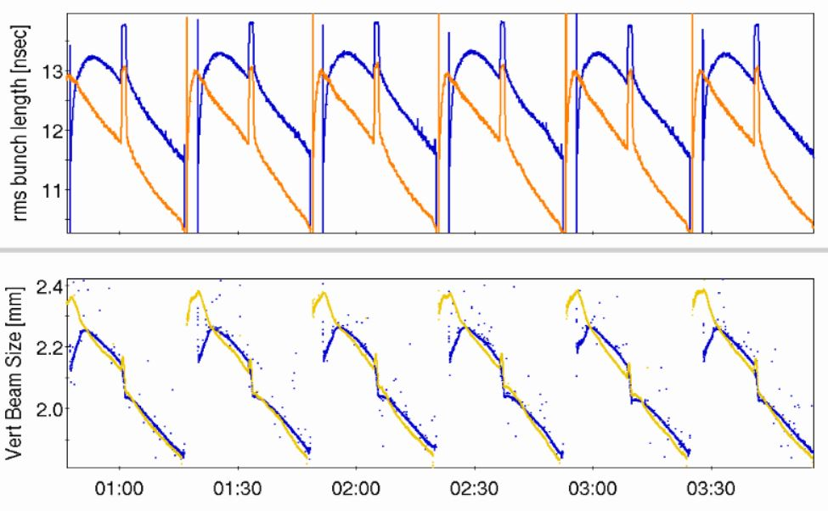
LEReC operational performance
2021 operation for physics (several physics stores),
1.6 MeV electrons, 111x111 Au ion bunches at 3.85 GeV/n,
rms bunch length (top) and rms beam size (bottom)
Spikes in bunch length are due to ion-beam RF manipulation
to alleviate space-charge effects during the beta-squeeze.
24/7 stable and robust cooling over many weeks
7

Slide 8
Electron cooling at high energy
Cooling time:
Since electron cooling scales unfavorably with energy, extension of this technique to high energies requires high electron beam densities/current, resulting in special considerations for electron accelerator.
Pre-cooling at low energy allows to reduce cooling requirements on the high-energy cooling, since ion beam with smaller velocity spread is cooled faster (as V³_{ion}).
8

Slide 9
EIC parameters from CDR and cooling goals
Goal of precooling is to obtain initial proton beam parameters
9

Slide 10
Cooling requirements for EIC
High-energy cooling of hadrons: Cooling should counteract longitudinal and transverse emittance growth due to IBS. Required cooling times at high energies should be comparable or smaller than IBS growth times. For example, transverse and longitudinal cooling times of about 2 hours are needed for cooling of protons at gamma=300.
Baseline for high-energy cooling (SHC) is based on CeC concept. Backup approach using conventional electron cooling method is being developed as well (electron Storage Ring Cooler)
Currently both High Energy Cooler scenarios suppose to provide sufficient cooling to compensate for heating effects and preserve proton beam quality during collision
10

Slide 11
Pre-cooler motivation:
Must cool the hadron beam normalized rms vertical emittance from 2.5 um (from injector) to 0.3 um in less than 2 hours at injection energy
Something to keep in mind
  Compatible with current layout of Strong Hadron Cooler
  Upgradable to keep protons cooled at 41 GeV
11

Slide 12
Integration of Precooler with SHC Challenges
Effective cooling section 60+60 m
Additional matching and mergers in the cooling sections
Proper mu-metal shielding of entire cooling sections
SRF frequency should cover operation at low and high energy
Mergers and 100+ m of transport line
Keep average current reasonable (< 100 mA)
  the record stable current demonstrated from DC Gun ~65 mA at Cornell University several years ago and ~50 mA at BNL during the last RHIC run (see Alexei’s talk early today). In long-term operation (>24hours), LEReC operated at about 20mA.
12

Slide 13
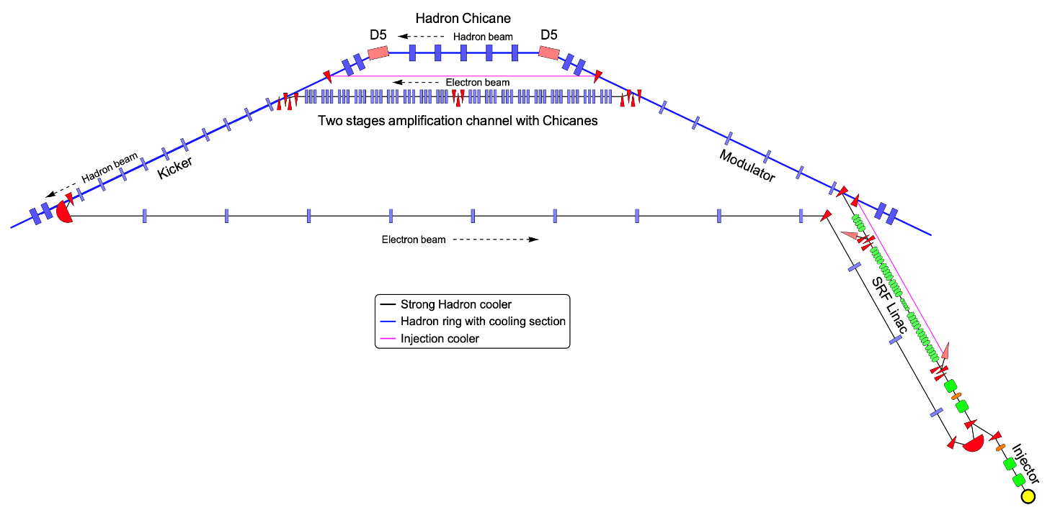
Integration of Precooler with present SHC layout at IR2
Hadron Chicane bypass
Cooling Section2
Cooling Section1
*Not to scale
SRF LINAC bypass
Beam Dump
Cooler at injection energy could use some of SHC accelerator components:
400 kV DC Gun
RF:
6 of SRF 197 MHz cavity
3 of SRF 591 MHz cavity
Returning loop (vacuum, magnets, instrumentation)
Some components of both common sections (Modulator and Kicker) might be used for beam transport
Additional critical components: SRF LINAC bypass, Hadron Chicane bypass, several mergers, and the high-power beam dump
13

Slide 14
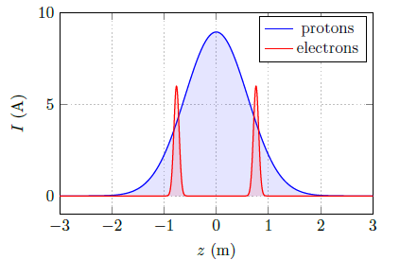
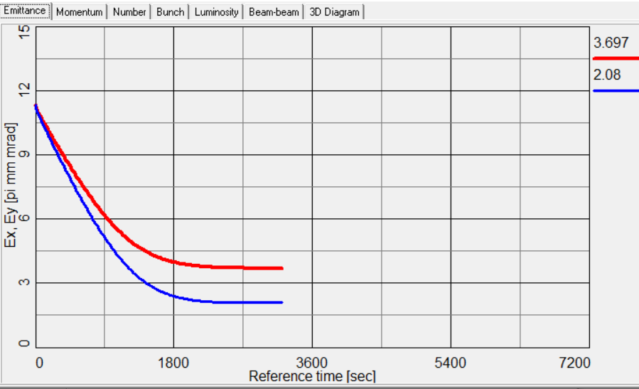
Cooling simulations
197MHz RF, 2 electron bunches at -0.75, 0.75m,
2 nC each, Qtotal=4nC, Iav=98.5mA,
Electron angles 20urad.
Plotted emittance is 95%, divide by 6 for rms values.
Red – x emittance, Blue – y emittance
Courtesy of A. Fedotov
Vertical emittance can be cooled to 0.3 um in less than 40 minutes, if one can achieve small angular spread.
14

Slide 15
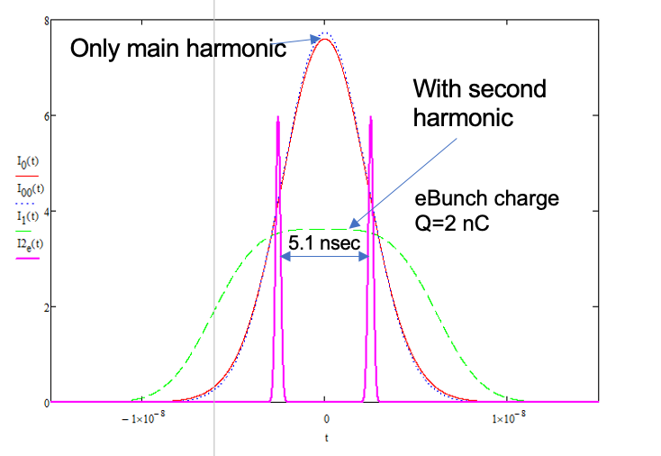
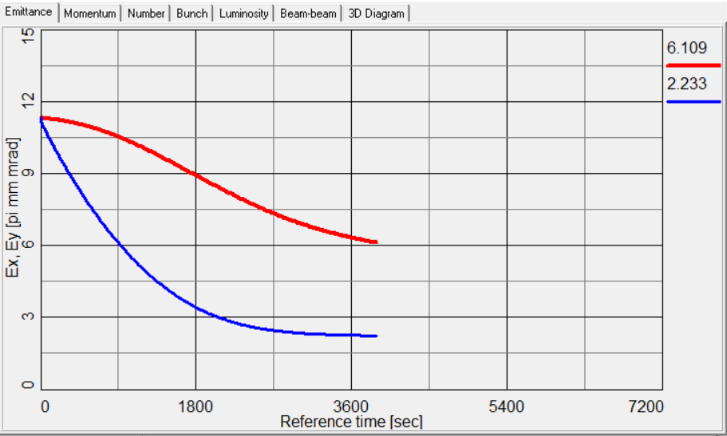
Cooling simulations (continued)
197 MHz RF, 2 electron bunches at -0.75, 0.75m,
2 nC each, Qtotal=4nC, Iav=98.5mA.
Electron angles 20urad.
With heating in horizontal direction to stay with space charge limit
Plotted emittance is 95%, divide by 6 for rms values.
Red – x emittance, Blue – y emittance
With 2nd harmonic RF used in the HSR space charge tune can be kept reasonable :
dQ_{x,y}: 0.07, 0.12
Courtesy of A. Fedotov
With heating in horizontal direction, cooling vertical emittance to 0.3 um might be still possible but it will take longer time.
15

Slide 16
Cooler parameters to cool protons at 23.8 GeV
 | electrons | protons
gamma | 25.4 | 25.4
RHIC RF frequency, MHz | 197 | 24.6
Cooling section length, m | 120 | 120
Cooling sections beta function, m | 200 | 200
Hadrons Dx, Dx’, m, rad |  | <0.5, <0.04
Charge per e-bunch charge, nC Total charge per proton bunch, nC | 2 4 | 45
Electrons kinetic energy, MeV | 12.5
Electron average current, mA | 98.5
Normalized emittance, rms, um | 1.5 | 2
rms bunch length, cm | 5 | 70
rms dp/p | 5e-4 | 6e-4
Angles in cooling section, urad | 20-30 | 20
Non-magnetized cooling approach, 197 MHz RF linac,
2 e-bunches per each proton bunch
16

Slide 17
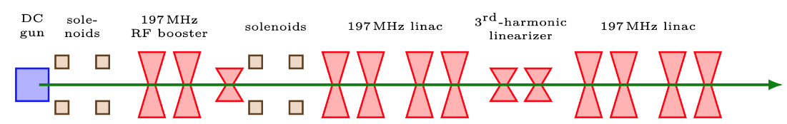
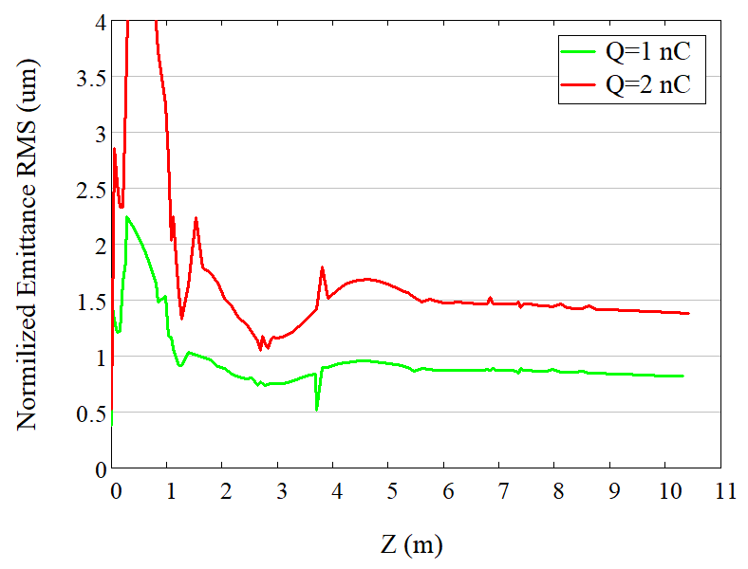
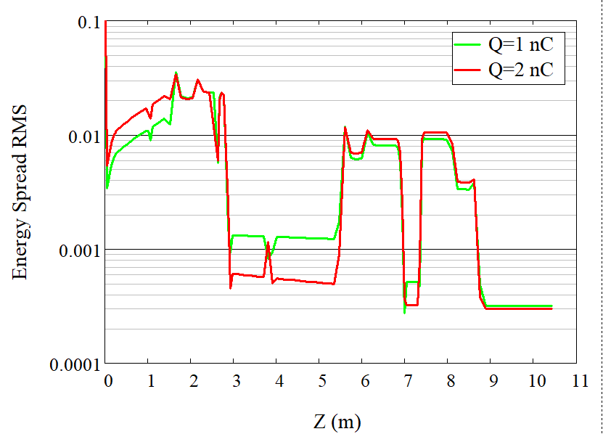
Beam dynamics simulation in 3 MeV injector +10 MeV LINAC
13 MeV
3 MeV
Achievable beam quality at the linac exit for bunch charge of 1-2 nC:
Energy spread < 3e-4
Normalized emittance <1.5um
Designed beta-function in cooling section 200 m, angular spread from emittance <17 urad
17

Slide 18

Cooling section (-s) approach:
The design of the cooling section will closely follow the LEReC approach *.
To maintain the transverse angle deviation of the electron beam trajectory < 20 μrad, the integral of residual transverse magnetic field between correctors in the cooling region must be kept below 1 μTm.
Shielding of the residual magnetic field to such level can be achieved using concentric cylindrical layers of high-permeability alloy in the cooling sections**.
Some cooling section space will be taken up by
  merger matching section with diagnostics,
  short weak solenoids, which control the angular spread of the electron beam due to its space charge. Such solenoids could be placed approximately every 10 m along the cooling section.
  correctors and BPMs every 10 m
μ-shielding
μ-shielding
μ-shielding
μ-shielding
μ-shielding
10 m
10 m
10 m
merging/matching section
merging/matching section
Weak solenoids
BPMs and correctors
[*] A. Fedotov et al., in Proc. NAPAC’16, Chicago, IL, USA, Oct. 2016, pp. 867-869.
[**] S. Seletskiy et al., in Proc. NAPAC’16, Chicago, IL, USA, Oct. 2016, pp. 1030-1032.
18

Slide 19
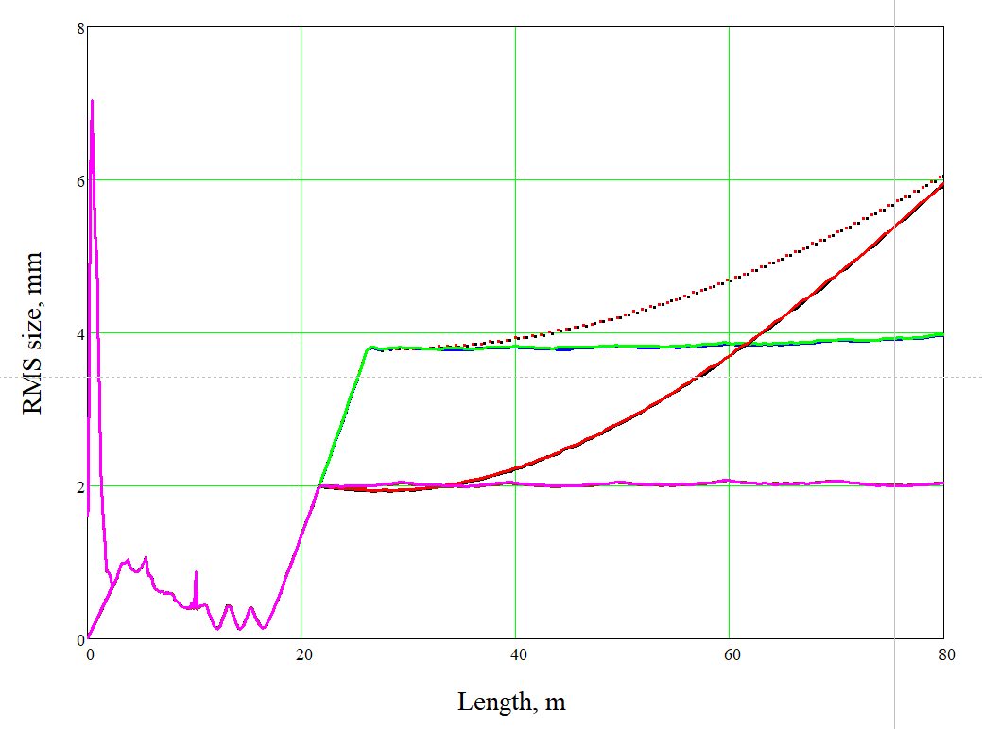
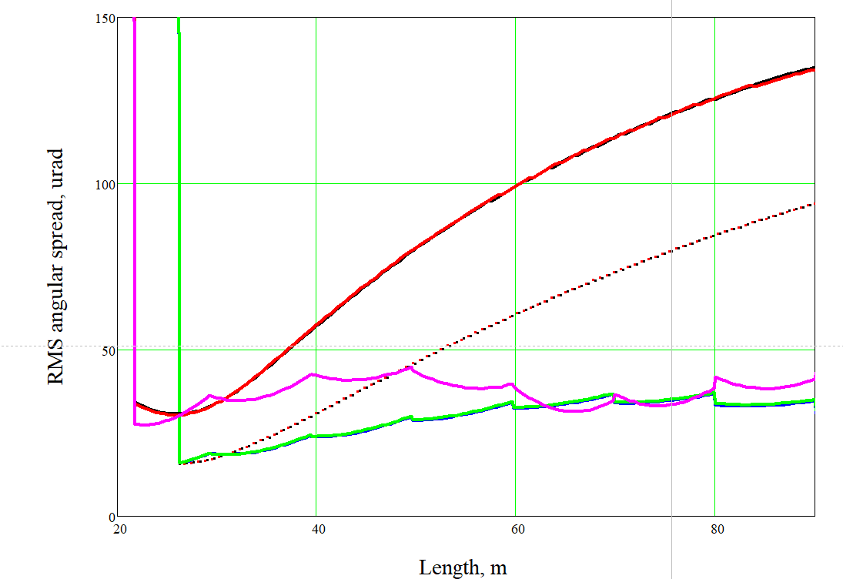
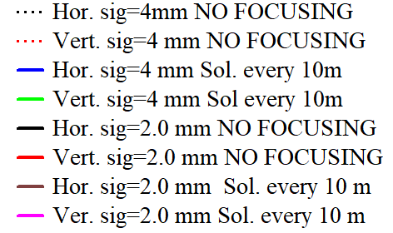
Beam dynamics simulation in the cooling section for bunch charge of 2 nC
For bunch sizes of 2, 4 mm in the cooling section transverse space charge could be compensated by using solenoids every 10 m
19

Slide 20
Precooler cooling sections using different magnets for space charge compensation
From ERL
Cooling section1 (SHC Modulator) ~60m (physical space 65m)
To bypass
protons
Bypass ~ 30 m
From CS1
To CS2
10 m
10 m
10 m
30 m
2 m
2 m
2 m
Cooling section2 (SHC Kicker) ~60m
protons
to ERL
10 m
10 m
10 m
10 m
from bypass
FODO quads are currently planed for SHC configuration in modulator (CS1) and kicker (CS2) sections
Q: can these quads be used to provide space charge compensation for preCooler?

Slide 21
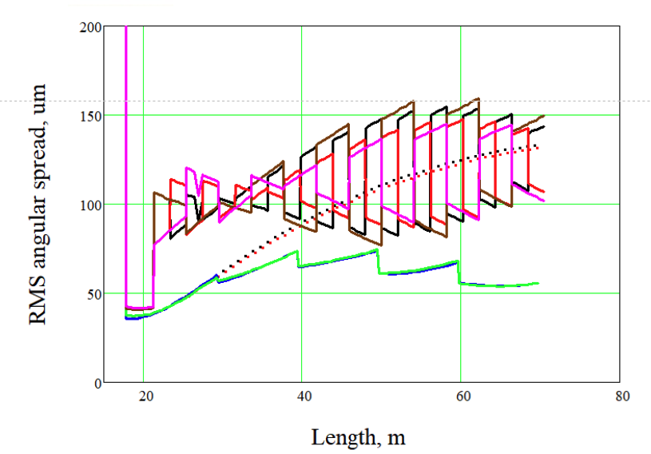
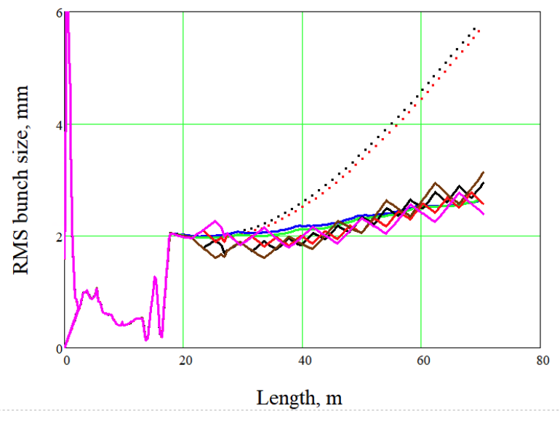
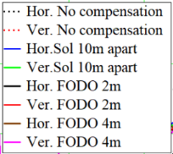
Simulation using quads (FODO)
Two FODO configurations were studied with quads 2 m and 4 m apart.
There is significant angular spread variations between quads in FODO structure.
Large angular spread results in strong reduction of Precooler cooling efficiency.
21

Slide 22

Cooling sections using different magnets for space charge force compensation
Modulator section modification:
Cooling section1 (modulator) ~60m
From ERL
SC Compensation Solenoids every 10 m
u-metal shielding
u-metal shielding
u-metal shielding
u-metal shielding
To bypass
10 m
10 m
10 m
10 m
protons
From CS1
To CS2
Bypass ~ 30 m
10 m
10 m
10 m
Kicker section would need a little bit more modification to optimize for low energy cooler :
Cooling section2 (kicker) ~60 m
protons
u-metal shielding
u-metal shielding
u-metal shielding
u-metal shielding
to ERL
10 m
10 m
10 m
10 m
from bypass
Add one more quad every 10 m and switch off (demagnetize) the rest of the quads to make 5 doublets per the cooling section
Then we still need to compensate/shield transverse field between doublets to satisfy cooling region requirement of 1 μTm.

Slide 23
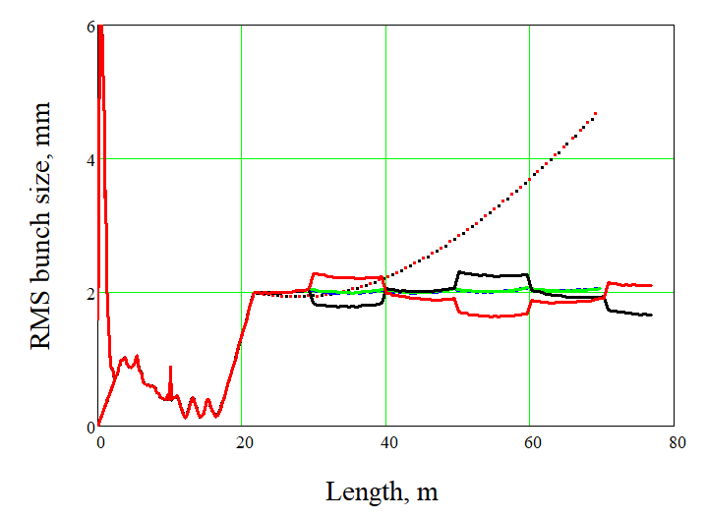
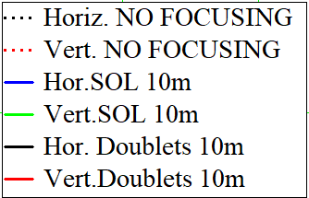
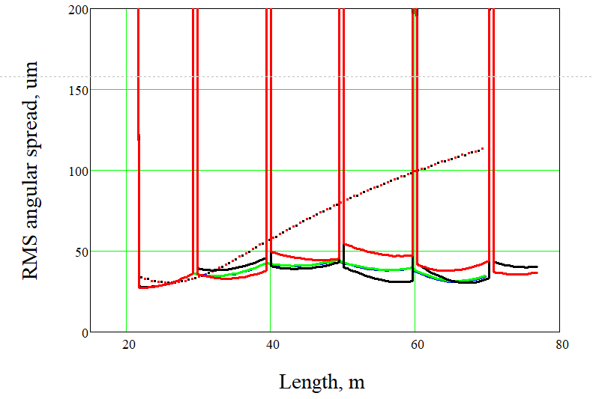
Simulation using quads (doublets)
Using quadrupoles in doublet configuration provides about the same angular spread as just solenoids configuration.
No triplets are necessary.
Open question: How well can we effectively shield 10 m between doublets with SHC quads and instrumentation located every 2 m in the kicker section?
23

Slide 24
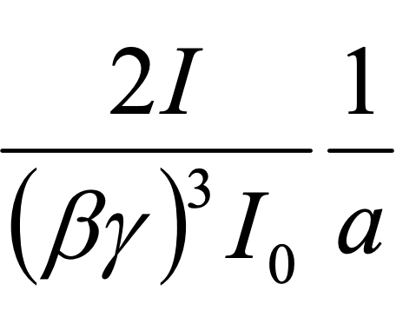
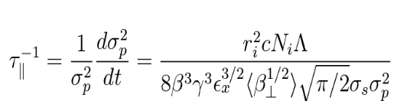
Mitigation of space charge effect during cooling at low energy
Using high harmonics cavity to elongate hadron bunches
Longer bunches for the about the same energy spread
Beam lifetime improvement (hadrons space charge tune is reduced)
Less and more uniformly focusing of electrons by hadrons
  reduced phase advance spread in the cooling section due to the hadrons space charge effect
  better matching, less projected emittance or angular spread degradation
Possible reduction of the intra beam scattering rate ( same energy spread for less peak current)
Large synchrotron tune spread provides Landau damping.
  Less problem with collective instability
Some aside notes
We should be careful when analyzing beam dynamics with High Harmonic RF even for the small amplitude
the synchrotron frequency is not a constant anymore and it linearly depends on amplitude
24

Slide 25
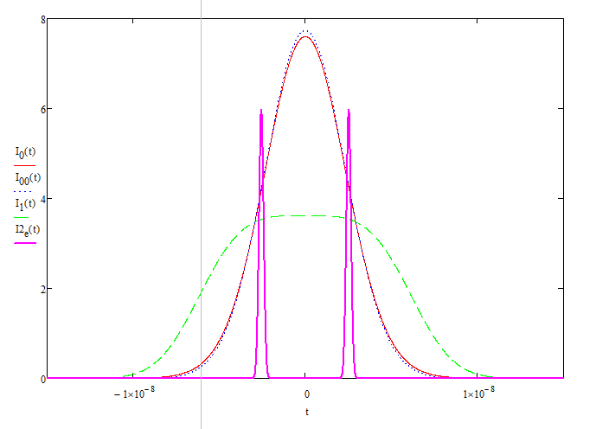
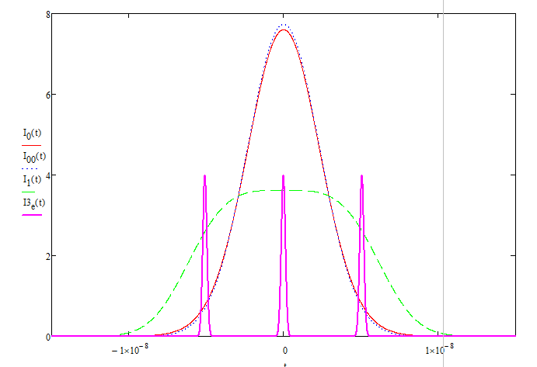
Using 2nd harmonic RF in HSR
The use of 2nd harmonic RF is flattening the longitudinal bunch profile
For the same energy spread of 6E-04:
Only 24.6 MHz RF voltage of 95 kV, rms bunch length 70 cm (or FWHM=5.4nsec).
With 2nd harmonics at voltage of 42.5 kV WFHM bunch length ~11 nsec.
Peak current is reduced more than twice
2 eBunches per hadron bunch
Electron MB charge of 4 nC
3 eBunches per hadron bunch
Only main harmonic
With second harmonic
eBunch charge Q=2 nC
Bunch charge Q=1.3 nC
5.1 nsec
5.1 nsec
5.1 nsec
With 2nd harmonics one can fit 3 e-bunches with lower charge
Weak dependance of hadron focusing effect to the different electron bunches in the MB
Hadron peak current is always lower than electron peak current.
The residual self space charge defocusing could be compensated by weak solenoids
25

Slide 26
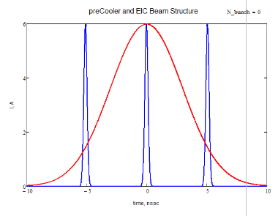
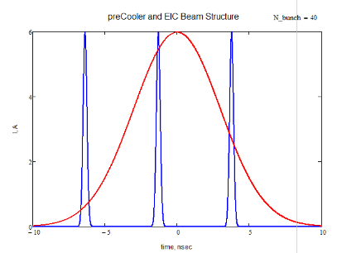
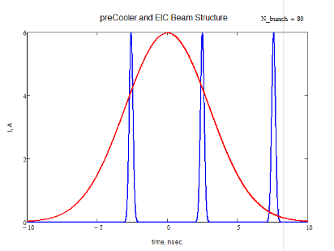
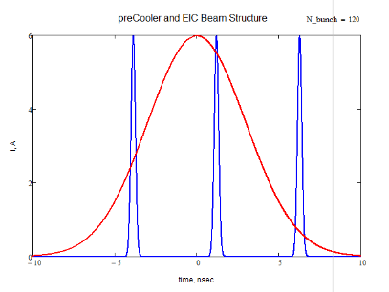
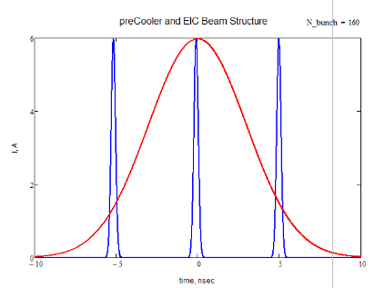
Operation at different harmonics
To use the same SRF cavities for PreCooler at gamma of 25.4 and SHC at gamma of 297 will require very large detuning: 150 kHz (for 197 MHz) and 450 kHz (for 591MHz), if electron linac harmonic is kept the same for high and low energies.
Using higher harmonics for the low energy (h=2522) reduces required tuning range of SRF cavities to 5 kHz (197MHz), 15 kHz (591MHz), but this might result in reducing cooling efficiency due to hadron bunch to bunch slippage of electron bunches
Bunch#0
Bunch#40
Bunch#80
Bunch#120
Bunch#160
the same pattern repeats
Proton bunch rep. rate harmonic: 2520, Electron bunch rep. rate harmonic: 2522
26

Slide 27
Summary
LEReC worked 24/7 cooling Au ions at gamma of 4.1 and 4 9.
LEReC-type electron cooler is being developed to provide cooling of protons at energy of 24 GeV. Such a Precooler requires 13 MeV electron accelerator.
The Precooler design parameters are challenging with required angular spread of electrons in cooling section about factor of 5 smaller than in LEReC and electron current about factor of 5 larger than used in long-term LEReC operations.
The Precooler is now included in the EIC scope.
Electron beam dynamics simulations for Precooler show that required electron beam parameters could be achieved.
Layout considerations of Precooler electron accelerator and its integration with the SHC is in progress.
EIC operating scenario with precooler needs to be studied in detail.
27

Slide 28
backups
28

Slide 29
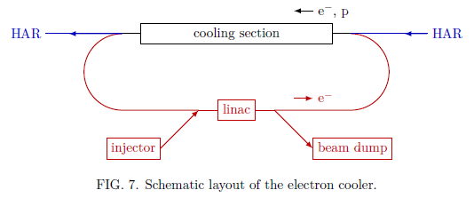
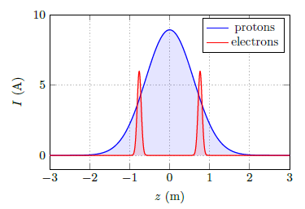
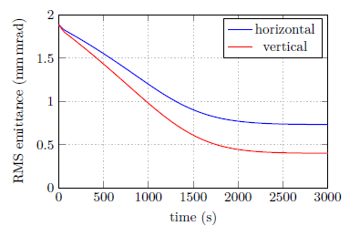
Stand-alone pre-cooler of protons at injection energy
Successful demonstration of cooling using LEReC (RF accelerated e-bunches) allows us to consider similar approach for electron cooling at higher energies
Precooling of protons could be performed at injection energy of 24 GeV, using 13 MeV electron accelerator.
Feasibility study of such stand-alone cooler were conducted by BNL-JLAB task force:
“Low-energy Cooling for the EIC”,
BNL-220686-2020-TECH (Dec 2020)
Stand alone cooler was also designed to cool protons at collision energy of 41 GeV (using 22 MeV ERL)
Using single 130 m cooling section 123 mA average e-current
29

Slide 30





Pre-Cooler at EIC injection energy (24GeV) ERL layout combined with SHC ERL
HSR SC Magnets
CS2 ~60m
(Kicker)
CS1 ~60m (Modulator)
HSR SC Magnets
HSR SC Chicane
HSR SC Magnets
~30 m
preCooler 13 MeV
U- turn
SHC 55-150 MeV
Beam direction
SHC/preCooler Shared Returning loop
IP2
E=13, 55, 150 MeV
Zoom in
SHC only transport
HSR
Hor. dipoles
preCooler 13 MeV
300 kW
Beam dump
197MHz Inj
DC Gun
Vertical dipoles
Solenoids
197MHz cavities
Quadrupoles
197MHz ERL
591 MHz cavities
DC Gun
μ- shielding
591 MHz SHC ERL
~50m
U-turn
4 Hor. comp dipoles might be needed
If beam dump is pointed down, we need vertical compensation chicane

Slide 31
PreCooler integration with SHC M/K
Based on new suggested IR2 modifications, one can expect about 60 meters of physical space available in Modulator and Kicker sections.
Assuming 60 meters of physical space, minus mergers on both sides, minus space for magnetic elements, about 55 meters could be covered by mu-metal shields –
about of 55 meters can be assumed as used for cooling.
For the Precooler, to bring electron current to reasonable numbers, we would like to have total cooling section space available for cooling (covered by mu-metal) to be around 120 meters.

Slide 32
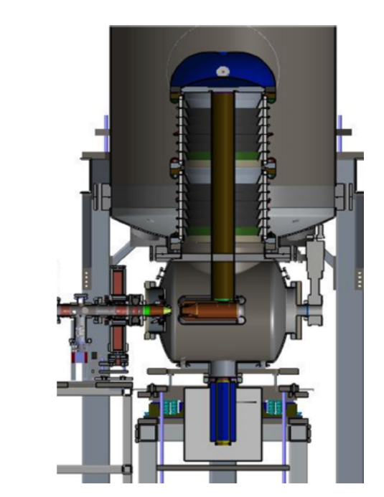
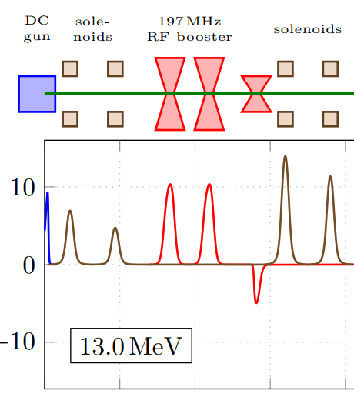
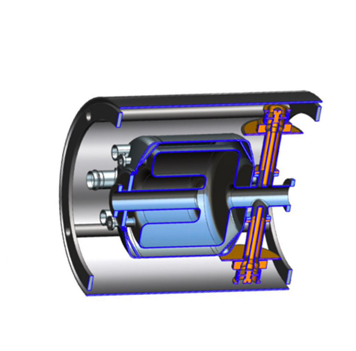
197 MHz injector:
3rd harmonics
400 kV DC Gun
Single 2x197 MHz QWR cavity module
3 MeV
32

Slide 33
Cooling at low energies in EIC
“Low-energy Cooling for the EIC”, BNL-220686-2020-TECH (Dec 2020):
LINAC could operate up to E=22MeV (good for cooling of protons at 41 GeV)
22 MeV
Shorter LINAC to operate only for PreCooling (protons at 24 GeV)
13 MeV
33

