Slide 1
Design of Affordable Proton ’FLASH’
Therapy Facility with Permanent Magnets
Abstract:
We present a complete design of the proton cancer FLASH therapy facility using permanent Halbach type magnets. The FLASH therapy is still in the evaluation stage with a treatment of a very small number of patients. Most of the studies were done with animals. The FLASH cancer radiation requires an ultra-high-dose-rate of more than 40 Gy/sec to be delivered in a very short time ~100 ms.
It has been demonstrated, mostly through multiple experiments with animals and just a few human exposures [1,2], that the FLASH radiation can decrease the normal tissue injury while maintaining destruction of the tumor cells as in conventional radiotherapy. This proposal removes limitations of the existing proton therapy facilities. It delivers protons with required energies in a very short time without changing the magnetic field. It is made of permanent magnets except in the spot scanning part. The facility includes:
Injector cyclotron commercially available with a maximum kinetic energy of 10,16.5 or 30 MeV.
Fast cycling permanent magnet synchrotron with kinetic energy range between 10-250 MeV.
Permanent magnets transfer beam lines.
Permanent magnet gantry with energy range 70-250 MeV.
Permanent magnets proposal is based on already achieved technology recently demonstrated in the Cornell-BNL Electron Test Accelerator “CBETA” commissioning [3].
[1] A. E. Mascia et. all, ‘Proton FLASH Radiotherapy for the Treatment of Symptomatic Bone Metastases’, JAMA Oncol. Published online October 23, 2022. doi:10.1001/jamaoncol.2022.5843.
[2] J. Bourhis, W. J. Sozzi, P. G. Jorge﻿, et All. “Treatment of a first patient with FLASH radiotherapy”. Radiotherapy Oncol. 2019;139:18-22. doi:10.1016/j.radonc.2019.06.019﻿.
[3] A. Bartnik et. all, “CBETA: First Multipass Superconducting Linear Accelerator with Energy Recovery”, PHYSICAL REVIEW LETTERS 125, 044803 (2020). https://journals.aps.org/prl/pdf/10.1103/PhysRevLett.125.044803

Slide 2
Layout of the talk: Design of the Affordable Proton ’FLASH’
Therapy Facility with Permanent Magnets
A short overview of the ‘FLASH’ radiation therapy is introduced. Essential properties of the Fixed Field Alternating (FFA) Gradient accelerators are described. A design, installation, and commissioning of the ‘CBETA’ (Cornell University Brookhaven National Laboratory ERL Test Accelerator) is presented as an explanation for the principle and use of the new permanent magnet technology. A new approach for the FLASH proton cancer therapy accelerator and the proton delivery gantry with permanent magnets will be presented.
Short overview of ’FLASH’ and present cancer radiation therapy facilities
Proton Therapy Facilities Limitations with respect to the ‘FLASH’
Recent Permanent Magnet FFA Multiturn Energy Recovery Linac – CBETA
‘FLASH’ Proton Therapy facility: Fast Cycling FFA proton Synchrotron
‘FLASH’ Proton Therapy facility: Beam transfer lines
‘FLASH’ Proton Therapy facility: Permanent Magnet FFA proton Gantry
The Whole Facility
Estimated Cost
SUMMARY - CONCLUSION

Slide 3
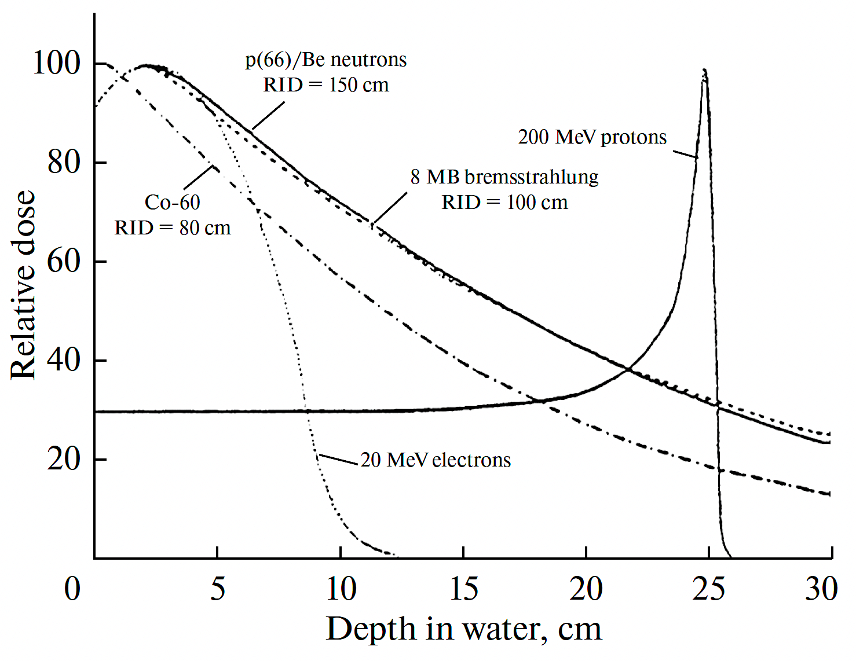
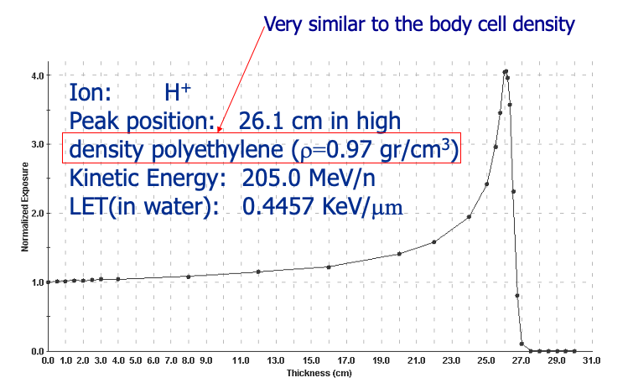
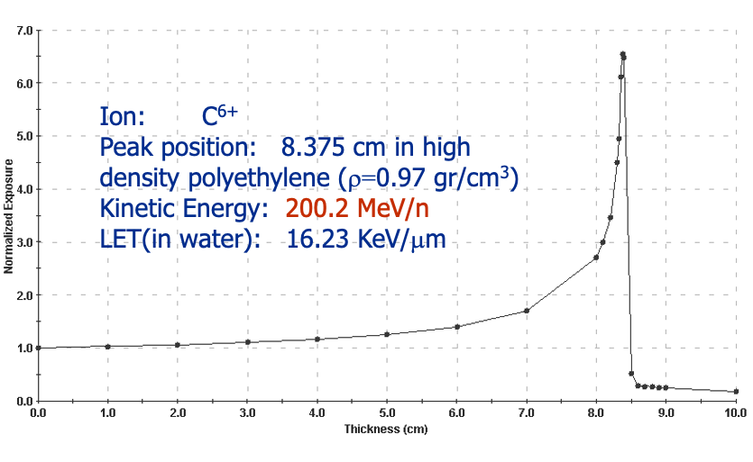
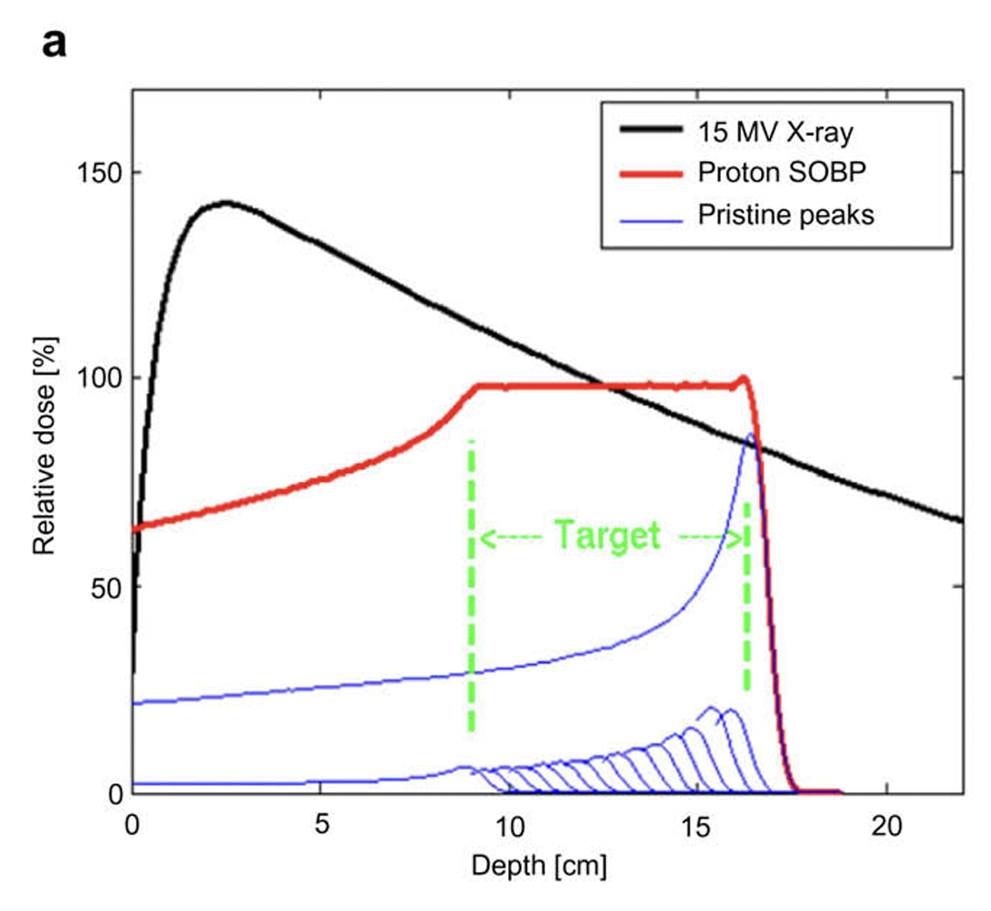
1. Hadron Radiation Therapy
The hadron-ion cancer radiation therapy deposits the energy in the body at the site of the cancerous tumor. Most of the energy is deposited at the Bragg peak. The position of the tumor in the body defines the proton energy required to propagate through the body and precisely deposits the energy. In radiation therapy ion energies can be adjusted allowing the spread-out Bragg peak to reach deep seated tumors inside of the body. The modern systems like VARIAN-ProBeam 360º, IBA Proteus^{R}, Hitachi synchrotron proton accelerator etc. use pencil beam scanning to allow precise and fully conformal dose distribution. In hadron therapy protons or carbon ions propagate through the body modifying biological structures due to direct ionization leading to the single or double-strand DNA break-ups. “ (for a single field to 1 litter volume in one minute.” [4]. Today’s treatments of about 60-80 Gy are delivered to the patients usually over a couple of weeks, with the dose fractionation of ~2 Gy per dose.
‘On the trajectories of ions there are secondary particles and ionization of molecules with radiation damage in the path of the order of few nano-meters. Photons and electrons create significant doses to the surrounding tissues.’ [5]
The ‘FLASH’ cancer therapy is a relatively new possibility in treating the cancerous tumors if radiation is required. Multiple biological studies and even a few patients’ treatments around the world in recent years confirmed significant improvements in the cancer treatment results by delivering ultra high radiation dose in much shorter time intervals — fractions of a second as opposed to minutes — and in far fewer fractions or even a single fraction and therefore at dose rates that are thousands of times higher. (RBE-Relative Biological Effectiveness, TCP=Tumor Control Probability, LET –Linear Energy Transfer, NTCP-Normal Tissue Complication Probability, PENUMBRA-lateral beam size, SOBT–Spread out Bragg Peak, OER-Oxygen Enhancement Ratio, Hypoxia – reduced oxygen levels.)
RBE=1.1
RBE=2.5-3.5
4. S. Jolly, H. Owen, M. Schippers, C. Welsch, “Technical challenges for FLASH proton therapy.” Phys. Med. 2020, 78, 71–82. https://www.sciencedirect.com/science/article/pii/S1120179720301964
Notes:
1.

Slide 4
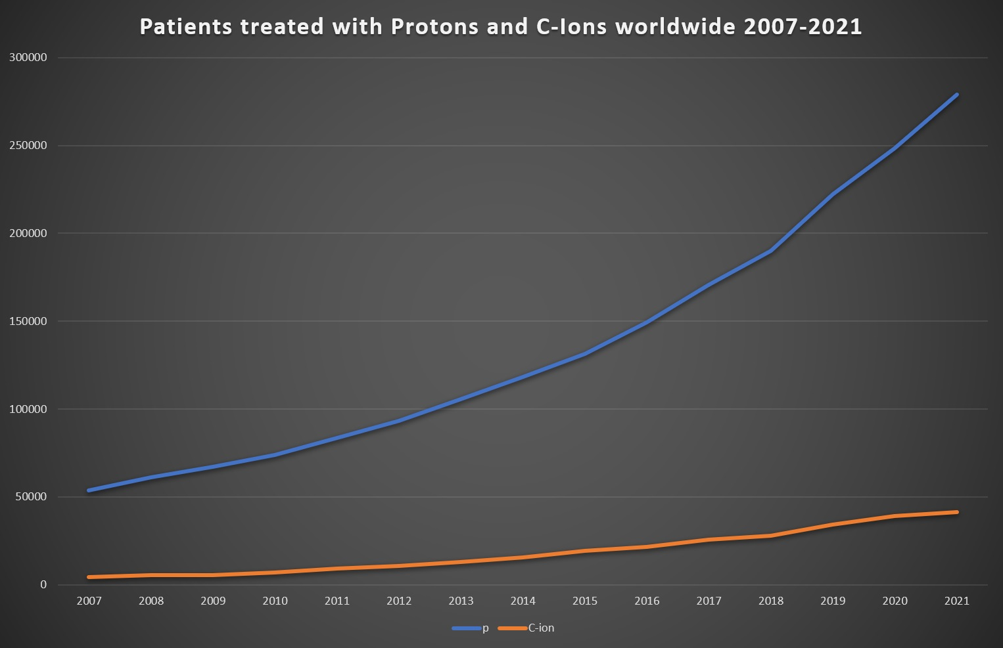
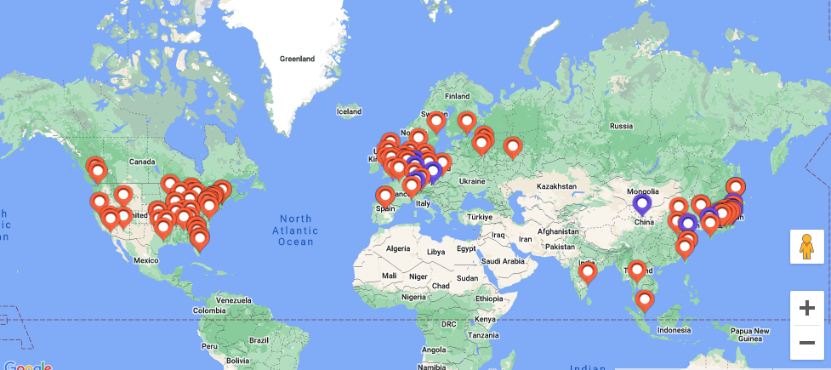
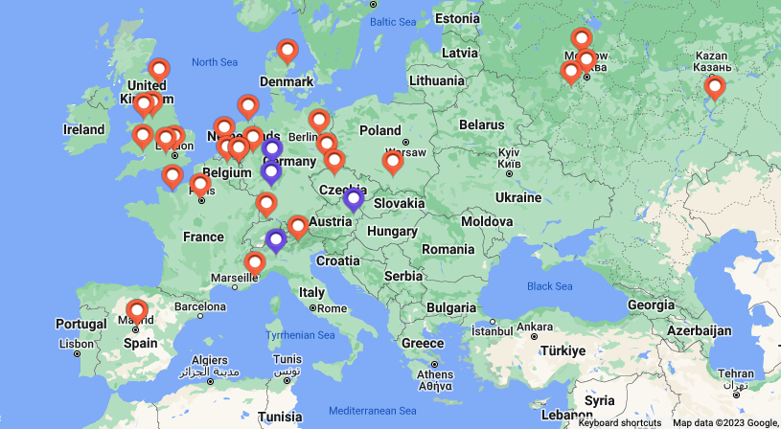
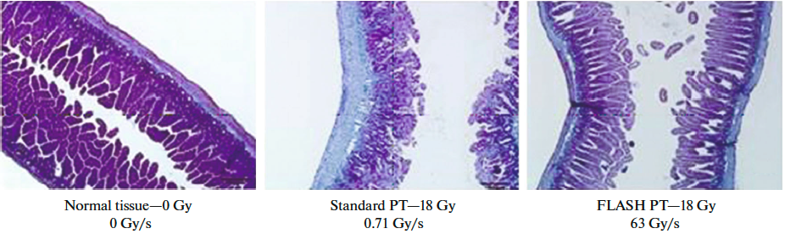
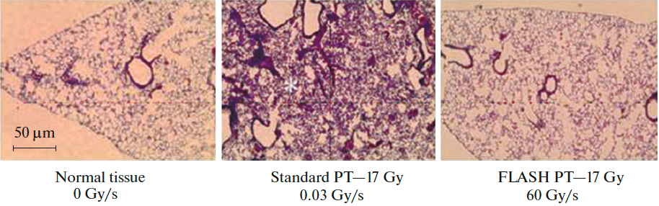
1. Hadron Beams and FLASH Radiation Therapy
Traditional proton therapy delivers dose rates 1-7 Gy/minute 2 Gy/fraction or (1Gray=Joule/l → Ws/l →AV/l= Coulomb∗V/ls 2Gy/minute/l in 15 cm deep tumor this is [4] 1.9x10¹¹ protons~30 nC. Half of all cancer patients are treated with Radiation Therapy (RT). Up to May 2023 there are operating 121 operating facilities with a total of 360,000 patients treated. 312,000 with proton, 46,800 with carbon 3500 with He ions or pions up to the end of 2022.
Exponential rise in the number of facilities
121
proton
carbon
The proton FLASH therapy requirements are 40 Gy/s with respect to 0.01 Gy/s in conventional RT. To obtain the dose of 40 Gy/s in 100 ms for a volume of 1000 ml (10x10x10 cm) this becomes 4 Gray in 100 ms. If we take 3.8x10¹¹ protons or 60 nC to be delivered in 100 ms, then this is equivalent to 600 nA.
It is not yet clear why the high radiation in a flash spares the healthy tissue, but it looks like that radiochemical depletion of oxygen occurs induces tissue radio resistance.
From [5] E. A. Gritskova et. All.,
5. E. A. Gritskova et. All., “Flash Method of Proton Therapy”, Physics of Particles and Nuclei Letters, 2022, Vol. 19, No. 6, pp. 834–844, https://link.springer.com/article/10.1134/S1547477122060103
Notes:
f

Slide 5
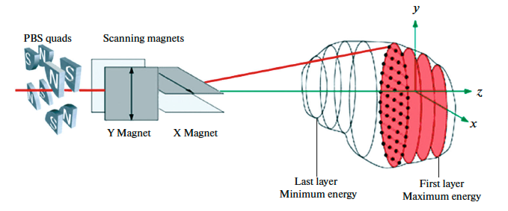
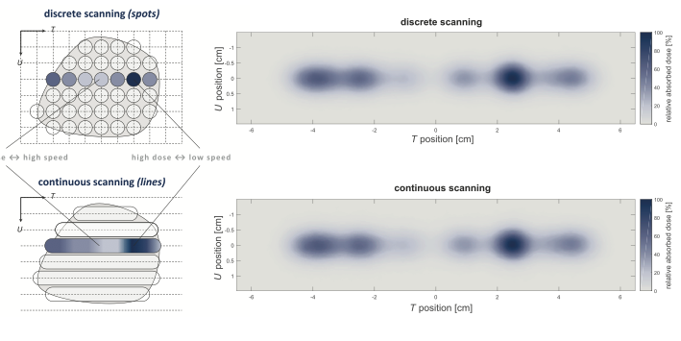
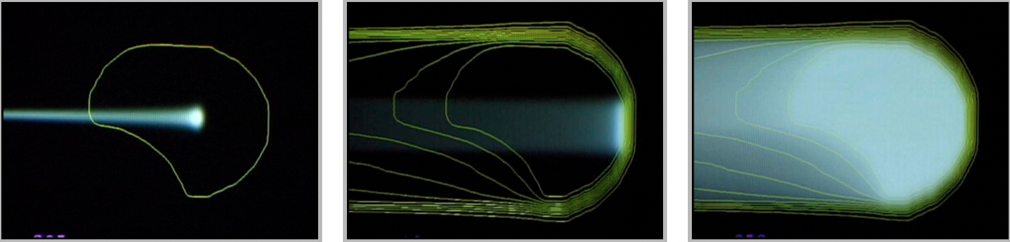

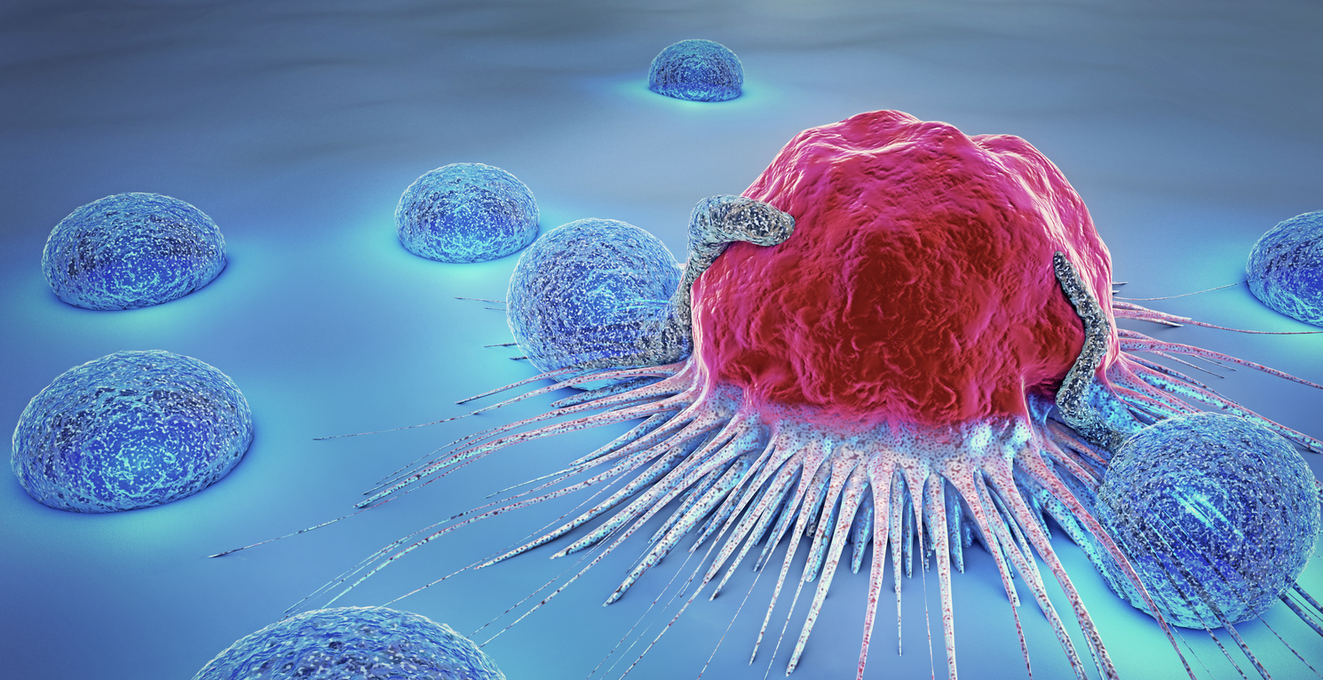
1. Spot Scanning should be required for FLASH
The spot-scanning is provided by steering magnets within the nozzle or upstream of the last bending magnet. The scanning directs the pencil beam to the desired spot within the treatment volume. The present systems require that every magnet within the entire beamline must adjust to match the beam energy for a given energy layer. This is avoided in our proposal. An important quote from the review shown in reference [4]: ...”In the future, rapid energy variation will demand beam delivery systems with large energy acceptance; rather than adjust the magnet settings for each energy layer, the beam dispersion is limited by a suitable beam-optical arrangement and sufficient aperture within the magnets and vacuum system provided to obtain a large energy acceptance.“ In proton therapy usually 2500 spots are delivered in one liter volume in 50x50 grid pattern [4] in a 50x50x50 cm³. Each layer has 625 spots or 2 mm per spot. For one liter volume and 100 ms time required for FLASH for 30 energy layers each layer must be done within 3.3 ms! In our proposal for the 1.3 kHz synchrotron the time between each cycle is 770 μs.
The nozzle magnets need to ramp very fast so that each spot is delivered in 2 μs.
Photographs of two cancerous tumors - from 100 of different types

Slide 6
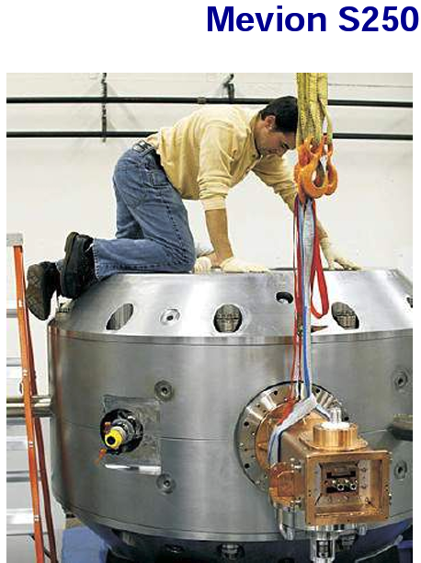
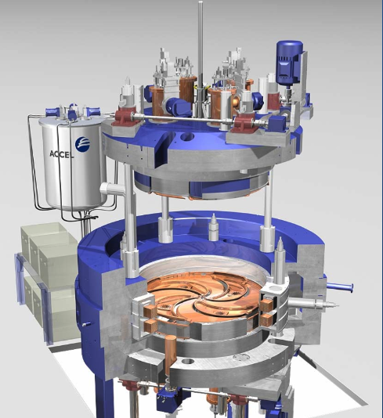
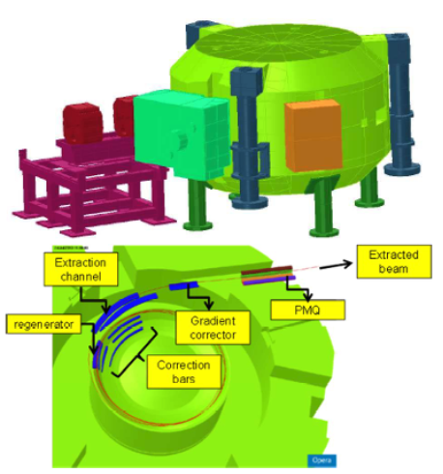
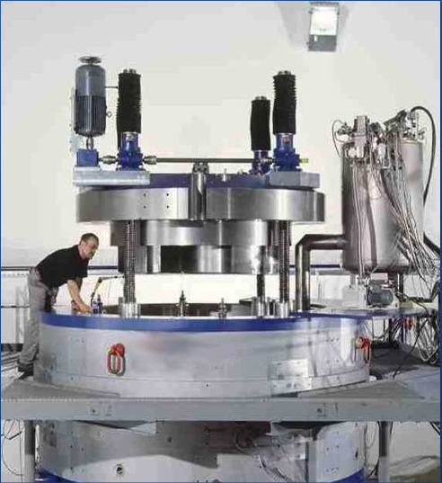
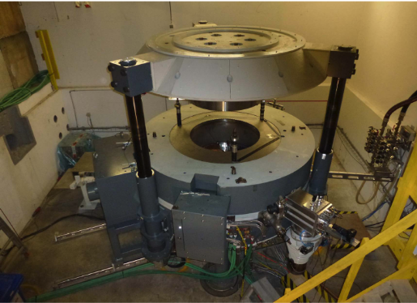
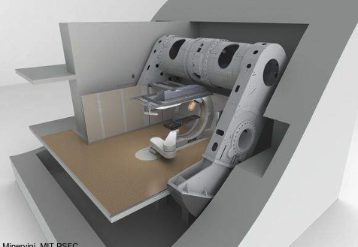
Superconducting Cyclotrons in Proton Therapy
VARIAN-SIEMENS PROBEAM
IBA S2C2
MEVION S250

Slide 7
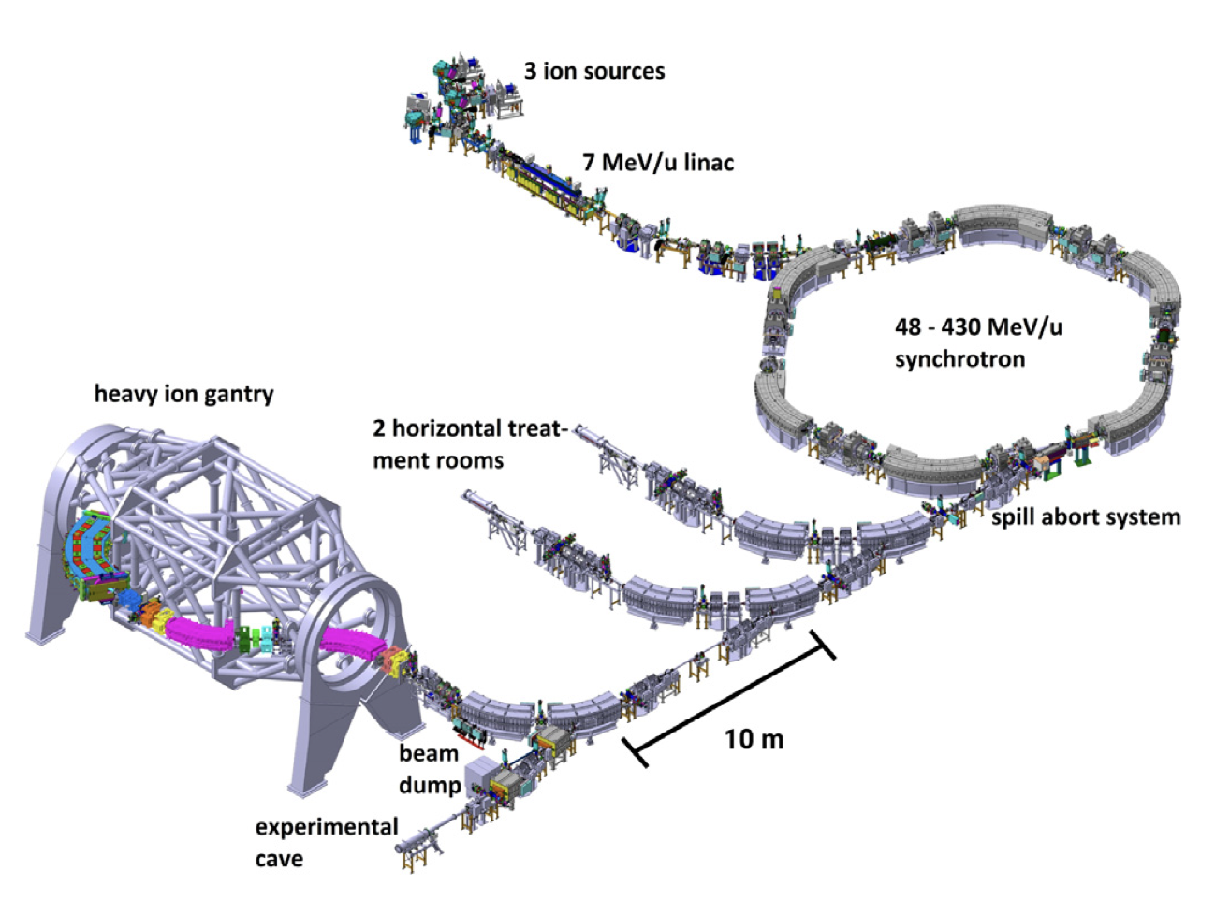
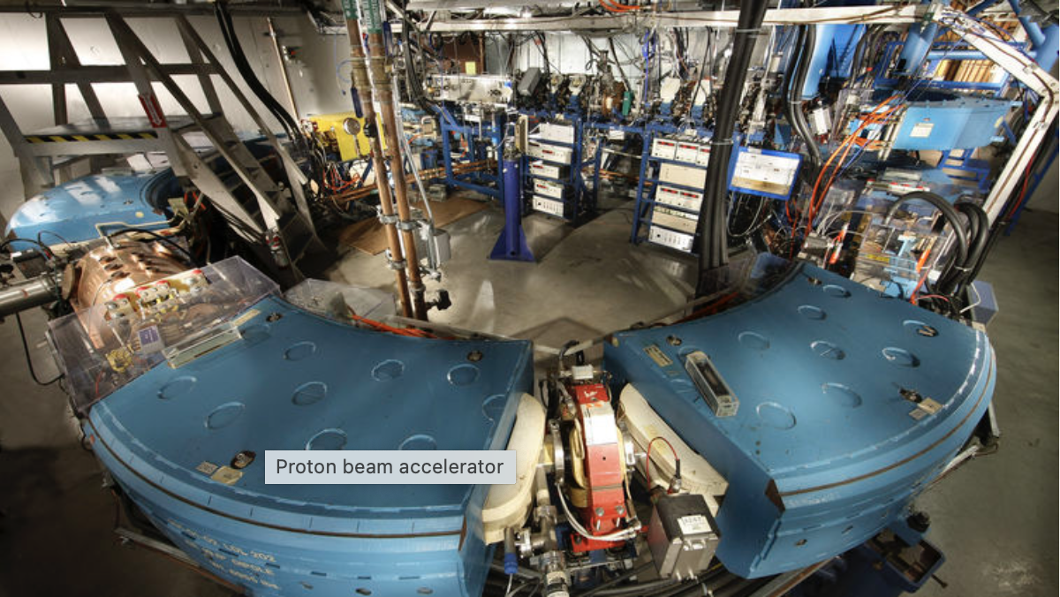
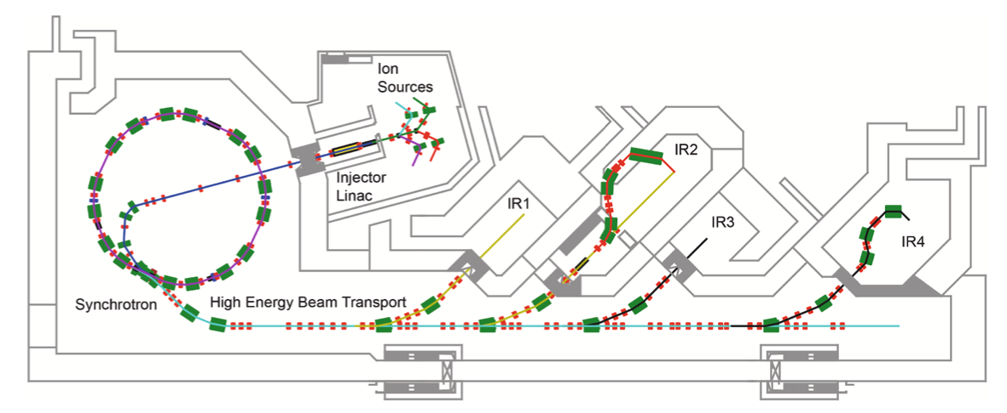
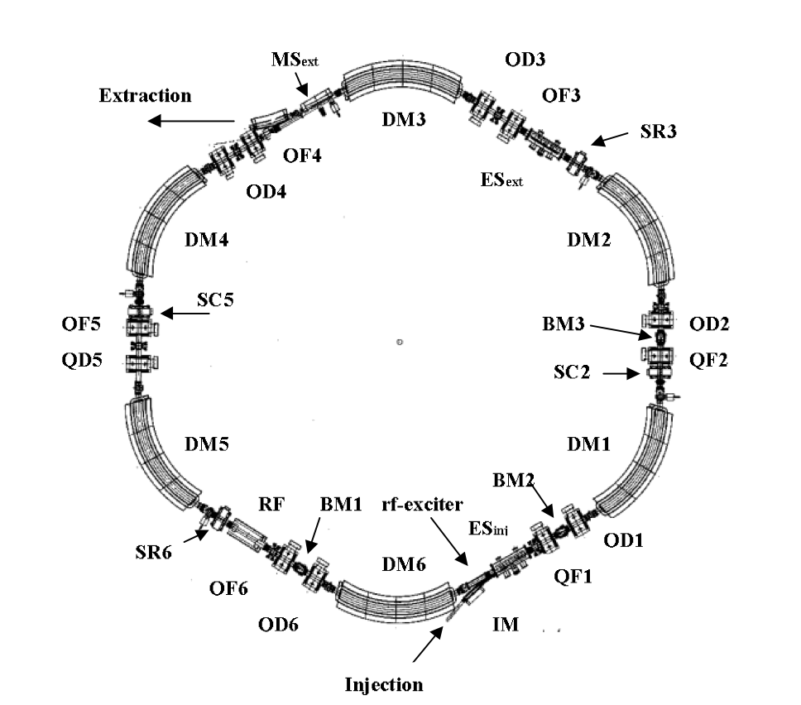
Synchrotrons for the Hadron Cancer Therapy
Loma Linda University Cancer Center 30 years of proton treatment
HEILDERBERG HADRON-proton-carbon PARTICLE THERAPY SYNCHROTRON WITH HEAVY ION GANTRY
MEDAUSTRON SYNCHROTRON and ion therapy lines

Slide 8
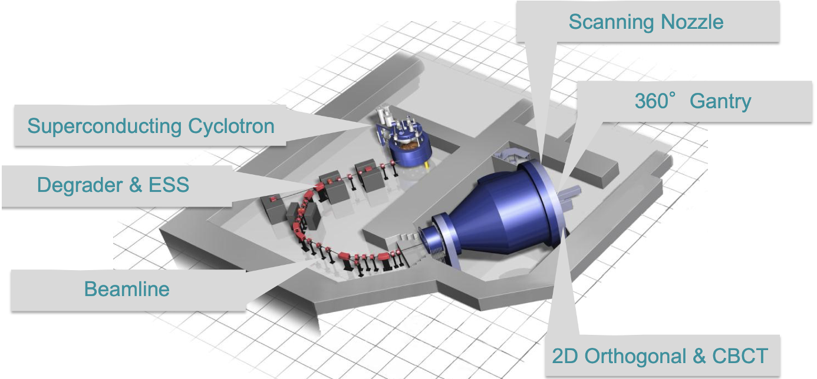
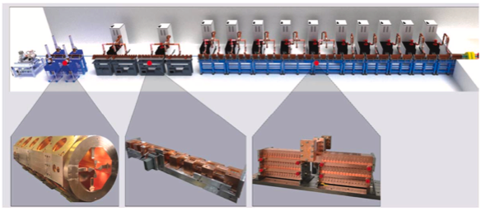
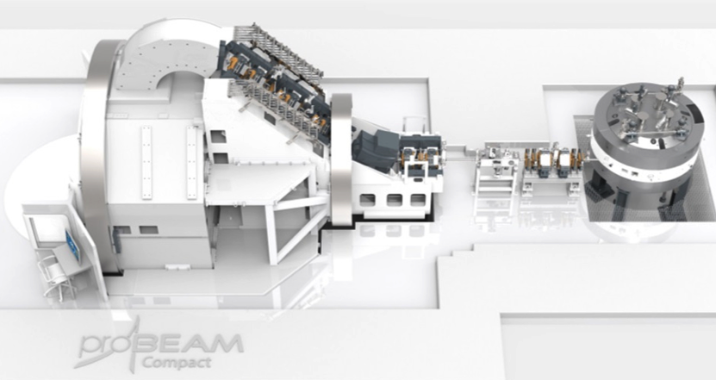
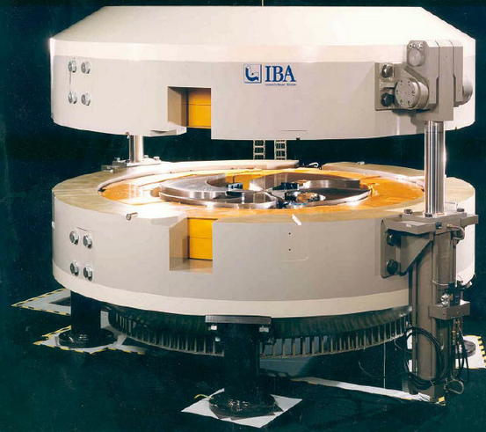
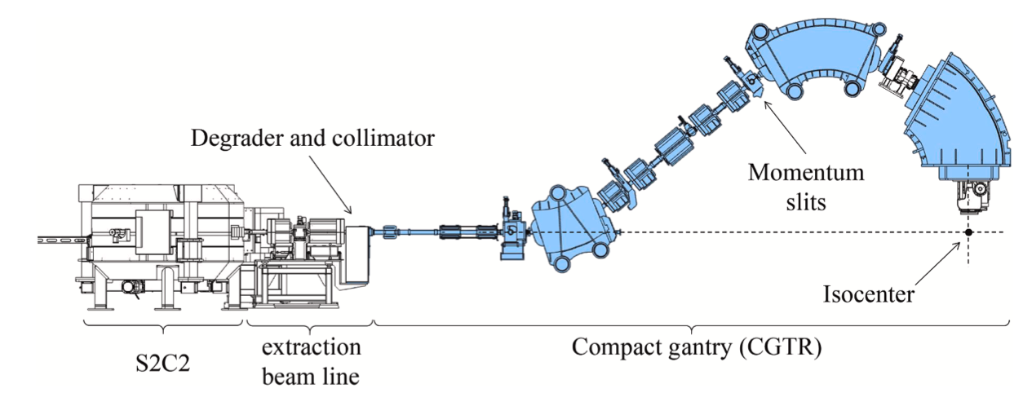
Proton therapy facilities limitations for applying FLASH
Advanced Oncotherapy
VARIAN -PROBEAM
AVO
VARIAN -ProBEAM^{R}
MEDAUSTRON SYNCHROTRON
IBA-Proteus^{R}
Notes:
Proton therapy facilities limitations for applying the FLASH
Proton therapy facilities limitations for applying the FLASH

Slide 9
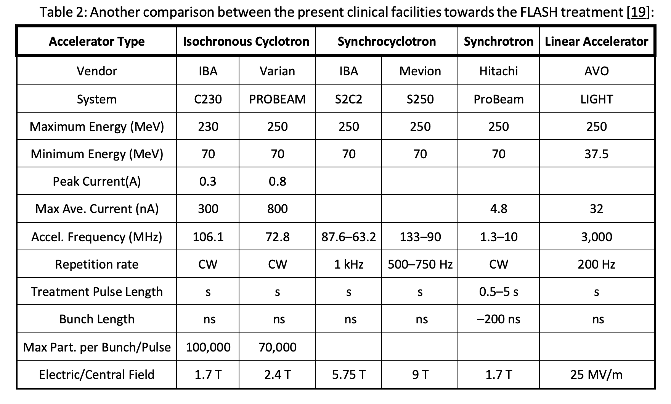
2. Limitations of the Present Facilities
FLASH REQUIREMENTS: 600 nA, 60 nC, 3.8 x 10¹¹ protons, in 100 ms
[4]
FFA SYNCHROTRON
BNL
FFA synchrotron
250
10-30
400 μA-1.2 mA
530-897 nA
378 MHz
500 Hz -1.3 kHz
10 - 405
Max 1.8 T
A total charge circulating in the permanent magnet proton synchrotron 30 proton bunches per cycle each with 1.2x10⁸ protons makes for a total of 30x1.2x10⁸ = 3.45x10⁹ protons or 553.8 pC or 553.8pc/100 ms = 5.538 nA. To get the required dose of 60 nC would require 60 nC/553.8 pC = 108 cycles of the fast proton synchrotron. As each cycle is 1.235ms long (809.5Hz) this makes for the total time of treatment T_{TREATMENT} =108x1.235ms ~133 ms.

Slide 10
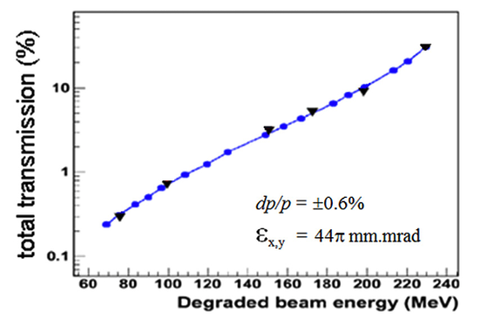
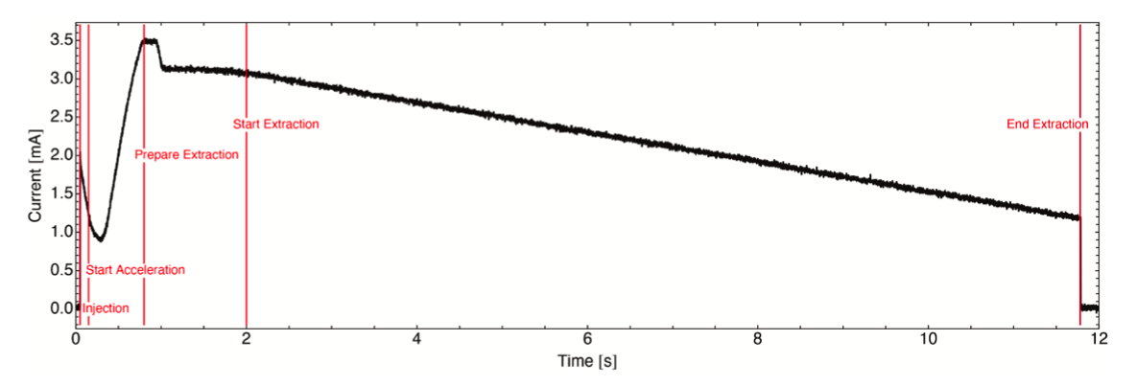
2. Limitations of Proton Therapy Facilities for FLASH
Major limitations at any existing cancer hadron radiation therapy system or facility are the variable magnetic field requirements for different energy settings. It is hard to adjust the magnetic field within the short time (hysteresis) required for FLASH.
CYCLOTRON based treatment centers required energy degraders as a single 230-250 MeV energy is extracted. At low energies only 1% of the initial beam is delivered to the patient. The beam size – emittance is always significantly enlarged (See Figure 1)
The synchrotrons are presently cycling with low frequencies and the slow extraction of the beam towards the patients is (Fig. 2) too long for FLASH.
For Synchro-cyclotrons (MEVION and IBA S2C2) the spot scanning has serious problems. It is unlikely that synchro-cyclotrons would be the eventual technology of choice for a pure spot-scanning FLASH proton therapy system.
At present, for AVO system the repetition rate of 200 Hz is simply too slow to enable delivery to anything but small volumes. The pulse repetition frequency of 200 Hz makes it possible to irradiate only 20 separate energy layers within a time window of 100 ms. An increase in this rate by a factor of >500 would be necessary [4] for spot-scanned FLASH delivery to a 1-liter volume.
The beam intensity is significantly reduced by degraders
Beam extraction from synchrotrons requires much longer time with required for FLASH

Slide 11
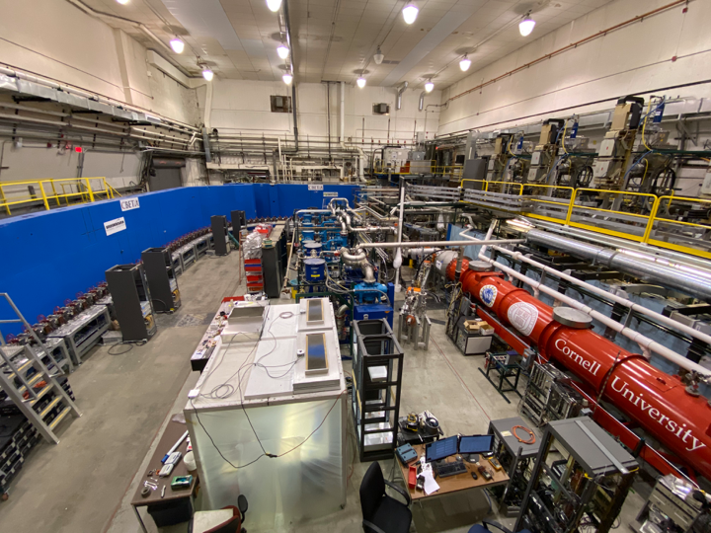
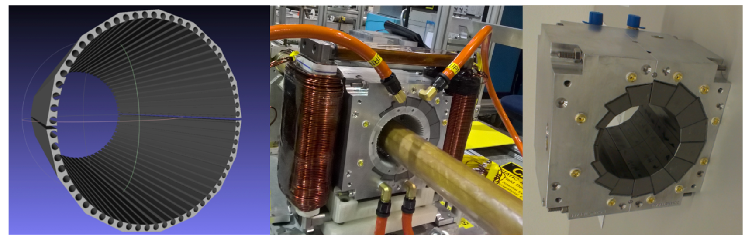
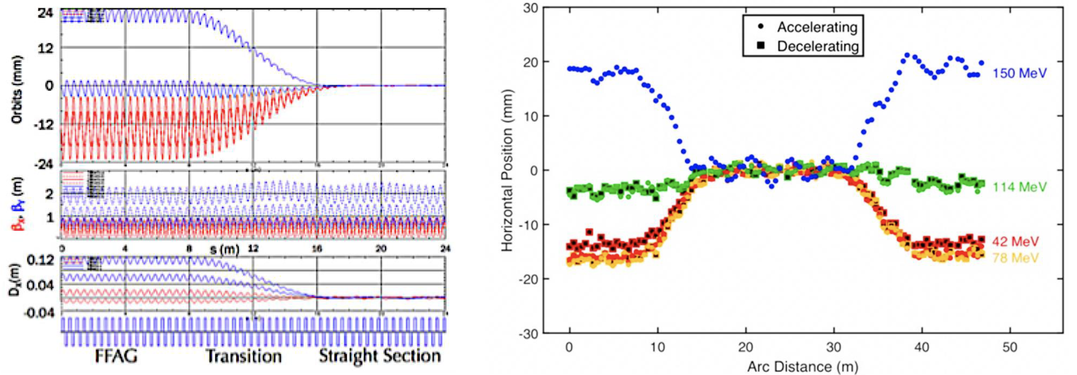
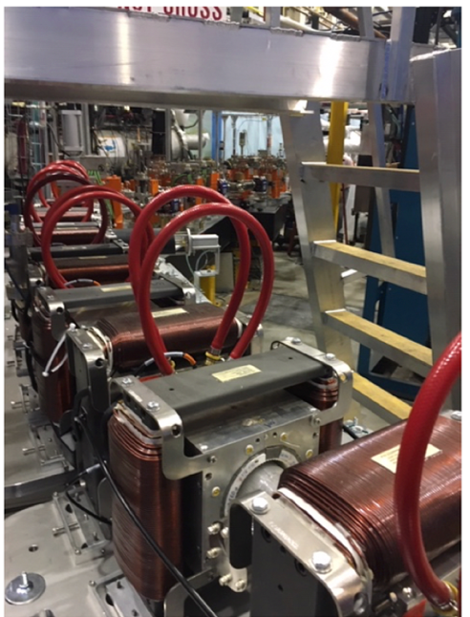
3. Recent Proof of Principle for the Permanent Magnet Fixed Field Accelerator is fully provided by Cornell University & Brookhaven National Laboratory Electron Test Accelerator - CBETA
Full proof of principle for the Non-scaling Fixed Field Alternating Gradient
Merging multiple energy orbits into a single straight-line orbit
Development of the new permanent magnet technology

Slide 12
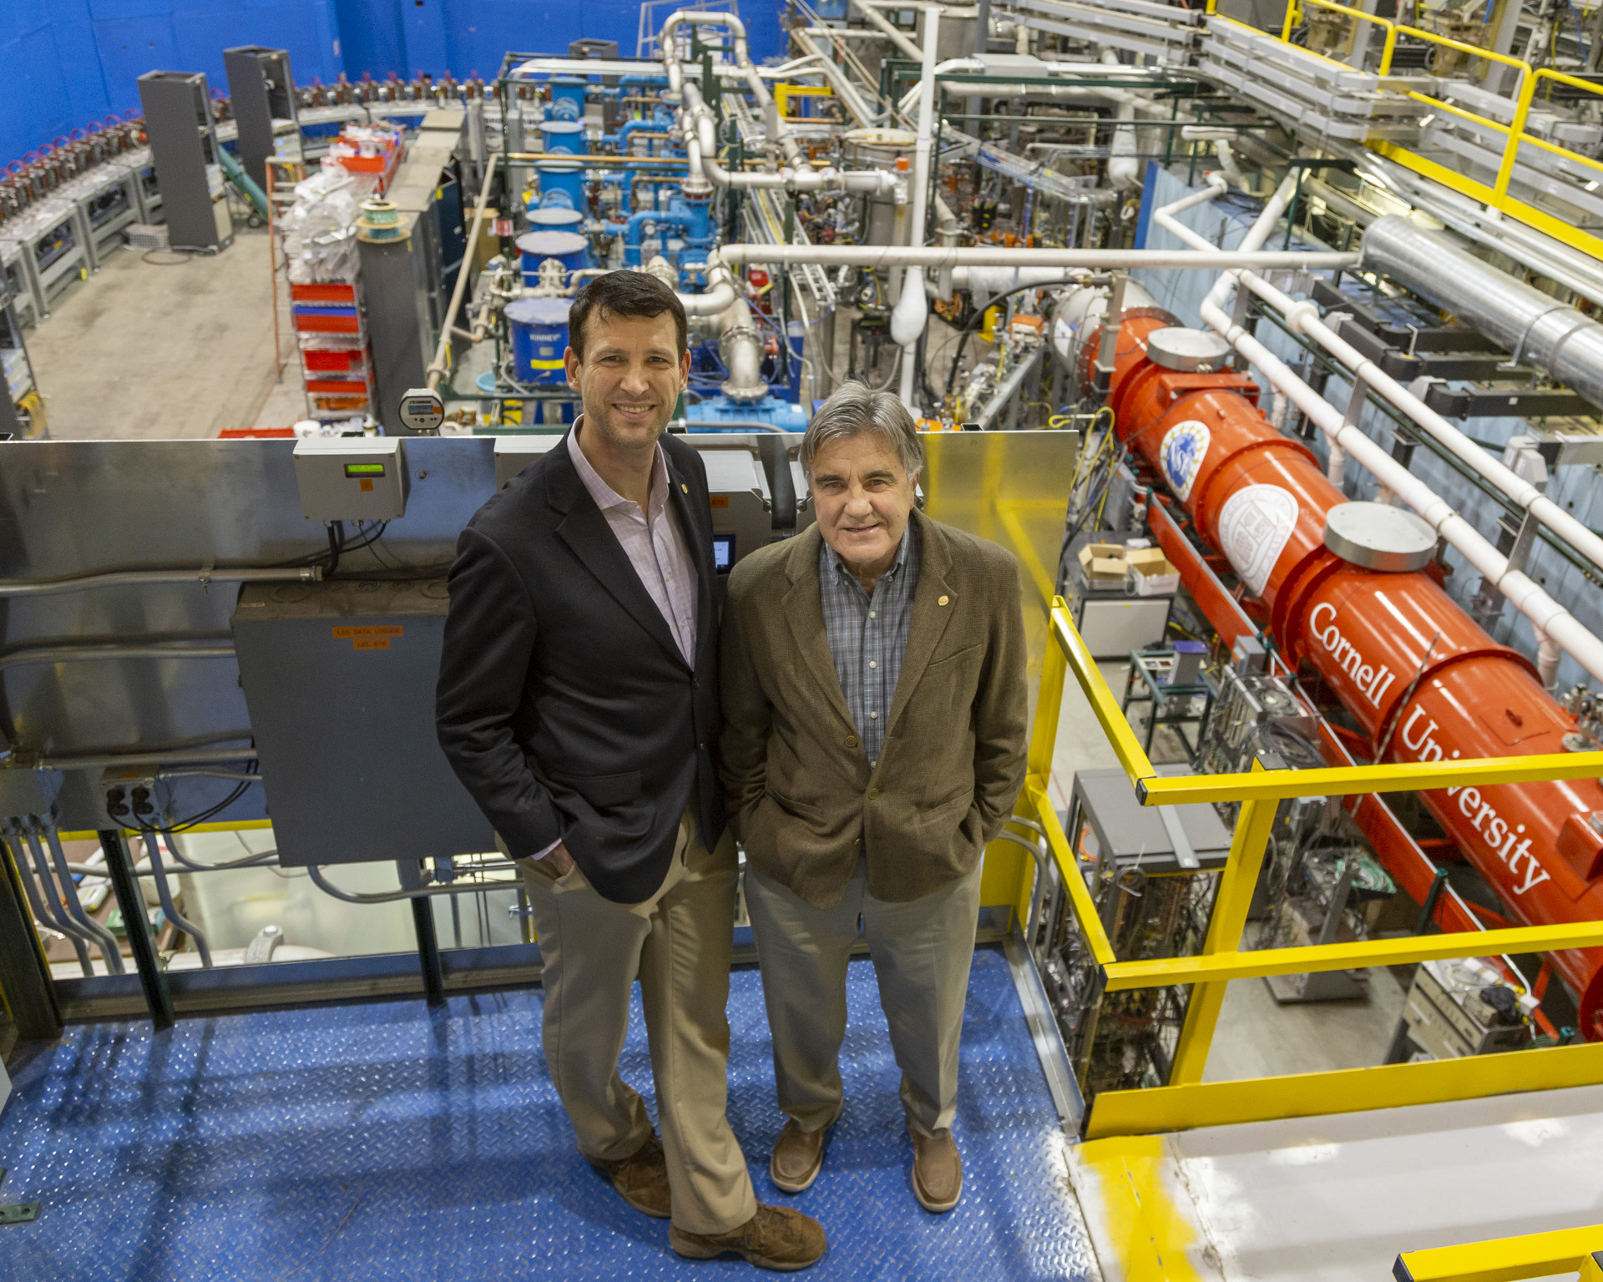

3. CBETA Spring 2019

Slide 13
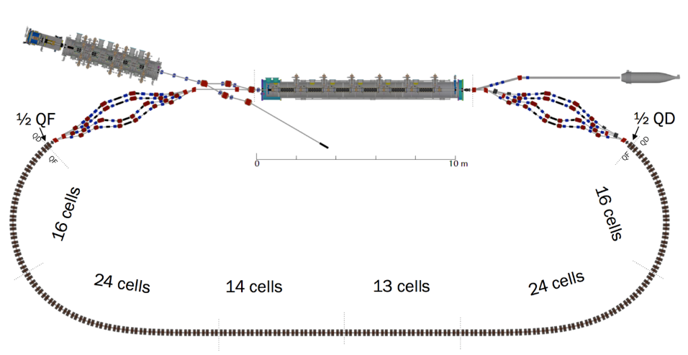
3. What is ‘CBETA’
Cornell DC gun, 2nC peak
100mA, 6MeV SRF injector (ICM), 1.3GHz
320mA, 6-cavity SRF CW Linac (MLC), 1.3GHz
4 Spreaders / Combiners with electromagnets
FFA cells with permanent magnets, 3.8 energy aperture, 7 beams
SRF Injector
600kW beam stop
Main Linac
Beam Stop
DC source
Spreaders
Permanent Magnet FFA

Slide 14
3. Novelties in CBETA
ENERGY RECOVERY MULTITURN LINAC WITH WITH 4 TURNS DURING ACCELERATION AND FOUR TURNS DURING ENERGY RECOVERY
SUPERCONDUCTING RF : INJECTOR AND MAIN LINAC CRYOMODULE
NON-SCALING FFAG – MULTI ENERGY SINGLE BEAM LINE
FFA Gradient ARCS
              TRANSITION FROM ARC-TO-STRAIGHT
              STRAIGHT SECTION WITH MULTI-ENERGY TRANSFER
PERMANENT HALBACH TYPE COMBINED FUNCTION MAGNETS

Slide 15
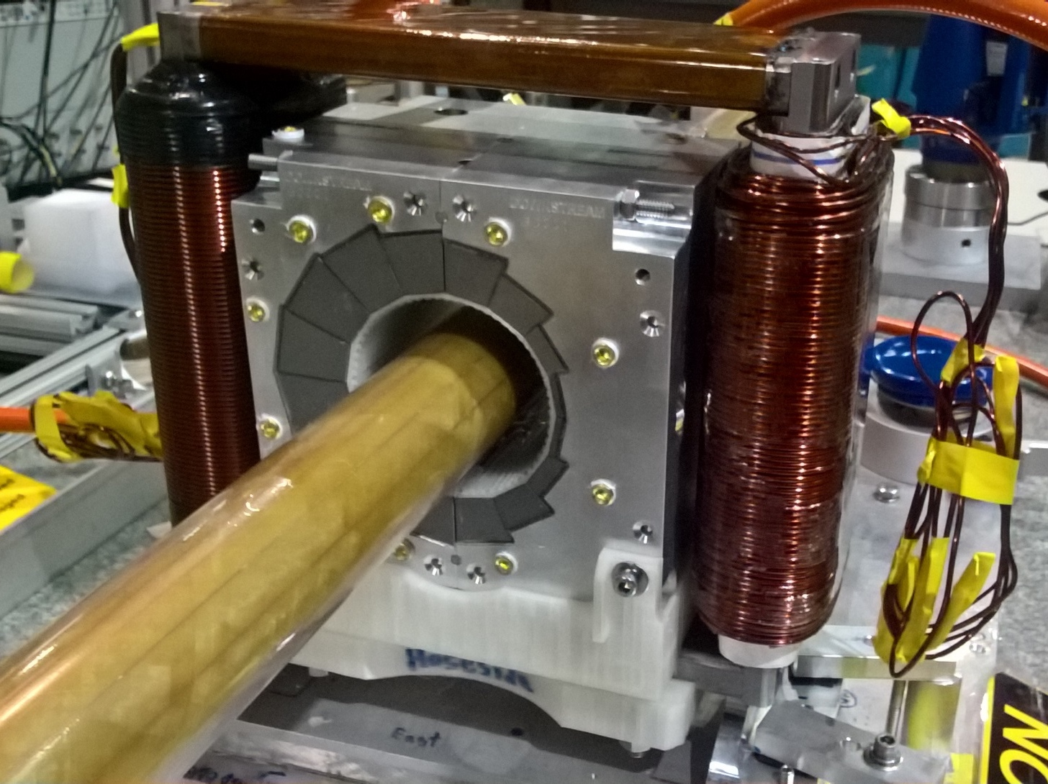
3. Permanent Combined Function Magnet Design
The Dipole Corrector magnets are made of iron frame with opposite copper windings – this is a vertical dipole corrector
Halbach design made of NdFeB material
This is a combined function magnet dipole + quad
It is measured by the rotating coil at BNL
3D printed multipole corrector pack inside
Window frame corrector coil outside
Temperature stabilised by water (orange hoses)

Slide 16
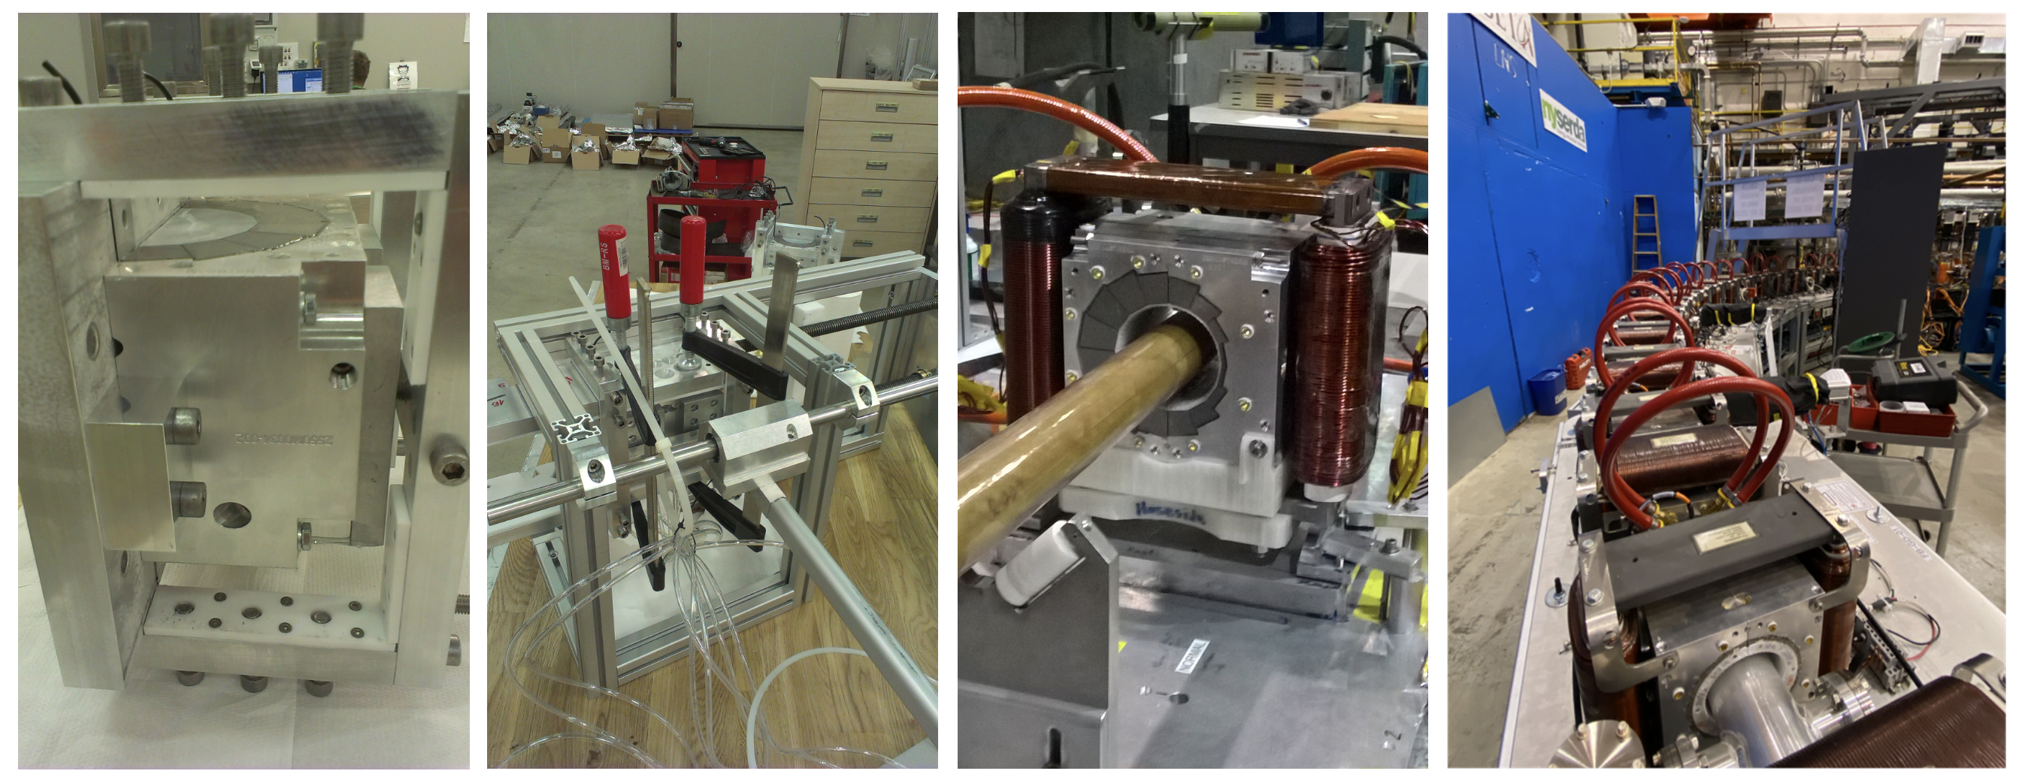
3. Established new permanent magnet technology
At BNL Stephen Brooks developed magnetic field correction method by inserting around vacuum chamber‘ harmonic’ iron wires
Exceptional company ‘KYMA’ in Sežana Slovenia and Trieste measured and assembled the permanent Magnets
Temperature stabilization is achieved by 25C constant water flow

Slide 17
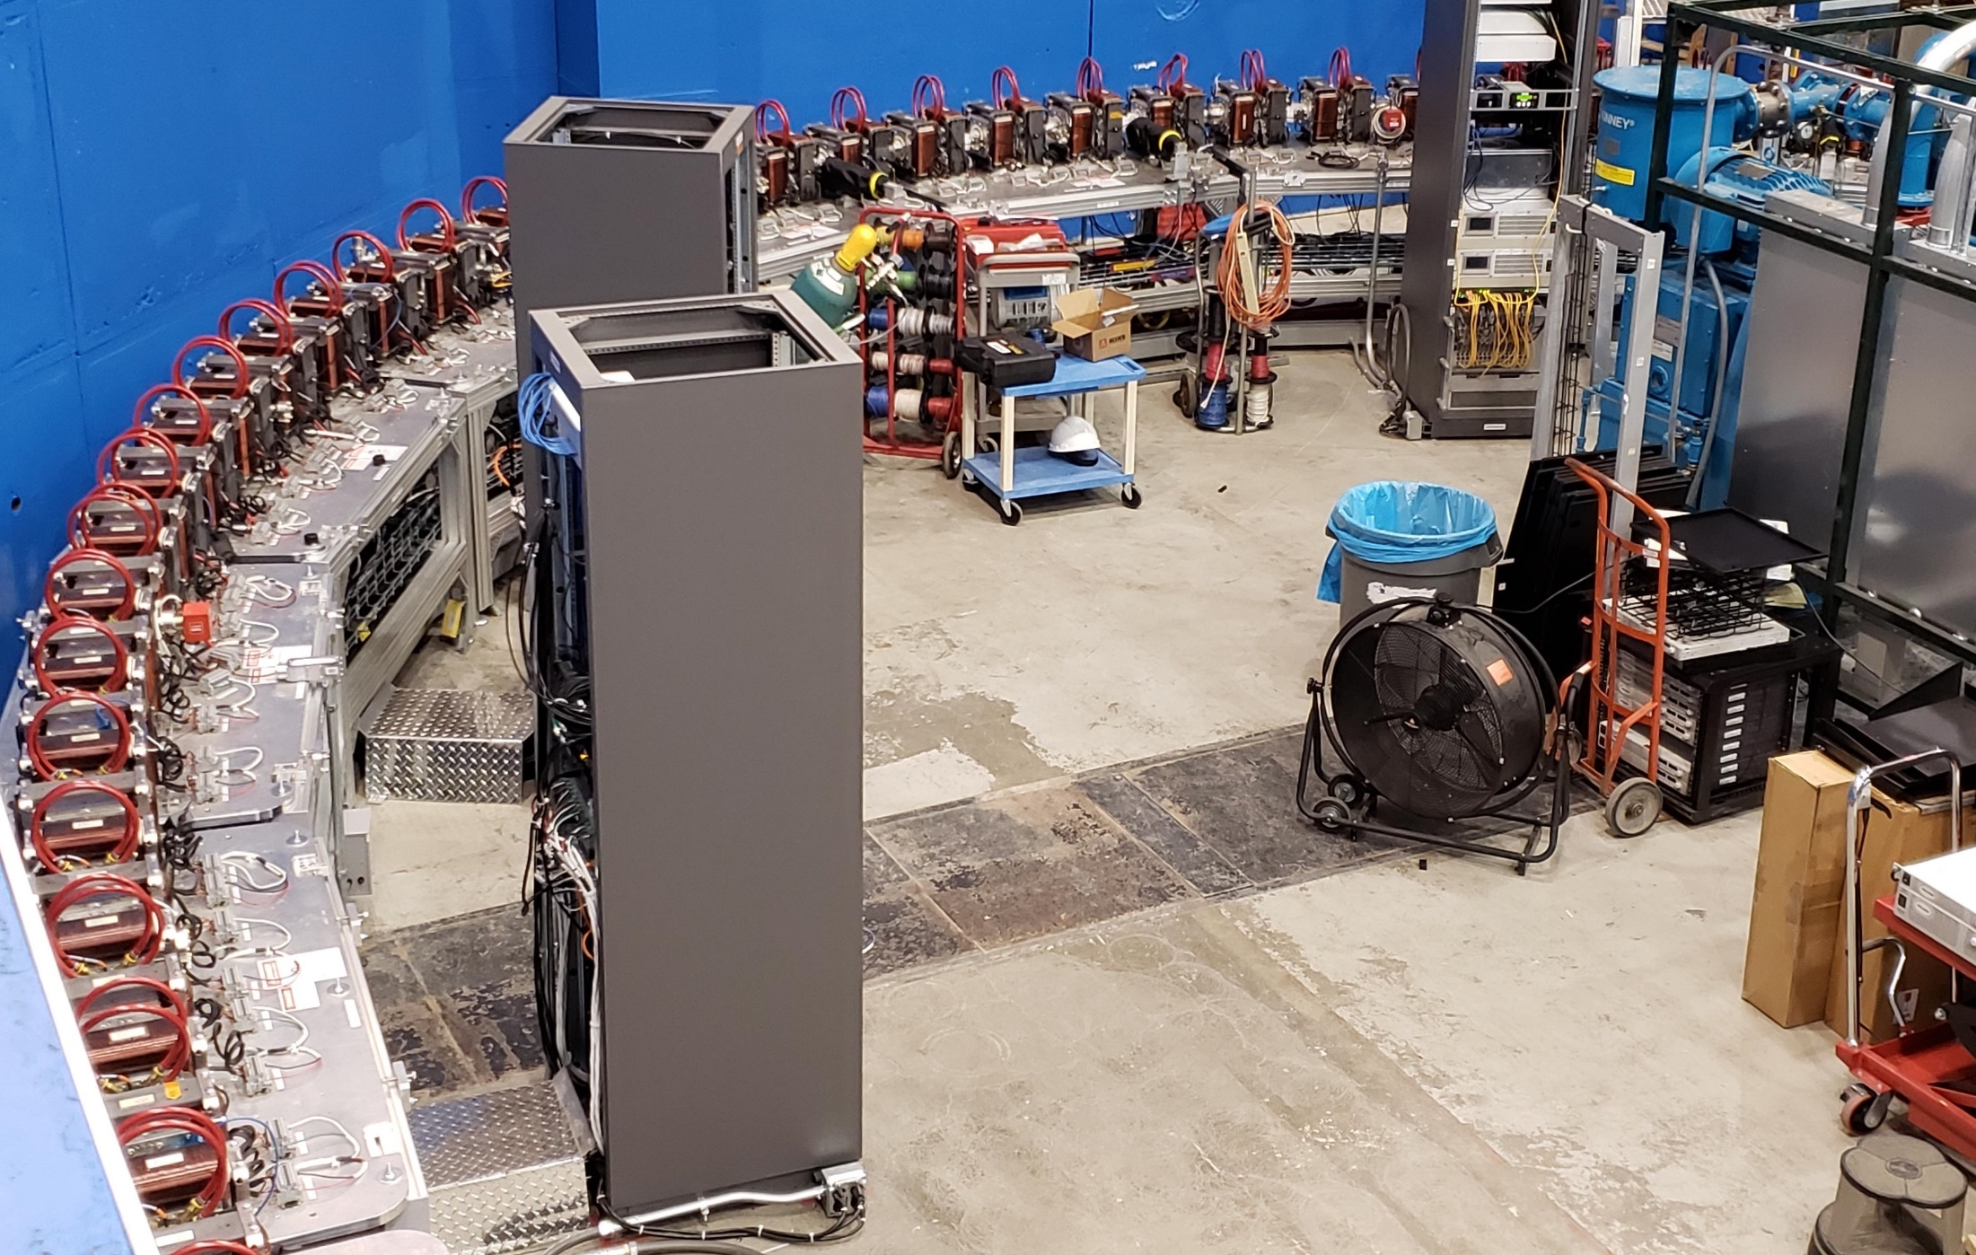
3. Fixed-Field Return Arc

Slide 18
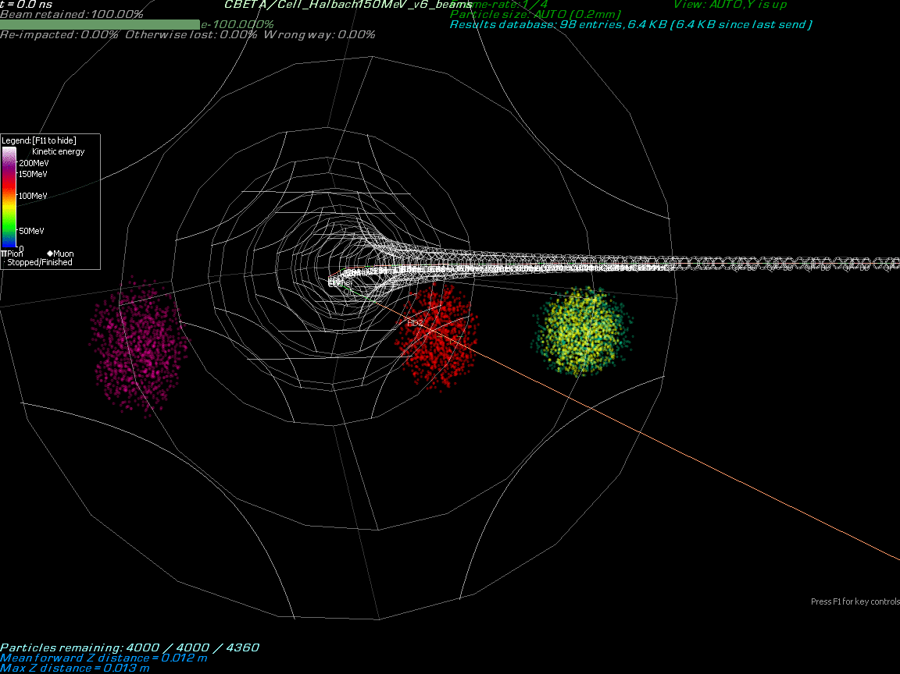
By Stephen Brooks

Slide 19
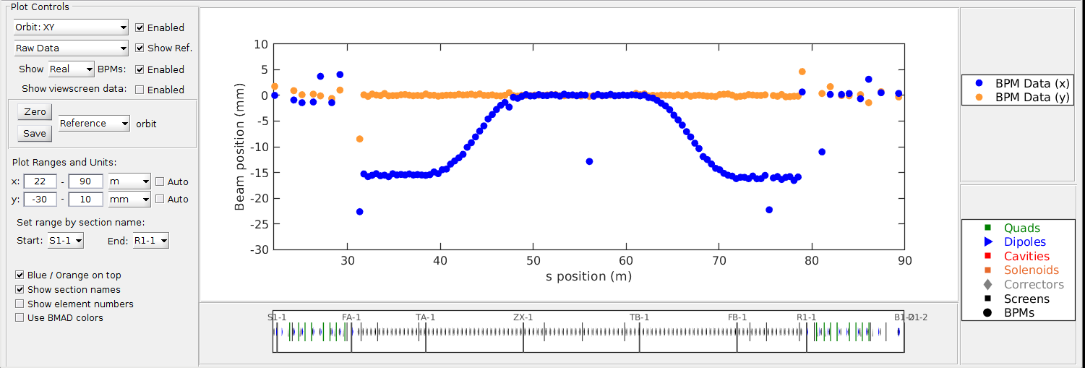
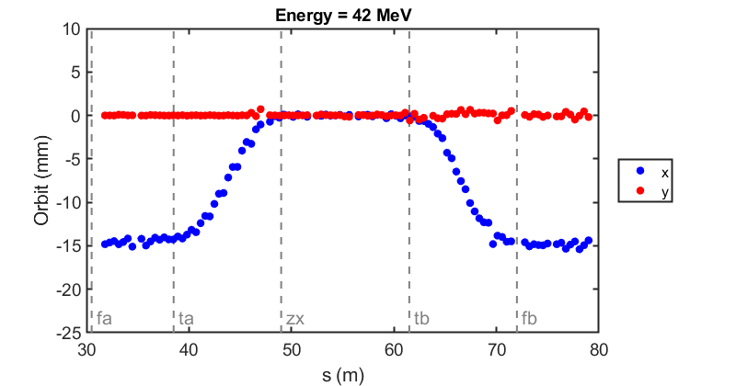
3. Commissioning results: orbit correction in fixed-field loop
The very first beam through the fixed-field loop on May 7, 2019
Corrected beam using section-by-section local SVD (did not converge for whole FFA)
(June 12, 2019)

Slide 20
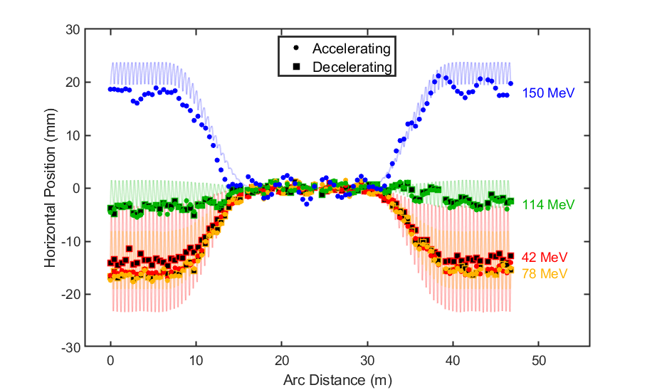
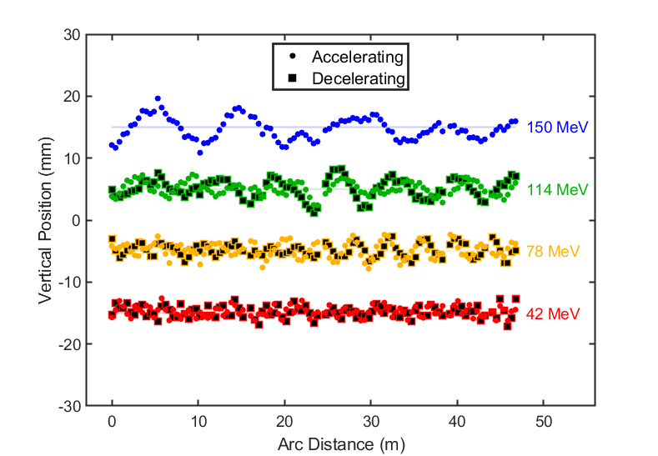
3. 7-turn ERL operation with corrected turns 1,2,3

Slide 21
3. Achieved Results with Permanent Magnet ERL
First multi-turn SRF ERL
Full Proof of Principle for the Non-Scaling Fixed Field Alternating Gradient Concept
Proof of Principle for the ARC to Straight Merging
Established New Technology for the superb quality Halbach-type permanent Combined Function
Opened door for application to the new electron-positron and electron ion colliders with permanent magnets
Established energy saving measures: Energy Recovery, SRF, and permanent magnets.

Slide 22
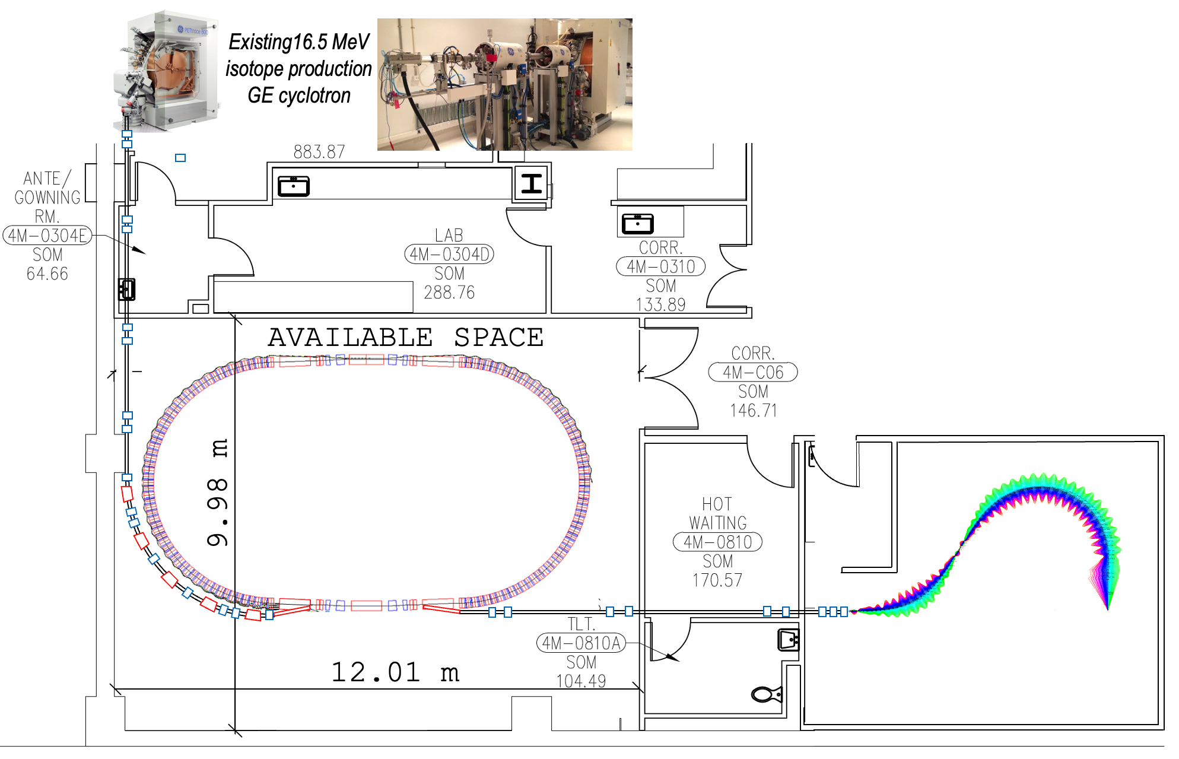
4. ‘FLASH’ Proton Therapy facility:
Stony Brook University Hospital – Radiation Oncology

Slide 23
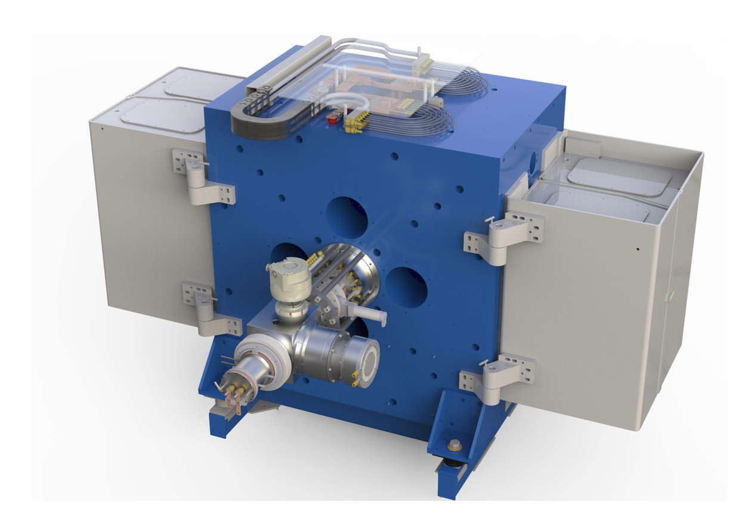
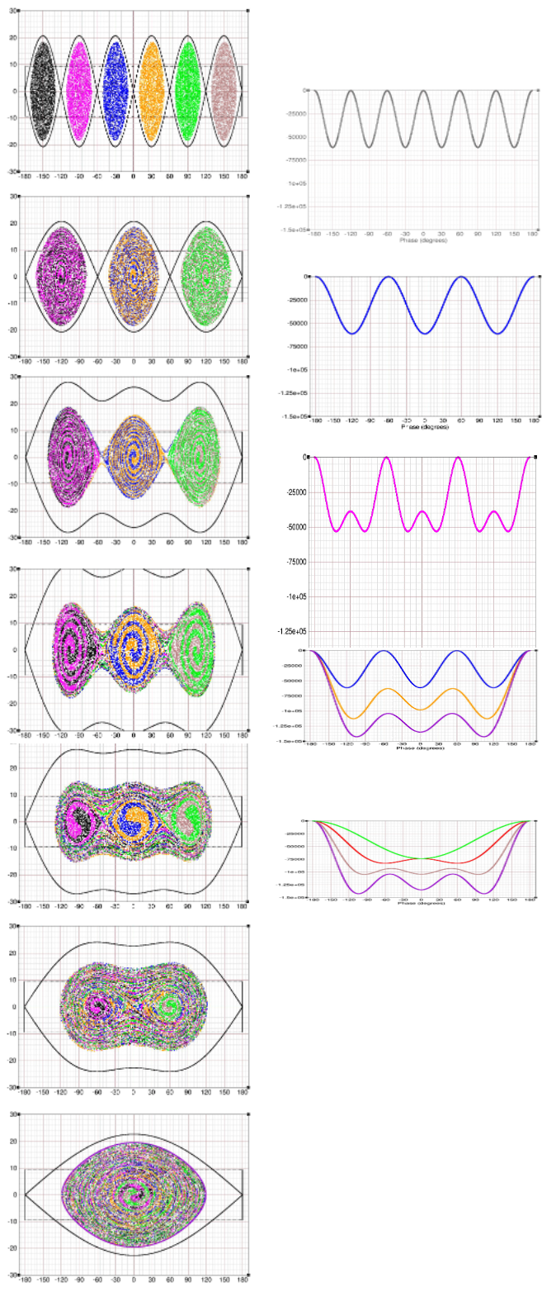
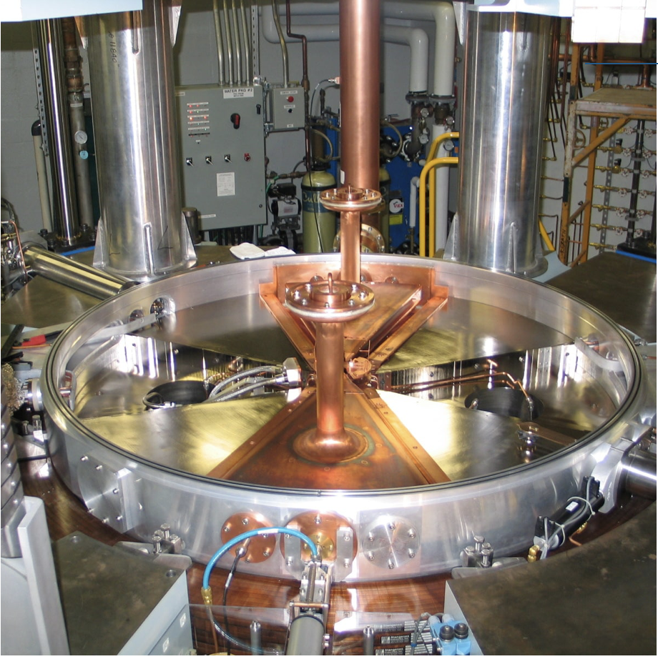
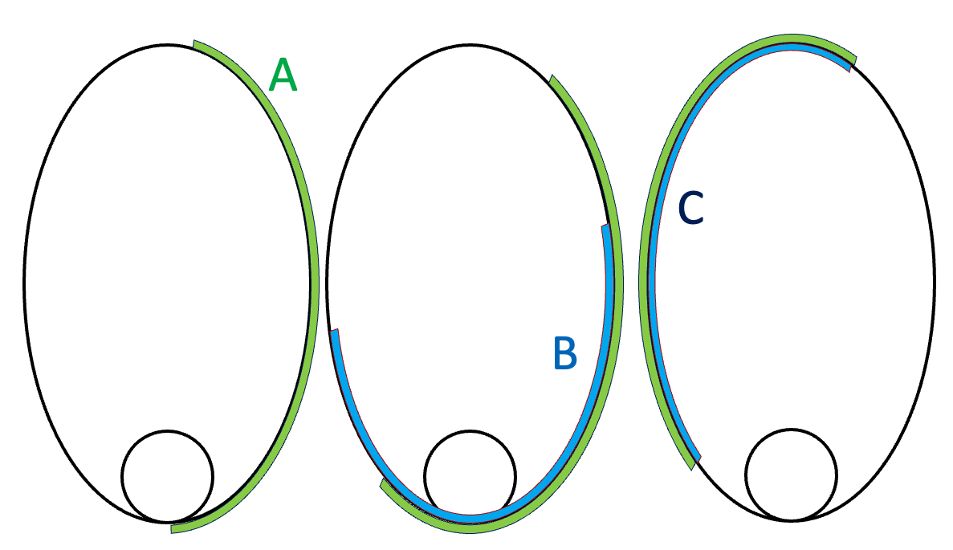

4. TR-19 Cyclotron as an Injector Possibility
6 to1 bunch Merge
TR-19 ADVANCED CYCLOTRON SYSTEM, INC. Canada
‘High performance cyclotron, for the production of PET isotopes. The only PET cyclotron with real variable energy and up to 400 μA of beam current.’ The Cyclotron RF frequency is 73.2 MHz, RF system power 20 kW, and 200 KeV energy gain per turn. Reaches the kinetic energy 19 MeV.
1 Coulomb=6.242x10¹⁸ protons.(73.2 MHz→ 13.66 ns)
400 x10⁻⁶ x 6.2415x10¹⁸/s x 13.66 x10⁻⁹ = 3.41x10⁷ protons/bunch
The time required for one turn at 19 MeV for ~30 m circumference is 5.857x10⁻⁷ sec. For TR-19 the time of one bunch τ =1/73.2x10⁶=13.66 ns. In the half of the ring there is a place for 18 bunches. FLASH requires 3.8x10¹¹ protons or 600 nC this requires 310 cycles in 100 ms = 3.1 kHz
RF Voltages
#dees 2
RF frequency 73.2 MHz
h-RF harmonic 4
Voltage on dees 50 keV
Energy/turn 200 keV
SLIP STACKING
CW

Slide 24
4. ‘FLASH’ Proton Therapy facility: Fast Cycling FFA Synchrotron
The proposal is based on the existing US patent by the speaker of this proposal [6]:
6. D. Trbojevic, Title: “Non-scaling fixed field alternating gradient permanent magnet cancer therapy accelerator”, patent number: US 9661737 B2, Date of the patent: May 23, 2017 (belongs to the DOE). https://patentimages.storage.googleapis.com/42/5e/92/f7da1cf617d6e3/US9661737.pdf

Slide 25









4. Injection, Extraction and three RF cavities
Cyclotron 10 MeV
RF-1
Magnified injection
orbit
Magnified extraction
orbit
2.7 m
5.68 m
RF-2
RF-3
Protons orbit at δp/p=+50%
Pill Box RF cavities for Phase Jump Acceleration
High Power Cavities
In Rutherford Lab for Very High Intensity
Proton beams.

Slide 26


4.Matching of the Multiple Energy Orbits to the Straight Section
5.8 m

Slide 27

4. Matching arc to the Straight

Slide 28

4. Tunes vs Energy in the FFA Synchrotron

Slide 29

4. Orbits in the FFA synchrotron
+17 - 30 mm

Slide 30



4. Synchrotron Beam and Magnets
Input beam is assumed to come from
the 10 MeV cyclotron
Measured emittance ~5 π mm mrad
β_{x}∼ 0.4 m
β_{y}∼ 1 m
At Injection kinetic energy is 10 MeV
γ = 1.010657 γ β = 0.14484
γ β = ⎷ γ ²-1
σ_{x} =1.517 mm
σ_{y} =2.398 mm
The length of the focusing magnet 18 cm
The length of the defocusing magnet 9.652 cm
~12.5 cm
~11 cm
~13 cm
~14 cm

Slide 31

4. Magnetic Fields at Focusing and Defocusing Permanent Magnets of the Fast-Cycling Synchrotron

Slide 32



4. Time of flight dependence during acceleration
Radio Frequency (RF)-Acceleration:
Using the harmonic number h=1 the frequency must follow the time of flight: f=1.981 MHz at 19 MeV
f=6.132 MHz at 250 MeV τ₂₅₀=163.08 ns
Barrier Bucket merging of multiple bunches
Time of flight for one turn at injection:
τ(10 MeV) = 690.9 ns, h=1→ 1.447 MHz
τ(14 MeV) = 585.7 ns, h=1→ 1.707 MHz
τ(16.5 MeV)= 540.6 ns, h=1→ 1.850 MHz
τ(19 MeV) = 504.8 ns, h=1→ 1.981 MHz
τ(30 MeV) = 405.2 ns, h=1→ 2.468 MHz
Time of flight for one turn at maximum energy:
τ(250 MeV) =163.08 ns, h=1→ MHz

Slide 33
4. Fast Cycling Acceleration with Ferrite cavities
(RF cavities proposed by the Rutherford Lab UK)
By Stephen Brooks
 | Choices for injector cyclotron |  |  |  | Units
 | ACSI | GE | TR-19 | IBA
Energy of Injector Cyclotron | 14 | 16.5 | 19 | 30 | MeV
Cyclotron current | 400 | 200 | 400 | 1200 | μA
Treatment charge | 60 | 60 | 60 | 60 | nC
Injection turns | 4 | 4 | 4 | 2 | #
RF acceleration per turn | 29.70 | 29.70 | 29.70 | 44.55 | kV
Calculation | Treatments Options
Turn duration | 585.74 | 540.6 | 504.8 | 405.1 | ns
Charge per turn | 0.234 | 0.108 | 0.151 | 0.486 | nC
Charge per injection | 0.937 | 0.432 | 0.606 | 0.972 | nC
Machine cycles | 65 | 139 | 100 | 62 | #
Machine cycle rate | 540 | 540 | 540 | 809.95 | Hz
Outputs
Treatment time | 120 | 257 | 185 | 76.54 | ms

Slide 34



4. Acceleration in Fast-Cycling FFA synchrotron
Phase Jump acceleration with Pill Box RF Cavities
Michael Blaskiewicz
(BNL)
$$N_{TURNS}=\frac{\left(E_{max}−E_{min}\right)}{{{N_{cav }V}_{SYNC}}_{per cavity}}=\frac{\left(250−10\right)∗{10}^{6}}{3∗22.2∗{10}^{3}}≈3600…$$
- The Phase Jump Acceleration (PJA) method is proposed by M. Blaskiewicz and follows a previous proposal by D. Boussard from CERN.
Acceleration is performed by adjusting the RF phase each turn. The phase jump during acceleration with a fixed frequency. The RF frequency needs to be in a high range, ~370-395 MHz, because of the required large number of RF cycles between the passages of bunches, to achieve higher values of Q. The basic idea is to accelerate a train of bunches with a gap. During the gap the RF phase is adjusted so that when next the bunch train arrives, the phase is correct for acceleration.

Slide 35


4. Fast Cycling Synchrotron Cycles
Kinetic
Energy
(MeV)
Extraction #2
250
Ex.1
Ex.2
RF manipulation
Ex.3
16.5-30
Injection
Energy
Second synchrotron cycle
t(ms)
Injection
Porch
One synchrotron cycle
Extraction kicker wave forms
0.8ms < τ < 1.85ms
1.3kHz< f < 540 Hz
If the RF kicks are $±$30 kV, during the slip-stacking merge a difference in the time of flight for two 2 energies is 773ps. If the batches are 15 m apart it would take 370 turns to get them aligned. Next step would be to merge into one bucket by snaping the new RF voltage on.
Time of bunch flight 405-550 ns
At the injection porch time of 926 μs there are 1680 turns. 15 turns for 15 Cyclotron bunches and 1650 turns for RF manipulations

Slide 36







4. Injection/Extraction in/from Synchrotron
NEW EIC KICKER @BNL
$$θ=\frac{Bl}{Bρ}$$
Βρ=0.79774 @ injection 30 MeV
Βρ=2.43213 @ extraction 250 MeV
Magnetic septum takes the beam toward the kicker or out after the kicker

Slide 37


5. ‘FLASH’ Proton Therapy facility: FFA Beam lines with 70—250 MeV kinetic energy range

Slide 38




6. ‘FLASH’ Proton Therapy facility: Permanent Magnet Gantry

Slide 39

6. ‘FLASH’ Proton Therapy facility: Permanent Magnet Gantry

Slide 40


6.‘FLASH’ Proton Therapy facility: Present VARIAN-SIEMENS gantry

Slide 41


7. ‘FLASH’ Proton Therapy facility: the Whole Facility

Slide 42
8. Estimated Cost for the FLASH radiation facility
We are basing the cost for the Proton FLASH radiation facility is based on the previous ‘CBETA’ project. This project was funded by the New York State Research and Energy Development Authority (NYSERDA) with a total budget of $25M.
Permanent magnet cost: There were 230 combined function magnets of 5 types. The total cost of ~$4.5M includes the permanent magnet material, measurements, assembly, and installation. A combined function magnets number for the fast-cycling synchrotron is ~80 magnets (64 for the arcs and 16 for the straights matching), for the transfer beam lines ~80 magnets (28 for the shorter beam line and 44 for the longer transfer line with 6 for the straight section). The total number of permanent magnets ~180 magnets (to include the transfer line from the cyclotron to the fast-cycling synchrotron). As the cost of the permanent magnet material fluctuates, we estimated for the total cost for magnets to be ~$8M.
Fast scanning system with the nozzle and dose measurements, with the patient treatment couch $5M.
Mechanical Assembly for fast cycling synchrotron, the rotating gantry structure, beam line assembly: ~$2M
Correction magnets ~$2M
Power supplies for the correction magnets ~$2M
Injection Cyclotron ~$3M
RF cavities ~$1.8M
Injection and extraction kickers ~$400,000.
Magnetic Septa ~$200,000.
Vacuum system ~$1.5M
Beam Instrumentation ~$600,000.
Bunch pattern Generator ~$80,000.
Abort system $500,000.
Personnel Protection system $80,000.
Control system and fiber connections $2.0M
Total estimated cost including the labor is: ~40M

Slide 43
9. Conclusions for Affordable ’FLASH’
Proton Therapy Facility with Permanent Magnets
FLASH cancer therapy: Multiple biological studies and even a few patients’ treatments around the world in recent years confirmed significant improvements in the cancer treatment results; termed FLASH radiotherapy, involves delivering the same treatment dose but in much shorter time intervals — fractions of a second as opposed to minutes — and in far fewer fractions or even a single fraction and therefore at dose rates that are thousands of times higher [7].
The 10-30 MeV commercially available cyclotron has frequency of 65-73.2 MHz and provides 400 μA-1200μA. This makes 3.4x10⁷ protons per bunch. As the synchrotron accelerates 80 bunches this makes per each synchrotron cycle N_{PROTONS} = 3.4x10⁷x 80 = 2.7x10⁹. To achieve the 3.8x10¹¹ protons for FLASH therapy it is required to run the synchrotron per one FLASH treatment N=3.8x10¹¹/2.7x10⁹~140. The total time for the FLASH treatment is t_{FLASH}=140 x 770μs = 100 ms!
[7] Konrad P. Nesteruk and Serena Psoroulas, “FLASH Irradiation with Proton Beams: Beam Characteristics and Their Implications for Beam Diagnostics”, applied sciences, 2021,11, 2170, https://doi.org/10.3390/app11052170

Slide 44
9. SUMMARY
Affordable ’FLASH’ radiation therapy facility includes:
  Injector 10-16.5 MeV low energy commercially available cyclotron (~$2-3M),
  Permanent magnet transfer beam lines.
  Fast-cycling permanent magnet synchrotron,
  The fixed field permanent magnet gantry. The permanent magnetic field removes limitations of the present proton therapy facilities as there is no need to adjust magnetic field.
The 10-250 MeV fast cycling proton synchrotron with cycling of 1.3 kHz is the fastest synchrotron proposed so far. Today’s synchrotron rates are in a range are 15-60 Hz.
In proton acceleration within the non-relativistic energy range the main problem is the limitation on the speed of magnetic field response to the change of energy. This limitation is now eliminated by using the permanent magnets for the same energy range.
The transverse scanning at the end of the gantry requires significantly higher rates to be able to deliver the beam within 100 ms.
Advantages:
The cost of the FLASH radiation therapy facility is significantly reduced (~$40M with respect to ~$160M).
Simplified operation as there is not a need to change the magnet settings for different proton energies.
A significant reduction of the power consumption as the permanent magnets do not require electrical power. Exceptions are the correction magnets and RF power amplifiers.
Significant reduction on radiation shielding as there the beam losses in synchrotron are controlled.
Significant reduction of the magnet sizes and weights. The gantry weight is significantly reduced.

Slide 45
Other Possible Applications
CEBAF upgrade, LHeC ERL collider

Slide 46

Layout of the LHeC-LHC-SPS
From Oliver Brüning, Andrei Seryi, and Silvia Verdu-Andres
Frontiers in Physics, 25 April 2022, Electron-Hadron Colliders: EIC, LHeC and FCC-eh

Slide 47


FFA LHeC Recirculator with Energy Recovery
Two 8.5 GeV linacs replace two 10 GeV linacs from the original LHeC design
Linac 1
8.5 GeV
Recovery:
51.5 GeV
34.5
17.5
500 MeV Injector
60 GeV
IP
Recovery:
43.0 GeV
  26.0 GeV
  9.0 GeV
Linac 2
8.5 GeV
500 MeV Dump
LHC
Acceleration:
  17.5 GeV
  34.5 GeV
  51.5 GeV
Total power consumption for six arcs in the present LHeC design is 7.1 MW to be compared to the permanent magnet arcs requiring only very small power for correction magnets.

Slide 48



FFA LHeC Recirculator with Energy Recovery
Lattice functions in a single FFA Cell
E=51.5 GeV
E=51.5 GeV
E=34.5 GeV
E=17.5 GeV
E=34.5 GeV
E=17.5 GeV

