Slide 1
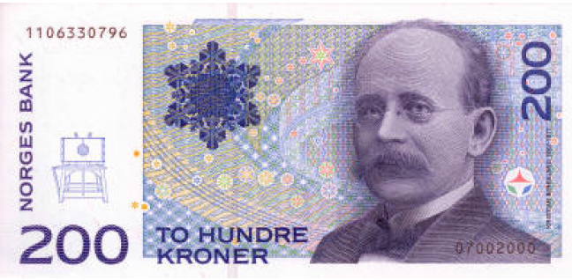
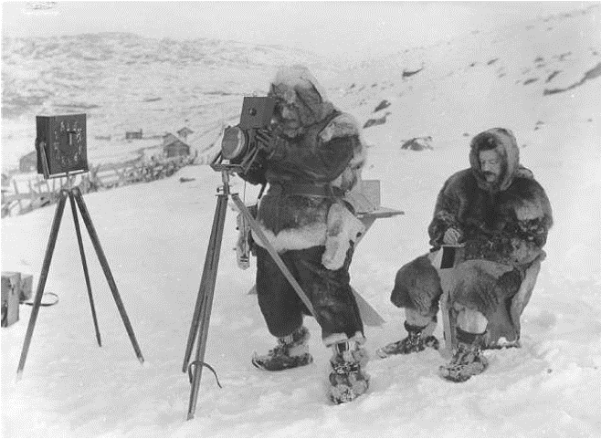
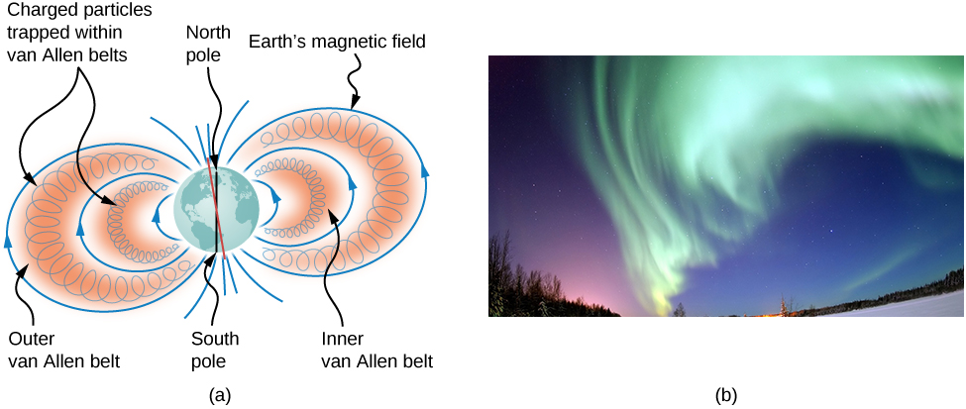
Integrable Dynamical Systems in Particle Accelerators
K. Birkeland
Størmer and Birkeland in 1910
Sergei Nagaitsev
Jefferson Lab and Old Dominion University
2023 Workshop on Fixed Field Alternating Gradient Accelerators (FFA’23)
Sep 15, 2023

Slide 2
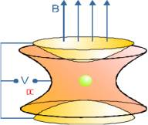
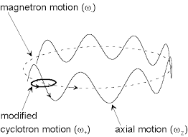
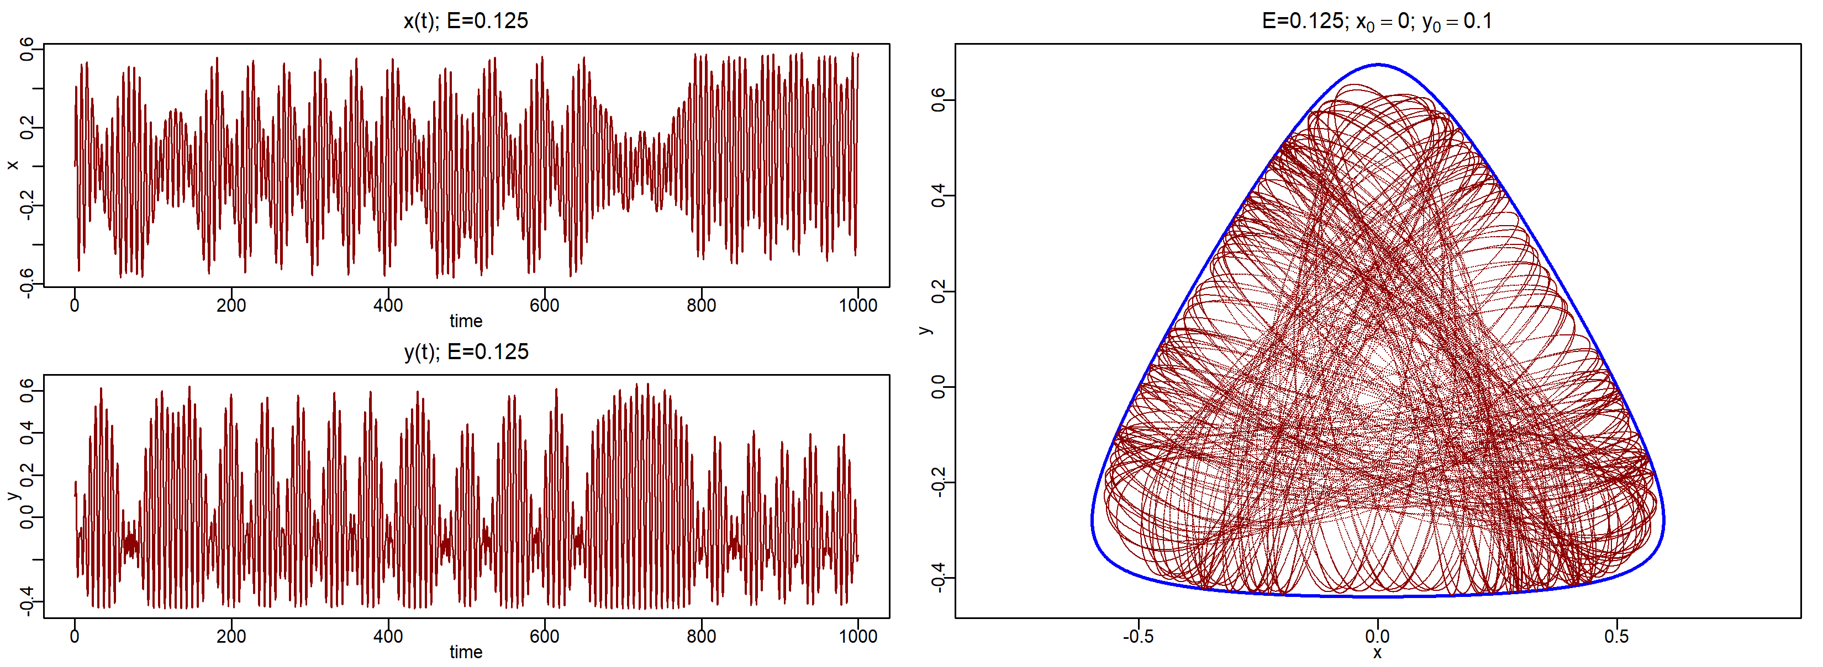
Hamiltonian systems and integrability
There are many definitions of integrability in dynamical system theories
Simplistic definition: Integrable means ‘Fully predictable, non-chaotic’
For a 3D Hamiltonian system to be integrable, there must exist 3 nontrivial independent Poisson-communing invariants (including the Hamiltonian itself, if it is time-independent).
Examples:
  (1) All 3D harmonic oscillators are integrable.
    An ideal Penning trap is an integrable system
  (2) An uncoupled 2D nonlinear oscillator is integrable
  (3) The Hénon–Heiles system (a coupled nonlinear oscillator) is nonintegrable
    Chaos appears for E > 0.125

Slide 3
Modern accelerators (the LHC case)
LHC: 27 km, 13 TeV per beam
  The total energy stored in the magnets is HUGE: 40 GJ (9,600 kilograms of TNT)
  The total energy carried by the two beams reaches 1400 MJ (340 kilograms of TNT)
  Loss of only one ten-millionth part (10⁻⁷) of the beam is sufficient to quench a superconducting magnet
LHC vacuum chamber diameter : ~40 mm
LHC average rms beam size (at 13 TeV): ~0.1 mm
LHC average rms beam angle spread: 2 µrad
  Very large ratio of forward to transverse momenta
LHC typical cycle duration: 10 hrs = 4x10⁸ revolutions
  Particles must have stable non-chaotic trajectories
Kinetic energy of a typical semi truck at 60 mph: ~7 MJ

Slide 4
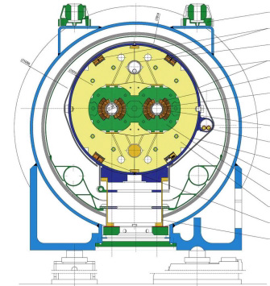
What keeps particles stable in an accelerator?
Particles are confined (focused) by static magnetic fields in a vacuum.
  Magnetic fields conserve the total energy
An ideal focusing system in all modern accelerators is nearly integrable
  There exist 3 conserved quantities (integrals of motion); the integrals are “simple” – polynomial in momentum.
  The particle motion is confined by these integrals.
-- particle’s action

Slide 5
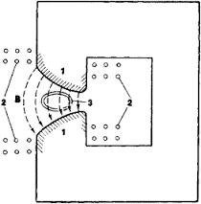
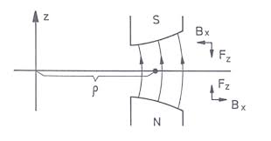
Particle motion in static magnetic fields
For accelerators, there are no useful exactly integrable systems for axially symmetric magnetic fields in vacuum:
Until 1959, all circular accelerators relied on approximate (adiabatic) integrability.
  These are the so-called weakly-focusing accelerators
  Required large magnets and vacuum chambers to confine particles;
The magnetic fields can be approximated by the field of two magnetic monopoles of opposite polarity

Slide 6
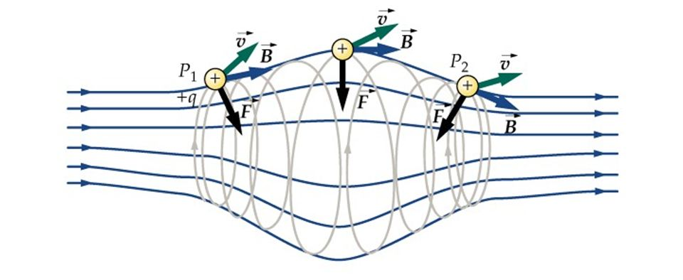
Two magnetic monopoles (‘ends’ of a solenoid)
One can imagine that the motion of an electric charge between two magnetic monopoles (of opposite polarity) would be integrable, but it is not.
  Only approximate “adiabatic” integrals exist, when poles are far apart (as compared to the Larmour radius)
  This is the principle of a magnetic “bottle” trap; also, the principle of “weak focusing in accelerators”.
The non-integrability in this case is somewhat surprising because the motion in the field of two Coulomb centers is integrable.
  This has been know since Euler and was Poincare’s starting point for the 3-body problem quest.

Slide 7
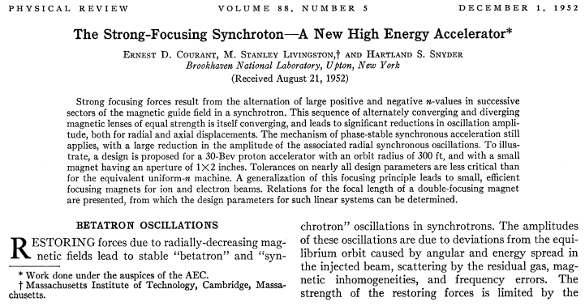
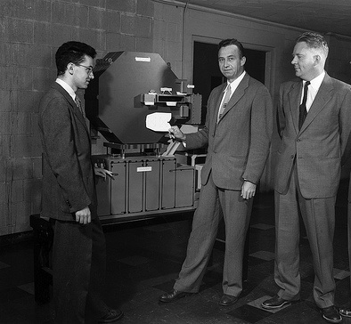
Strong Focusing with static magnetic fields

Slide 8
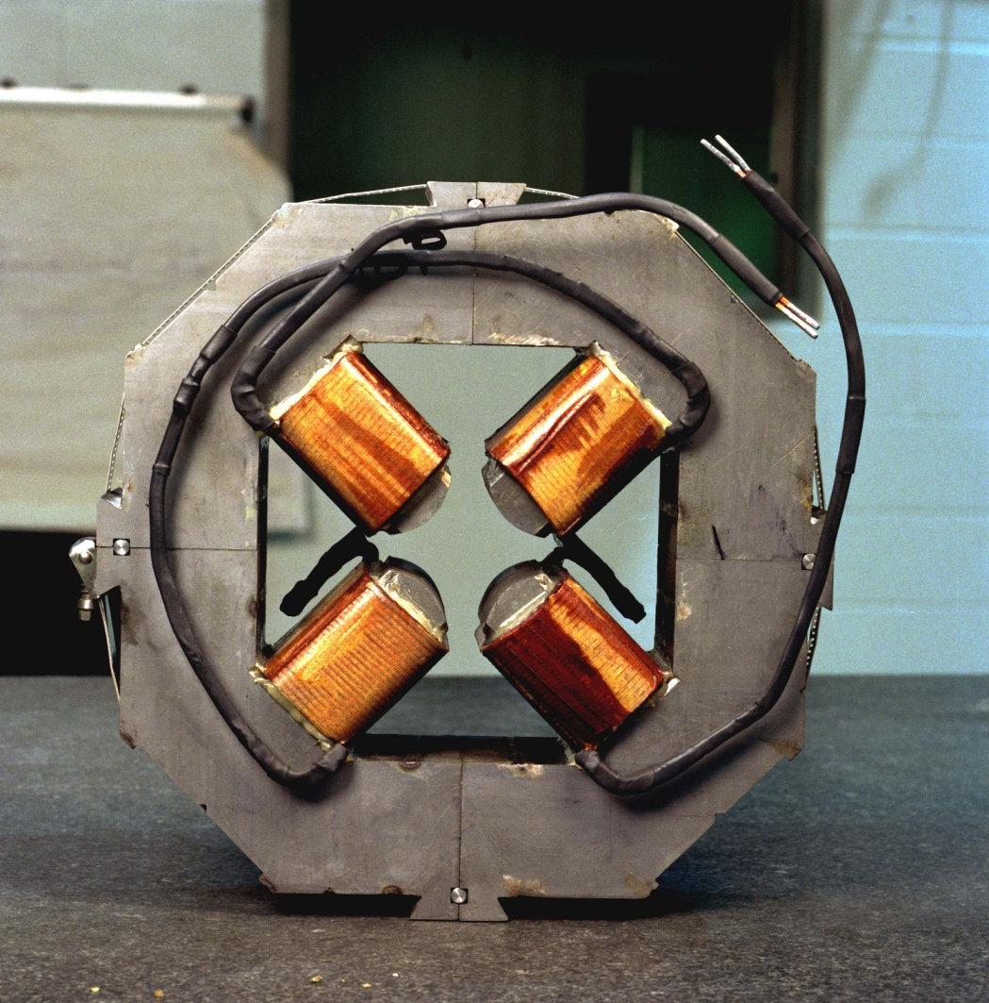
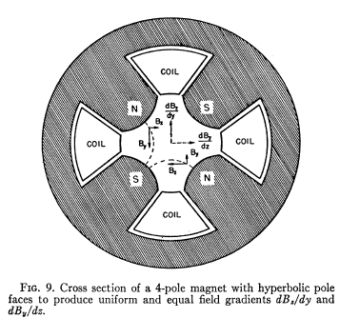
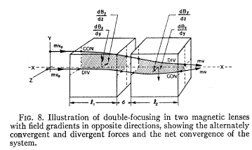
Strong focusing
Specifics of accelerator focusing:
Focusing fields must satisfy Maxwell equations in vacuum
For stationary fields: focusing in one plane while defocusing in another
  quadrupole:
  However, alternating quadrupoles
  results in effective focusing in both planes

Slide 9
The accelerator Hamiltonian
After some canonical transformations and in a small-angle approximation
where δ is the relative momentum deviation. For δ << 1:
For a pure quadrupole magnet: K_{x}(s) = - K_{y}(s)
This Hamiltonian is separable and thus integrable!

Slide 10
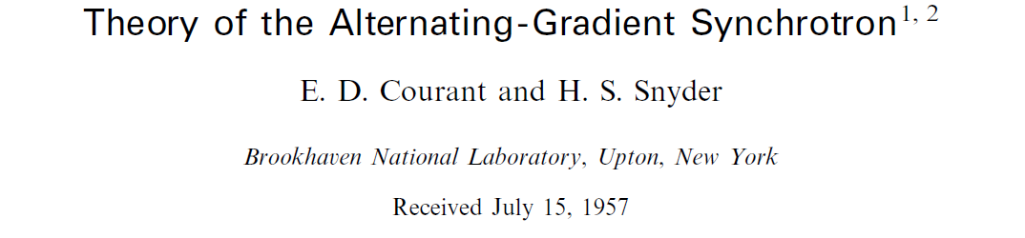
Ideal linear equations of motion in an accelerator:
$$x”+K_{x}\left(s\right)x=0$$
$$y”+K_{y}\left(s\right)y=0$$
Courant and Snyder discovered in 1952 that these two uncoupled time-dependent equations can be transformed into two time-independent equations by introducing two betatron phase variables and instead of the time variable, s:
All particles have the same frequencies:
There are two conserved quantities, corresponding to each degree of freedom – the so-called Courant-Snyder invariants

Slide 11
Non-linear focusing
It became obvious very early on (~1960), that the use of nonlinear focusing elements in accelerators is necessary and some nonlinearities are unavoidable (magnet aberrations, space-charge forces, beam-beam forces)
  Sexupoles appeared in 1960s for chromaticity corrections
  Octupoles were installed in CERN PS in 1959 but not used until 1968. For example, the LHC has ~350 octupoles for Landau damping.
It was also understood at the same time, that nonlinear focusing elements have both beneficial and detrimental effects, such as:
  They drive nonlinear resonances (resulting in particle losses) and decrease the dynamic aperture (also particle losses).

Slide 12
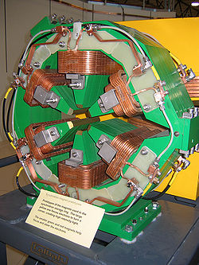
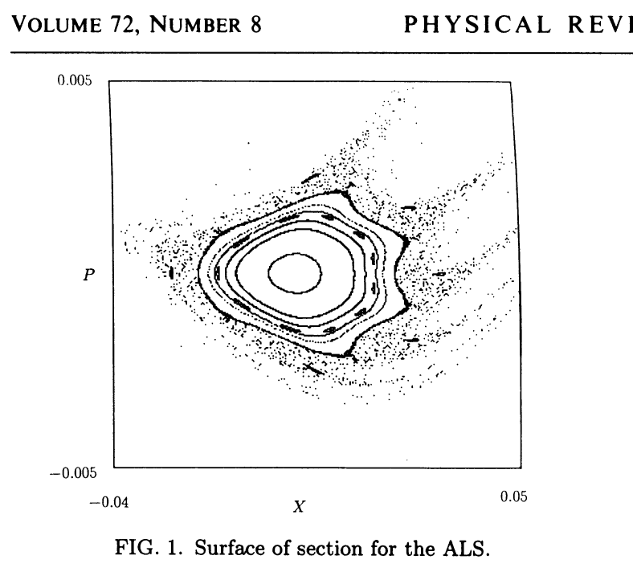
Example: electron storage ring light sources
Low beam emittance (size) is vital to light sources
  Requires Strong Focusing
  Strong Focusing leads to strong chromatic aberrations
  To correct Chromatic Aberrations special nonlinear magnets (sextupoles) are added
dynamic aperture
limitations lead
to reduced beam
lifetime

Slide 13
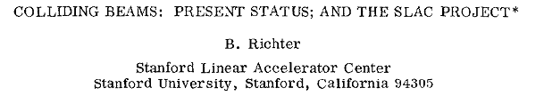
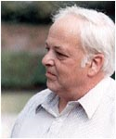
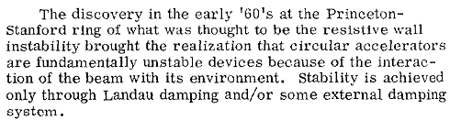
Example: Landau damping
Report at HEAC 1971
Landau damping – the beam’s “immune system”. It is related to the spread of betatron oscillation frequencies. The larger the spread, the more stable the beam is against collective instabilities.
  The spread is achieved by adding special magnets -- octupoles
External damping (feed-back) system – presently the most commonly used mechanism to keep the beam stable.

Slide 14
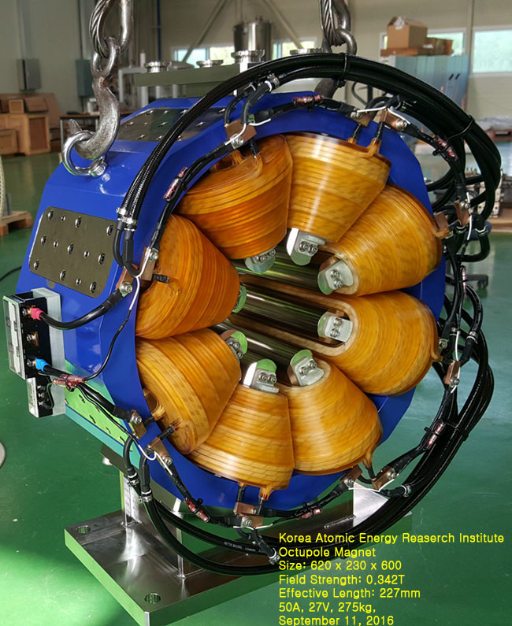
Most accelerators rely on both
LHC:
  Has a transverse feedback system
  Has 336 Landau Damping Octupoles
Octupoles (an 8-pole magnet):
  Octupole potential:
  Results in a cubic nonlinearity (in force)
Note: this is a quartic Henon-Heiles potential,
which is non-integrable

Slide 15
If we try to introduce a frequency spread (add nonlinearities):
Using the Courant-Snyder phase variables leads to:
  Two coupled driven non-linear oscillators
  These generally describe both regular, resonant and chaotic particle trajectories (depending on nonlinear terms and initial conditions)
$$x”+K_{x}\left(s\right)x=S1\left(s\right)x^{2}+S2\left(s\right)xy+S3\left(s\right)y^{2}+O1\left(s\right)x^{3}+⋯$$
$$y”+K_{y}\left(s\right)y=S4\left(s\right)x^{2}+S5\left(s\right)xy+S6\left(s\right)y^{2}+O2\left(s\right)y^{3}+⋯$$

Slide 16
Let’s add a cubic nonlinearity…
D
F
D
F
D
F
D
L
L
L
L
L
L
s
particle
(x, x')
add a cubic
nonlinearity
in every D lens

Slide 17
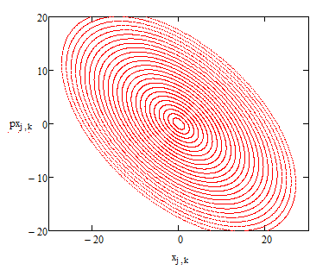
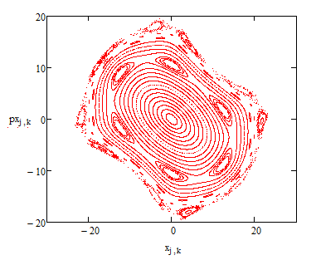
The result of this nonlinearity:
Betatron oscillations are no longer isochronous:
  The frequency depends on particle amplitude (initial conditions)
Stability depends on initial conditions
  Regular trajectories for small amplitudes
  Resonant islands (for larger amplitudes)
  Chaos and loss of stability (for even larger amplitudes)

Slide 18
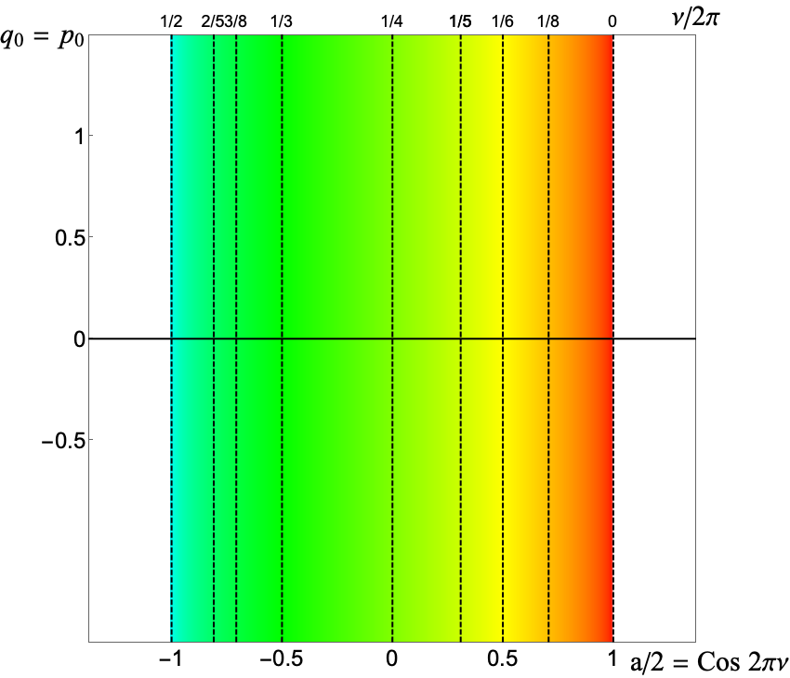
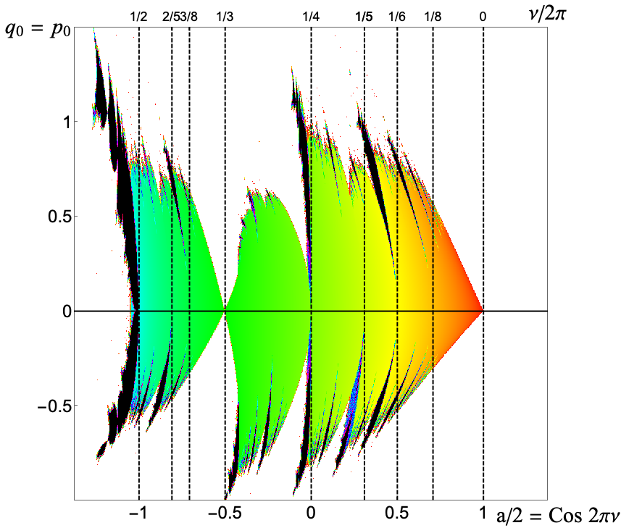
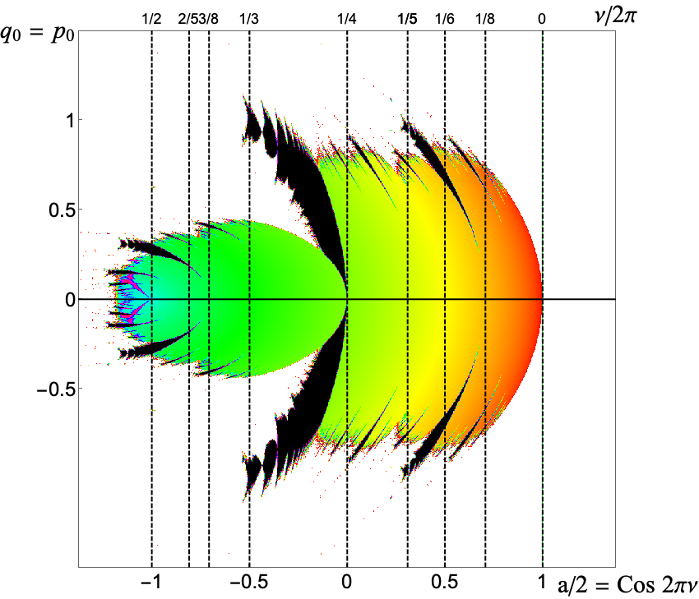
A ‘model’ accelerator mapping
Dynamic aperture as a function of linear tune (betatron freq.)
Linear
Sextupole
Octupole

Slide 19
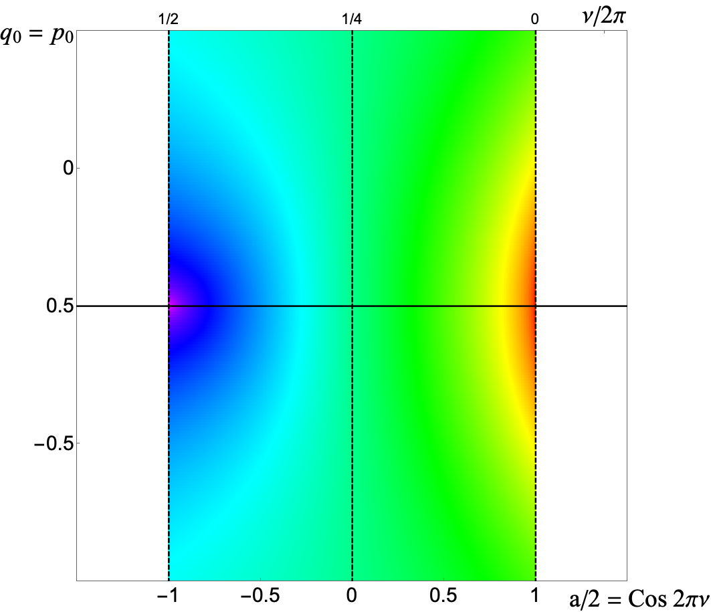
Are there “magic” nonlinearities with zero resonance strength?
Chaotic motion
Yes, we call them “integrable”
Integrable motion
Octupole
McMillan map

Slide 20
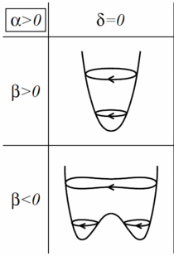
Non-accelerator example
The unforced Duffing 1D oscillator
Can we make something equivalent
to this in accelerators in 2D and with
s-dependent magnets that must also
satisfy the Maxwell equations?
  Like the integrable Henon-Heiles
  potential

Slide 21
Accelerator research areas, where integrability would help
Single particle dynamics:
  How to make the dynamical aperture larger? (light sources, colliders)
  How to make the tune spread larger? (Landau damping in high-intensity rings)
  How to reduce beam halo?
Multi-particle dynamics:
  How to reduce detrimental beam-beam effects?
  How to compensate space-charge effects?
  How to suppress instabilities?
  How to reduce beam halo?

Slide 22
Specifics of accelerator focusing
The transverse focusing system is effectively time-dependent
  In a linear system (strong focusing), the time dependence can be transformed away by introducing 2 new “time” variables (the betatron phase advances). Thus, we have the Courant-Snyder invariant.
The focusing elements we use in accelerator must satisfy:
  The Laplace equation (for static fields in vacuum)
  The Poisson equation (for devices based on charge distributions, such as electron lenses or beam-beam interaction)

Slide 23
Integrable nonlinearities in accelerators
So far, we were able to find 2 classes of nonlinear accelerator-suitable systems;
Systems, where we are able to remove the time dependence, thus making it effectively autonomous.
  This requires for the “time” variable to be the same in x and y. And then we can find some simple examples of autonomous “useful” integrable systems.
  We know only a handful of examples in 4D
Systems, that are discrete integrable nonlinear mappings
  This class originates from Edwin McMillan (the McMillan mapping).
  We know only one example in 4D, suitable for accelerators.

Slide 24
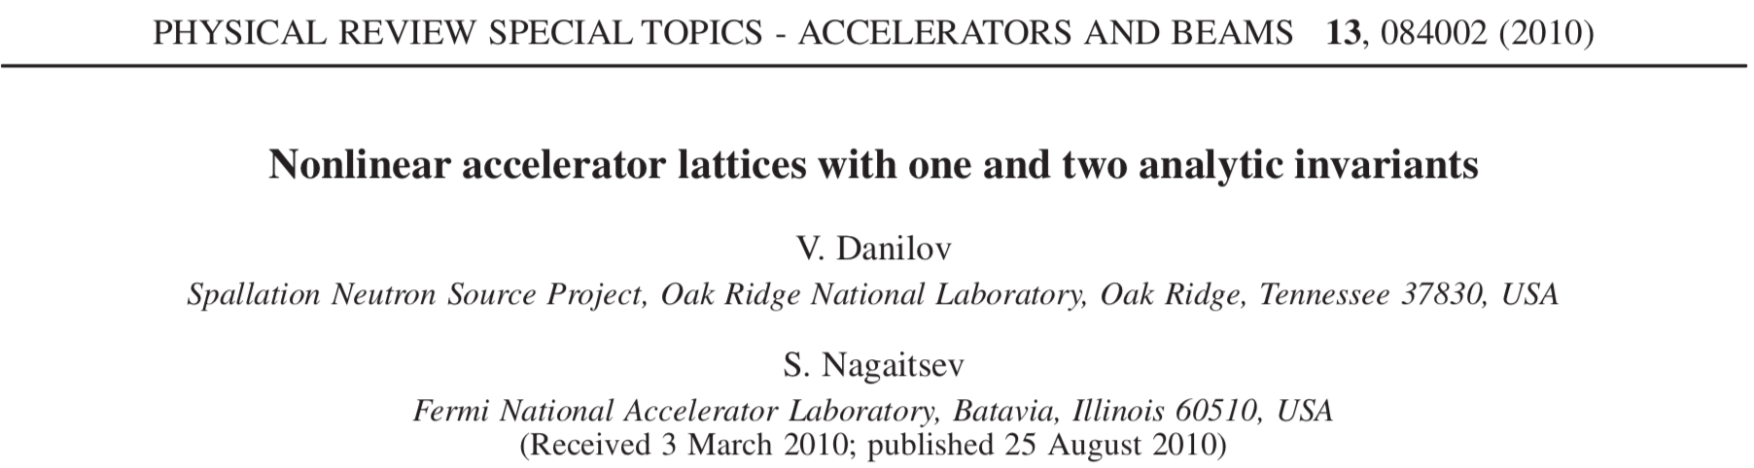

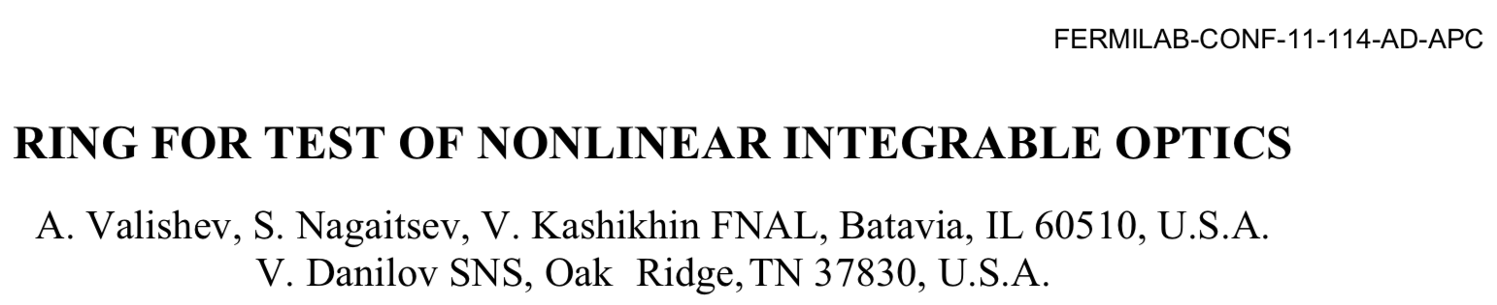
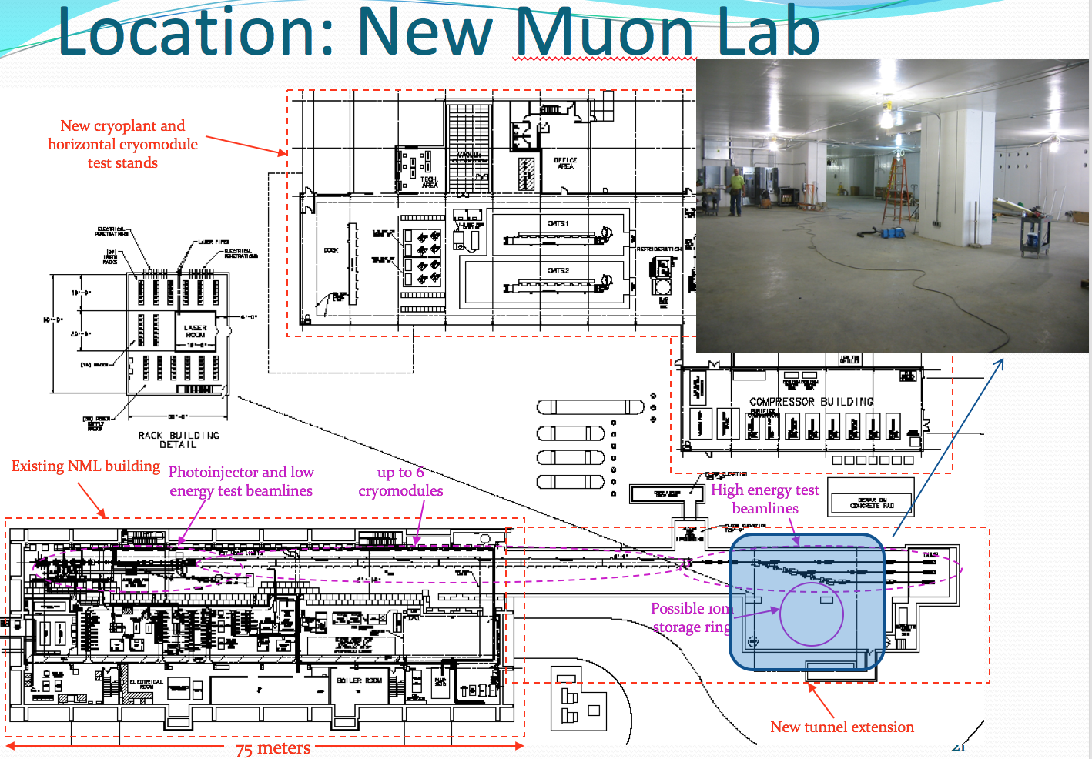
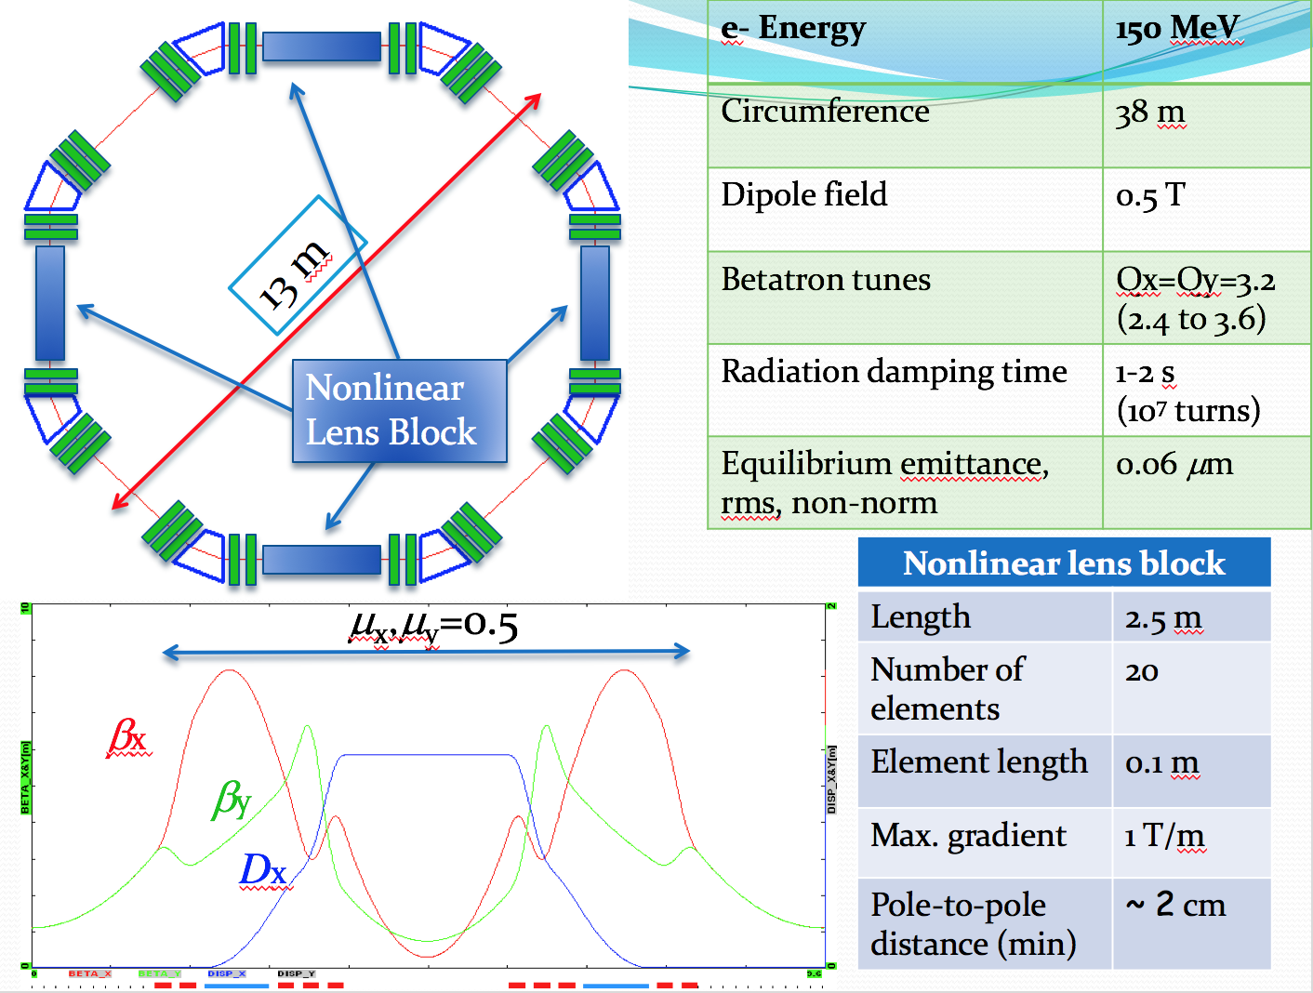
Integrable Optics Concept Emerges
HB 2010
PAC’11

Slide 25
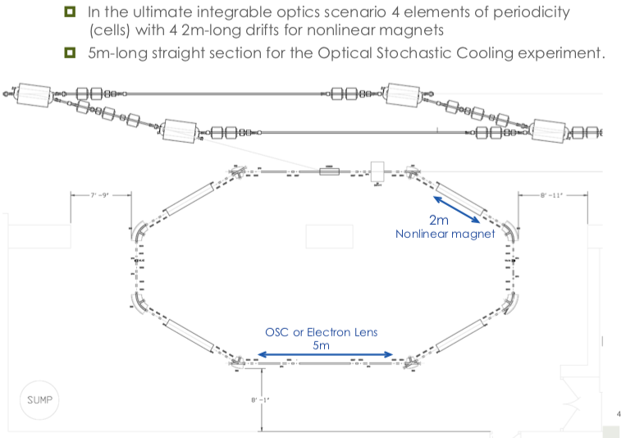
IOTA Design – Layout 2/23/2012
Published as S. Antipov et al 2017 JINST 12 T03002

Slide 26
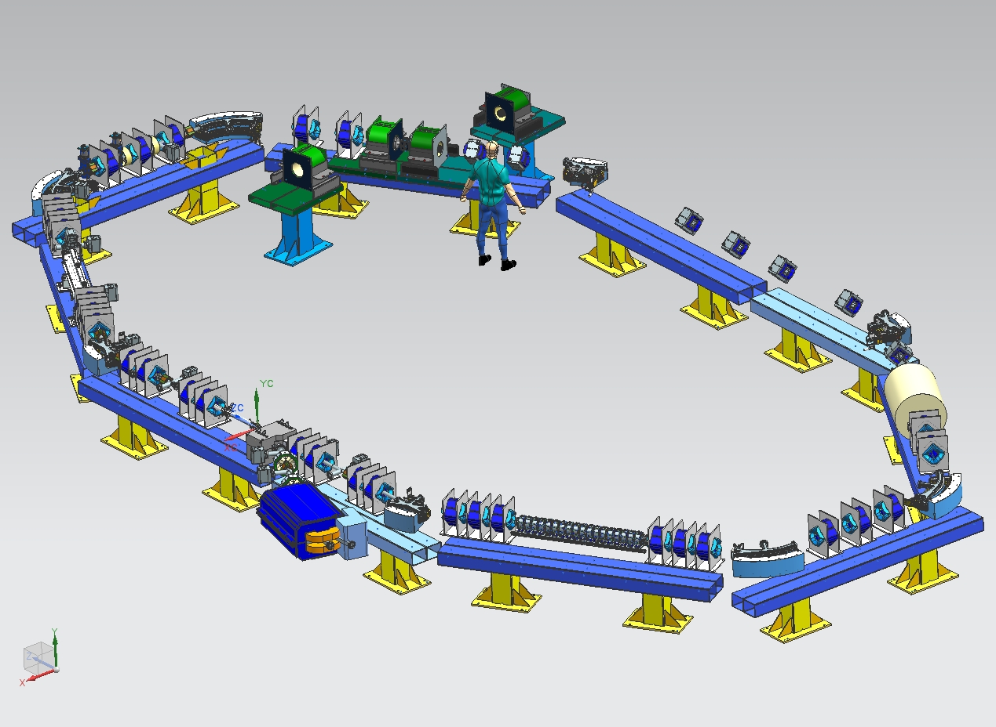
IOTA Layout

Slide 27
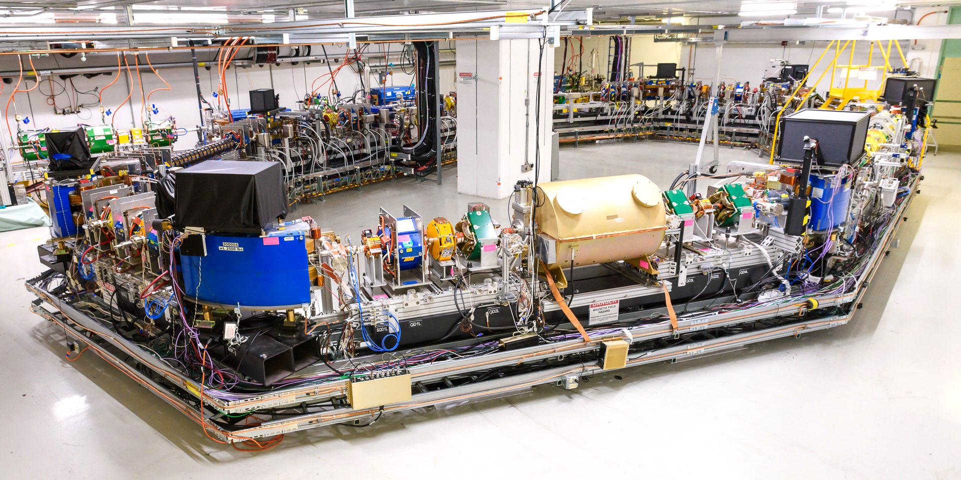
IOTA Assembly Completed 7/29/2018
INJECTION LINE
STRAIGHT SECTIONS FOR EXPERIMENTS
UNDULATOR
OCTUPOLE CHANNEL
OPTICAL STOCHASTIC COOLING EXPERIMENT
SYNCHROTRON-RADIATION STATIONS
RF CAVITY
Photo: Giulio Stancari / Fermilab
The IOTA Storage Ring in May 2021

Slide 28
Example 1
Conceptually, we now know how to make a focusing system (with quadrupoles and thin octupoles), which results in the following 2D integrable nonlinear Hamiltonian
This concept is highly impractical but very important as it may serve as a model for modeling studies.
OR
In normalized
variables

Slide 29
Example 2
A nonlinear partially-integrable focusing system with one integral of motion. Can be implemented in practice (with octupoles). This system is being tested at Fermilab.
A quartic Henon-Heiles system

Slide 30
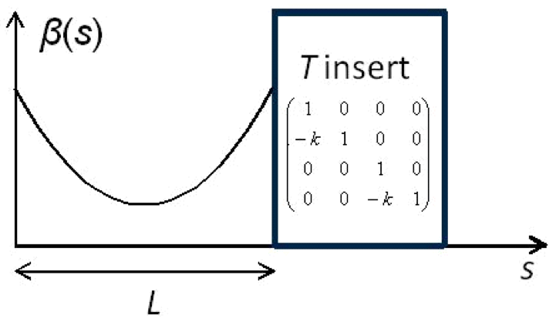
Implementation concept
Start with a round axially-symmetric linear lattice (FOFO) with the element of periodicity consisting of
  Drift L
  Axially-symmetric
  focusing block “T-insert”
  with phase advance n×π
2 Add special nonlinear potential V(x,y,s) in the drift such that
Example only

Slide 31
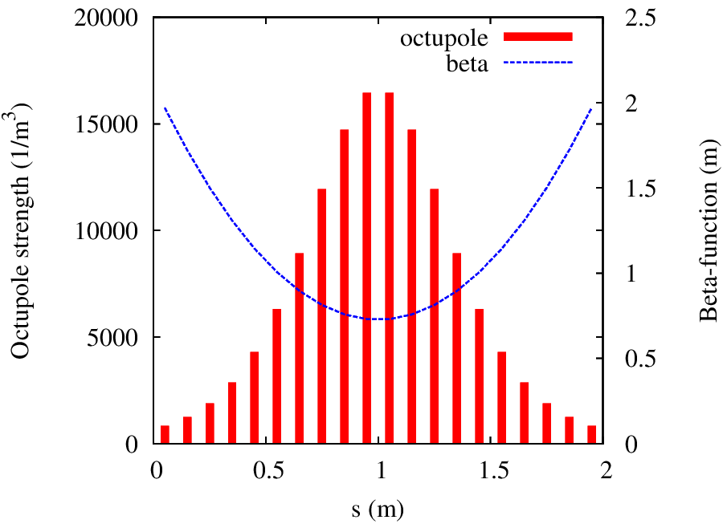
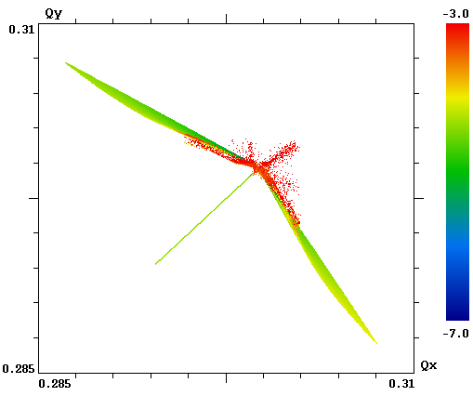
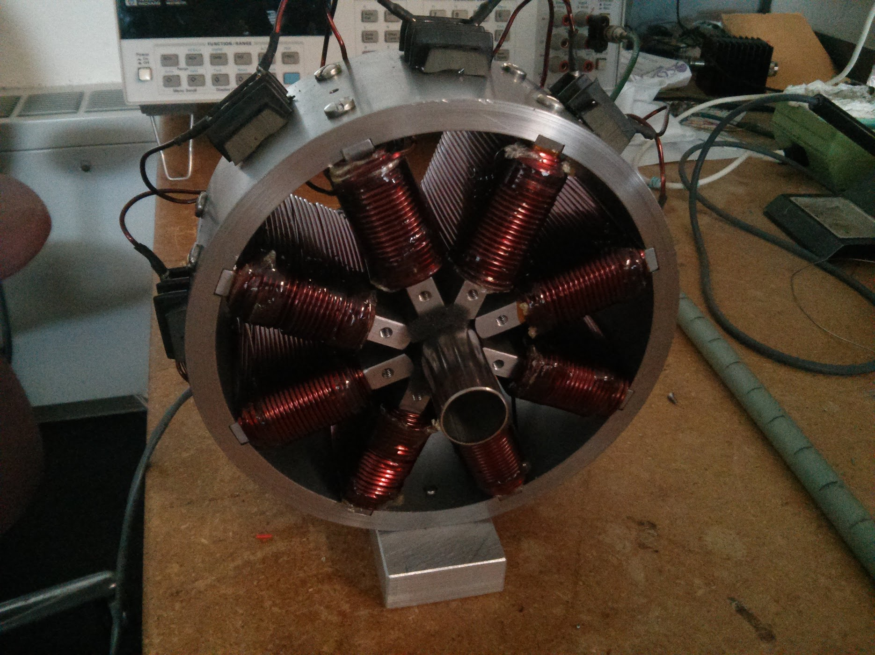
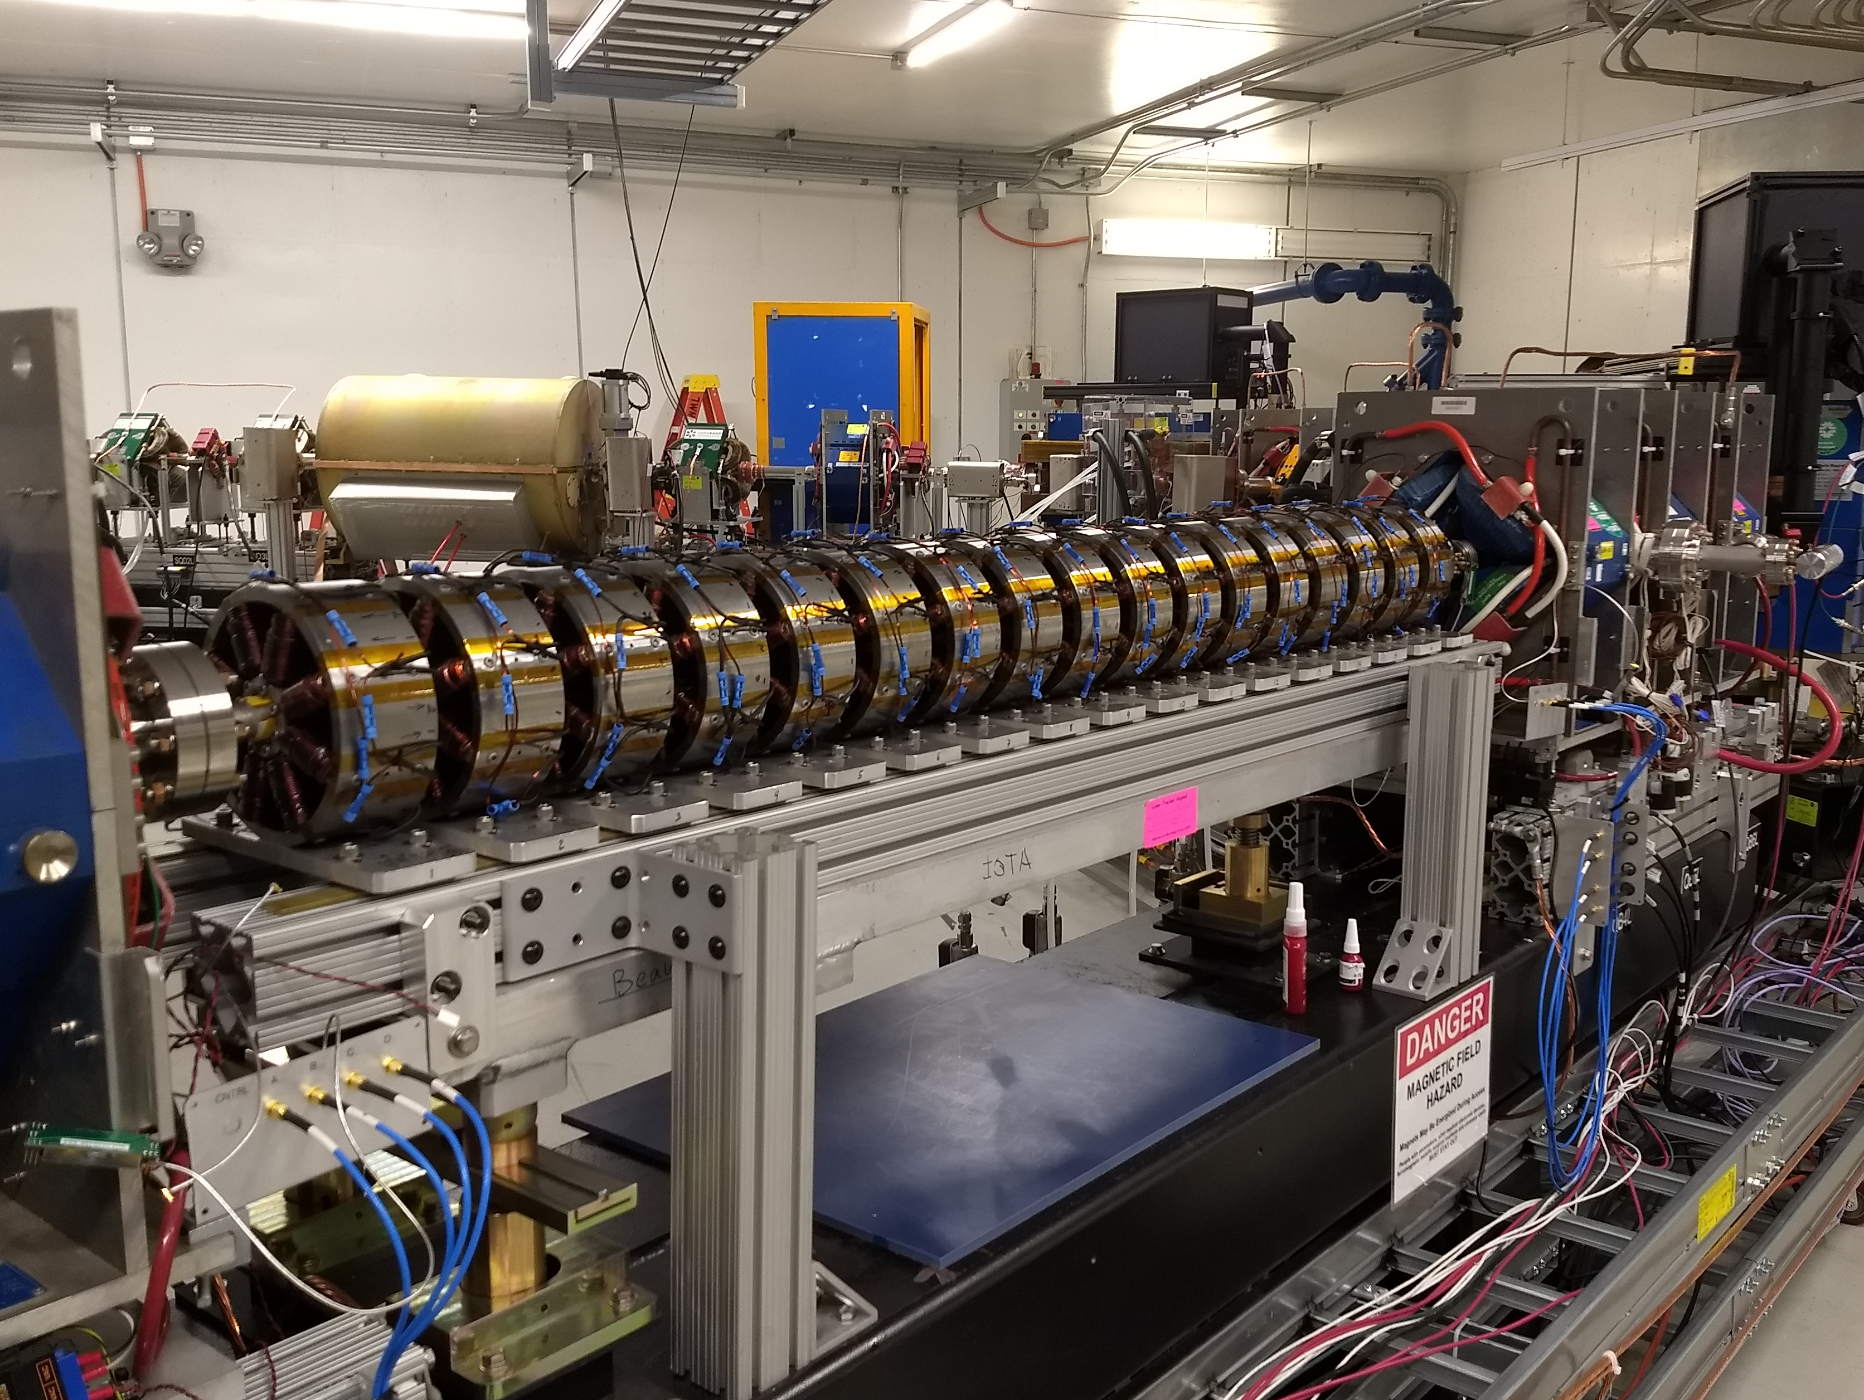
Implementation in IOTA
While the dynamic aperture is limited, the attainable tune spread is large ~0.03 – compare to 0.001 created by LHC octupoles
Q_{y}
20 octupoles, scaled as 1/β(s)³
Q_{x}

Slide 32
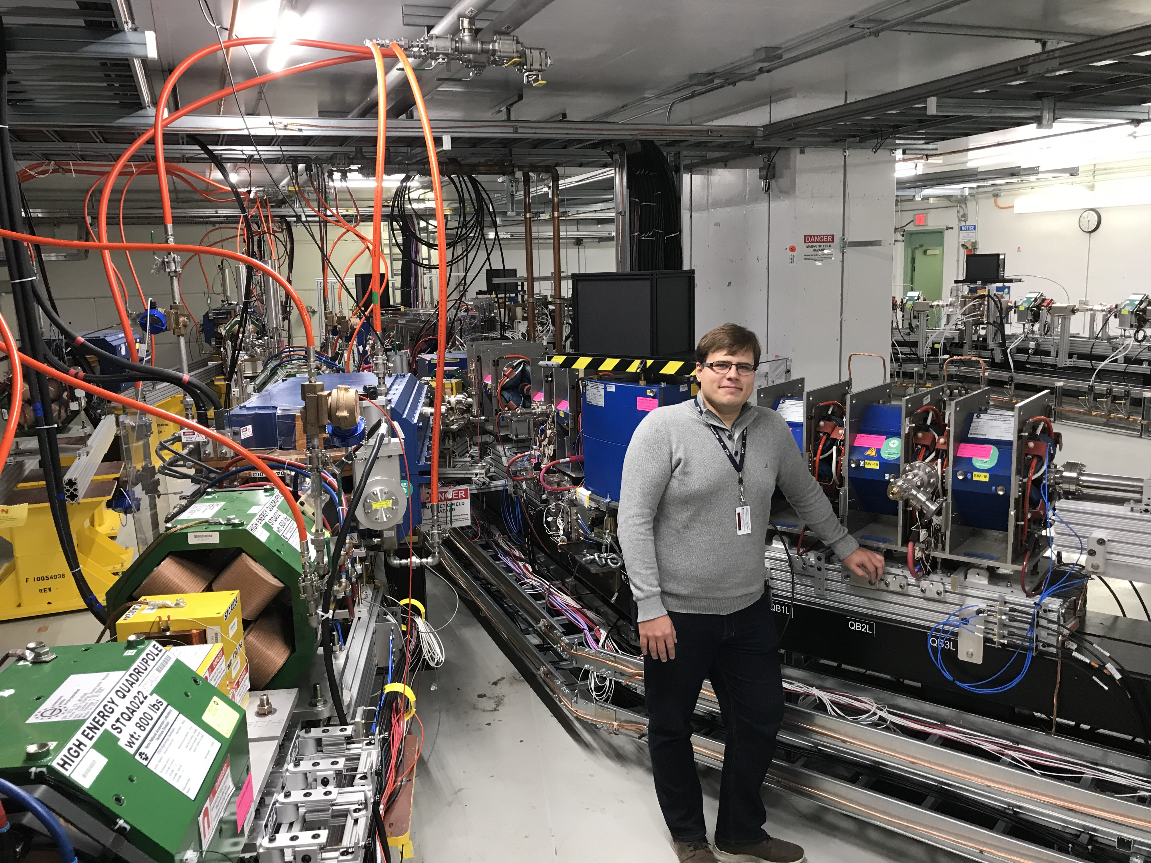
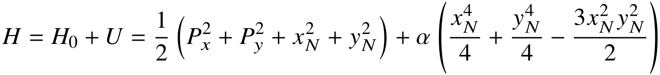
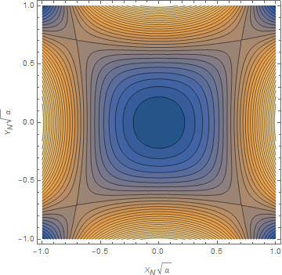
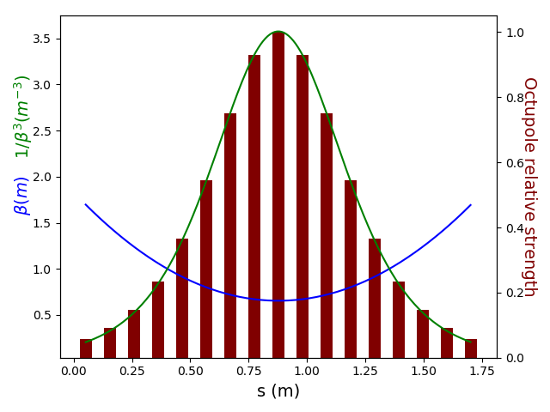
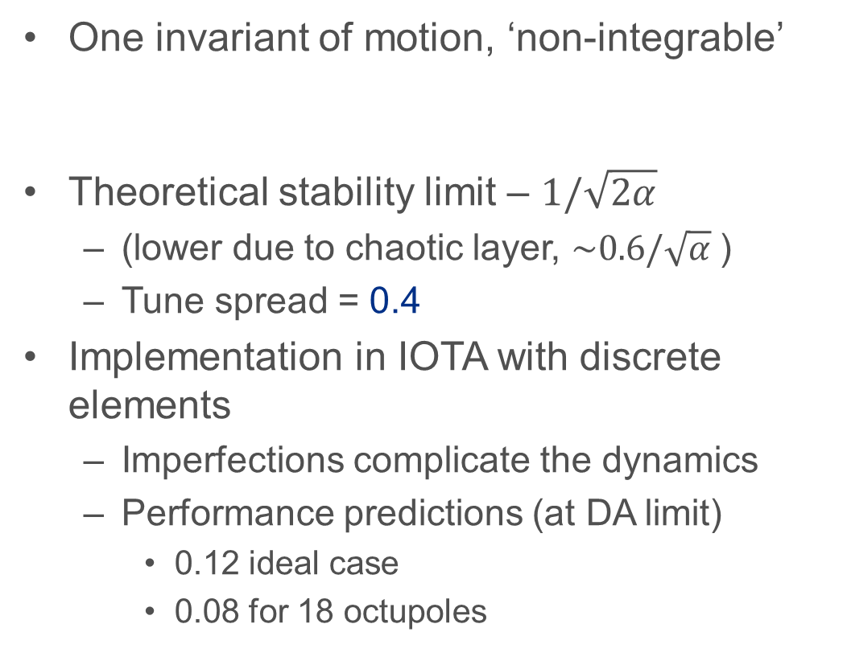
Henon-Heiles Type System with Octupoles (N.Kuklev (grad student 2021), U.Chicago)
One invariant of motion, ‘non-integrable’
Theoretical stability limit – $1/\sqrt{2α}$
  (lower due to chaotic layer, $\sim 0.6/\sqrt{α}$)
  Tune spread = 0.4
Implementation in IOTA with discrete elements
  Imperfections complicate the dynamics
  Performance predictions (at DA limit)
    0.12 ideal case
    0.08 for 18 octupoles

Slide 33
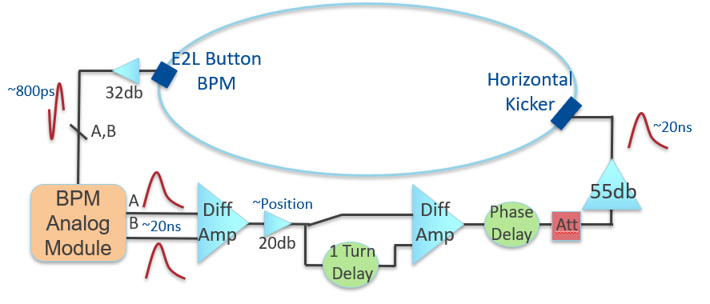
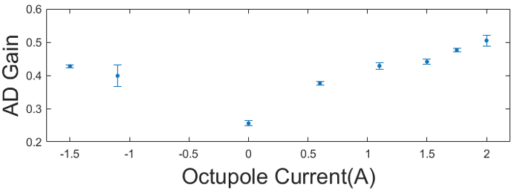
Suppression of Coherent Instability via Landau Damping
Experiment:
Artificially induce controlled instability with a feedback system
Study the effect of nonlinear optics on instability thresholds
System schematic
2x increase of stability threshold !!!

Slide 34
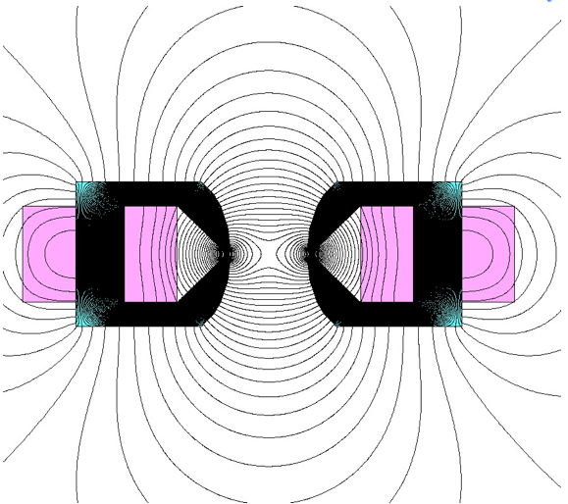
Example 3: (Danilov and Nagaitsev, Phys. Rev. Accel. Beams 13, 084002)
An integrable nonlinear system with a special Darboux potential (separable in elliptic coordinates).
For |z| < c
This potential has two adjustable parameters:
t – strength and c – location of singularities
2×c

Slide 35
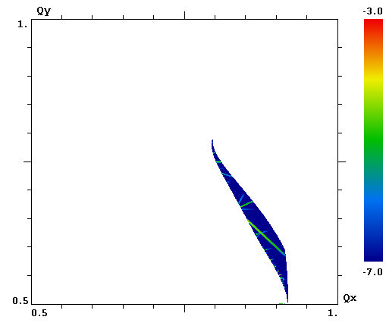

A single 2-m long nonlinear lens creates a tune spread of ~0.25.
FMA, fractional tunes
1.0
Large amplitudes
ν_{y}
Small amplitudes
(0.91, 0.59)
0.5
0.5
ν_{x}
1.0
1.8-m long magnet to be delivered in 2016

Slide 36







Two integrals of motion
Two integrals of motion :
$$×$$

Slide 37




IOTA Beam on an integer resonance !!!
Real-time video of IOTA beam
in NIO optics on an integer resonance
Minimal beam loss crossing integer !!!
Theory / Model
IOTA Experiment

Slide 38


Example 4: McMillan mapping
In 1967 E. McMillan published a paper
Final report in 1971. This is what later became known as the “McMillan mapping”:
If A = B = 0 one obtains the Courant-Snyder invariant

Slide 39
McMillan 1D mapping
At small x:
Linear matrix: Bare tune:
At large x:
Linear matrix: Tune: 0.25
A=1, B = 0, C = 1, D = 2

Slide 40
McMillan mapping in 2d
We were unable to extend this mapping into 2d with magnets (Laplace equation).
We have a solution on how to realize such a lens with a charge column (Poisson equation).
1. A ring with a transfer matrix
2. An axially-symmetric kick
can be created with an electron lens

Slide 41


McMillan electron lens (future experiment at IOTA)
Electron lens current density:
FMA analysis
The tune spread of ~0.2
is achievable

Slide 42
Final thoughts and unanswered questions
Some nonlinear integrable systems are better than others. Which ones are most suitable for accelerators?
We need more examples of accelerator-suitable 4D integrable mappings.
How to “correct” the existing nonlinearities in a ring to improve integrability?
How to compensate a distributed nonlinear force from space charge of the beam itself with a localized nonlinear element?

Slide 43
Summary: Integrability in Accelerators
All present machines are designed to be integrable: drifts, quadrupoles, dipoles-- can all be accommodated in the Courant-Snyder invariants.
  These are all examples of linear systems (equivalent to a harmonic oscillator)
The addition of nonlinear focusing elements to accelerators breaks the integrability, …but this additions are necessary and unavoidable in all modern machines – for chromatic corrections, Landau damping, strong beam-beam effects, space-charge, etc
There are ‘magic’ nonlinearities that result in integrable dynamics. Such systems are now being explored experimentally at IOTA.

