Slide 1
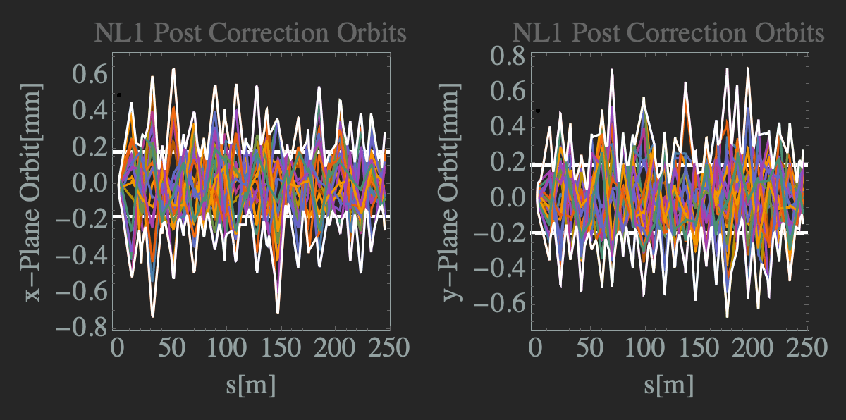
Current Status Of CEBAF 22GeV S2E Simulations
Brief Introduction to 22 GeV CEBAF
Simulation Effort
Machine Changes
S2E Current Status
Next Steps
Donish Khan

Slide 2
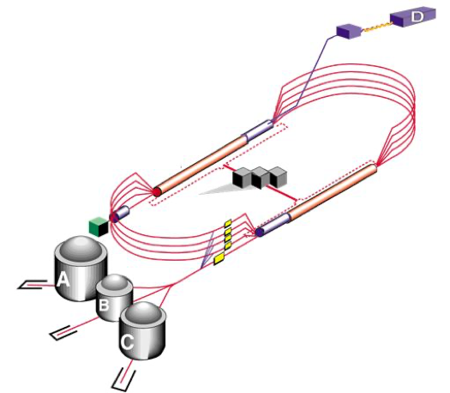
22GeV CEBAF Upgrade
Today’s CEBAF contains 5-recirculation passes to 12GeV
A 22GeV CEBAF could open the facility to new physics experiments/opportunities
More Passes
Basic idea of the upgrade is simple, increase number of passes to increase the energy
Engineering is not so simple!

Slide 3
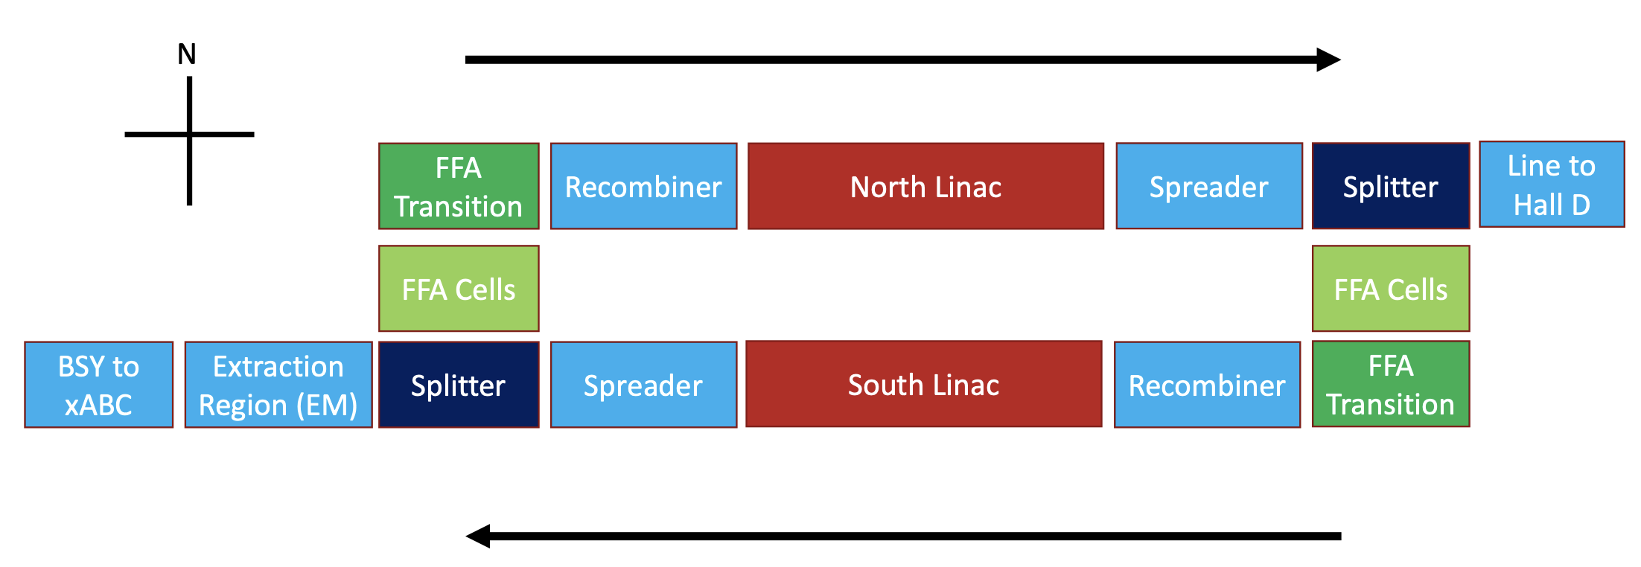
The Fixed Field Accelerator (FFA) Concept At CEBAF
Tune the passage of multiple beams in a single arc beamline
Kirsten D.
New problems will arise!
Simulation studies aim to identify problems, both predicted and unpredicted

Slide 4
Simulation Effort Organization
OptiM
elegant
Bmad
Dennis T: Injector
Stephen B: FFA
Alex B: Linacs
Dejan T: Optics
Ryan B: Spreaders, Splitters
Scott B: Optics
Donish K: Linacs, EM Arcs, S2E
Alex C: FFA
Vasiliy M: FFA Transition
Randy G: FFA Transition
Kirsten D: Radiative Effects
Georg H: FFA
Jay B: Hall Optics

Slide 5
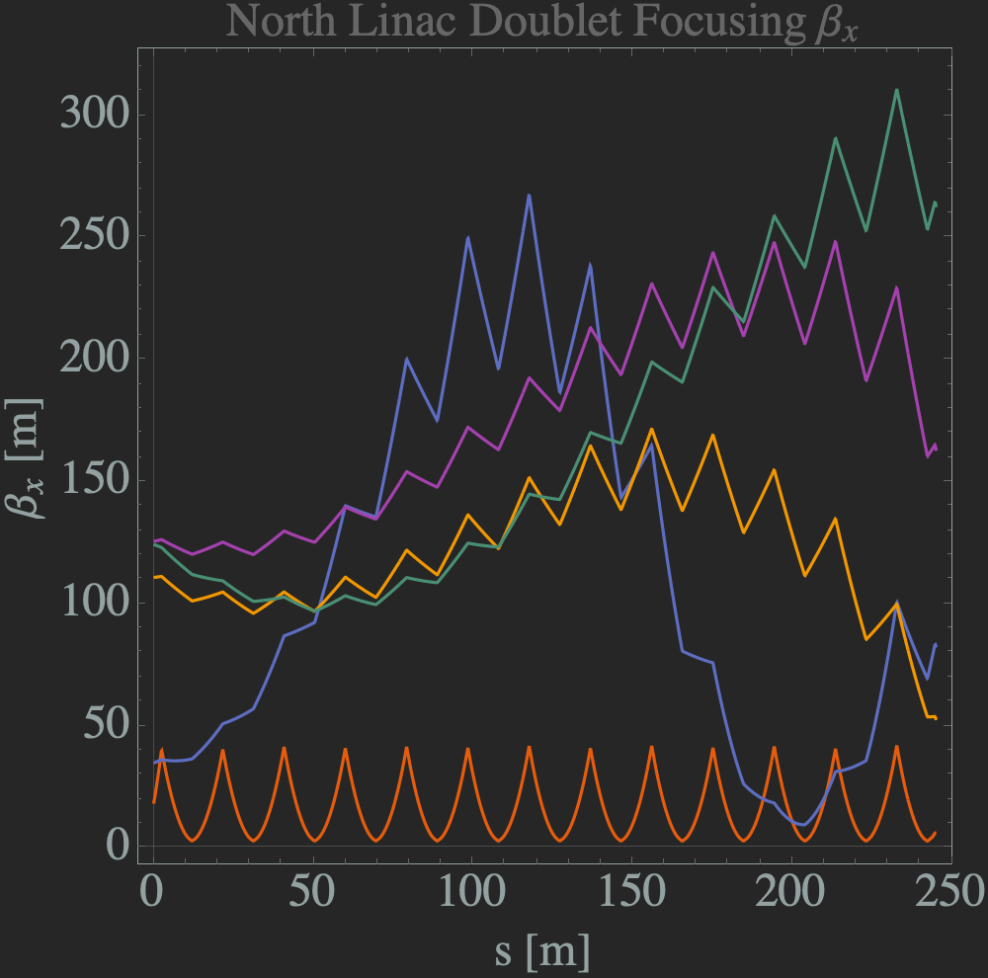
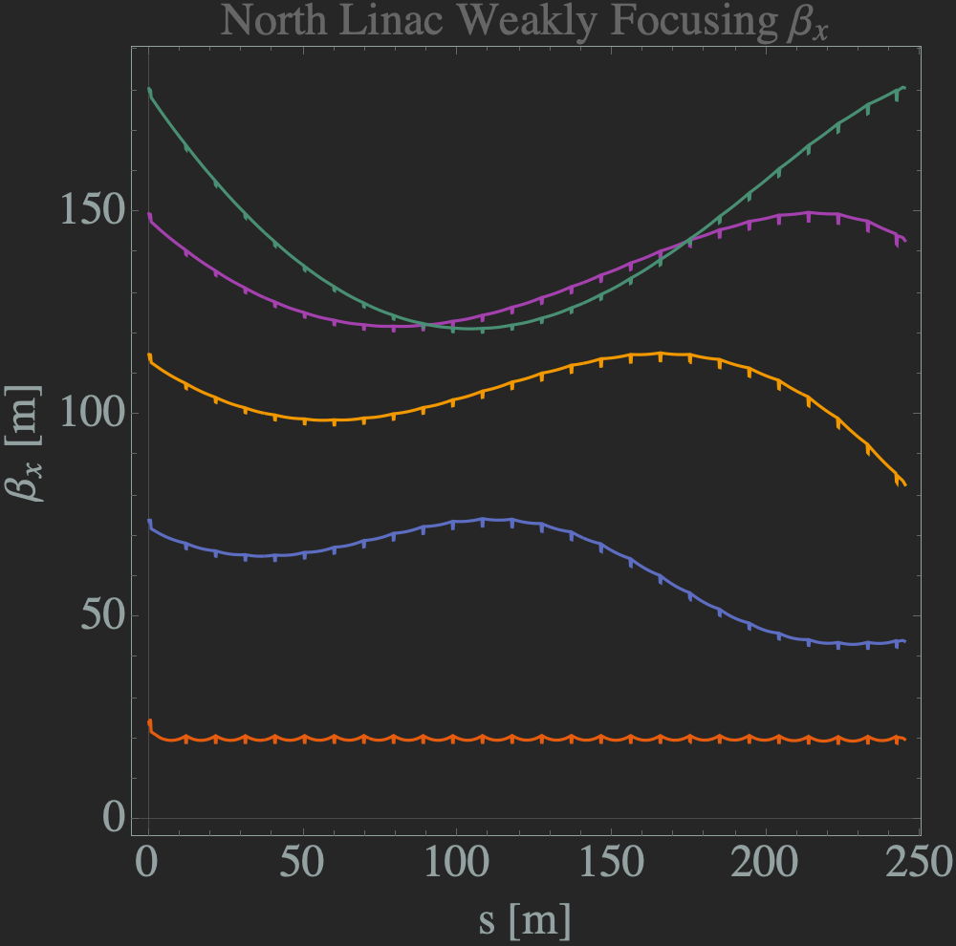
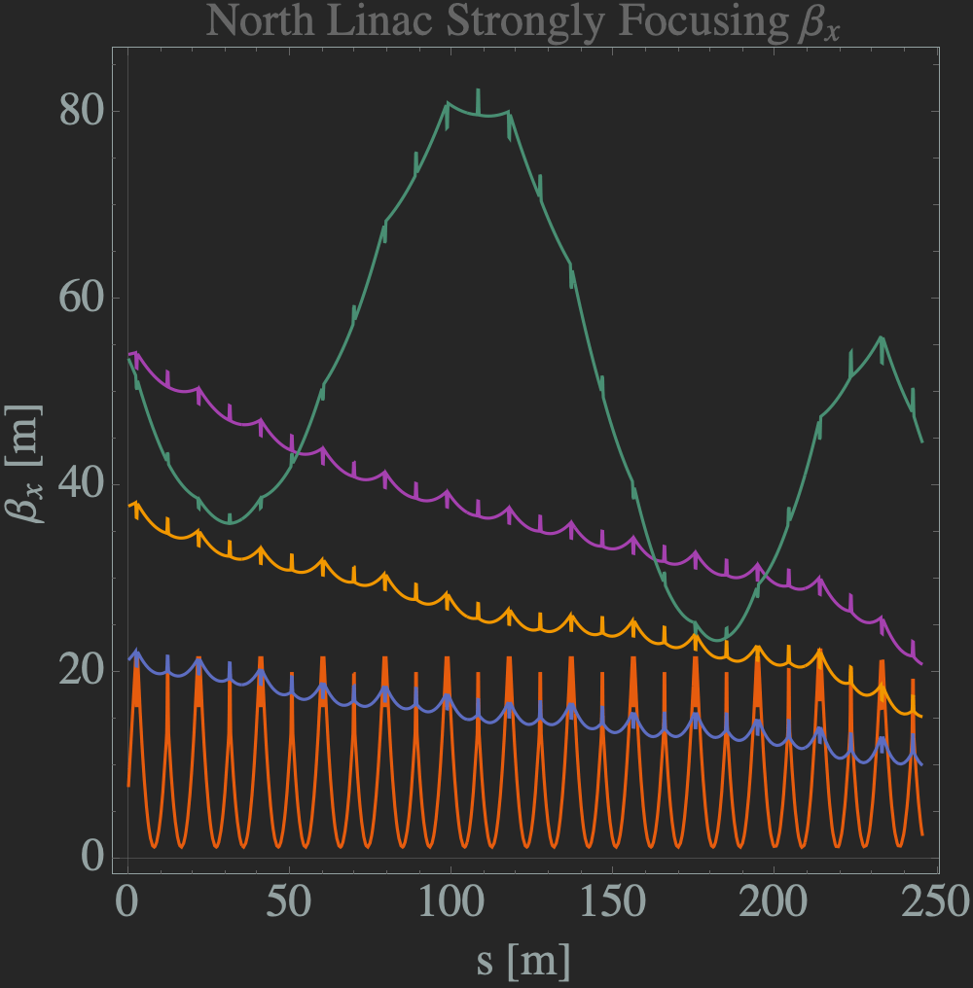
Machine Changes: Linacs
Changed from doublet (12GeV) to triplet:
SRF
9.6m
Again, changing weakly focusing to strongly focusing (Alex B.)
Smaller beta functions in higher passes
Accommodates FFA cells and merger

Slide 6
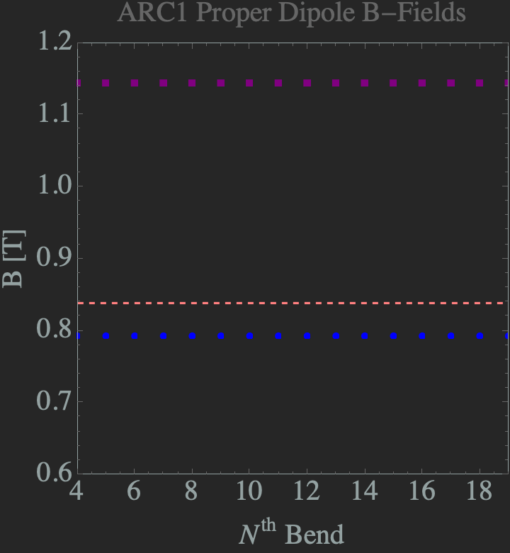
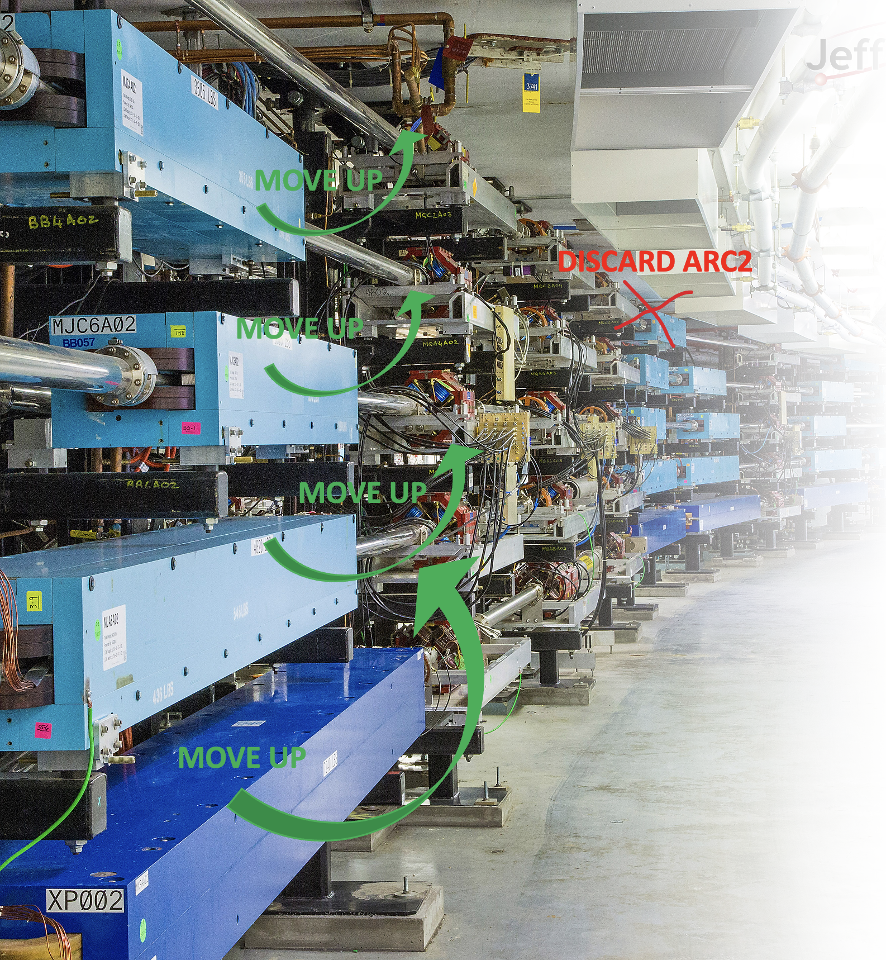
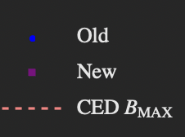
Machine Changes: EM Arcs
Redesigned Spreaders/Recombiners with new magnets to accommodate higher energy (Ryan B.)
Arc1/Arc2 (lowest) proper discarded and the rest moved up-by-one (Jay B.)
Retune arcs for isochronicity ($R_{56}→0$)
Rematch arcs from and to linacs

Slide 7
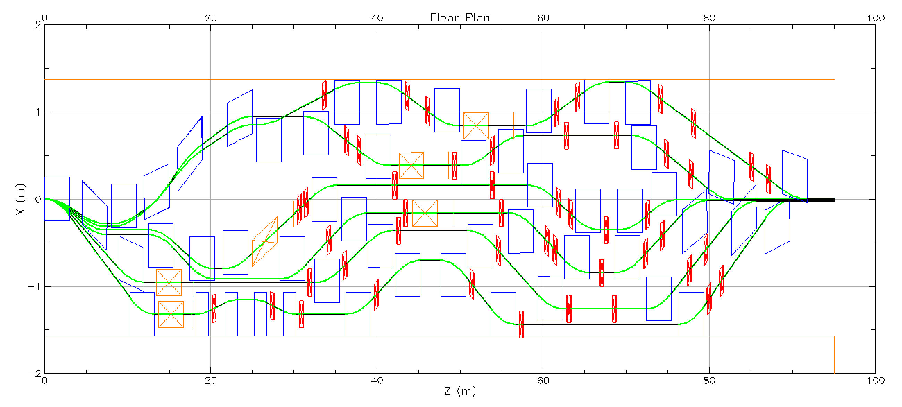
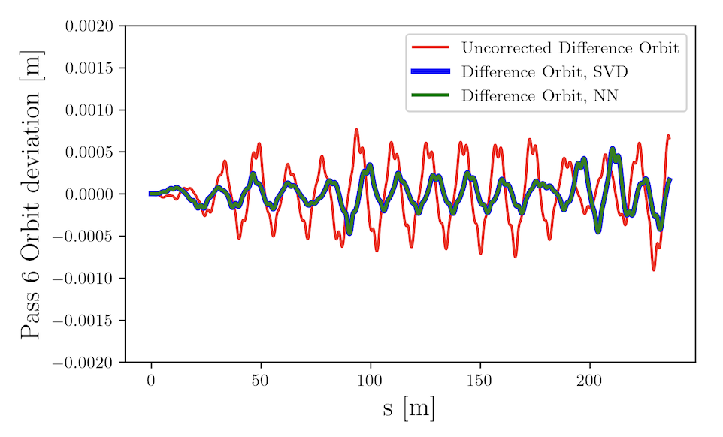
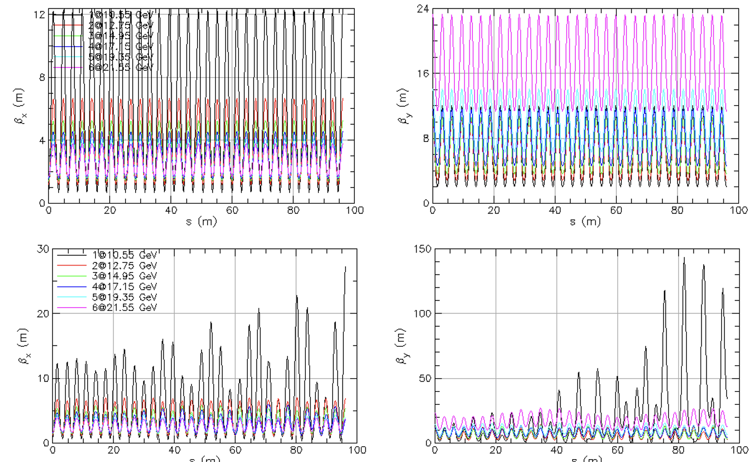
Machine Changes: Splitters/FFA/FFA Merger
Splitters
FFA & Neural Networks
Alex C
Ryan B
FFA Transition
Added right before the FFA arcs
Work in progress but very close!
Challenge to fine tune the optics while maintaining space requirements:
Added right after the FFA arcs
Linac optics changed to strong focusing to accommodate smaller betatron functions
Ryan B
Vasiliy M

Slide 8
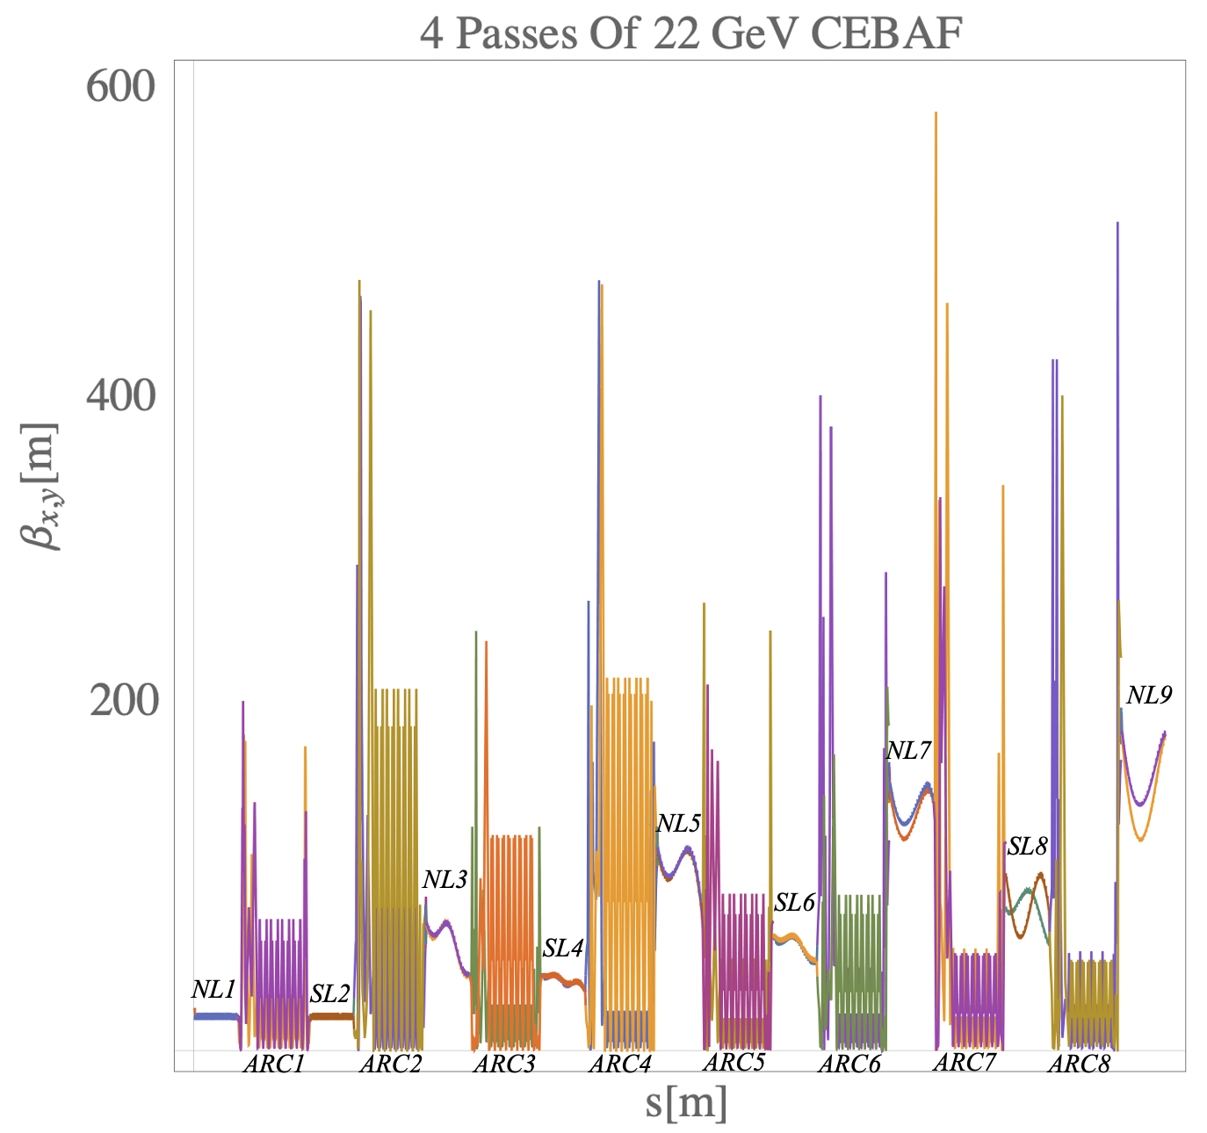
Current S2E Status
We have EM portion of accelerator (NL9 Exit) “connected”
Optics matched
Error/Orbit Correction & Beam loss

Slide 9
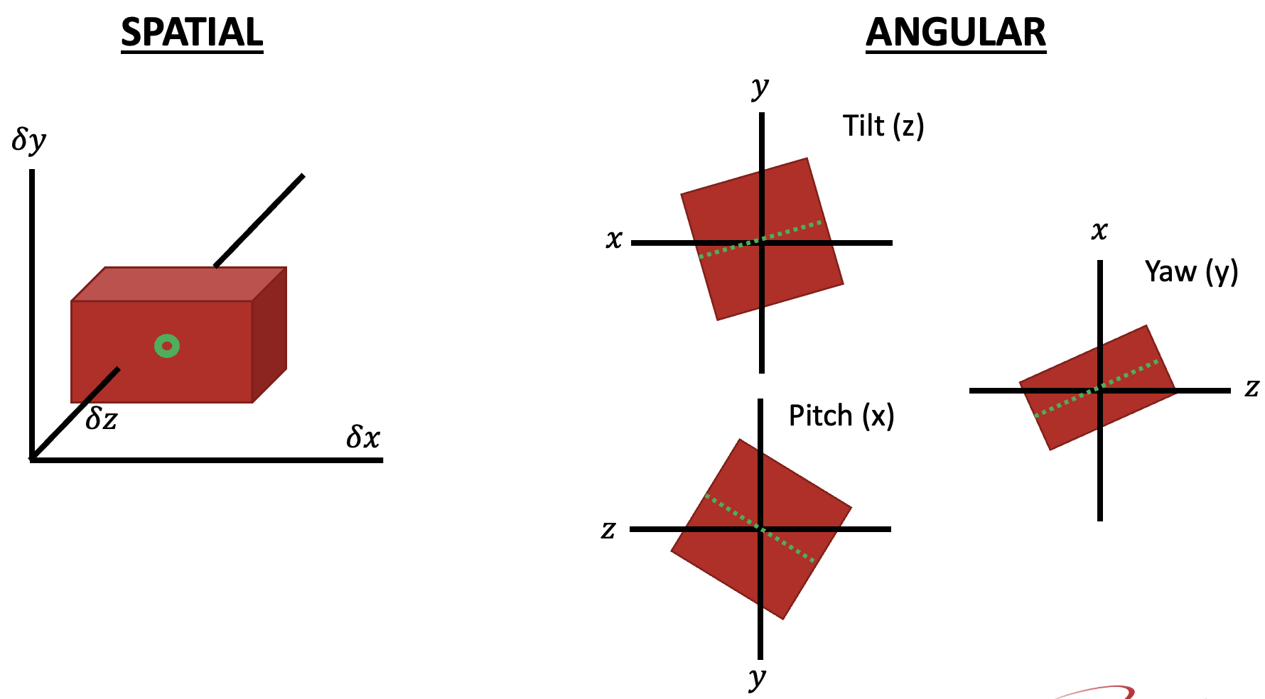
Current S2E Status: Error/Orbit Correction & Beam Loss Studies
Study the effects of errors intrinsic to an accelerator’s operation:
spatial and angular element placement errors
Field strength errors
Errors sampled randomly from a Gaussian in $10k$ simulation runs
Error Type | Error $σ$
Dipole $<δΧ$, $δΥ$, $δℤ>$ | $$2 mrad$$
Dipole $<δx$, $δy$, $δz>$ | $$200 μm$$
Dipole FSE | $$0.01\%$$
Quad $<δΧ$, $δΥ$, $δℤ>$ | $$2 mrad$$
Quad $<δx$, $δy$, $δz>$ | $$200 μm$$
Quad FSE | $$0.01\%$$
SRF $<δΧ$, $δΥ$, $δℤ>$ | $$2 mrad$$
SRF $<δx$, $δy$, $δz>$ | $$200 μm$$
BPM $<δΧ$, $δΥ$, $δℤ>$ | $$2 mrad$$
BPM $<δx$, $δy$, $δz>$ | $$200 μm$$

Slide 10
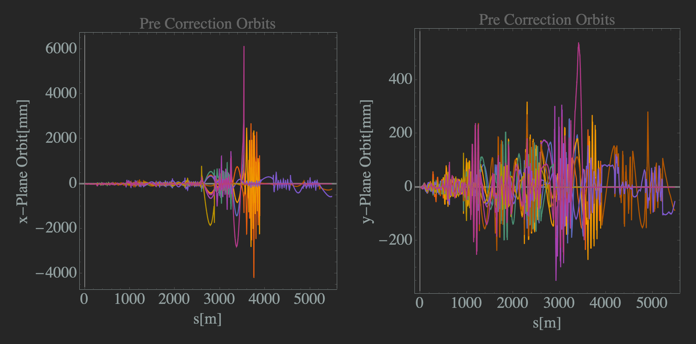
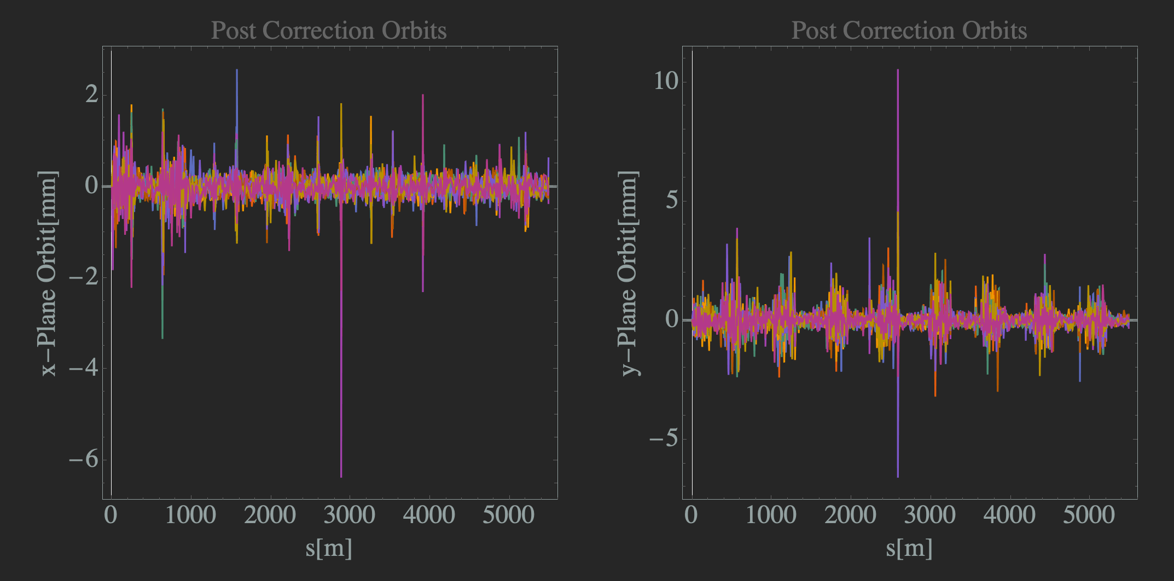
Current S2E Status: Error/Orbit Correction
Used the standard Singular Value Decomposition (SVD) algorithm
Results are good! After orbit correction both x and y plane RMS orbit is $<1cm$
$\sim 4\%$ of $10k$runs have results in beam loss
Areas where orbit exceed the chamber ($>1cm$) will result in beam loss
N=10
N=10
N=10
N=10

Slide 11
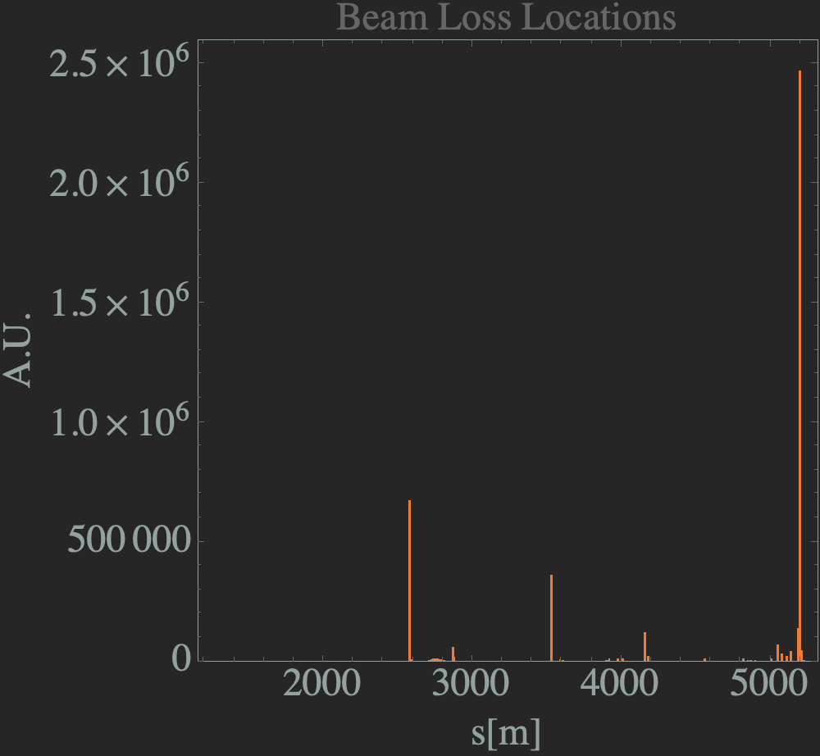
Current S2E Status: Beam Loss Studies
Combined all beam loss data from $10k$ simulation runs
Beam loss histogram post-orbit correction
Helpful in determining hotspots in the accelerator
Vertical bending systems!
N=10k
Recombiner8
Spreader4
Spreader6
Spreader7

Slide 12
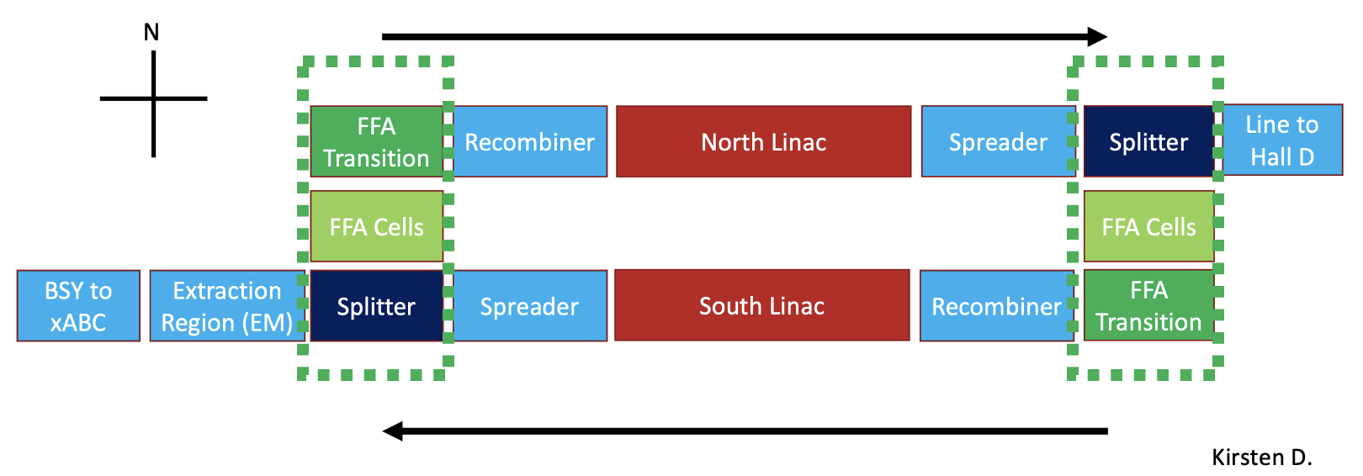
Next Steps
Strongly focusing North and South linacs have been designed by Alex B.
Match optically with rest of accelerator
Conduct error sensitivity studies (stronger focusing implies greater sensitivity to errors)
Complete Beam Break Up (BBU) Studies
Join pieces as they are completed
Splitters
FFA Transitions
Beamline optimization
Radiative effects
Dispersion leakage
Betatron mismatch

Slide 13
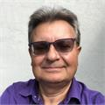
The End! Thank You!
Thank you for your time and the opportunity to present some of the interesting work I’ve been involved in at JLAB
Would additionally like to thank:
CEBAF FFA Lead
LDRD Lead
Alex Bogacz
Ryan Bodenstein
The research described in this paper (on this poster, in this report, etc) was conducted under the Laboratory Directed Research and Development Program at Thomas Jefferson National Accelerator Facility for the U.S. Department of Energy.

