Slide 1


Superconducting CCT Magnets: A Flexible Technology for Compact FFA’s
September 14th, 2023
2023 Workshop on Fixed Field Alternating Gradient Accelerators
Lucas Brouwer
Lawrence Berkeley National Laboratory

Slide 2
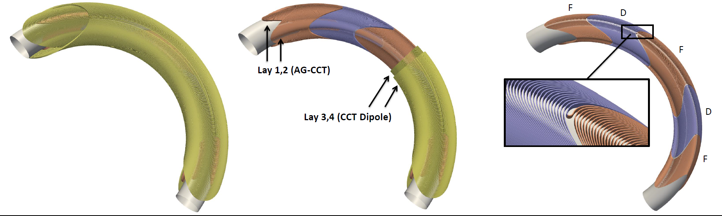
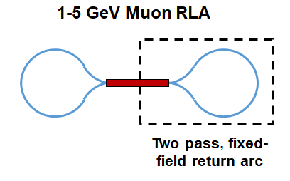
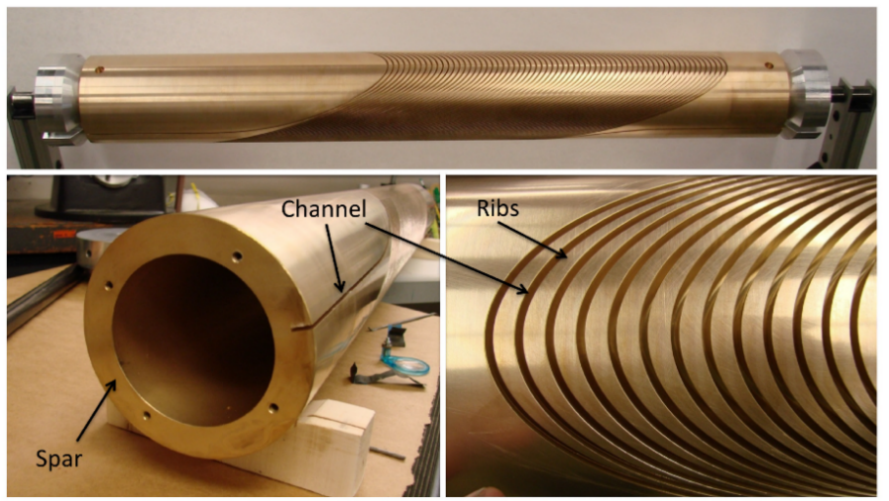
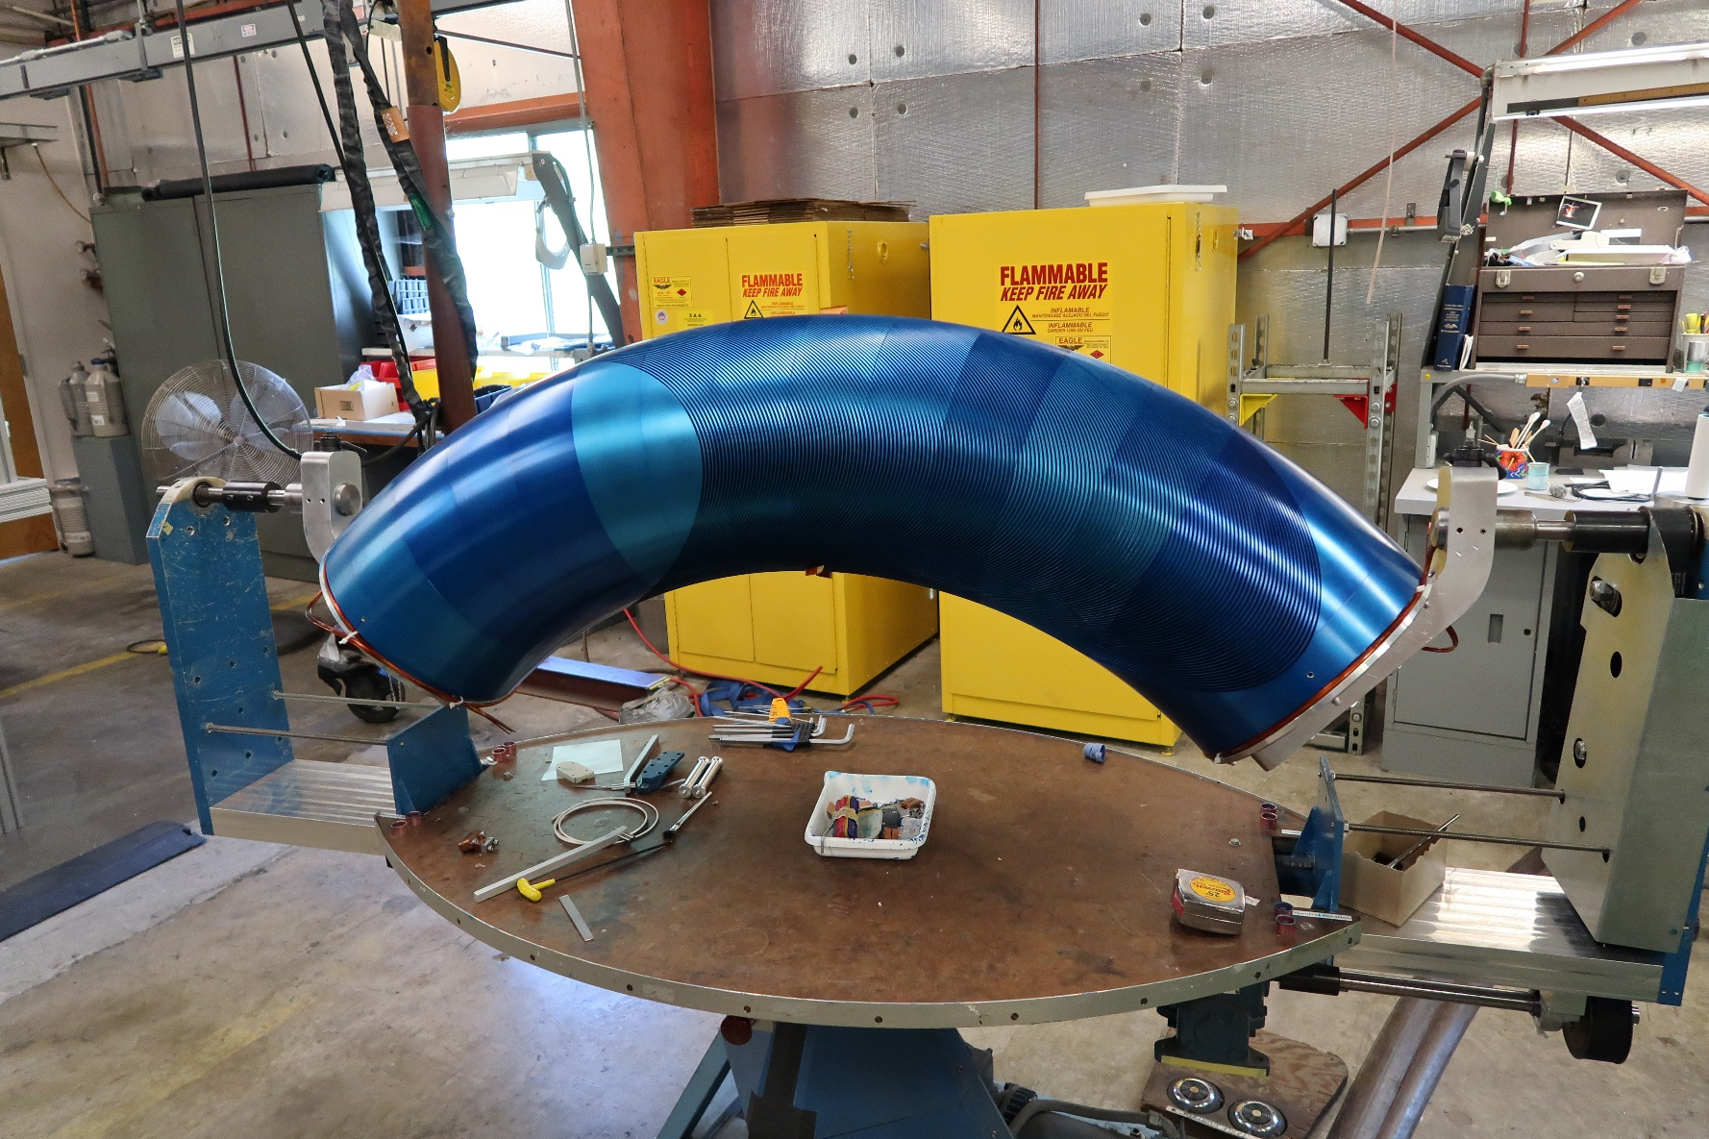
Outline
Background
Status
Plans
Introduction to CCT
Introduction to the AG-CCT
HEP high-field (straight), ARDAP project for proton therapy (curved)
Combined function CCT’s relevant to FFA’s
Flexible generation of combined function fields for curved and straight magnets
Alternating gradients for large ∆p/p with fixed-field
The AG-CCT for fixed-field return arc design
Nb₃Sn + HTS magnets
A 2.4 T curved dipole magnet
introduction to the Canted-Cosine-Theta (CCT) magnet design
incorporating alternating gradients into a continuous coil (AG-CCT)

Slide 3
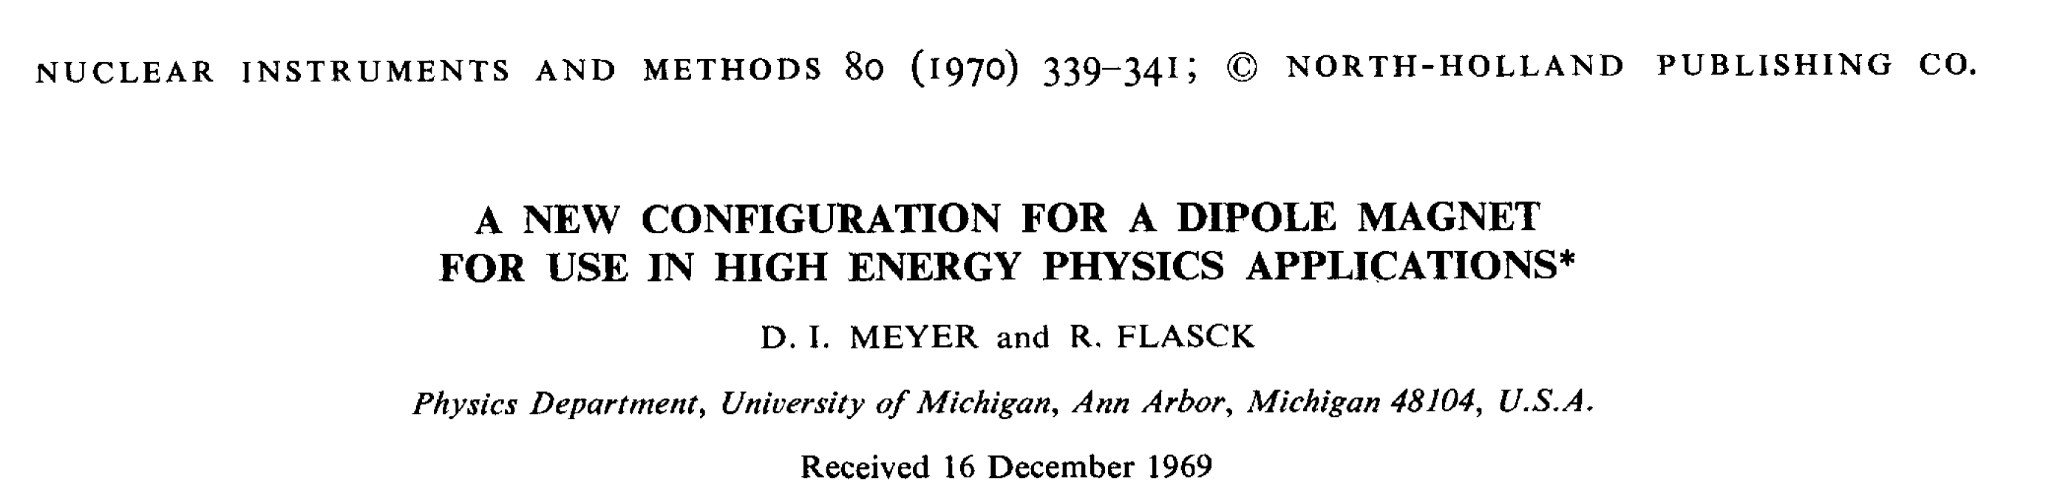
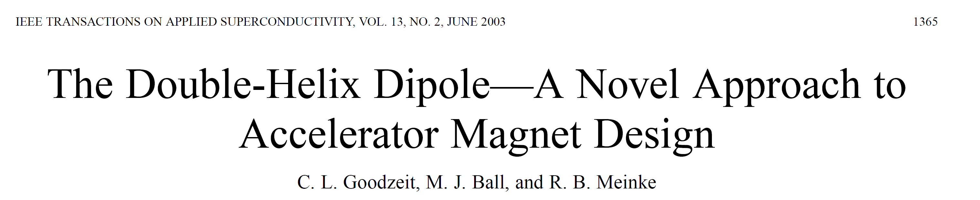
Abbreviated History of the Concept (HEP focused)
1970, basic concept published
Highlights: extension to combined function + curved magnets, low current demonstrators ~2-3 T
~2000-2015, revisited by industry and labs
Highlights: 8-10 T Nb₃Sn dipoles at LBNL/PSI, NbTi orbit correctors for HiLumi LHC
~2015-now, push for high field Nb₃Sn magnets + CCT’s going into accelerators

Slide 4
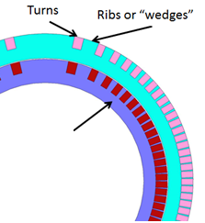

Canted-Cosine-Theta (CCT) SC Magnets
Advantages
excellent field quality (to large % of aperture)
stress management for high-field and/or large apertures
combined function fields (i.e. dipole + quadrupole)
Challenges
slightly more conductor (~15-20%)
tradeoff of longer ends vs. efficiency for very short magnets
$$J_{z}\sim cos⁡(θ)$$
D.I. Meyer, R. Flasck, 1970, doi.org/10.1016/0029-554X(70)90784-6

Slide 5
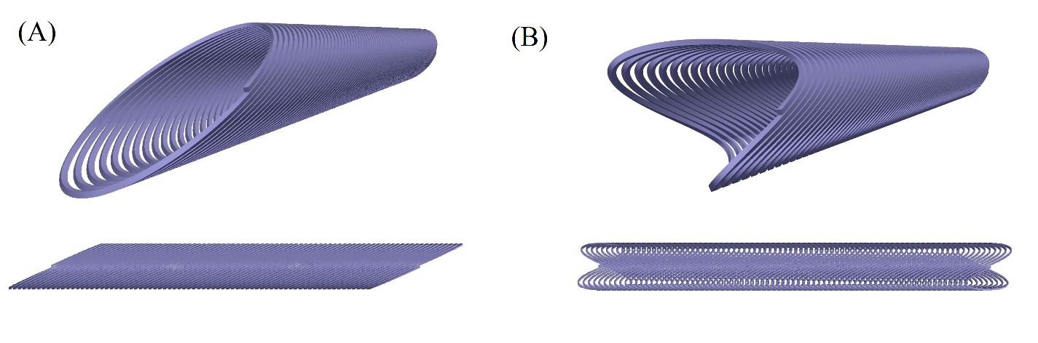
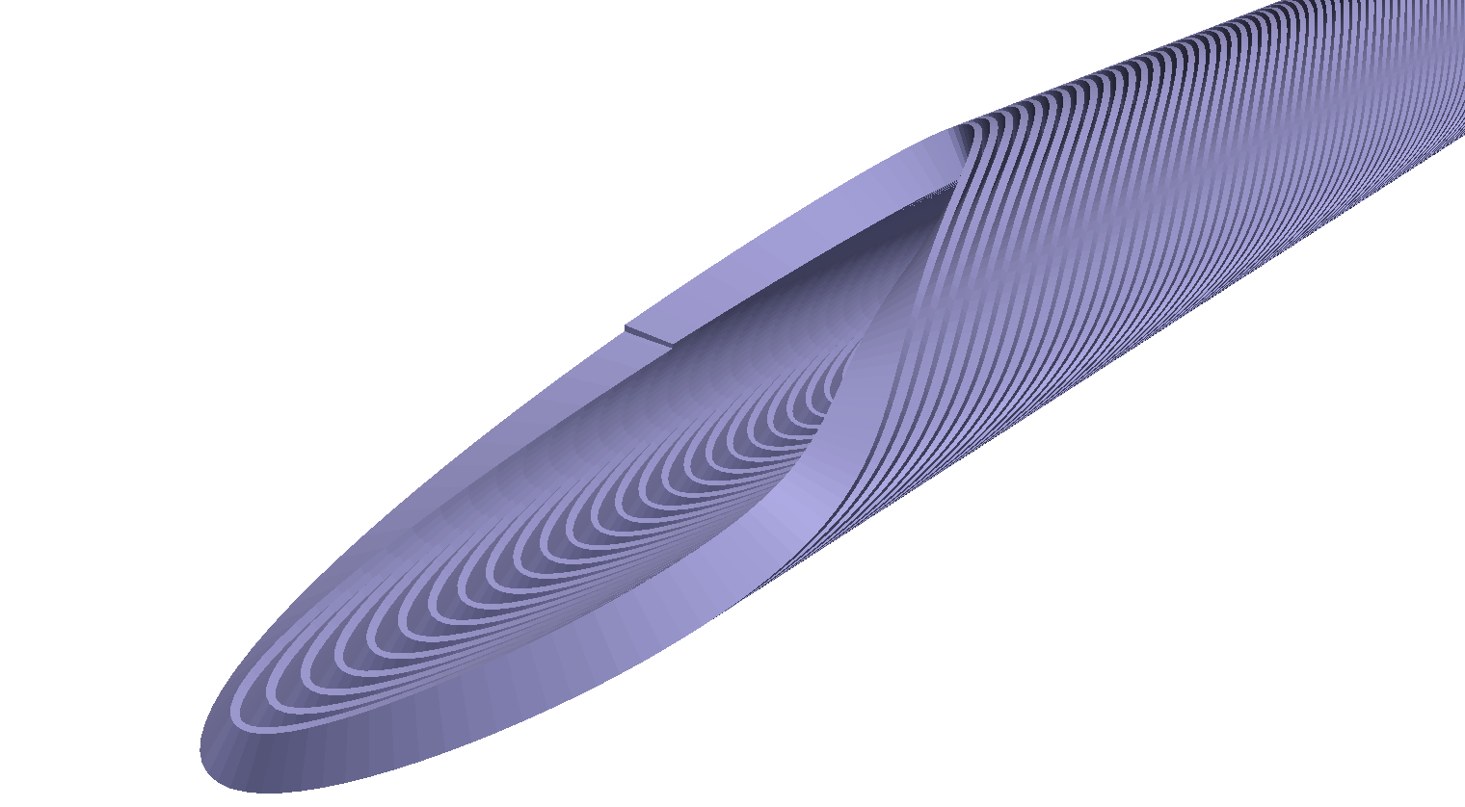
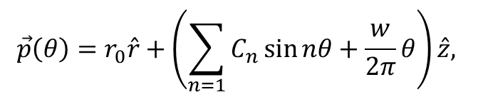
The CCT is a Flexible Technology for Combined Function Fields
n=1, dipole
$$\vec{p}\left(θ\right)=r_{0}\hat{r}+\left(\sum_{n=1}{C_{n}\sin{nθ}}+\frac{w}{2π}θ\right)\hat{z},$$
n=2, quadrupole
n=1, 2, 3, dipole+quad.+sext.

Slide 6
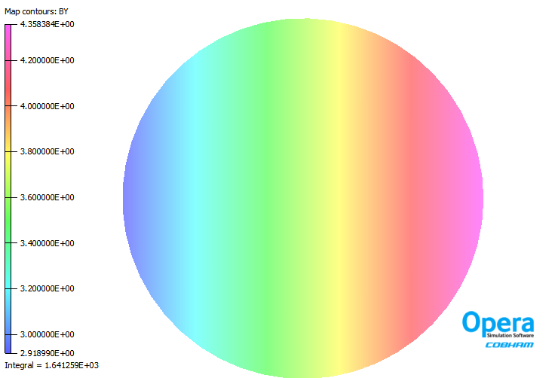
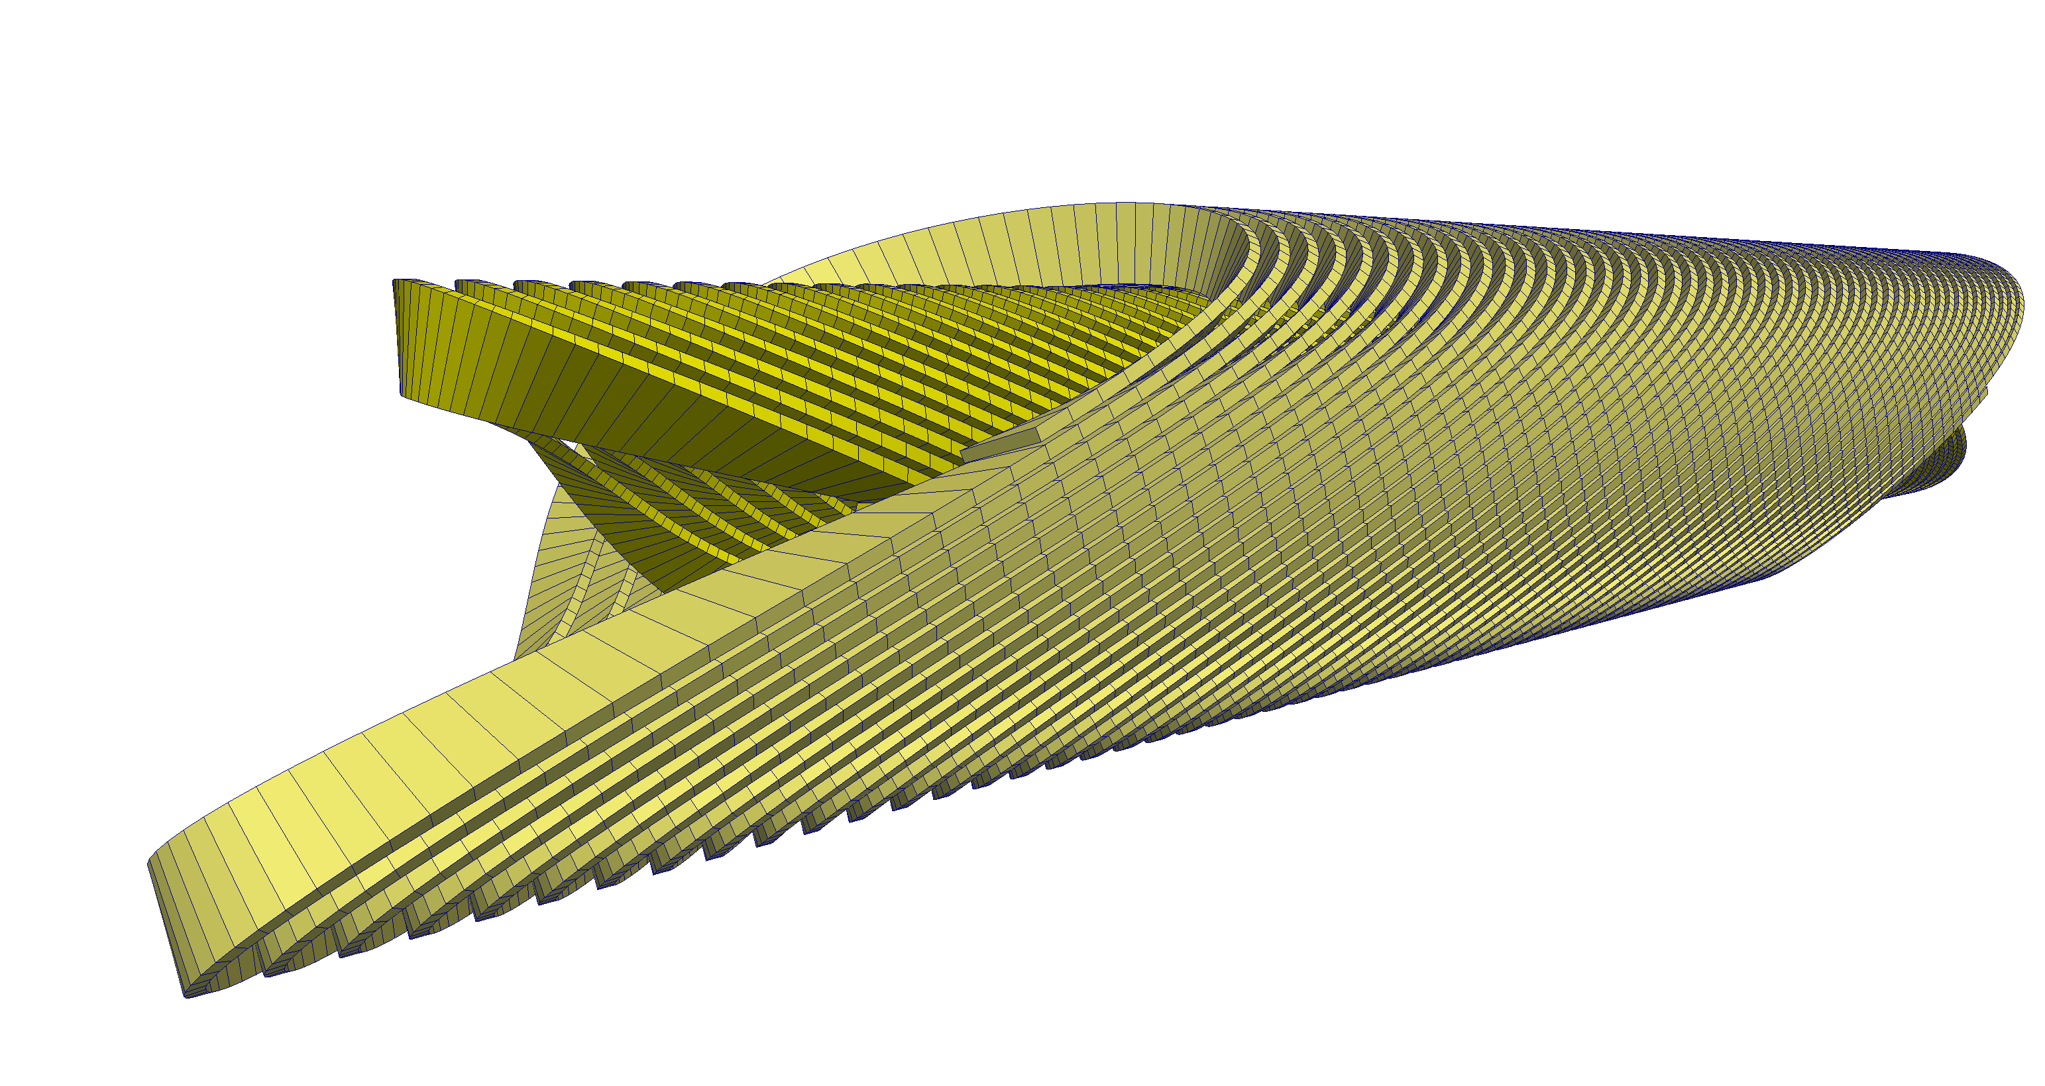
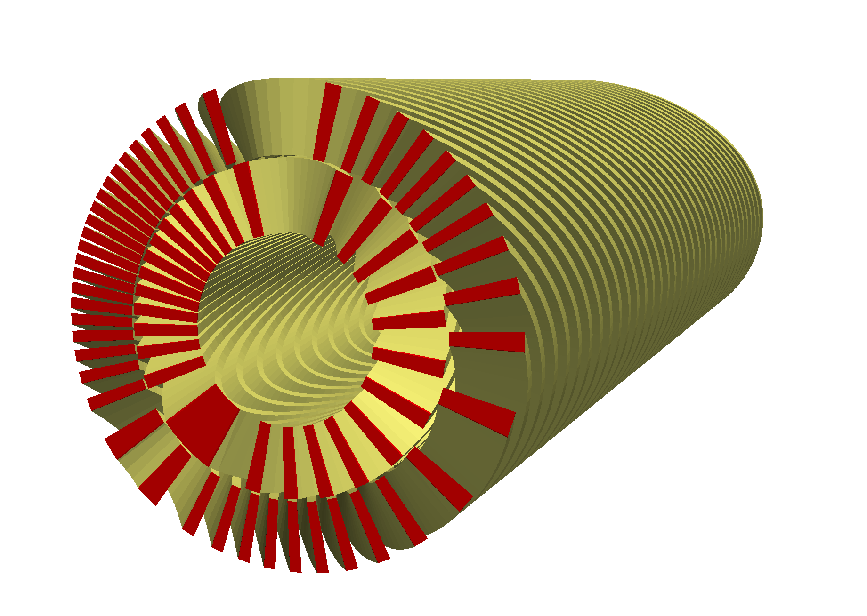
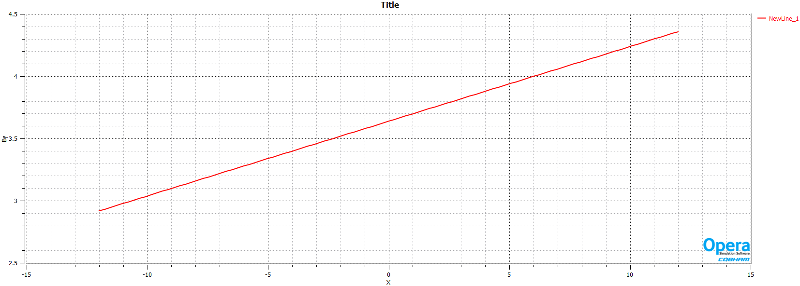
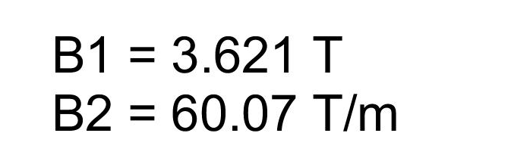
Example: Combined Function Dipole + Quadrupole (40 mm ø)
4.36 T
2.91 T
-12 mm
12 mm

Slide 7
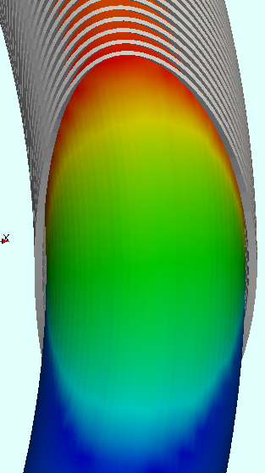
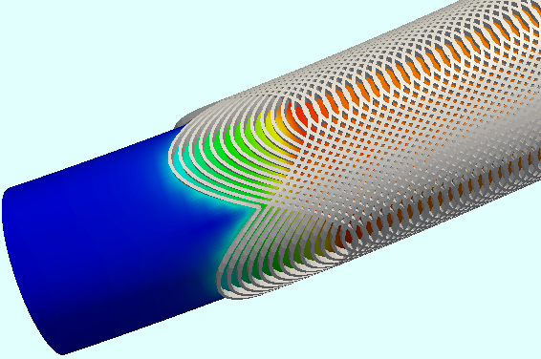
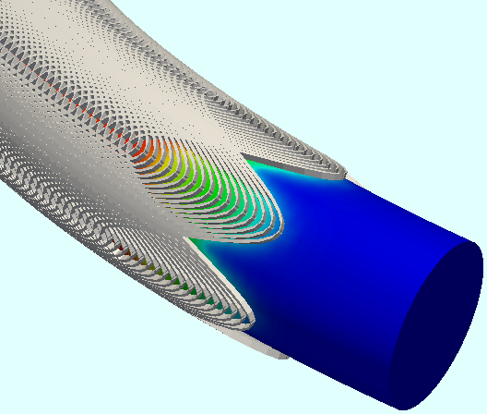
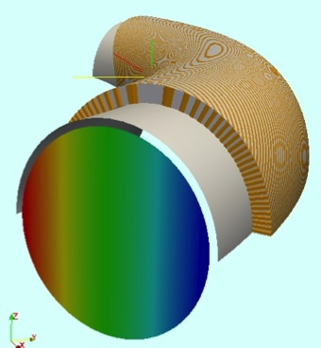
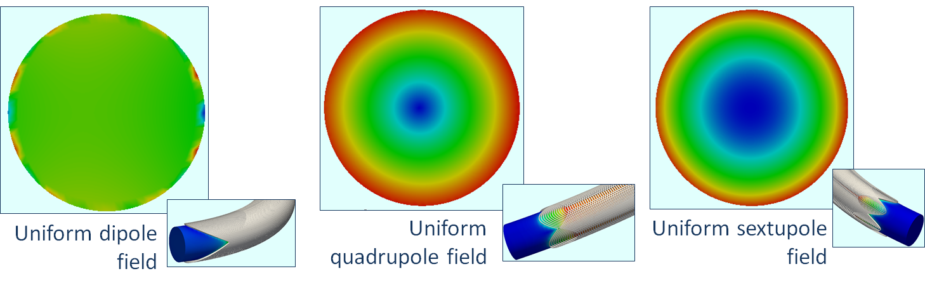
The CCT Naturally Extends to Curved Magnets
Dipole Quadrupole Sextupole
Single winding combined function: dipole+quad.+sext.

Slide 8
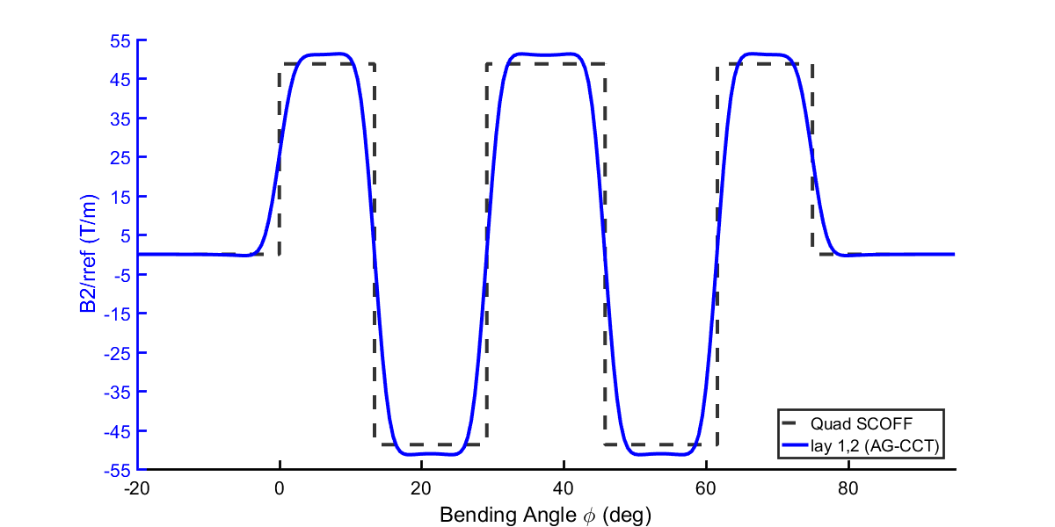
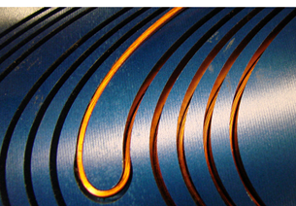
The alternating gradient CCT (AG-CCT) is a method for producing alternating gradient fields with continuous windings instead of separate magnets
Quadrupole fields along the bend, blue is produced by AG-CCT and dash-black is desired integral
Example: 5 section AG-CCT layer (FDFDF)
Compact nesting of ends
W. Wan, et al., PRAB, 2015, https://doi.org/10.1103/PhysRevSTAB.18.103501

Slide 9
Magnetic design of curved CCTs: in toroidal (binormal) coordinates you can derive the relation between the winding path and the toroidal harmonics (but is it useful?)
Parametrization of winding path
Field harmonics (arbitrary combinations allowed)
Current density sheet (pitch averaged)

Slide 10


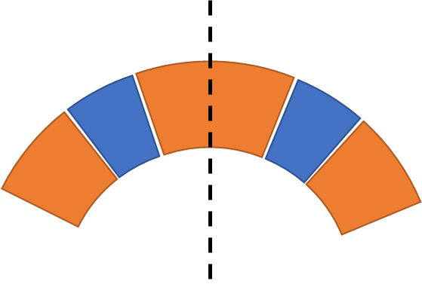
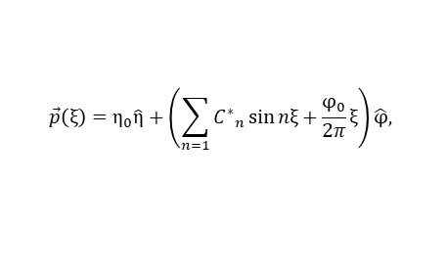
Instead, parameterize the CCT geometry in the beam dynamics software COSY INFINITY
Initial Hard Edge Model
Biot-Savart Model from Coil Parameterization
generate “seed” set of curved CCT winding coefficients approximating hard-edge solution
$$\vec{p}\left(ξ\right)=η_{0}\hat{η}+\left(\sum_{n=1}{{C^{∗}}_{n}\sin{nξ}}+\frac{φ_{0}}{2π}ξ\right)\hat{φ},$$
Motivation: analytic coil design in curved frame is difficult, but coil parameterization is straight-forward
Directly connects coil geometry to beam optimization (eliminates field parameterization in curved system)
Biot-Savart model includes all end effects and coil transitions
example: W. Wan et. al., 2015, doi.org/10.1103/PhysRevSTAB.18.103501

Slide 11
Outline
Background
Status
Plans
Introduction to CCT
Introduction to the AG-CCT
HEP high-field (straight), ARDAP project for proton therapy (curved)
Combined function CCT’s relevant to FFA’s
Flexible generation of combined function fields for curved and straight magnets
Alternating gradients for large ∆p/p with fixed-field
The AG-CCT for fixed-field return arc design
Nb₃Sn + HTS magnets
A 2.4 T curved dipole magnet
US-MDP program for Nb₃Sn and HTS magnets
AG-CCT design for proton therapy
fabrication and test of curved dipole layers

Slide 12
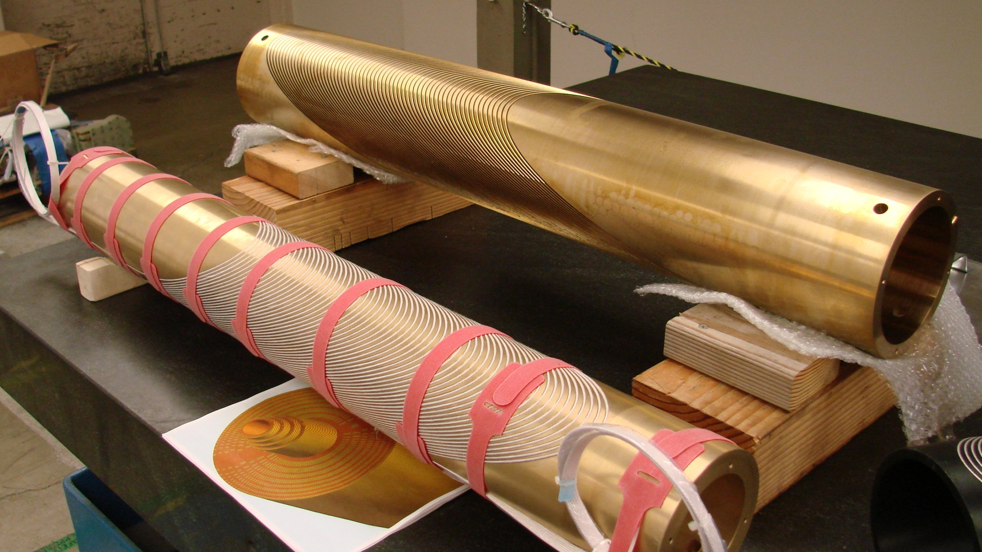
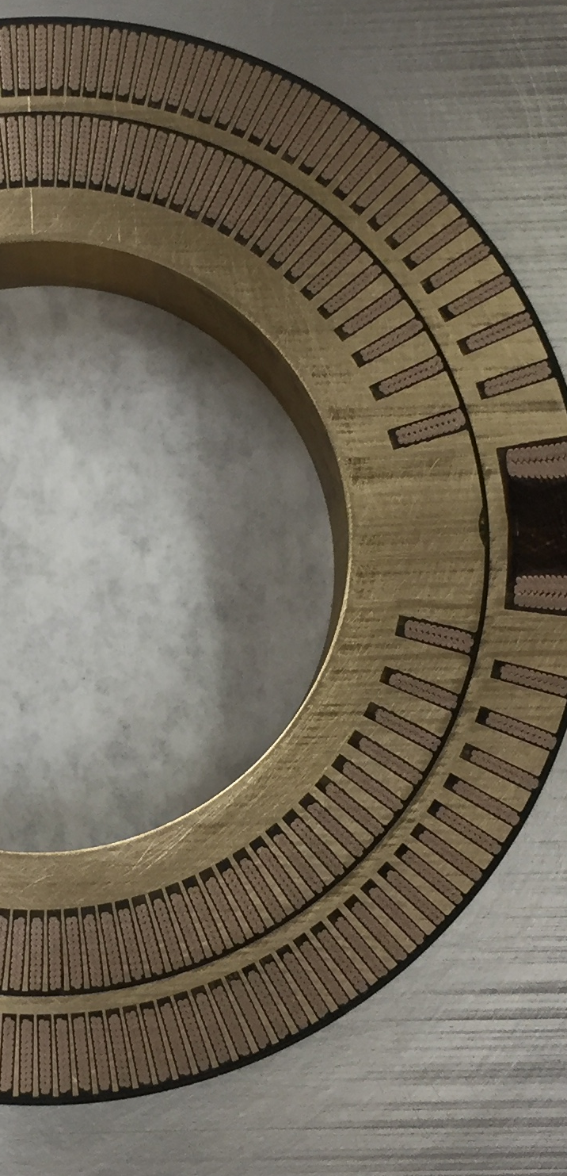
Metallic Winding Mandrels Accurately Position the Conductor and Intercept Lorentz Forces for Stress Management
Force accumulation in traditional Cos(θ)
CCT ribs intercept force
Important for high field magnets with strain sensitive conductor (Nb₃Sn/HTS)
Important for large aperture magnets

Slide 13
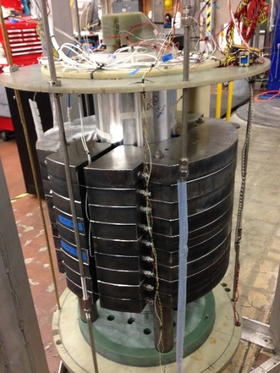
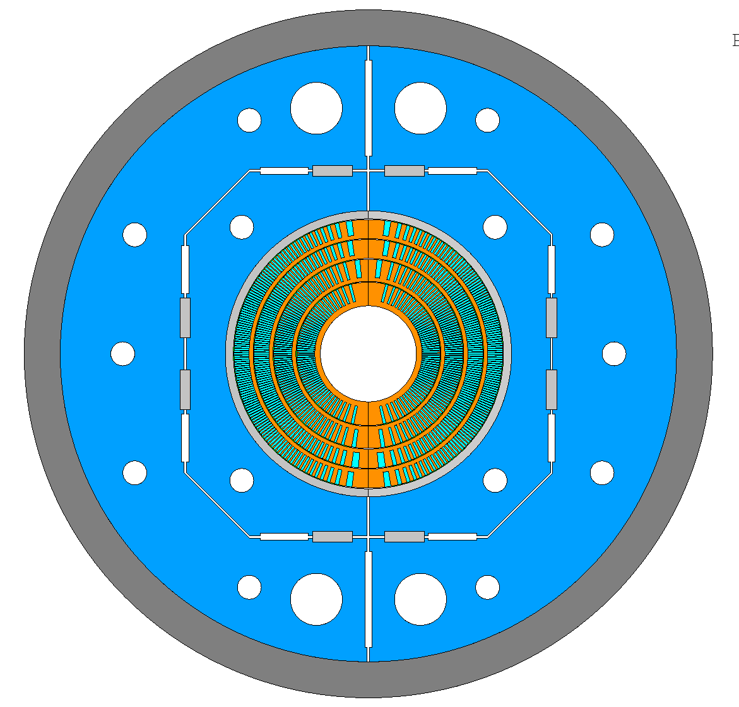
Nb₃Sn and HTS CCT Dipole Development at LBNL (within the HEP - US Magnet Development Program)
Nb₃Sn: 9 T demonstrated in a 90 mm bore, 13 T to be demonstrated in a 120 mm bore in ~3 years
HTS: demonstrated 1.5-3 T, future focus is hybrid ~15 T (HTS+Nb₃Sn)
CCT3,4,5: 9.2 T, 90 ø (2015-2018)
C2: 3 T, 60 ø (2021) - REBCO
subscale: 5 T, 50 ø (now)
CCT6: 13 T, 120 ø (2026)
BIN5c: 1.6 T, 31 ø (2021) – Bi2212
D. Arbelaez et. al, 2022, doi.org/10.1109/TASC.2022.3155505
X. Wang et al., 2021, doi.org/10.1088/1361-6668/abc2a5
T. Shen et al., 2022, DOI: 10.1103/PhysRevAccelBeams.25.122401

Slide 14


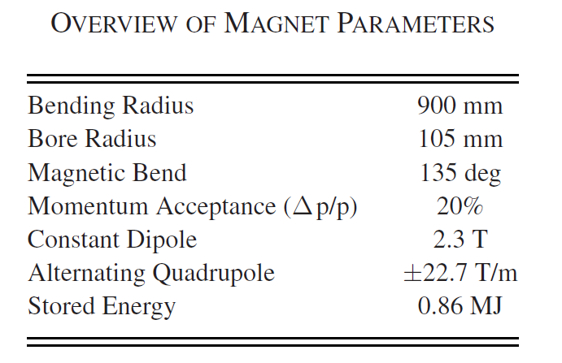
ARDAP Accelerator Stewardship project to develop a large momentum acceptance SC gantry for proton therapy
A single AG-CCT magnet provides 1:1 imaging from the degrader source to patient (with large momentum acceptance)
L. Brouwer, et al., IEEE Trans. Appl. Supercond, 2017, https://doi.org/10.1109/TASC.2016.2628305

Slide 15
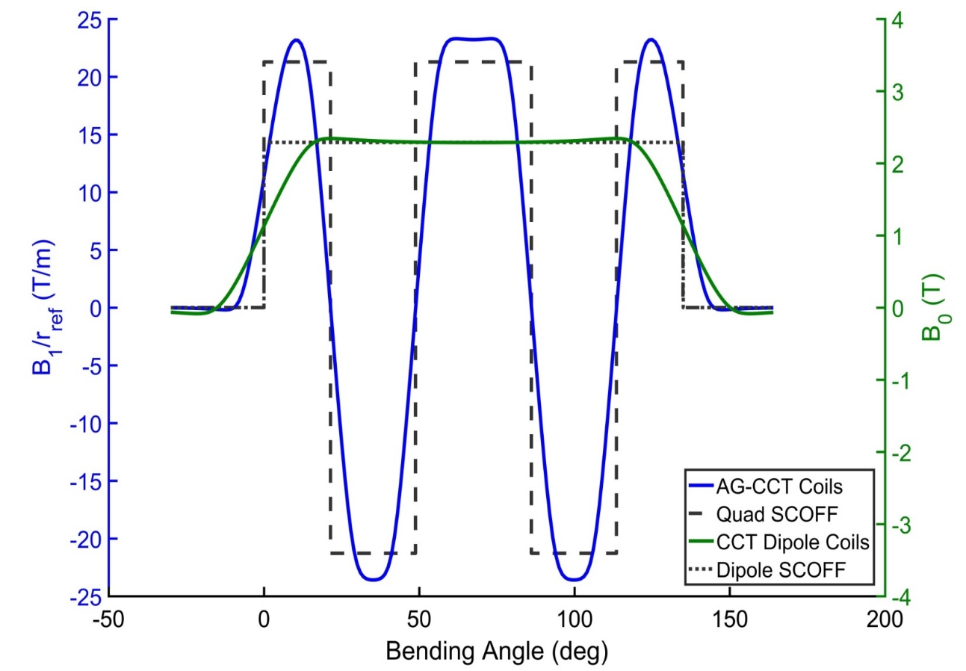
Large momentum acceptance beam optics with a single, 5 T magnet for proton therapy gantries (70-250 MeV)
Alt. Quadrupole (± 22.7 T/m)
Const. Dipole (2.3 T)
Four layers
Lay12: AG-CCT
Lay34: CCT dipole
+11% dp/p
-6% dp/p

Slide 16
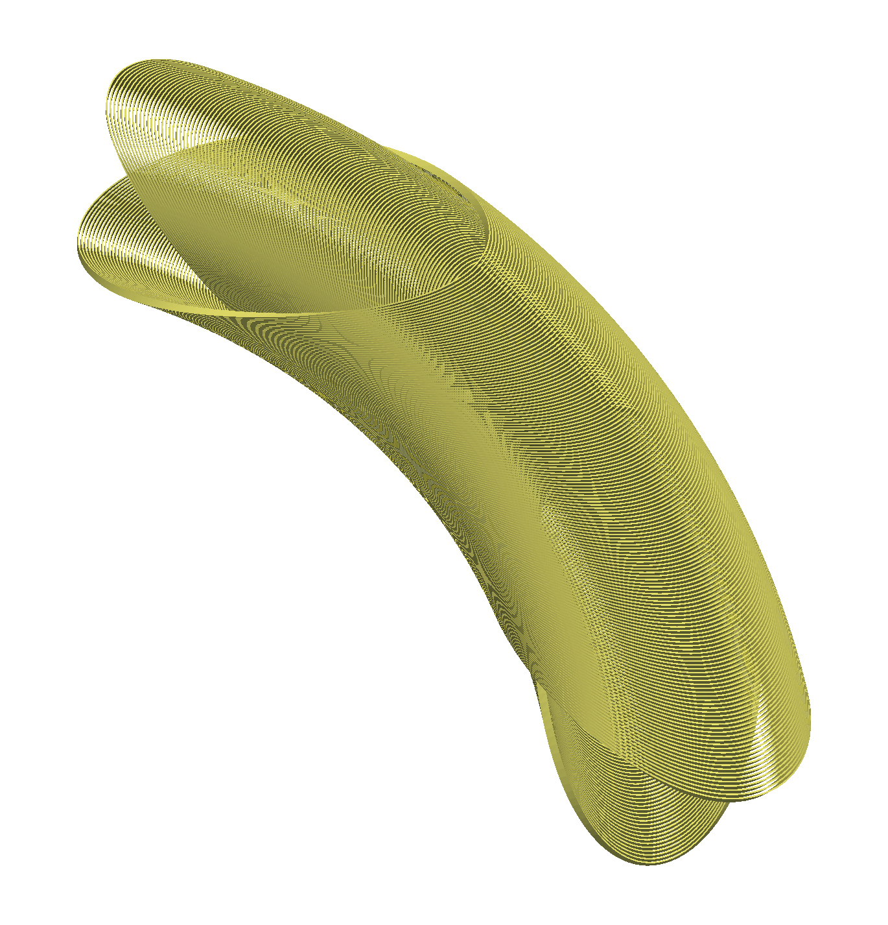

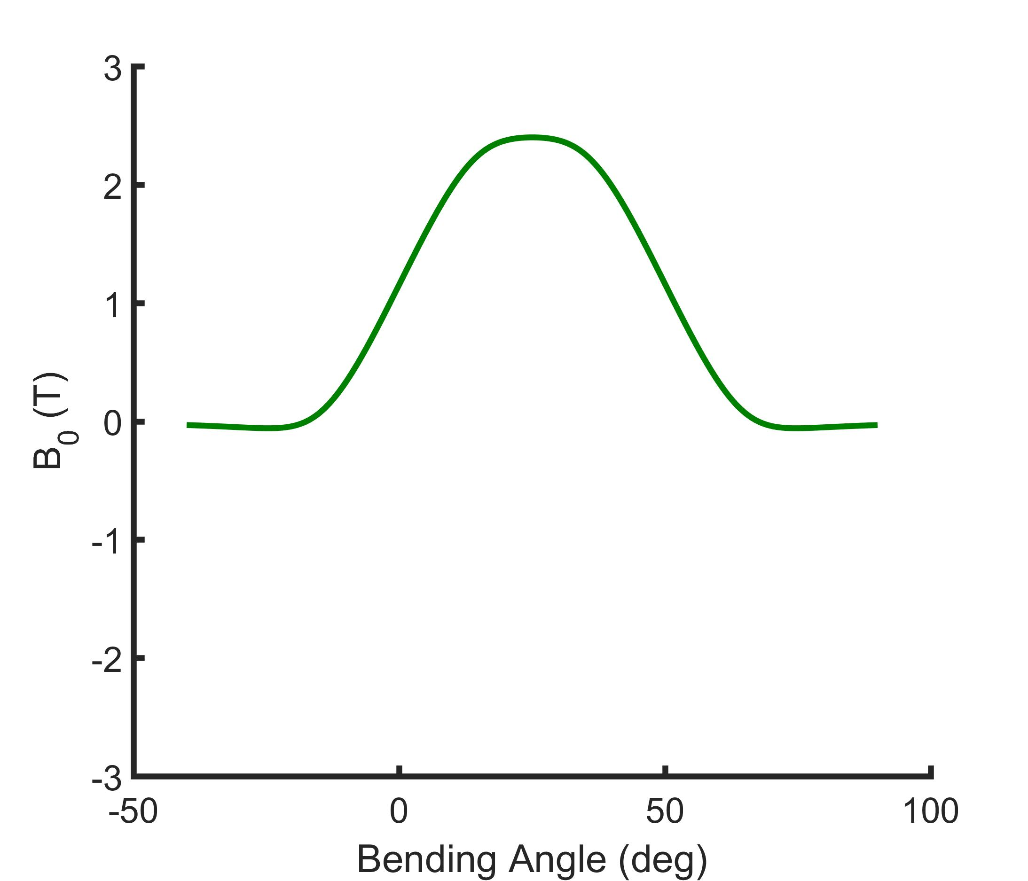
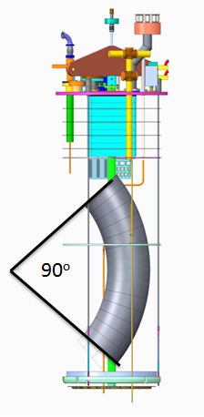
A reduced bend prototype for a first test
Four layer CCT design with large acceptance (20%)
Fabrication and test of two dipole layers
2.4 T dipole in 290 mm aperture (reduced bend angle)
Alternating Quadrupole (± 22.7 T/m)
Constant Dipole (2.3 T)

Slide 17
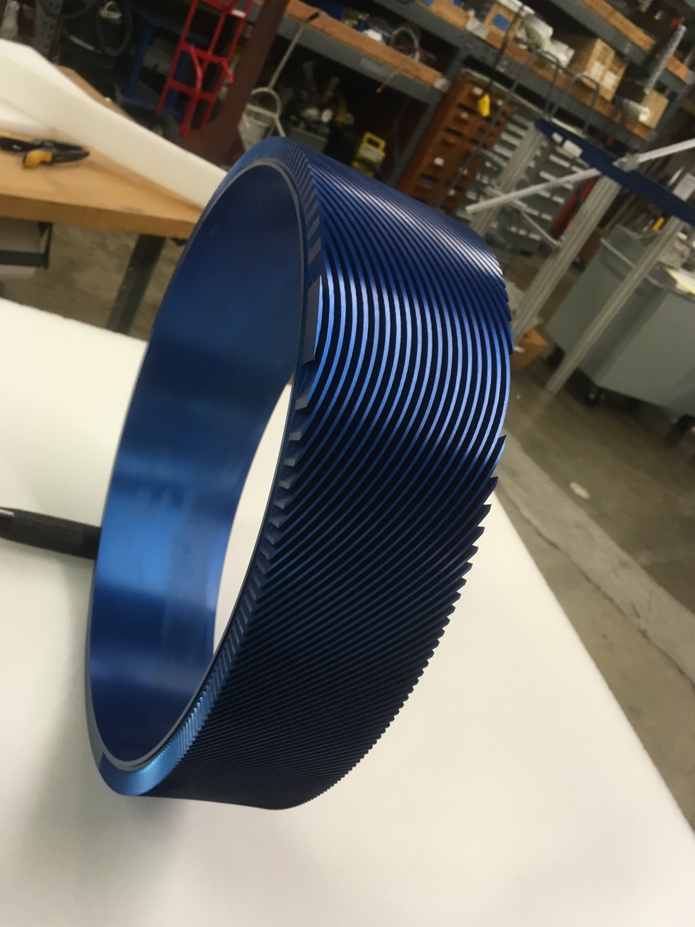
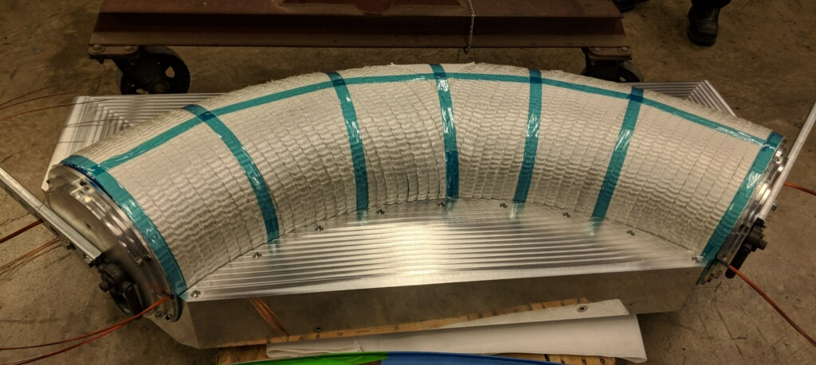
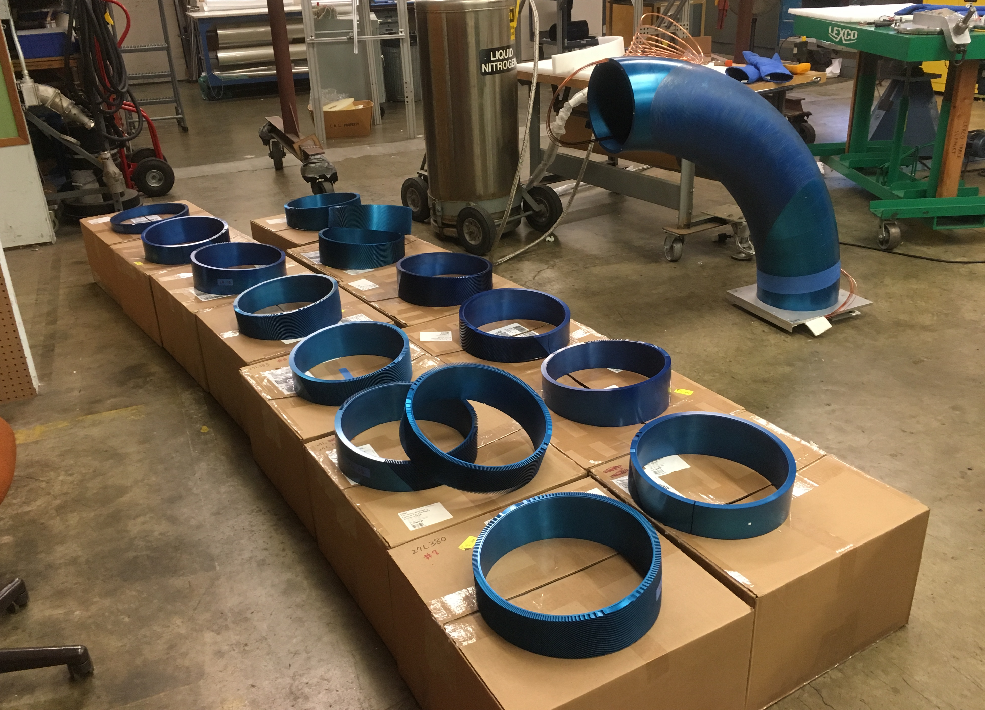
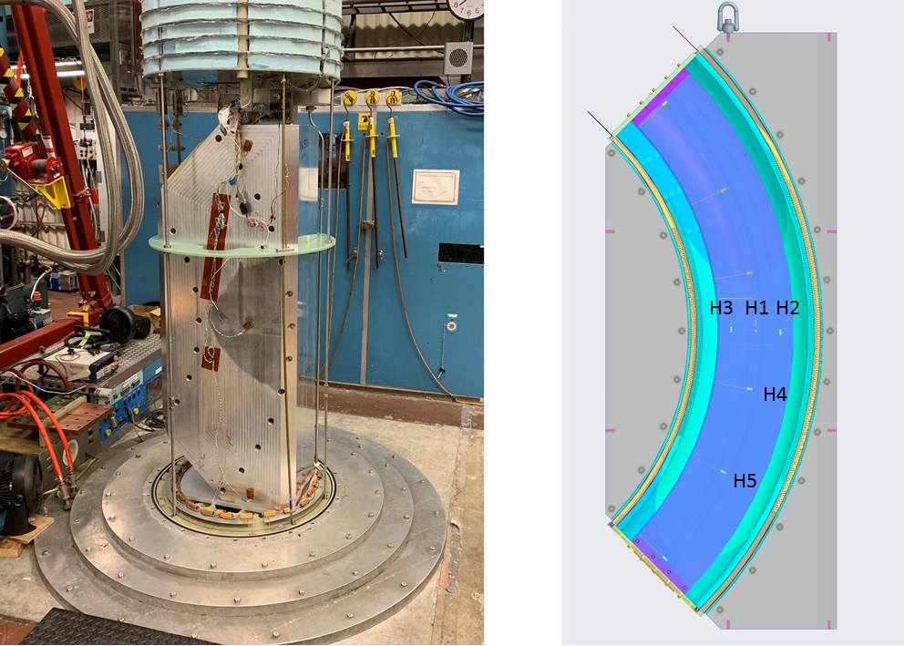
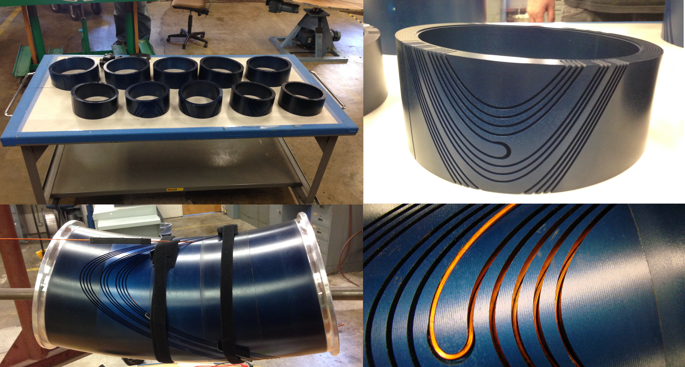
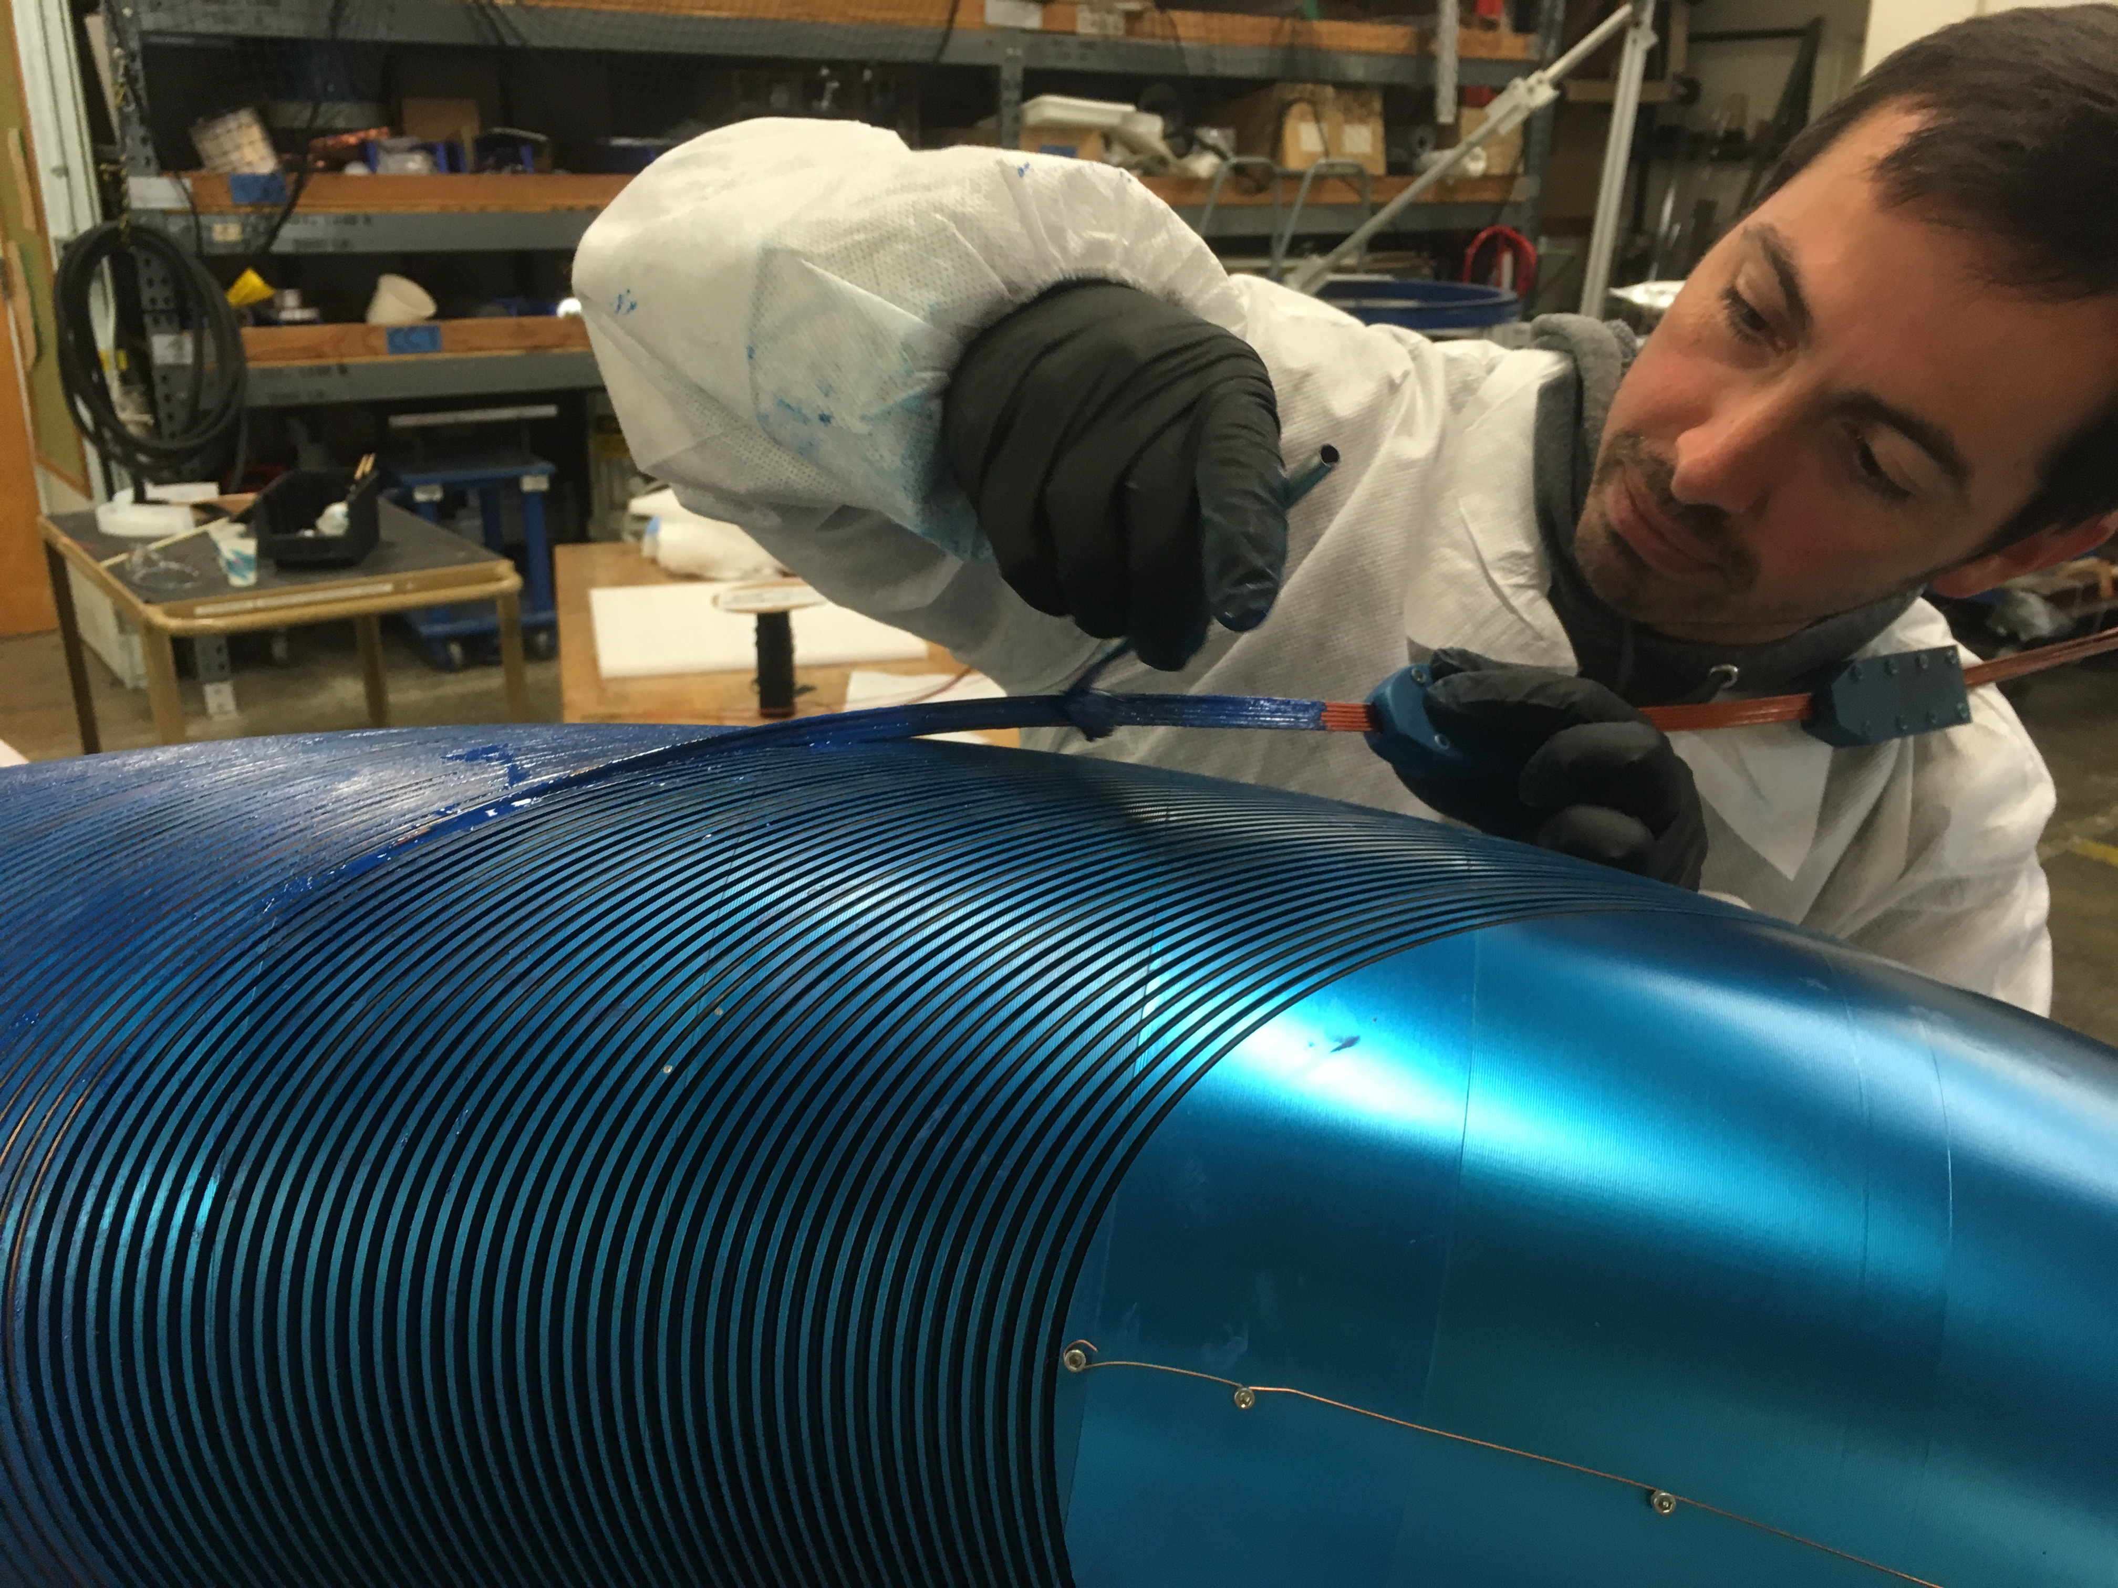
Baseline technology established for design, fabrication, and test of high-curvature CCT magnets with very large apertures

Slide 18
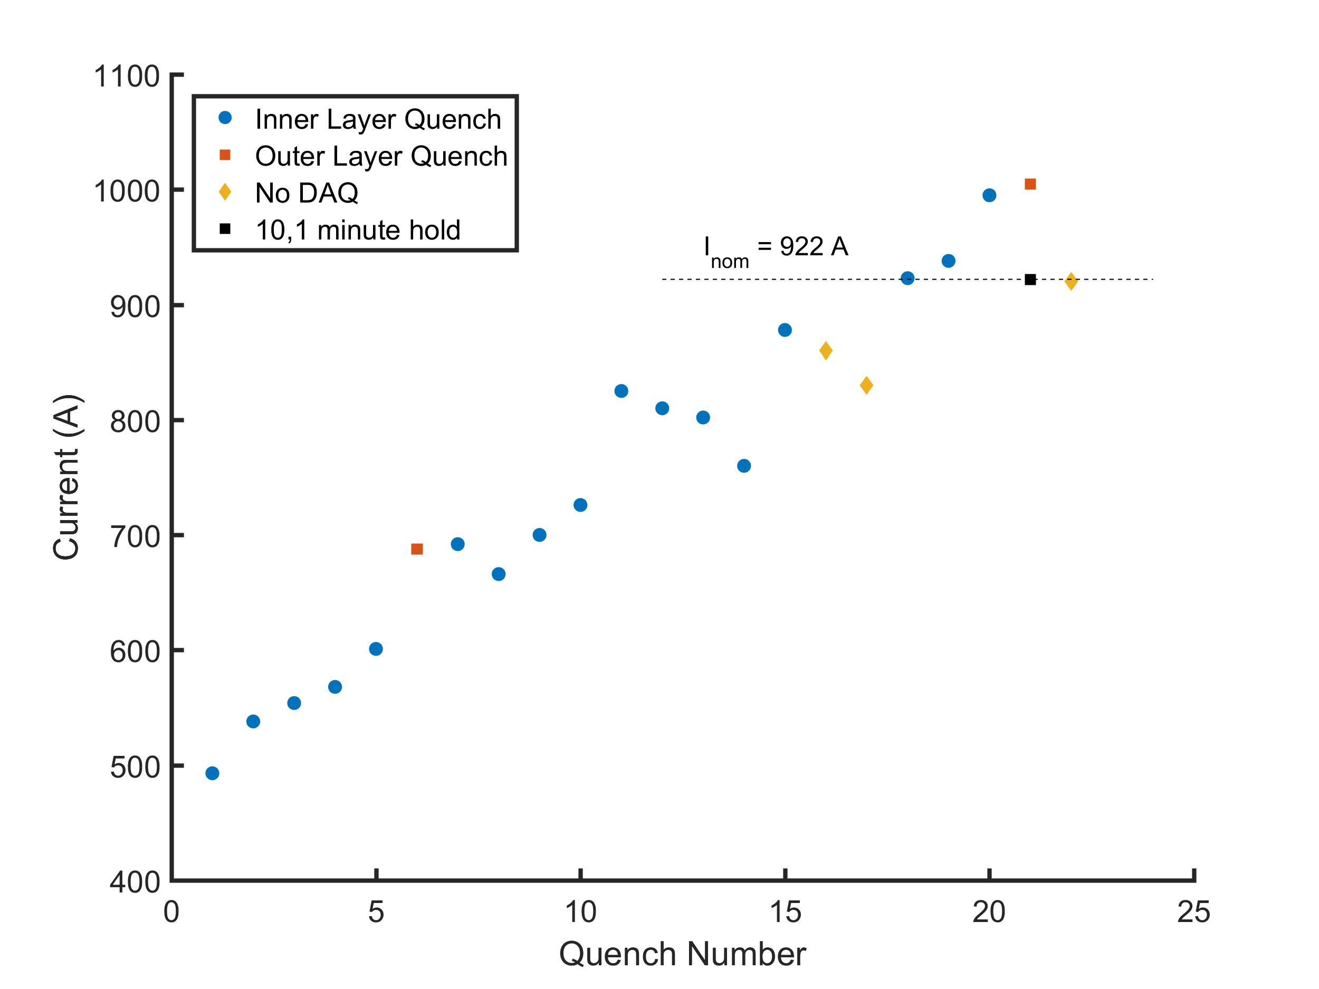
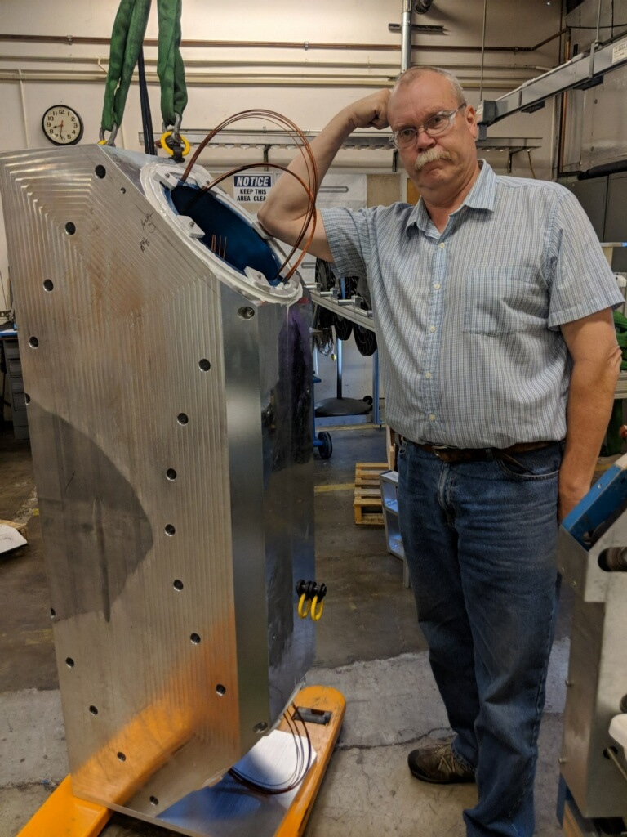
A prototype magnet consisting of the two dipole layers reached the design field in a liquid helium bath (4.5 K)
The magnet reached nominal current after 17 quenches (60% of wire short-sample)
2.4 T dipole field in very large aperture (290 mm) with tight bend radius (ρ=0.9 m)
peak current of 1008 A
10 minute hold at nominal current
LBNL: L. Brouwer, S. Caspi, J. Herrera, J. Swanson, M Maruszewski, M. Marchevsky, K. Edwards, J. Taylor, W. Wan, S. Prestemon, X. Wang, C. Myers, S. Myers, R. Hafalia, M. Turqueti, C. Sun, D. Robin, M. Reynolds, A. Hodgkinson, T. Lipton
Varian Medical: A. Godeke, M. Schillo, A. Huggins, R. Nast
Paul Scherrer Institute: M. Schippers, A. Gerbershagen, C. Calzolaio, S. Sanfilippo
onset of electrical damage to outer layer which leads to end of testing
L. Brouwer et al., “Design and test of a curved superconducting dipole magnet for proton therapy,” NIM-A, vol. 957, p. 163414, Mar. 2020, https://doi.org/10.1016/j.nima.2020.163414

Slide 19
Outline
Background
Status
Plans
Introduction to CCT
Introduction to the AG-CCT
HEP high-field (straight), ARDAP project for proton therapy (curved)
Combined function CCT’s relevant to FFA’s
Flexible generation of combined function fields for curved and straight magnets
Alternating gradients for large ∆p/p with fixed-field
The AG-CCT for fixed-field return arc design
Nb₃Sn + HTS magnets
A 2.4 T curved dipole magnet
new program to build and test combined function CCT magnets relevant to FFA’s

Slide 20
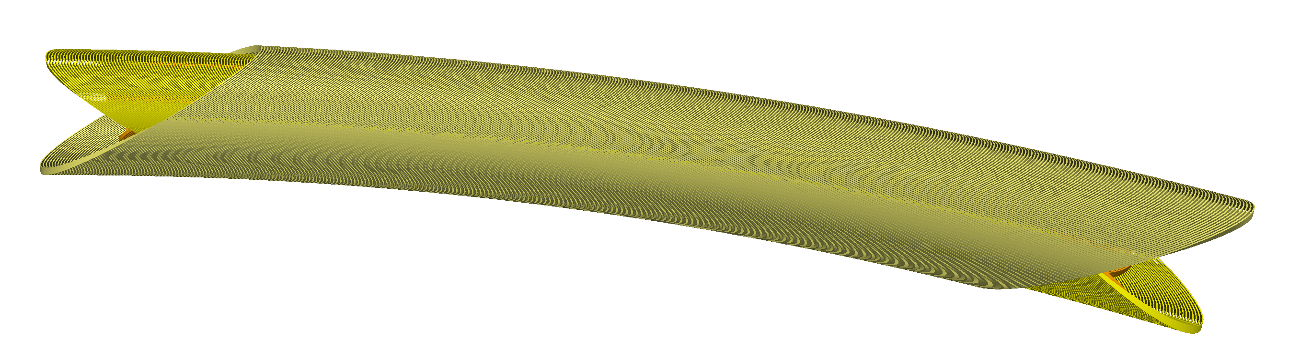
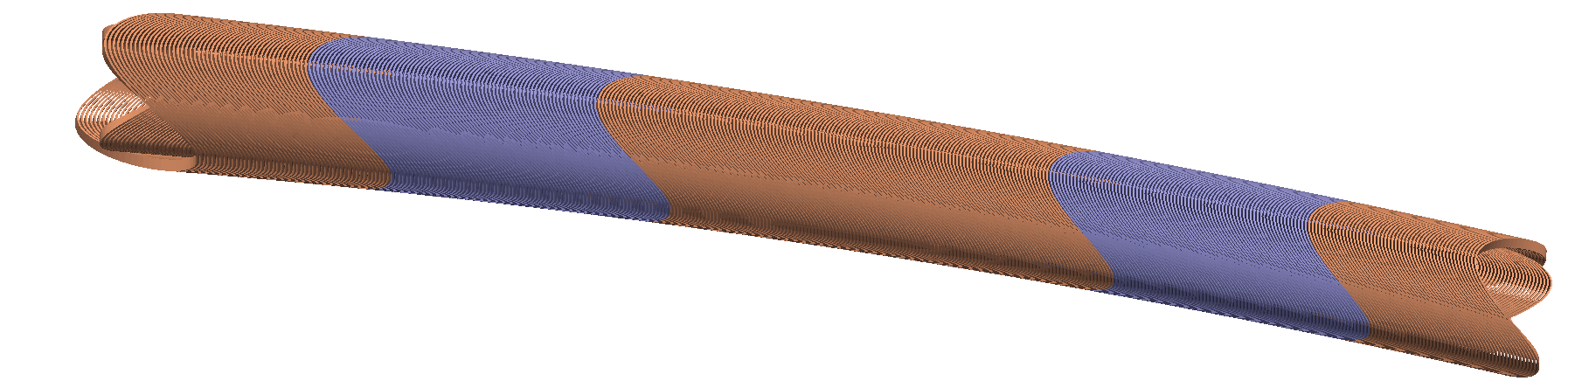
We have new R&D funding to develop combined function CCT magnets (relevant to FFA applications)
  Combined function CCT’s map onto existing layouts
  Goals for five year program:
  develop the technology for combined function, superconducting CCT magnets
  build and test a prototype magnet to demonstrate performance in the 5-7 T range
  New accelerator layouts leveraging the AG-CCT?
  Near term: solidify design parameters for the prototype magnet within 1 year.
  Question for this workshop - what do you see as the key aspects of SC magnet technology which needs to be demonstrated for future FFA’s?

Slide 21
Summary
Background
Status
Plans
Introduction to CCT
Introduction to the AG-CCT
HEP high-field (straight), ARDAP project for proton therapy (curved)
Combined function CCT’s relevant to FFA’s
Flexible generation of combined function fields for curved and straight magnets
Alternating gradients for large ∆p/p with fixed-field
The AG-CCT for fixed-field return arc design
Nb₃Sn + HTS magnets
A 2.4 T curved dipole magnet
CCT is flexible design for combined function fields in straight and curved geometries
The AG-CCT integrates alternating gradients into a single magnet
8-10 T Nb₃Sn dipoles for HEP (US-MDP)
2.4 T curved NbTi dipole for proton therapy
13 T, 120ø Nb₃Sn dipole
plan to build and test ~5 T combined function CCT magnets relevant to FFA’s (now is an excellent time for community feedback)

Slide 22
Backup Slides

Slide 23
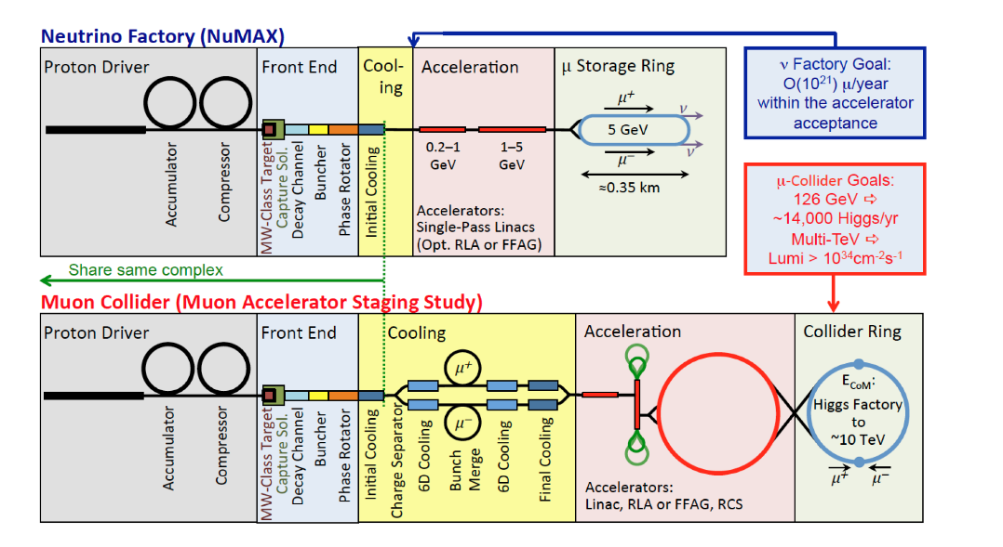
Focus on scoping the AG-CCT design to 1.2, 2.4 GeV/c passes in collaboration with LBNL’s Accelerator Modeling Program (AMP)
K. M. Black et al., “Muon Collider Forum Report.”, 2023, http://arxiv.org/abs/2209.01318

Slide 24
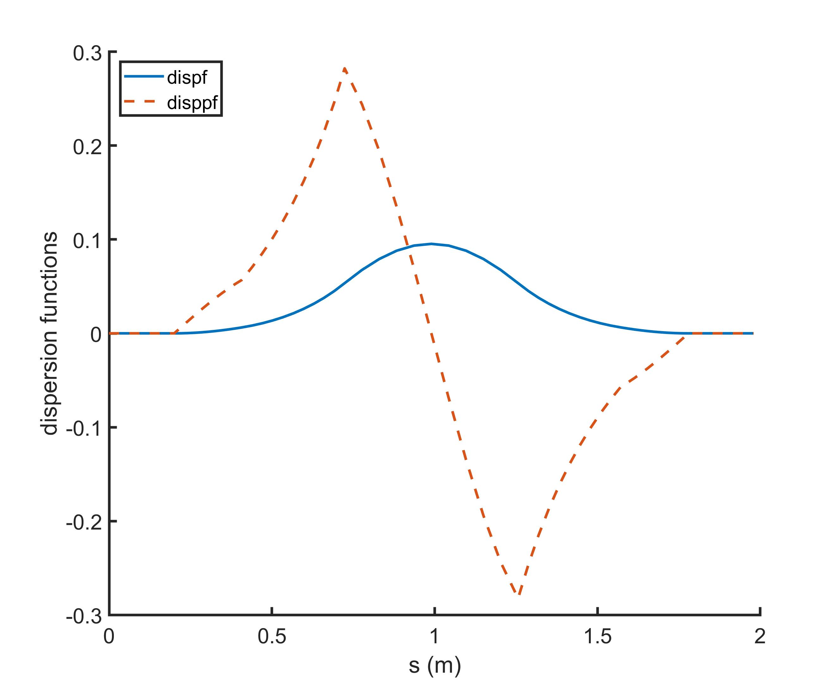
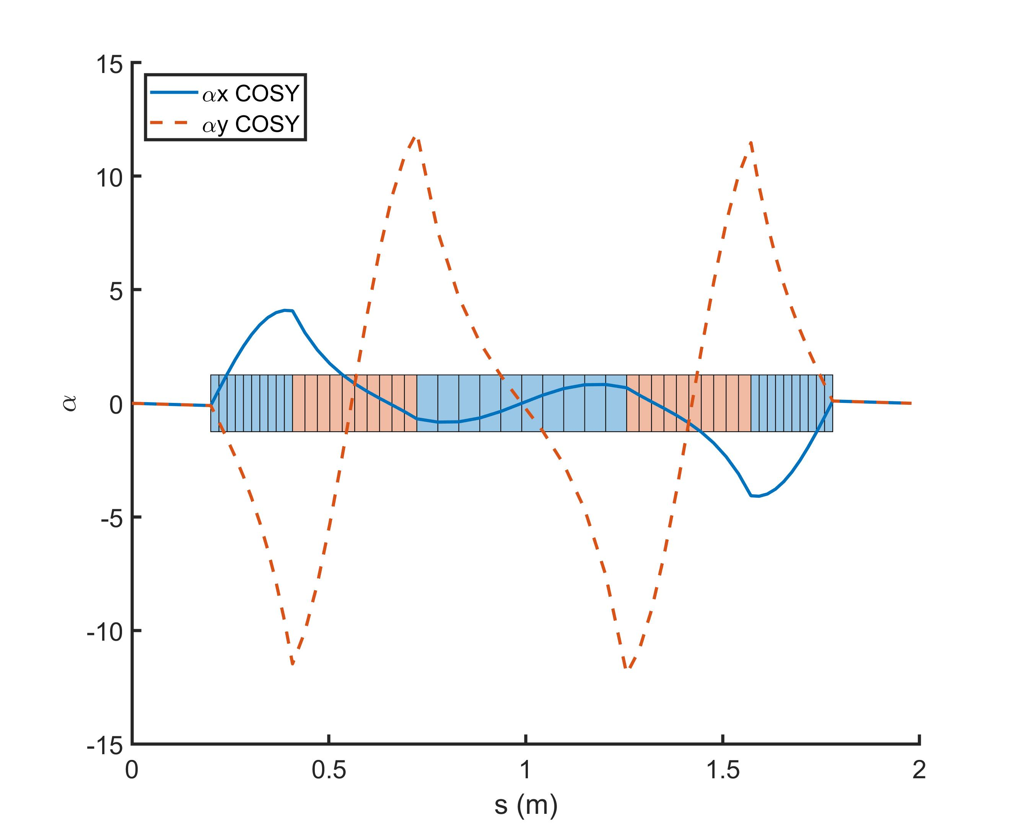
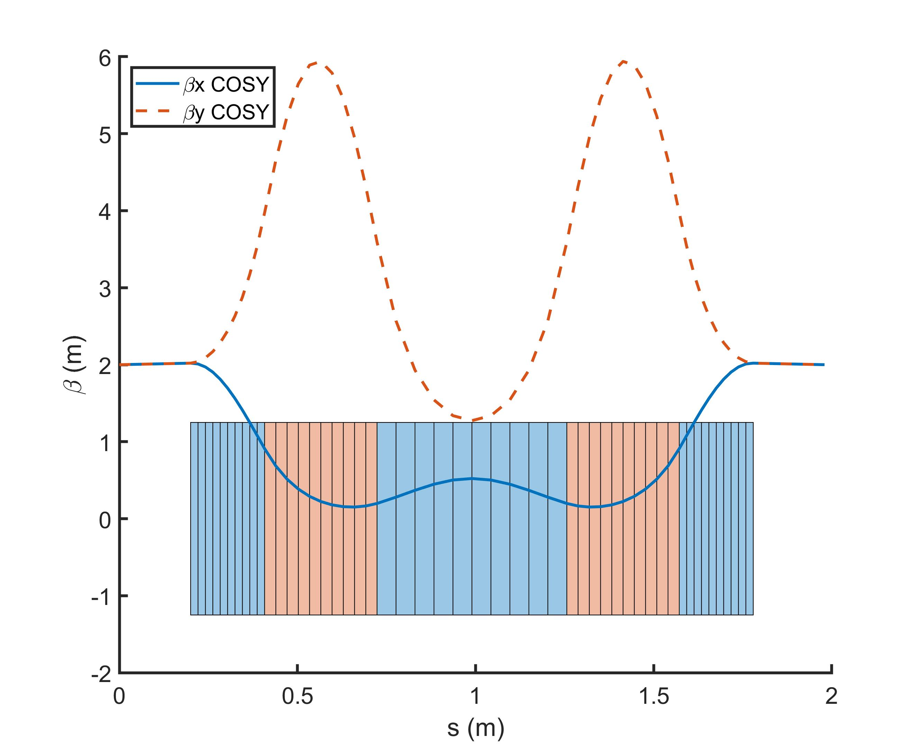
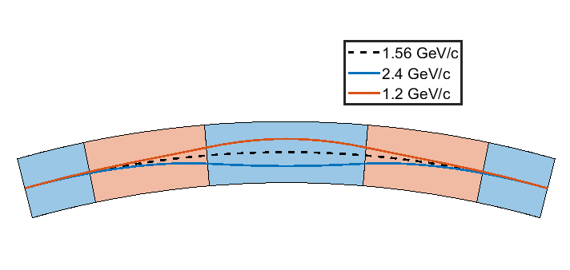
Focus on scoping the AG-CCT design to 1.2, 2.4 GeV/c passes in collaboration with LBNL’s Accelerator Modeling Program (AMP)
For reference energy
B0 = 1.725 T
G = 87.67 T/m
φtot = 30 deg
φsplit = 3.95, 6.0, 10.11, 6.0, 3.95
aperture = 100 mm
ρ = 3.02 m

Slide 25
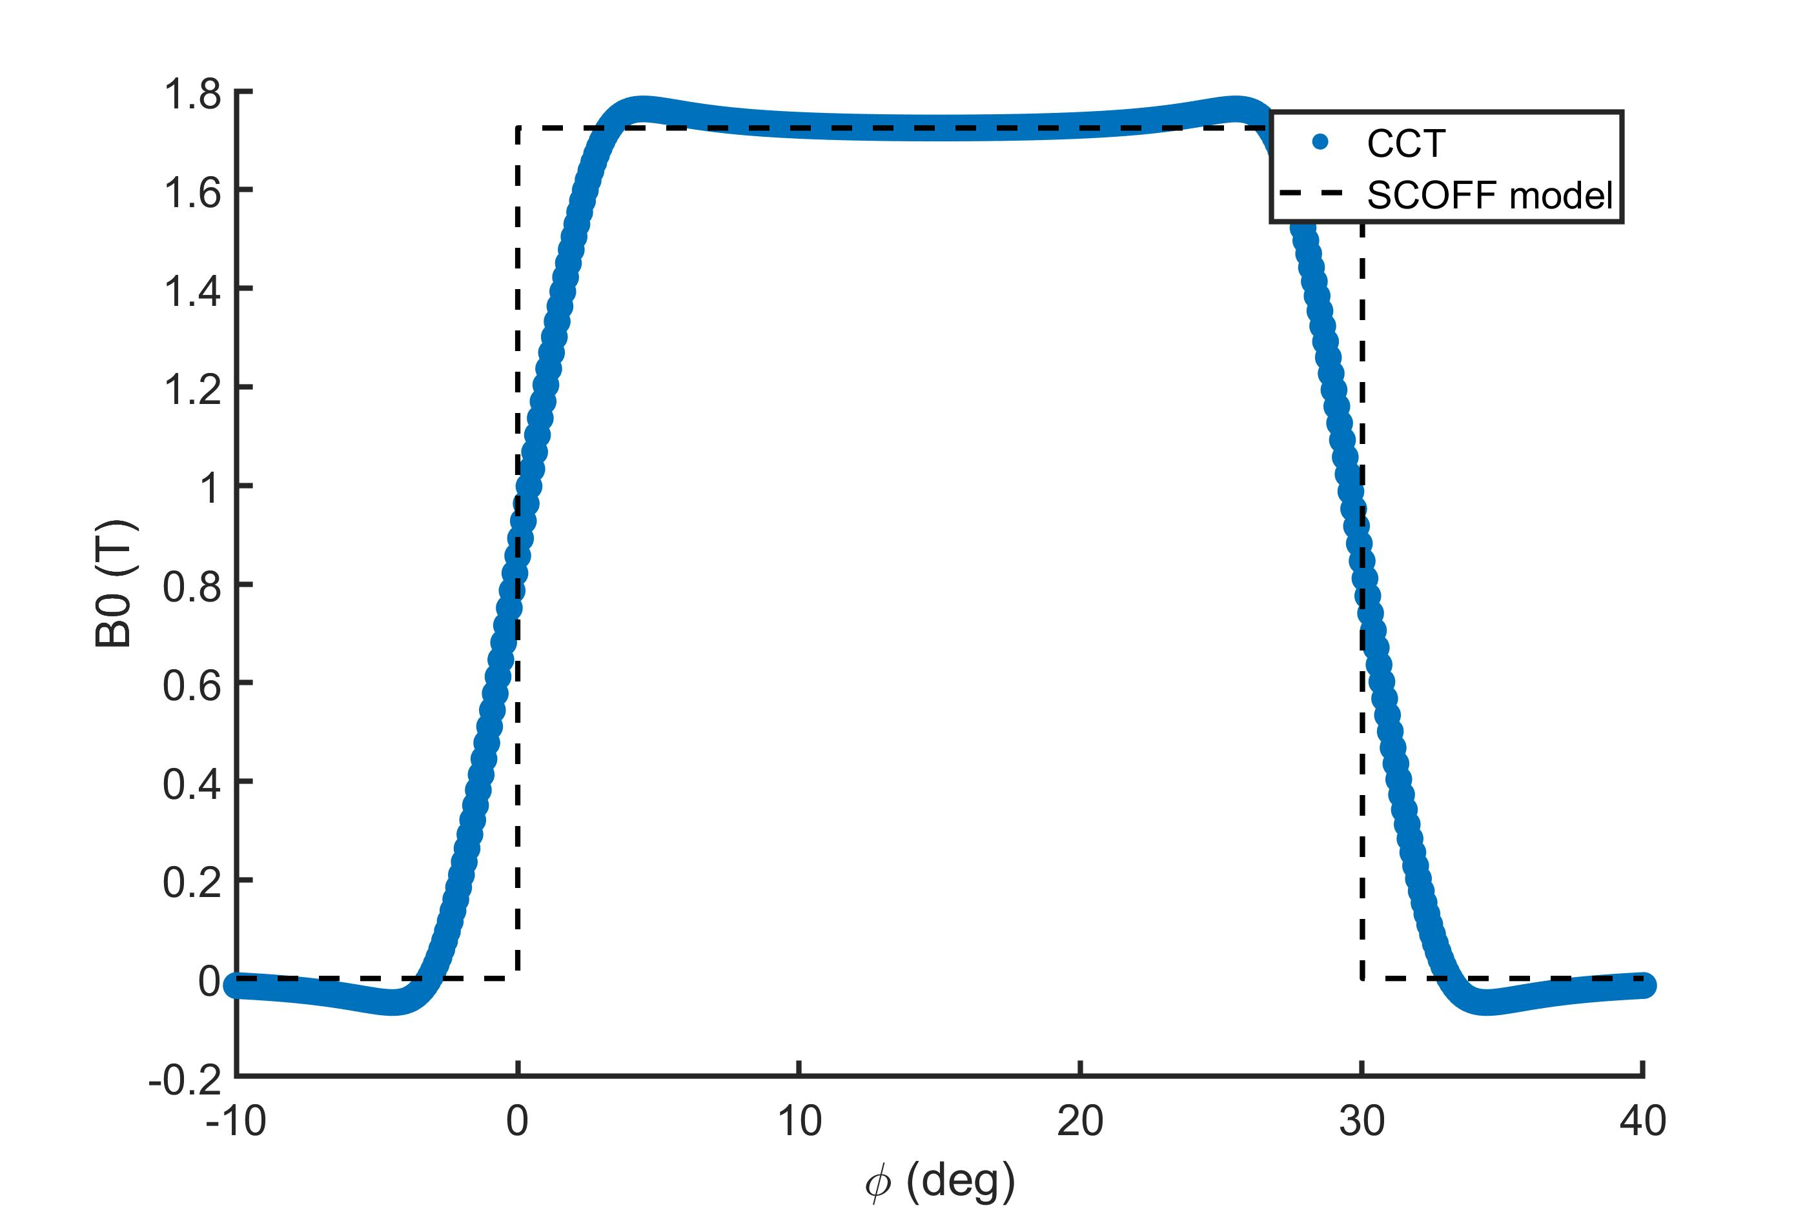
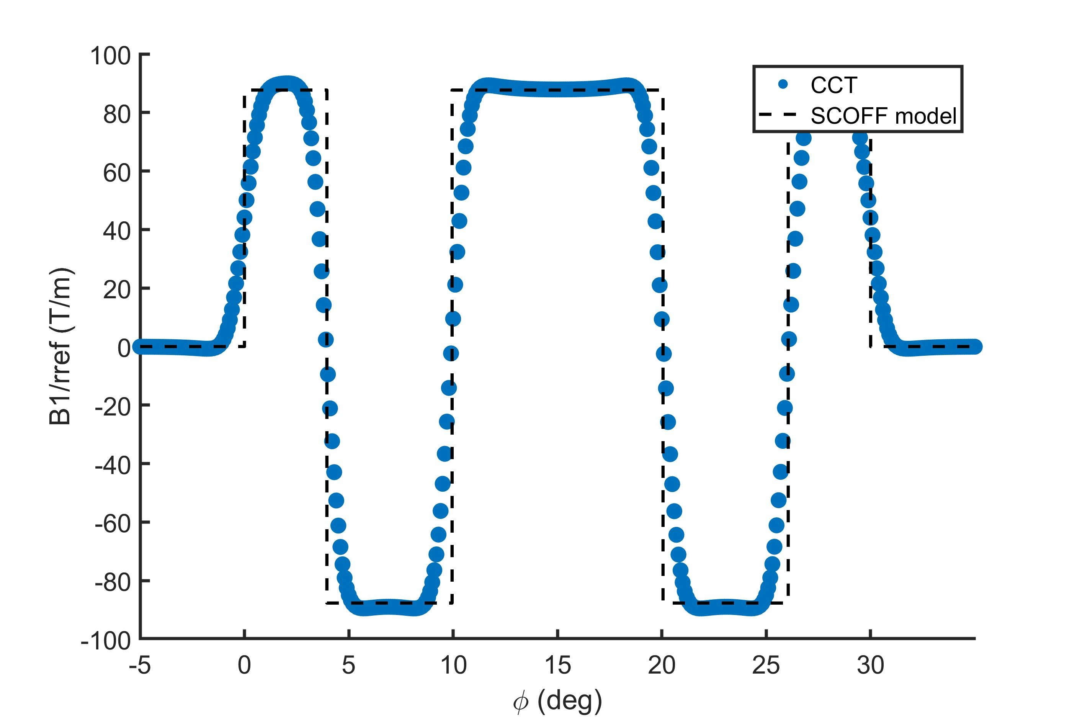



Harmonics along the length for coil design based on SCOFF model (at 30 mm reference radius – 60% of aperture)
B3 integrates to zero through ends
B4 integrates to zero through ends

Slide 26




In plane fields for perfect sectioning + peak field on conductor
Quad Layers
Dipole only
Combined
4.5 T
1.76 T
6.25 T
Peak field on the conductor is 7.5 T, a 23% rise (from 6.11 T of dipole+gradient)
-4.5 T

Slide 27


These fields are a bit high for Nb-Ti, but feasible with respect to conductor performance (the LHC NbTi cable is a good reference)
Short-sample assuming LHC NbTi cable
36 strands of 0.825 mm wire (15.1 mm thick)
Test winding into old AG-CCT mandrel

Slide 28


Momentum Acceptance Addresses a Key Technical Risk (Fast Field Ramping)
With a large momentum acceptance, each magnet setting covers a range of treatment energy (e.g. 20% dp/p)
Fast depth scanning with beam energy is desired during treatment
Magnetic rigidity settings
1.87
3.73 cm
15.75 cm
1.50
1.19
7.96 cm
✓
some tumors can be treated at fixed-field
order of magnitude reduction in magnet field ramping for worst-case scenario
✓

Slide 29


Hall probes verified the design field at nominal current, a more complicated measurement system is required for future field quality characterization determining the harmonic content
H1
H4
H5
At 4.5 K and nominal current of 922 A
probes/predicted agree within error on center axis: H1, H4, H5
probes/predicted fall slightly outside error off center axis: H2,H3
Measurements by C. Myers and X. Wang

