Slide 1

Dreaming of a Muon Ion Collider: μIC
Based on the History, Science and Timelines of the EIC
Abhay Deshpande
Center for Frontiers in Nuclear Science
Stony Brook University & Brookhaven National Laboratory
Abhay Deshpande

Slide 2
Outline of this talk
Physics of EIC
EIC project
  EIC Accelerator and detector (ePIC) timeline
EIC realization timeline
Lessons learned
While Past performance is no guarantee of future success, I still would dare to extrapolate and advise toward realizing Fantasies of MuIC

Slide 3

Deep Inelastic Scattering: Precision and control
Kinematics:
Measure of resolution power
Measure of inelasticity
Measure of momentum fraction of struck quark
High lumi & acceptance
Exclusive DIS
  detect & identify everything e+p/A → e’+h(π,K,p,jet)+…
Semi-inclusive events:
  e+p/A → e’+h(π,K,p,jet)+X
  detect the scattered lepton in coincidence with identified hadrons/jets
Inclusive events:
  e+p/A → e’+X
  detect only the scattered lepton in the detector
with respect to γ∗
s = 4 E_{h} E_{e}
Low lumi & acceptance

Slide 4
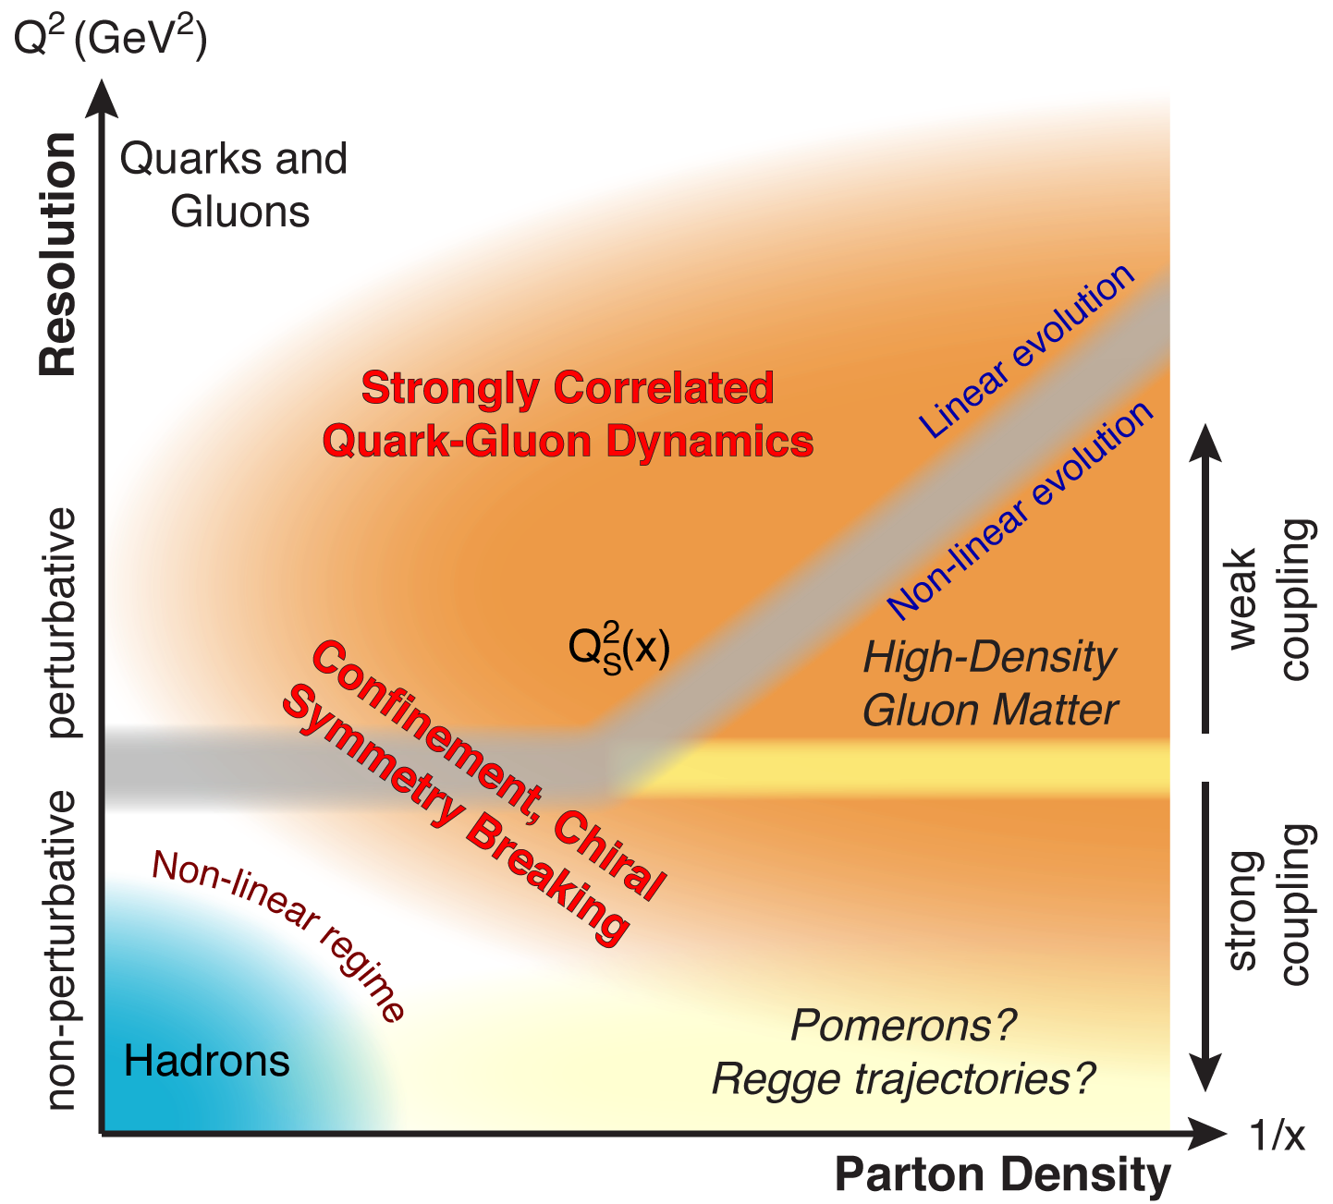
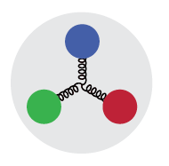
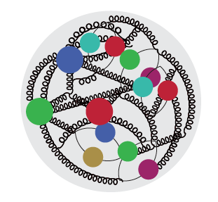

QCD Landscape to be explored by a new future facility
QCD at high resolution (Q²) —weakly correlated quarks and gluons are well-described
Systematically explore correlations in this region.
An exciting opportunity: Observation of a new regime in QCD of weakly coupled high-density matter
arXiv: 1708.01527
Strong QCD dynamics creates many-body correlations between quarks and gluons
→ hadron structure emerges
Need Precision and Control

Slide 5
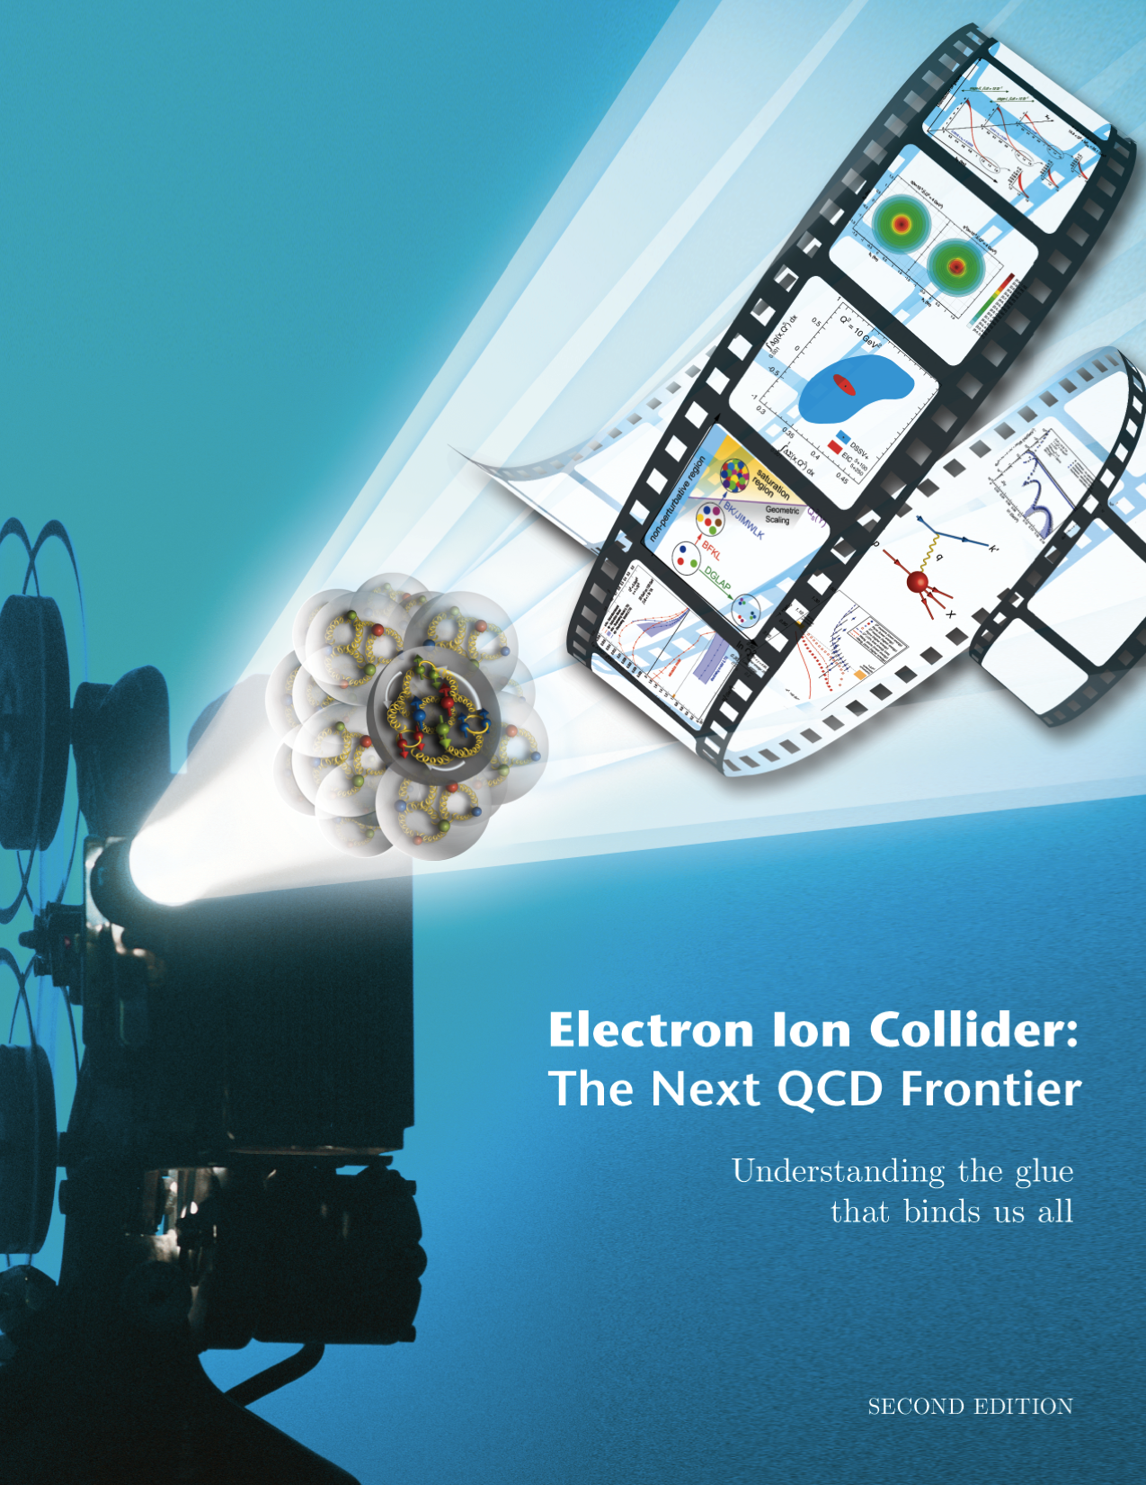

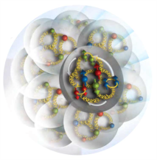
EIC Physics at-a-Glance
Eur. Phys. J. A 52 (2016) 9, 268 arXiv:1212.1701 (nucl-ex)
How are the sea quarks and gluons, and their spins, distributed in space and momentum inside the nucleon? How do the nucleon properties (mass & spin) emerge from their interactions?
How do color-charged quarks and gluons, and colorless jets, interact with a nuclear medium? How do the confined hadronic states emerge from these quarks and gluons? How do the quark-gluon interactions create nuclear binding?
How does a dense nuclear environment affect the quark- and gluon- distributions? What happens to the gluon density in nuclei? Does it saturate at high energy, giving rise to a gluonic matter with universal properties in all nuclei, even the proton?
gluon
emission
gluon recombination
?
=

Slide 6

Gluons, the carriers of the strong force, bind the quarks together inside nucleons and nuclei and generate nearly all of the visible mass in the universe. Despite their importance, fundamental questions remain about the role of gluons in nucleons and nuclei. These questions can only be answered with a powerful new electron ion collider (EIC), providing unprecedented precision and versatility. The realization of this instrument is enabled by recent advances in accelerator technology.
RECOMMENDATION:
We recommend a high-energy high-luminosity polarized EIC as the highest priority for new facility construction following the completion of FRIB.
FRIB construction completed, operations began May 2022.
http://science.energy.gov/np/reports

Slide 7
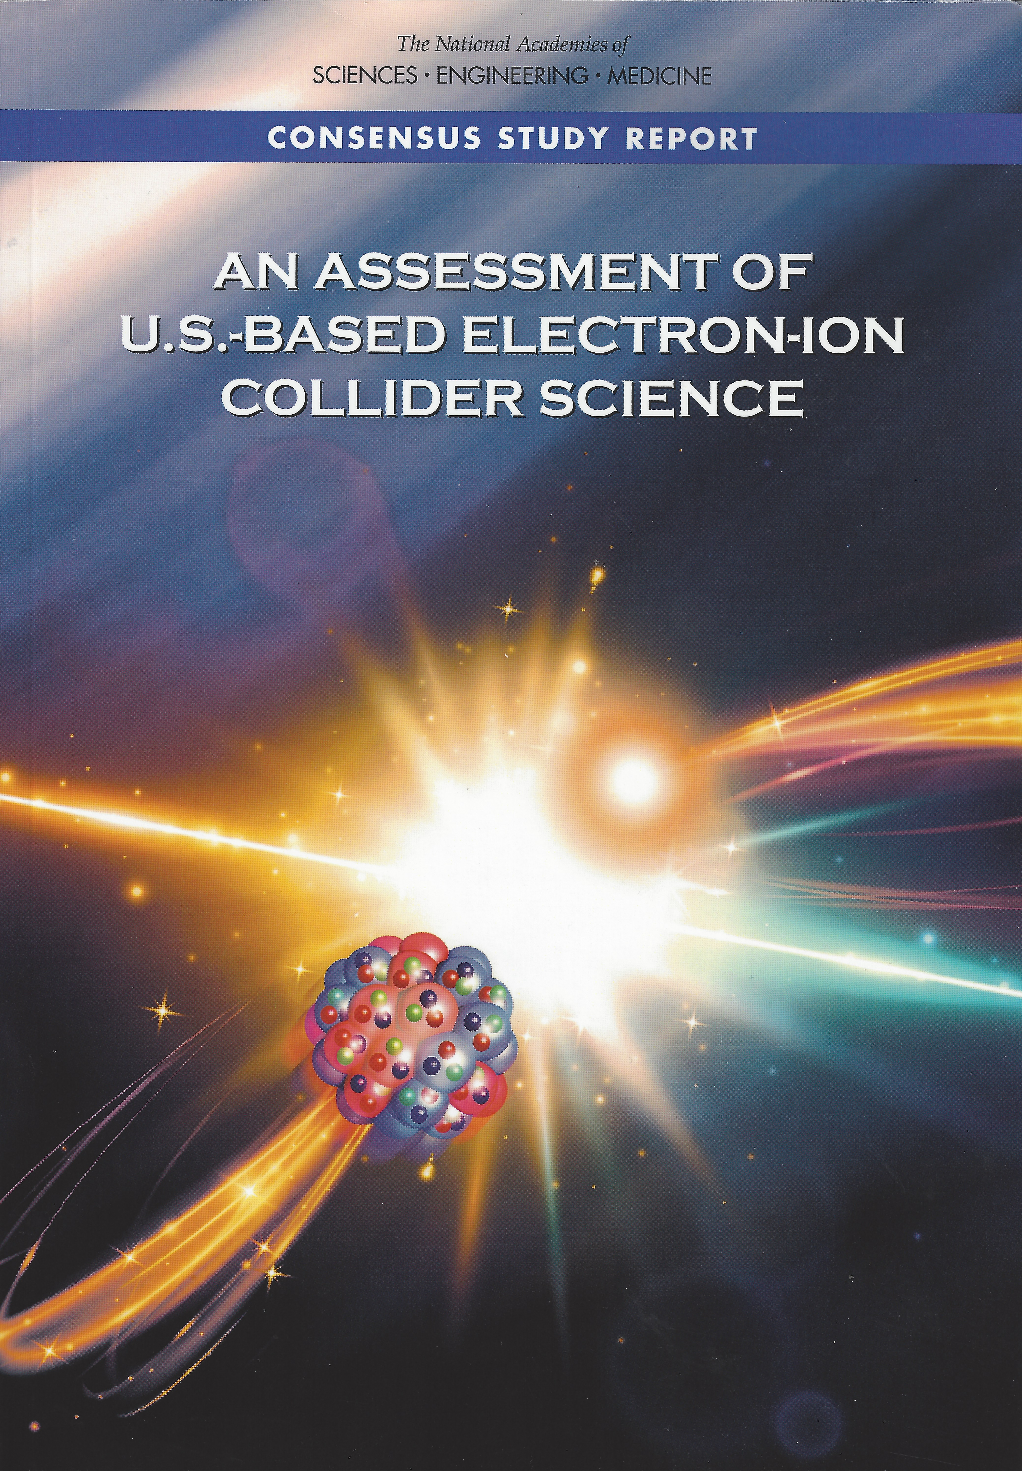

National Academy of Science, Engineering and Medicine
Assessment July 2018
Physics of EIC
Emergence of Spin
Emergence of Mass
Physics of high-density gluon fields
Machine Design Parameters:
High luminosity: up to 10³³-10³⁴ cm⁻²sec⁻¹
  a factor ~100-1000 times HERA
Broad range in center-of-mass energy: ~20-140 GeV
Polarized beams e-, p, and light ion beams with flexible spin patterns/orientation
Broad range in hadron species: protons…. Uranium
Up to two detectors well-integrated detector(s) into the machine lattice
EIC science:
compelling, fundamental
and timely

Slide 8
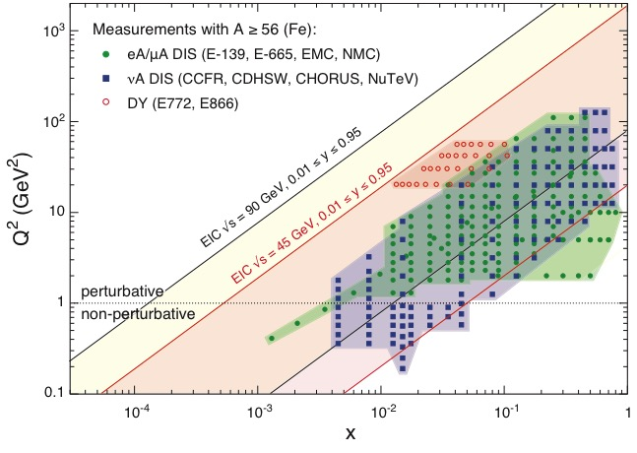
EIC: NEW Kinematic reach & properties
Resolution ➔
For e-N collisions at the EIC:
Polarized beams: e, p, d/³He
Variable center of mass energy
Wide Q² range → evolution
Wide x range → spanning valence to low-x physics
Momentum fraction
Resolution ➔
For e-A collisions at the EIC:
Wide range in nuclei
Luminosity per nucleon same as e-p
Variable center of mass energy
Wide x range (evolution)
Wide x region (reach high gluon densities)
Momentum fraction
Notes:
Minimize words, keep and enhance the figures….

Slide 9
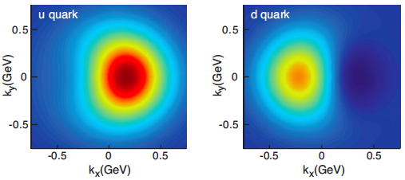
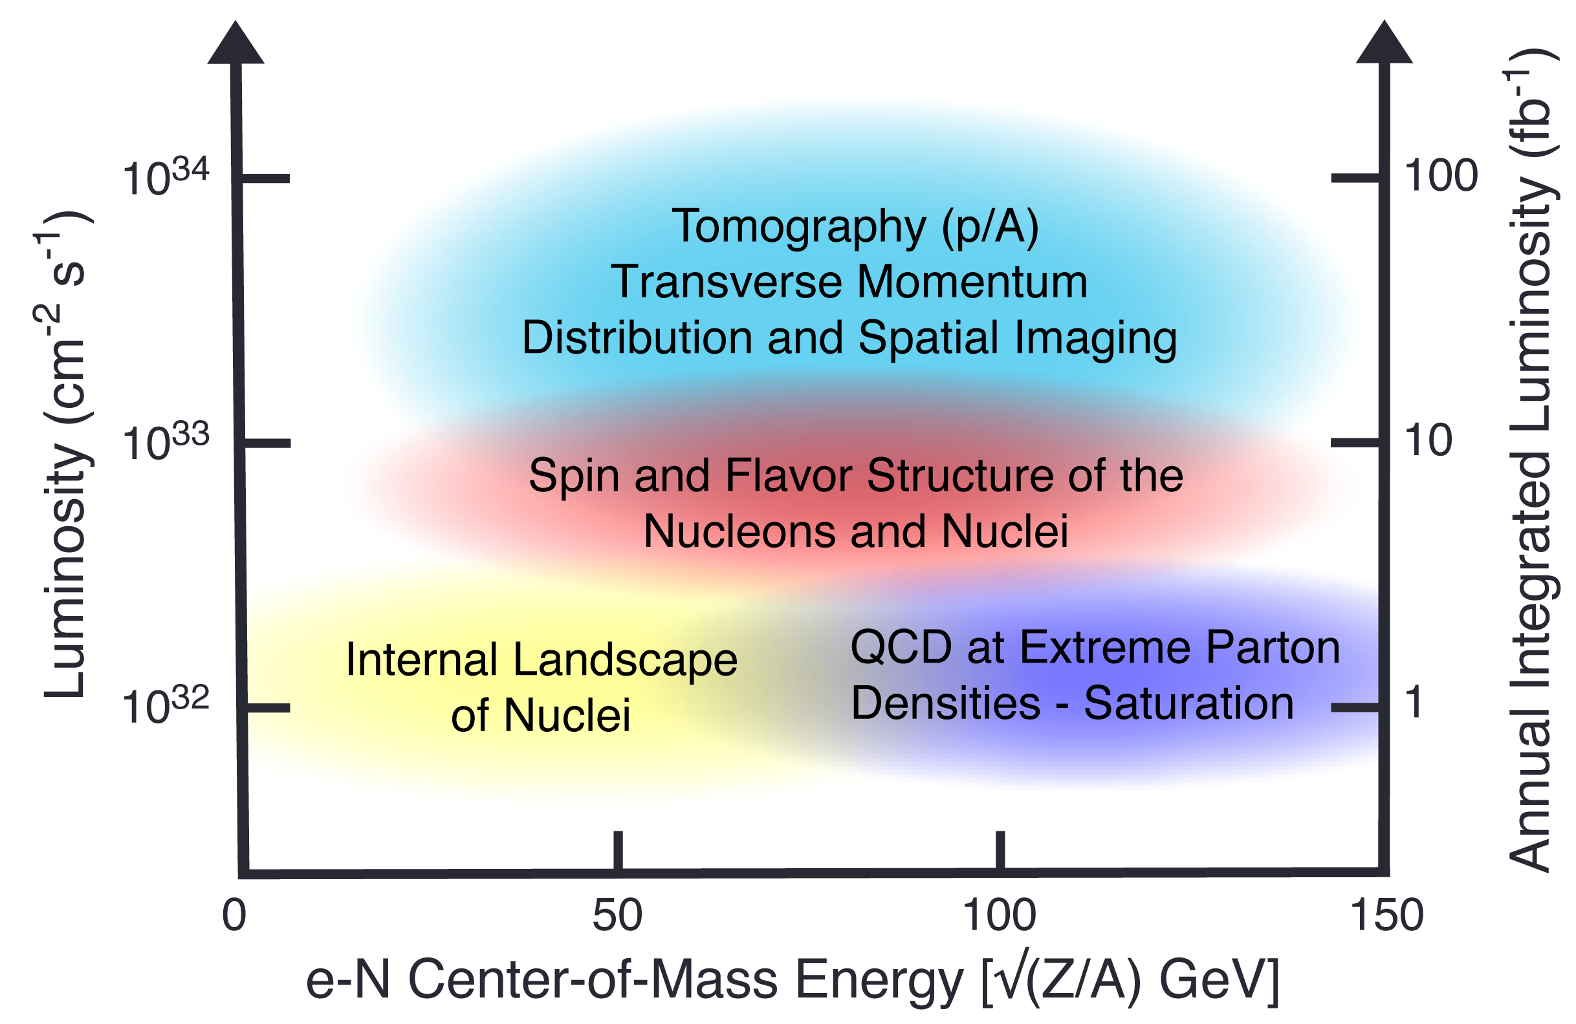
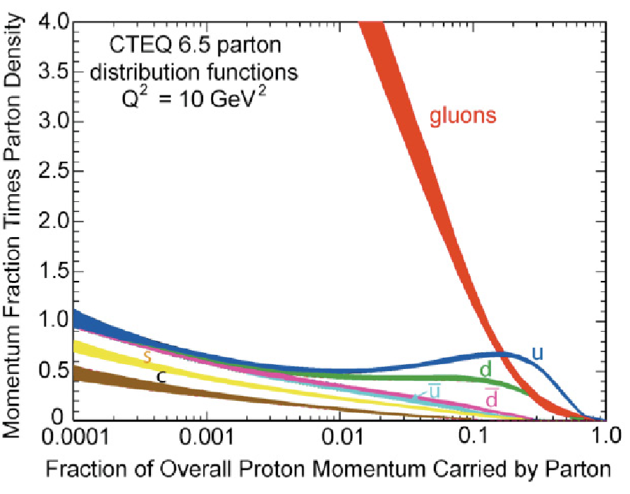
EIC science highlights
?

Slide 10
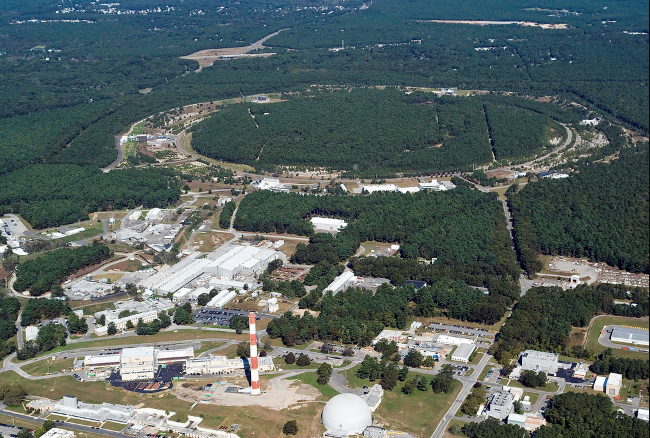

EIC Accelerator Design Overview
Hadron storage ring (HSR): 41-275 GeV (based on RHIC)
  up to 1160 bunches, 1A beam current (3x RHIC)
  bright vertical beam emittance (1.5 nm)
  strong cooling (coherent electron cooling, ERL)
Electron storage ring (ESR): 2.5–18 GeV (new)
  up to 1160 polarized bunches
    high polarization by continual reinjection from RCS
  large beam current (2.5 A) ➔ 9 MW SR power
  superconducting RF cavities
Rapid cycling synchrotron (RCS): 0.4-18 GeV (new)
  2 bunches at 1 Hz; spin transparent due to high periodicity
High luminosity interaction region(s) (new)
  L = 10³⁴ cm⁻²s⁻¹
  superconducting magnets
  25 mrad crossing angle with crab cavities
  spin rotators (produce longitudinal spin at IP)
EIC

Slide 11

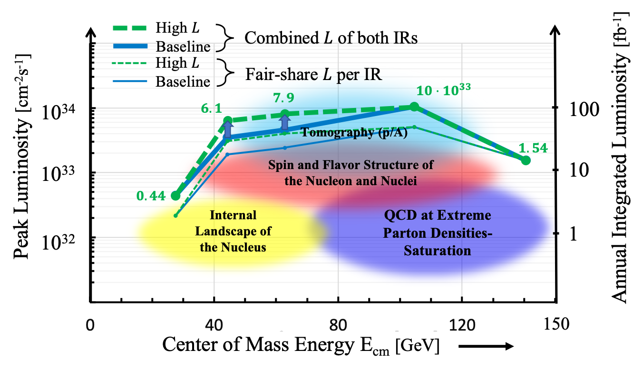
EIC Accelerator Design
Center of Mass Energies: | 20GeV - 140GeV
Luminosity: | 10³³ ⁻ 10³⁴ cm⁻²s⁻¹ / 10-100fb⁻¹ / year
Highly Polarized Beams: | 70%
Large Ion Species Range: | p to U
Number of Interaction Regions: | Up to 2!
IR-8
IR-6, ePIC Detector

Slide 12
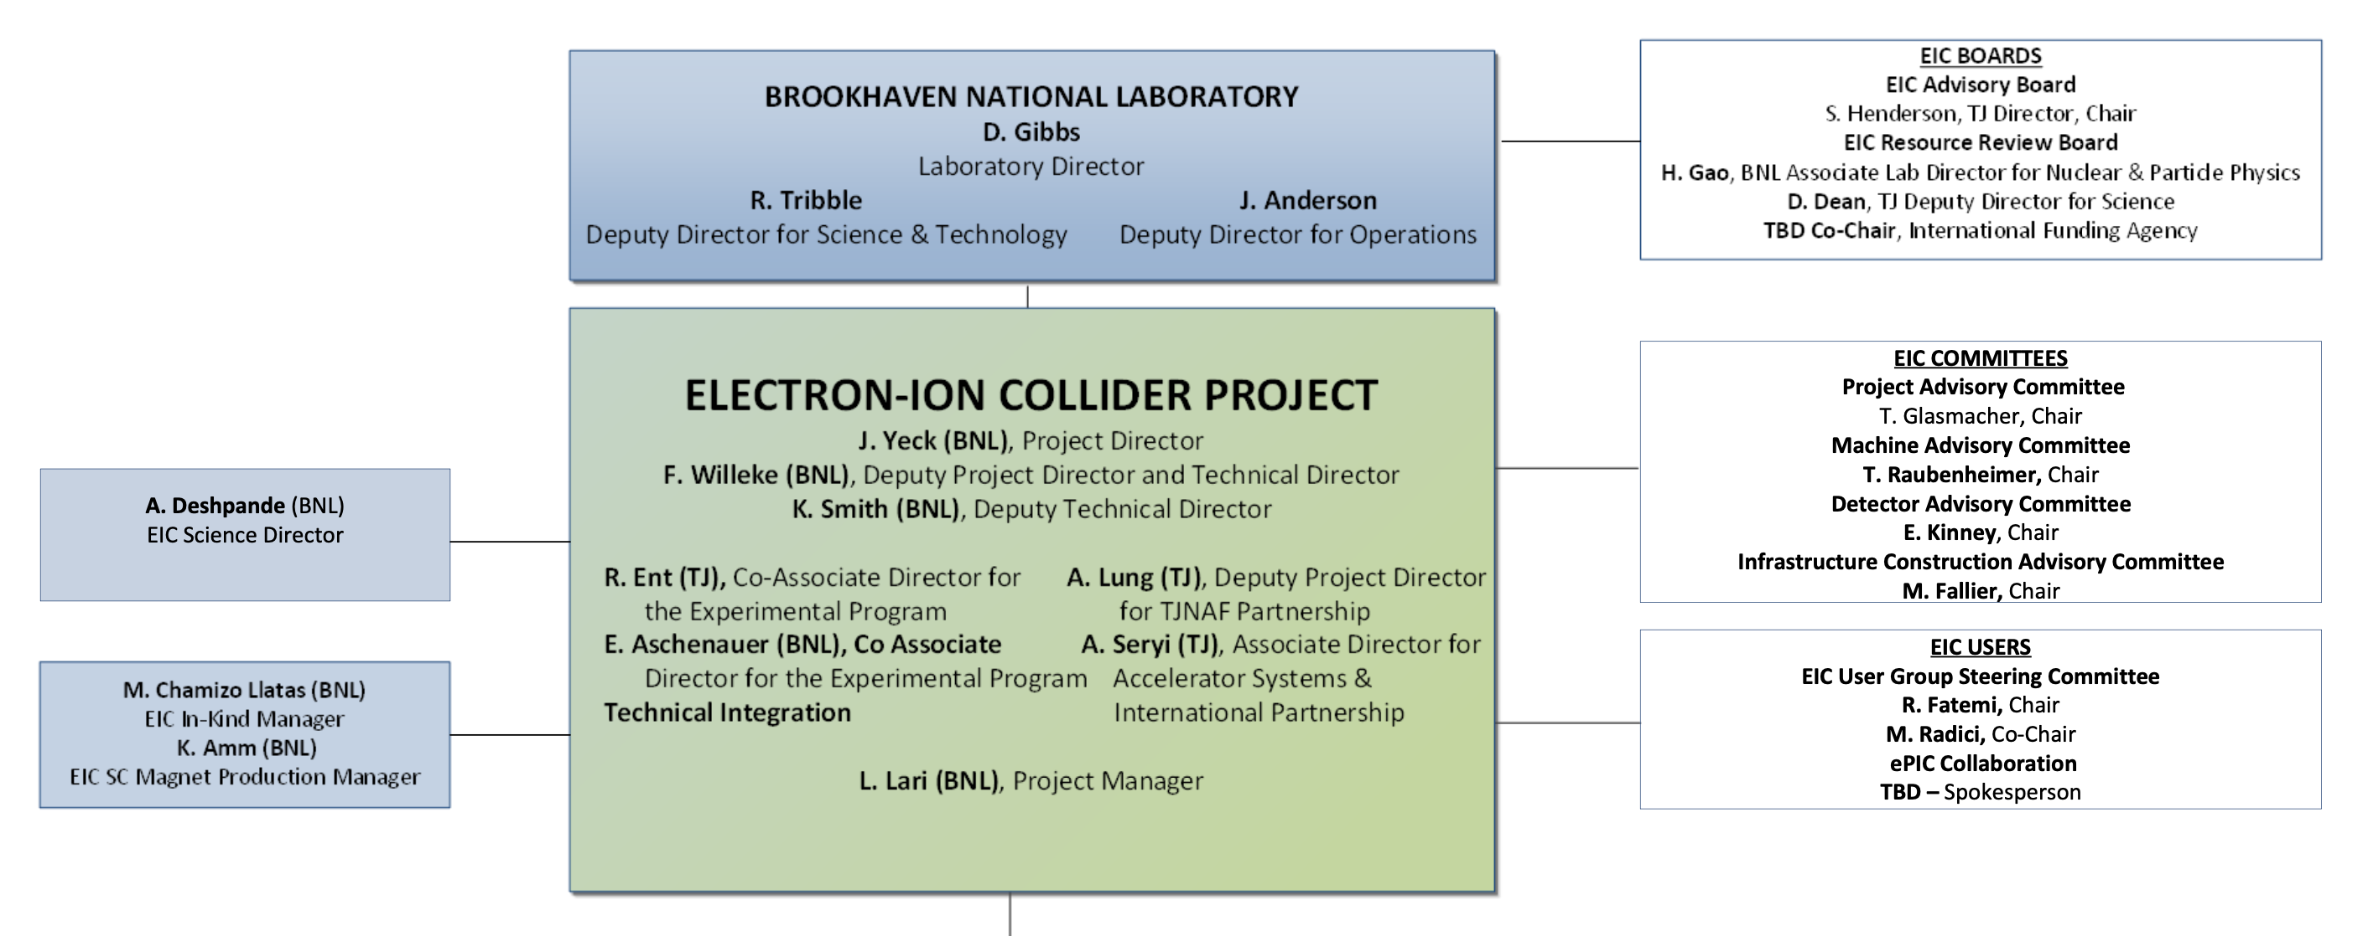
EIC Project – BNL/JLab, Boards, Advisory Committees
DOE, together with BNL and JLab, envision an EIC facility that is “fully international in character.”
EIC Advisory Board provides oversight and advice on the construction of the facility, focusing on the accelerator (BNL, TJNAF, LBNL, ANL, TRIUMF, IN2P3, CEA, STFC, INFN).
EIC Project Advisory Committee provides advice on the successful delivery of the DOE Project (management, scope, schedule, cost, and performance).
EIC Resource Review Board (RRB) to provide oversight of the experiments.

Slide 13
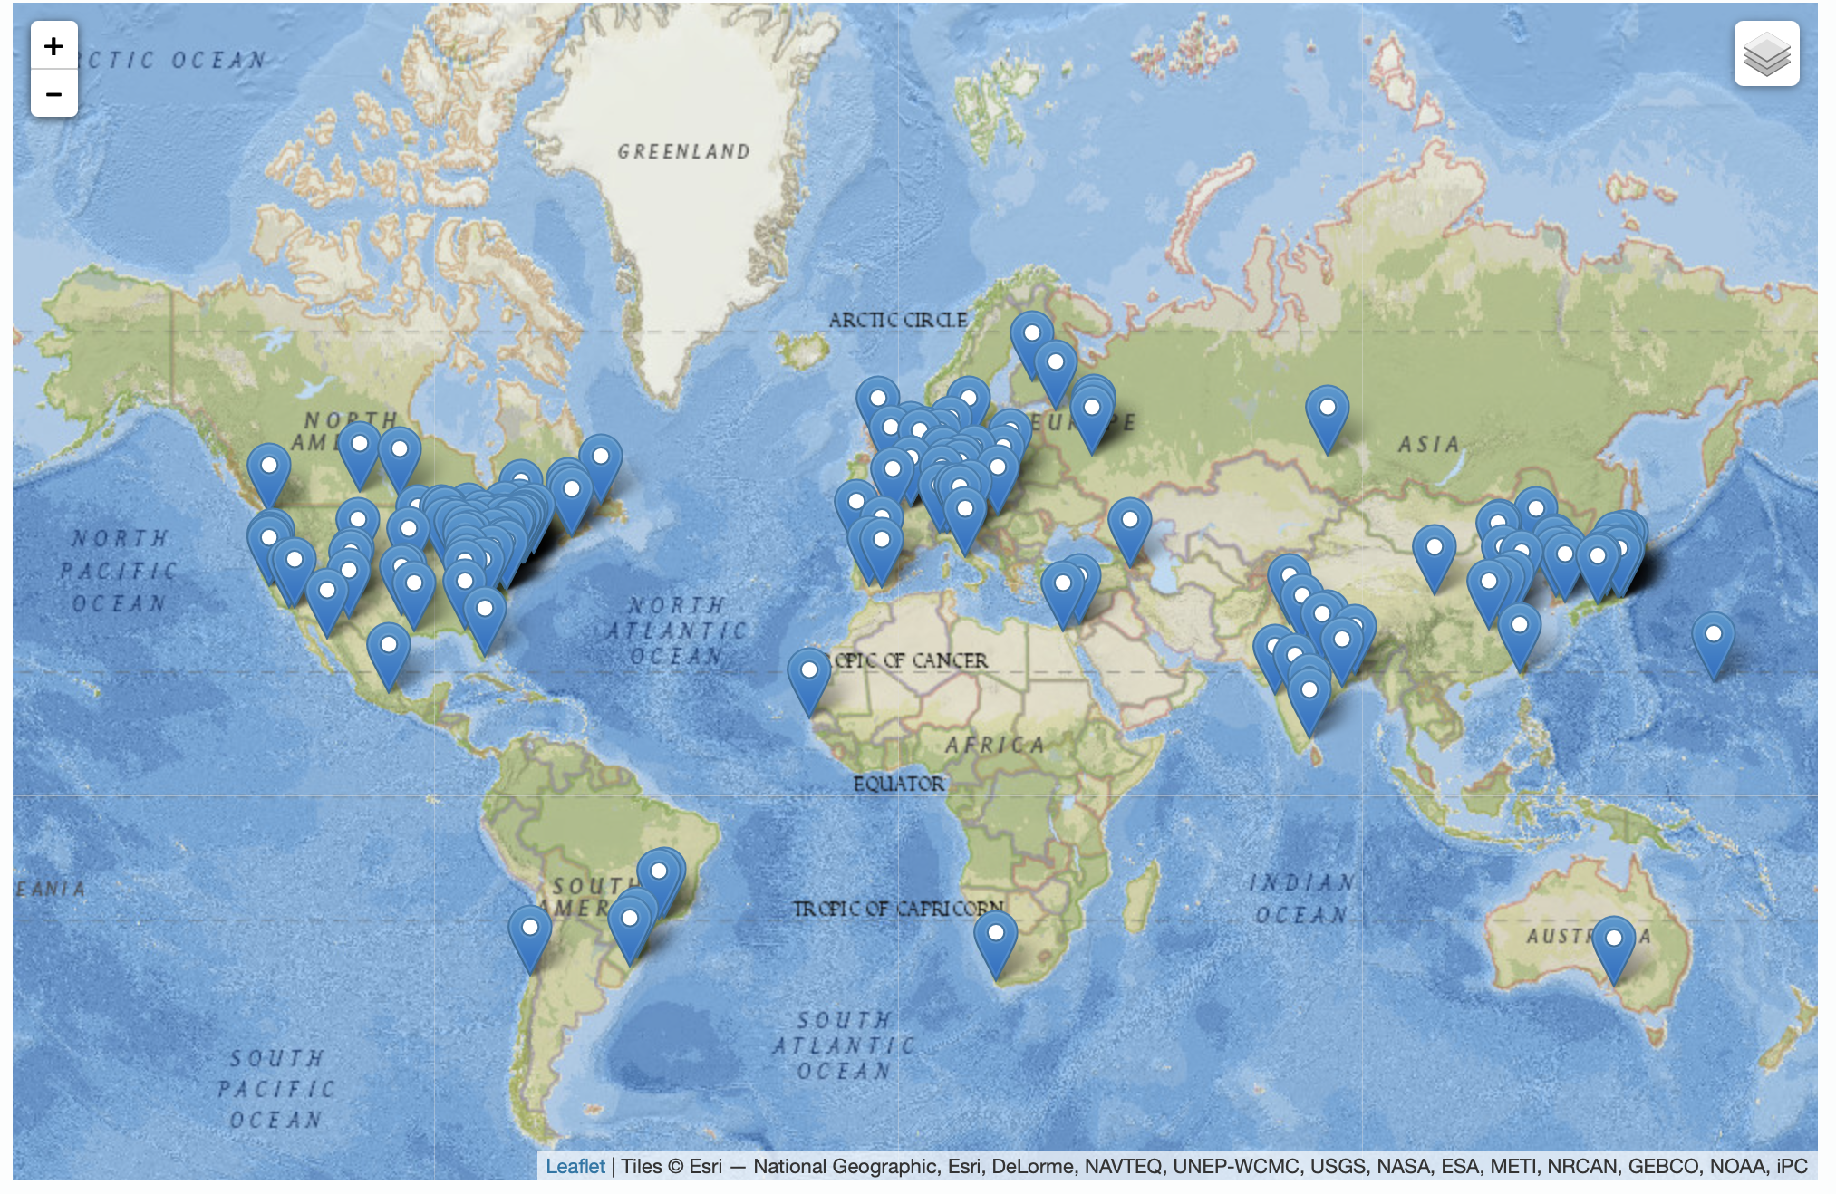
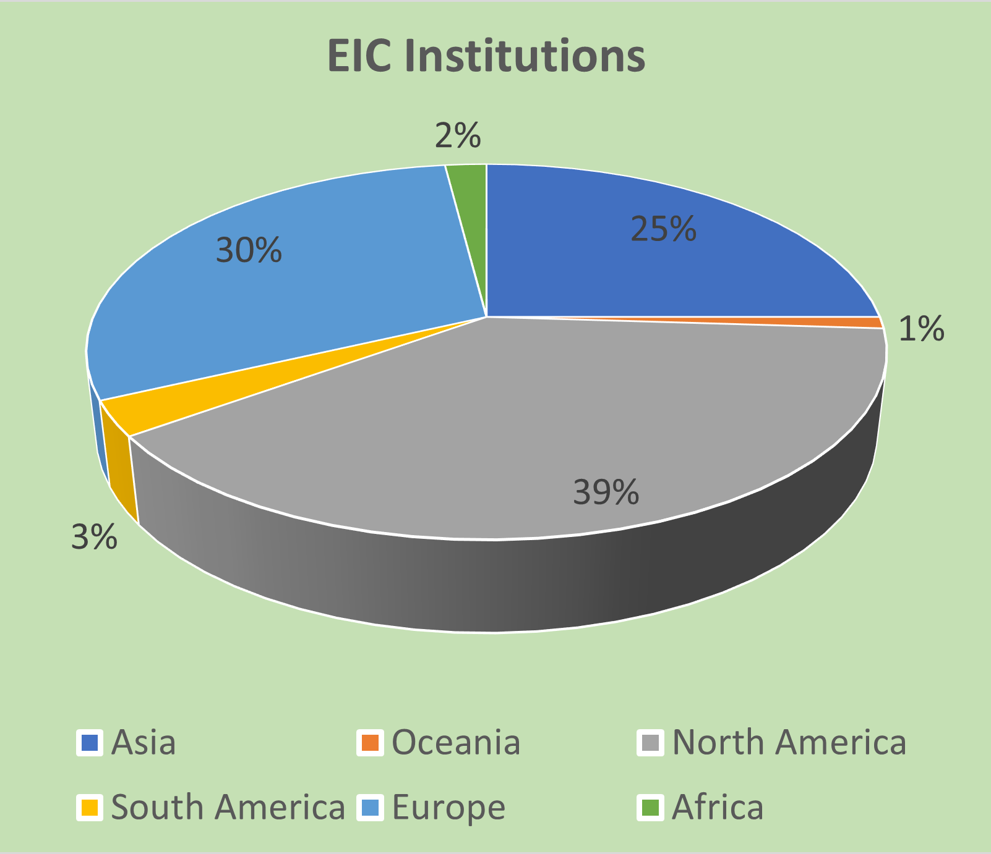
Institutions
The EIC User Group: https://eicug.github.io/
Formed in 2016, Currently:
1369 collaborators,
36 countries,
267 institutions
International Participation Growing
Annual EICUG meeting
2016 UC Berkeley, CA
2016 Argonne, IL
2017 Trieste, Italy
2018 CUA, Washington, DC
2019 Paris, France
2020 Miami, FL
2021 VUU, VA & UCR, CA
2022 Stony Brook U, NY
2023 Warsaw, Poland
13

Slide 14
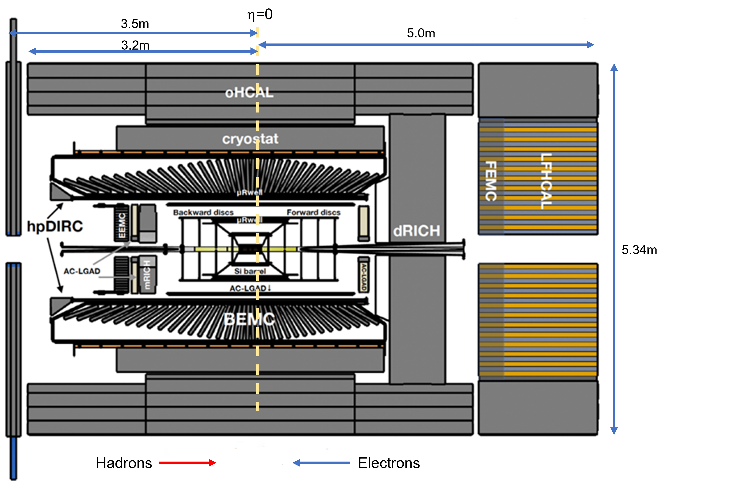
ePIC Detector Current Design
Collaboration Setup
February 2023 : Elections
John Lejoie & Silvia Dalla Torre
Tracking:
  New 1.7T solenoid
  Si MAPS Tracker
  MPGDs (μRWELL/μMegas)
PID:
  hpDIRC
  mRICH/pfRICH
  dRICH
  AC-LGAD (~30ps TOF)
Calorimetry:
  SciGlass/Imaging Barrel EMCal
  PbWO4 EMCal in backward
  direction
  Finely segmented EMCal +HCal
  in forward direction
  Outer HCal (sPHENIX re-use)
From John Lajoie @ Epiphany 2023

Slide 15
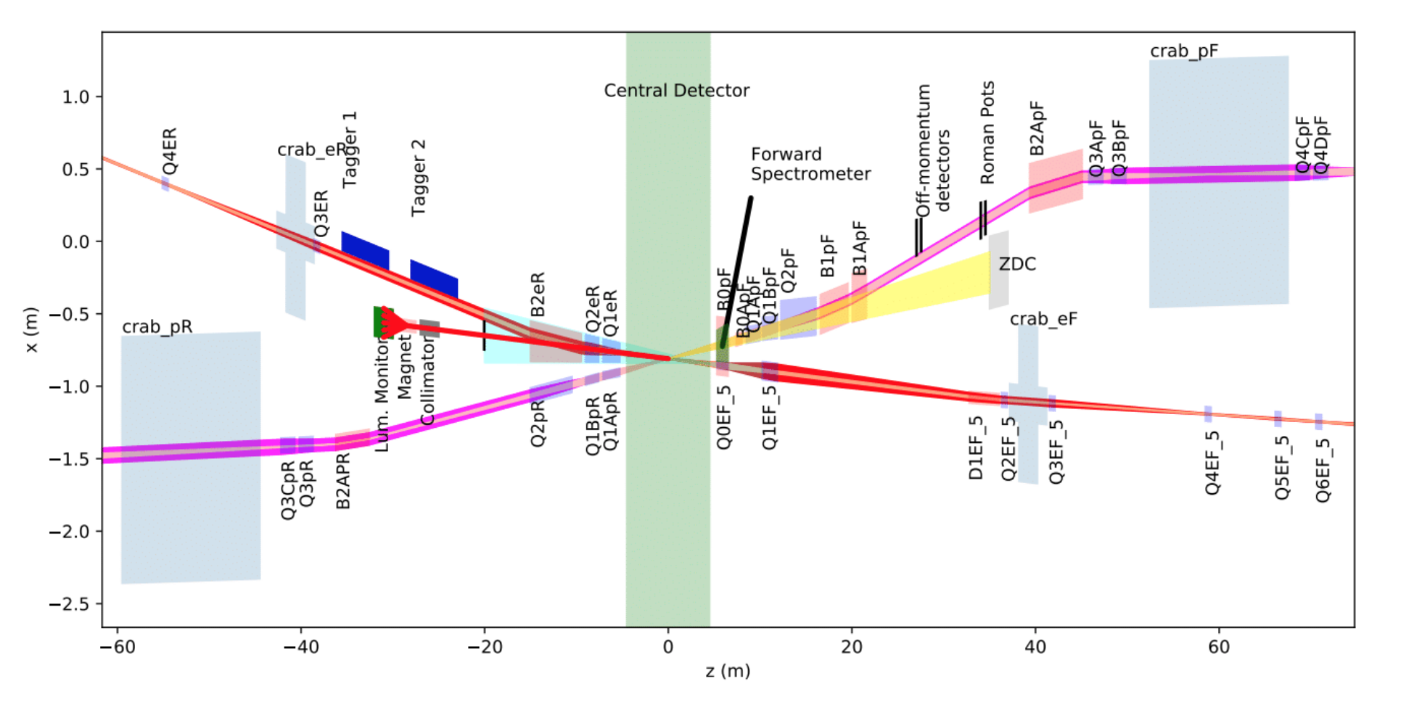
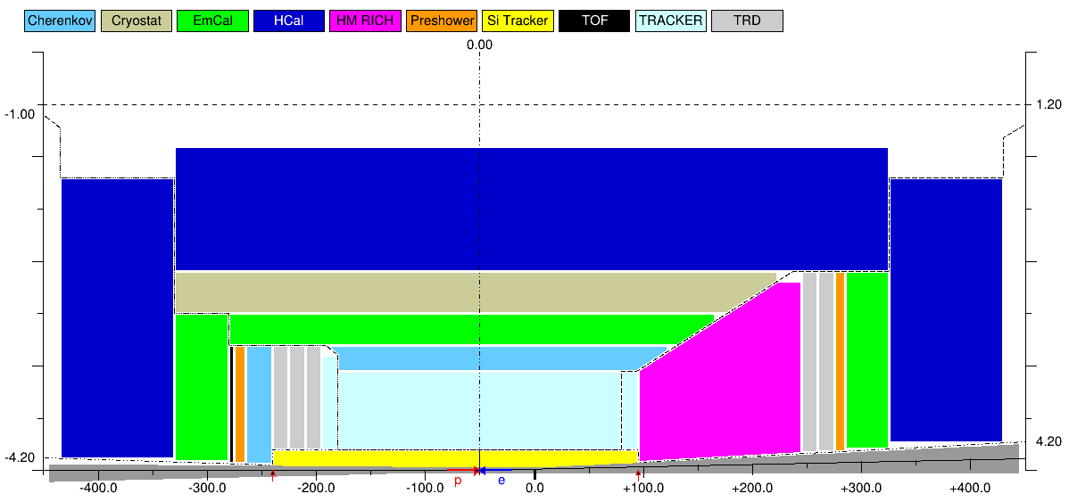
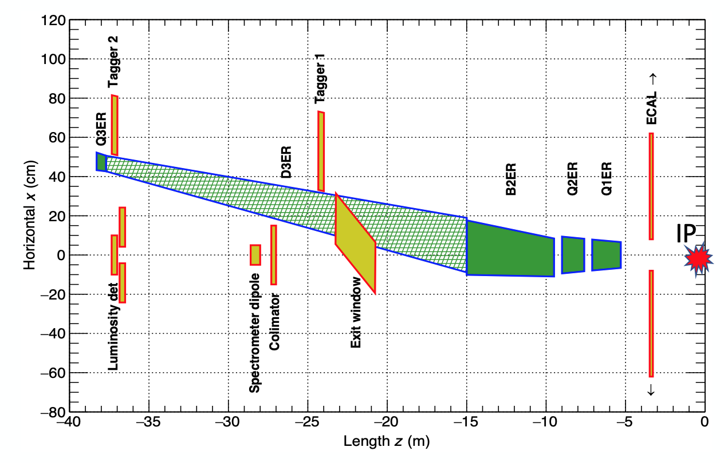
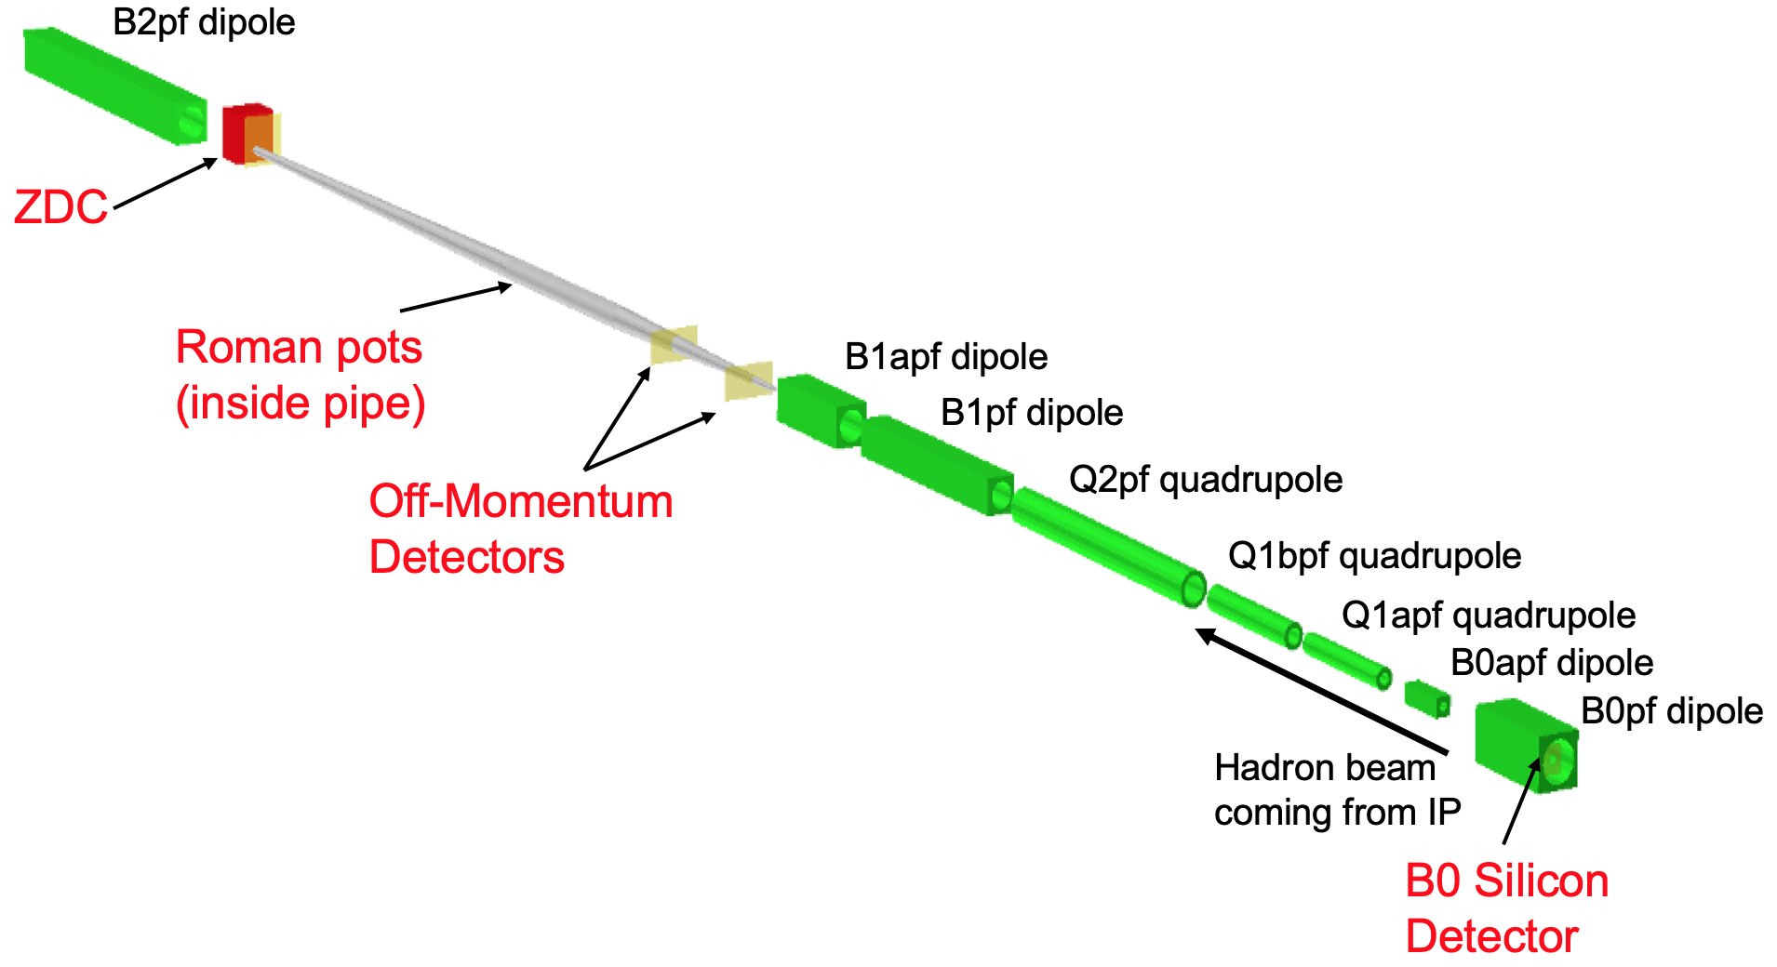
Reference Detector – Backward/Forward Detectors
far-backward detectors
far-forward detectors
Extensive integration of forward and backward detector elements into the accelerator lattice

Slide 16
2nd IR and 2nd Detector
Not in the EIC project
Challenging parameters of EIC require careful attention to the post 2nd IR era.
No design decisions now should negate the possibility of the second IR and detector
Activities starting now: Led by EIC Users Group
Kick off meeting at Temple University May 17-19, 2023
What is a compelling physics case for the 2nd IR?
Balance between new physics and affirming important core physics (Detector 1)
Complementary technologies ⬅➔ generic detector R&D
Need to get consensus amongst the EIC Users ➔ acceptance in US NP community along with a buy-in from non-DOE sources (within and outside of the US)
Proposals for a timeline and realization plans

Slide 17
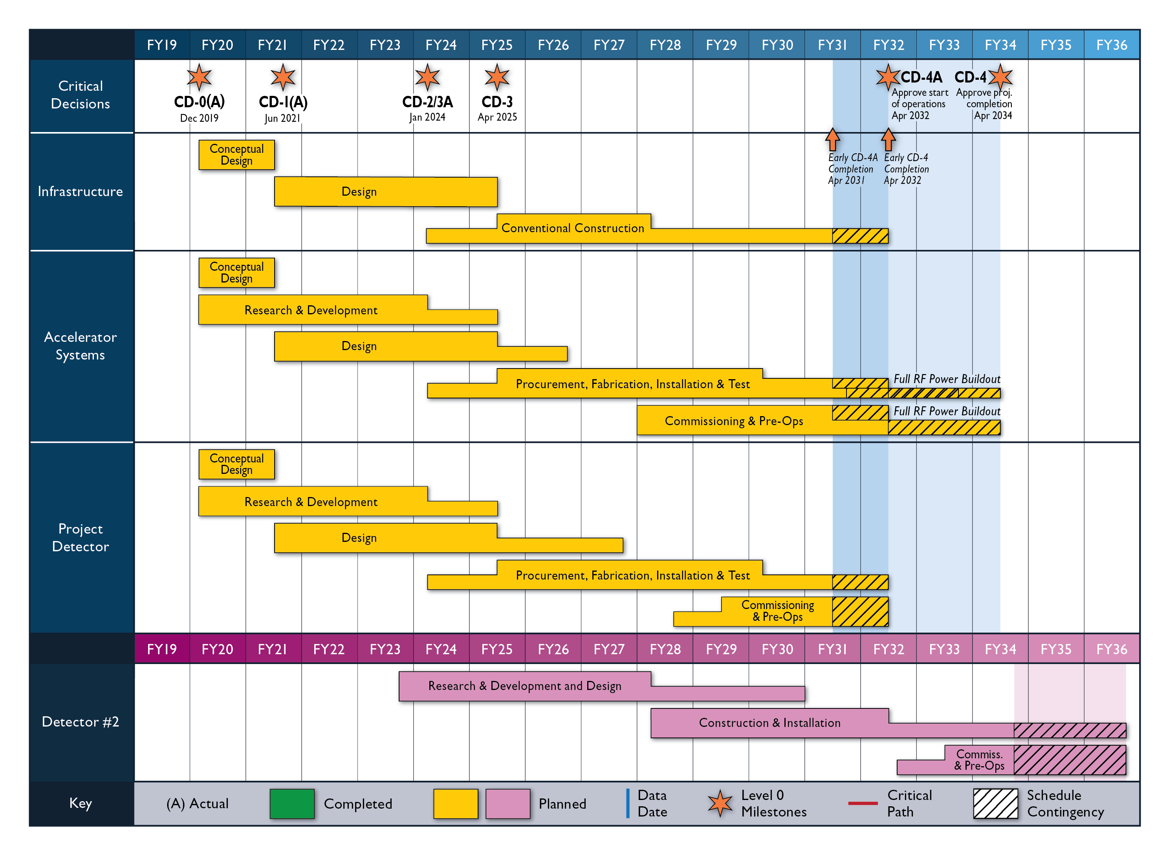
Overall Schedule
CD3A. CD2/3
CD4A early finish, collisions begin for machine tuning
Detector 1 needs to be ready to give feedback.
CD4 Machine delivers for physics
Detector 1 should be fully functional to start physics
2nd Detector and IR
Current assumption realization trailing ~ 5 years behind Detector-1
focus on complementary IR/physics & technologies
Today

Slide 18
It is reasonable to assume that the EIC physics program will run for about 15 years starting 2035, and possibly extended by another ~5-10 years with detector upgrades.
So we are now in year 2050-2055.
You have 25-30 years to prepare for what comes next! Perfect timing….

Slide 19
Some personal thoughts/questions on muons – unorganized but hopefully helpful…..
Muons!
Historically extremely important… heavier sister/brother of electron
  many valuable complementary experiments have been performed in atomic, nuclear and particle physics
  200 times larger mass ➔ significantly less radiation losses while acceleration ➔ hope to achieve much higher initial beam energy.
  On the flip side: it is unstable and has to be accelerated to high energy to be used in a collider experiment
  Challenges here are the same as future Muon Collider! (Synergies)

Slide 20
Some personal thoughts/questions on muons – unorganized but hopefully helpful…..
What is the optimal beam energy one would like to have? ➔ This is governed by the physics you pursue.
Is LHeC center of mass energy a reasonable goal at this time?
Science of LHeC starting from EIC (CM energy) has been given much thought over past decades…
  could be a time saver
  Community interested in this physics already exists
LHeC is just a target, you should be flexible at this early stage including not only considering RHIC as a location of the future facility

Slide 21
Some personal thoughts/questions on muons – unorganized but hopefully helpful…..
Assuming you go in the direction of a LHeC:
  What luminosity is needed? What is enough luminosity?
  What are the schemes of muon production? Is there hope for enough luminosity?
What sort of detector planning would one need? (very different than an EIC detector being considered)

Slide 22
Some personal thoughts/questions on muons – unorganized but hopefully helpful…..
Can one imagine developing the muon beam of high enough energy to overcome at least some of the technical hurdles faced by muon collider enthusiasts? i.e. Can it (μIC) be viewed as an important R&D milestone for HEP (μ+ μ- collider) while still resulting in a significant physics program? ➔ this combination seems very potent to me.
Collaboration between accelerator scientists working on muon collider should look at this critically. Experimental nuclear and particle physicists should decide whether the resulting collisions are reasonable and physics communities (theorists included) from both sides should opine if this program is compelling.

Slide 23
Final thoughts: on timeline…. (are you ahead of the curve?)
EIC was being discussed (as polarized HERA or eRHIC) from 1995/6 in various small workshops until 1999/2000 when a dedicated workshops were held at Yale and RBRC. (Other options at lower energy @IUCF, MIT and GSI/Fair).
Groups came came together from 2000-2001 @ MIT – first eRHIC white paper followed by multiple WS at RBRC/Indiana/MIT and eRHIC got its first mention in the LRP 2002. ➔ [5-7 years since conception]
It went through one more LRP 2007 (strong mention, recommended significant accelerator and detector R&D) before it was recommended in LRP 2015/6 ➔ [20 years since conception].
Going by currently planned timeline expected date of CD3 2025 [30 years sc]
And CD4 – operations will start in ~2033 ➔ [~ 40 years since conception or ~30 years since first mention in the LRP]

Slide 24
The timeline is not to discourage you but infact challenge you. If the science is good, it needs to be done, and will get done.
My advice is to put your head down and develop a strong:
Physics case and a collaboration
Connection with HEP accelerator scientists to develop a ~300-500 GeV muon beam – see if it is useful towards their ultimate goal
Accelerator R&D towards a TeV muon beam coupled with a strong physics motivation could be be a win-win for everyone

Slide 26
DOE Project Phases
EIC
*
Operating* Funds
Project Engineering and Design (PED) Funds
Construction & PED
Funds
Operating Funds
Initiation
Definition
Execution
Closeout
Conceptual Design
Preliminary Design
Final Design
Construction
Critical
Decisions
CD-0
Approve Mission Need
CD-1
Approve Alternative Selection
and Cost
Range
CD-2
Approve Performance Baseline (PB)
CD-3
Approve Start of Construction or Execution
CD-4
Approve
Start of Operations or Project Completion
Formal Process of DOE Gateway Reviews
CD-0, Mission Need ✓
CD-1, Alternative Selection and Cost Range ✓
Partner and collaboration engagement needed to establish the baseline
CD-2, Performance Baseline
CD-3a, Long Lead Procurement

Slide 27

Complementarity for 1st-IR & 2nd-IR
1st IR (IP-6)
2nd IR (IP-8)
Geometry:
ring inside to outside
ring outside to inside
tunnel and assembly hall
are larger
Tunnel: ⦰ 7m +/- 140m
tunnel and assembly hall are smaller
Tunnel: ⦰ 6.3m to 60m then 5.3m
Crossing Angle:
25 mrad
35 mrad
secondary focus
different blind spots
different forward detectors and acceptances
different acceptance of central detector
Luminosity:
optimize Doublet focusing FDD vs. FDF
→ impact of far forward p_{T} acceptance
Experiment:
1.7-2.0 Tesla or 3(?) Tesla
different subdetector technologies
ECA and RE

Slide 28
Physics @ the US EIC beyond the EIC’s core science
Of HEP/LHC-HI interest to Snowmass 2021 (EF 05, 06, and 07 and possibly also EF 04)
Perhaps other intersections with LQCD?
New Studies with proton or neutron target:
Impact of precision measurements of unpolarized PDFs at high x/Q², on LHC-Upgrade results(?)
Precision calculation of α_{S} : higher order pQCD calculations, twist 3
Heavy quark and quarkonia (c, b quarks) studies with 100-1000 times lumi of HERA and with polarization
Polarized light nuclei in the EIC
Physics with nucleons and nuclear targets:
Quark Exotica: 4,5,6 quark systems…? Much interest after recent LHCb led results.
Physic of and with jets with EIC as a precision QCD machine:
  Jets as probe of nuclear matter & Internal structure of jets : novel new observables, energy variability
  Entanglement, entropy, connections to fragmentation, hadronization and confinement
Precision electroweak and BSM physics:
Electroweak physics & searches beyond the SM: Parity, charge symmetry, lepton flavor violation
LHC-EIC Synergies & complementarity
Study of universality: e-p/A vs. p-A, d-A, A-A at RHIC and LHC

Slide 29
EIC’s versatility, resolving power and intensity (luminosity) open new windows of opportunity to address some of the crucial and fundamental scientific questions in particle physics. The paper summarizes the EIC physics from the perspective of the HEP community participating in Snowmass 2021
Beyond the Standard Model Physics at the EIC
Tomography (1,3,5 d PDFs) of Hadrons and Nuclei at the EIC
Jets at EIC
Heavy Flavors at EIC
Small-x Physics at the EIC
High luminosity wide CM range
Polarized e, p, and ion beams
All nuclei

Slide 30
Towards high luminosity: optimizing a multidimensional parameter space
Luminosity will always benefit from large beam currents ➔ maximize beam currents
EIC luminosity benefits from reducing hadron emittance by “cooling” to maximize luminosity as normalized emittance from source is too large
Minimizing number of bunches (1060, still a large number) will
  Reduce demand on beam cooling (since cooling is hard)
  Is detector friendly because bunch spacing is relatively large (12 ns)
  Results in smaller beam divergence at IP ➔ helps with p_{T} acceptance

