Slide 1
Proton-Driven Muon Source
J. Scott Berg
Brookhaven National Laboratory
Workshop: muons from backscattered photons at the EIC
April 5, 2023

Slide 2
Parameters: Muon Collider vs. EIC
Short muon lifetime affects how you produce luminosity
Difficult to make high muon flux
Need more charge per bunch, smaller collision size
Acceptable since less worry about long term beam growth
 | EIC ESR | µ Collider (3 TeV)
Luminosity (10³³) | 10 | 18
Particles/bunch (10¹⁰) | 17 | 220
Bunches | 1160 | 1
Bunch Collision Frequency (kHz) | 100000 | 5
Collision beam size (µm) | 95 (h)/9 (v) | 3

Slide 3
Muon Collider Facility Overview
Front end: capture muons, convert to bunch train
Cooling: reduce emittance, combine into one bunch
Acceleration: increase energy
Collider ring

Slide 4
Some Definitions
Emittance: characterizes beam size via area in phase space. Invariant under conservative forces.
  Transverse: area in position and transverse momentum (angular divergence): muon collider goal is 25 µm (normalized)
  Longitudinal: area in energy and arrival time
Acceptance: maximum emittance transmitted down a beamline
Cooling: use non-conservative processes to reduce emittance

Slide 5
Target and Initial Capture
Proton beam hits target, producing
pions (both charges, around 200 MeV)
which eventually decay to muons
Pions produced with a large angular
and energy spread but a relatively
small spot size
Target is in a high field solenoid
(15–20 T), which tapers down to a
lower field to capture a large angular
divergence

Slide 6
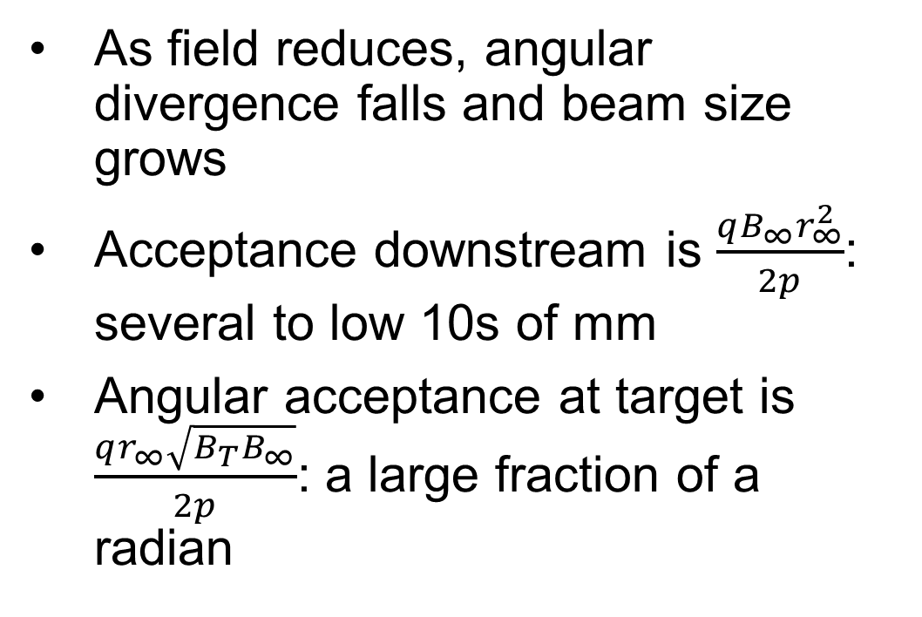
Target and Initial Capture
As field reduces, angular divergence falls and beam size grows
Acceptance downstream is $\frac{qB_{∞}r_{∞}^{2}}{2p}$: several to low 10s of mm
Angular acceptance at target is $\frac{qr_{∞}\sqrt{B_{T}B_{∞}}}{2p}$: a large fraction of a radian

Slide 7
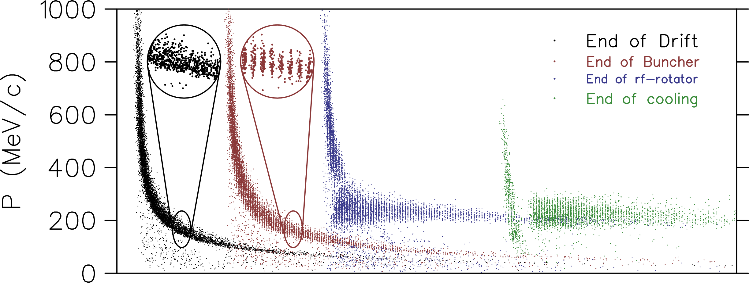
Capture of Bunch Train
Beam develops a time-energy correlation as it travels down the beamline
RF cavities form bunches
Adjust RF
frequencies to give
bunches similar
energies
Works for both
muon signs

Slide 8
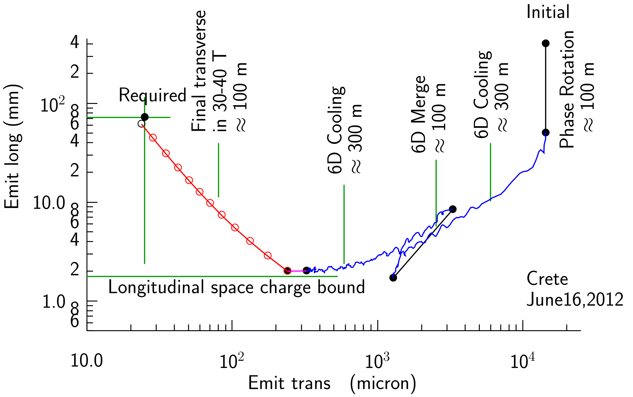
Cooling Overview
Capture and initial cooling: train of ~21 bunches
6-D rectilinear cooling
  Prepare for bunch merge
Combine 21 bunches into 1
6-D rectilinear cooling
Final cooling

Slide 9
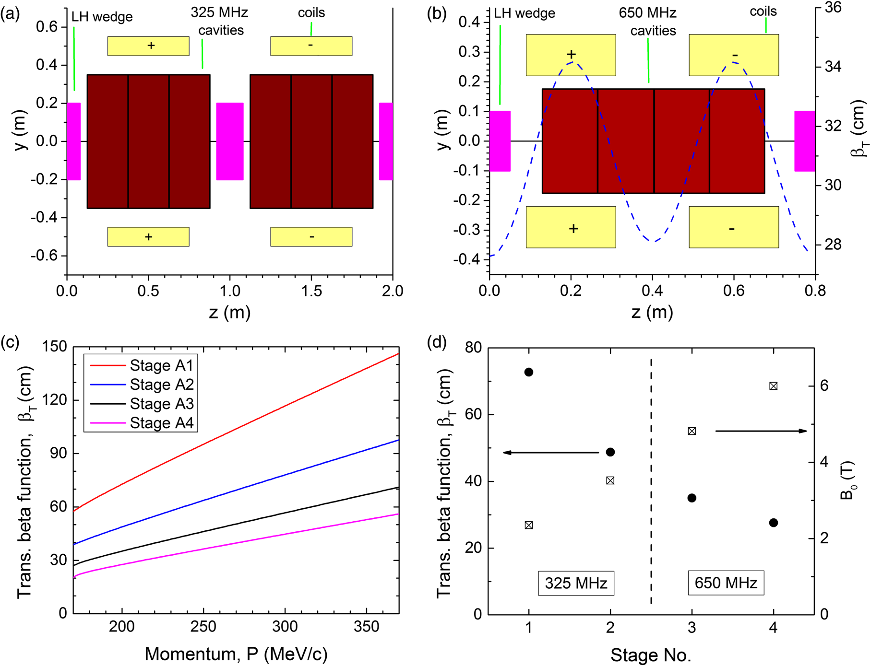
6-D Cooling of Bunch Train
Cool beam enough to merge into one bunch
  Merge in longitudinal and transverse, so cool both
Absorbers alternating with RF cavities, surrounded by focusing solenoids
Solenoid field varies longitudinally: lower beta function than uniform solenoid

Slide 10
6-D Cooling of Bunch Train
As emittances reduce,
progressively modify cells
Reduce beta function
  Keep angular spread constant
  Higher magnetic fields
  Shorter cells
Increase RF frequency
  Keep energy spread high
Adiabatic

Slide 11
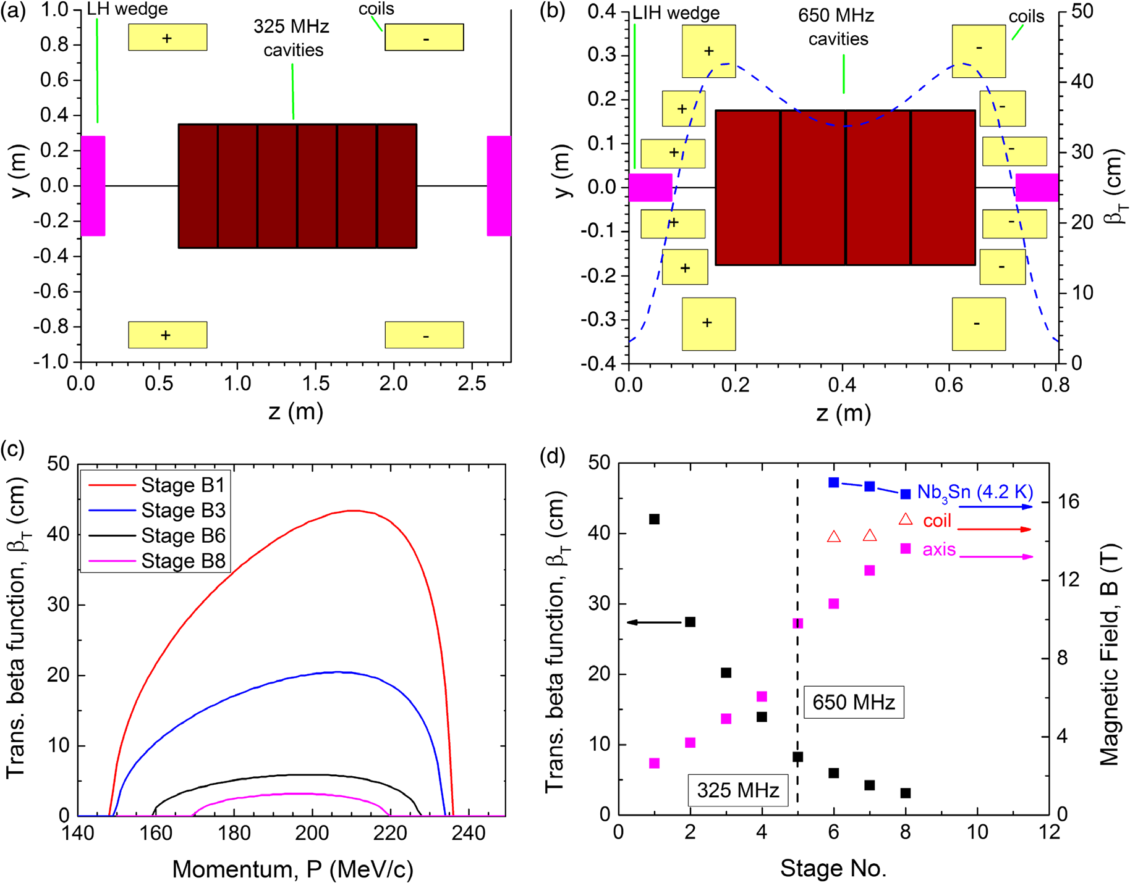
6-D Cooling of Merged Bunch
Get lowest transverse emittance possible
Lower beta functions than pre-merge
  Higher magnetic fields
  Stronger longitudinal variation of fields
  Reduced energy acceptance
Progressive changes in beta, field, length like before

Slide 12
6-D Cooling of Merged Bunch
Late stages very challenging
  High fields
  Proximity of magnets to each other and to RF cavities
Reaches a performance limit
  Achievable magnetic field
  Energy acceptance (energy straggling)
  Transverse acceptance falling faster than emittance
  Intensity-dependent effects

Slide 13
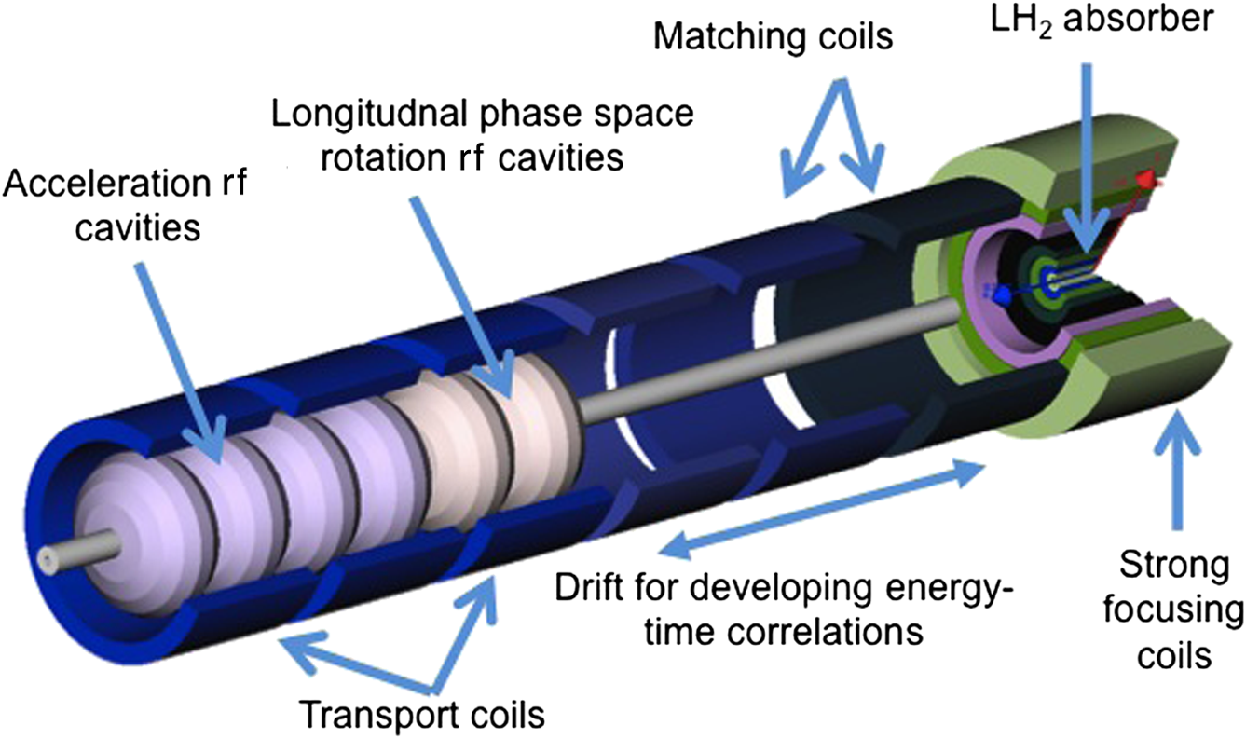
Final Cooling
Switch to cooling in a uniform, very high field solenoid
Non-adiabatic: significant amount of cooling before reacceleration
  Difficult beam dynamics
Allow energy to drop, solenoid effectively stronger
  Longitudinal emittance growth from slope of
  Bethe-Bloch curve
Forced to lower RF frequencies
Simulated performance currently worse
than we would like

Slide 14
Comments on Cooling
Cooling system is large and expensive
Will only likely be built at a muon collider facility (HEP)
If you want a bunch train, you could use the beam before the merge
  Significantly more transverse cooling required
  Low frequencies in final cooling are a problem. Options:
    Long beamline to stretch bunch spacing
    Use a different method for final cooling (nothing else known to work)

Slide 15
Avoiding Cooling
Can muons be produced with a small initial emittance?
Muon pair production from electron-positron at threshold
  Positrons on fixed target (LEMMA)
  Asymmetric collisions (B-factory)
Stopped muons
Problem is always getting sufficient muon flux for decent luminosity
  High repetition rates hurt, low emittances help luminosity
Major advantages in a low current muon beam: neutrino radiation for a very high energy muon collider

Slide 16
Summary
High luminosity achieved at a muon collider by
  Having a high charge per bunch, a low repetition rate, and combining bunches from a train
  Reducing emittance by ionization cooling
We know how to perform ionization cooling
  Ionization cooling for a muon collider is a large and expensive system
  Significant engineering is required to get from existing designs to operating systems. Could impact performance.
Methods for muon production with low emittance have thus far not been able to achieve good luminosity, but don’t stop looking...

