Slide 1
Critical Detector analysis needed by the project
E.C. Aschenauer (BNL)

Slide 2
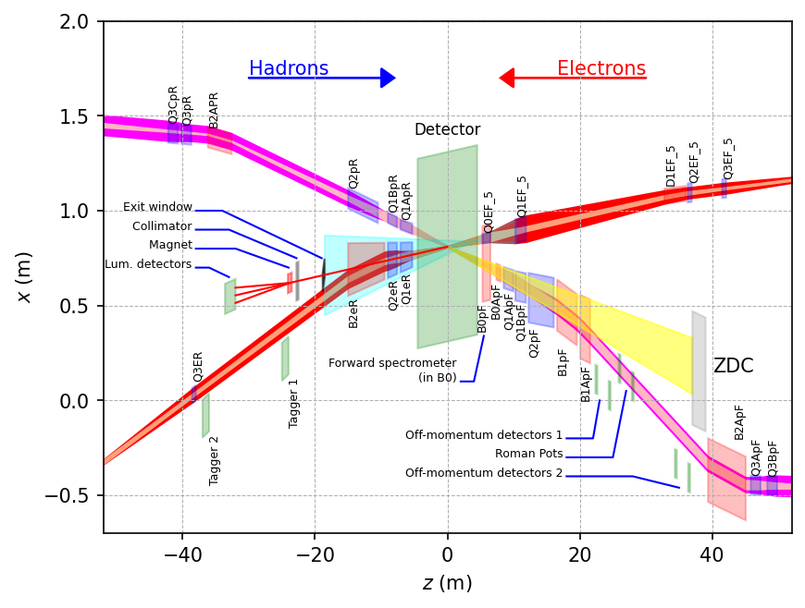
Scope Experimental Equipment
hadronic calorimeters
Solenoidal Magnet
e/m calorimeters
ToF, DIRC,
RICH detectors
MPG trackers
MAPS tracker
25 Subdetectors
incl. Polarimeters
provides coordination that
2nd detector remains possible

Slide 3
B0 detector equipment
B0 has a tracker (proton detection) and some people want a PbWO4 calorimeter instead of a preshower for photon detection
Calo not easy to integrate → needs to sit behind tracker
Simulation tasks to determine Calo is needed and what its requirements are
Can the Pi0 reconstruction be done with just the opening angle information gleaned from conversion lepton pairs in the preshower/shower-max style detector?
If not, what is the resolution and granularity required to achieve this with a calorimeter? How many radiation lengths do you need?
Is there any other channel where this calorimeter is *required* to do NAS EIC physics? Incoherent vetoing can be done with the preshower concept (https://arxiv.org/abs/2108.01694), so this is not a major consideration for the B0EMCAL.
Will backgrounds play a significant role in the ability for the calorimeter vs. preshower to do their jobs? Will one obviously work better than the other?

Slide 4
Calorimeters
Forward ECal and HCal and backward HCal
To what outer radius do we need to instrument the calorimeters,
there is a lot of material infront of the calorimeters, i.e dRICH photon matrix and support
→ how is the performance impacted, especially forward ECal
→ can we give up the longitudinal segmentation for the forward HCal
→ potential impact on cost decreases
Backward HCal
Science requirements are still not clearly established → has impact on segmentation in x,y,z
not discussing the need for help for the barrel ecal solutions

Slide 5
Backgrounds
Have formed a background group to continue provide feedback to the collider and the experiment on beam backgrounds
Contribution members welcome
Need to study:
total electromagnetic, hadronic, especially neutron radiation load
rates due to background
………….

