Slide 1

25th Annual
Accelerator Test Facility (ATF) Users' Meeting
Progress on Laser Upgrades
Marcus Babzien, Igor Pogorelsky, Misha Polyanskiy, William Li
Accelerator Facilities Division
2023-02-28

Slide 2
Outline
LWIR status and present capabilities
CO₂ system upgrades
Ti:Sapphire system performance
NIR upgrades
Vacuum laser transport overview
Laser scientific productivity
Accelerator Facilities Division

Slide 3
Accelerator Facilities Division
3

Slide 4
L-WIR Highlights 2022—23
Getting ready to deliver 5 TW to IP in 2023
  Vacuum compressor and photon delivery
  Polarization rotator
Reliability improvements
  Implemented shot counter
  Increased # of shots between spark-gap replacement
  by enforcing 1 min delay between shots
Clear roadmap from 2ps/5TW to 0.5ps/15TW and 100fs/25TW
Accelerator Facilities Division

Slide 5
The L-WIR
Chirped-pulse amplification
Solid-state seed
High-pressure, mixed-isotope CO₂ amplifiers
Accelerator Facilities Division

Slide 6
L-WIR Spec Sheet v.2023
--------------------------------------------------------------------------
High-power regime High-repetition regime
(two amplifiers) (pre-amplifier only)
--------------------------------------------------------------------------
Central wavelength 9.22 μm 9.22 μm
Peak power 5 TW 1 GW
Pulse energy 12 J 2.5 mJ
Pulse duration 2 ps (FWHM) 2 ps (FWHM)
Repetition rate 1 shot/min 1.5 or 3 Hz (e-beam rep-rate)
--------------------------------------------------------------------------
Accelerator Facilities Division

Slide 7
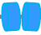
Present Status 5 TW
1st Upgrade 7 TW
7 mJ pump
800 nm
2 μJ
140 ps
10 mJ
70 ps
20 J
70 ps
5 TW
2 ps
7 TW
500 fs
OPA
Stretcher
CO₂
CO₂
Compressor
Post-compressor
High-pressure, mixed-isotope gas amplifiers
Active R&D
2nd Upgrade 15 TW
3rd Upgrade 25 TW
~200 mJ pump
800 nm [2 um]
10 mJ
100 ps
14 J
100 ps
15 TW
500 fs
25 TW
100 fs
LWIR converter
Stretcher
CO₂
Compressor
NLPC
Active R&D
High-pressure,
mixed-isotope gas amplifier
Accelerator Facilities Division

Slide 8
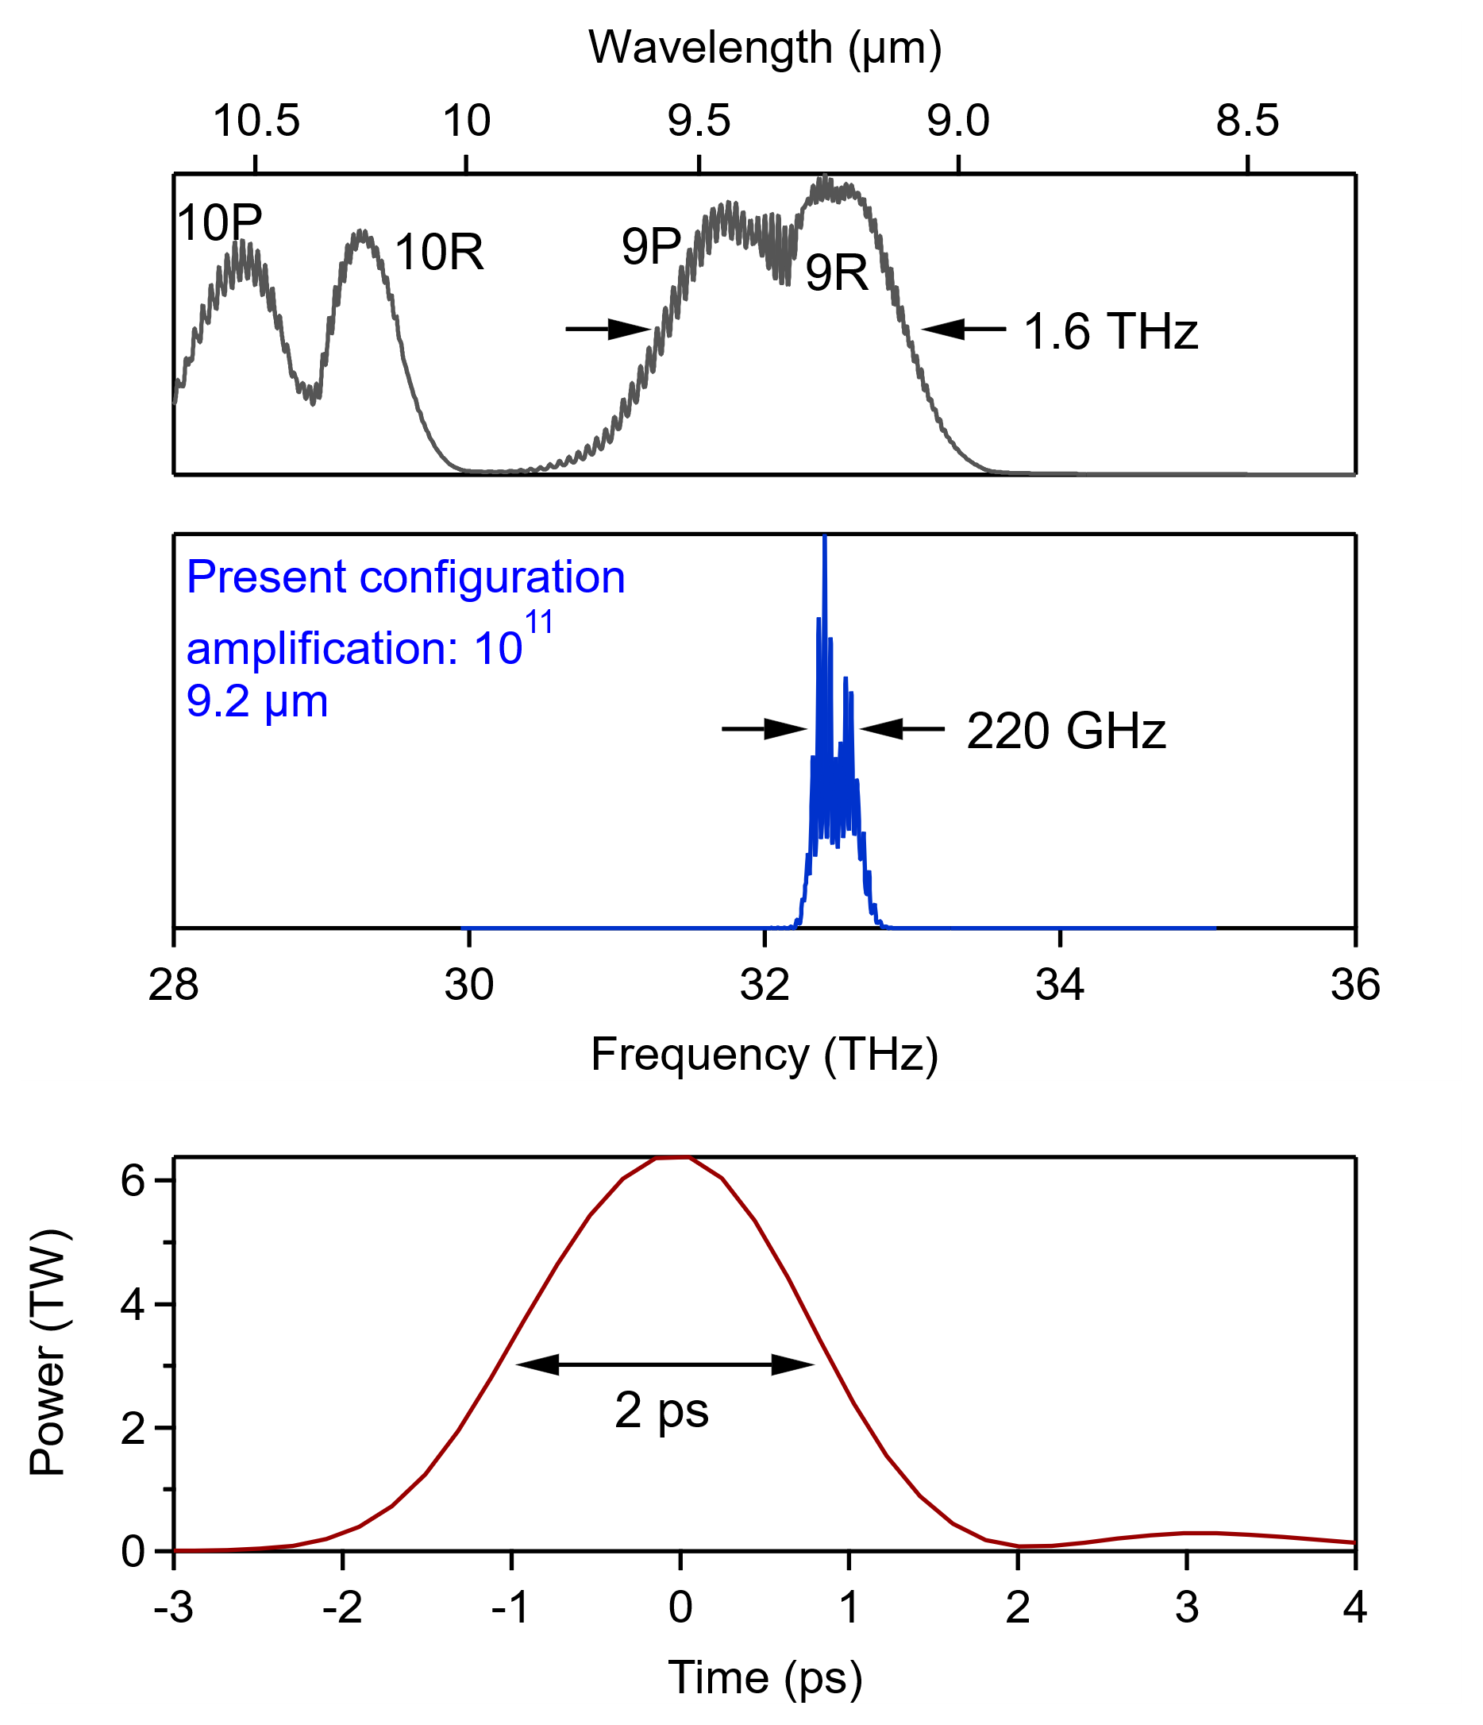
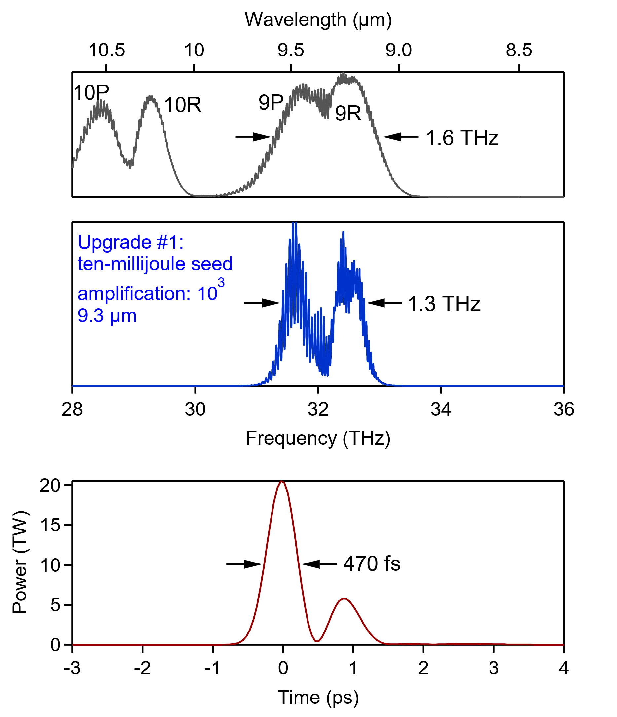
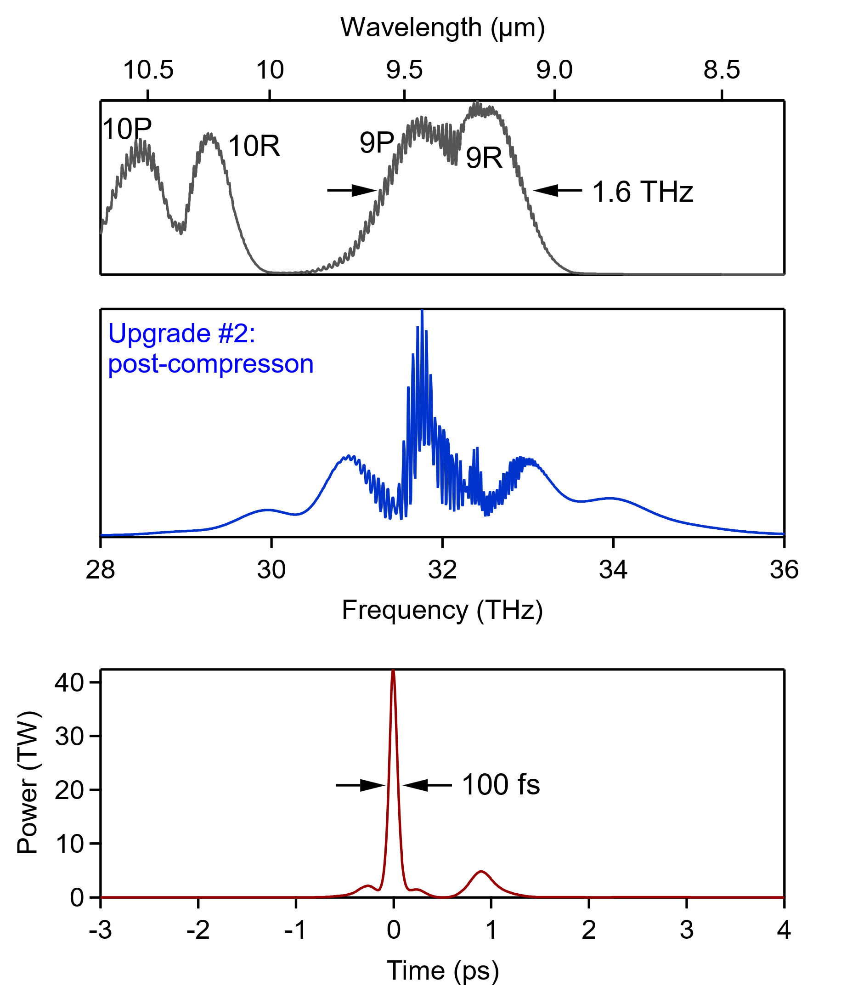
L-WIR Upgrade Roadmap
Polyanskiy et al., AAC ‘22
Gain
Gain
2023: 5 TW
*isotopes, CPA, µJ seed*
*vacuum beam delivery*
Upgrade #2: 15 TW
*10 mJ seed*
Upgrade #3: 25 TW
*post-compression*
Accelerator Facilities Division

Slide 9
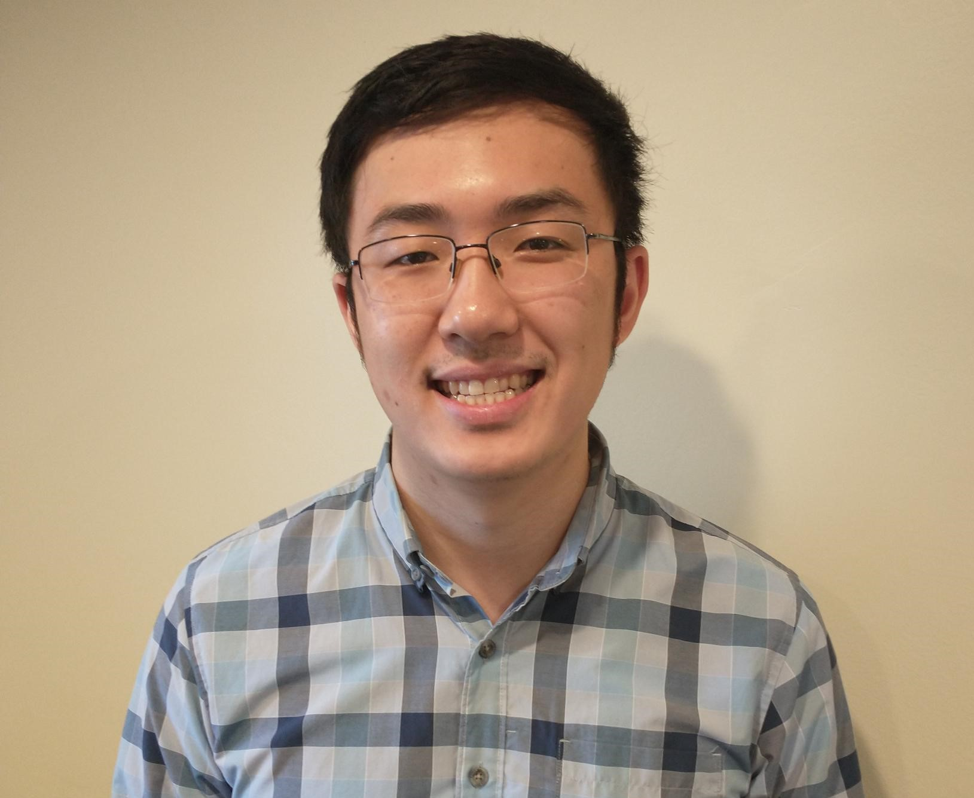
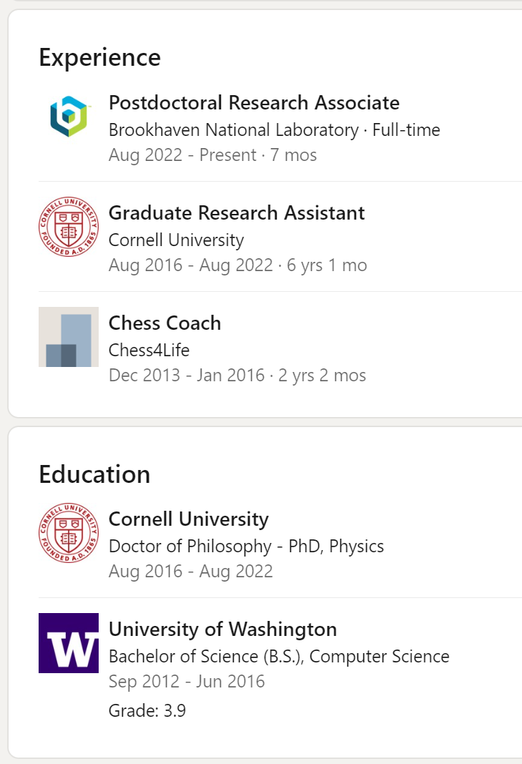
Welcome to ATF Laser Team! --- William Li
Accelerator Facilities Division

Slide 10
NIR Performance Transitioning Phase I → II
Parameter | Units | Stage I Values | Current Values | Stage II Values
Central Wavelength | nm | 800 | 811 | 800
FWHM Bandwidth | nm | 20 | 20 | 13
Compressed FWHM Pulsewidth | fs | <55 | <70 | <75
Chirped FWHM Pulsewidth | ps | >50 | >50 | >50
Chirped Energy | mJ | >30 | 50 | 200
Compressed Energy | mJ | >14 | 32 | 100
Energy to Experiments | mJ | >10 | >30 | >80
Power to Experiments | GW | >250 | >400 | >1067
Accelerator Facilities Division

Slide 11
Ongoing NIR Work
Diagnose and eliminate ~15% amplitude pre-pulse in Ti:Sapphire discovered during last run period
Enlarge front end vacuum aperture to enable delivery of full Phase II Ti:Sapphire energy to experiments (100 mJ) – (Spring 2023)
Integrate previously utilized optical trombone and Nd:YAG amplifier with vacuum transport to re-establish delivery of 1064 nm to BL1 for Compton scattering experiments
Continue to automate system startup/shutdown as experience is gained to enable autonomous user operation
Accelerator Facilities Division

Slide 12
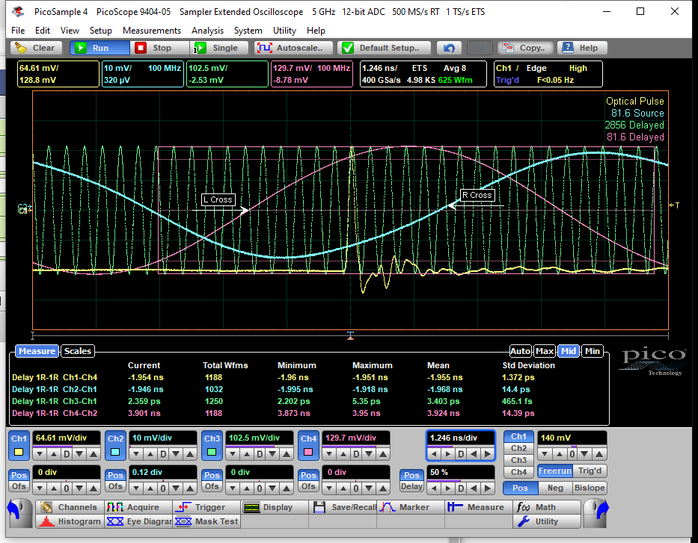
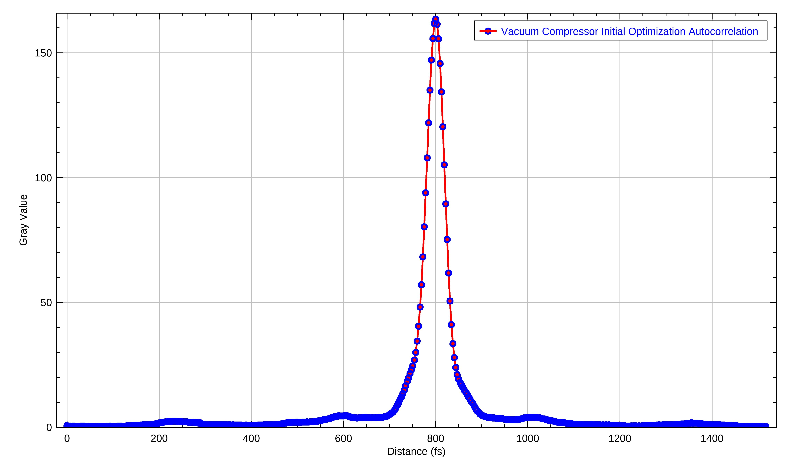
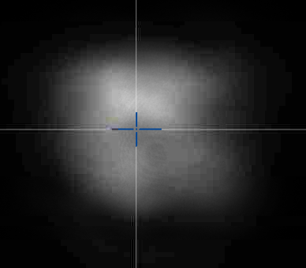
Future NIR Upgrades
Improve Ti:Sapphire diagnostics to more efficiently use run time
  Make existing instruments accessible to users online/realtime,e.g. synchronization monitoring oscilloscope
  Add diagnostics for more complete characterization and possible normalization of shot-to-shot variations in spot size, position, energy, pulsewidth, and timing
  Investigate reduction of beam profile distortion from amplifier non-uniform pumping to improve M²/Strehl ratio
  Finish optical delay line for user control of CO2 synchronization when RF engineer becomes available
Accelerator Facilities Division

Slide 13
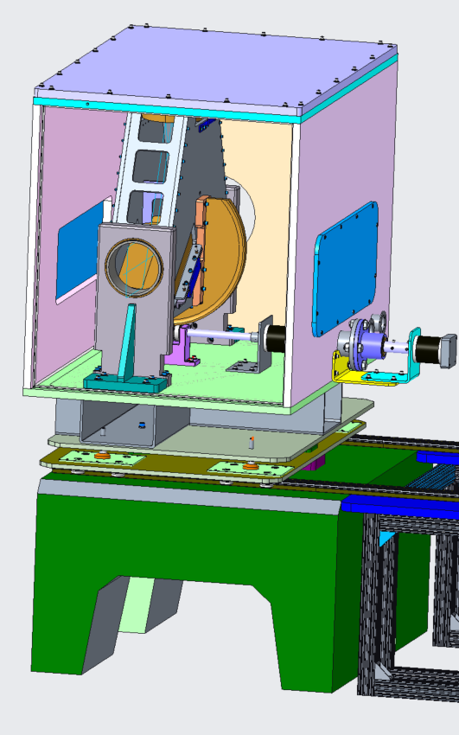
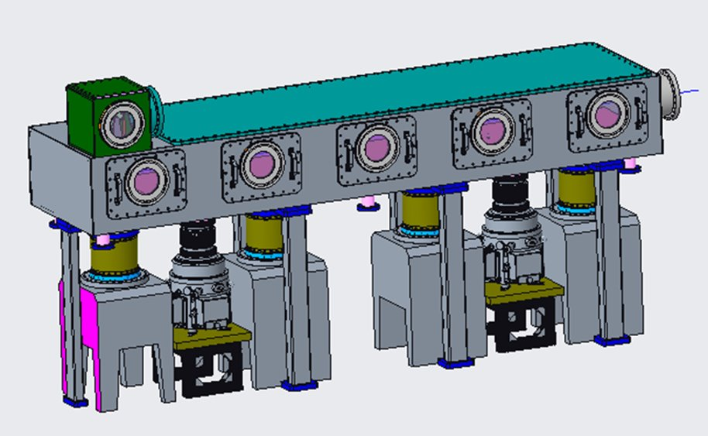
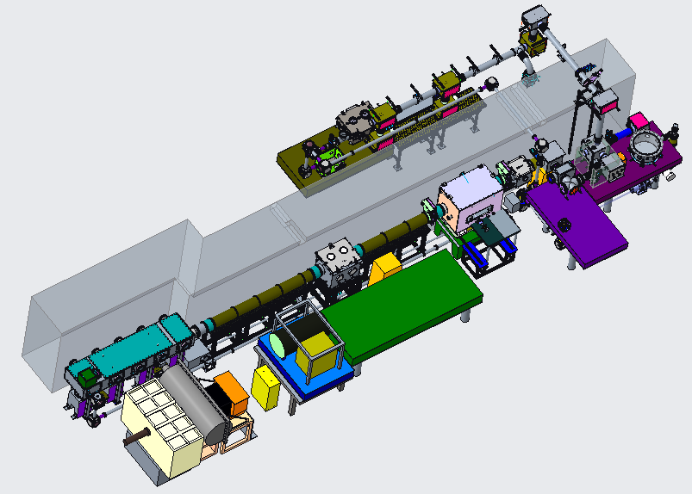
LWIR Vacuum Transport
Standard requirement: B < 1
 | Air (12 m) | NaCl (40 mm) | Air + NaCl
n2 | 3.0e-19 cm²/W | 3.0e-16 cm²/W
B-integral @ 5 TW | 1.0 | 3.3 | 4.3
Accelerator Facilities Division

Slide 14
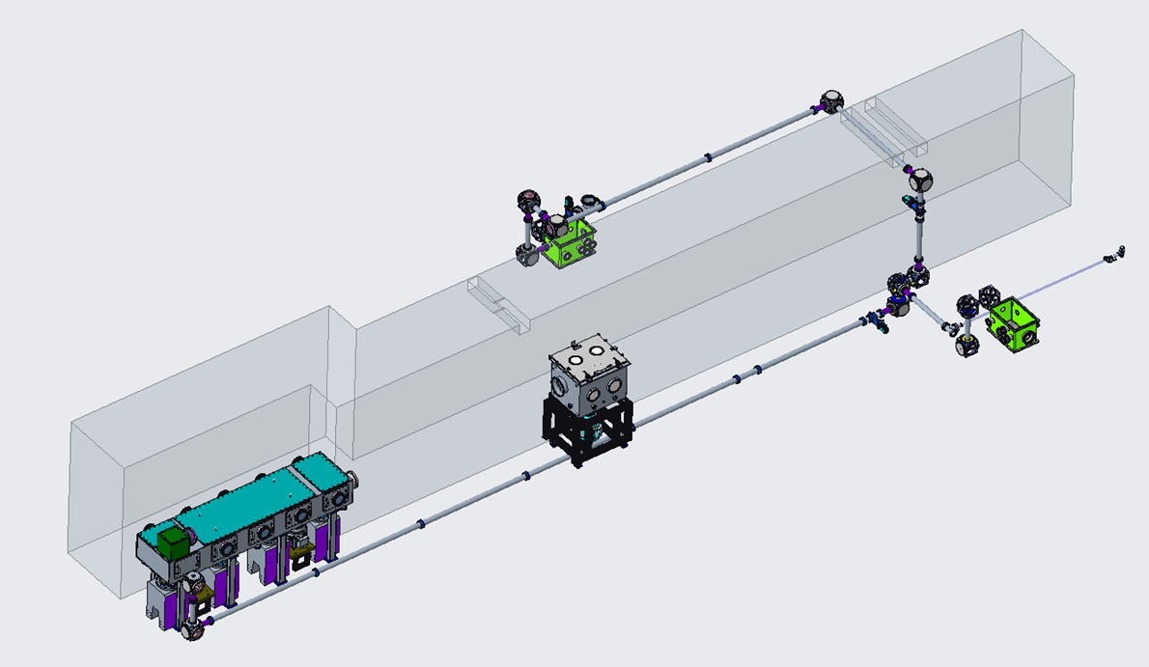
NIR vacuum transport
Accelerator Facilities Division

Slide 15
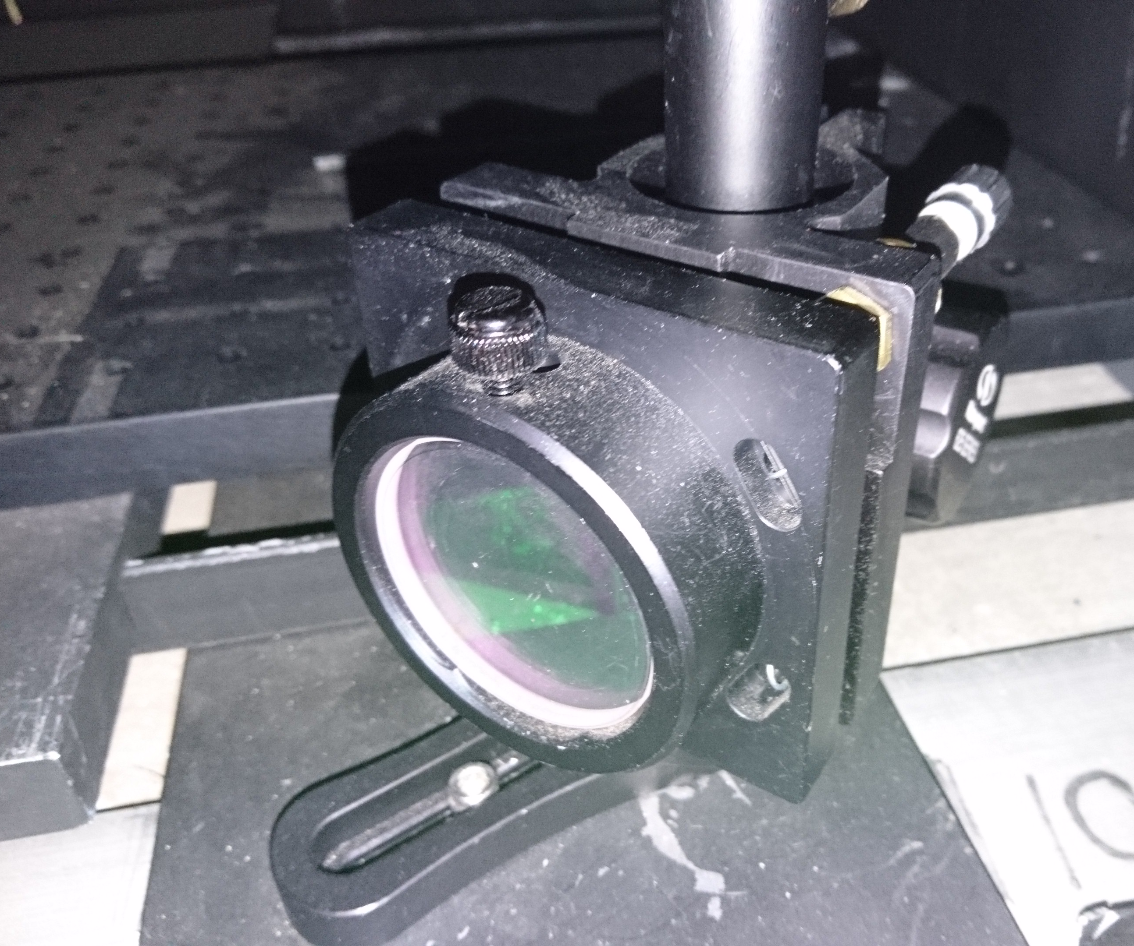
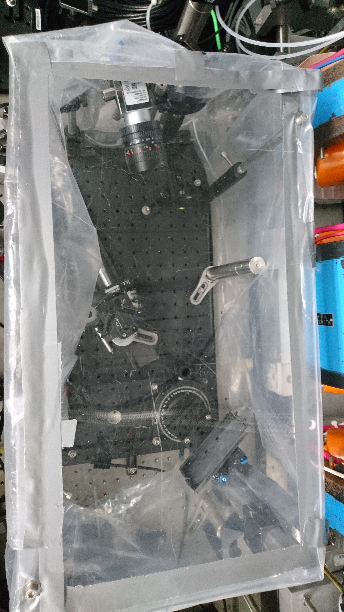
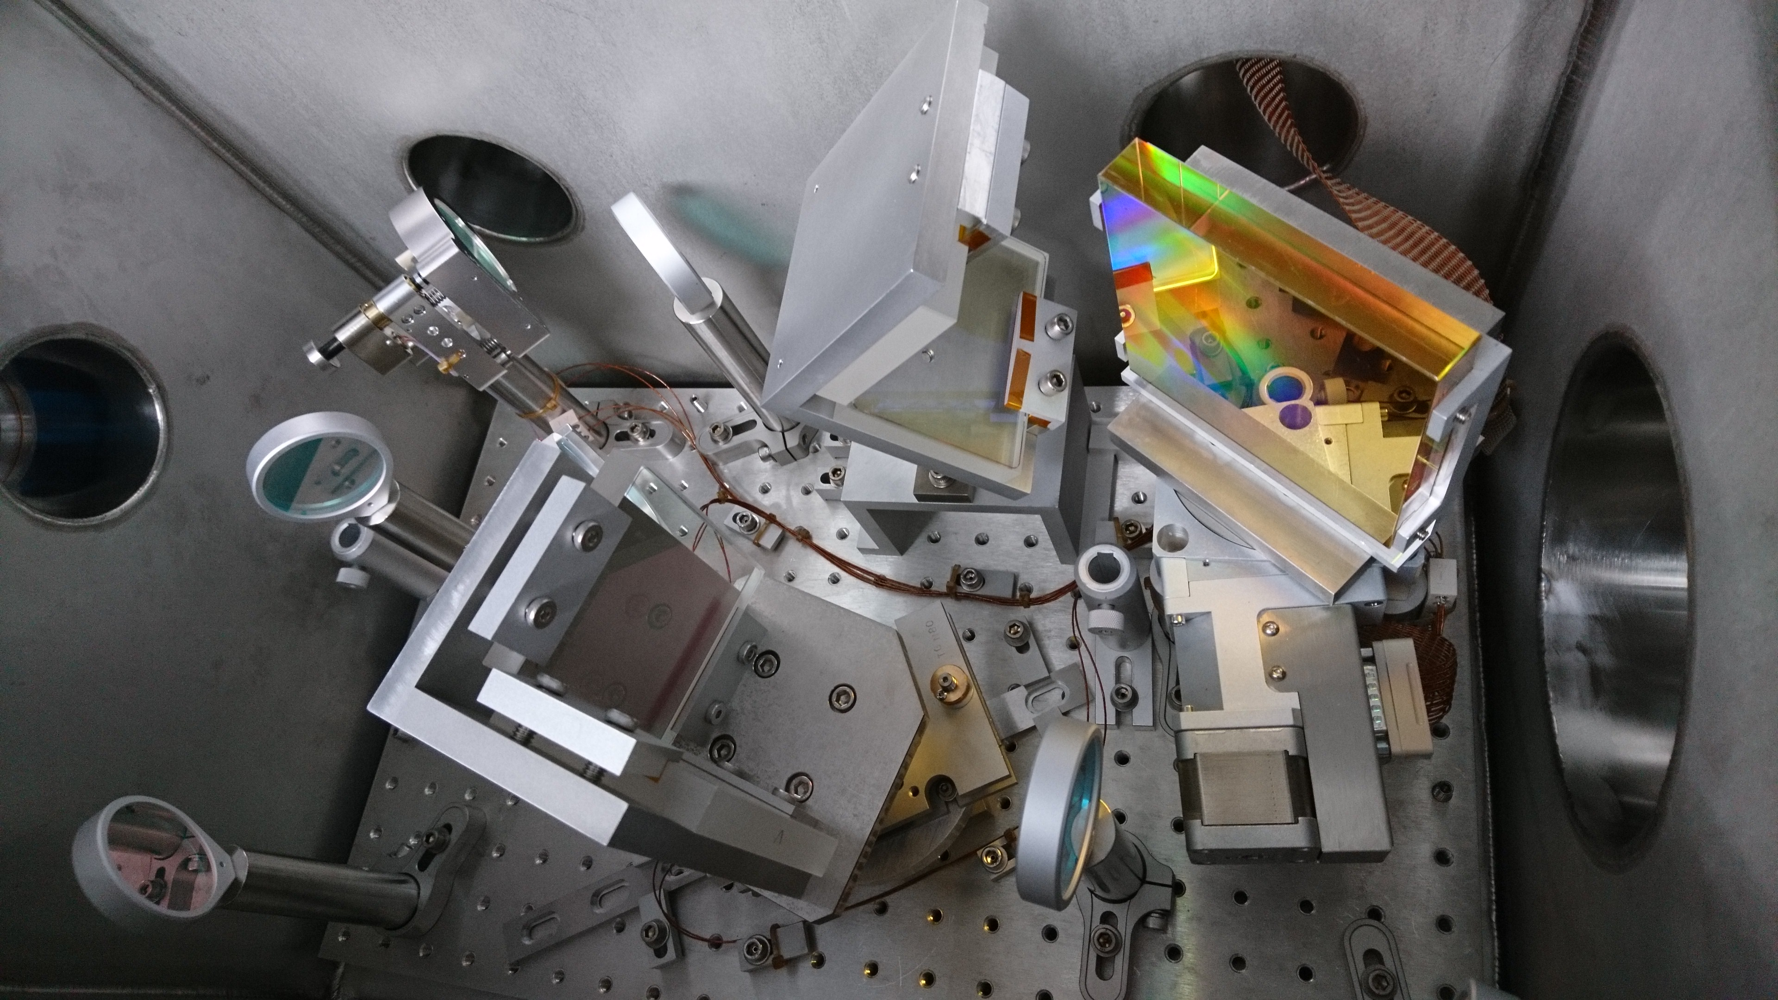
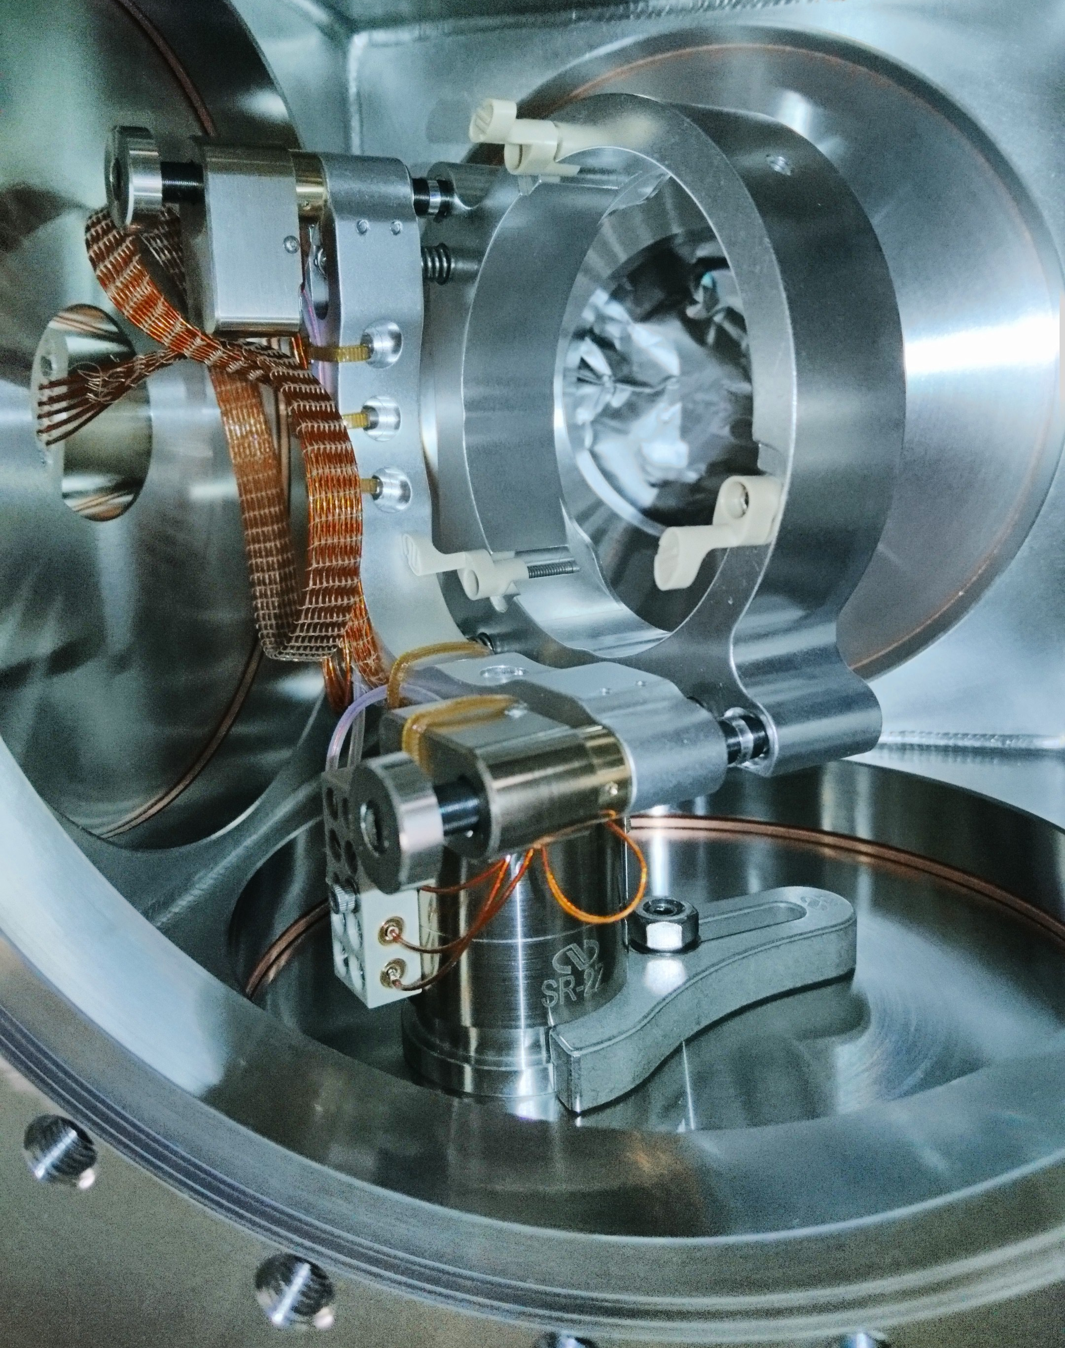
NIR Vacuum Transport Upgrade
Motivated by need to deliver higher energy & power with greater stability and reliable long-term performance
Vacuum envelope extended from front end through to IP’s
Full remote actuation of mounts
Diagnostic cameras at bends
Dedicated chamber for in-vacuum compressor can be isolated from user chamber
Compressor design is modular for use at other IP’s as needs arise
First user runs validated stable day-to-day alignment
Some pumpdown flexure observed and now being mitigated
Turning Mirrors
Grating Compressor
Accelerator Facilities Division

Slide 16
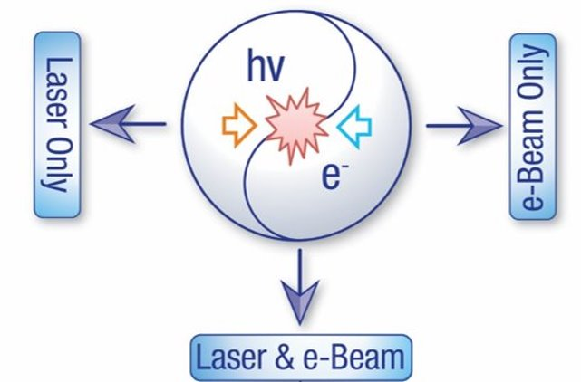
Active laser experiments and hours delivered at ATF in FY2022
Expt | Title | LWIR | NIR | e-
AE087 | Hard X-ray ICS
AE089 | Plasma compression for terawatt long wavelength lasers | 12 | 51 | NA
AE093 | Direct measurement of fields and radiation in the self-modulated plasma wakefield regime | 220 |  | 
AE095 | Optical diagnosis of self-modulated CO₂-laser driven plasma wake
AE098 | Probing electron Weibel instability in optical field-ionized plasmas using ultrashort electron bunches | 130 | 188 | 
AE099 | Directional X-ray radiation produced by an ultra-short period plasma magneto-static undulator
AE100 | The study of high-intensity laser pulse interactions with near-critical density plasmas | 94 | 92 | NA
AE101* | Optical materials for ultrahigh-power long-wave infrared lasers | 122 |  | NA
AE108* | Development of wavelength conversion techniques for generation of coherent radiation at the mid- to long-wave infrared |  | 40 | NA
AE119* | Broadband microwave emission from LWIR picosecond laser ablation | 94 |  | NA
AE122* | Remote detection of radioactivity using long-wave infrared laser-driven avalanche breakdown | 73 |  | NA
Laser + e-beam Laser only *In-air transport
Accelerator Facilities Division

Slide 17
Publications
Laser + e-beam
Laser
JOURNALS
R. Kupfer et al., “Raman wavelength conversion in ionic liquids”, Phys. Rev. Appl. 19, 014052, 2023
C. Zhang et al., "Electron Weibel instability induced magnetic fields in optical-field ionized plasmas", Phys. Plasmas 29, 062102, 2022
Z. Chang et al., "Intense infrared lasers for strong-field science", Adv. Opt. Photonics 14, 652–782, 2022
CONFERENCES
Advanced Accelerator Concepts Workshop (AAC), Long Island, NY (USA), November 6–11, 2022
W. Li et al., “Raman-based Wavelength Conversion for Seeding and Optical Pumping of CO₂ Laser Amplifiers”
I. Petrushina, et al, “Characterization of the fields inside the CO2-laser-driven wakefield accelerators using relativistic electron beams”
N. Vafaei-Najafabadi , et al, “Experimental Evidence for Suitability of Krypton as a Plasma Source for Two-Color Ionization Injection”
M. Polyanskiy et al., "9.3 microns: Toward next-generation CO₂ laser for particle accelerators“
I. Pogorelsky, et al, “Fulfilling the mission of Brookhaven ATF as a DOE’s flagship user facility in Accelerator Stewardship”
64th Annual Meeting of the APS Division of Plasma Physics, Spokane, WA (USA), October 17–21, 2022
Y.-H. Chen et al., ” Proton acceleration in an overdense hydrogen plasma by intense CO₂ laser pulses with nonlinear focusing effects in the underdense preplasma”
Other conferences
M. Polyanskiy, "Multi-terawatt long wave infrared lasers: Status and perspectives", 23rd International Symposium on High-Power Laser Systems and Applications, Prague (Czech Republic) June 13–16, 2022
M. N. Polyanskiy et al., "The choice of materials for post-compression of high-peak-power long-wave infrared pulses", Conference on Lasers and Electro-Optics (CLEO), San Jose, CA (USA), May 15–20 2022
Accelerator Facilities Division

Slide 18
Questions?
Accelerator Facilities Division

Slide 19
Backup slides
Accelerator Facilities Division

Slide 20
Enabling technologies
Ti:S
Ho:
YLF
7 mJ
@ 0.8 µm
~100 mJ
@ 2.1 µm
Efficient 2 μm laser
Ho:YLF
& = “mid-IR Ti:Sapphire”
Ho:YAG
osc
osc
15 μJ
@ 9.2 µm
10 mJ
@ 9.2 µm
OPA
(*)
(*) OPCPA or
Raman+DFG
(see AE-108 report)
2) Reliable post-compressor
Two-element bulk-material LWIR
post-compressor with spatial filter
- see AE-101 report-
Accelerator Facilities Division

Slide 21
Accelerator Facilities Division

