Slide 1
25th Annual Accelerator Test Facility (ATF) Users' Meeting Facility Updates and Plans
Andrew Simmonds
Accelerator Facilities Division
March 2, 2023

Slide 2
ATF Upgrades
Design Process
Configuration Control
B820
Laser Capability
Capability and Safety Upgrades
Facility Upgrades
Summary Next Steps
Accelerator Facilities Division

Slide 3
Design Process
Scientific need is identified by the user community or AF staff member
A specification document is generated
Development of a conceptual design
Hold design review with AF staff and relevant outside experts
Conduct detailed design and structural analysis
Check & approval of drawings and critical analyses
Archival of drawings and analyses
Utilize matrixed support from ATRO for engineering and drafting
Accelerator Facilities Division

Slide 4
Configuration Control
Radiation calculations are archived by the C-AD RSC
Shielding is approved by the C-AD RSC. The drawings are reviewed and approved by a cognizant Engineer or Physicist, their supervisor, the Chief Engineer (ME or EE), Division Head, QA, Safety/RSC and the Department Chair before being archived in Windchill.
Utilize Windchill to release and archive controlled documents
Shift part numbering and controlled document release process fully to AF responsibility
Store a Reference Only PDF copy of relevant drawings on SharePoint for wider accessibility
Accelerator Facilities Division

Slide 5
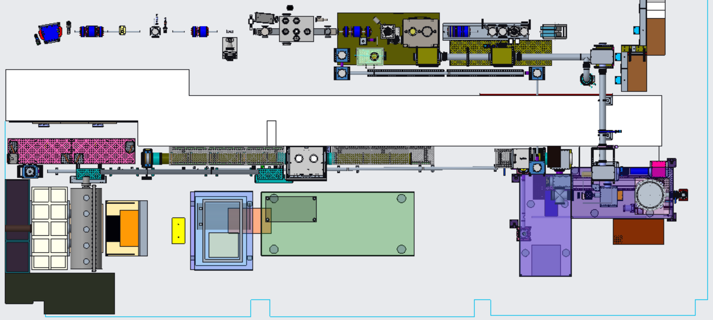
Present Laser Configuration w/ FY22 upgrades
LWIR
NIR
Shielding wall
NLPC 1
NLPC 2
CPA Table
Polarization Rotator
Seed Laser Table
Final Amplifier
Accelerator Facilities Division

Slide 6
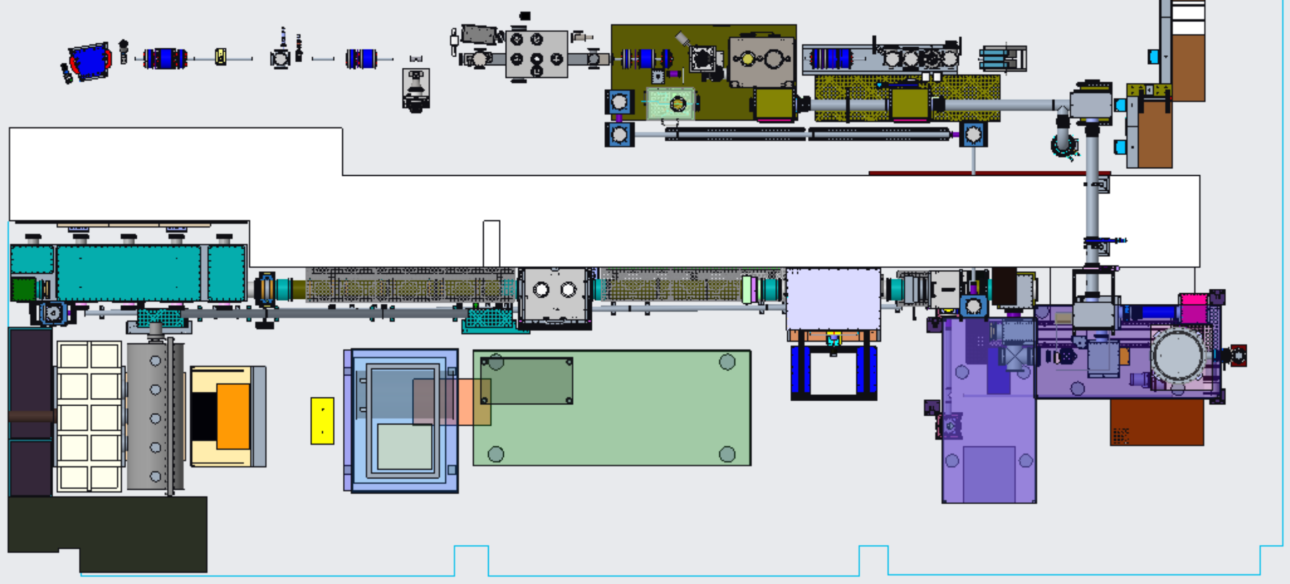
Modified Laser Transport Systems – Plan View
LWIR
NIR
Shielding wall
NLPC 1
NLPC 2
CPA Chamber
Seed Laser Table
Polarization Rotator Chamber
Final Amplifier
Accelerator Facilities Division

Slide 7
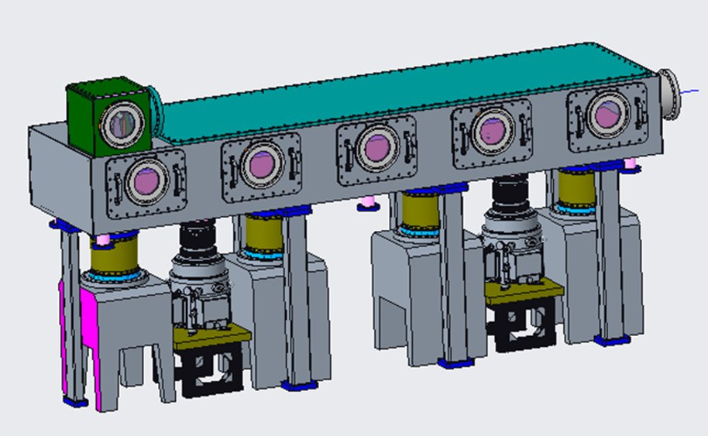
CPA Vacuum Chamber
Optics mounted to concrete pedestals for thermal stability and vibration isolation
Vacuum chamber supported by SS legs
Bellow is only mechanical connection
Accelerator Facilities Division

Slide 8
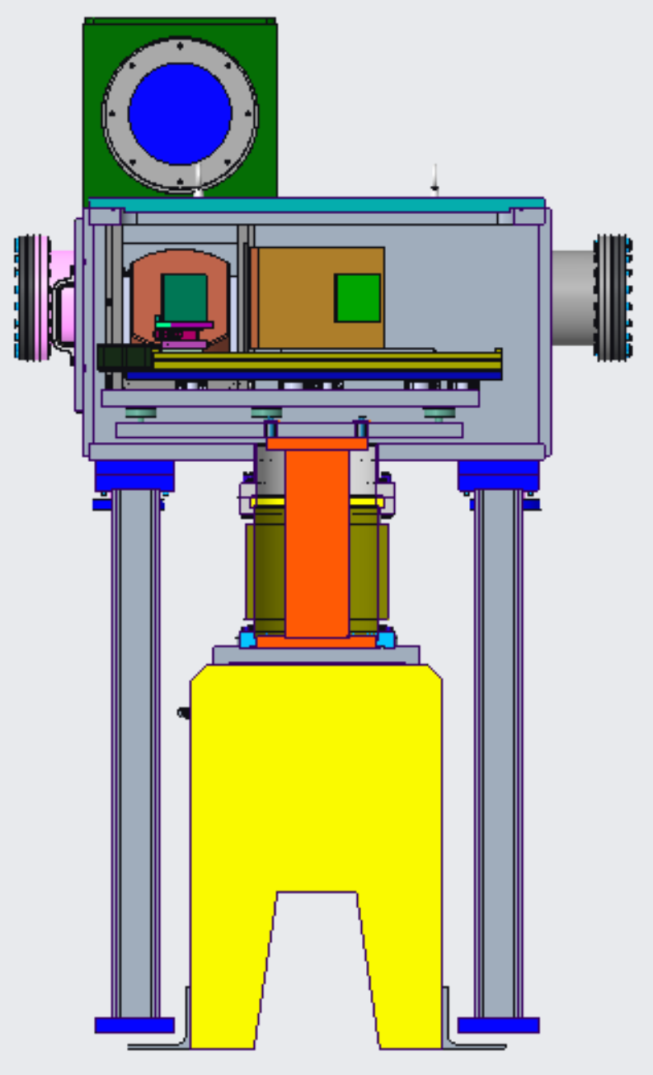
Improvements inside CPA Chamber
Original CPA breadboard frame and legs were used in air
Many opportunities for improvement were identified
Breadboard frames were re-made from solid plate rather than welded tubes
Produces much flatter and stiffer base for the breadboards to be supported
Breadboard legs were re-made with solid center section
Greatly reduces flex of the breadboard due to cantilevered weight of the periscope
A frame clamp was developed to tie the two piece frame together once installed
Two piece frames are required for installation into the chamber
Redesigned leveling legs allow for adjustment and lock from topside
Redesigned Periscope frame for improved stiffness and replacement
Accelerator Facilities Division

Slide 9
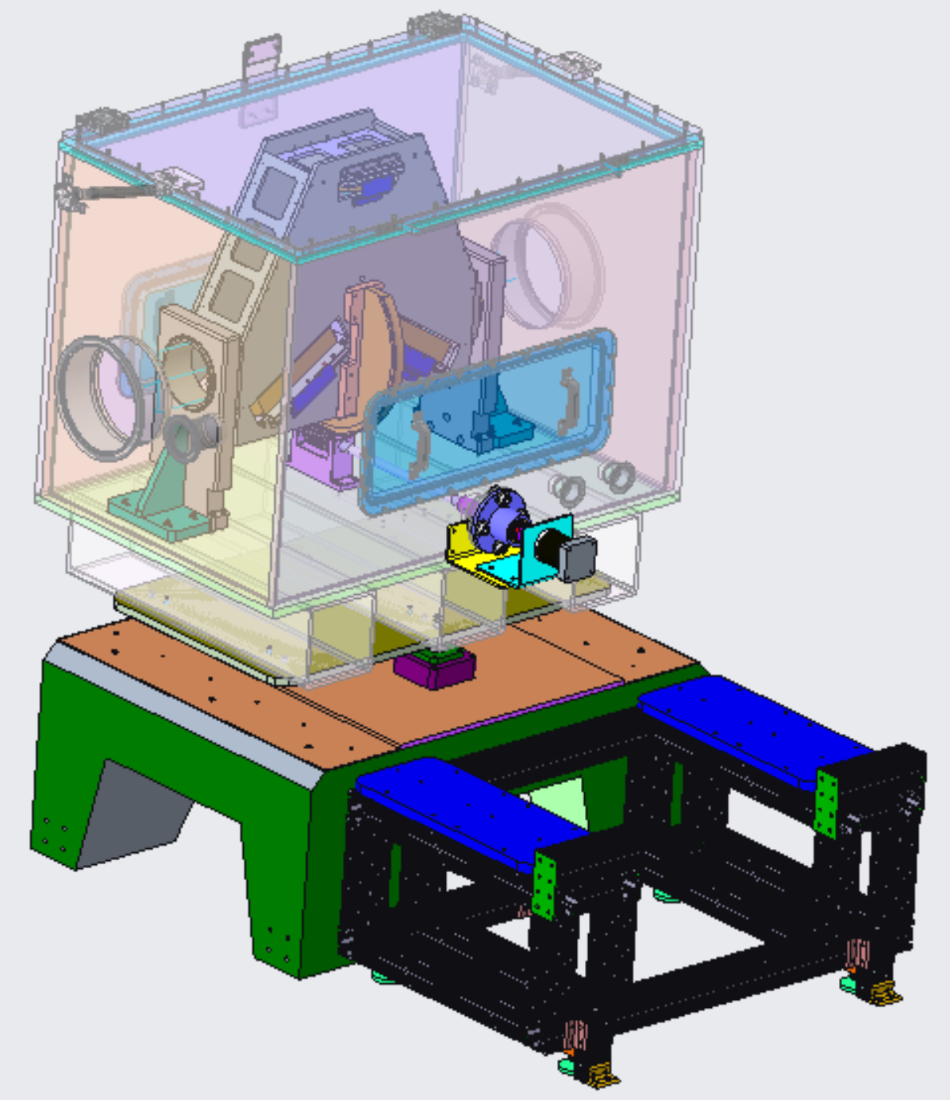
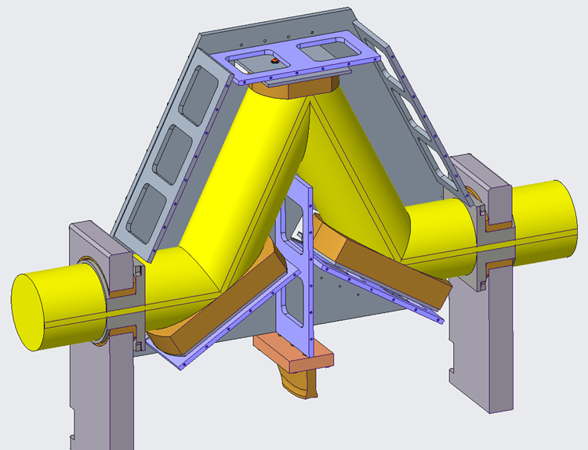
Flexible Polarization Rotator (FPR)
Provides infinitely adjustable beam polarization from horizontal to vertical
6” diameter clear aperture
FPR and chamber are being installed
Accelerator Facilities Division

Slide 10
Future Steps…
Continue LWIR vacuum transport to BL2
LWIR
Extend Vacuum transport to BL#2
NIR
Front end vacuum transport upgrade
to increase aperture and energy to experiments
Capillary Compressor line upgrade to produce sub-10 fs pulse width
Accelerator Facilities Division

Slide 11
B820 Capability and Safety Upgrades
Experimental Hall
Continued in vacuum CO2 laser transport to the Compton chamber
Upcoming Improvements to shielding
Labyrinth at end of BL#1
After Spectrometer Dipole at the end of BL#2
CO2 Room
Upcoming Improvements to shielding
Extended exclusion zone on the table at N of CO2 room
Additional shielding of the plasma shutter
Accelerator Facilities Division

Slide 12
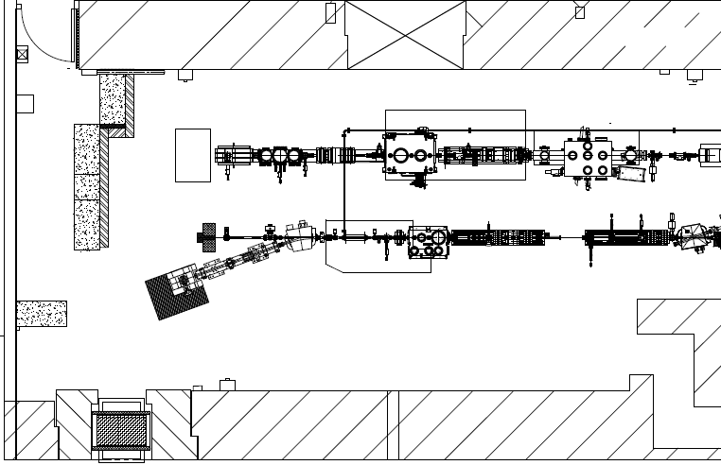
EH Shielding
Labyrinth/Shielding
Inverse Compton Scattering
Laser Wakefield
20° Leg of BL2
Accelerator Facilities Division

Slide 13
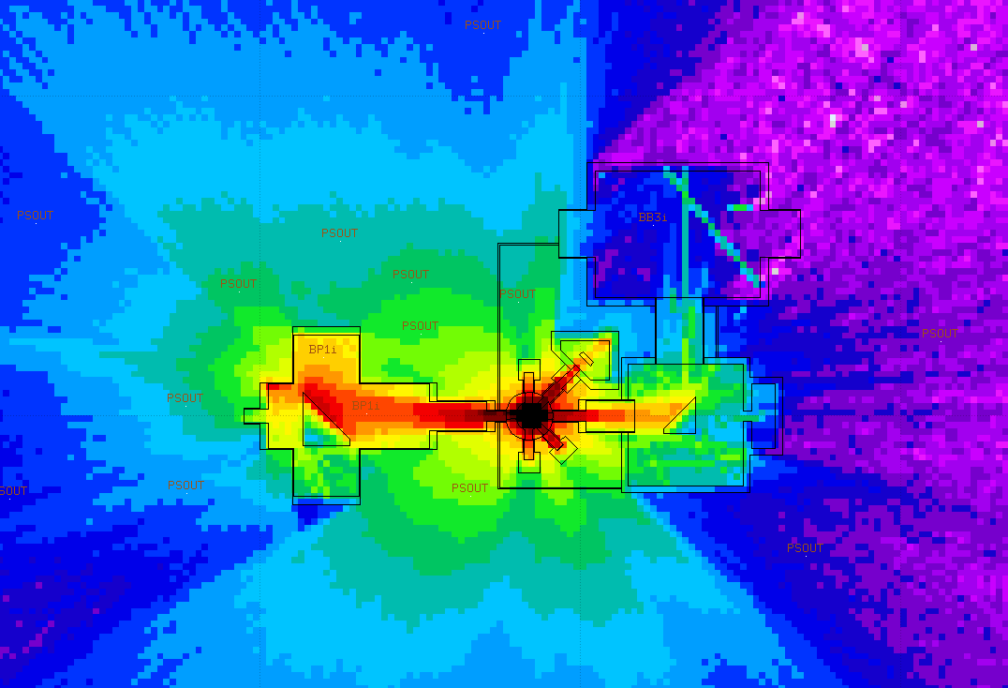
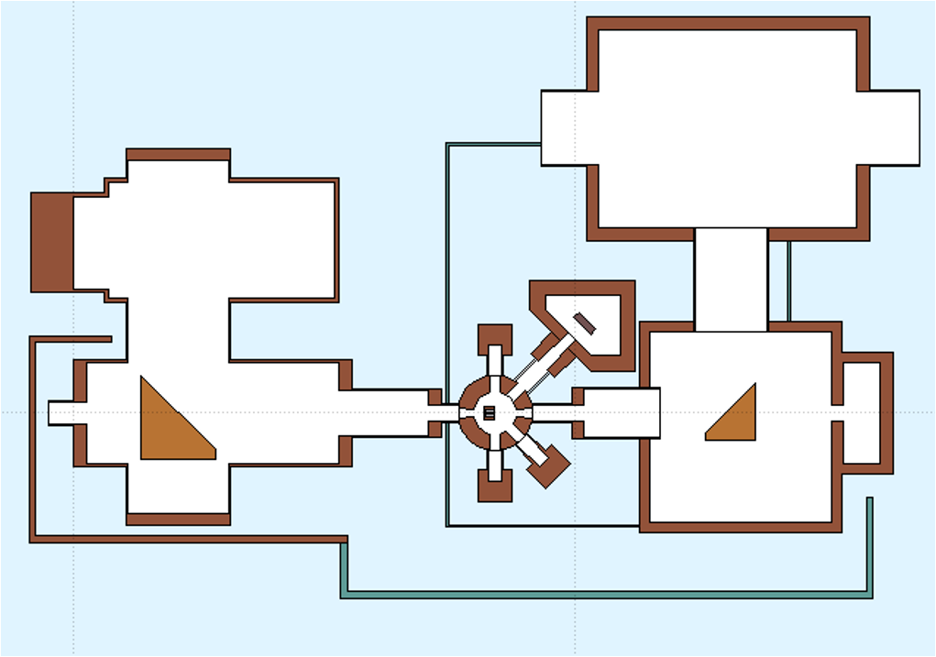
CO2 Shielding
Accelerator Facilities Division

Slide 14
B820 Facility Upgrades
CO2 Room
Blue steel wall separating CO2 and FEL rooms was removed
New LED lighting throughout the CO2 room
Cable tray system installed
Bridge Crane installed to service water capacitor and CPA chamber
Begin replacing drop ceiling with clean room ceiling tiles
Experimental Hall
BL#1 Electrical reconfiguration
Better organization of power to the BL from panel in the EH
Power strips removed and replaced with hard mounted wiremold
Floor level utility crossover has been eliminated
High Bay
Moving Machine Shop. Previous location will become a dedicated utility room
Created an assembly area for items that are larger or need cleaner environment
Accelerator Facilities Division

Slide 15
 | FY17 |  | FY18 |  | FY19 |  | FY20 |  | FY21 |  | FY22 |  | FY23 |  | FY24
ATF User Program
ATF CO₂ Power Upgrade R&D
NLPC Proof-of-Principle Demonstration
Building 820 Remedial Maintenance Program
Ti:Sapphire Laser System (TW-Class)*
Near-term Laser Power Upgrades (NIR/LWIR)
Electron Beam Improvements
Non-Linear Materials R&D Program
LWIR Power and Rep. Rate Improvements
Extended User Program
Approved ATF Operations
ARR Process
Plasma Shutter
Isotopic Mixtures
~0.5 TW to Users
CPA Config
5TW Demonstration, Air Transport a ~2.5TW to Users w/good beam quality
NLPC PoP
Initial 0.6 ps Demo with subsequent ~2x improvement
Facility Reliability, Electrical Infrastructure, Environmental Systems, MPS, etc.
LINAC/eBeam Refurb.
DELAYED
Procure, Deploy, Commission
COVID Delays/ Funding Limitations
TW operation for users
*BNL/NRL Collaboration
Upgraded
Transport
COVID Delays/ Funding Limitations
In-Vacuum
Transport System
5TW to Users
Pulse Compression (a~30fs), Long. Diagnostic - DELAYED
Non-linear Materials Development & NLPC Engineering Design
3-year Goal: > 10TW, sub-ps LWIR to Users
ATF (B820) Upgrade Proposal

Slide 16
Summary Next Steps
FY23:
LWIR and NIR upgraded capabilities available for users
CO₂ Laser Room
EH Beamline #1
Plans to extend to EH Beamline #2 when funding permits
Accelerator Readiness Review Preparations and Execution
FY24-25
Major focus will shift to further improvements in Electron Beam Performance as strongly driven by user needs
LINAC RF system improvements
Pulse compression (to better match with combined e-beam/laser requests)
Short-pulse diagnostics
Continue facility-level corrective action plans (CAPs) as developed during ARR process
Example: Electrical Systems CAP will continue for multiple years
Facility Upgrade Proposal – a few identified thrusts
Path to <500 fs & >20 TW LWIR capabilities
Dedicated shielded research space to pursue laser-only particle source experiments
Further development of multi-beam research capabilities
Dedicated Ips
Improved multi-beam timing and synchronization
LWIR rep-rate path
User requirements to be further explored during upcoming Science Planning Meeting (see next talk)
Accelerator Facilities Division

Slide 17
Questions?
Accelerator Facilities Division

