Slide 1

25th Annual
Accelerator Test Facility (ATF) Users' Meeting
Closing Session
Science Priority Research Directions & Next Science Planning Workshop
Navid Vafaei-Najafabadi
Accelerator Facilities Division
March 2, 2023

Slide 2
Synthesis
Priority research direction (PRDs) for the facility are determined through science planning workshops
The PRDs in turn define a set of core capabilities as targets for investment
Primary areas of experiment for ATF consist of
Particle generation and acceleration research
Integrated multi-beam experiments to explore novel plasma physics and radiation sources (e.g. ICS)
Laser, plasma, and beam science using unique ATF sources
Major laser infrastructure upgrades have been carried out to facilitate high-impact experiments, but electron beam facility upgrade is also needed to take full advantage of its capability in beam-driven and integrated experiments
The next workshop is planned for later this year to gather community input on the future of science program at ATF

Slide 3
ATF Science Planning Process
Goals:
  Determine the Priority Research Directions (PRDs) that can be leveraged to establish a priority-based upgrade path for the facility.
  Determine the set of parameters to best support the PRDs and enable the exploration of new Physics
Strategy
  Refine and update the PRDs using the community input through a series of Science Planning Workshops
  Determine a set of core capabilities and upgrades required for ATF facilities to best serve the research
2019 Report Editors:
  Navid Vafaei-Najafabadi (Stony Brook University)
  Michael Downer (University of Texas at Austin)
  David Sutter (University of Maryland)
  Gerard Andonian (University of California, Los Angeles)
  Aakash Sahai (University of Colorado)
2019Report: https://www.bnl.gov/atf/docs/ATF%20Science%20Workshop%20Report%202019.pdf

Slide 4
Overview of Previous Priority Research Directions
Long-Wave Infrared (LWIR) Driven Science.
  LWIR Laser-Driven Plasma Ion Acceleration
  LWIR Laser-Driven Plasma Electron Acceleration
  Basic Plasma Physics Research in Novel Regimes
  LWIR Laser Technology Development
Electron-Beam-Driven Science
  Advanced Acceleration Research
  Beam Phase Space Optimization
  Low Emittance Source Development
  Novel and Efficient Terahertz Radiation Generation
Laser Electron Beam Interactions
  Basic Research of Laser-Plasma Charged-Lepton-Beam Production
  Electron Acceleration Techniques Driven by the Combination of Electron Beam and LWIR Laser
  Radiation Generation

Slide 5
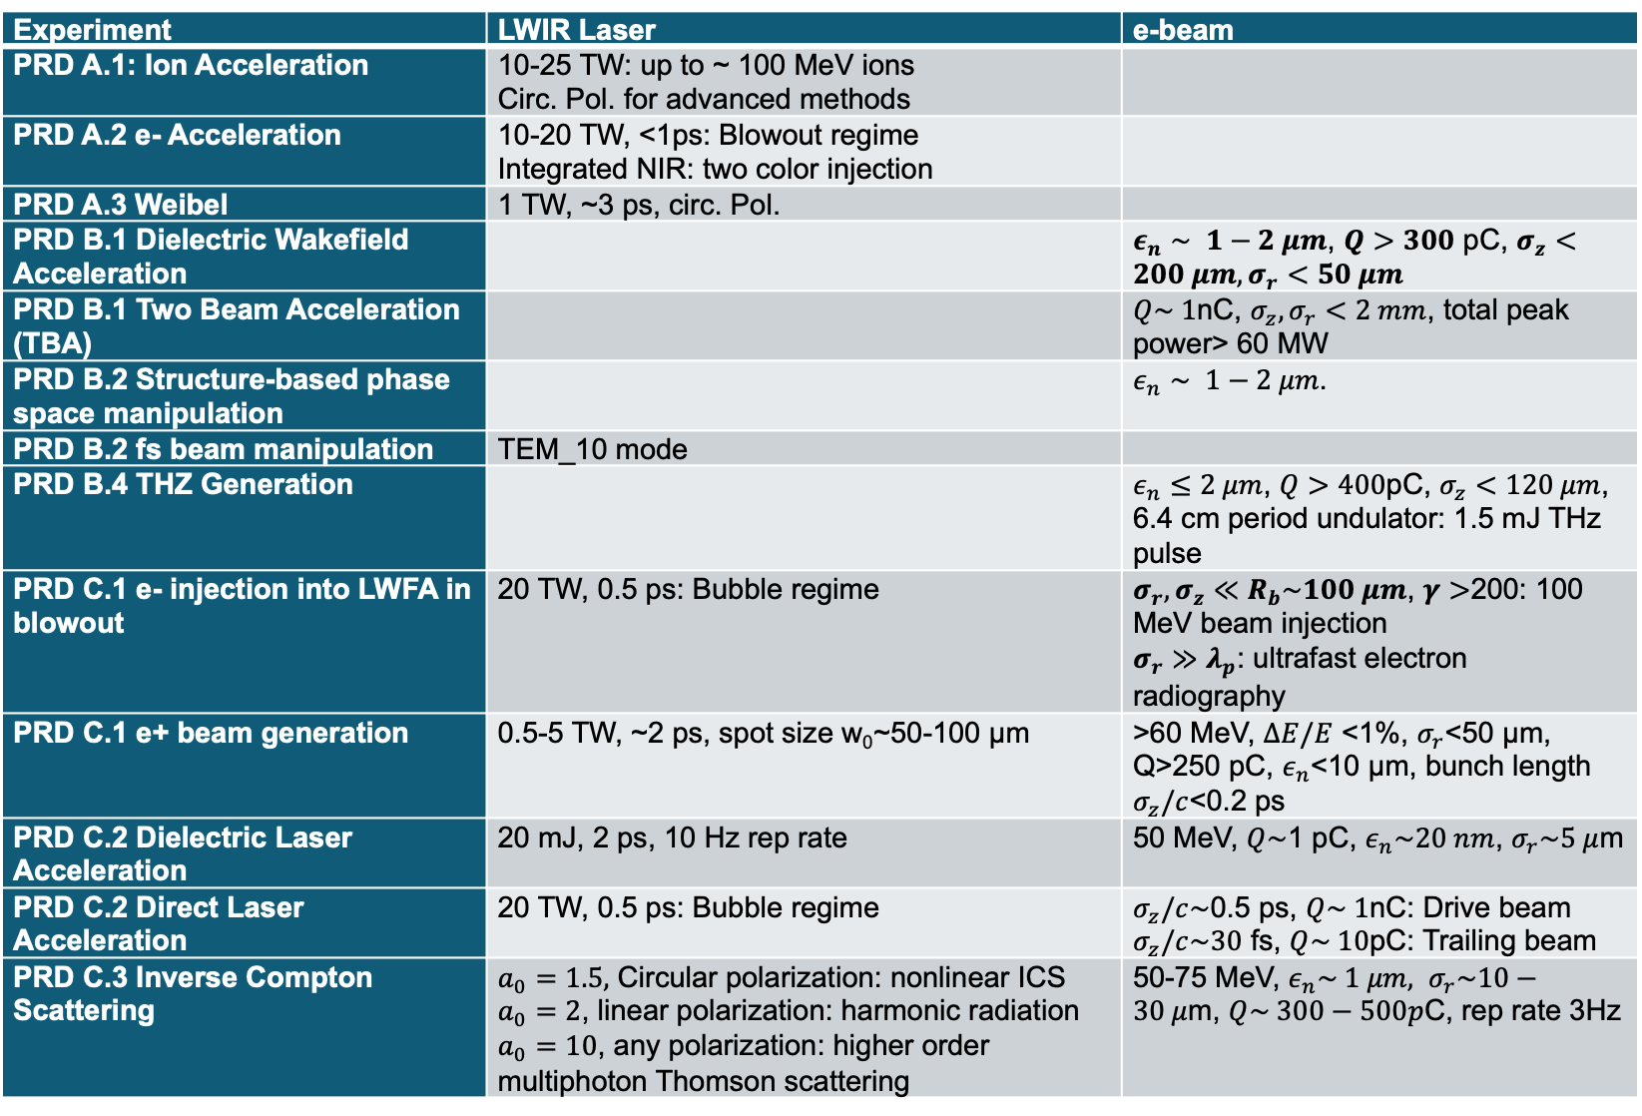
Review: Facility Needs
Experiment | LWIR Laser | e-beam
PRD A.1: Ion Acceleration | 10-25 TW: up to ~ 100 MeV ions Circ. Pol. for advanced methods
PRD A.2 e- Acceleration | 10-20 TW, <1ps: Blowout regime Integrated NIR: two color injection
PRD A.3 Weibel | 1 TW, ~3 ps, circ. Pol.
PRD B.1 Dielectric Wakefield Acceleration |  | $ε_{n}∼ 1−2 μm$, $Q>300$ pC, $σ_{z}<200 μm, σ_{r}<50 μm$
PRD B.1 Two Beam Acceleration (TBA) |  | $Q\sim 1$nC, $σ_{z}, σ_{r}<2 mm$, total peak power> 60 MW
PRD B.2 Structure-based phase space manipulation |  | $ε_{n}∼ 1−2 μm$.
PRD B.2 fs beam manipulation | TEM_10 mode
PRD B.4 THZ Generation |  | $ε_{n}≤2 μm$, $Q>400$pC, $σ_{z}<120 μm$, 6.4 cm period undulator: 1.5 mJ THz pulse
PRD C.1 e- injection into LWFA in blowout | 20 TW, 0.5 ps: Bubble regime | $σ_{r},σ_{z}≪R_{b}\sim 100 μm$, $γ>$200: 100 MeV beam injection $σ_{r}≫λ_{p}$: ultrafast electron radiography
PRD C.1 e+ beam generation | 0.5-5 TW, ~2 ps, spot size w₀~50-100 µm | >60 MeV, $ΔE/E$ <1%, $σ_{r}$<50 µm, Q>250 pC, $ε_{n}$<10 µm, bunch length $σ_{z}/c$<0.2 ps
PRD C.2 Dielectric Laser Acceleration | 20 mJ, 2 ps, 10 Hz rep rate | 50 MeV, $Q\sim$1 pC, $ε_{n}\sim 20 nm$, $σ_{r}\sim 5 μ$m
PRD C.2 Direct Laser Acceleration | 20 TW, 0.5 ps: Bubble regime | $σ_{z}/c\sim$0.5 ps, $Q\sim 1$nC: Drive beam $σ_{z}/c\sim 30$ fs, $Q\sim 10$pC: Trailing beam
PRD C.3 Inverse Compton Scattering | $a_{0}=1.5,$ Circular polarization: nonlinear ICS $a_{0}=2$, linear polarization: harmonic radiation $a_{0}=10$, any polarization: higher order multiphoton Thomson scattering | 50-75 MeV, $ε_{n}\sim 1 μm, σ_{r}\sim 10−30 μ$m, $Q\sim 300−500p$C, rep rate 3Hz

Slide 6
Review: Diagnostic Needs
Expanded Experimental Diagnostic Capabilities
  Plasma Diagnostics (interferometry, shadowgraphy,etc)
  Prepulse contrast diagnostics better than 4 orders of magnitude
  Characterization of high quality e-beams requires full e-trajectory recovery within a magnetic spectrometer’s energy-dispersion plane, e-beam polarimeters based on Møller e-e scattering from polarized ferromagnetic targets, and CTR-based 6D profiling of e- bunches.
  Radiation detectors, including KBr, MCPs, x-ray CCDs, and CsI scintillators with CCD, flux measurements, Crystal Si or CdTe average flux energy spectrometer, Single Shot Double differential diagnostic, Curved bent multi layer or Si & Quartz spectrometer, liquid scintillator detector in combination with single photon count PMT, and Compton magnet spectrometer
  Achievable through collaboration with users
Beam characterization: Transverse deflective cavity (T- CAV), 2 THz interferometry from coherent transition radiation (CTR), coherent diffraction/edge/Cerenkov radiation (CDR/CER/CCR)
Alignment and Synchronization Requirements for Multi-Beam Experiments
  Implementation of computer-based optimization technologies and accompanying high repetition rate are needed for achieving and maintaining high precision alignment and synchronization between the beams
Expanded Computational Capabilities
  Availability of user-friendly simulation codes for modelling short/long-term plasma dynamics, radiation production, and machine-learning tools for beam diagnostics and steering will be a great asset for users

Slide 7
Major Infrastructure Upgrades Facilitate High-Impact Experiments

Slide 8
Investments in Capability Upgrades
In response to the scientific plan, the facility has focused on development of capabilities with highest scientific payoff:
  R&D in LWIR laser technologies to achieve >20 TW, <1 ps pulse
  Integration of laser and beam sources for multi-beam experiments
  Implementation of integrated femtosecond (Ti:Sapphire) laser for enabling key experiments in accelerator science and plasma physics
Investment in stability and diagnostics for the electron beam are required to fully take advantage of its capability as a science driver as well as multi-beam integrated experiments

Slide 9
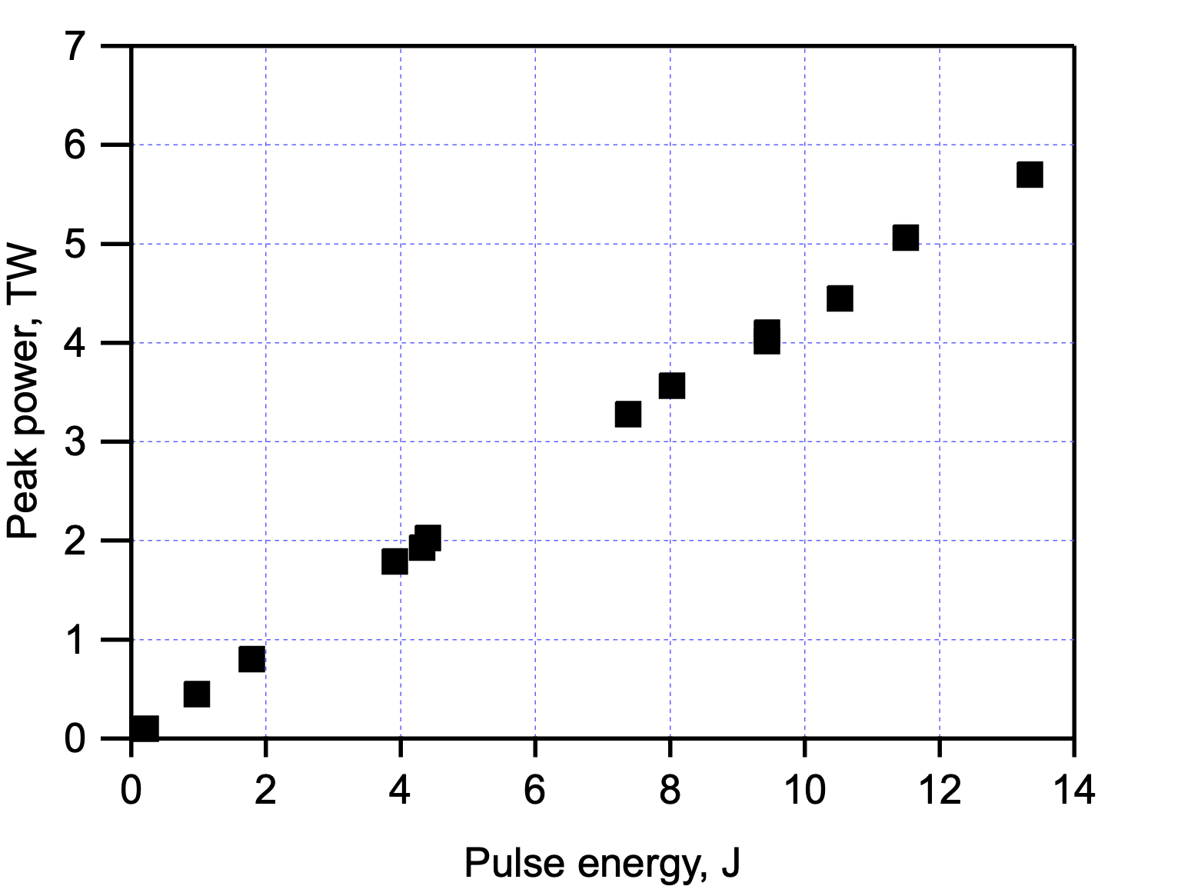
Current Status and Future LWIR R&D
Science plan shows the promise of high-impact results at >20 TW, <1ps laser pulse
Aggressive R&D program has been put in place to meet this milestone, including
  Vacuum transport to enable delivery of 5 TW to user IPs
  Development of solid-state seed (~10 mJ) enabling better use of CO₂ gain bandwidth
  Research in novel nonlinear pulse compression methods to reach 100s of fs
  R&D in plasma optics (user collaboration) to supersede the gradual long-term degradation of compressor gratings
March 2019: 5 TW
2018: 2 TW
M. N. Polyanskiy, I. V. Pogorelsky, M. Babzien, M. Palmer, "Demonstration of a 2 ps, 5 TW long-wave infrared laser based on chirped-pulse amplification with mixed-isotope CO₂ amplifiers," (Submitted to “OSA Continuum”, Oct. 2019).

Slide 10
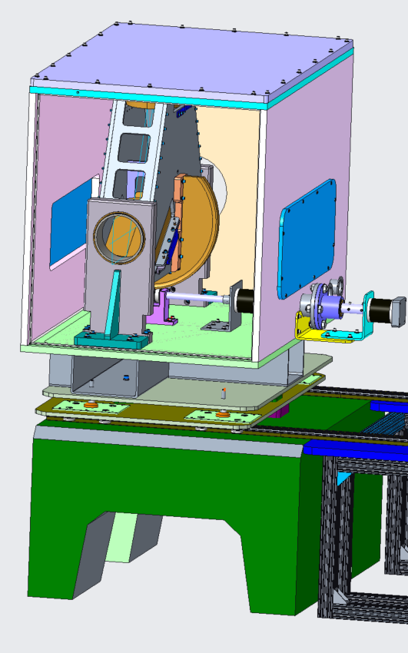
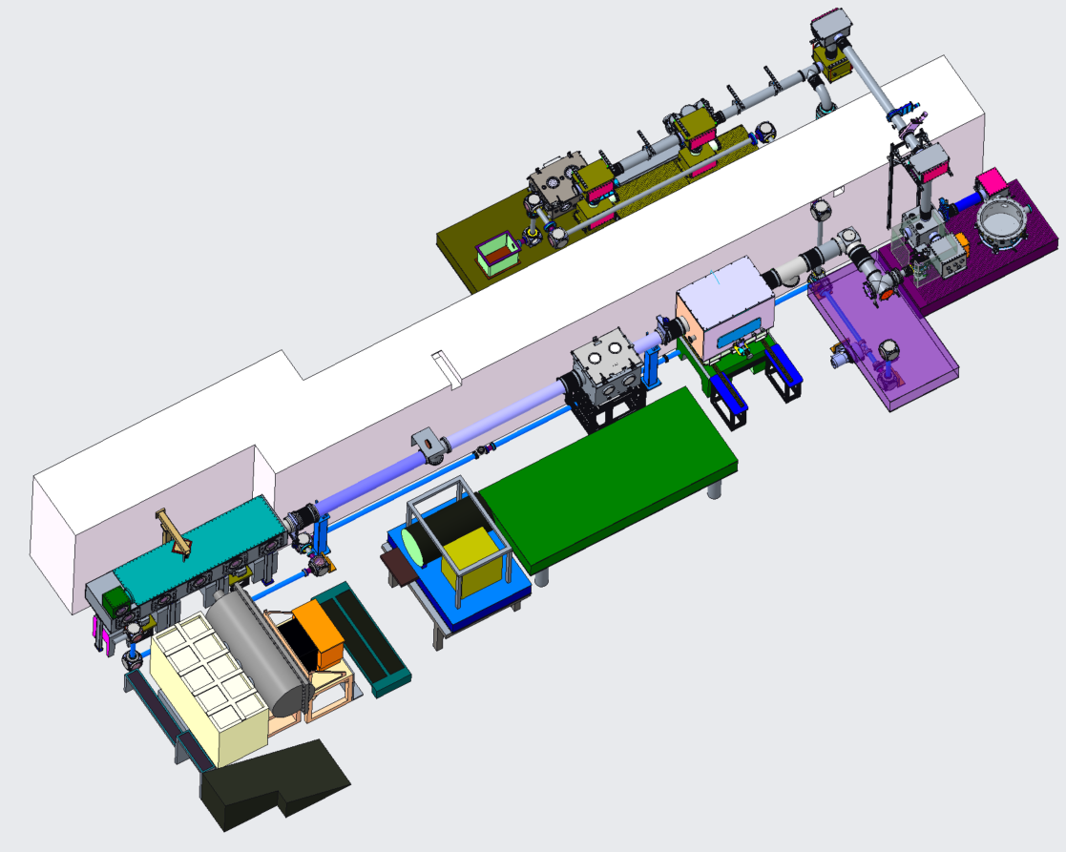
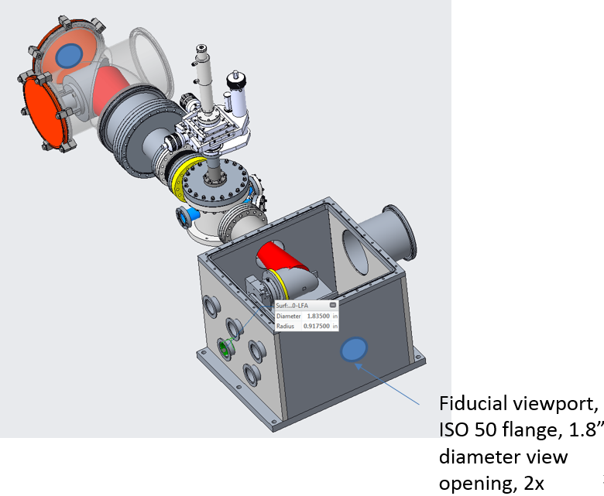
LWIR laser infrastructure after upgrade
Flexible polarization rotator (FPR)
Nonlinear pulse compressor
Test chamber
Experimental Hall
FEL Room
Compressor
Shielding wall
CO₂
Seed Laser Table
YAG
YAG
CO₂
plasma
Final amplifier
CO2 Room
Plasma shutter

Slide 11
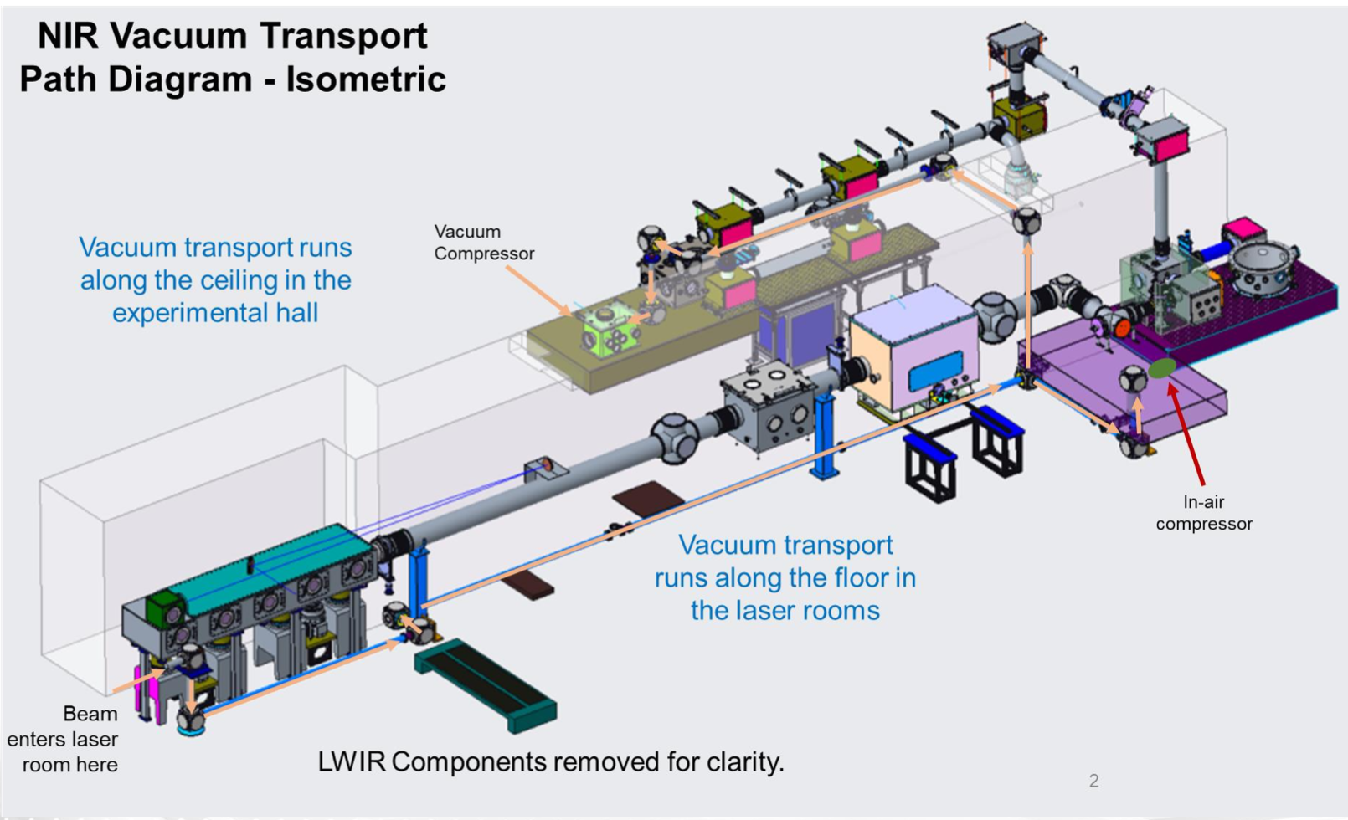
Two Compressors Enable Integration of the Ti:Saph at User IPs

Slide 12
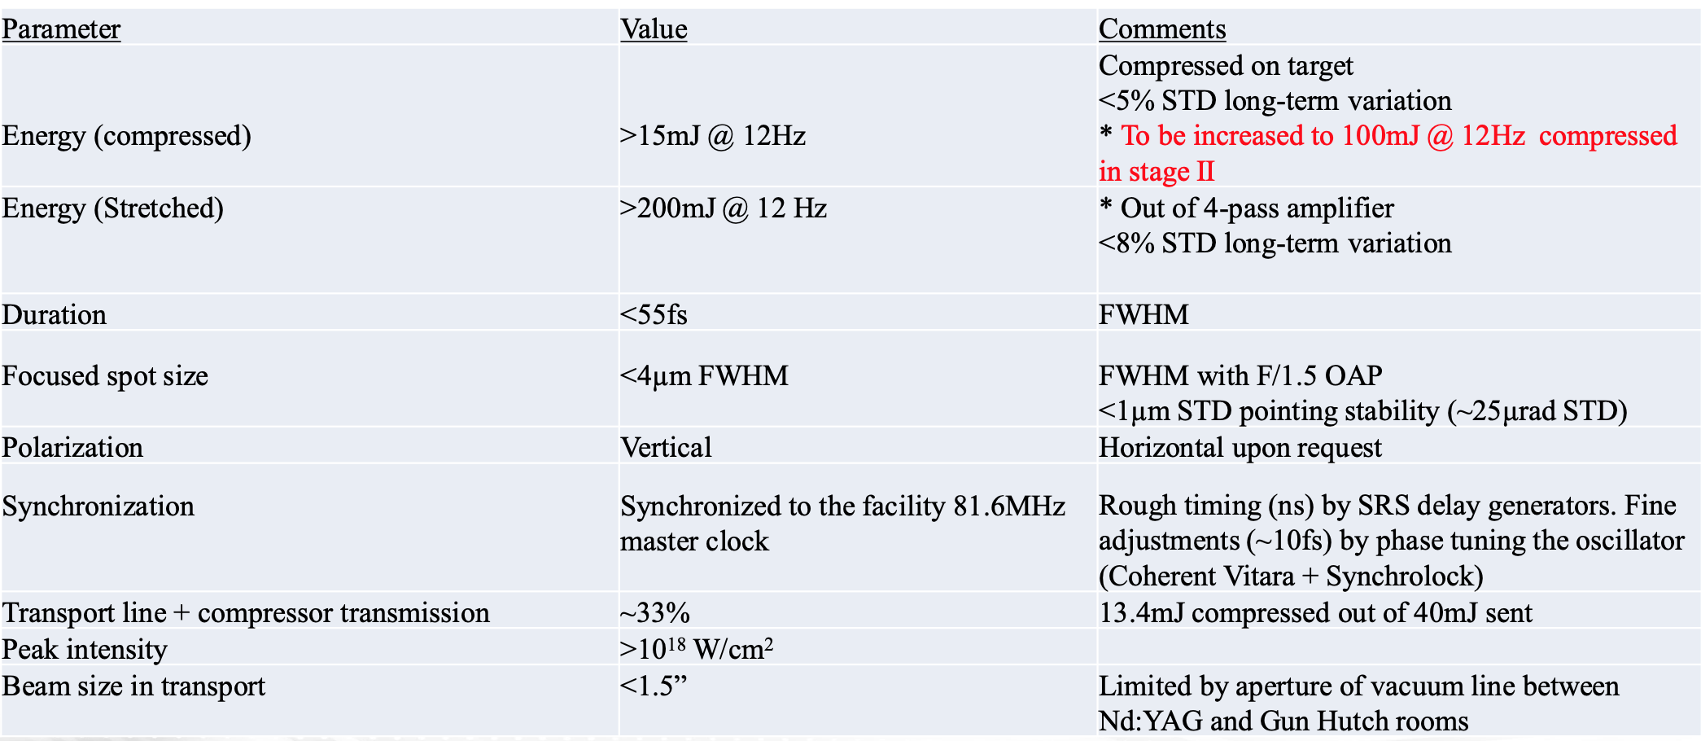
Integration of Ti:Saph at ATF
Addition of Ti:Saph is represents an important upgrade in the capabilities of ATF

Slide 13
Planning the Future Science at ATF

Slide 14
Science Planning Workshop, 2023
The next science planning workshop is slated for late 2023
Our goal will be to further develop and refine priority research directions and set the facility development priorities for high-impact results
Community input will be requested for refining PRDs, focusing on research where
  ATF can make a unique contribution
  Expected research outcomes are significant
  ATF facilities are well-suited for carrying out the proposed research
The outcome of the workshop will be
  An assessment of new opportunities enabled by the upgraded capabilities of ATF facility
  An assessment of needs for future capabilities, which will in turn inform an upgrade path for capabilities delivered by ATF

Slide 15
Science Opportunities
Two primary areas of current focus with unique ATF contributions
Particle generation and acceleration research based on unique laser and particle sources at ATF
Integrated multi-beam experiments to explore novel plasma physics and radiation sources
Other science opportunities
Laser science in LWIR regime
Electron beam driven science

Slide 16
Integrated Multi-Beam Experiments
Integration of LWIR laser, NIR lasers and the e-beam simultaneously, allows any beam to be used as driver or diagnostic. This has enabled novel research, including
  Study of two-color ionization injection to enable an all-optical, high-brightness “photoinjectors”
  Visualization and field mapping inside LWIR-driven wakefield
  External injection of e-beam into LWIR-driven wake for frontier LWFA research
  Study of Inverse Compton Scattering in novel regimes
  Investigation of “laboratory astrophysics”, e.g. instabilities in plasma that also seed the magnetic fields in outer space plasma

Slide 17
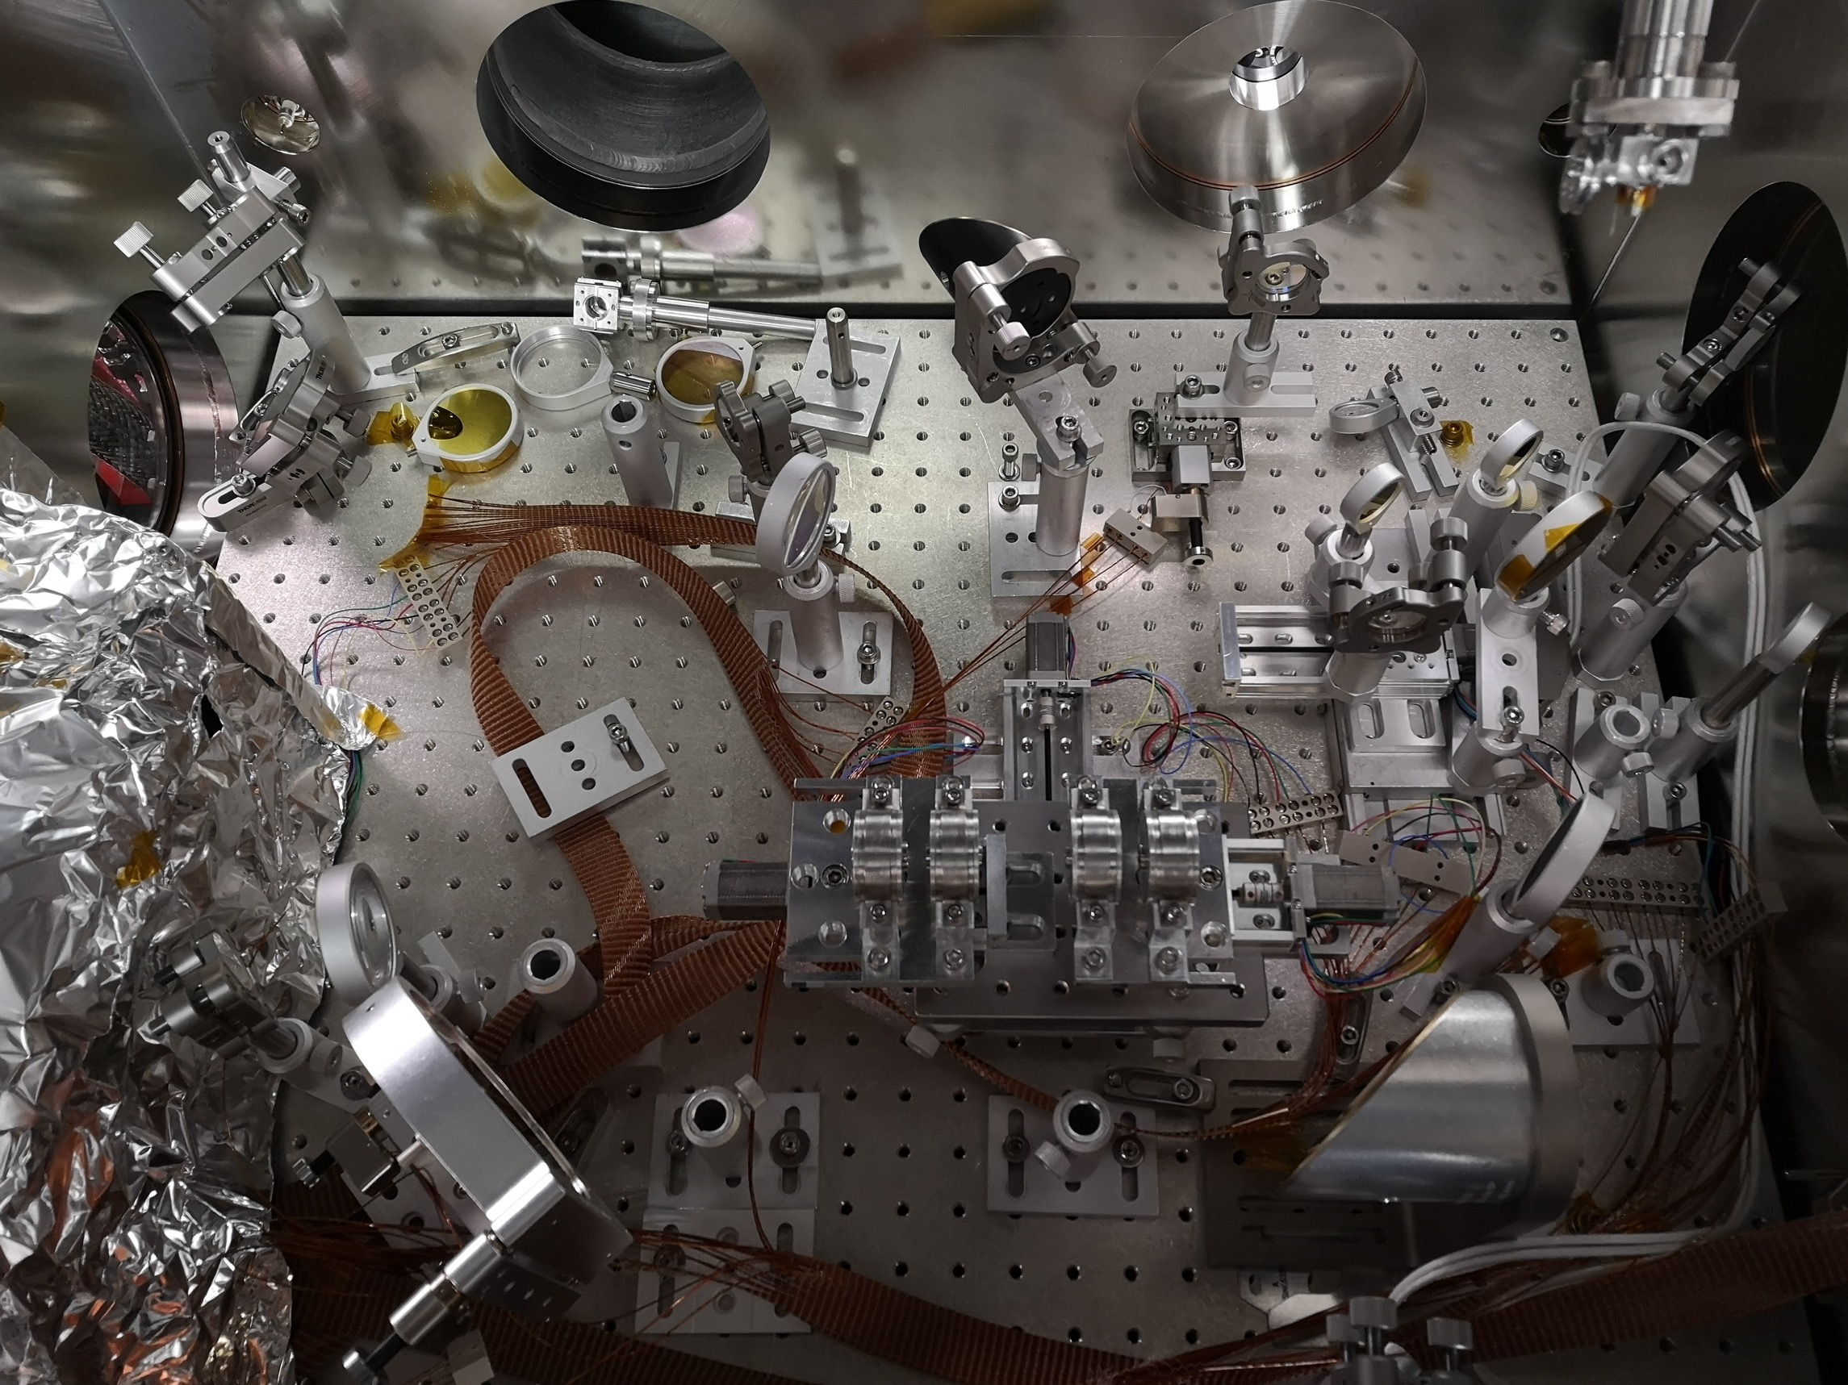
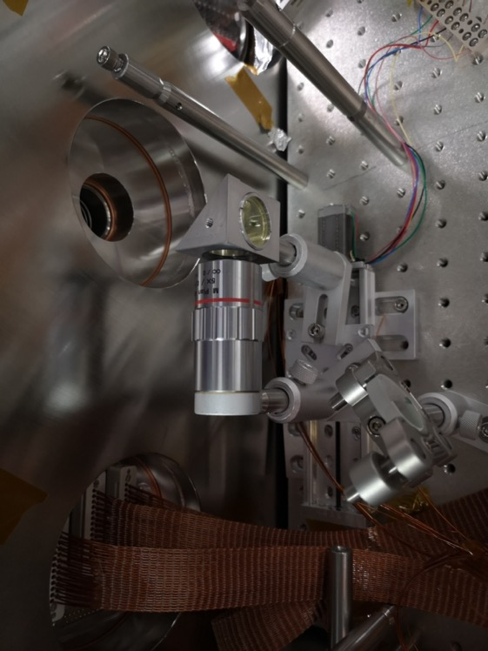
Experimental Setup for Magnetostatic Mode Visualization
CO2 focus diag.
(Pyrocam IV)
CO2 laser, ~1 mJ to avoid ionizing H2
Ti:S main beam (~10 mJ, 80 fs)
Ti:S probe beam (<0.5 mJ, 80 fs)
shadowgraphy
100 µm YAG:Ce
5x obj
IP
e- beam
(50.5 MeV, ~0.2% energy spread
motorized PMQs
camera lens
CCD (GPOP10)
Ti:S focus diag.

Slide 18
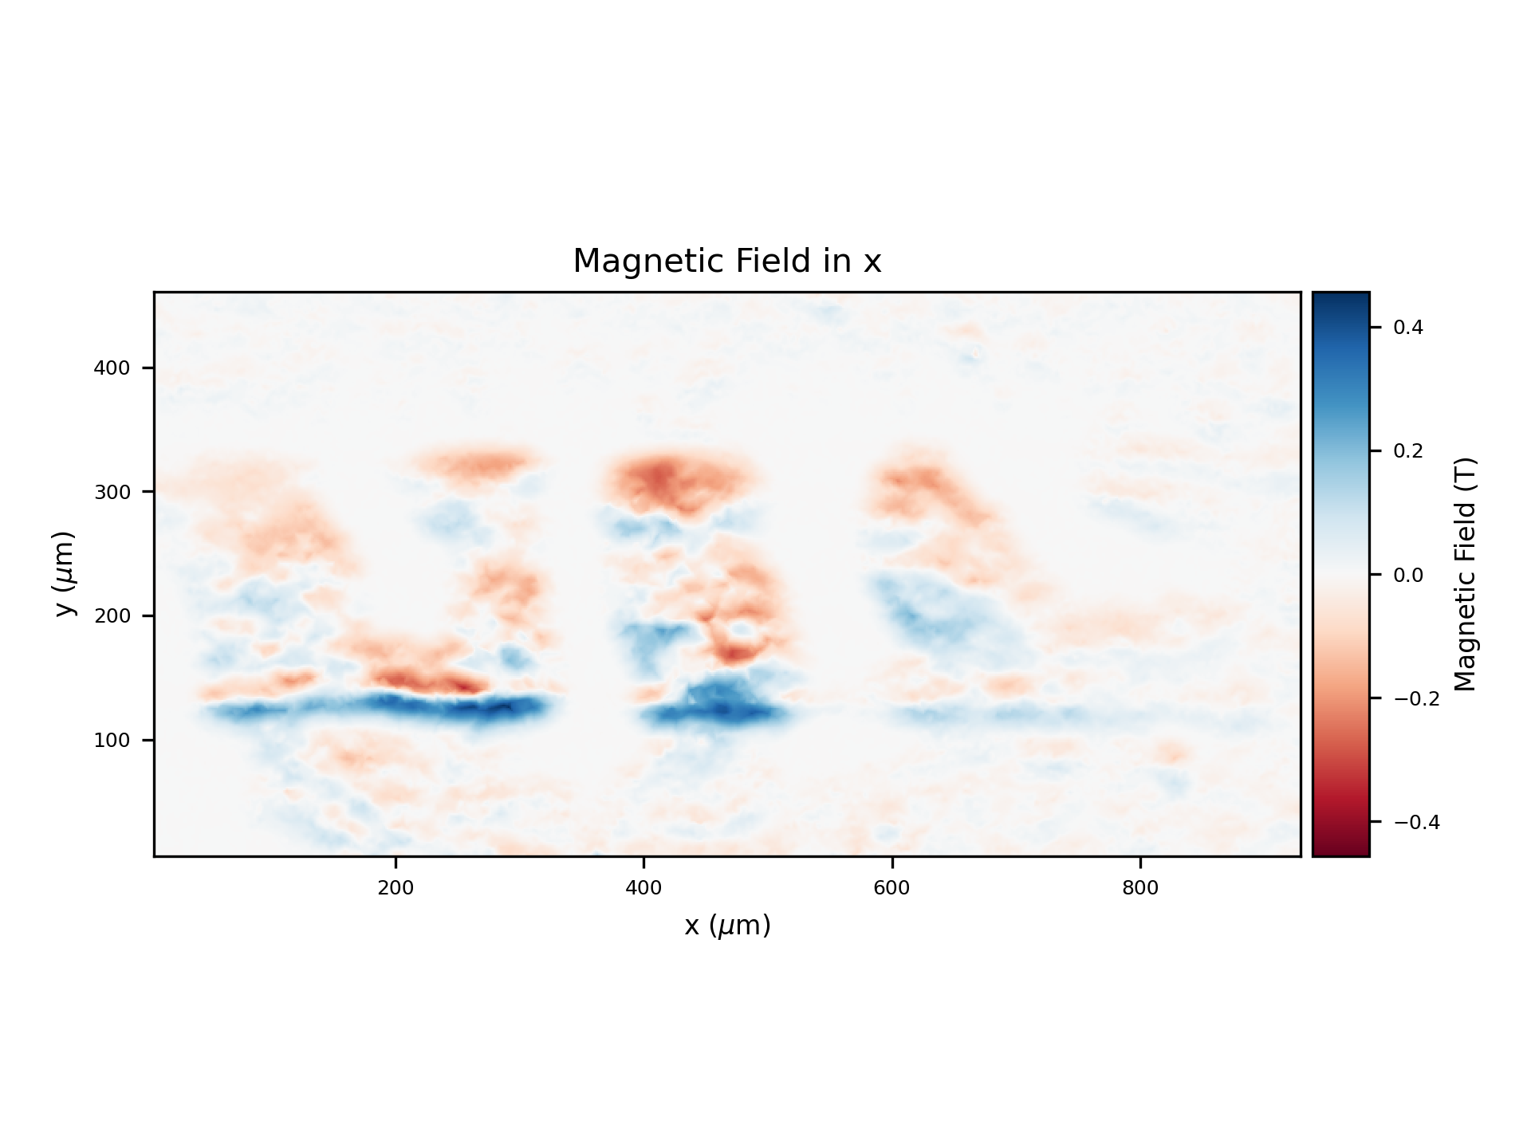
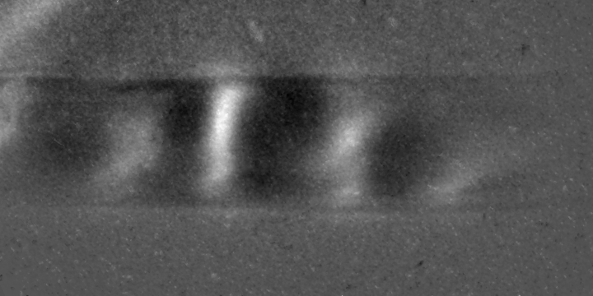
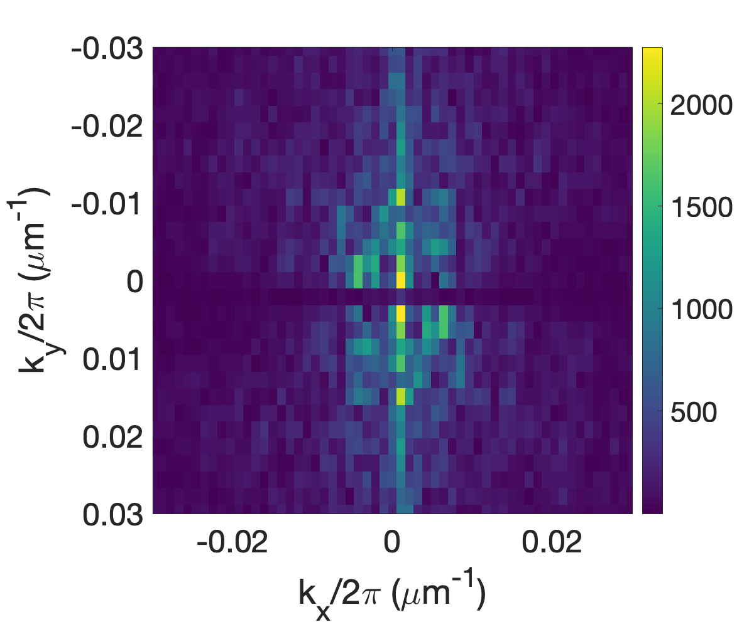
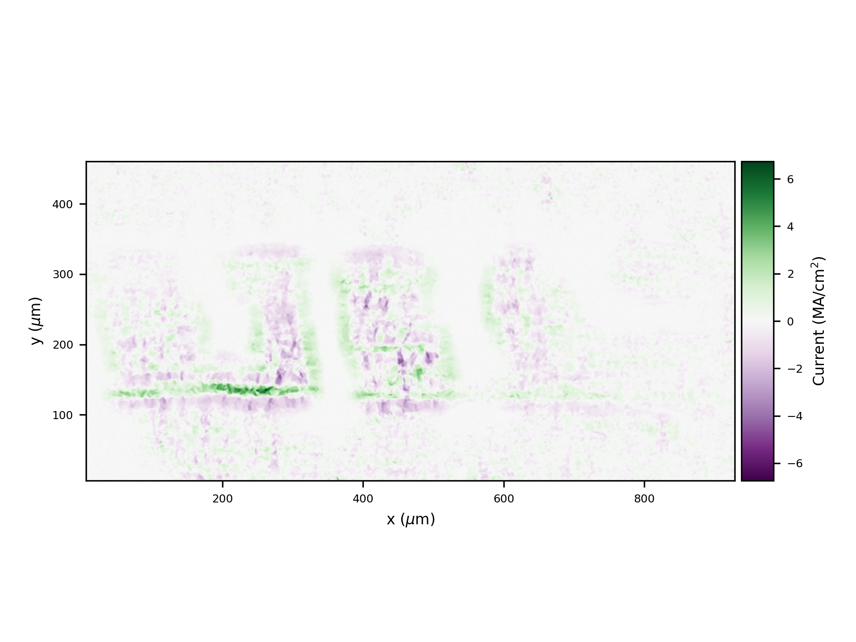
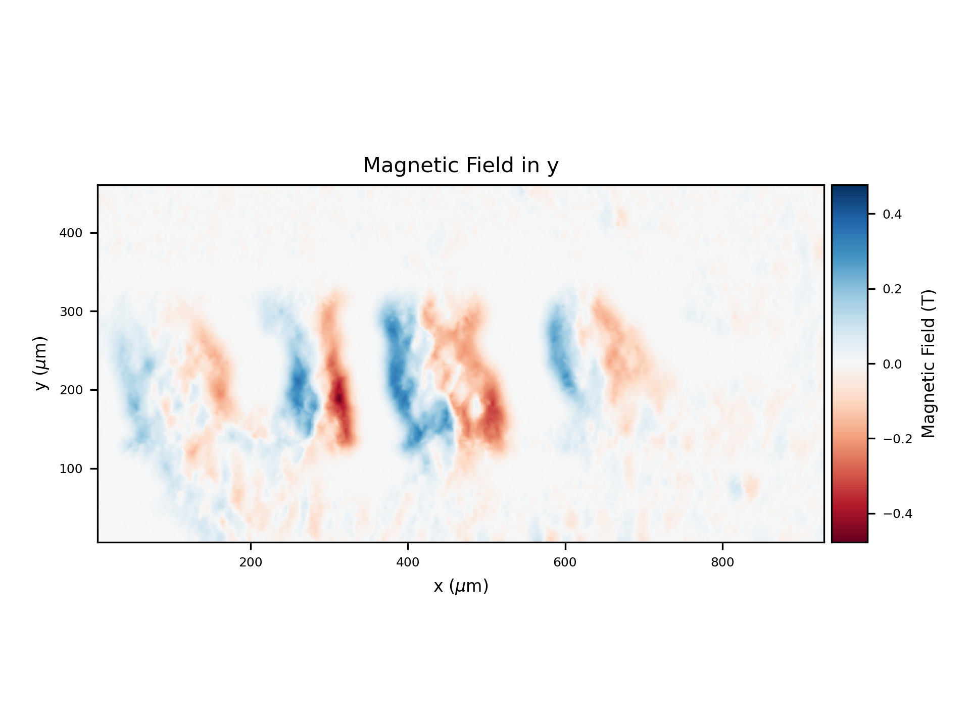
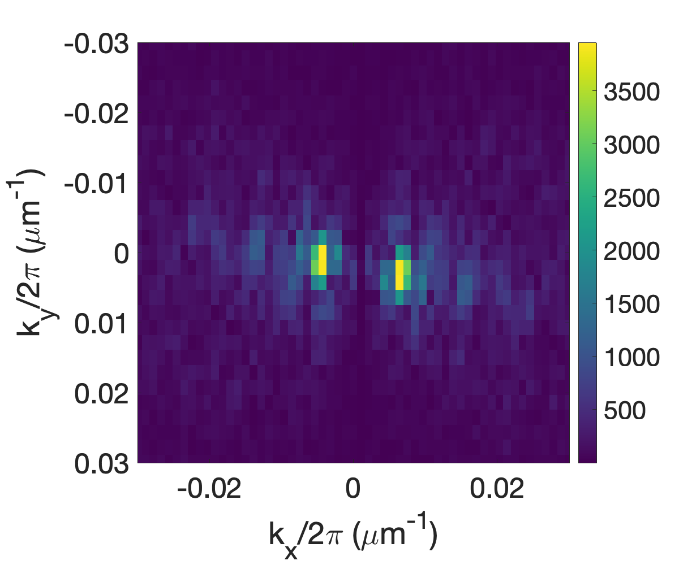
Weibel instability in the bounded plasma
Calculating magnetic fields and plasma currents
t=60ps
Bx
Jz
By
Y. Yu’s presentation (Tuesday)

Slide 19
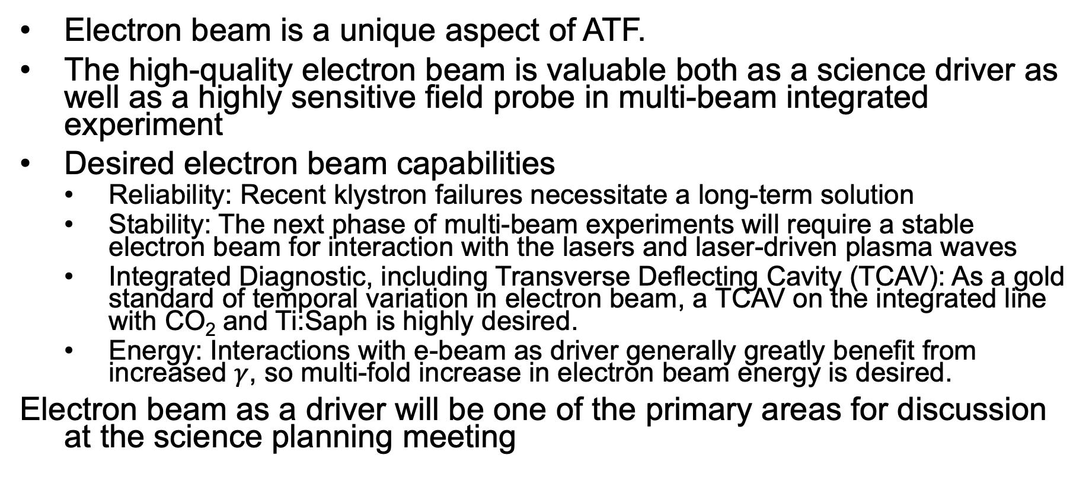
Electron Beam Facility Upgrades Required for Maintaining its Role as a Science Driver
Electron beam is a unique aspect of ATF.
The high-quality electron beam is valuable both as a science driver as well as a highly sensitive field probe in multi-beam integrated experiment
Desired electron beam capabilities
  Reliability: Recent klystron failures necessitate a long-term solution
  Stability: The next phase of multi-beam experiments will require a stable electron beam for interaction with the lasers and laser-driven plasma waves
  Integrated Diagnostic, including Transverse Deflecting Cavity (TCAV): As a gold standard of temporal variation in electron beam, a TCAV on the integrated line with CO₂ and Ti:Saph is highly desired.
  Energy: Interactions with e-beam as driver generally greatly benefit from increased $γ$, so multi-fold increase in electron beam energy is desired.
Electron beam as a driver will be one of the primary areas for discussion at the science planning meeting

Slide 20
Summary
Priority research direction (PRDs) for the facility are determined through science planning workshops
The PRDs in turn define a set of core capabilities as targets for investment
Primary areas of experiment for ATF consist of
Particle generation and acceleration research
Integrated multi-beam experiments to explore novel plasma physics and radiation sources (e.g. ICS)
Laser, plasma, and beam science using unique ATF sources
Major laser infrastructure upgrades have been carried out to facilitate high-impact experiments, but electron beam facility upgrade is also needed to take full advantage of its capability in beam-driven and integrated experiments
The next workshop is planned for later this year to gather community input on the future of science program at ATF

Slide 21
The End

Slide 22
Research Area A Facility Needs
Experiment | LWIR Laser | e-beam
PRD A.1: Ion Acceleration | 10 TW: ~ 10 MeV ions 25 TW: ~ 100 MeV ions Circ. Pol. For advanced methods (RPA, etc)
PRD A.2 e- Acceleration | 10 TW, 1ps: Blowout regime 20 TW, 0.5 ps: Bubble regime Integrated intense NIR: two color injection
PRD A.3 Weibel | 1 TW, ~3 ps, circ. Pol.
Expanded Diagnostic Capabilities
  Plasma Diagnostics (interferometry, shadowgraphy,etc)
  Prepulse contrast diagnostics better than 4 orders of magnitude
  Ultrafast electron radiography (See research area C for more discussion)
  Accurate synchronization and alignment diagnostics for multiple beams (See research area C for more discussion)

Slide 23
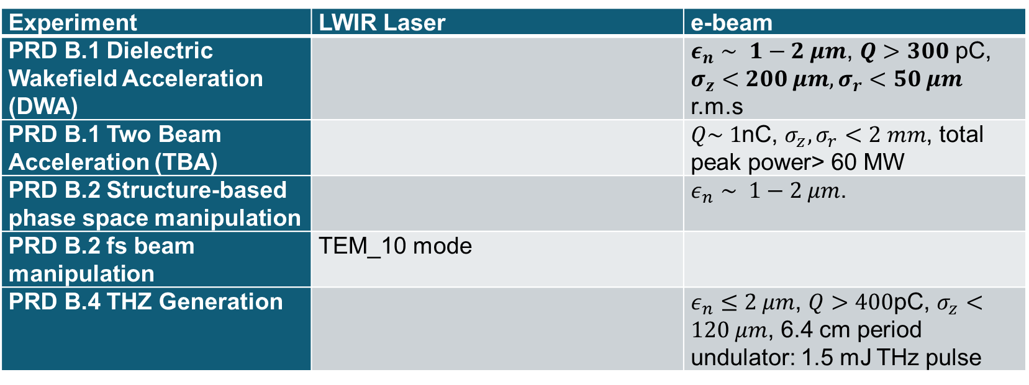
Research Area B Facility Needs
Experiment | LWIR Laser | e-beam
PRD B.1 Dielectric Wakefield Acceleration (DWA) |  | $ε_{n}∼ 1−2 μm$, $Q>300$ pC, $σ_{z}<200 μm, σ_{r}<50 μm$ r.m.s
PRD B.1 Two Beam Acceleration (TBA) |  | $Q\sim 1$nC, $σ_{z}, σ_{r}<2 mm$, total peak power> 60 MW
PRD B.2 Structure-based phase space manipulation |  | $ε_{n}∼ 1−2 μm$.
PRD B.2 fs beam manipulation | TEM_10 mode
PRD B.4 THZ Generation |  | $ε_{n}≤2 μm$, $Q>400$pC, $σ_{z}<120 μm$, 6.4 cm period undulator: 1.5 mJ THz pulse
Required Diagnostic Capabilities
  Beam characterization: Transverse deflective cavity (T- CAV), 2 THz interferometry from coherent transition radiation (CTR), coherent diffraction/edge/Cerenkov radiation (CDR/CER/CCR)

Slide 24
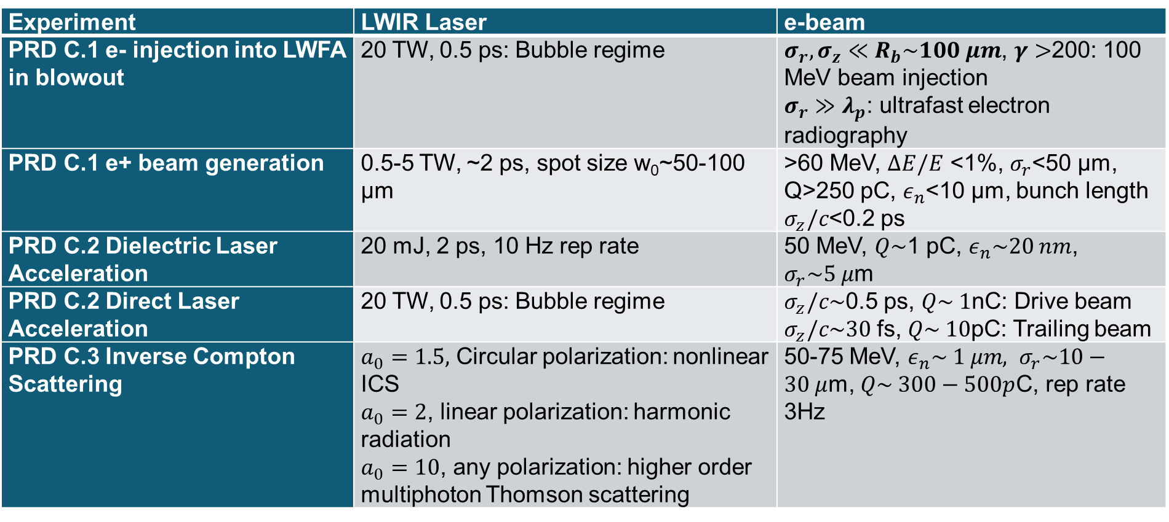
Research Area C Facility Needs
Experiment | LWIR Laser | e-beam
PRD C.1 e- injection into LWFA in blowout | 20 TW, 0.5 ps: Bubble regime | $σ_{r},σ_{z}≪R_{b}\sim 100 μm$, $γ>$200: 100 MeV beam injection $σ_{r}≫λ_{p}$: ultrafast electron radiography
PRD C.1 e+ beam generation | 0.5-5 TW, ~2 ps, spot size w₀~50-100 µm | >60 MeV, $ΔE/E$ <1%, $σ_{r}$<50 µm, Q>250 pC, $ε_{n}$<10 µm, bunch length $σ_{z}/c$<0.2 ps
PRD C.2 Dielectric Laser Acceleration | 20 mJ, 2 ps, 10 Hz rep rate | 50 MeV, $Q\sim$1 pC, $ε_{n}\sim 20 nm$, $σ_{r}\sim 5 μ$m
PRD C.2 Direct Laser Acceleration | 20 TW, 0.5 ps: Bubble regime | $σ_{z}/c\sim$0.5 ps, $Q\sim 1$nC: Drive beam $σ_{z}/c\sim 30$ fs, $Q\sim 10$pC: Trailing beam
PRD C.3 Inverse Compton Scattering | $a_{0}=1.5,$ Circular polarization: nonlinear ICS $a_{0}=2$, linear polarization: harmonic radiation $a_{0}=10$, any polarization: higher order multiphoton Thomson scattering | 50-75 MeV, $ε_{n}\sim 1 μm, σ_{r}\sim 10−30 μ$m, $Q\sim 300−500p$C, rep rate 3Hz

Slide 25
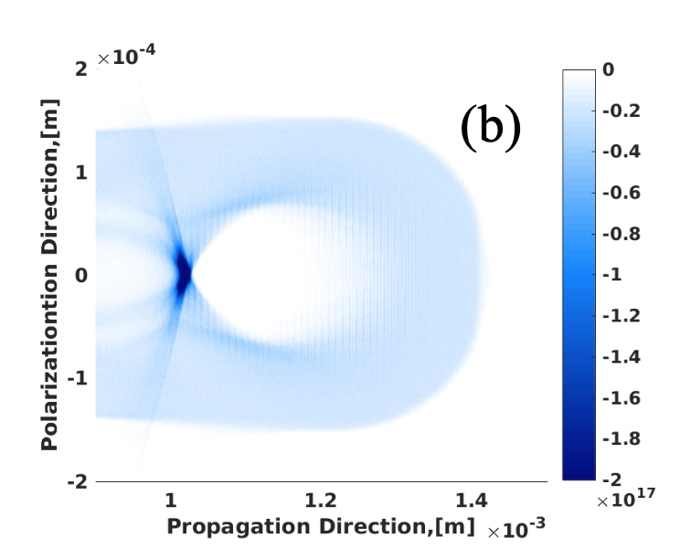
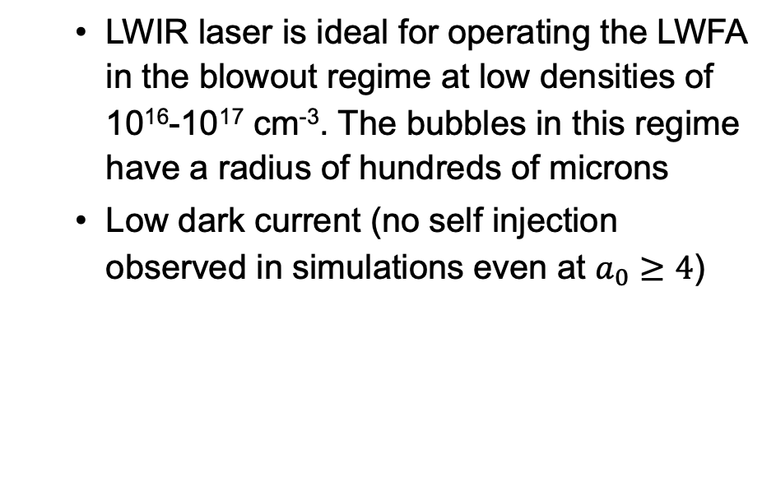
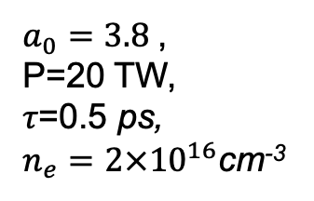
Electron and Ion Acceleration
Uniqueness of ATF Contribution
  LWIR laser is ideal for operating the LWFA in the blowout regime at low densities of 10¹⁶-10¹⁷ cm⁻³. The bubbles in this regime have a radius of hundreds of microns
  Low dark current (no self injection observed in simulations even at $a_{0}≥4$)
$a_{0}=3.8$,
P=20 TW,
𝜏=0.5 ps,
$n_{e}=2×{10}^{16}$cm⁻³

Slide 26
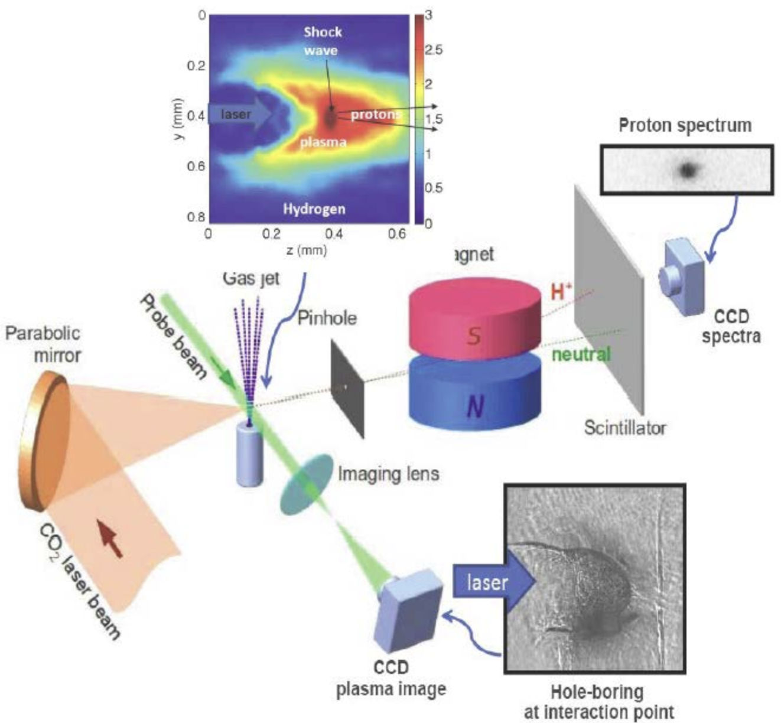
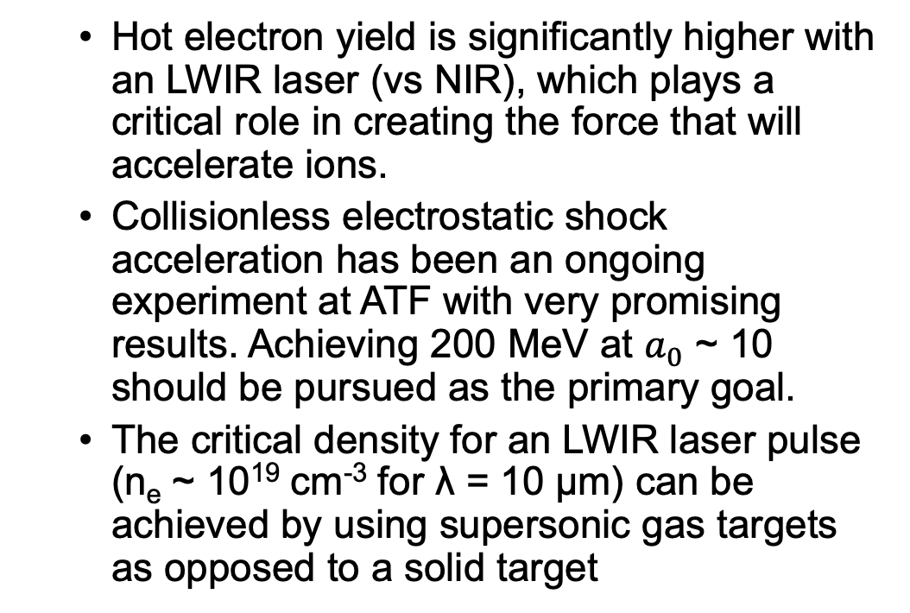
Electron and Ion Acceleration
Ion Acceleration at ATF
Uniqueness of ATF Contribution
  Hot electron yield is significantly higher with an LWIR laser (vs NIR), which plays a critical role in creating the force that will accelerate ions.
  Collisionless electrostatic shock acceleration has been an ongoing experiment at ATF with very promising results. Achieving 200 MeV at $a_{0}$ ~ 10 should be pursued as the primary goal.
  The critical density for an LWIR laser pulse (n_{e} ~ 10¹⁹ cm⁻³ for λ = 10 μm) can be achieved by using supersonic gas targets as opposed to a solid target

Slide 27
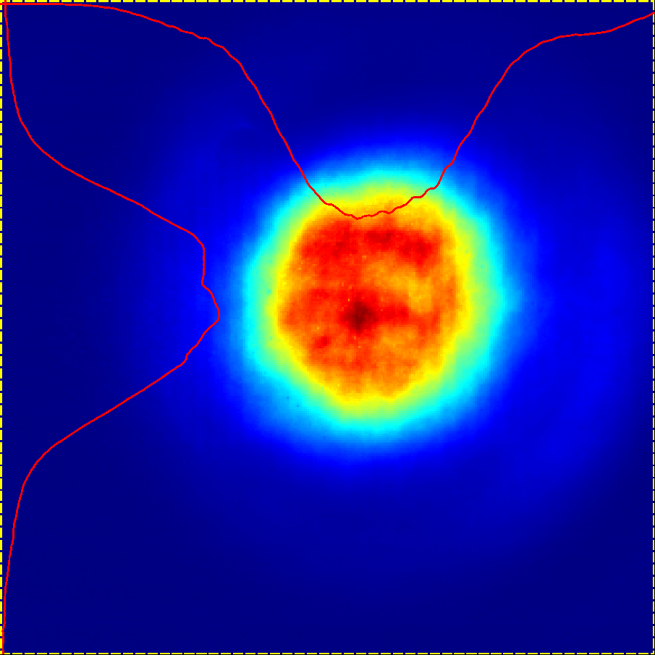
Proof-of-principle NLPC experiment
Autocorrelator image
5 J
500 mJ
Pulse compressed from 2 ps to 290 fs
Opt. Express 29, 31714 (2021)
Principle Diagram of Full-Scale NLPC
5 TW
2 ps
10 TW
500 fs
BaF2
lens
beam spatial filtering for higher uniformity
KCl
5 cm
BaF2
5 cm

Slide 28
Plasma Compression
Counter-propagate ATF CO₂ and an ultra-short seed pulse with slightly longer wavelength
  Timing jitter must satisfy Δt << c/L, where L is the interaction length, L ~ 1 mm
Pump source
Seed source
9.2 micron, 3 J, 5 ps
ATF CO₂ Laser
Driven by ATF Ti:sapphire laser
Helium/Hydrogen
N_{e} = 5x10¹⁷ cm⁻³
L = 1.5 mm
Output:
0.5 J
11 micron
150 fs
100 nJ
11 micron
100 fs
Demonstrate plasma compression of a CO₂ laser pulse from 3 picoseconds to 0.15 picoseconds, with multi-terawatt peak power
28

Slide 29
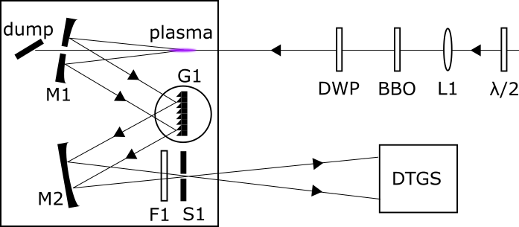
Experimental Setup for LWIR Seed Source
D.F. Gordon et al., Phys. Plasmas 28, 033104 (2021)
29

Slide 30
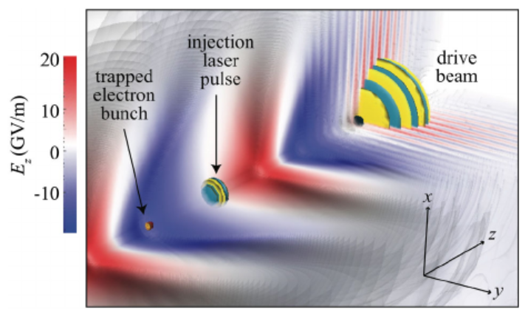
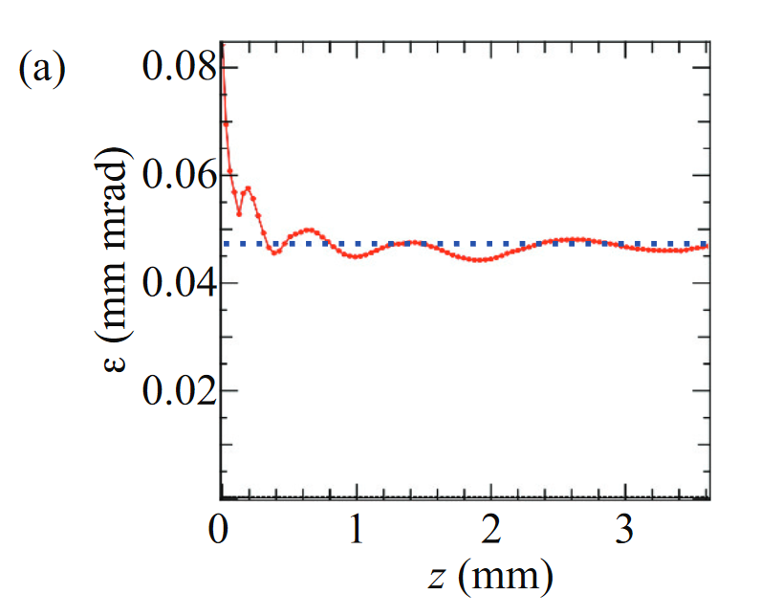
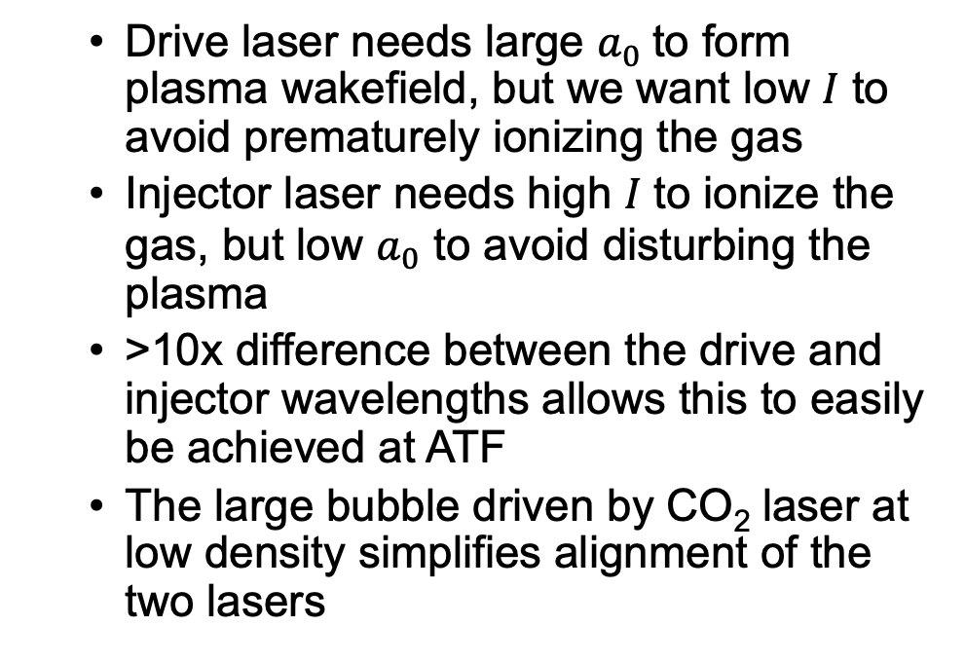
Two-Color Ionization Injection
Uniqueness of ATF Contribution
  Drive laser needs large $a_{0}$to form plasma wakefield, but we want low 𝐼 to avoid prematurely ionizing the gas
  Injector laser needs high 𝐼 to ionize the gas, but low $a_{0}$ to avoid disturbing the plasma
  >10x difference between the drive and injector wavelengths allows this to easily be achieved at ATF
  The large bubble driven by CO₂ laser at low density simplifies alignment of the two lasers
Schroeder, PRSTAB 17, 101301 (2014)
Schroeder, European Conference on Lasers and Electro-Optics (2015)
Low emittance

