Slide 1

25th Annual
Accelerator Test Facility (ATF) Users' Meeting
ATF ARR and 2023 User Plans
M. Palmer
Accelerator Facilities Division
February 28, 2023

Slide 2
2018 Accelerator Safety Order Review
2018 review of several BNL accelerator facilities resulted in the requirement that all facilities that became operational before establishment of the Accelerator Readiness Review process would need to undergo a full ARR to continue operating
ATF is part of an extensive list and the draw on laboratory resources is significant
The ATF ARR is now planned for late 2023
  This will put to the test improvements to the ATF configuration control effort that have been underway since 2017
  This is forcing particular attention on quickly addressing aging facility issues a impacting facility prioritizations
  Thankfully, we have seen strong support from the laboratory to execute this effort
There are challenges and risks with our approach:
  The ATF, in conjunction with its move from HEP to ARDAP, has moved from the Nuclear & Particle Physics Directorate to the Advanced Technology Research Office (ATRO) within BNL.
    This has provided a team with more dedicated focus and enables adoption of improved tools for our approach
  Other facilities have required significant updates in order to pass their ARRs (a significant delays)
  Finally, revisions to the Accelerator Safety Order were implemented (DOE O420.2D) has gone into effect during our preparations for the ARR process

Slide 3
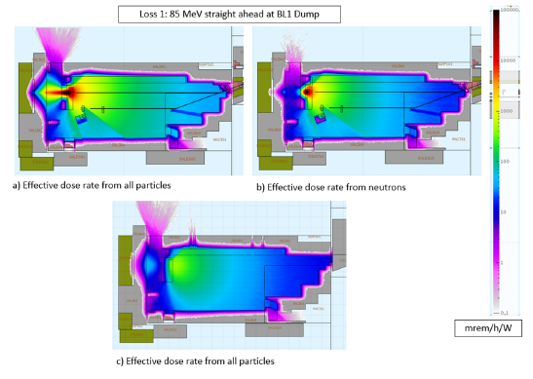
Extensive Modeling of the ATF by the SLAC Radiation Protection Team

Slide 4
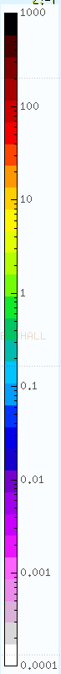
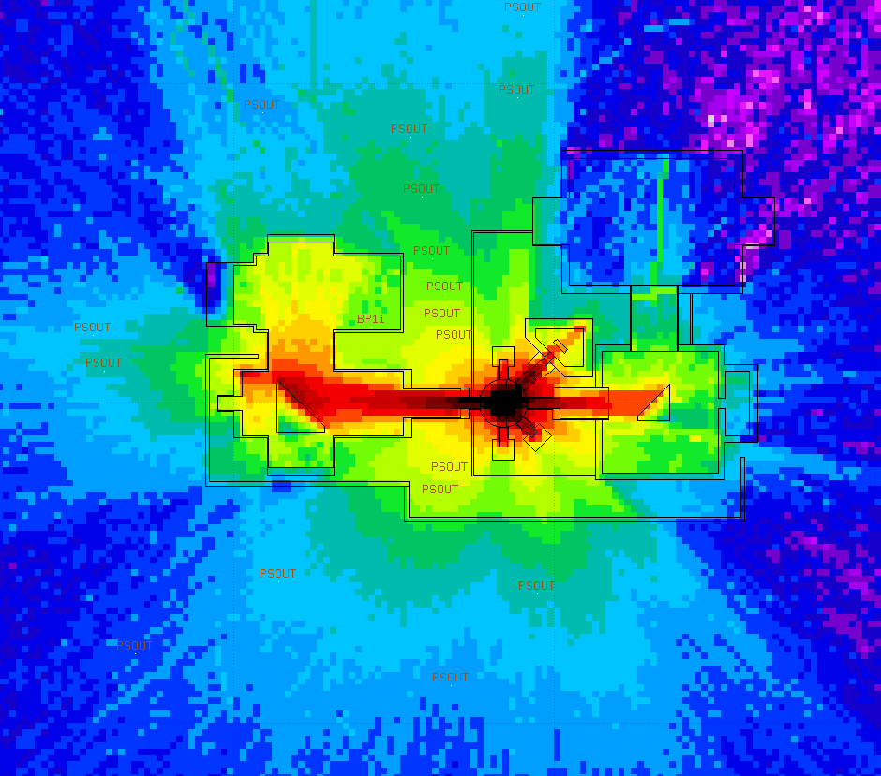
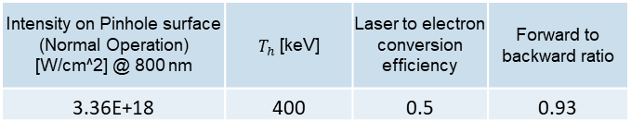
LWIR Laser Upgrade Analysis:
2 ps and 20 J @ 9300 nm
Plan View
0.75 mrem/laser shot
0.75 mrem/laser shot
The maximum dose rate at the exclusion barrier would result in 133 shots before the 100 mrem limit is reached
0.7 mrem/laser shot
mrem/laser shot

Slide 5
User Impacts
FY22 and FY23 operating schedules heavily constrained by ongoing ARR preparation activities
  FY22 User Hour Target: 1800 total user hours
  FY23 User Hour Target: 1900 total user hours
    We are working hard to minimize the net impact on user hours
Infrastructure improvements and facility corrective action plans have impacted operations in both years
  Current down was designed to accommodate significant infrastructure improvements that prevent facility operations
  Expectation is that more efficient operations will be possible in subsequent years

Slide 6
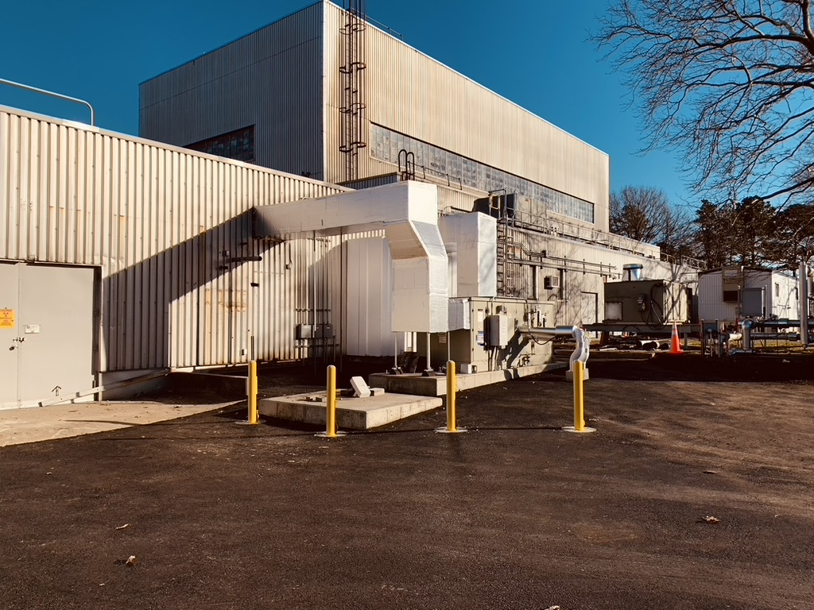
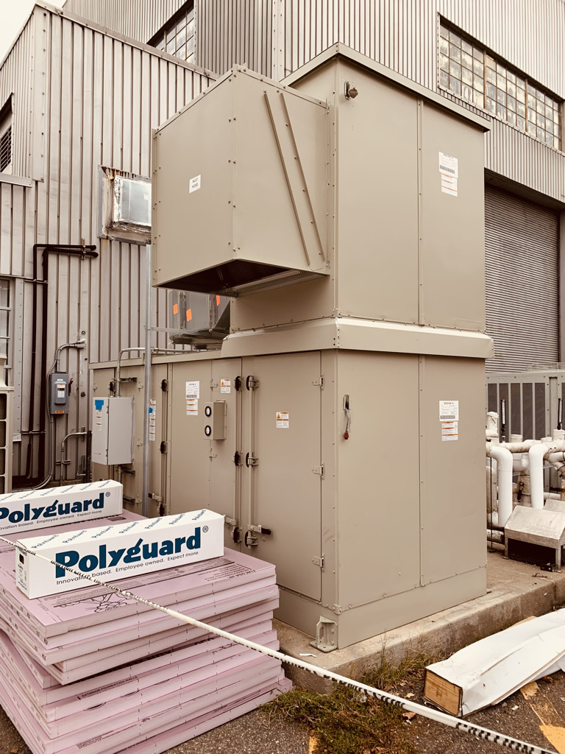
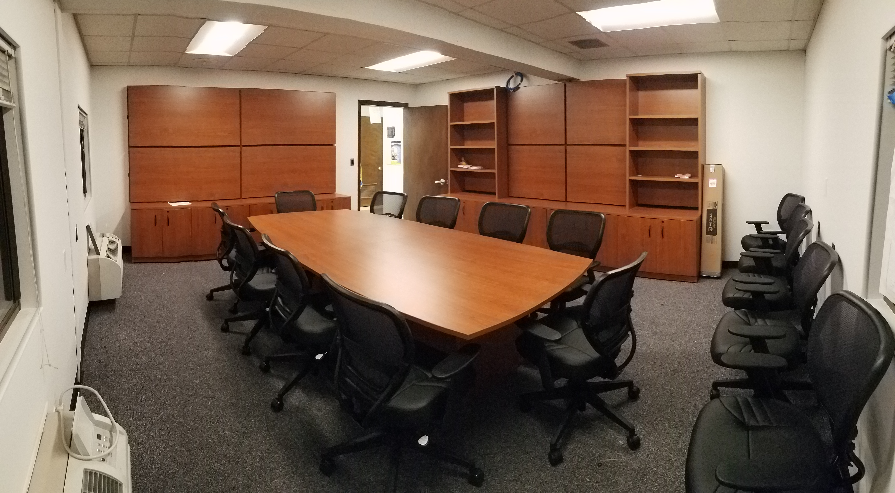
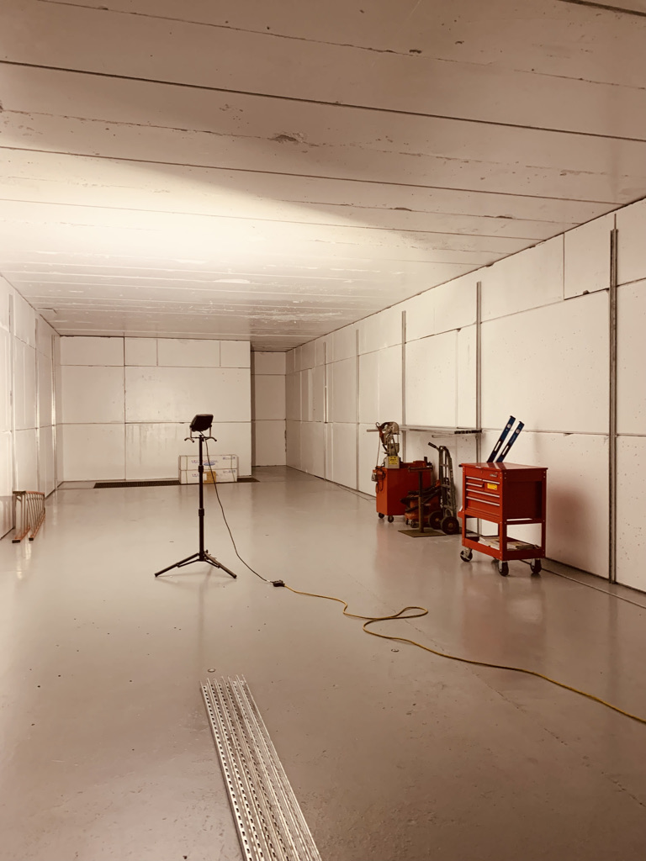
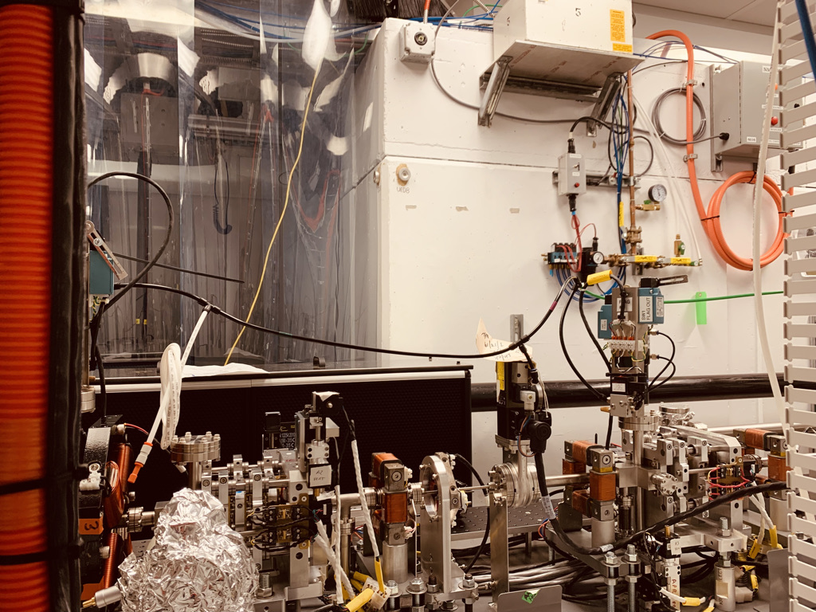
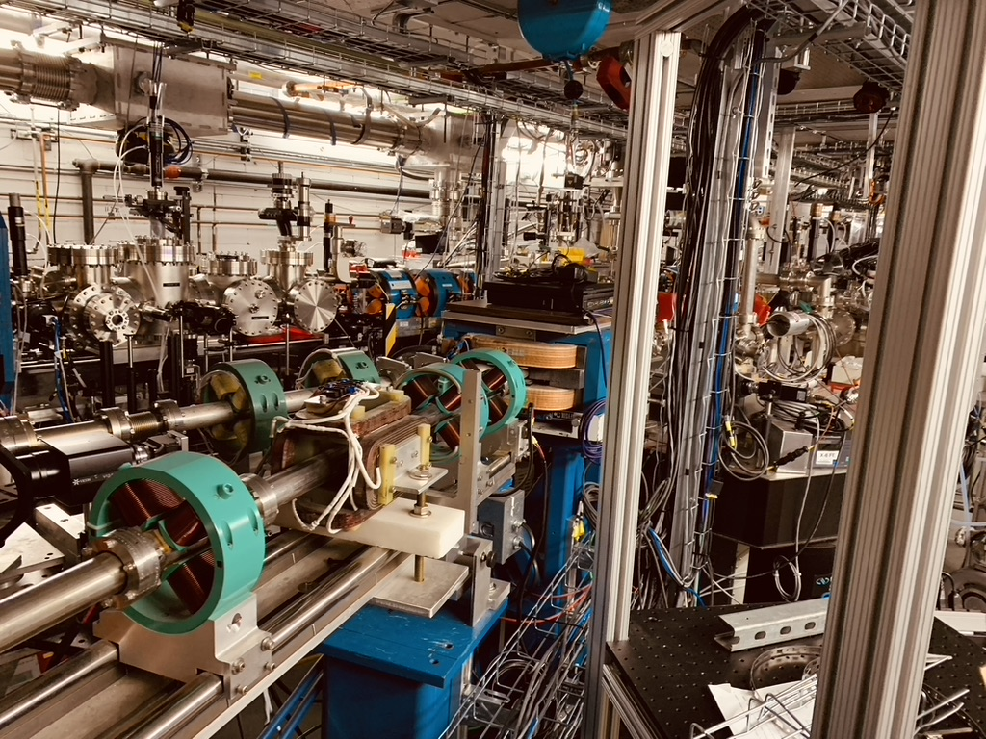
ATF Facility Changes
NIR Laser Systems:
Air Handler (AHU2)
Replacement
Christina Swinson-Cruz Memorial Conference Room
EH & CO2 Areas:
Air Handler (AHU1)
Replacement
Deployment of Ultrafast Electron Microscopy Beamline @B912
New Radiation Shielded Research Space @B912

Slide 7
ATF FY23 Operations Plan &
Key Initiatives

Slide 8
CO₂ Laser Parameters
Configuration | Parameter | Units | Typical Values | Comments
CO₂ Regenerative Amplifier Beam | Wavelength | μm | 9.2 | Wavelength determined by mixed isotope gain media
 | Peak Power | GW | ~3
 | Pulse Mode | --- | Single
 | Pulse Length | ps | 2
 | Pulse Energy | mJ | 6
 | M² | --- | ~1.5
 | Repetition Rate | Hz | 1.5 | 3 Hz also available if needed
 | Polarization | --- | Linear | Circular polarization available at slightly reduced power
CO₂ CPA Beam | Wavelength | μm | 9.2 | Wavelength determined by mixed isotope gain media
Note that delivery of full power pulses to the Experimental Hall is presently limited to Beamline #1 only. | Peak Power | TW | 5 | ~5 TW operation will become available shortly into this year’s experimental run period. A 3-year development effort to achieve >10 TW and deliver to users is in progress.
 | Pulse Mode | --- | Single
 | Pulse Length | ps | 2
 | Pulse Energy | J | ~5 | Maximum pulse energies of >10 J will become available within the next year
 | M² | --- | ~2
 | Repetition Rate | Hz | 0.05
 | Polarization |  | Linear | Adjustable linear polarization along with circular polarization can be provided upon request

Slide 9
Near IR Laser Parameters
Ti:Sapphire Laser System | Units | Stage I Values | Stage II Values | Comments
Central Wavelength | nm | 800 | 800 | Stage I parameters are presently available and setup to deliver Stage II parameters should be complete during FY22
FWHM Bandwidth | nm | 20 | 13
Compressed FWHM Pulse Width | fs | <50 | <75 | Transport of compressed pulses will initially include a very limited number of experimental interaction points. Please consult with the ATF Team if you need this capability.
Chirped FWHM Pulse Width | ps | ≥50 | ≥50
Chirped Energy | mJ | 10 | 200
Compressed Energy | mJ | 7 | ~20 | 20 mJ is presently operational with work underway this year to achieve our 100 mJ goal.
Energy to Experiments | mJ | >4.9 | >80
Power to Experiments | GW | >98 | >1067
Nd:YAG Laser System | Units | Typical Values | Comments
Wavelength | nm | 1064 | Single pulse
Energy | mJ | 5
Pulse Width | ps | 14
Wavelength | nm | 532 | Frequency doubled
Energy | mJ | 0.5
Pulse Width | ps | 10

Slide 10
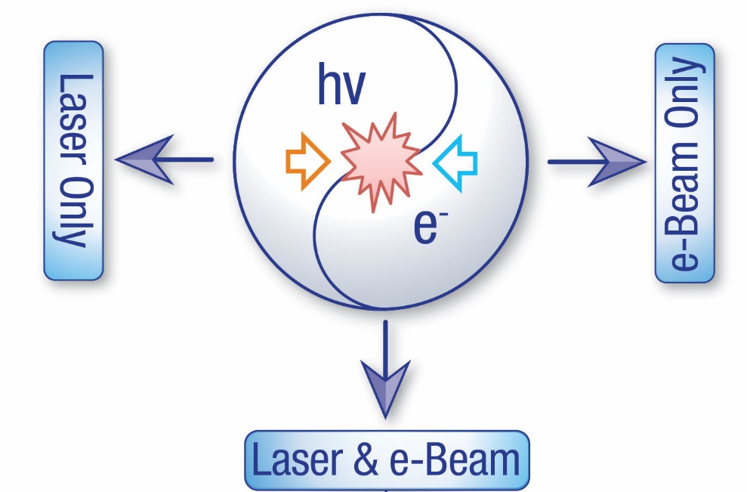
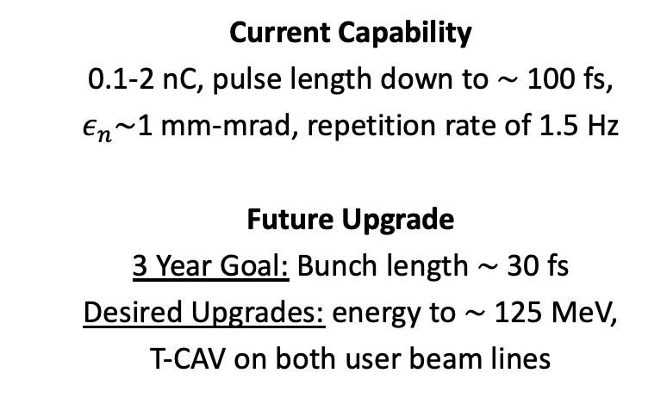
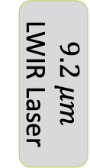
ATF Current Capabilities & Potential Upgrade Paths
  Current Capability
  5 TW, 2 ps CO₂ laser pulses at the output of the final amplifier, up to 2.5 TW delivered to users
  Upgrades
  Current Efforts: 5 TW delivered to users
  3 Year Goal: 10-20 TW of CO₂ laser power with sub-ps pulse length delivered to users
  Current Capability
  0.1-2 nC, pulse length down to $\sim$100 fs, $ε_{n}\sim$1 mm-mrad, repetition rate of 1.5 Hz
  Future Upgrade
  3 Year Goal: Bunch length $\sim$30 fs
  Desired Upgrades: energy to $\sim$125 MeV, T-CAV on both user beam lines
$$9.2 μm$$
LWIR Laser
75 MeV e-beam
NIR Probes
  Current Capability
  Nd:YAG: 1-5 mJ, 1-15 ps pulse length delivered
  Ti:Sapphire: 20 mJ, ≤100 fs pulses delivered
  Commissioning underway
  Ti:Sapphire: 100 mJ energy upgrade
Notes:
Upgrades: mJ seed pulse, NLPC, gain profile modification to reach 1 ps.

Slide 11
Current Layout of the ATF at B820
New Location for the ATF Strong Field Laser (Ti:Sapph), BNL/NRL Collaboration
Beamline 1
Experimental stations
Accelerator sections
Photocathode gun
Bunch compressor
Deflector cavity
Beamline 2
Experimental stations

Slide 12
Aiming to resume beam operations in mid-February
2024 after the conclusion of the ARR process

Slide 13
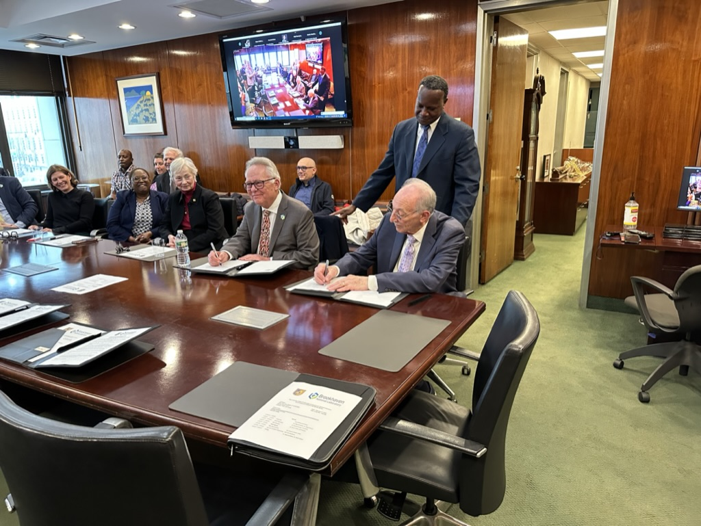
DEI
Initiatives
Continue
MOU signing with City Tech (CUNY)
Director Gibbs
President Hotzler
Expanded work force training in accelerators and lasers

Slide 14
Questions?
Accelerator Facilities Division

