Slide 1

25th Annual
Accelerator Test Facility (ATF) Users' Meeting
ATF Status
M. Fedurin, M. Palmer
Accelerator Facilities Division
February 28, 2023

Slide 2
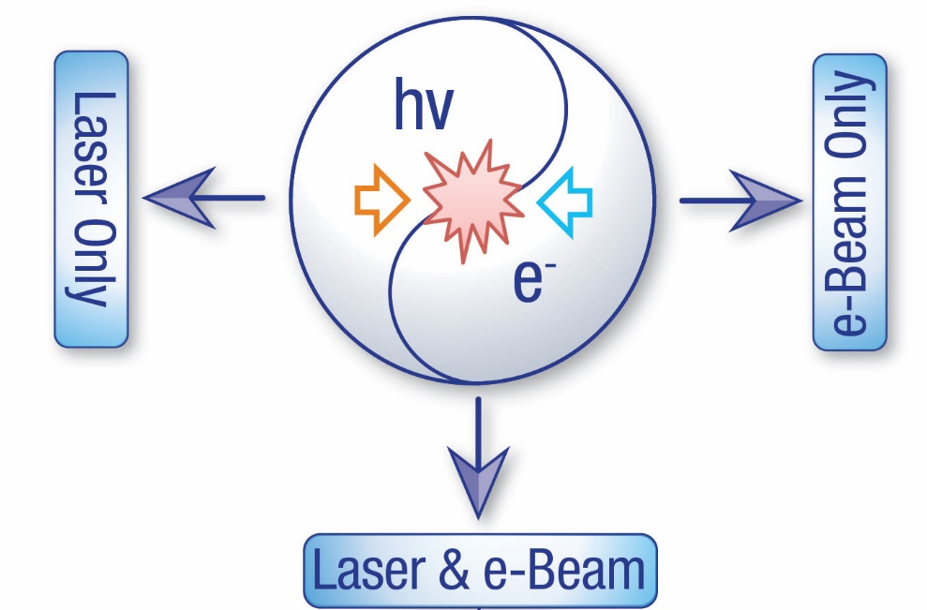
The ATF User Program
Designated a DOE National User Facility in 2015
Accelerator Stewardship Program
User Research Thrusts:
  Novel particle acceleration techniques
  R&D for smaller, more cost-effective accelerators including:
    Plasma and dielectric wakefield acceleration
    Direct laser acceleration
    Inverse free-electron lasers…
  High-brightness radiation sources
  New techniques to produce electromagnetic radiation
  from THz to X-rays:
    FEL R&D
    Inverse Compton scattering
    THz radiation from dielectric structures…
  Beam manipulation and beam instrumentation
  Sophisticated longitudinal and transverse beam manipulation capabilities
    Wide range of beam parameters enabling development and testing of advanced accelerator hardware, beam diagnostics and detectors
  Ion generation and acceleration
    Experimental hardware for producing supersonic hydrogen gas jets provides capabilities for generating mono-energetic multi-MeV proton beams
  Ultrafast Electron Diffraction/Microscopy
  Technique for characterizing materials that is complementary to x-ray sources
    Developmental beam line and experimental station for diffraction and imaging
    studies with MeV-class electron beams
CO₂ long-wave infrared (LWIR) laser system
λ = 9.2 μm
>5 TW peak power
full power to user IPs in 2023
5-15 J @ 2.0ps width
0.05 Hz repetition rate
New near IR capabilities
High-brightness photocathode linac: 20-75 MeV
Emittance: 1μm
Energy spread: 0.1%
Charge: ~1 nC
Single bunch:
10 ps – 200 fs
Multi-bunch trains

Slide 3
Current Layout of the ATF at B820
New Location for the ATF Strong Field Laser (Ti:Sapph), BNL/NRL Collaboration
Beamline 1
Experimental stations
Accelerator sections
Photocathode gun
Bunch compressor
Deflector cavity
Beamline 2
Experimental stations

Slide 4
Electron Beam Parameters
Parameter | Units | Typical Values | Comments
Beam Energy | MeV | 50-65 | Full range is ~15-75 MeV with highest beam quality at nominal values
Bunch Charge | nC | 0.1-2.0 | Bunch length & emittance vary with charge
Compression | fs | Down to 100 fs (up to 1 kA peak current) | A magnetic bunch compressor available to compress bunch down to ~100 fs. Beam quality is variable depending on charge and amount of compression required. NOTE: Further compression options are being developed to provide bunch lengths down to the ~10 fs level
Transverse size at IP (σ) | μm | 30 – 100 (dependent on IP position) | It is possible to achieve transverse sizes below 10 um with special permanent magnet optics.
Normalized Emittance | μm | 1 (at 0.3 nC) | Variable with bunch charge
Rep. Rate (Hz) | Hz | 1.5 | 3 Hz also available if needed
Trains mode | --- | Single bunch | Multi-bunch mode available. Trains of 24 or 48 ns spaced bunches.

Slide 5
CO₂ Laser Parameters
Configuration | Parameter | Units | Typical Values | Comments
CO₂ Regenerative Amplifier Beam | Wavelength | μm | 9.2 | Wavelength determined by mixed isotope gain media
 | Peak Power | GW | ~3
 | Pulse Mode | --- | Single
 | Pulse Length | ps | 2
 | Pulse Energy | mJ | 6
 | M² | --- | ~1.5
 | Repetition Rate | Hz | 1.5 | 3 Hz also available if needed
 | Polarization | --- | Linear | Circular polarization available at slightly reduced power
CO₂ CPA Beam | Wavelength | μm | 9.2 | Wavelength determined by mixed isotope gain media
Note that delivery of full power pulses to the Experimental Hall is presently limited to Beamline #1 only. | Peak Power | TW | 5 | ~5 TW operation will become available shortly into this year’s experimental run period. A 3-year development effort to achieve >10 TW and deliver to users is in progress.
 | Pulse Mode | --- | Single
 | Pulse Length | ps | 2
 | Pulse Energy | J | ~5 | Maximum pulse energies of >10 J will become available within the next year
 | M² | --- | ~2
 | Repetition Rate | Hz | 0.05
 | Polarization |  | Linear | Adjustable linear polarization along with circular polarization can be provided upon request

Slide 6
Near IR Laser Parameters
Ti:Sapphire Laser System | Units | Stage I Values | Stage II Values | Comments
Central Wavelength | nm | 800 | 800 | Stage I parameters are presently available and setup to deliver Stage II parameters should be complete during FY22
FWHM Bandwidth | nm | 20 | 13
Compressed FWHM Pulse Width | fs | <50 | <75 | Transport of compressed pulses will initially include a very limited number of experimental interaction points. Please consult with the ATF Team if you need this capability.
Chirped FWHM Pulse Width | ps | ≥50 | ≥50
Chirped Energy | mJ | 10 | 200
Compressed Energy | mJ | 7 | ~20 | 20 mJ is presently operational with work underway this year to achieve our 100 mJ goal.
Energy to Experiments | mJ | >4.9 | >80
Power to Experiments | GW | >98 | >1067
Nd:YAG Laser System | Units | Typical Values | Comments
Wavelength | nm | 1064 | Single pulse
Energy | mJ | 5
Pulse Width | ps | 14
Wavelength | nm | 532 | Frequency doubled
Energy | mJ | 0.5
Pulse Width | ps | 10

Slide 7
ATF FY22 Status Report

Slide 8
Introduction
FY22 Planned User Hours
Severely constrained by required ARR process at B820
(see later talk)
FY22 Targets
  Electron Beam: 400
  UED: 950
  Laser (LWIR + NIR): 450
  Facility Total: 1800

Slide 9
Overall Availability
FY22 Overall User Hour Target Met
Challenges:
Electrical Failures at B912 impacted UED maintenance
ARR preparations and surprise discoveries at B820 led to
significant extension of the planned down period
a leading to significant unscheduled down time
  Major impacts - particularly
  for the ATF laser systems
Gun klystron failure near
end of the FY22 user
campaign

Slide 10
FY22 Hours Summary

Slide 11
ATF FY23 Operations Plan

Slide 12
FY23 Planned Hours and Progress-To-Date
User Hour Constraints:
Pre-ARR corrective actions
Complete 5TW peak power CO2 upgrade
Gun klystron replacement
UED Facility to be removed from the
ATF SC User Facility portfolio effective April 1, 2023
  Operations to continue as an Non-Designated User Facility (NDUF) with full cost recovery
2nd year with severe operating hour limitations:
1900 capability hours planned (versus 2500 optimal)

Slide 13
Summary
FY23 is our 2nd “non-standard” year for ATF User operations
Reduced user hours due to Accelerator Readiness Review preparations (see later talk)
UED Facility is providing user hours only to experiments already underway
  Transition to a NDUF will take place on April 1
Ongoing challenges of aging hardware → Gun klystron failure
Nonetheless,
We are continuing with improvements to our laser capabilities (both NIR and LWIR)
We will offer a major user run from April to early September at B820

Slide 14
Questions?
Accelerator Facilities Division

