Slide 1
Multiatmopshere CO₂ amplifier optically pumped by a 4.3 μm Fe:ZnSe laser
(AE85 funded by DoE Accelerator Stewardship grant)
Sergei Tochitsky, Dana Tovey, Jeremy Pigeon, Chan Joshi
Department of Electrical Engineering, UCLA
Igor Pogorelsky, Mikhail Polyanskiy
Brookhaven National Laboratory, USA
Sergei Mirov, V Fedorov
University of Alabama at Birmingham

Slide 2
Motivation
Particle Acceleration using relativistic laser pulses
Ponderomotive force scales as Iλ²
a₀=1 I=10¹⁶W/cm² (CO₂) ≈ 10¹⁸W/cm² (1µm)
Plasma Based Ion Accelerators
Overdense plasma phenomena in range n_{e} = 1-10n_{cr} (n_{cr}=10¹⁹ cm³) can be easily realized in an ionized gas .
Laser Wakefield Accelerators
Need subpicosecond 0.3-0.5 ps multi-TW mid-IR pulses.
Despite demonstrated 15 TW, 3 ps (UCLA) and 5 TW, 2 ps (BNL) CO₂ lasers,
subpicosecond multi-TW laser-driver is yet to be developed. Both
bandwidth and repetition rate are limited by pulsed power technology.
Neptune Laboratory
ATF -2023
Notes:
2

Slide 3
Optically Pumped CO₂ Laser
CO₂ Molecule
Recipe for success: High-gain CO₂ laser
Population of 001 level Maximized
Population of 100 level Minimized
CO
Gain Spectrum
2
1
0.8
1atm
10atm
20atm
Δν~1.2THz
0.6
Normalized Ampl..
Normalized Gain
0.4
0.2
0
10.4
10.6
10.8
11
10.4
10.6
10.8
11
10.4
10.6
10.8
11
μ
Wavelength (μm)
Wavelength (
m)
ATF -2023

Slide 4
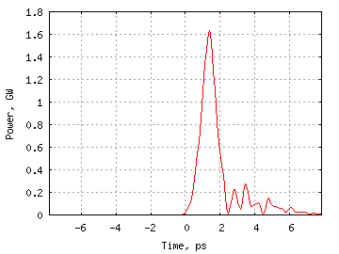
Modeling of Ultrafast Pulse Amplification
4.3 μm
Laser
0.5 ps seed
2 mJ, ~1.0 ps
(FWHM)
10 μm pulses
500 fs
10 GW
10 μm
<300 fs
OPA
Seed
10-15 atm
Isotope CO₂
Amplifier
Feasibility study of a compact GW class
CO₂ amplifier and gain dynamics.
D. Tovey et al. Appl. Opt., 58, 5756, 2019,
ATF -2023

Slide 5
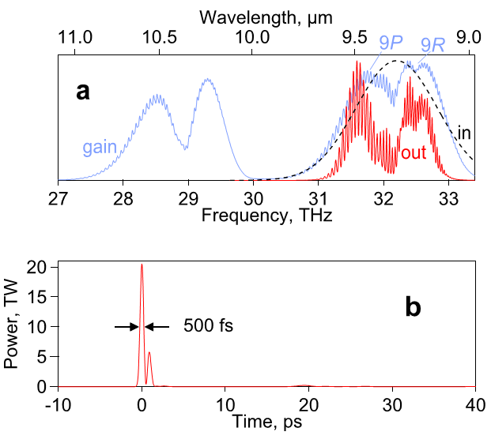
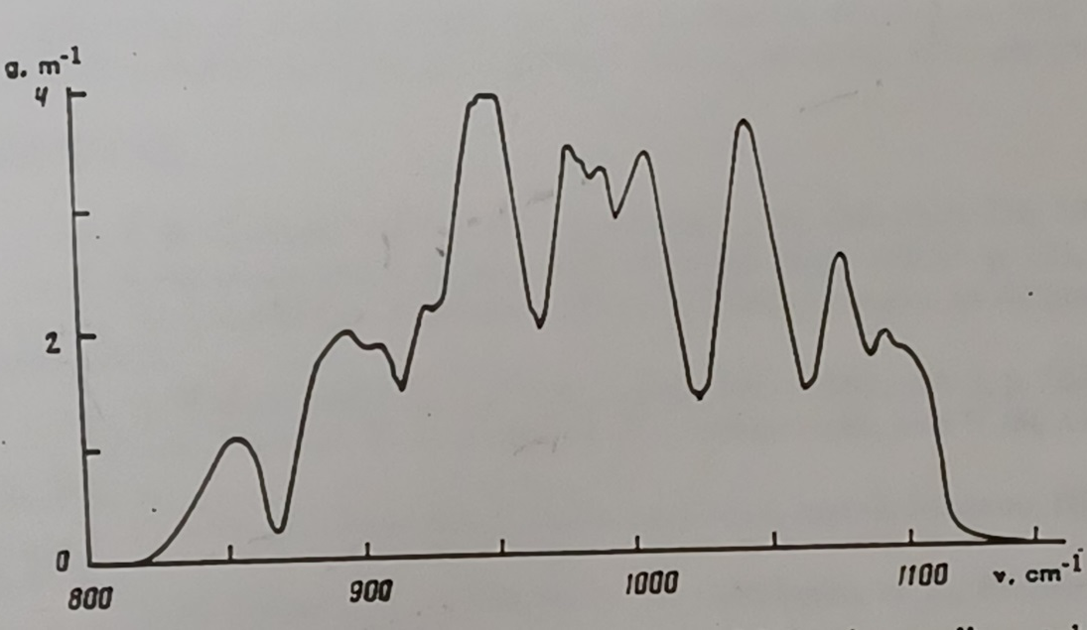
Gain Tailoring in Isotopic CO₂ amplifier
CO₂ gain profile
Z. Biglov, et al MSU, Bulletin of the Academy of Sciences of the USSR, 55, 135 (1991).
Multi-isotopic Mix at 15 atm can support
100 fs, 10 μm pulses
ATF Path to multi-TW, 0.5 ps pulses for LWFA requires a few mJ, 300 fs, 9.2 μm seed.
M. Polyanskiy, et al “High-peak-power long wave infrared lasers with CO₂ amplifiers”, Photonics, 8, 101 (2021).
Optically pumped high-pressure mix of several stable isotopic CO₂ + He can become a viable gain medium for 0.3-0.5 ps mid-IR pulses.
ATF -2023

Slide 6
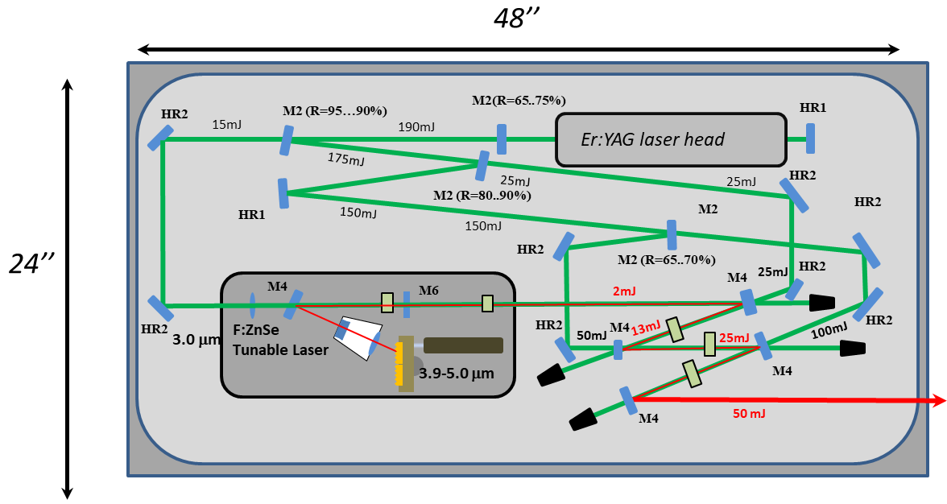
Tunable 3.9-5 μm Fe:ZnSe source for
Optical Pumping of the CO₂ laser
Group of Prof. S. Mirov
ATF -2023

Slide 7
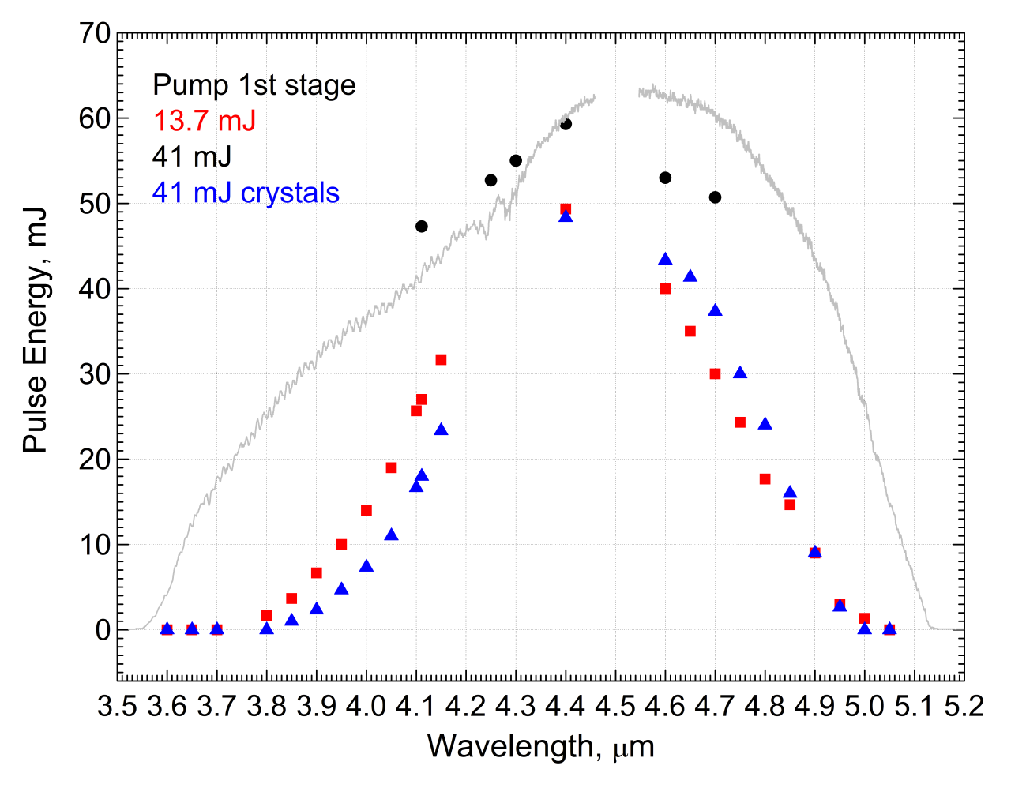
Tunable 3.9-5 μm Fe:ZnSe source for
Optical Pumping of the CO₂ laser
D. Martyshkin, et al “Room temperature, nanosecond, 60 mJ/pulse
Fe:ZnSe master oscillator power amplifier system operating at
3.8-5.0 µm,” Opt. Express 29, 2387-2393 (2021).
Group of Prof. S. Mirov
ATF -2023

Slide 8
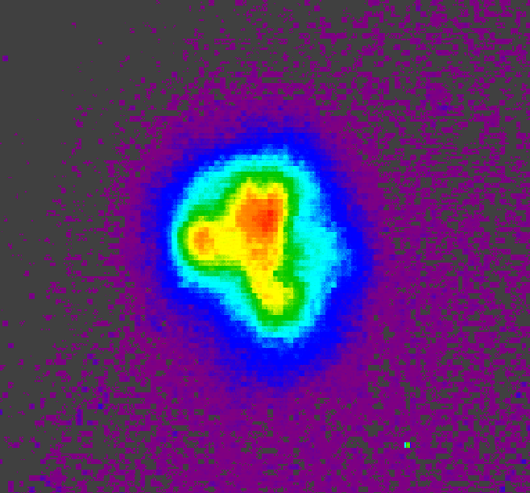
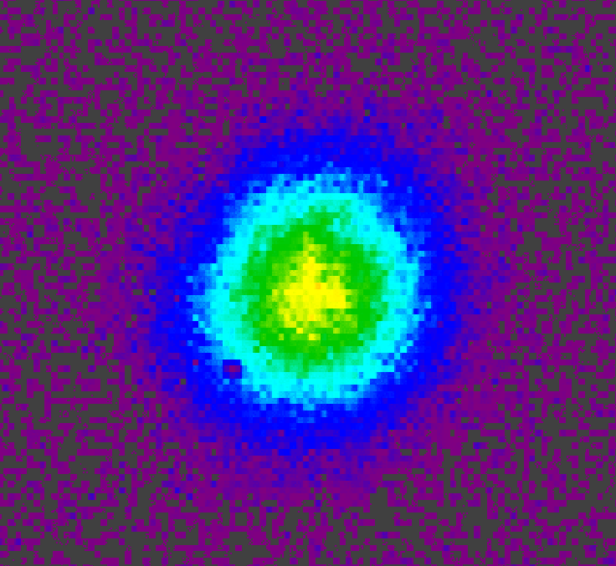
Optically Pumped 10-15 atm CO₂ Laser
Optically pumped CO₂ cell
4.3 μm pump
DM
DM
NaCl
Lens
Fe:ZnSe
laser
10 μm lasing
10 μm filter
4.3 μm pump: 50 mJ, 150 ns
9.3 mm
Lens
Diffraction grating
10 μm lasing
15 atm
Calorimeter
HCT detector /
Calorimeter /
Pyrocamera
9.3 mm
A 10-cm long high-pressure CO₂ cell.
Neptune Laboratory
ATF -2023
Notes:
Is it ok that we don’t show reflection off diffraction grating (when used as output coupler)?
Should I make FZS box smaller? Put on right maybe?
Got new beam profile for 15 atm lasing but using old beam profile for FZS pump beam (should I get new one?)

Slide 9
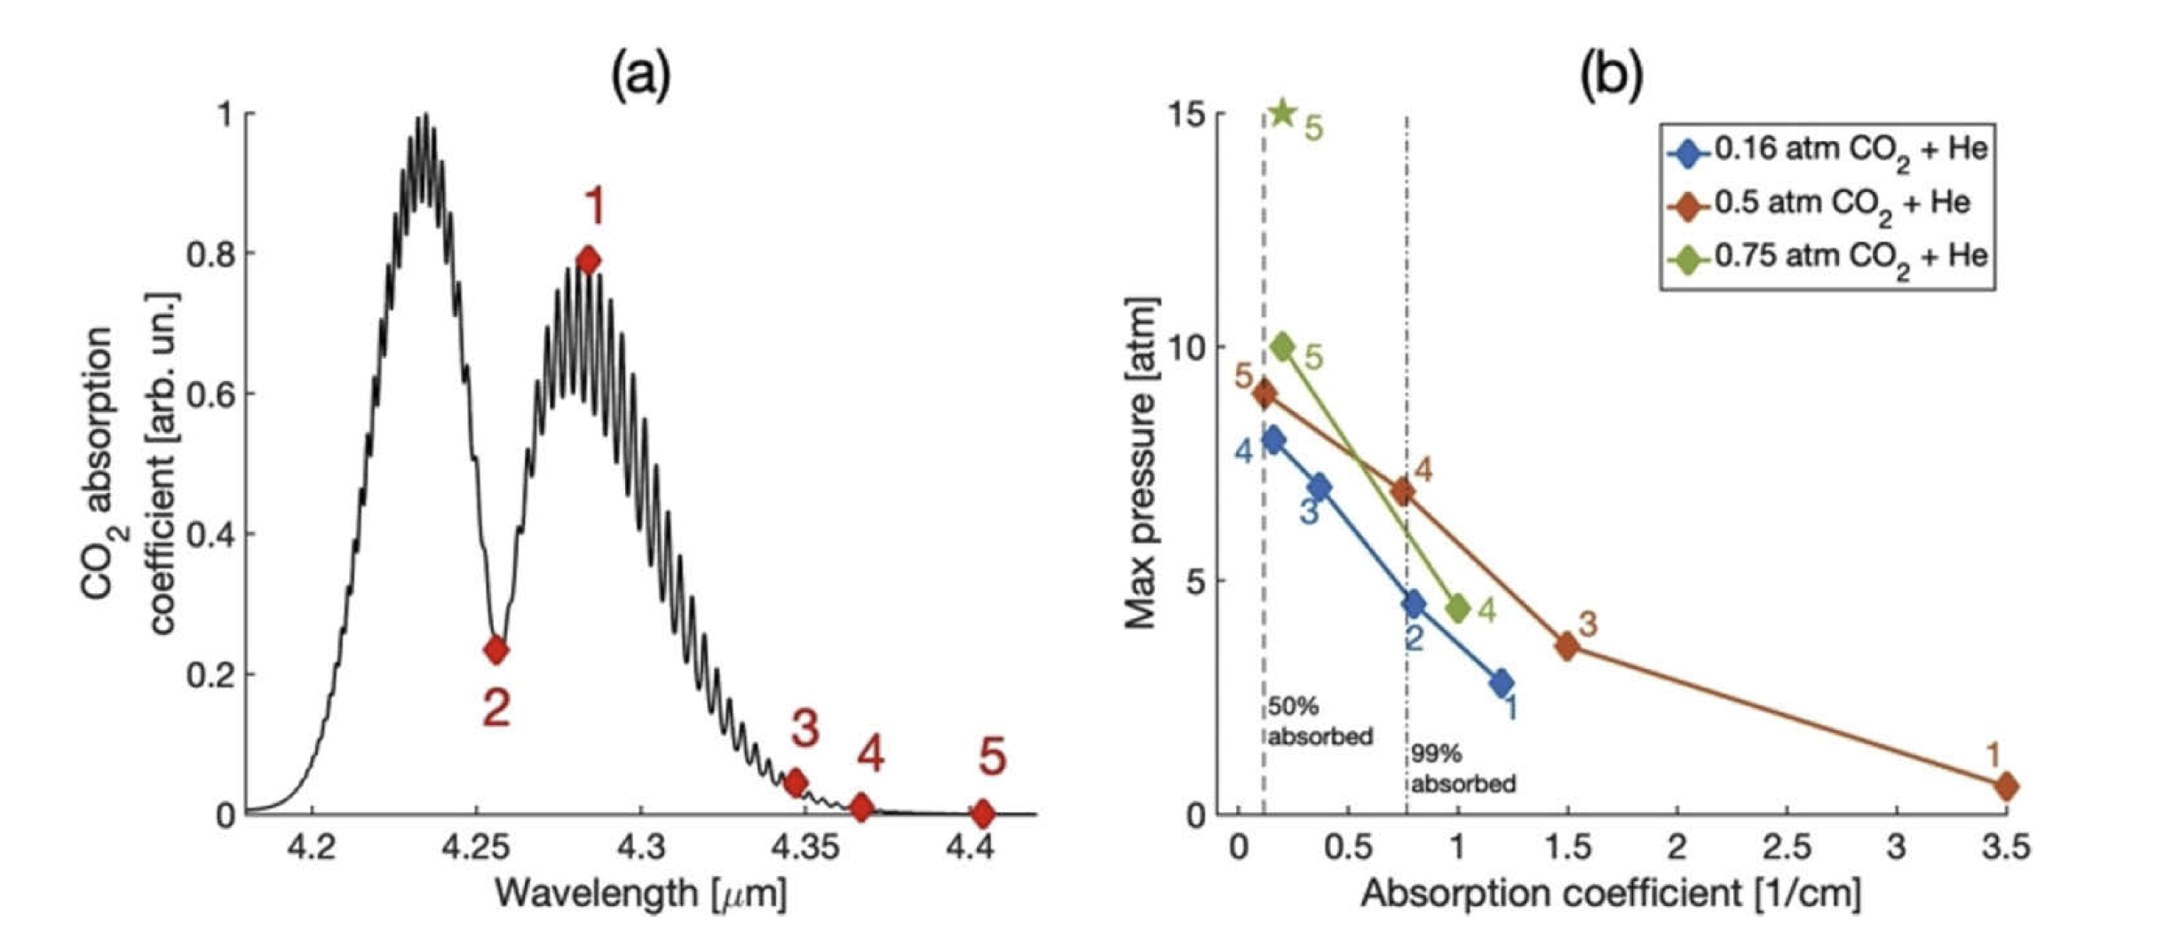
Lasing and Gain Dynamics in OP CO₂ cell
Achieving lasing at high pressures required greater amounts of CO₂ and tuning pump wavelength to reduce absorption, D. Tovey et al, Optics Express, 29 (2021).
With >35 mJ absorbed at 4.4 μm , up to 3.5 mJ at 10.3 μm lasing measured in a palm-size the CO₂ cell.
Neptune Laboratory
ATF -2023

Slide 10
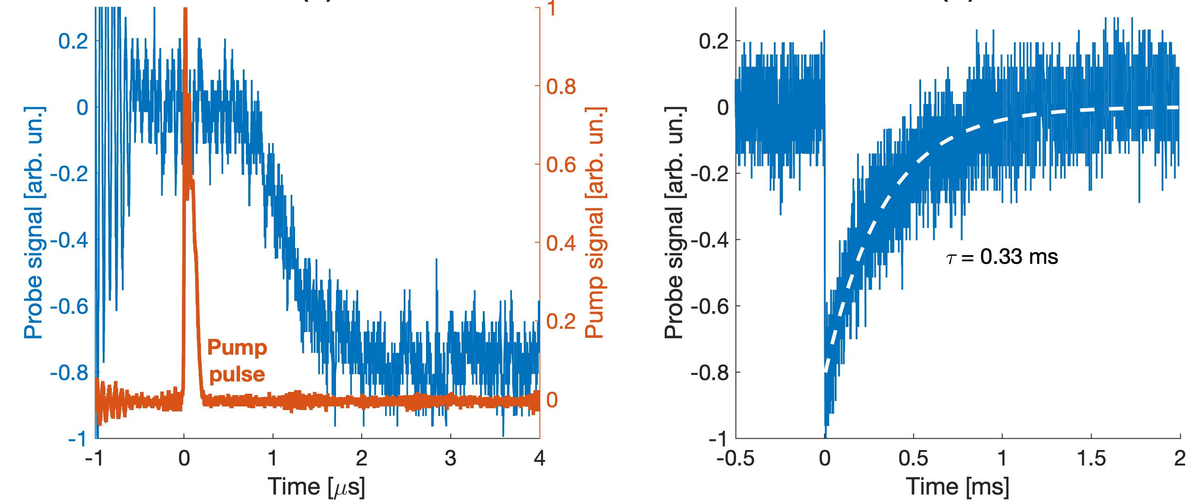
Repetition Rate Scaling in OP CO₂ Laser
Measurements of lasing and gain of a high-pressure optically pumped CO₂ laser
>10% efficiency near 10 atm
>10% small signal gain
Can be scaled to 1 KHz – limited by gas dynamics
Visible He-Ne beam deflectometry shows fast heat dissipation in the multiatmosphere CO₂ cell. Repetition rate ~1 kHz is durable.
Neptune Laboratory
ATF -2023
Notes:
- What pressure/mix should I show for absorption spectrum (a) ?

Slide 11
Two-color 0.8 and 10 μm ultrafast laser system
2022 Femtosecond/Picosecond Ti:sapphire system at the UCLA Neptune Laboratory
12’ x 5’ optical table
Element
Element Seed Kit
Spitfire Ace
Pulse Width: 35fs
Repetition Frequency: 1kHz
Ascend
Ascend
PD
External Compressor
Ascend
Translation
BS
Spitfire Ace
Pulse Width: 1ps
Repetition Frequency: 1kHz
HE Topas
NDFG
TOPAS 800
Neptune Laboratory
ATF -2023

Slide 12
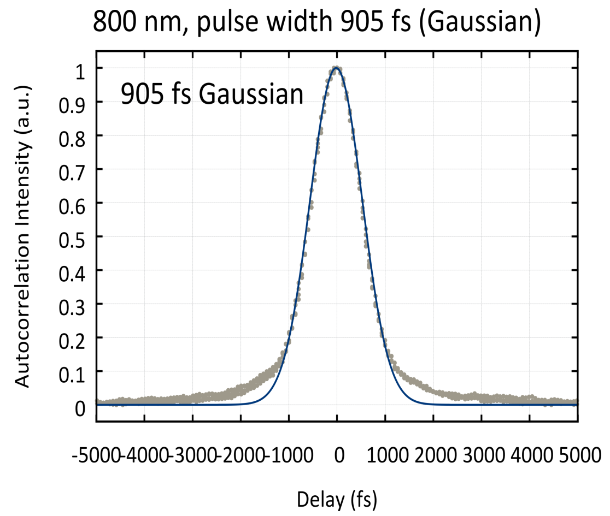
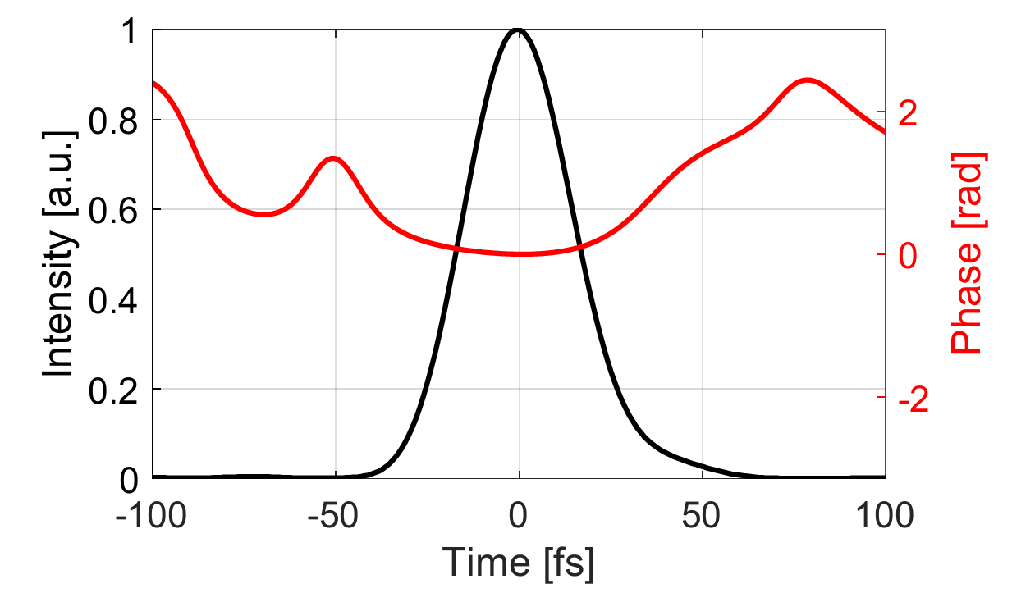
Two-color 0.8 and 10 μm ultrafast laser system
Measured ps Pulse profile using autocorrelator
Measured fs Pulse profile using SPIDER
E≥8 mJ
FWHM = 900 fs
PRF=1000 Hz
E≥7 mJ
FWHM = 35 fs
PRF=1000 Hz
Neptune Laboratory
ATF -2023

Slide 13
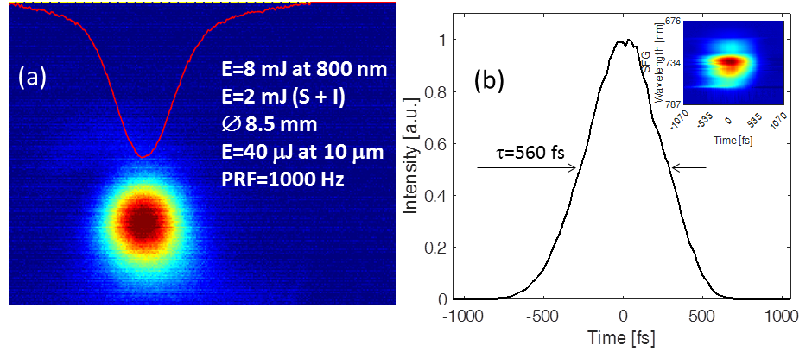
Mid-IR 4-16 μm ultrafast laser system
DFG in GaSe
Mid-IR XFROG
Tunable 9-11 μm ultrashort seed pulses are available at UCLA.
Neptune Laboratory
ATF -2023

Slide 14
EO Q-switched 2.8 μm Er:YSGG laser
CaF2
f=500 mm
HR
LGS Q-switch
Cr:Er:YSGG
4x100mm
λ/4
OC 40%
2794 nm
70 cm
74 cm
Sapphire
plate
Sapphire
plate
171 cm
Input vs Output, (triangles) free running regime,
(circles) Q-switched regime
Pulse duration, (triangles) long cavity 171cm,
(circles) short cavity 39 cm.
Pulse duration at 39 J pump energy
and 146 mJ output energy.
ATF -2023

Slide 15
2023-2026 mid-IR USP Program
Development of a compact, multiatmosphere CO₂ amplifier for picosecond and sub-picosecond 10 μm pulses will require several steps.
At UCLA
Step 1 Using a regular ¹²CO₂-He mix demonstrate ~3 ps, 3 mJ pulses at 3-10Hz in the optically pumped regenerative amplifier.
Step 2 Using a ¹²CO₂+¹³CO₂/He mix demonstrate 1 ps, 3 mJ pulses at 10.7 μm in a direct amplification regime.
At ATF BNL
Step 3 Amplification of 0.5 ps pulses to a few mJ (GWs) using the BNL isotopic mix ¹²C¹⁶O₂-¹⁶O¹²C¹⁸O-¹²C¹⁸O₂ mix in a CPA regime.
Step 4 Study and develop a broadband isotopic amplifier suitable to support 0.3-0.5 ps bandwidth. Demonstrate amplification of subpicosecond 9-10 μm pulses.
ATF -2023

Slide 16
Summary
We have made important and necessary steps in developing a compact, multiatmosphere CO₂ amplifier but picosecond and sub-picosecond 10 μm pulses are yet to be amplified.
Gain dynamics+lasing study in optically pumped CO₂ active medium pumped by a ~50 mJ Fe:ZnSe laser indicates that a short ≤10 cm long cell-amplifier at >10 atm pressure is durable.
Conversion efficiency from pump could reach 10%.
Next steps in 2023 will be developing a 50 mJ 4.3 Fe:ZnSe synchronizable pump laser system (UAB), building an OP regenerative amplifier and demonstrating amplification of a subpicosecond pulse in isotope CO₂ active medium (UCLA+BNL).
ATF -2023

Slide 17
Activities & Impacts Associated with this Experiment – All Years
Invited Talks:
S. Tochitsky et al, “High-pressure CO₂ laser optically pumped at 4.3 mm,” Directed Energy Annual Symposium, Albuquerque, NM, March 2021, (invited).
Manuscripts (books, conference and journal articles, other; please include works submitted by not yet accepted):
S.Ya. Tochitsky and C. Joshi “Long-Wave Infrared filamentation in air: lasers and high-field phenomena” chapter in Light Filaments: Structures, challenges and applications, ed. J.C. Diels, IET, UK, 2021
E. C. Welch, S.Ya. Tochitsky, J.J. Pigeon, and C. Joshi “ Long-wave infrared picosecond parametric amplifier based on Raman shifter technology,” Optical Express, 26, 5154-5163, 2018. DOI/10.1364/OE.26.005154
D. Tovey, S. Ya Tochitsky, J. J. Pigeon, M. N. Polyanskiy, I. Ben-Zvi, and C. Joshi . “Multi-atmosphere picosecond CO₂ amplifier optically pumped at 4.3 µm.” Applied Optics, 58, 5756-5763 (2019).
J. J. Pigeon, D. Tovey, S. Ya Tochitsky, G. J. Louwrens, I. Ben-Zvi, D. Martyshkin, V. Fedorov, K. Karki, S. Mirov, and C. Joshi. “Resonant nonlinear refraction of 4.3-µm light in CO₂ gas.” Physical Review A (R), 100, 011803 (2019).
Dana Tovey, J. J. Pigeon, S. Ya Tochitsky, G. J. Louwrens, I. Ben-Zvi, C. Joshi, D. Martyshkin, V. Fedorov, K. Karki, and S. Mirov, “Gain dynamics in a CO₂ active medium optically pumped at 4.3 μm,” Journal of Applied Physics,128, 103103 (2020).
D. Martyshkin, K. Karki, V. Fedorov, and S. Mirov, “Room temperature, nanosecond, 60 mJ/pulse Fe:ZnSe master oscillator power amplifier system operating at 3.8-5.0 µm,” Optics Express 29, 2387-2393 (2021).
J. J. Pigeon, D. Tovey, S. Ya. Tochitsky, G. Louwrens, D. Maryshkin, V. Fedorov, K. Karki, S. Mirov, I. Ben-Zvi, and C. Joshi, “Resonant nonlinear refraction of mid-IR light in CO and CO₂ gas” Phys. Rev. A 104, 043519 (2021).
D. Tovey, J. J. Pigeon, S. Ya. Tochitsky, G. Louwrens, D. Maryshkin, V. Fedorov, K. Karki, S. Mirov, I. Ben-Zvi, and C. Joshi, “Lasing in 15 atm CO₂ cell optically pumped by a Fe:ZnSe laser”Optics Express, 29, 31455-31464 (2021).
Overall: 1 chapter in a book, 7 refereed papers, 8 + Conference papers
Theses awarded
Dana T. Tovey, MSc. Thesis 2021
Patents and/or hardware delivered: A novel 4.3 um Fe:ZnSe MOPA laser system built by UAB and used at UCLA.
Other

Slide 18
Compact OP CO₂ TW Laser
UCLA
10 Hz 4.3 μm
Fe:ZnSe Laser
10 Hz 4.3 μm
Fe:ZnSe amplifier
4 J
100 ns
1 J
3 J
10 mJ
MARS
Mode-locked
15 atm OPCO₂
Laser
~μJ
0.5 ps
15 atm
OPCO₂
Preamp
15 atm
OPCO₂
Amplifier
0.5 J
0.5 ps
+++) Table-top electrical discharge-free compact TW LWIR
laser system is suitable for advanced accelerators and self-guiding in air over kms.
+++) Optical-to-optical conversion efficiency 0.1-0.4 is far above
any state-of-the-art LWIR OPA.
- - - ) Laser hysics of Optically Pumped high-pressure CO₂ medium needs to be studied.
Optically pumped high-pressure CO₂ lasers can be the game changer in LWIR USP:100 ns pump and 0.3-3 ps LWIR pulse
AAC-2022

