Slide 1
Project ID:
AE93
Project Title:
Direct Measurements of Fields and Radiation in the Self-Modulated Plasma Wakefield Regime
Collaborators:
Stony Brook University
Brookhaven National Laboratory
University of Texas at Austin
University of California Los Angeles
V.N. Litvinenko (Lead PI), N. Vafaei-Najafabadi (PI),
R. Samulyak, I. Petrushina, A. Jain, A. Gaikwad, A. Cheng
I. Pogorelsky (PI), M. Fedurin, M. Polyanskiy, M. Babzien, W. Li,
K. Kusche, M. Palmer
M. Downer (PI), R. Zgadzaj, Y. Cao
C. Joshi (PI), A. Farrell, M. Sinclair, C. Zhang, Y. Wu
Funding Source:: DOE HEP DE-SC0014043 (Received)
CORI @ NERSC under contract DE-AC02-05CH11231
SEAWULF @ Stony Brook University

Slide 2
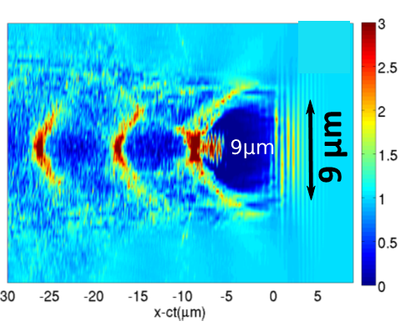
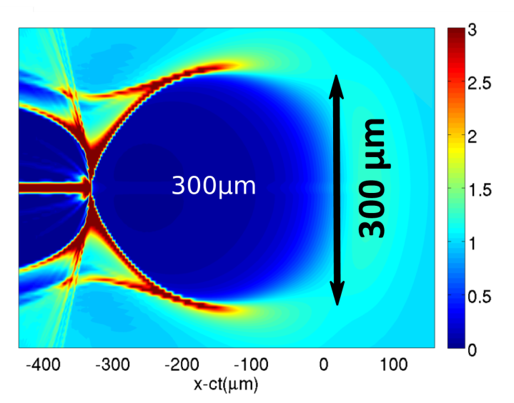
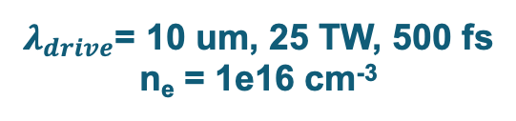
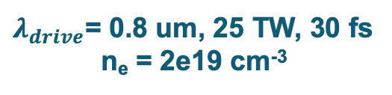
Motivation: what is available at ATF that we can use for LWFA?
CO₂ laser system: 2 ps pulses, up to 5 J energy, wavelength ~10.2 um
$λ_{drive}$= 0.8 um, 25 TW, 30 fs
n_{e} = 2e19 cm⁻³
$λ_{drive}$= 10 um, 25 TW, 500 fs
n_{e} = 1e16 cm⁻³
Courtesy of Gennady Shvets
Courtesy of Gennady Shvets
Precise and controllable external injection!
Diagnostic tools are needed to characterize the fields inside such structures and to improve the means of external injection.
How is LWFA diagnostic usually done?
Use optical methods—lasers.
These methods rely on the index of refraction of plasma.
Optical methods have been extensively studied and have successfully demonstrated the ability to capture shadowgraphs of the plasma wakes.
BUT: difficult at low plasma densities.

Slide 3
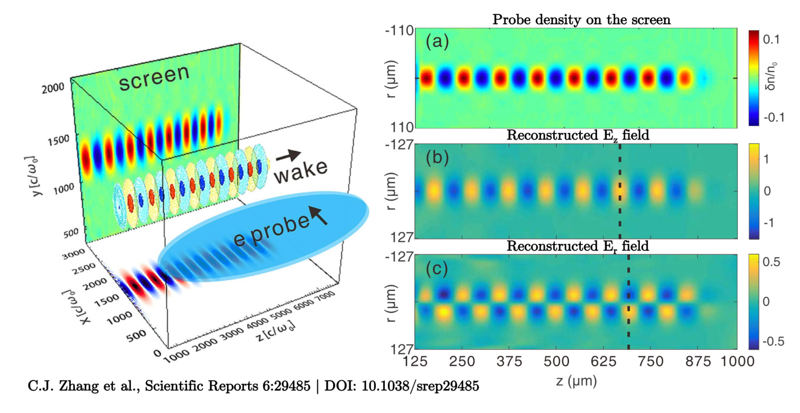
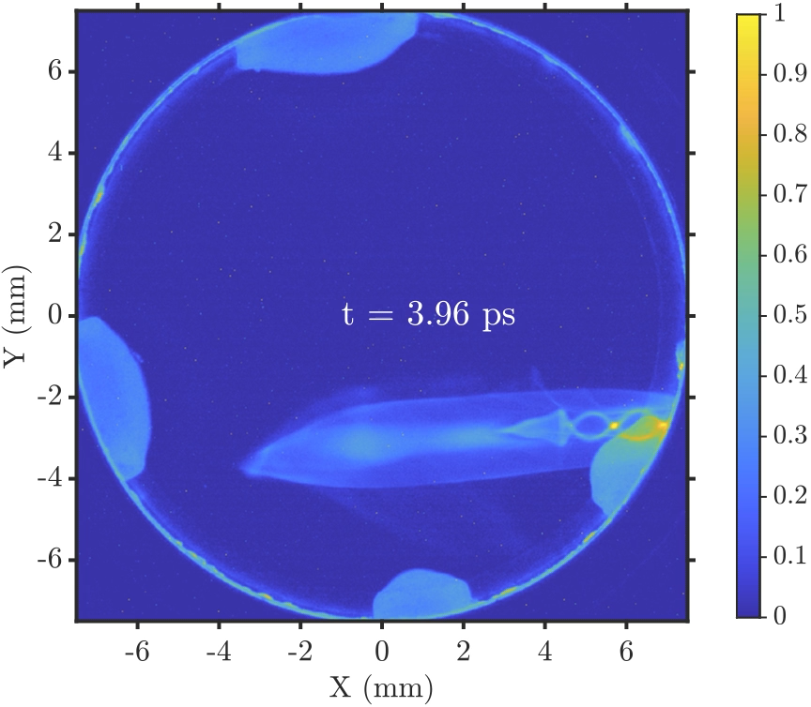
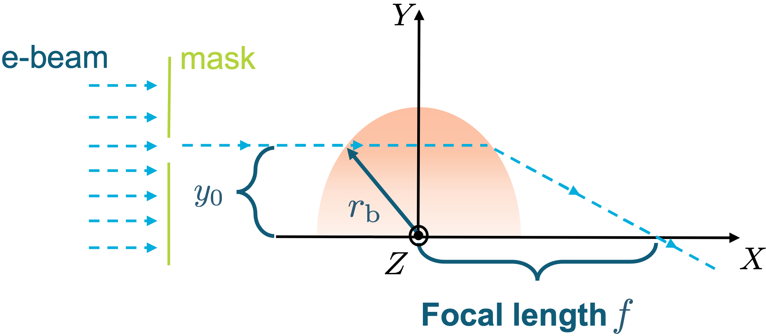
Experimental goal: probing of fields in LWFA using electron beam
Taking it one step further:
Linear focusing force in a bubble: (wakefield theory suggests )
, where
Focal length
Depth of field
If we can measure the focal length, we can characterize the field inside the bubble.

Slide 4
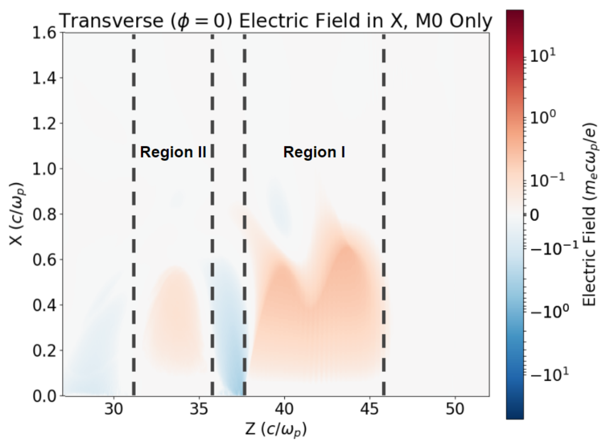
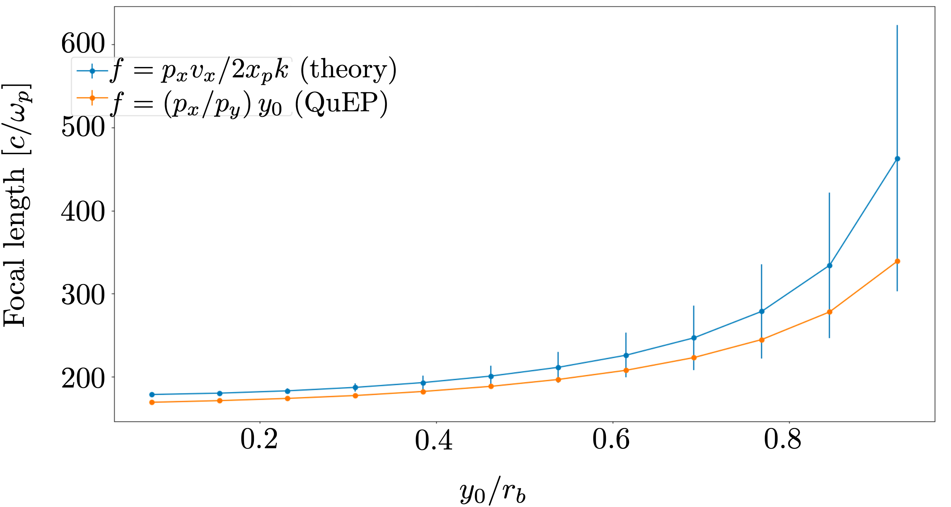
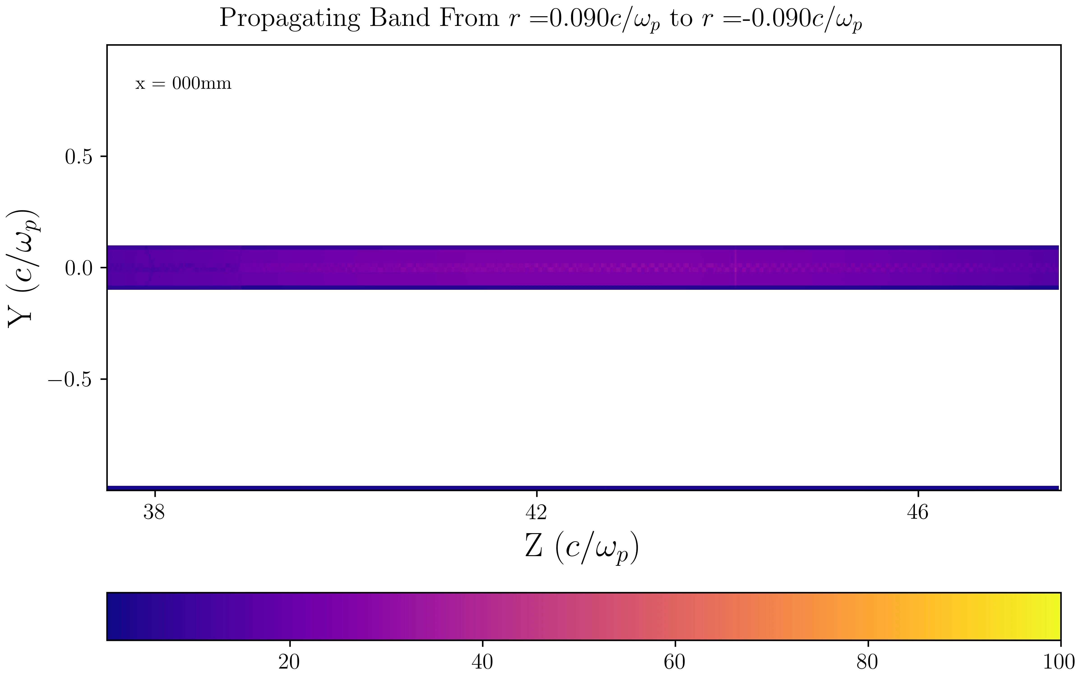
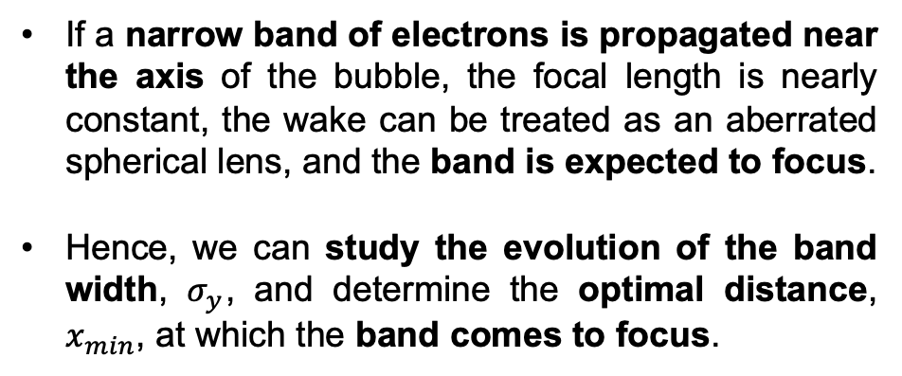
Experimental goal: field characterization based on focal length
If a narrow band of electrons is propagated near the axis of the bubble, the focal length is nearly constant, the wake can be treated as an aberrated spherical lens, and the band is expected to focus.
Hence, we can study the evolution of the band width, $σ_{y}$, and determine the optimal distance, $x_{min}$, at which the band comes to focus.

Slide 5
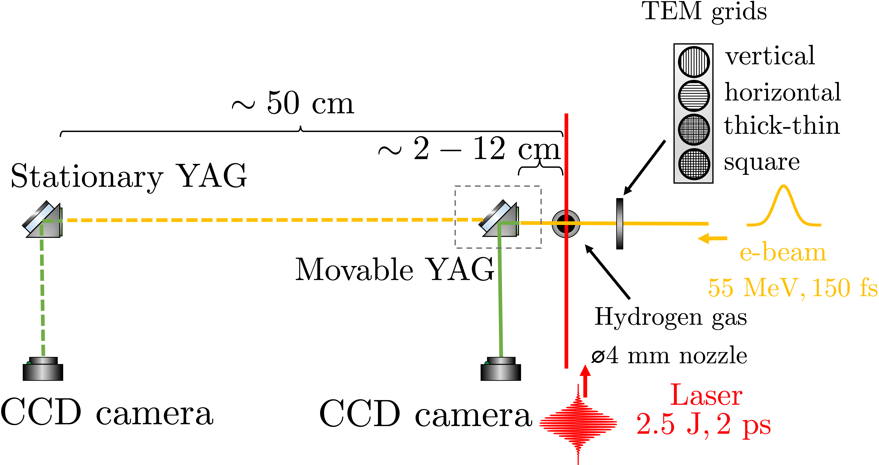
Experimental overview: LWFA chamber setup

Slide 6
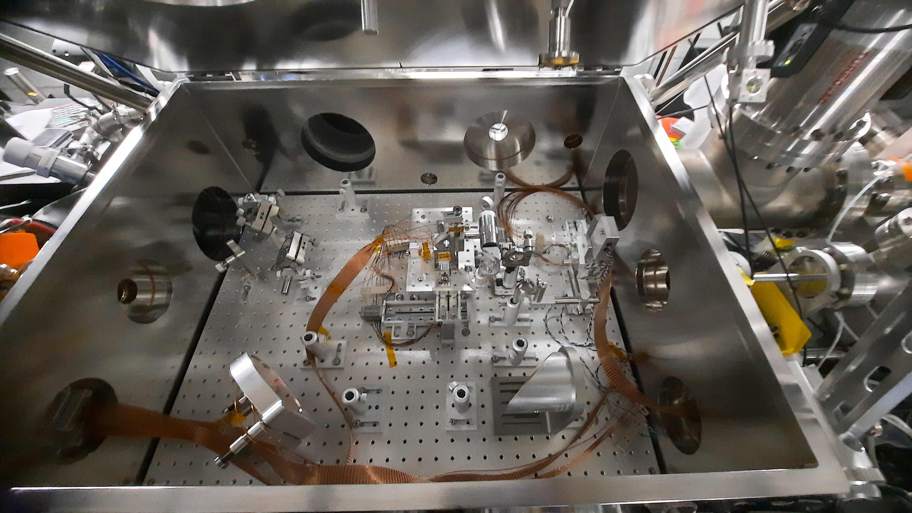
Experimental overview: LWFA chamber setup
nozzle
CO₂ in
CO₂ out
TEM grids assembly
e-beam in

Slide 7
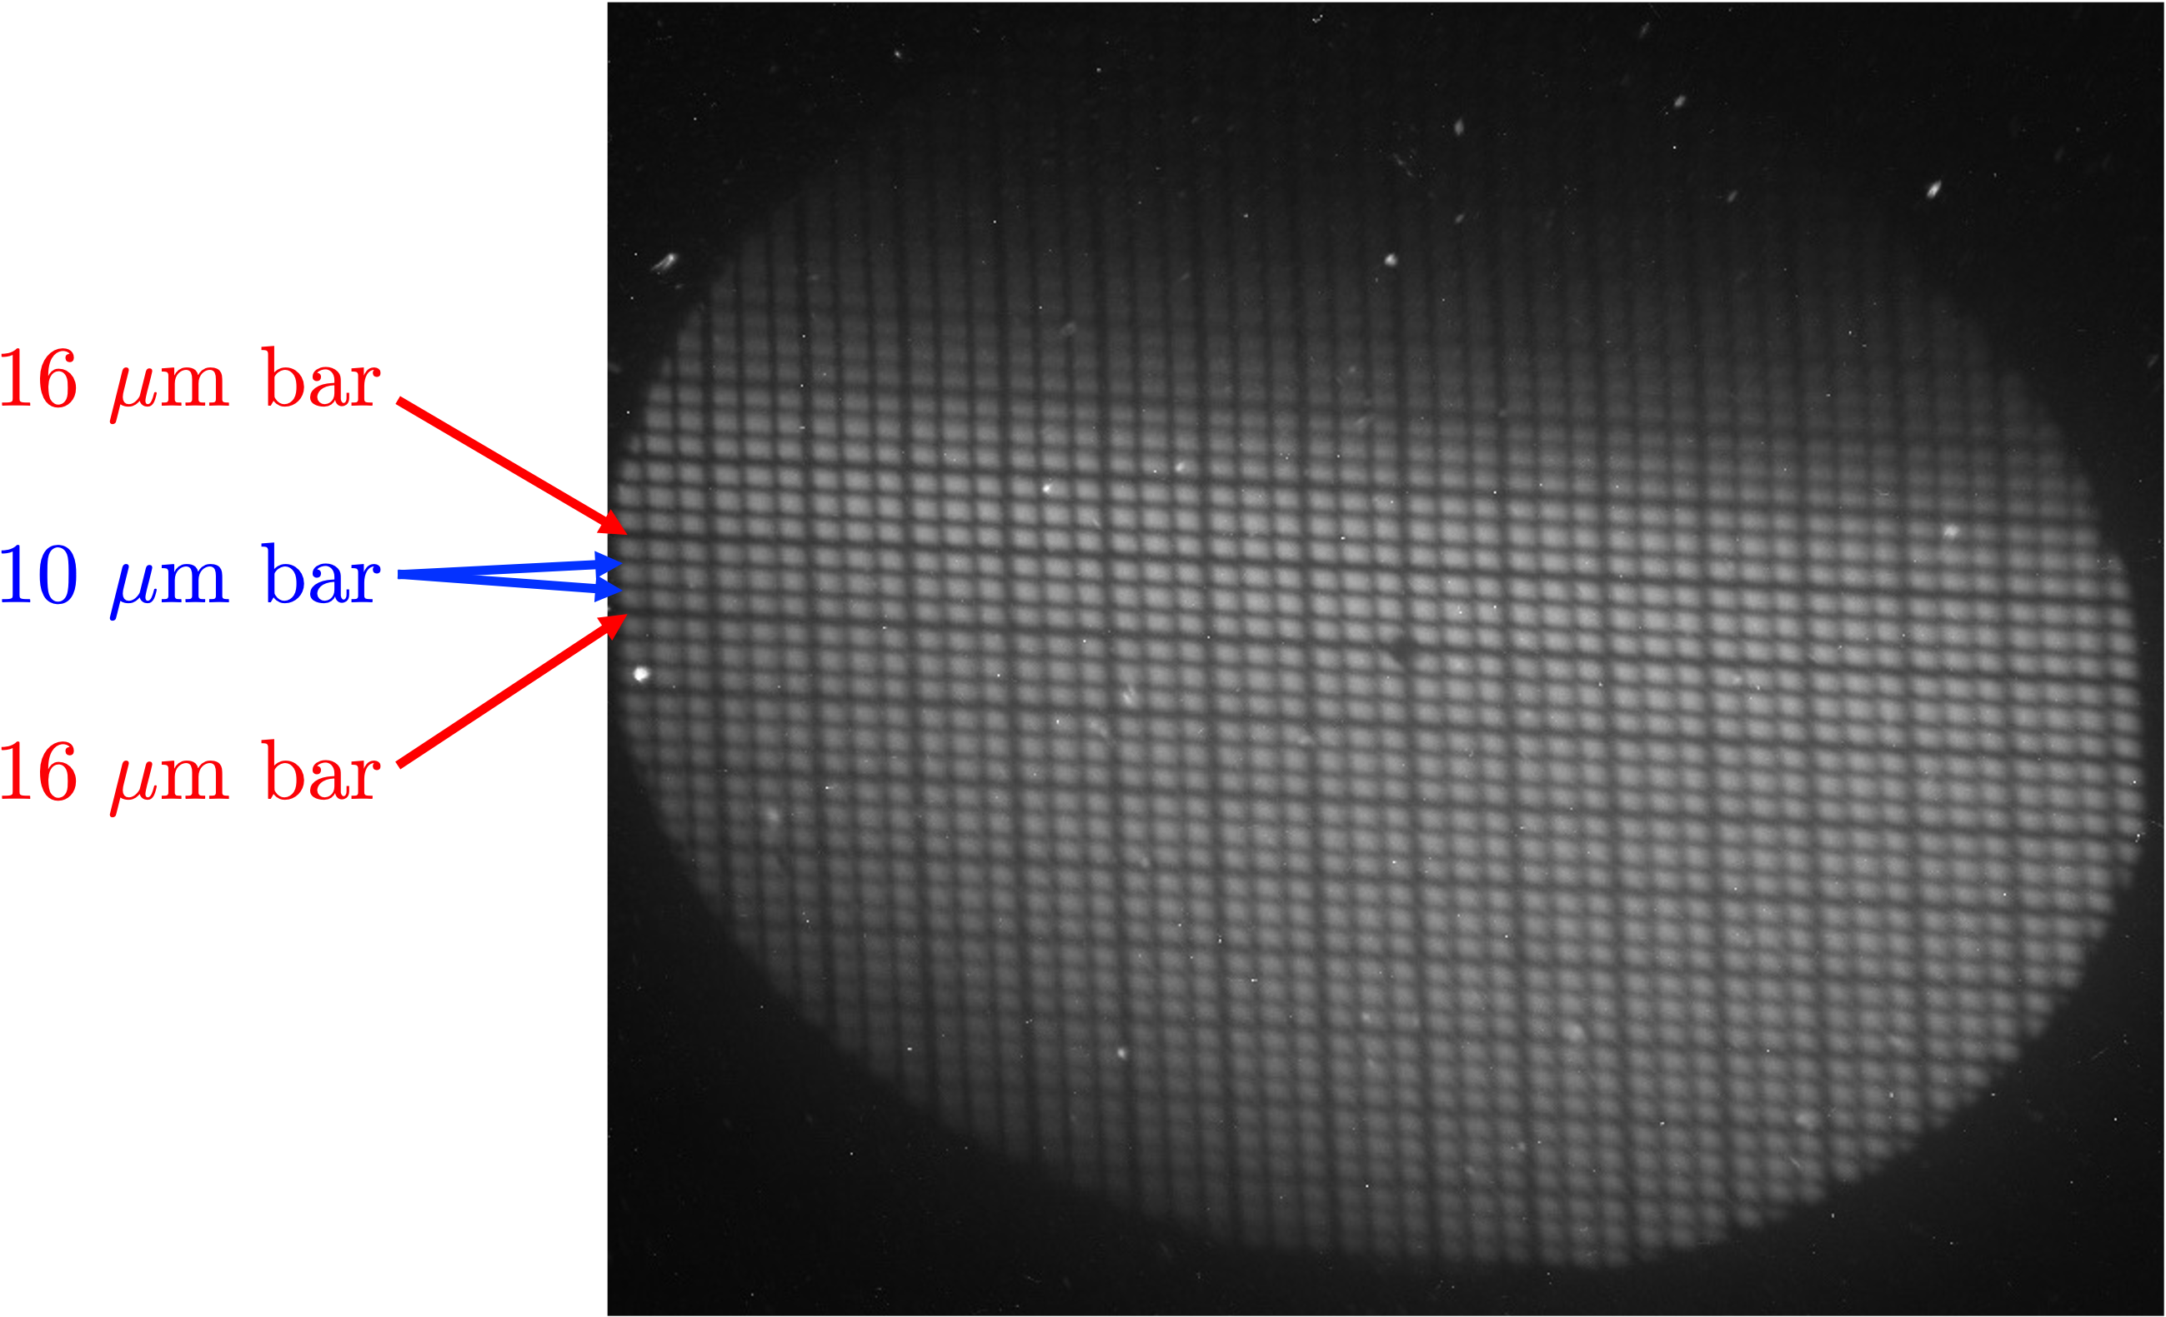
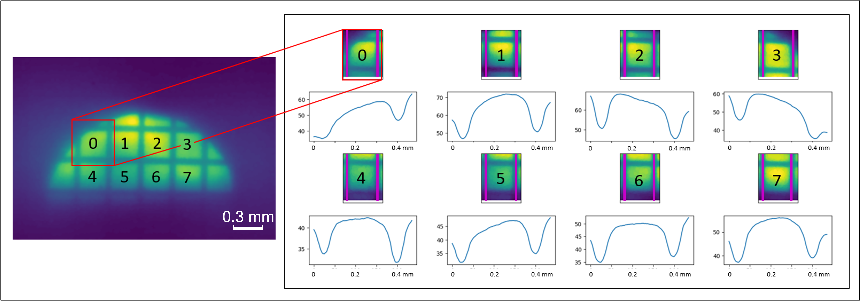
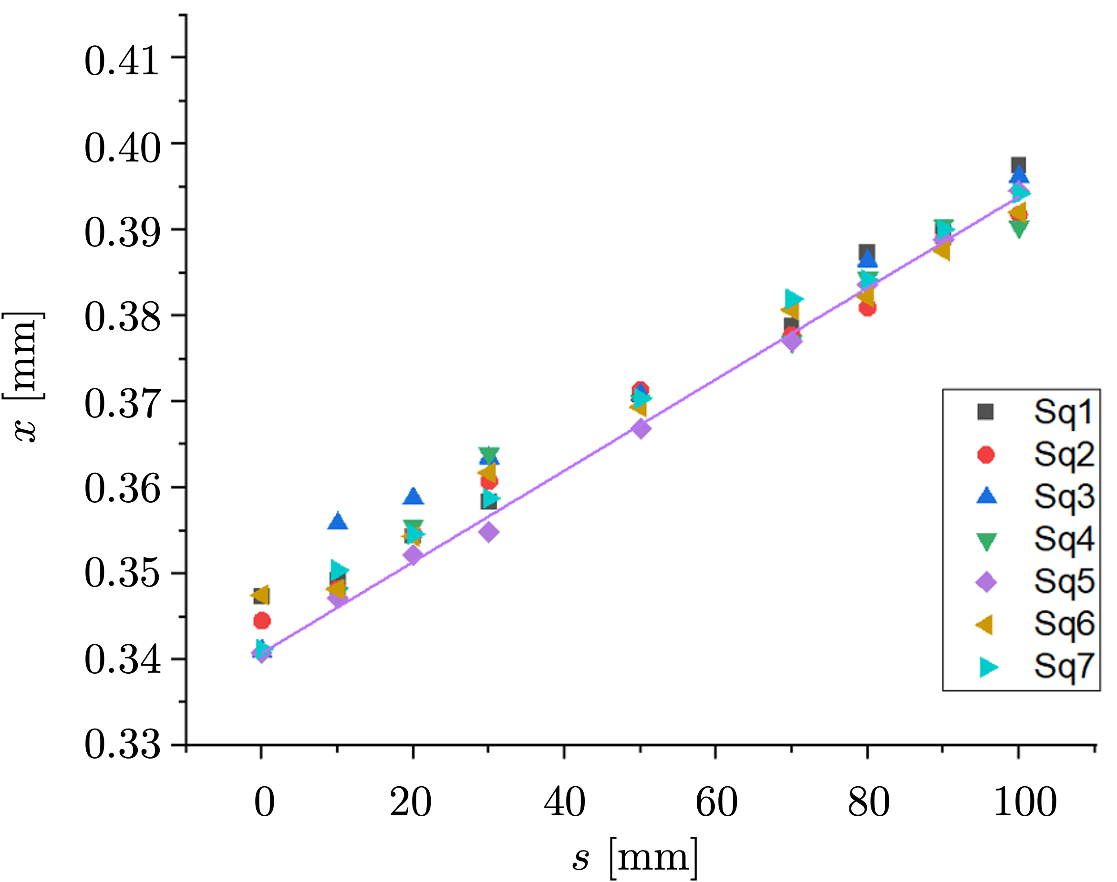
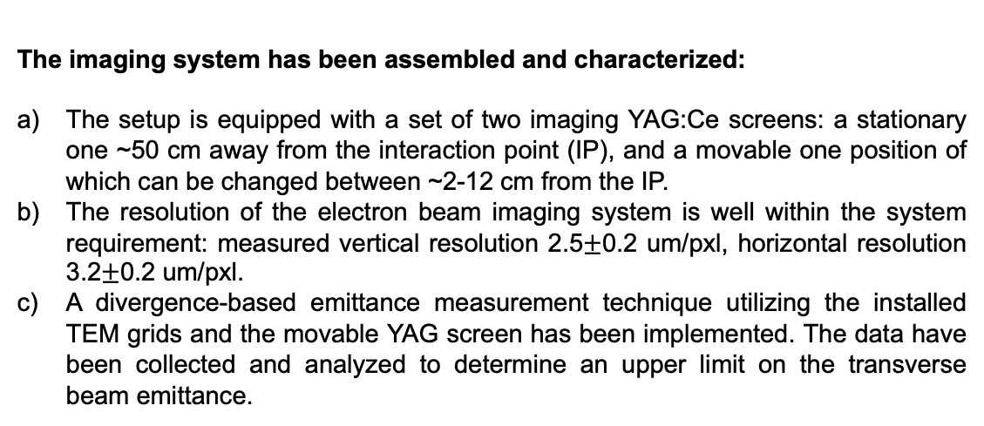
Summary of major results:
The imaging system has been assembled and characterized:
The setup is equipped with a set of two imaging YAG:Ce screens: a stationary one ~50 cm away from the interaction point (IP), and a movable one position of which can be changed between ~2-12 cm from the IP.
The resolution of the electron beam imaging system is well within the system requirement: measured vertical resolution 2.5$±$0.2 um/pxl, horizontal resolution 3.2$±$0.2 um/pxl.
A divergence-based emittance measurement technique utilizing the installed TEM grids and the movable YAG screen has been implemented. The data have been collected and analyzed to determine an upper limit on the transverse beam emittance.
Shadow of the TEM grid (square thick/thin 30um opening/16-10-10um bars) obtained using an improved e-beam imaging system.
Divergence-based emittance estimate: (a) Electron beam image with a coarse grid inserted. The respective grid squares are labeled, and the profile of each square is obtained at various locations of the YAG screen. (b) Average square width vs. imaging plane location for each grid square; linear fit with least error is shown in purple.

Slide 8
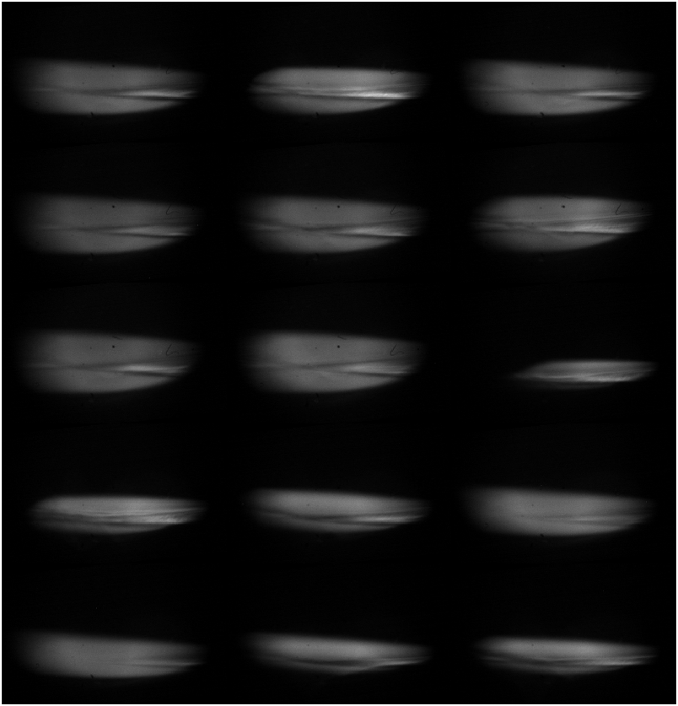
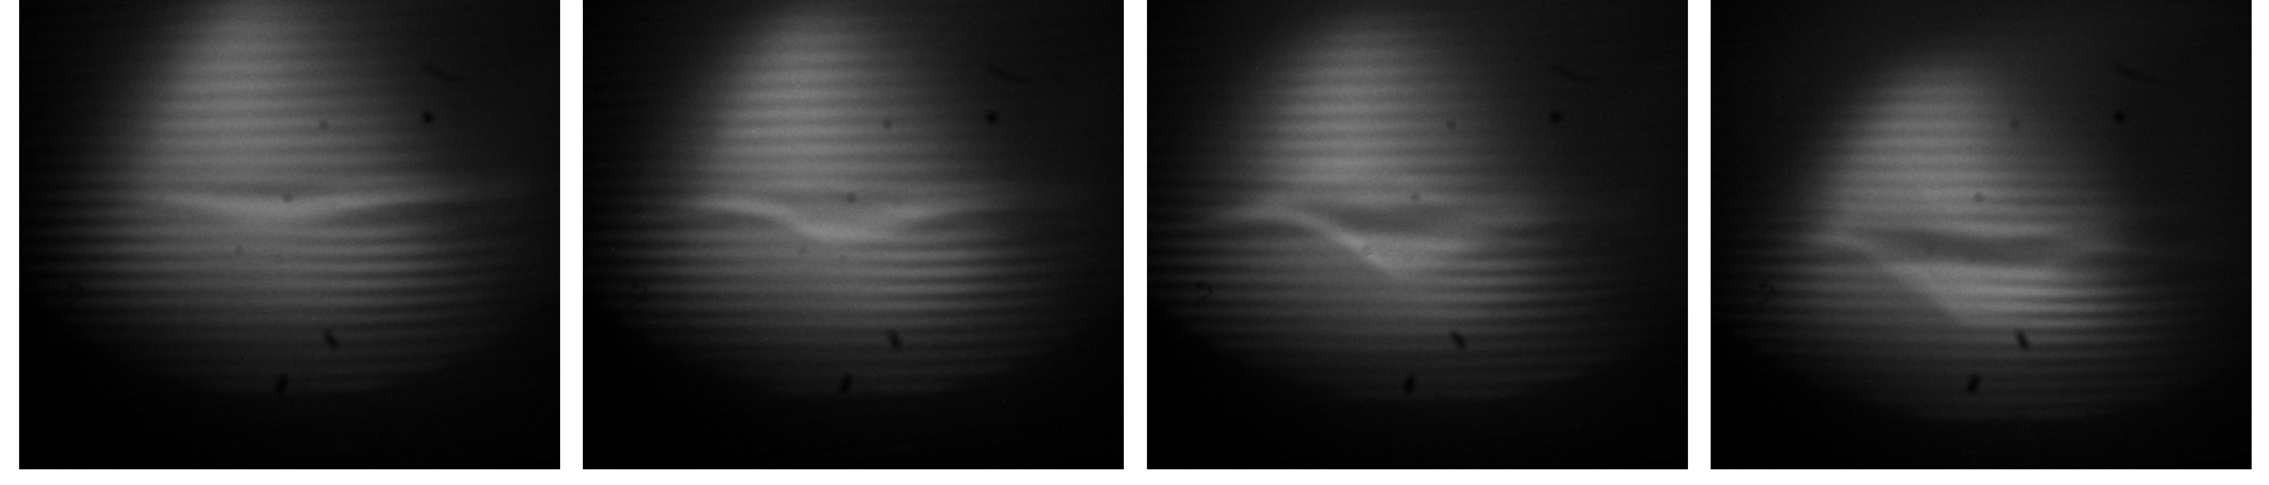
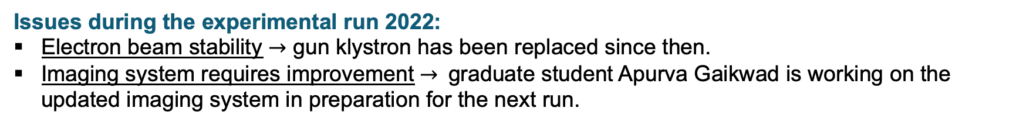
Summary of major results:
Two sets of data have been collected to confirm the proposed method of characterizing the radial field in the wake at very low densities (<10¹⁵ cm⁻³).
#93: E = 3.55 J ; x = 3.16 cm
#89: E = 4.01 J; x = 4.16 cm
#85: E = 4.56 J; x = 5.16 cm
#98: E = 4.82 J ; x = 6.16 cm
#211: E_{L} = 2.8 J, x = 4.66 cm
#204: E_{L} = 2.8 J, x = 6.66 cm
#220: E_{L} = 3.1 J, x = 2.66 cm
#216: E_{L} = 2.3 J, x = 3.66 cm
Issues during the experimental run 2022:
Electron beam stability $→$ gun klystron has been replaced since then.
Imaging system requires improvement $→$graduate student Apurva Gaikwad is working on the updated imaging system in preparation for the next run.

Slide 9
Experimental plans for next year:
Goals presented at the 24th ATF Users’ meeting:
Start implementation of the e-beam plasma density diagnostic based on the focal length measurements.
Continue development of the e-beam compression chicane.
Moving towards the ability to perform simultaneous diagnostic of AE93 and AE95.
Goals for next year:
Develop and implement an improved imaging system (improve system rigidity, constant magnification throughout the full span of motion).
Collect the data for the focal length-based characterization of the transverse electric field in a wake.
Continue the effort on the e-beam compression chicane development.
Continue effort towards the ability to perform simultaneous diagnostic of AE93 and AE95.

Slide 10
Summary of products:
High involvement of early-career scientists:
The bulk of the experimental work was carried out by Dr. Irina Petrushina (assistant research professor at Stony Brook University) and the self-injection simulations were carried out by Dr. Arohi Jain (Postdoctoral associate).
Students Apurva Gaikwad (PhD, SBU), Yuxuan Cao (PhD, UT), Brianna Romasky (Undergrad, SBU and Rutgers), and Evan Trommer (Undergrad, SBU) participated directly in the set up and carrying out of the experiment. Evan Trommer and Nicholas Manzella (Undergrad, SBU) contributed significantly to the development of a particle tracking code to model the radiography interaction, with Nicholas completing an undergraduate honors thesis on his work [5].
[1] I. Petrushina, “Characterization of the fields inside the CO2-laser-driven wakefield accelerators using relativistic electron beams,” presented at the 20th Advanced Accelerator Concepts Workshop (AAC’22), 2022.
[2] I. Petrushina, R. Zgadzaj, M. Petrusky, et al. “Characterization of the fields inside the CO2-laser-driven wakefield accelerators using relativistic electron beams,” submitted for publication in Proceedings of the 20th Advanced Accelerator Concepts Workshop (AAC’22), 2022.
[3] A. Jain, “Self-injection process in laser‑wakefield accelerator driven by CO2 laser pulses,” presented at the 20th Advanced Accelerator Concepts Workshop (AAC’22), 2022.
[4] A. Jain, et al. “Self-injection process in laser‑wakefield accelerator driven by CO2 laser pulses,” submitted for publication in Proceedings of the 20th Advanced Accelerator Concepts Workshop (AAC’22), 2022.
[5] N. Manzella, “Development of methods for modeling the interactions of plasma wakefields with a realistic 3D electron probe.” Bachelor’s Thesis, Stony Brook University, Stony Brook, NY (2022).

Slide 11
- Relevant e-beam/laser requirements
- Special Equipment Requirements and Hazards
- Experimental time request

Slide 12
Electron Beam Requirements
Parameter | Units | Typical Values | Comments | Requested Values
Beam Energy | MeV | 50-65 | Full range is ~15-75 MeV with highest beam quality at nominal values | Nominal (~55 MeV)
Bunch Charge | nC | 0.1-2.0 | Bunch length & emittance vary with charge | ~1nC
Compression | fs | Down to 100 fs (up to 1 kA peak current) | A magnetic bunch compressor available to compress bunch down to ~100 fs. Beam quality is variable depending on charge and amount of compression required. NOTE: Further compression options are being developed to provide bunch lengths down to the ~10 fs level | 100 fs
Transverse size at IP (σ) | μm | 30 – 100 (dependent on IP position) | It is possible to achieve transverse sizes below 10 um with special permanent magnet optics. | 2 mm (horizontal) 0.5 mm (vertical)
Normalized Emittance | μm | 1 (at 0.3 nC) | Variable with bunch charge | 1
Rep. Rate (Hz) | Hz | 1.5 | 3 Hz also available if needed | 1.5
Trains mode | --- | Single bunch | Multi-bunch mode available. Trains of 24 or 48 ns spaced bunches. | Single bunch

Slide 13
CO₂ Laser Requirements
Configuration | Parameter | Units | Typical Values | Comments | Requested Values
CO₂ Regenerative Amplifier Beam | Wavelength | μm | 9.2 | Wavelength determined by mixed isotope gain media
 | Peak Power | GW | ~3
 | Pulse Mode | --- | Single
 | Pulse Length | ps | 2
 | Pulse Energy | mJ | 6
 | M² | --- | ~1.5
 | Repetition Rate | Hz | 1.5 | 3 Hz also available if needed
 | Polarization | --- | Linear | Circular polarization available at slightly reduced power
CO₂ CPA Beam | Wavelength | μm | 9.2 | Wavelength determined by mixed isotope gain media | 9.2
Note that delivery of full power pulses to the Experimental Hall is presently limited to Beamline #1 only. | Peak Power | TW | 5 | ~5 TW operation is planned within the next year (requires further in-vacuum transport upgrade). A 3-year development effort to achieve >10 TW and deliver to users is in progress. | 2-5
 | Pulse Mode | --- | Single |  | Single
 | Pulse Length | ps | 2 |  | 2
 | Pulse Energy | J | ~5 | Maximum pulse energies of >10 J will become available within the next year | 5
 | M² | --- | ~2 |  | ~2
 | Repetition Rate | Hz | 0.05 |  | 0.05
 | Polarization |  | Linear | Adjustable linear polarization along with circular polarization can be provided upon request | Linear

Slide 14
Other Experimental Laser Requirements
Ti:Sapphire Laser System | Units | Stage I Values | Stage II Values | Comments | Requested Values
Central Wavelength | nm | 800 | 800 | Stage I parameters are presently available and setup to deliver Stage II parameters should be complete during FY22 | N/A
FWHM Bandwidth | nm | 20 | 13 |  | N/A
Compressed FWHM Pulse Width | fs | <50 | <75 | Transport of compressed pulses will initially include a very limited number of experimental interaction points. Please consult with the ATF Team if you need this capability. | N/A
Chirped FWHM Pulse Width | ps | ≥50 | ≥50 |  | N/A
Chirped Energy | mJ | 10 | 200 |  | N/A
Compressed Energy | mJ | 7 | 100 |  | N/A
Energy to Experiments | mJ | >4.9 | >80 |  | N/A
Power to Experiments | GW | >98 | >1067 |  | N/A
Nd:YAG Laser System | Units | Typical Values | Comments | Requested Values
Wavelength | nm | 1064 | Single pulse | N/A
Energy | mJ | 5 |  | N/A
Pulse Width | ps | 14 |  | N/A
Wavelength | nm | 532 | Frequency doubled | N/A
Energy | mJ | 0.5 |  | N/A
Pulse Width | ps | 10 |  | N/A

Slide 15
Special Equipment Requirements and Hazards
Electron Beam
  Please indicate any special equipment that you expect to need, including (but not limited to) the transverse deflecting cavity, shaped bunch using mask technique, plasma capillary discharge system, bolometer/interferometer setup etc.: bunch shortening using HES
CO₂ Laser
  Please note any specialty laser configurations required here: N/A
Ti:Sapphire and Nd:YAG Lasers
  Please note any specialty non-CO₂ laser configurations required here: N/A
Hazards & Special Installation Requirements
  Large installation (chamber, insertion device, etc.): N
  Cryogens: N
  Introducing new magnetic elements: Y (Magnetic dipole)
  Introducing new materials into the beam path: Y (YAG screens)
  Any other foreseeable beam line modifications: N

Slide 16
Experimental Time Request
CY2023 Time Request
Capability | Setup Hours | Running Hours
Electron Beam Only | - | -
Laser* Only (in Laser Areas) | - | -
Laser* + Electron Beam | 40 | 80
Remaining Time Estimate Through End of Experiment (including CY2023-25)
Capability | Setup Hours | Running Hours
Electron Beam Only | - | -
Laser* Only (in Laser Areas) | - | -
Laser* + Electron Beam | 240 | 720
* Laser = Near-IR or LWIR (CO₂) Laser

