Slide 1

AE99 progress report:
Directional x-ray radiation produced by plasma magneto-static undulator
Yipeng Wu
Feb. 28, 2023
UCLA Team:
Chan Joshi (P.I.), Yipeng Wu, Chaojie Zhang, Mitchell Sinclair, Audrey Farrell, Ken Marsh
ATF Team:
Igor Pogorelsky, Mikhail Fedurin, Karl Kusche, Rotem Kupfer, Misha Polyanskiy, Marcus Babzien, William Li, Andrew Simmonds, Paul Jacob, Mary Jane Ilardi and Mark Palmer
SBU Team:
Irina Petrushina, Navid Vafaei-Najafabadi
Currently supported by DOE-NNSA, DOE-HEP
Accelerator Test Facility

Slide 2
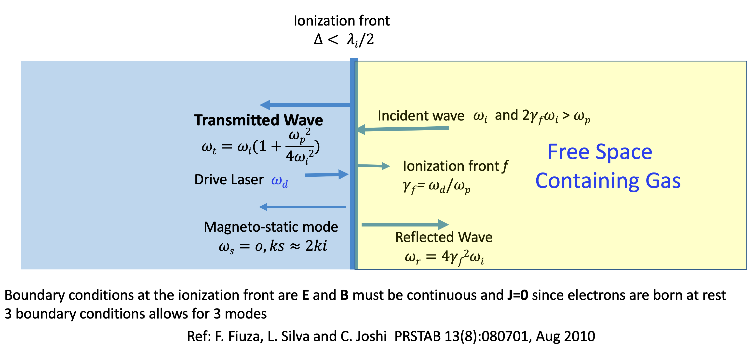
What happens when e.m. wave is incident on a relativistic underdense plasma ionization front?
Plasma
Notes:
The e.m. wave moves from right to left and the ionization front moves from left to right. In the front frame, the analysis becomes a boundary condition problem.3 boundary conditions allows for 3 modes: transmitted, reflected and free-streaming mode. When transformed back to the lab frame, the free-streaming mode has zero frequency, which is a static magnetic field.

Slide 3
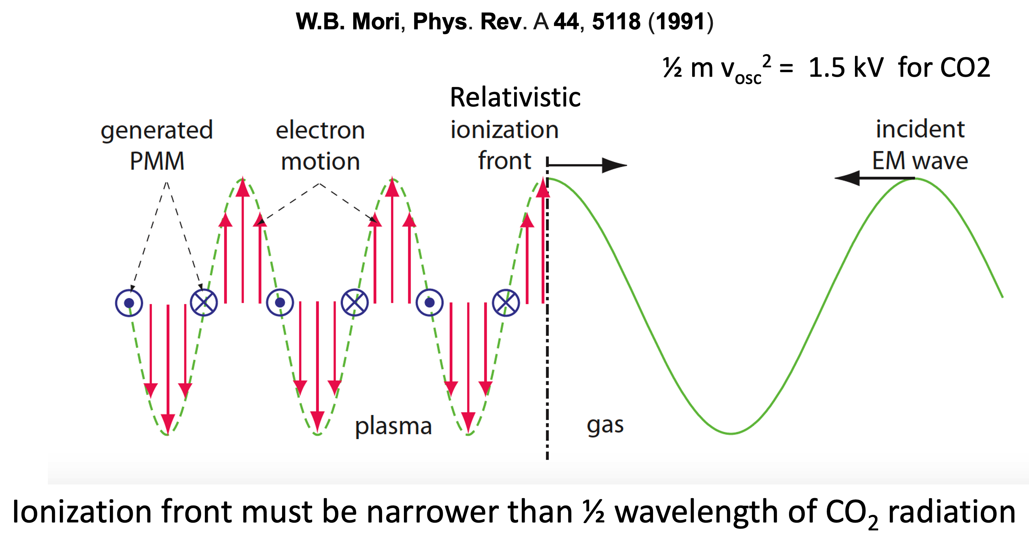
Observable 1: Magneto-static (MS) mode
Notes:
As electron are born at the ionization front, with zero mean velocity, they are kicked transversely according to the phase of the incident wave. The generated currents then give rise to a static and modulated transverse magnetic field.

Slide 4
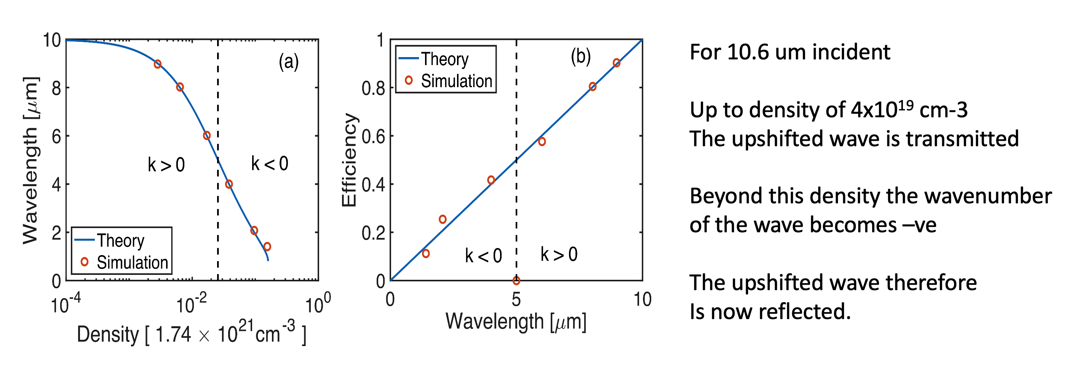
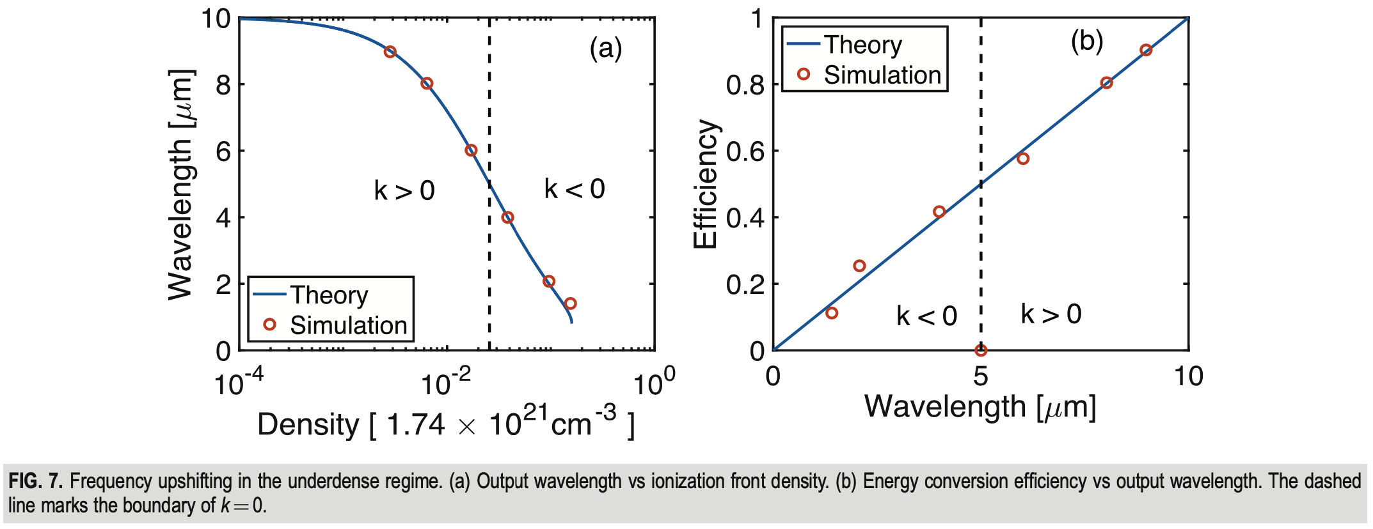
Observable 2: Frequency upshifted e.m. waves
negative
Zan Nie, Yipeng Wu, et al., Phys. Plasmas 28, 023106 (2021)

Slide 5
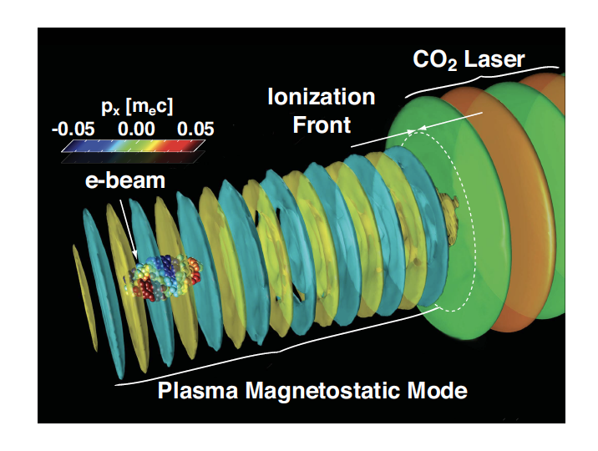
Experimental goal
1. Year 2022: Demonstrate the excitation of MS mode through the collision of relativistic ionization front with CO2 laser pulse by measuring:
magnetic field using electron probe with permanent magnet quadrupoles (PMQ) imaging system
frequency upshifted radiation using LWIR spectrometer
ion density perturbation using Thomson scattering diagnostic
2. Final goal: Demonstrate X-ray radiation generation through an electron beam propagating through the MS mode

Slide 6
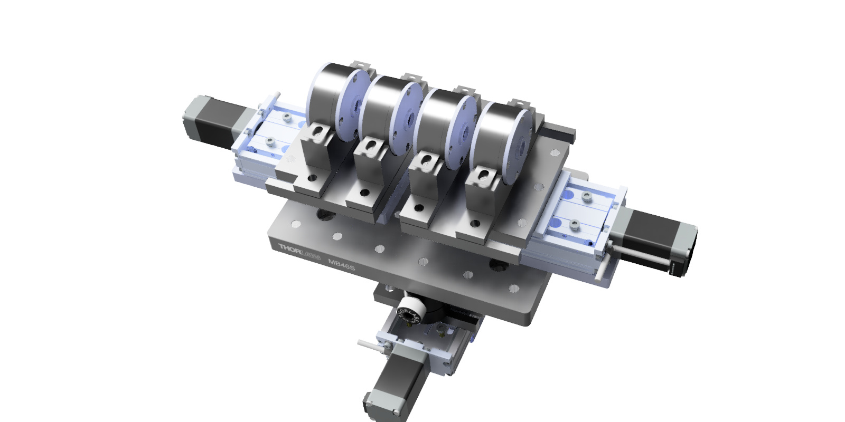
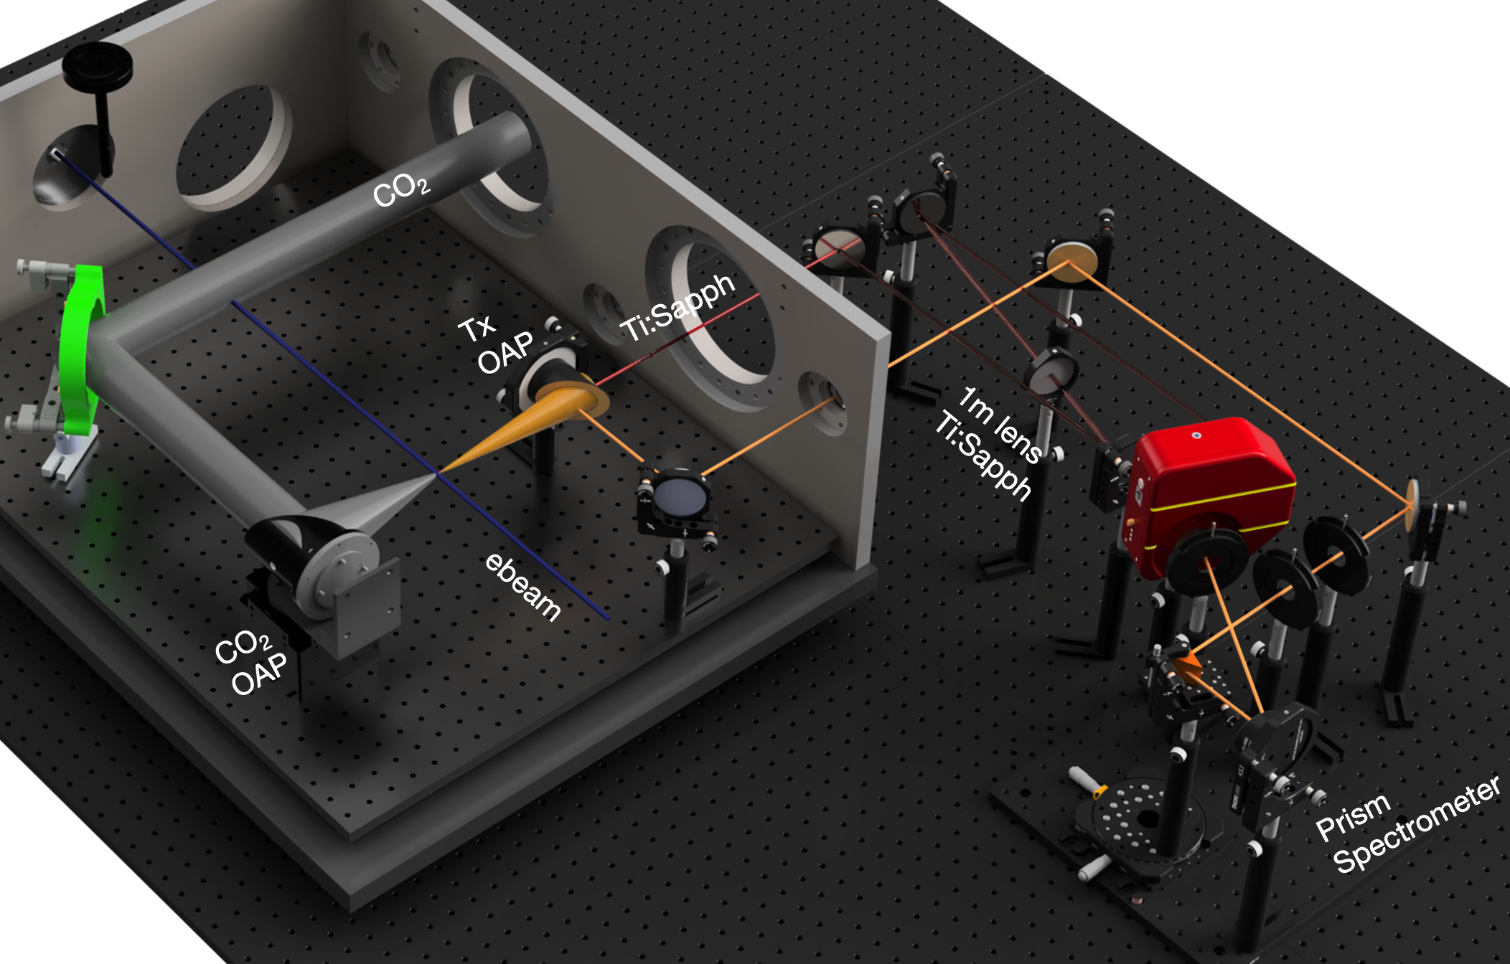
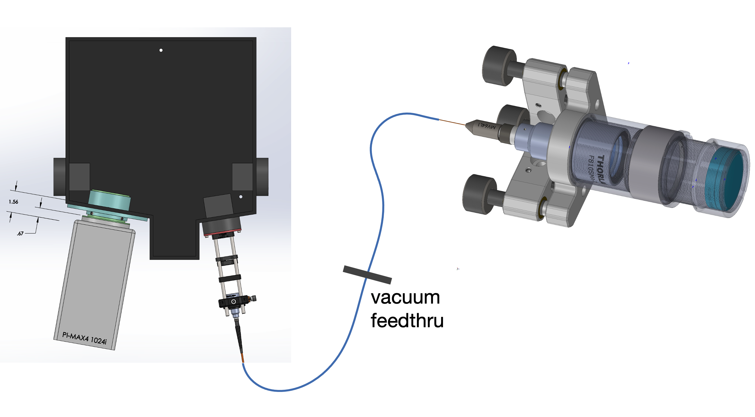
Experimental campaign for Year 2022
Developed/optimized the PMQ imaging system, LWIR spectrometer, and Thomson scattering diagnostic
In September, we tried the AE99 experiment at ATF. Although we did not obtain the final results, we made some progress. The preliminary data we collected allow us to figure out how to improve the AE99 experiment in the future.
With the similar setup, we obtained some interesting results of Weibel instability and stimulated Raman backscattering instability
PMQ
LWIR spectrometer
Thomson scattering

Slide 7
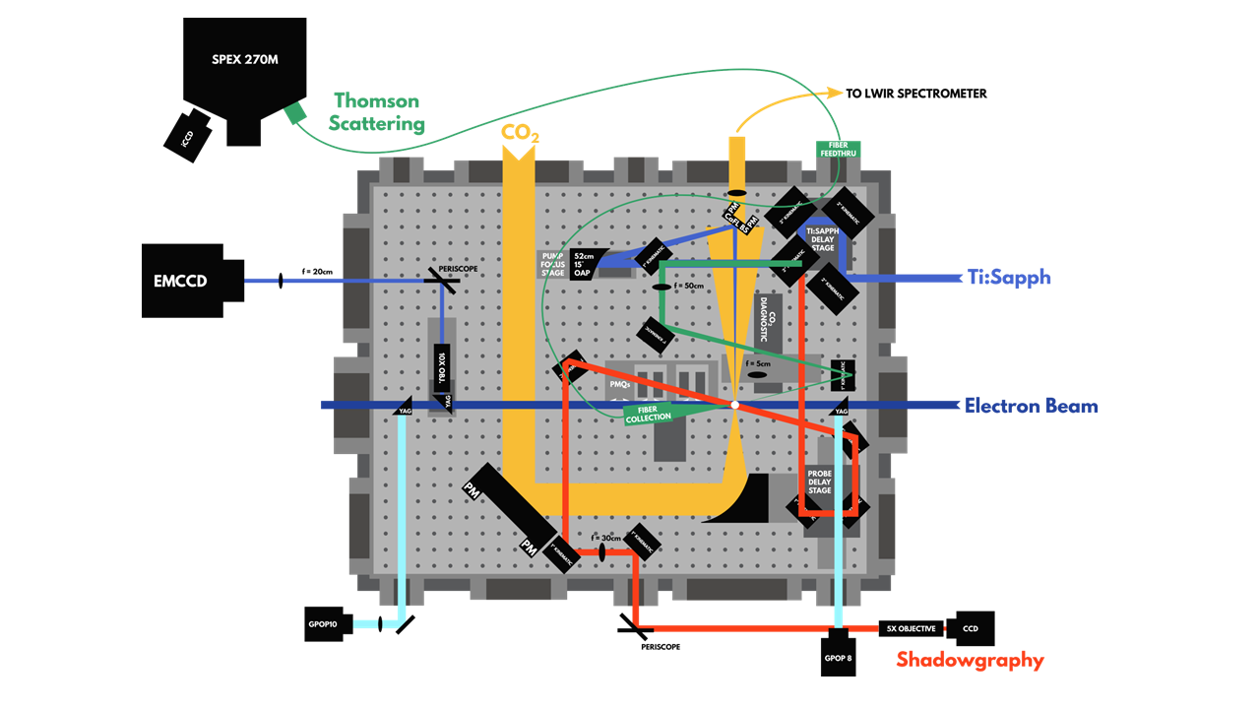
Experimental layout
Experimental Setup
Counter propagating CO2 & Ti:Sa lasers
Ti:Sa laser creates an ionization front in the hydrogen gas
CO2 laser collides with the ionization front and generates the MS mode
Diagnostics
Shadowgraphy: ionization front
e-probing with PMQ: MS mode B-field
LWIR spectrometer: reflected or transmitted upshifted radiation
Thomson Scattering: ion density perturbations of the MS mode

Slide 8
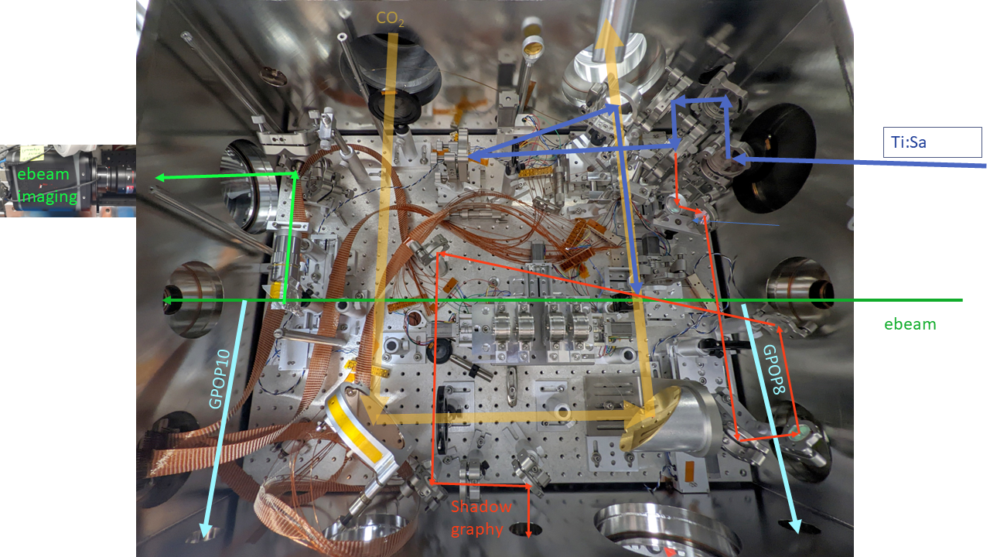
Experimental layout
CO2 laser
IR spectrometer
Ti:Sa laser ~10-20mJ, ~68fs
100 µm YAG:Ce
IP
50.5 MeV e-beam
~0.2% energy spread (use slit)
motorized PMQs

Slide 9
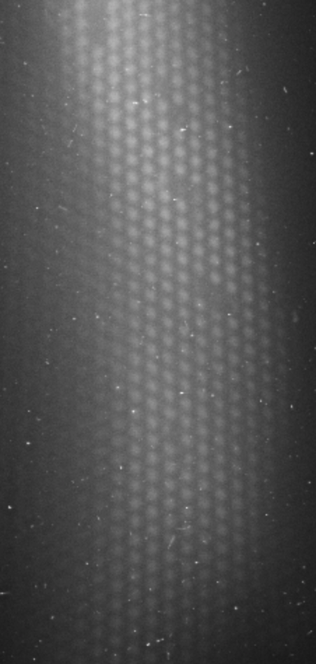
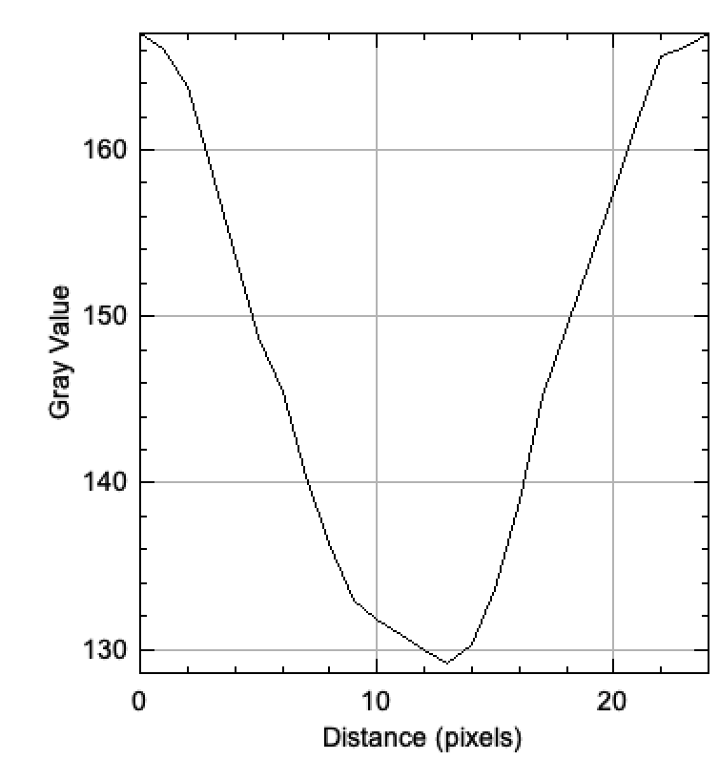
Resolving power measured using the TEM grids
Overall magnification (e- beam + optical): ~17.8x
Optical magnification: ~4.8x
PMQ e- beam magnification: 3.7x
Resolving power: ~3.2 µm
400-mesh
Bar width 20 µm
Hole width 37 µm
2000-mesh
Bar width 5 µm
Hole width 7.5 µm

Slide 10
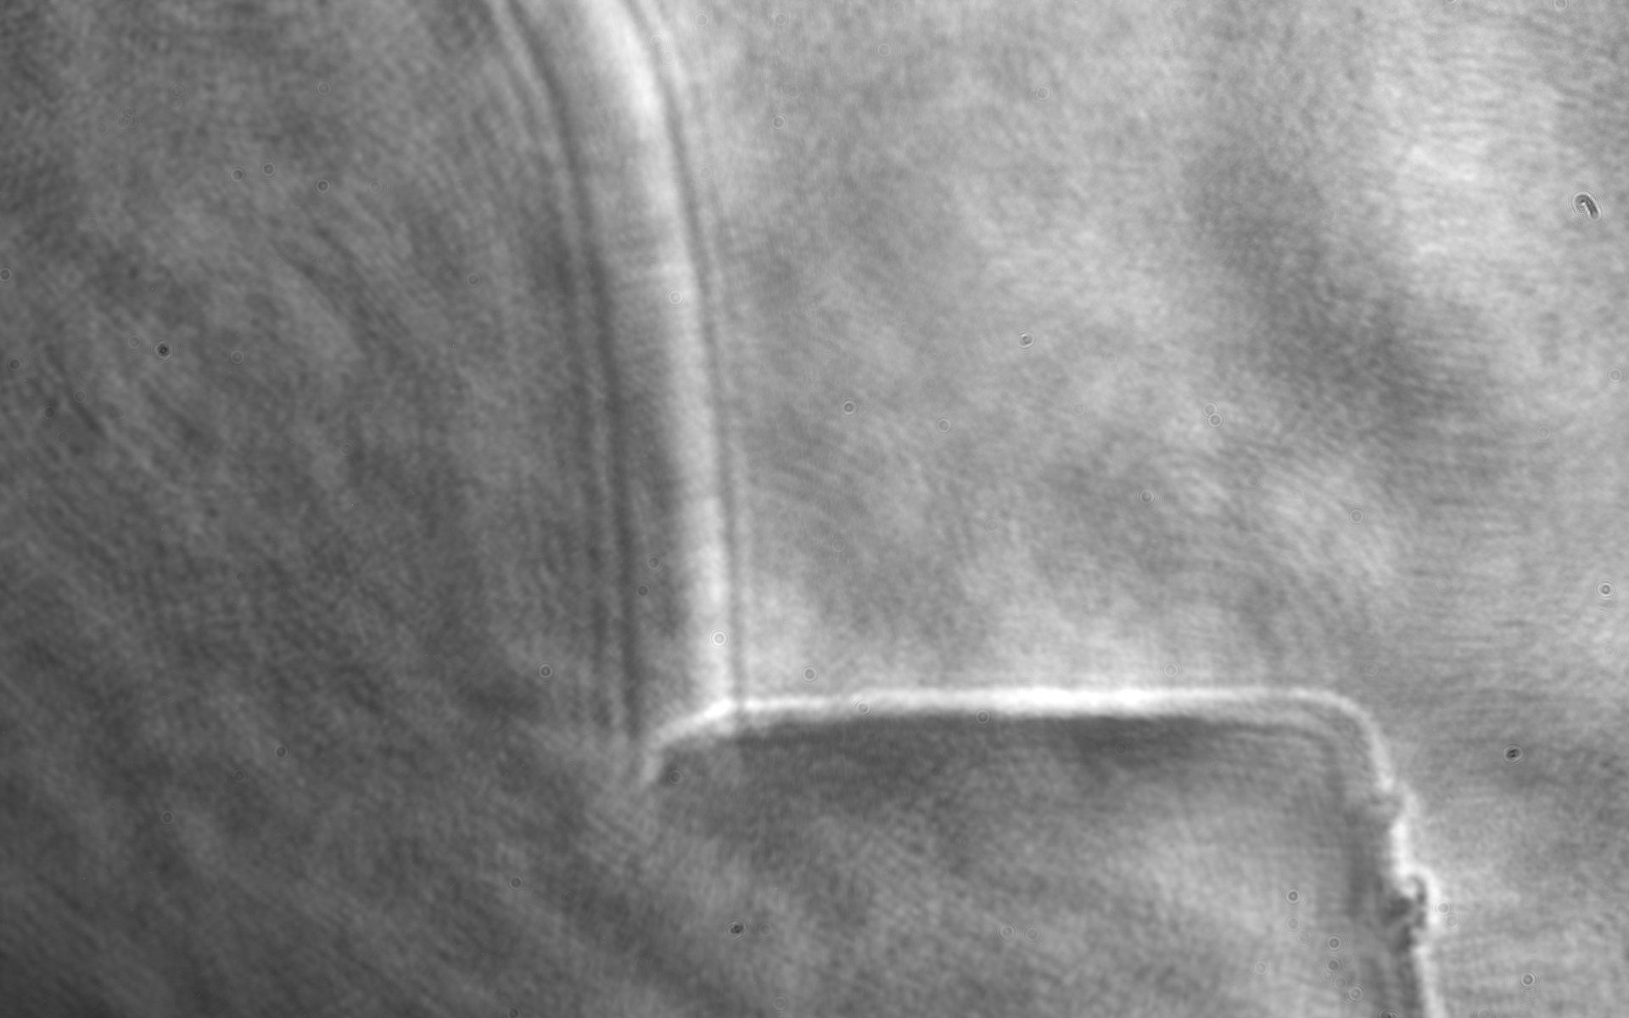
Ionization front measured using optical shadowgraph
Ti:Sa Laser Parameters
Pulse length ~68 fs
Energy: ~10 mJ on target
Spot size ~50 µm FWHM
Gas: H2, 25psig
T=-75 ps
Ti:Sa
Gas jet
1.83 µm/pixel

Slide 11
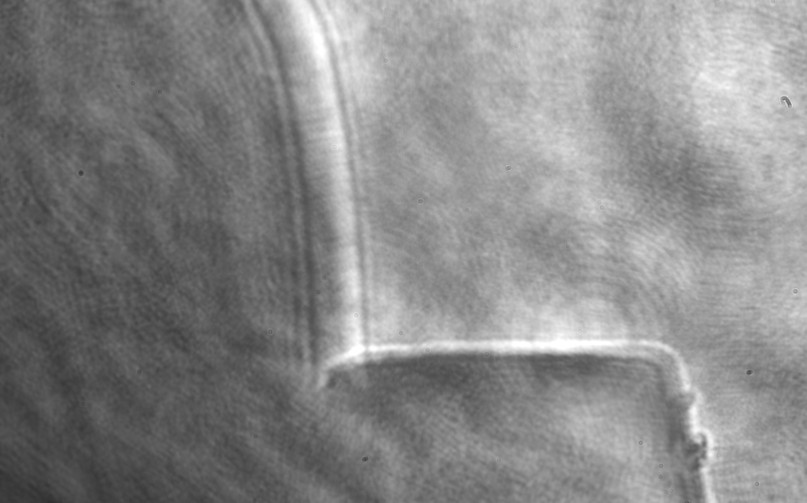
Ionization front measured using optical shadowgraph
T=-73 ps
Ti:Sa
Pre-ionization
prepulse ~15% energy
Gas jet

Slide 12
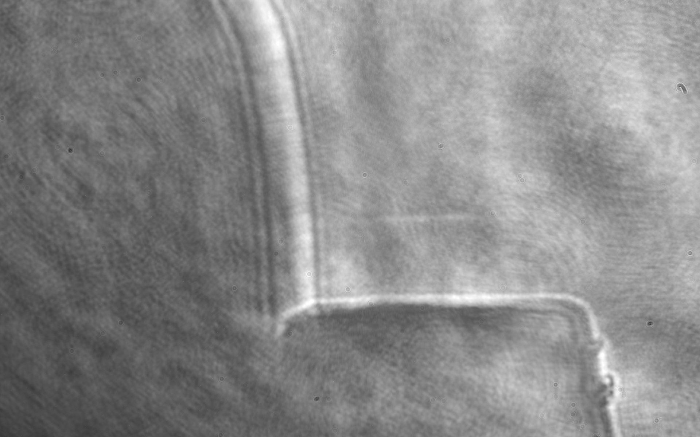
Ionization front measured using optical shadowgraph
T=-0.67 ps
Ti:Sa
Pre-ionization
prepulse ~15% energy
Gas jet

Slide 13
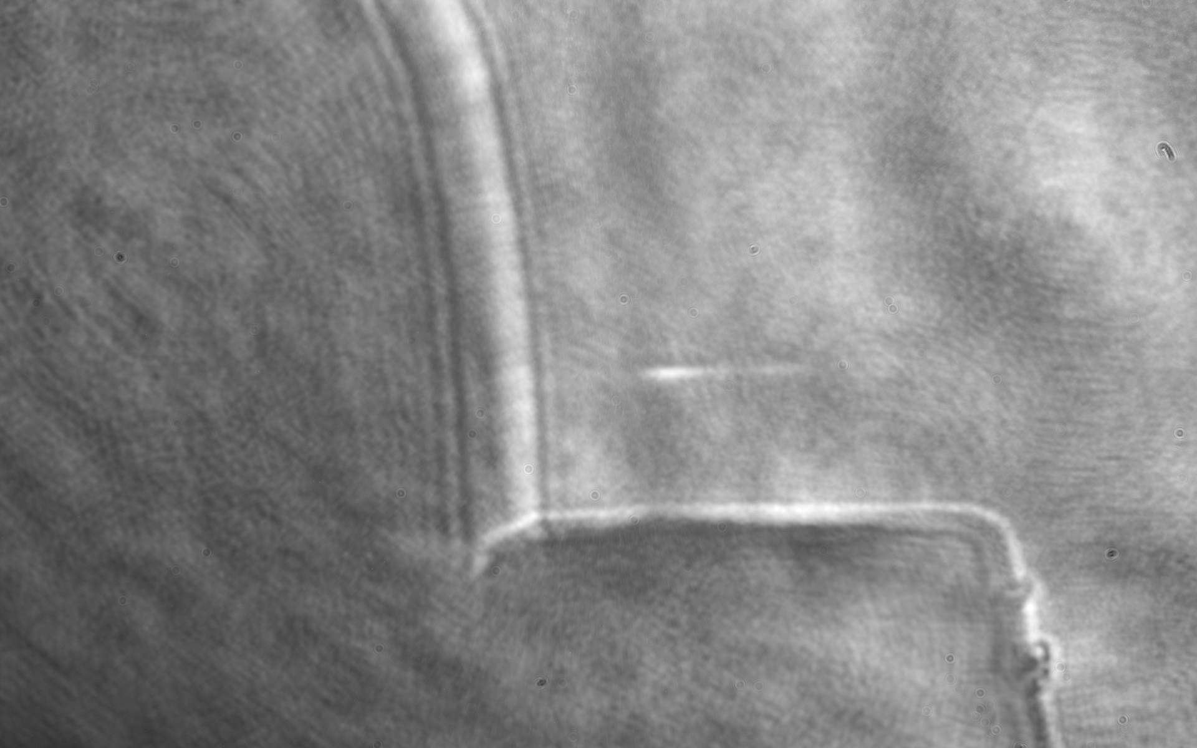
Ionization front measured using optical shadowgraph
T=0 ps
Ti:Sa
Pre-ionization
prepulse ~15% energy
Gas jet

Slide 14
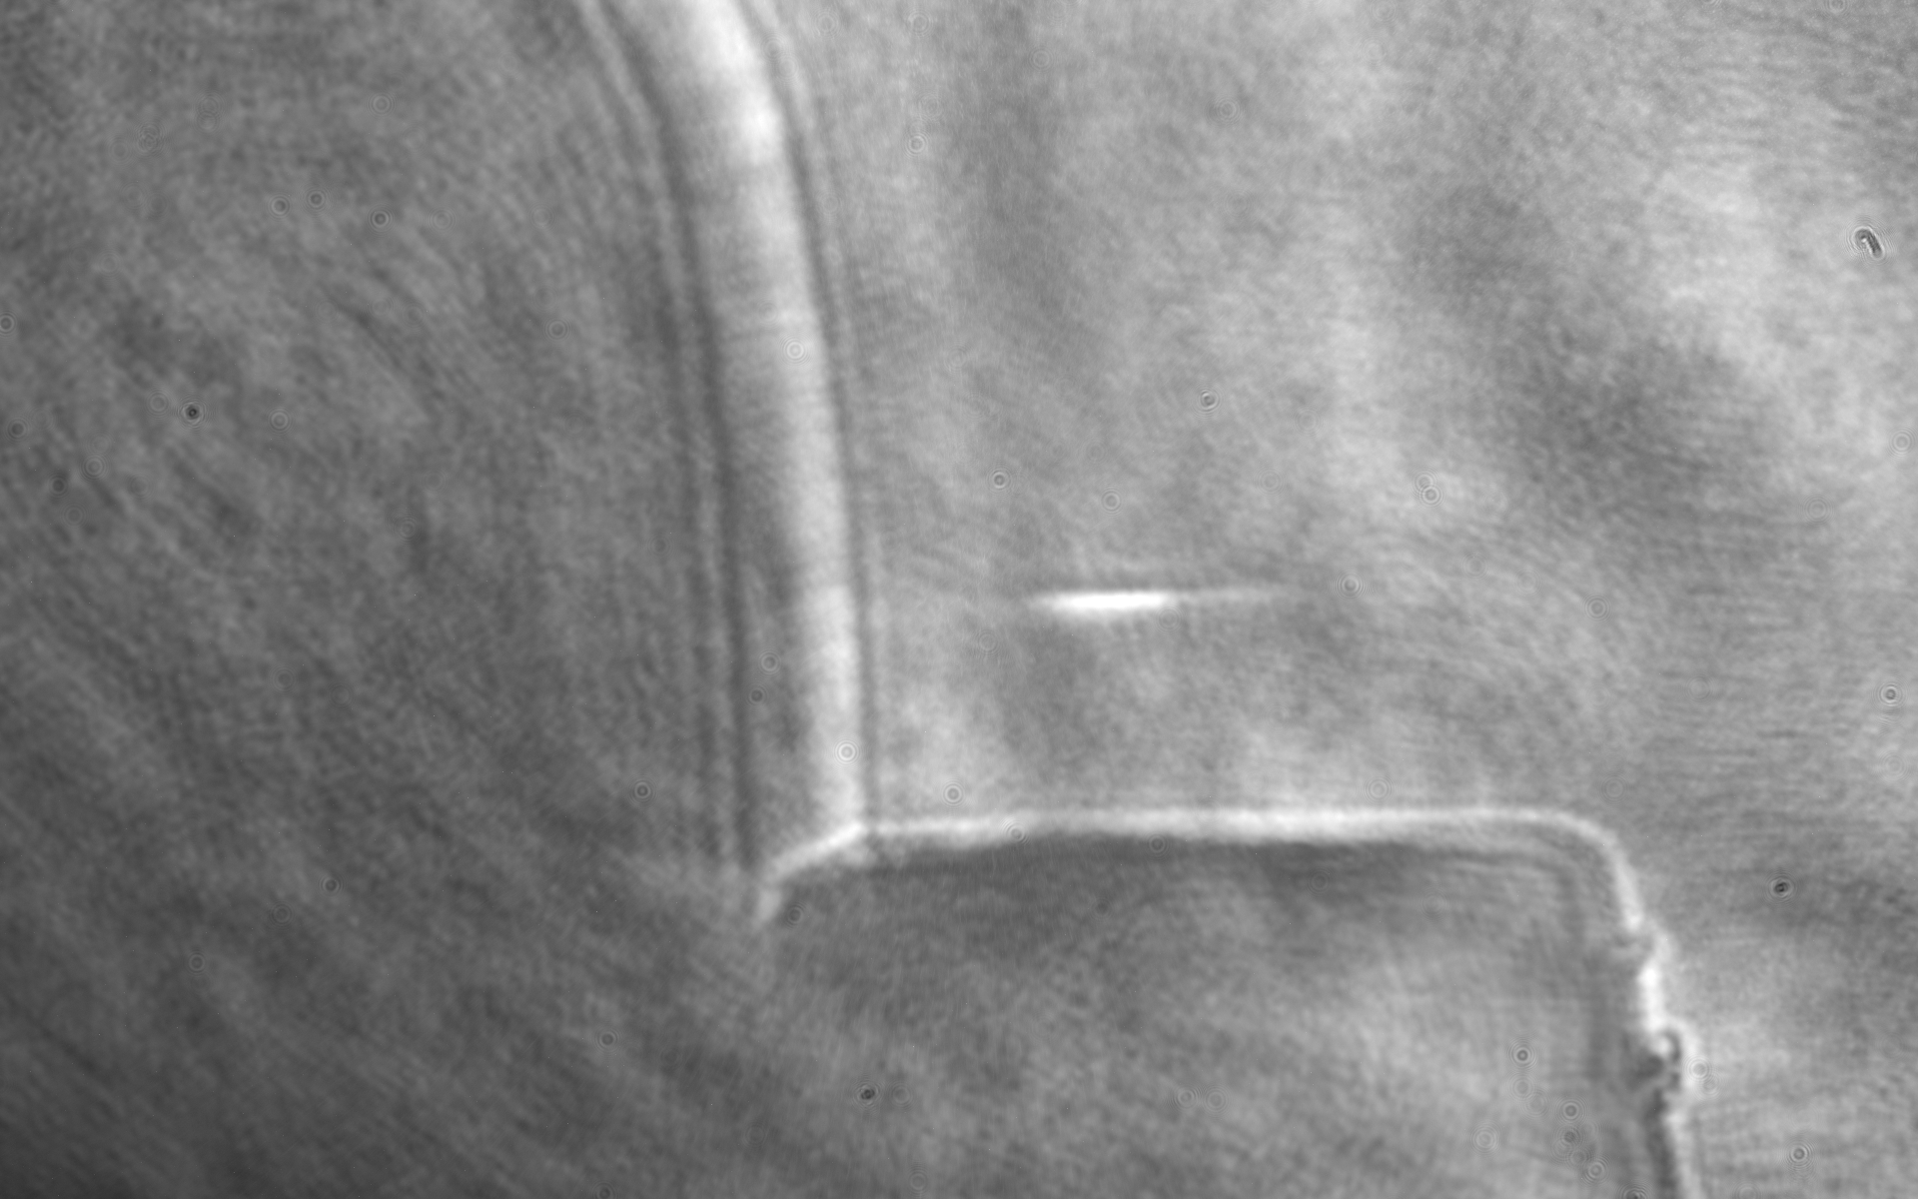
Ionization front measured using optical shadowgraph
T=0.67 ps
Ti:Sa
Pre-ionization
prepulse ~15% energy
Gas jet

Slide 15
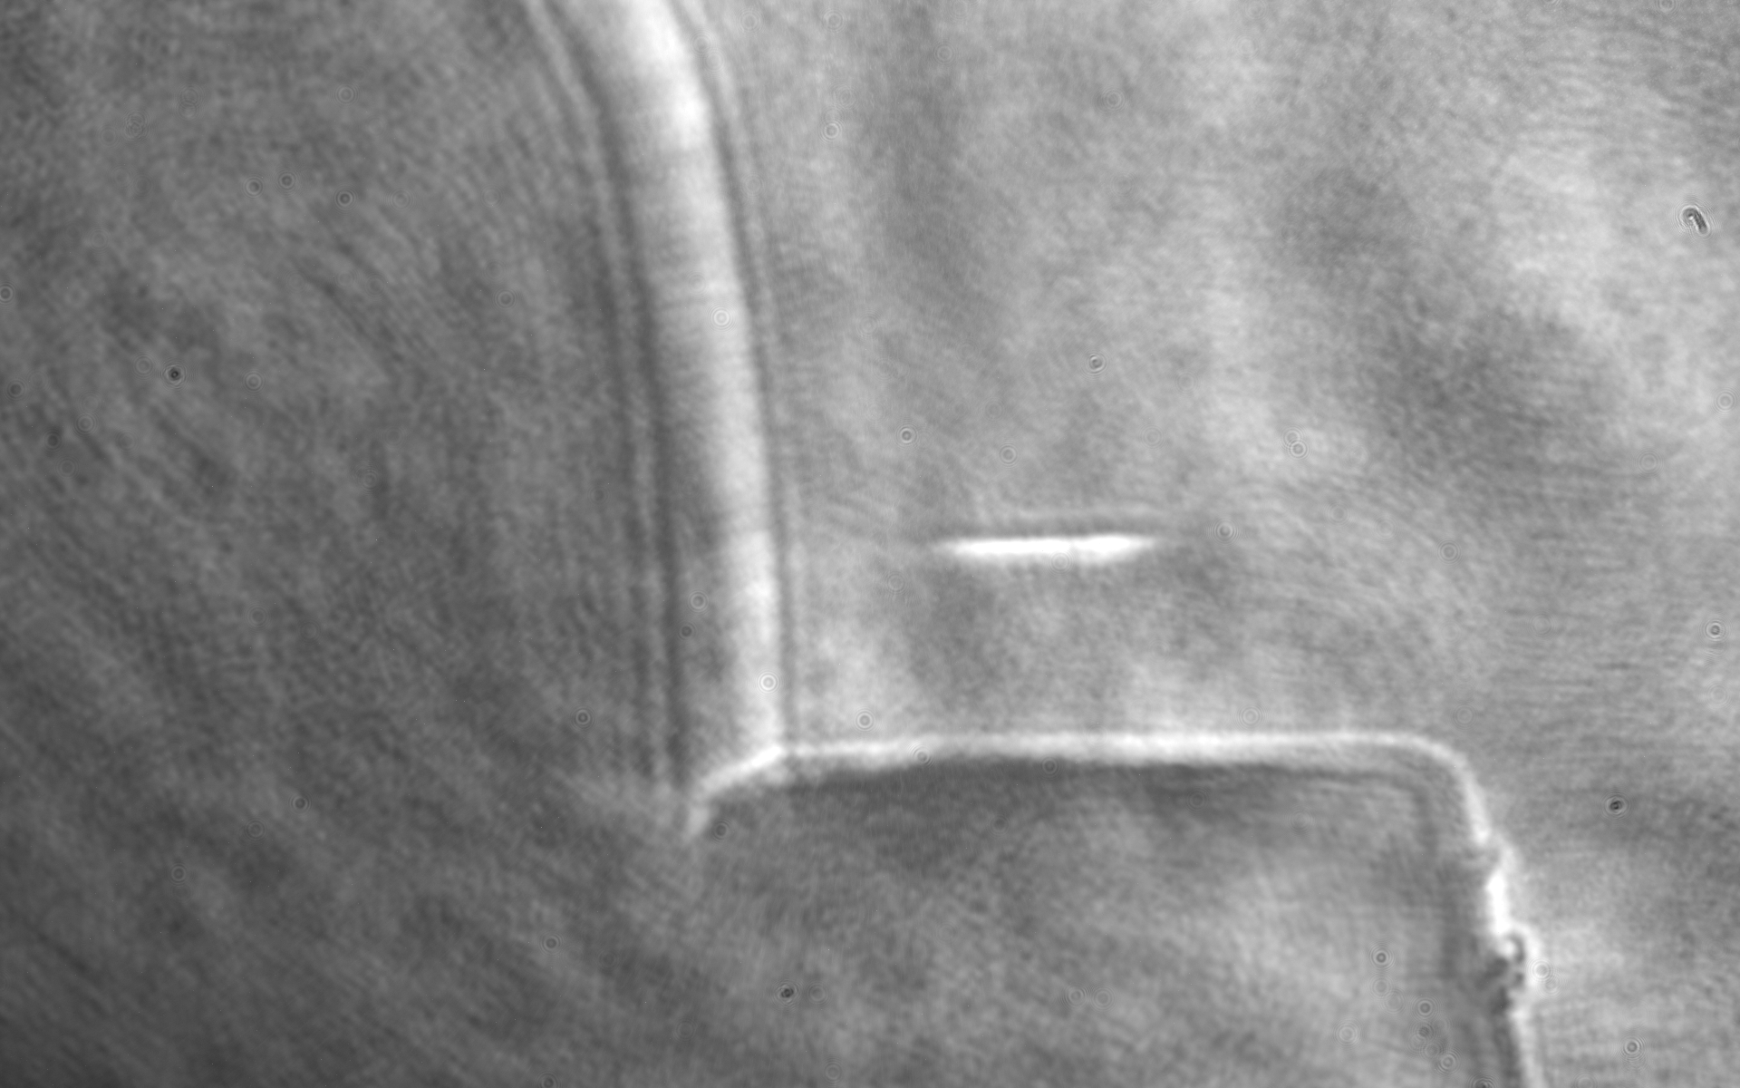
Ionization front measured using optical shadowgraph
T=1.33 ps
Ti:Sa
Pre-ionization
prepulse ~15% energy
Gas jet

Slide 16
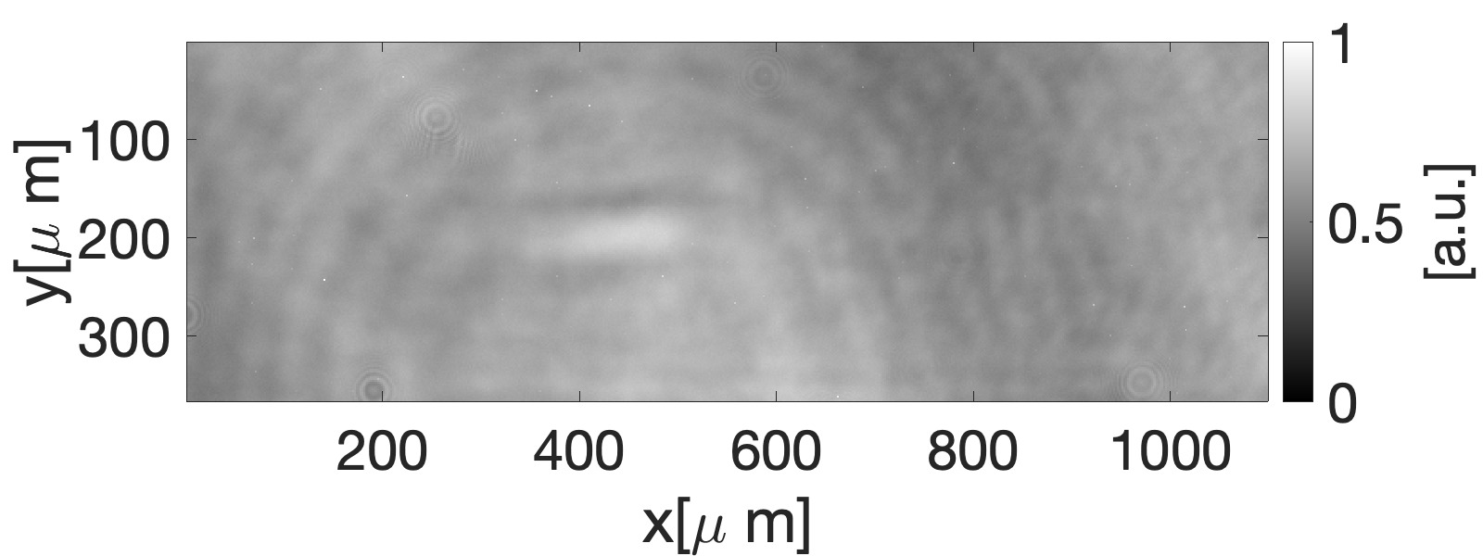
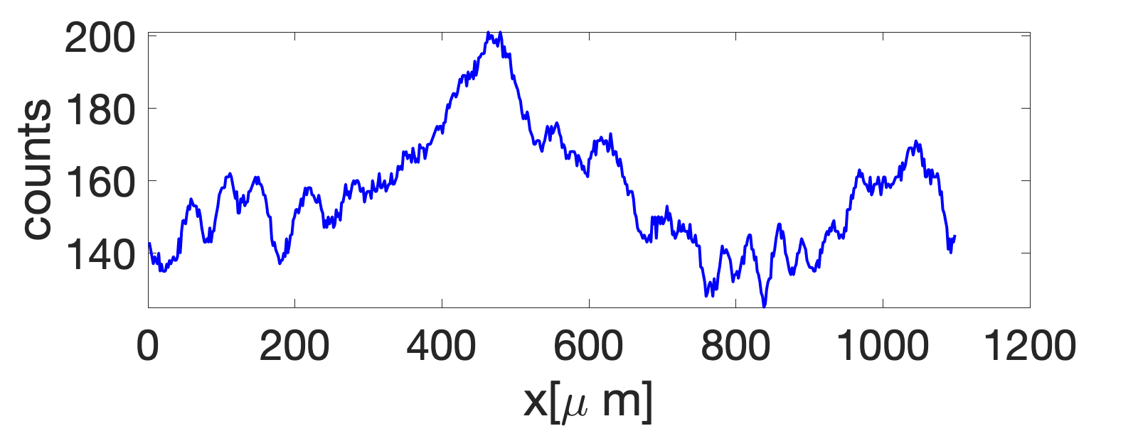
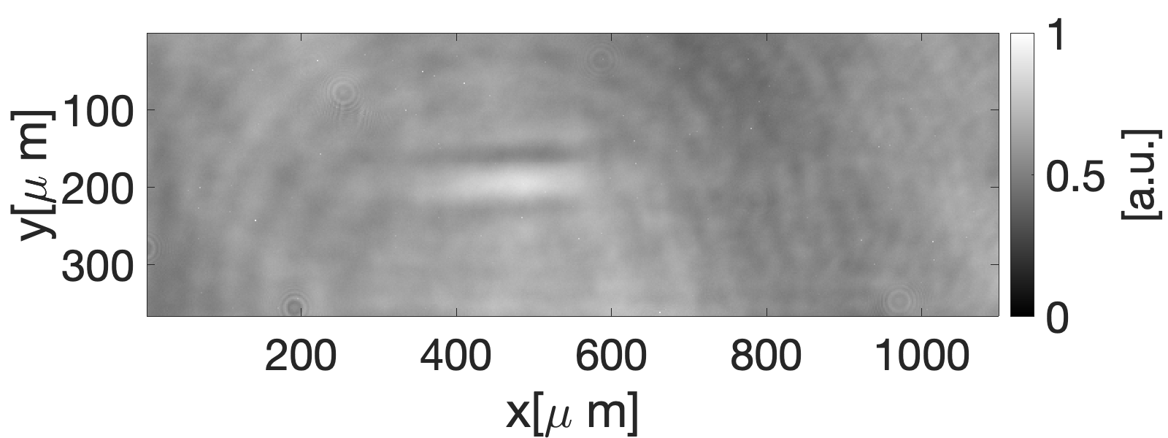
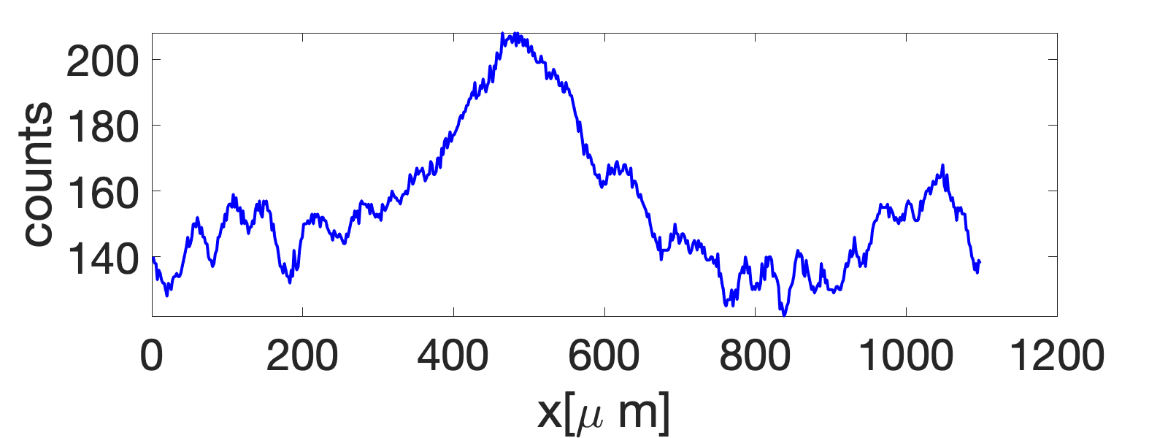
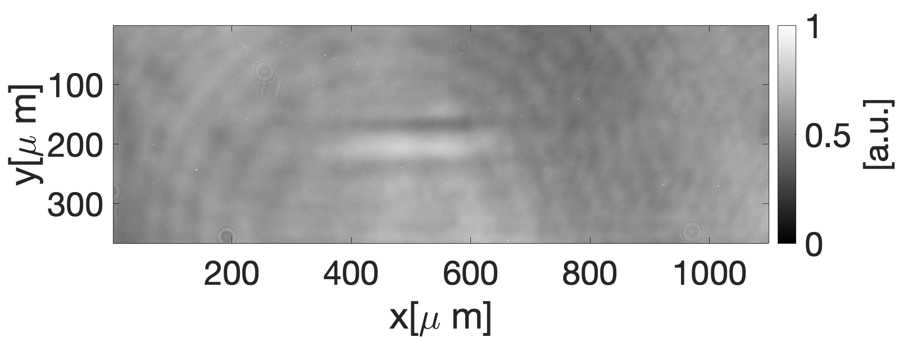
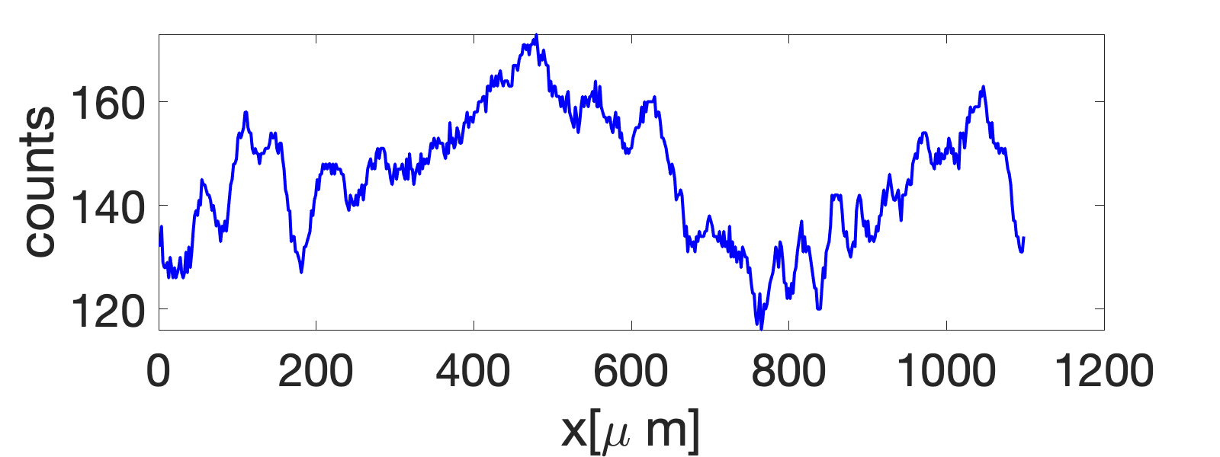
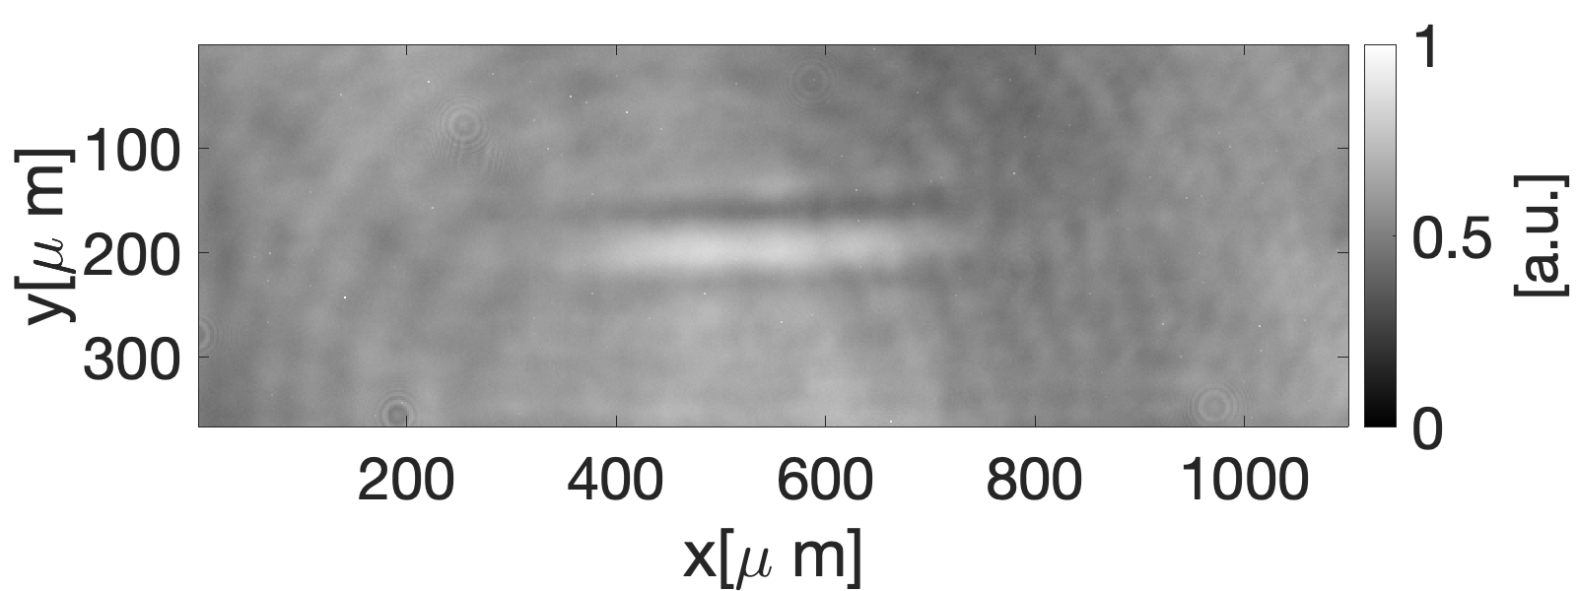
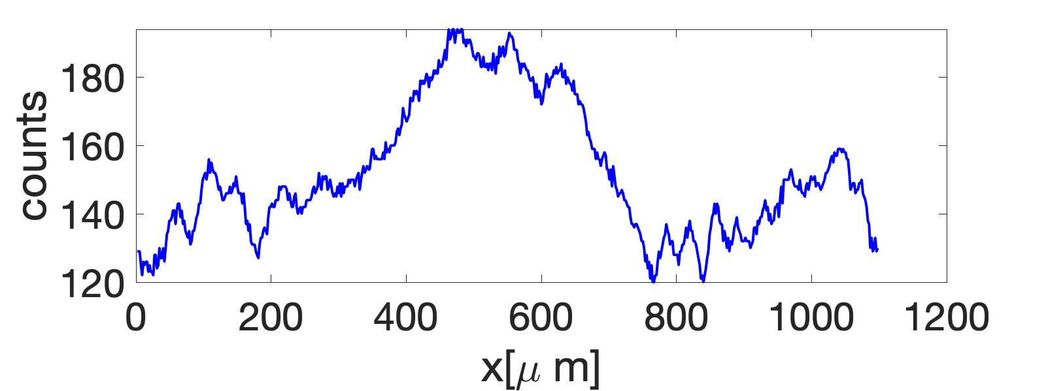

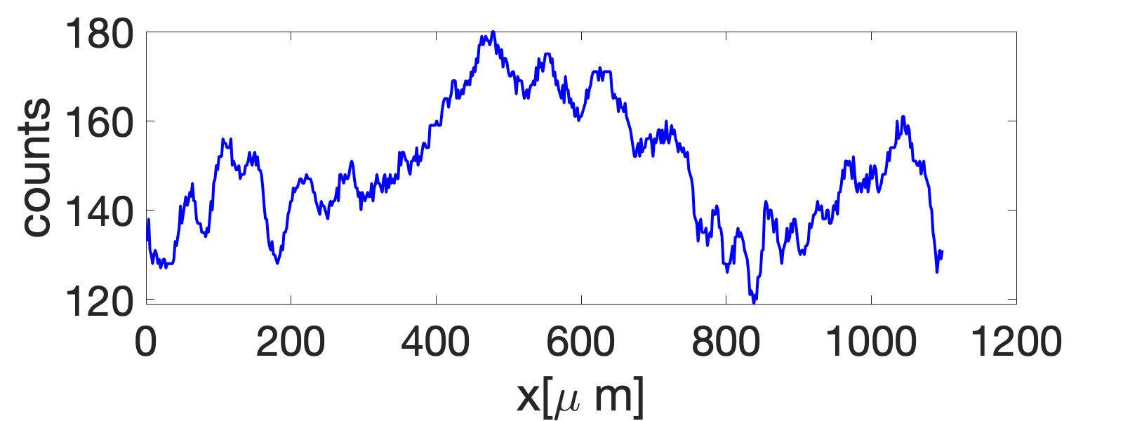
Ionization front measured using optical shadowgraph
Ti:Sa
Ti:Sa Laser Parameters
Pulse length ~68 fs
Energy: ~12 mJ on target
Spot size ~50 µm FWHM
Gas: He, 50psig
T=0.33ps
T=0.67ps
Excite an ionization front
length 400 µm (80 periods of B field)
width > 100 µm, much larger than half of the CO2 wavelength (Ti:Sa prepulse)
T=1ps
measured ionization front
T=1.33ps
required ionization front
Desired Upgrades to Ti:Sa laser
Reduce the prepulse
Decrease the pulse length
T=1.67ps

Slide 17
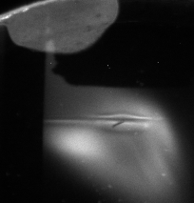
Synchronization and overlapping
Try to synchronize the Ti:Sa and CO2 using the optical shadowgraph (Ti:Sa postpulse)
Synchronize three beams using the e-beam probing
Spatial overlap the Ti:Sa and CO2 using a needle tip (within 100 µm) and e-beam probing (vertical direction)
metal needle
Gas jet
Ti:Sa
CO2
Ionization due to Ti:Sa and CO2

Slide 18
e-probing data with PMQ
The PMQ e-beam imaging system can probe the ionization line very well.
We found that the synchronization was not stable during the experiment.
CO2
Ti:S
Ti:Sa
Notes:
We did not get the signal of upshifted radiation on the LWIR spectrometer.

Slide 19
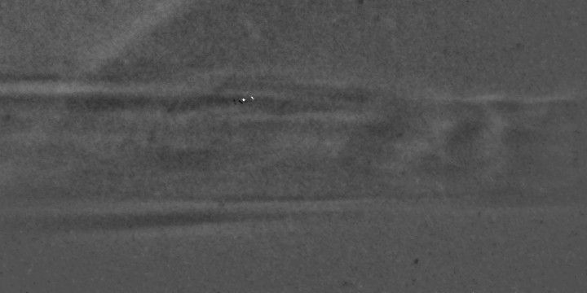
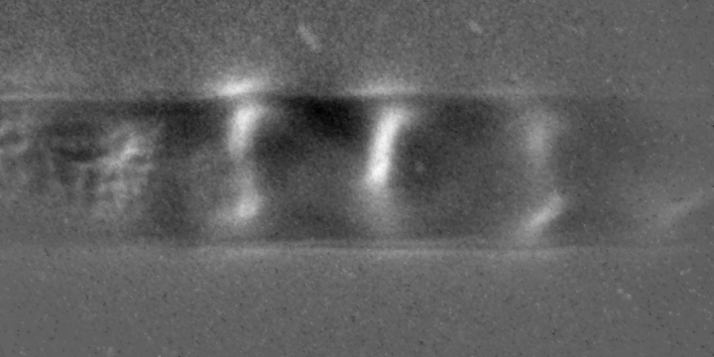
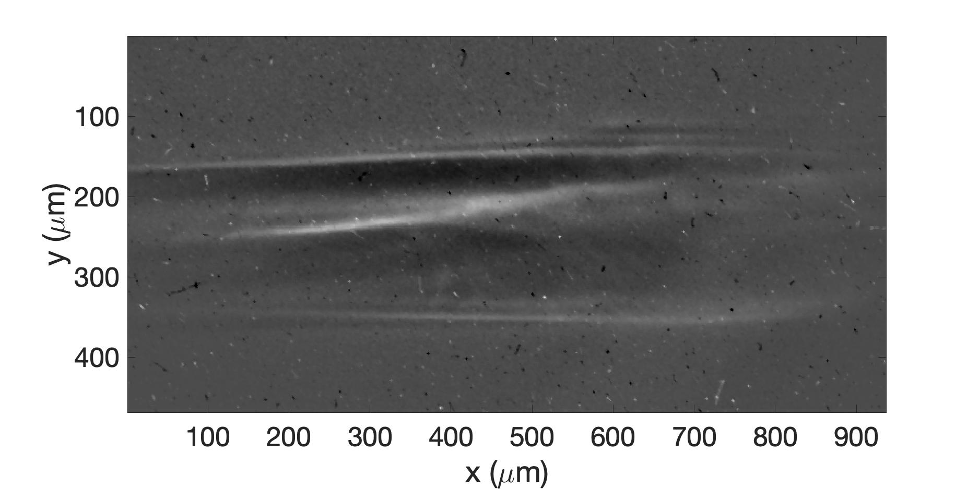
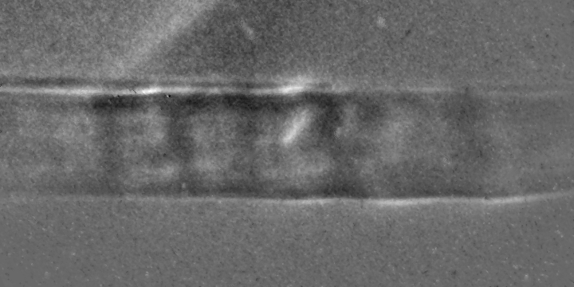
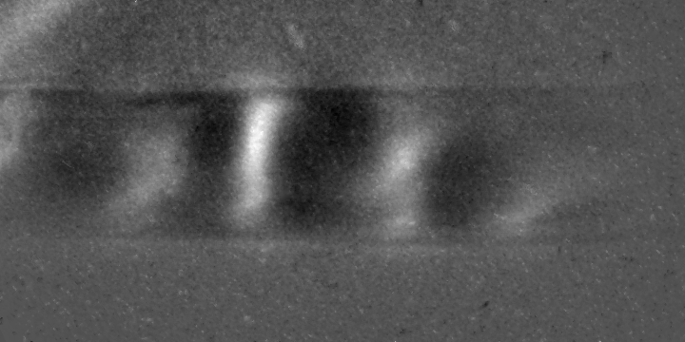
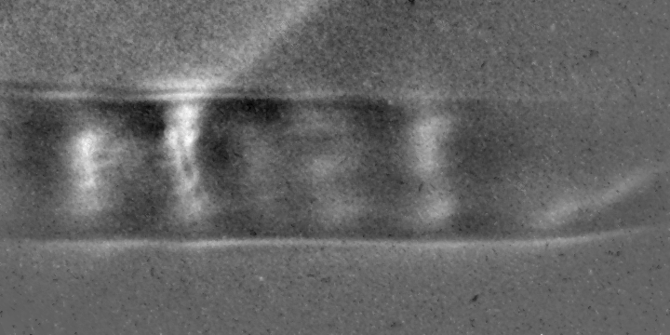
e-beam image measured using the PMQ probing system in 2022 run
Weibel instability in the bounded plasma
t=6.67ps
t=46.67ps
CO2 laser: ~400-800 mJ
H2: ~30psig (~2e17cm⁻³)
PMQ position: distance from object plane to IP ~3-4cm
t=20ps
t=60ps
t=33.3ps
The evolution of B fields in a bounded plasma is different from that in a wider plasma

Slide 20
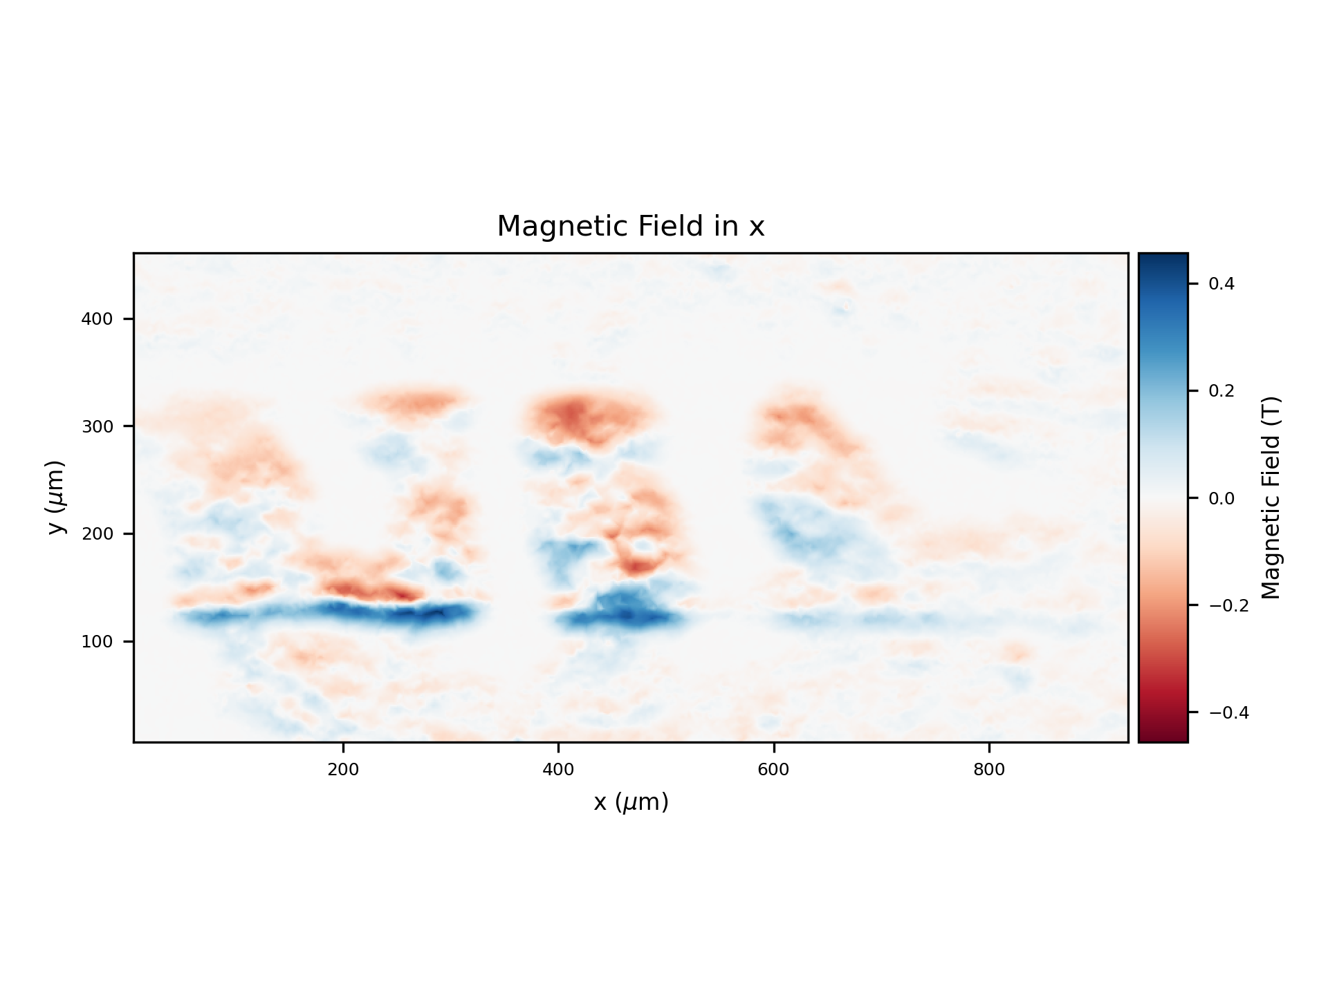
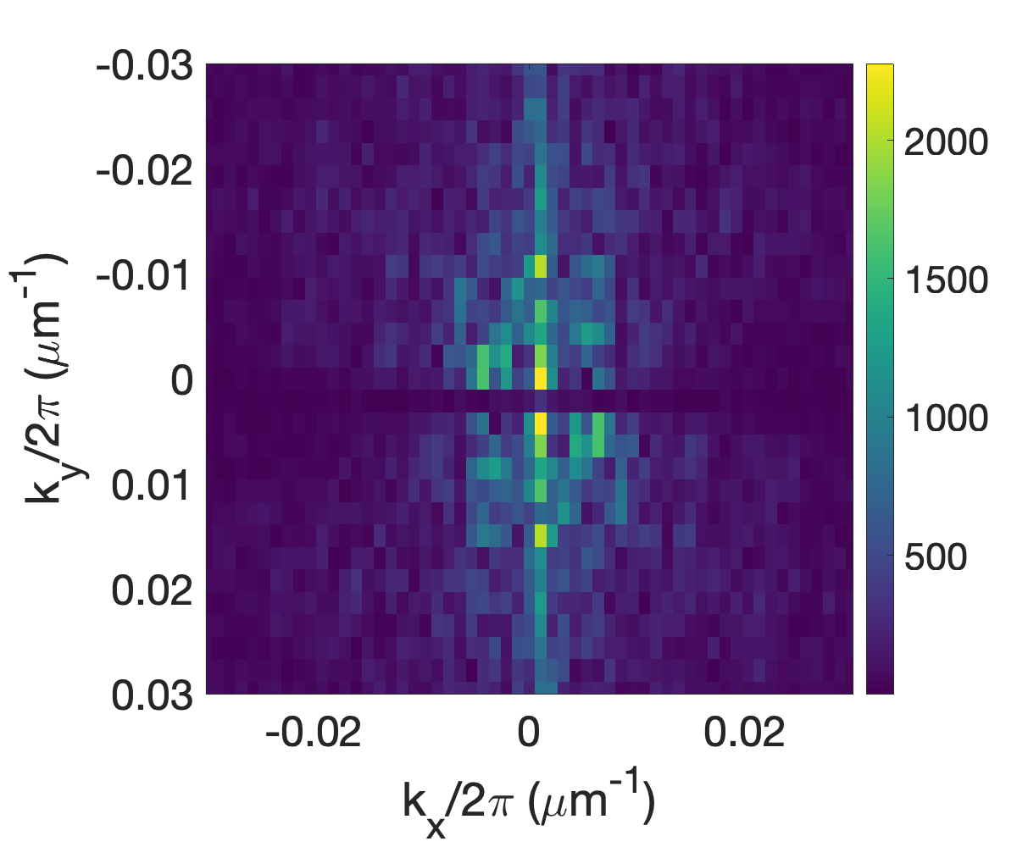
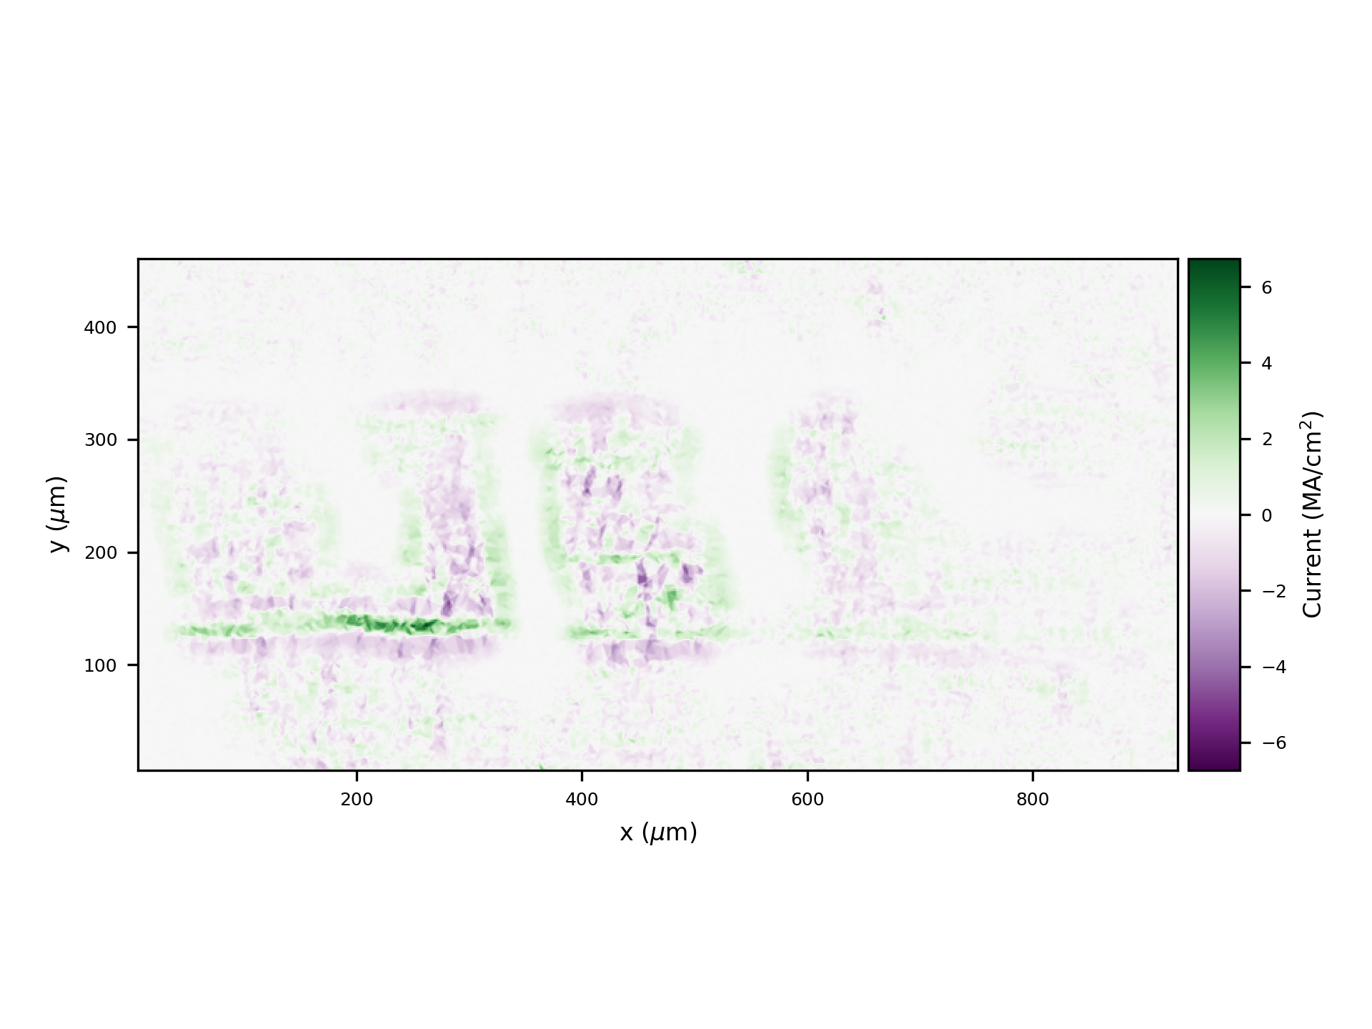
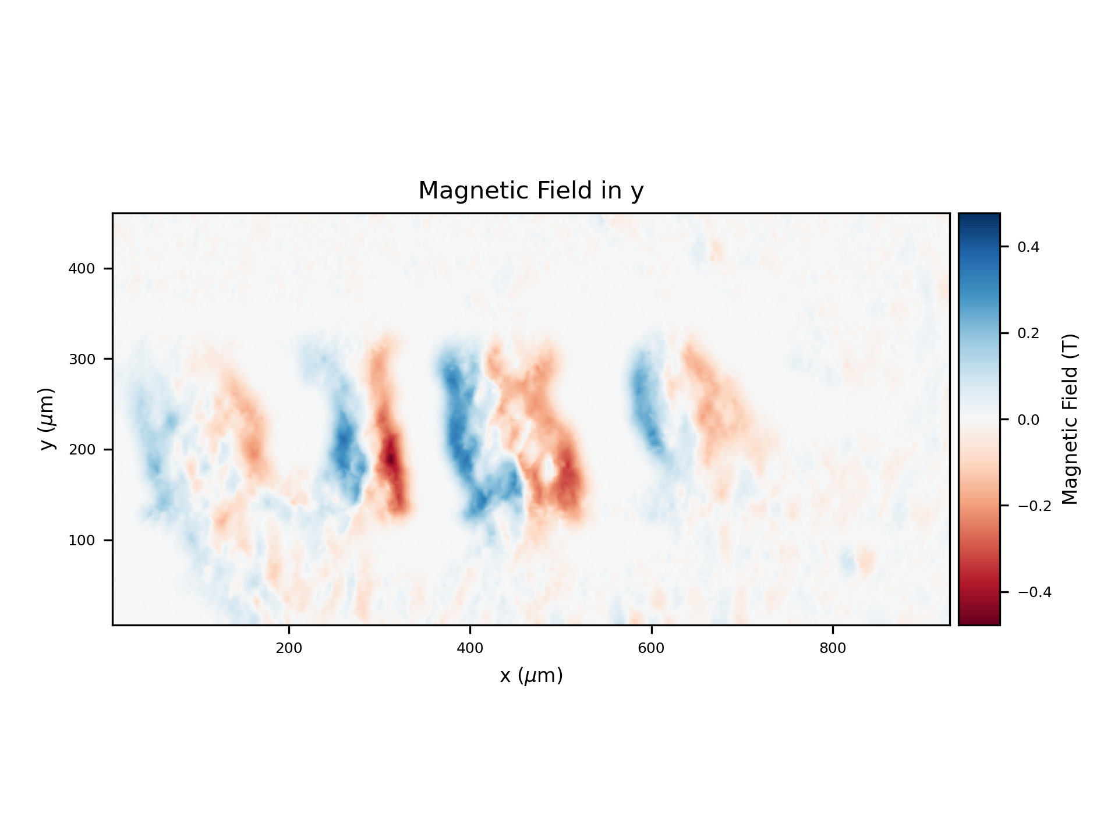
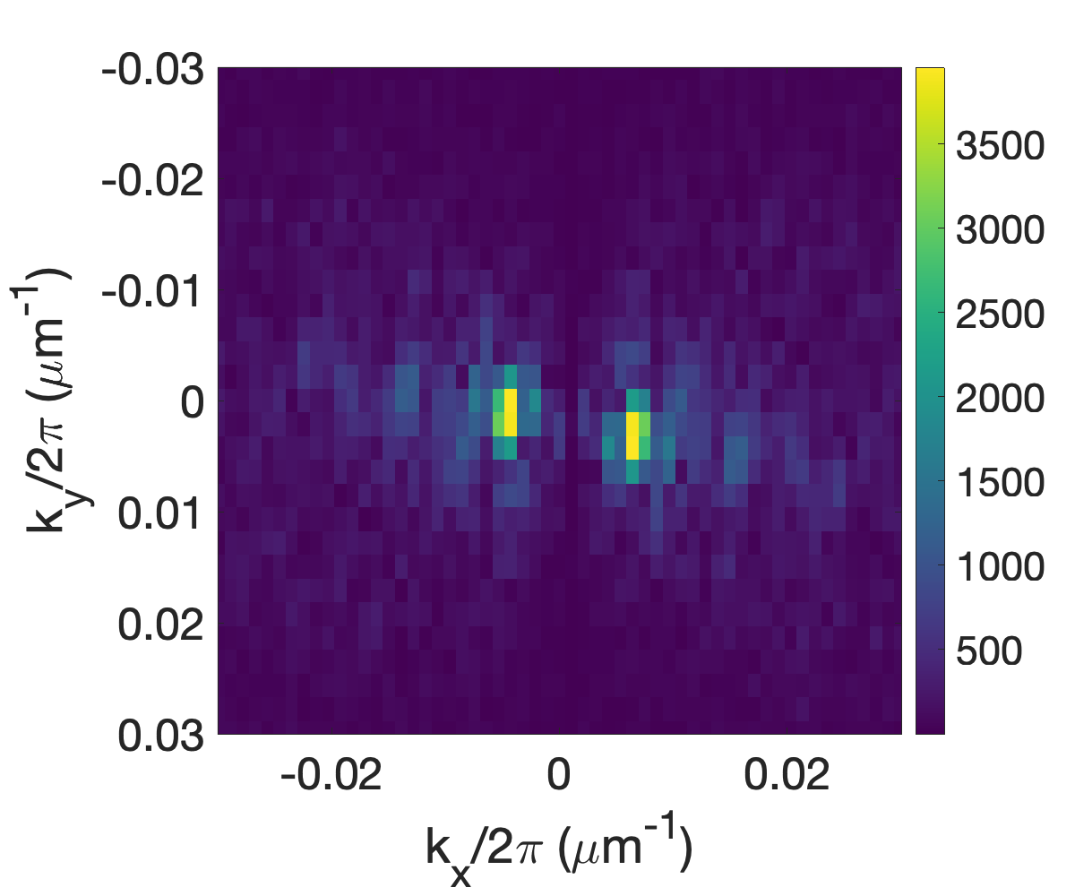
Weibel instability in the bounded plasma
Calculating magnetic fields and plasma currents
t=60ps
Bx
Jz
By

Slide 21
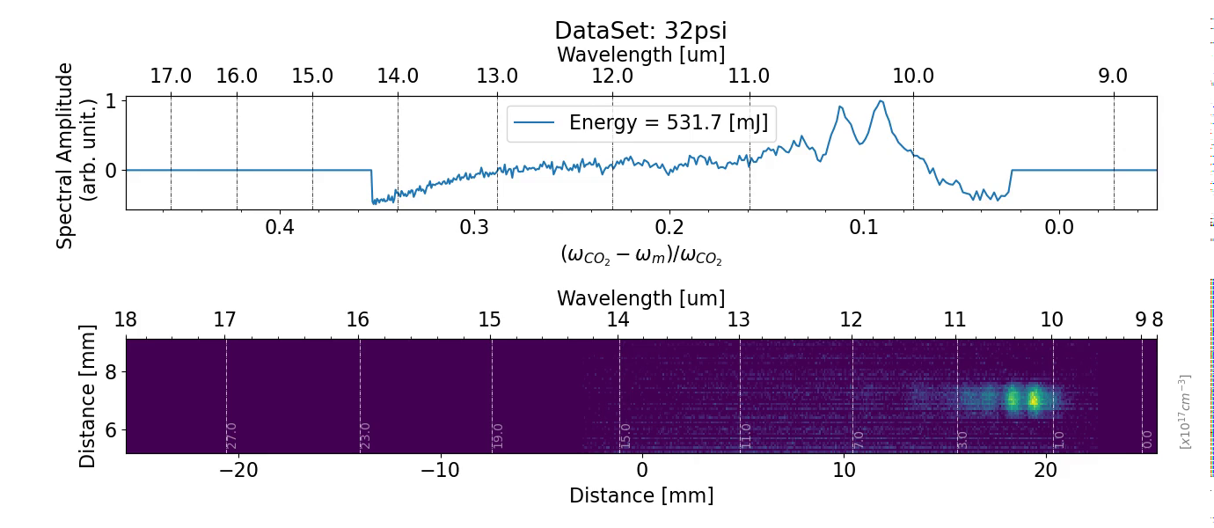
Backwards SRS Spectrum
Stimulated Raman backscattering instability in a plasma density ramp

Slide 22
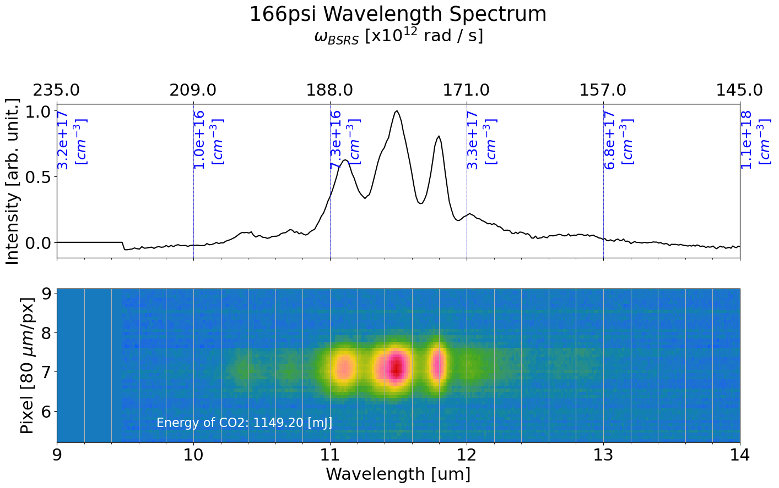
Selected Results of B-SRS Spectrum
Stimulated Raman backscattering instability in a plasma density ramp
Observation of localized spectral generation of B-SRS
High Power CO₂ ionized plasmas have demonstrated localized growth of B-SRS
Exploring WKB approximation in a plasma density ramp
Rosenbluth PRL 1972 and Estabrook & Kruer 1983,
  ΔΦ = 1/2 -> significant phase mismatch
  Calculated phase mismatch is within this range

Slide 23
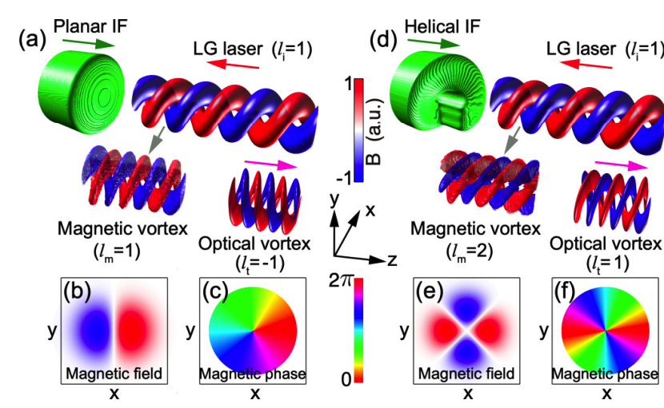
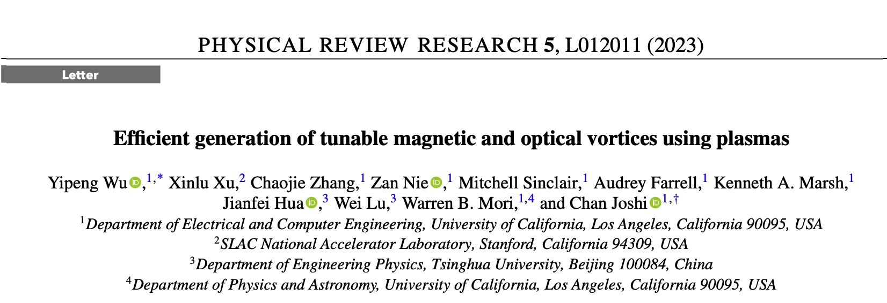
Summary of products delivered from the work
Conference
  One talk at the 64th APS-DPP meeting (Mitchell)
Papers
  Efficient generation of tunable magnetic and optical vortices using plasmas, Yipeng Wu, et al., Physical Review Research 5, L012011 (2023)
  Weibel instability in the bounded plasma, in preparation

Slide 24
Desired ATF facility upgrade for AE99 in the future
  Ti:Sa laser
  decrease the pulse length: compression optimization
  reduce the pre- and post-pulse
  single-shot mode (need a shutter)
  improve the synchronization of Ti:Sa with CO2/e-beam (adding a monitor)
  e-beam
  improve the stability and quality to obtain a higher resolution for e-probing
  CO2 laser
  nearly the same parameters as those used in Year 2022

Slide 25
Thank you for your attention
We want to thank the ATF BNL team for their support.

Slide 26
Backup slides

Slide 27
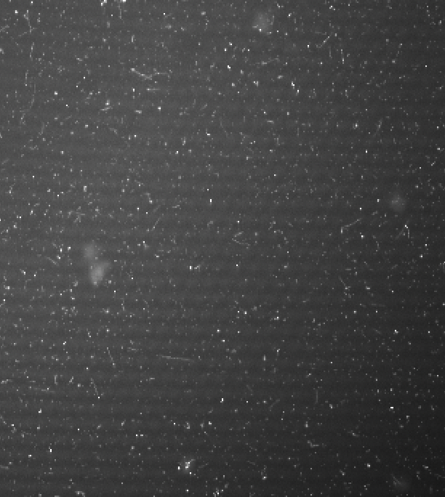

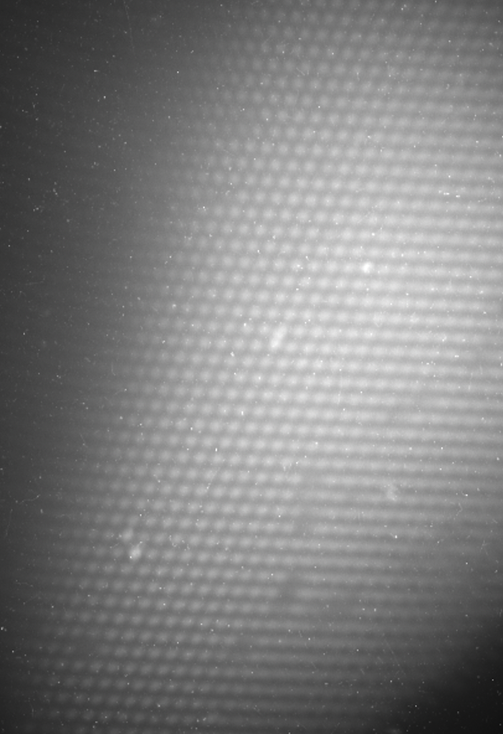
Resolving power strongly depends on the beam parameters (e.g., divergence)

Slide 28
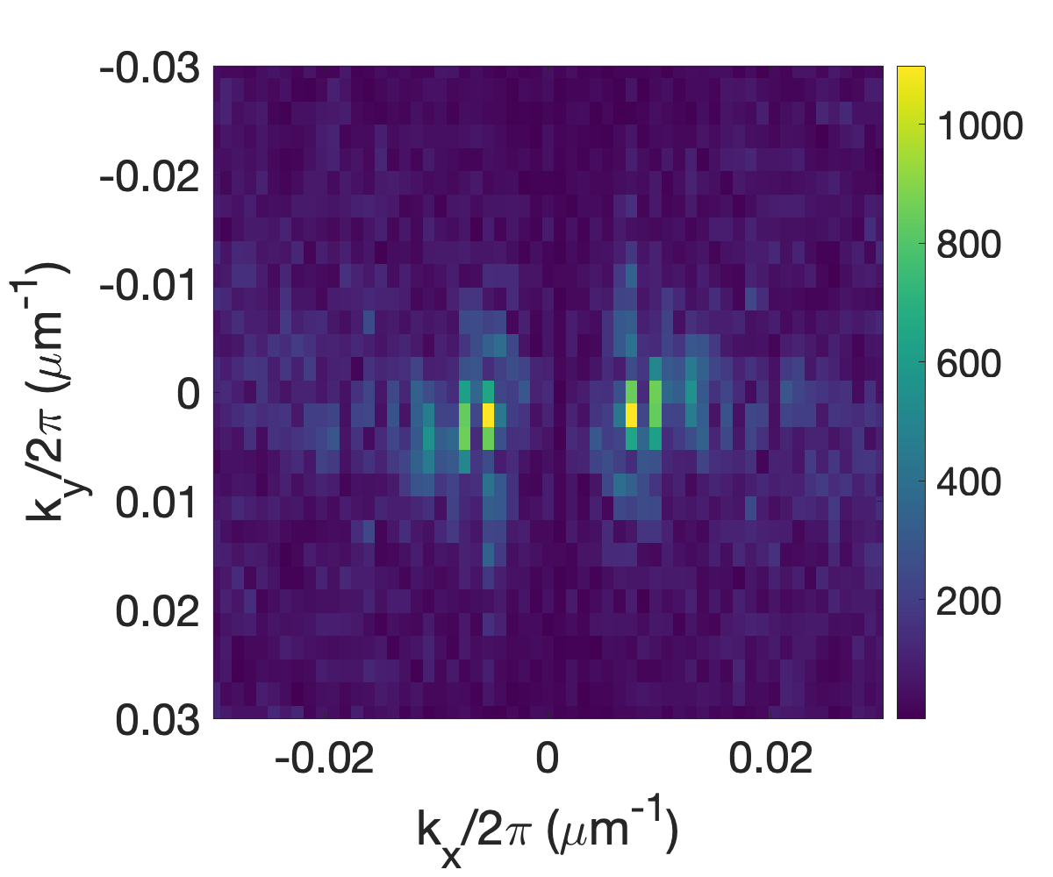
k-evolution of B_{y}
Weibel instability in the bounded plasma
t=33.3ps
As time increases, k slightly decreases
t=60ps

Slide 29

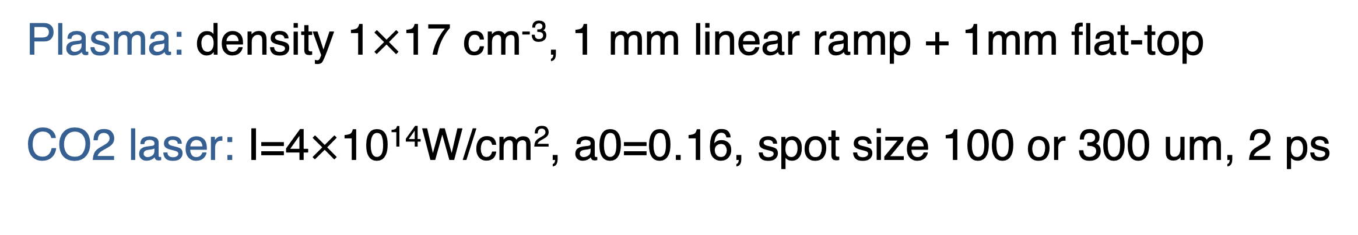
3D PIC Simulations
Weibel instability in the bounded plasma
Plasma density
Plasma: density 1$×$17 cm⁻³, 1 mm linear ramp + 1mm flat-top
CO2 laser: I=4$×$10¹⁴W/cm², a0=0.16, spot size 100 or 300 um, 2 ps

Slide 30
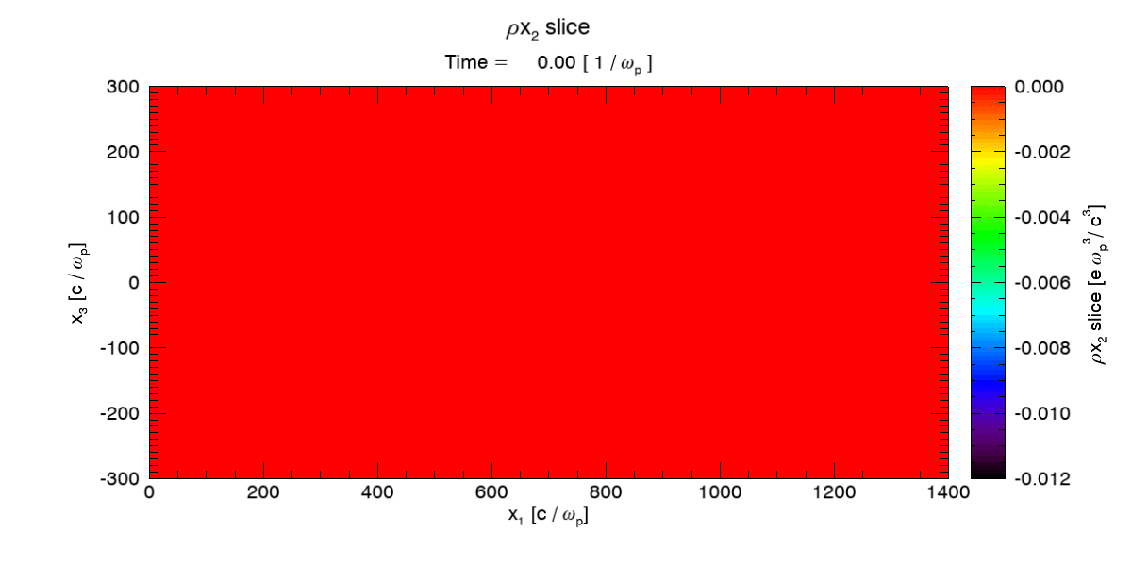
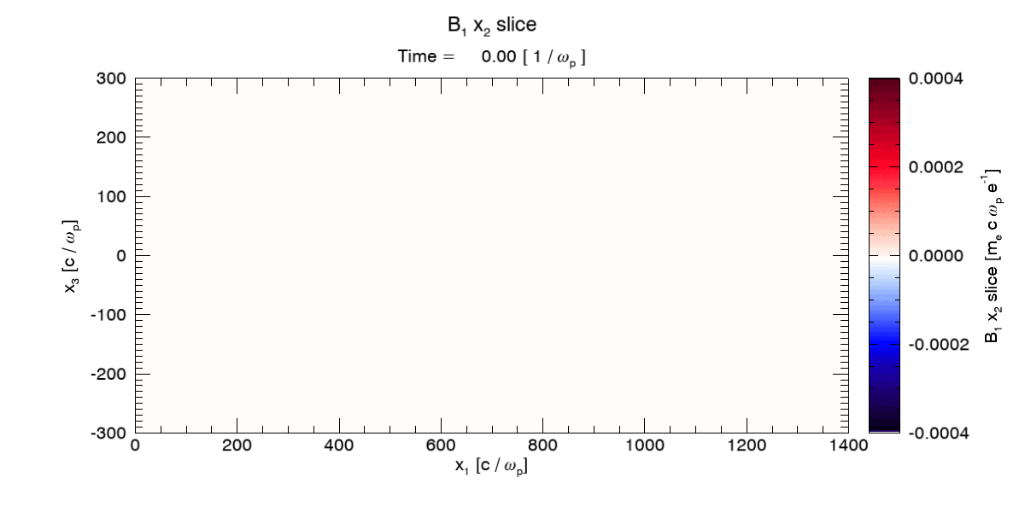
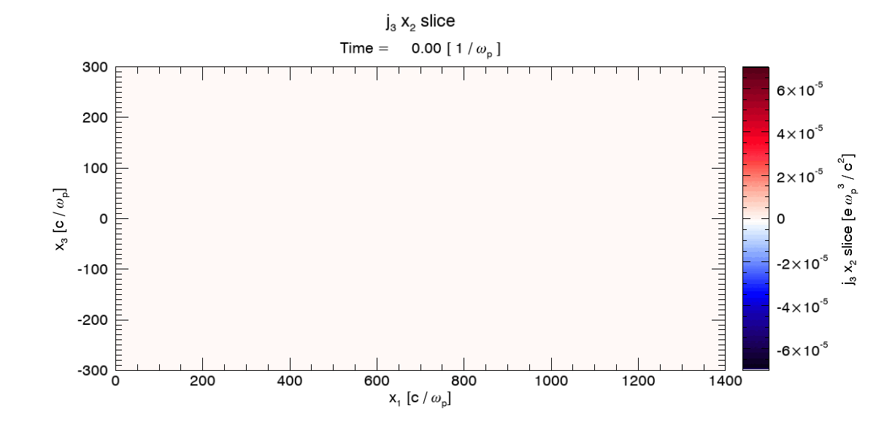

Simulation results (bounded plasma)
Laser spot size 100 um
Bx
Jz
By

Slide 31




Simulation results (wider plasma)
Laser spot size 300 um
Bx
Jz
By

Slide 32




Simulation results (k-evolution in the bounded plasma)
t=42ps
t=78.6ps
As time increases, k slightly decreases

Slide 33

Switch to SRS/AE98
Thomson scattering
Ti:S

Slide 34
Generation of magnetic vortex
Future plans
Generation of circularly polarized MS B fields by using a circularly polarized CO2 laser
Generation of magnetic vortex by using a Laguerre-Gaussian CO2 laser

