Slide 1

25th Annual
Accelerator Test Facility (ATF) Users' Meeting
AE-101 status report
Misha Polyanskiy
Accelerator Facilities Division
2023-02-28

Slide 2
AE-101
Title | Optical Materials for Ultrahigh-Power​ Long-Wave Infrared Lasers
Status | Active (reporting completion of year 3 out of 6)
PIs | Mikhail Polyanskiy Igor Pogorelsky
Team | BNL: M. Polyanskiy, I. Pogorelsky, M. Babzien UCF CREOL: K. Vodopyanov BAE Systems: P. Schunemann
Funding | DOE ARDAP grant KA2601020 (2019—2022; PI: M. Polyanskiy) DOE ARDAP grant KW0101020 (2022—2025; PI: M. Polyanskiy) BNL LDRD grant #20-010 (2020—2023; PI: I. Pogorelsky)
Funding Status | Received
Accelerator Facilities Division

Slide 3
Goals
“We propose a systematic study of the properties of a wide range of materials under the action of ultra-intense long-wave infrared (LWIR) laser pulses. The information that will be obtained during the proposed effort is critically needed for the development of the next-generation multi-terawatt LWIR lasers.”
(DOE ARDAP Accelerator Stewardship proposal, 2019)
Systematically study properties of infrared materials under the action of intense L-WIR laser irradiation
Develop a concept of nonlinear post-compression of picosecond L-WIR pulses to a sub-picosecond
Demonstrate post-compression at multi-TW level
Accelerator Facilities Division

Slide 4
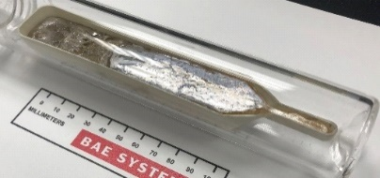
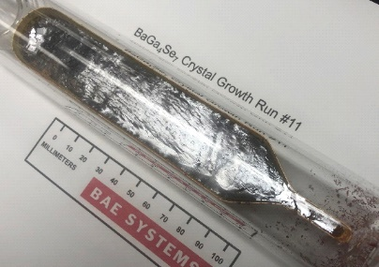
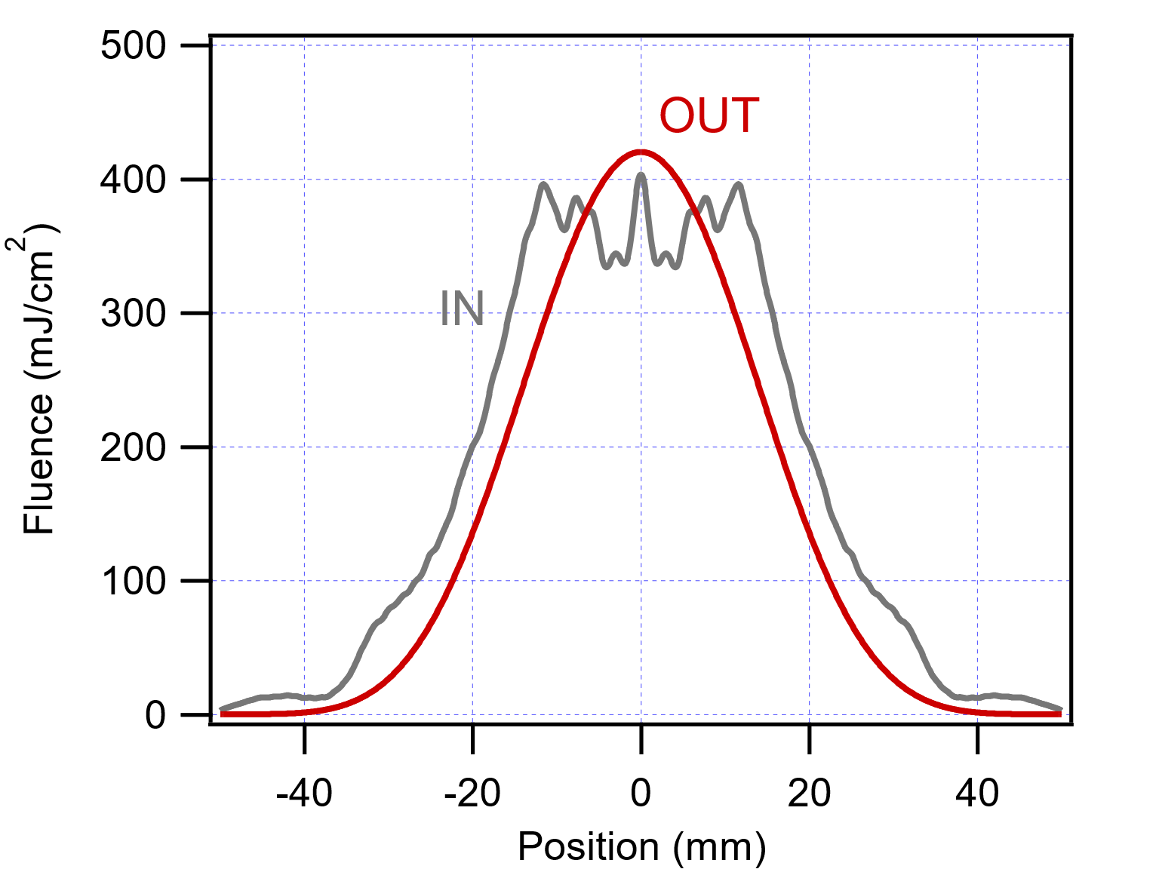
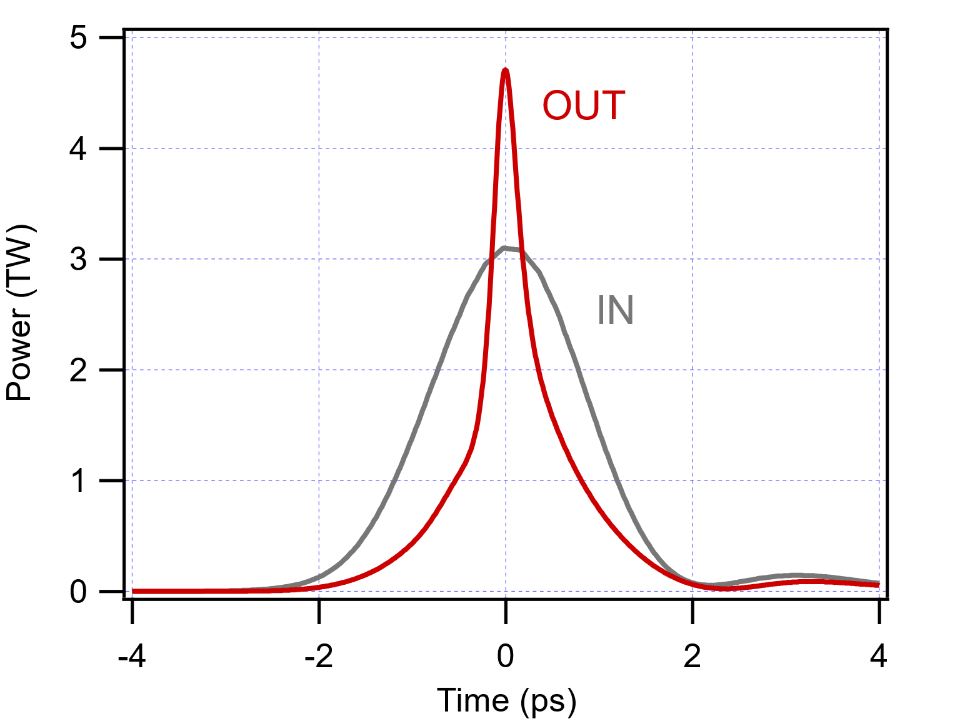
DOE ARDAP project: Team & directions
UCF (Konstantin Vodopyanov)
BNL (Mikhail Polyanskiy)
BAE (Peter Schunemann)
BGS
BGSe
Fundamental study: Physics of interaction of IR materials with intense MWIR/LWIR optical fields
Applied science:
Database of nonlinear constants, new concepts of nonlinear L-WIR optical systems
Advanced materials:
Fabrication methods for new
types of IR crystals
Accelerator Facilities Division

Slide 5
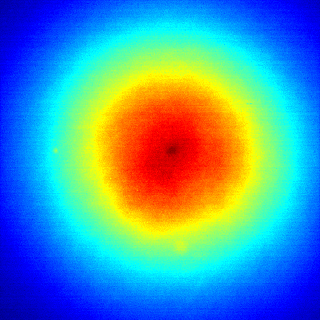
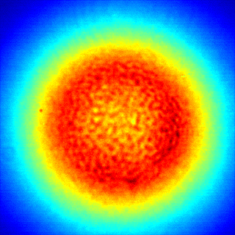
ATF experiments: Single-shot measurements of nonlinear absorption or refraction
12.8 mm
97 mm
508 mJ
12.8 mm
Example: ZnSe, 6 mm thick
Accelerator Facilities Division

Slide 6
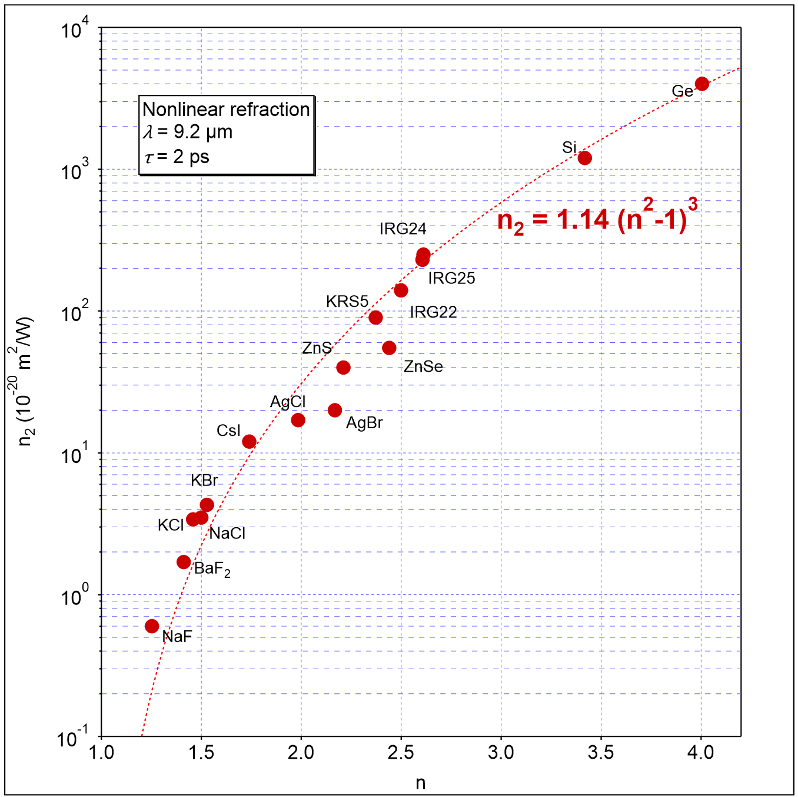
ATF Results: material properties
Accelerator Facilities Division

Slide 7
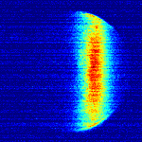
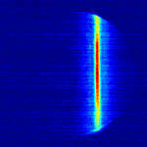
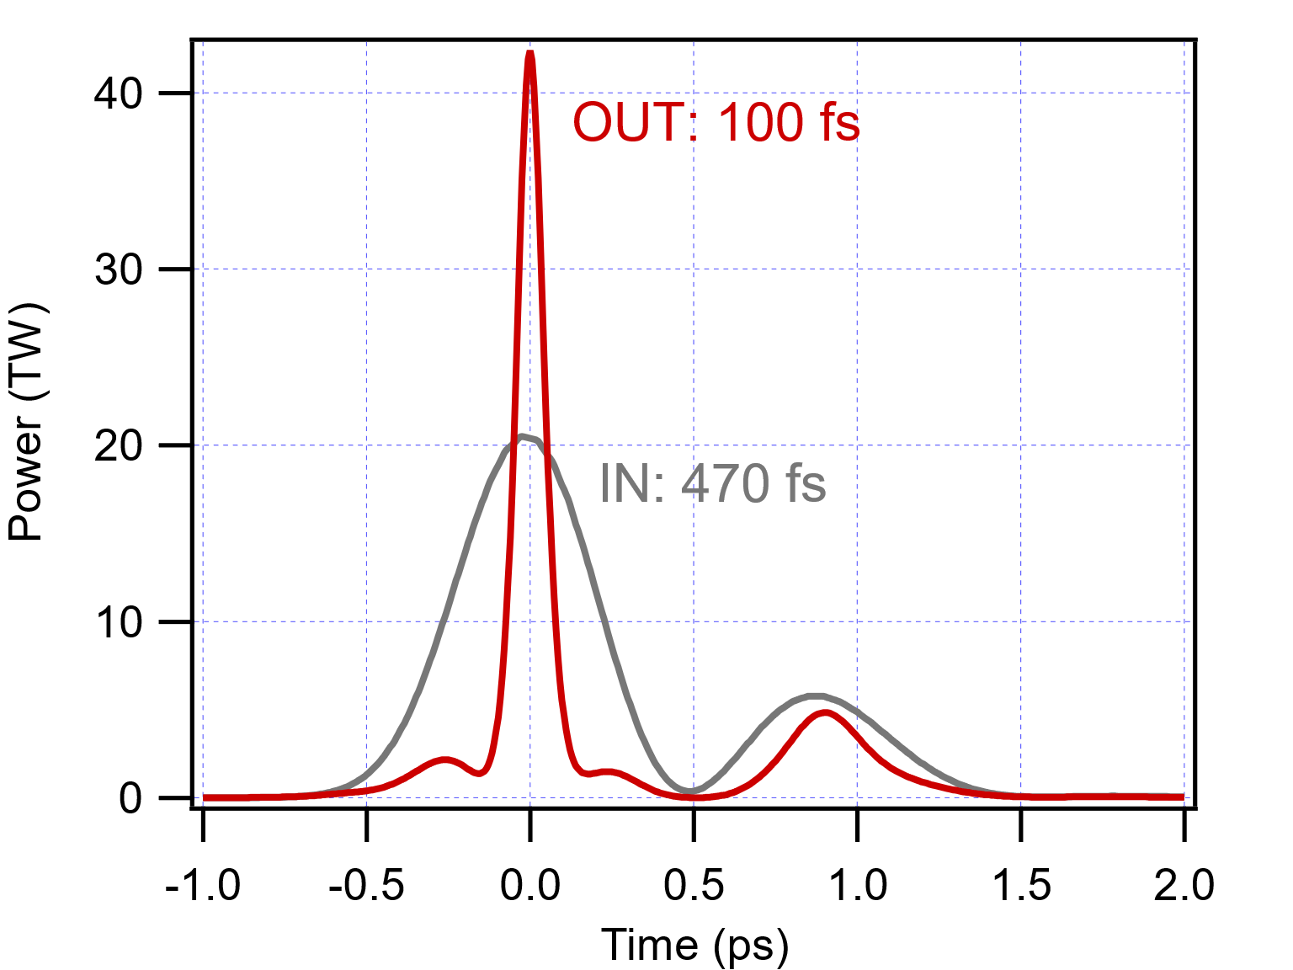
ATF Results: Design of a post-compressor
Demonstrated post-compression
Opt. Express 29, 31714 (2021)
IN
OUT
Autocorrelation
Next demonstration “3 TW”
2023 to-do
Ultimate design
Proceedings of AAC ‘22
ARDAP Phase I product

Slide 8
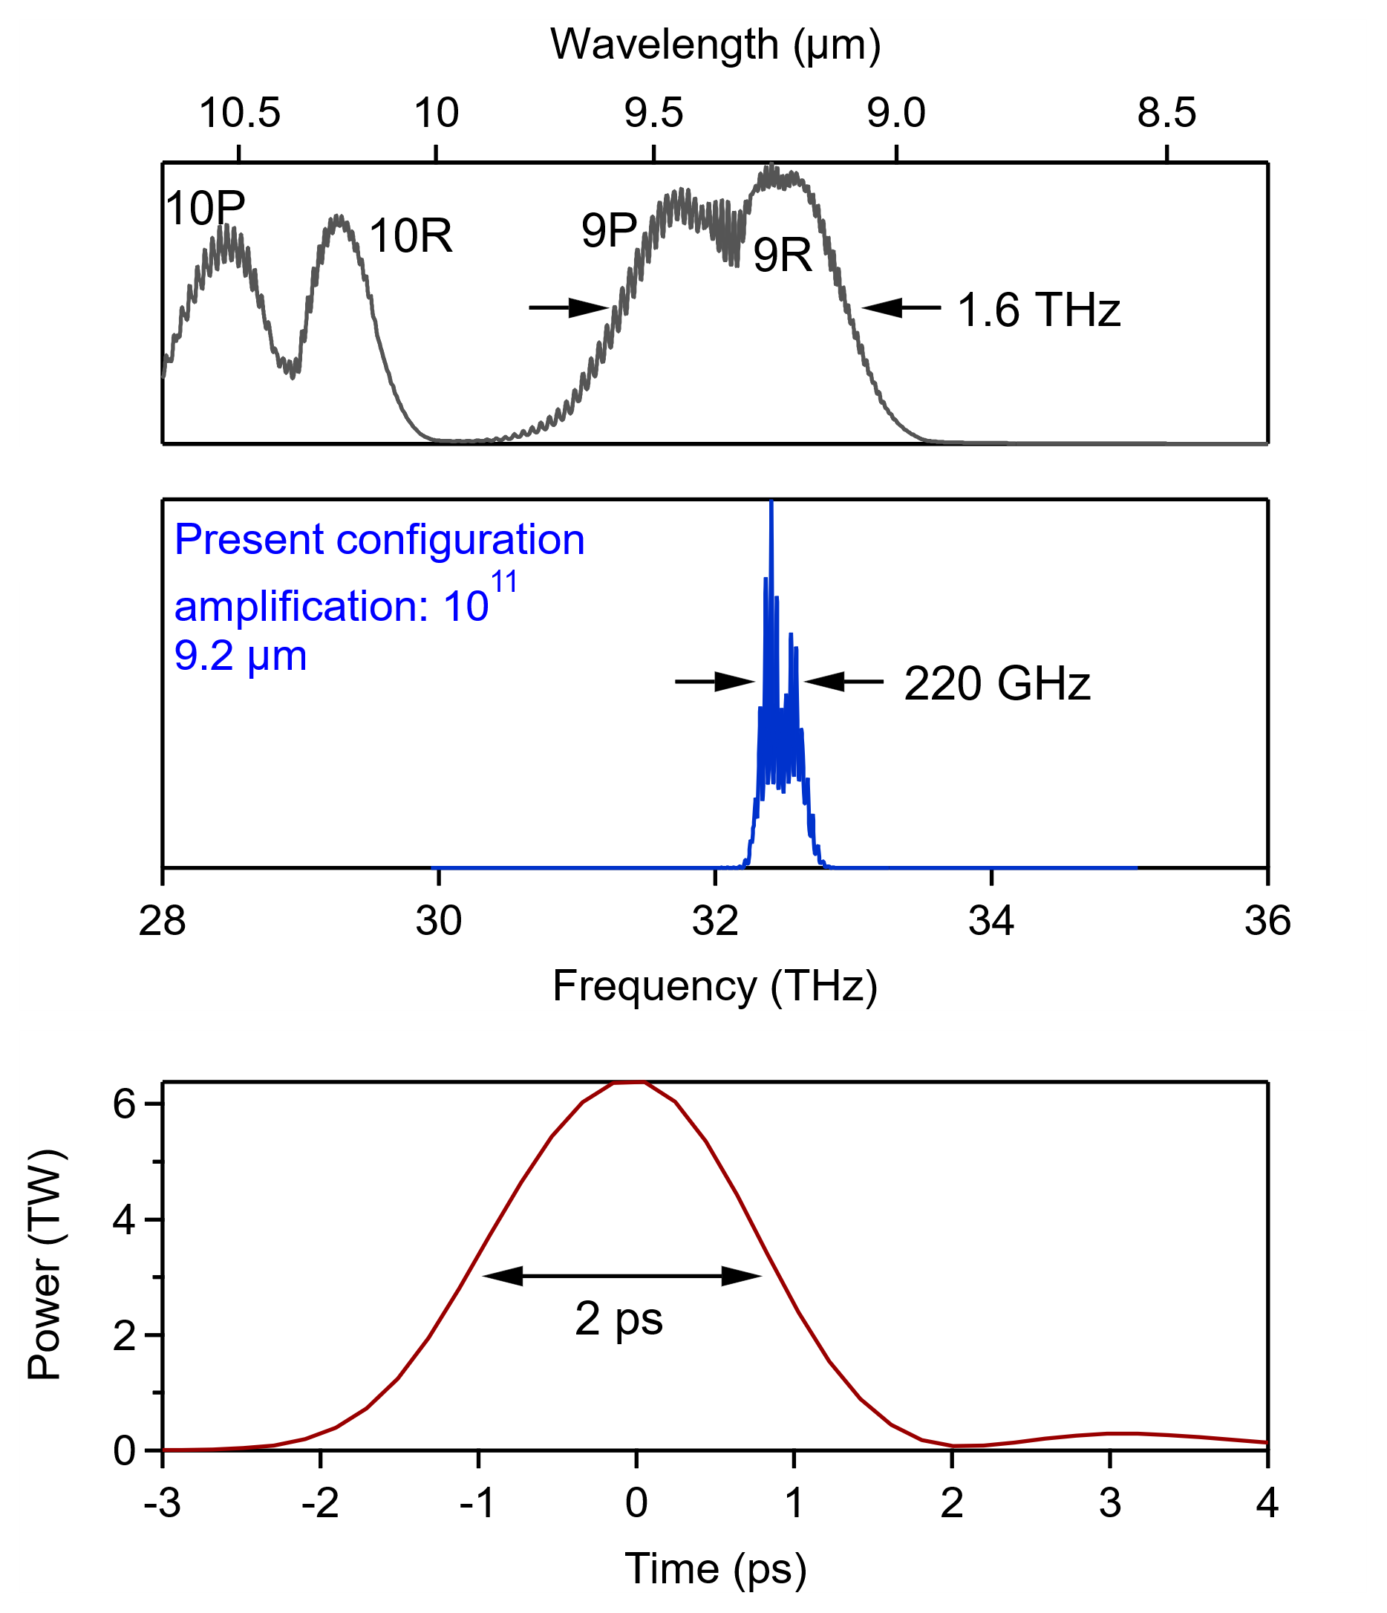
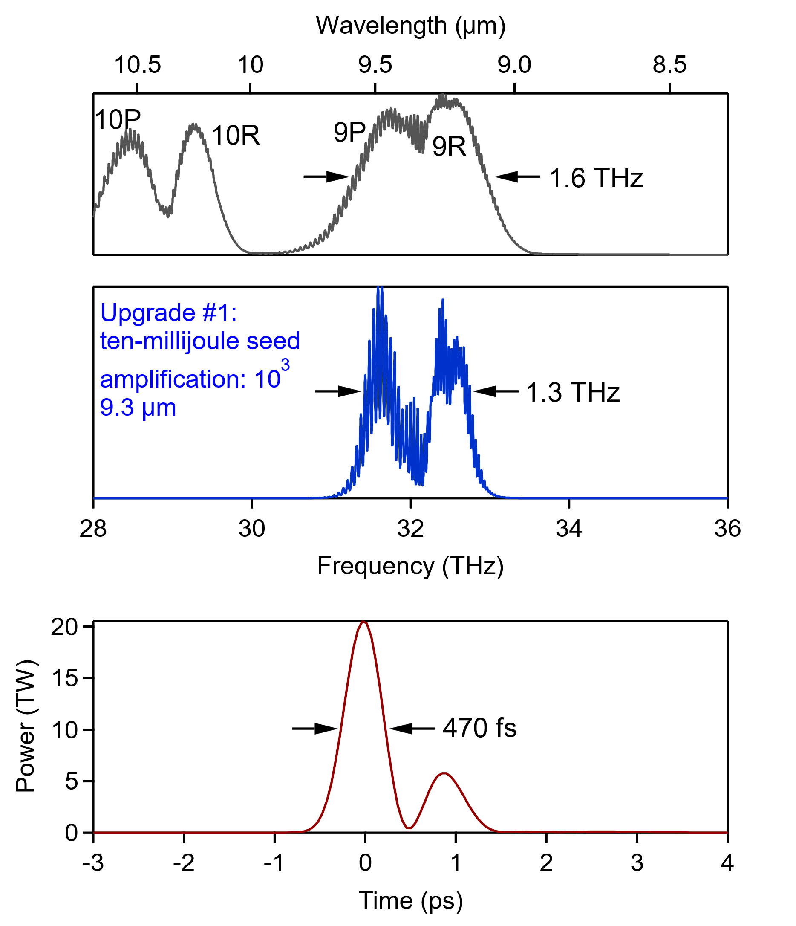
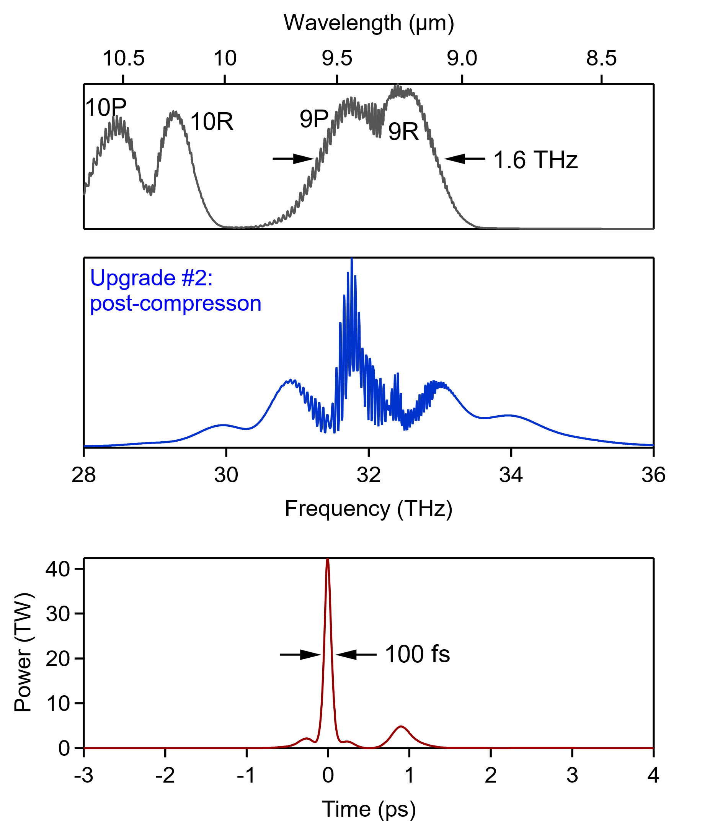
L-WIR Upgrade Roadmap
Polyanskiy et al., AAC ‘22
Gain
Gain
2023: 5 TW
*isotopes, CPA, µJ seed*
*vacuum beam delivery*
Upgrade #2: 15 TW
*10 mJ seed*
Upgrade #3: 25 TW
*post-compression*

Slide 9
UCF Results
Z-scan
Goal: understand physics of the interaction of intense optical fields with materials when band-gap is many times wider that the energy of a photon.
Kawamori et al., APL Photon. 7, 086101 (2022)

Slide 10
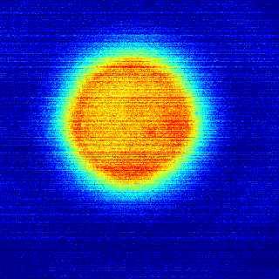
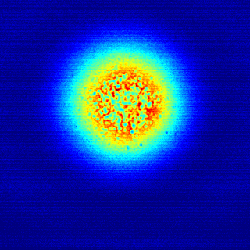
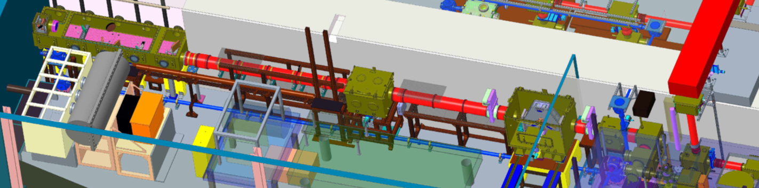
Plans ‘23
Decoupling nonlinear refraction and absorption
Micro-filamentation
 | NLA | n₂
Energy | HIGH | LOW
Sample | THIN | THICK
Finalize measurements and publish n₂ and nonlinear absorption at 2 ps
Initiate full-energy post-compression proof-of-principle experiments
Initiate laser damage threshold measurements
Design two-laser experiment VIS/NIR + LWIR
1 mm Si
8 mm IRG25
5 m
4 m
COMPRESSOR
CO2
AMPLIFIER
NLPC-1
NLPC-2
Dynamics of laser-induced free carriers
Improved LWIR optical switch
e.g., chalcogenide glass Ge₁₀As₄₀Se₅₀ or Ge₂₈Sb₁₂Se₆₀
Accelerator Facilities Division

Slide 11
Products delivered
Peer-reviewed papers
T. Kawamori, P. G. Schunemann, V. Gruzdev, K. L. Vodopyanov, “High-order (N=4–6) multiphoton absorption and mid-infrared Kerr nonlinearity in GaP, ZnSe, GaSe, and ZGP crystals”, APL Photon. 7, 086101, 2022 https://doi.org/10.1063/5.0089925
M. N. Polyanskiy, I. V. Pogorelsky, M. Babzien, R. Kupfer, K. L. Vodopyanov, M. A. Palmer , "Post-compression of long-wave infrared 2 picosecond sub-terawatt pulses in bulk materials", Opt. Express 29, 31714-31725, 2021 https://doi.org/10.1364/OE.434238
M. N. Polyanskiy, M. Babzien, I. V. Pogorelsky, R. Kupfer, K. L. Vodopyanov, M. A. Palmer, "Single-shot measurement of the nonlinear refractive index of air at 9.2 µm with a picosecond terawatt CO₂ laser", Opt. Lett. 46, 2067, 2021 https://doi.org/10.1364/OL.423800
M. N. Polyanskiy, I. V. Pogorelsky, M. Babzien, R. Kupfer, N. Vafaei-Najafabad, M. A. Palmer, "High-peak-power long-wave infrared lasers with CO₂ amplifiers", Photonics 8, 101, 2021 https://doi.org/10.3390/photonics8040101
Conference presentations
M. Polyanskiy, I. Pogorelsky, M. Babzien, R. Kupfer, W. Li, M. Palmer, “9.3 microns: Toward next-generation CO₂ laser for particle acceleration”, 20th Advanced Accelerator Concepts Workshop (AAC’22), Hauppauge, NY, November 6–11 2022
M. Polyanskiy, “Multi-terawatt long wave infrared lasers: Status and perspectives”, XXIII International Symposium on High-Power Laser Systems and Applications (HPLS&A) 2022, Prague, Czech Republic, June 13–16 2022
M. N. Polyanskiy, I. V. Pogorelsky, M. Babzien, R. Kupfer, M. A. Palmer, “The choice of materials for post-compression of high-peak-power long-wave infrared pulses”, Conference on Lasers and Electro-Optics, San Jose, CA, May 16–20 2022 https://opg.optica.org/abstract.cfm?uri=CLEO_SI-2022-JTh3A.31
T. Kawamori, P. G. Schunemann, V. Gruzdev, K. L. Vodopyanov, “High order (N=4–6) multiphoton mid-IR absorption in GaP, ZnSe, GaSe, and ZGP and the role of free carriers”, Conference on Lasers and Electro-Optics, San Jose, CA, May 16–20 2022 https://opg.optica.org/abstract.cfm?uri=CLEO_AT-2022-JW3A.57
K. L. Vodopyanov, P. G. Schunemann, T. Kawamori, “Mid-IR high-order multiphoton absorption and nonlinear refraction in GaP, ZnSe, GaSe, and ZGP crystals”, Laser-Induced Damage in Optical Materials 2021 (virtual), October 12–15 2021 https://doi.org/10.1117/12.2601661
M. Polyanskiy, I. Pogorelsky, M. Babzien, R. Kupfer, M. Palmer (poster presented by I. Pogorelsky), "Ultrashort-pulse, terawatt, long-wave infrared lasers based on high-pressure CO₂ amplifiers", EOS Annual Meeting (EOSAM), Rome, Italy (virtual), September 13–17 2021 https://doi.org/10.1051/epjconf/202125511010
I. V. Pogorelsky, M. N. Polyanskiy, M. Babzien, M. A. Palmer, "Post-compression of 9.2-μm terawatt laser pulses to femtoseconds", EOS Annual Meeting (EOSAM), Rome, Italy (virtual), September 13–17 2021 https://doi.org/10.1051/epjconf/202125511007
I. Pogorelsky, M. Polyanskiy, M. Babzien, M. Palmer, “Long-wave IR terawatt laser pulse compression to sub-picoseconds”, 12th International Particle Accelerator Conference, Campinas, SP, Brazil (virtual), 24–28 May 2021 https://doi.org/10.18429/JACoW-IPAC2021-THPAB062
T. Kawamori, P. Schunemann, and K. Vodopyanov, “High-order mid-IR multiphoton absorption and nonlinear refraction in GaP, ZnSe, GaSe, and ZGP crystals”. Conference on Lasers and Electro-Optics, San Jose, CA (virtual), May 09–14 2021 https://ieeexplore.ieee.org/document/9572386
I. Pogorelsky, M. Polyanskiy, M. Babzien, and M. Palmer, “Experiment on long-wave IR terawatt laser pulse compression to sub-picoseconds”. Mid-Infrared Coherent Sources 2020, Washington, DC United States (virtual), 16–20 November 2020 https://doi.org/10.1364/MICS.2020.MF2C.1
Other
All-new version of co2amp code “co2amp 2020” with advanced support for nonlinear effects in materials https://github.com/polyanskiy/co2amp
One graduate student training (UCF)
Accelerator Facilities Division

Slide 12
Questions?
Accelerator Facility Division

Slide 13
Slides for Program Advisory Committee

Slide 14
Electron Beam Requirements
Parameter | Units | Typical Values | Comments | Requested Values
Beam Energy | MeV | 50-65 | Full range is ~15-75 MeV with highest beam quality at nominal values | -
Bunch Charge | nC | 0.1-2.0 | Bunch length & emittance vary with charge | -
Compression | fs | Down to 100 fs (up to 1 kA peak current) | A magnetic bunch compressor available to compress bunch down to ~100 fs. Beam quality is variable depending on charge and amount of compression required. NOTE: Further compression options are being developed to provide bunch lengths down to the ~10 fs level | -
Transverse size at IP (σ) | μm | 30 – 100 (dependent on IP position) | It is possible to achieve transverse sizes below 10 um with special permanent magnet optics. | -
Normalized Emittance | μm | 1 (at 0.3 nC) | Variable with bunch charge | -
Rep. Rate (Hz) | Hz | 1.5 | 3 Hz also available if needed | -
Trains mode | --- | Single bunch | Multi-bunch mode available. Trains of 24 or 48 ns spaced bunches. | -

Slide 15
CO₂ Laser Requirements
Configuration | Parameter | Units | Typical Values | Comments | Requested Values
CO₂ Regenerative Amplifier Beam | Wavelength | μm | 9.2 | Wavelength determined by mixed isotope gain media | -
 | Peak Power | GW | ~3 |  | -
 | Pulse Mode | --- | Single |  | -
 | Pulse Length | ps | 2 |  | -
 | Pulse Energy | mJ | 6 |  | -
 | M² | --- | ~1.5 |  | -
 | Repetition Rate | Hz | 1.5 | 3 Hz also available if needed | -
 | Polarization | --- | Linear | Circular polarization available at slightly reduced power | -
CO₂ CPA Beam | Wavelength | μm | 9.2 | Wavelength determined by mixed isotope gain media | 9.2
Note that delivery of full power pulses to the Experimental Hall is presently limited to Beamline #1 only. | Peak Power | TW | 5 | ~5 TW operation will become available shortly into this year’s experimental run period. A 3-year development effort to achieve >10 TW and deliver to users is in progress. | 2
 | Pulse Mode | --- | Single |  | Single
 | Pulse Length | ps | 2 |  | 2
 | Pulse Energy | J | ~5 | Maximum pulse energies of >10 J will become available within the next year | 5
 | M² | --- | ~2 |  | 2
 | Repetition Rate | Hz | 0.05 |  | 0.05
 | Polarization |  | Linear | Adjustable linear polarization along with circular polarization can be provided upon request | Linear

Slide 16
Other Experimental Laser Requirements
Ti:Sapphire Laser System | Units | Stage I Values | Stage II Values | Comments | Requested Values
Central Wavelength | nm | 800 | 800 | Stage I parameters are presently available and setup to deliver Stage II parameters should be complete during FY22 | -
FWHM Bandwidth | nm | 20 | 13 |  | -
Compressed FWHM Pulse Width | fs | <50 | <75 | Transport of compressed pulses will initially include a very limited number of experimental interaction points. Please consult with the ATF Team if you need this capability. | -
Chirped FWHM Pulse Width | ps | ≥50 | ≥50 |  | -
Chirped Energy | mJ | 10 | 200 |  | -
Compressed Energy | mJ | 7 | ~20 | 20 mJ is presently operational with work underway this year to achieve our 100 mJ goal. | -
Energy to Experiments | mJ | >4.9 | >80 |  | -
Power to Experiments | GW | >98 | >1067 |  | -
Nd:YAG Laser System | Units | Typical Values | Comments | Requested Values
Wavelength | nm | 1064 | Single pulse | -
Energy | mJ | 5 |  | -
Pulse Width | ps | 14 |  | -
Wavelength | nm | 532 | Frequency doubled | -
Energy | mJ | 0.5 |  | -
Pulse Width | ps | 10 |  | -

Slide 17
Special Equipment Requirements and Hazards
Electron Beam
  -
CO₂ Laser
  Space to arrange 14 meters of open-air beam propagation between laser output and experimental setup (for diffraction-based beam forming)
  Two vacuum chambers for post-compression R&D integrated into CO2-FEL vacuum transport line
Ti:Sapphire and Nd:YAG Lasers
  -
Hazards & Special Installation Requirements
  Large installation (chamber, insertion device, etc.): post-compression (NLPC) chambers
  Cryogens: -
  Introducing new magnetic elements: -
  Introducing new materials into the beam path: -
  Any other foreseeable beam line modifications: -

Slide 18
Experimental Time Request
CY2023 Time Request
Capability | Setup Hours | Running Hours
Electron Beam Only
Laser* Only (in Laser Areas) | 80 (2 runs: 1 week setup each) | 80 (2 runs: 1 week run each)
Laser* + Electron Beam
Total Time Request for the 3-year Experiment (including CY2023-25)
Capability | Setup Hours | Running Hours
Electron Beam Only
Laser* Only (in Laser Areas) | 240 | 240
Laser* + Electron Beam
* Laser = Near-IR or LWIR (CO₂) Laser

