Slide 1

25th Annual
Accelerator Test Facility (ATF) Users' Meeting
AE108 - Development of wavelength conversion techniques for generation of coherent radiation at the XUV to LWIR
W. Li¹, R. Kupfer², F. Wang¹, J. Wishart¹, M. Babzien¹, M. Polyanskiy^{1*}, I. Pogorelsky¹, T. Rao¹, L. Cultrera¹, N. Vafaei-Najafabadi^{1,3}, M. Palmer¹
¹Brookhaven National Laboratory,²Lawrence Livermore National Laboratory,
³Stony Brook University, *PI
Accelerator Facilities Division
March 1st, 2023

Slide 2
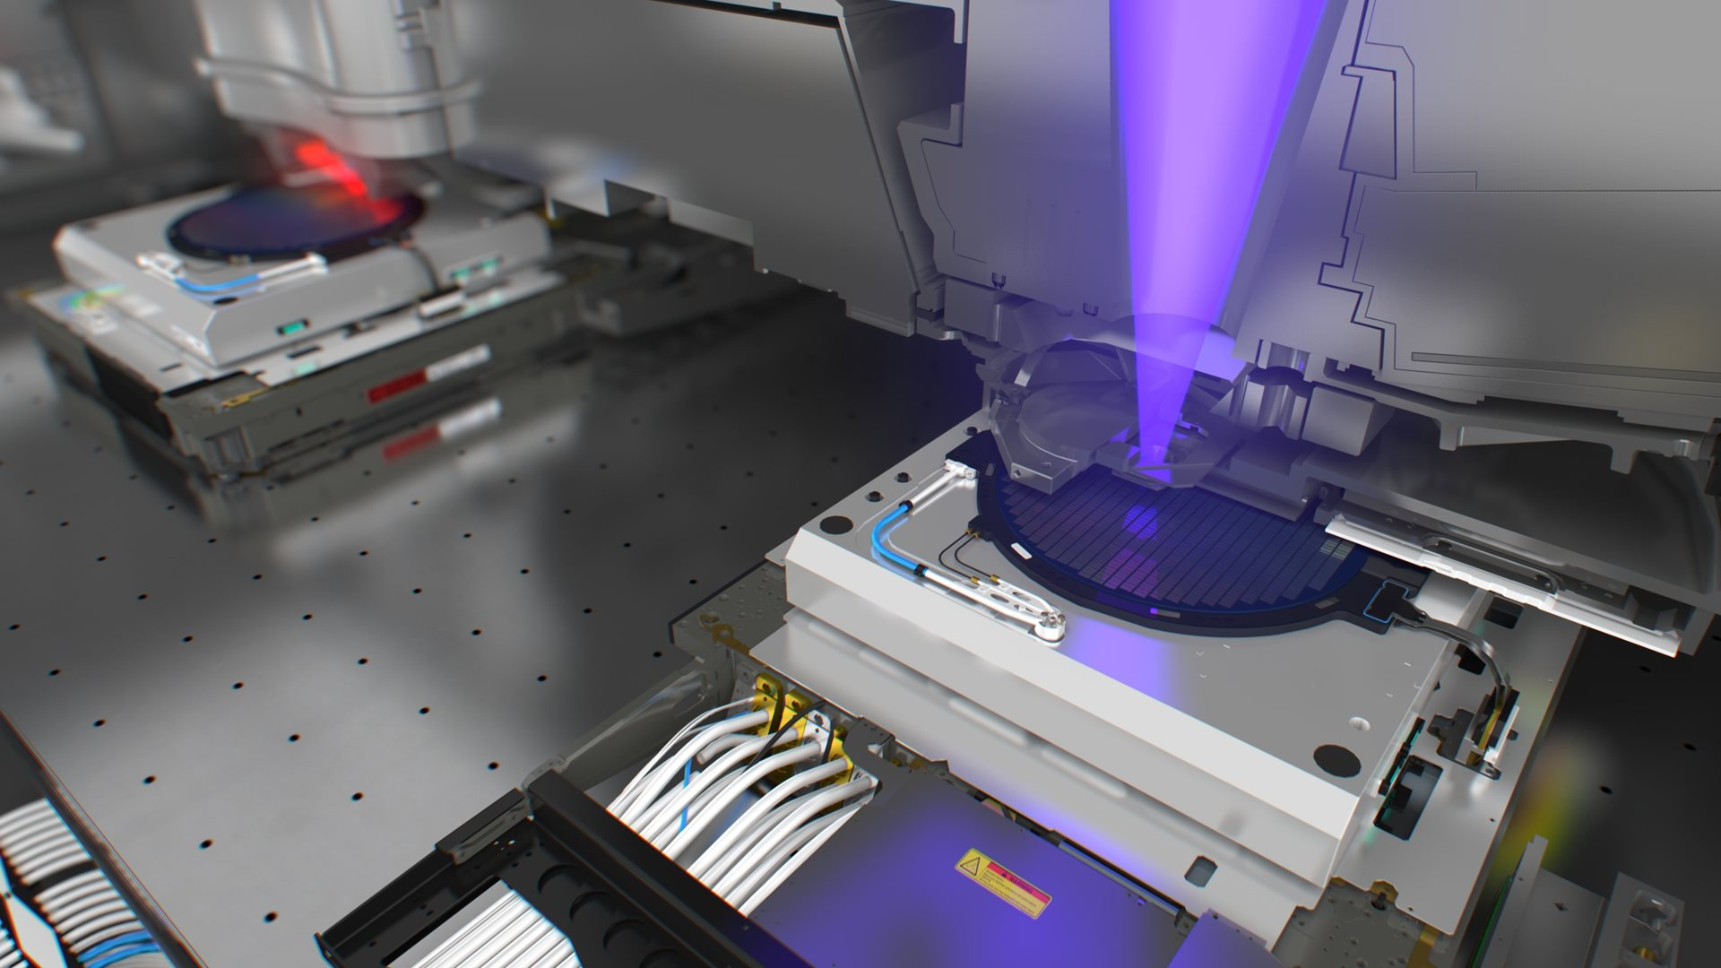
Experimental goals
CO₂ amplifier
10++ TW
~500 fs
Seed
few mJ
<500 fs
9.3 µm
Upgrading ATF CO₂ laser
  9.3 μm: better LWIR seed → shorter pulse length
  4.3 μm: optical pumping → much higher repetition rate
EUV for imaging and lithography
  HHG scales with wavelength: natural fit for ATF
  With CO₂ laser, potentially extend to zeptosecond hard x-rays
Pump
100s J, < 1 µs, 4.3 µm
CO₂
laser
Popmintchev, Nat. Photonics 4, 828 (2010)
Photo credit: ASML
Accelerator Facilities Division

Slide 3


Raman conversion
Raman Scattering →
Difference-frequency
generation (DFG)
in
out
ω_{pump}
ω_{signal}
Inelastic scattering with vibrational modes
ΔE
ω_{DFG}
Residual pump ω_{p}
Residual pump ω_{p}
Raman Converter
$$ω_{vibration}=ω_{target}$$
Nonlinear crystal $χ^{(2)}≠0$
$$ω_{p}−\left(ω_{p}−ω_{target}\right)=ω_{target}$$
ω_{target}
‘Cheap’ high energy laser source ω_{p}
Converted pump ω_{p}- ω_{target}
Converted pump ω_{p}- ω_{target}
Typical Raman shifts are on the order of 1000 cm⁻¹
Perfect for generating LWIR!
Accelerator Facilities Division

Slide 4
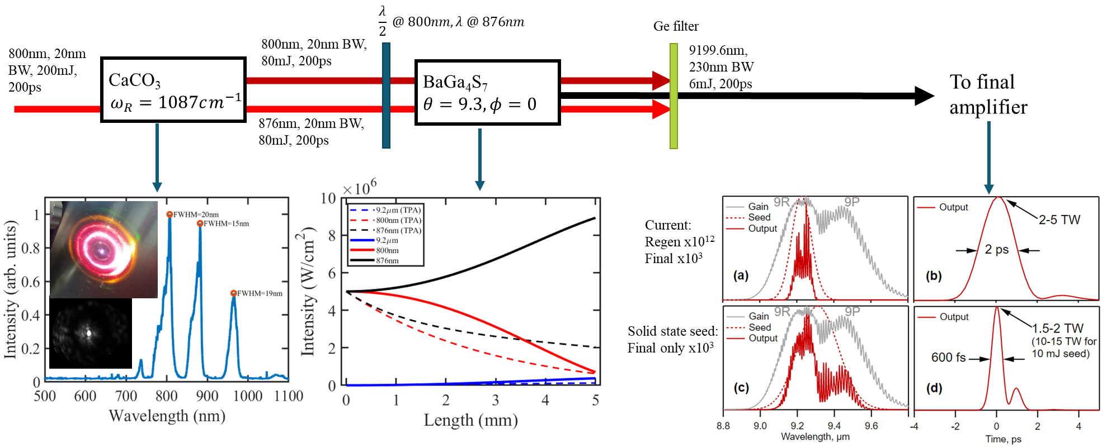
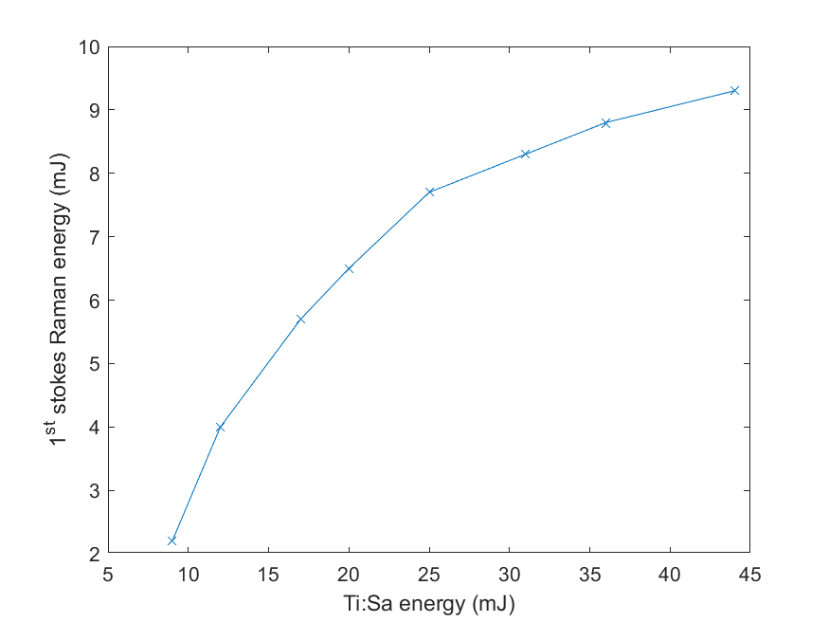
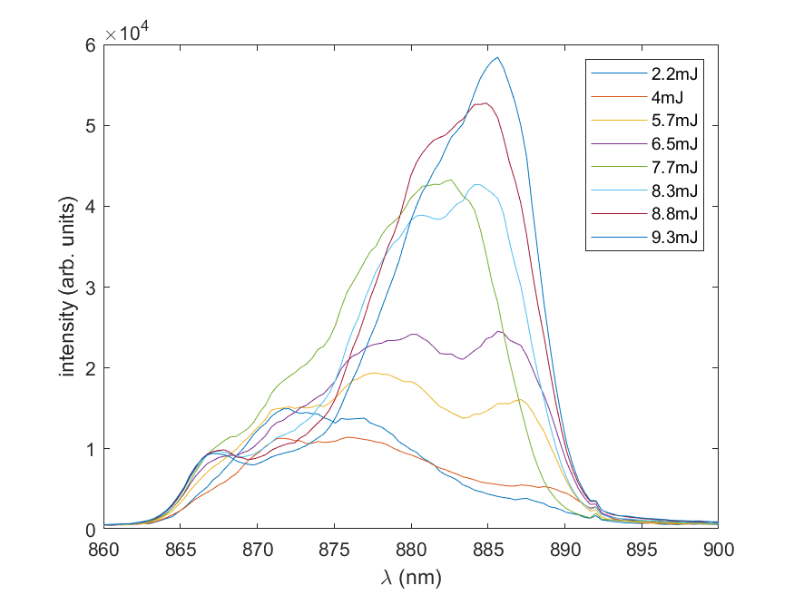
Seed generation in calcite (previous years)
Possibly use 2 μm pump for better DFG efficiency
simulated
simulated
Correct peaks
BGS suppresses TPA
Effect on CO₂ laser
Good efficiency and energy scaling
Red-shifts at saturation
Accelerator Facilities Division

Slide 5
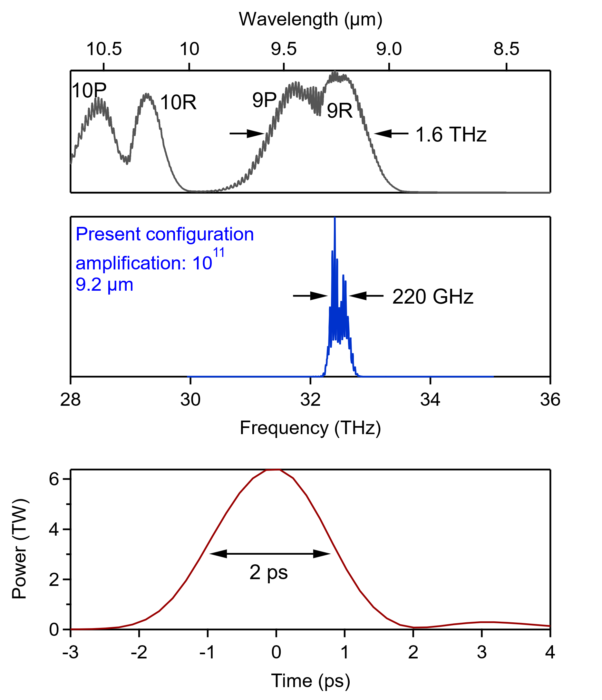
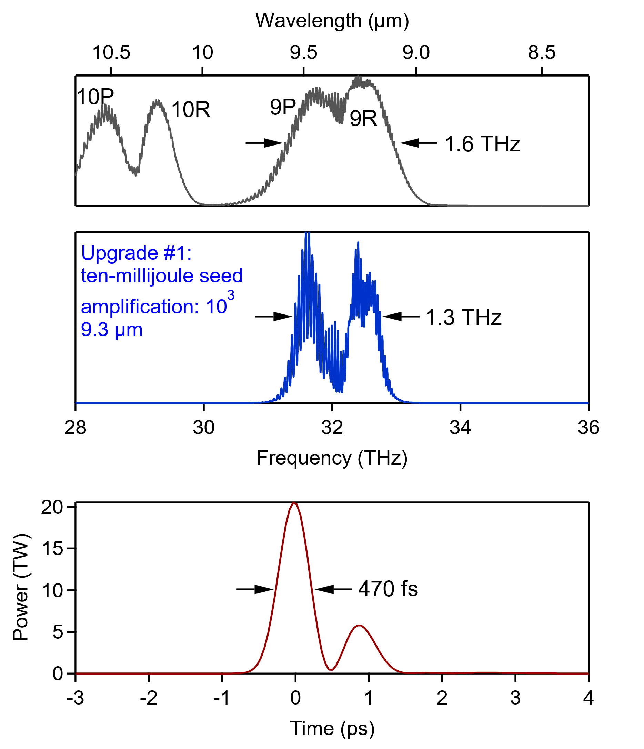
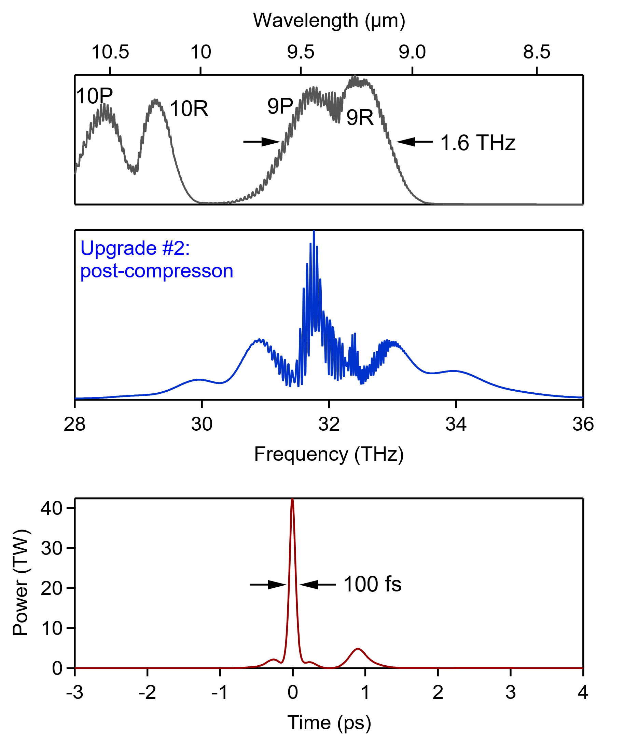
Polyanskiy et al., AAC ‘22
LWIR Roadmap
Gain
Gain
2023: 5 TW
*isotopes, CPA, µJ seed*
*vacuum beam delivery*
Upgrade #2: 15 TW
*10 mJ seed*
Upgrade #3: 25 TW
*post-compression*
Accelerator Facilities Division

Slide 6
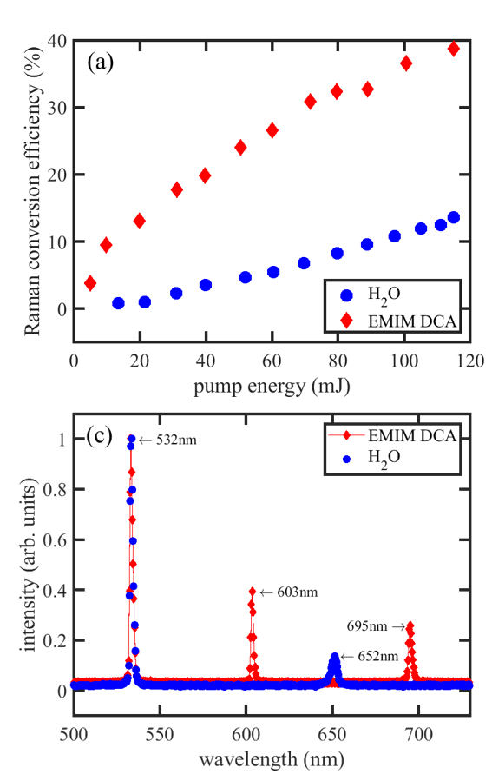
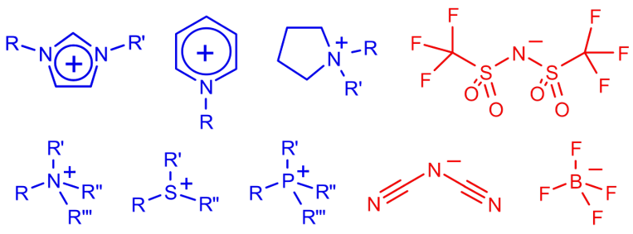
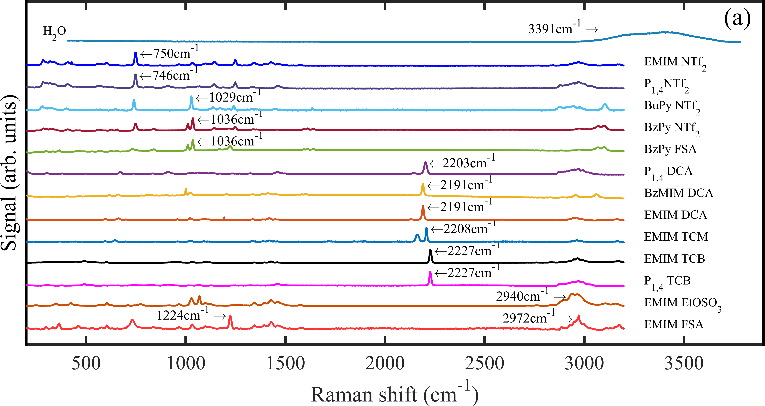
Pump generation in ionic liquids (previous years)
Artificial salts that are liquid at room temperature
Can be designed to have specific properties
Settled on EMIM DCA
  Transparent at pump and Stokes wavelengths
  Peak Raman cross section at desired shift
  High viscosity (suppressing Brillouin scattering)
  Good stability
High efficiency
Good spectrum
Raman shifts of selected ILs
Accelerator Facilities Division
Plots from Kupfer, Phys. Rev. Applied 19, 014052 (2023)

Slide 7
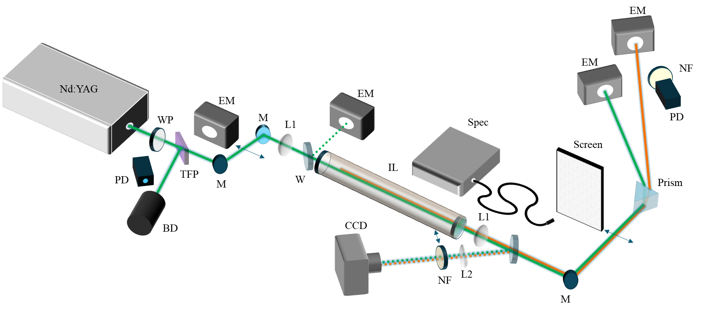
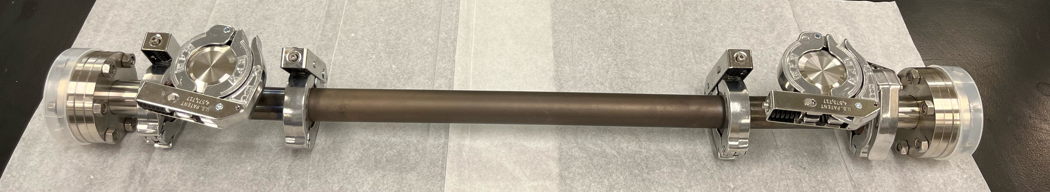
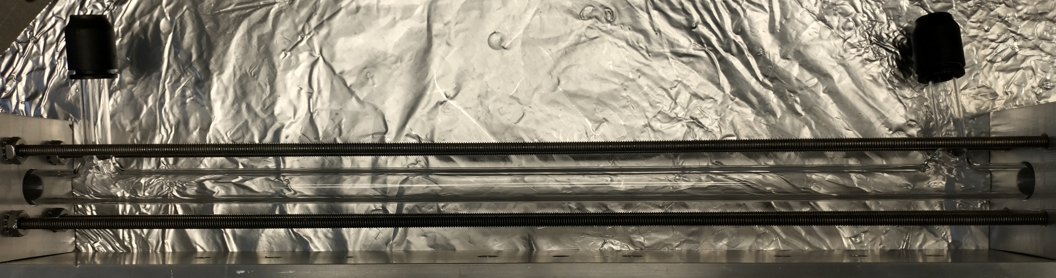
Upgrades to experimental setup
Modified to run in parallel with Ti:sapphire operations instead of competing for the Nd:YAG
Switch to small glass tube for ionic liquid instead of metal container
  Drastic reduction in quantity of IL needed
Use this branch for experiment instead
~300 ml
~30 ml
Accelerator Facilities Division

Slide 8
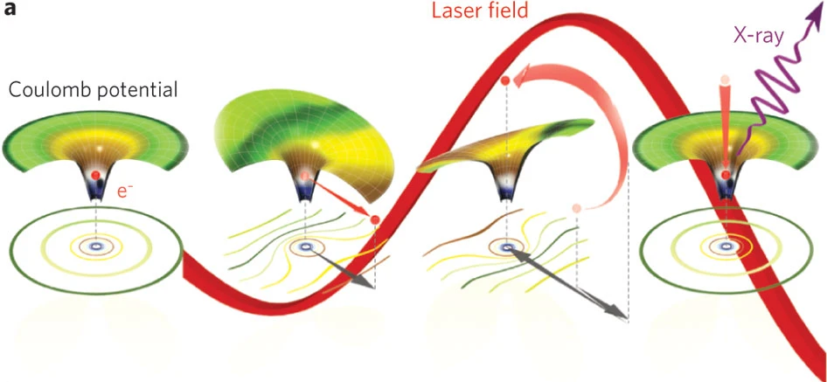
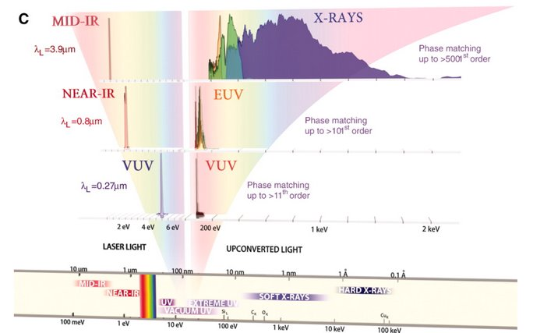
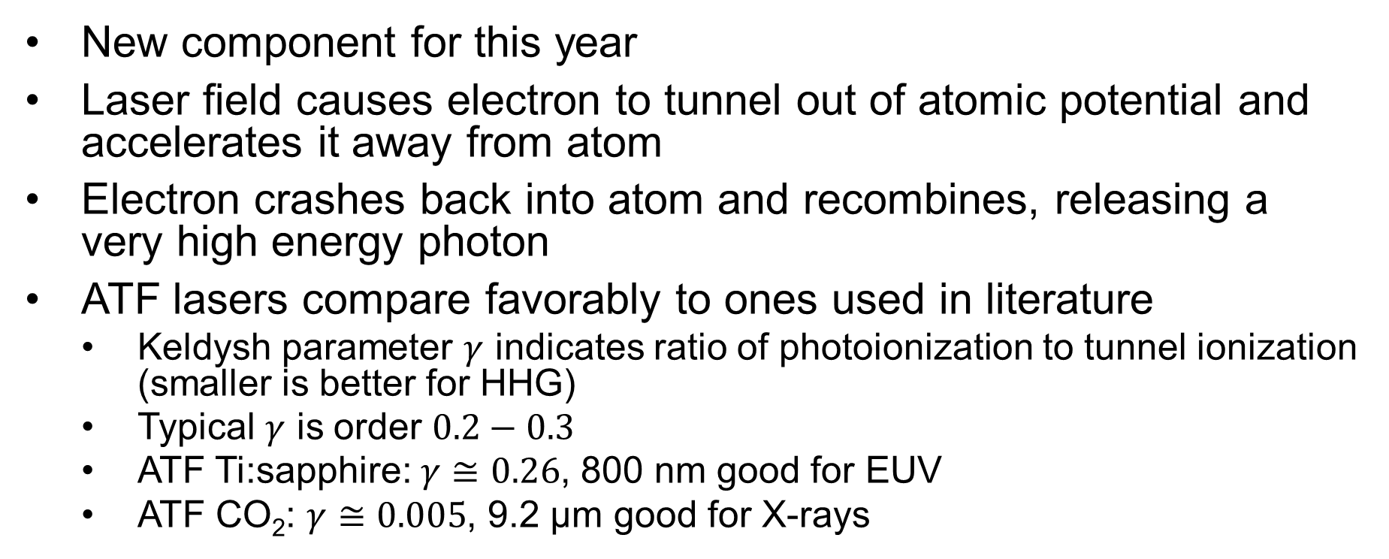
High harmonic generation
New component for this year
Laser field causes electron to tunnel out of atomic potential and accelerates it away from atom
Electron crashes back into atom and recombines, releasing a very high energy photon
ATF lasers compare favorably to ones used in literature
  Keldysh parameter $γ$ indicates ratio of photoionization to tunnel ionization (smaller is better for HHG)
  Typical $γ$ is order $0.2−0.3$
  ATF Ti:sapphire: $γ≅0.26$, 800 nm good for EUV
  ATF CO₂: $γ≅0.005$, 9.2 μm good for X-rays
Popmintchev, Nat. Photonics 4, 828 (2010)
Popmintchev, Science 336, 1287 (2012)

Slide 9
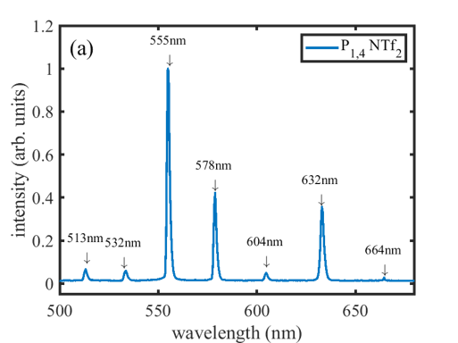
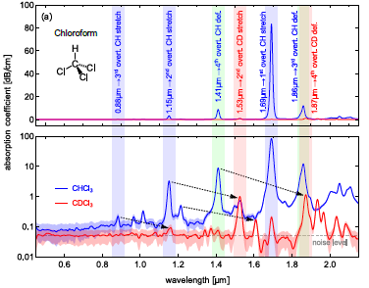
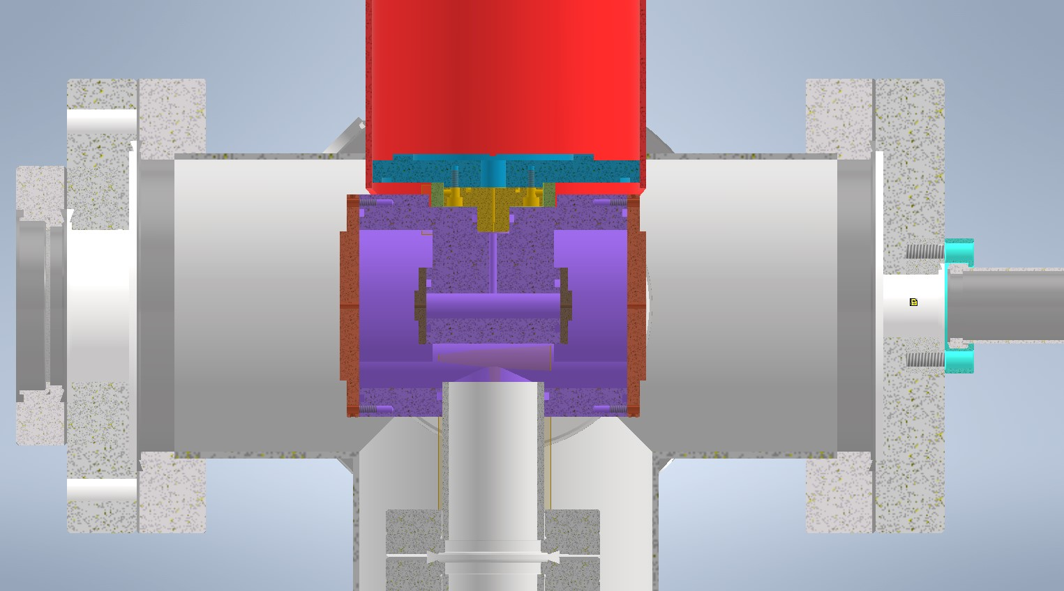
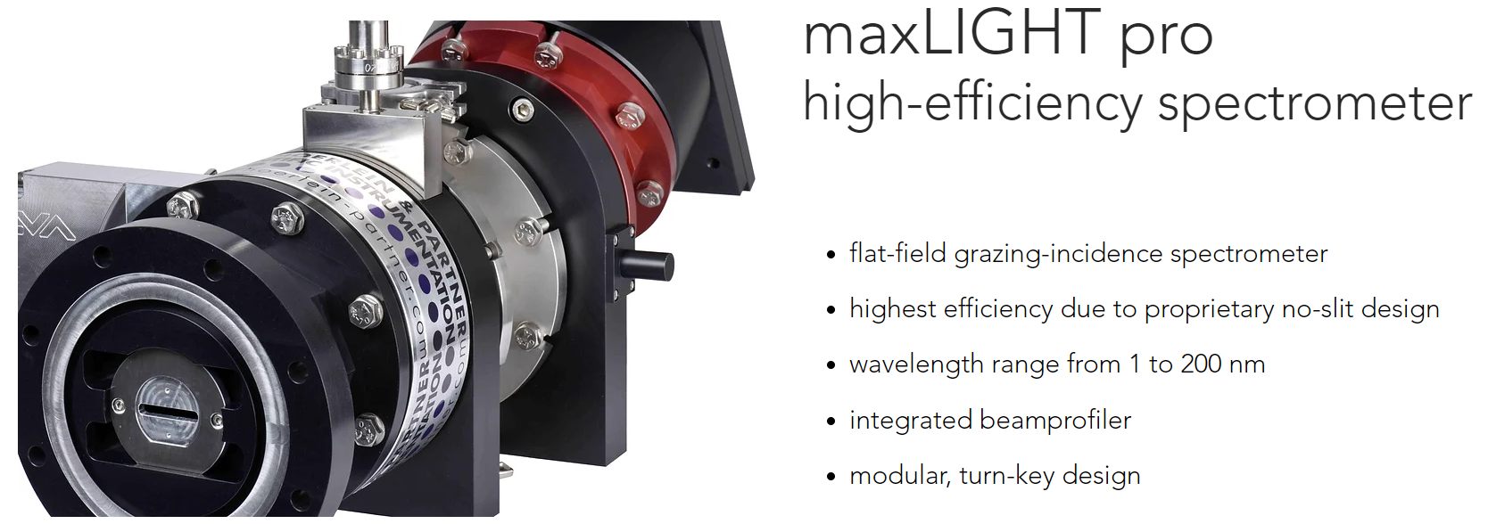
Plans for next year
Spectrum of a potentially interesting IL
Examine other ionic liquids
  Ex: deuterated EMIM DCA to generate ~1390 nm from 1064 nm
Employ DFG to produce the seed and pump wavelengths
  DFG crystal acquired for 4.5 μm, pending delivery for 9.2 μm
Demonstrate HHG capability with Ti:sapphire (800 nm → ~30 nm)
Produce first X-rays with CO₂ laser (9.2 μm → ~1 nm)
Kupfer, Phys. Rev. Applied 19, 014052 (2023)
Deuteration pushes absorption bands deeper into IR
HHG gas cell chamber
Pildschun, Opt. Mater. Express 7, 1122-1130 (2017)
Accelerator Facilities Division

Slide 10
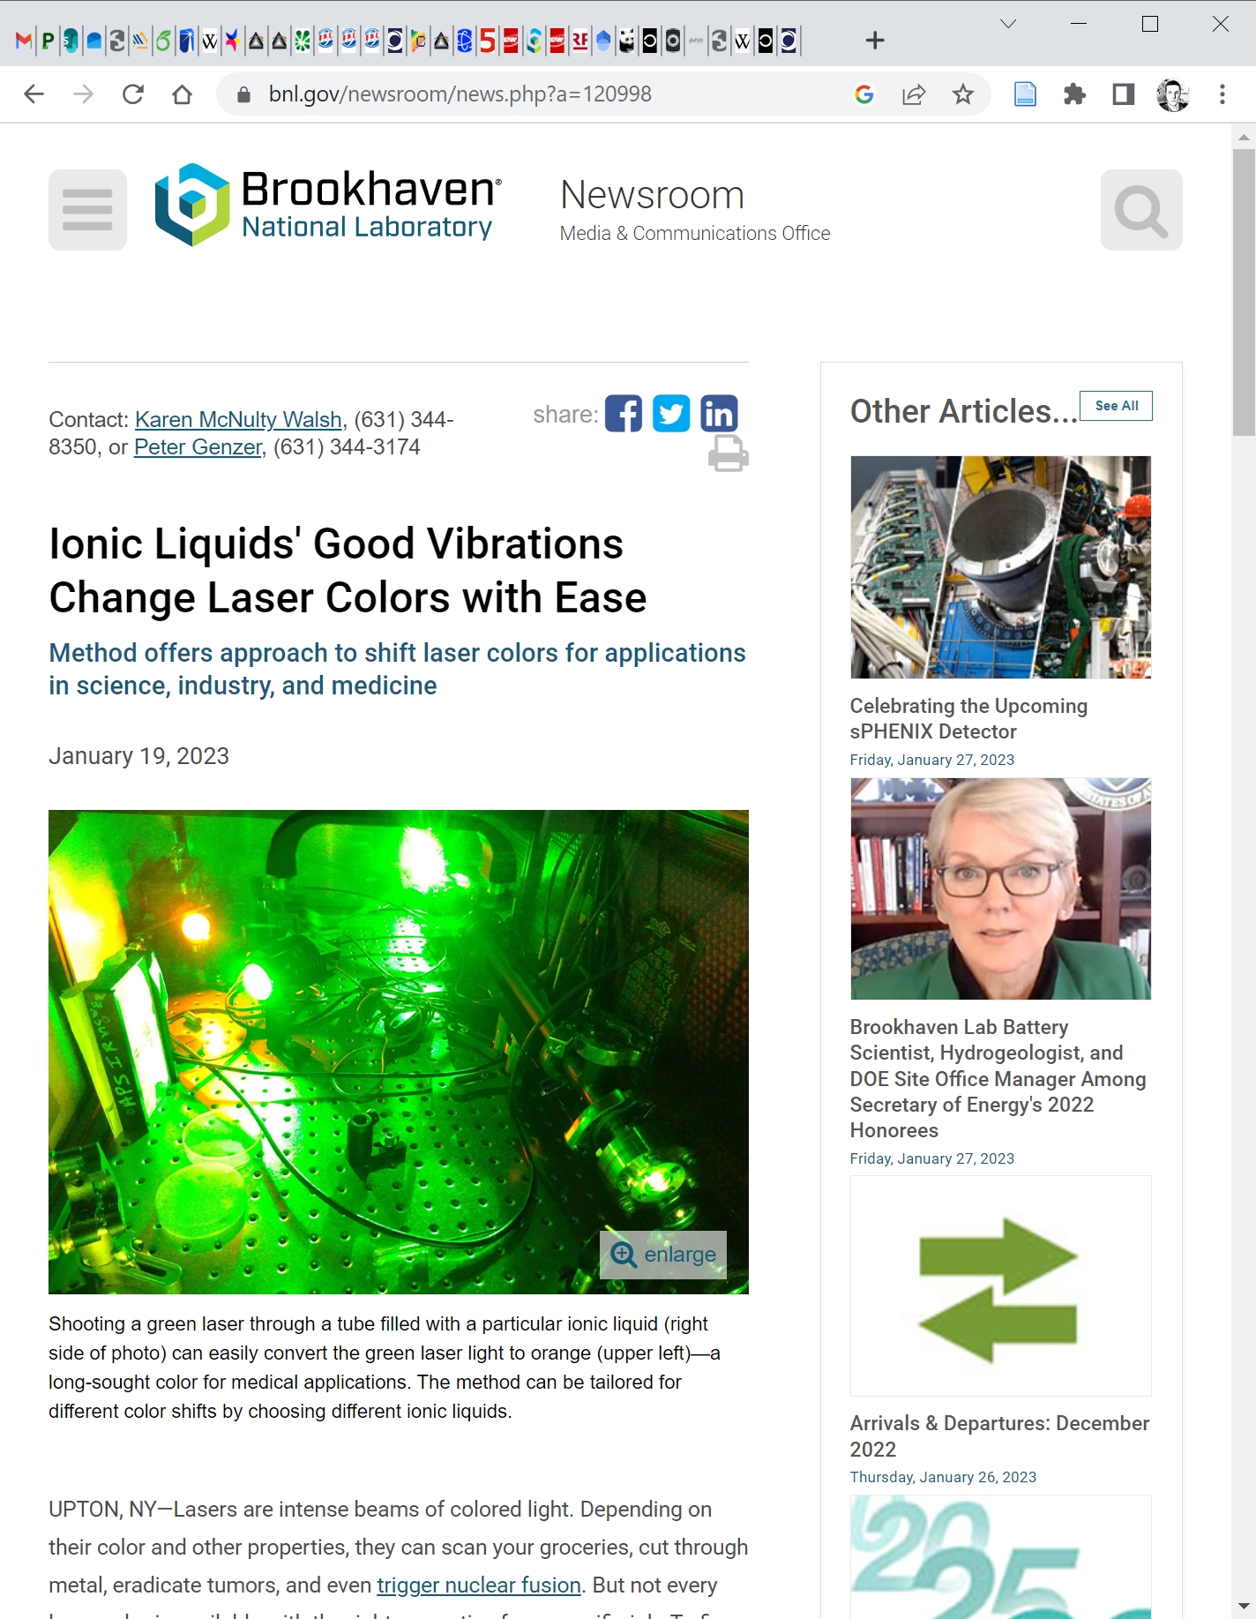
Products delivered
Journal Publications:
R. Kupfer, F. Wang, J. F. Wishart, M. Babzien, M. N. Polyanskiy, I. V. Pogorelsky, T. Rao, L. Cultrera, N. Vafaei-Najafabadi, M. A. Palmer. “Raman Wavelength Conversions in Ionic Liquids” – Phys. Rev. Applied 19, 014052 (2023)
Conference Presentations:
W. Li, R. Kupfer, F. Wang, J. Wishart, M. Babzien, M. Polyanskiy, I. Pogorelsky, T. Rao, L. Cultrera, N. Vafaei-Najafabadi, M. Palmer, “Raman-based Wavelength Conversion for Seeding and Optical Pumping of CO₂ Laser Amplifiers”, Advanced Accelerator Concepts Workshop (AAC), Long Island, NY (USA), November 6–11, 2022
https://www.bnl.gov/newsroom/news.php?a=120998
Thank you for your attention!
Accelerator Facilities Division

Slide 11
Backup slides
Accelerator Facilities Division

Slide 12
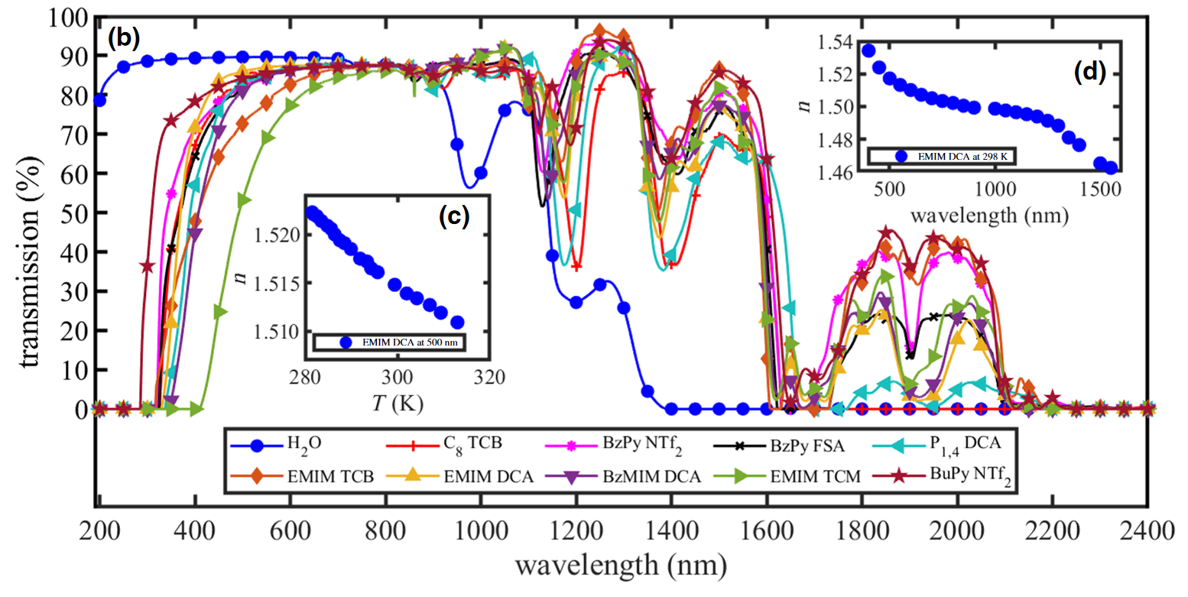
EMIM DCA transmission spectrum
Problem for using Nd:YAG fundamental
Absorption peak from overtones of aliphatic C-H bonds
Deuteration should shift this peak without affecting the Stokes shift, which comes from C-N triple bonds
Accelerator Facilities Division

Slide 13
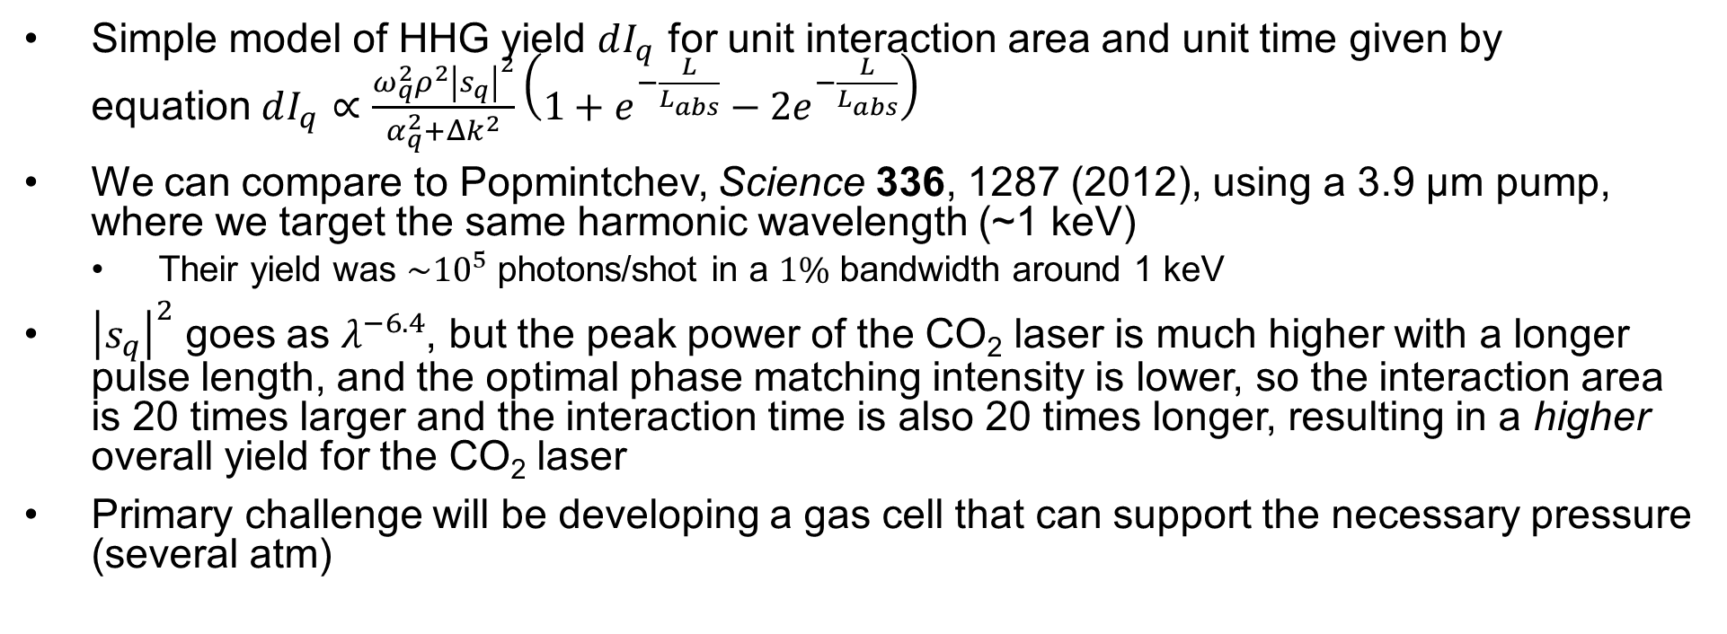
HHG Feasibility for CO₂
Simple model of HHG yield $dI_{q}$ for unit interaction area and unit time given by equation$dI_{q}∝\frac{ω_{q}^{2}ρ^{2}{\left|s_{q}\right|}^{2}}{α_{q}^{2}+Δk^{2}}\left(1+e^{−\frac{L}{L_{abs}}}−2e^{−\frac{L}{L_{abs}}}\right)$
We can compare to Popmintchev, Science 336, 1287 (2012), using a 3.9 μm pump, where we target the same harmonic wavelength (~1 keV)
  Their yield was $\sim {10}^{5}$ photons/shot in a $1\%$ bandwidth around 1 keV
${\left|s_{q}\right|}^{2}$ goes as $λ^{−6.4}$, but the peak power of the CO₂ laser is much higher with a longer pulse length, and the optimal phase matching intensity is lower, so the interaction area is 20 times larger and the interaction time is also 20 times longer, resulting in a higher overall yield for the CO₂ laser
Primary challenge will be developing a gas cell that can support the necessary pressure (several atm)
Accelerator Facilities Division

Slide 14
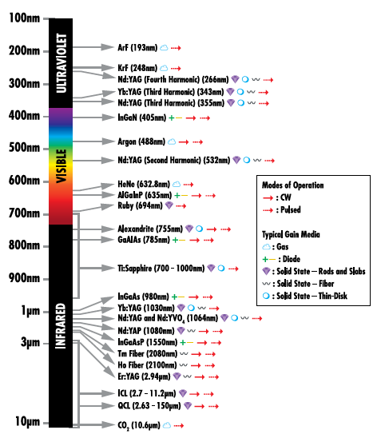
Experimental goals
Commonly available laser wavelengths
Commonly available high energy/ultrashort lasers are limited to specific wavelengths
Problem is exacerbated for wavelengths far outside UV-NIR
We want ways to convert from commonly available wavelengths to (ideally) arbitrary wavelengths
Primary targets: MIR-LWIR and EUV
Photo credit: Edmund Optics
Accelerator Facilities Division

Slide 15
Slides for Program Advisory Committee

Slide 16
CO₂ Laser Requirements
Configuration | Parameter | Units | Typical Values | Comments | Requested Values
CO₂ Regenerative Amplifier Beam | Wavelength | μm | 9.2 | Wavelength determined by mixed isotope gain media
 | Peak Power | GW | ~3
 | Pulse Mode | --- | Single
 | Pulse Length | ps | 2
 | Pulse Energy | mJ | 6
 | M² | --- | ~1.5
 | Repetition Rate | Hz | 1.5 | 3 Hz also available if needed
 | Polarization | --- | Linear | Circular polarization available at slightly reduced power
CO₂ CPA Beam | Wavelength | μm | 9.2 | Wavelength determined by mixed isotope gain media | 9.2
Note that delivery of full power pulses to the Experimental Hall is presently limited to Beamline #1 only. | Peak Power | TW | 5 | ~5 TW operation will become available shortly into this year’s experimental run period. A 3-year development effort to achieve >10 TW and deliver to users is in progress.
 | Pulse Mode | --- | Single
 | Pulse Length | ps | 2 |  | 2
 | Pulse Energy | J | ~5 | Maximum pulse energies of >10 J will become available within the next year | 5
 | M² | --- | ~2
 | Repetition Rate | Hz | 0.05
 | Polarization |  | Linear | Adjustable linear polarization along with circular polarization can be provided upon request

Slide 17
Other Experimental Laser Requirements
Ti:Sapphire Laser System | Units | Stage I Values | Stage II Values | Comments | Requested Values
Central Wavelength | nm | 800 | 800 | Stage I parameters are presently available and setup to deliver Stage II parameters should be complete during FY22 | 800
FWHM Bandwidth | nm | 20 | 13
Compressed FWHM Pulse Width | fs | <50 | <75 | Transport of compressed pulses will initially include a very limited number of experimental interaction points. Please consult with the ATF Team if you need this capability. | 75
Chirped FWHM Pulse Width | ps | ≥50 | ≥50
Chirped Energy | mJ | 10 | 200
Compressed Energy | mJ | 7 | ~20 | 20 mJ is presently operational with work underway this year to achieve our 100 mJ goal. | 15
Energy to Experiments | mJ | >4.9 | >80
Power to Experiments | GW | >98 | >1067
Nd:YAG Laser System | Units | Typical Values | Comments | Requested Values
Wavelength | nm | 1064 | Single pulse
Energy | mJ | 5
Pulse Width | ps | 14
Wavelength | nm | 532 | Frequency doubled
Energy | mJ | 0.5
Pulse Width | ps | 10

Slide 18
Special Equipment Requirements and Hazards
CO₂ Laser
  We will require a long focal length focusing optic in the CO₂ transport line for HHG
Ti:Sapphire and Nd:YAG Lasers
  We will be running the ionic liquid conversion experiment in parallel with Ti:Sapphire operations.
Hazards & Special Installation Requirements
  We will require a vacuum chamber and associated pumping to be installed in the CO₂ room for the HHG gas cell. The gas cell itself will be fed with lecture bottles.

Slide 19
Experimental Time Request
CY2023 Time Request
Capability | Setup Hours | Running Hours
Electron Beam Only
Laser* Only (in Laser Areas) | 80 (1 week early in year, 1 week late in year) | 80 (1 week early in year, 1 week late in year)
Laser* + Electron Beam
Total Time Request for the 3-year Experiment (including CY2023-25)
Capability | Setup Hours | Running Hours
Electron Beam Only
Laser* Only (in Laser Areas) | 80 | 80
Laser* + Electron Beam
* Laser = Near-IR or LWIR (CO₂) Laser

