Slide 1

25th Annual
Accelerator Test Facility (ATF) Users' Meeting
ID: 312804
“Theory to Practice: Hands-On Experience with the Latest Accelerator and Laser Systems”
BNL&CASE@SBU: Mikhail Fedurin (PI), Dmitry Kayran, Mikhail Polyanskiy, Navid Vafaei-Najafabdi, Vladimir Litvinenko
CUNY: Viviana Vladutesku
Accelerator Facilities Division
03/01/2023

Slide 2
AE63 “Stony Brook Accelerator Laboratory Course CASE@ATF” + classes and tours for MSI + training for other institutions
The purpose of this proposal to extend AE63 “Stony Brook Accelerator Laboratory Course CASE@ATF” with capability to advertise and train other institution students
Objective of AE63: Training, growing and educating of the next generation of accelerator physics using unique advance accelerator capabilities at ATF
Objective of Extension: Advertise accelerator science research in Brookhaven National Laboratory for MSI (classes and tours in CUNY) and potential to conduct training for students of other institutions
Accelerator Facilities Division

Slide 3
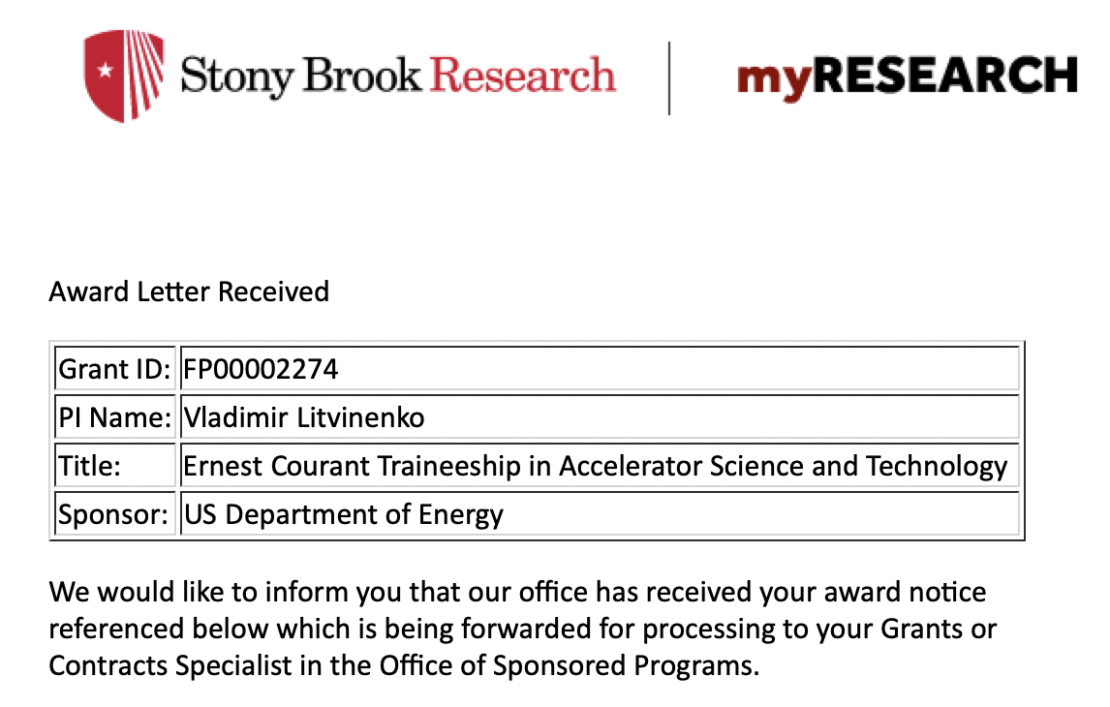
CASE at SBU, Ernest Courant Traineeship
CASE – The Center for Accelerator Science and Education has been established established as a Type I Institute within the University on November 19, 2008 as a Joint venture of BNL and SBU,
  To train scientists and engineers with the aim of advancing the field of accelerator science;
  To develop a unique program of educational outreach that will provide broad access to a research accelerator; and,
  To attract Federal and industrial funding for an expanding interdisciplinary research and education program that utilizes accelerators.
The Stony Brook University / BNL connection provides an ideal educational environment. The close proximity to BNL and the BSA connection provides for a superb combination of both university and national laboratory environment.
http://case.physics.stonybrook.edu/index.php/Main_Page
$2.9M over 5 years
Collaboration of BNL, FNL, Cornell and
Stony Brook Universities

Slide 4
PHY542 “Fundamentals of Accelerator Physics and Technology with Simulations and Measurements Lab”
Introduce students to the field of experimental Accelerator Physics
Demonstrate e-beam techniques and diagnostics used in Advanced Accelerator Concept experiments at Accelerator Test Facility
Teach students to model experiments, compare model results with measurements.
http://case.physics.stonybrook.edu/index.php/PHY542_spring_2023

Slide 5
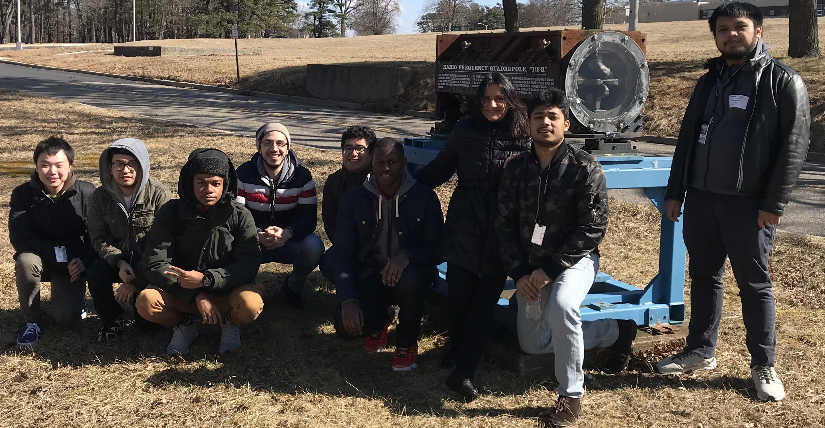
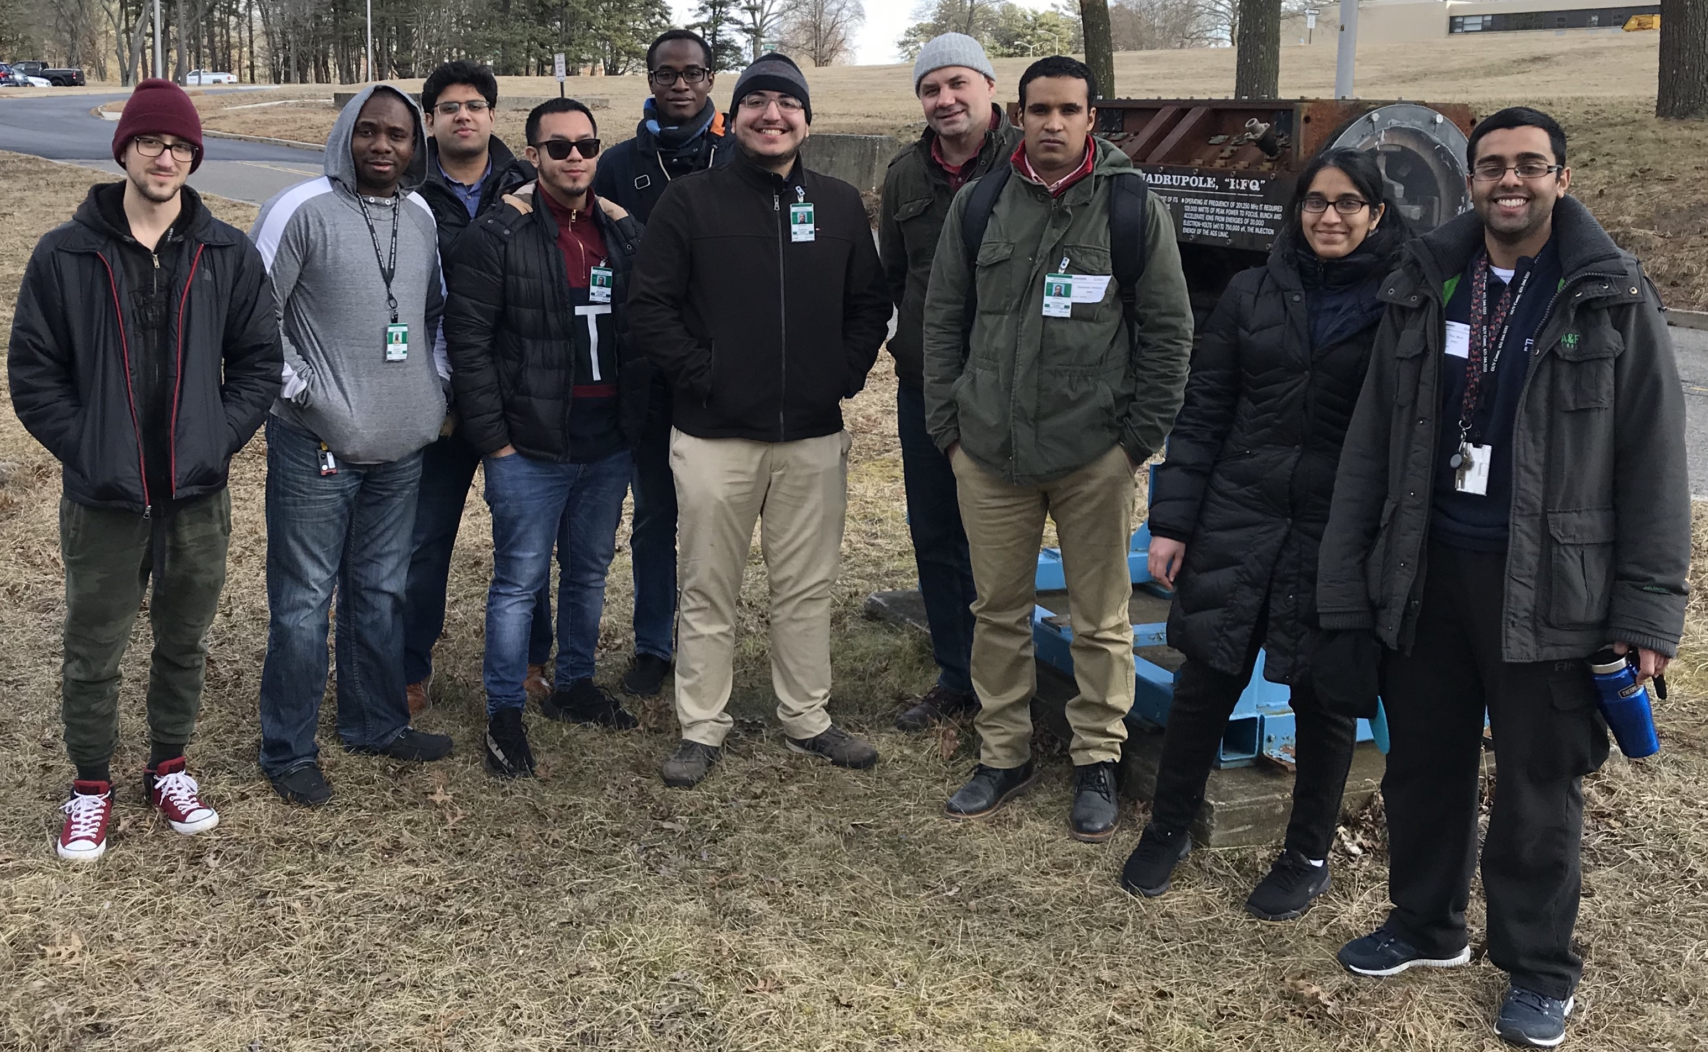
City University New York tours at ATF
Starts in spring 2019 AE63 was extended to give introductory Advance Accelerator Laboratory course for CUNY students
AE63 extension was supported by BNL diversity program:
  Round trip travel expenses from NYC to BNL was covered for 18 students
  32 hours /year presentations and tours dedicated accelerator and laser physics by Mikhail Fedurin and Mikhail Polyansky

Slide 6
Summer intern training at ATF
Since 2020 ATF provides summer intern training for students by “Ernest Courant Traineeship for Accelerator Science and Technology” (CASE@SBU) funding
List of students in summer program at ATF:
Roshni Patil (SBU, 2020)
Neil McCarthy (SBU,2021)
Apurva Gaikwad (SBU,2021-2022)
Evan Trommer (SBU, 2022)
Brianna Romasky (Rutgers Univ. 2022-2023)
http://case.physics.stonybrook.edu/index.php/Ernest_courant_traineeship_main

Slide 7
SBU + CUNY+?? >> “Training program at ATF”
..with training program goals:
Introduce students from SBU,CUNY, MSI, college or staff from other national facilities to the field of experimental Accelerator Physics
Demonstrate students e-beam and laser physics, techniques and diagnostics used in Advanced Accelerator Concept experiments at Accelerator Test Facility
Teach students to model experiments, compare model results with measurements.
Summer intern training at ATF
http://case.physics.stonybrook.edu/index.php/Ernest_courant_traineeship_main

Slide 8
Electron Beam Requirements
Parameter | Units | Typical Values | Comments | Requested Values
Beam Energy | MeV | 50-65 | Possibility to redistribute energy gain in linac acceleration sections (phase shifter control) | 35-55
Bunch Charge | nC | 0.1-2.0 | for QE measurements 0 -2nC, 0.5nC for other | 0.1-2.0
Compression | fs | Down to 100 fs (up to 1 kA peak current) | (for 0.5 nC bunch) Compression demonstration, Enhance CSR effect | 700-1500
Transverse size at IP (σ) | μm | 30 – 100 (dependent on IP position) | Convenient beam size to deliver beam to spectrometer at end of beamline | 100-500
Normalized Emittance | μm | 1 (at 0.3 nC) | (at 0.3 nC or at 0.5nC) | 1 - 3
Rep. Rate (Hz) | Hz | 1.5 | 3 Hz also available if needed | 1.5
Trains mode | --- | Single bunch | Multi-bunch mode available. Trains of 24 or 48 ns spaced bunches. | Single bunch

Slide 9
CO₂ Laser Requirements
Configuration | Parameter | Units | Typical Values | Comments | Requested Values
CO₂ Regenerative Amplifier Beam | Wavelength | μm | 9.2 | Wavelength determined by mixed isotope gain media | --
 | Peak Power | GW | ~3 |  | --
 | Pulse Mode | --- | Single |  | --
 | Pulse Length | ps | 2 |  | --
 | Pulse Energy | mJ | 6 |  | --
 | M² | --- | ~1.5 |  | --
 | Repetition Rate | Hz | 1.5 | 3 Hz also available if needed | --
 | Polarization | --- | Linear | Circular polarization available at slightly reduced power | --
CO₂ CPA Beam | Wavelength | μm | 9.2 | Wavelength determined by mixed isotope gain media | --
Note that delivery of full power pulses to the Experimental Hall is presently limited to Beamline #1 only. | Peak Power | TW | 5 | ~5 TW operation will become available shortly into this year’s experimental run period. A 3-year development effort to achieve >10 TW and deliver to users is in progress. | --
 | Pulse Mode | --- | Single |  | --
 | Pulse Length | ps | 2 |  | --
 | Pulse Energy | J | ~5 | Maximum pulse energies of >10 J will become available within the next year | --
 | M² | --- | ~2 |  | --
 | Repetition Rate | Hz | 0.05 |  | --
 | Polarization |  | Linear | Adjustable linear polarization along with circular polarization can be provided upon request | --

Slide 10
Other Experimental Laser Requirements
Ti:Sapphire Laser System | Units | Stage I Values | Stage II Values | Comments | Requested Values
Central Wavelength | nm | 800 | 800 | Stage I parameters are presently available and setup to deliver Stage II parameters should be complete during FY22 | --
FWHM Bandwidth | nm | 20 | 13 |  | --
Compressed FWHM Pulse Width | fs | <50 | <75 | Transport of compressed pulses will initially include a very limited number of experimental interaction points. Please consult with the ATF Team if you need this capability. | --
Chirped FWHM Pulse Width | ps | ≥50 | ≥50 |  | --
Chirped Energy | mJ | 10 | 200 |  | --
Compressed Energy | mJ | 7 | ~20 | 20 mJ is presently operational with work underway this year to achieve our 100 mJ goal. | --
Energy to Experiments | mJ | >4.9 | >80 |  | --
Power to Experiments | GW | >98 | >1067 |  | --
Nd:YAG Laser System | Units | Typical Values | Comments | Requested Values
Wavelength | nm | 1064 | Single pulse | --
Energy | mJ | 5 |  | --
Pulse Width | ps | 14 |  | --
Wavelength | nm | 532 | Frequency doubled | --
Energy | mJ | 0.5 |  | --
Pulse Width | ps | 10 |  | --

Slide 11
Special Equipment Requirements and Hazards
Electron Beam
  Mask for mask technique demonstration, Bunch compressor for demonstration
CO₂ Laser
  Possibility to conduct tour
Ti:Sapphire and Nd:YAG Lasers
  None
Hazards & Special Installation Requirements
  None

Slide 12
Experimental Time Request
CY2023 Time Request
Capability | Setup Hours | Running Hours
Electron Beam Only | none | 48
Laser* Only (in Laser Areas) | Tour | 8 down post hours for tour
Laser* + Electron Beam | none | 56
Total Time Request for the 3-year Experiment (including CY2023-25)
Capability | Setup Hours | Running Hours
Electron Beam Only |  | 144
Laser* Only (in Laser Areas) |  | 24 down post hours for tour
Laser* + Electron Beam |  | 168
* Laser = Near-IR or LWIR (CO₂) Laser

Slide 13
Questions?
Accelerator Facilities Division

