Slide 1



25th Annual
Accelerator Test Facility (ATF) Users' Meeting
NP-312796: Two-color Injection of Bright Electron Beams
N. Vafaei-Najafabadi^{1,2*}, W. Li¹, I. Petrushina², R. Zgadzaj³, M. Downer³, A. Gaikwad², B. Romasky², E. Trommer², A. Cheng², R. Samulyak², A. Farrell⁴, C. Zhang⁴, Y. Wu⁴, C. Joshi⁴, M. Babzien¹, M. Polyanskiy¹, I. Pogorelsky¹, M. Palmer¹
¹Brookhaven National Laboratory, ²Stony Brook University,
³University of Texas at Austin, ⁴UCLA, *PI
March 1st, 2023
Funding Source: DOE HEP DE-SC0014043
NSF 2238840
CORI @ NERSC under contract DE-AC02-05CH11231
SEAWULF @ Stony Brook University
Accelerator Facilities Division

Slide 2
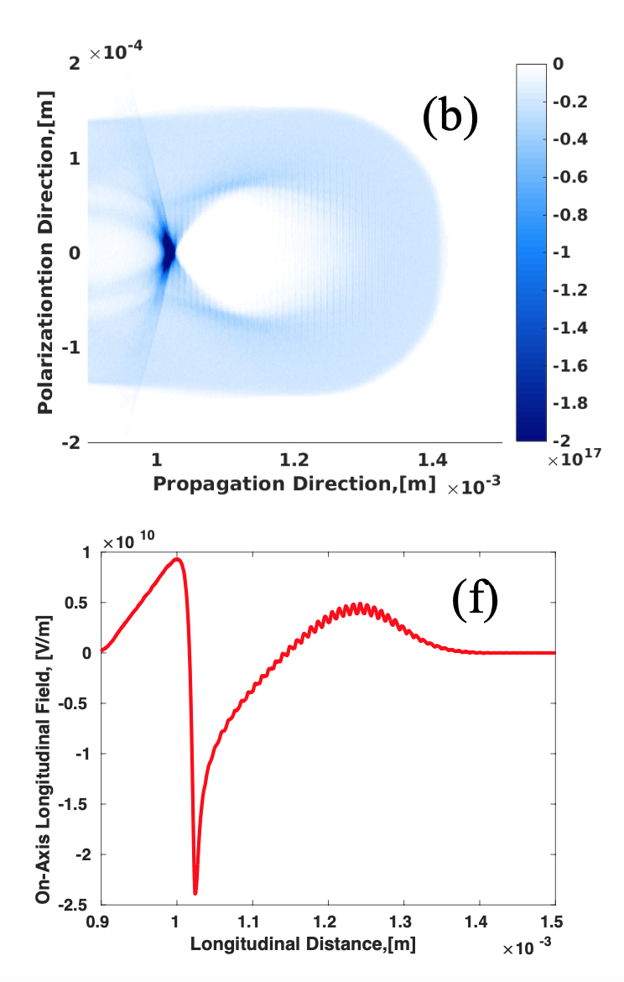
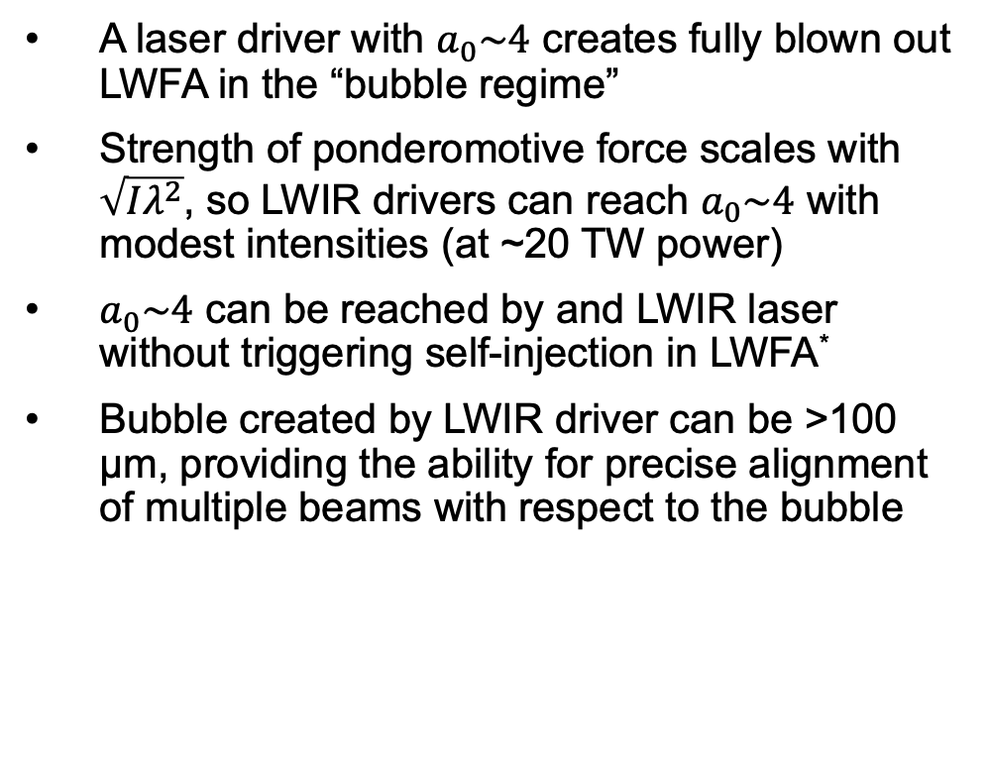
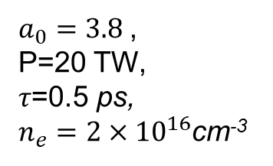
LWIR-driven laser wakefield acceleration
P. Kumar, Physics of Plasmas, 28, 013102 (2021)
A laser driver with $a_{0}\sim 4$ creates fully blown out LWFA in the “bubble regime”
Strength of ponderomotive force scales with $\sqrt{Iλ^{2}}$, so LWIR drivers can reach $a_{0}\sim 4$ with modest intensities (at ~20 TW power)
$a_{0}\sim 4$ can be reached by and LWIR laser without triggering self-injection in LWFA*
Bubble created by LWIR driver can be >100 µm, providing the ability for precise alignment of multiple beams with respect to the bubble
$a_{0}=3.8$,
P=20 TW,
𝜏=0.5 ps,
$n_{e}=2×{10}^{16}$cm⁻³
* See A. Jain, Proceedings of AAC 2022
Accelerator Facilities Division

Slide 3
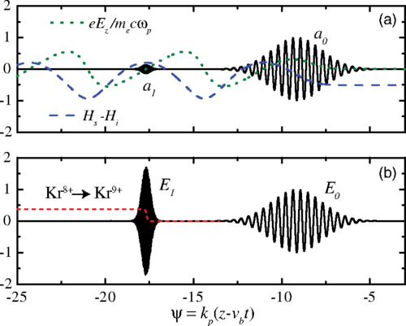
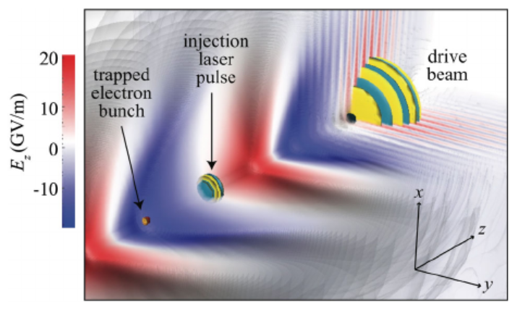
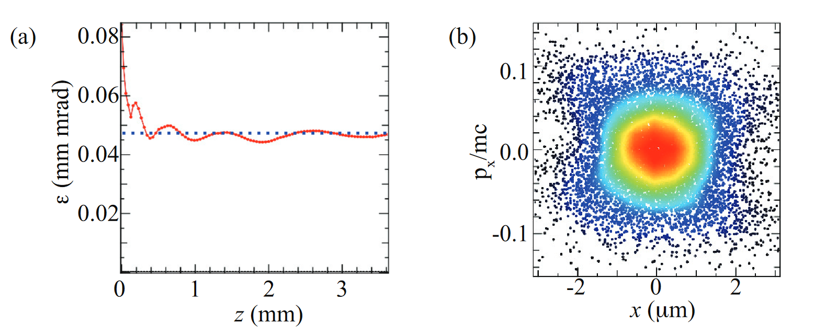


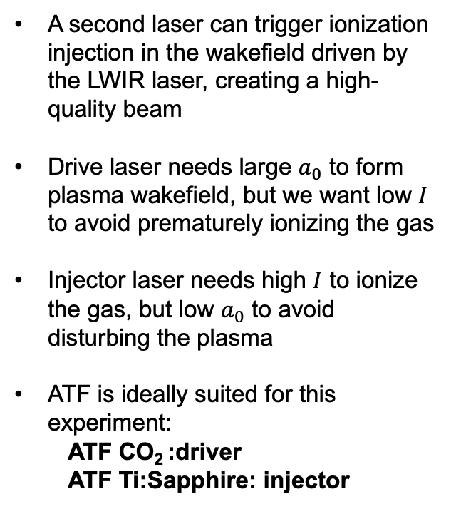
Two-color ionization injection
Very intense, small $a_{0}$
Less intense, large $a_{0}$
A second laser can trigger ionization injection in the wakefield driven by the LWIR laser, creating a high-quality beam
Drive laser needs large $a_{0}$ to form plasma wakefield, but we want low $I$ to avoid prematurely ionizing the gas
Injector laser needs high $I$ to ionize the gas, but low $a_{0}$ to avoid disturbing the plasma
ATF is ideally suited for this experiment:
  ATF CO₂ :driver
  ATF Ti:Sapphire: injector
Schroeder, PRSTAB 17, 101301 (2014)
Yu, PRL 112, 125001 (2014)
Excellent phase space
Low emittance
Schroeder, European Conference on Lasers and Electro-Optics (2015)
Accelerator Facilities Division

Slide 4
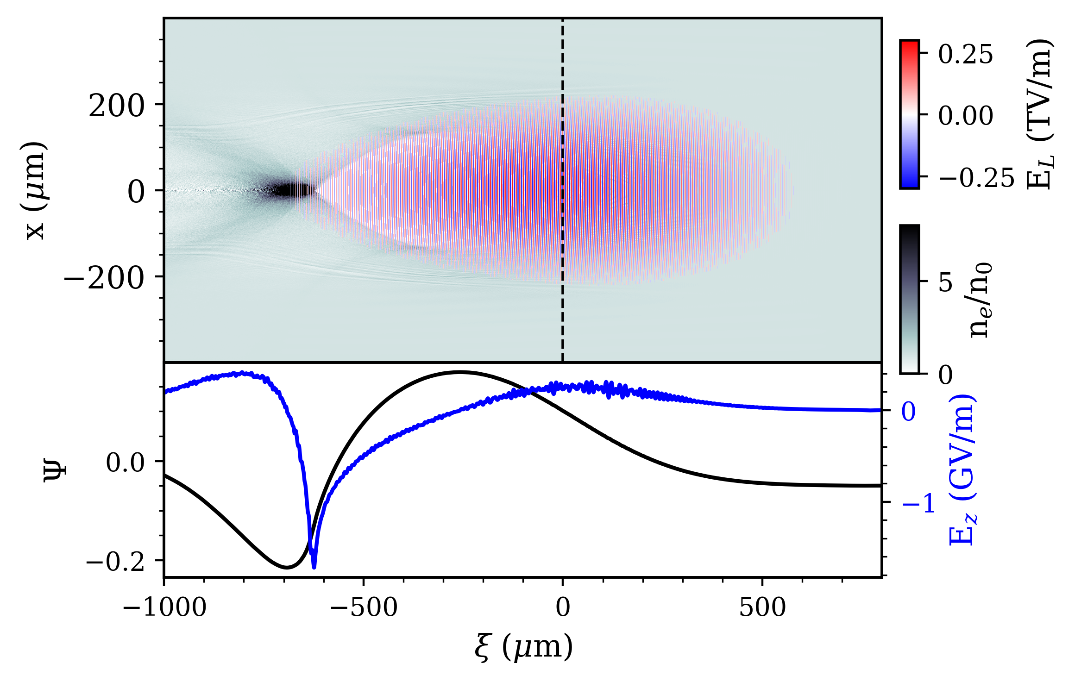
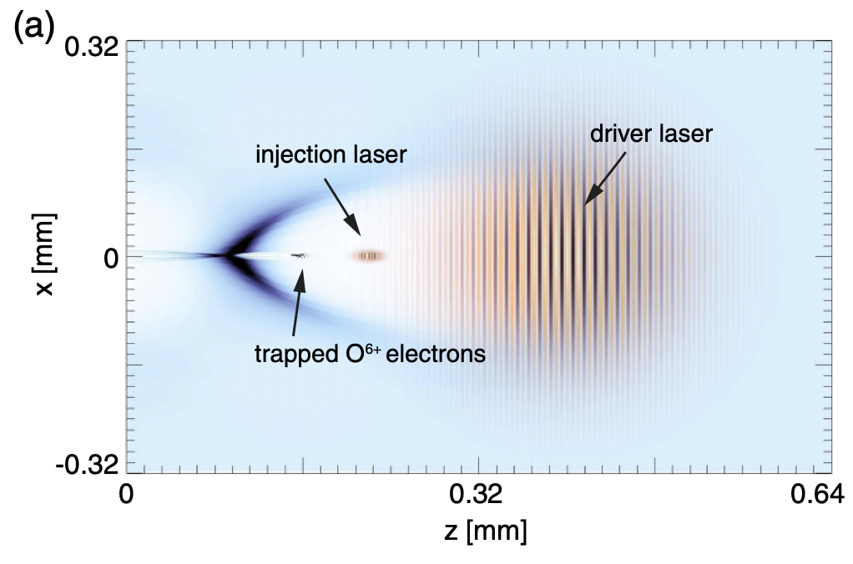
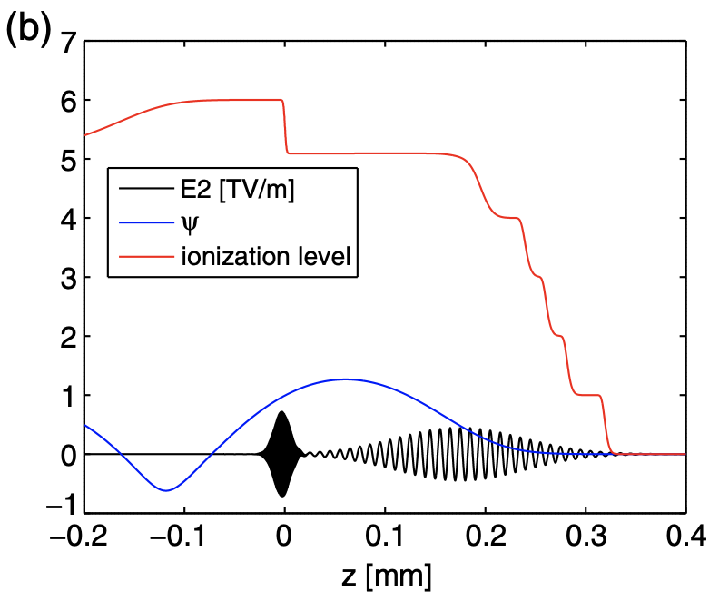

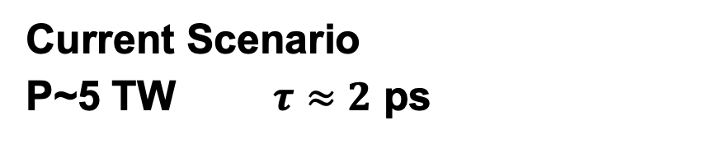
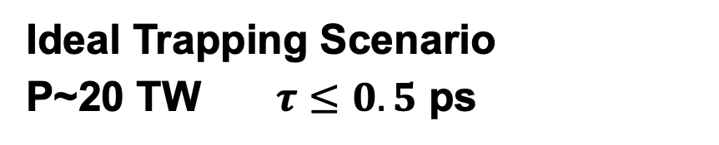
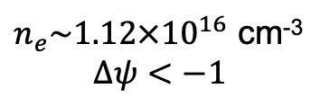
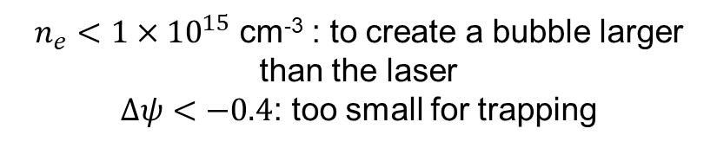
Trapping condition for electrons
Ideal Trapping Scenario
P~20 TW $τ≤0.5$ ps
Current Scenario
P~5 TW $τ≈2$ ps
X.L. Xu, et al., PRSTAB, 17, 061301 (2014)
A. Jain, private communication
$n_{e}\sim 1.12×{10}^{16}$ cm⁻³
$$Δψ<−1$$
$z=4.5$mm
$n_{e}<1×{10}^{15}$ cm⁻³ : to create a bubble larger than the laser
$Δψ<−0.4$: too small for trapping
Accelerator Facilities Division

Slide 5
Ionization Injection with Current Laser Config
Accelerator Facilities Division

Slide 6
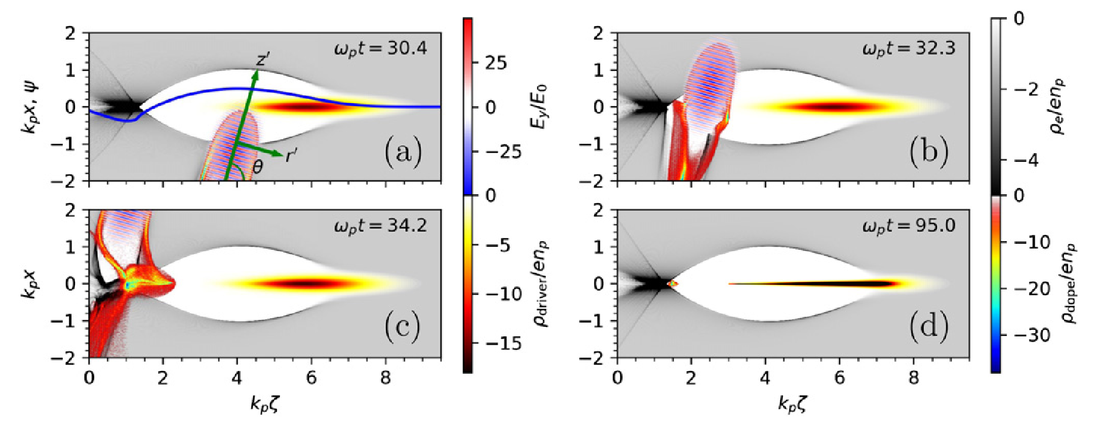
Ponderomotive assistance
We can use the injector laser to help!
Ponderomotive force of injector laser at oblique angle accelerates the ionized electrons
The electrons have an initial momentum, lowering the necessary trapping potential
Zeng, New J. Phys. 22, 123003 (2020)
Note: driver is an e-beam, but the physics of injection is the same
Accelerator Facilities Division

Slide 7
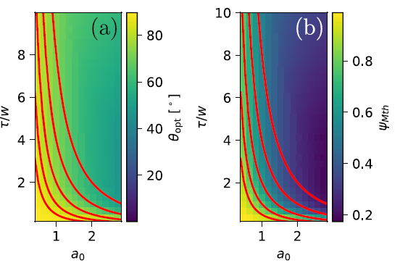
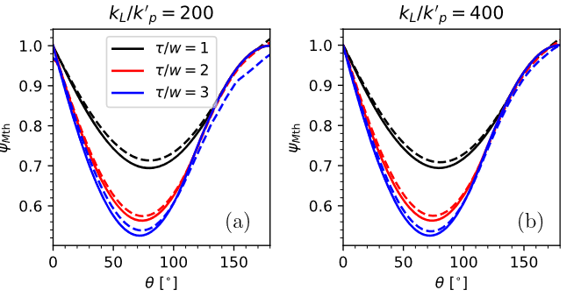

Ponderomotive assistance parameters
Trapping threshold depends strongly on angle of incidence
Optimal angle of incidence and magnitude of trapping threshold dependent on $a_{0}$ and $\frac{τ}{w}$, the laser aspect ratio
Contours of constant $a_{0}^{2}\frac{τ}{w}:0.5, 1, 2, 4, 8$
Trapping threshold as fraction of ponderomotive-free trapping threshold
At optimal angle
15 mJ
90 mJ
For ATF, f/1.5 focusing, $a_{0}≅0.7$(at 15 mJ), $\frac{τ}{w}≅5$
Accelerator Facilities Division
Zeng, New J. Phys. 22, 123003 (2020)

Slide 8
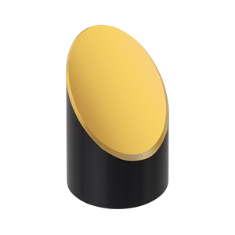
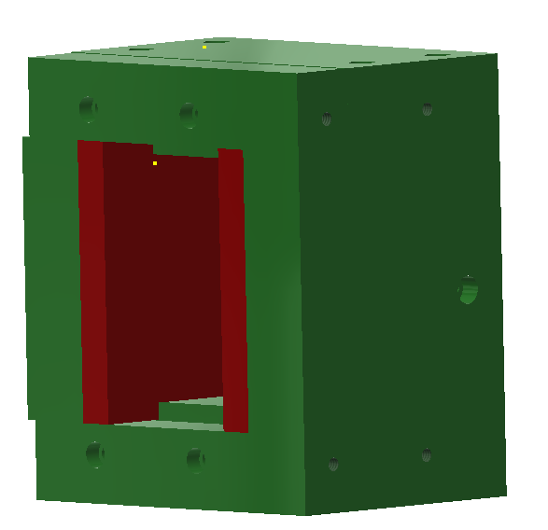
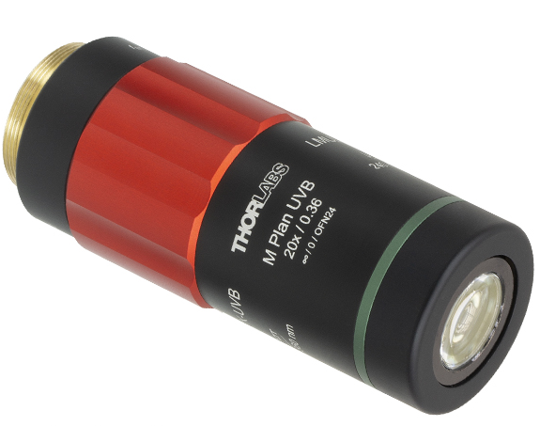
Experimental setup (inherited from AE88)
NIR pulse
LWIR pulse
Dipole
magnet
LANEX
Slit
f/#1.5 focusing
Nozzle
LWIR focus diagnostic
NIR focus diagnostic
f/#2 focusing
Accelerator Facilities Division

Slide 9
Experimental setup (new modifications)
NIR pulse
LWIR pulse
AOI rotation
Dipole
magnet
Pepperpot
LANEX
Slit
f/#1.5 focusing
Nozzle
LWIR focus diagnostic
NIR focus diagnostic
f/#2 focusing
Accelerator Facilities Division

Slide 10
Experimental setup (new modifications)
NIR pulse
LWIR pulse
Dipole
magnet
Pepperpot
LANEX
Slit
Nozzle
LWIR focus diagnostic
f/#2 focusing
f/#1.5 focusing
Accelerator Facilities Division

Slide 11
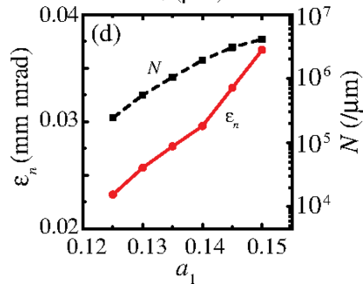
Proposed measurements
Measure dependence of yield on angle of incidence, drive laser intensity, and injector laser intensity: confirmation that ponderomotive assistance is occurring
Measure dependence of emittance on angle of incidence, drive laser intensity, and injector laser intensity: confirmation of beam quality and finding optimal beam brightness
Zeng, New J. Phys. 22, 123003 (2020)
Yu, PRL 112, 125001 (2014)
Accelerator Facilities Division

Slide 12
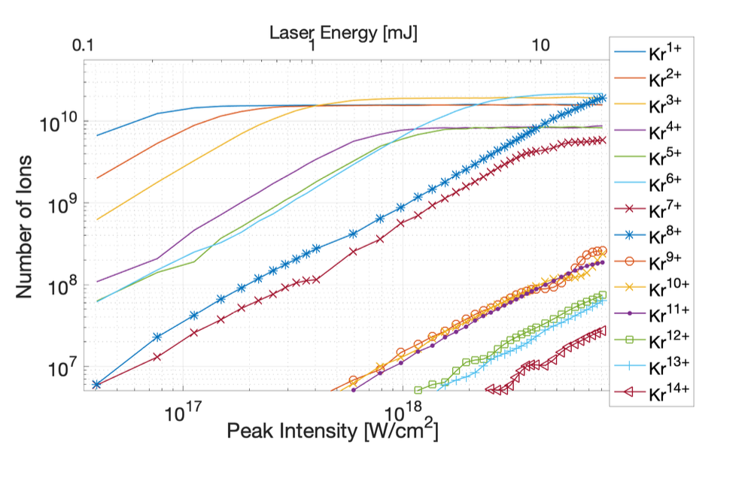
Expected experimental parameters
Expected gradient >1 GeV/m = 1 MeV/mm
Expected electron energy 5-10 MeV (~5 mm gas jet)
Expected electron emittance <1 mm-mrad (number obtained in Zeng, New J. Phys. 22, 123003, 2020 simulation)
High levels of Kr ionization is expected
Ionization of Krypton
N. Vafaei-Najafabadi, Proceedings of AAC 2022

Slide 13
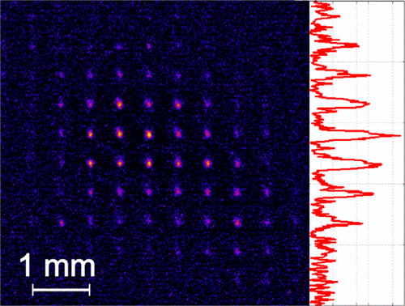
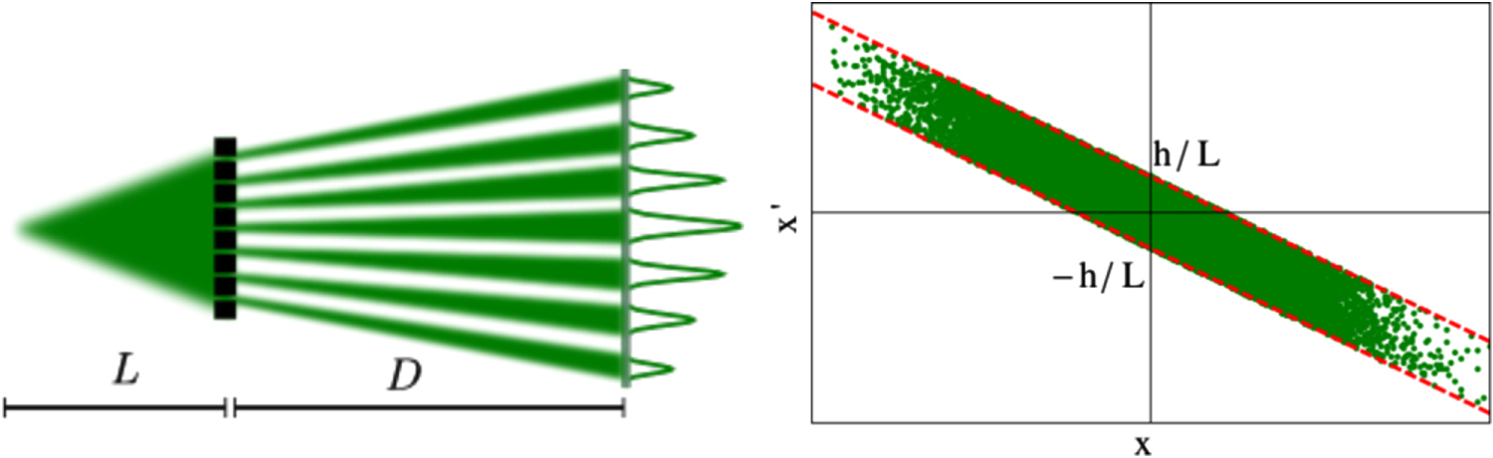
Emittance measurement
Need a single-shot measurement due to shot-to-shot fluctuations
Pepperpot is well-established method used in previous LWFA experiments
Intercept beam with a grid of holes and measure the size, shape, and spacing between the transmitted beamlets to retrieve transverse phase space
Manahan, New J. Phys. 16, 103006 (2014)
Brunetti, Phys. Rev. Lett. 105, 215007 (2010)
Accelerator Facilities Division

Slide 14
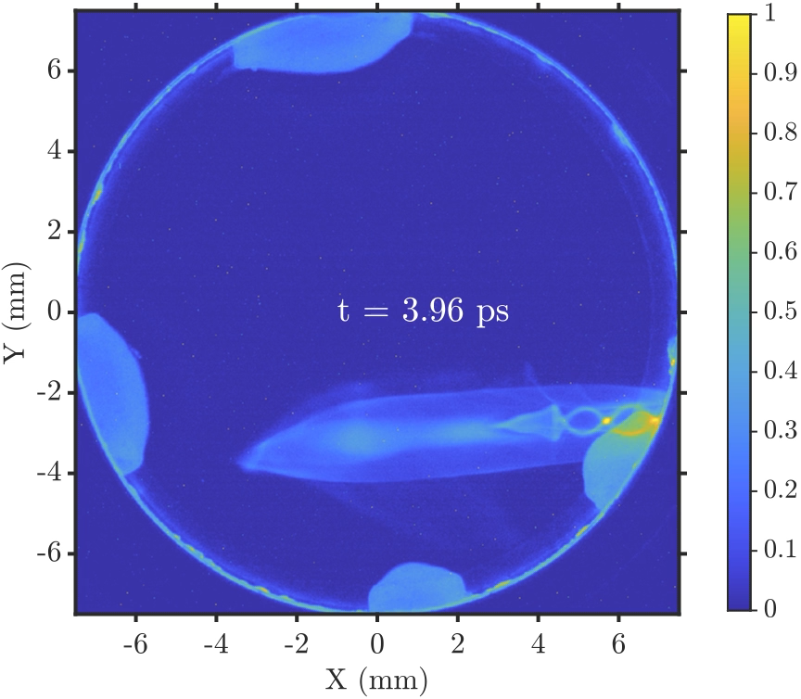
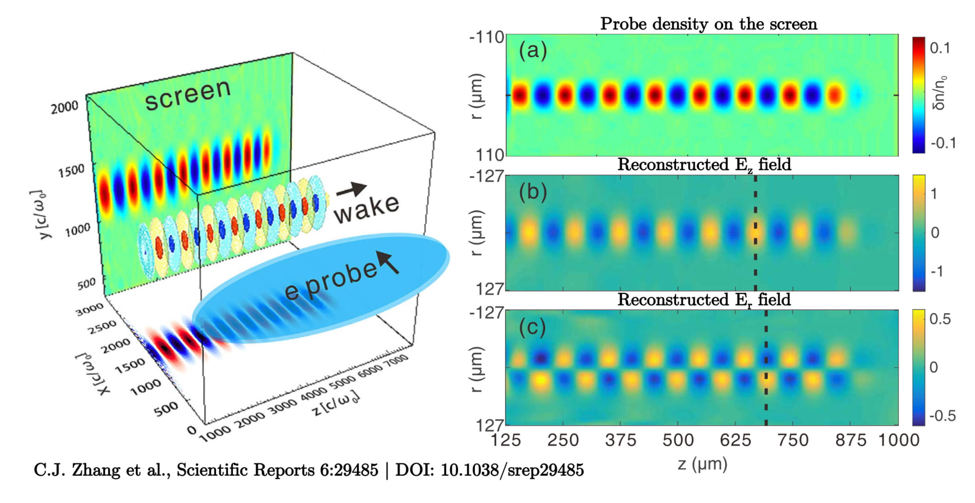
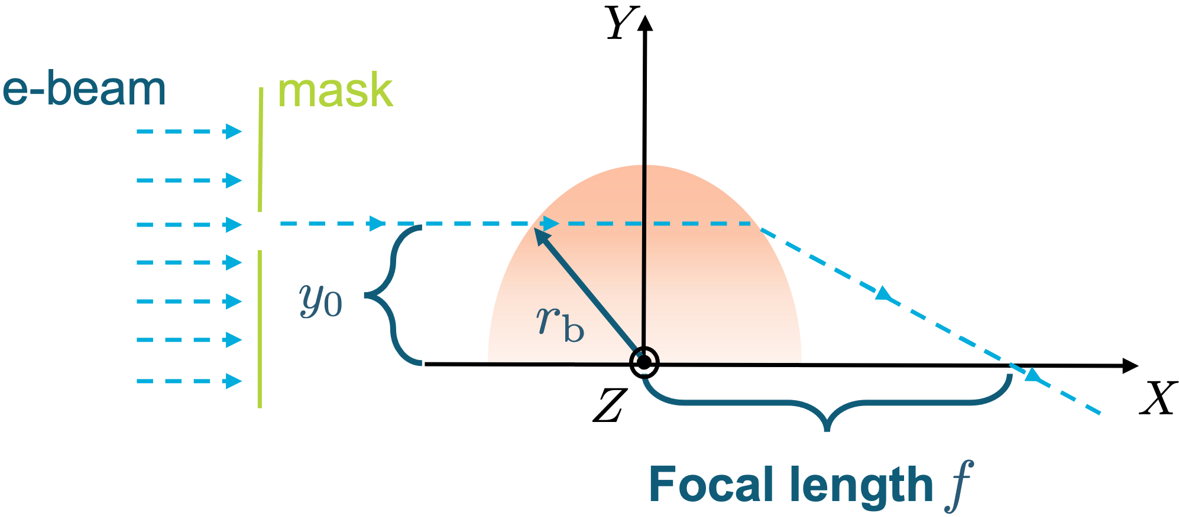
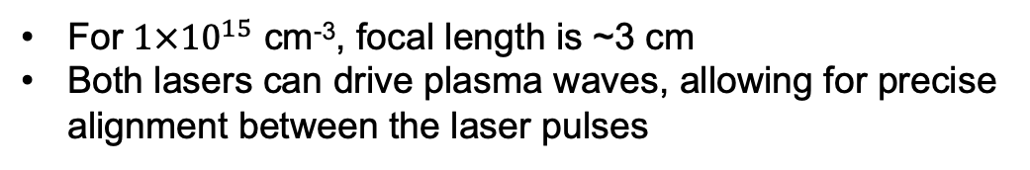
Optional: Electron Beam as Probe
Linear focusing force in a bubble: (wakefield theory suggests )
For $1×{10}^{15}$ cm⁻³, focal length is ~3 cm
Both lasers can drive plasma waves, allowing for precise alignment between the laser pulses

Slide 15
Conclusion
Two-color ionization injection has been shown in simulation to produce high quality electron beams
Ponderomotively assisted injection allows us to conduct the first two-color ionization injection experiments with the potential for low-emittance beam generation
Stepping stone towards producing ultra-low emittance, high brightness beams in a colinear configuration after ATF CO₂ upgrades to >15 TW
Accelerator Facilities Division

Slide 16
Backup slides
Accelerator Facilities Division

Slide 17
Slides for Program Advisory Committee

Slide 18
Electron Beam Requirements
Parameter | Units | Typical Values | Comments | Requested Values
Beam Energy | MeV | 50-65 | Full range is ~15-75 MeV with highest beam quality at nominal values | nominal
Bunch Charge | nC | 0.1-2.0 | Bunch length & emittance vary with charge | nominal
Compression | fs | Down to 100 fs (up to 1 kA peak current) | A magnetic bunch compressor available to compress bunch down to ~100 fs. Beam quality is variable depending on charge and amount of compression required. NOTE: Further compression options are being developed to provide bunch lengths down to the ~10 fs level | Max compression available
Transverse size at IP (σ) | μm | 30 – 100 (dependent on IP position) | It is possible to achieve transverse sizes below 10 um with special permanent magnet optics. | 1 mm
Normalized Emittance | μm | 1 (at 0.3 nC) | Variable with bunch charge | 1 um
Rep. Rate (Hz) | Hz | 1.5 | 3 Hz also available if needed | 0.02 Hz (limited by CO2)
Trains mode | --- | Single bunch | Multi-bunch mode available. Trains of 24 or 48 ns spaced bunches. | Single Mode

Slide 19
CO₂ Laser Requirements
Configuration | Parameter | Units | Typical Values | Comments | Requested Values
CO₂ Regenerative Amplifier Beam | Wavelength | μm | 9.2 | Wavelength determined by mixed isotope gain media
 | Peak Power | GW | ~3
 | Pulse Mode | --- | Single
 | Pulse Length | ps | 2
 | Pulse Energy | mJ | 6
 | M² | --- | ~1.5
 | Repetition Rate | Hz | 1.5 | 3 Hz also available if needed
 | Polarization | --- | Linear | Circular polarization available at slightly reduced power
CO₂ CPA Beam | Wavelength | μm | 9.2 | Wavelength determined by mixed isotope gain media | 9.2
Note that delivery of full power pulses to the Experimental Hall is presently limited to Beamline #1 only. | Peak Power | TW | 5 | ~5 TW operation will become available shortly into this year’s experimental run period. A 3-year development effort to achieve >10 TW and deliver to users is in progress. | >5
 | Pulse Mode | --- | Single |  | Single
 | Pulse Length | ps | 2 |  | 2 (phase I) <1 (phase II)
 | Pulse Energy | J | ~5 | Maximum pulse energies of >10 J will become available within the next year | 5
 | M² | --- | ~2
 | Repetition Rate | Hz | 0.05 |  | 0.05
 | Polarization |  | Linear | Adjustable linear polarization along with circular polarization can be provided upon request | linear

Slide 20
Other Experimental Laser Requirements
Ti:Sapphire Laser System | Units | Stage I Values | Stage II Values | Comments | Requested Values
Central Wavelength | nm | 800 | 800 | Stage I parameters are presently available and setup to deliver Stage II parameters should be complete during FY22 | 800
FWHM Bandwidth | nm | 20 | 13
Compressed FWHM Pulse Width | fs | <50 | <75 | Transport of compressed pulses will initially include a very limited number of experimental interaction points. Please consult with the ATF Team if you need this capability. | 60
Chirped FWHM Pulse Width | ps | ≥50 | ≥50
Chirped Energy | mJ | 10 | 200
Compressed Energy | mJ | 7 | ~20 | 20 mJ is presently operational with work underway this year to achieve our 100 mJ goal. | 90
Energy to Experiments | mJ | >4.9 | >80
Power to Experiments | GW | >98 | >1067
Nd:YAG Laser System | Units | Typical Values | Comments | Requested Values
Wavelength | nm | 1064 | Single pulse
Energy | mJ | 5
Pulse Width | ps | 14
Wavelength | nm | 532 | Frequency doubled
Energy | mJ | 0.5
Pulse Width | ps | 10

Slide 21
Special Equipment Requirements and Hazards
CO₂ Laser
  No specialty configurations required.
Ti:Sapphire and Nd:YAG Lasers
  No specialty configurations required.
Hazards & Special Installation Requirements
  We will require the installation of a 3.6 kG dipole spectrometer in the experimental chamber.

Slide 22
Experimental Time Request
CY2023 Time Request
Capability | Setup Hours | Running Hours
Electron Beam Only
Laser* Only (in Laser Areas) | 40 | 80
Laser* + Electron Beam
Total Time Request for the 3-year Experiment (including CY2023-25)
Capability | Setup Hours | Running Hours
Electron Beam Only
Laser* Only (in Laser Areas) | 120 | 240
Laser* + Electron Beam
* Laser = Near-IR or LWIR (CO₂) Laser

Slide 23
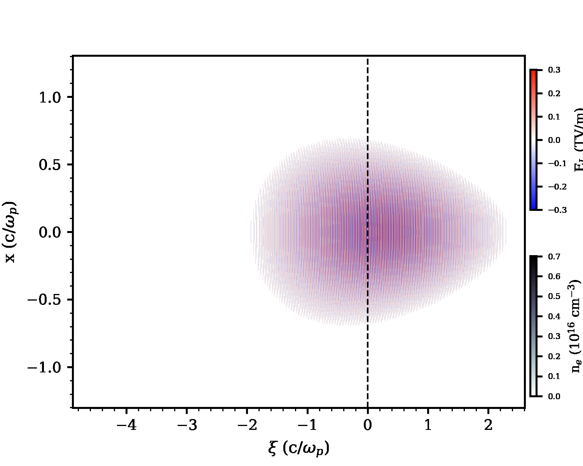
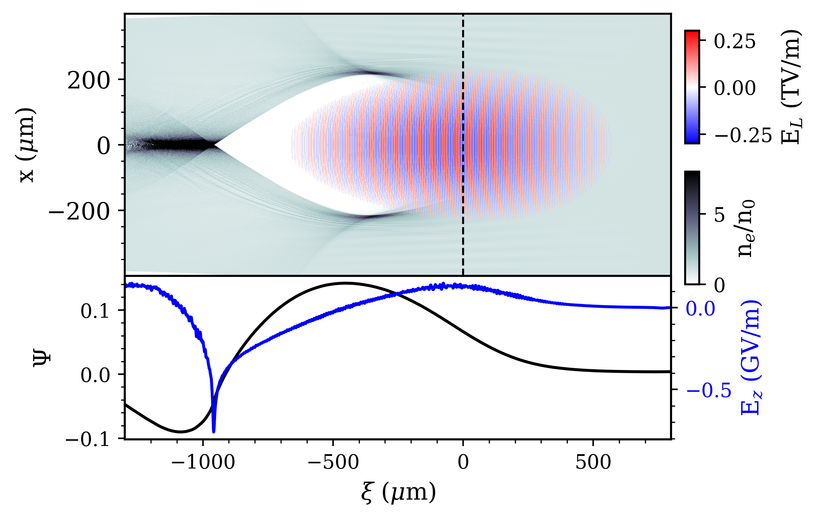
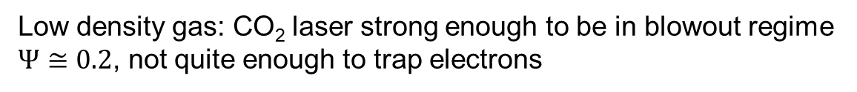

Ponderomotive assistance at ATF
Low density gas: CO₂ laser strong enough to be in blowout regime
$Ψ≅0.2$, not quite enough to trap electrons
$z=4.8$mm
$Power=5 TW$, $a_{0}=3.56$, $w_{0}=40 μm$, $τ_{FWHM}=2$ps, $n_{0}=3×{10}^{14} cm^{−3}$, $z_{0}=0 μm$, $z_{f}=2.2$ mm
Accelerator Facilities Division

Slide 24
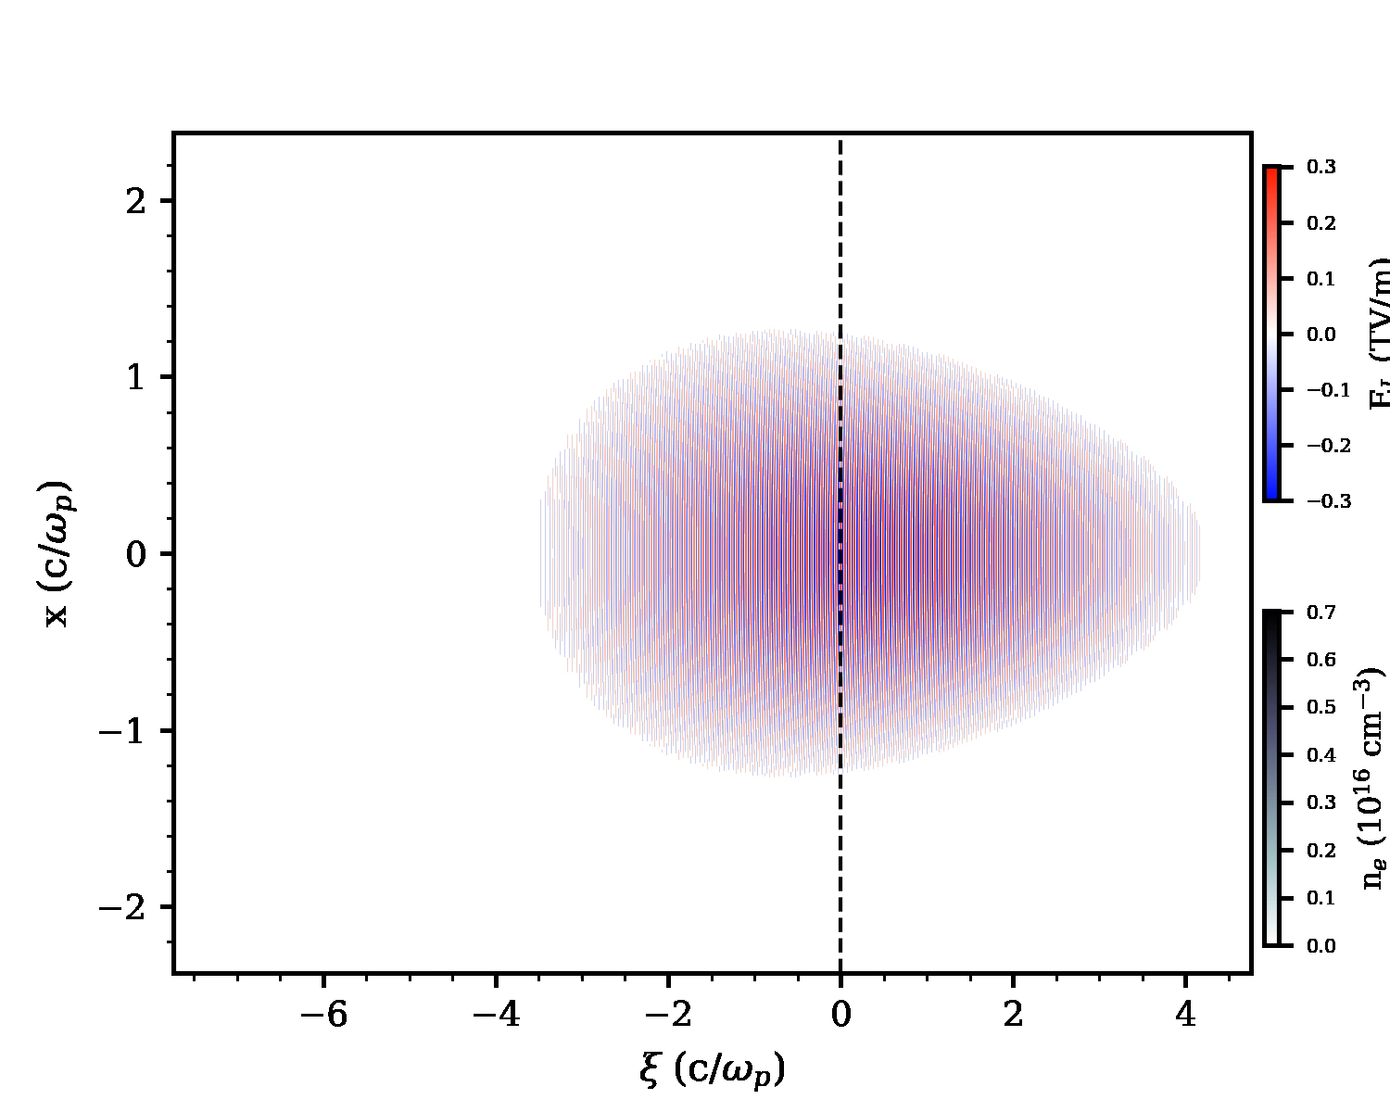
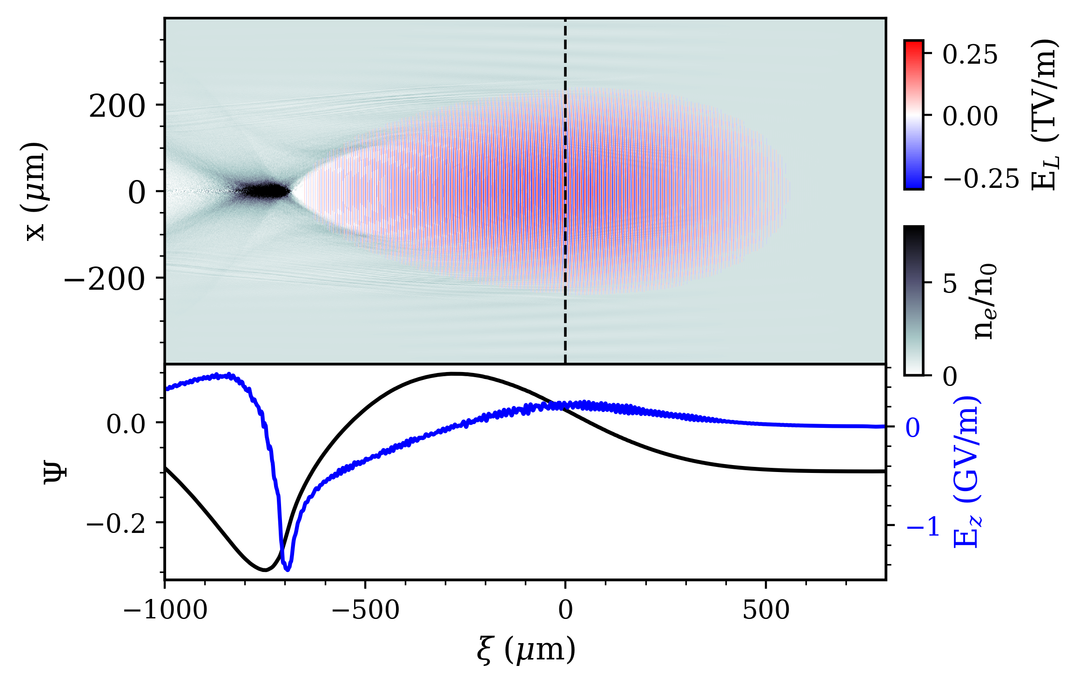
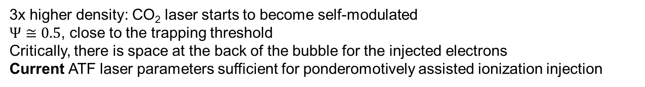
Higher density
3x higher density: CO₂ laser starts to become self-modulated
$Ψ≅0.5$, close to the trapping threshold
Critically, there is space at the back of the bubble for the injected electrons
Current ATF laser parameters sufficient for ponderomotively assisted ionization injection
$Power=5 TW$, $a_{0}=3.56$, $w_{0}=40 μm$, $τ_{FWHM}=2$ps, $n_{0}=1×{10}^{15} cm^{−3}$, $z_{0}=0 μm$, $z_{f}=2.2$ mm
Accelerator Facilities Division

Slide 25

Ti:sapphire parameters
$$E=15 mJ$$
$$FWHM_{t}=60 fs$$
${w=σ}_{x}≅1.5 μm$ (f/1.5 focusing, conservative M² of 2)
$$τ=cσ_{t}≅7.5 μm$$
$$a_{0}≅0.7$$
$\frac{τ}{w}≅5$
$$a_{0 }^{2}\frac{τ}{w}≅2.5$$
Accelerator Facilities Division

