Slide 1
Radiofrequency emission from 9.2-micron short pulsed laser in gases and on solid targets
Erin Thornton¹², Jennifer Elle^{2*}, Andy Goers³, Brian Gibbons³
1 March 2023
1. University of North Texas, 2. Air Force Research Laboratory, 3.Applied Physics Laboratory at Johns Hopkins University, * Principal Investigator
Funding: AFRL Program Funds and the Office of Naval Research
Approved for public release; distribution is unlimited. Public Affairs release approval #AFRL-2023-0067

Slide 2
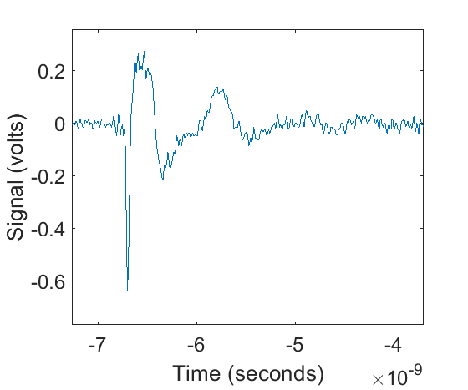
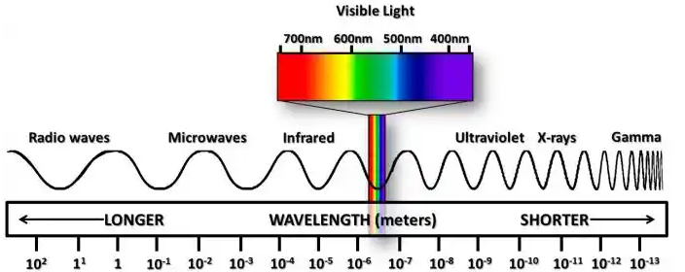
Experimental Goals
Ultrashort pulse lasers(USPLs) have been used to generate atmospheric filaments that are a novel source of ultra-broadband microwave generation(10s GHz)
A model has been developed describing the generation of the RF by atmospheric filaments.
Goal of the Brookhaven CO₂ experiment:
Better characterize Far IR generated plasmas and its ultra-broadband RF emission
Use data to expand the model to include joule class, ps, far-IR driven plasma filaments
Solid targets
BNL CO₂
λ = 9.2 microns
Approved for public release; distribution is unlimited. Public Affairs release approval # AFRL-2023-0067
Notes:
We’ve been interested in better understanding the RF to use it as a non-interfering method of filament diagnostic as well as means of remote sensing via microwave spectroscopy.
*our model was primarily developed using fs/mj near ir pulses

Slide 3
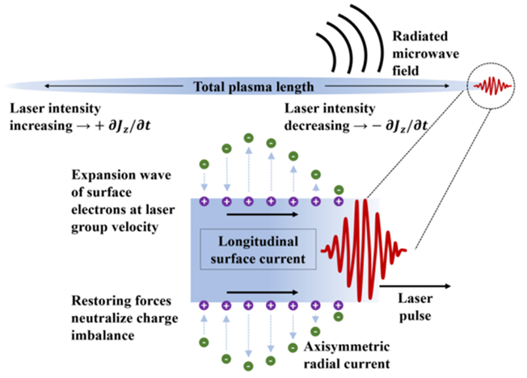
Current understanding of microwave generation
Radial current densities arise from ionized electrons gaining energy from the laser pulse, collide in electron-neutral collisions, and return due to restoring force of ions in plasma channel.
Radial current densities drive a surface wave on plasma channel.
Surface wave builds coherently along the length of the plasma and ejects at the end.
Hypothesis
Longer wavelengths were predicted to drive hotter electrons through greater ponderomotive heating, U_{p} $∝$ λ².
Hotter, denser plasmas were predicted to result in much higher magnitude of RF production.
A. Englesbe et al., “Ultrabroadband microwave radiation from near- and mid-infrared laser-produced plasmas in air,” Phys. Rev. A, vol. 104, no. 1, p. 013107, Jul. 2021, doi: 10.1103/PhysRevA.104.013107.
Approved for public release; distribution is unlimited. Public Affairs release approval # AFRL-2023-0067

Slide 4
Experimental set up
Angular scans are important as RF amplitude and frequency content vary with angle of emission. For air plasmas RF is radially polarized in a forward conical direction.
ICCD camera
Approved for public release; distribution is unlimited. Public Affairs release approval # AFRL-2023-0067
Notes:
For much of this talk we will be comparing again the COMET laser at LLNL. Pulse duration, energy, and focusing set up were comparable to BNL experiment

Slide 5
Air Plasma Characteristics
Wavelength: 9.2 microns
Pulse duration: 2 ps
Energy: 3.08 ± .875 J
Rep Rate: .05Hz (essentially single shot)
F/N = 44 (Focused with 2 4m lenses)
Actual focus: 1.97 m from lens
Unamplified beam waist: ~.5mm FWHM
Visible plasma lifetime = ~2.7ns
Horizontally polarized
Average Length(1/e²) = 17.4 ± 1.4 cm
Direction of laser propagation
Average Width(1/e²) = 2.89 ± .40 mm
Approved for public release; distribution is unlimited. Public Affairs release approval # AFRL-2023-0067

Slide 6
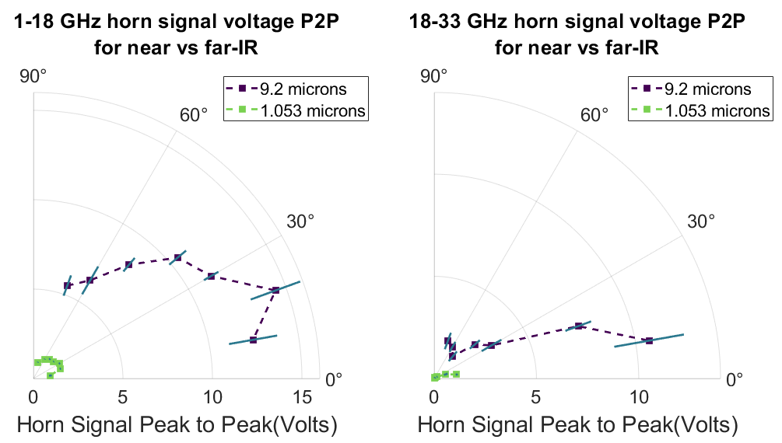
Signal amplitude
Compared to COMET laser (1.053 micron, 4.75 ps, 5J) the microwave signal has increased by nearly an order of magnitude for all angles off laser axis. Since power goes as V² this represents a 100 time increase in power
Approved for public release; distribution is unlimited. Public Affairs release approval # AFRL-2023-0067

Slide 7
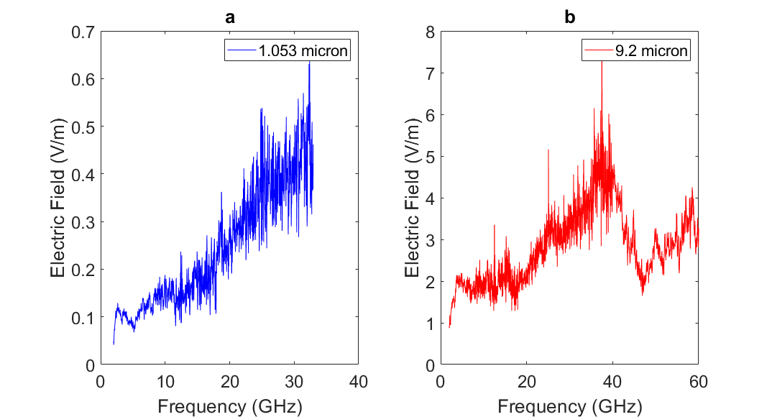
Frequency resolved electric field
The magnitude increase in signal occurs across measured frequencies as well.
Frequency resolved electric field spectrum of 1.053-micron laser at 10 degrees off the laser axis
Frequency resolved electric field spectrum of 9.2-micron laser at 10 degrees off laser axis
Approved for public release; distribution is unlimited. Public Affairs release approval # AFRL-2023-0067

Slide 8
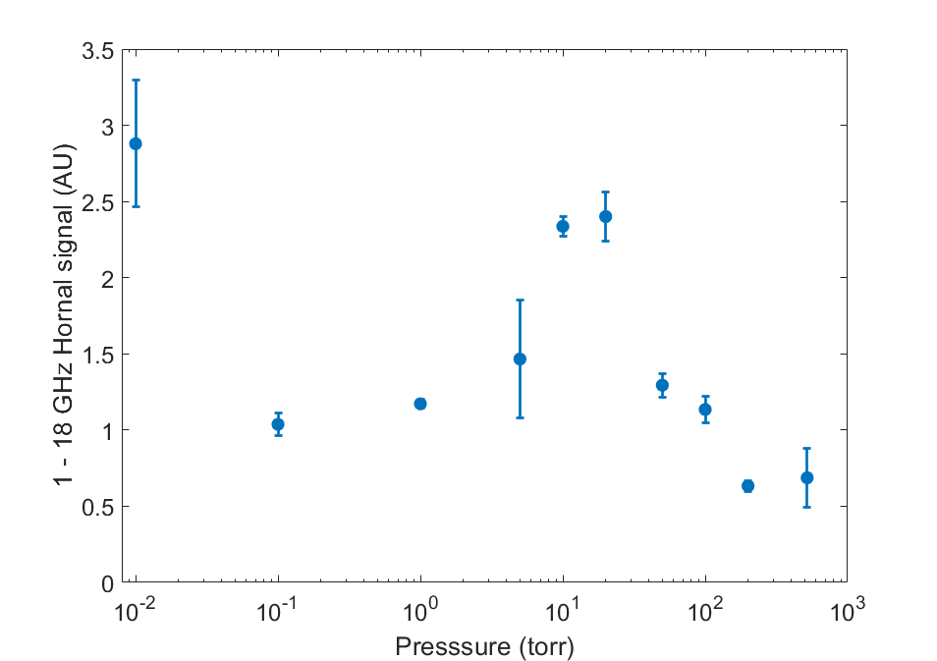
Signal as a function of pressure
[1] A. Englesbe et al., “Gas pressure dependence of microwave pulses generated by laser-produced filament plasmas,” Opt. Lett., vol. 43, no. 20, p. 4953, Oct. 2018, doi: 10.1364/OL.43.004953.
Suggests electron-neutral collisions do not result in signal dampening for Far-IR pulses nearly to the extent it does for Near-IR.
Approved for public release; distribution is unlimited. Public Affairs release approval # AFRL-2023-0067
Notes:
9.2 micron gets 4 fold increase, 800 nm sees 40 fold increase

Slide 9
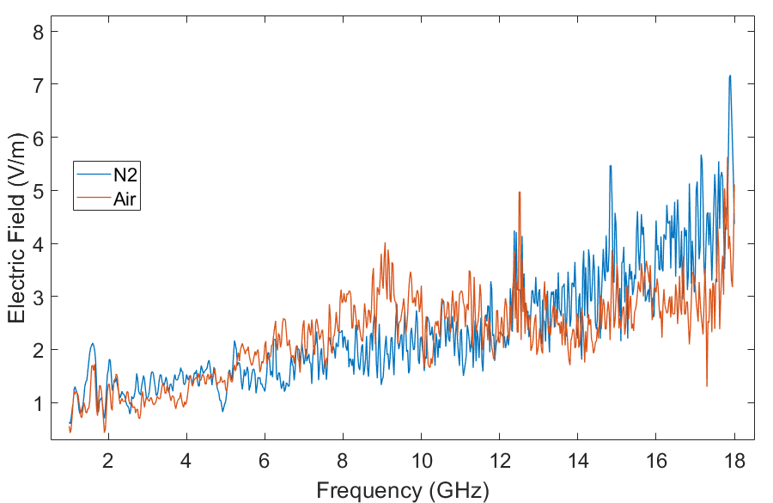
Air vs N₂
Electric field spectrum of plasma produced in air and N₂
Spectrum generated by plasma in dry N₂ gas did not yield a significant difference in spectrum.
Pure N₂ did not remove the brighter breakdown/avalanche spots within the plasma
Air at 200 torr
Length:
Air : 21.1 ± 4 cm
N₂ : 28.3 ± 4.6 cm
N₂ at 200 torr
Approved for public release; distribution is unlimited. Public Affairs release approval # AFRL-2023-0067

Slide 10
Solid Target Plasma
Angle off normal incidence(deg) | Area as measured by light on target (cm²) | Area as measured by damage spot on plexiglass(cm²)
0 | .731 | .239
10 | .743 | .243
25 | .807 | .264
45 | 1.03 | .338
Plasma decay time: 14 ns (as measured by visible fluorescence)
.965 cm
Approved for public release; distribution is unlimited. Public Affairs release approval # AFRL-2023-0067

Slide 11
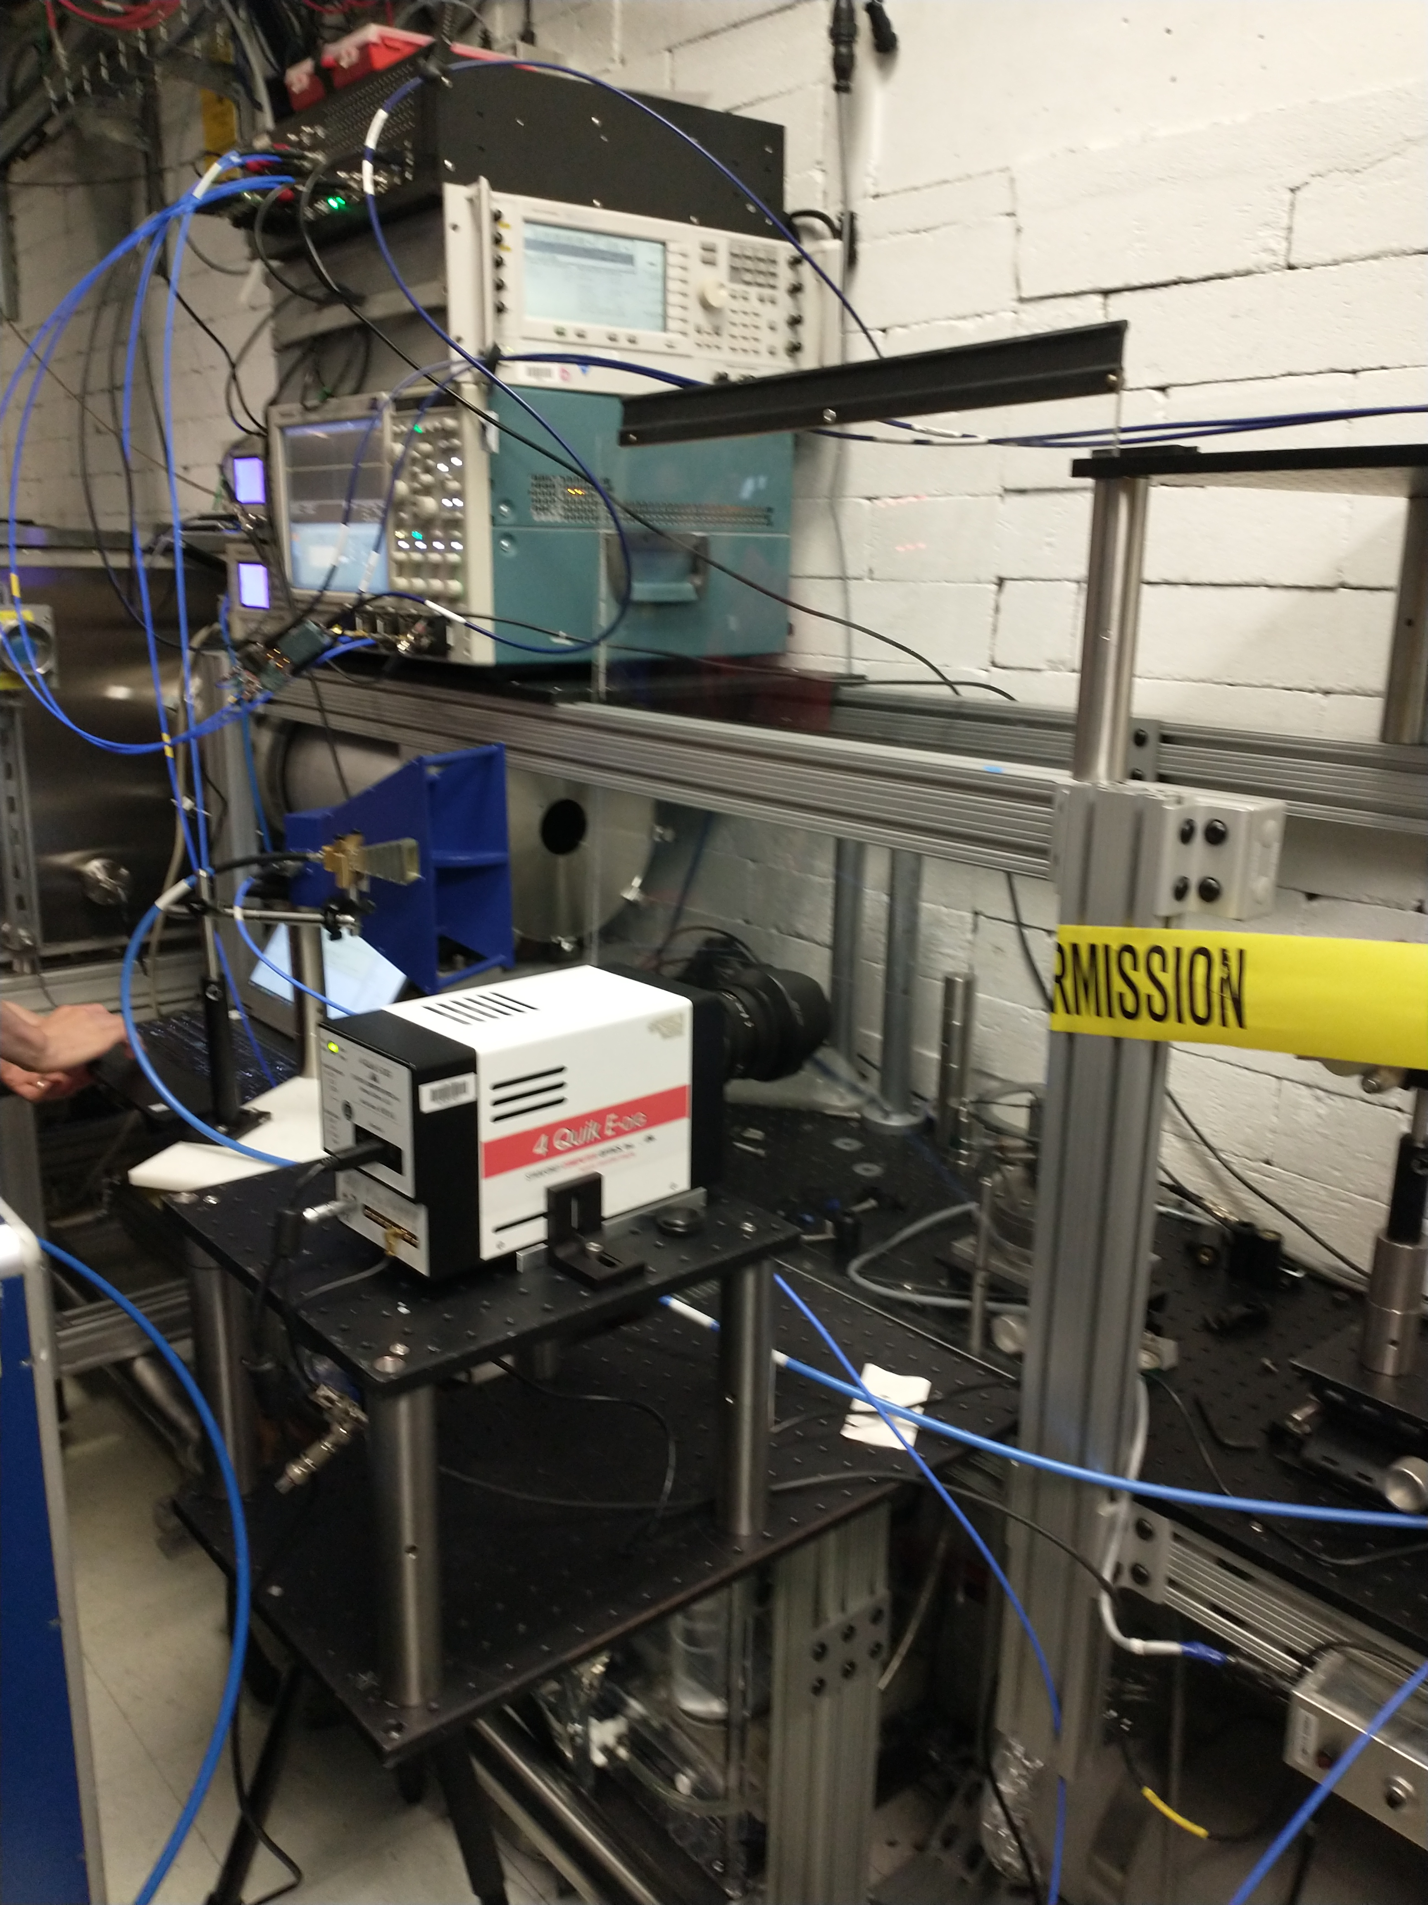
Experimental Setup
$\hat{x}$ axis
$−\hat{z}$ axis
Target
Laser
AOI
$\hat{y}$ axis
Normal
$\hat{z}$ axis
Angle Scan
Fast Oscilloscope
1-18 GHz Horn
18-33 GHz Horn
Approved for public release; distribution is unlimited. Public Affairs release approval # AFRL-2023-0067

Slide 12
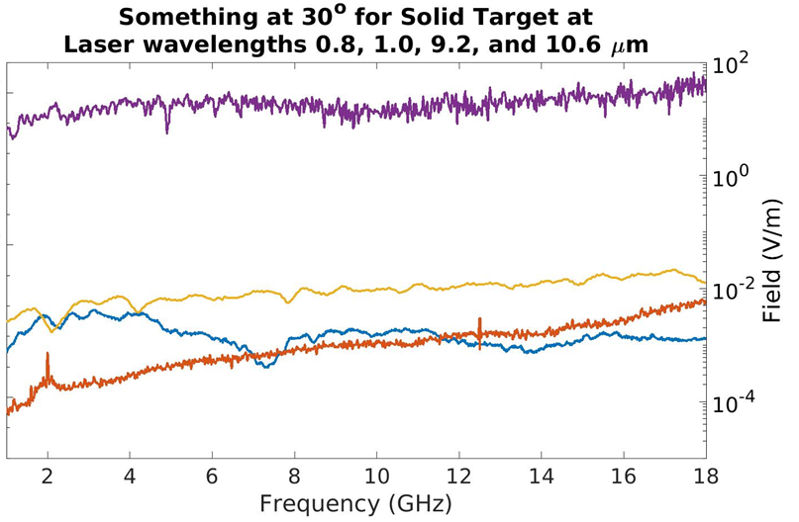
Spectra of all sampled lasers
AAU
λ (microns) | Energy (joules) | Duration (fs)
0.8 | .04 | 50
1.0 | .03 | 1300
9.2 | 3 | 2000
10.6 | .01 | 3000
A.U.
Orders of magnitude improvement across all frequencies achieved with BNL laser
Approved for public release; distribution is unlimited. Public Affairs release approval # AFRL-2023-0067

Slide 13
Above
Position
Polarization
Ch. 3
Ch. 1
$⊥_{pol}$ to laser polarization
Above
$\hat{x}$ axis
Ch. 1
Behind
$∥_{prop}$ to laser propagation
Ch. 3
Behind
Target
$−\hat{z}$ axis
Ch. 1
$∥_{pol}$ to laser polarization
Perpendicular
Laser
Perpendicular
Ch. 3
AOI
$\hat{y}$ axis
Normal
Fast Oscilloscope
$\hat{z}$ axis
Dual Polarization Horn
Approved for public release; distribution is unlimited. Public Affairs release approval # AFRL-2023-0067

Slide 14
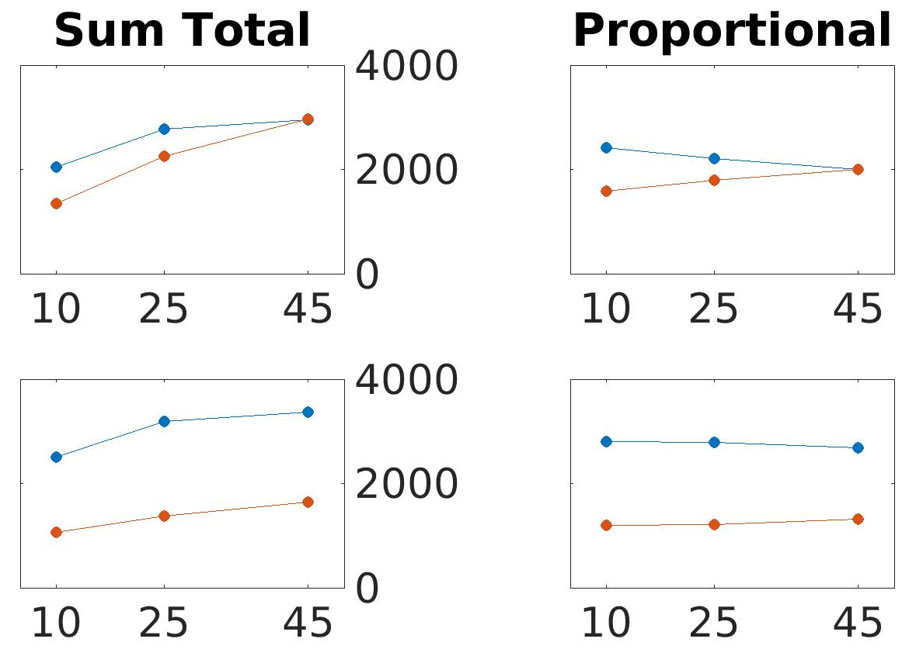
Sum of Frequency Content for Alumina
Results from this experiment suggest a two dipole radiation patterns (one perpendicular to target surface and one parallel to target surface) for alumina.
This has prompted new series of investigation with AFRL’s laser and have been useful insights when building a solid target model.
$$∥_{pol}$$
$$∥_{pol}$$
$$∥_{prop}$$
$$∥_{prop}$$
A.U.
Ratio
$$∥_{pol}$$
$$∥_{pol}$$
$$⊥_{pol}$$
$$⊥_{pol}$$
AOI (°)
AOI (°)
Approved for public release; distribution is unlimited. Public Affairs release approval # AFRL-2023-0067

Slide 15
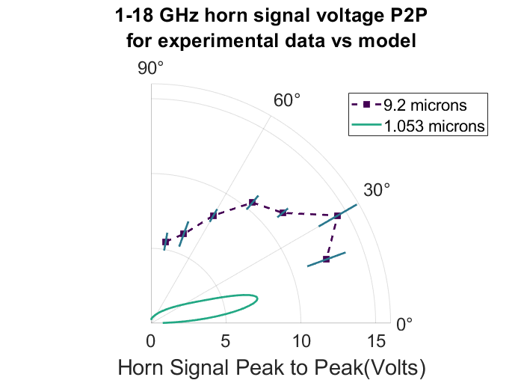
Moving forward
Comparing experimental data to current model shows model underestimating resulting RF by nearly a factor of 2, likely due insufficient calculation of electron temperature. (laser heating was not a significant factor for fs scale pulses)
Work is being done currently developing a better model the heating of the electrons due to the ps scale pulse/far-IR.
Microwave modeling is underway to better capture the radiation patterns generated by the ejection and surface currents for solid target experiments.
Approved for public release; distribution is unlimited. Public Affairs release approval # AFRL-2023-0067

Slide 16
Products delivered
“Ultrashort Pulse Laser Effects Testing at JHU/APL” presentation at DEPS Systems Symposium in La Jolla, CA-November 2022
“Radio Frequency Emission from 9.2-micron Short Pulsed Laser in Gases” Abstract submitted for presentation at DEPS Science and Technology Symposium in San Antonio, TX- April 2023
“9.2 –Micron Short Pulse Laser Generated RF from Solid Target Interactions” Abstract submitted for presentation at DEPS Science and Technology Symposium in San Antonio, TX- April 2023

Slide 17
Supercontinuum Generation
Sneak peak for 2024 experimental campaign at BNL: supercontinuum generation study in collaboration with ARL
Visible light produced by 9.2-micron source!
Approved for public release; distribution is unlimited. Public Affairs release approval # AFRL-2023-0067
Notes:
First taste supercontinuum generation, currently unsure if true supercontinuum or just harmonic generation

