Slide 1



AE122 Status Report & New Proposal 312793:
Remote detection of radioactive materials using long wave infrared laser-driven avalanche breakdown
A. Zingale^{1,2}, S. Waczynski¹, J. Sears³ (co-PI), R. E. Lakis² (co-PI), H. M. Milchberg¹ (PI)
¹University of Maryland
²Los Alamos National Laboratory
³Lawrence Livermore National Laboratory
Funding: NNSA Office of Defense Nuclear Nonproliferation Research and Development
^{Funding Status: Received}
3/1/2023

Slide 2
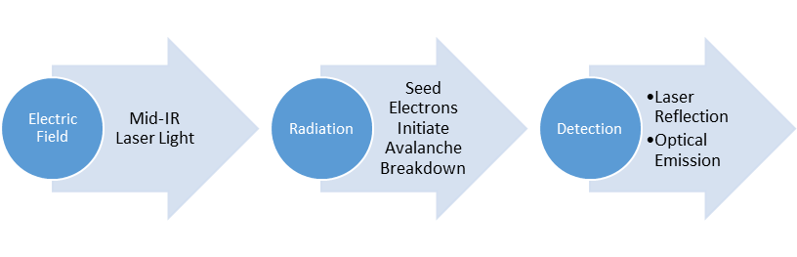

Background: Long range radiation detection scheme
particle range
Laser-driven avalanche breakdown in a radiation field propagated from outside the range of the decay particles
Need Mid-IR to Long wave IR laser to suppress Multiphoton ionization of neutrals in air
Measure reflected laser light characteristics to determine breakdown timing
source

Slide 3
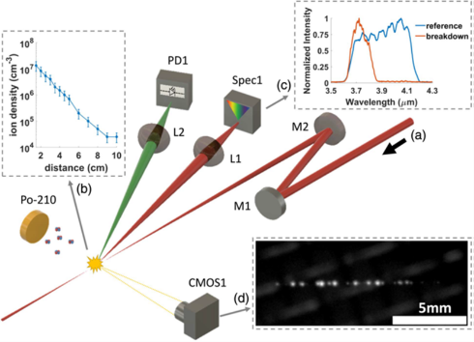
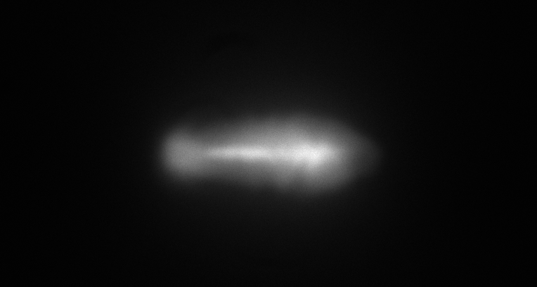
Background: Short Pulse IR Avalanche Breakdowns
Avalanche breakdowns are local
  Centered around seed electrons
  Bounded by diffusion during pulse
Discrete plasma sites
  Discontinuous plasma density
  Each site surrounded by neutrals
Short pulse:
100 ps, λ=4 µm
Long pulse:
100 ns, λ=10.6 µm
5 mm
Short λ
  Enough unwanted MPI seed electrons that their separation is smaller than the diffusion length
Long τ_{p}
  Enough time that the diffusion length is greater than the seed separation.
Discrete model necessary for:
  λ>2µm
  τ_{p}<1ns

Slide 4
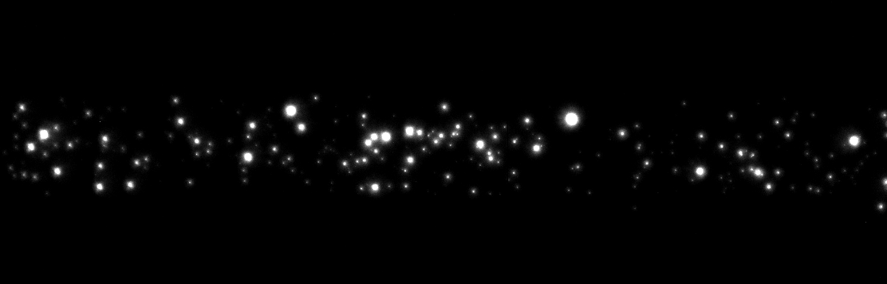

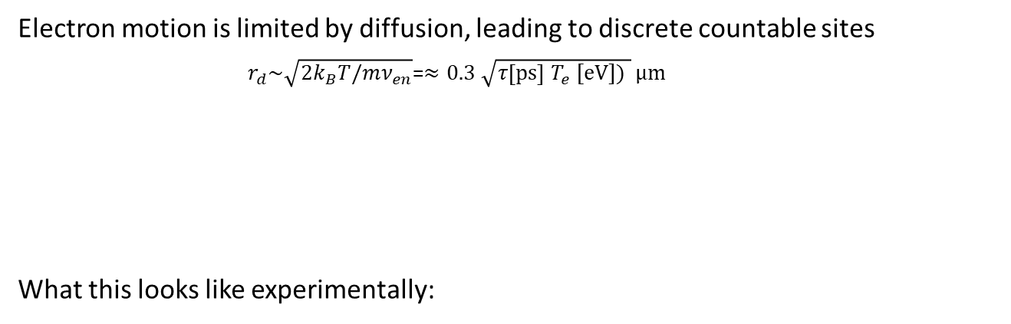

Background: Short Pulse IR Avalanche Breakdowns
Electron motion is limited by diffusion, leading to discrete countable sites
$r_{d}\sim \sqrt{2k_{B}T/mν_{en}}$=$≈0.3 \sqrt{τ\left[ps\right] T_{e} [eV]) } μm$
What this looks like experimentally:
$$r_{d}$$
$$r_{d}<N_{e}^{−\frac{1}{3}}$$
1 mm

Slide 5
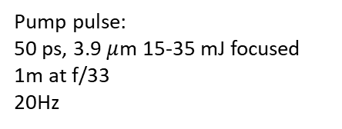
Background: Proof-of-Concept Experiments
Breakdown time advance from backscattered spectra
Shot-by-shot spectra of the backscattered pulse
Pump pulse:
50 ps, 3.9 $μ$m 15-35 mJ focused 1m at f/33
20Hz
-R. M. Schwartz, D. Woodbury, J. Isaacs, P. Sprangle, and H. M. Milchberg, Sci. Adv. 5, eaav6804 (2019)
-D. Woodbury R. M. Schwartz, and H. M. Milchberg, Optica 6 (6) (2019)

Slide 6
Publications
R. M. Schwartz, D. Woodbury, J. Isaacs, P. Sprangle, and H. M. Milchberg, “Remote detection of radioactive material using mid-IR laser-driven electron avalanche,” Sci. Adv. 5, eaav6804 (2019).
D. Woodbury R. M. Schwartz, and H. M. Milchberg, “Measurement of ultralow radiation-induced charge densities using picosecond mid-IR laser-induced breakdown,” Optica 6 (6) (2019).
D. Woodbury R. M. Schwartz, E. Rockafellow, J. K. Wahlstrand, and H. M. Milchberg, “Absolute Measurement of Laser Ionization Yield in Atmospheric Pressure Range Gases over 14 Decades,” Phys. Rev. Lett. 124, 013201 (2019).
R. Lakis, J. Sears, A Favalli, T. Stockman “Concept of Operations for Mid-IR Laser Driven Ion Detection,” LA-UR-21-21282.
D. Woodbury, A. Goffin, R. M. Schwartz, J. Isaacs, and H. M. Milchberg, “Self-Guiding of Long-Wave Infrared Laser Pulses Mediated by Avalanche Ionization,” Phys. Rev. Lett. 125, 133201 (2020).
A. Zingale, S. Waczynski, J. Sears, R. E. Lakis, H. M. Milchberg, “Atmospheric effects on laser driven avalanche-based remote detection of radiation,” Optics Letters (submitted)

Slide 7
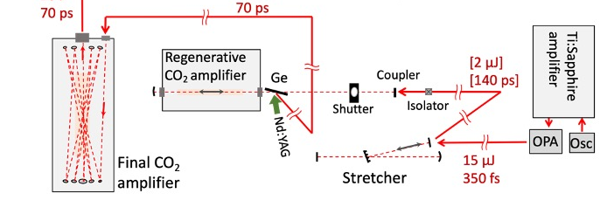
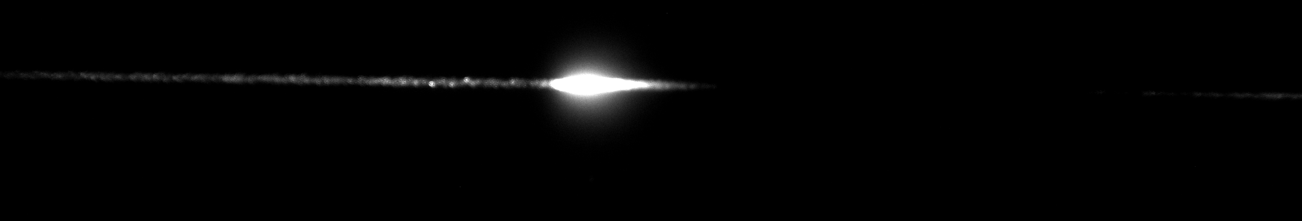
AE122 07/2022: Experimental Setup
  λ = 9.2 µm, 70 ps FWHM duration, 50 mJ - 1 J energy range
  Diagnostics: backscatter photodiodes (MCT) ~ns time resolution, images of plasma fluorescence
  ~f/200 geometry: 2.1 mm FWHM beam waist diameter, ~2 m Rayleigh range, 0.21 TW/cm² breakdown threshold
~10 m
Po-210
~2 m
Fluorescence imager

Slide 8
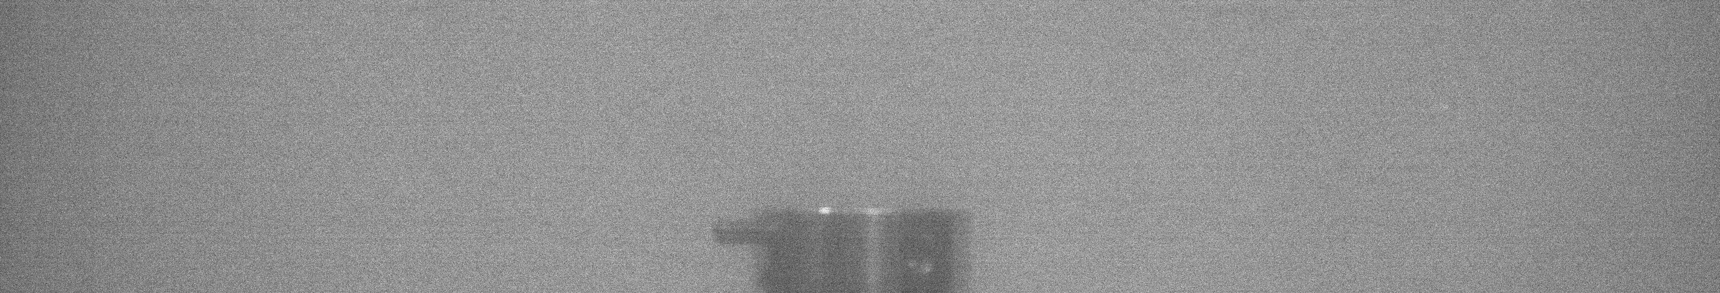
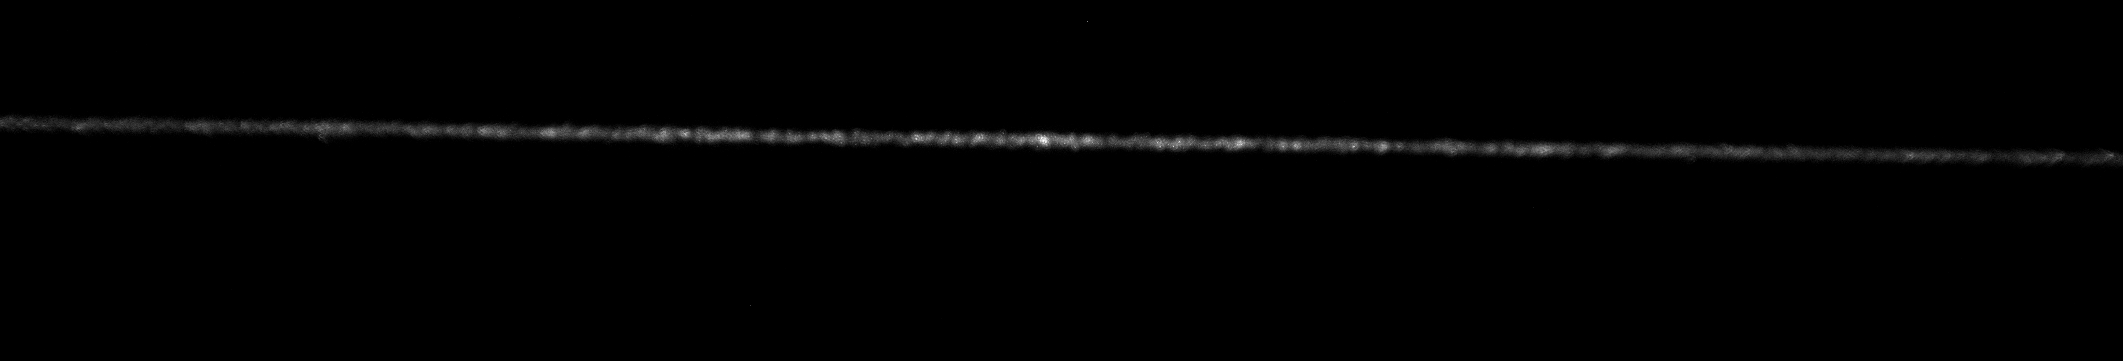
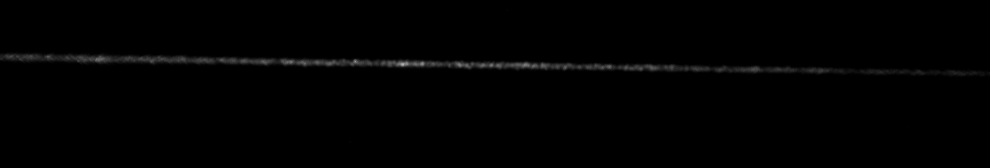

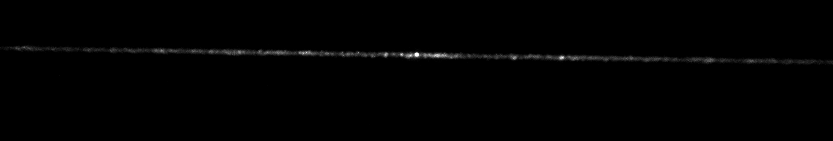
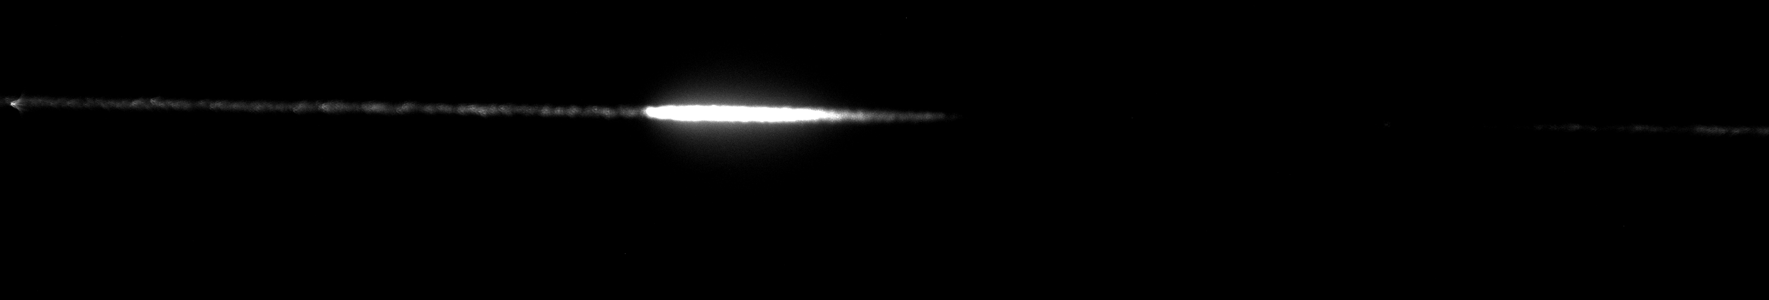
Laser path
AE122 07/2022:
Fluorescence images
2 cm
Po-210
2 cm
Source covered with foil
Source uncovered
2 cm

Slide 9
AE122 07/2022:
Fluorescence images
Image taken at ~40 inches from focus with 1.5” collection lens
Scaled back to 10 m this would require a ~12” collection optic
Readily reproduce this image at 10 m standoff distance

Slide 10
AE122 07/2022: Amplified back-reflection diagnostic
Laser path shown below
Gain lifetime of CO₂ is ~1 µs. Back reflected light is amplified by the laser and detected by in-situ regenerative amplifier energy monitor (MCT)
Po-210
Final Amp
Back reflection MCT (~48 m upstream)
Regenerative amp
Plasma mirror

Slide 11
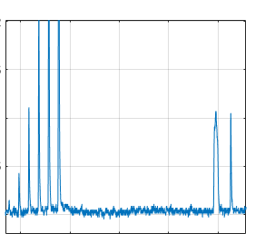
AE122 07/2022: Amplified back-reflection diagnostic
Gain lifetime of CO₂ is ~1 µs. Back reflected light is amplified by the laser and detected by in-situ regenerative amplifier energy monitor (MCT)
Temporally resolved (~1 ns), not spatially resolved
Sample trace:
Regen
build-up
Beam dump
back reflection
Plasma back
reflection
316 ns
corresponds to ~48 m from plasma to MCT

Slide 12
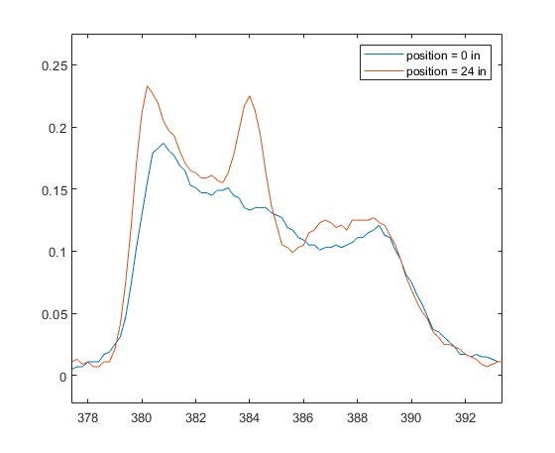
AE122 07/2022: Source longitudinal position scan
Move source along laser propagation direction, keeping transverse distance constant
Temporal profile of back reflection indicated position of source
  i.e. source moved 2 ft, spike in back reflection shifted 4 ns.
Increased signal due to Po-210
24 in
MCT voltage
Laser propagation direction
Time (ns)

Slide 13
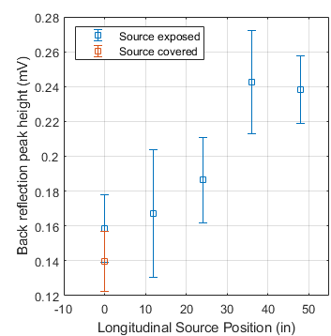
Laser propagation direction
AE122 07/2022: Results
Mean of peak voltage on MCT
Increase as the source gets closer to the peak intensity
Appears to distinguish presence of Po-210 at 50 m path
Near background level when source is placed at 0 in, near the edge of the focal volume
Downstream of best focus was inaccessible in the experimental configuration
0 in
50 in

Slide 14
AE122 07/2022: Conclusions
Successfully distinguished presence of Po-210 with time resolved MCT detectors at >10 m using direct back reflection.
Insights:
Direct back-reflection into the laser amplifier can serve as a self-aligned, high sensitivity diagnostic
  Po-210 only irradiated ~1% of focal volume, γ-source should significantly improve signal level by irradiating larger fraction of focal volume
  Possibly install a spectrometer instead of a single MCT detector
  Need to understand integrated back reflection signal as a function of seed density from a 2 m long focal volume, which will include multiple scattering
Long focusing geometry (f/200) could readily be extended to 100 m scale

Slide 15
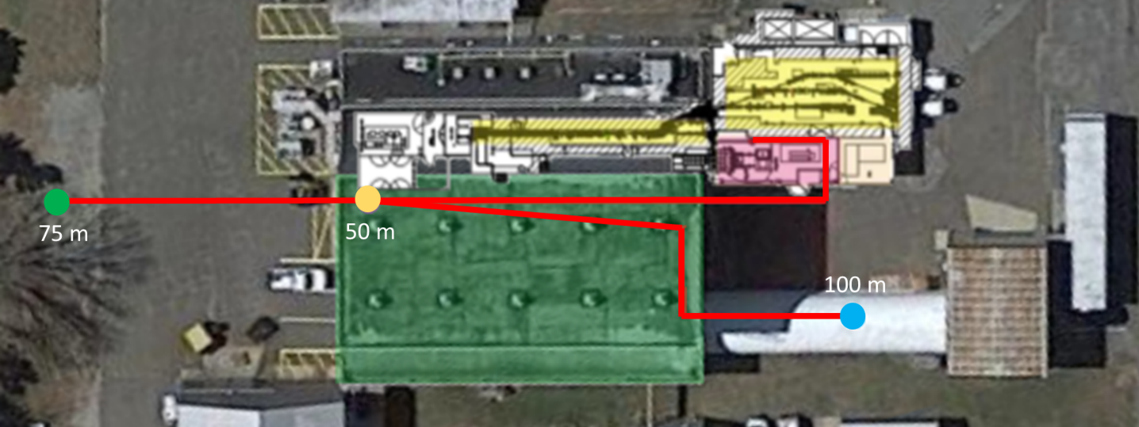
Proposal 312793: Propagation range
Extend propagation length to 50 - 100 meters
Use 0.5 m diameter focusing optic for f/200 geometry (same as AE122 experiment)
Arial photo of
ATF facility
CO₂ laser
room
High-bay
Possible Laser paths

Slide 16
Proposal 312793: Radioactive source
Irradiate ~2.5 m long focal volume (70 mCi Cs-137 source available at BNL)
~3 cm with elevated seed density
AE122 setup
Po-210
5.3 MeV α-particles, 3 mCi
Improved irradiated volume for Proposal 312793
*much larger range of γ-rays allows the source to generate seed ions over the full focal volume
Cs-137
662 keV γ-rays, 70 mCi

Slide 17
Proposal 312793: Diagnostics
Amplified back-reflection MCT photodiode
  Propagation and back-reflection total “time-of-flight” ~668 ns for 100 m propagation
  May require focusing onto 1 mm² MCT photodiode to increase signal, If signal strength falls as r ⁻², then collection area will need to increase by 100x going from 10 m to 100 m propagation. >100 mm² collection lens will be required to maintain signal level
Non-normal back-reflection MCT that will be placed at various stand-off distances
Optical telescope to measure the plasma fluorescence at various stand-off distances
  Brightness of plasma fluorescence goes with the number of individual breakdown sites. Cs-137 will produce 10³ – 10⁴ times the number of seeds over the entire focal volume

Slide 18
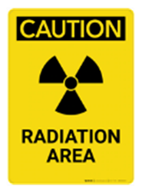
-4 m spherical mirror
Proposal 312793: Experimental Schematic
8 m spherical mirror
Beam focused using telescope
  0.15 m diameter expansion optic (-4 m focal length)
  0.5 m diameter focusing optic (+8 m focal length)
  Spacing tuned to generate focus at 50 – 100 m
Not shown: Amplified back-reflection MCT photodiode is in the laser chain and used to monitor pass-by-pass regenerative amplifier output
CO₂ amplifier
~4 m
High magnification fluorescence imager
Breakdown plasma
~10 cm
Cs-137 70 mCi
Optical telescope
off-normal MCT photodiode and collection optic

Slide 19
Proposal 312793: Experimental Schedule
Experiment | Goals/milestones
Demonstrate detection of radioactive material at 50 - 100 m range (3 weeks, 25% dedicated to setup) | Optics setup for 50 - 100 m range experiments Calibrate and optimize the backscatter spectrum diagnostic Calibrate fluorescence telescope and noise level in outdoor and indoor conditions. Measure seed density as a function of source distance and validate models for γ-ray sources. Demonstrate detection of radioactive material at 100 m

Slide 20
Electron Beam Requirements
Parameter | Units | Typical Values | Comments | Requested Values
Beam Energy | MeV | 50-65 | Full range is ~15-75 MeV with highest beam quality at nominal values | N/A
Bunch Charge | nC | 0.1-2.0 | Bunch length & emittance vary with charge | N/A
Compression | fs | Down to 100 fs (up to 1 kA peak current) | A magnetic bunch compressor available to compress bunch down to ~100 fs. Beam quality is variable depending on charge and amount of compression required. NOTE: Further compression options are being developed to provide bunch lengths down to the ~10 fs level | N/A
Transverse size at IP (σ) | μm | 30 – 100 (dependent on IP position) | It is possible to achieve transverse sizes below 10 um with special permanent magnet optics. | N/A
Normalized Emittance | μm | 1 (at 0.3 nC) | Variable with bunch charge | N/A
Rep. Rate (Hz) | Hz | 1.5 | 3 Hz also available if needed | N/A
Trains mode | --- | Single bunch | Multi-bunch mode available. Trains of 24 or 48 ns spaced bunches. | N/A

Slide 21
CO₂ Laser Requirements
Configuration | Parameter | Units | Typical Values | Comments | Requested Values
CO₂ Regenerative Amplifier Beam | Wavelength | μm | 9.2
 | Peak Power | GW | ~3
 | Pulse Mode | --- | Single
 | Pulse Length | ps | 2
 | Pulse Energy | mJ | 6
 | M² | --- | ~1.5
 | Repetition Rate | Hz | 1.5
 | Polarization | --- | Linear
CO₂ CPA Beam | Wavelength | μm | 9.2 |  | 9.2
Note that delivery of full power pulses to the Experimental Hall is presently limited to Beamline #1 only. | Peak Power | TW | 5 |  | ~10 GW
 | Pulse Mode | --- | Single |  | Single
 | Pulse Length | ps | 2 | Uncompressed pulse duration desired | ~70 ps
 | Pulse Energy | J | ~5 |  | <5 J
 | M² | --- | ~2 |  | ~2
 | Repetition Rate | Hz | 0.05 |  | 0.05 Hz
 | Polarization |  | Linear | Adjustable linear polarization along with circular polarization can be provided upon request | Linear

Slide 22
Other Experimental Laser Requirements
Ti:Sapphire Laser System | Units | Stage I Values | Stage II Values | Comments | Requested Values
Central Wavelength | nm | 800 | 800 |  | N/A
FWHM Bandwidth | nm | 20 | 13 |  | N/A
Compressed FWHM Pulse Width | fs | <50 | <75 |  | N/A
Chirped FWHM Pulse Width | ps | ≥50 | ≥50 |  | N/A
Chirped Energy | mJ | 10 | 200 |  | N/A
Compressed Energy | mJ | 7 | ~20 |  | N/A
Energy to Experiments | mJ | >4.9 | >80 |  | N/A
Power to Experiments | GW | >98 | >1067
Nd:YAG Laser System | Units | Typical Values | Comments | Requested Values
Wavelength | nm | 1064 |  | N/A
Energy | mJ | 5 |  | N/A
Pulse Width | ps | 14 |  | N/A
Wavelength | nm | 532 |  | N/A
Energy | mJ | 0.5 |  | N/A
Pulse Width | ps | 10 |  | N/A

Slide 23
Special Equipment Requirements and Hazards
Electron Beam
  N/A
CO₂ Laser
  Access to uncompressed 70 ps pulse with <5J energy
  Extended propagation range (outside laser/accelerator rooms), along with necessary beam enclosure according to BNL safety regulations.
Ti:Sapphire and Nd:YAG Lasers
  N/A
Hazards & Special Installation Requirements
  50 ‐ 100 meter propagation range, indoor or outdoor interaction site
  Equipment: Routing and focusing optics
  Hazards: BNL owned 70 mCi Cs‐137 source

Slide 24
Experimental Time Request
CY2023 Time Request
Capability | Setup Hours | Running Hours
Electron Beam Only
Laser* Only (in Laser Areas) | 40 | 120
Laser* + Electron Beam
Total Time Request for the 3-year Experiment (including CY2023-25)
Capability | Setup Hours | Running Hours
Electron Beam Only
Laser* Only (in Laser Areas) | 120 | 360
Laser* + Electron Beam
* Laser = Near-IR or LWIR (CO₂) Laser

