Slide 1
ATF Proposal Status Report AE124: Simulation-aided Instrument Optimization using Artificial Intelligence and Machine Learning Methods
Co-PIs: Maksim Rakitin (DSSI, NSLS-II), Yonghua Du (TES, NSLS-II), Mikhail Fedurin (ATF)
Team Members: Thomas Morris, Abigail Giles, Brianna Romasky, Irina Petrushina
2023-03-01

Slide 2
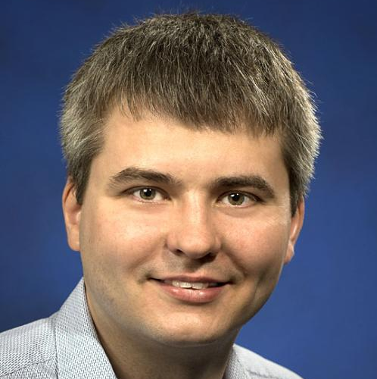
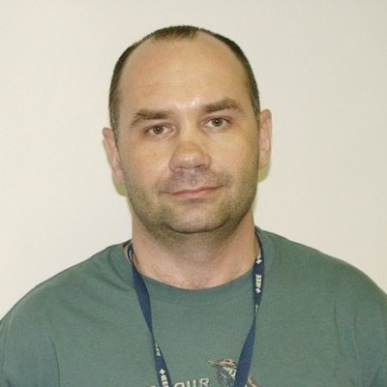
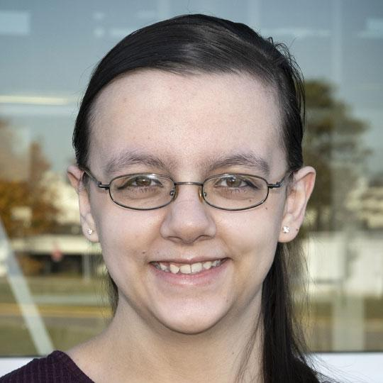
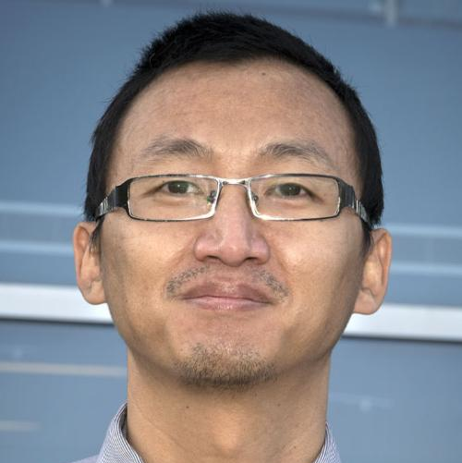
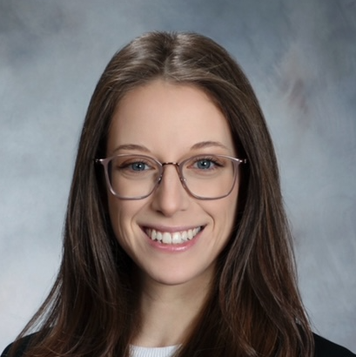
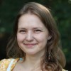
Team
Maksim Rakitin, NSLS-II
Mikhail Fedurin, ATF
Abigail Giles, NSLS-II
Thomas Morris, NSLS-II
Yonghua Du, NSLS-II
Brianna Romasky, Rutgers/ATF
Irina Petrushina, SBU/ATF

Slide 3
Bluesky Data Collection Ecosystem
https://blueskyproject.io

Slide 4
Recent achievements
Integration of the ATF hardware with the Bluesky data acquisition framework/Ophyd abstractions:
Basler cameras integration via Pylon API (ATF production & emulation):
https://github.com/BNL-ATF/ophyd-basler
ATFDB Ophyd support (ATF production & emulation):
https://github.com/BNL-ATF/atfdb
IPython startup files:
https://github.com/BNL-ATF/profile_atf
MAD-X simulations via Sirepo-Bluesky:
https://nsls-ii.github.io/sirepo-bluesky/notebooks/madx.html
Beamline Optimization

Slide 5
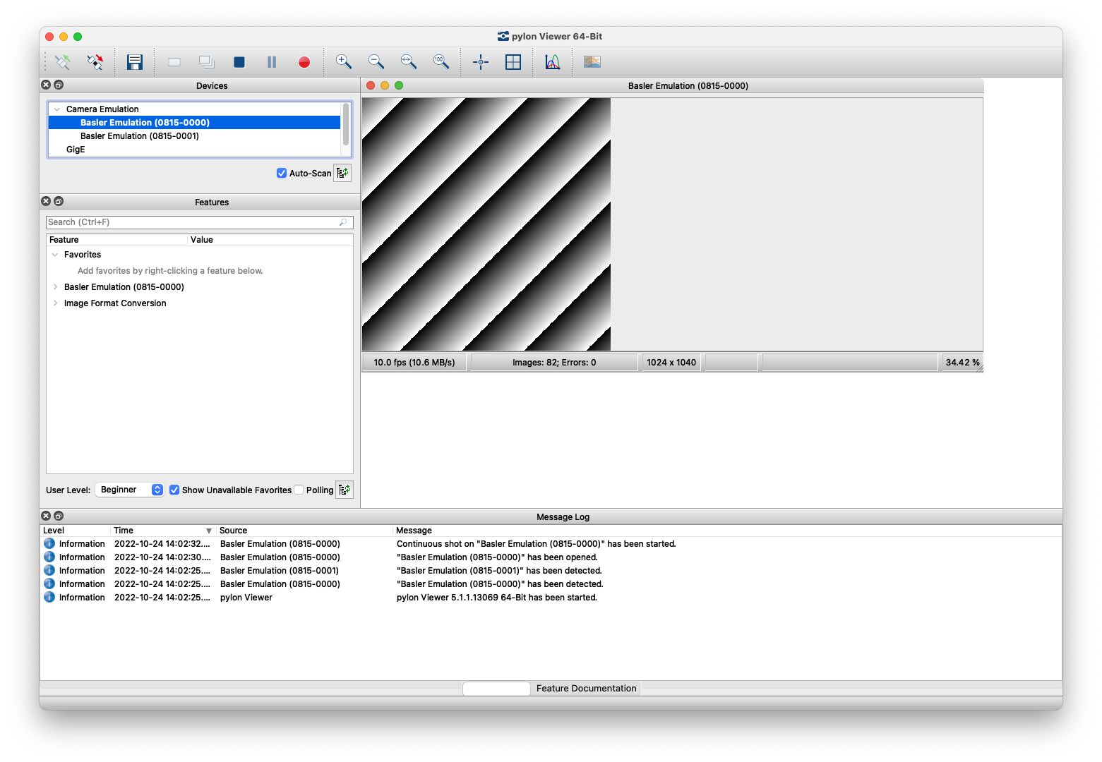
Basler cameras integration via Pylon API (emulation)
https://www.baslerweb.com/en/products/basler-pylon-camera-software-suite/
The Pylon software is available for all major platforms:
Linux
macOS
Windows
Registration required, but it's free; we use v5.x.

Slide 6
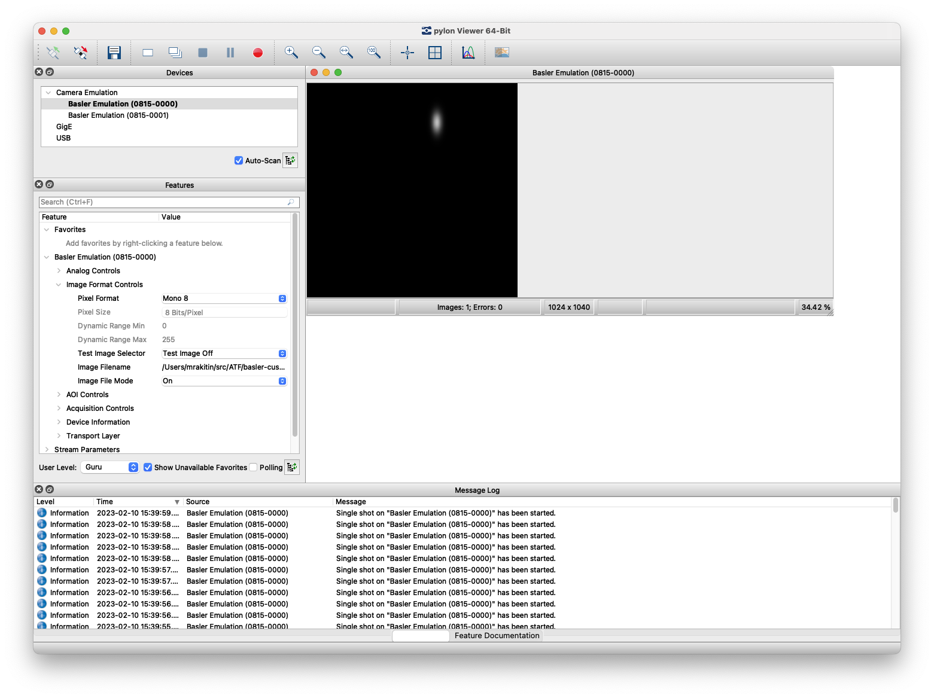
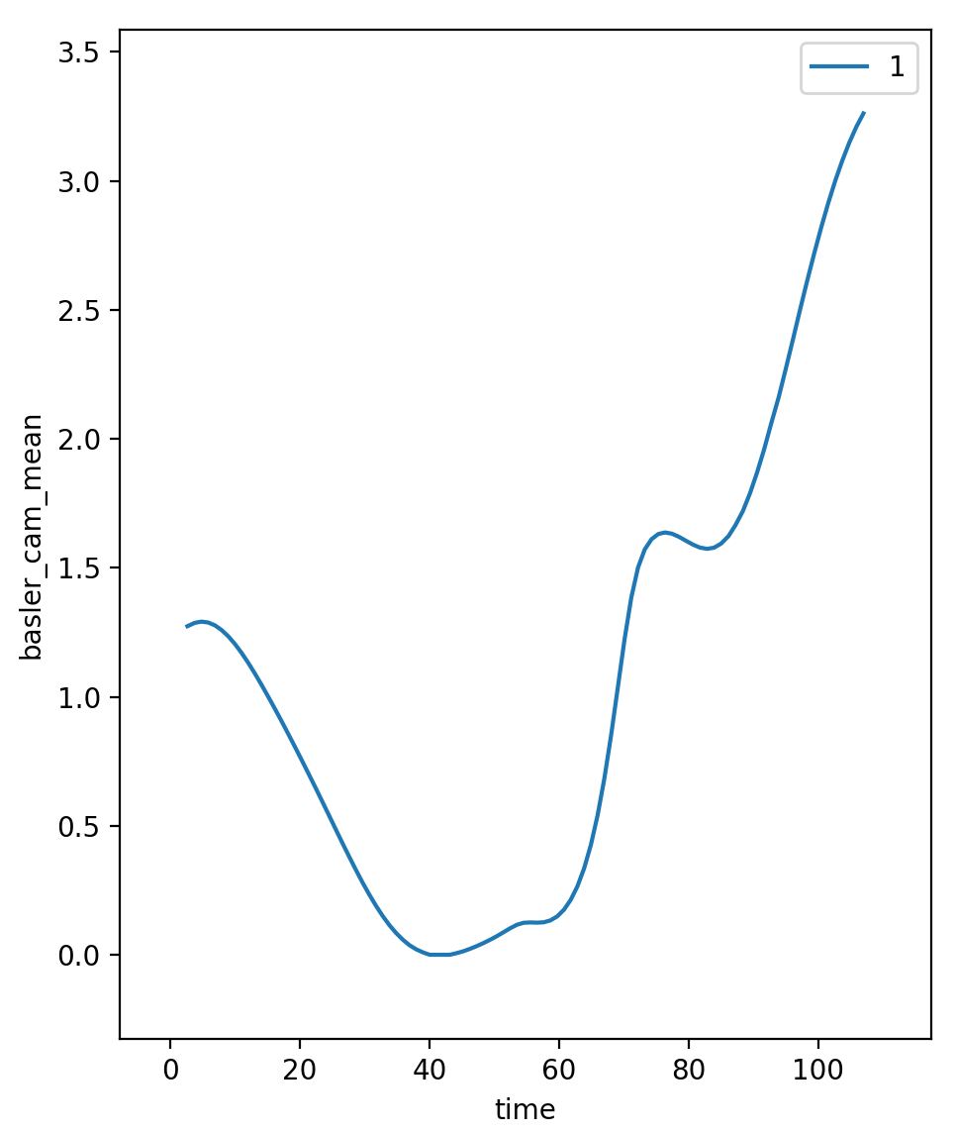
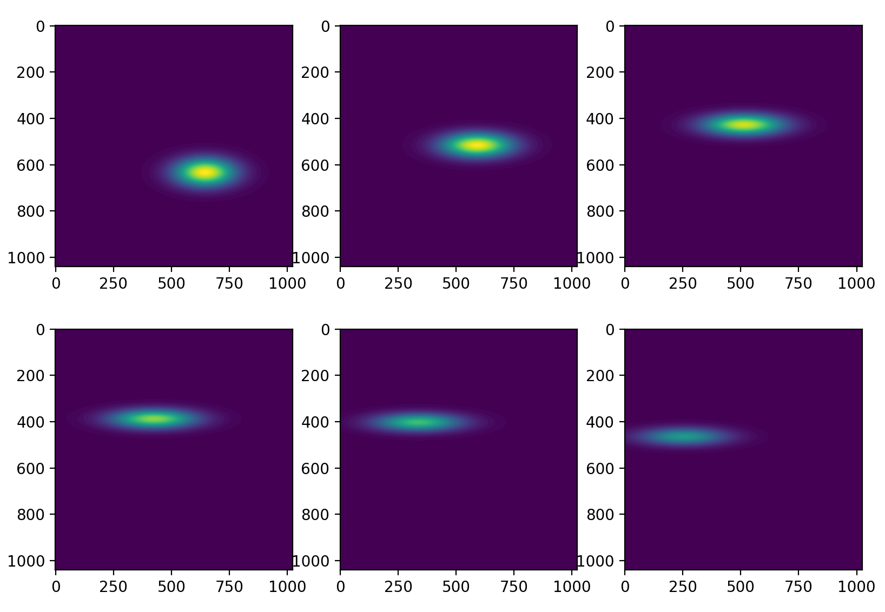
Basler cameras integration via Pylon API (realistic emulation)
https://github.com/BNL-ATF/ophyd-basler *
Selected images (data[::4][:6]) extracted using a Databroker API (the second row’s sequence is from left to right).
Live plot produced during a Bluesky “count” plan displaying the averaged signal from the emulated Basler camera with predefined images over the course of 100 individual counts.
* Development of the ophyd-basler
interface was led by T. Morris.

Slide 7
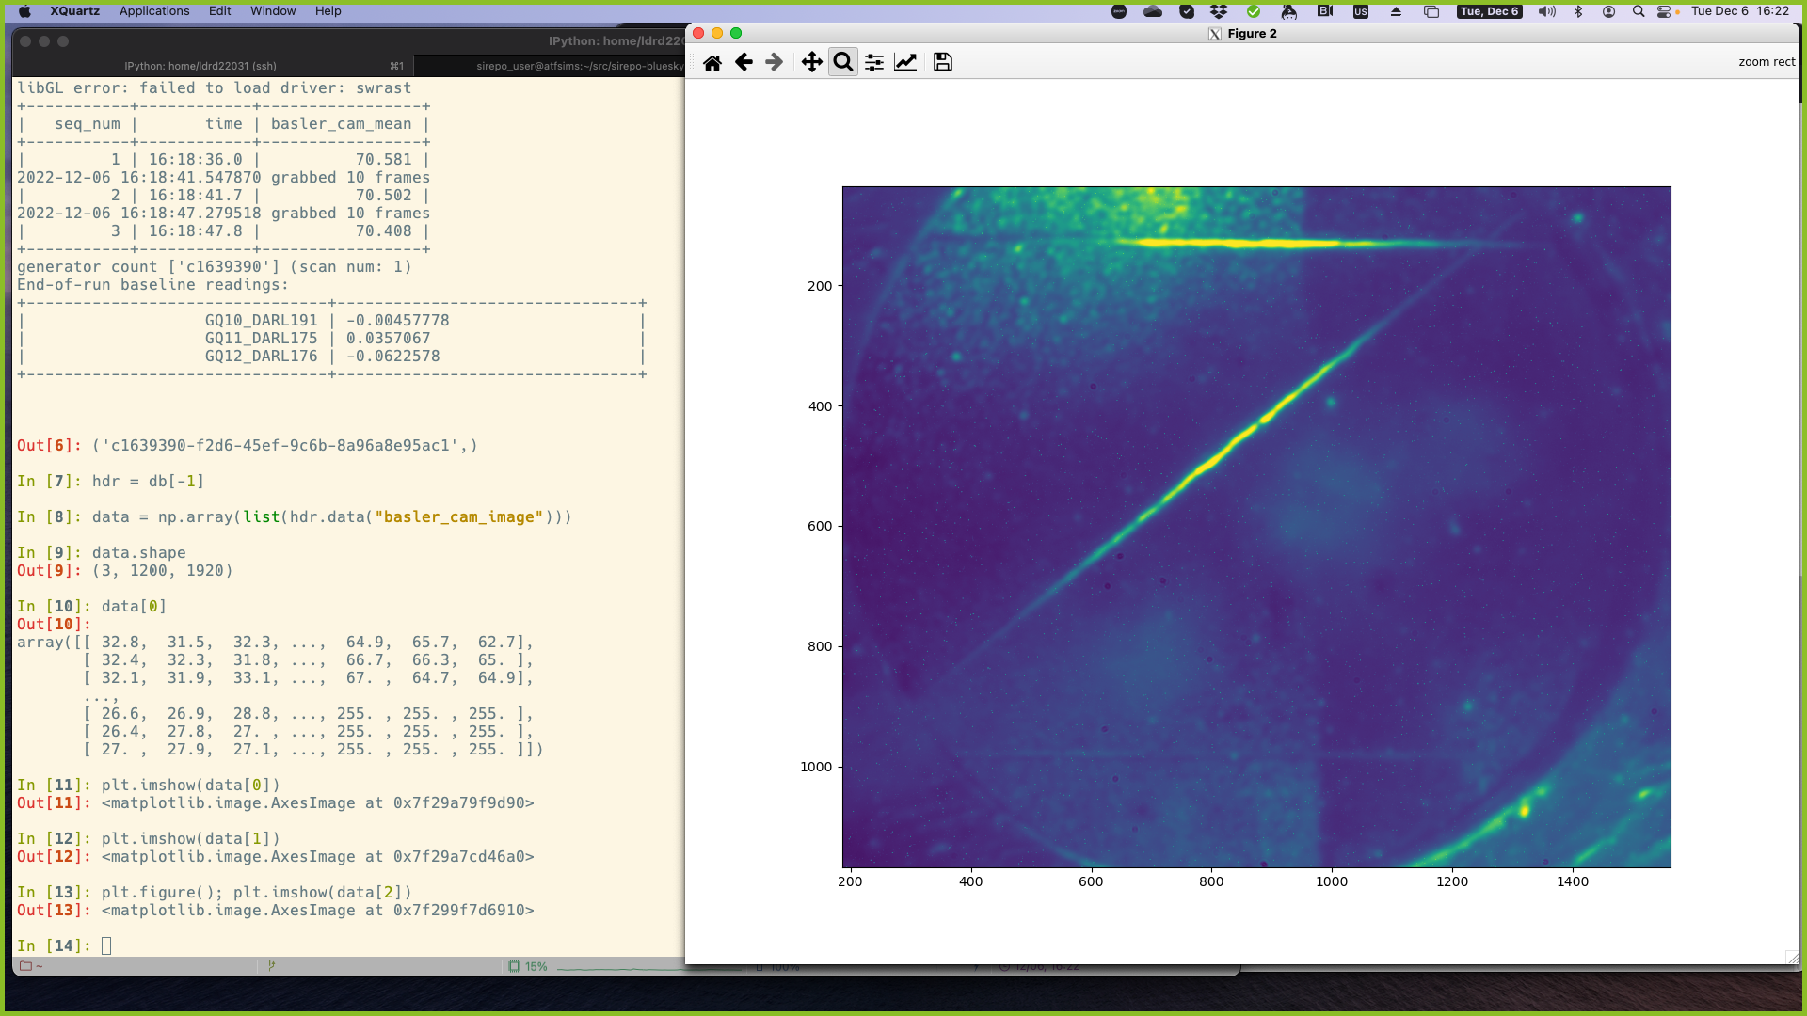
Basler cameras integration via Pylon API (ATF production)
https://github.com/BNL-ATF/ophyd-basler

Slide 8
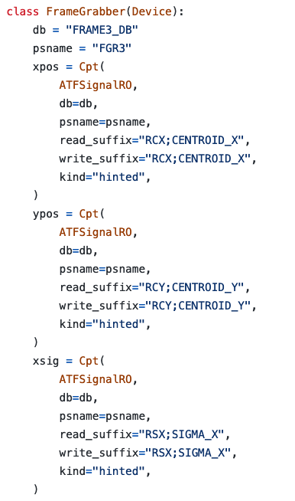
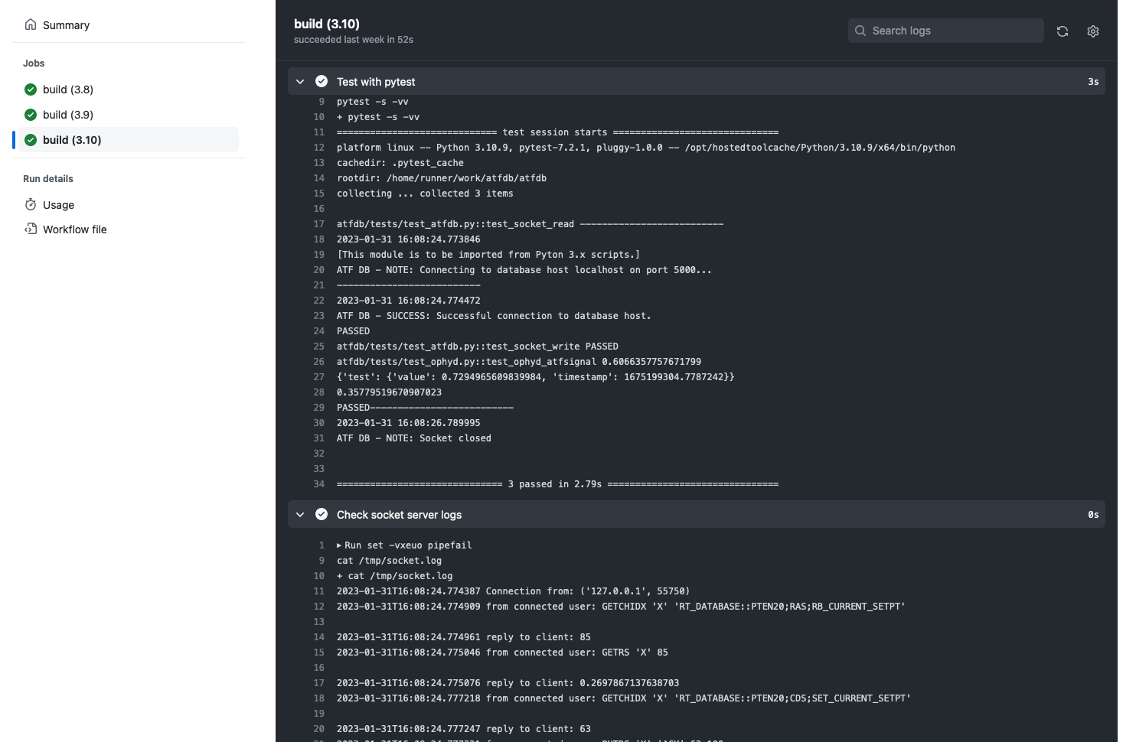
ATFDB Ophyd support (ATF production & emulation)
https://www.vista-control.com/about_vista.html
https://github.com/BNL-ATF/atfdb
Support of ATFDB components

Slide 9
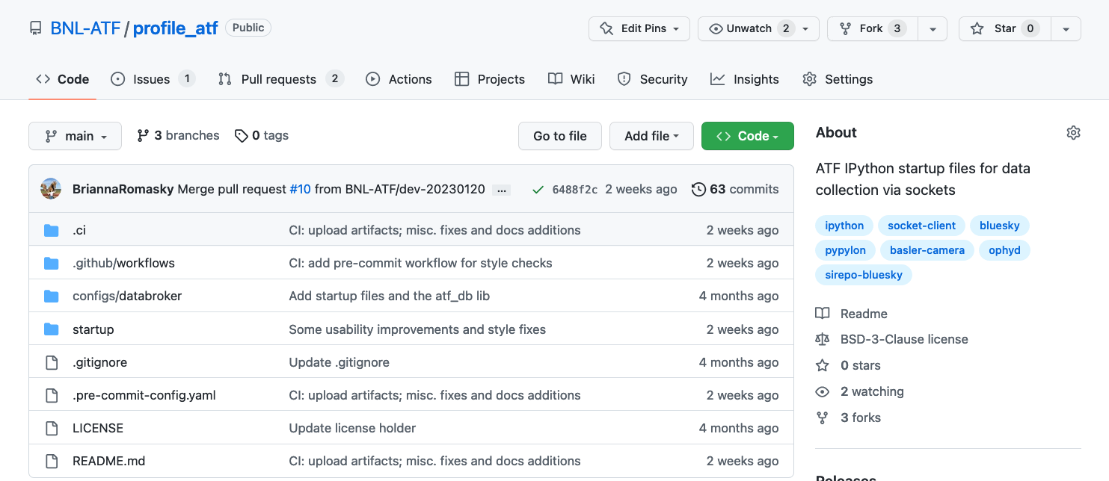
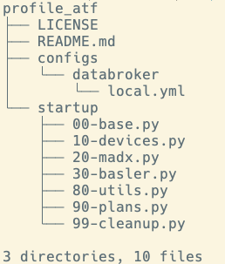
IPython startup files
https://github.com/BNL-ATF/profile_atf

Slide 10
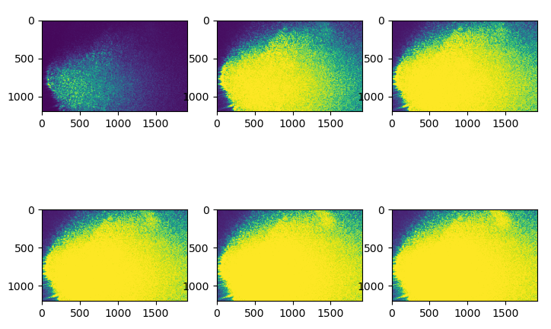
Scans with Bluesky (controlled over Pylon API & ATFDB)
https://github.com/BNL-ATF/profile_atf
Results of the Bluesky scan performed at ATF where the HeNe laser intensity was captured by a Basler camera as the laser intensity increased. Exposure time: 0.667 s

Slide 11
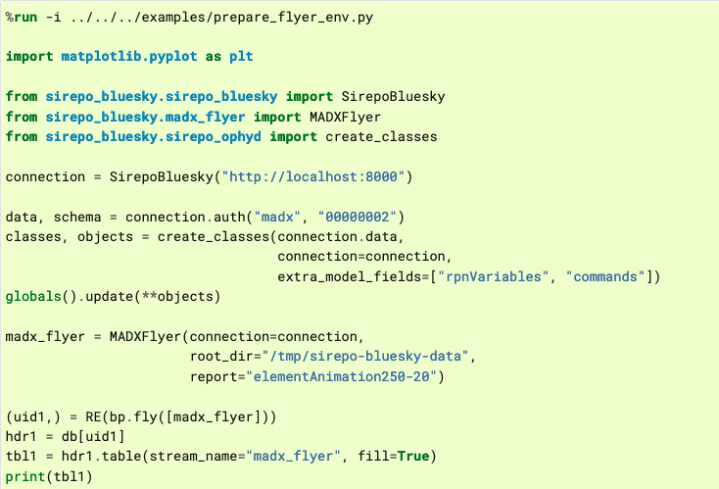
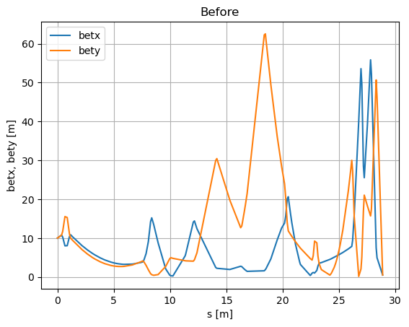
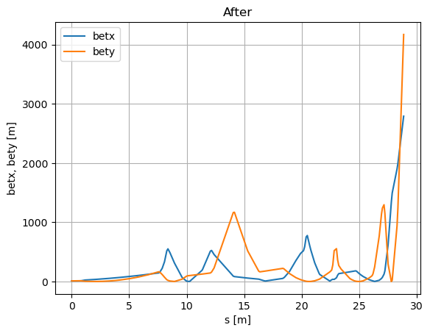
MAD-X simulations via Sirepo-Bluesky
https://nsls-ii.github.io/sirepo-bluesky/notebooks/madx.html

Slide 12
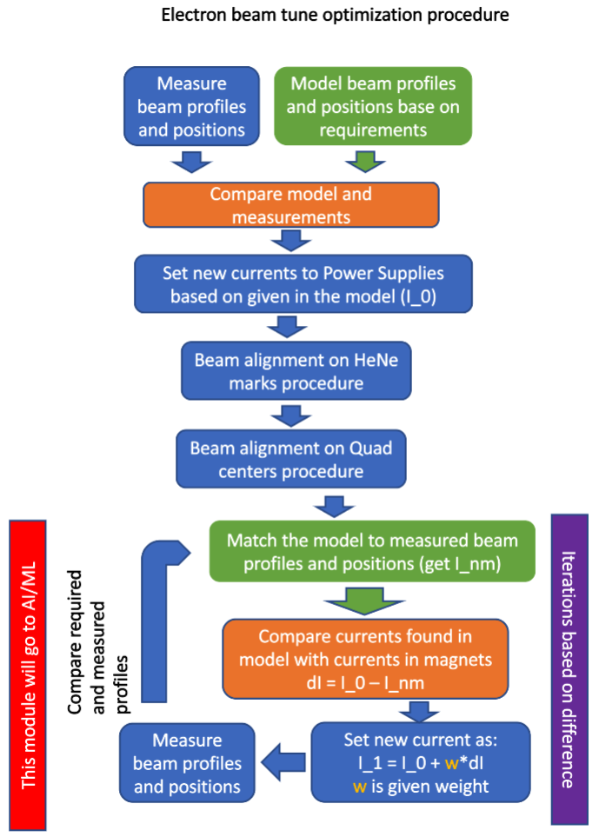
Mix: * Vista * Basler * Sirepo/MAD-X

Slide 13
Multi-dimensional optimization

Slide 14
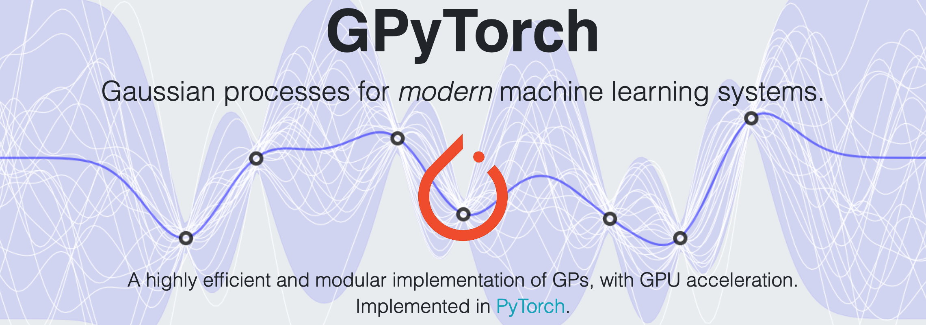
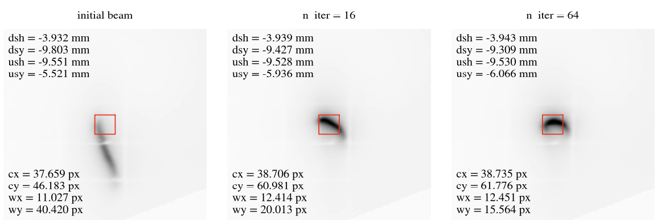
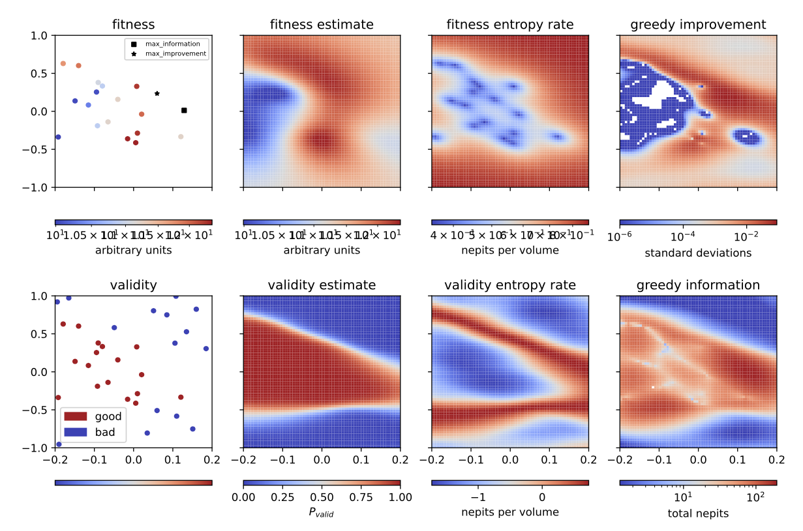
Beamline Optimization
Auto-alignment of the toroidal mirror at NSLS-II TES. The evolution of the beam shape and position can be seen clearly after 16 and 64 iterations.
T. W. Morris, M. Rakitin, A. Giles, J. Lynch, A. L. Walter, B. Nash, D. Abell, P. Moeller, I. Pogorelov, and N. Goldring "On-the-fly optimization of synchrotron beamlines using machine learning", Proc. SPIE 12222, Optical System Alignment, Tolerancing, and Verification XIV, 122220M (3 October 2022); https://doi.org/10.1117/12.2644996
Optimization based on Gaussian Processing (GP)
Sirepo/Shadow3 simulations

Slide 15
e-Beam requirements
No special requirements, the team can be using the beam in a “parasitic” mode for collecting the data from ongoing experiments.
With the active learning, we will need to modify steering magnet parameters (DARL*)

Slide 16
Future Plans
Perform integration and stress testing of the Ophyd abstractions at the ATF beamlines.
Develop the alignment procedures and integrate them with the MAD-X simulation data.
Apply the GP optimization routines to the ATF hardware using multi-parameter optimization (8+ dimensions) – a few 2-to-4-hour periods will be very useful for these studies.

