Slide 1
Ionization Currents and Secondary Radiation from Two-Color Pulses at Long Laser Wavelengths Proposal # 312798 Funding Status: NRL Base Program, Received
Alexander Englesbe, Jessica Peña, Michael Helle, Daniel Gordon
Plasma Physics Division, Naval Research Laboratory

Slide 2
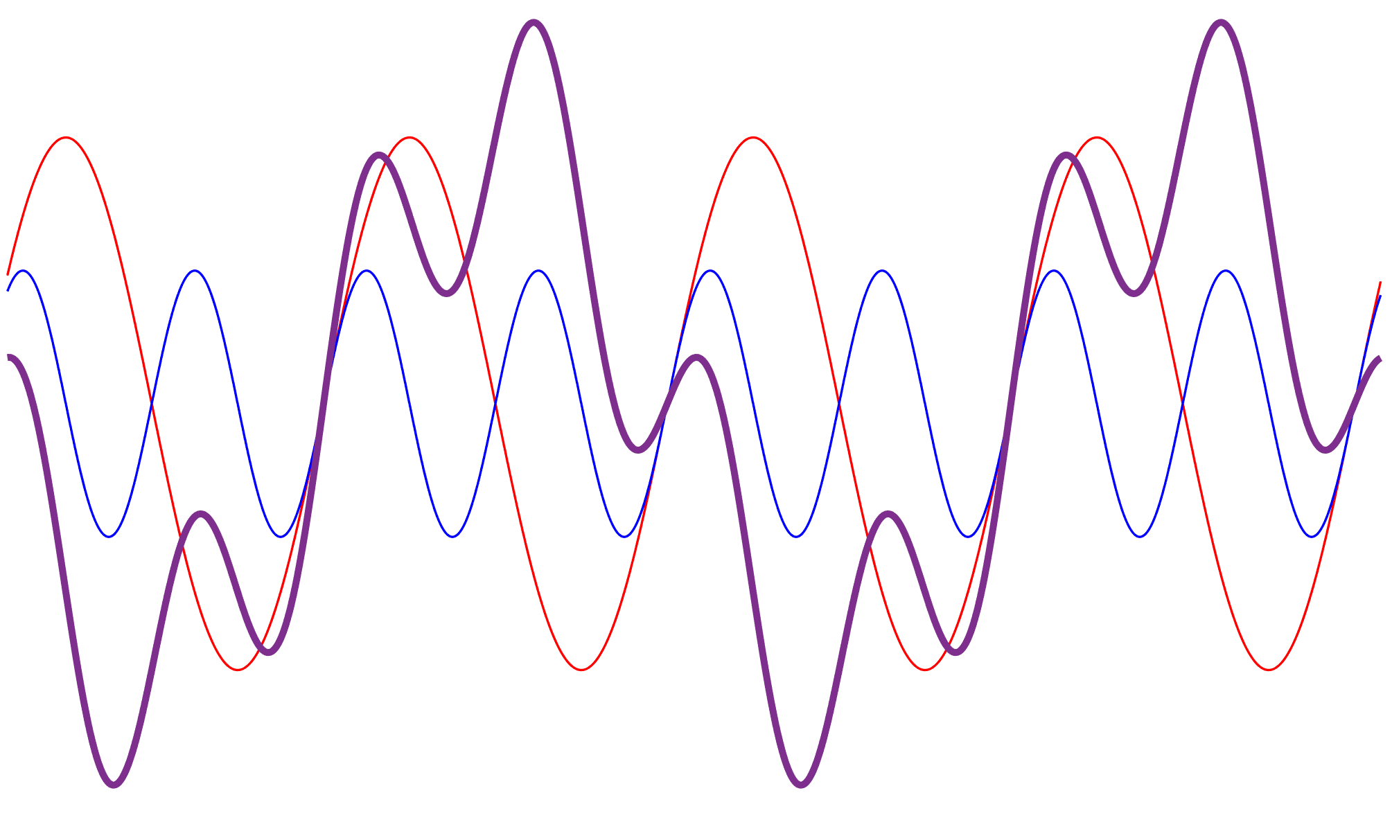
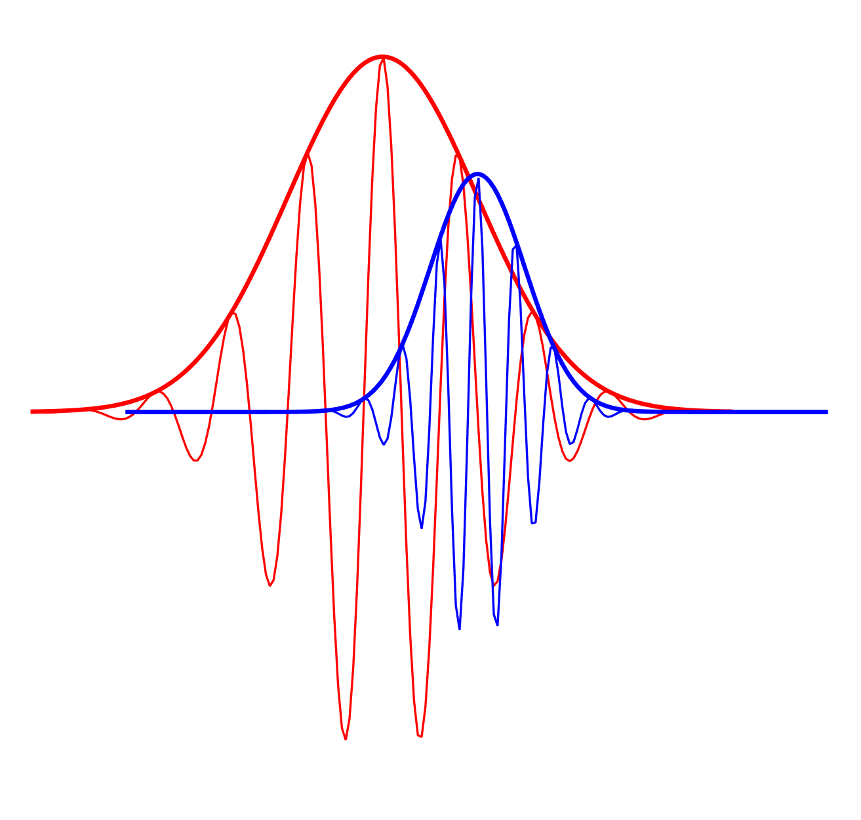
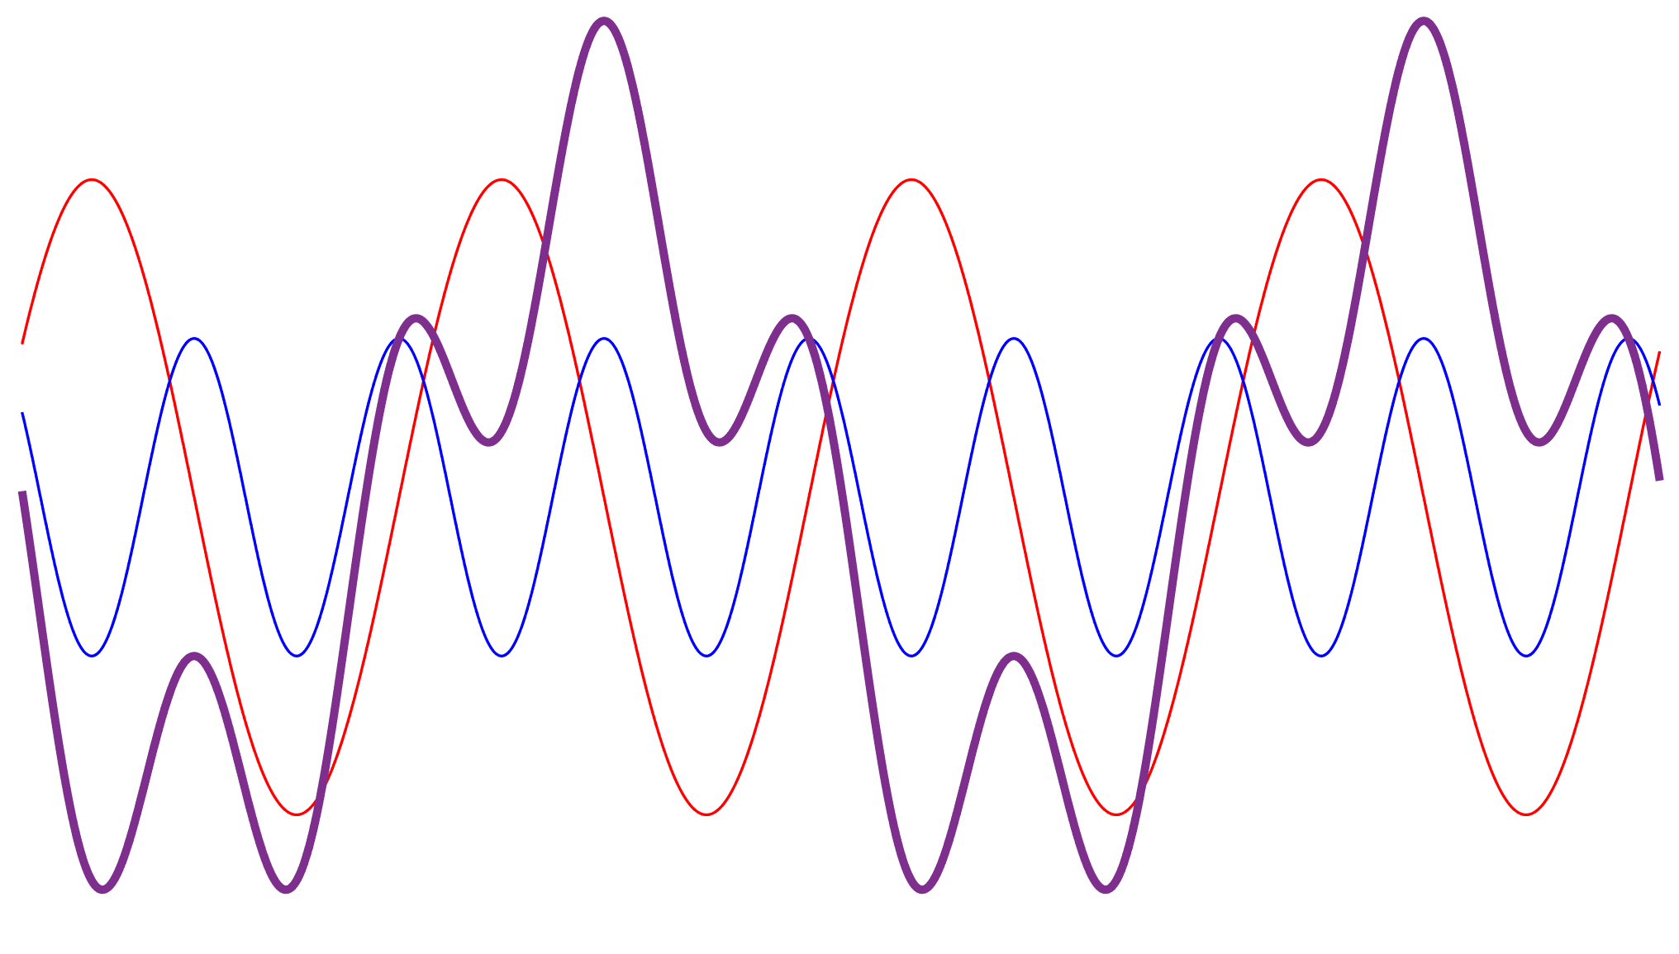
Controlling Tunneling Ionization of Air with Two-Color Pulses
Input two-color laser pulse
Optical field ionization by intense laser pulses occurs in the tunneling or multiphoton regime – Keldysh theory
For ionization of atmospheric air, traditional NIR sources ionize via multiphoton
Long wavelengths are needed to drive tunneling ionization in air
The liberation of electrons constitutes an ionization current, whose time dependence can be step-like (tunneling) with each laser field maximum, or vary slowly with the laser envelope (multiphoton)
The relative phase of a two-color pulse changes the shape of the laser electric field waveform, and thus the ionization currents
Terahertz radiation
Brunel harmonics
Air plasma
Microwave radiation
Relative phase (intra-cycle)
Envelope overlap (multiple cycles)
Δθ = 0
Δt
Δθ = π/2

Slide 3
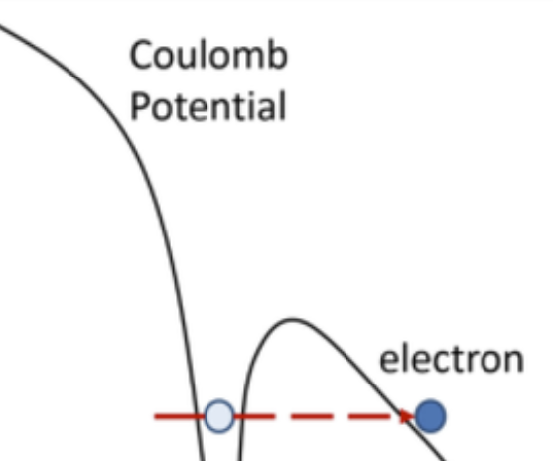
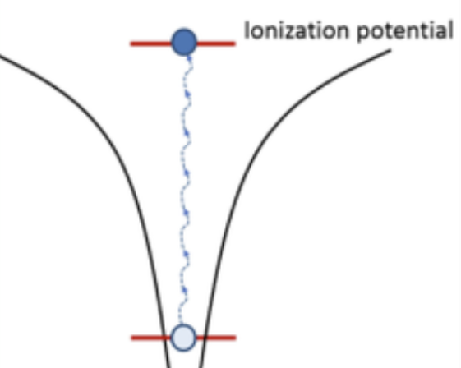
Ionization Currents Determine Secondary Radiation
Tunneling
Understand how ionization physics of air changes as a function of laser wavelength
Use microwave, THz, and laser harmonics that radiate as a consequence of ionization currents (secondary radiation) to infer ionization physics
Amplitude and frequency spectrum
Identify generation mechanism of microwave radiation with two-color pulses
Link early and late plasma lifetime by combining secondary radiation measurements with plasma diagnostics
Interferometry and optical emission spectroscopy
Black line = ionization rate
Binding Potential
electron
Multiphoton
electron
Binding
potential
I. Babushkin, J. Mod. Opt. 64(10), 1078 (2017).

Slide 4
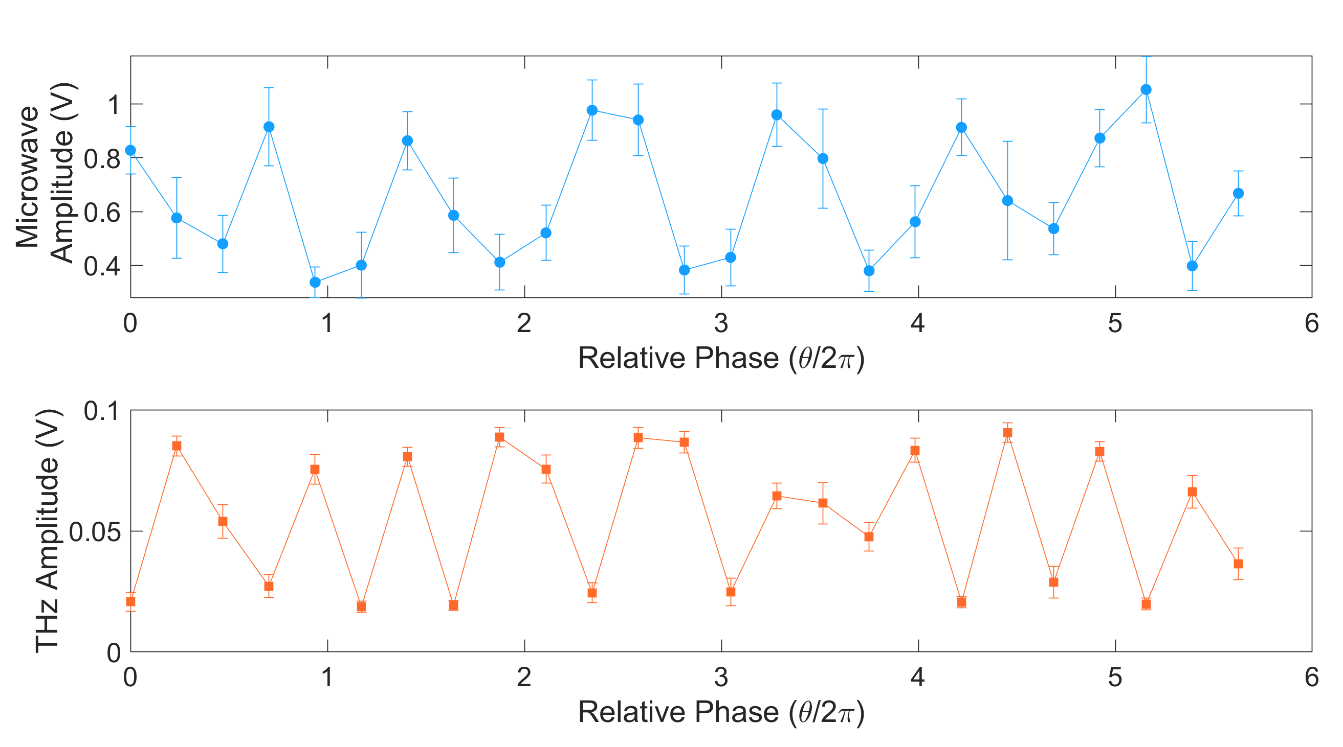
Compare Relative Phase Dependence of Secondary Radiation
Input two-color laser pulse
Terahertz radiation
Microwave Signal (V)
Brunel harmonics
Air plasma
THz Signal (V)
Microwave radiation
Two-color scheme is common to generate THz in air, but doing it with LWIR fundamental would be unique (no publications yet as far as we know)
Two-color NIR is in multiphoton regime, but Keldysh theory doesn’t neatly apply. LWIR would be far into tunneling regime
Two-color microwave generation is different from single-color, but mechanism is unclear. Going to tunneling regime may clarify physics.

Slide 5
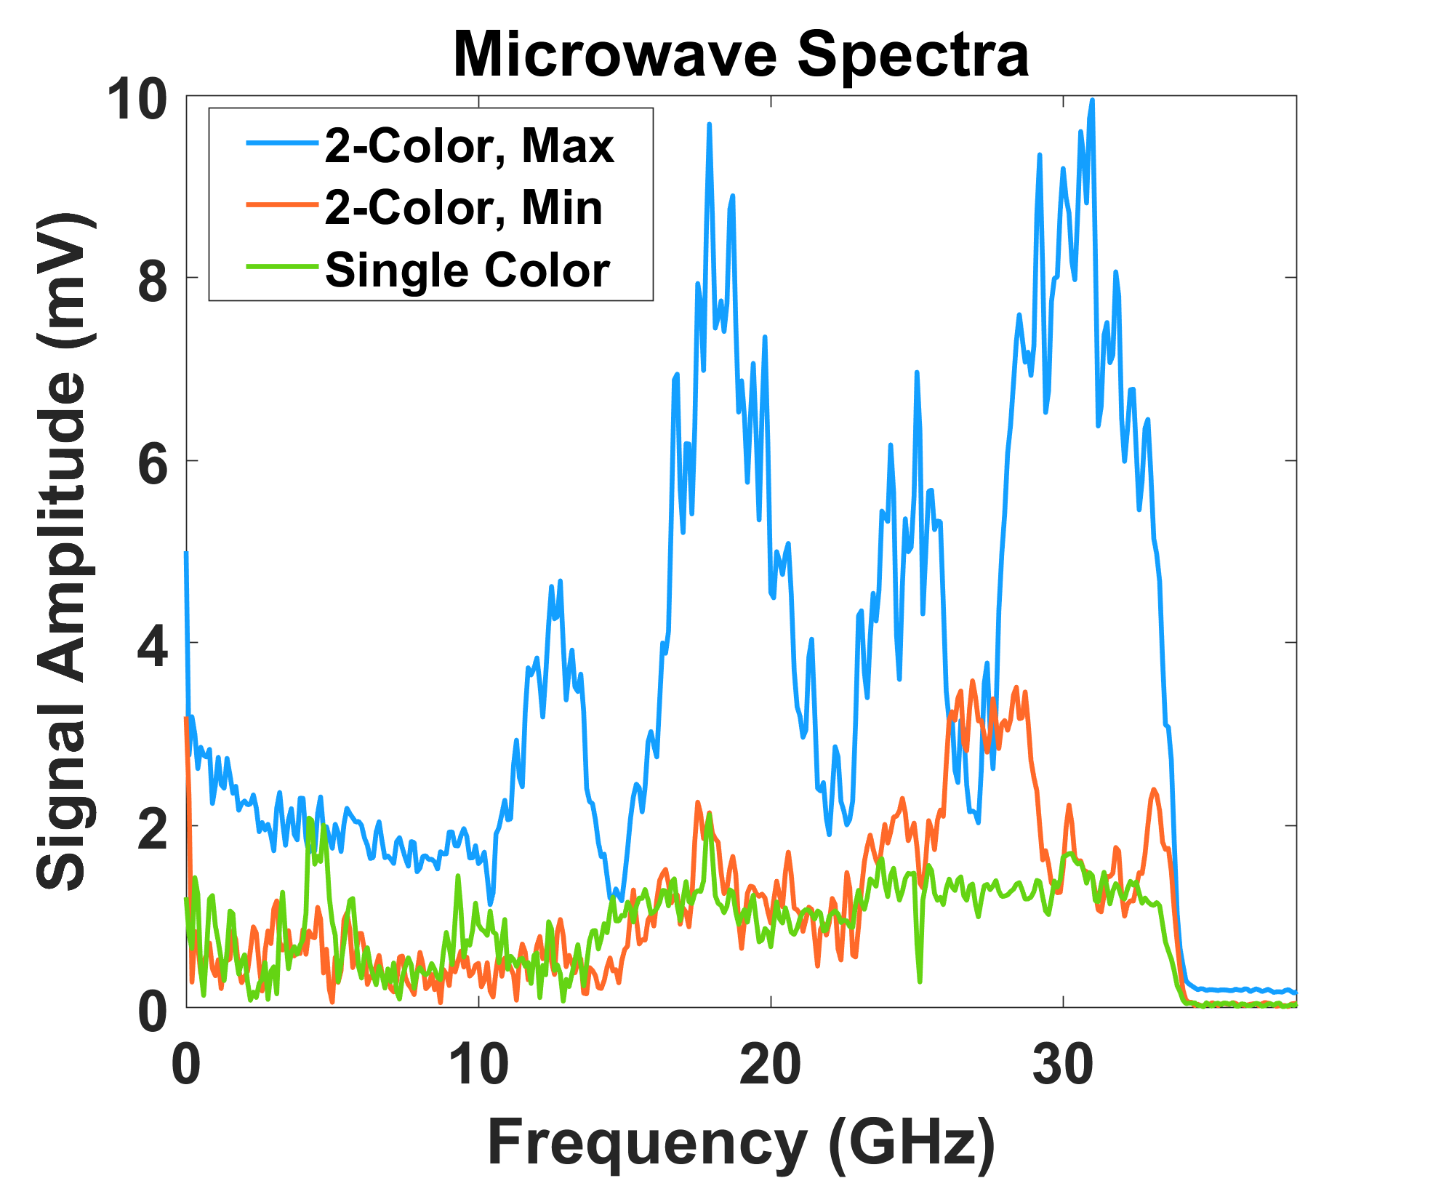
Compare Relative Phase Dependence of Secondary Radiation
Input two-color laser pulse
Terahertz radiation
Brunel harmonics
Air plasma
Microwave radiation
Two-color scheme is common to generate THz in air, but doing it with LWIR fundamental would be unique (no publications yet as far as we know)
Two-color NIR is in multiphoton regime, but Keldysh theory doesn’t neatly apply here. LWIR would be far into tunneling regime
Two-color microwave generation is different from single-color, but mechanism is unclear. Going to tunneling regime may clarify physics.

Slide 6
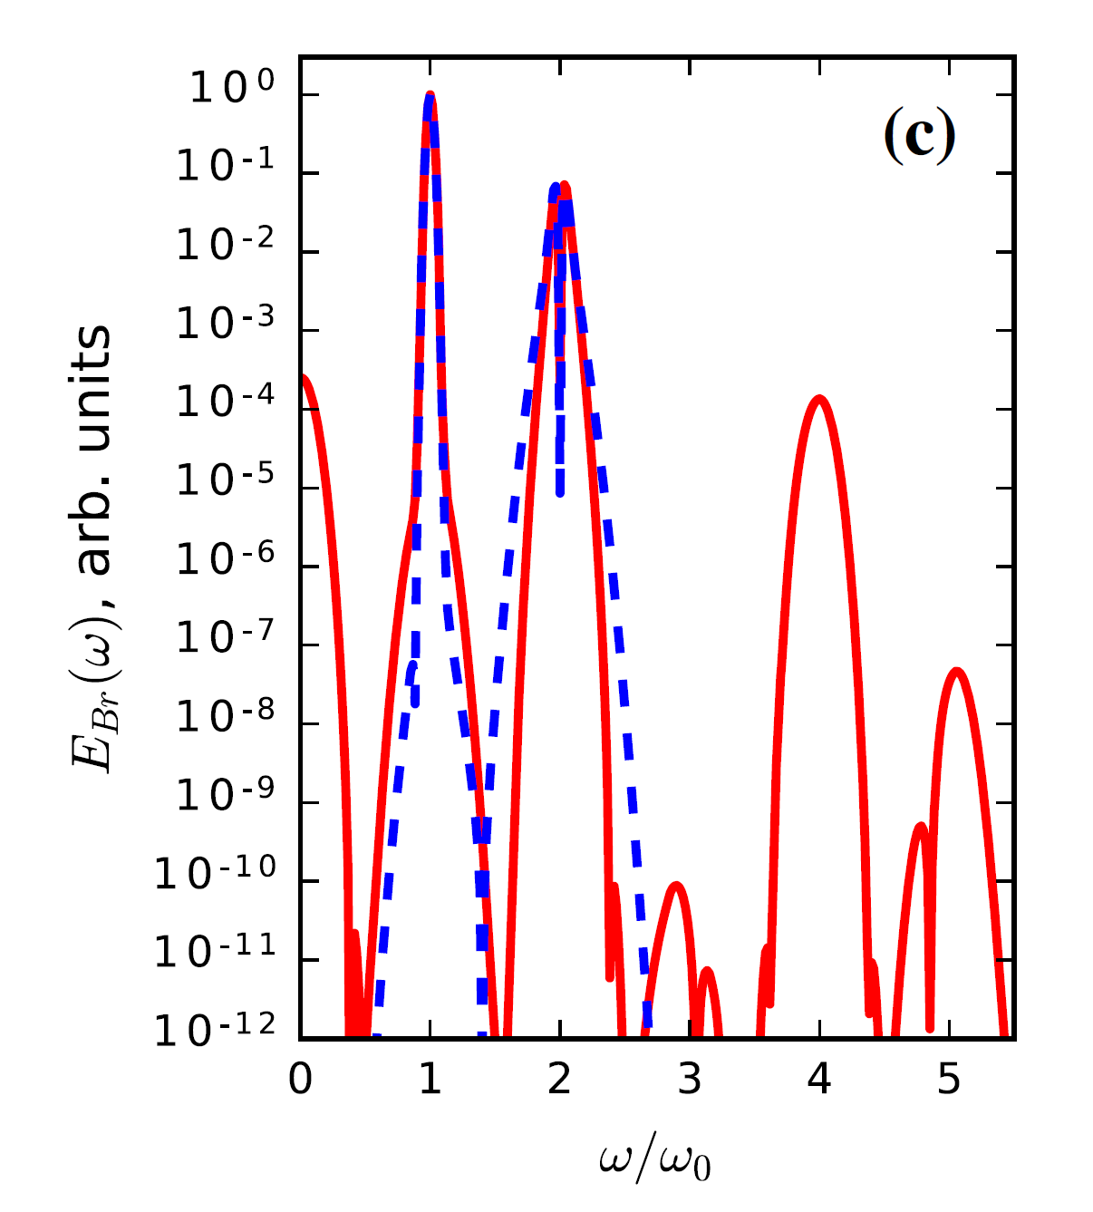
Long Wavelength Pulses Allow Additional Comparison with Brunel Harmonics
Input two-color laser pulse
Harmonic Spectrum
Tunneling ionization current
Terahertz radiation
Tunneling
Multiphoton
Time
Brunel harmonics
Two-color field
Air plasma
Microwave radiation
In the tunneling regime, the ionization current efficiently generates harmonics via Brunel mechanism
Brunel is not the same as recollision-driven high harmonic generation
Two-color NIR pulses do not generate Brunel harmonics, would be strongly absorbed in air if they did
I. Babushkin, J. Mod. Opt. 64(10), 1078 (2017).

Slide 7
Experimental Goals and Setup
Complete dataset = secondary radiation + plasma diagnostics as a function of two-color relative phase for single laser pulse format
Deploy single-shot, triggerable measurements of:
Microwave radiation
THz radiation
Brunel harmonics
Plasma interferogram
Plasma optical emission spectrum
Repeat experiment on NRL lasers: NIR (Ti:sapphire),
SWIR + MWIR (OPA)
Use relative phase dependence for quantitative points of comparison for simulations: SeaRay, CHMAIR/SPARC, and TurboWave
UV-VIS and NIR-SWIR imaging spectrometers for Brunel harmonics
Plasma emission collection optics
NIR interferometry probe
Terahertz spectrometer
To folded wavefront interferometer
Air plasma
Neutral/ionic emission with UV-VIS, NIR spectrometer
Microwave D-dot probe
Input LWIR fundamental
Time delay
compensator
SHG crystal
(ZGP, AgGaSe2)

Slide 8
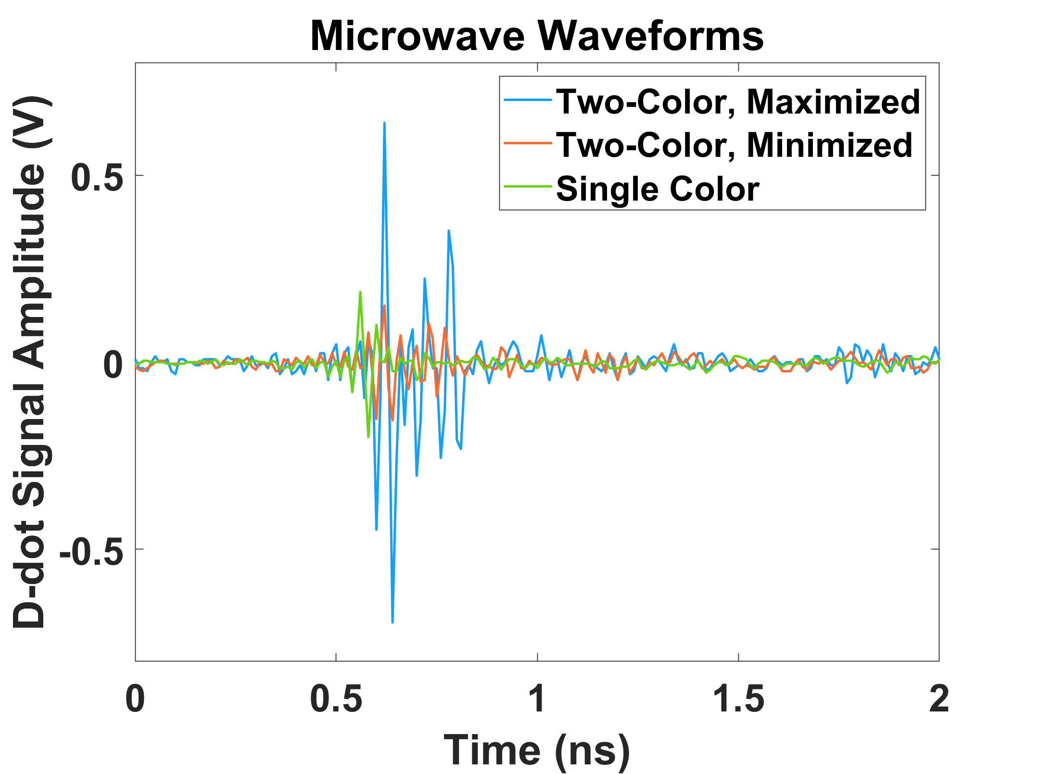
Microwave Pulse Detection
Microwave Receiver
Plasma currents radiate a broadband electromagnetic pulse that extends down to sub-GHz frequencies
Detect microwaves with a high-frequency d-dot probe, sensitive to fields up to 50 GHz
D-dot probe does not have a lower cutoff frequency unlike antenna
Useful info contained in relative waveform amplitude, and the real part of the frequency spectrum
D-dot probe
Fast oscilloscope
$$V\left(t\right)=A_{eq}R\frac{dD}{dt}$$
Photodiode trigger

Slide 9
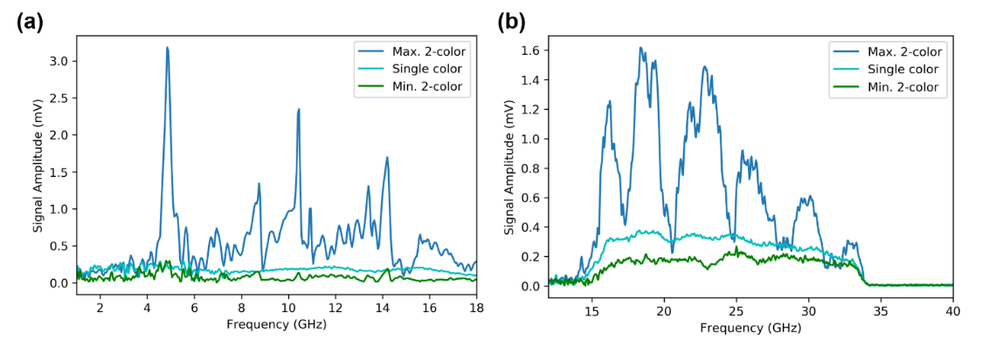
Modulations in Microwave Frequency Spectrum are Physical
SWIR, picosecond
At the relative phase that maximizes microwave generation, we see very regular modulations of the microwave frequency spectrum
Have also seen modulations with SWIR and NIR pulses
Optimized amplitude is ~10X more peak power than single-color pulse
Mechanism that explains single-color microwaves does not account for the spectral modulations
Will modulations persist with tunneling ionization from LWIR driver?
NIR, femtosecond

Slide 10
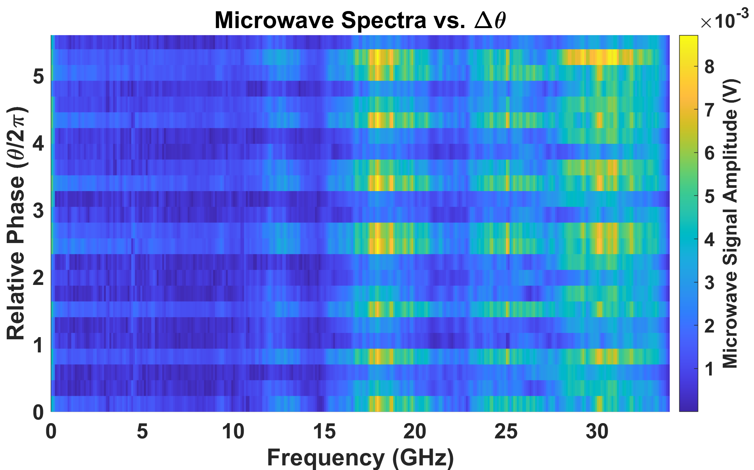
Modulations in Microwave Frequency Spectrum are Physical
SWIR, picosecond
At the relative phase that maximizes microwave generation, we see very regular modulations of the microwave frequency spectrum
Have also seen modulations with SWIR and NIR pulses
Will modulations persist with tunneling ionization from LWIR driver?
Mechanism that explains single color microwaves does not account for the spectral modulations
NIR, femtosecond

Slide 11
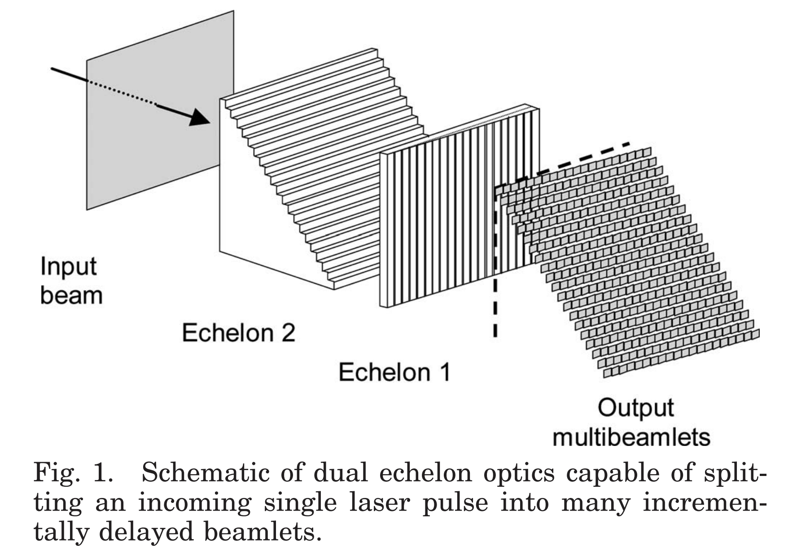
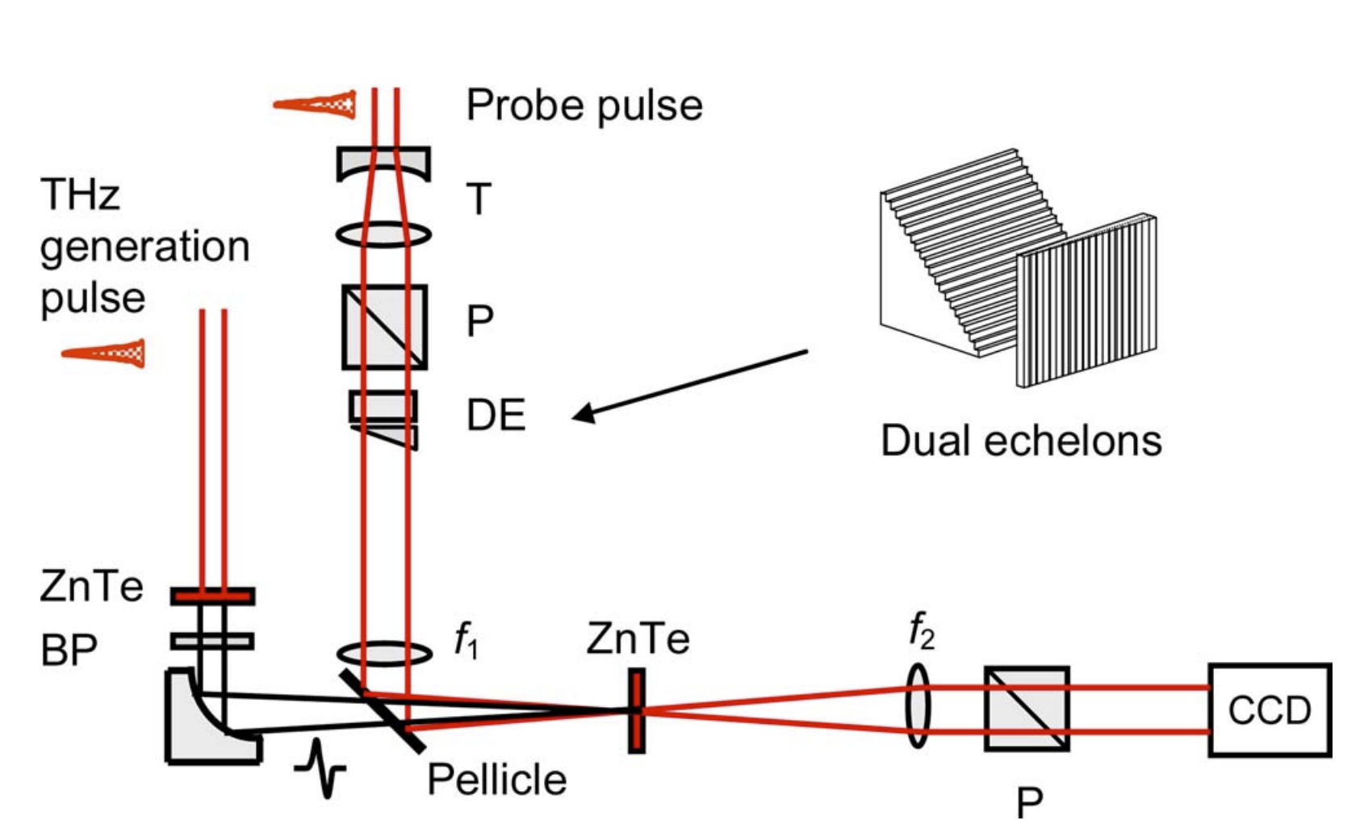
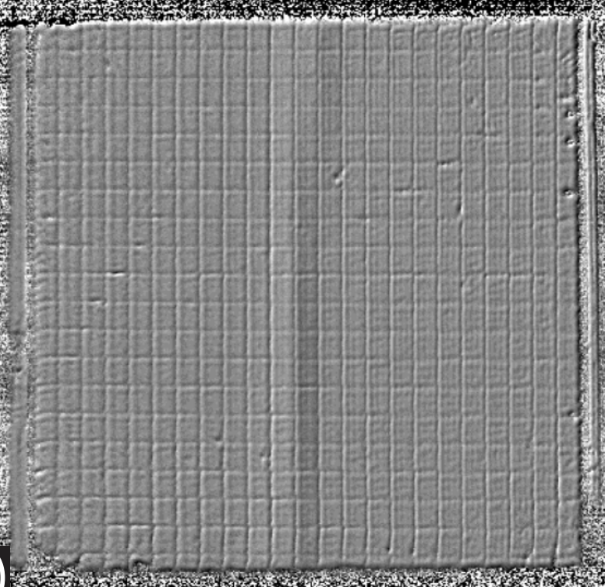
Implement Single-Shot THz Electro-Optic Sampling
Echelons generate NIR beamlets
Image echelon through EO crystal on to camera
Read out THz waveform from intensity in boxes
NIR probe
LWIR beam
Polarizer
λ/4
THz pulse
Combining optic
Polarizer
Subtract CCD images with and without THz field
K.-Y. Kim, Opt. Lett. 32(14), 1968 (2007).
S. Teo, Rev. Sci. Inst. 86, 051301 (2015).
Want to look for changes in THz spectrum due to relative phase
Echelon-based electro-optic sampling obviates delay line scanning over many laser shots
Sample ~2 ps THz field at 10’s fs resolution over ~10 ps time window
Requires synchronized NIR laser pulses
Build our own at NRL, and thoroughly test before ATF experiments

Slide 12
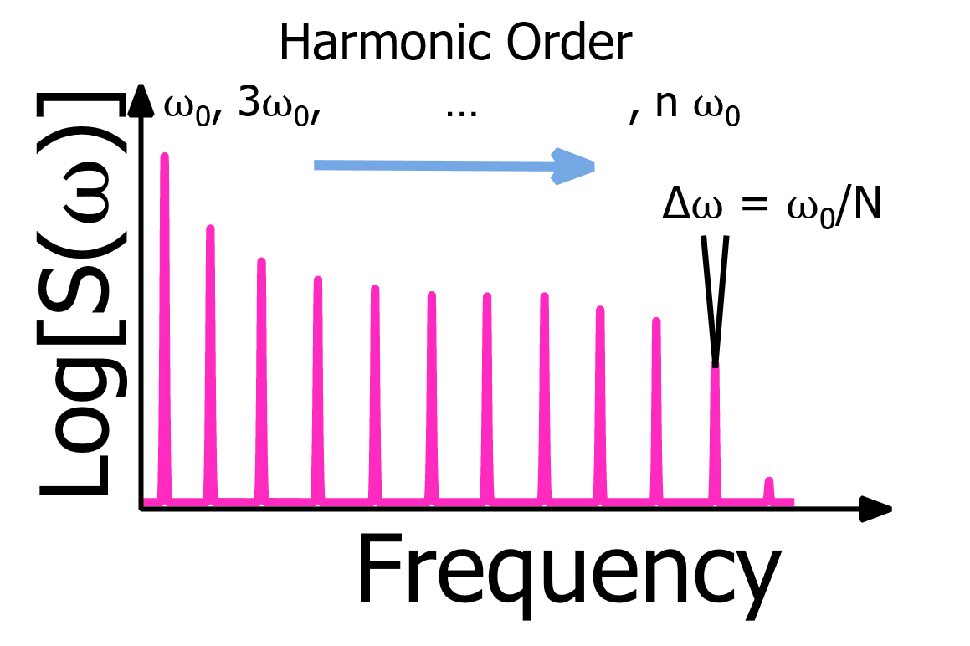
Spectrum of Brunel Harmonics Indicates Early Electron Dynamics
Need tunneling ionization to produce Brunel harmonics – cannot be done in air with NIR laser
The relative amplitudes and linewidths of the Brunel harmonics contain valuable information about electron behavior within laser field
Linewidths related to number of jumps in ionization current. Look for changes in linewidth with relative phase, and also look for trends with fundamental laser wavelength
Primarily use NIR-SWIR spectrometer in ATF experiments, but will also look at higher order harmonics in visible range
Number of “step-ups” in ionization current
$$∆ω \sim 1/N$$
Harmonic Order | 2 | 3 | 4 | 5 | 6 | 7 | 8 | 9 | 10 | 11 | 12 | 13 | 14
Wavelength (μm) | 4.6 | 3.1 | 2.3 | 1.8 | 1.5 | 1.3 | 1.1 | 1.0 | 0.92 | 0.84 | 0.77 | 0.71 | 0.66

Slide 13
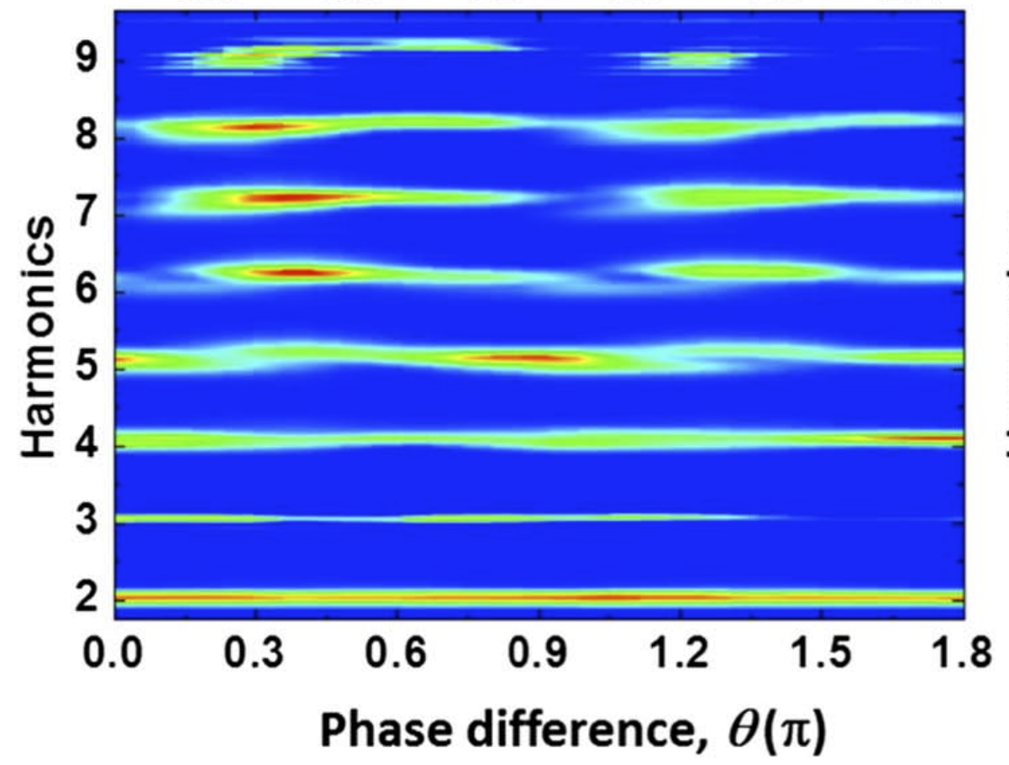
Spectrum of Brunel Harmonics Indicates Early Electron Dynamics
1.9 + 3.9 μm pulse Brunel harmonics vs. relative phase, Experiment
0.43 μm
Relative phase relationship between THz and Brunel harmonics can be simulated using carrier-resolving solver – SeaRay
Difficult to discriminate low-order bound electron harmonics and Brunel harmonics
Focus of year 2 experiments will be comparing Brunel and recollision-driven harmonic generation in air
1.9 μm
D. Jang, Optica 6(10), 1338 (2019).

Slide 14
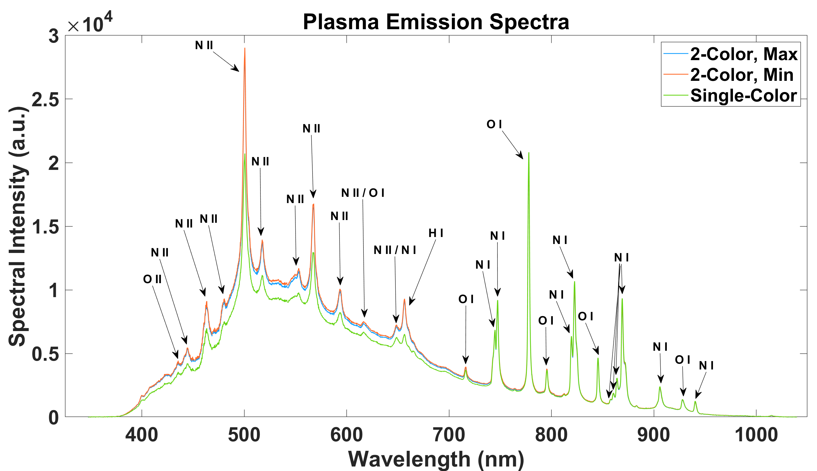
Plasma Diagnostics: Interferometry and Optical Emission Spectroscopy
Optical emission spectroscopy over large spectral range (e.g. 350-1100 nm) can give rough idea of electron kinetics
Compare emission lines to two-color pulses at other fundamental wavelengths
Population and decay of many excited states takes time period much longer than laser pulse, ionization currents
Benchmark air chemistry using CHMAIR/SPARC
Interferometry to measure nominal plasma density and size:
Input an accurate electron density into simulations
If two-color field perturbs ionization rate in space and time, this may appear in interferogram fringes
Transverse probing
NIR Plasma Emission Spectra

Slide 15
Summary
Use the secondary radiation (microwaves, THz, and Brunel harmonics) to understand the role of ionization currents, and other potential collisional and collective charged particle dynamics excited by the two-color laser field.
Link early and late plasma characteristics with concurrent measurements of the plasma size, density, and optical emission spectrum.
Field single-shot diagnostics. Cameras for spectroscopy, interferometry, and oscilloscope for microwave receiver are triggerable. Need to build up echelon-based THz receiver.
Integrate LWIR results in comparison study with NIR, SWIR, MWIR wavelengths

Slide 16
CO₂ Laser Requirements
Configuration | Parameter | Units | Typical Values | Comments | Requested Values
CO₂ Regenerative Amplifier Beam | Wavelength | μm | 9.2 | Wavelength determined by mixed isotope gain media
 | Peak Power | GW | ~3
 | Pulse Mode | --- | Single
 | Pulse Length | ps | 2
 | Pulse Energy | mJ | 6
 | M² | --- | ~1.5
 | Repetition Rate | Hz | 1.5 | 3 Hz also available if needed
 | Polarization | --- | Linear | Circular polarization available at slightly reduced power
CO₂ CPA Beam | Wavelength | μm | 9.2 | Wavelength determined by mixed isotope gain media | 9.2 microns
Note that delivery of full power pulses to the Experimental Hall is presently limited to Beamline #1 only. | Peak Power | TW | 5 | ~5 TW operation will become available shortly into this year’s experimental run period. A 3-year development effort to achieve >10 TW and deliver to users is in progress. | < 100 GW
 | Pulse Mode | --- | Single |  | Single
 | Pulse Length | ps | 2 |  | 2 ps
 | Pulse Energy | J | ~5 | Maximum pulse energies of >10 J will become available within the next year | ~ 100-150 mJ
 | M² | --- | ~2
 | Repetition Rate | Hz | 0.05 |  | 0.05
 | Polarization |  | Linear | Adjustable linear polarization along with circular polarization can be provided upon request | Linear

Slide 17
Other Experimental Laser Requirements
Ti:Sapphire Laser System | Units | Stage I Values | Stage II Values | Comments | Requested Values
Central Wavelength | nm | 800 | 800 | Stage I parameters are presently available and setup to deliver Stage II parameters should be complete during FY22 | 800 nm
FWHM Bandwidth | nm | 20 | 13
Compressed FWHM Pulse Width | fs | <50 | <75 | Transport of compressed pulses will initially include a very limited number of experimental interaction points. Please consult with the ATF Team if you need this capability. | ~ 50 fs
Chirped FWHM Pulse Width | ps | ≥50 | ≥50
Chirped Energy | mJ | 10 | 200
Compressed Energy | mJ | 7 | ~20 | 20 mJ is presently operational with work underway this year to achieve our 100 mJ goal. | < 7 mJ
Energy to Experiments | mJ | >4.9 | >80 |  | < 4 mJ
Power to Experiments | GW | >98 | >1067 |  | << 100 GW
Nd:YAG Laser System | Units | Typical Values | Comments | Requested Values
Wavelength | nm | 1064 | Single pulse
Energy | mJ | 5
Pulse Width | ps | 14
Wavelength | nm | 532 | Frequency doubled
Energy | mJ | 0.5
Pulse Width | ps | 10

Slide 18
Electron Beam Requirements – Not Applicable
Parameter | Units | Typical Values | Comments | Requested Values
Beam Energy | MeV | 50-65 | Full range is ~15-75 MeV with highest beam quality at nominal values
Bunch Charge | nC | 0.1-2.0 | Bunch length & emittance vary with charge
Compression | fs | Down to 100 fs (up to 1 kA peak current) | A magnetic bunch compressor available to compress bunch down to ~100 fs. Beam quality is variable depending on charge and amount of compression required. NOTE: Further compression options are being developed to provide bunch lengths down to the ~10 fs level
Transverse size at IP (σ) | μm | 30 – 100 (dependent on IP position) | It is possible to achieve transverse sizes below 10 um with special permanent magnet optics.
Normalized Emittance | μm | 1 (at 0.3 nC) | Variable with bunch charge
Rep. Rate (Hz) | Hz | 1.5 | 3 Hz also available if needed
Trains mode | --- | Single bunch | Multi-bunch mode available. Trains of 24 or 48 ns spaced bunches.

Slide 19
Special Equipment Requirements and Hazards
Introduction of transmissive optics into LWIR beam:
Second harmonic crystal
Time delay compensator
Half waveplate to co-polarize harmonics (needed if using Type 1 SHG)

Slide 20
Experimental Time Request
CY2023 Time Request
Capability | Setup Hours | Running Hours
Electron Beam Only | N/A
Laser* Only (in Laser Areas) | 40 | 80
Laser* + Electron Beam
Total Time Request for the 3-year Experiment (including CY2023-25)
Capability | Setup Hours | Running Hours
Electron Beam Only
Laser* Only (in Laser Areas) | 80 | 160
Laser* + Electron Beam
* Laser = Near-IR or LWIR (CO₂) Laser

