Slide 1
Broadband microwave emissions from LWIR picosecond laser ablation with pre-ionization
Proposal #312114
PI: Dr. Andy Goers, Johns Hopkins Applied Physics Laboratory
Co-PI: Dr. Jennifer Elle, Air Force Research Laboratory
Funding: ONR (JHU/APL, received)
AFRL Program Funds (AFRL, received)

Slide 2
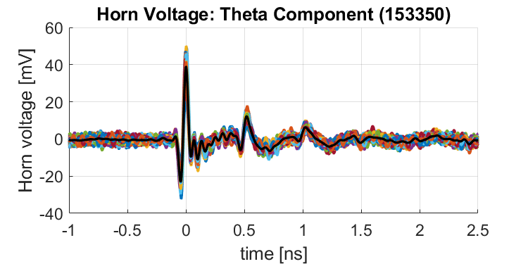
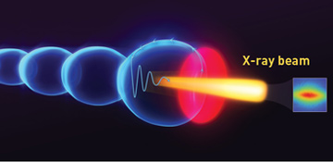

Broadband emissions from pulsed laser ablation
Extreme nonlinear optics of ultra-short pulse lasers enables research and applications across the entire electromagnetic spectrum…
Radio
Microwave
Infrared
VIS
UV
X-Ray
Gamma
Parametric Conversion
High Harmonic Generation
RF EMP
Terahertz Sources
Optical Supercontinuum
Accelerator-based light sources
OPN News, Laser Wakefield Accelerators: Next-Generation Light Sources,” Albert 2018.

Slide 3



RF Emissions From Short Pulse Laser Ablation
Low-frequency (RF) emissions measured from ablation as early as 1970’s
Typically found in large laser facilities with lasers reaching relativistic intensities
Recent work has investigated “atmospheric” and relatively low intensity sources of EMP from laser-plasma interactions
Three main sources of low frequency emission
  “Rectification” physics
  Long scale-length plasma currents
  Target charging and neutralization
Plasma emission
Solid target
-
Prompt (THz) EMP
-
+
-
+
-
-
+
$${\vec{v}}_{e}$$
$$\vec{E}$$
+
Laser
-
+
-
-
+
-
-
-
Delayed (GHz) EMP
-
-
-
-
Neutralizing current

Slide 4
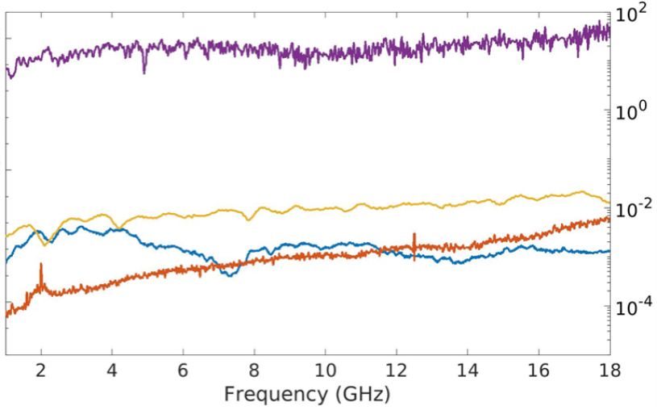
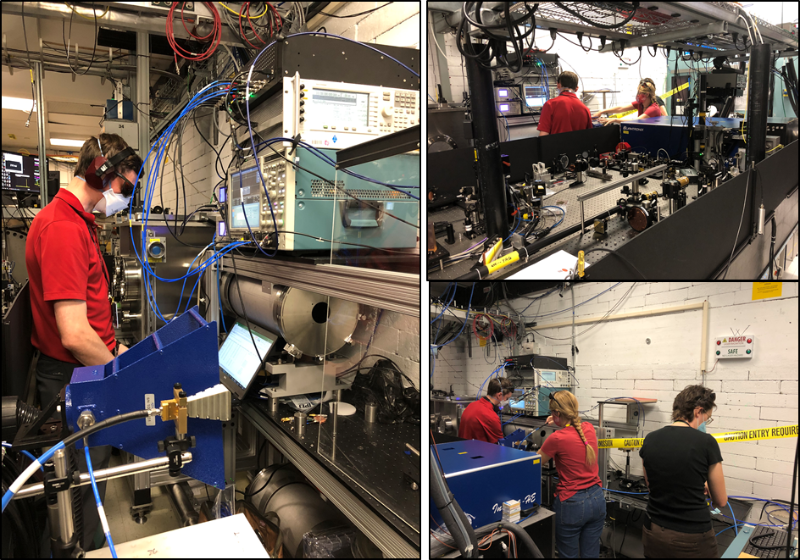
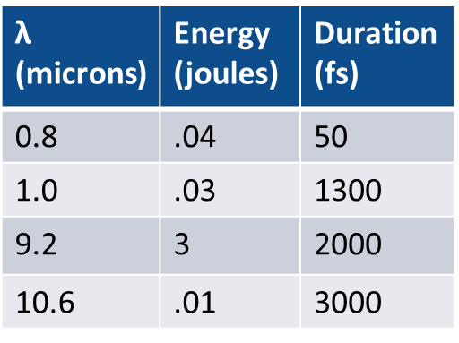
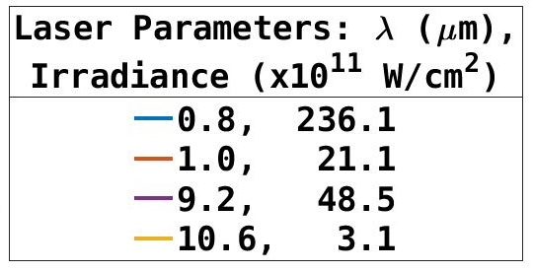
Wavelength Scaling into the LWIR
Measured RF Power Spectral Density
FY22 results exceeded expectations!
Orders of magnitude improvement across all frequencies achieved with BNL laser
Arbitrary Units

Slide 5



Target pre-ionization
Previous work at JHU/APL showed orders of magnitude increase in RF emissions from pre-ionized dielectric targets with NIR drive lasers
Hypothesize improved laser absorption at the critical density layer in the expanding plasma causes a higher electron temperature
S. Varma, J. Spicer, B. Brawley, and J. Miragliotta, “Plasma enhancement of femtosecond laser-induced electromagnetic pulses at metal and dielectric surfaces,” Opt. Eng., vol. 53, no. 5, p. 051515, 2014.
Option 1:
Option 2:
Option 3:
Pulse stacker before main amp
Ti:Sapphire fs pre-ionization
Nd:YAG ns pre-ionization
ps – ns delays $±$ 100 fs
ps – 10s ns delays $±$ ps
10s ns delays $±$ 0.25 ns

Slide 6
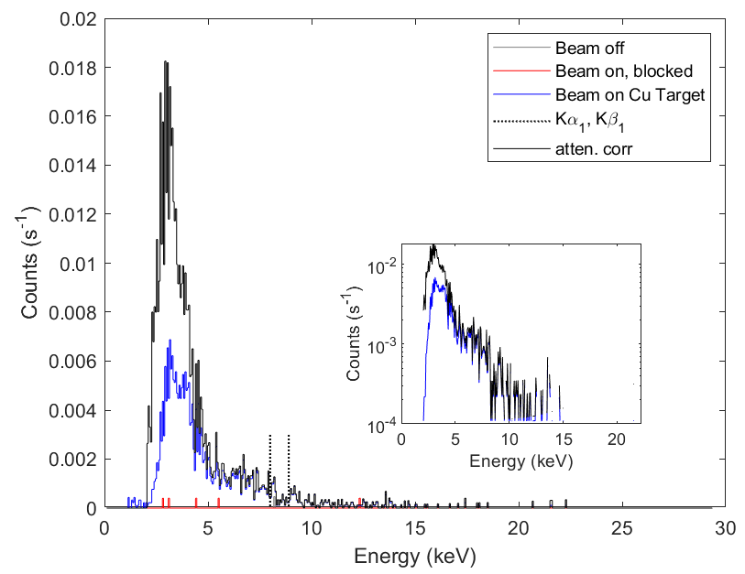
Key experimental questions
How does RF emission change with laser incidence angle and intensity? Can we match theoretical models?
  How does emissions strength compare between dielectric and metal targets?
Does pre-ionization increase the RF emission from solid targets similar to what we see in the NIR?
  What pulse separation time scale improves RF emission?
  Does pre-ionization improve LWIR absorption by the plasma?
Can we detect a temperature electron population through keV bremsstrahlung? Does the electron temperature correlate with RF emission?
What effects does the emitted ultrawideband RF field have on electronic devices?
X-ray emission spectrum measured from USPL ablation of copper wire in air

Slide 7
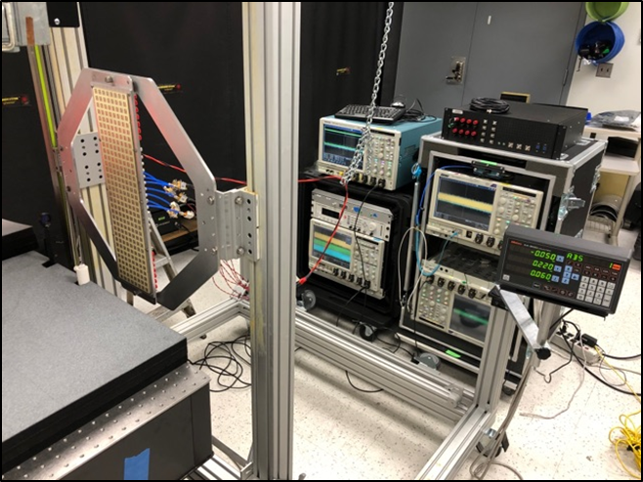
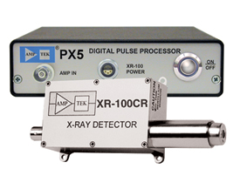
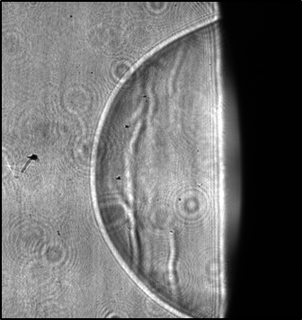
Diagnostics
RF collection equipment
  High speed oscilloscope(s) and broadband horn antenna(s)
Shadowgraph imaging of shock dynamics
  mW-class laser diode and gated ICCD
  Shock evolution allows estimate of laser absorption
Pump reflectometer
  Power meter based reflectance measurement
X-ray spectrometer (preferably filter based)
  Detects bremsstrahlung emission from hypothesized high temperature electrons
“DUT” electronics
  Field effects on transistors, etc.

Slide 8
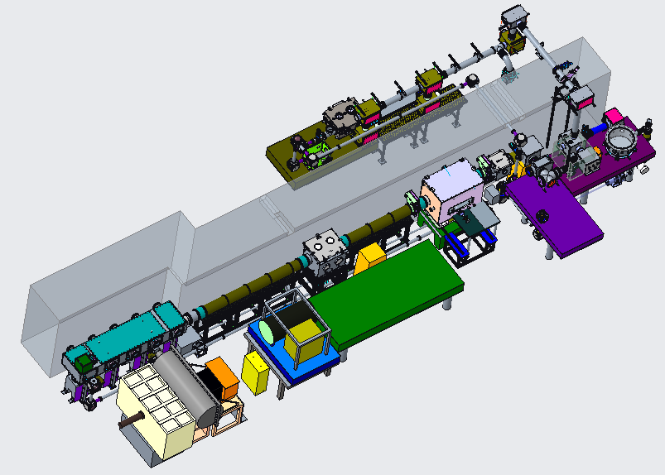
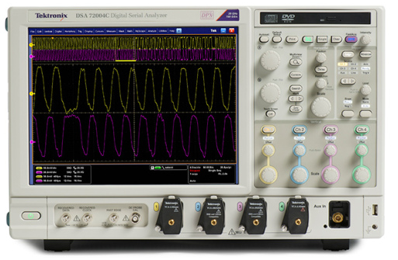
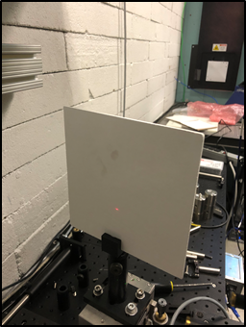



Experimental Layout
Plan to set up on 18” wide breadboard ahead of polarization rotator
RF Horn Antenna
Point of NIR lasers extraction; runs along the floor?
Target on an open rotation mount
NIR beam for pre-ionization and/or plasma probe
144”
Multi-level system helps with space constrains
200ns diode probe beam
X-ray detector
Schlieren ICCD camera
ICCD
$$f≈1 m$$

Slide 9
Funding / Timeline
AFRL and JHU/APL programs are funded through FY23
Lead times for experimental components push likely timeline to summer 2023
Proposed 1 year effort – 2 to 3 weeks of beam time
  Week 1 – Set up dual pulse pre-ionization formats. Check initial RF signal levels and begin setup of diagnostics.
  Week 2 – Scan pulse delay with spectrometer and probe pulse diagnostics to verify optimal beam timing and overlap. Study RF emission as a function of incident laser properties.
  Week 3 – Test electronic device response to high field RF.
Potential FY24 proposal for more advanced plasma diagnostics (e.g. spectral interferometry on reflected and/or transmitted femtosecond probe beam)
Positive results likely to drive continued interest in ultrafast CO2 laser development from DoD sponsors

Slide 11
Electron Beam Requirements
No electron beam time requested

Slide 12
CO₂ Laser Requirements
Configuration | Parameter | Units | Typical Values | Comments | Requested Values
CO₂ Regenerative Amplifier Beam | Wavelength | μm | 9.2 | Wavelength determined by mixed isotope gain media
 | Peak Power | GW | ~3
 | Pulse Mode | --- | Single
 | Pulse Length | ps | 2
 | Pulse Energy | mJ | 6
 | M² | --- | ~1.5
 | Repetition Rate | Hz | 1.5 | 3 Hz also available if needed
 | Polarization | --- | Linear | Circular polarization available at slightly reduced power
CO₂ CPA Beam | Wavelength | μm | 9.2 | Wavelength determined by mixed isotope gain media | 9.2
Note that delivery of full power pulses to the Experimental Hall is presently limited to Beamline #1 only. | Peak Power | TW | 5 | ~5 TW operation will become available shortly into this year’s experimental run period. A 3-year development effort to achieve >10 TW and deliver to users is in progress. | 0.5 – 2
 | Pulse Mode | --- | Single | JHU/APL to install a pulse splitter for some experiments | Single / Double
 | Pulse Length | ps | 2 |  | 2ps
 | Pulse Energy | J | ~5 | Maximum pulse energies of >10 J will become available within the next year | 1 – 4
 | M² | --- | ~2 |  | 2
 | Repetition Rate | Hz | 0.05 |  | 0.05
 | Polarization |  | Linear | Adjustable linear polarization along with circular polarization can be provided upon request | Linear
Regen beam needed for beam path alignment.
Request access to regen output to install Mach-Zehnder style pulse splitter (2 pulses, provided by JHU/APL)

Slide 13
Other Experimental Laser Requirements
Ti:Sapphire Laser System | Units | Stage I Values | Stage II Values | Comments | Requested Values
Central Wavelength | nm | 800 | 800 | Stage I parameters are presently available and setup to deliver Stage II parameters should be complete during FY22 | 800nm
FWHM Bandwidth | nm | 20 | 13 |  | 13
Compressed FWHM Pulse Width | fs | <50 | <75 | Transport of compressed pulses will initially include a very limited number of experimental interaction points. Please consult with the ATF Team if you need this capability. | 75
Chirped FWHM Pulse Width | ps | ≥50 | ≥50
Chirped Energy | mJ | 10 | 200
Compressed Energy | mJ | 7 | ~20 | 20 mJ is presently operational with work underway this year to achieve our 100 mJ goal. | 20+
Energy to Experiments | mJ | >4.9 | >80 |  | 10+
Power to Experiments | GW | >98 | >1067
Nd:YAG Laser System | Units | Typical Values | Comments | Requested Values
Wavelength | nm | 1064 | Single pulse
Energy | mJ | 5
Pulse Width | ps | 14
Wavelength | nm | 532 | Frequency doubled
Energy | mJ | 0.5
Pulse Width | ps | 10

Slide 14
Special Equipment Requirements and Hazards
Electron Beam
  N/A
CO₂ Laser
  ‘Single beam’ pre-ionization scheme will require installation of a pulse stacker between the CO2 regenerative amplifier and the main power amp.
  Experiments performed in air will require disassembly of part of the beam routing vacuum tube. We anticipate using the existing 80/20 stands to help support our experimental diagnostics and alleviate space constraints. Setup will require at least 4’ x 1.5’ space, preferably a little more.
Ti:Sapphire and Nd:YAG Lasers
  Requesting use of the Ti:Sapphire beam for probe and/or target pre-ionization. Beam will need to be routed to our experimental area. Experiments at JHU/APL ongoing to determine if compressed vs uncompressed beam is needed.
Hazards & Special Installation Requirements
  Large installation (chamber, insertion device, etc.): Disassembly of vacuum beam line to accommodate experiment in ambient environment
  Cryogens: N/A
  Introducing new magnetic elements: N/A
  Introducing new materials into the beam path: CO2 pulse stacker between regen and main amp (ZnSe optics)
  Any other foreseeable beam line modifications: No

Slide 15
Experimental Time Request
CY2023 Time Request
Capability | Setup Hours | Running Hours
Electron Beam Only
Laser* Only (in Laser Areas) | 0.5 – 1 week | 2 weeks
Laser* + Electron Beam
Total Time Request for the 3-year Experiment (including CY2023-25)
Capability | Setup Hours | Running Hours
Electron Beam Only
Laser* Only (in Laser Areas) | 0.5 – 1 week | 2 weeks
Laser* + Electron Beam
* Results may warrant follow-on FY24/25 proposals if funding is secured
* Laser = Near-IR or LWIR (CO₂) Laser

