Slide 1

Accelerator Test Facility (ATF) Users' Meeting
Novel Application of a Pulsed Electron Linear Accelerator as a Single Event Effects Simulator
Greg Allen, NASA JPL
In collaboration with Aerospace Corp.
Proposal ID: 312807
Funding Source: NASA
Funding Status: Received

Slide 2
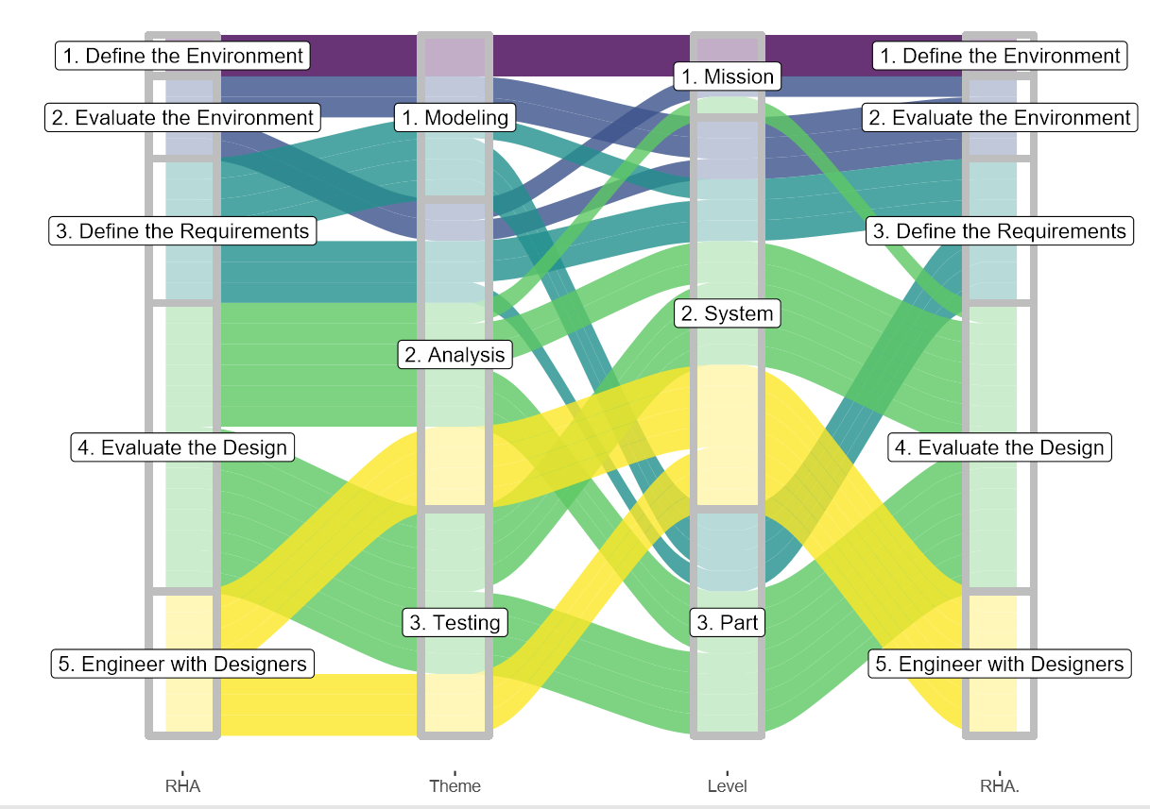
Accelerator Test Facility (ATF) Users' Meeting
RHA Philosophy
M.E.A.L. – Mission. Environment. Application. Lifetime.
The RHA process is laid out with interdependent activities. It may help to group these activities
by the type or “theme” of work (e.g., modeling, analysis, or testing), or to examine the “level” or
scope to which these activities can address information (e.g., mission, system, or part level).
Defining radiation requirements relies on modeling and model fidelity.
Radiation requirements exist at the system and part levels.
Testing and analysis may be conducted at the part level, but outcomes and engineering are most prevalent and defined at the system level.

Slide 3
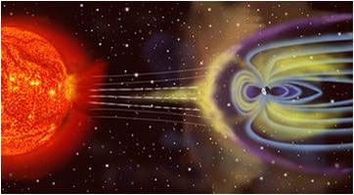
Accelerator Test Facility (ATF) Users' Meeting
Natural Space Environment Overview
Particle radiation – High-energy electrons, protons & heavy ions
  Solar
  Galactic cosmic rays (GCR)
  Trapped in magnetospheres
Plasma
  Ionosphere
  Plasmasphere – Magnetosphere
  Solar wind
Neutral gas particles
  Lower – atomic oxygen (AO)
  Higher – hydrogen & helium
Ultraviolet and X-ray
Micrometeoroids & orbital debris

Slide 4
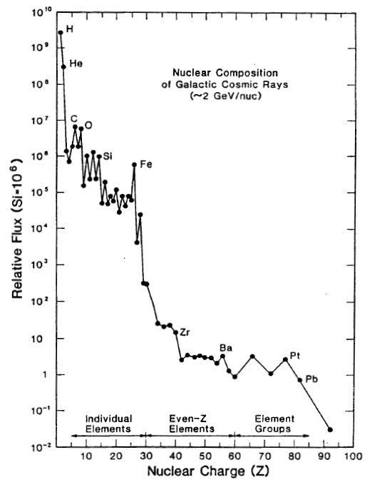
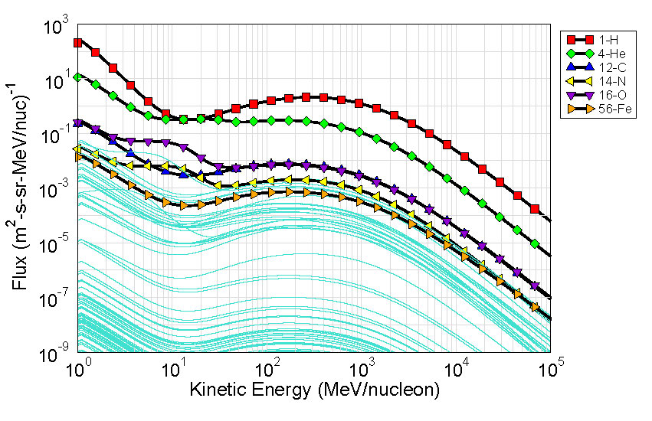
Accelerator Test Facility (ATF) Users' Meeting
Natural Space Environment: GCR
Nymmik 1992 Model, Geostationary Orbit
https://creme.isde.vanderbilt.edu/
R. A. Mewaldt, Adv. in Space Res., 1994.
Originate outside the solar system (e.g., supernovae)
Include all naturally-occurring elements
  Drops off rapidly for Z > 26 (iron)
Most energetic of all space environment radiation

Slide 5
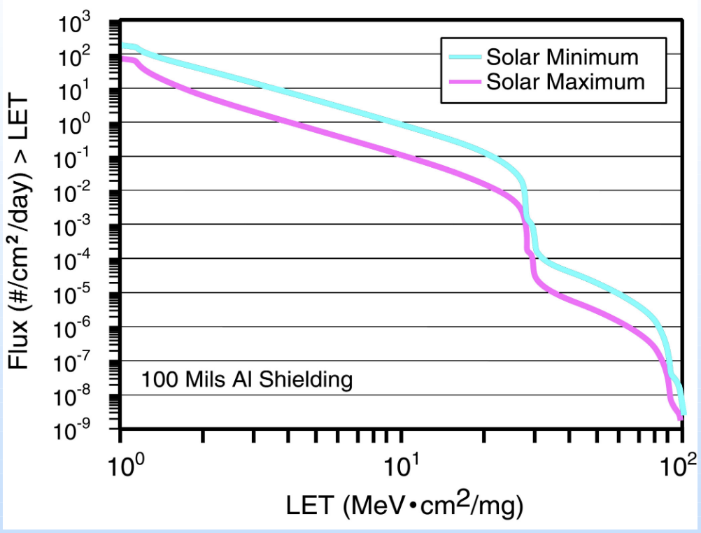
Accelerator Test Facility (ATF) Users' Meeting
Application of LET

Slide 6
Accelerator Test Facility (ATF) Users' Meeting
Breaking down radiation effects
Ionizing Radiation Effects
Total Ionizing Dose (TID)
Total Non-Ionizing Dose (TNID)
Single-Event Effects (SEE)
Non-Destructive
Destructive
Primarily high-energy protons and heavy ions

Slide 7
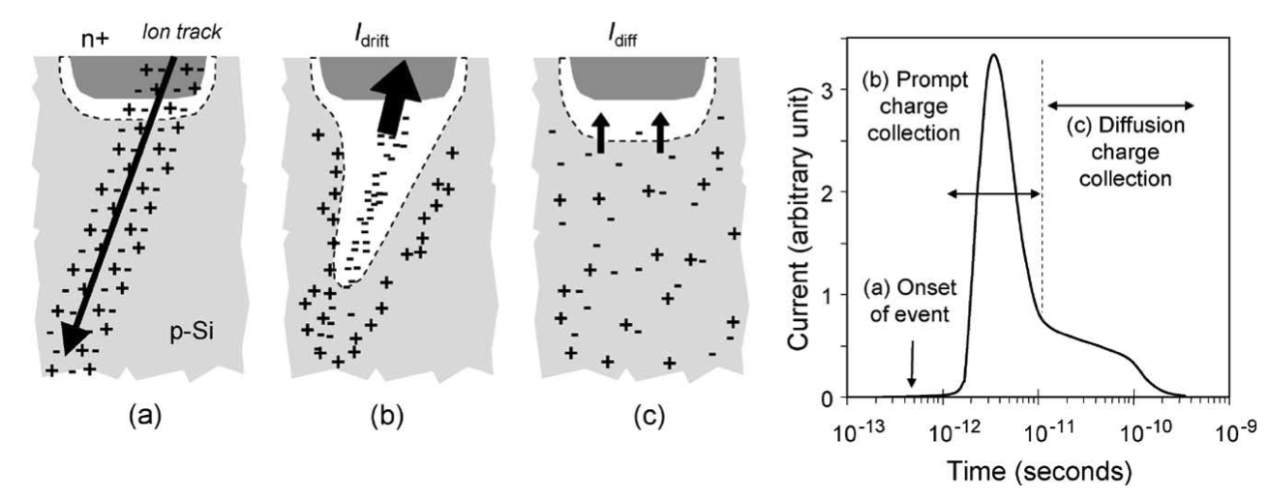
UC Berkeley Department of Nuclear Engineering's Spring 2023 Colloquia
SEE Mechanisms
When an ion passes through a conductor or semiconductor e.g. Si:
  Most charge deposition is compensated quickly through recombination, drift and diffusion.
  This is what causes SEE
  BUT, from a TID perspective charge isn’t accumulated or stored.
Image reproduced from Baumann: Radiation-Induced Soft Errors in Advanced Semiconductor Technologies

Slide 8
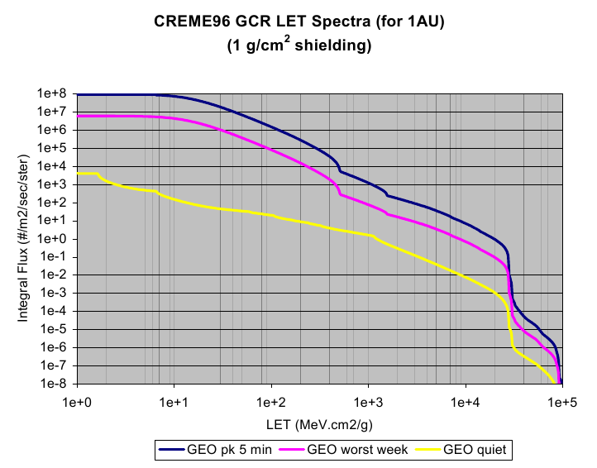
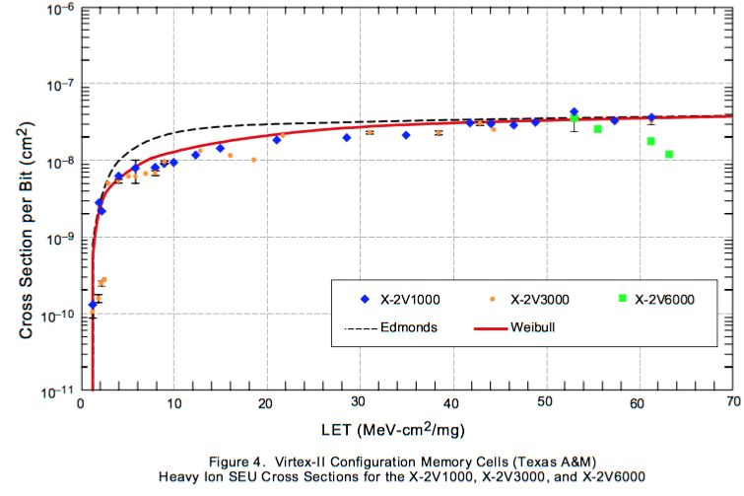
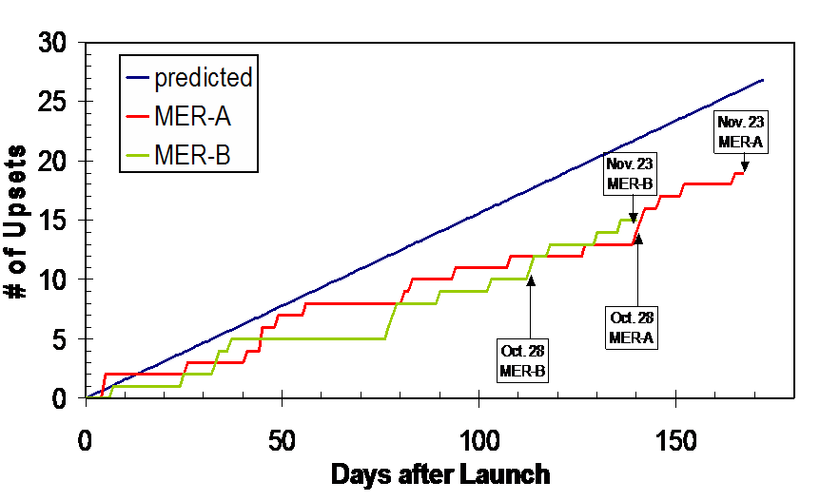
UC Berkeley Department of Nuclear Engineering's Spring 2023 Colloquia
Putting it all Together

Slide 9



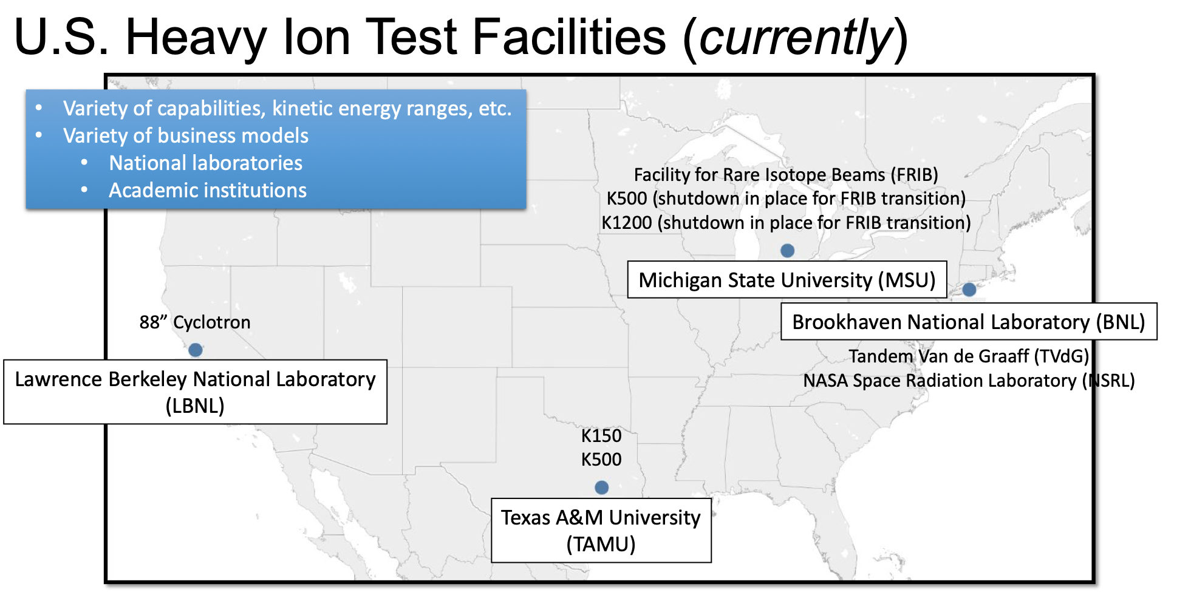
COLLABORATION IS NECESSARY
NASEM 2017-2018
AOA 2019
Agency-wide facility block buys
Key findings
• Growing use and tightening supply
• Infrastructure showing signs of strain
• Aging workforce in a domain that requires specialized training and skills
• Fast-moving technology
Points to / needs
• More organizational coordination
• Test facility sustainment & new investments
• Coupled with appropriate research & development
• Workforce development
Existing heavy ion SEE test facilities cannot meet current or future SEE test demand (~5000 hour/year gap)
Department of Defense efforts as well as U.S. Government and commercial space are driving significant increases in SEE testing demand
Current heavy ion accelerators for SEE testing at U.S. universities and Department of Energy labs have limited capacity and capability
NASA-DoD Collaborations:
Workforce Development
SEE Testing Advisement
Data Sharing
Common Part Testing
New Facility Shakeouts
SINGLE EVENT EFFECTS
RECENT ASSESSMENTS AND RESPONSES

Slide 10
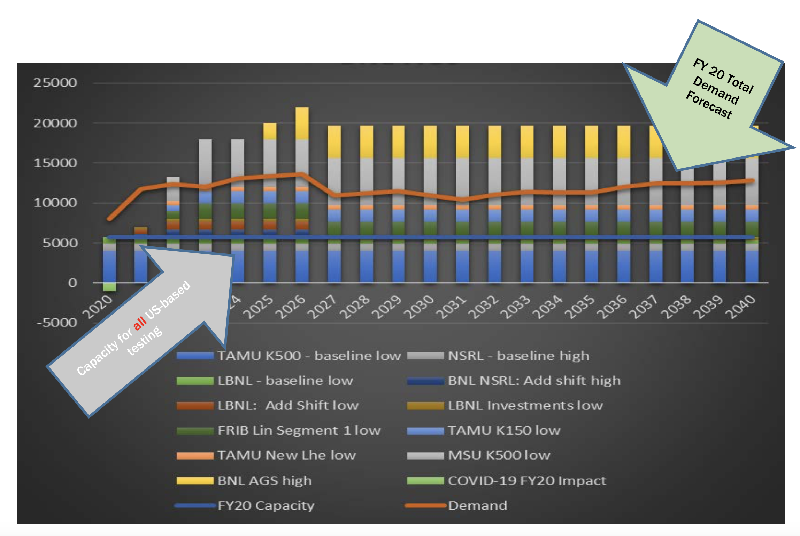
Accelerator Test Facility (ATF) Users' Meeting
Accelerator Supply and Demand

Slide 11
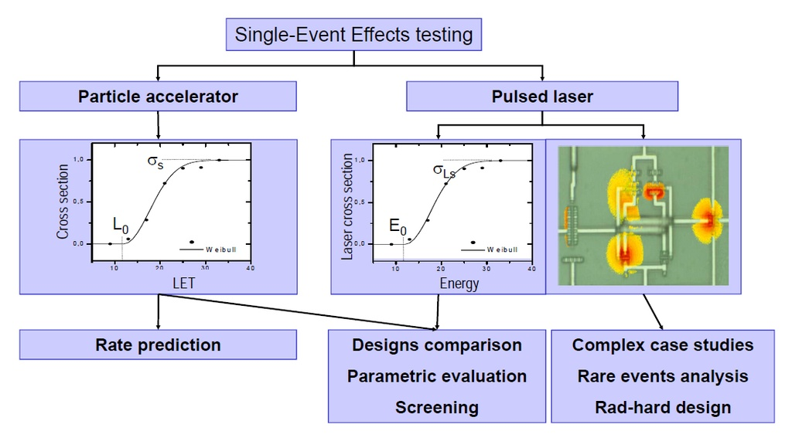
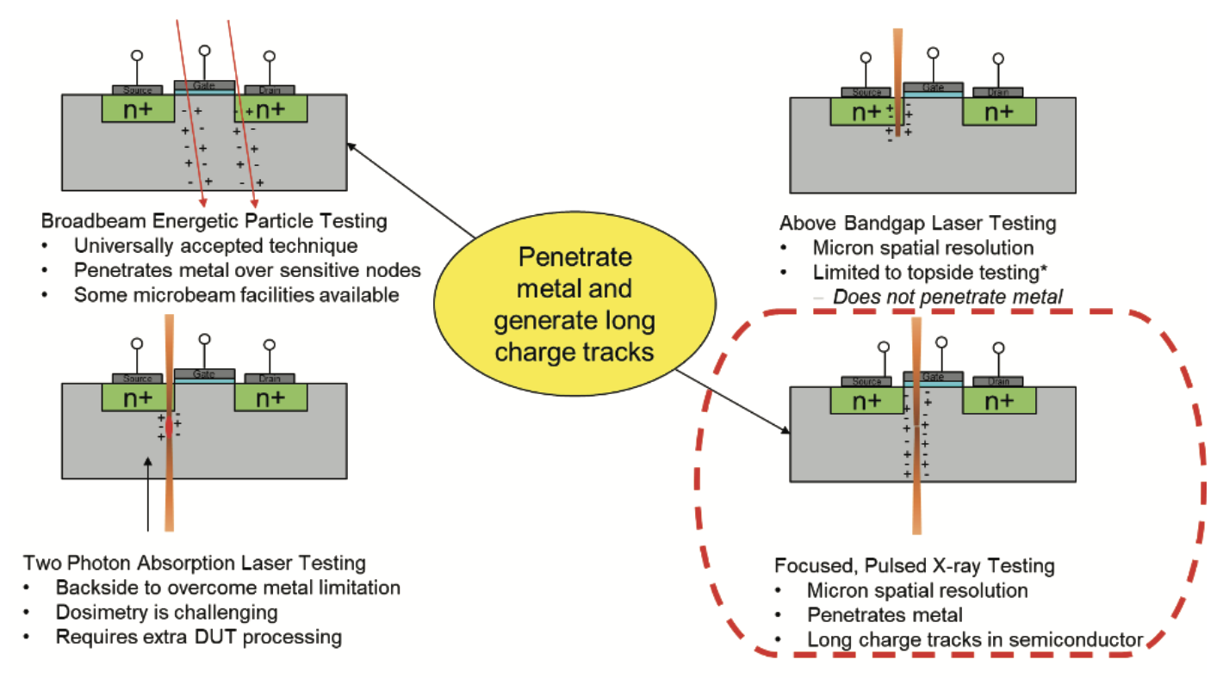
Accelerator Test Facility (ATF) Users' Meeting
Alternative Test Techniques
The Radiation Effects Community has developed a few alternative approaches to generate SEE
Pulsed Laser
Pulsed X-Ray
Pros:
Provides spatial correlation
Can be productized
Cons:
Charge track structure
Cannot penetrate through overlayers/packaging
Pros:
Similar ranges to terrestrial heavy ion facilities
Provides spatial correlation
Cons:
Dose effects
For required markings, please visit https://mh.jpl.nasa.gov

Slide 12
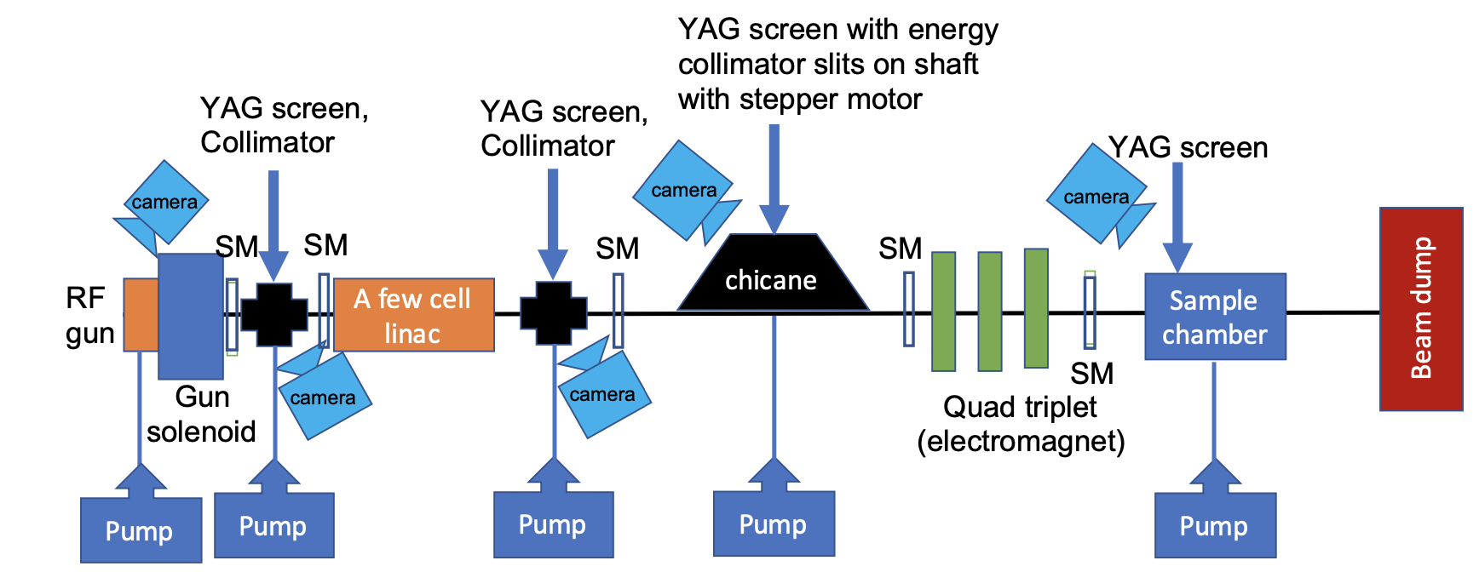
Accelerator Test Facility (ATF) Users' Meeting
Proposed Alternative
Pulsed Electron Beam

Slide 13




Accelerator Test Facility (ATF) Users' Meeting
Requirements
Duration
Energy/Range
Equivalent LET
Track Radius
Sub-picosecond
A relativistic particle travels a 1-micron distance in several femtoseconds
For either case (electron pulse or heavy ion), there is virtually no charge collection or charge-carrier recombination during this time, so all charge liberated at the beginning of the process is still present at the end .
A short bunch allows us to consider the energy deposition to scale linearly with n number of electrons. The number of electrons in a pulse can be adjusted to produce an equivalent LET for a pulse having any value up to a value at least as large as 100 MeV-cm²/mg and beyond
1 micron diameter
Large lateral dimensions of the semiconductor allow a track to expand by radial diffusion without being inhibited by dielectric structures.
Such radial diffusion expands an initially very narrow track (e.g. from a heavy ion) into a track having a 1-micron diameter in a few tens of picoseconds.
The 3-30 MeV electrons have ranges much longer than most heavy ions used for SEE tests.
Notes:
Also, for devices having large semiconductor structures, the total charge that will be collected at a junction is much greater than the charge collected during the first few tens of picoseconds, so there is little distinction between a very narrow track and a track that began with a one-micron diameter. This establishes an equivalence between pulsed electrons and heavy ions for devices satisfying the above requirement.

Slide 14
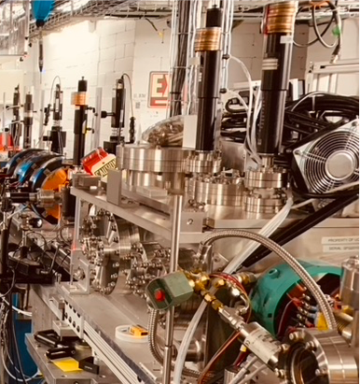


Accelerator Test Facility (ATF) Users' Meeting
Next Steps
Energy/Dosimetry Calibration
Proof of concept study - target beam structure & dosimetry
Sample Chamber installation (BNL supplied)
Compact permanent magnet quadrupoles (PMQ) mounted inside the sample chamber
Installation and test of diamond detectors (BNL Instrument Division – existing technology)
Target spot size measurement
Correlated Testing
Test simple devices in increasing complexity: Photodiode, linear devices, scaled memory, etc. Compare with existing heavy ion measurements characterized over LET
Request: 80-120 Hours Setup Time
80-120 Hours Facility Beam Time

Slide 15
Accelerator Test Facility (ATF) Users' Meeting
Impact
Near-term
Inform a DARPA backed BAA
Long-term
Productization of the technology
Relevant Publications:
National Academies of Sciences, Engineering, and Medicine. 2018. Testing at the Speed of Light: The State of U.S. Electronic Parts Space Radiation Testing Infrastructure. Washington, DC: The National Academies Press. https://doi.org/10.17226/24993.
John Franco, DTRA Jim Ross, NSWC Crane Strategic Radiation-Hardened (SRH) Electronics Council (SRHEC) Public Summary from Analysis of Alternatives (AoA) for Domestic Single- Event Effects (SEE) Test Facilities. https://nepp.nasa.gov/workshops/dhesee2021/talks/6a_SEE%20AoA%20summary%20Nov%202020%20approved%20for%20release.pdf
L. D. Flesner, R. Zuleeg and W. A. Kolasinski, "Comparison of heavy ion and electron-beam upset data for GaAs SRAMs," in IEEE Transactions on Nuclear Science, vol. 35, no. 6, pp. 1670-1672, Dec. 1988, doi: 10.1109/23.25519.
Buchner, Stephen & Miller, Florent & Pouget, Vincent & McMorrow, Dale. (2013). Pulsed-Laser Testing for Single-Event Effects Investigations. Nuclear Science, IEEE Transactions on. 60. 1852-1875. 10.1109/TNS.2013.2255312.
Cardoza, David & LaLumondiere, Stephen & Tockstein, Michael & Brewe, Dale & Wells, Nathan & Koga, R. & Gaab, Kevin & Lotshaw, William & Moss, Steven. (2014). Comparison of Single Event Transients Generated by Short Pulsed X-Rays, Lasers and Heavy Ions. IEEE Transactions on Nuclear Science. 61. 3154-3162. 10.1109/TNS.2014.2368057.
Partners
Aerospace
BNL
UCLA

Slide 16
Accelerator Test Facility (ATF) Users' Meeting
DEIA - @ JPL
About
Inclusion is a JPL core value, and fostering a diverse and equitable work environment is mission-critical for the Lab. Just as we are fearless in doing the impossible, we must also be fearless in taking action, respecting our employees' experiences, creating an inclusive environment where differing perspectives are valued and respected, and being a catalyst for positive change.
What We Do
The Office of Inclusion (OOI) develops, implements, evaluates, and informs the matrix of activities and efforts that involve Diversity, Equity, Inclusion, and Accessibility (DEIA) at JPL. Examples of this work include:
Developing and implementing a DEIA strategic plan for the Lab
Driving mechanisms and partnerships to cultivate the growth an inclusive, welcoming environment for all employees and the communities with which we engage
Collaborating with the Communities of Inclusion to ensure issues affecting marginalized communities are heard by senior leadership
Working with HR, senior leadership, managers, and other stakeholders to ensure our business practices are equitable and inclusive
Partnering with NASA and Caltech to help ensure DEIA efforts are aligned with both NASA and Caltech’s goals

Slide 17
Accelerator Test Facility (ATF) Users' Meeting
DEIA – Personal Activities
JPL Activities
Member of the Office of Safety and Mission Success DEIA advisory counsel
Have lead multiple listening sessions for our section
Community Activities
Initiated the first ever IEEE Nuclear and Space Radiation Effects Conference DEIA session

Slide 18
Electron Beam Requirements
Parameter | Units | Typical Values | Comments | Requested Values
Beam Energy | MeV | 50-65 | Full range is ~15-75 MeV with highest beam quality at nominal values | 3-30
Bunch Charge | nC | 0.1-2.0 | Bunch length & emittance vary with charge | <1 pC
Compression | fs | Down to 100 fs (up to 1 kA peak current) | A magnetic bunch compressor available to compress bunch down to ~100 fs. Beam quality is variable depending on charge and amount of compression required. NOTE: Further compression options are being developed to provide bunch lengths down to the ~10 fs level | <1 ps
Transverse size at IP (σ) | μm | 30 – 100 (dependent on IP position) | It is possible to achieve transverse sizes below 10 um with special permanent magnet optics. | 1 um
Normalized Emittance | μm | 1 (at 0.3 nC) | Variable with bunch charge | 1 um
Rep. Rate (Hz) | Hz | 1.5 | 3 Hz also available if needed | any
Trains mode | --- | Single bunch | Multi-bunch mode available. Trains of 24 or 48 ns spaced bunches. | Single

Slide 19
CO₂ Laser Requirements
Configuration | Parameter | Units | Typical Values | Comments | Requested Values
CO₂ Regenerative Amplifier Beam | Wavelength | μm | 9.2 | Wavelength determined by mixed isotope gain media | 9.2
 | Peak Power | GW | ~3 |  | ~3
 | Pulse Mode | --- | Single |  | Single
 | Pulse Length | ps | 2 |  | 2 ps
 | Pulse Energy | mJ | 6 |  | 6 mJ
 | M² | --- | ~1.5 |  | 1.5
 | Repetition Rate | Hz | 1.5 | 3 Hz also available if needed | 1.5
 | Polarization | --- | Linear | Circular polarization available at slightly reduced power | Linear
CO₂ CPA Beam | Wavelength | μm | 9.2 | Wavelength determined by mixed isotope gain media | 9.2
Note that delivery of full power pulses to the Experimental Hall is presently limited to Beamline #1 only. | Peak Power | TW | 5 | ~5 TW operation will become available shortly into this year’s experimental run period. A 3-year development effort to achieve >10 TW and deliver to users is in progress.
 | Pulse Mode | --- | Single |  | Single
 | Pulse Length | ps | 2 |  | 2
 | Pulse Energy | J | ~5 | Maximum pulse energies of >10 J will become available within the next year | ~5
 | M² | --- | ~2 |  | ~2
 | Repetition Rate | Hz | 0.05 |  | .05
 | Polarization |  | Linear | Adjustable linear polarization along with circular polarization can be provided upon request | Linear

Slide 20
Other Experimental Laser Requirements
Ti:Sapphire Laser System | Units | Stage I Values | Stage II Values | Comments | Requested Values
Central Wavelength | nm | 800 | 800 | Stage I parameters are presently available and setup to deliver Stage II parameters should be complete during FY22 | 800
FWHM Bandwidth | nm | 20 | 13
Compressed FWHM Pulse Width | fs | <50 | <75 | Transport of compressed pulses will initially include a very limited number of experimental interaction points. Please consult with the ATF Team if you need this capability.
Chirped FWHM Pulse Width | ps | ≥50 | ≥50
Chirped Energy | mJ | 10 | 200
Compressed Energy | mJ | 7 | ~20 | 20 mJ is presently operational with work underway this year to achieve our 100 mJ goal.
Energy to Experiments | mJ | >4.9 | >80
Power to Experiments | GW | >98 | >1067
Nd:YAG Laser System | Units | Typical Values | Comments | Requested Values
Wavelength | nm | 1064 | Single pulse
Energy | mJ | 5
Pulse Width | ps | 14
Wavelength | nm | 532 | Frequency doubled
Energy | mJ | 0.5
Pulse Width | ps | 10

Slide 21
Experimental Time Request
CY2023 Time Request
Capability | Setup Hours | Running Hours
Electron Beam Only
Laser* Only (in Laser Areas)
Laser* + Electron Beam
Total Time Request for the 3-year Experiment (including CY2023-25)
Capability | Setup Hours | Running Hours
Electron Beam Only
Laser* Only (in Laser Areas)
Laser* + Electron Beam
* Laser = Near-IR or LWIR (CO₂) Laser

