Slide 1
SLAC RPG Measurement of Ionizing Radiation from CO₂ laser interactions at ATF
SLAC Team: S. Rokni, J. Liu, A. Rosenstrom, M. Santana, H. Tran
ATF Team: M. Palmer, K. Kusche, A. Simmonds, K. Roy, C. Schaefer, S. Harling, A. Emrick, L. Hammons, K. Yip
ATF User Meeting 3/1/2023

Slide 2
Motivation
Increasing intensity of lasers will continue to push their operation into regimes where ionizing radiation can be generated
Current state of the art models rely on coupling Particle in Cell codes with Monte Carlo Radiation Transport Codes
In order to be sure models are producing reasonable estimate of ionizing radiation from the laser plasma interaction experimental benchmarks with a variety of laser parameters are needed.

Slide 3
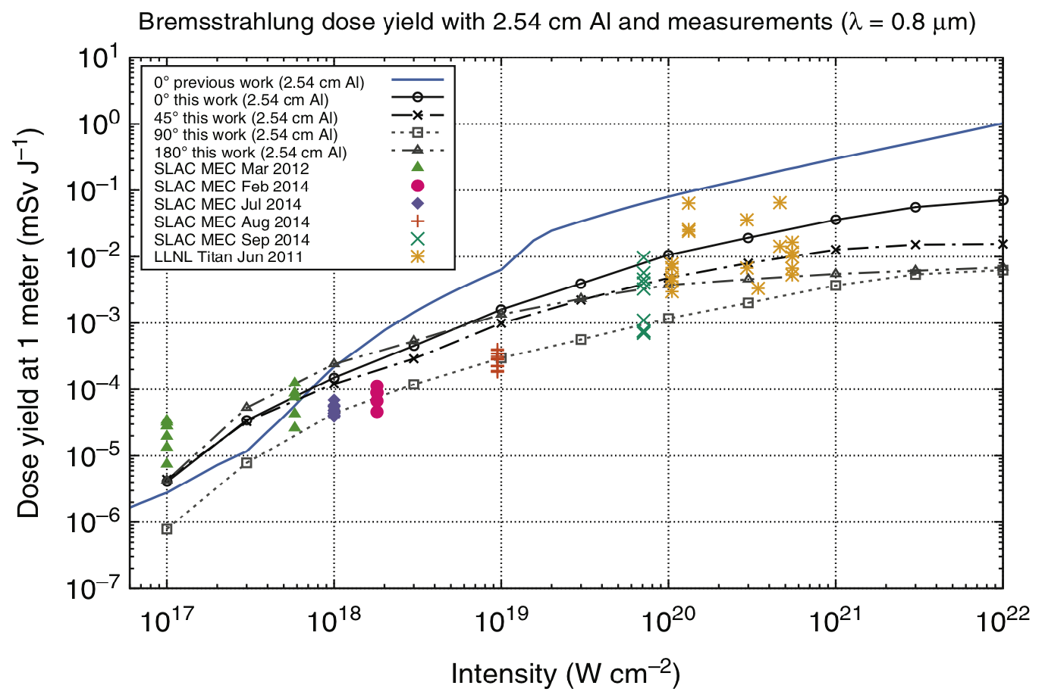
Laser-Induced Ionizing Radiation from Solid Targets
  Particle-in-Cell Code (EPOCH)
  Measurements of dose yields outside MEC & Titan target chambers
  Calculated source term for solid target:
  spectrum (Maxwellian)
  and direction of electrons for given irradiance
  Calculate dose yield (mSv/J at 1 m) outside 1 inch thick Al target chamber
  Radiation Particle Transport Code
  (FLUKA)
  Additional sources for liquid targets and thin solid targets:
  High energy protons/ions
  (hazard of secondary neutrons)
  Calculate dose at ATF parameters
  (irradiance, energy/shot, number of shots, shielding geometry)

Slide 4
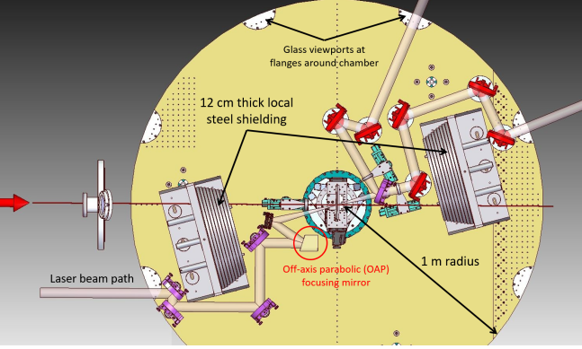
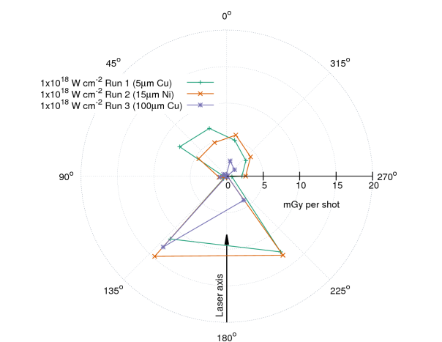
Previous Work and Publications:
Laser-Induced Ionizing Radiation from Solid Targets
Experimental Configuration of MEC Hutch at SLAC
Dose Measurements inside of the MEC Hutch at SLAC
Previous Publications and SLAC Radiation Physics Notes:
T. Liang, PhD dissertation, Georgia Institute of Technology & SLAC, 2017
Liang, T., Bauer, J., Blaha, J., Cimeno, M., Ferrari, A., Liu, J., Rokni, S., and Woods, M., “Ionizing Radiation Measurements from Interaction of MEC Laser (0.7 J, 1019 W/cm2) with Cu and Ni Targets,” SLAC Radiation Physics Note, no. RP–14–23, pp. 1–22, 2014.
Liang, T., Bauer, J., Cimeno, M., Ferrari, A., Galtier, E., Granados, E., Lee, H. J., Liu, J., Nagler, B., Prinz, A., Rokni, S., Tran, H., and Woods, M., “Radiation Dose Measurements for High-Intensity Laser Interactions with Solid Targets at SLAC,” Radiation Protection Dosimetry, vol. 172, no. 4, pp. 346–355, 2016.
Liang, T., Bauer, J., Cimeno, M., Ferrari, A., Galtier, E., Granados, E., Liu, J., Nagler, B., Prinz, A., Rokni, S., Tran, H., and Woods, M., “Measurements of High-Intensity Laser Induced Ionizing Radiation at SLAC,” SLAC Publication, no. SLAC-PUB-15973, pp. 1–18, 2014.
Liang, T., Bauer, J., Liu, J., and Rokni, S., “Bremsstrahlung Dose Yield for High-Intensity Short-Pulse Laser-Solid Experiments,” Radiation Protection Dosimetry, 2016.
Liang, T., Bauer, J., Liu, J., and Rokni, S., “Development of a Photon Dose Yield Model for Laser-Solid Interaction by Coupling EPOCH and FLUKA,” SLAC Radiation Physics Note, no. RP–16–14, pp. 1–28, 2016.

Slide 5
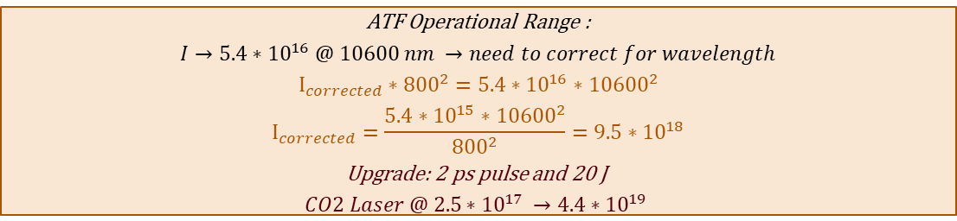
Applying Previous Work to ATF
Calculated and measured dose yields agree
Good agreement between model and experimental measurements for 800 nm and 1053 nm lasers
T. Liang, J. Bauer, J. Liu & S. Rokni, Bremsstrahlung Dose Yield for High-Intensity Short-Pulse Laser-Solid Experiments”. In: Radiation Protection Dosimetry 175 (3 2017), pp. 304–312.
doi: 10.1093/rpd/ncw325.
ATF Operational Range :
$I→{5.4∗10}^{16} @ 10600 nm →need to correct for wavelength$
$$I_{corrected}∗{800}^{2}=5.4∗{10}^{16}∗{10600}^{2}$$
$$I_{corrected}=\frac{5.4∗{10}^{15}∗{10600}^{2}}{{800}^{2}}=9.5∗{10}^{18}$$
Upgrade: 2 ps pulse and 20 J
$$CO2 Laser @ {2.5∗10}^{17} →4.4∗{10}^{19}$$

Slide 6
Previous Work: Motivation
Slide adapted from M. Palmer and ATF team
Goals:
  Directly measure the x-ray source field within the vacuum chamber
  Apply a thin Al filter (thickness of 3.35 mm) to distinguish low energy (< few 10s of keV) x-ray dose from high energy dose
  Obtain measurements near likely ultimate parameters for B820 operation to aid future analysis of upgrades [extrapolate to lower fluences for radiation safety analysis]
IR camera
TLD
TLD
Interaction Chamber
Plasma Shutter
TLD
TLD
OAP
sphere
TLDs
lens
laser
target
Test sphere 6” diam.; windows are for placing TLDs around a target
Optical transport
6

Slide 7
Previous Work: Experimental Study Parameters
Slide adapted from M. Palmer and ATF team
Designed to significantly exceed the present and potential upgrades to operational configuration of the plasma shutter!!
Relevant laser parameters for test dose rate estimate:
Laser pulse length 2.3 ps
Laser pulse energy 5 J
Laser pulse rep rate 0.03 Hz
Energy fluence @ 5 J 6.25E5 J/cm²
Laser intensity @5J and 2.3 ps 2.7E17 W/cm²
Plasma kT_{H} (Ref 1) 976 keV
Hard X-ray energy / laser energy (Ref 1) 0.011 (range is 0.00737 to 0.0165)
Ref 1: Physical Review A Volume 32, Number 6 December 1985, Superhot-X-Ray and -Electron Transport in High- Intensity CO2-Laser-Plasma Interactions, G. D. Enright and N. H. Burnett.

Slide 8
Previous Work: Results
Slide adapted from M. Palmer and ATF team
Nanodot Serial # | Rad in an hour (108 laser pulses in an hour) | Location
DB08650715G | 1.042 | 1a
DB086529564 | 1.241 | 2a
DB08653362M | 2.978 | 3a
DB08652850I | 16.03 | 4a
DB08630542R | 492.2 | 1
DB08630517K | 860.1 | 2
DB08652923D | 927.6 | 3
DB08650691I | 2,768 | 4

Slide 9
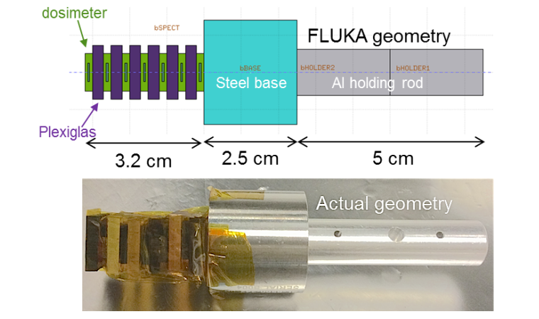
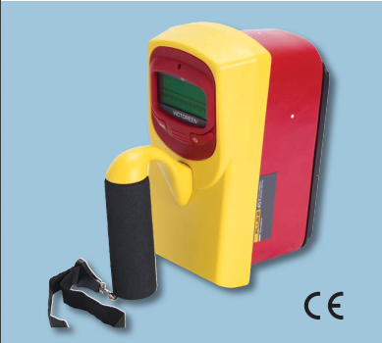

Proposed Experiments
Conduct passive and active spectral and dose rate measurements of the radiation that is produced from a solid target interaction at several intensities and angles
  This will enable a comparison of the model produced using 800 nm to a very different wavelength (10600) to show the wide range of applicability for the model and $Iλ^{2}$ scaling for use in radiation protection assessments
Stacked dosimeters used for passive spectral measurements
Ambient dose Ion chamber for active dose measurements

Slide 10
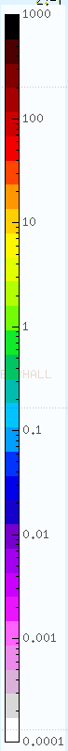
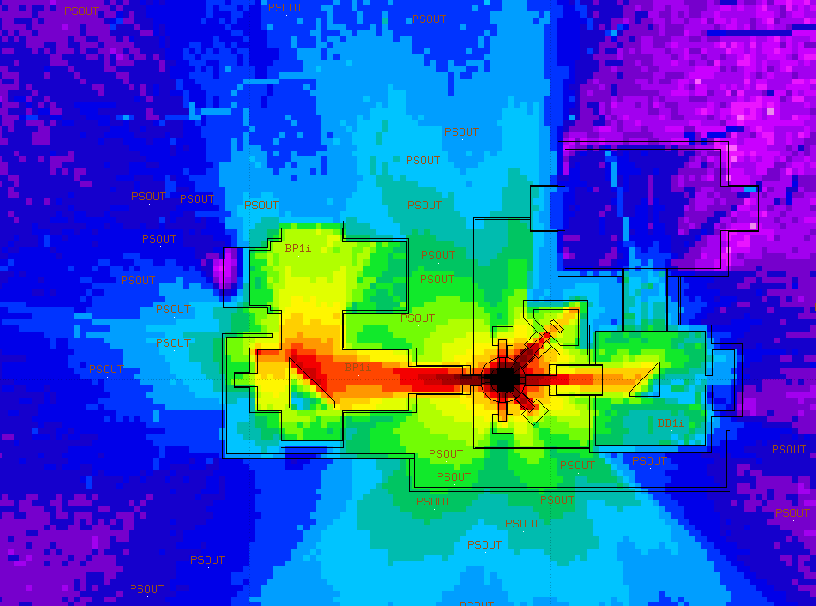
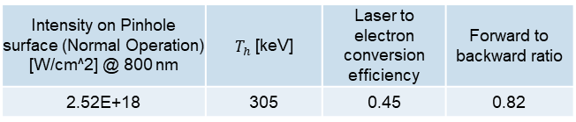
Application at the ATF
This work would support analysis of fault conditions in the ATF plasma shutter
Plan View
0.5 mrem/laser shot
0.5 mrem/laser shot
The maximum dose rate at the exclusion barrier would result in 200 shots before the 100 mrem limit is reached
0.5 mrem/laser shot
mrem/laser shot

Slide 11
Conclusion
Coupled PIC and Monte Carlo Radiation Transport codes are useful tools in developing mitigations for ionizing radiations produced by high intensity laser interactions
In order to reliably predict the dose to personnel using state of art models, benchmarking of the angular distribution, radiation spectra, and dose rate are needed over a wide range of laser conditions

