Slide 1
Overview of ePIC Tracking System
Francesco Bossù (CEA), Kondo Gnanvo (JLab), Laura Gonella (U. of Birmingham), Xuan Li (LANL).
On behalf of EIC ePIC Detector Tracking Working Group
ePIC Collaboration Meeting
Jefferson Lab, January 09 – 11, 2023

Slide 2
Outline
  Overview of ePIC tracking detector
      Current design geometry
      Tracking performance
  Update on tracking detector technologies
      ESC Consortium – Si R&D effort
      eRD108 Consortium – MPGD R&D effort
  Remaining issues
      Background simulation
      Further detector geometry Optimization
      Integration & services

Slide 3
ePIC Tracking Detector WG
ePIC Tracking working group:
  Conveners: Xuan Li (xuanli@lanl.gov), Kondo Gnanvo (kagnanvo@jlab.org), Laura Gonella (laura.gonella@cern.ch), Francesco Bossu (francesco.bossu@cea.fr)
  Email mailing list: eic-projdet-tracking-l@lists.bnl.gov
  We have weekly meetings scheduled at 11:00AM US eastern time every Thursday and the meeting indico link: https://indico.bnl.gov/category/404/
  Mattermost channel: https://eic.cloud.mattermost.com/main/channels/tracking
  WIKI page: https://wiki.bnl.gov/EPIC/index.php?title=Tracking#Tasks_list
ESC : EIC Silicon Consortium
    Mailing list: https://lists.bnl.gov/mailman/listinfo/eic-rd-silicon-l
    Indico: https://indico.bnl.gov/category/386/
    Contacts: Laura Gonella (laura.gonella@cern.ch), Giacomo Contin (giacomo.contin@ts.infn.it), Ernst Sichtermann (epsichtermann@lbl.gov)
eRD108: EIC MPGD Consortium
  Contacts: Kondo Gnanvo (kagnanvo@jlab.org), Francesco Bossu (francesco.bossu@cea.fr)
  Bi-weekly meetings on Wednesday at 1:30PM EST - indico link: https://indico.bnl.gov/category/425/
  WIKI page: https://wiki.bnl.gov/eic/index.php/Eic-rd-meeting

Slide 4
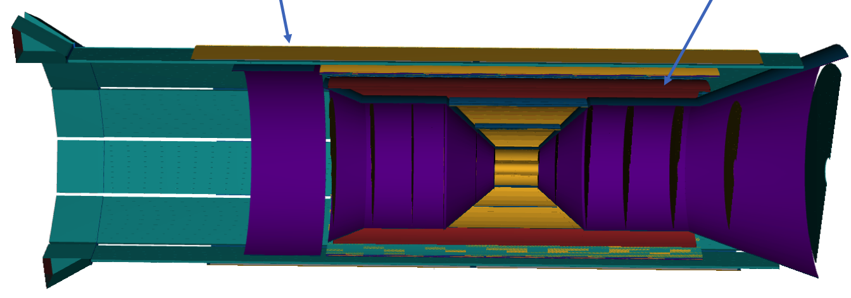
ePIC Barrel tracker: Current configuration
The EPIC tracking detector consists of the MAPS, MPGD and AC-LGAD layers/disks. Latest geometry has been implemented in the default simulation configuration.
  MAPS: 5 barrel layers (3 vertex layers and 2 sagitta layers), 5 hadron-endcap disks, 5 electron-endcap disks.
  MPGD: 1 MPGD Barrel layer in the “Bryce Canyon” tag, 1 MPGD Barrel layer and 1 MPGD DIRC layer in the “Arches” tag.
  AC-LGAD: 1 AC-LGAD barrel layer and 1 AC-LGAD hadron endcap disk

Slide 5
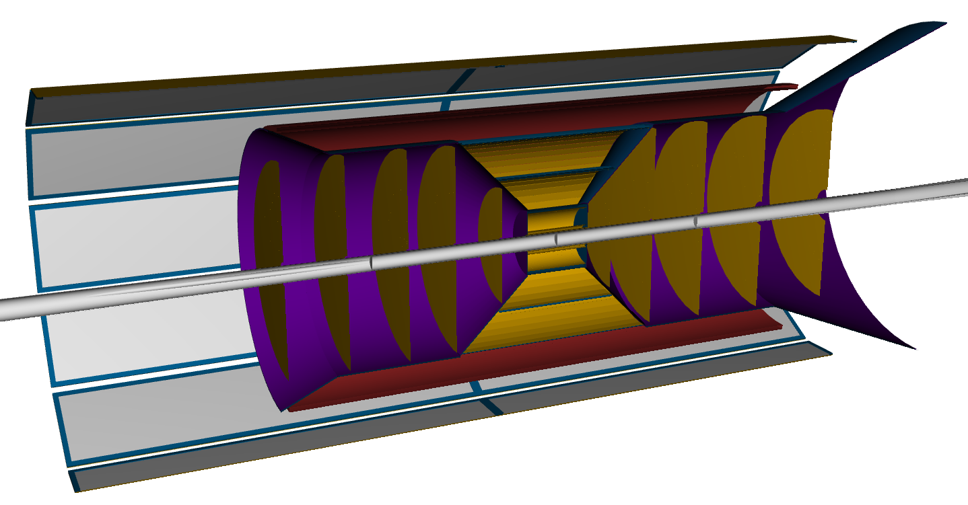
Barrel tracker: Current configuration
Vertex layers:
  Radii of two innermost vertex layers optimised for beam pipe bake out (5 mm clearance) and ITS3 sensor size.
  3rd vertex layer at r = 120 mm, dual purpose vertexing & sagitta layer, without increase in material (i.e. 0.05% X/X0, bent layer).
Sagitta layers:
  Moved at larger radii to increase lever arm with high precision measurements to improved momentum resolution.
  Layer at 27 cm made two halves of 0.25% X/X0.
Cyl. Micromegas & AC-LGAD layers:
  Additional space point for pattern recognition / redundancy
  Ongoing geometry optimization
µRWELL planar layer behind hpDIRC
  Impact point and direction for the ring seeding of hpDIRC
  Additional space point for pattern recognition / redundancy
  Not be required if imaging calorimeter is used
MPGD layers
BARREL | r [mm] | l [mm] | X/X0 %
Si vertex layer 0 | 36 | 270 | 0.05
Si vertex layer 1 | 48 | 270 | 0.05
Si layer 2 | 120 | 270 | 0.05
Si sagitta layer 3 | 270 | 540 | 0.25
Si sagitta layer 4 | 420 | 840 | 0.55
Cyl.Micromegas layer | 550 | 2300 | 0.5
AC-LGAD layer | 640 | 2400 | 1.0
µRWELL behind DIRC | 730 | 3420 | ~1.0%
See talk by Stephen & Ernst at https://indico.bnl.gov/event/16261/
See talk by Laura & Ernst at https://indico.bnl.gov/event/16582/

Slide 6
ePIC end cap trackers: Current configuration
Number of disks in the electron direction increased to improve acceptance at high eta/increase number of points on track.
  At |eta| >= 3 in the electron going direction, hits on three disks only in reference detector. Insufficient considering noise and inefficiency.
Use all available space in z to increase lever arm.
  The table below show the current layout implemented in simulation. This is the envelop assuming the pfRICH in the electron going direction. The disk design can be symmetric if the mRICH is used (i.e. envelop on electron side up to ~1350 mm).
DISKS | +z [mm] | -z [mm] | X/X0 %
Disk 1 | 250 | -250 | 0.24
Disk 2 | 450 | -450 | 0.24
Disk 3 | 700 | -650 | 0.24
Disk 4 | 1000 | -900 | 0.24
Disk 5 | 1350 | -1150 | 0.24
See talks by Ernst at https://indico.bnl.gov/event/16582/ and https://indico.bnl.gov/event/17348/

Slide 7

Tracking performance
Performance studies of the current ePIC tracker configuration are presented in detail in next three talks by Stephen, Wenqing and Rey https://indico.bnl.gov/event/17621/
Will just present two slides that highlight the areas to focus our next effort for the ePIC detector geometry optimization
  Studies of the average number of hits per track for performance optimisation
  Study of the role of the MPGD and AC-LGAD layers in the barrel tracker

Slide 8
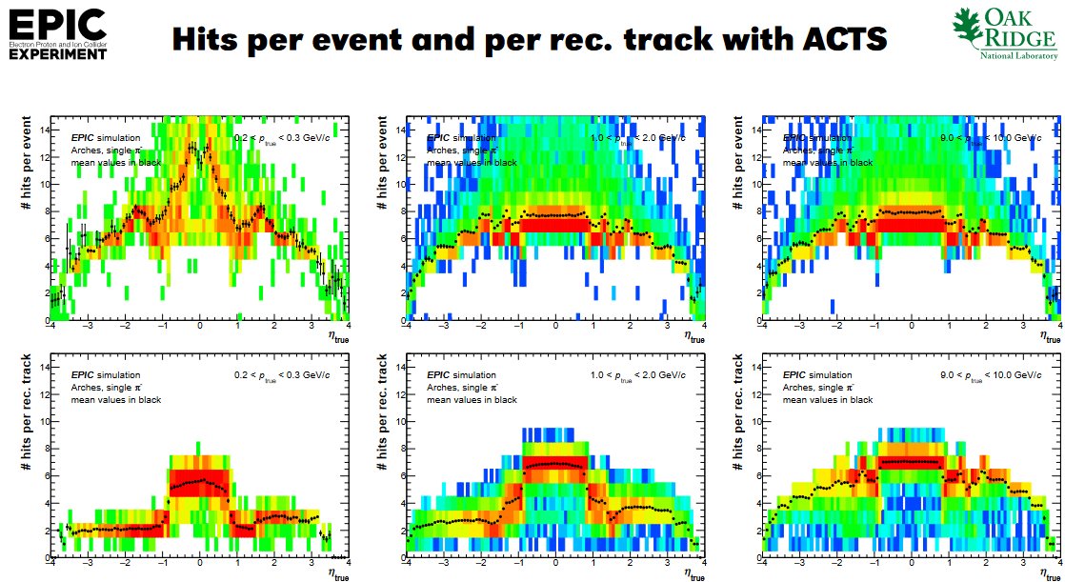
Tracking performance: Average number of hits per track
EPIC detector performance studies with DD4hep and eicrecon: Average number of reconstructued hits per tracks vs. eta and p
See talk by Nicolas Schmidt at https://indico.bnl.gov/event/17752/

Slide 9
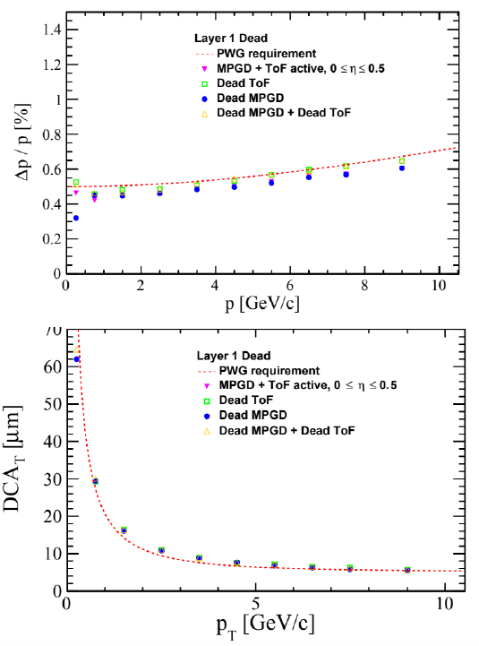
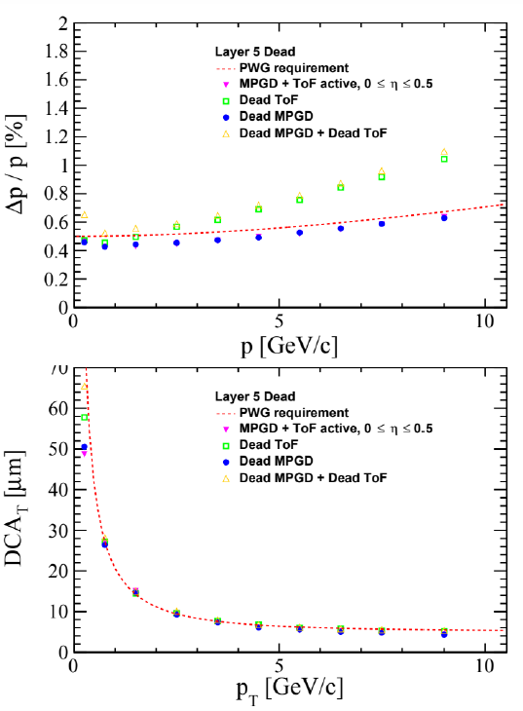
Tracking performance: Role of MPGD & AC-LGAD layers
Simulations in Fun4All to study the contribution of the barrel MPGD and AC-LGAD layers to momentum and DCA resolutions
Hits in all 5 Si layers:
Momentum & DCA resolutions dominated by Si layers
Small improvement of momentum resolution with ToF
Negligible contribution by MPGD or ToF to either p or DCA measurement
Hits missing in one of the 5 Si layers:
Negligible impact on momentum and DCA resolution, except for Si layer 5
Improvement to momentum resolution by ToF layer if missing hit from outer Si layer (layer 5).
MPGD helps improve performance at low momentum only when hits are missing in both Si and ToF layers
To summarize:
Barrel MPGD has minimal impact on performance even for redundancy when hit are missing in Si layers
Performance improvement by ToF layers when single hit missing in Si layers
MPGD will be mostly needed for pattern recognition
Very important study for further optimization of tracking detector geometry
Missing hit in inner Si layer
Missing hit in outer Si layer
See talk by Stephen Maple at https://indico.bnl.gov/event/17752/

Slide 10
EIC Silicon Consortium – R&D effort
  Overarching goal is the development and construction of a full tracking and vertexing detector subsystem for the EIC detector(s) based on 65 nm Monolithic Active Pixel Sensors (MAPS),
  Consortium grew out of the previous Generic EIC Detector R&D program; eRD16, eRD18, and eRD25 (2015—2021), contributed to all detector proposals, and many members are active within ePIC,
  Open to collaborators new to the effort,
    Mailing list: https://lists.bnl.gov/mailman/listinfo/eic-rd-silicon-l
    Indico: https://indico.bnl.gov/category/386/
    Contacts: Laura Gonella, Giacomo Contin, Ernst Sichtermann
  Two streams of R&D:
    Targeted R&D for the ePIC detector:
      eRD104 – services reduction aims to significantly reduce the all-important services (powering; readout)
      eRD111 – development of tracking and vertexing solution (modules; barrel and disks; mechanics, integration, cooling)
      eRD113 – development of the EIC MAPS sensor (sensor design; sensor characterization)
    Generic R&D for ePIC improvements and upgrades, or for a future second detector

Slide 11
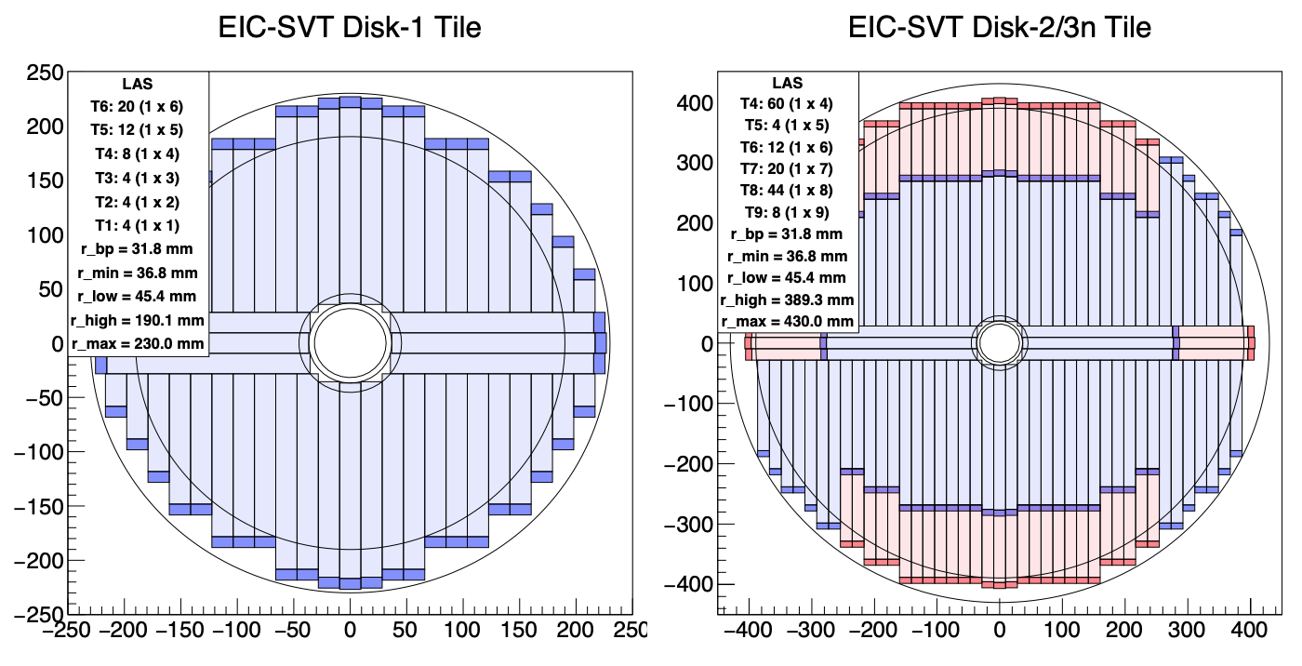
EIC Silicon Consortium – R&D effort (eRD111)
  The EIC science program requires a well-integrated, large acceptance tracking and vertexing solution designed with high-granularity and minimized material (including services),
  65 nm MAPS technology – being spearheaded by the ALICE ITS3 project – choice and focus was a carefully considered outcome from a broad survey, see e.g. Laura Gonella’s talk at the 1st Yellow Report Workshop, https://indico.bnl.gov/event/7449/
  The path to ePIC / an EIC detector based on 65 nm MAPS thus requires us to develop:
    ITS3-like vertex layers re-using the ITS3 large-area sensor (LAS) as is in a configuration adapted to the larger EIC radii (R&D)
    EIC variant optimized for large area coverage for outer barrels and disks – that is high yield, cost, etc. This sensor will have the same interfaces as ITS3 and will be stitched, but not to wafer scale (R&D). More conventional carbon fiber support structures with integrated cooling (R&D).
  Ongoing studies on tiling of staves and disks, illustrated on the right for two representative disks, to inform the EIC LAS formats (stitching plan, digital periphery).

Slide 12
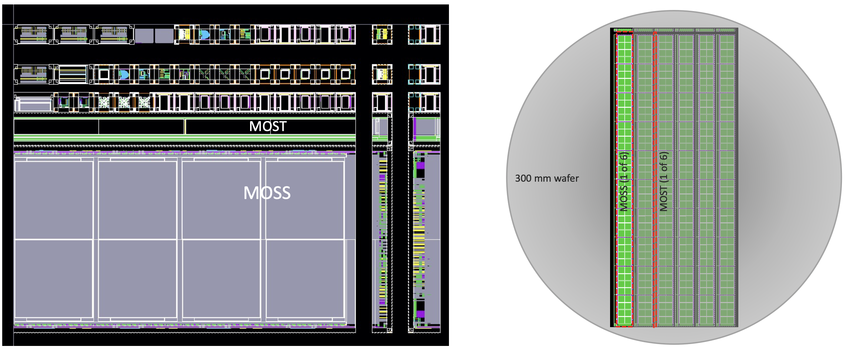
EIC Silicon Consortium – R&D effort
  Sensor design (eRD113) - Current EIC SC designer groups: RAL and (new) BNL and LBNL,
  MLR1 – Q4 2020
    First submission in Towerjazz 65 nm; scoped within CERN EP R&D WP1.2, significant drive from ITS3, important contributions from many groups,
    Scope: Technology exploration and prototype circuit blocks for future sensors,
    Large number of test structures included,
    RAL contributions: high-speed data transmission IP blocks (LVDS receiver, CML transmitter),
  ER1 – Q4 2022
    First Engineering Run, driven by ITS3 stitched sensor prototype,
    Scope: learning about stitching and yield of LAS
    Two large stitched sensor chips (MOSS, MOST) plus small test and development chips,
    RAL contributions: high-speed data transmission IP blocks (PLL, CML receiver); on-chip signal transmission I2C block; DFM cell improvements.

Slide 13
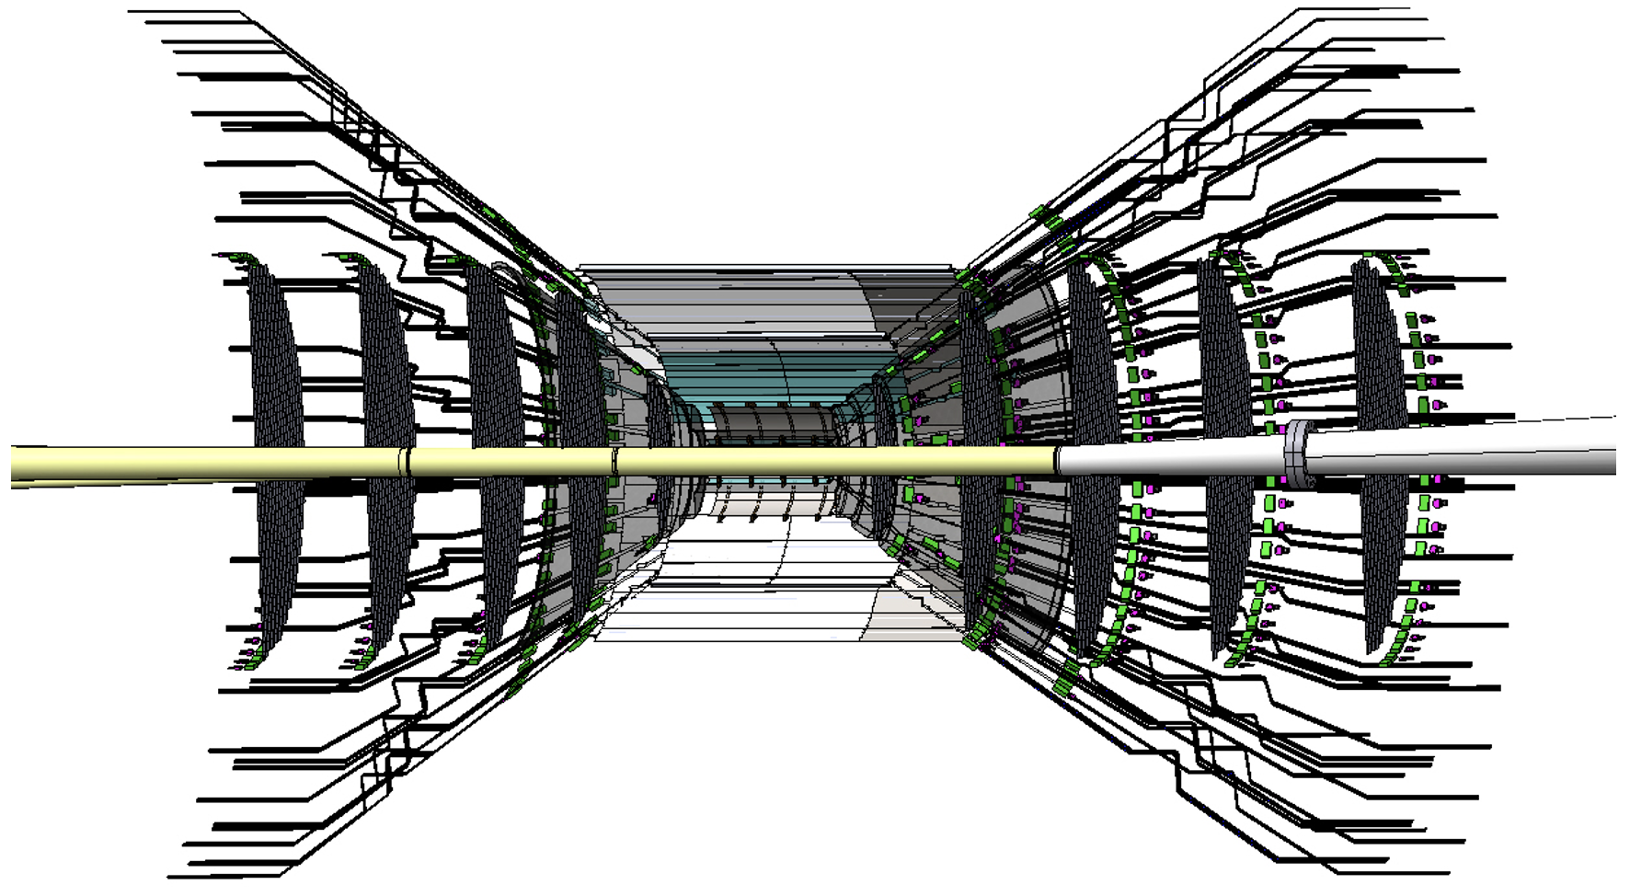
EIC Silicon Consortium – R&D effort
  Sensor characterization efforts gearing up (eRD113),
    INFN groups leading tests of DPTS circuits,
    INFN and Berkeley groups participated in test beams,
    Test setups received and being commissioned (and produced) – currently LBNL, ORNL, UK groups,
    Characterization of the MLR1 RAL IP blocks – UK groups,
  Power and Readout are integral to service reduction (eRD104),
    Powering – as the outcome of a survey, serial powering and DC-DC conversion with integrated regulator is currently being considered as the most promising candidate for the ePIC MAPS-based tracking and vertexing subsystem – pursued by UK groups,
    Readout – ongoing exercises to estimate and refine hit loads; candidates for radiation tolerant FPGA and optical interconnect, and electrical / optical interface being identified – pursued by ORNL,
  CAD modeling continues from the effort for the initial detector proposals at JLab and LANL,

Slide 14
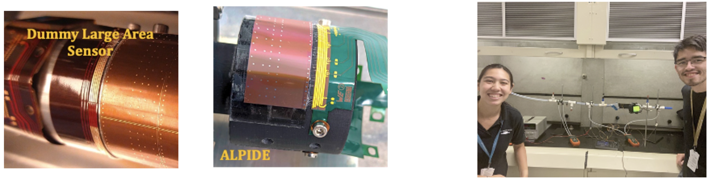
EIC Silicon Consortium – R&D effort
    Mechanical studies on single-reticle and large-size MAPS are ongoing at INFN,
      Bending, thinning, and interconnection,
      Characterization in flat and curved geometries,
      Bending and wire-bonding have been successfully exercised at EIC vertex-layer radii,
    Studies of cooling option for staves and disks – for example, air cooling internal to the mechanical structures – are ongoing at LBNL,
    Starting assessments of materials to construct disks and supports at LANL, LBNL.

Slide 15


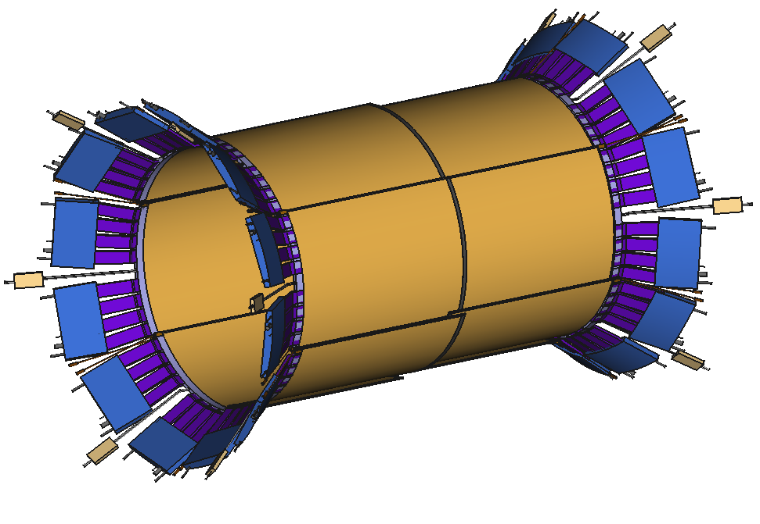
MPGD - Barrel Cylindrical Micromegas
Motivation
Build a full acceptance light-weight modular MPGD barrel tracker to complement the silicon vertex detector
Due to space limitations and material budget limits: cylindrical tiles
Light cylindrical Micromegas technology is already in use (CLAS12 and ASACUSA)
Cylindrical µRWELL is viewed as back up technology for Micromegas
Objectives
Resolutions of ~150µm
Fewest possible number of channels to limit the material budget
Keep the material budget at ~0.5% X0 per layer
R&D ongoing within eRD108
2D readout, with large strips (~1mm)
  2022–2023: optimization and choice of the 2D pattern on small prototypes
Optimize the production by limiting the number of types of modules:
  2023-2024: production of full scale tile (50x70cm²) and a mockup of longer size
CAD design of one layer of overlapping cylindrical tiles with FEE and services
R ~ 50cm, L ~ 140cm

Slide 16
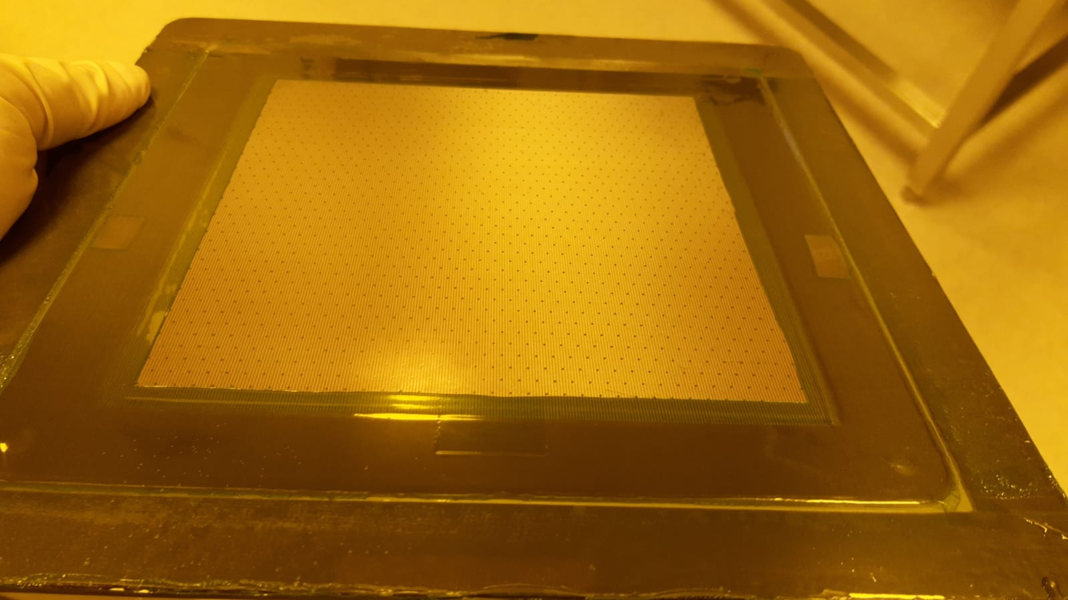
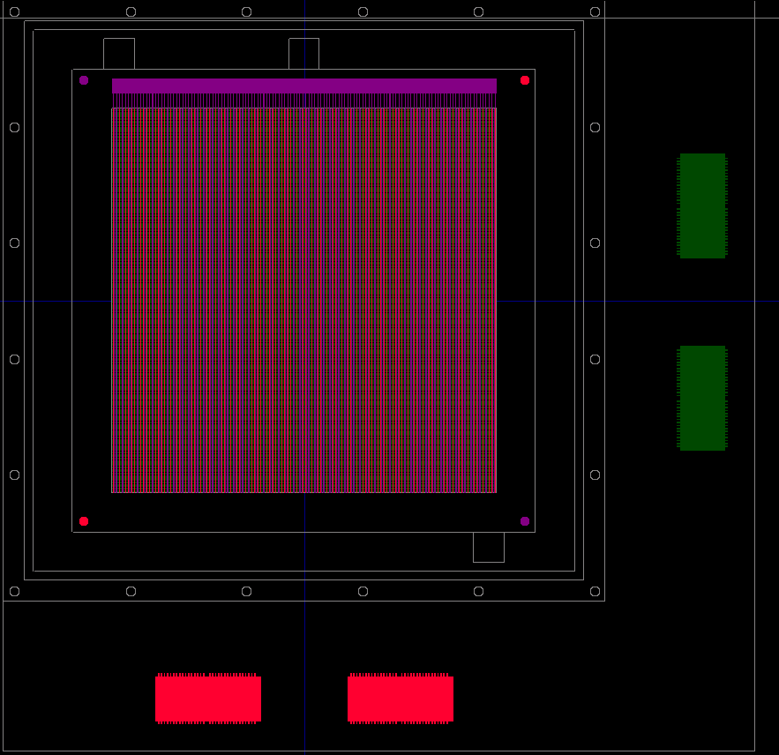
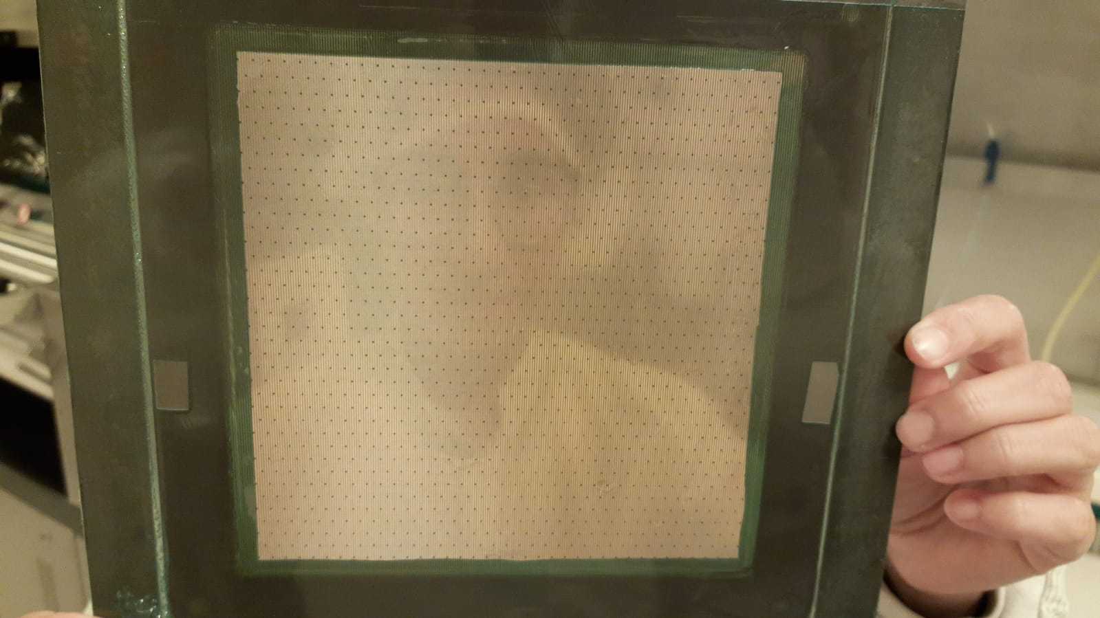
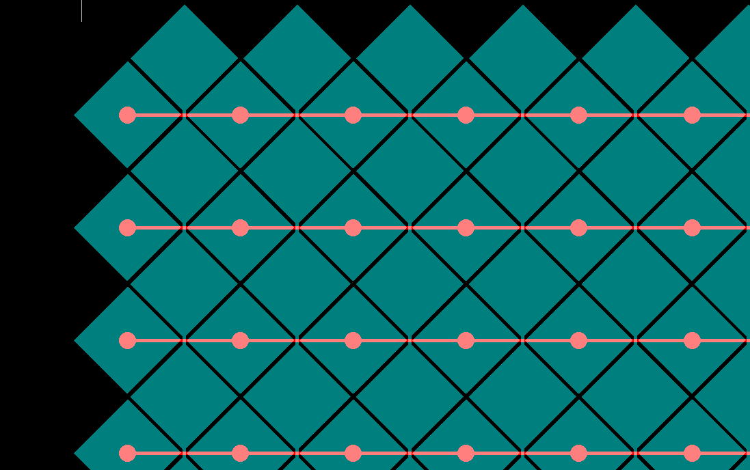
MPGD - R&D effort (eRD108)
2022 – 2023: 2D readout optimization on small prototypes
Amplification Kapton (AK): a Kapton foil with resistive paste stretched on a carbon fiber frame and then bulk with a micromesh
AKs with different resistivity will be glued together with Kapton foils with 2D readout patterns
Readout pattern design:
Several design 2D patterns:
  Orthogonal strips
  ASACUSA like readout
Tests:
Beam test in June 23

Slide 17
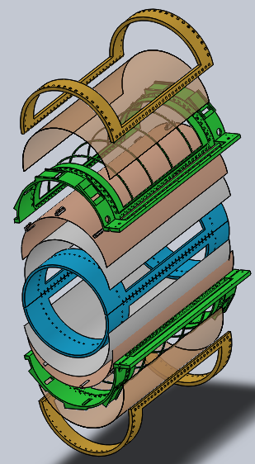
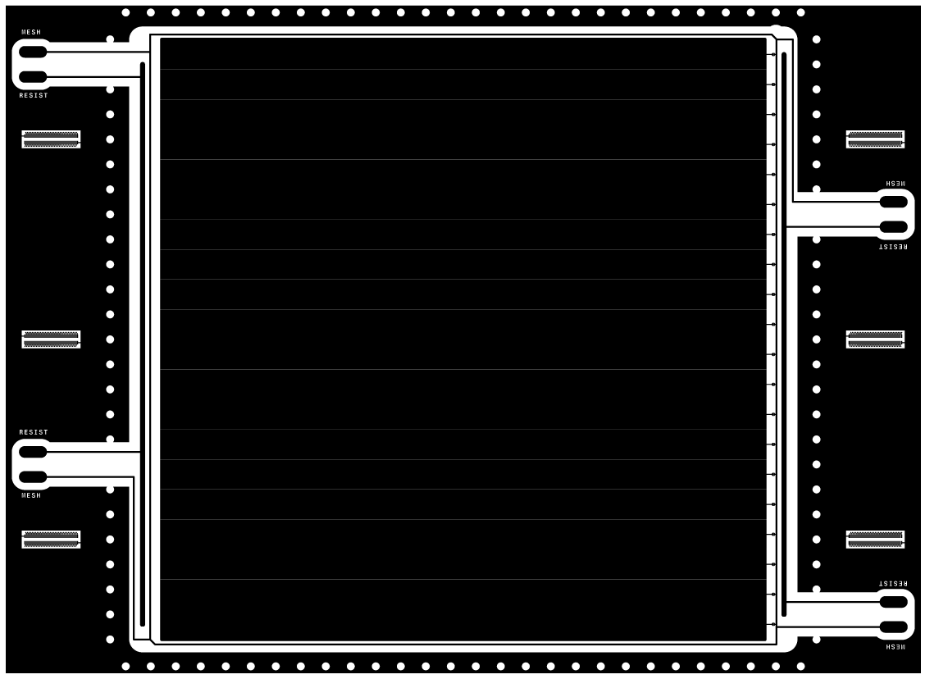
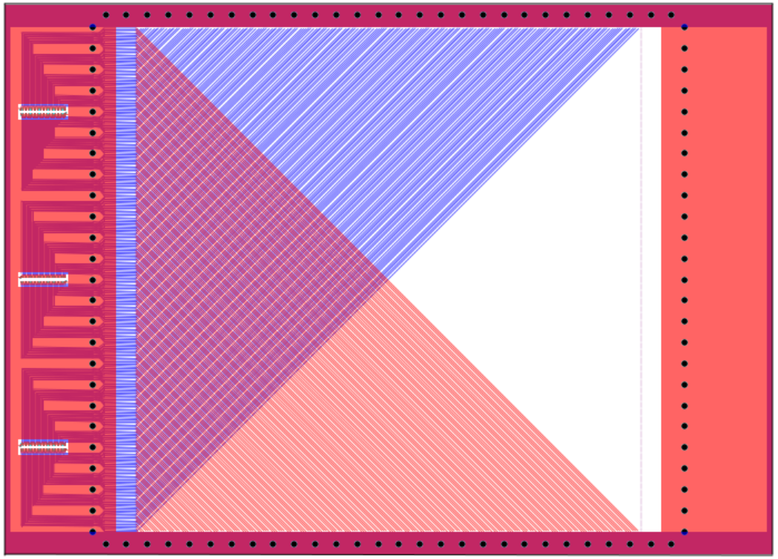
MPGD - R&D effort (eRD108)
Development of cylindrical µRWELL prototype: (BNL, Florida Tech, JLab, Temple U.)
Prototype consists of 2 half-cylinder chambers with different readout structures
  CapaSh-uRWELL: uRWELL/readout foil with U-V capacitive-sharing readout
  Zigzag-uRWELL: uRWELL/readout foil with U-V :zigzag” readout structure
Design of all parts (2 uRWELL/RO foils) and mechanical structure are completed,
Fabrication at CERN assemblyt of the prototype at Florida Tech ➔ April 2023
Tests in hadron beam at FNAL ➔ June 2023
Data analysis, report / presentation at DAC committee meeting and preparation for publication in peer-review journal ➔ June – December 2023
CAD drawing / mechanical design completed
Outer clamp
Cathode foil
Main frame
µRWELL-R/O composite foil (w/ FE connectors)
uRWELL foil design completed
U-V strip readout design completed
Inner clamp
366.4 mm
U-strips
Prepreg base
(0.2-1mm thick)
Panasonic connectors to the APV25-SRS FE electronics
366.4 mm
400 mm
Support for
FE cards
V-strips
560. mm
https://wiki.bnl.gov/eic/upload/ERD108_Proposal_FY23.pdf

Slide 18
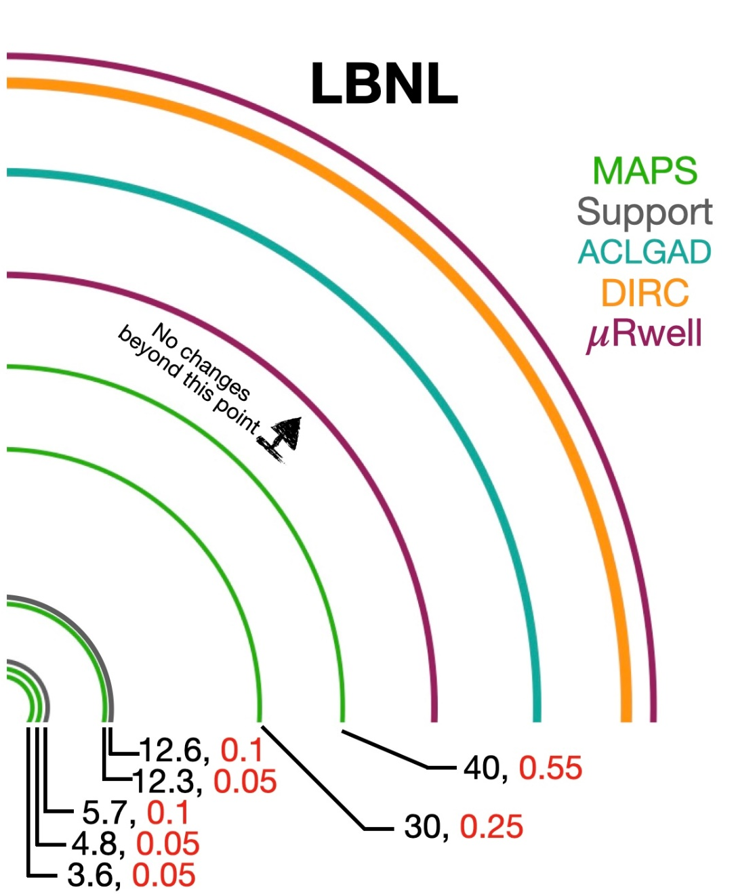
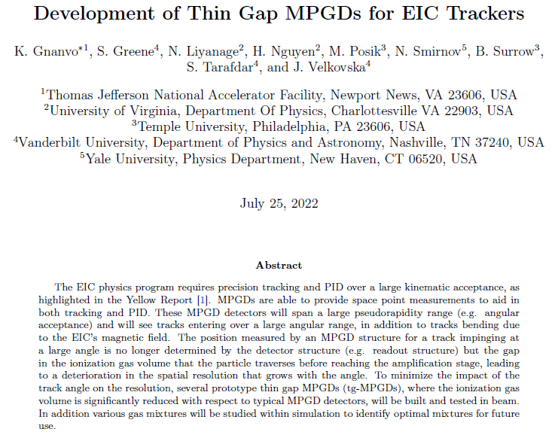
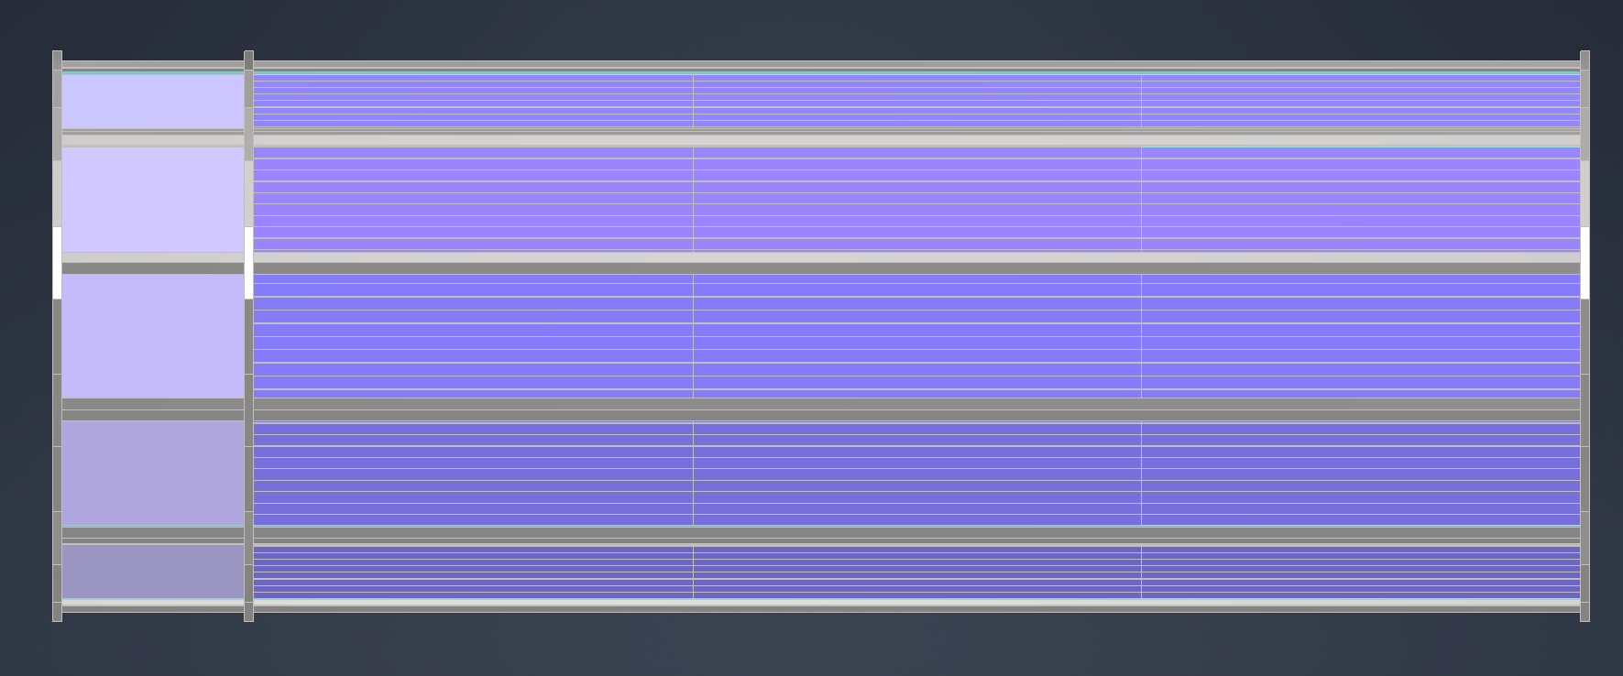
MPGD - Planar µRWELL layers
Requirements & expectations from YR & various detector proposals:
Low mass (< 1% X0) not justified here ➔ 1% to 2% X0 in front of EM Cal. is not an issue
But space limitation for layer behind hpDIRC ➔ 2 cm thick box space for MPGD layer
Spatial resolution (50 - 100 µm) in both phi and z
EIC Detector Generic R&D - EICGENRandD_2022_23
µRWELL layer behind hpDIRC
µRWELL layer
200 cm
Courtesy Roland Wimmer
https://www.jlab.org/research/eic_rd_prgm/receivedproposals

Slide 19
Remaining tasks / issues
Implementation of the background in simulation for tracking performance studies
  MPGD trackers for pattern recognition
        How many barrel MPGD layers are required, what is the best configuration (radii and size …) for optimal configuration
        Do we need additional Si disks in the forward and backward regions to increase the number of hits in background environment
Optimization of the interface between barrel MPGD layer and the Si support structure
  Do we need barrel MPGD layers to cover an eta range > 1.1? or rather increase the Si disks radii in the end cap
  Complement with MPGD rings instead
MPGD layer behind dRICH
  Simulation studies is needed to evaluate the impact dRICH ring reconstruction and overall tracking performance
Integration & Services
  More realistic evaluation of the services (cables, FE cards, HV …) and integration issues only after new geometry optimization phase
Technology review:
  Complete review of the choice of tracking technologies.
  Identify risks & fallback solutions for each technology.
  Close coordination with the detector consortia (EIC Silicon consortium, MPGD consortium)

Slide 20
Backup

Slide 21
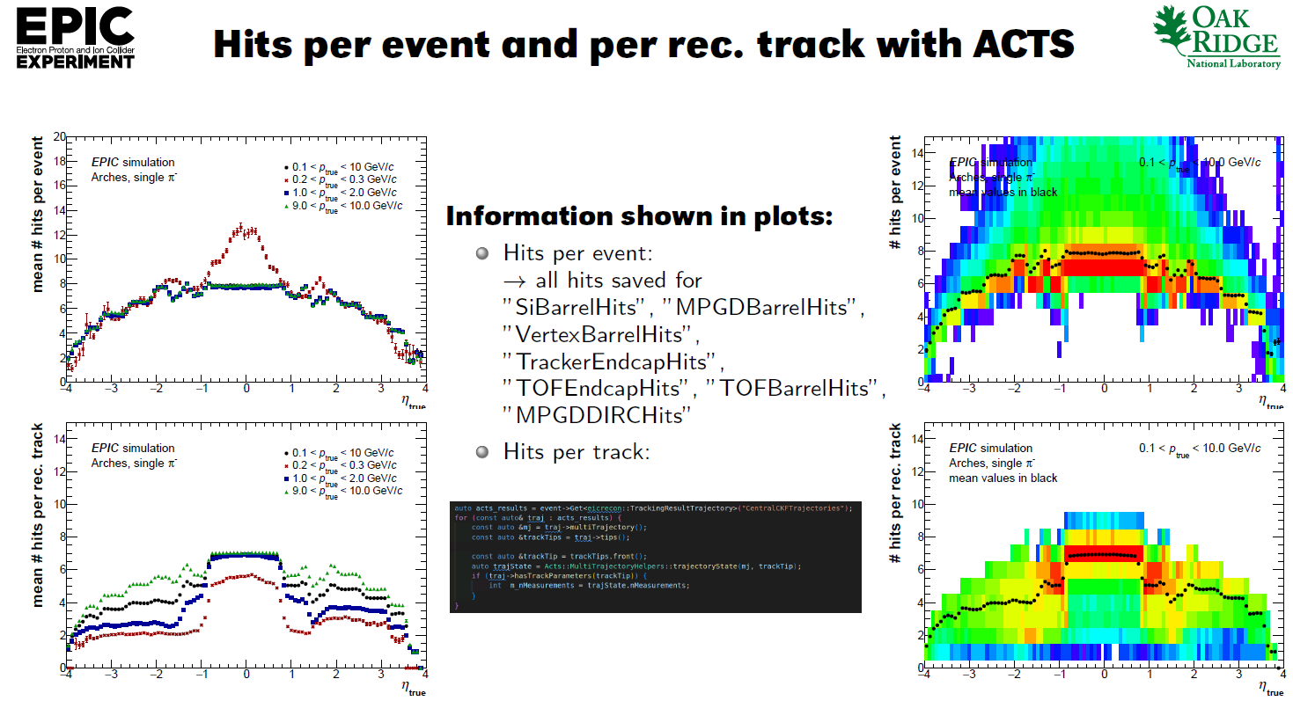
Tracking performance: Average number of hits per track
EPIC detector performance studies with DD4hep and eicrecon: Average number of reconstructued hits per tracks vs. eta and p
See talk by Nicolas Schmidt at https://indico.bnl.gov/event/17752/

Slide 22
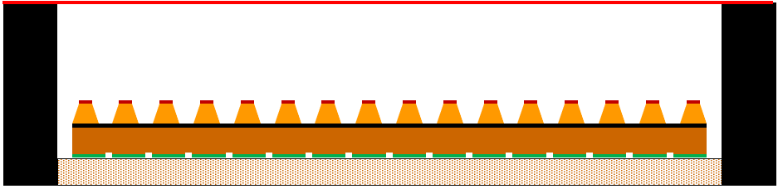
MPGD – Generic R&D: Thin Gap MPGDs
Proposal - EICGENRandD_2022_23
Motvation for thin gap MPGDs
Limitation with standard gap MPGDs (~ 3mm):
  deterioration of spatial resolution with track angle .
  Degradation spatial resolution due to E x B effect inside magnetic field.
Thin Gap MPGDs will address the above issues ➔ Reduce drift gap (< 1mm)
  Improve spatial resolution over a large angle range
  Minimize E × B effect on resolution dependence
  Improve timing resolution by a factor > 2
Challenges:
  affect detector efficiency ➔ use heavier gas
  Mechanical stability for large area detector
EICGENRandD_2022_23 Proposal:
  Multi institution protosal
  Prototypes with all 3 MPGDs technologies (MM, GEM, µRWELL)
  Explore single and double amplification stages to recover efficiency
  Will directly benefit ePIC MPGD tracking layers.
1 mm
µRWELL
https://www.jlab.org/research/eic_rd_prgm/receivedproposals

Slide 23
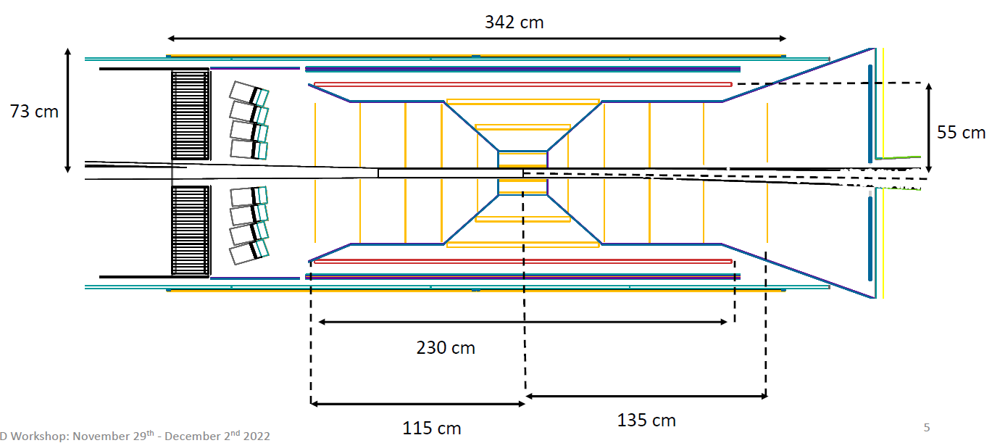
EPIC reference detector: Question 2
η = 1.1
Why does the cyl. MPGD coverage in eta extended beyond η > 1.1?
  Does not add anything to the tracking performance in the barrel
Shorter Cyl. MPGD in z direction tracker will minimize the challenges for
  fabrication and minimize the MPGD cables and service
As layer providing additional space point for both end cap Si-trackers
  Poor space point resolution ➔ because of large track angles (> 45º)
  Material of the Si support cone structure in front of the layer …
Similar argument can be held for the AC-LGAD disk
  But this is a discussion for another day

Slide 24
EPIC reference detector: Possible option to question 2
Cable routing of the Si disks
η = 1.1
Complement the Si disks with thin gap MPGD rings (or extending Si disks radius)
Optimizing the Si-layer cable and services “cone” support ➔ (red lines)
Could the cables of the Si-disks be routed vertically up to the cone structure?
  This will be optimal for performances

