Slide 1
pfRICH Design Update
Alex Eslinger (Jlab)
12/14/22

Slide 2
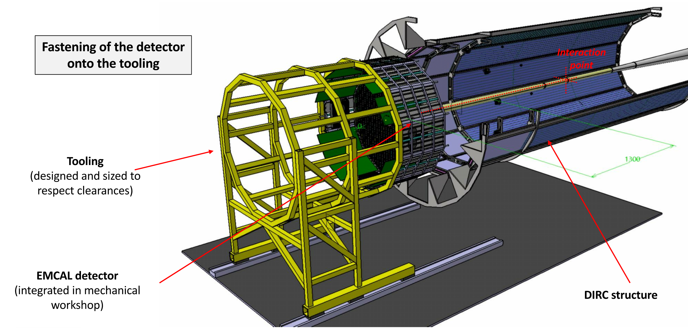
Integration
Discrepancy between integration and project about whether we will need to roll the barrel in the assembly hall every time we need to do maintenance…
Spurred by the Backward ECAL slides

Slide 3
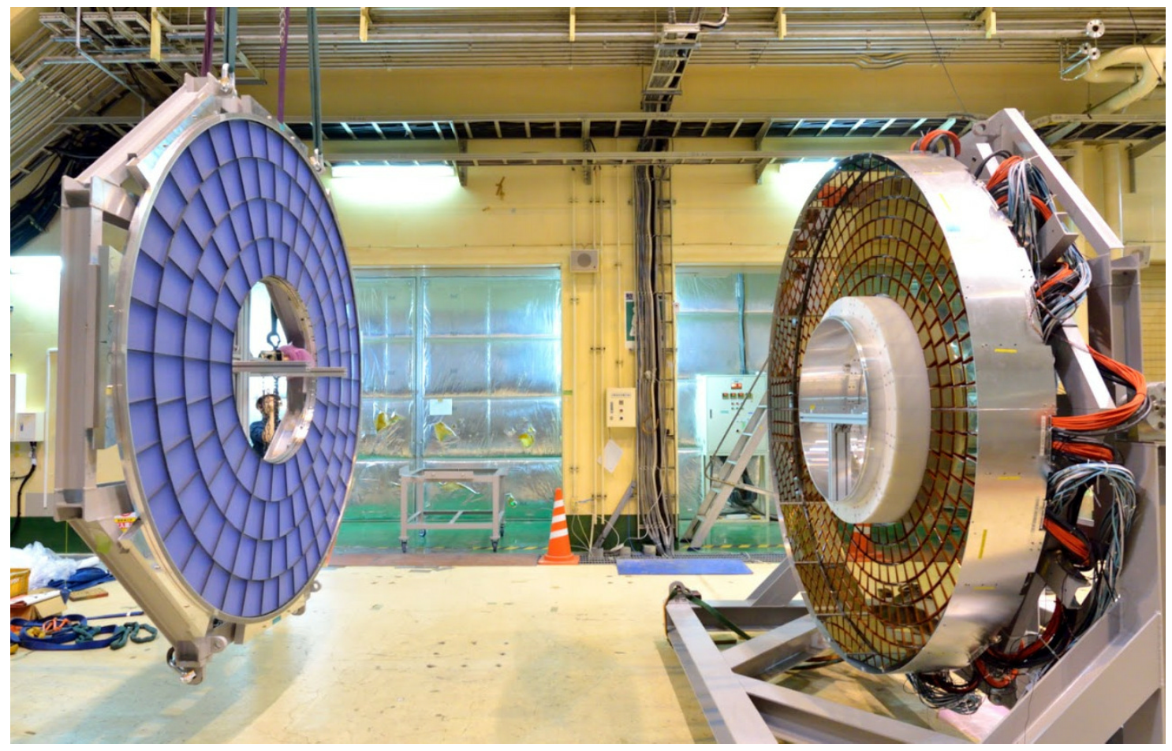
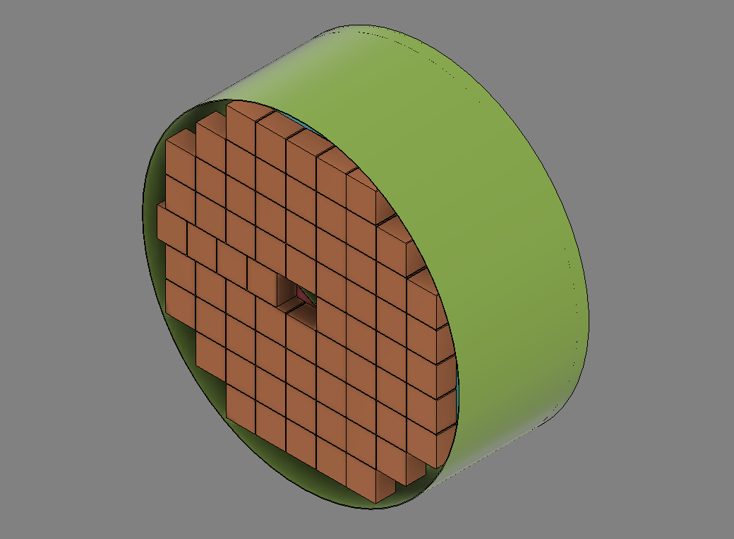
Cont’d
Through clarification, we learned:
5mm beam pipe flange tolerance needs to be maintained
Detector does not need to be split as originally thought…
If ECAL comes out as a whole, meaning we can design ours similar to Belle II with a fore/aft split or we could design it so that it goes in and out as a whole

Slide 4
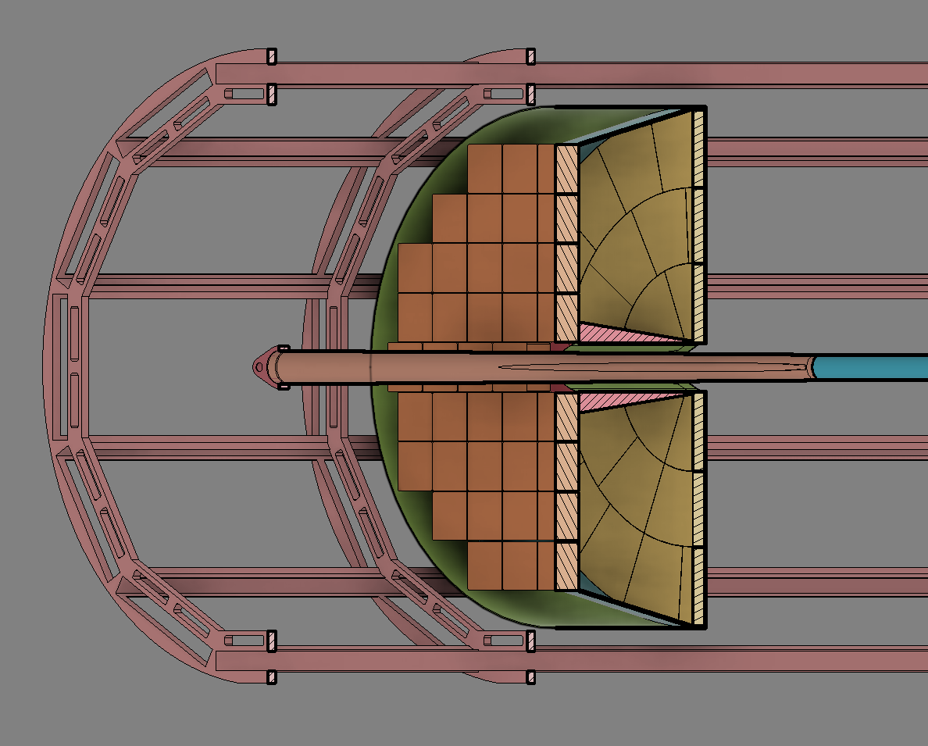
Design
Updated tiling scheme
Enlarged aerogel radius to fit to proposed mirrors
Made the cutout for the aerogel inner radius
Conceptually placed
Outer mirrors
Inner mirror/structure (due to flange shape, we may just lose small mirror portion)
Containment vessel

Slide 5
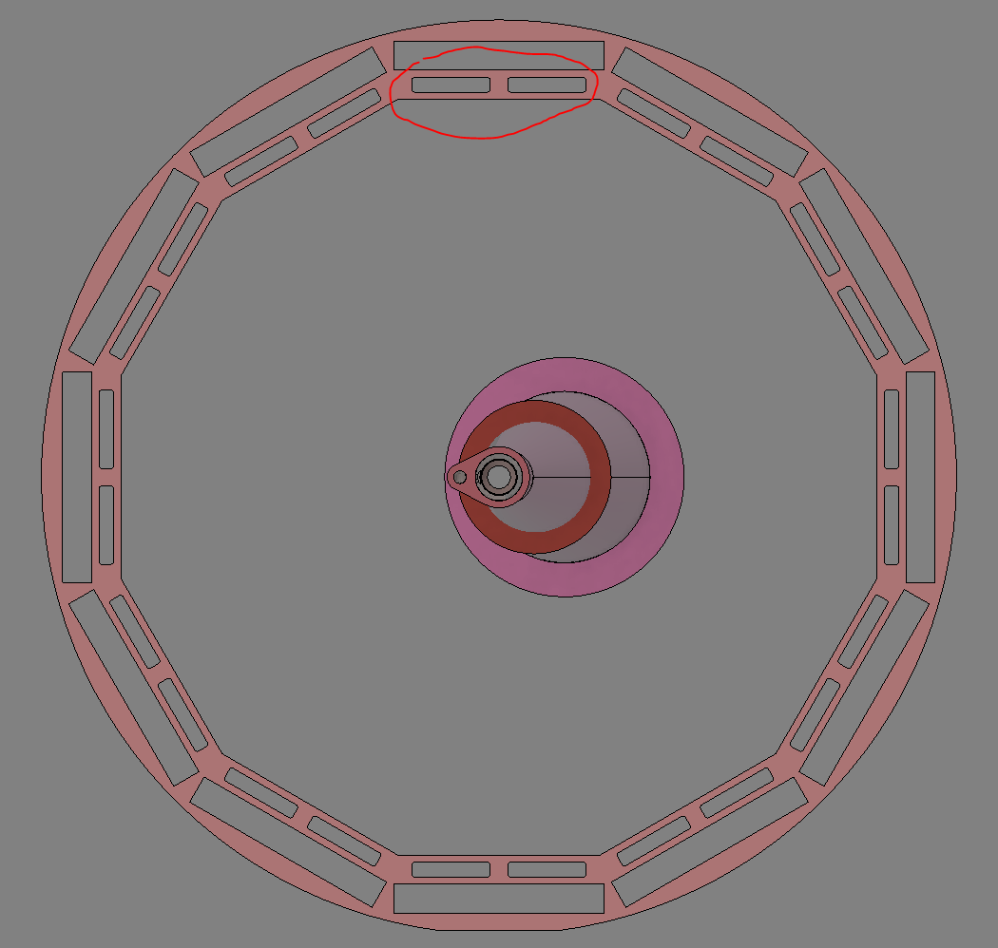
Electronics
Consider the slack needed for the cables – the cables should be fed through the DIRC support frame cutouts
Design the containment system to have distribution at the dead space along the tiling scheme.
Wouldn’t continue the cylinder, we’d reshape it to match the outer contour of the tiling scheme

Slide 6
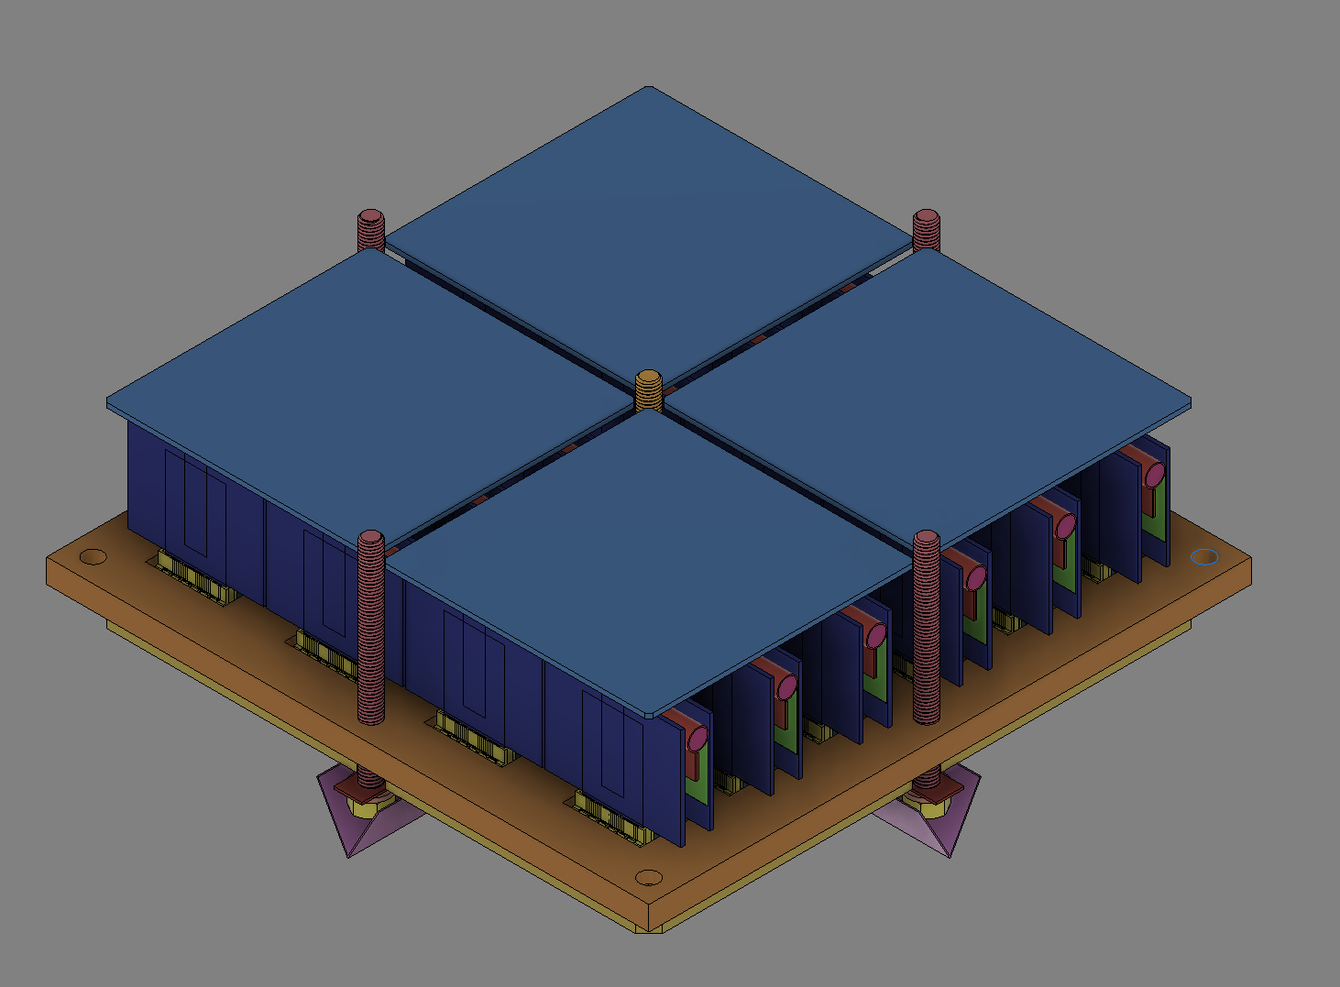
Light Tightening
The current thought process is to add black paper or a gasket between the mounting plates and the sensors, the bolt holes will also need some sort of scheme as well, possibly on the backside of the plate
Input is appreciated

Slide 7
Material Choice/Budget
Material choice is still undetermined
Project brought up a concern about the inner mirror structure causing issues with the backward ECAL downstream, still looking into this

Slide 8
Questions?

