Slide 1
EIC Far-Backward Component Radiation Damage Study
A. Kowalewska¹, J. Nam², K. Piotrzkowski¹, B. Surrow²
1. AGH University of Science and Technology, Krawkow
2. Temple University, Philadelphia

Slide 2
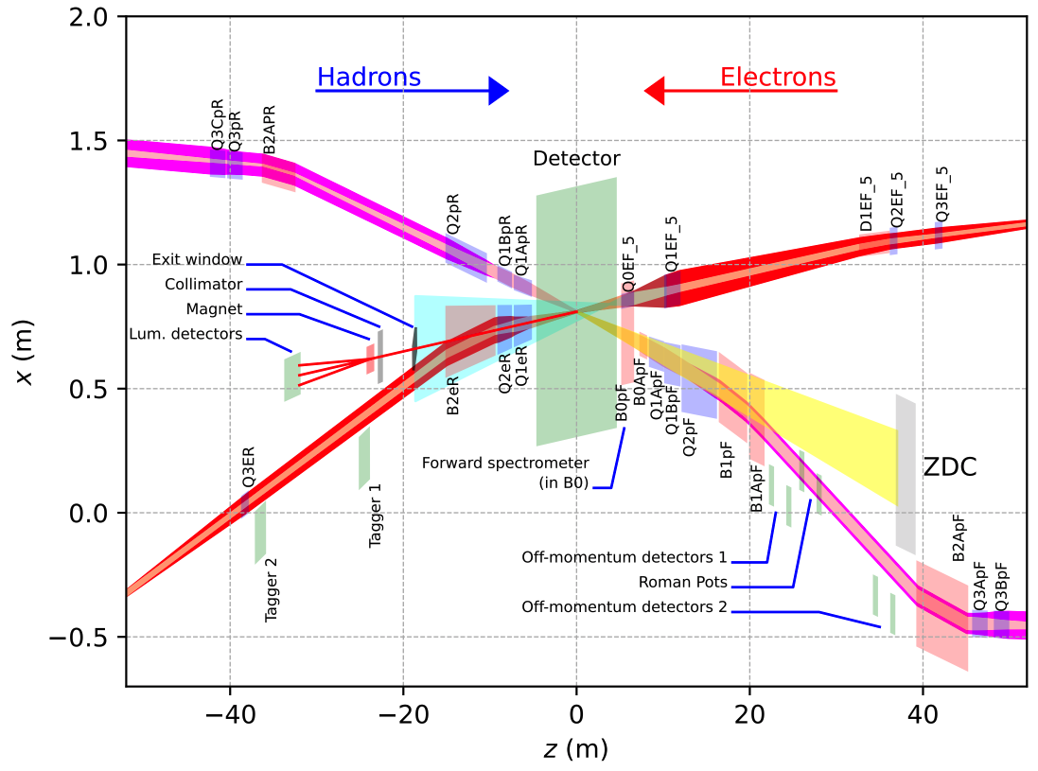
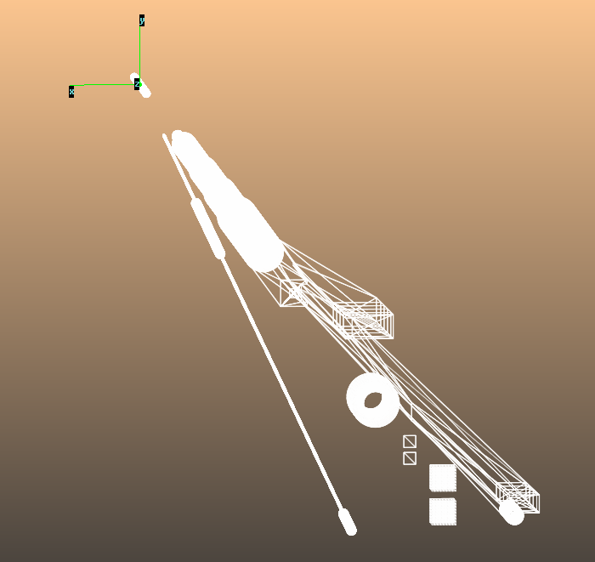
SR Study
Recap
SR study based on SynRad+
https://indico.bnl.gov/event/17867/
Beam/Field info
H. Witte et al., DOI: 10.18429/JACoW-IPAC2021-WEPAB003
Available in the EIC standard platform
Latest electron beam lattice info, courtesy of Charles Hetzel (EIC/BNL).
Geometry ready for use with high flexibility on EIC platform.
Enables studies of optimal filter specifications.
Tests of various detector configurations.

Slide 3
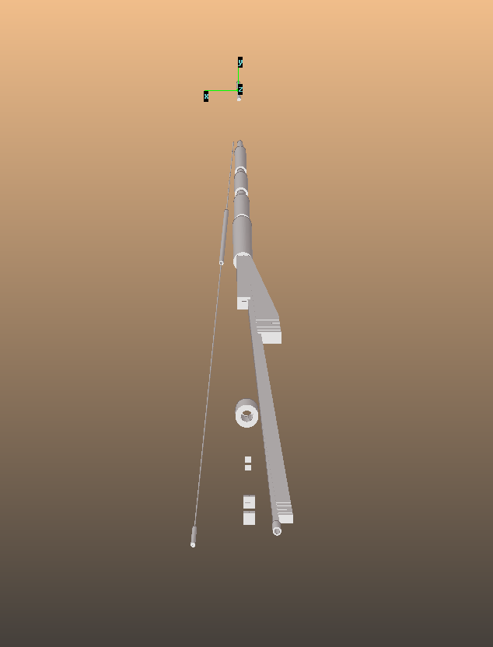
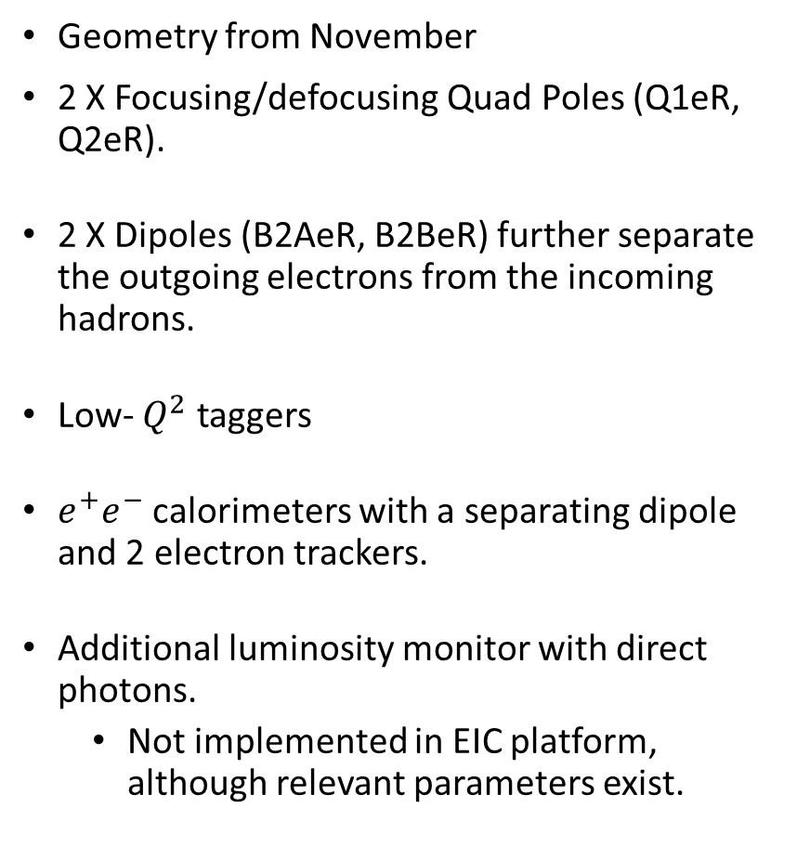
Relevant Far Backward Geometry
Geometry from November
2 X Focusing/defocusing Quad Poles (Q1eR, Q2eR).
2 X Dipoles (B2AeR, B2BeR) further separate the outgoing electrons from the incoming hadrons.
Low- $Q^{2}$ taggers
$e^{+}e^{−}$ calorimeters with a separating dipole and 2 electron trackers.
Additional luminosity monitor with direct photons.
Not implemented in EIC platform, although relevant parameters exist.
Q1eR
B2AeR
Q2eR
B2BeR
Exit
window
Taggers
SPEC
Direct
Photon

Slide 4
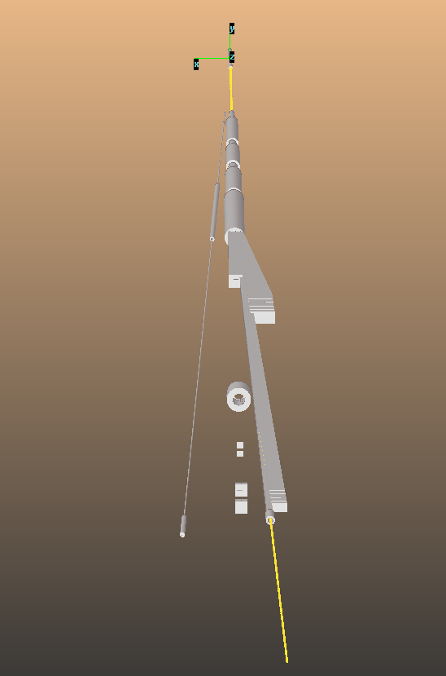
Beam/Field
Electron beam
18 GeV electron beam at 250 mA current.
Further beam properties need to be implemented (emittance, energy spread, tail info, etc.)
Magnetic Field
B2AeR/B2BeR
0.192/0.238T dipoles.
Located at 10.5/13.275m downstream.
Q1eR/Q2eR
-13.3/12.1(T/m) focusing/defocusing quad poles.
At 6.2/8.3m.

Slide 5
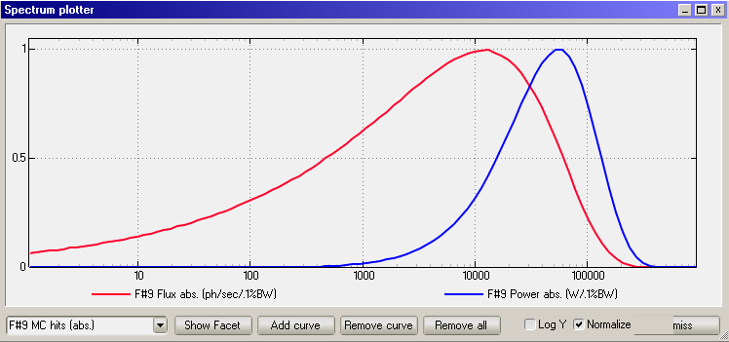
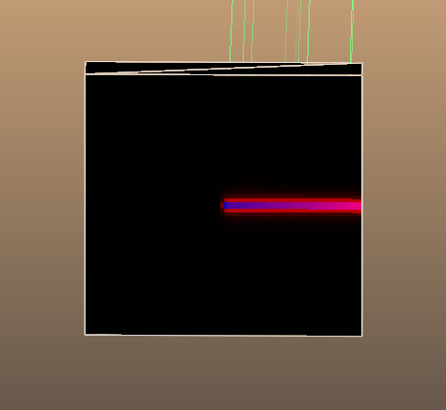
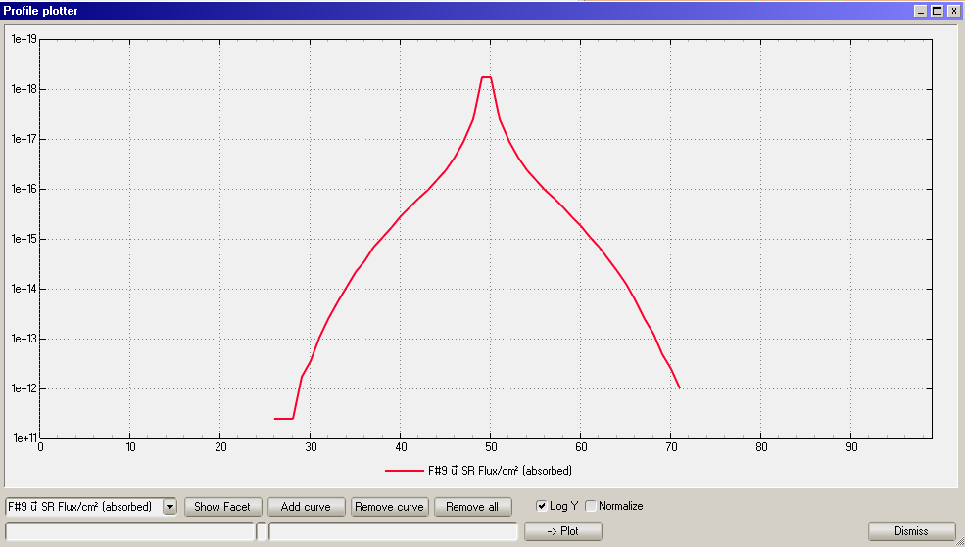
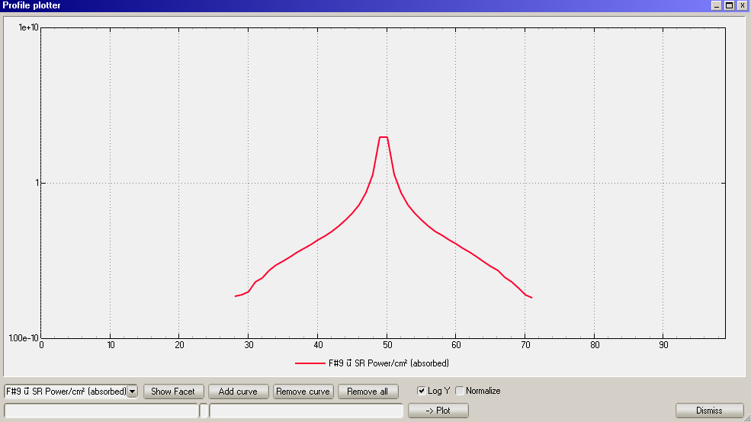
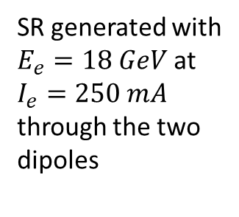
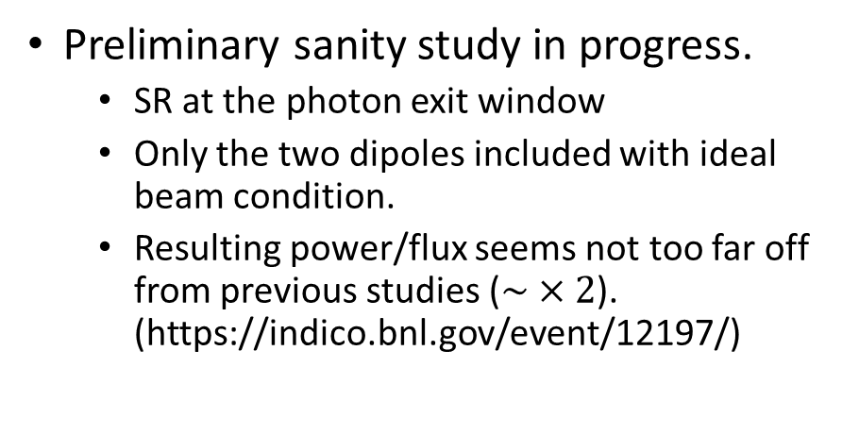
Update (WIP)
Power/Flux spectrum
Photon distribution on exit window
SR generated with
$E_{e}=18 GeV$ at $I_{e}=250 mA$
through the two dipoles
Flux along vertical direction
Preliminary sanity study in progress.
SR at the photon exit window
Only the two dipoles included with ideal beam condition.
Resulting power/flux seems not too far off from previous studies ($\sim ×2$). (https://indico.bnl.gov/event/12197/)
Power along vertical direction

Slide 6
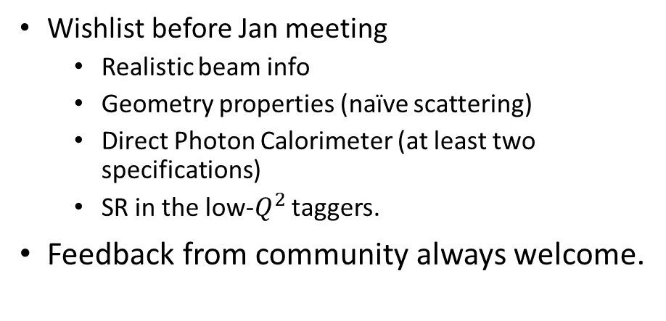
Update (WIP)
Power/Flux spectrum
Photon distribution on exit window
SR generated with
$E_{e}=18 GeV$ at $I_{e}=250 mA$
through the two dipoles
Flux along vertical direction
Wishlist before Jan meeting
Realistic beam info
Geometry properties (naïve scattering)
Direct Photon Calorimeter (at least two specifications)
SR in the low-$Q^{2}$ taggers.
Feedback from community always welcome.
Power along vertical direction

