Slide 1
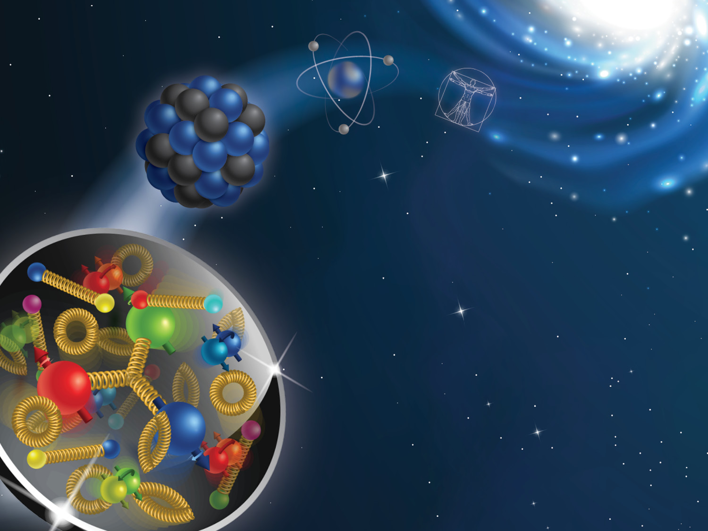
The 2023 CFNS-CTEQ Summer School on the Physics of the Electron-Ion Collider

Slide 2
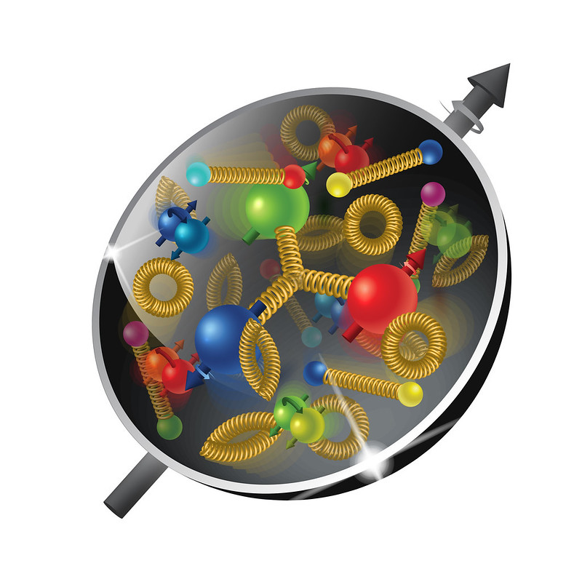
Welcome to the 2023 CFNS-CTEQ Summer School
It is our fourth school, the first was in 2019 with 25 students
the second was online in 2021 with 63 students
The third was in 2022 with 20 students in person and 30 online
Welcome to the 2023 CFNS-CTEQ Summer School dedicated to the physics of the Electron-Ion Collider
The Electron-Ion Collider is at a very mature stage and your participation in the project is crucial for its success!
We have 40 in-person students this year and we are looking forward to a very exciting time

Slide 3
The SCHool organizers
Organizing Committee:
Ross Corliss (SBU)
Abhay Deshpande (SBU, CFNS Director)
Prakhar Garg (PSU)
Wenliang “Bill” Li (SBU)
Fred Olness (SMU)
Alexei Prokudin (PSU Berks, School Chair)
Zack Sullivan (IIT)
Administrative support:
Socorro Delquaglio (SBU)
Rachel Nieves (BNL)
Marlene Vera-Viteri (SBU)

Slide 4
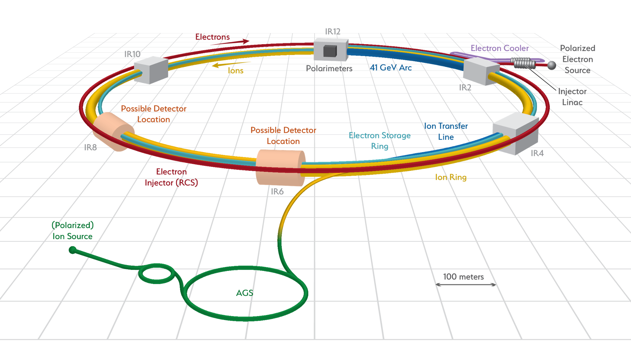
The electron-ion collider @ BNL
High luminosity: (~10³³ - 10³⁴ cm⁻² s⁻¹) (~1000 times that of HERA)
Variable CM energy: 20 — 100 GeV upgradable to 140 GeV
Highly polarized ~70% electron and ~70% nucleon beams
Ion beams from deuterons to heavy nuclei such as gold, lead, or uranium
Possibility of more than one interaction region (none of the major facilities operates with one detector only - important for discovery potential)
White Paper (2012)
Accardi et al, arXiv:1212:1701

Slide 5
The electron-ion collider: scientific questions
White Paper (2012)
Accardi et al, arXiv:1212:1701
How do the nucleonic properties such as mass and spin emerge from partons and their underlying interactions?
How are partons inside the nucleon distributed in both momentum and position space?
How do color-charged quarks and gluons, and jets, interact with a nuclear medium? How do the confined hadronic states emerge from these quarks and gluons? How do the quark-gluon interactions create nuclear binding?
How does a dense nuclear environment affect the dynamics of quarks and gluons, their correlations, and their interactions? What happens to the gluon density in nuclei? Does it saturate at high energy, giving rise to gluonic matter or a gluonic phase with universal properties in all nuclei and even in nucleons?

Slide 6
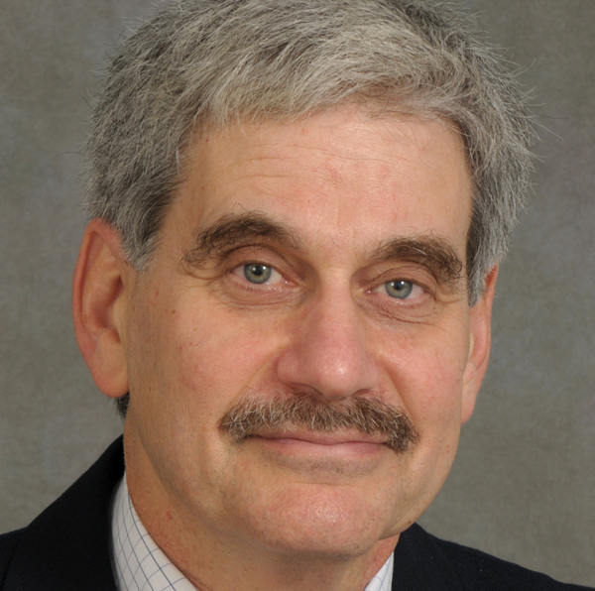
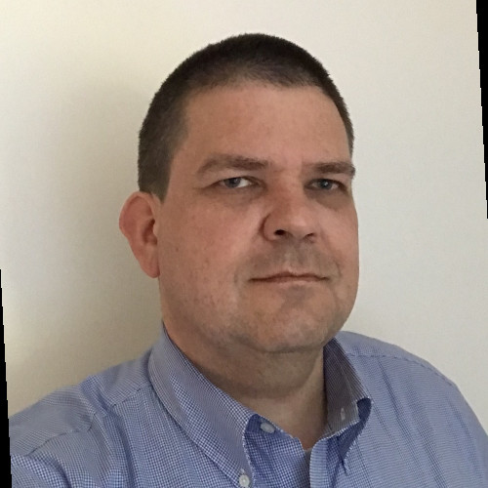
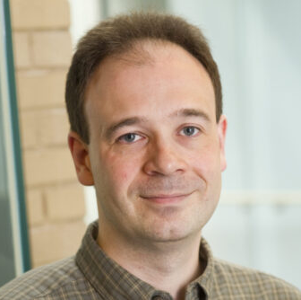
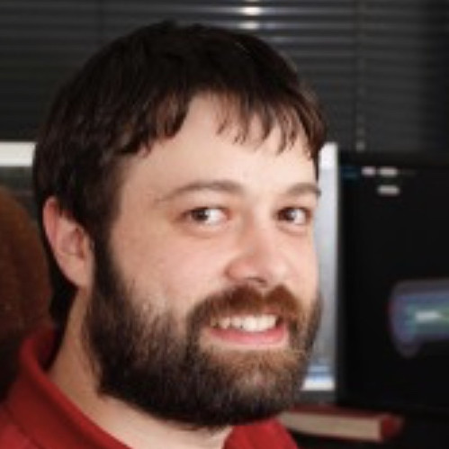
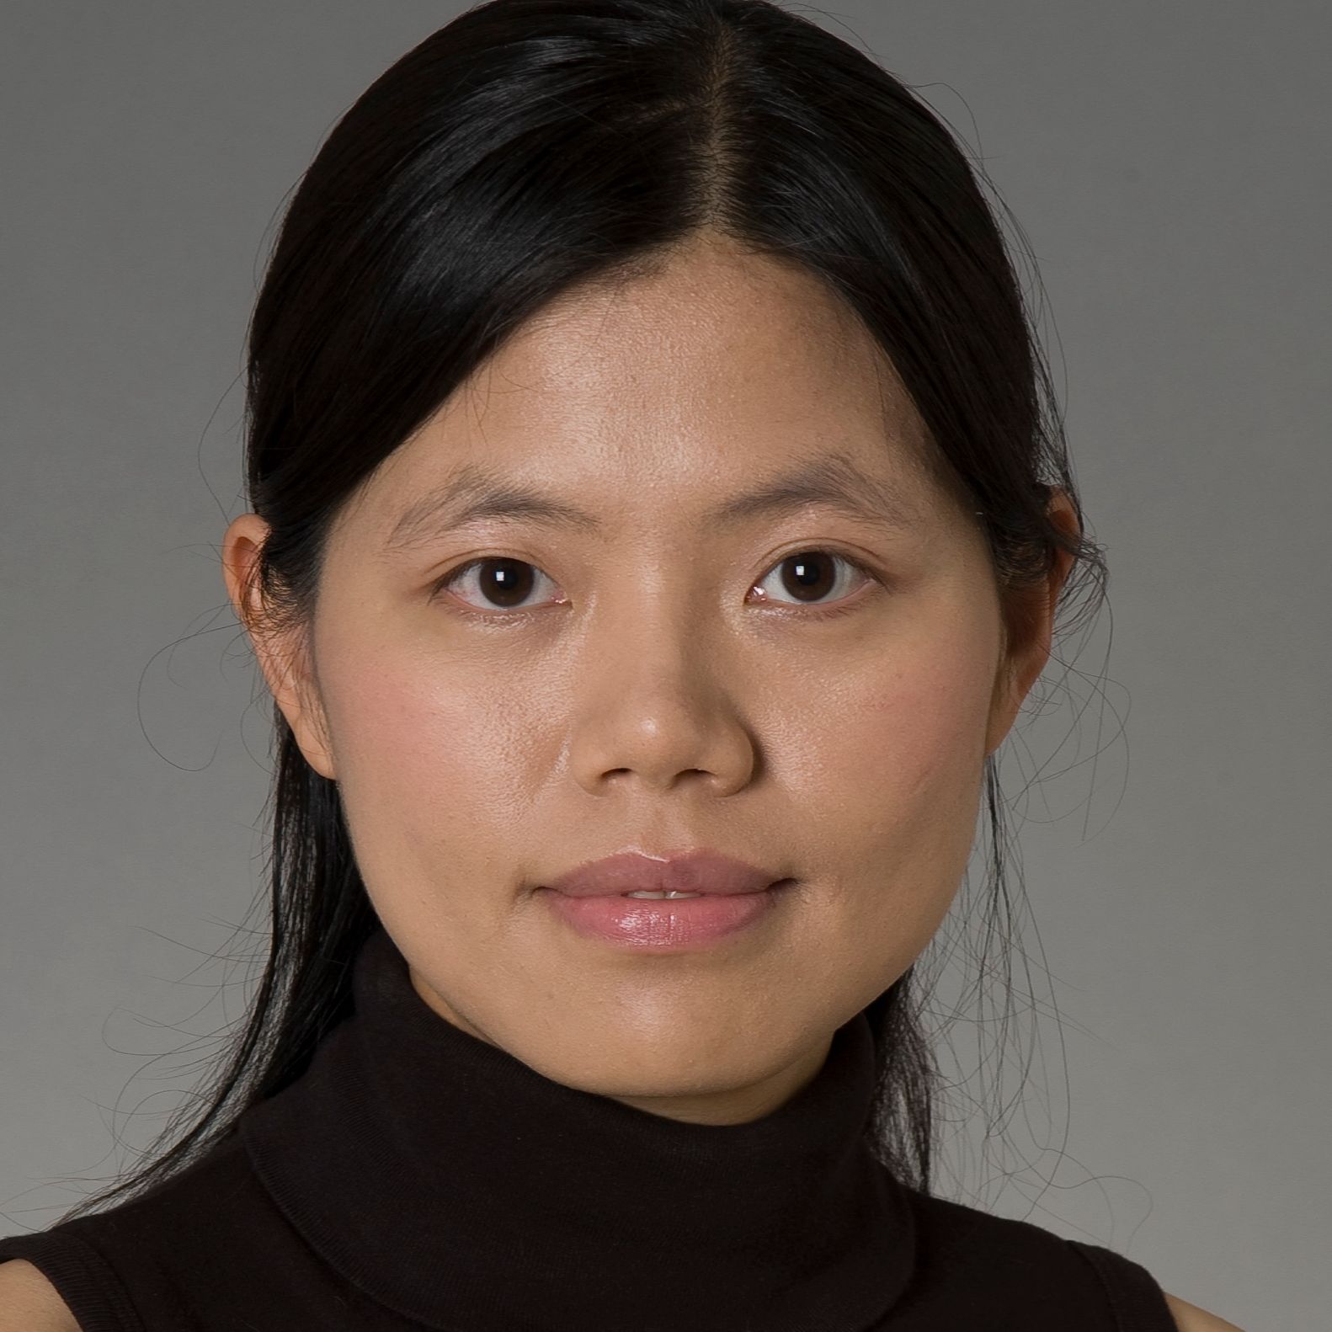
The SCHool lecturers: first week
George Sterman (SBU)
Ernst Sichtermann (LBL)
Iain Stewart (MIT)
Thomas Britton (JLab)
Huey-Wen Lin (MSU)
Todd Satogata (JLab)
John Lajoie (ISU)

Slide 7
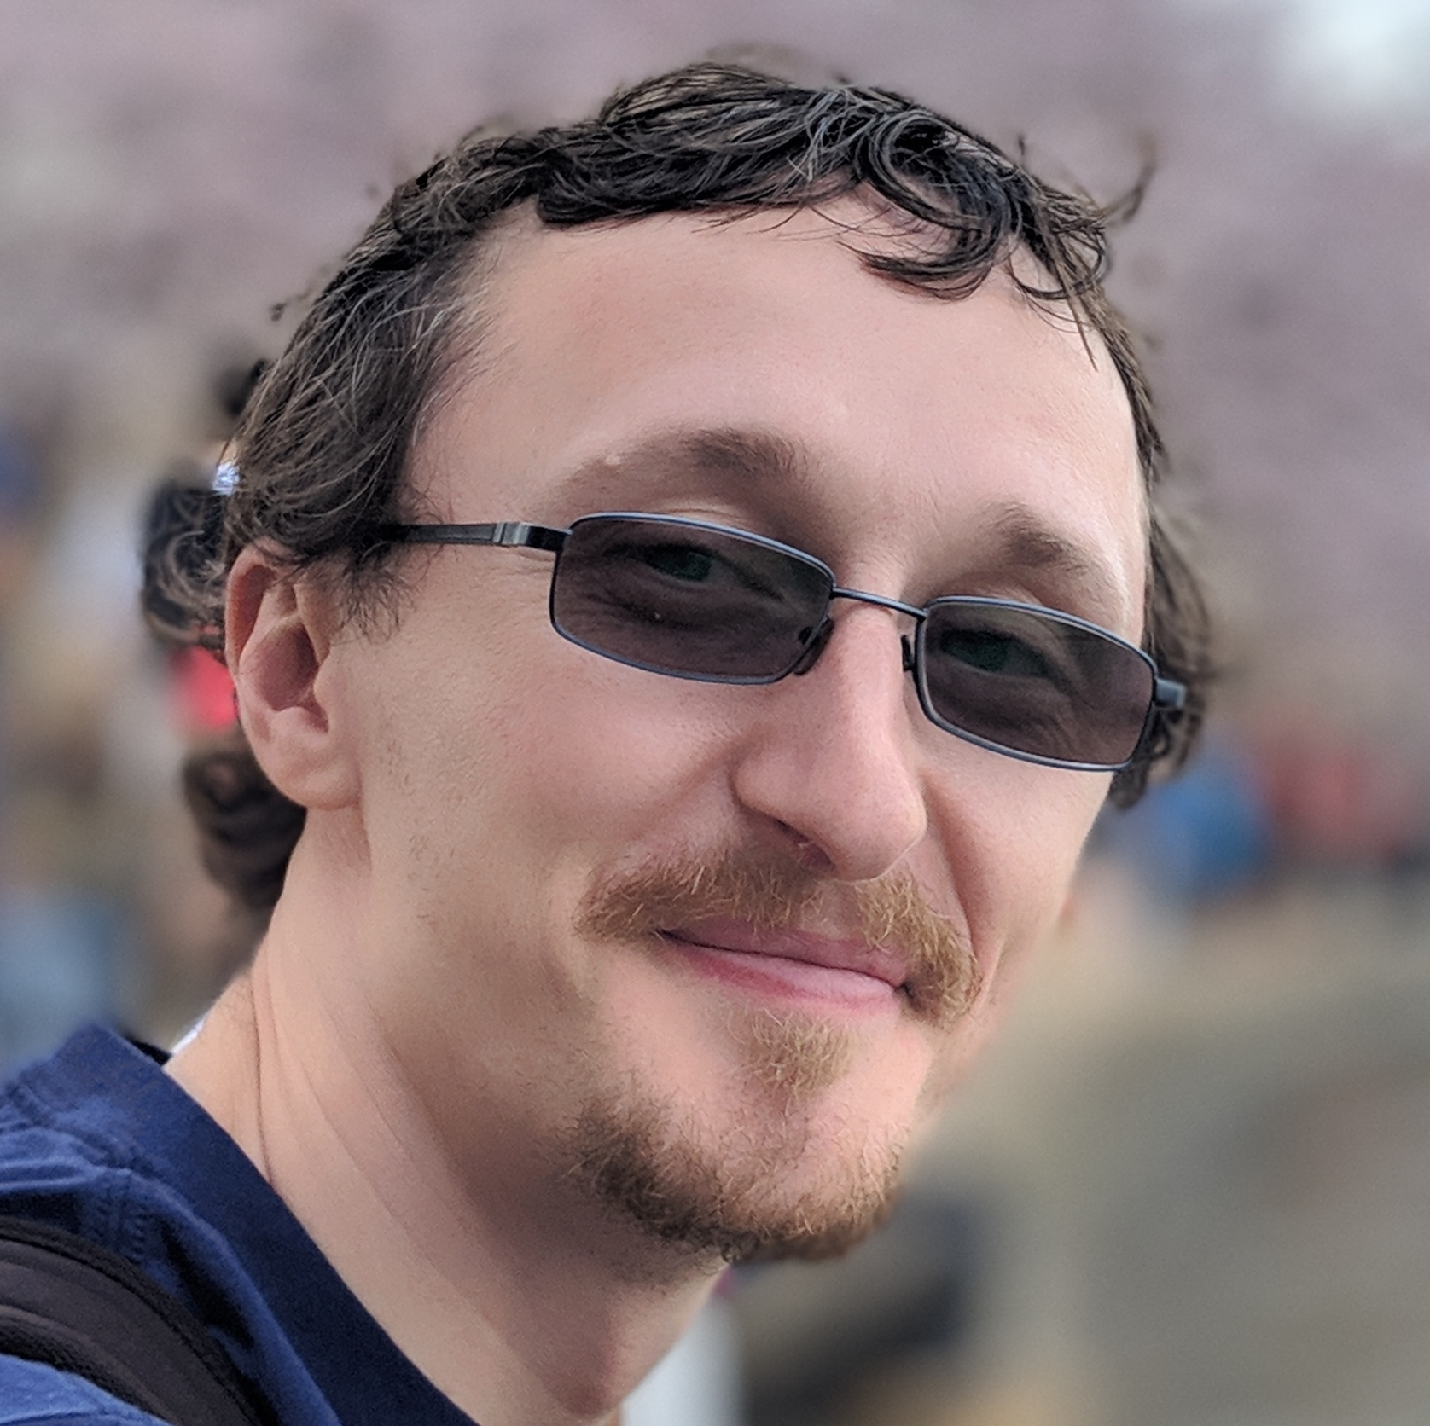
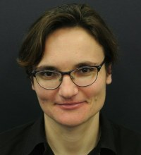
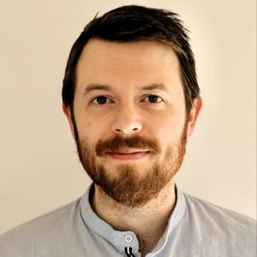
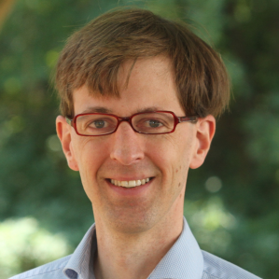
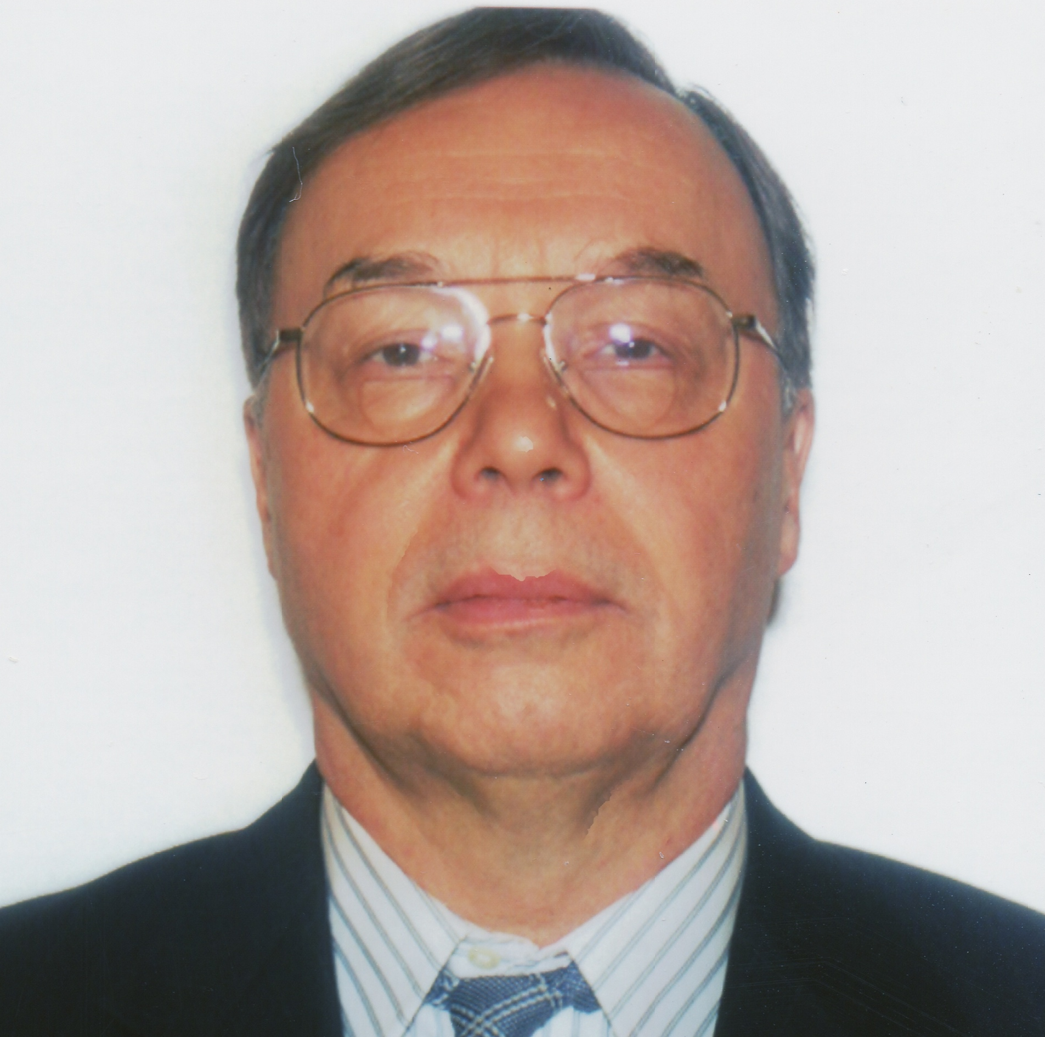
The SCHool lecturers: SECOND week
Oleg Eyser (BNL)
Ciprian Gal (JLab)
Sally Dawson (BNL)
Raju Venugopalan (BNL)
Anna Stasto (PSU)
Timothy Hobbs (ANL)
Wouter Deconinck (UManitoba)
Vladimir Korepin (SBU)

Slide 8
the school schedule
The school runs in person 9:00 am - 3:30 pm ET US.
In the evening we have recitations/discussion at 7:30 pm (snacks & drinks are provided)
The program is posted on Indico: https://indico.bnl.gov/event/17958/timetable/#20230605

Slide 9
Dining options: Lunch SUGGESTION
Lunch Suggestion:
Since we have only 90mins for lunch, we suggest the on-campus SAC option.
We will lead you there after the morning lectures.

Slide 10
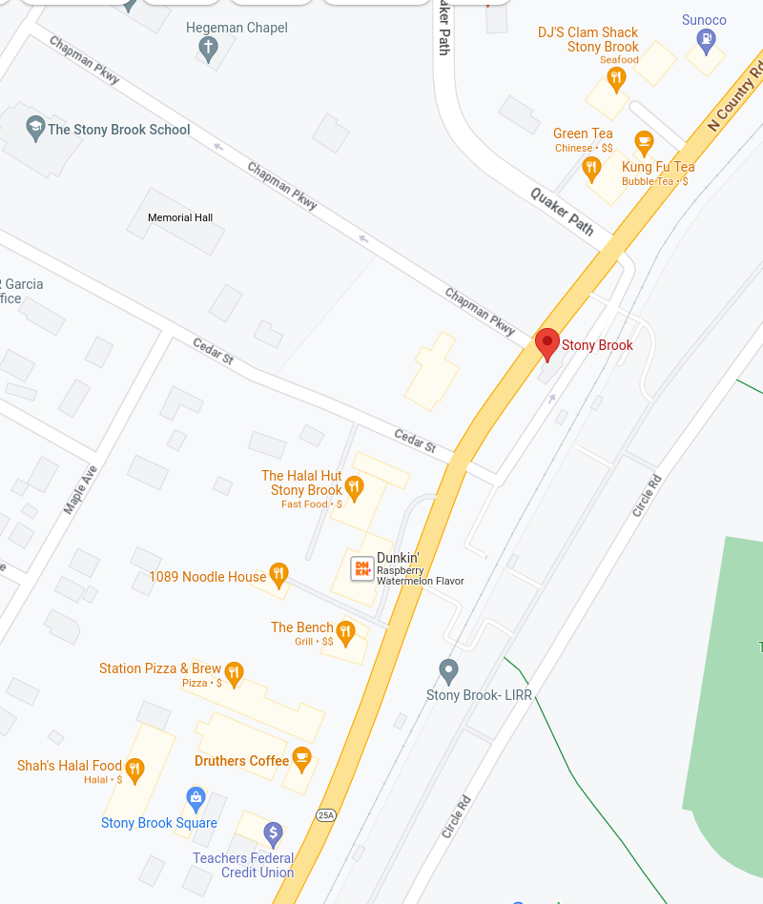
Dining options: DINNER SUGGESTION
Dinner Suggestion:
Since we have a bit more time for dinner,
you might want to try some of the off-campus options near the LIRR.
We then return at 7:30 for snacks and a relaxing discussion session

